Slide 1
Managing Enterprise Cybersecurity
MIS 4596
Unit#8

Slide 2
GPS Spoofing – How do we know what’s true?

Slide 3
Agenda
Symmetric cryptography
Block versus Stream ciphers
Block ciphers
Block ciphers mode of operations
Hashes

Slide 4
Symmetric and asymmetric algorithms
…both are 2-way functions that support encryption & decryption
Symmetric cryptography
  Use a copied pair of symmetric (identical) secret keys
  The sender and the receive use the same key for encryption and decryption functions
Asymmetric cryptography
  Also know as “public key cryptography”
  Use different (“asymmetric”) keys for encryption and decryption
  One is called the “private key” and the other is the “public key”

Slide 5
A strong cipher contains
2 main attributes
  Confusion: usually carried out through substitution
  Diffusion: Usually carried out through transposition
Harris, S. and Maymi, F. (2016) All-In-One CISSP Exam Guide, McGraw Hill Education

Slide 6
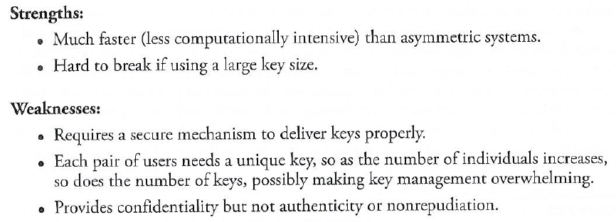
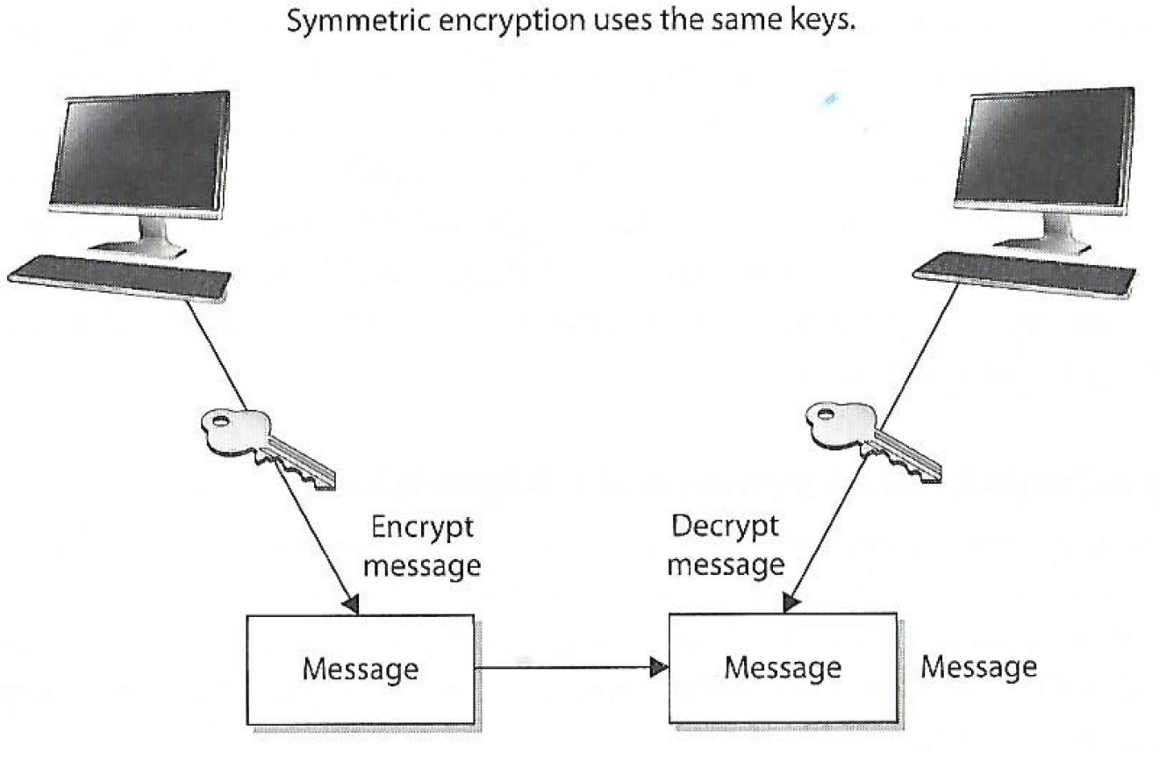
Symmetric cryptography
Two types: Stream and Block Ciphers
Stream Ciphers treat the message a stream of bits and performs mathematical functions on each bit individually
Block Ciphers divide a message into blocks of bits and transforms the blocks one at a time

Slide 7
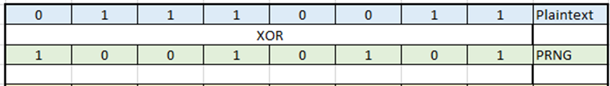
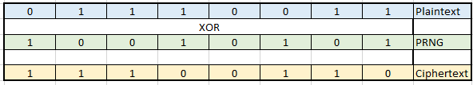
Block Ciphers versus Stream Ciphers
Stream ciphers work on a single bit at a time:
Key
PRNG = Pseudo Random Number Generator

Slide 8
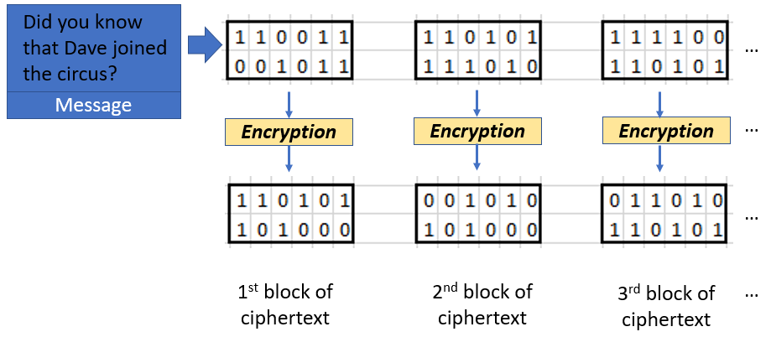
Block Cyphers (“Cipher”)
Message is divided into blocks of bits
Blocks are put through encryption functions 1 block at a time
Suppose you are encrypting a 648-bit long message to send to your mother using a block cypher that uses 12 bits
Your message would be chopped up into 54 blocks each 12 bits long
Each block, in turn, would be run through a series of encryption functions (substitution and transposition)
Ending up with 54 blocks of ciphertext
Note: Block ciphers typically use 64, 128, 512 bits at a time

Slide 9
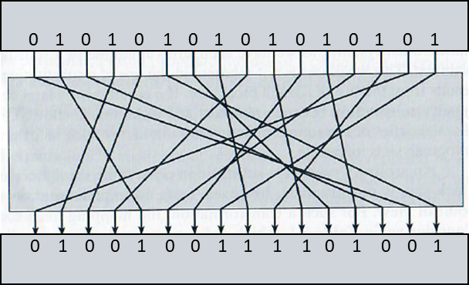
Remember this example:
2 main attributes combined in a cypher
0101010101010101
  Confusion: usually carried out through substitution
  Diffusion: Usually carried out through transposition
Harris, S. and Maymi, F. (2016) All-In-One CISSP Exam Guide, McGraw Hill Education
0100100111101001

Slide 10
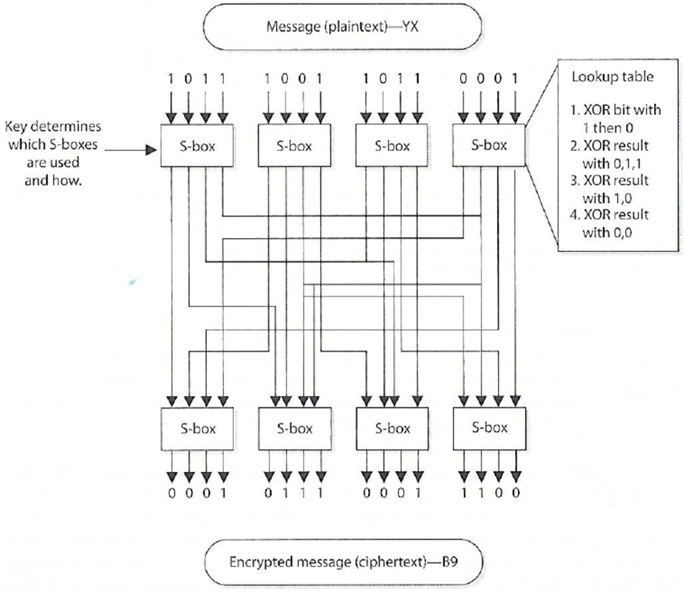
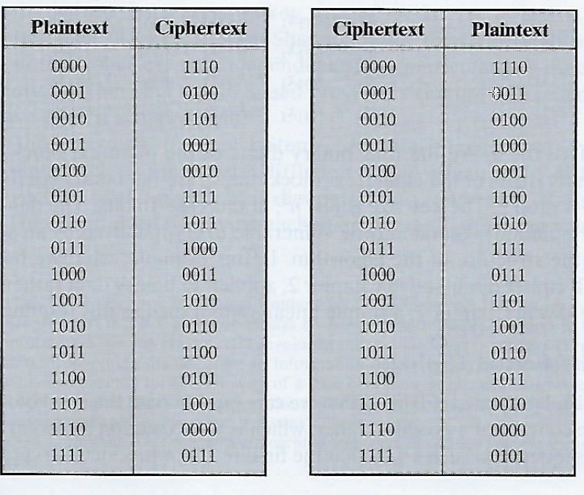
Block Ciphers versus Stream Ciphers
In contrast, block ciphers encrypt a block of bits at a time
In this example, each Substitution Box (S-box) contains a lookup table used by the algorithm as instructions on how the bits are substituted
…followed by transposition…
Encryption table
Decryption table

Slide 11


Block Ciphers
Message is divided into blocks of bits
Blocks are put through mathematical functions 1 block at a time
You send the message to your mother. She uses the same block cipher and key (symmetric) to decipher the message
The 54 ciphertext blocks go back through the algorithm in the reverse sequence
Resulting in your original plaintext message your message
Did you know that Dave joined the circus?
…
Message
Decryption
Decryption
Decryption
…
…
1st block of ciphertext
2nd block of ciphertext
3rd block of ciphertext
…

Slide 12
Modern Block Ciphers
Use block sizes of 128-bits or greater
  Examples of Block Ciphers that can be used are:
    AES (NIST’s 2001 Advanced Encryption Standard – originally known as Rijndael)
      128 bit block size, but 3 different key lengths: 128, 192, and 256 bits
    Blowfish
    Twofish
    Serpent
Do not use these examples of block ciphers which have a 56 bit key length, which is too small to provide secure encryption:
  DES (Data Encryption Standard)
  3DES

Slide 13
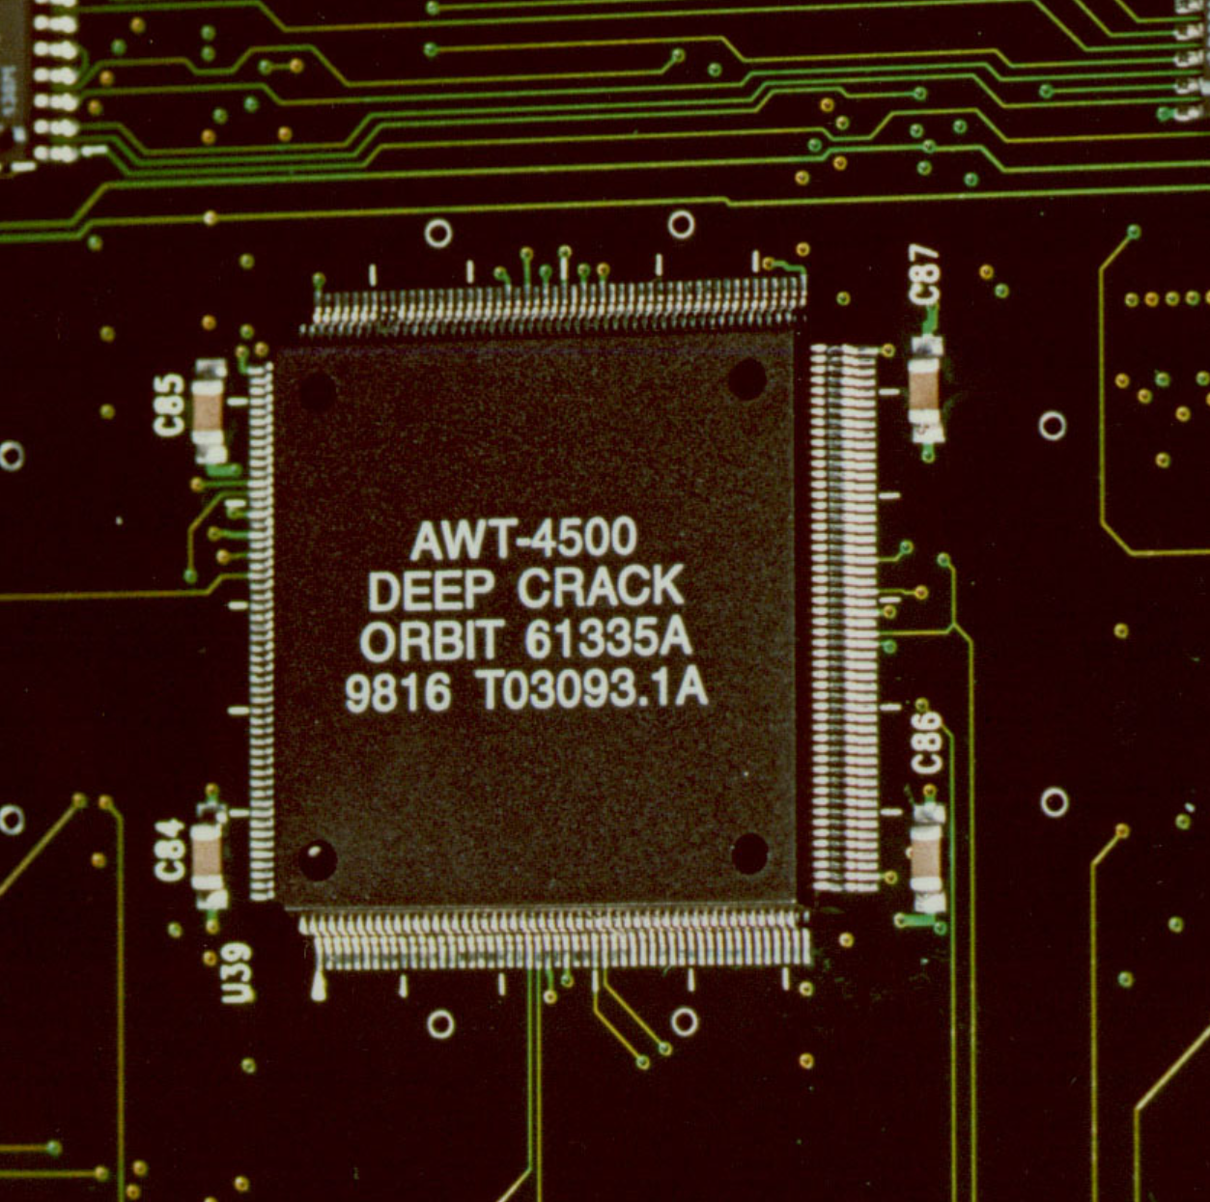
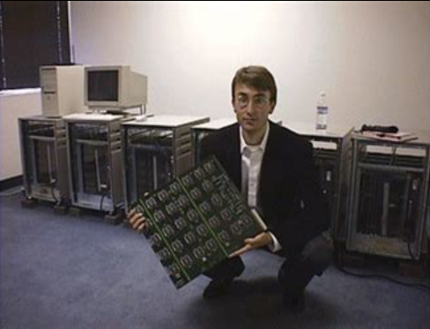
Practical Cryptanalysis
DES Cracker:
  A DES key search machine
  Contains 1,536 chips
  Cost: $250,000
  Searches 88 billion keys per second
  In 1998, Electronic Freedom Foundation (EFF) won $10,000 in RSA Laboratory’s “DES Challenge II-2” by successfully finding a DES key through brute force in 56 hours
DES uses a 56-bit key, meaning that there are 256 possible keys under which a message can be encrypted.
  This is: 72,057,594,037,927,936, or approximately 72 quadrillion possible keys
One of the major criticisms of DES, when proposed in 1975, was that the key size was too short
  Martin Hellman and Whitfield Diffie of Stanford University estimated that a machine fast enough to test that many keys in a day would have cost about $20 million in 1976,
    An affordable sum to national intelligence agencies
Subsequent advances in the price/performance of chips kept reducing that cost until, twenty years later, it became affordable for even a small nonprofit organization such as the EFF to mount a realistic attack

Slide 14
Agenda
Updated Schedule
Symmetric cryptography
Block versus Stream ciphers
Block ciphers
Block ciphers mode of operations
Hashes

Slide 15
Block cipher’s “mode of operation”
5 modes of operation are used to tailor them for use in different applications:
ECB – Electronic Code Book mode
CBC – Cipher Block Chaining mode
CFB – Cipher FeedBack mode
OFB – Output FeedBack mode
CTR – CounTeR mode

Slide 16
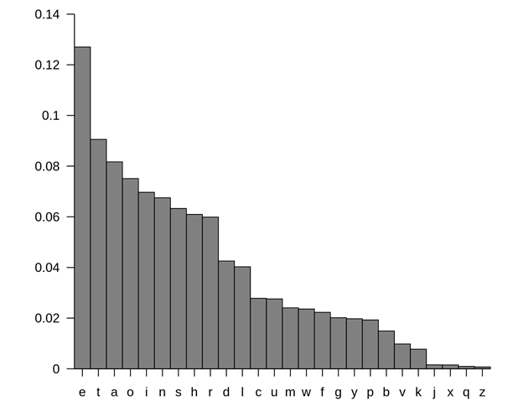
ECB – Electronic Code Book mode
A data block of a certain size (e.g. 64 bits or 128 bits or…) is entered into the algorithm with the key, and a block of cipher text is produced
Ci = Encrypt(Key, Pi)
for i = 1, ..., k
Where:
Ci is block i of ciphertext
P, is a block of plaintext
Encrypts every block the same way every time for a given key
Why is this a problem?
  This is a problem because frequency analysis of the encrypted text can reveal a lot of information
  Not enough randomness

Slide 17
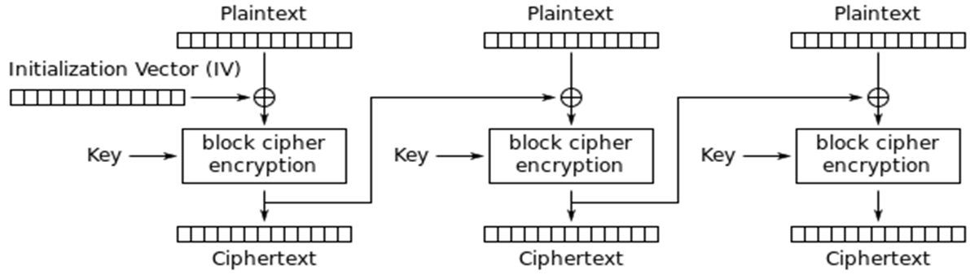
Solution: CBC – Cipher Block Chaining mode
Is much more secure
Does not reveal a pattern of encryption for frequency analysis
Each block of text, the key, and the value based on the previous block are processed in the algorithm and applied to the next block of text
XORs a plaintext with the last encrypted block before encrypting it. This ensures that the same plaintext is encrypted differently every time.
Requires an initialization vector (or IV) to get started, since the first block doesn’t have a previous encrypted block to XOR against.

Slide 18
A similar concept to diffusion is known as the
The Avalanche Effect
A changed to a single plaintext bit should have an influence over several of the resulting ciphertext bits
In a strong block cipher, if 1 plaintext bit is changed, it will change every ciphertext bit with the probability of 50%
  That is, if 1 plaintext bit changes, then about ½ of the ciphertext bits will change
  Avalanche Effect: A small change to the key or to the plaintext should cause drastic changes to the resulting ciphertext
Harris, S. and Maymi, F. (2019) All-In-One CISSP Exam Guide, McGraw Hill Education

Slide 19
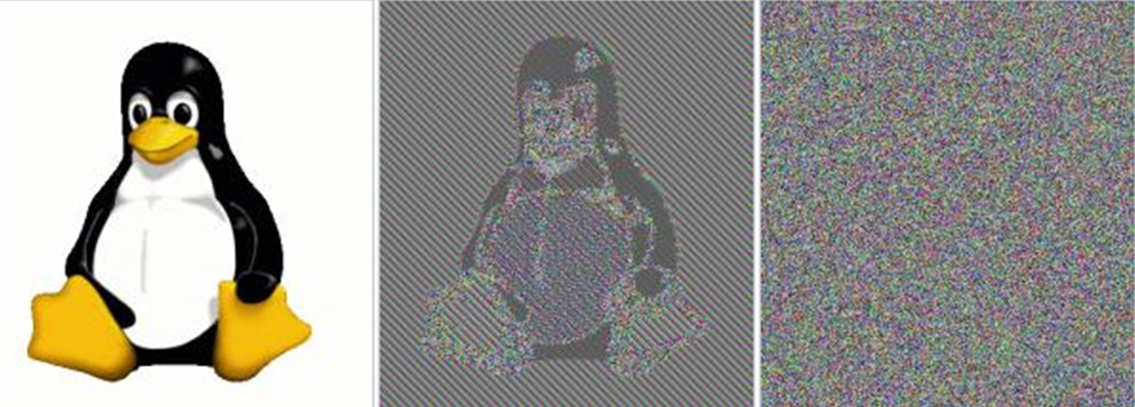
Visa
Original Image
Block cipher with ECB (Electronic Code Book) encryption
Not good!
Block cipher with CBC
(Cipher Block Chaining) or any of the other modes of encryption
These are good!

Slide 20
Agenda
Updated Schedule
Symmetric cryptography
Block versus Stream ciphers
Block ciphers
Block ciphers mode of operations
Hashes

Slide 21


Slide 22
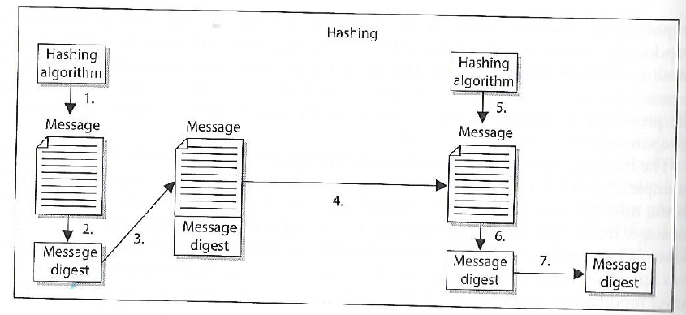
One-way Hash function
Sender puts message through hashing function
Message digest generated
Message digest appended to the message
Sender sends message to receiver
Receiver puts message through hashing function
Receiver generates message digest value
Receiver compares the two message digests values. If they are the same, the message has not been altered
Assures message integrity
A function that takes a variable-length string (i.e. message) and produces a fixed-length value called a hash value
Does not use keys

Slide 23
Hashing results in fixed-sized output
Names for the output of a hashing functions include “hash” and a message digest (md), because a hash “digests” an input of any size down to a fixed-sized output
  No matter the size of the input, the output is the same, for example the md5 hash function’s output:
    Letter ‘a’ in binary: 01000001 => md5 hash => 32-character string
    Blu-ray disk digest => md5 hash => 32-character string
    6 TB hard drive digest => md5 hash => 32-character string

Slide 24
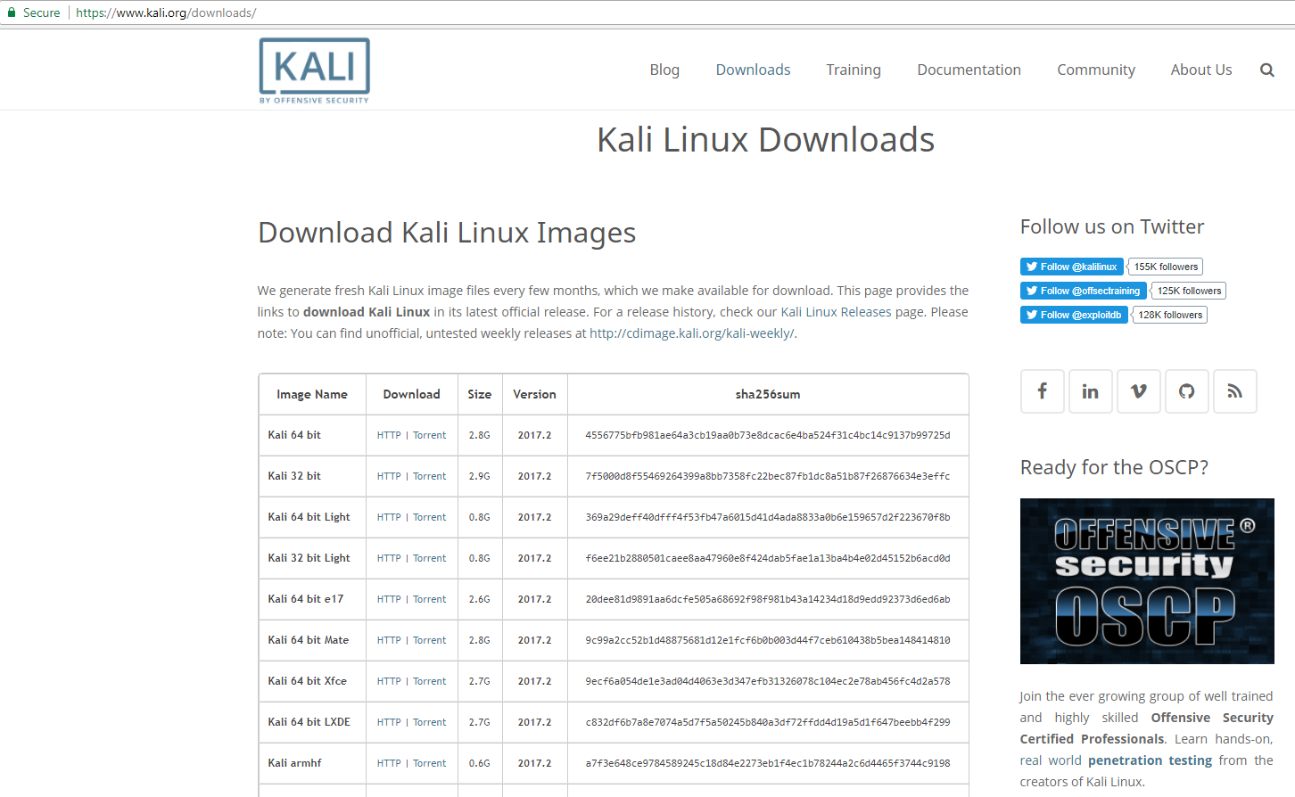
One-way hash example…
One useful example: Testing the integrity of a file (e.g. program) downloaded from the internet…

Slide 25

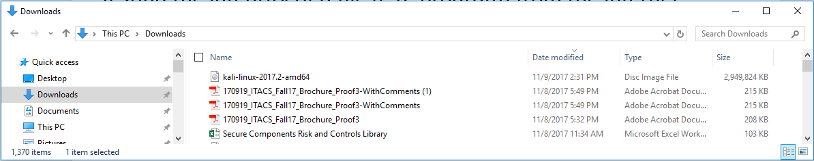
One-way hash example…
Testing the integrity of a file (e.g. program) from the internet…
Is the Kali I downloaded the same Kali that was published?

Slide 26
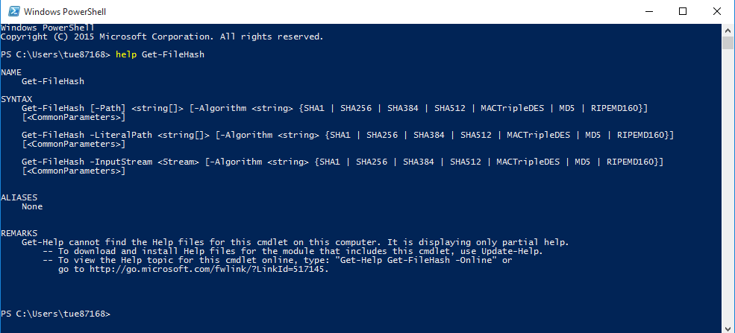
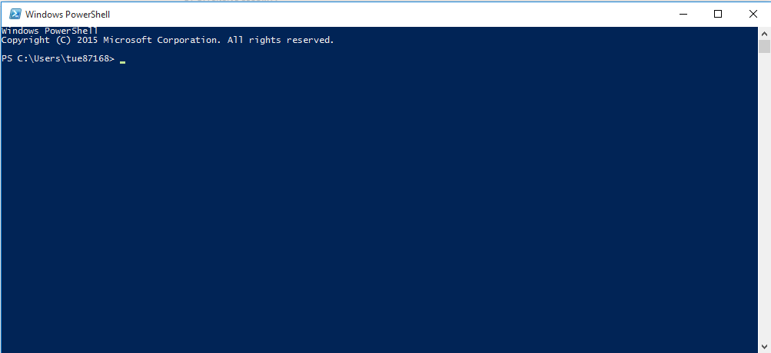
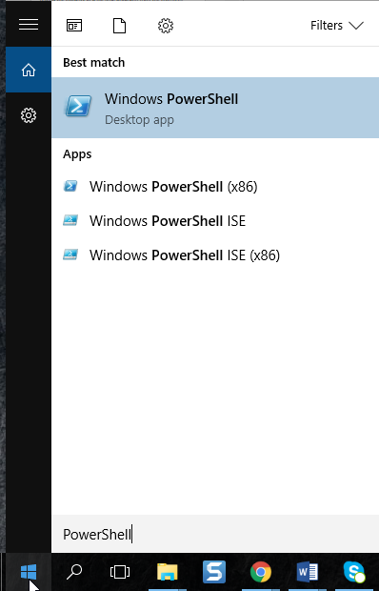
One-way hash example…

Slide 27
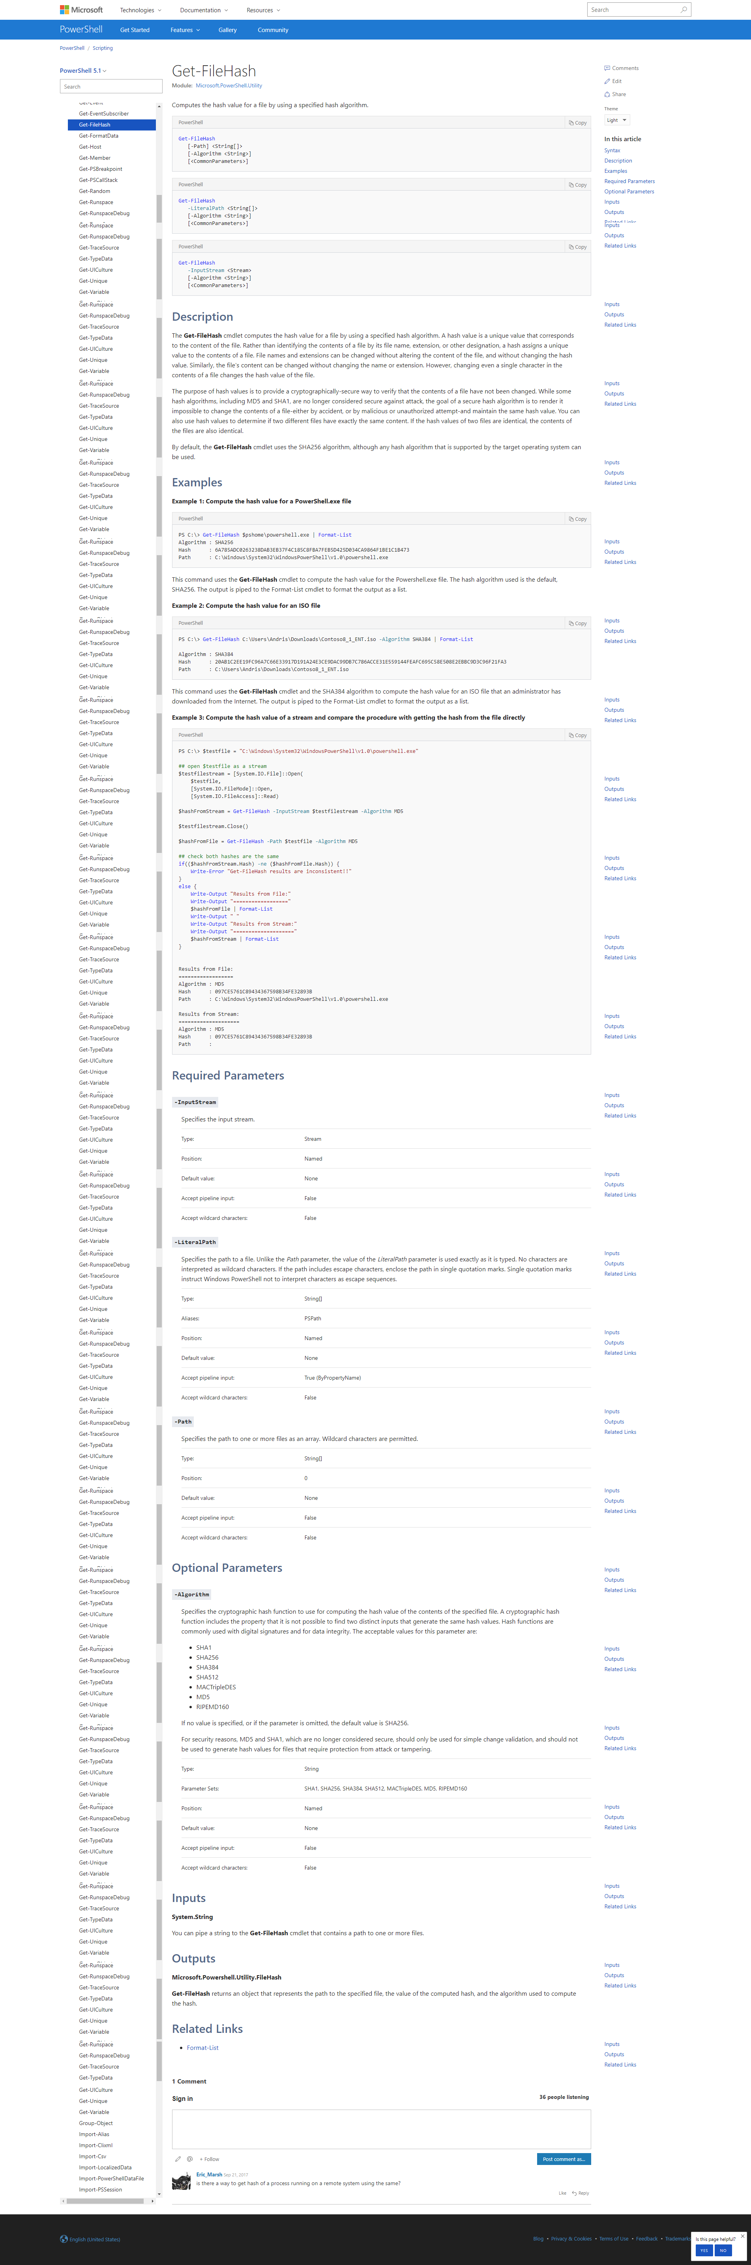
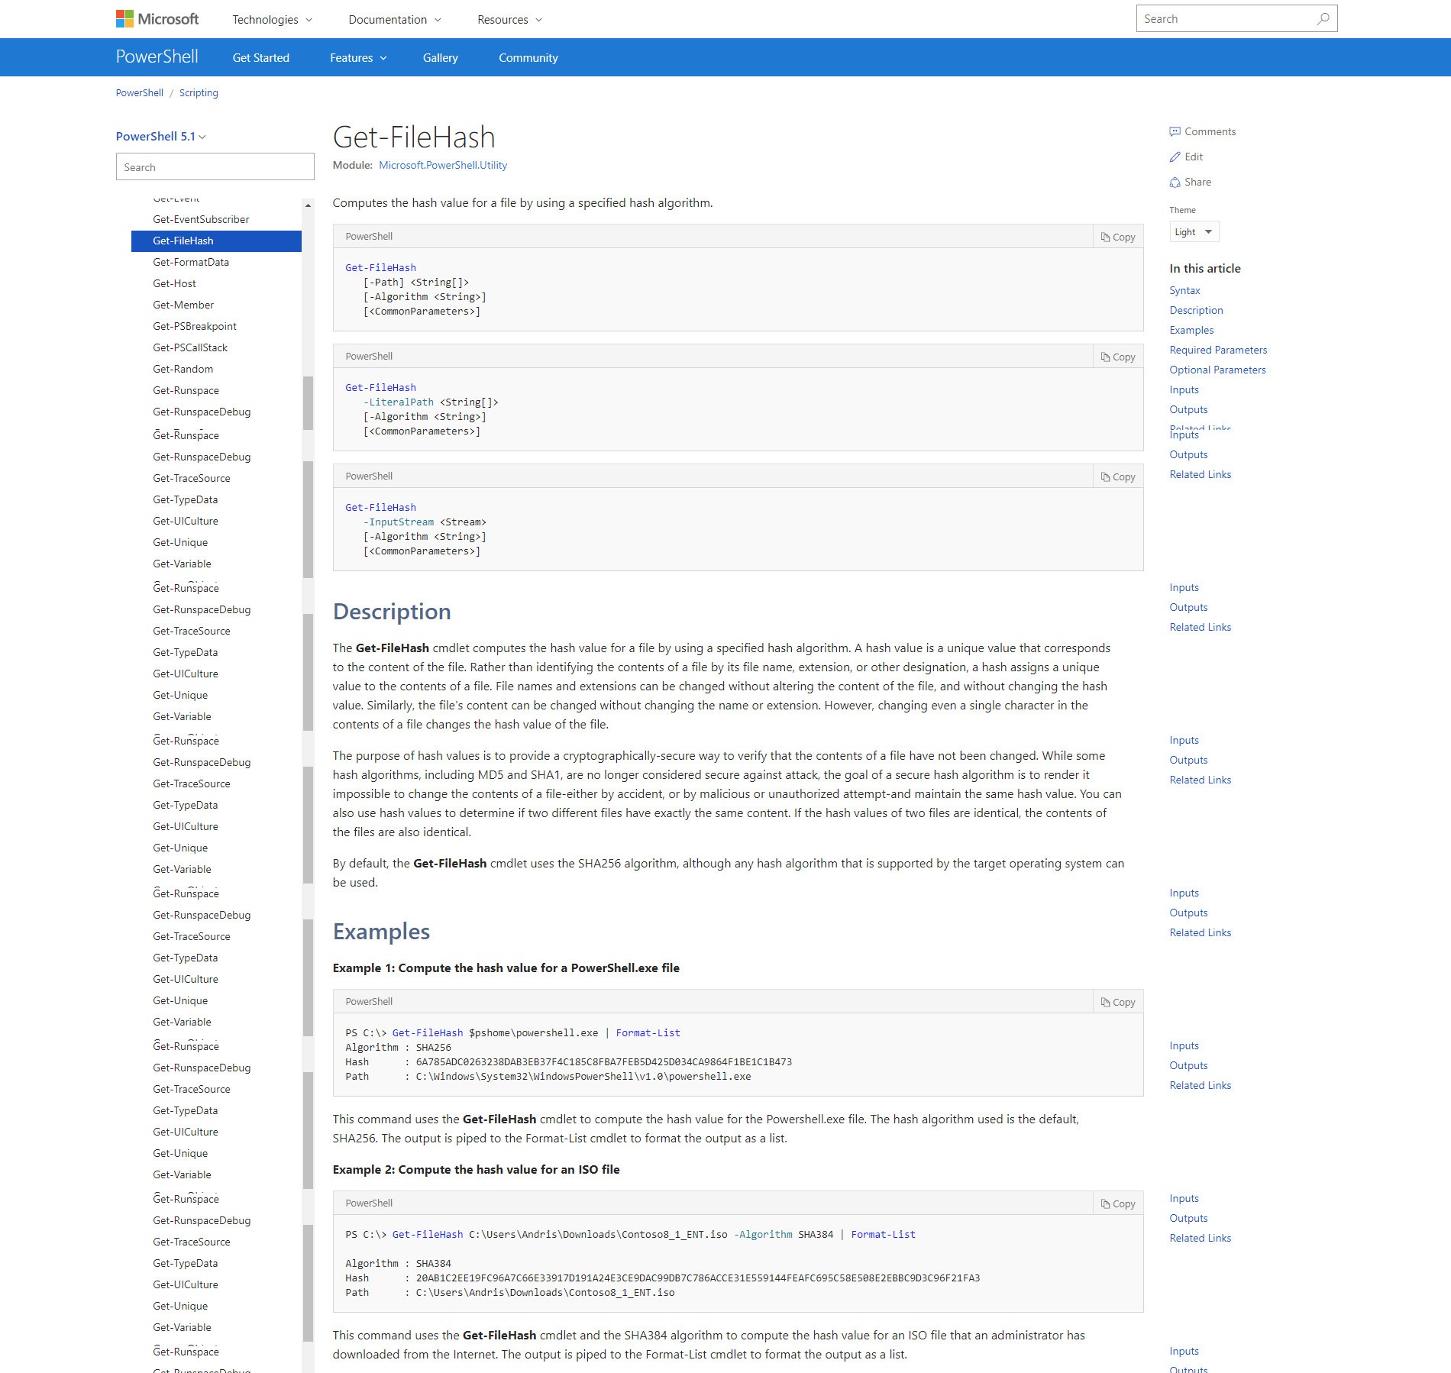
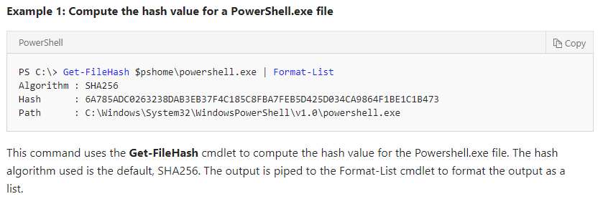
One-way hash example…
https://docs.microsoft.com/en-us/powershell/module/microsoft.powershell.utility/get-filehash?view=powershell-5.1

Slide 28
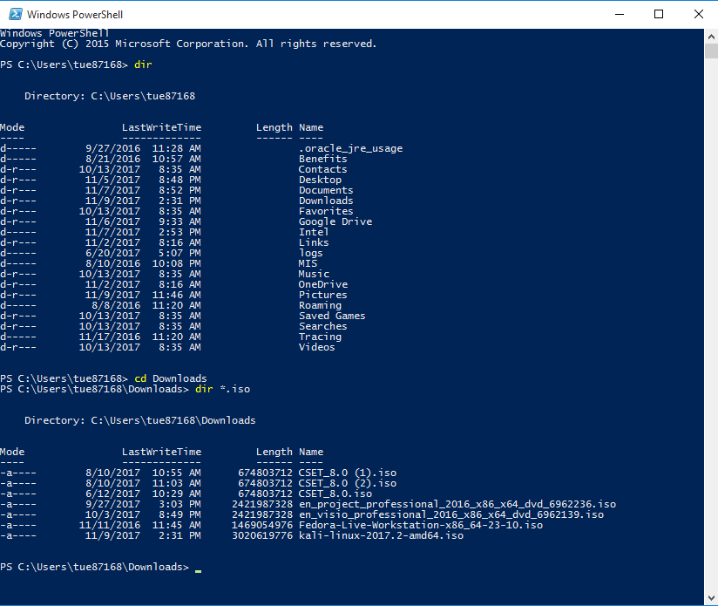

Slide 29
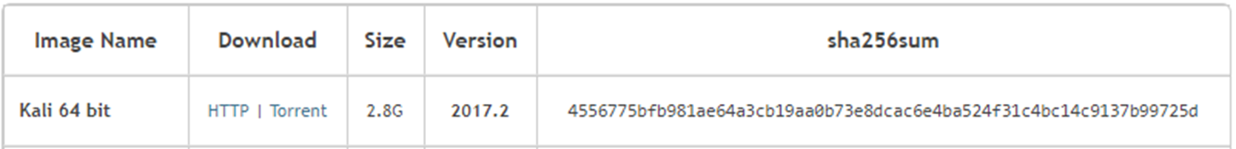
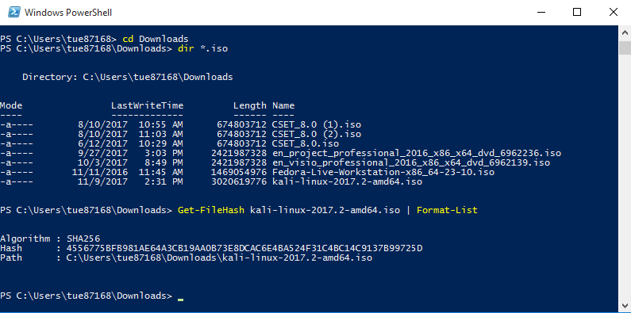
One-way hash example…

Slide 30
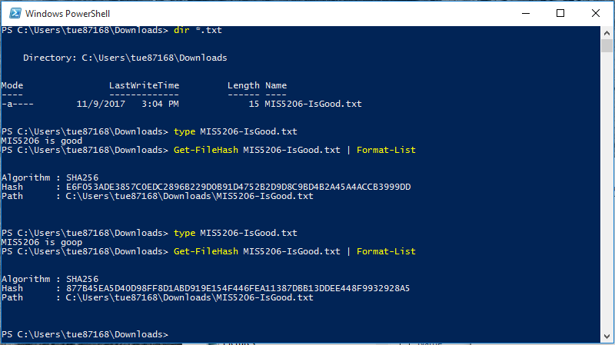
One-way hash example…
Notice the amount of confusion and diffusion resulting from a 1-character change!

Slide 31
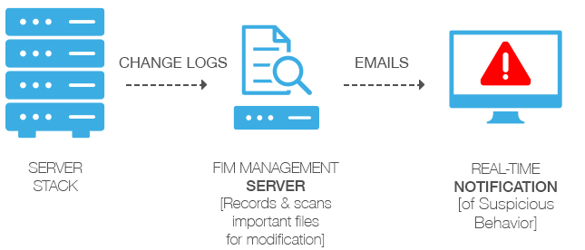
File Integrity Monitoring
An internal control process
Validates the integrity of operating system and application software files
Uses hash verification to compare the current file state and a known good baseline state
Involves calculating and storing a hash value of a known good version of the file (“original baseline”)
Compares the baseline with the calculated hash of the current state of the file to detect unauthorized changes

Slide 32
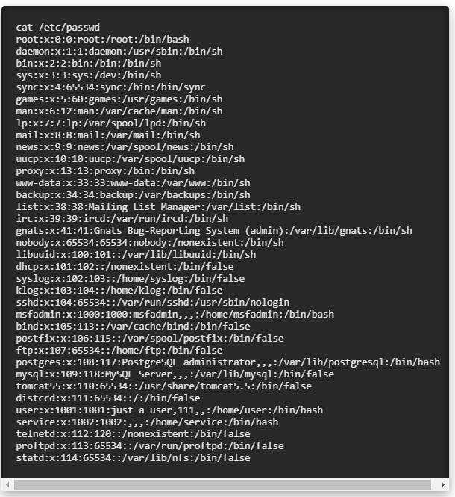
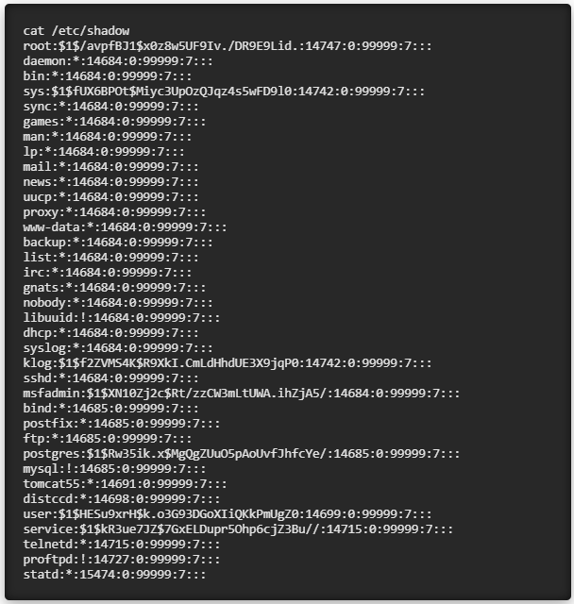
How are passwords stored in Linux?
Passwords are hashed!
Don’t store plaintext passwords
Shadow file
Password file

Slide 33
Cryptanalysis Attacks
Random Number Generator (RNG) Attack
  Predict initialization vector used by an algorithm
Social Engineering
  Humans are the weakest link
Brute force
  Trying all key values in the keyspace
Frequency Analysis
  Guess values based on frequency of occurrence
Dictionary Attack
  Find plaintext based on common words
Known Plaintext
  Format or content of plaintext available
Chosen Plaintext
  Attack can encrypt chosen plaintext
Chosen Ciphertext
  Decrypt known ciphertext to discover key

Slide 34
Cryptanalysis Attacks
Collisions
  Two different messages with the same hash value
  Based on the “birthday paradox”
  Hash algorithms should be resistant to this attack
The birthday paradox, also known as the birthday problem, states that in a random group of 23 people, there is about a 50 percent chance that two people have the same birthday.

Slide 35
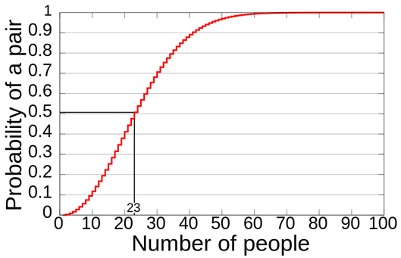
Is the Birthday Attack Real?
There are multiple reasons why this seems like a paradox
One is that when in a room with 22 other people, if a person compares her/his birthday with the birthdays of the other people it would make for only 22 comparisons—only 22 chances for people to share the same birthday.
When all 23 birthdays are compared against each other, it makes for much more than 22 comparisons. How much more?
Well, the first person has 22 comparisons to make, but the second person was already compared to the first person, so there are only 21 comparisons to make.
The third person then has 20 comparisons, the fourth person has 19 and so on.
If you add up all possible comparisons (22 + 21 + 20 + 19 + … +1) the sum is 253 comparisons, or combinations. Consequently, each group of 23 people involves 253 comparisons, or 253 chances for matching birthdays.

Slide 36
MD5 (Message Digest 5)
A 128-bit hash algorithm, still in common use
Has been broken
128-bit hash, but only need 2^{128/2} = 2⁶⁴ to find a collision
Not strong enough for modern computers
SHA -1 (Security Hash Algorithm 1)
A 160-bit hash algorithm, still in common use
Has been broken
160-bit hash, but only need 2^{160/2} = 2⁸⁰ to find a collision
No longer strong enough for modern computers

Slide 37
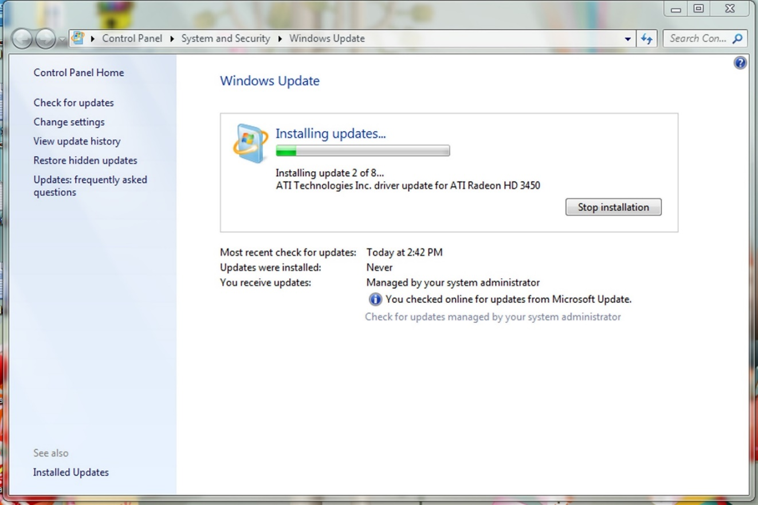
  The malware Flame used a MD5 hash collision to hijack Microsoft Windows Update and spread itself across networks
    Flame collected audio, keystrokes, screenshots which it sent to a malicious server
    Found a collision within a single millisecond
    Cost ~$200k computing time just for 1ms
    Attributed to advanced persistent threat group Equation Group
    Espionage attacks on countries in and around Iran

Slide 38

PWN (verb)
1. An act of dominating an opponent.
2. Great, ingenious; applied to methods and objects.
Originally dates back to the days of WarCraft, when a map designer mispelled "Own" as "Pwn“
What was originally suppose to be "player has been owned." was "player has been pwned"
Use of the term “Pwn’ grew and is now used throughout the online world, especially in online games:
  "I pwn these guys on battlenet"
  "This strategy pwns!" or "This game pwn."
Equation Group’s Flame malware
won 2012 “Epic 0wnage” Pwnie award
Pwnie Awards recognize both excellence and incompetence in the field of information security
Awards are presented yearly at the Black Hat Security Conference
https://www.urbandictionary.com/define.php?term=pwn

Slide 39
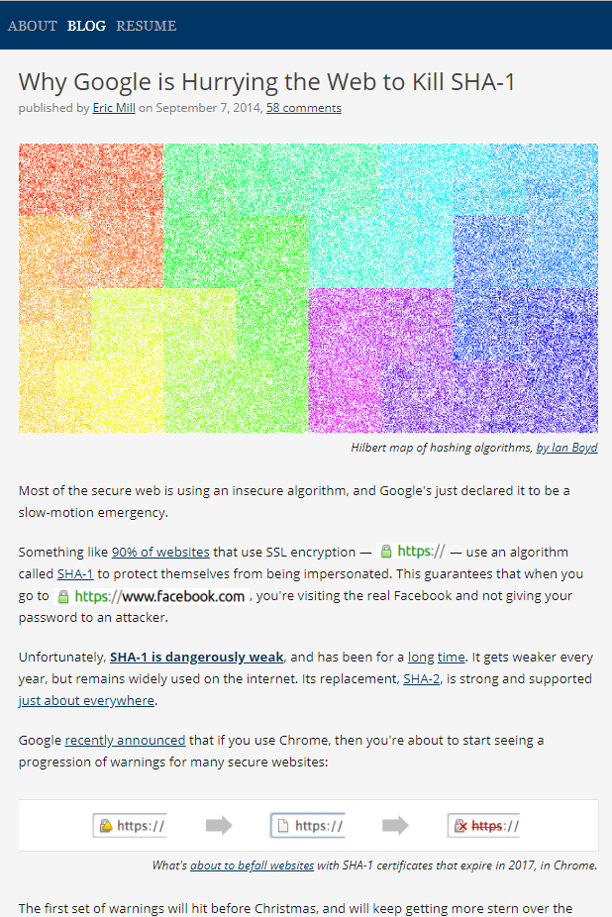
Hashing algorithms are used for browser ssl (secure sockets layer)
In 2014, many sites were still using SHA-1, at the time known to be dangerously vulnerable
Google declared state of emergency to push companies to upgrade

Slide 40
SHA-2 uses 224, 256, 384, and 512-bit hashes
  But… it is built using the design of SHA-1, and prone to the same weaknesses
  It’s believed to be a matter of time before SHA-2 is also exploited
SHA-3 was just ratified recently by NIST, the U.S. National Institute of Standards and Technology
  It was the result of a six-year hashing competition. Also uses 224-, 256-, 384-, 512-bit hashes
Why does this matter for businesses?
Business needs a reliable way to prove integrity of data, files, programs, that can be trusted
Notes:
Demo an SSL certificate with Chrome

Slide 41
Agenda
Updated Schedule
Symmetric cryptography
Block versus Stream ciphers
Block ciphers
Block ciphers mode of operations
Hashes

