Slide 1
Managing Enterprise Cybersecurity
MIS 4596
Class 10
Asymmetric Cryptography and Digital Signatures

Slide 2
Agenda
Key sharing problem: Metcalf’s Law
Symmetric key sharing with Diffie-Hellman public key algorithm
Man-In-The-Middle Attack
RSA - Public Key Encryption with confidentiality, authentication and non-repudiation
Hybrid Encryption
Session Key
Digital Signature
Finding algorithms in internet browser certificates

Slide 3
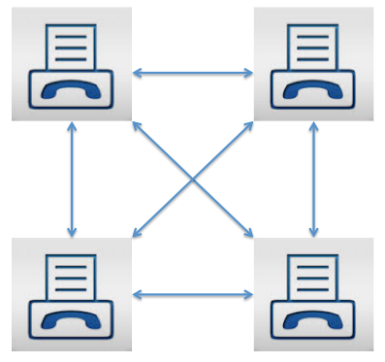

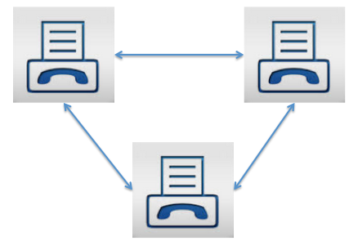
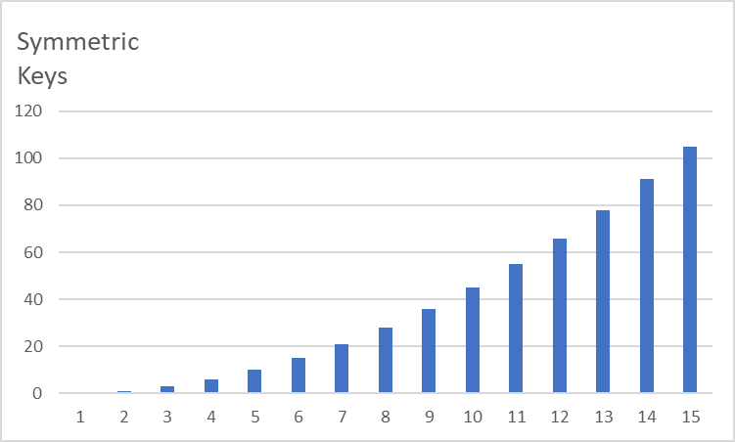
Key sharing problem
Sharing cryptographic keys has been a problem throughout history
The number of pairs of keys (“secure network connections”) grows at a near exponential rate (i.e. geometric rate) as the number of users increases
Users

Slide 4
Key sharing problem
The number of pairs of keys needed for “n” users is determined by an equation known as Metcalf’s Law
Number of key pairs needed for n users = (n*(n-1))/2
  The reason for the n-1 is that you do not need to communicate with yourself
For MIS 4596 with 20 students how many keys would we need:
      (20 *19)/2 = 190 keys

Slide 5
Agenda
Key sharing problem: Metcalf’s Law
Symmetric key sharing with Diffie-Hellman public key algorithm
Man-In-The-Middle Attack
RSA - Public Key Encryption with confidentiality, authentication and non-repudiation
Hybrid Encryption
Session Key
Digital Signature
Finding algorithms in internet browser certificates

Slide 6


Slide 7


Slide 8
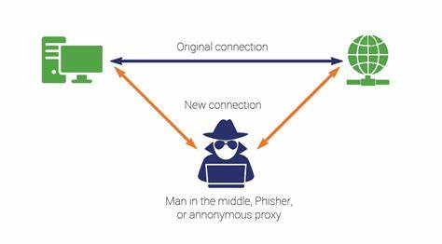

Slide 9
Diffie-Hellman Algorithm:
Secret symmetric key derivation through public key sharing
Assumptions:
A prime number is a positive whole number whose only factors (i.e. integer divisors) are 1 and the number itself (e.g. 2, 3, 5, 7, 11, 13, 17, 19, 23, …). Bob & Alice want to compute a shared secret key to protect confidentiality of their conversation. Eve eavesdrops…
Algorithm:
Bob & Alice publicly agree on “p” called prime modulus (e.g. p = 23) & “g” called generator (e.g. g = 5), Eve overhears
Bob & Alice each choose their own secret key:
  Bob’s secret key is referred to as “x_bob” which is a number between 1 and p-1 (e.g. x_bob = 12)
  Alice’s secret key is referred to as “x_alice” which also is a number between 1 and p-1 (e.g. x_alice = 7)
Bob & Alice each computes their own public key, which they share with each other and Eve intercepts…
  Bob computes: y_bob = g ^{x_bob} mod p which is: y_bob = 5¹² mod 23 = 18 which he shares with Alice (and Eve)
  Alice computes: y_alice = g ^{x_alice} mod p which is: y_alice = 5⁷ mod 23 = 17 which she shares with Bob (and Eve)
Bob & Alice each compute their shared secret symmetric key
  Bob computes: y_alice^{x_bob} mod p which is: 17¹² mod 23 = 6
  Alice computes: y_bob^{x_alice} mod p which is: 18⁷ mod 23 = 6
Bob & Alice now have a shared secret (“symmetric”) key = 6
Eve has Bob & Alice’s public keys: y_bob=18 & y_alice=17, prime modulus: p=23 and generator: g=5, but not their secret keys x_bob = 12 & x_alice = 7
  Eve cannot calculate Bob& Alice’s shared symmetric secret key from their public keys, p and g alone – even though she knows they are using the Diffie-Hellman algorithm!
let’s use WolframAlpha online calculator

Slide 10
Generic Diffie-Hellman Algorithm – Important for Lab 3
Run the algorithm together
Bob & Alice publicly agree on “p” called prime modulus (e.g. p = 31) and “g” called generator (e.g. g = 3), Eve overhears
Bob & Alice each choose your own secret key:
  Bob’s secret key is referred to as “x_bob” which is a number between 1 and p-1 (write it down but keep it secret)
  Alice’s secret key is referred to as “x_alice” which also is a number between 1 and p-1 (write it down but keep it secret)
Bob & Alice each computes your own public key, which you share with each other, and Eve intercepts…
  Bob computes: y_bob = g ^{x_bob} mod p which he writes down and shares with Alice (and Eve)
  Alice computes: y_alice = g ^{x_alice} mod p which she writes down and shares with Bob (and Eve)
Bob & Alice each secretly compute your shared secret symmetric key which you write down and do not share
  Bob computes: y_alice^{x_bob} mod p which he writes down and does not share
  Alice computes: y_bob^{x_alice} mod p which she writes down and does not share
Bob & Alice now have a shared secret (“symmetric”) key compare your secret keys and confirm they are the same
Eve has Bob & Alice’s public keys: y_bob & y_alice, prime modulus: p and generator: g, but not their secret keys x_bob & x_alice
  Eve cannot calculate Bob& Alice’s shared symmetric secret key from their public keys, p and g alone – even though she knows they are using the Diffie-Hellman algorithm!

Slide 11
In practice, p must be much larger prime number… this is a 4096-bit p
857,756,147,438,808,767,721,482,523,862,479,196,091,217,066,271,200,126,894,701,702,329,327,872,802,487,425,224,246,373,206,756,773,954,180,315,945,664,685,564,049,690,107,228,861,210,053,005,306,168,041,237,244,792,245,832,497,260,206,801,417,396,745,674,574,281,768,112,711,519,809,332,223,737,878,554,093,201,446,763,995,425,025,965,323,912,149,043,161,823,975,594,943,915,411,109,637,902,372,642,611,214,196,649,667,036,726,005,577,041,694,781,738,635,943,018,156,362,403,714,091,905,448,620,990,965,500,814,912,289,738,636,687,051,381,358,564,729,963,735,782,176,280,511,819,070,673,927,579,180,484,836,950,910,945,840,410,470,935,832,100,360,510,117,962,261,152,920,101,946,255,789,679,435,711,472,267,368,823,730,863,971,596,718,223,674,224,106,003,985,209,174,353,308,077,140,794,884,546,003,360,030,727,697,326,025,663,819,442,780,105,880,604,943,197,516,223,343,068,846,392,924,237,875,653,640,416,933,764,628,191,065,601,980,281,442,005,263,033,849,543,723,716,743,986,123,624,356,871,152,793,177,027,462,801,070,011,526,783,269,474,338,816,734,553,122,757,257,382,121,230,562,181,721,318,331,271,107,036,972,788,062,816,322,387,506,944,045,038,739,178,684,349,474,317,534,892,731,313,651,324,179,101,369,222,316,429,969,662,605,450,068,078,088,031,941,042,867,503,697,721,512,539,949,128,099,005,160,179,345,242,776,041,458,121,259,813,719,561,319,392,760,414,249,584,984,440,063,314,771,039,261,920,249,005,444,014,069,555,961,131,639,966,539,872,980,057,279,636,609,441,274,119,014,567,294,590,620,498,019,375,631,405,622,479,332,810,401,520,856,695,524,524,855,468,645,479,042,909,834,183,316,487,318,824,544,358,235,183,243,643
Notes:
This is a 4096-bit prime number (safe prime)
$ time openssl dhparam 4096 -text

Slide 12
Diffie-Hellman
Uses asymmetric public and private keys to exchange a symmetric key
Does not use asymmetric keys for confidentiality (i.e. to encrypt or decrypt any messages)
Users/systems need to negotiate a new key for every new person
No authentication, no non-repudiation

Slide 13
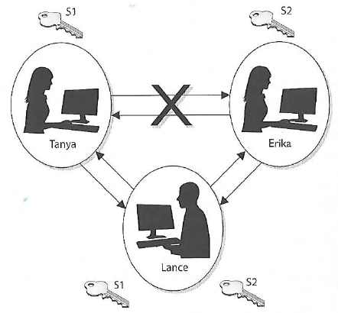
Diffie-Hellman was vulnerable to man-in-the-middle attack, because no authentication occurs before public keys are exchanged
Tanya sends her public key to Erika, but Lance grabs the key during transmission so it never makes it to Erika
Lance spoofs Tanya’s identity and sends over his public key to Erika. Erika now thinks she has Tanya’s public key
Erika sends her public key to Tanya, but Lance grabs the key during transmission so it never makes it to Tanya
Lance spoofs Erika’s identity and sends over his public key to Tanya. Tanya now thinks she has Erika’s public key
Tanya combines her private key and Lance’s public key and creates a symmetric key S1
Lance combines his private key and Tanya’s public key and creates symmetric key S1
Erika combines her private key and Lance’s public key and creates symmetric key S2
Lance combines his private key and Erika’s public key and creates symmetric key S2
Now Tanya and Lance share a symmetric key (S1) and Erika and Lance share a different symmetric key (S2). Tanya and Erika think they are sharing a key between themselves and do not realize Lance is involved
Tanya writes a message to Erika, and uses her symmetric key (S1) to encrypt the message, and sends it
Lance grabs the message and decrypts it with symmetric key S1, reads or modifies the message and re-encrypts it with symmetric key S2, and then sends it to Erika
Erika take symmetric key S2 and uses it to decrypt and read the message….
Harris, S. and Maymi, F. (2019) All-In-One CISSP Exam Guide

Slide 14
Agenda
Key sharing problem: Metcalf’s Law
Symmetric key sharing with Diffie-Hellman public key algorithm
Man-In-The-Middle Attack
RSA - Public Key Encryption with confidentiality, authentication and non-repudiation
Hybrid Encryption
Session Key
Digital Signature
Finding algorithms in internet browser certificates

Slide 15
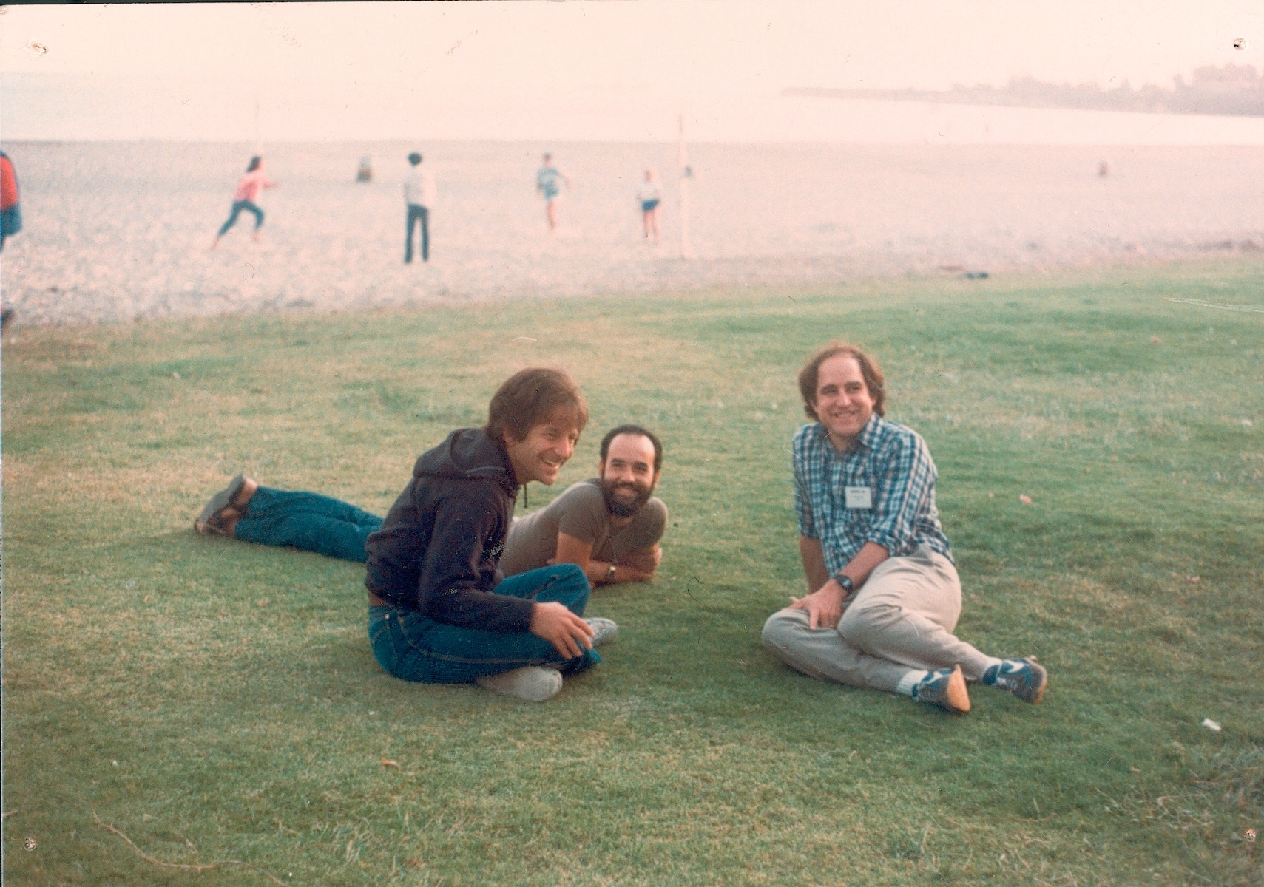
Ron Rivest
Leonard Adleman
Adi Shamir
Notes:
Ron Rivest, Adi Shamir, Leonard Adleman, three computer science professors at MIT.

Slide 16
RSA Public Key Algorithm
Most popular worldwide standard, that can be used for:
  Asymmetric encryption/decryption
  Key exchange (i.e. used to encrypt AES symmetric key)
  Digital signatures
In one direction, RSA provides:
  Confidentiality through encryption
  Authentication and non-repudiation through signature verification
In the inverse direction, RSA provides:
  Confidentiality through decryption
  Authentication and non-repudiation through signature generation

Slide 17
RSA Public Key Algorithm
Based on factoring large numbers into their prime numbers
  A prime number is a positive whole number whose only factors (i.e. integer divisors) are 1 and the number itself
    E.g. 2, 3, 5, 7, 11, 13, 17, 19, 23, …
  Prime number factoring is
    Easy when you know the result and one of the factors
      6,700,283 = 1889 * 3547
    Difficult when you do not know the factors, and the result is large
      6,700,283 = prime1 * prime2

Slide 18
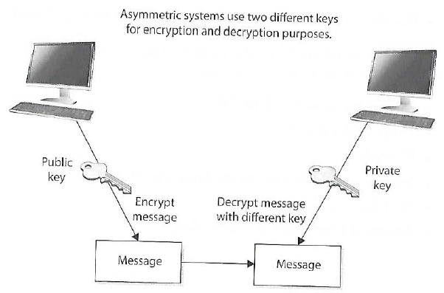
Asymmetric cryptography
Public and Private keys are mathematically related
  Public keys are generated from private key
  Private keys cannot be derived from the associated public key (if it falls into the wrong hands)
Public key can be known by everyone
Private key must be known and used only by the owner
Asymmetric cryptography is computationally intensive and much slower (1,000 times slower) than symmetric cryptography
Harris, S. and Maymi, F. (2016) All-In-One CISSP Exam Guide

Slide 19
Asymmetric cryptography
Do not get confused and think the public key is only for encryption and private key is only for decryption!
Each key type can be use used to encrypt and decrypt
  If data is encrypted with a private key it cannot be decrypted with the same private key (but it can be decrypted with the related public key)
  If data is encrypted with a public key it cannot be decrypted with the same public key (but it can be decrypted with the related private key)

Slide 20
Asymmetric cryptography
If the sender (“Jill”) encrypts data with her private key, the receiver (“Bill”) must have a copy of Jill’s public key to decrypt it
  By decrypting the message with Jill’s public key Bill can be sure the message really came from Jill
  A message can be decrypted with a public key only if the message was encrypted with the corresponding private key
    This provides authentication because Jill is only the only one who is supposed to have her private key
If Bill (the receiver) wants to make sure Jill is the only one who can read his reply, he will encrypt the response with her public key
  Only Jill will be able to decrypt the message, because she is the only one who has the necessary private key
  This provides confidentiality because only Jill is able to decrypt the message with her private key

Slide 21
Asymmetric cryptography
Why would Bill (now the sender) choose to encrypt his reply to Jill with his private key instead of using Jill’s public key?
  Authentication – Bill wants Jill to know that the message came from him and no one else
  If he encrypted the data with Jill’s public key, it does not provide authenticity because anyone can get Jill’s public key
  If he uses his private key to encrypt the data, then Jill can be sure the message came from him and no one else
  Note: Symmetric keys do not provide authenticity – because the same key is used on both ends (using one of the secret keys does not ensure the message originated from a specific individual

Slide 22
Asymmetric cryptography
If confidentiality is the most important security service, the sender would encrypt the file with the receiver’s public key
  This is called a “secure message format” because it can only be decrypted by the person with the corresponding private key
If authentication is most important, the sender would encrypt the data with her/his private key
  This provides assurance to the receiver that the only person who could have encrypted the data is the individual in possession of the private key
  If the sender encrypted the data with receiver’s public key, authentication is not provided because the public key is available to anyone
  Encrypting data with the sender’s private key is called an “open message format” because anyone with a copy of the corresponding public key can decrypt the message
  Confidentiality is not assured

Slide 23
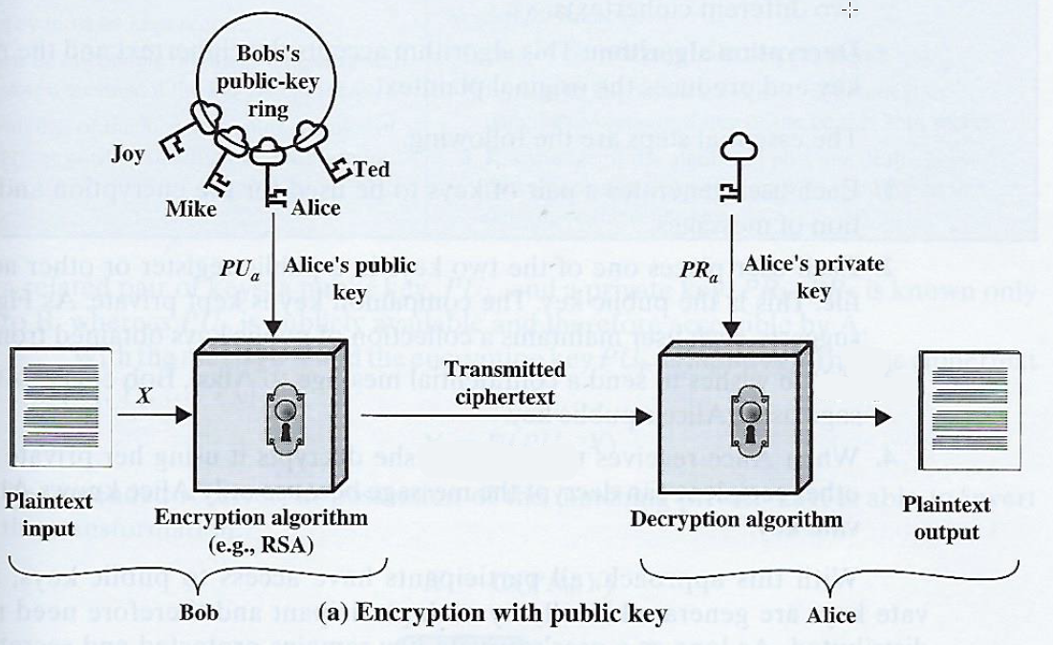
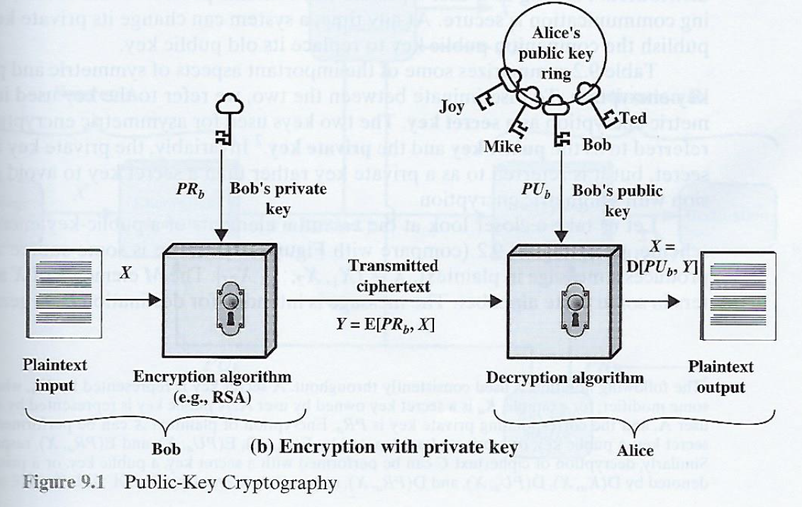
Public Key Management
Stallings, W. (2014) Cryptography and Network Security

Slide 24
Agenda
Key sharing problem: Metcalf’s Law
Symmetric key sharing with Diffie-Hellman public key algorithm
Man-In-The-Middle Attack
RSA - Public Key Encryption with confidentiality, authentication and non-repudiation
Hybrid Encryption
Session key
Digital Signature
Finding algorithms in internet browser certificates

Slide 25
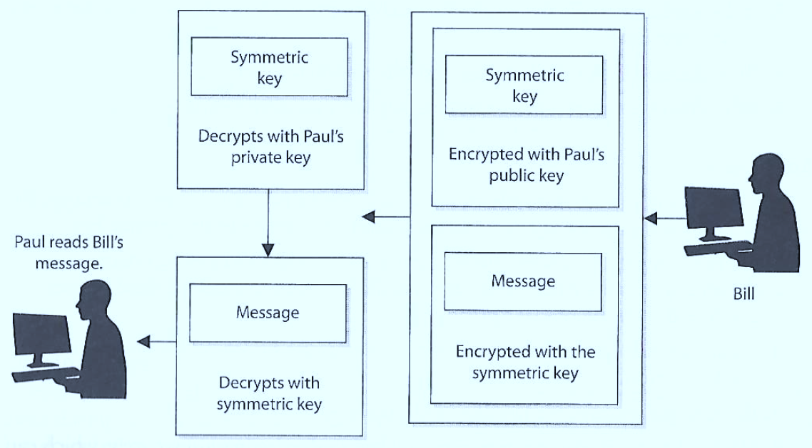
Hybrid Encryption
3
2
1
4
Symmetric algorithm uses a secret key to encrypt the message and the asymmetric key encrypts the secret key for transmission (SSL/TLS uses hybrid)
Harris, S. and Maymi, F. (2016) All-In-One CISSP Exam Guide, McGraw Hill Education

Slide 26
Quick review
If a symmetric key is encrypted with a receiver’s public key, what security service is provided?
  Confidentiality: only the receiver’s private key can be used to decrypt the symmetric key, and only the receiver should have access to this private key

Slide 27
Quick review
If data is encrypted with the sender’s private key, what security services are provided?
  Authenticity of the sender and nonrepudiation. If the receiver can decrypt the encrypted data with the sender’s public key, then receiver knows the data was encrypted with the sender’s private key

Slide 28
Quick review
Why do we encrypt the message with the symmetric key rather than the asymmetric key?
  Because the asymmetric key algorithm is too slow

Slide 29
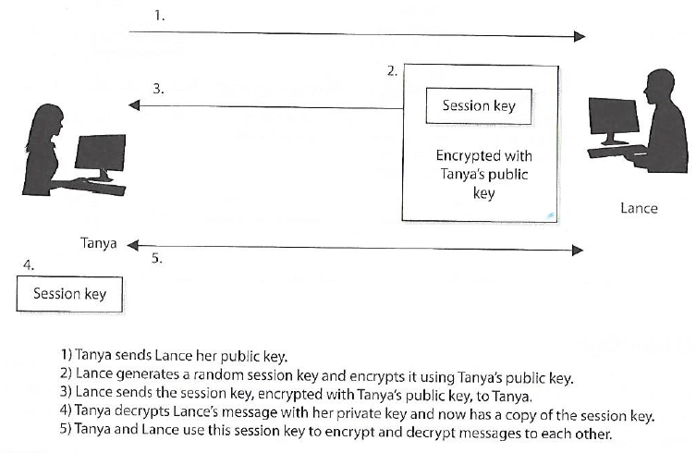
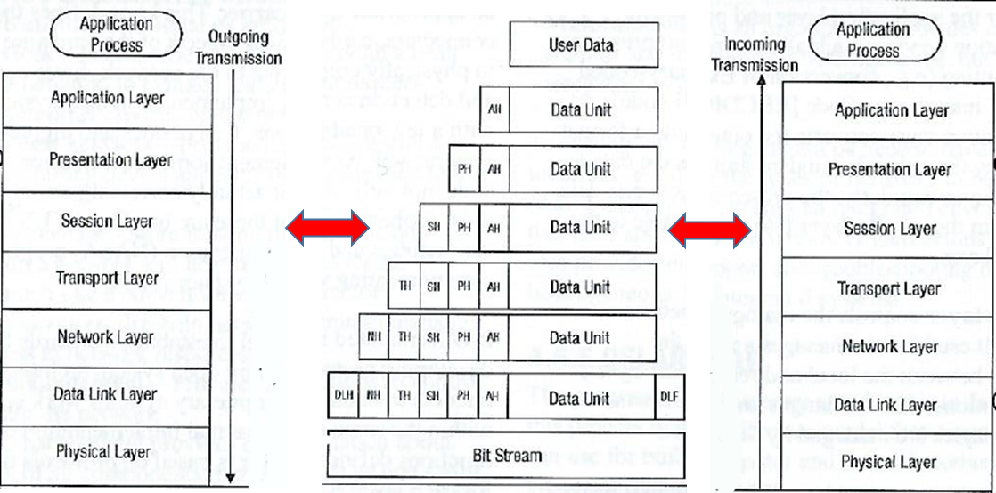
Session keys
Single-use symmetric keys used to encrypt messages between two users in an individual communication session
This is how secure web client applications communicate with server-side services
Harris, S. and Maymi, F. (2016) All-In-One CISSP Exam Guide, McGraw Hill Education

Slide 30
Agenda
Key sharing problem: Metcalf’s Law
Symmetric key sharing with Diffie-Hellman public key algorithm
Man-In-The-Middle Attack
RSA - Public Key Encryption with confidentiality, authentication and non-repudiation
Hybrid Encryption
Session key
Digital Signature
Finding algorithms in internet browser certificates

Slide 31
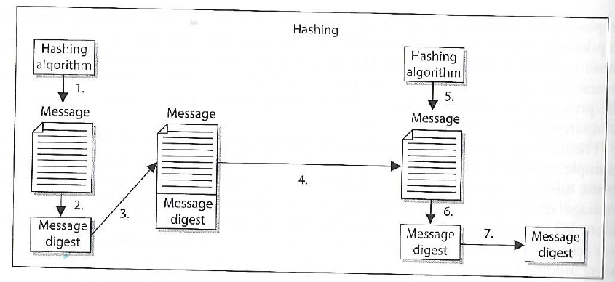
Quick Review: One-way Hash
Sender puts message through hashing function
Message digest generated
Message digest appended to the message
Sender sends message to receiver
Receiver puts message through hashing function
Receiver generates message digest value
Receiver compares the two message digests values. If they are the same, the message has not been altered
Assures message integrity
A function that takes a variable-length string (i.e. message) and produces a fixed-length value called a hash value
Does not use keys

Slide 32
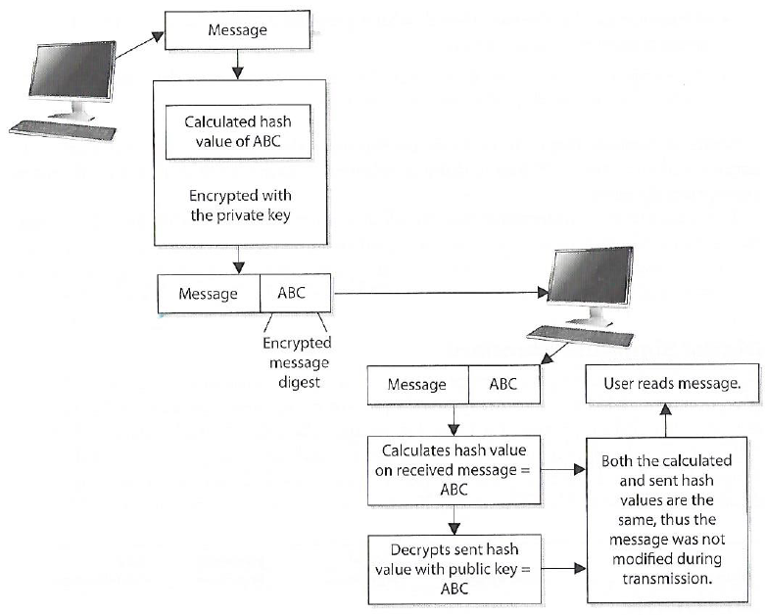
Digital Signature
A hash value encrypted with the sender’s private key
The act of signing means encrypting the message’s hash value with the private key
Creating a digital signature for a message
Harris, S. and Maymi, F. (2016) All-In-One CISSP Exam Guide, McGraw Hill Education

Slide 33
Reasons to Use Cryptography
Reason | How achieved
Confidentiality | The message can be encrypted
Integrity | The message can be hashed and/or digitally signed
Authentication | The message can be digitally signed
Nonrepudiation | The message can be digitally signed

Slide 34
Agenda
Key sharing problem: Metcalf’s Law
Symmetric key sharing with Diffie-Hellman public key algorithm
Man-In-The-Middle Attack
RSA - Public Key Encryption with confidentiality, authentication and non-repudiation
Hybrid Encryption
Session key
Digital Signature
Finding algorithms in internet browser certificates

Slide 35
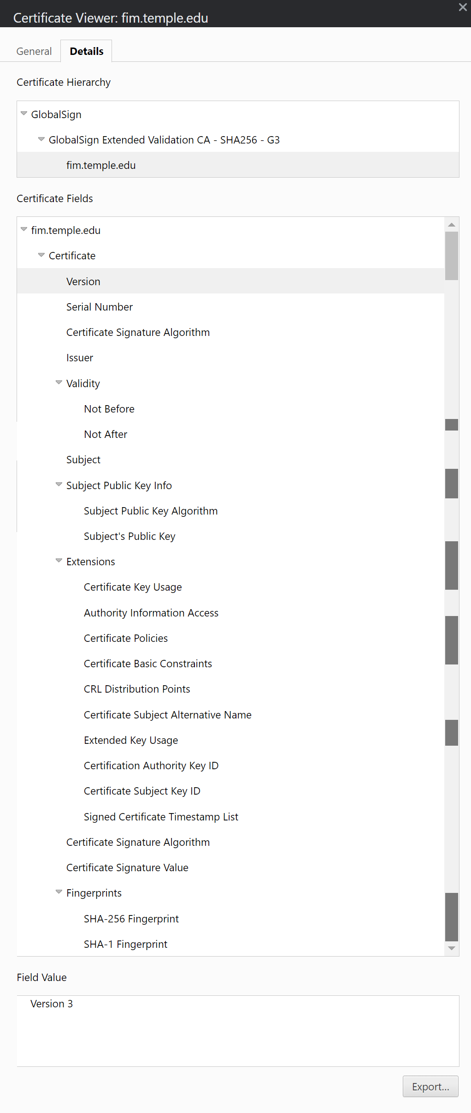
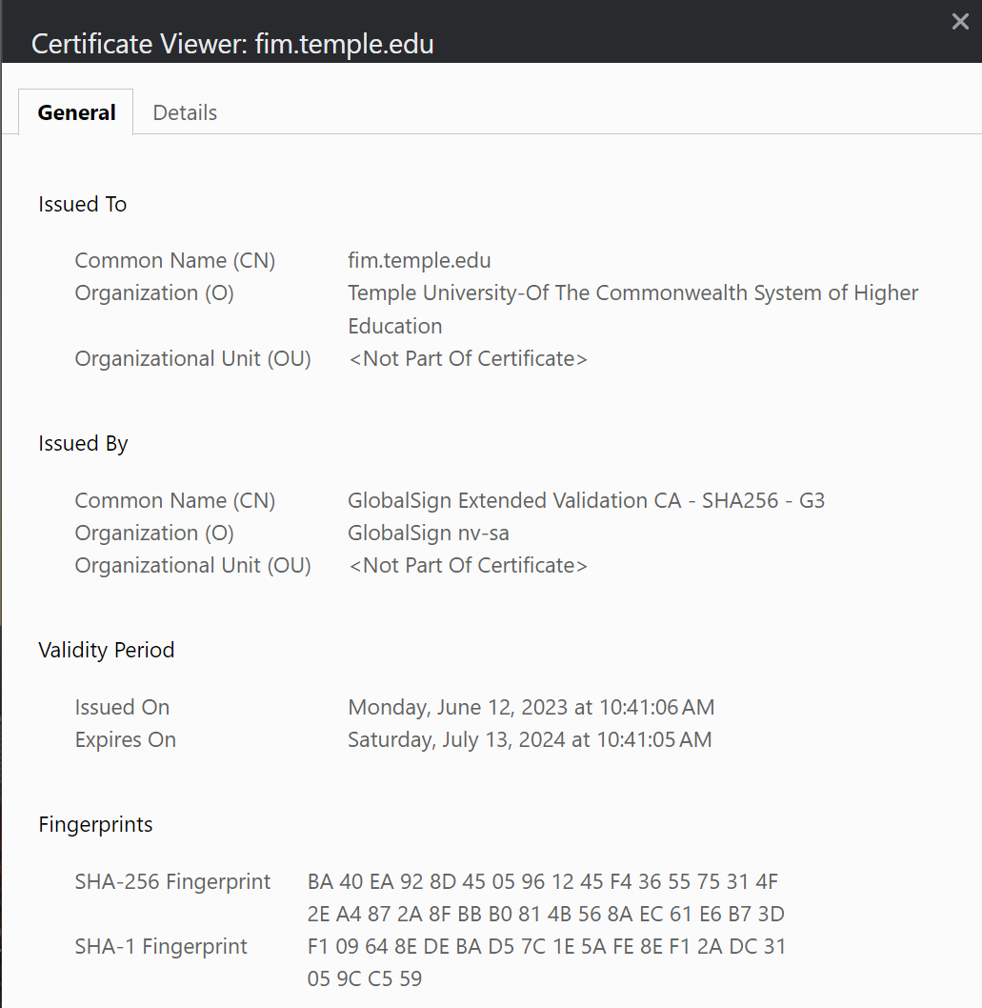
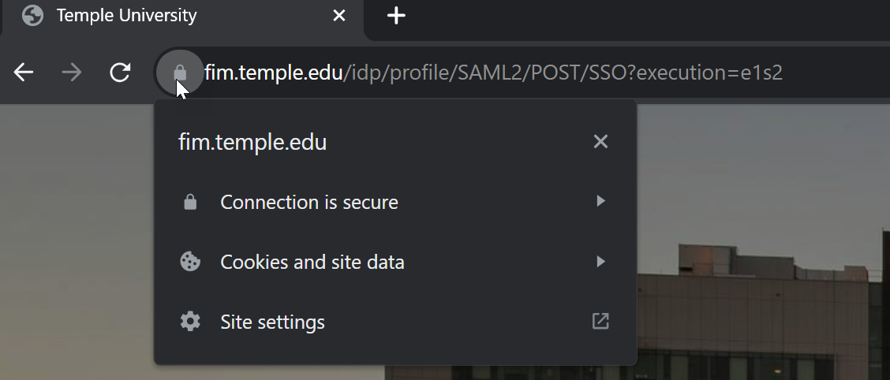
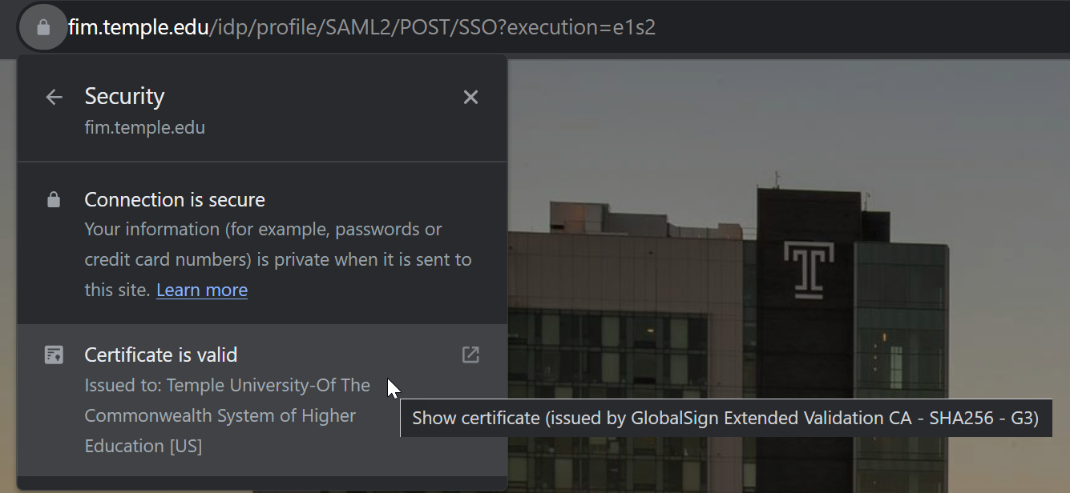
Viewing Digital Certificates to see algorithms used
Chrome Browser
Click the padlock in the URL bar
Click the “Connection is secure”
Click “Certificate is valid”

Slide 36
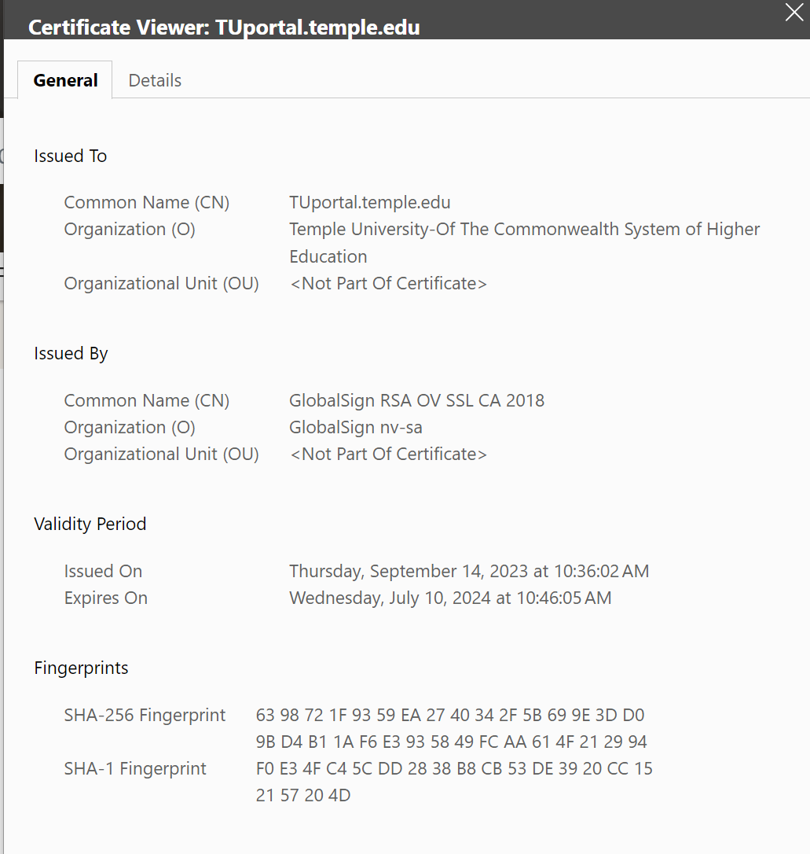
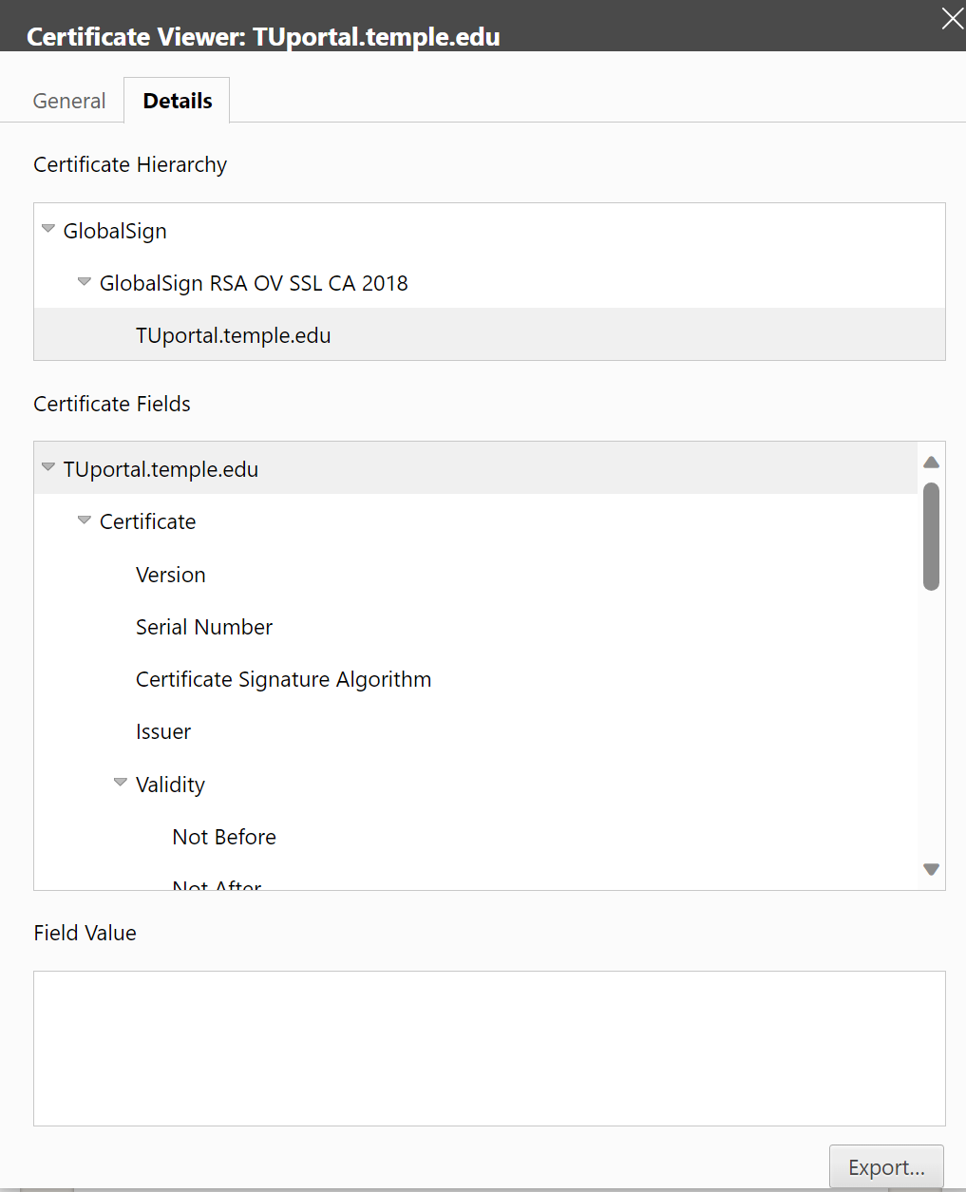
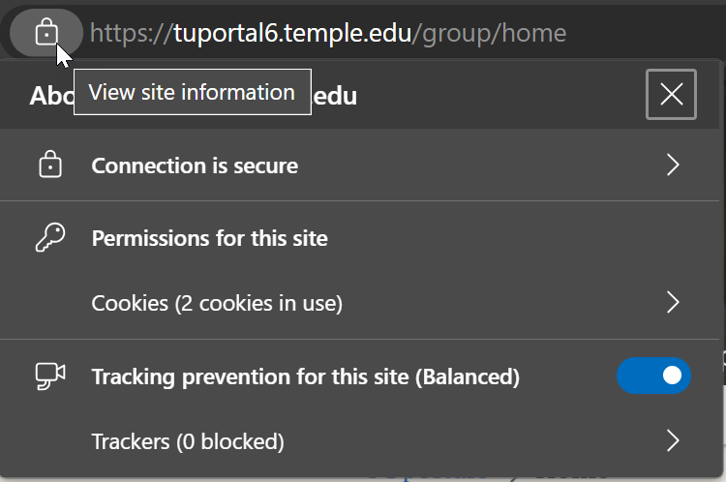
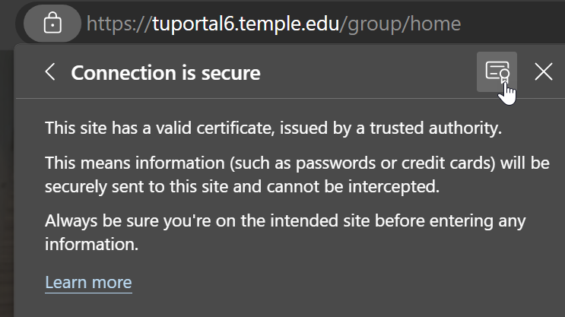
Viewing Digital Certificate
Microsoft Edge
Click the padlock on the URL bar
Click Connection is secure
Click Certificate icon…

Slide 37
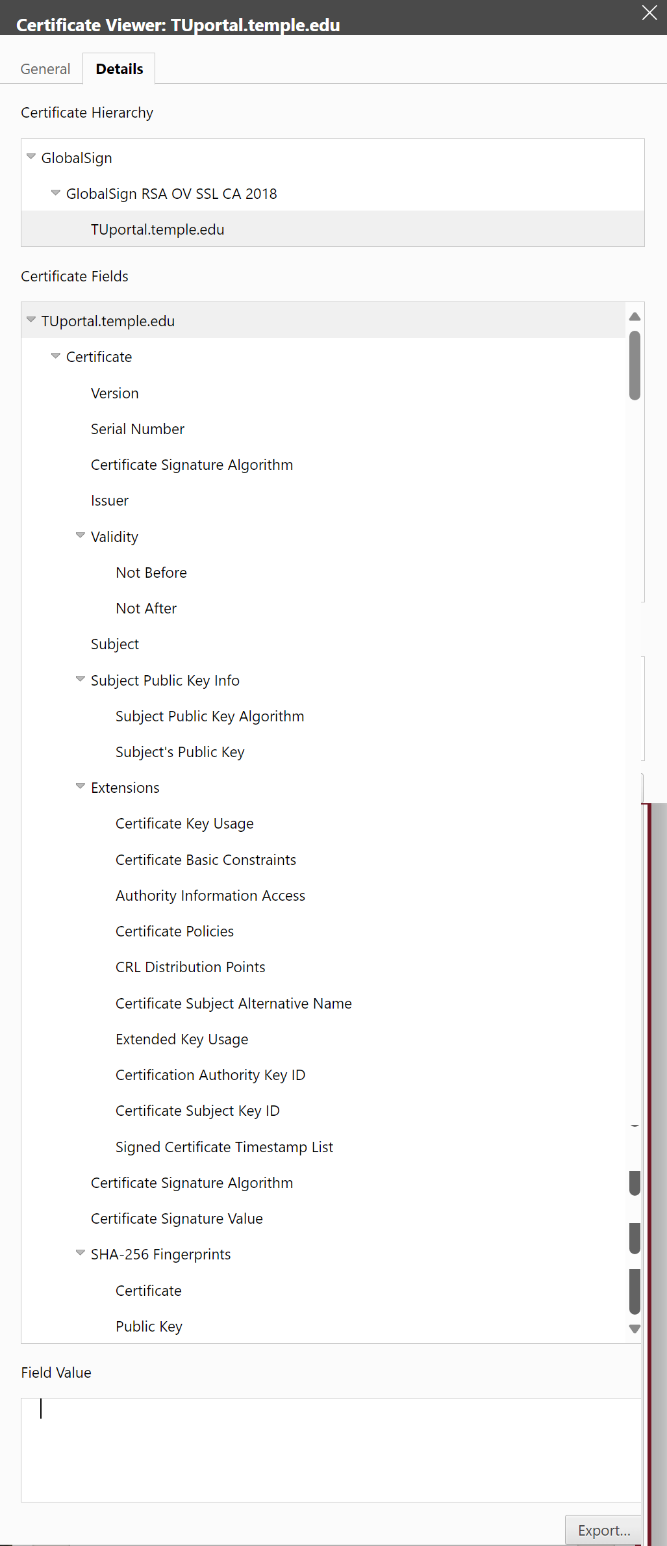
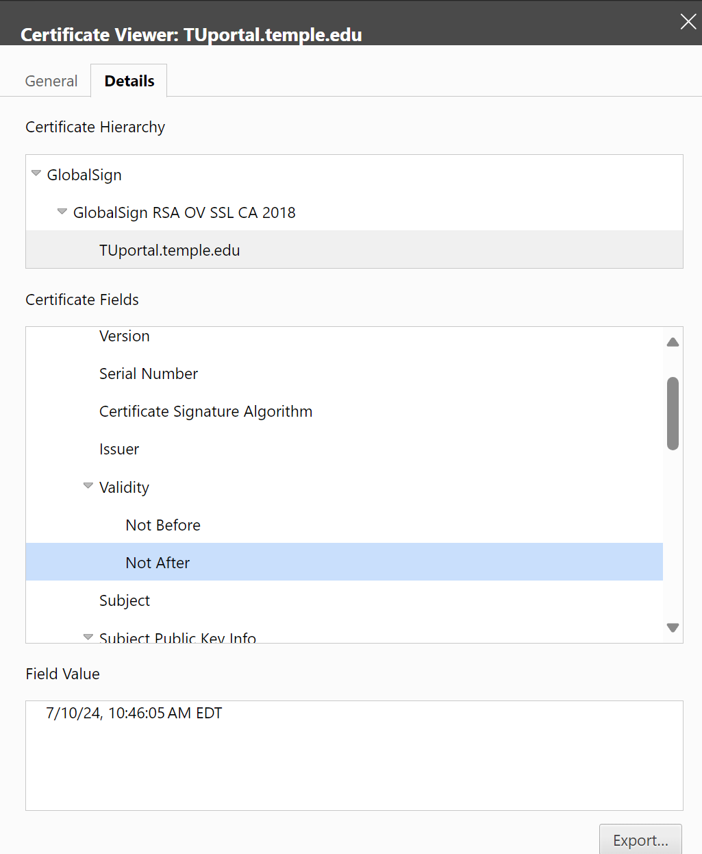
Certificate Details

Slide 38
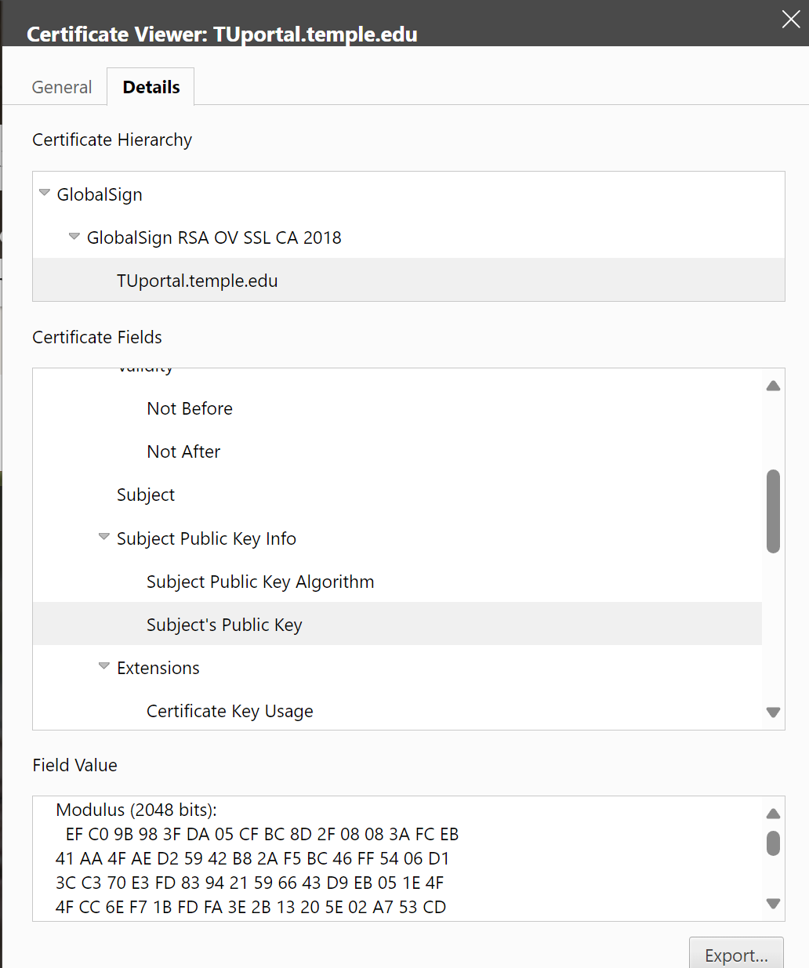
Certificate Details

Slide 39
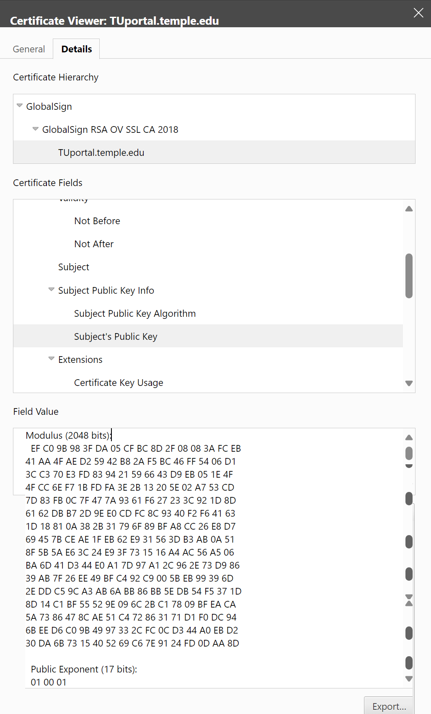
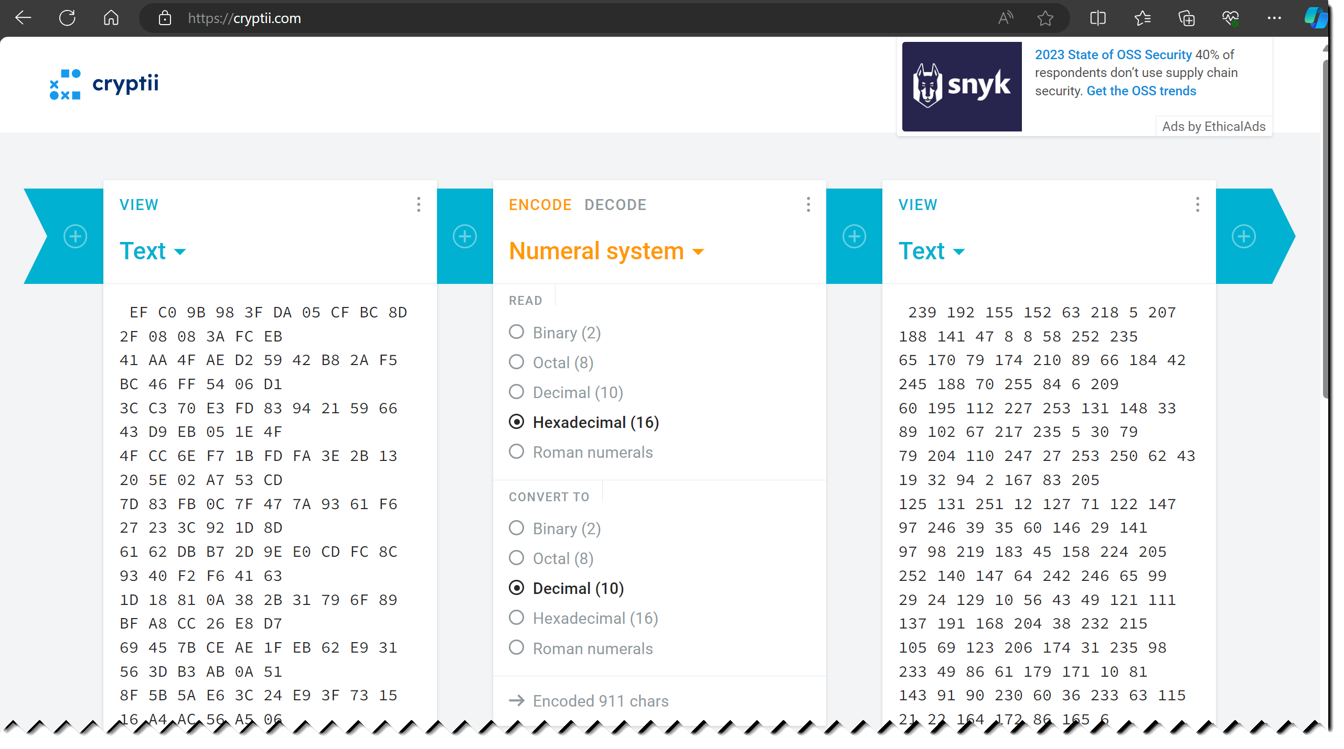
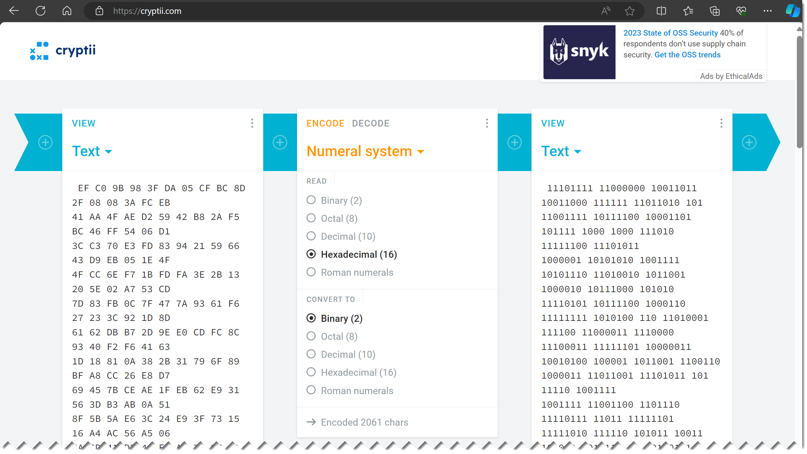
https://cryptii.com/

Slide 40
Agenda
Key sharing problem: Metcalf’s Law
Symmetric key sharing with Diffie-Hellman public key algorithm
Man-In-The-Middle Attack
RSA - Public Key Encryption with confidentiality, authentication and non-repudiation
Hybrid Encryption
Session key
Digital Signature
Finding algorithms in internet browser certificates

