Slide 1
Managing Enterprise Cybersecurity
MIS 4596
Unit#13

Slide 2
Agenda
Introduction
Hacker’s workflow
Password vulnerabilities
Password security techniques
Password cracking
Warning
Lab 5: Password cracking
Password entropy
Note: An openssl manual – chapter 2 shows hashing commands

Slide 3
Password Cracking…
This week begins offensive security (e.g., ethical hacking & penetration testing)
  Explains techniques to crack (i.e., guess) passwords using a variety of techniques
  This lecture and the associated Lab: Password Cracking provides you with what you need to know to crack passwords on Milestone 3: Penetration Test
In Milestone 3, you may have the opportunity to crack passwords in:
  A cryptographic protocol for operating network services securely over an unsecured network
  A local Linux server’s user accounts from the hashes found in /etc/shadow,
  Unsalted MD5 hashes in a local database
  And you will have the opportunity to decrypt an encrypted file by guessing its password
  …

Slide 4

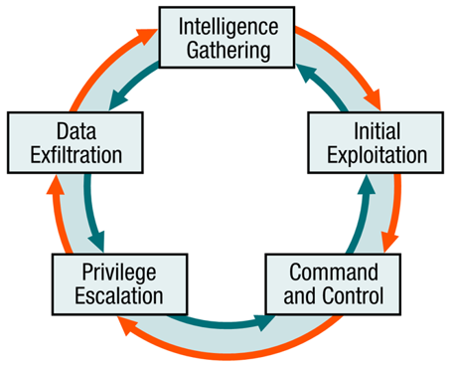
Hacker’s workflow – Where Password Cracking fits in…
Background research
Vulnerability scanning
A penetration test is an authorized simulated cyberattack on a computer system, performed to evaluate the security of the system
Vulnerability exploitation
Colloquially known as a “pen test”, “pentest” or ethical hacking,
Password cracking
Internal reconnaissance
Note: We are teaching Password Cracking now (before vulnerability scanning and exploitation), because knowing how to secure your passwords as soon as possible is essential to providing you personally relevant secure awareness training

Slide 5
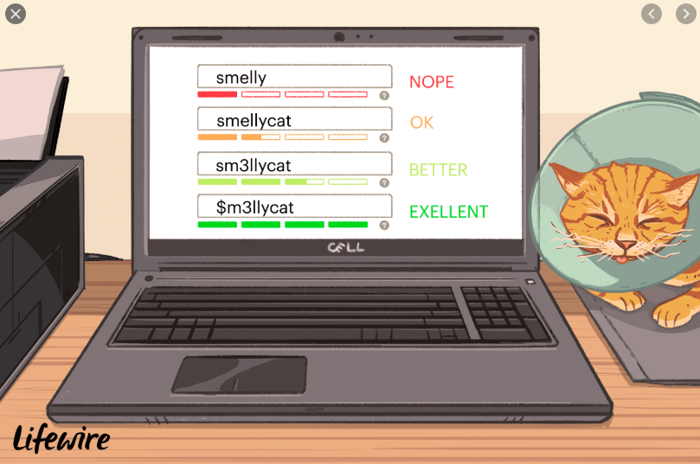
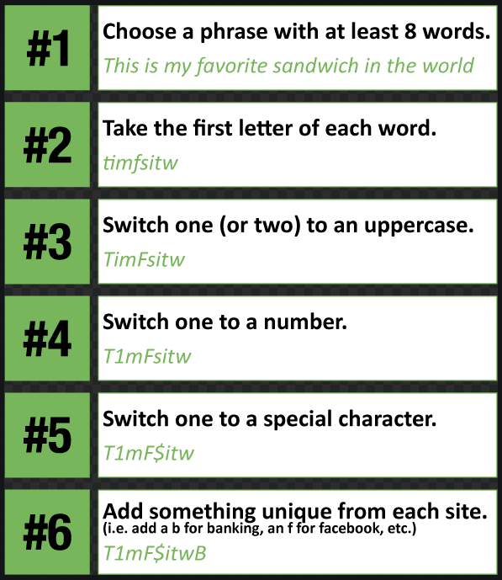
Password
A (hopefully) protected string of characters used to authenticate an individual
Authentication factor based on what a person knows
Is one of the most often used authentication mechanism

Slide 6
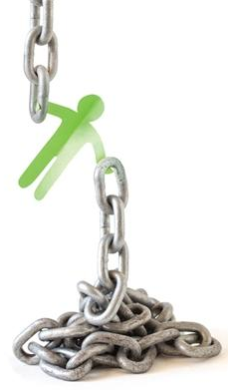
Password vulnerabilities
Although passwords are the most common authentication mechanism, they are one of the weakest security mechanisms available
Why?
  Users choose words easily guessed
  Users tell others their passwords
  Users write passwords down on a sticky note and hide it under the keyboard
  Many users consider security an unimportant uninteresting part of using computers – until someone steals their confidential information…
This is why password policies are needed
  With good policies passwords can provide effective security, if they are:
    Properly generated, updated, and kept secret

Slide 7
Techniques used to attack a password
Electronic monitoring – Replay Attack
  Listening to network traffic to capture data when a user is sending her password to an authentication server
  The password can be copied and reused by the attacker at another time
Access the password file
  Usually done on an authentication server
  Password file contains many users’ passwords – if compromised can be a source of much damage
  File should be protected with encryption and access control
Brute-force attack
  Performed with tools that cycle through many possible character, number, and symbol combinations to uncover a password
Dictionary attack
  Files of thousands of words are compared to the user’s password until a match if found
Rainbow table
  An attacker uses a table that contains all possible passwords already in a hash format
Social engineering
  An attacker falsely convinces an individual that she has the necessary authorization to access specific resources

Slide 8
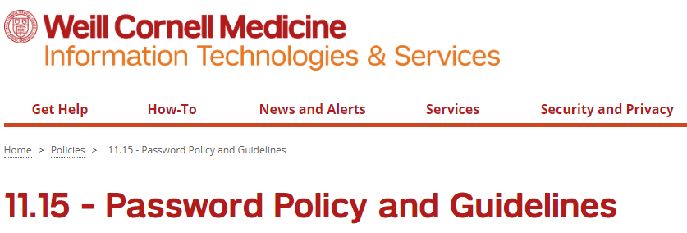
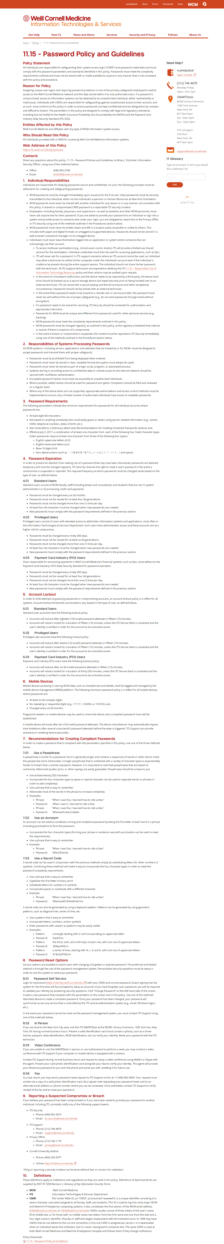
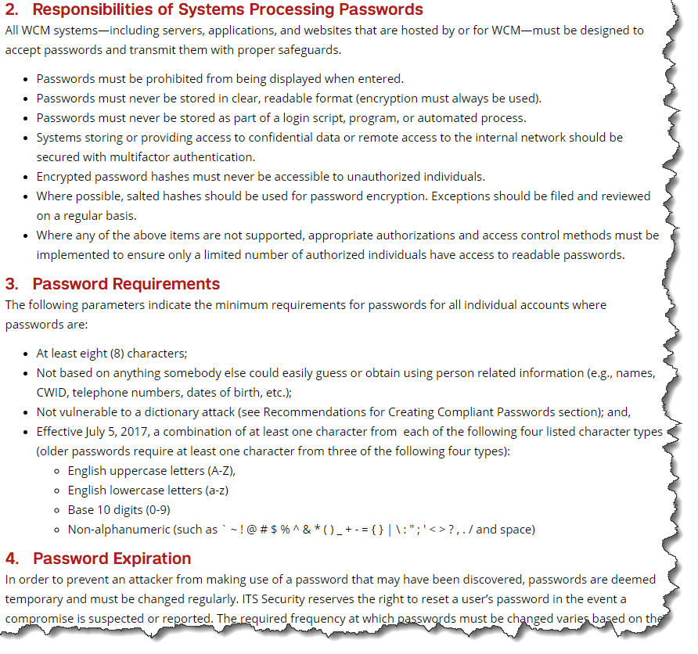
Password Policy
Is a set of rules designed to enhance computer security by encouraging users to employ strong passwords and use them properly
Is often part of an organization's official regulations and may be taught as part of security awareness training
Either the password policy is merely advisory, or the computer systems force users to comply with it

Slide 9
Additional Password Security Techniques
A systems’ administrator can:
  Set operating parameters to test the strength of a password and only accept new passwords that meet password strength rules
  Set operating parameters to lock the user out after a certain number of failed logon attempts
    Users can be locked out for 5 minutes or a full day based on a threshold
  Turn on alerts sent to bring the user’s attention to logon attempts using his/her credentials
    After each successful logon, presenting the date and time of the last successful logon and if there were any unsuccessful logon attempts
  Turn on an audit trail to track password usage, and both successful and unsuccessful logon attempts
    This audit information should include: date, time, user ID, and workstation user logged in from
  Force the user to change a password on a more frequent basis to assure the password will not be guessed by an intruder, remembering the password history and blocking reuse of passwords (e.g. last 5 or 10)
    A balance between protection and practicality must be enforced – too often may lead to users forgetting their passwords and unnecessary management overhead

Slide 10
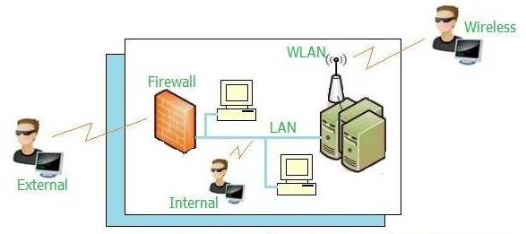
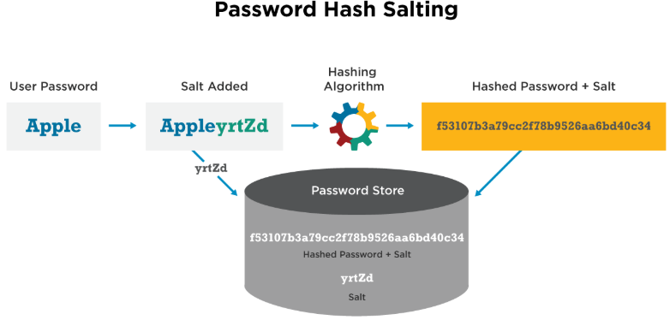
Additional Password Security Techniques…
Password hashing
  An attacker capturing (“sniffs”) a password from the network typically has more work to do before knowing the password value because many systems hash the password with a hashing algorithm to ensure passwords are not sent nor stored in cleartext
  Linux and Unix systems do not store plaintext passwords but run the passwords through a hash algorithm and place the hashed passwords in a “shadow” file system
Network Sniffer Types
Password hashing with “salt”
  Unix systems can be set to add “salt” to its password hashing
  A salt is a random value concatenated with the password before the hashing to add more randomness and complexity into the encryption process
  This makes it harder for the hacker to decrypt and uncover the password
  Adding different salts into the hashing of the same password can result in several thousand different hashes – making it much more difficult for a hacker to attack the passwords

Slide 11
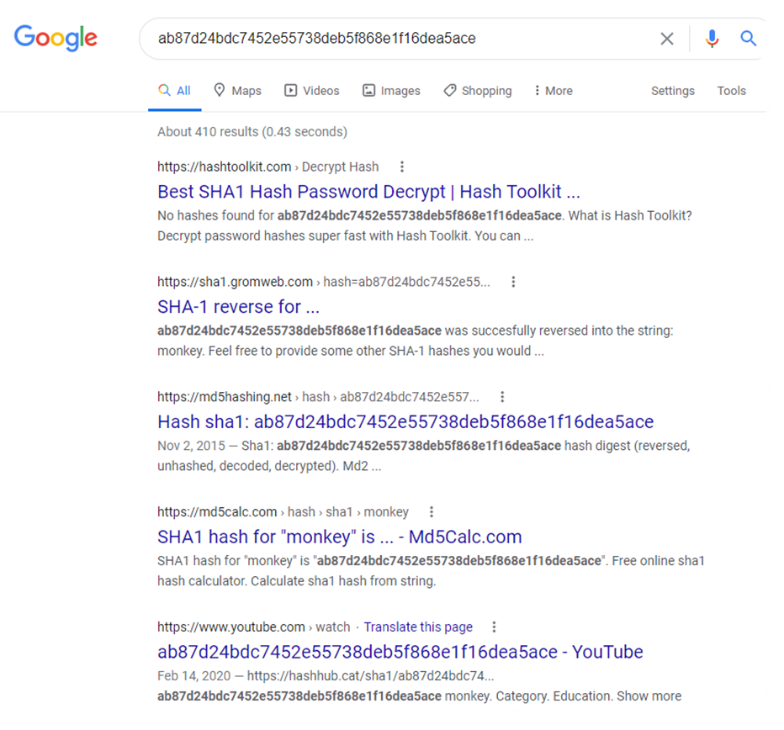
Hash without salt

Slide 12
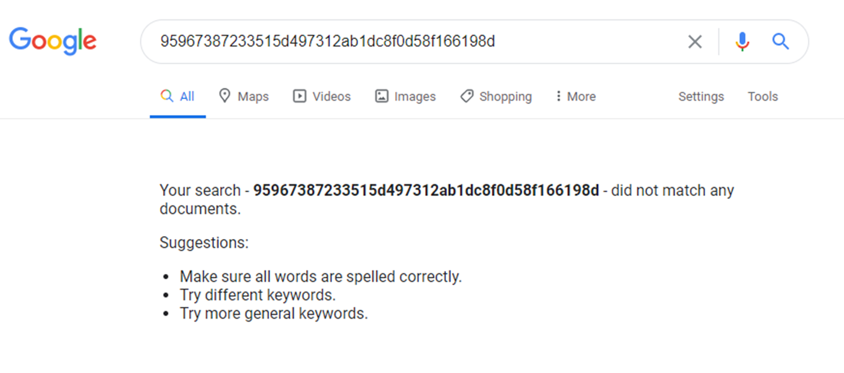
Hash with a salt

Slide 13
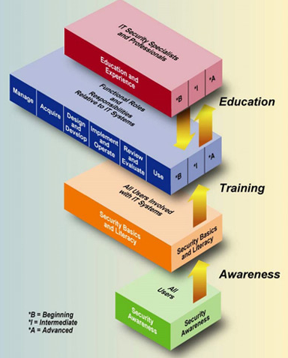
Additional Password Security Techniques…
Education is the key!
  Users should be an extension of a security team, not the opposition
  Security awareness programs should help users
    Understand what is expected of them
    Why they should protect their passwords
    How passwords can be stolen
    How to protect passwords

Slide 14
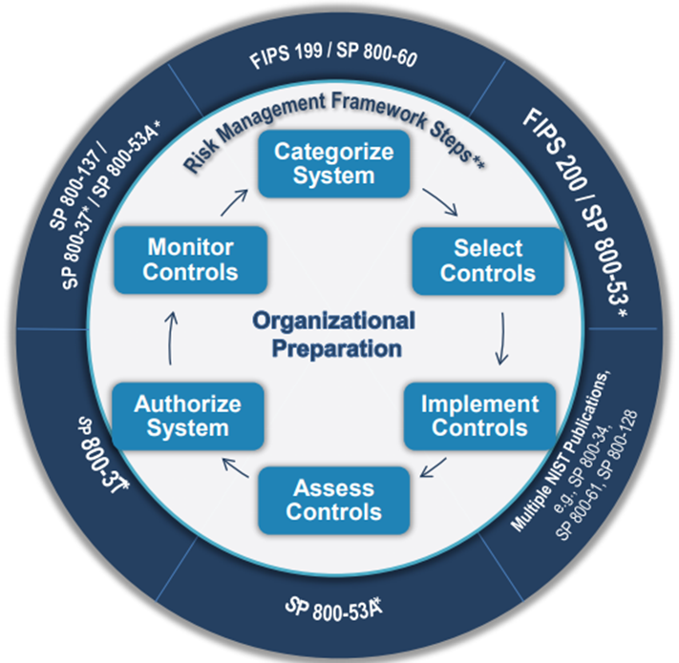
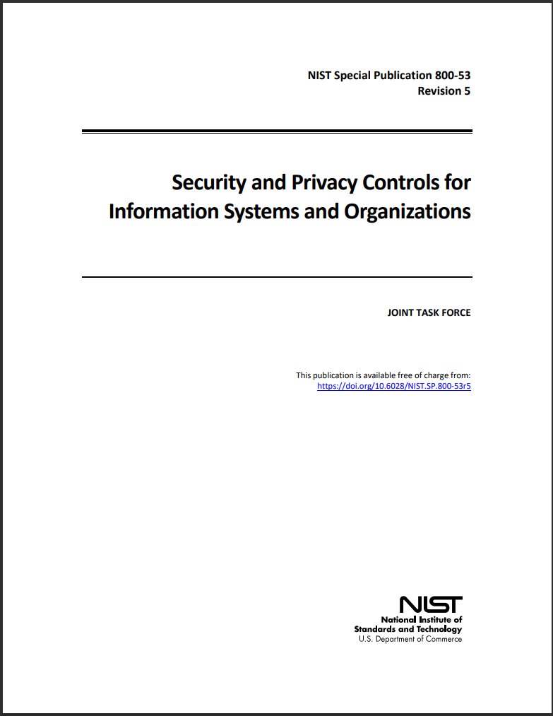
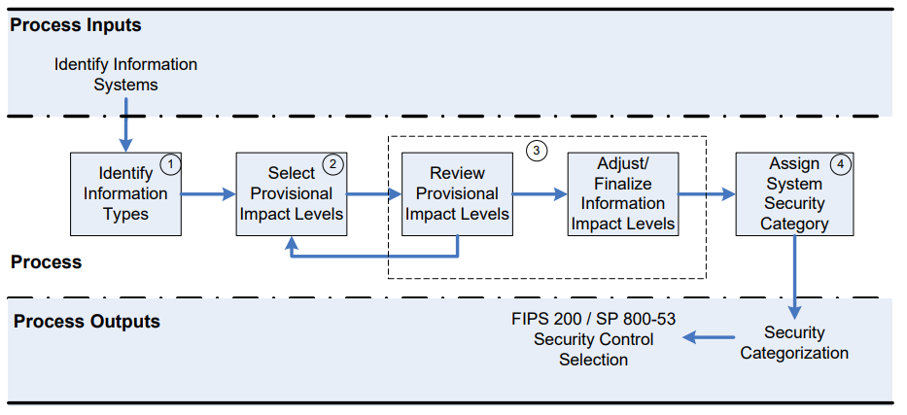

Slide 15
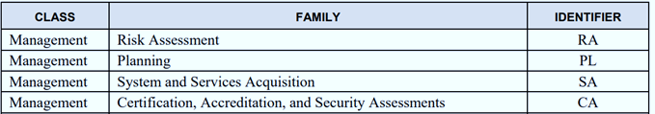
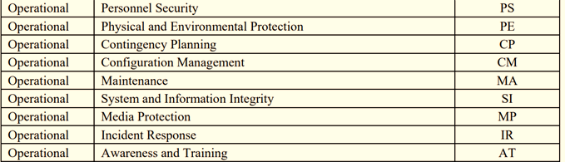
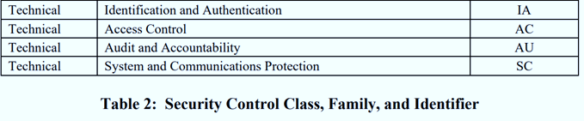
Security control class designations help clarify controls in preparation of system security plans
Management controls focus on management of the information system and management of risk for a system
Operational controls address security methods focusing on mechanisms primarily implemented and executed by people (as opposed to systems) with technical expertise and/or management expertise
Technical controls focus on automated security controls that the computer system(s) executes

Slide 16
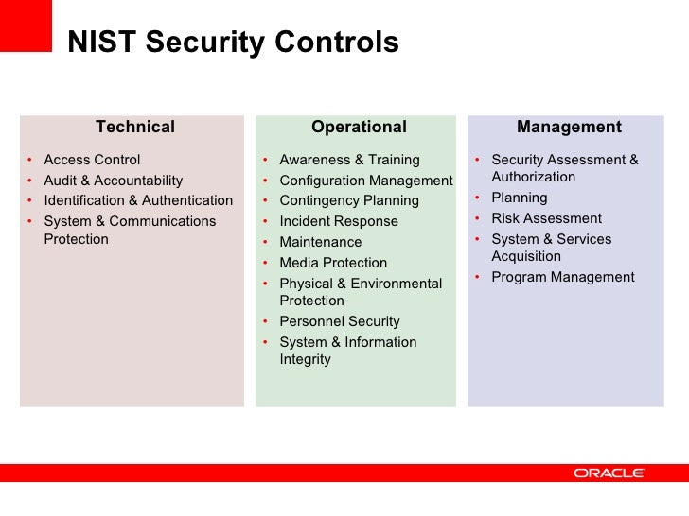

Slide 17
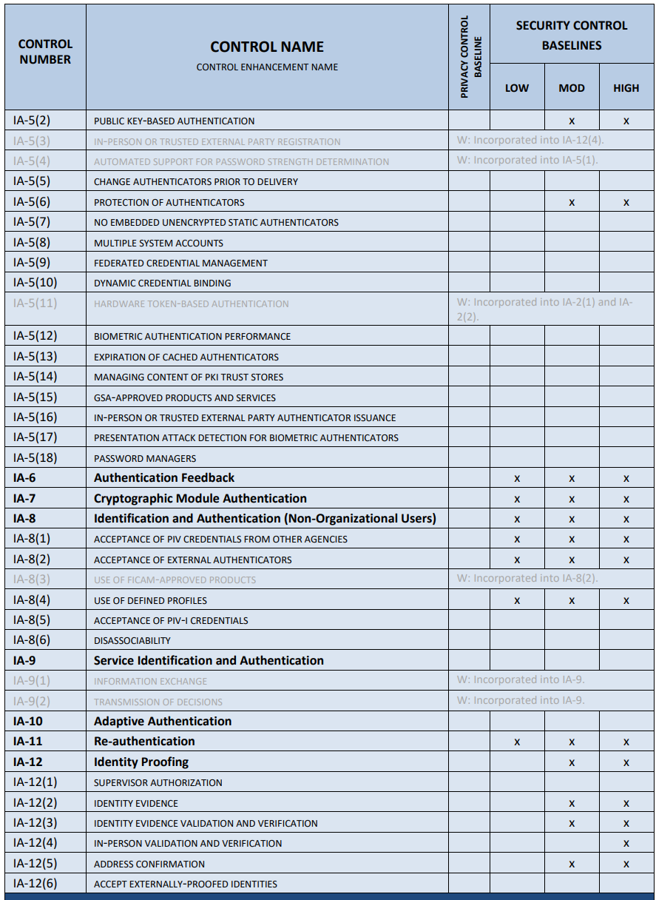
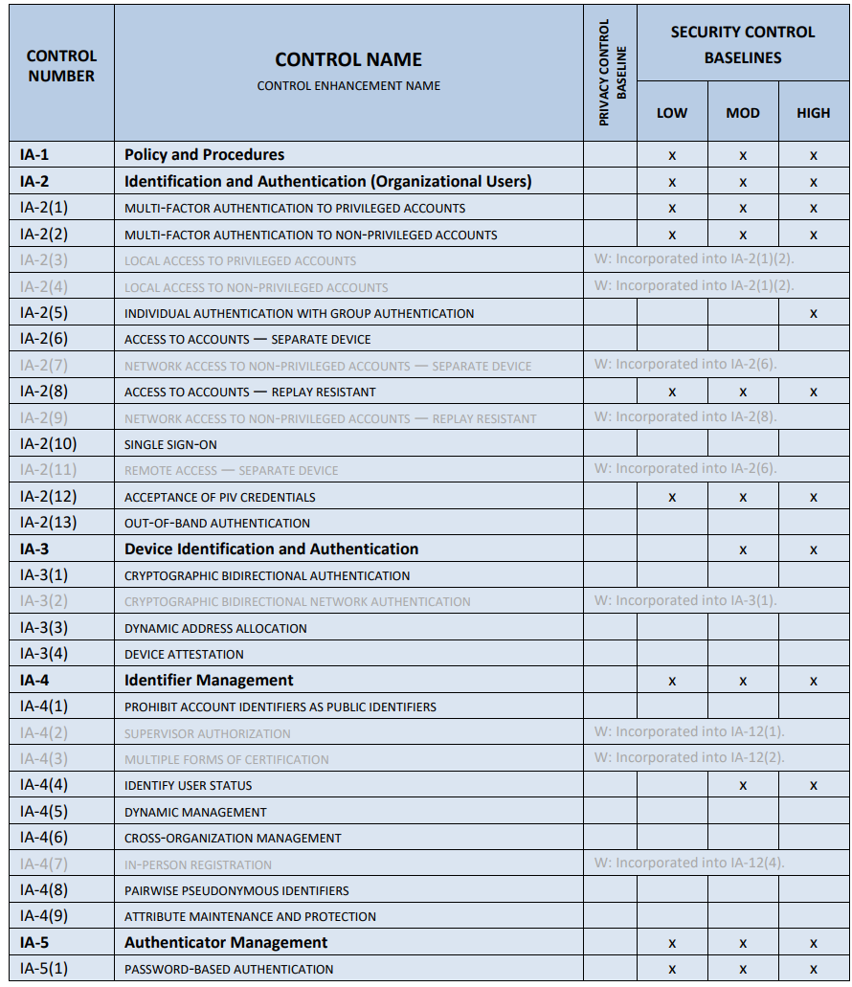
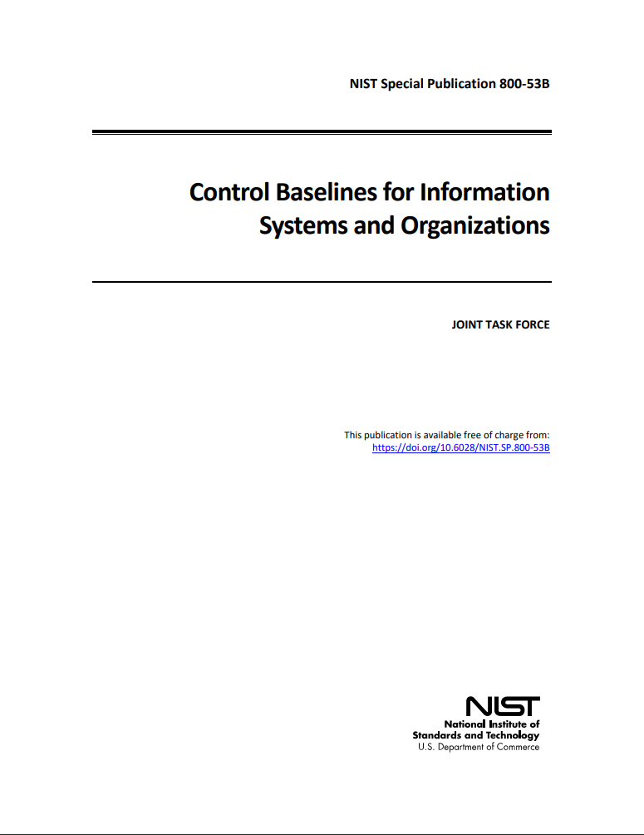
Identification and Authentication
Control Family

Slide 18
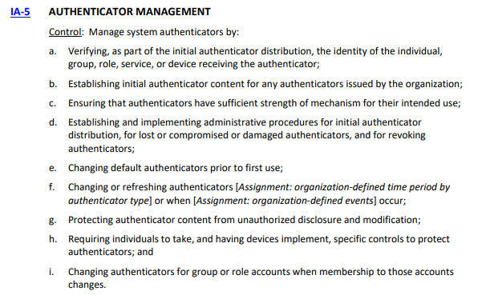
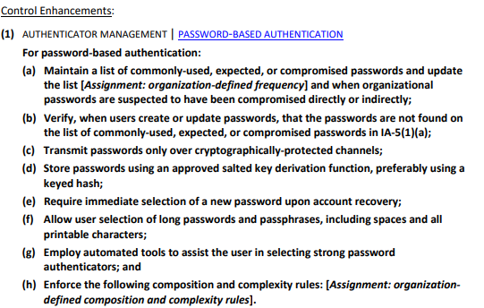
NIST Special Publication 800-53

Slide 19
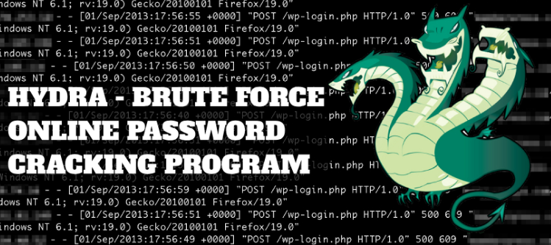
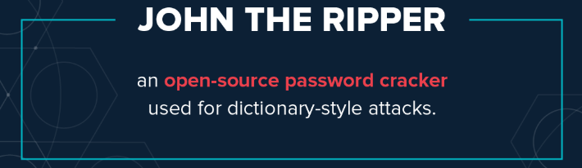

Additional Password Security Techniques
Password Checker
  Is a tool used by a security professional to test the strength of a password
  Performs brute-force, dictionary attacks and/or hybrid techniques to detect weak passwords and fix them before an attacker find the vulnerabilities
Password Cracker
  Is the same tool (i.e. Password Checker) but used by a hacker to uncover vulnerabilities to exploit before the security professional can fix them
Most security tools have this dual nature!

Slide 20
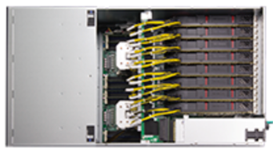
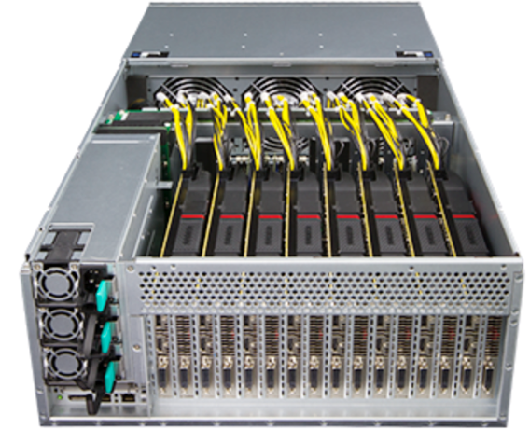
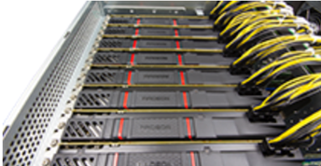
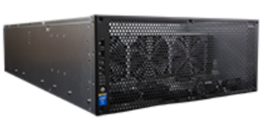
Brutalis
At one time, this was the: “Fastest, meanest, most hardcore password cracker money can buy, …clawing through hashes at unprecedented speeds”
Sold online for: $21,169
Shipped with 3-year warranty and full commercial support
Used Graphics Processing Units (GPU)
  Their highly parallel structure makes them more efficient than general-purpose central processing units (CPUs) for algorithms that process large blocks of data in parallel
Used
  8 NVIDIA GTX GPUs
  2 Intel Xeon E5-2600 v4 CPUs
  Up to 3 TB memory
  18 TB Solid State Device storage
Open Source: L0phtCrack

Slide 21
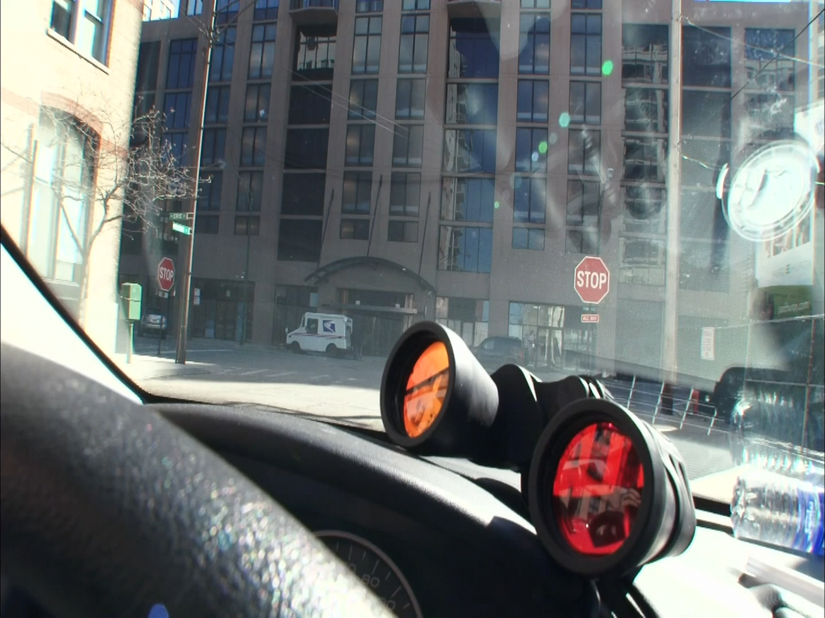

Slide 22
WARNING
Never use the tools you learn in this class to test, attack, or break a computer that you do not own or have written permission to do so!
For example, you need to obtain management’s approval before attempting to test employees’ passwords with the intent of identifying weak passwords.
Explaining you are trying to help the situation, and not hurt it, after the fact is not a good situation to be in.

Slide 23

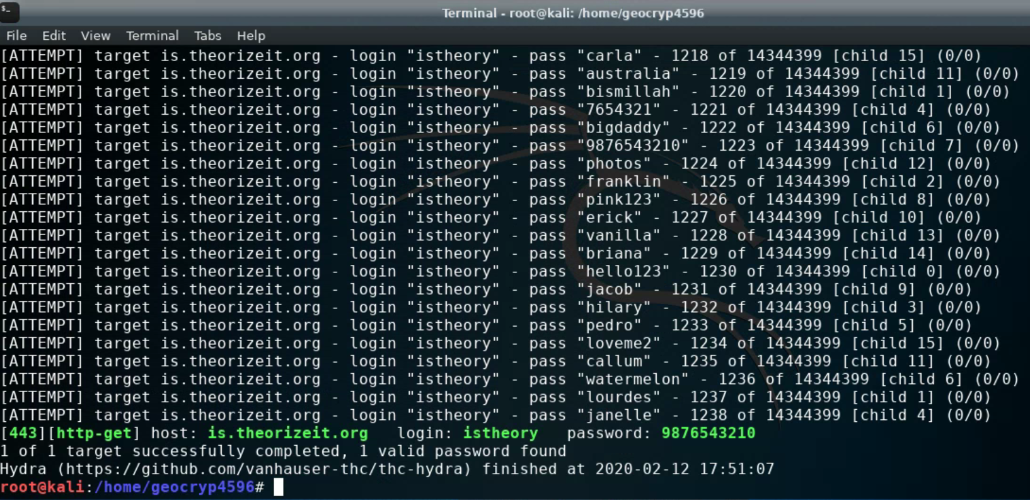
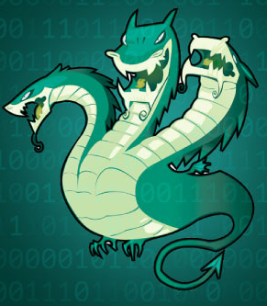
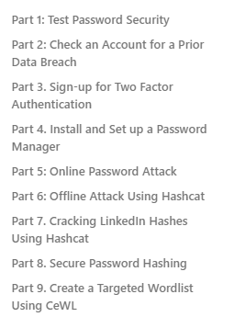
Lab 5: Online & Offline password attacks
I recommend you look at the questions in the quiz while doing the lab might be hard to go back and get some answers after it’s all done

Slide 24
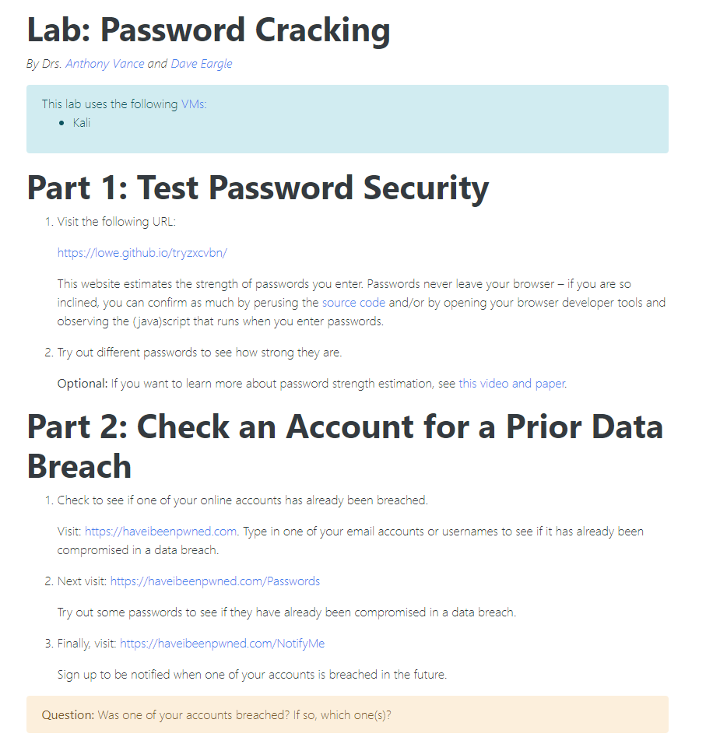
Use Caution!
Never test a password you are currently using and dependent on!
If you wish to test your password’s strength, try a “similarly structured” password
  Similar length
  Similar structured use of letters, capitals, special characters, numbers…

Slide 25
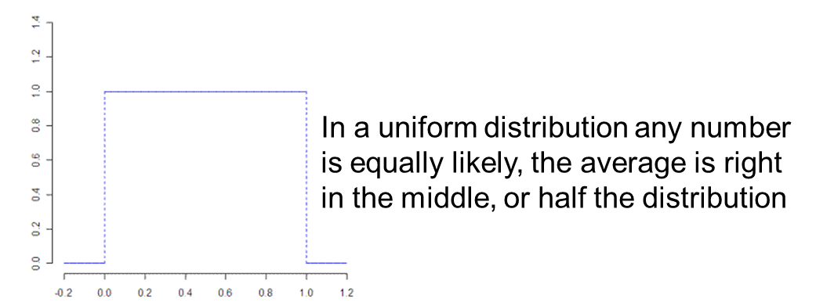
Password Entropy
Password entropy is a measurement of how unpredictable a password is
  Password strength is usually expressed in terms of ”information entropy”
  A password based on a random selection of 64 bits (8 8-bit ASCII characters) would require 2⁶⁴ (18,446,744,073,709,551,616) attempts to exhaust all possibilities during a brute force search
    Thus, by increasing the entropy of the password by one more randomly selected bit doubles the number of guesses, making an attacker's task twice as difficult
    On average, an attacker will have to try half the possible number of passwords before finding the correct one

Slide 26
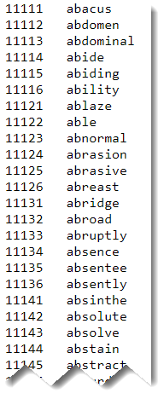
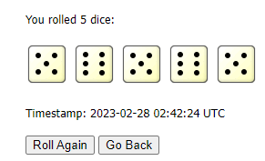
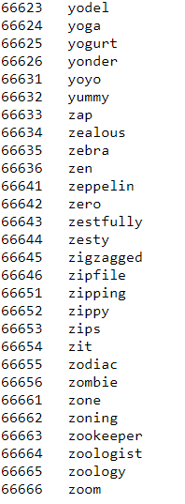
Diceware Exercise
In teams of 2:
Role the 5 dice to generate a random 5-digit number
  https://www.random.org/dice/
Use the 5-digit to select a “random” word from:
  https://www.eff.org/files/2016/07/18/eff_large_wordlist.txt

Slide 27
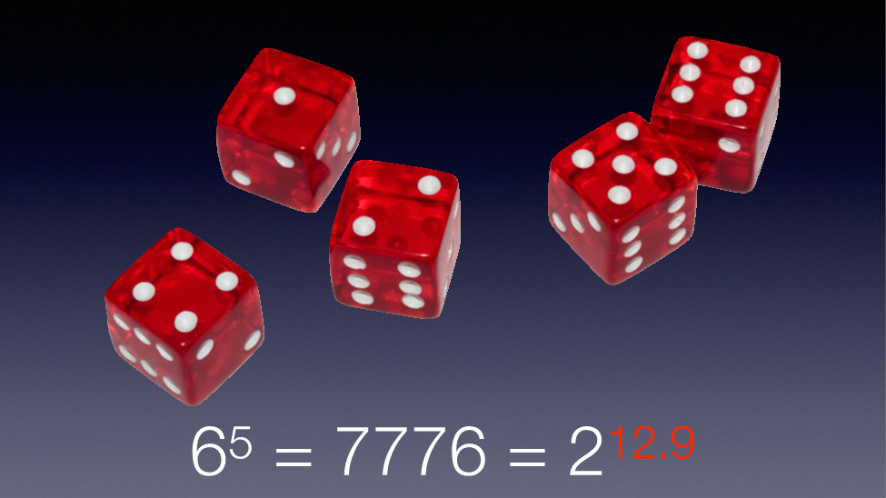
Diceware Exercise
The strength of a Diceware passphrase depends on how many words it contains. If you choose one word (out of a list of 7,776 words), an attacker has a 1 in 7,776 chance of guessing your word on the first try. To guess your word it will take an attacker at least one try, at most 7,776 tries, and on average 3,888 tries (because there’s a 50 percent chance that an attacker will guess your word by the time they are halfway through the word list).
This means that with two words, there are 7,776², or 60,466,176 different potential passphrases. On average, a two-word Diceware passphrase could be guessed after the first 30 million tries.
And a five-word passphrase, which would have 7,776⁵ possible passphrases, could be guessed after an average of 14 quintillion tries (a 14 with 18 zeroes).
The amount of uncertainty in a passphrase (or in an encryption key, or in any other type of information) is measured in bits of entropy. You can measure how secure your random passphrase is by how many bits of entropy it contains.
Each word from the Diceware list is worth about 12.92 bits of entropy (because 2^{12.92} is about 7,776). Therefore, if you choose seven words – you will end up with a passphrase with about 90.5 bits of entropy (because 12.92 times seven is about 90.5).
https://theintercept.com/2015/03/26/passphrases-can-memorize-attackers-cant-guess/

Slide 28
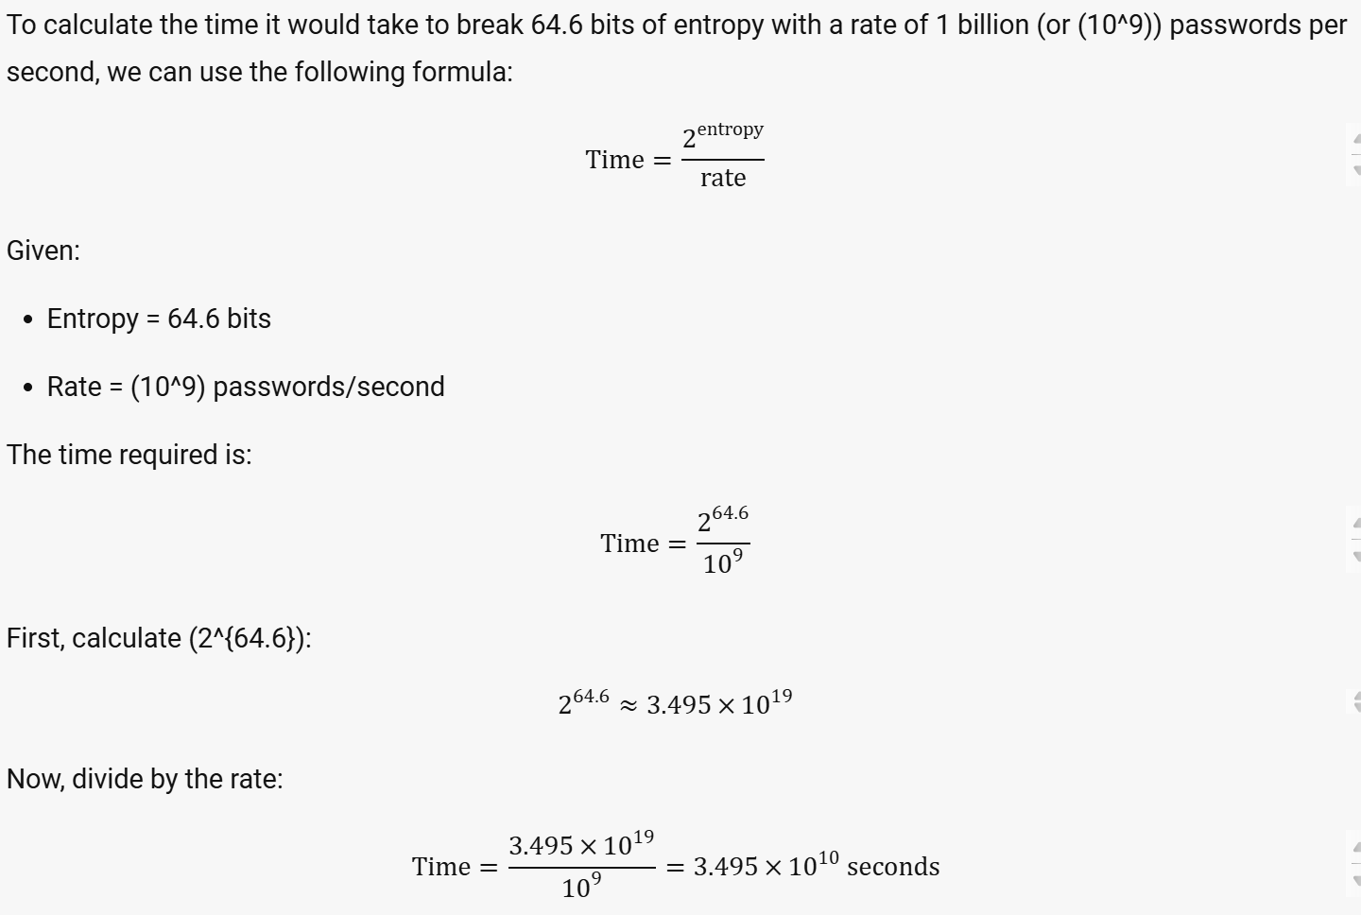

Slide 29
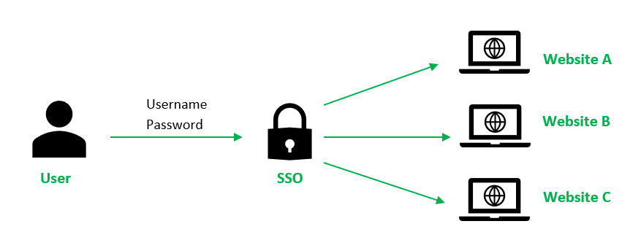
Single Sign On (SSO)

Slide 30
Agenda
Introduction
Hacker’s workflow
Password vulnerabilities
Password security techniques
Password cracking
Warning
Lab 5: Password cracking
  Caution
Password entropy

