Slide 1
Managing Enterprise Cybersecurity
MIS 4596
Unit# 15

Slide 2
Agenda
Zero-Day Vulnerabilities
Introduction to the Exploitation Lab, continued…
The bigger context…

Slide 3
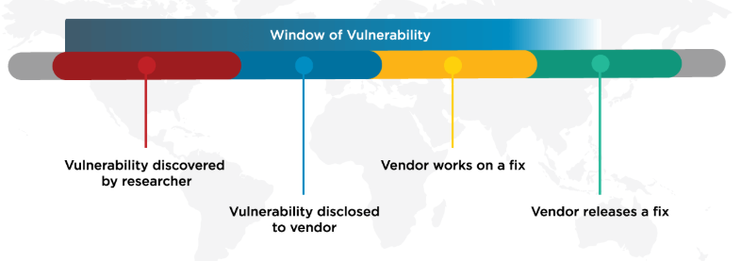
Zero-Day Vulnerabilities
Zero day (0-day) is a vulnerability for which there is no software patch available
    Bug > Vulnerability > Proof of concept > weaponized exploit
First day a software patch is released, is Day 1 of the patch
Day 0 - no patch available
Time

Slide 4

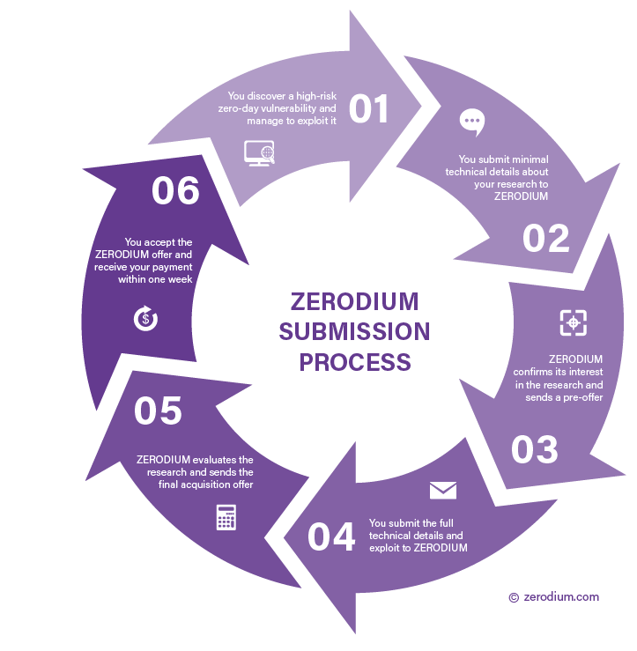
Zero-day exploit market
1st Exploit sold in-public was a Microsoft Excel exploit posted on eBay in 2005
  Subsequently discontinued
    It violated eBay’s policy against encouraging illegal activity
Today: Zerodium is a zero-day purchaser and researcher

Slide 5
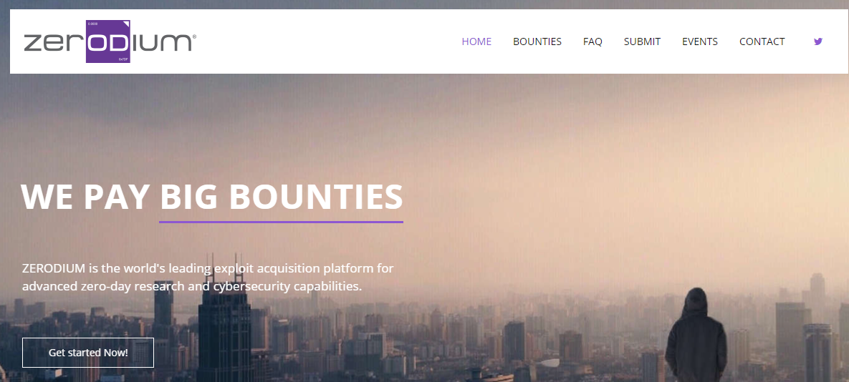
Zerodium
An American information security company founded in 2015 with operations in Washington D.C.
and Europe
Its main business is developing and acquiring premium zero-day exploits from security researchers and reporting the research, along with protective measures and security recommendations to its government clients as part of the ZERODIUM Zero Day Research Feed
The company has reportedly more than 1,500 researchers and has paid more than $50,000,000 in bounties between 2015 and 2021
https://en.wikipedia.org/wiki/Zerodium

Slide 6

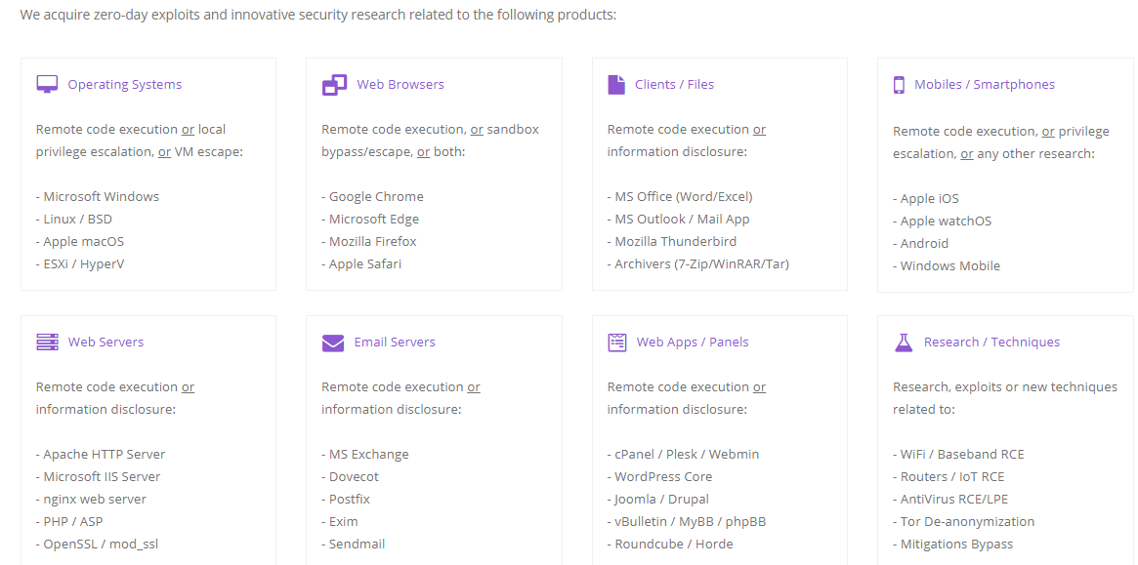

Slide 7
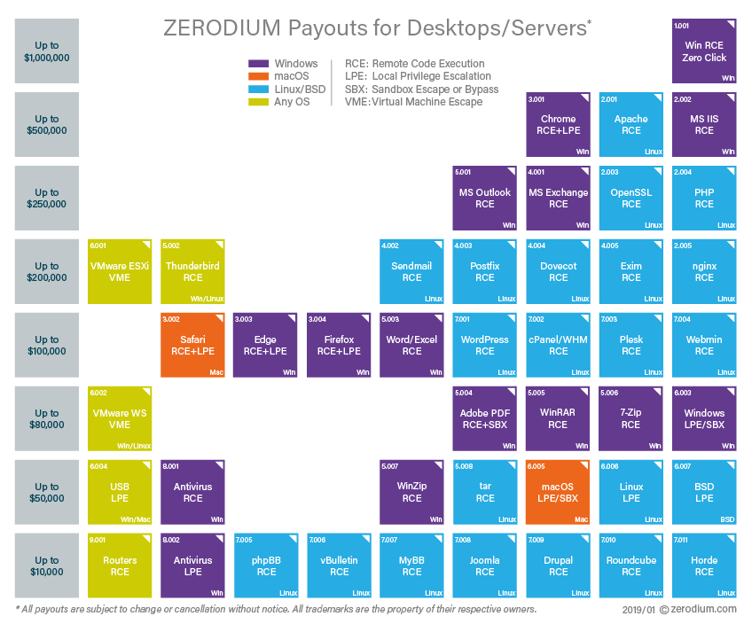

Slide 8
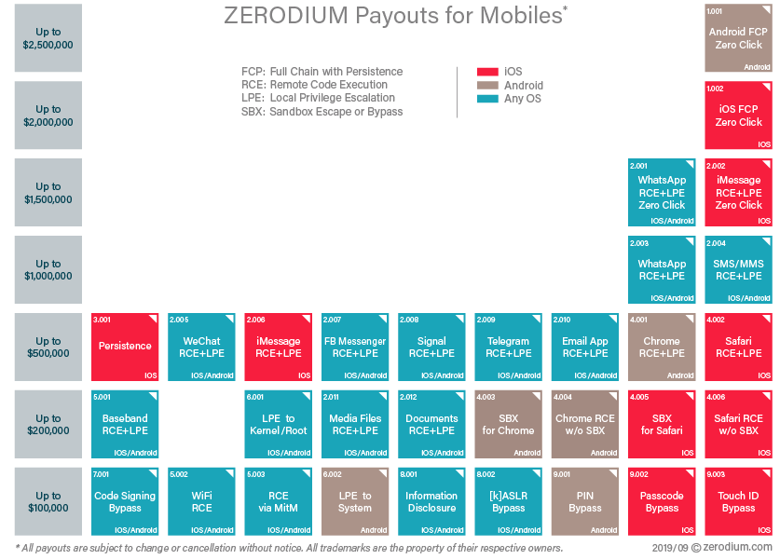

Slide 9
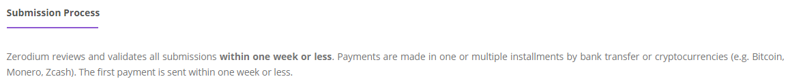
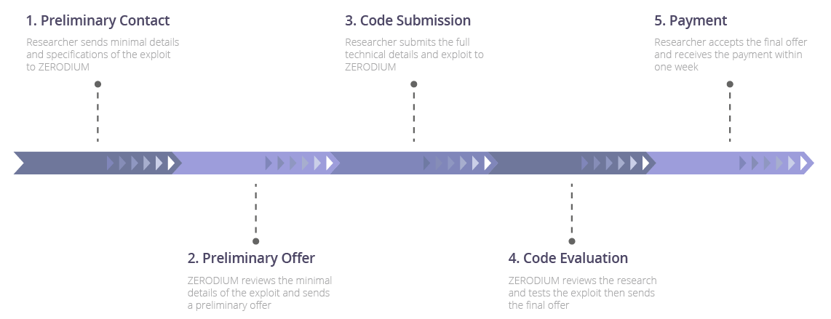

Slide 10
Agenda
Zero-Day Vulnerabilities
Introduction to the Exploitation Lab, continued…
The bigger picture
  NIST Risk Management Framework
  Categorizing information systems to select the right amount of cybersecurity

Slide 11
Caution
The tools and techniques discussed and used in this course should only be used on systems you personally own, or have written permission to use
Some of the tools used have potential to disrupt or break computer systems

Slide 12

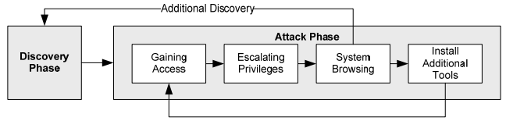
Penetration Testing Execution Standard
http://www.pentest-standard.org/index.php/Main_Page
Penetration Testing’s main activities:
  Pre-engagement Interactions
  Intelligence Gathering
  Threat Modeling
  Vulnerability Analysis
  Exploitation
  Post Exploitation
  Reporting
Exploitation Lab

Slide 13
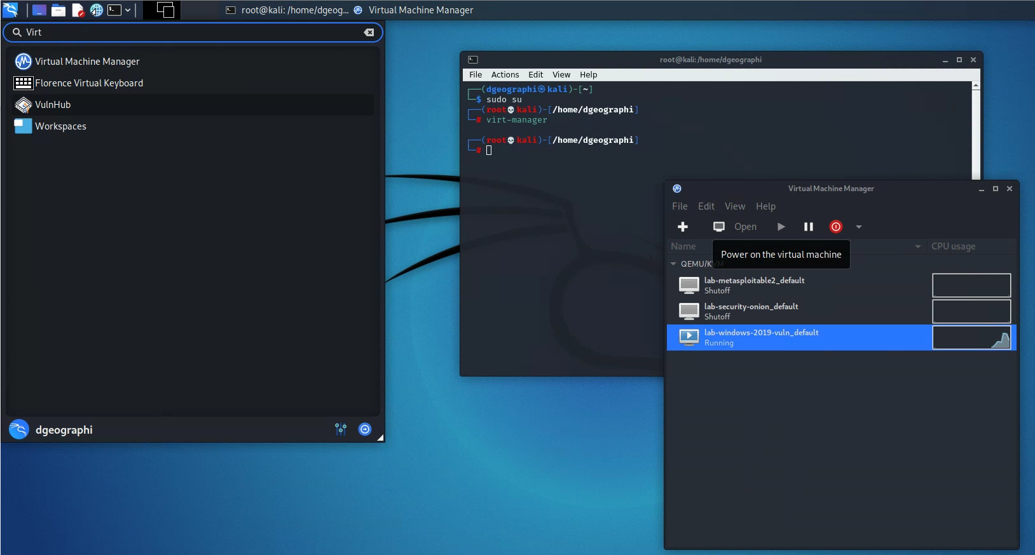
Lab: Exploitation

Slide 14
Part 1: Exploit Windows 7 via Icecast Vulnerability
Simple logical network diagram
Kali Linux
Windows 7
Vulnerability Scanning
Metasploit
Icecast
Exploit + Payload
Reverse Shell
Command & Control

Slide 15

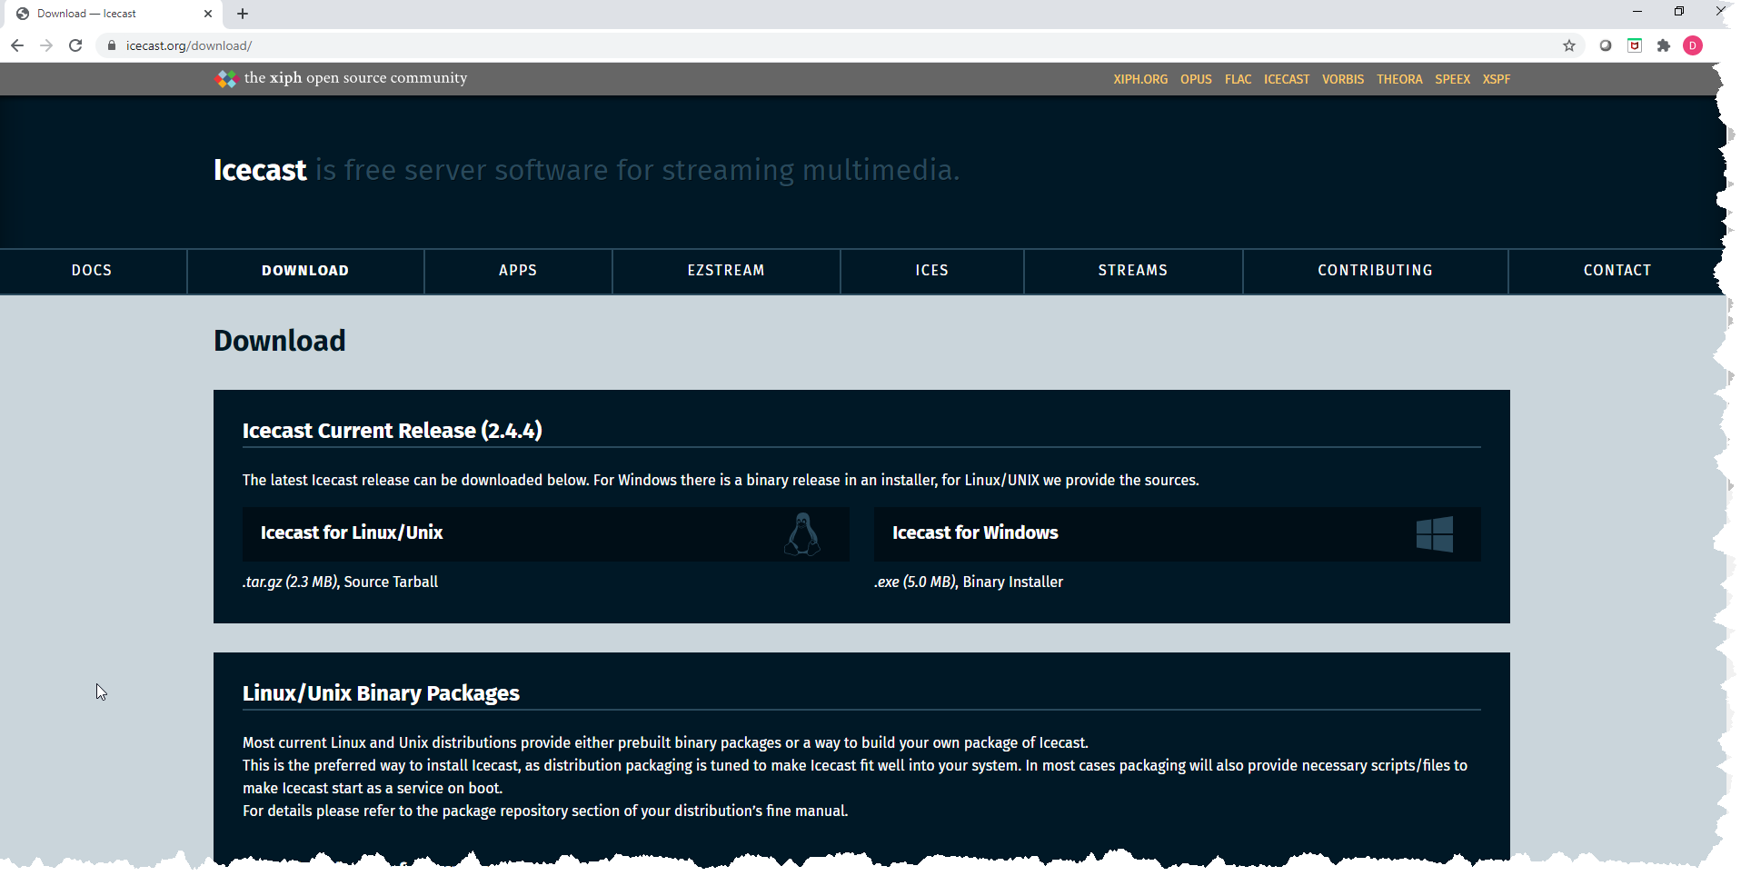
Icecast
Free server software for streaming multimedia
  Supports Ogg (Vorbis and Theora), Opus, WebM and MP3 streams
  For creating an Internet radio station, private jukebox, or something in between
  Very versatile - new sound data file formats added relatively easily based on open standards for communication and interaction

Slide 16
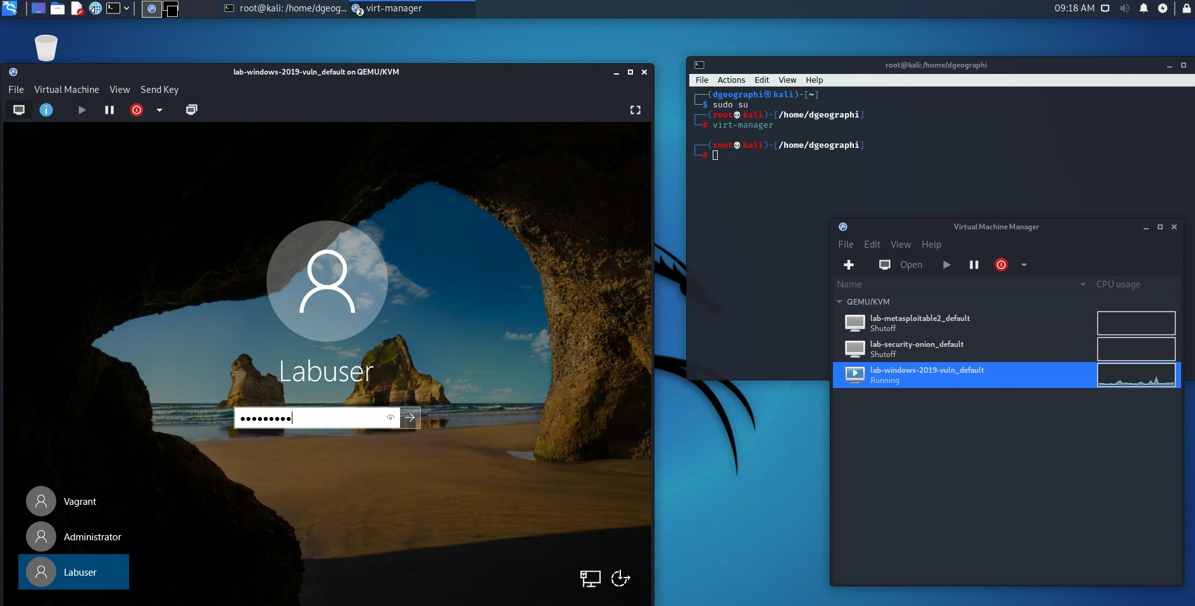
Start Windows

Slide 17
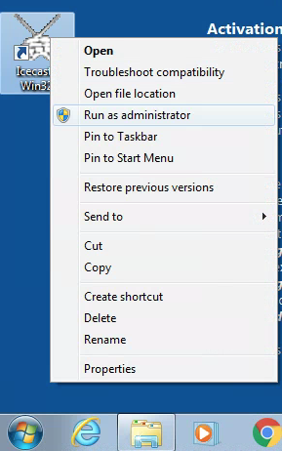
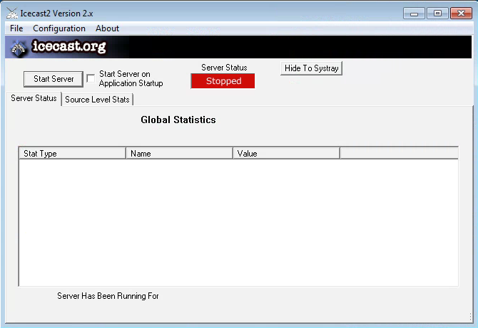
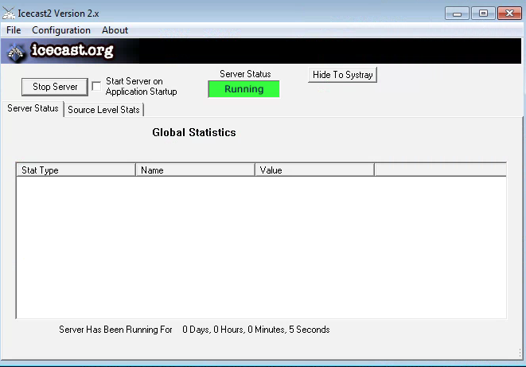
On Win7, run Icecast as administrator
Start Server

Slide 18
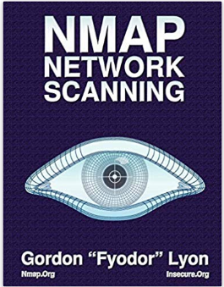
What is running on the Win7 box in our lab?
Kali Linux
Windows 7
Vulnerability Scanning
Metasploit
Icecast

Slide 19
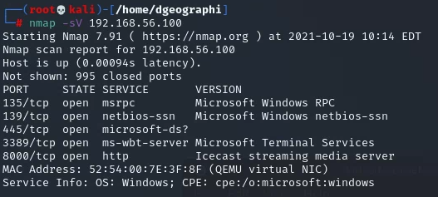
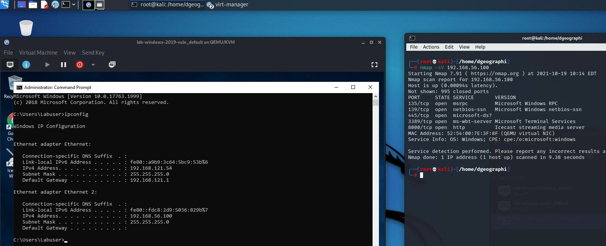
What is running on the Win7 box in our lab?
Nmap flag -sV is for service version scanning

Slide 20
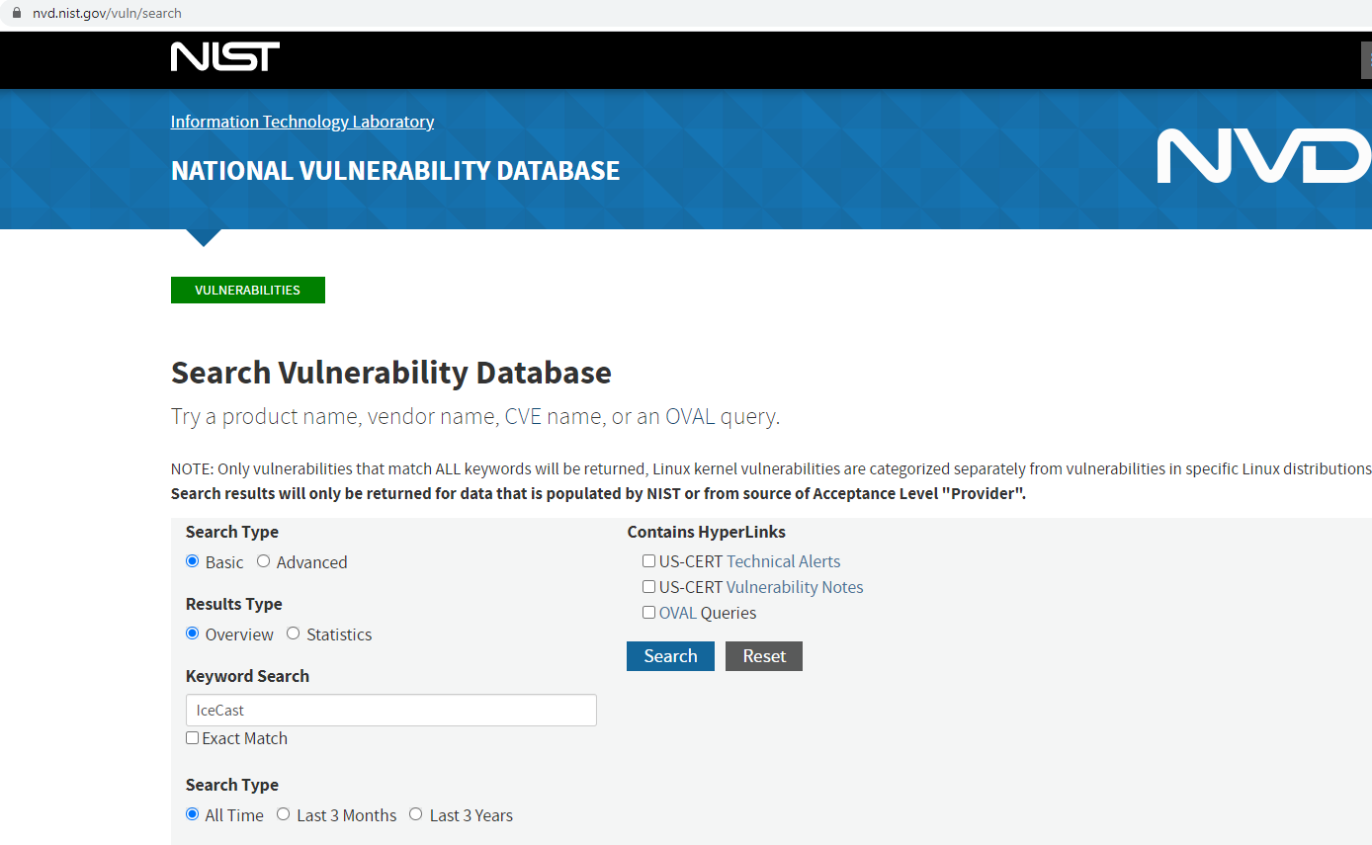
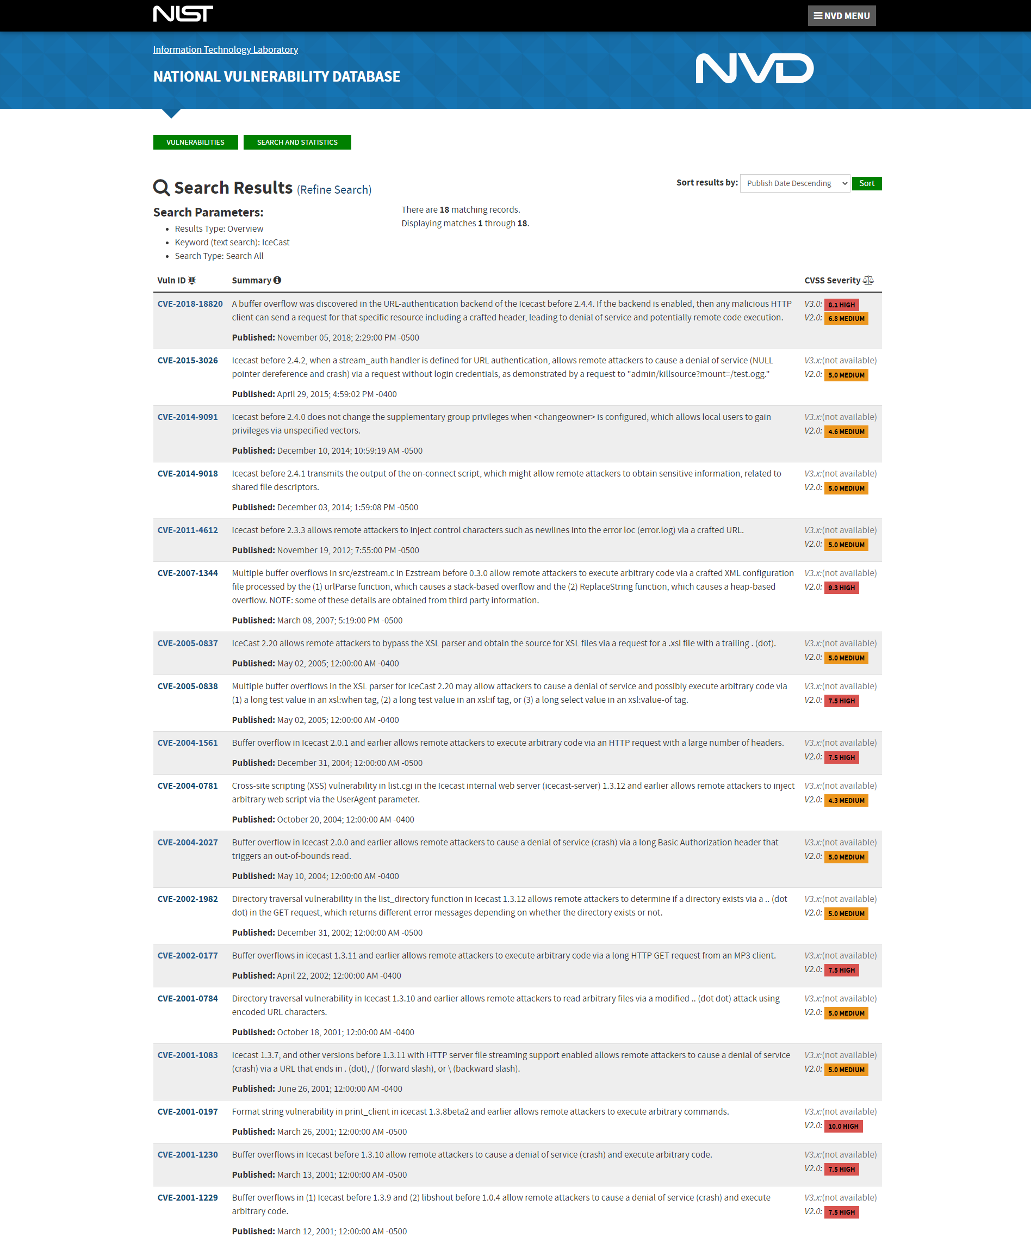
Where do you find information on IceCast’s vulnerabilities?

Slide 21
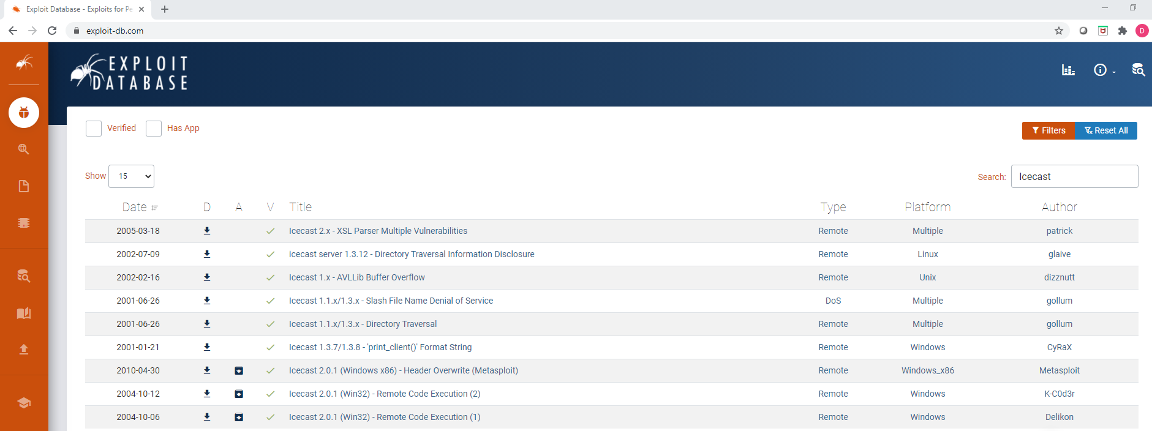
Where do you find information on IceCast’s vulnerabilities?

Slide 22

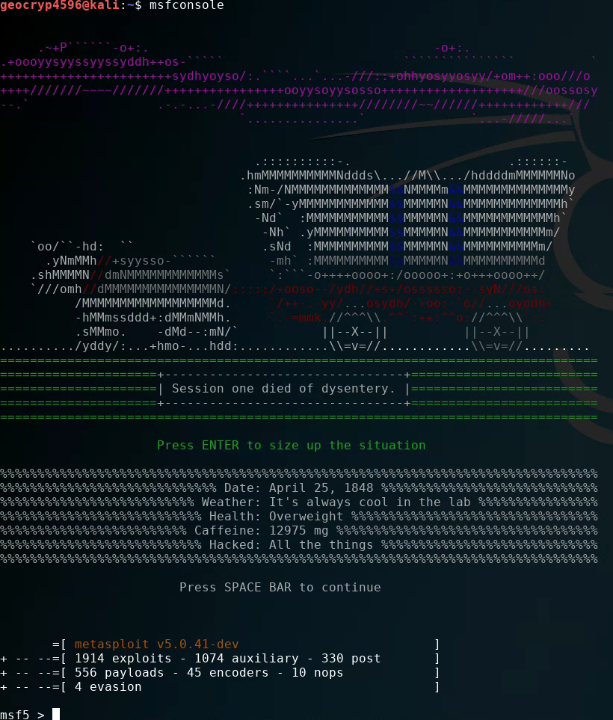
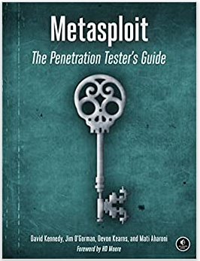
Metasploit basics
Start Metasploit’s database:
Start Metasploit:

Slide 23
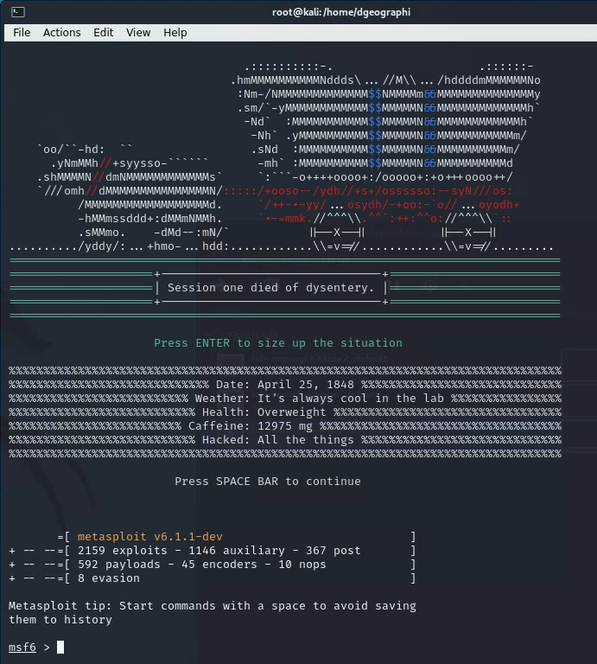

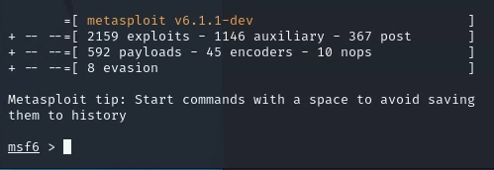
Metasploit basics
Start Metasploit:

Slide 24
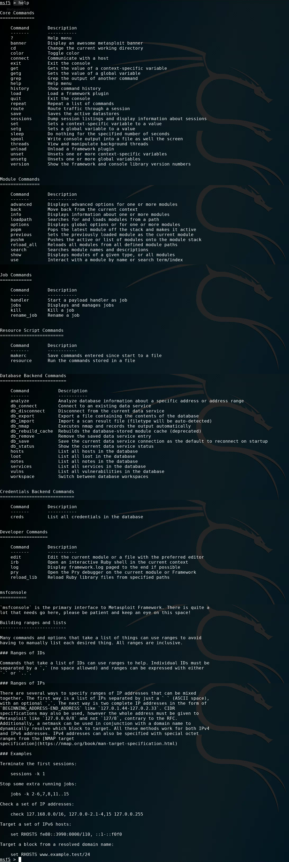
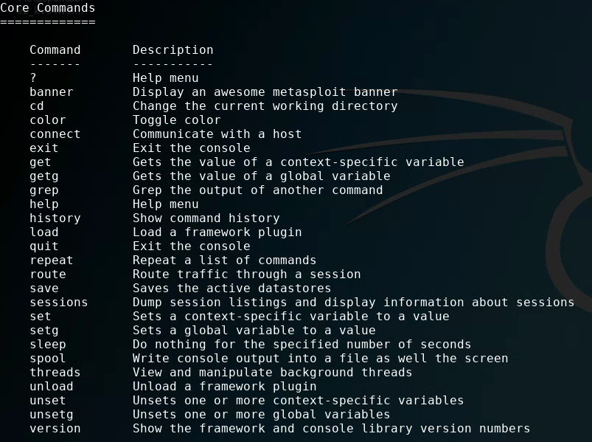
Metasploit basics

Slide 25
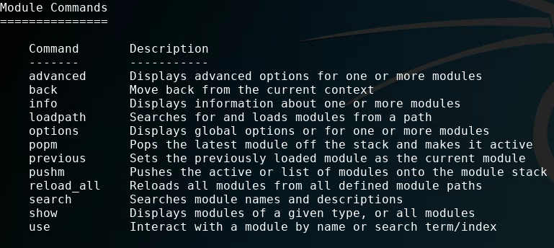
Metasploit basics

Slide 26

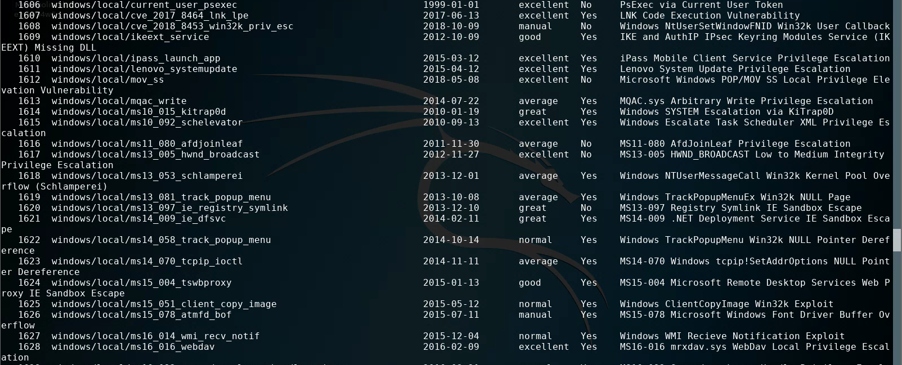
Metasploit basics
You can show all the exploits, but there are many…

Slide 27
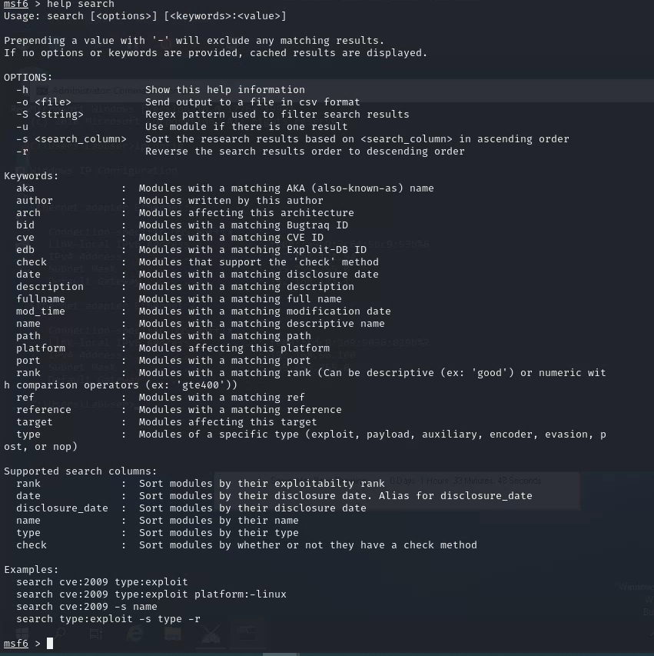

Metasploit basics
You can search for a Metasploits’ database of exploits for specific exploits by name

Slide 28
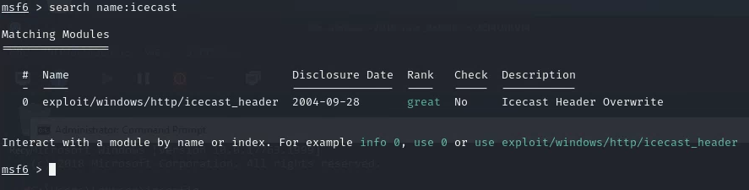
Metasploit basics
You can search Metasploit’s database for specific exploits by name

Slide 29
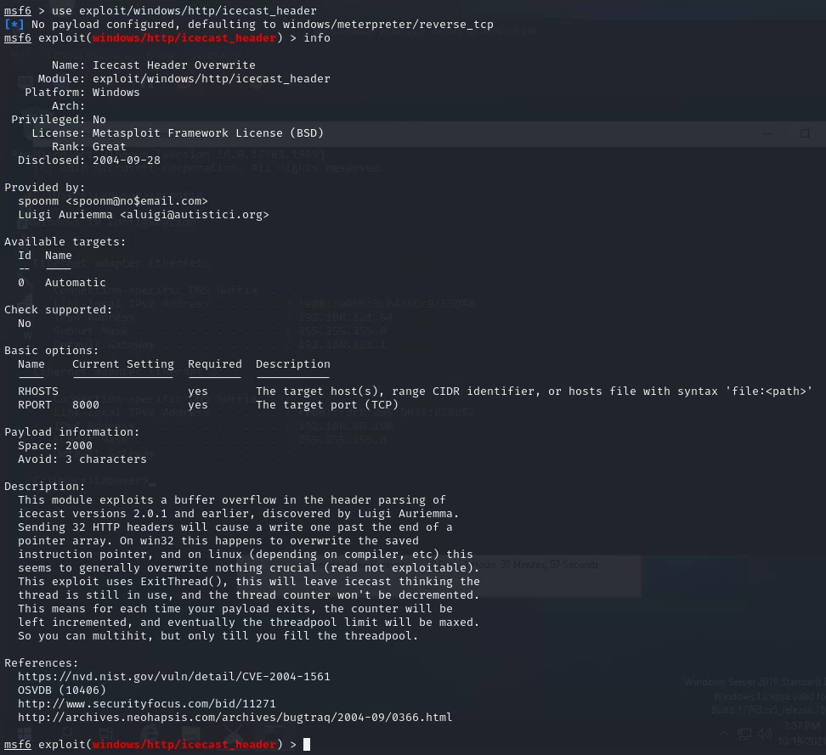

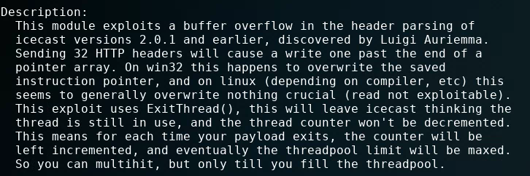
Metasploit basics
You can find out more about the exploit

Slide 30
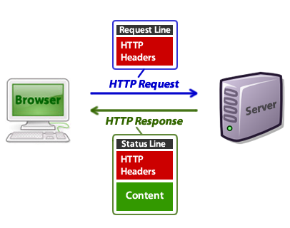
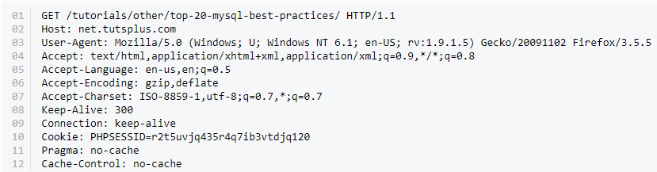
Icecast – HTTP Headers Exploit
In 2004, Luigi Auriemma discovered that sending 32 HTTP headers will cause Icecast versions 2.0.1 and earlier running on Windows will cause a write one past the end of an instruction pointer array (“command buffer”)…
…resulting in the ability to get Icecast to run arbitrary code (i.e. the Meterpreter payload) placed by the exploit

Slide 31
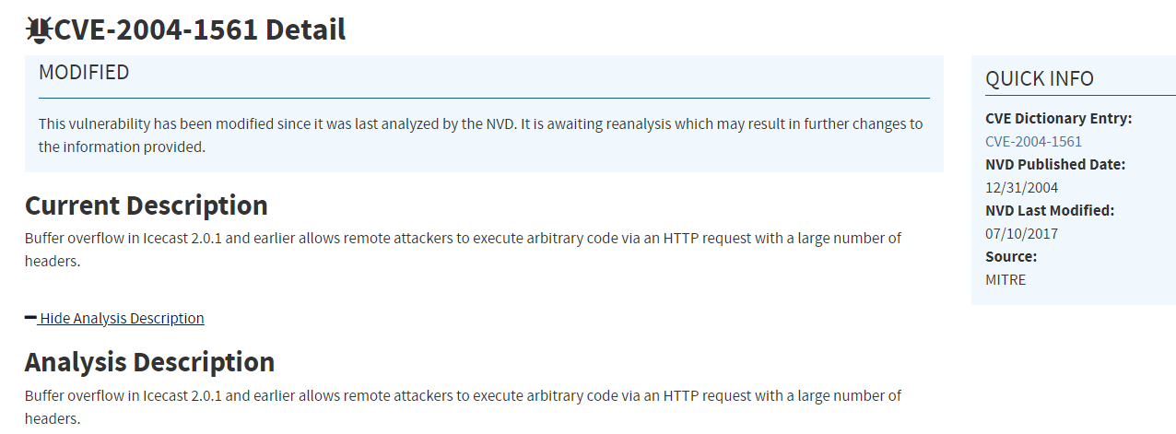
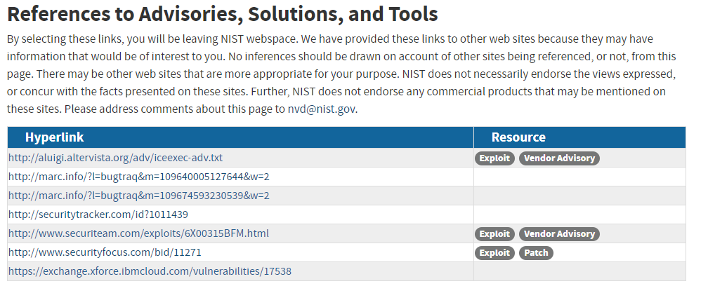
NIST: CVE-2004-1561
http://aluigi.altervista.org/adv/iceexec-adv.txt

Slide 32
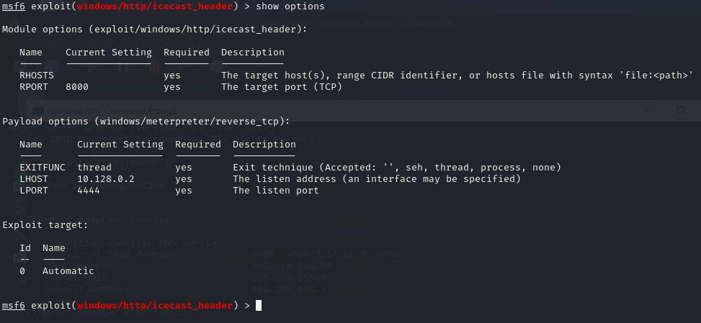
Metasploit basics
You can find out about the exploit’s runtime options

Slide 33
Part 1: Exploit Windows 7 via Icecast Vulnerability
Simple logical network diagram
Kali Linux
Windows 7
Vulnerability Scanning
Metasploit
Icecast
Exploit + Payload

Slide 34
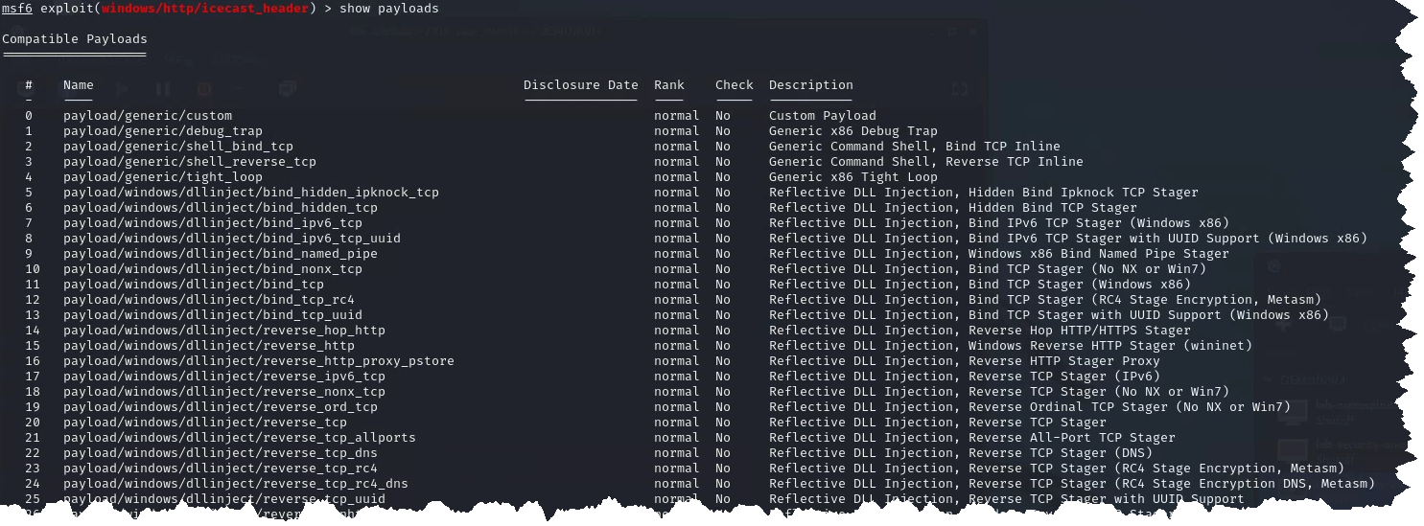
Metasploit basics
You can find out about the exploit’s payloads for this exploit…

Slide 35
Metasploit basics – reverse shell
https://metasploit.help.rapid7.com/docs/working-with-payloads
Reflective programming: Is a metaprogramming strategy, the provides a process the ability to modify its own structure and behavior at runtime
Reflective DLL injection is employed to load a library (e.g. reverse shell) into memory and then into a host process
Reverse shell in an interpreter that runs on one computer, but its command input/output is from another computer
  This will enable you to reach Windows from Kali, and Kali from Windows
  A reverse shell is usually a “first choice” exploit
  There are many different reverse shells available, and the most commonly known and stable has been the windows/meterpreter/reverse_tcp payload

Slide 36
Part 1: Exploit Windows 7 via Icecast Vulnerability
Simple logical network diagram
Kali Linux
Windows 7
Vulnerability Scanning
Metasploit
Icecast
Exploit + Payload
Reverse Shell
Command & Control

Slide 37
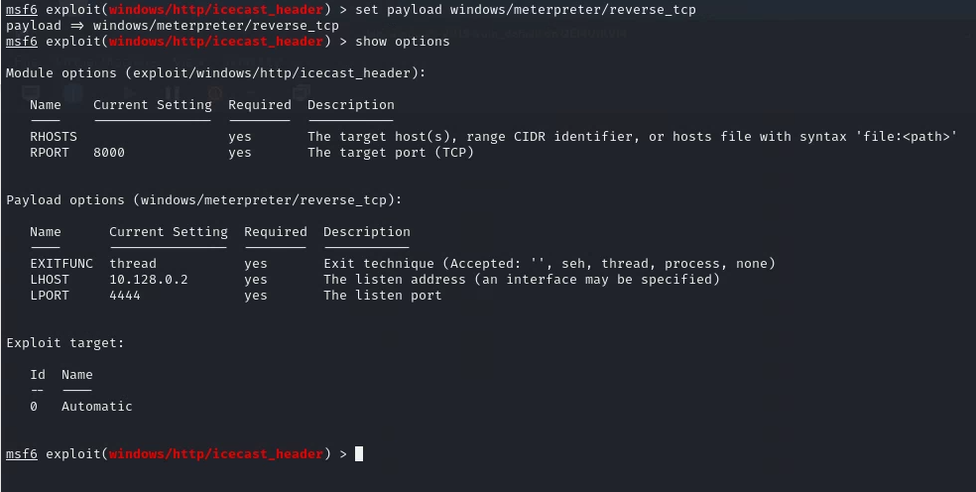
Metasploit basics – reverse shell
Remote host: Win7
Local host:
Kali Linux

Slide 38
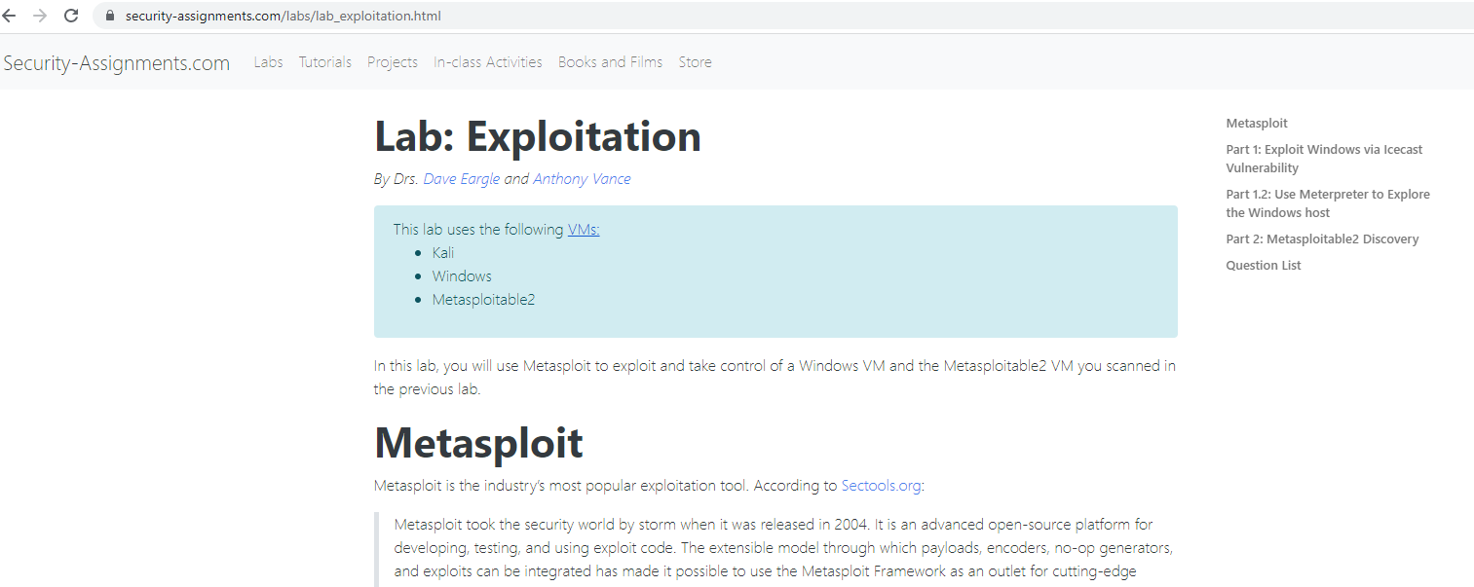
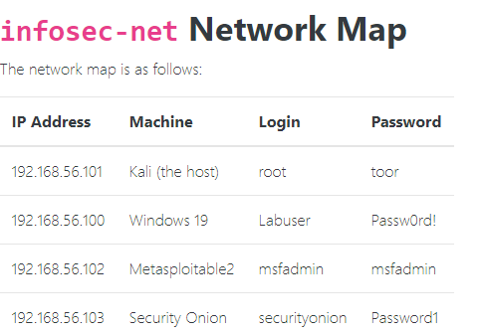
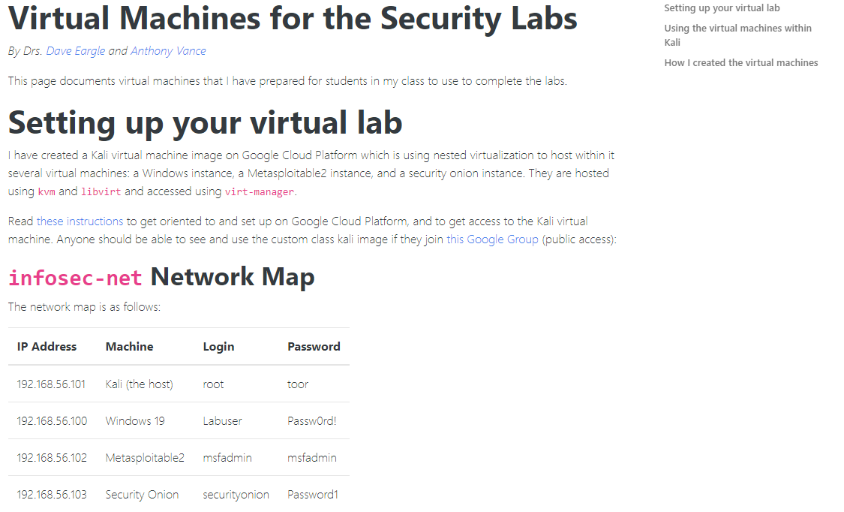
Remember: Where do you find IP addresses of your machines?

Slide 39
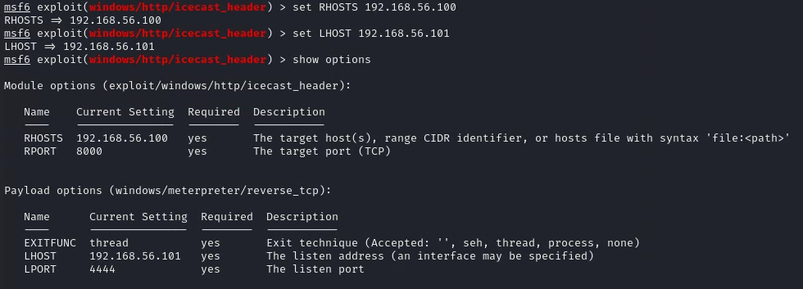
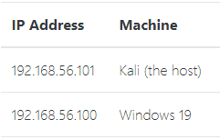
Metasploit basics – setting up the reverse shell
Remote
host:
Local
host:

Slide 40
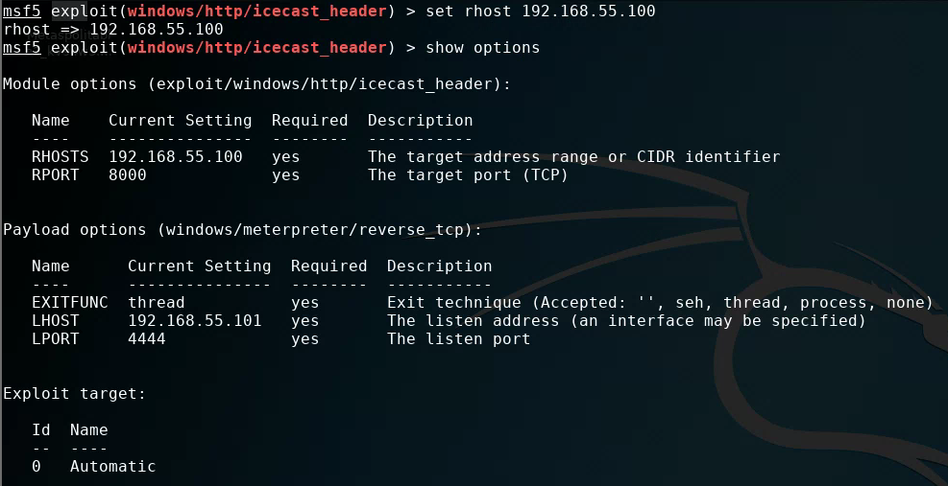
Metasploit basics – setting up the reverse shell

Slide 41
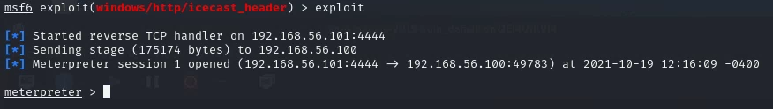
Metasploit basics – run the exploit

Slide 42
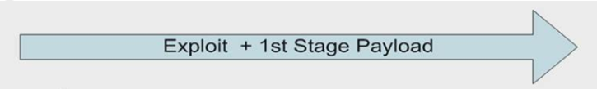

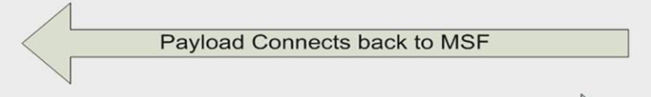
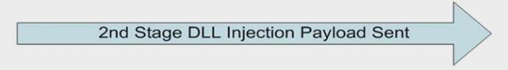


Metasploit Framework’s Meterpreter workflow

Slide 43

Metasploit basics
Meterpreter commands

Slide 44


Metasploit basics
Meterpreter commands

Slide 45

Metasploit basics
Meterpreter commands

Slide 46

Metasploit basics – run the exploit

Slide 47

Metasploit basics – run the exploit

Slide 48

Metasploit basics – Meterpreter commands
Working with the Windows command prompt through Meterpreter

Slide 49

Metasploit basics – Exiting Meterpreter

Slide 50
Agenda
Zero-Day Vulnerabilities
Introduction to the Exploitation Lab, continued…
The bigger context…

Slide 51




Risk Management Framework (RMF)

Slide 52


Where does vulnerability scanning and penetration testing fit in the RMF?

Slide 53


For what kinds of information systems do organizations employ vulnerability scanning & penetration testing ?

Slide 54
Agenda
Zero-Day Vulnerabilities
Introduction to the Exploitation Lab, continued…
The bigger context…

