Slide 1
Managing Enterprise Cybersecurity
MIS 4596
Class 3
Notes:
Generated by Copilot
This slide introduces the topic of managing enterprise cybersecurity within the context of the MIS 4596 course, specifically for Class 3. It sets the stage for a detailed exploration of cybersecurity principles and frameworks relevant to enterprise environments.
______

Slide 2
Agenda
National Institute of Standards and Technology (NIST)
  Cybersecurity Framework
  Risk Management Framework
Applying the NIST Risk Management Framework
Milestone 1 Assignment
Notes:
Generated by Copilot
Today's agenda covers key frameworks and methodologies from the National Institute of Standards and Technology (NIST). We'll explore the Cybersecurity Framework and the Risk Management Framework, focusing on how to apply these frameworks effectively. The session will also include details about the Milestone 1 assignment, which will require practical application of these concepts.
______

Slide 3
Agenda
National Institute of Standards and Technology (NIST)
  Cybersecurity Framework
  Risk Management Framework
Applying the NIST Risk Management Framework
Milestone 1 Assignment
Notes:
Generated by Copilot
This slide reiterates the agenda, emphasizing the importance of understanding NIST's Cybersecurity Framework and Risk Management Framework. It highlights the practical application of these frameworks and prepares you for the Milestone 1 assignment, ensuring a comprehensive grasp of risk management in cybersecurity.
______

Slide 4
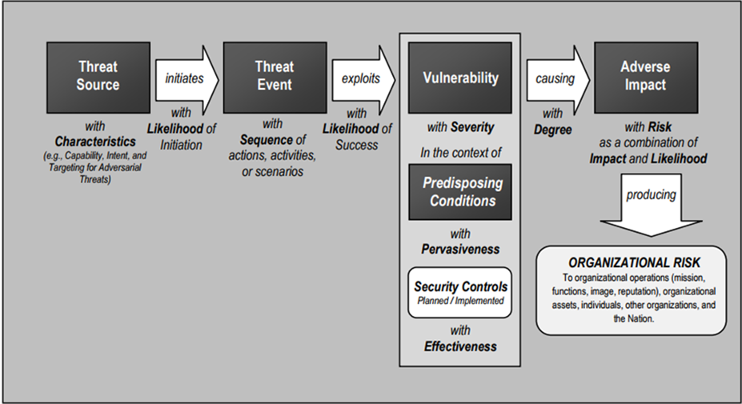
Business cybersecurity risk
…is a function of what?
Notes:
Generated by Copilot
This diagram breaks down business cybersecurity risk into its fundamental components. It starts with a threat source and traces how threats exploit vulnerabilities within an organization, influenced by predisposing conditions. The resulting adverse impact is a combination of organizational risk and the likelihood and severity of incidents. Understanding this flow helps in identifying where controls can be most effective to mitigate risk.
______

Slide 5
Business cybersecurity risk
…is a function of what?
cybersecurity risk = f(?, ?, …)
f(threats, vulnerabilities, assets)
f(threat, (vulnerability * lack of control), (asset * dependencies))
Results in impacts which have an adverse effect on:
  Organizational operations
  Assets
  individuals
Notes:
Generated by Copilot
Here, cybersecurity risk is expressed as a function of threats, vulnerabilities, and assets, factoring in the lack of controls and dependencies. The formula underscores that risk arises not just from threats but also from how vulnerable assets are and the controls in place. The slide also points out that these risks can adversely affect organizational operations, assets, and individuals, highlighting the broad impact of cybersecurity incidents.
______

Slide 6

Federal Information Security Management Act (FISMA) of 2002
Federal Information Security Modernization Act (FISMA) of 2014
Recognizes importance of information security to the economy and national security
Requires each government organization to provide information security for information and information systems supporting their operations and assets
      Including those provided or managed by another agency, contractors, or other sources
Made NIST responsible for developing standards, guidelines, and associated methods and techniques for providing adequate information security for all agency operations and assets (excluding national security systems)
https://www.dhs.gov/fisma
Notes:
Generated by Copilot
This slide reviews the Federal Information Security Management Act (FISMA) of 2002 and its 2014 modernization. FISMA underscores the critical role of information security in national security and the economy. It mandates government agencies to secure their information systems, including those managed by contractors. NIST is tasked with developing the standards and guidelines to ensure adequate security across federal agencies, excluding national security systems.
______

Slide 7
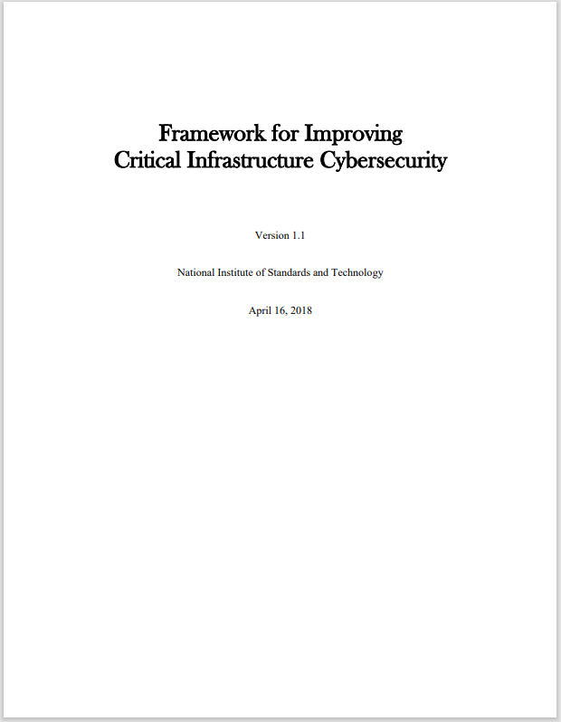
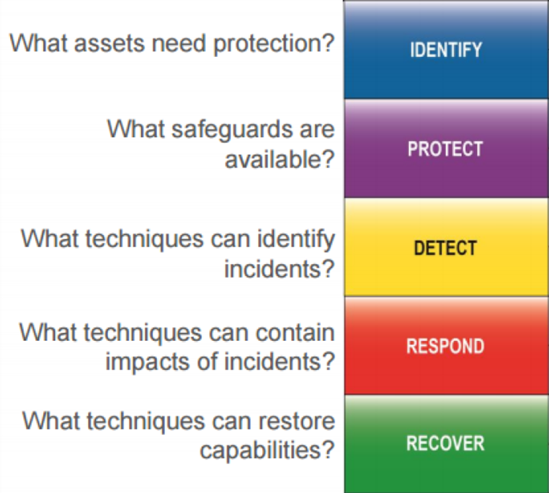
NIST’s “Cybersecurity Framework”
Notes:
Generated by Copilot
NIST’s Cybersecurity Framework is structured around five core functions: Identify, Protect, Detect, Respond, and Recover. Each function represents a critical area of cybersecurity management, guiding organizations to understand their risks, implement safeguards, detect incidents, respond effectively, and recover from disruptions. This framework provides a comprehensive approach to managing cybersecurity risk.
______

Slide 8
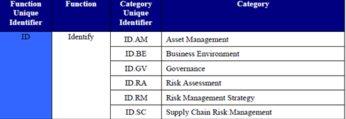
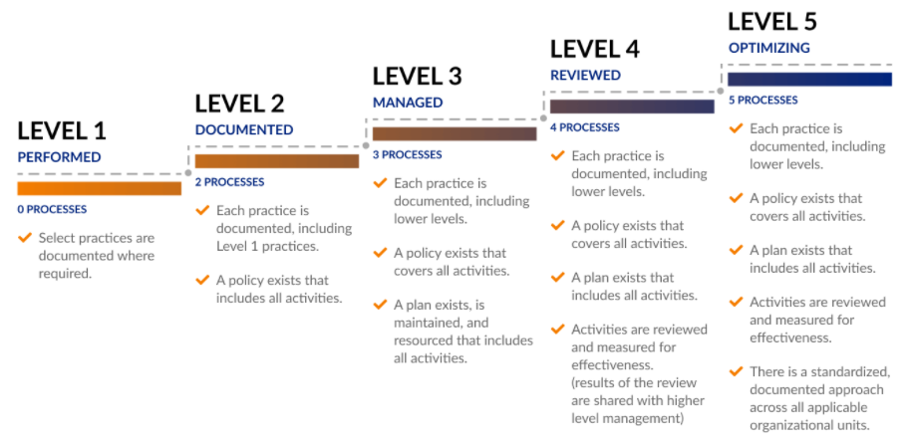
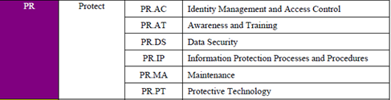

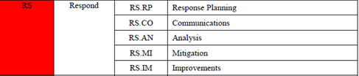

NIST Cybersecurity Framework
Cybersecurity Maturity Model Certification (CMMC) levels
Is used to assess an organization’s cybersecurity capability maturity level, and recommend steps for improvement
Notes:
Generated by Copilot
This slide explains how the NIST Cybersecurity Framework is used to assess an organization's cybersecurity maturity and guide improvements. It introduces the Cybersecurity Maturity Model Certification (CMMC) levels, ranging from basic performed processes to optimized practices. Understanding these levels helps organizations benchmark their cybersecurity capabilities and plan for progressive enhancements.
______

Slide 9
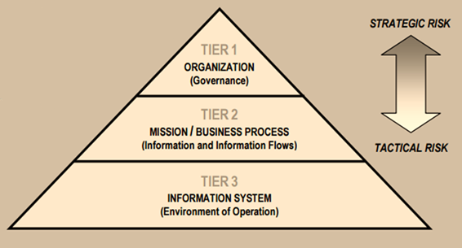
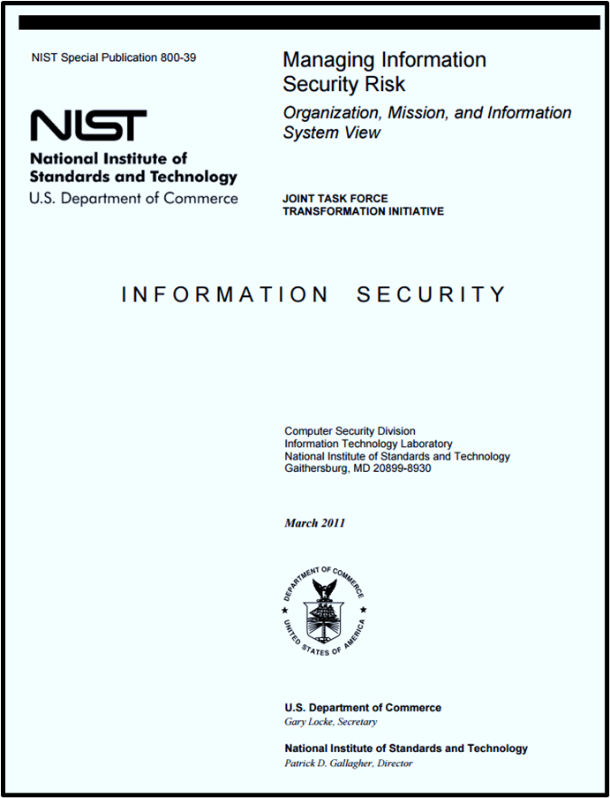
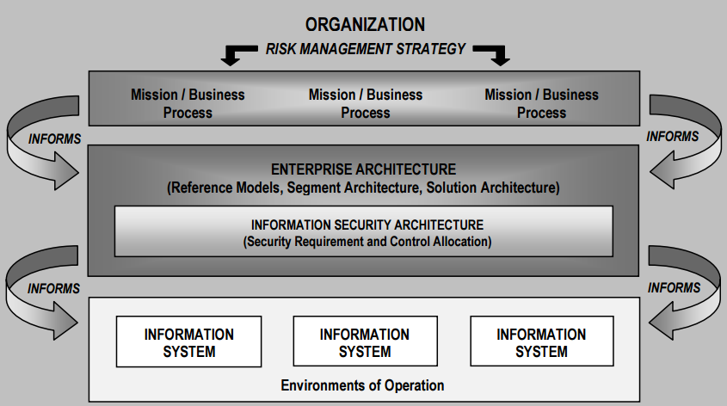
NIST’s Risk Management Framework
Notes:
Generated by Copilot
The NIST Risk Management Framework is depicted here with its organizational context. The pyramid illustrates the hierarchy from organizational risk to system-level controls, while the layered diagram shows how enterprise architecture integrates with information security architecture and systems. This framework provides a structured approach to managing risk across all levels of an organization.
______

Slide 10
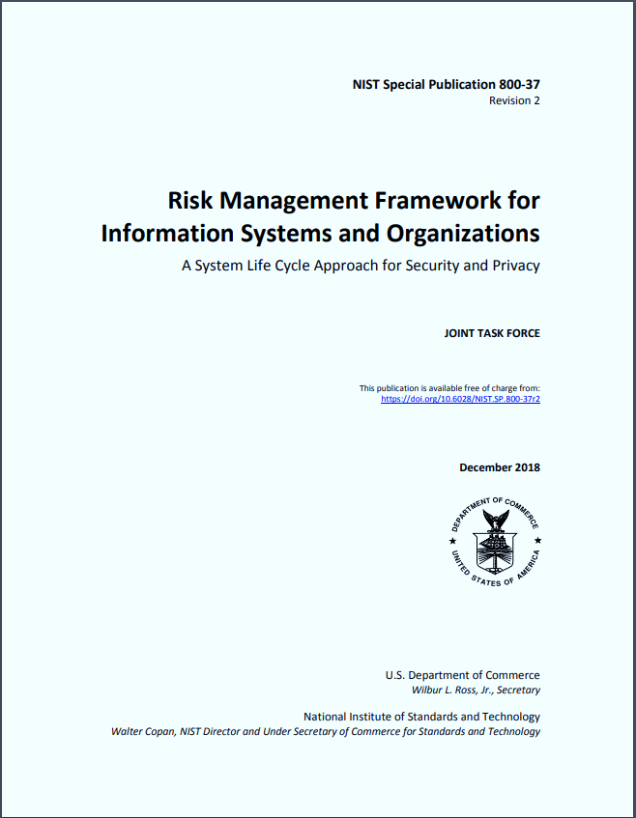
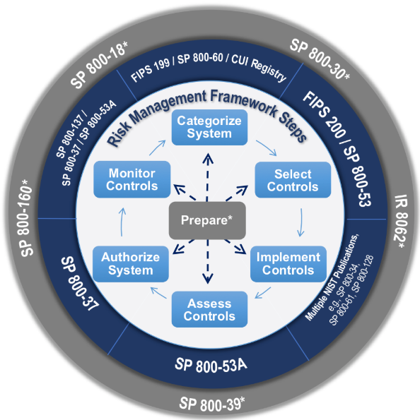
Security Categorization & Selecting a Baseline of Cybersecurity Risk Controls
Notes:
Generated by Copilot
This slide focuses on security categorization and selecting baseline cybersecurity controls. The circular diagram outlines the risk management steps, emphasizing preparation, categorization, control selection, implementation, authorization, and monitoring. It highlights the importance of aligning security controls with the organization's risk profile and relevant standards to ensure effective protection.
______

Slide 11
1st Step in cybersecurity is security categorization (i.e. risk assessment)
Inventory the data content of the information system
Determine the security categorization of the information based on potential impacts a breach of confidentiality, integrity and availability will have on organizational operations, assets, or individuals based FIPS 199 standard
Notes:
Generated by Copilot
Security categorization is the foundational step in cybersecurity risk management. It involves inventorying the data within an information system and determining its security category based on potential impacts to confidentiality, integrity, and availability. This process follows the FIPS 199 standard and sets the stage for selecting appropriate security controls tailored to the system's risk level.
______

Slide 12
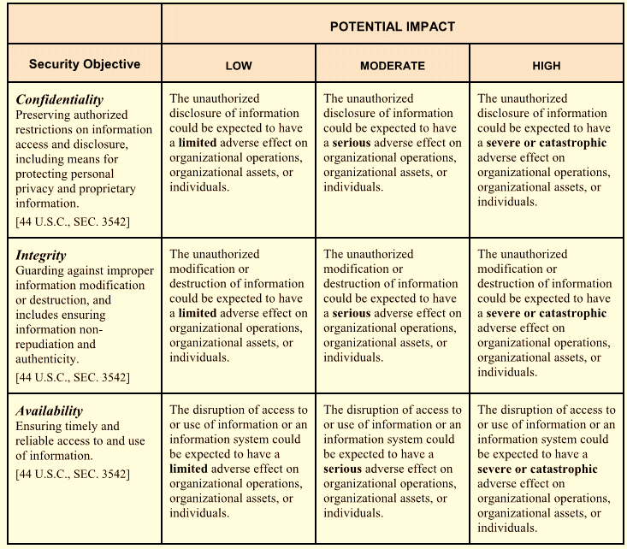
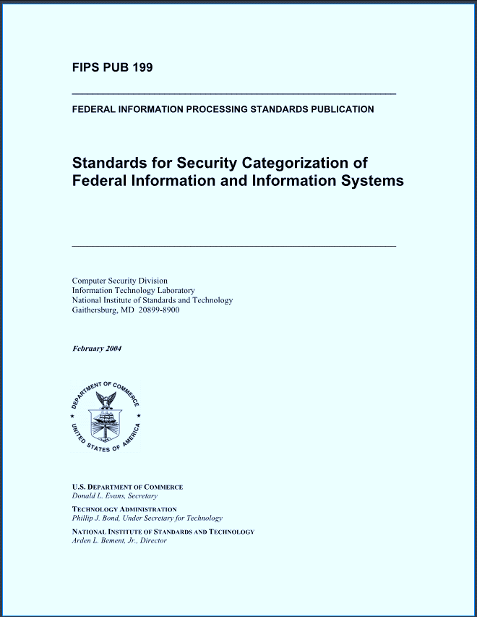
Risk is based on impact of a security breach
In the Risk Management Framework (RMF) likelihood of a breach is treated as 100%
https://nvlpubs.nist.gov/nistpubs/FIPS/NIST.FIPS.199.pdf
8/31/2025
Notes:
Generated by Copilot
Risk assessment here is centered on the impact of a security breach, with the Risk Management Framework assuming a breach likelihood of 100%. The table categorizes impacts as low, moderate, or high across confidentiality, integrity, and availability. This approach ensures that organizations focus on the severity of potential impacts when prioritizing security measures.
______

Slide 13

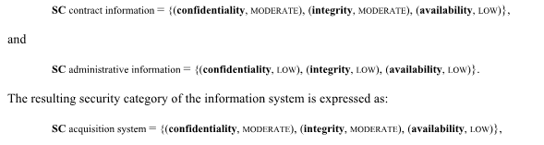
FIPS Pub 199 Standards for Security Categorization
Low: Limited adverse effect
Medium: Serious adverse effect
High: Severe or catastrophic adverse effect
Example with multiple information types:
= MODERATE rating
= LOW rating
= MODERATE rating
Notes:
Generated by Copilot
FIPS Publication 199 provides standards for security categorization by evaluating confidentiality, integrity, and availability impacts. This slide illustrates how multiple information types within a system can have different impact ratings, which combine to determine the overall security category. Understanding these ratings helps in accurately assessing and managing system risks.
______

Slide 14
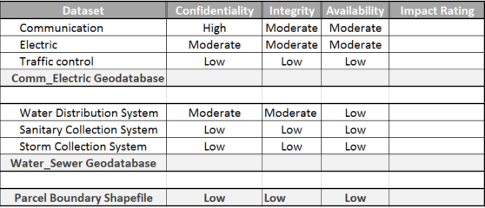
What are the security categorizations of these datasets?
?
?
?
?
?
?
?
Notes:
Generated by Copilot
This slide presents a table for evaluating the security categorizations of various datasets, considering confidentiality, integrity, availability, and overall impact. The diverse ratings across datasets highlight the need for tailored security approaches depending on the sensitivity and criticality of each data type within an organization.
______

Slide 15
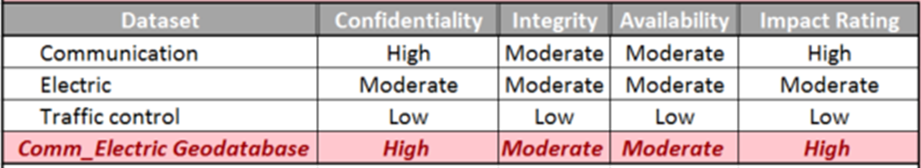
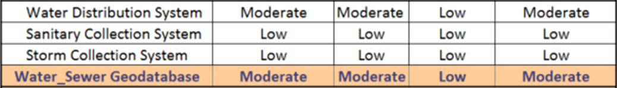
What are the security categorizations of the geodatabases?
?
?
?
?
?
?
?
?
Notes:
Generated by Copilot
Focusing on geodatabases, this slide categorizes their security requirements. For example, the Comm_Electric Geodatabase shows high confidentiality and integrity needs, reflecting its critical nature. Other geodatabases have varying levels of security needs, emphasizing the importance of assessing each system individually to apply appropriate controls.
______

Slide 16
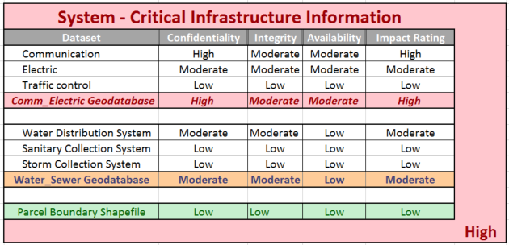
What is the overall security categorization of the information system containing these datasets?
?
?
?
?
?
?
?
?
Notes:
Generated by Copilot
This slide assesses the overall security categorization of an information system containing multiple datasets. It shows that some systems, like Communication and Comm_Electric Geodatabase, require high security, while others have lower requirements. This comprehensive view aids in prioritizing security efforts and resource allocation across the system.
______

Slide 17
Agenda
National Institute of Standards and Technology (NIST)
  Cybersecurity Framework
  Risk Management Framework
Applying the NIST Risk Management Framework
Milestone 1 Assignment
Notes:
Generated by Copilot
Reiterating the agenda, this slide prepares us to delve deeper into NIST's Cybersecurity Framework and Risk Management Framework. It also sets the context for applying these frameworks practically and completing the Milestone 1 assignment, reinforcing the session's learning objectives.
______

Slide 18
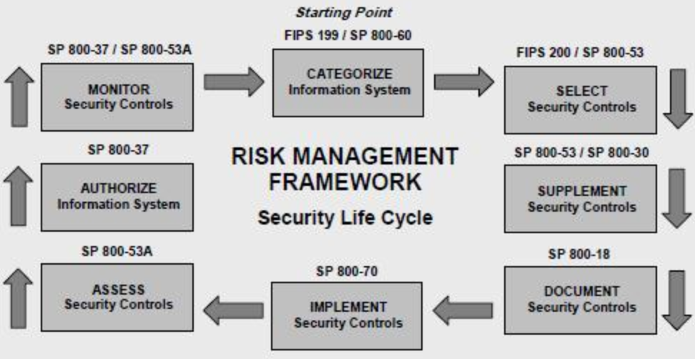
NIST Risk Management Framework
Notes:
Generated by Copilot
The NIST Risk Management Framework lifecycle is outlined here, detailing stages such as categorizing information systems, selecting and implementing security controls, and continuous monitoring. The emphasis on the 'Categorize' step highlights its critical role in understanding system risks and guiding subsequent security decisions.
______

Slide 19
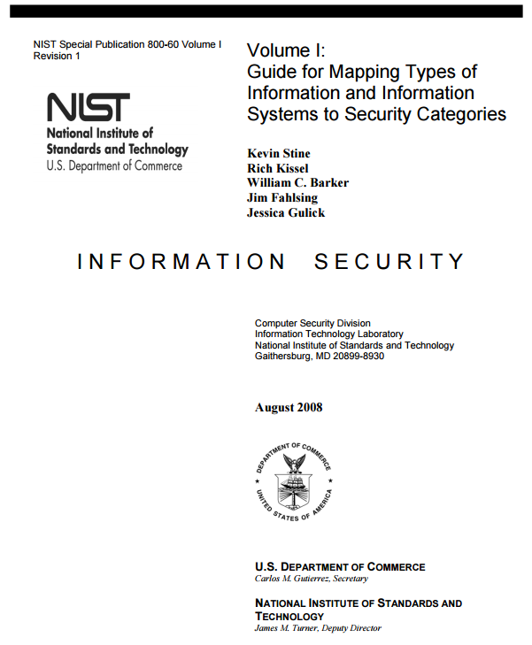
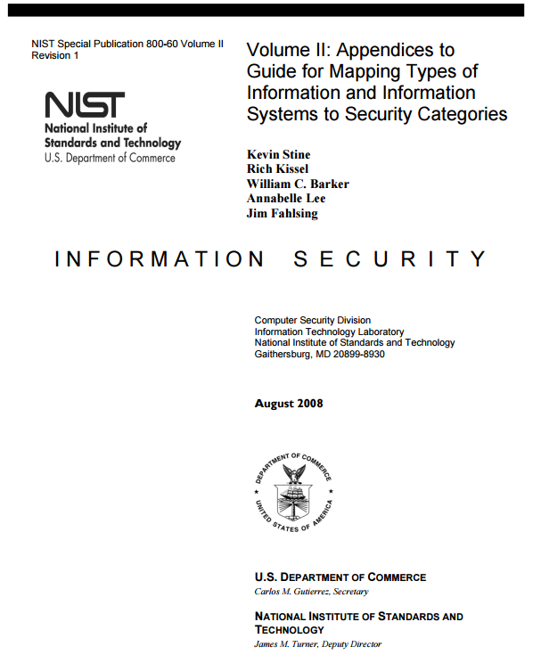
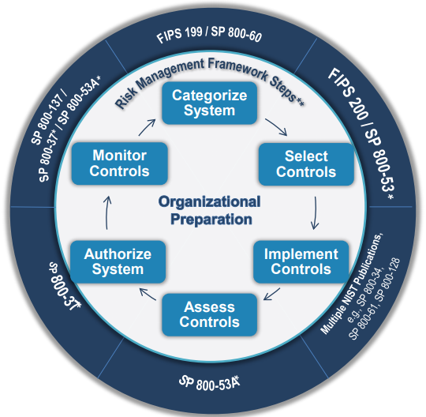
A guide for provisional security categorization
Found at NIST and on the Lecture Materials page of the MIS Community website
8/31/2025
Notes:
Generated by Copilot
This slide offers a guide for provisional security categorization, referencing key NIST publications and resources available on the MIS Community website. The circular diagram illustrates the iterative nature of risk management, emphasizing categorization, authorization, and monitoring as ongoing processes essential for maintaining security posture.
______

Slide 20
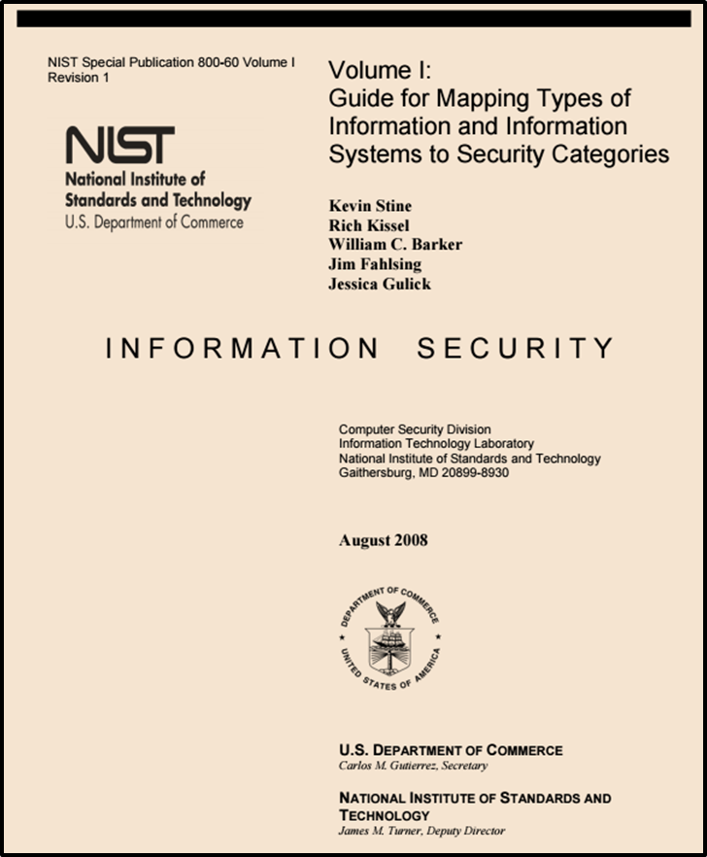
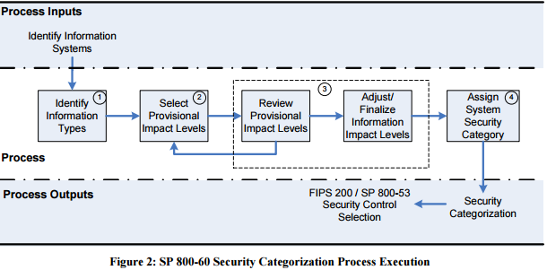
http://nvlpubs.nist.gov/nistpubs/Legacy/SP/nistspecialpublication800-60v1r1.pdf
Notes:
Generated by Copilot
The flowchart details the SP 800-60 process for security categorization, starting with identifying information types and selecting provisional impact levels. It shows the review and adjustment steps leading to final security category assignment. This structured approach ensures accurate and consistent categorization aligned with organizational risk management.
______

Slide 21
2 Broad types of Information and Information Systems
Mission-based Information & Information Systems
Management and Support Information & Information Systems
Notes:
Generated by Copilot
Information and information systems broadly fall into two categories: mission-based and management/support. Mission-based systems support core organizational objectives, while management and support systems facilitate operational functions. Recognizing these distinctions helps in applying appropriate security measures tailored to the system's role and criticality.
______

Slide 22
Mission-based Information and Information Systems
Defense and National Security
Homeland Security
Intelligence Operations
Disaster Management
International Affairs and Commerce
Natural Resources
Energy
Environmental Management
Economic Development
Community and Social Services
Transportation
Education
Workforce Management
Health
Income Security
Law Enforcement
Litigation and Judicial Activities
Federal Correctional Activities
General Sciences and Innovation
Knowledge Creation and Management
Regulatory Compliance and Enforcement
Public Goods Creation and Management
Federal Financial Assistance
Credit and Insurance
Transfers to State/Local Governments
Direct Services for Citizens
Notes:
Generated by Copilot
This slide lists various mission-based information systems across sectors such as defense, homeland security, intelligence, disaster management, and more. The highlighted focus on Intelligence Operations underscores its importance. Understanding these mission areas helps in mapping security requirements to the specific functions and risks associated with each domain.
______

Slide 23
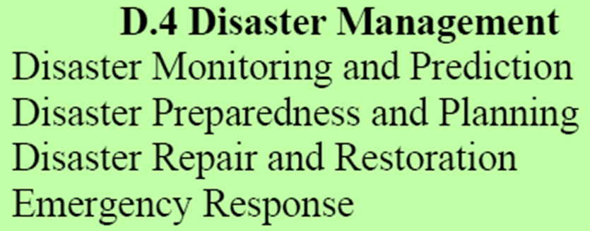
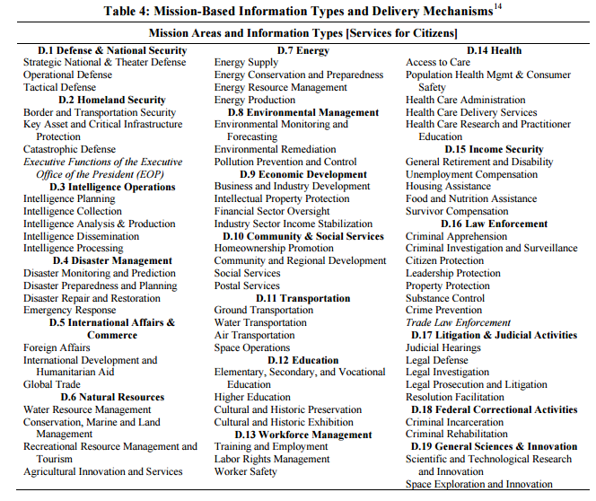
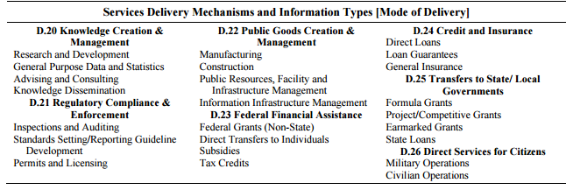
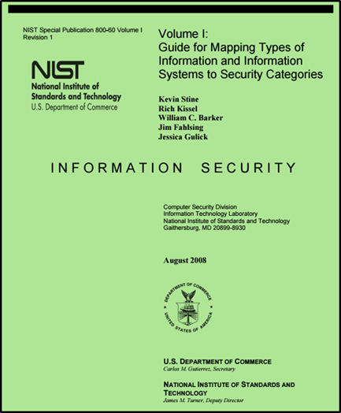
Disaster Management Information Types
Notes:
Generated by Copilot
Disaster management information types are categorized here, covering monitoring and prediction, preparedness and planning, repair and restoration, and emergency response. Each category supports different phases of disaster management, requiring tailored security considerations to ensure timely and effective response while protecting critical information.
______

Slide 24
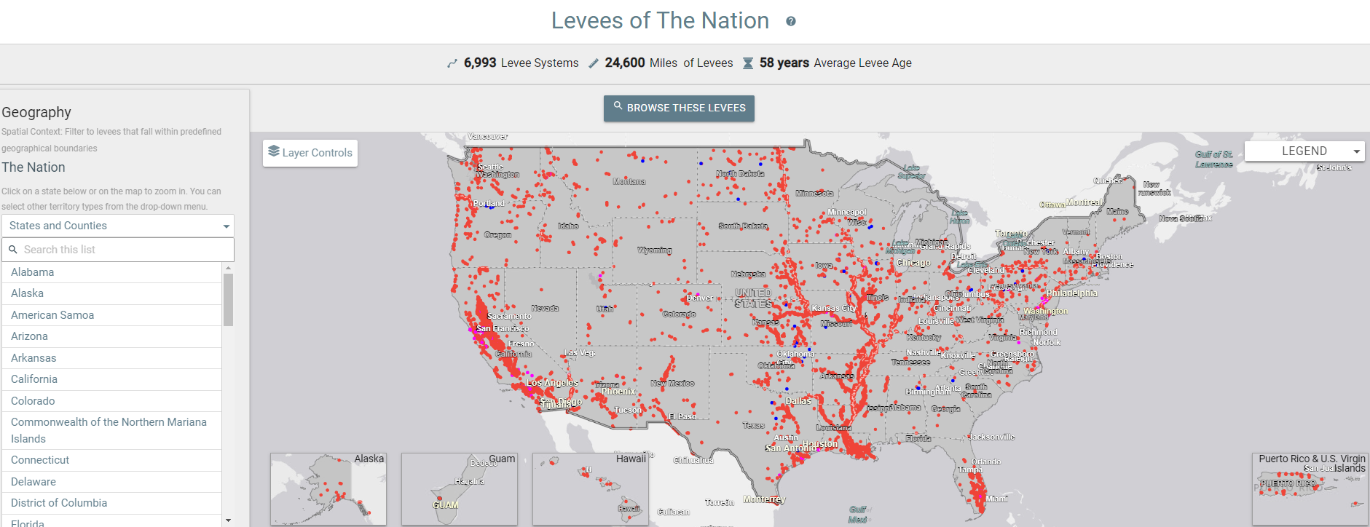

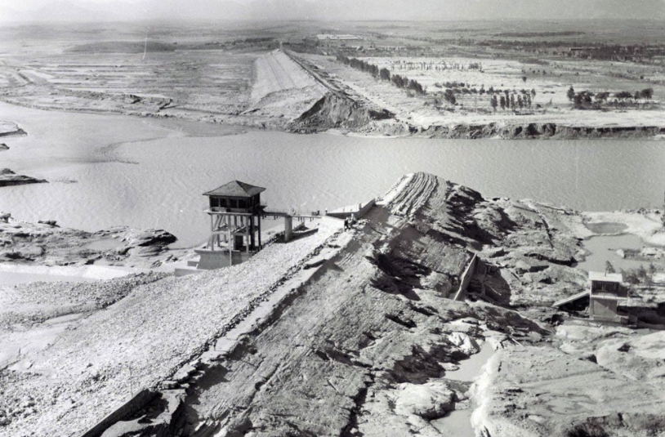


Disaster Management Information System Example
National Levee Database
Notes:
Generated by Copilot
The National Levee Database example illustrates a disaster management information system that integrates geographic data to monitor levee systems across the U.S. The map and interface demonstrate how such systems support disaster preparedness and response by providing critical infrastructure information to stakeholders.
______

Slide 25
Select Provisional Impact Levels for the identified information system
Notes:
Generated by Copilot
Selecting provisional impact levels is a key step in security categorization. This slide shows the process flow and references NIST guidance, emphasizing the importance of accurately assessing potential impacts to assign appropriate security categories that inform control selection and risk management strategies.
______

Slide 26
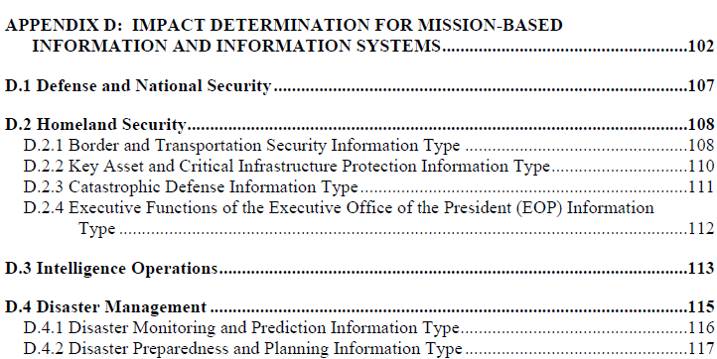
Disaster Management Information Types
https://nvlpubs.nist.gov/nistpubs/Legacy/SP/nistspecialpublication800-60v2r1.pdf
Notes:
Generated by Copilot
This slide references a NIST publication detailing disaster management information types. It provides authoritative guidance on categorizing and securing information critical to disaster management missions, supporting informed decision-making and effective risk mitigation in emergency scenarios.
______

Slide 27

Disaster Management Information Impact
Notes:
Generated by Copilot
Disaster management information is vital for preparing, mitigating, responding to, and recovering from disasters. Compromise of this information can severely impact critical infrastructure and national security. This slide highlights the high stakes involved and the need for robust security measures to protect disaster-related data.
______

Slide 28
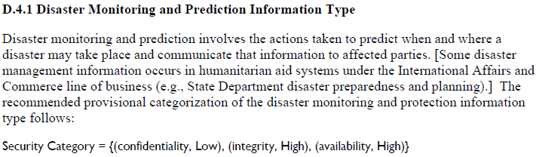
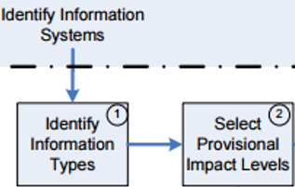
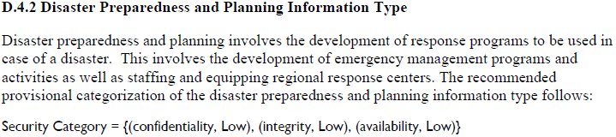
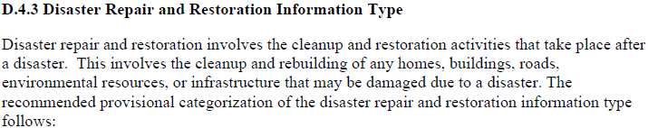
Disaster Management Information Types
Notes:
Generated by Copilot
This slide categorizes disaster management information into monitoring and prediction, preparedness and planning, and repair and restoration. It emphasizes the importance of confidentiality, integrity, and availability in each category, guiding the selection of security controls to protect information throughout the disaster management lifecycle.
______

Slide 29
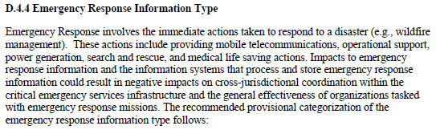
Disaster Management Information Types
Notes:
Generated by Copilot
Focusing on emergency response, this slide explains the critical nature of timely and accurate information. It outlines the security categorization recommended for emergency response information, prioritizing high integrity and availability to ensure effective coordination and minimize negative impacts during disasters.
______

Slide 30
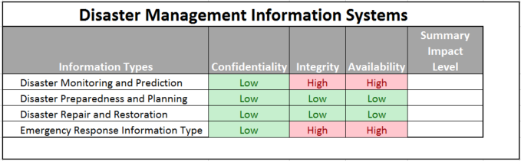
Exercise
Determine the Summary Impact Levels for the Disaster Information Types
?
?
?
?
Notes:
Generated by Copilot
This exercise challenges you to determine summary impact levels for various disaster information types. By evaluating confidentiality, integrity, and availability, you can practice applying security categorization principles to real-world scenarios, reinforcing your understanding of risk assessment in disaster management contexts.
______

Slide 31
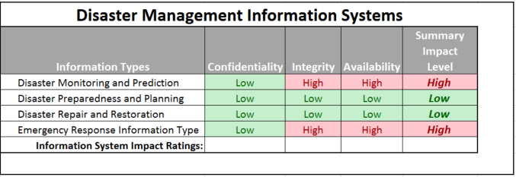
Determine the Overall Impact Levels for the Disaster Information Types
?
?
?
Notes:
Generated by Copilot
The slide presents overall impact levels for disaster management information systems, showing that while confidentiality and integrity may be low, availability is consistently high. This reflects the critical need for these systems to remain operational during emergencies, guiding prioritization of security controls accordingly.
______

Slide 32
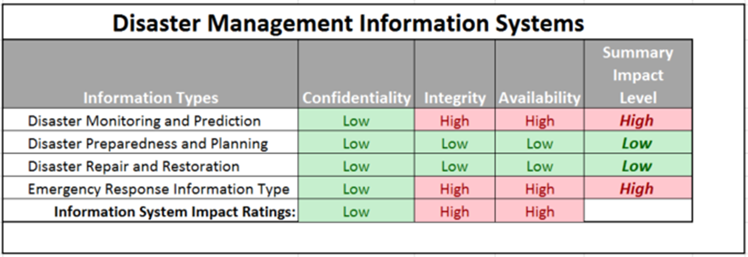
Determine the overall security categorization of a Disaster Information System
?
Notes:
Generated by Copilot
Here, the overall security categorization of a disaster information system is assessed, considering confidentiality, integrity, and availability. The color-coded table helps visualize the varying levels of impact across different information types, supporting informed decisions on security requirements and resource allocation.
______

Slide 33
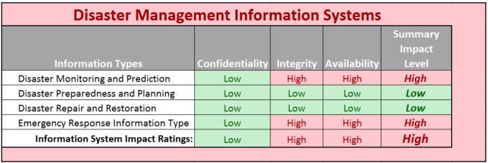
Determine the overall security categorization of a Disaster Information System
Notes:
Generated by Copilot
This slide further analyzes the overall security categorization of disaster information systems. It highlights that certain information types, like monitoring and emergency response, require high security across all dimensions, while others have lower requirements. This differentiation is crucial for effective risk management and control implementation.
______

Slide 34
What synonyms should you use to explain the meaning of low, moderate, or high impact breaches?
8/31/2025
Copyright @ URISA 2021
Notes:
Generated by Copilot
Understanding and communicating the meaning of low, moderate, and high impact breaches is essential. This slide provides synonyms and descriptions to help explain the potential adverse effects on organizational operations, assets, and individuals, facilitating clearer risk communication with stakeholders.
______

Slide 35
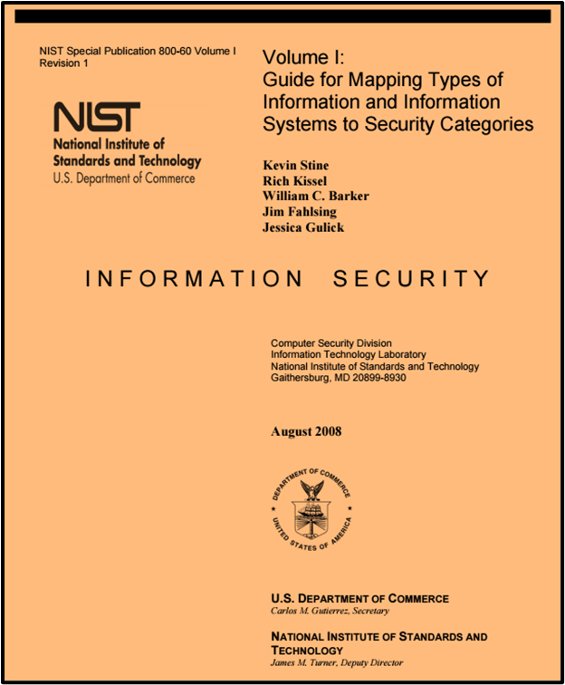
Once categorized, select security control baseline for the information system
Notes:
Generated by Copilot
After categorizing information systems, selecting an appropriate security control baseline is the next step. This slide outlines the process flow for finalizing security categories and emphasizes the importance of aligning controls with the system's risk profile to ensure effective protection.
______

Slide 36
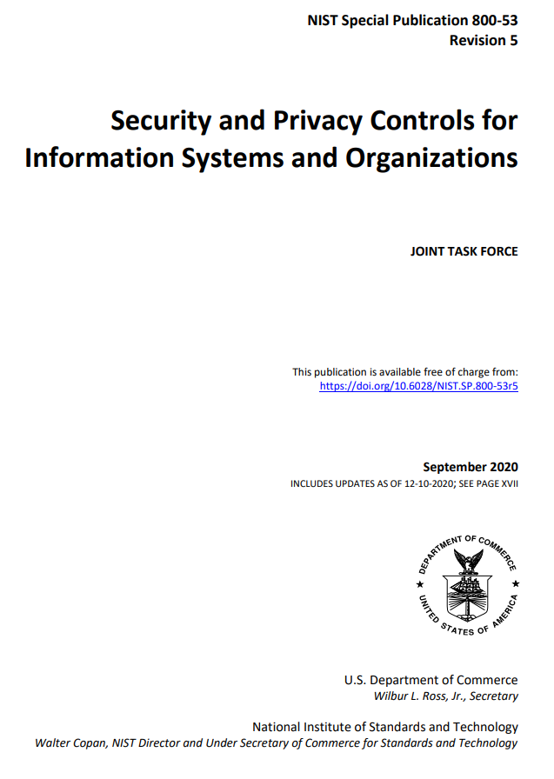
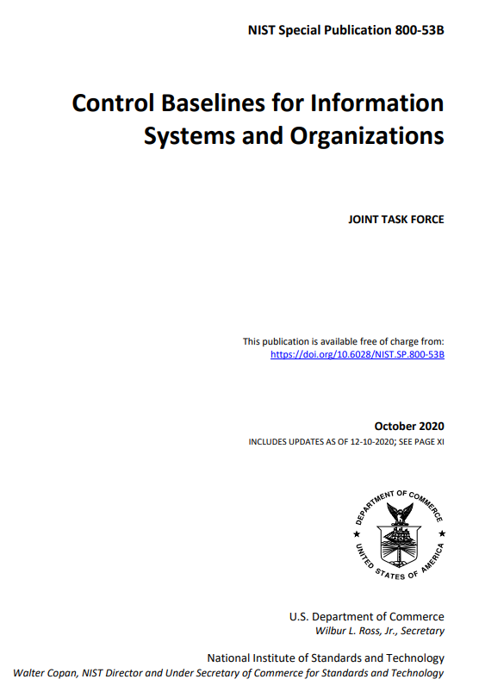
Selecting cybersecurity risk controls
Notes:
Generated by Copilot
Selecting cybersecurity risk controls involves following the Risk Management Framework steps, particularly focusing on selecting and implementing controls. The slide references key NIST publications (SP 800-53 and SP 800-53B) that provide comprehensive guidance on security and privacy controls, supporting organizations in building robust cybersecurity programs.
______

Slide 37
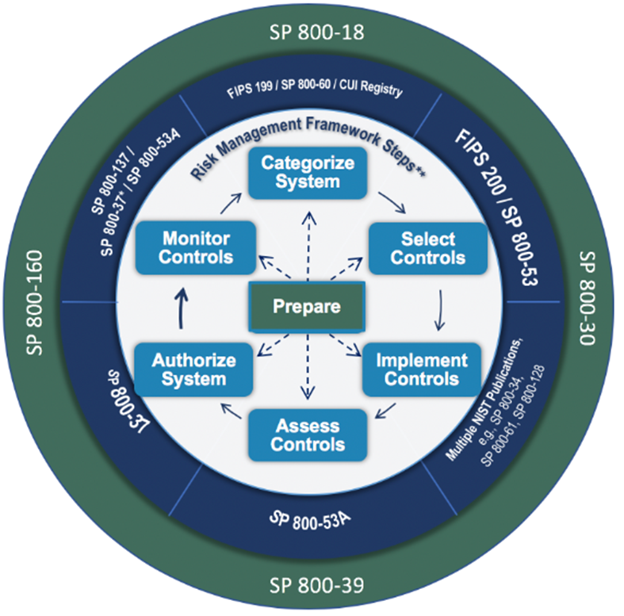
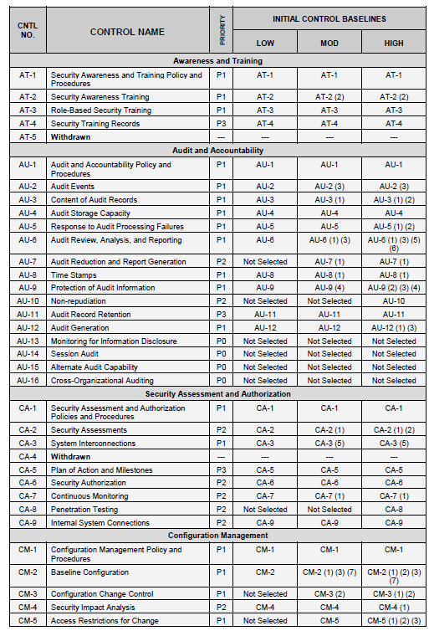
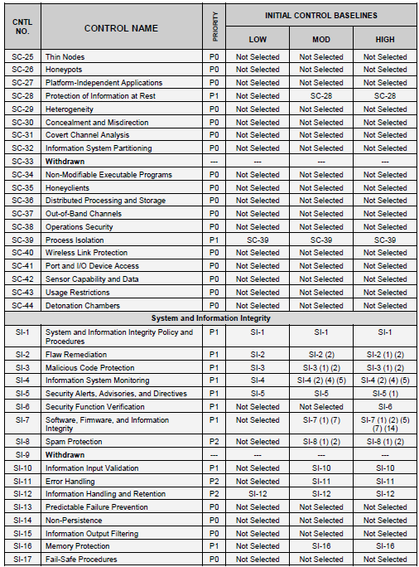
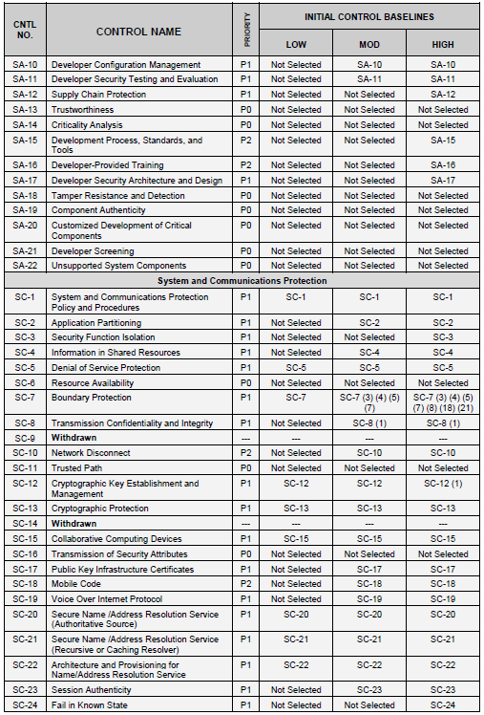
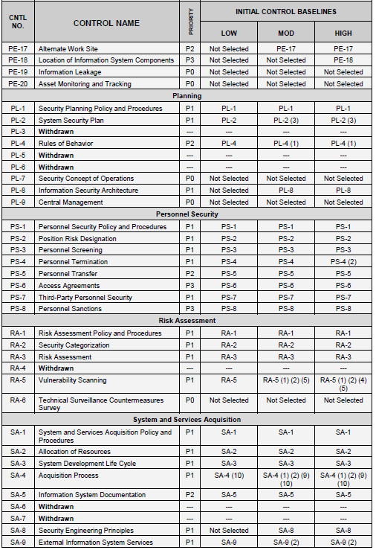
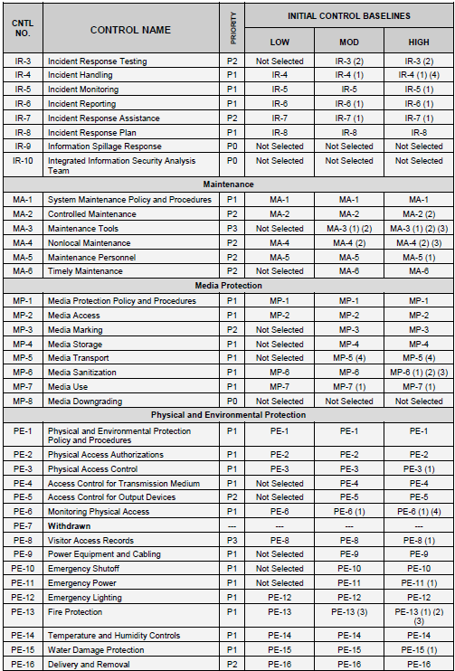



FIPS 199 categorization is used to select among 3 impact-based baselines of security controls
Notes:
Generated by Copilot
FIPS 199 categorization guides the selection among three impact-based baselines of security controls: low, moderate, and high. This slide illustrates how categorization informs control selection, ensuring that security measures are commensurate with the potential impact of security breaches, thereby optimizing resource use and risk mitigation.
______

Slide 38
Agenda
100 Digits of Pi Quiz
National Institute of Standards and Technology (NIST)
  Cybersecurity Framework
  Risk Management Framework
Applying the NIST Risk Management Framework
Milestone 1 Assignment
Notes:
Generated by Copilot
The agenda here includes a quiz on the 100 digits of Pi, followed by a review of NIST's Cybersecurity Framework and Risk Management Framework. It also covers applying the NIST Risk Management Framework and details about the Milestone 1 assignment, setting expectations for the session's activities.
______

Slide 39
Milestone 1 – Risk Assessment Report
Milestone 1 Assignment is found in Canvas
Your assignment is to apply the NIST Risk Management Framework and create a risk assessment report for managers of a (fictitious) company that owns and depends on financial information contained in a financial management system
Financial management involves the aggregate set of accounting practices and procedures that allow for the accurate and effective handling of all a business’ revenues, funding, and expenditures. NIST SP 800-60 Volume 2 identifies a set of business functions and associated types of data typically supported by and included in financial management information systems. What are they?
Your risk assessment assignment requires that you introduce and discuss:
  Security objectives and potential impacts defined in Federal Information Processing Standard 199: “Standards for Security Categorization of Federal Information and Information Systems”
  Methodology for assigning impact levels to information and information system types described in NIST Special Publication 800-60 Volume I
  Provisional security categorizations assigned to the financial management information types by NIST Special Publication 800-60 Volume II
  You Determination of an overall security categorization for the financial information management system (FIMS) based on the provisional security categorization of the FMIS data types
Notes:
Generated by Copilot
Milestone 1 requires applying the NIST Risk Management Framework to create a risk assessment report for a fictitious company's financial management system. The assignment involves defining security objectives, assigning impact levels based on federal standards, and determining overall security categorization, providing practical experience in cybersecurity risk assessment.
______

Slide 40
How should you proceed in getting started with Milestone 1 ?
Inventory content of information in the Financial Information Management System (FIMS)
  Use NIST SP 800-60v1.r1 and 800-60v2.r1
  Determine the security categorization of the information contained within the FIMS
Determine the overall security categorization of the FIMS
Translate the FIMS’ security categorization into non-technical language of organizational risk that a senior manager can understand and relate to
NIST SP800-60V2R1: “Appendices to Guide for Mapping Types of Information and Information Systems to Security Categories”
Notes:
Generated by Copilot
To start Milestone 1, inventory the information content within the Financial Information Management System using NIST SP 800-60 volumes. Determine the security categorization of this information and the overall system. Finally, translate these technical categorizations into language that senior managers can understand, linking cybersecurity risk to organizational impact.
______

Slide 41
NIST SP 800-60 Volume I includes tables that identify broad types of information types stored in a wide variety of information systems
NIST SP800-60V1R1: “Guide for Mapping Types of Information and Information Systems to Security Categories”
Mission-based Information & Information Systems
Management and Support Information & Information Systems
  Services Delivery Support Functions
  Resource Management Functions
HINT: Use Volume 1’s tables to identify which section of Volume II will contain the security categorizations you need for the data types found in your organization’s Financial Information Systems
NIST SP 800-60 Volume II Revision 1, Volume II: “Appendices to Guide for Mapping Types of Information and Information Systems to Security Categories”
Notes:
Generated by Copilot
NIST SP 800-60 Volume I includes tables that identify broad types of information stored in various systems, divided into mission-based and management/support categories. This slide advises using Volume I to locate relevant sections in Volume II, which contains detailed security categorizations needed for assessing your organization's financial information systems.
______

Slide 42
Agenda
National Institute of Standards and Technology (NIST)
  Cybersecurity Framework
  Risk Management Framework
Applying the NIST Risk Management Framework
Milestone 1 Assignment
Notes:
Generated by Copilot
This agenda slide summarizes the key topics: NIST's Cybersecurity Framework, Risk Management Framework, applying the Risk Management Framework, and the Milestone 1 assignment. It reinforces the focus areas for the session and prepares participants for the practical application of these cybersecurity concepts.
______

