Slide 1
Managing Enterprise Cybersecurity MIS 4596
Class 6

Slide 2
Agenda
Cryptography terminology
Substitution
Transposition
Symmetric key cryptography
Symmetric stream cryptography
Next: Symmetric Encryption Lab

Slide 3
Cryptography
Method of transmitting and storing data in a form that only those it is intended for can read and process
An effective way of protecting sensitive information as it is transmitted through untrusted network communication paths or stored on media
Complements physical and logical access controls
The etymology is Greek and means: “secret writing”

Slide 4
Cryptanalysis
The study of methods to break cryptosystems
Often targeted at obtaining a key
Attacks may be passive or active
Kerckhoff’s Principle
The only secrecy involved with a cryptosystem should be the key
Cryptosystem Strength
How hard is it to determine the secret associated with the system?

Slide 5
Cryptology
“The study of codes, or the art of writing and solving them”
Is a term that encompasses both cryptography and cryptanalysis

Slide 6
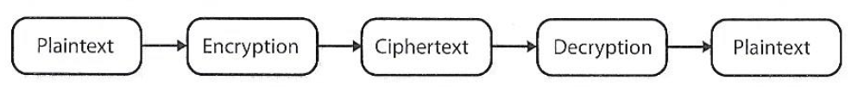
Terminology
Plaintext – is the readable version of a message
Ciphertext – is the unreadable results after an encryption process is applied to the plaintext
Cryptosystem – includes all the necessary components for encryption and decryption
Algorithms
Keys
Software
Protocols
Harris, S. and Maymi, F. (2016) All-In-One CISSP Exam Guide, McGraw Hill Education

Slide 7
Cipher = encryption algorithm
2 main attributes combined in a cypher
Confusion: usually carried out through substitution
Diffusion: Usually carried out through transposition
Harris, S. and Maymi, F. (2016) All-In-One CISSP Exam Guide, McGraw Hill Education

Slide 8

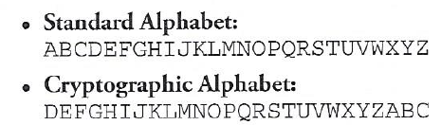
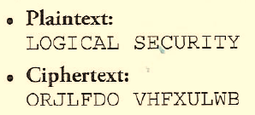
Example: Substitution cipher or algorithm
A mono-alphabetic substitution cipher
“SECURITY” <=> “HVXFIRGB”

Slide 9
Services of cryptosystems
Confidentiality – Renders information unintelligible except by authorized entities
Integrity – Data has not been altered in an unauthorized manner since it was created, transmitted, or stored
Authentication – Verifies the identity of the user or system that created, requested or provided the information
Authorization – On proving identity, the individual is provided with the key or password that will permit access to some resource
Nonrepudiation – Ensure the sender cannot deny sending the information
Repudiation – the sender denying he sent the message
Harris, S. and Maymi, F. (2016) All-In-One CISSP Exam Guide, McGraw Hill Education

Slide 10
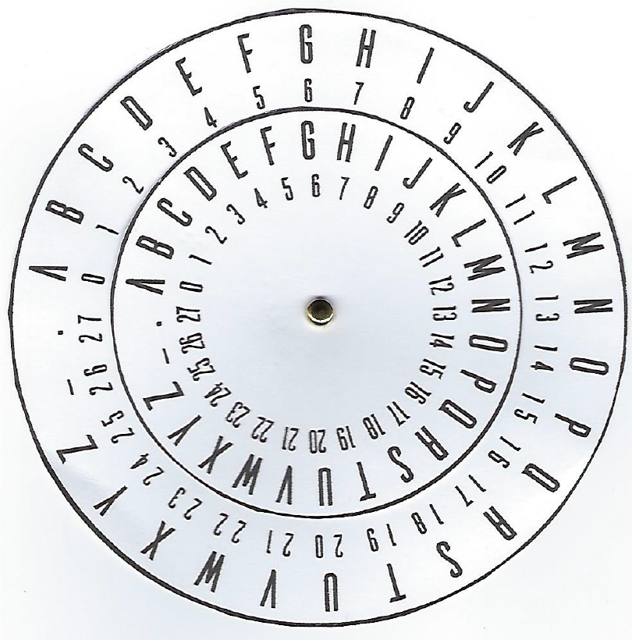
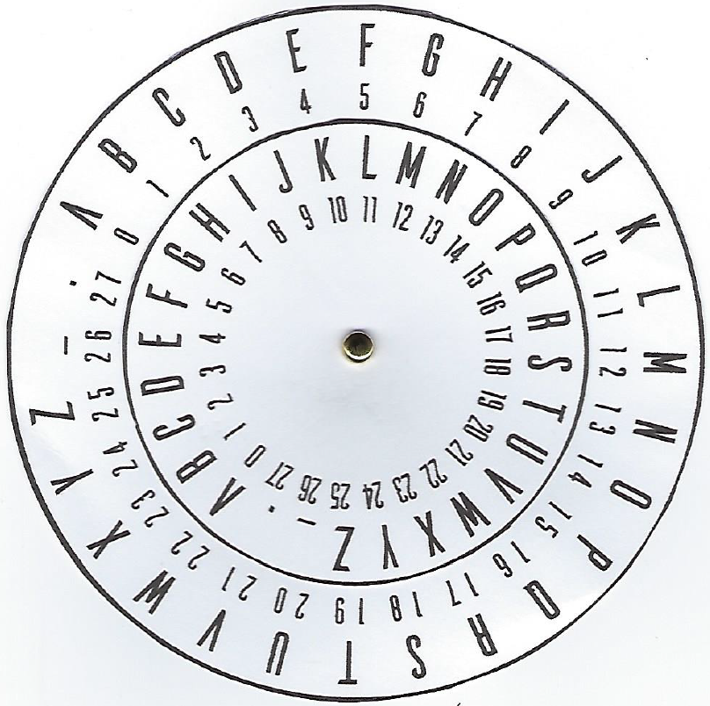
Cipher Disk
Outer wheel is for the plaintext alphabet
Inner wheel is for ciphertext
When the outer wheel and inner wheel and are both aligned at the letter “A” (i.e. position zero), there is no encryption mapping the letters on the outer wheel to letters on the inner wheel

Slide 11
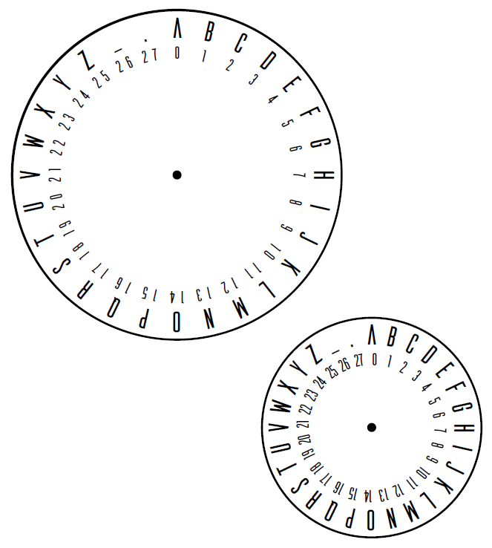
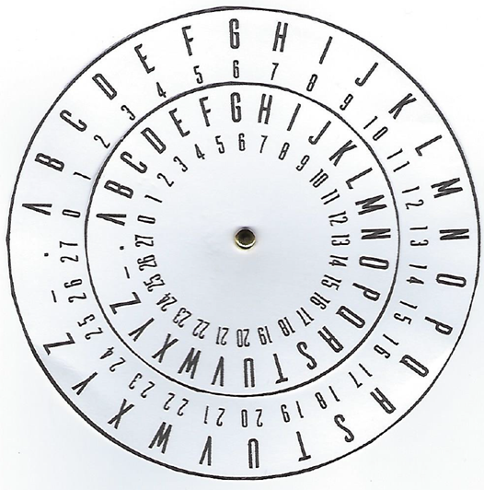
You can make your own cipher disk

Slide 12




0

Slide 13
Secret
0

Slide 14
1

Slide 15
Tfdsfu
1

Slide 16
2

Slide 17
Ugetgv
2

Slide 18
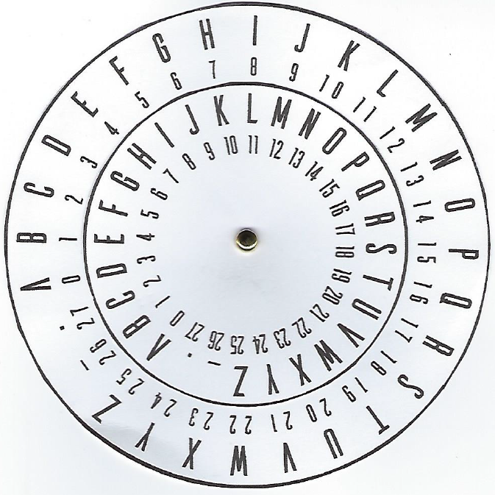
Using the Cipher Disk
Outer wheel is for the plaintext alphabet
Inner wheel is for ciphertext
Setup the Cipher Disk: Make sure the letter “A” on the inner disk is aligned with the letter “A” on the outer disk
When the outer wheel and inner wheel and are both aligned at the letter “A” (i.e. position zero), there is no encryption mapping the letters on the outer wheel to letters on the inner wheel
Rotate the inner wheel 3 positions counter-clockwise
The position set on the inner wheel is the encryption “key”
Key = 3 (A for plaintext aligns with D for ciphertext)
Encrypt the plaintext “SECRET” Question: What is the resulting ciphertext?
VHFUHW

Slide 19
Using the Cipher Disk
Choose a different key (a number between 1 – 27)
We cannot use “0”, which will return the plaintext without encryption
Write the ciphertext on a piece of paper and think about how your friend could decrypt it…
Question: What is the maximum number of guesses needed to find the plaintext?

Slide 20
In-class activity: Cipher Disk
Question: What is the maximum number of guesses needed to find the plaintext?
Answer: 28, the size of the alphabet 26 + “.” and “-”
Guessing all possible keys is called “brute force search” or “brute forcing”

Slide 21
“Keyspace" is the number of possible keys
28

Slide 22
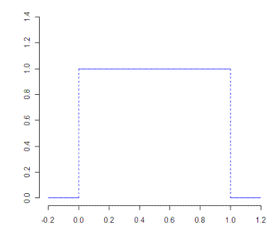
Question B: Assuming each key is equally likely (randomly distributed) how many random guesses would your friend likely have to make to find the key to decrypt the plaintext?
Answer: ~14, (28 -1) = 27 and 27/2 = 13.5 which is approximately 14
Because the average of a uniform distribution is half
Recall 26 letters in the alphabet + “.” and “-” = 28, but we cannot use “0” as the key which gives us the original plaintext back the size of the alphabet
This is important in cryptography because the average number of attempts needed to successfully guess the key through brute forcing is half of the key space
This is true of the simple cipher wheel as well as modern encryption schemes with very large key spaces.
Uniform Distribution
In a uniform distribution any number is equally likely, the average is right in the middle, or half the distribution

Slide 23
Could your friend make fewer guesses than 14 guesses?
Question A: What is the maximum number of guesses needed to find the plaintext?
Answer: The size of the keyspace
Question B: Assuming each key is equally likely (randomly distributed) how many random guesses would your neighbor likely have to make (“on average”) to find the key to decrypt the plaintext?
Answer: Half the size of the keyspace
Question C: If your friend did it faster than 14 or 27 attempts, how was your neighbor able to do it faster?
If it was not just a lucky guess, then they were likely using “cryptanalysis”, the science of breaking codes
What strategies did might they use?

Slide 24
Linguistic cryptanalysis…
Examples:
Recognizing the beginning of the word
Looking for letter pairs
Looking at vowels
This form of cryptanalysis uses your knowledge of the English language

Slide 25
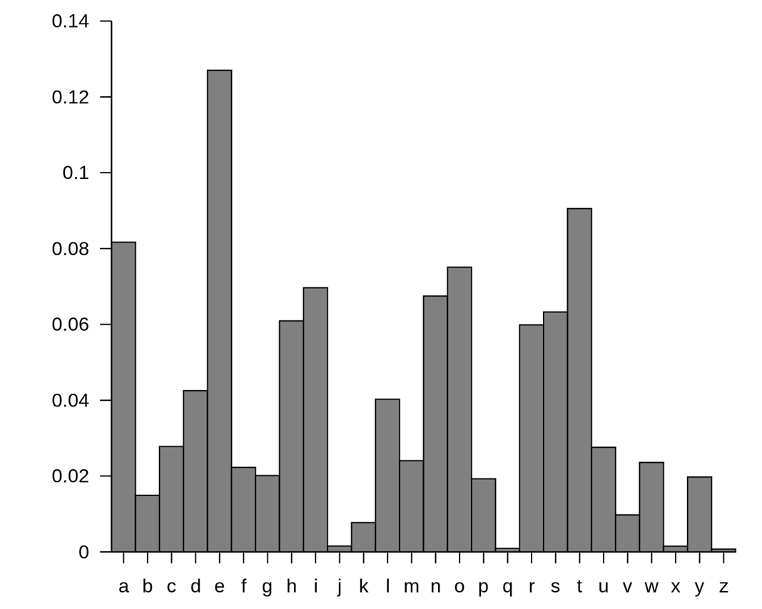
Linguistic cryptanalysis examples…
One form of linguistic cryptanalysis is frequency analysis of letters used in English
Frequency analysis recognizes that different letters have different probabilities of frequencies of use in words:
Given a sentences written in the English language
E, T, A and O are the most common
Z, Q and X are rare
TH, ER, ON, and AN are the most common pairs of letters (termed bigrams or digraphs)
SS, EE, TT, and FF are the most common repeats

Slide 26
Example: Substitution cipher or algorithm
A mono-alphabetic substitution cipher
“SECURITY” <=> “HVXFIRGB”

Slide 27
Polyalphabetic Cipher
Ciphers can be made stronger, and frequency analysis made more difficult when more than one cipher alphabet is used
For example, encrypt the plaintext message “SEND MONEY”
Use the word “SECURITY” as the key, but repeat its use in the key to make it have as many letters as the plaintext:
Plaintext: SEND MONEY (10 characters including the space “_”)
Key: SECURITYSE (10 characters)
Encrypt by rotating the inner wheel so that “s” in the word “security” aligns with “a” on the outer wheel. Now “s” in the word “send” on the outer wheel maps to the letter “i” on the inner wheel, so “i” is the ciphertext.

Slide 28
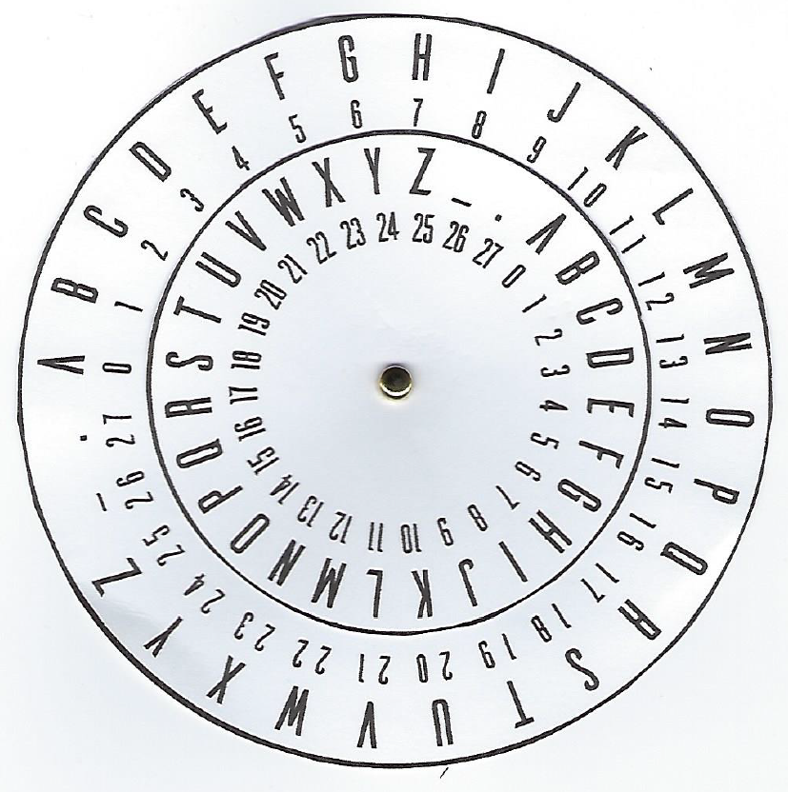
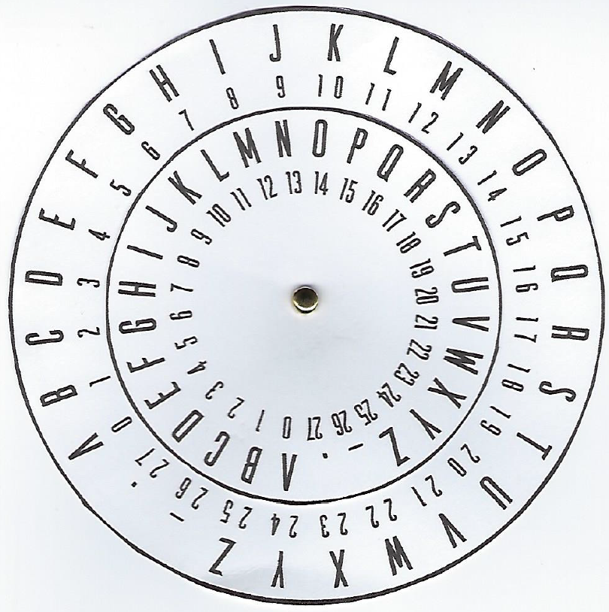
Polyalphabetic Cipher
Plaintext: SEND MONEY (10 characters including the space “_”)
Key: SECURITYSE (10 characters)
Encrypt by rotating the inner wheel so that “S” in the word “SECURITY” aligns with “A” on the outer wheel
Now “S” in the word “SEND” on the outer wheel maps to the letter “I” on the inner wheel, so “I” is the ciphertext
Next, rotate the inner wheel so that “E” in the word “SECURITY” aligns with “A” on the outer wheel. Now “E” in the word “SEND” on the outer wheel maps to “I” on the inner wheel, so “I” is the ciphertext again, even though the plaintext is different than before
Question D: What is the rest of the ciphertext for “SEND MONEY” using the polyalphabetic key “SECURITY”?
Compare your answer to your neighbor’s

Slide 29
Polyalphabetic Cipher
Plaintext: SEND MONEY (10 characters including the space “_”)
Key: SECURITYSE (10 characters)
Question D: What is the rest of the ciphertext for “SEND MONEY” using the polyalphabetic key “SECURITY”?
IIPXPUFJWA
Polyalphabetic ciphers make frequency analysis more difficult
Polyalphabetic substitution is another building block of cryptography
To help you, use the following formula:
Encryption: ciphertext = (plaintext + key) mod 28
Decryption: plaintext = (ciphertext - key) mod 28
Number your alphabet so that it starts with zero, e.g., A = 0, Z=25, _ = 26, . = 27
This means that your alphabet will be abcdefghijklmnopqrstuvwxyz_.
As a general rule for shift ciphers, the modulus is always the size of the alphabet, but you must start your alphabet at 0

Slide 30
Random Polyalphabetic Cipher
What if we use a random polyalphabetic key that is as long as the message?
For example, let’s say our plaintext is:
We intend to begin on the first of February unrestricted submarine warfare.
And the polyalphabetic key is a string of random characters as long as the message:
ackwulsjwkblogbzcukn.kqubpnnefjvcebuymaclzvzmzwfbxpmmzqwmm.tejzfutjcqrsf_hq
Question E: How can an attacker attempt to crack this message?
Is an attack possible?

Slide 31
Services of cryptosystems
Confidentiality – Renders information unintelligible except by authorized entities
Integrity – Data has not been altered in an unauthorized manner since it was created, transmitted, or stored
Authentication – Verifies the identity of the user or system that created, requested or provided the information
Nonrepudiation – Ensure the sender cannot deny sending the information
Repudiation – the sender denying she/he sent the message
Harris, S. and Maymi, F. (2016) All-In-One CISSP Exam Guide, McGraw Hill Education

Slide 32
Cipher = encryption algorithm
2 main attributes combined in a cypher
Confusion: usually carried out through substitution
Diffusion: Usually carried out through transposition
Harris, S. and Maymi, F. (2016) All-In-One CISSP Exam Guide, McGraw Hill Education

Slide 33
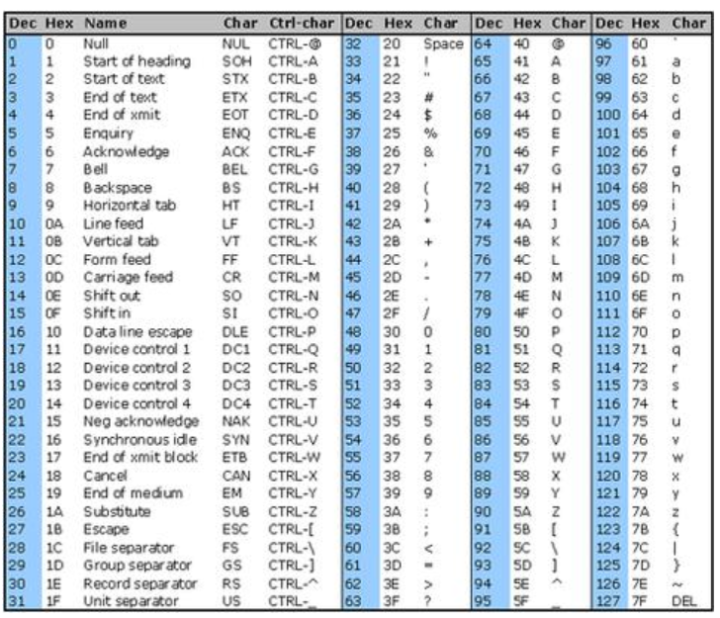
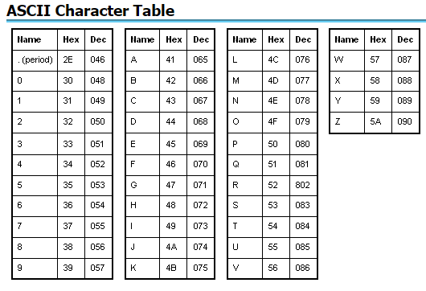
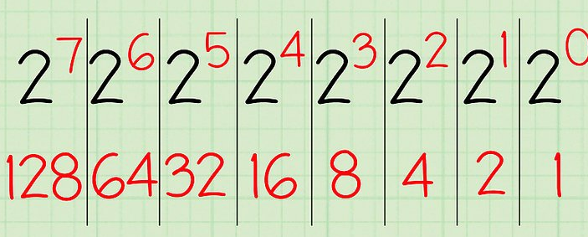
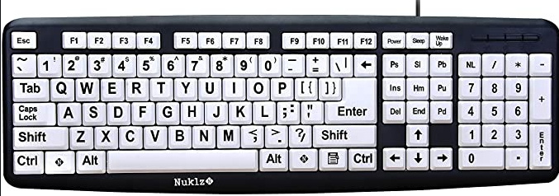
Binary – Decimal
Translating what we type, into ASCII, and then into binary… which is what is sent as data packets across the network to other computers…
ASCII - Decimal
0
0
0
0
0
0
0
0
=
0
1
1
1
1
1
1
1
1
=
255
8 bits supports 256 numbers

Slide 34
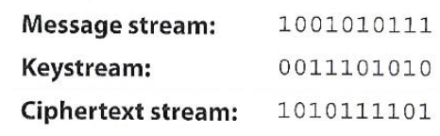
XOR – Exclusive OR
Creating “confusion” (i.e. substitution) through a binary mathematical function called “exclusive OR”, abbreviated as XOR
Harris, S. and Maymi, F. (2016) All-In-One CISSP Exam Guide, McGraw Hill Education

Slide 35
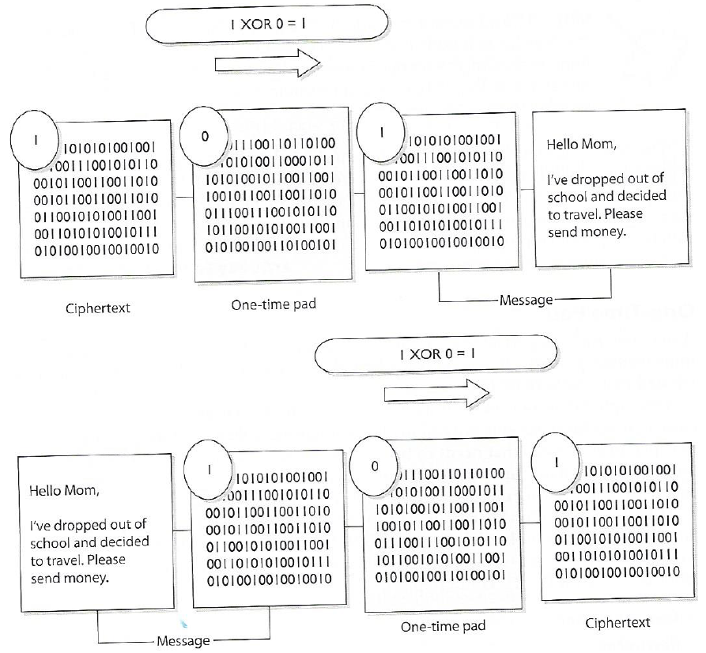
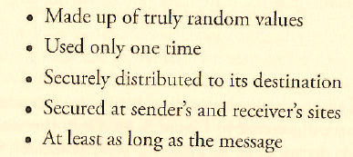
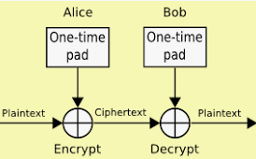
One-Time Pad a perfect encryption scheme
One-Time Pad Requirements
Harris, S. and Maymi, F. (2016) All-In-One CISSP Exam Guide, McGraw Hill Education

Slide 36
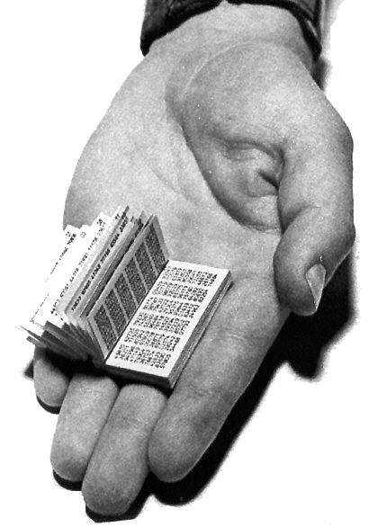
One-time pad -- Problems
Must be perfectly random
Pad must be as long as the message
Must be used only once
Skimp on any of these conditions, it becomes trivial to break your system
Any software product claiming to use one-time pad is snake-oil.
Computers are bad at generating truly random numbers
Notes:
Claude Shannon proved that a one-time pad is provably uncrackable
In WW2, submarines and warships used one-time pads ➔

Slide 37
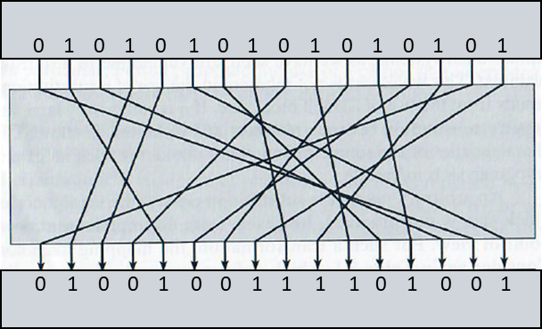
2 main attributes combined in a cypher
0101010101010101
Confusion: usually carried out through substitution
Diffusion: Usually carried out through transposition
Harris, S. and Maymi, F. (2016) All-In-One CISSP Exam Guide, McGraw Hill Education
0100100111101001

Slide 38
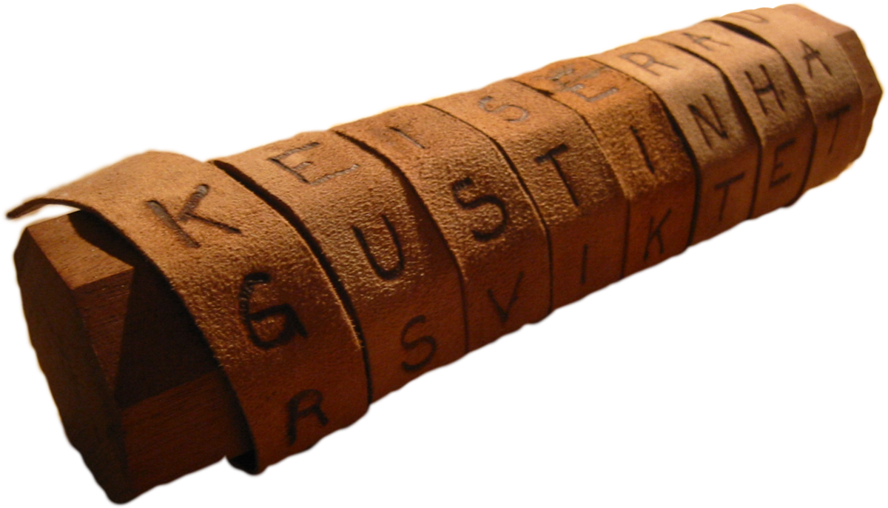
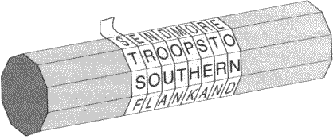
Transposition
Ancient example: scytale

Slide 39
A profit was achieved by our ACT unit
Notes:
Columnar transposition example

Slide 40
a
a
o
p
c
u
r
h
r
o
i
a
f
e
c
i
v
t
t
e
u
w
d
n
a
b
i
s
y
t

Slide 41
0
1
2
3
4
5
6
7
8
9
a
a
o
p
c
u
r
h
r
o
i
a
f
e
c
i
v
t
t
e
u
w
d
n
a
b
i
s
y
t

Slide 42
6
0
2
5
4
8
7
1
3
9
t
e
u
a
a
o
r
h
r
i
v
t
f
e
c
a
b
i
w
d
n
p
c
u
o
i
a
s
y
t

Slide 43
0
1
2
3
4
5
6
7
8
9
a
a
o
p
c
u
r
h
r
o
i
a
f
e
c
i
v
t
t
e
u
w
d
n
a
b
i
s
y
t

Slide 44
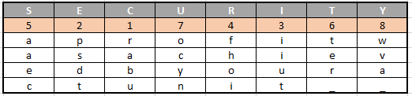
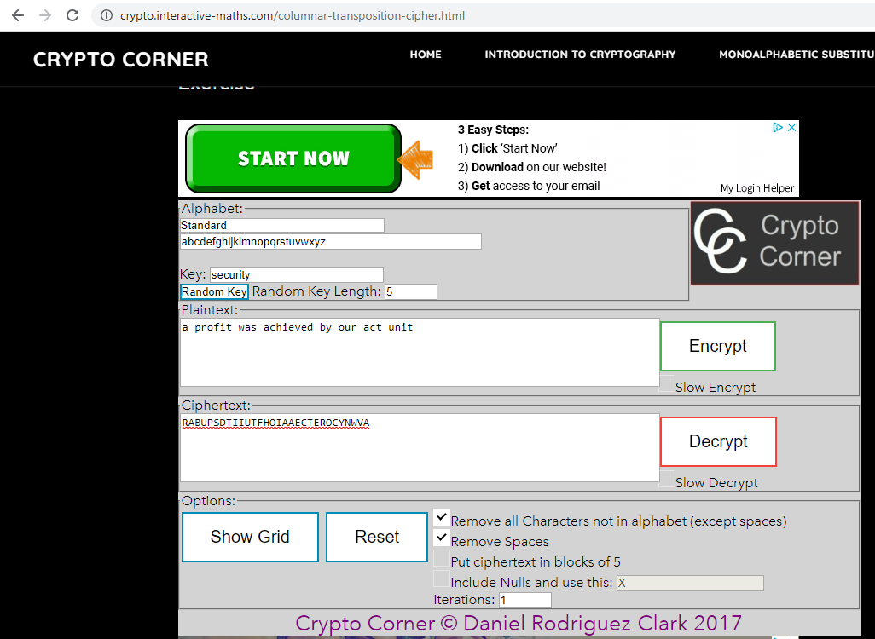
How would you apply the transposition method using the key: SECURITY ?
Transform the key into a numeric representation based on alphabetic order:
Lay out the plaintext in columns aligned with the key:
Reorganize the columns based on alphabetical order, collect data in row order: rabupsdtiiutfhoiaaecter_ocynwva_
https://crypto.interactive-maths.com/columnar-transposition-cipher.html

Slide 45
Dichotomies is cryptography
Symmetric versus Asymmetric
Stream versus block
2-way functions versus 1-way functions

Slide 46
Symmetric versus asymmetric algorithms
Symmetric cryptography
Use a copied pair of symmetric (identical) secret keys
The sender and the receive use the same key for encryption and decryption functions
Asymmetric cryptography
Also know as “public key cryptography”
Use different (“asymmetric”) keys for encryption and decryption
One is called the “private key” and the other is the “public key”

Slide 47
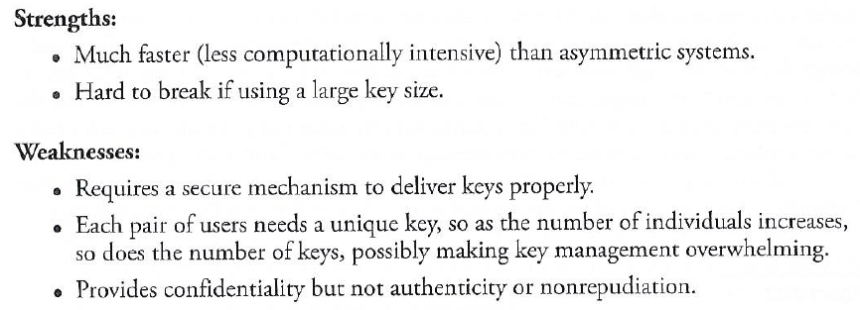
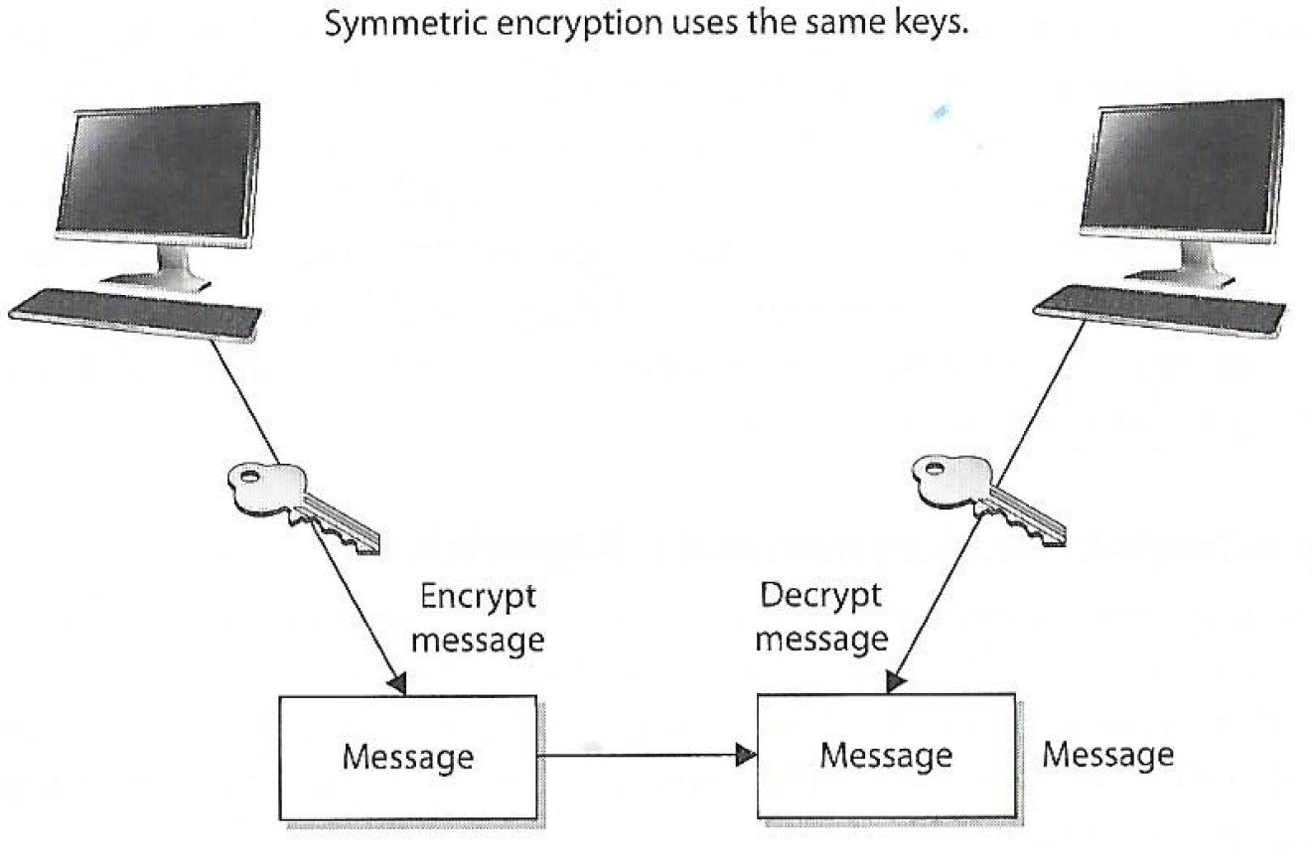
Symmetric cryptography
Symmetric cryptography is 1,000 times faster than Asymmetric cryptography
Two types: Stream and Block Ciphers
Stream Ciphers treat the message a stream of bits and performs mathematical functions on each bit individually
Block Ciphers divide a message into blocks of bits and transforms the blocks one at a time

Slide 48
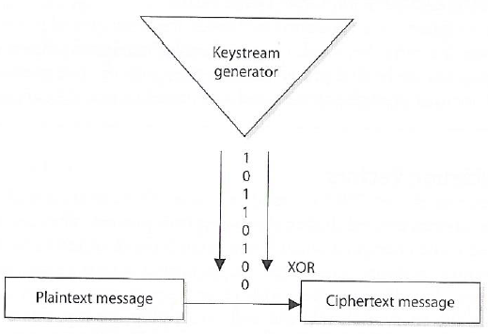
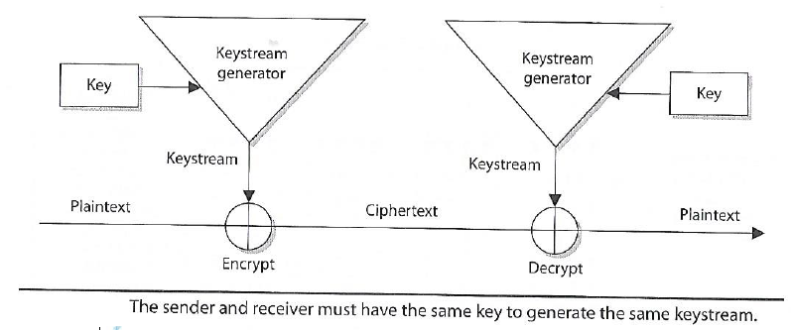
Symmetric Stream Ciphers
Pseudo-random number generator (PRNG)
Easy to implement in hardware
Used in cell phones and Voice Over Internet Protocol
Wi-Fi access points (like the one on the classroom ceiling) and cell phone use stream ciphers to encrypt/decrypt data they send and receive
Harris, S. and Maymi, F. (2016) All-In-One CISSP Exam Guide, McGraw Hill Education

Slide 49
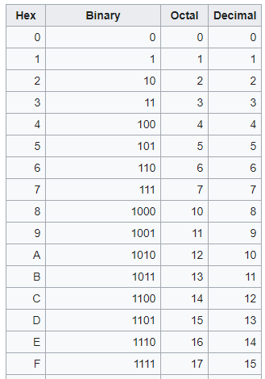
One more thing…
Hexadecimal ("hex“) is a number system made up of 16 symbols (base 16)
Our standard numeral system, decimal (base 10) uses 10 symbols: 0,1,2,3,4,5,6,7,8,9
Hexadecimal uses 16 symbols: 0,1,2,3,4,5,6,7,8,9,A,B,C,D,E,F
There are no numerical symbols that represent values greater than 9, so English alphabet letters are used
For example: Hexadecimal A = decimal 10, and Hexadecimal F = decimal 15
Humans mostly use the decimal system, probably because humans have ten fingers on our hands
Computers only have on and off, called a binary digit (or bit)
A binary number is just a string of zeros and ones, e.g. 11011011
For convenience, engineers working with computers tend to group bits together
In earlier days, such as the 1960s, they would group 3 bits at a time, 3 bits, each being on or off, can represent the eight numbers from 0 to 7:
000 = 0; 001 = 1; 010 = 2; 011 = 3; 100 = 4; 101 = 5; 110 = 6 and 111 = 7. This is called octal
As computers got bigger, it was more convenient to group bits by four instead of three to double the numbers that the symbol would represent; giving it 16 hexadecimal values instead of eight
In computer jargon four bits make a nibble (sometimes spelled nybble). A nibble is one hexadecimal digit, written using a symbol 0-9 or A-F
Two nibbles make a byte (8 bits). Most computer operations use the byte, or a multiple of the byte (16 bits, 24, 32, 64, etc.). Hexadecimal makes it easier to write these large binary numbers.
To avoid confusion with decimal, octal or other numbering systems, hexadecimal numbers are sometimes written with a "h" after or before the number. For example, 63h and 0x63 mean 63 hexadecimal
https://simple.wikipedia.org/wiki/Hexadecimal

Slide 50
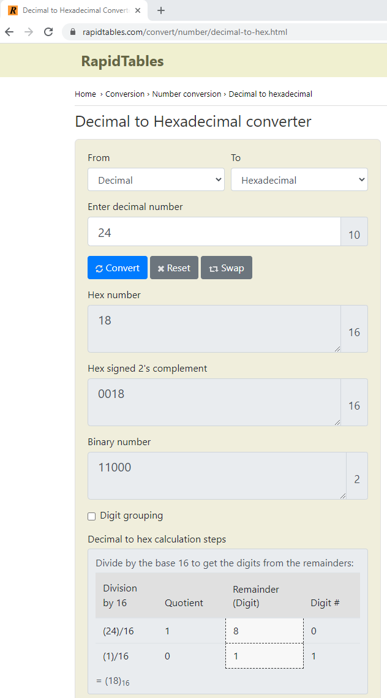
One more thing…

Slide 51
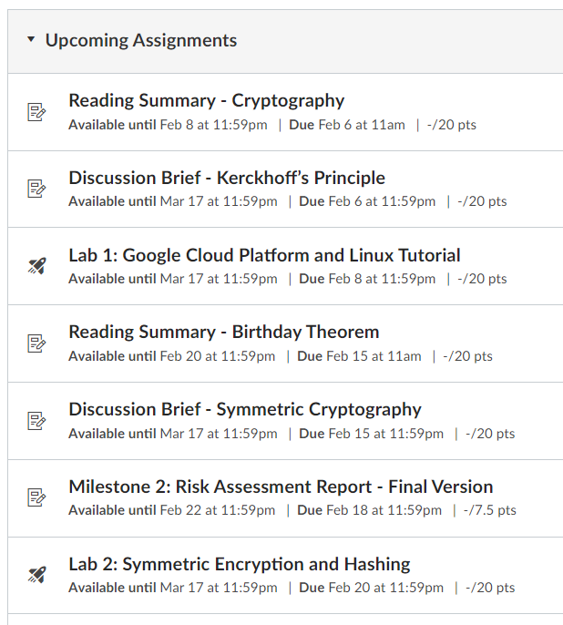
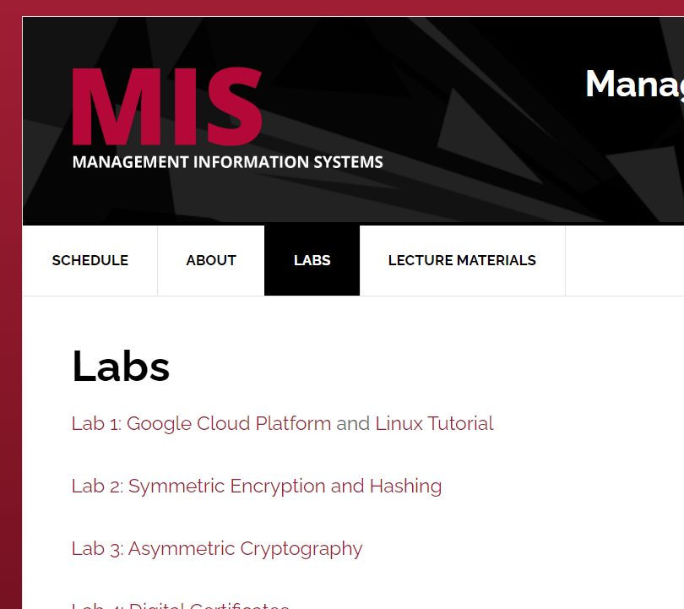
Symmetric Encryption Lab
https://security-assignments.com/labs/lab_hashing_and_symmetric_encryption.html
Today’s lecture should help you do “Part 1” of the lab
Next class we will cover hashing and equip you to finish “Part 2”

Slide 52
Agenda
Cryptography terminology
Substitution
Transposition
Symmetric key cryptography
Symmetric stream cryptography
Next: Symmetric Encryption Lab

