Slide 1
Managing Enterprise Cybersecurity
MIS 4596
Class 1

Slide 2
Agenda
Instructor
Course overview
Introduction
Need for Cybersecurity Professionals

Slide 3
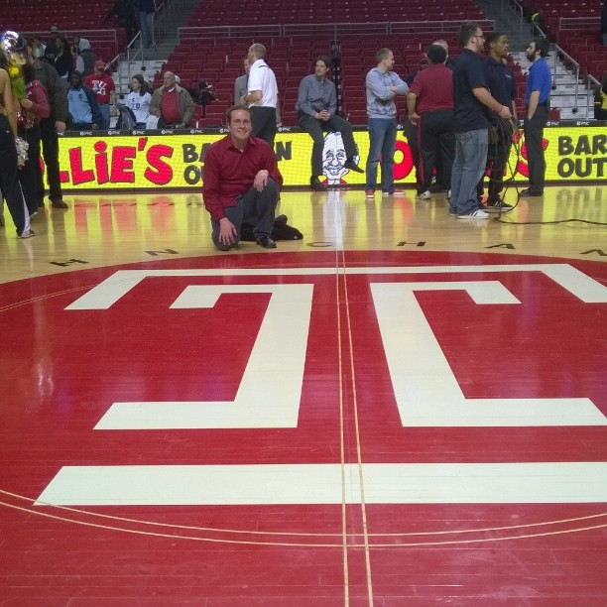



Darin Bartholomew
MIS ‘14, MS-ITACS ’17
Vanguard 7 years
  IAM Multicloud Manager
  DevSecOps Manager and PM
  Crew mobile productivity security PM
  Third Party Security
Systems analyst at Temple 2 years
CISSP, CRISC
Temple Football and Basketball season ticket holder
Huge racing fan (I watched Formula 1 before drive to survive existed)
Office hours – After class (Tue,Thur) 5-6PM Speakman 206E or by appointment
FOX
MIS

Slide 4
Agenda
Instructor
Introduction
Course overview
Need for Cybersecurity Professionals

Slide 5
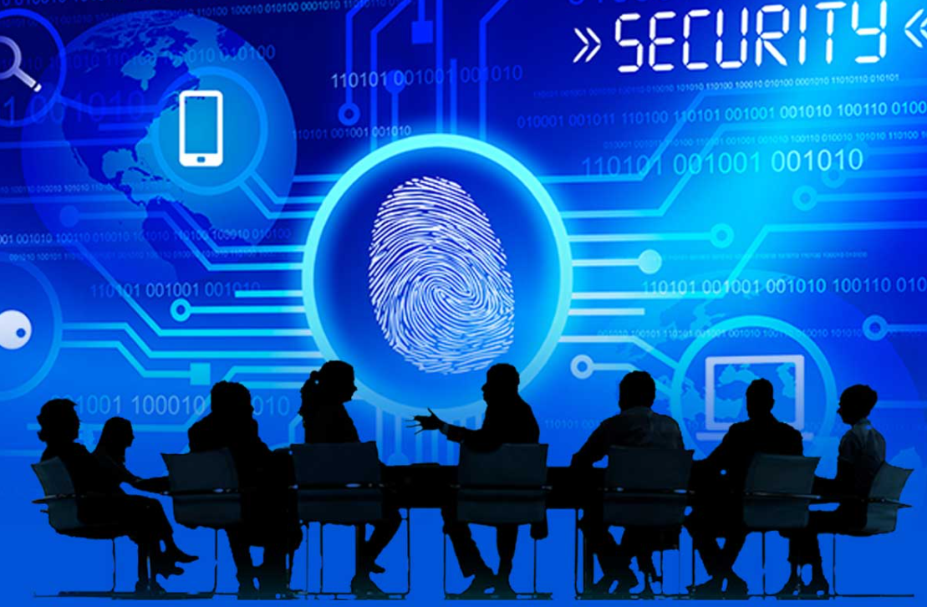
Course objective
This course is a broad introduction to the managerial issues of information security
Because security is multifaceted, the topics of the class range widely, including technical, managerial, physical, and psychological issues
A key objective of the class is to develop a security mindset, in which one learns to think like an attacker for ways to exploit a system

Slide 6
Course learning goals
Develop a security mindset
  Learn to think like a security professional—how to identify threats like an attacker, and how to model and mitigate those threats.
Gain a working knowledge of methods to protect data
  Gain a working knowledge of modern methods of protecting data: encryption, hashing, confidentiality, authentication, integrity, non-repudiation, certificates, and IP security.
Learn methods of attack and defense
  Learn methods of attacking systems and how to protect against those methods of attacks.
Appreciate the broad disciplines required for IS security
  Appreciate the broad disciplines required for information security to work. We'll cover subjects as comprehensive as cryptology, physical security, psychology, and management, based on based on:
  NIST Cybersecurity Framework Version (https://www.nist.gov/cyberframework/framework)
  NIST Risk Management Framework (https://csrc.nist.gov/projects/risk-management/about-rmf)
Communicate security risks and responses effectively
  A substantial portion of the course will be devoted to practicing capable, proficient written and verbal communication of cybersecurity risks, threats, mitigations, and responses to relevant stakeholders for their decision making.

Slide 7
Course learning goals
University-Designated Writing-Intensive (W) Course
  This is a University-designated writing-intensive course, and by passing this course, students will fulfill the University requirement that “All undergraduate students must complete at least two writing-intensive courses for a total of at least six credits” (https://bulletin.temple.edu/undergraduate/academic-programs/writing-intensive-courses/).
  This course requires a substantial amount of writing for individual assignments throughout the semester.
  There is no group project in this class; all deliverables are individual assignments. There will be no mid-term and final exams.

Slide 8
Course learning goals
Writing-Related Goals
Students will learn how to write about highly technical cybersecurity topics for a non-technical audience.
Students will learn how to explain business implications of cybersecurity risks, threats, mitigations, and responses.
Students will learn how to organize their writing for impact and actions.
Students will learn how to produce an executive summary in a concise manner for executive clients/superiors.
Information Literacy Goals
Students will learn how to discover relevant information on cybersecurity risks, vulnerabilities, and mitigations from credible, reliable, and authoritative sources in a self-directed manner.
Students will learn how to deploy these information resources effectively in their project reports to advise on cybersecurity risks, vulnerabilities, and mitigations.
Students will develop the following information literacy skills with in-class instructions and activities:
  How to identify credible and authoritative sources for cybersecurity matters
  How to discover relevant information resources
  How to incorporate the information in their writing assignments

Slide 9
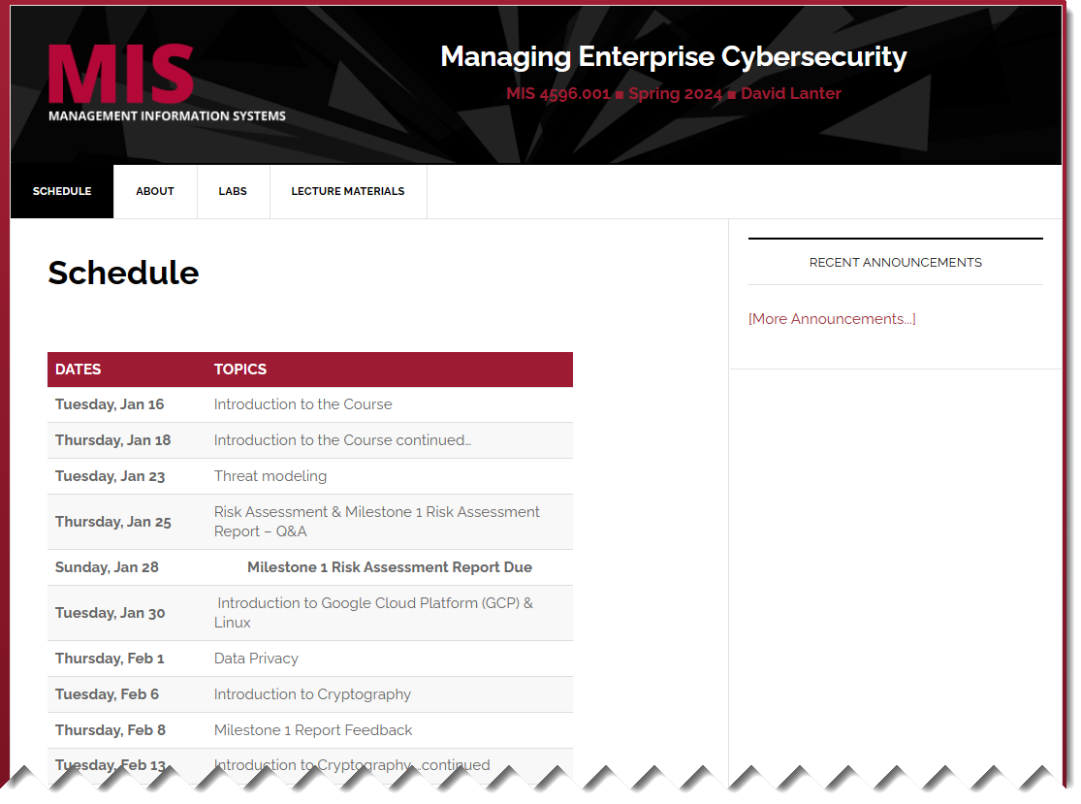
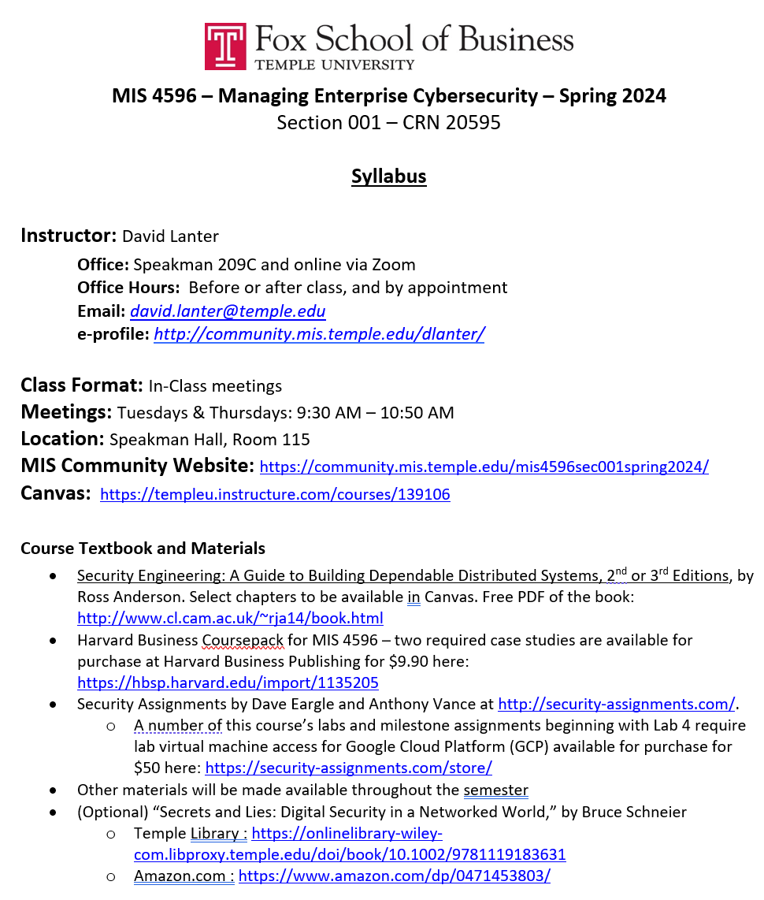
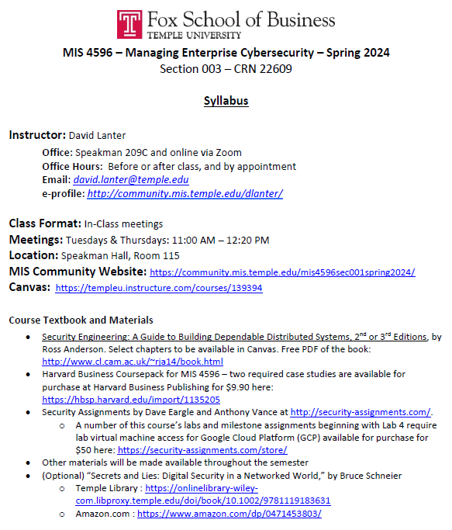
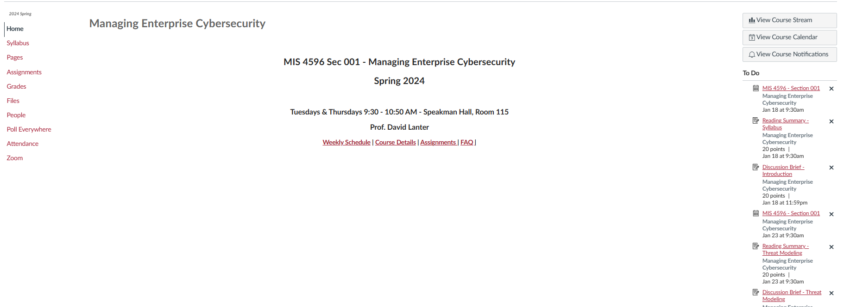
Syllabus and Course websites

Slide 10
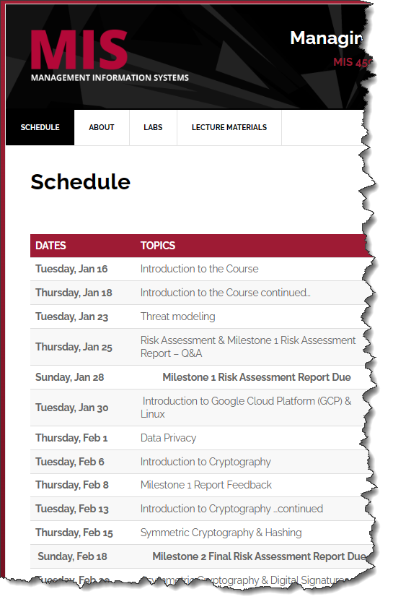
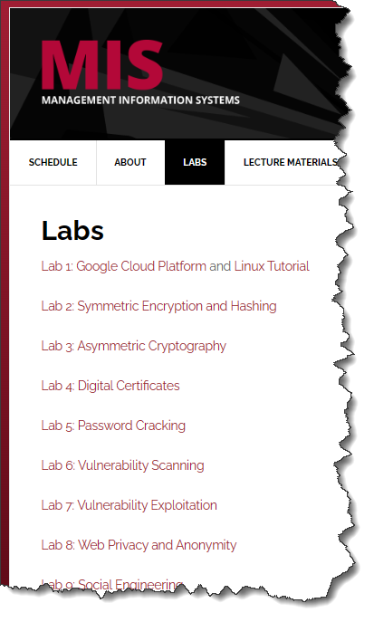
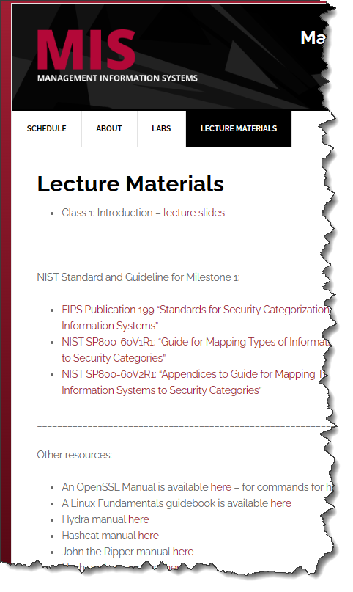
MIS Community Web Site provides easy access to…
https://community.mis.temple.edu/mis4596sec002fall2024/
Updated course schedule
Lab links (also found in Canvas assignments)
Lecture notes and supporting material

Slide 11
Grading

Slide 12
Milestones
Milestone Projects (40%)
Students will complete Milestone projects that utilize hands-on skills and apply knowledge from class discussions and lab activities. Each will require submission of a written report for superiors or consulting clients to advise them of important cybersecurity concerns.
There are four milestone project reports that will help students develop professional written and verbal cybersecurity communication skills.
Milestone 1: Draft Risk Assessment Report
Milestone 2: Final Risk Assessment Report
Milestone 3: Penetration Test Findings Report
Milestone 4: Penetration Test with Recommendations Report
Late submissions are subject to a 20% deduction in points per each 12 hours late.
Note: Completing lab assignments 1-7 during the weeks they are assigned will provide you with necessary knowledge and skills that will enable you to complete Milestones 3 & 4.

Slide 13
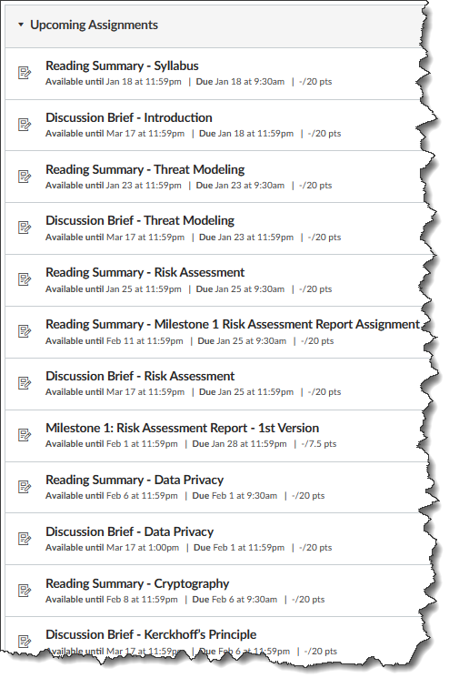
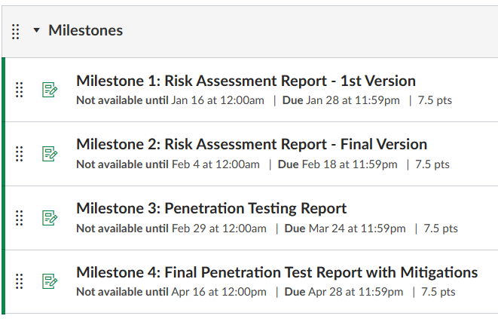
Milestones are found in Canvas
Section 002: Managing Enterprise Cybersecurity (instructure.com)

Slide 14
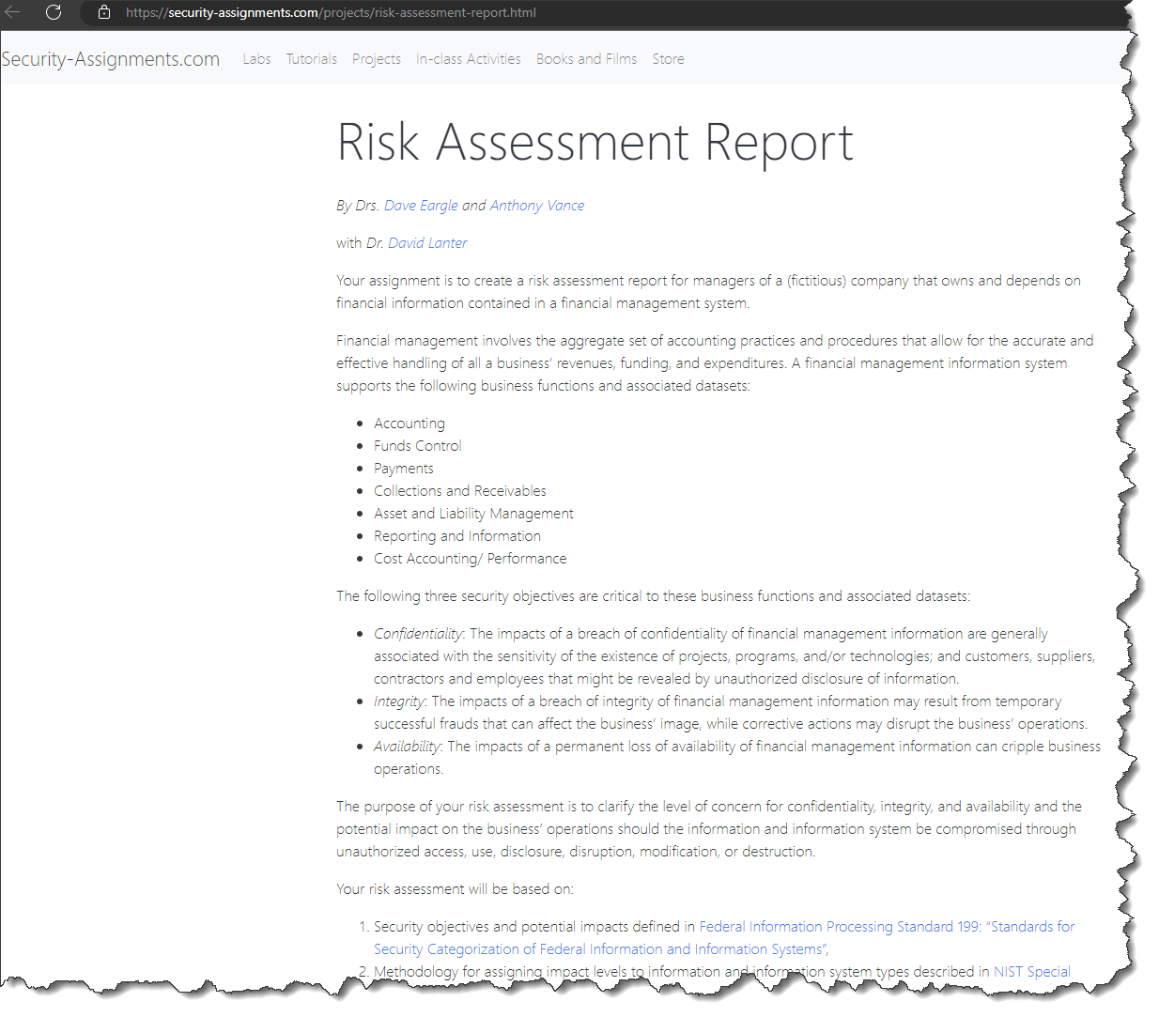
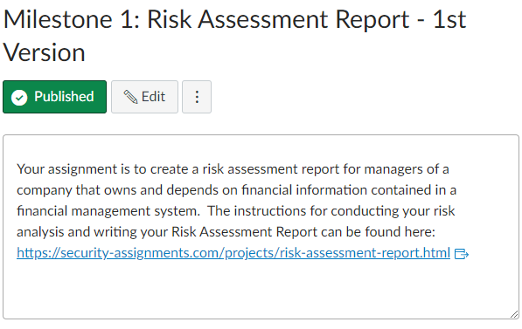
Milestones are found in Canvas

Slide 15
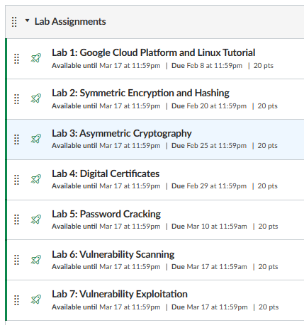
Labs
Lab Assignments (25%)
These are hands-on learning activities that are completed by students outside of class.
There are 9 labs. It is strongly recommended to complete each lab within the week that the corresponding topic is covered in class throughout the semester.
Notes:
  Completing Lab Assignments 1-7 will provide you with knowledge and skills necessary for completing Milestones 3 & 4.
  Completing Milestones 2 & 3 will provide you with the knowledge necessary for completing your Milestone 3 & 4 report

Slide 16
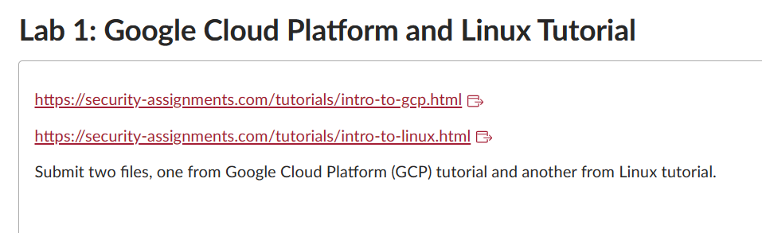
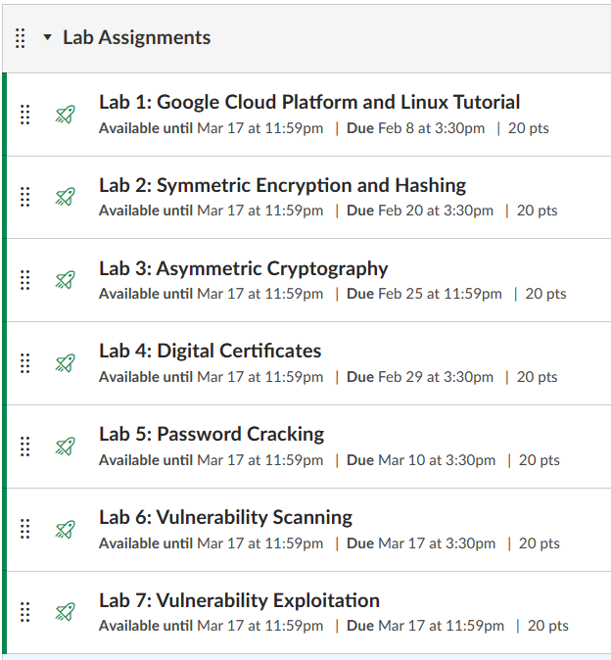
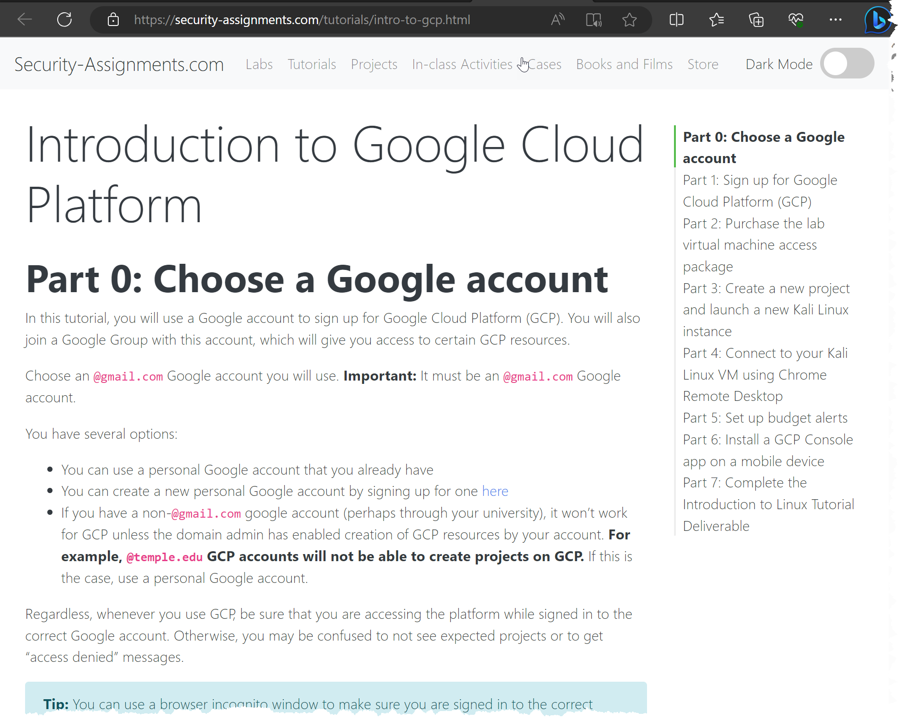
Labs are found in Canvas

Slide 17

Labs
Lab Peer Support:
  Students are encouraged to help each other complete lab and milestone assignments.

Slide 18
Grading

Slide 19
Reading Summaries (10%)
Students are to summarize assigned readings (news articles, textbook chapters, or Harvard Business cases) before each week’s class.
Up to 200 words in each summary
Due before the class on which the reading is assigned
No late submission will be accepted
Goal: This is to make sure students read assigned readings which promote more effective in-class discussions
Grading Criteria: Clarity, Comprehensiveness, Spelling Grammar, and Organization

Slide 20
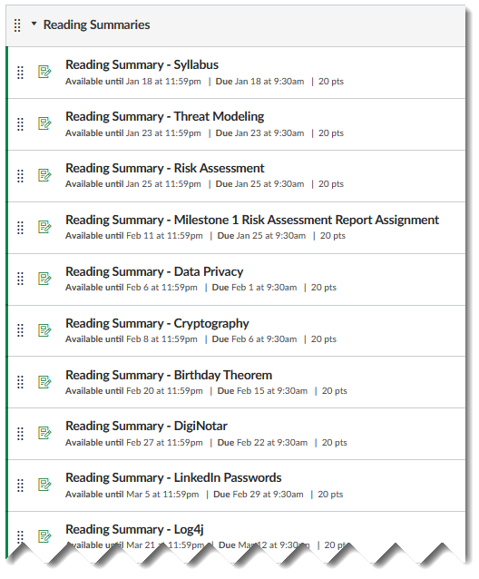
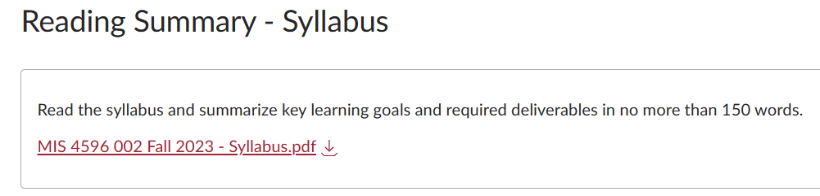
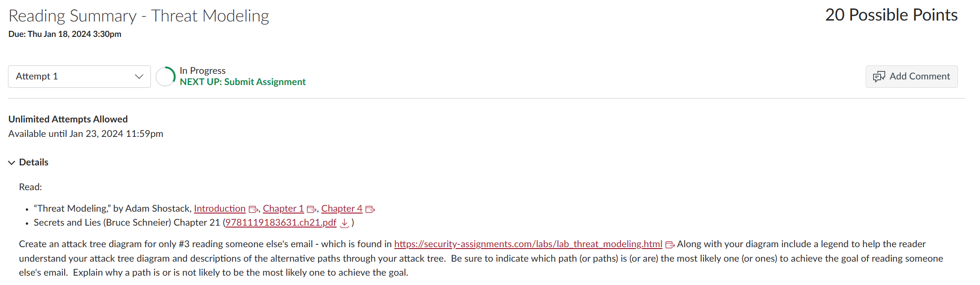
Reading Summaries are found in Canvas

Slide 21
Discussion Briefs (10%)
After each week’s class, students are to write a short write-up that is based on in-class lecture & discussions.
At least 150 words and no more than 300 words in each brief
Students can skip up to two discussion briefs throughout the semester.
It is strongly recommended that you write up your discussion brief after the associated class.
No late submission is to be accepted.
Grading Criteria: Clarity, Comprehensiveness, Spelling, Grammar, and Organization

Slide 22
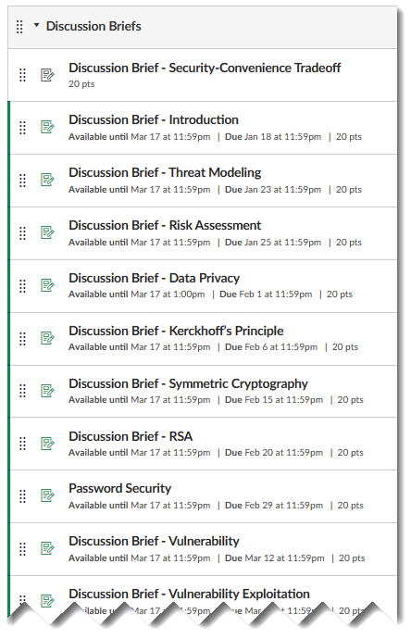
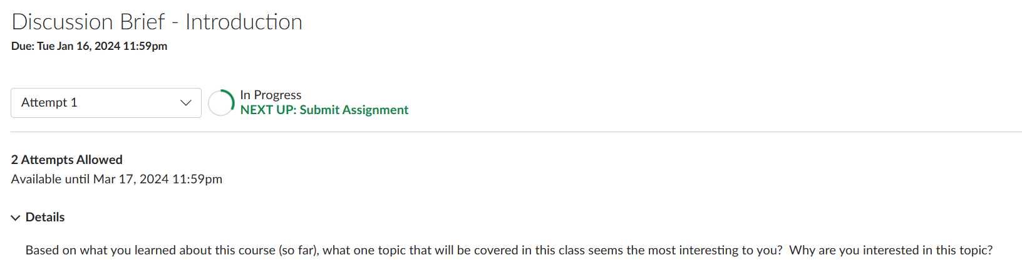
Discussion Briefs are found in Canvas

Slide 23
In-Class Participation (15%)
In-Class Participation (15%)
Attendance and in-class participation are key components of the learning experiences
It is strongly encouraged to read/review assigned materials (readings, case studies, labs, milestone assignment, etc.) prior to class to enable you to actively take part in class discussions and activities

Slide 24
Technology requirements
Information Security Assignments: Labs & Milestones 3 & 4
  This course will use lab and milestone project assignments at http://security-assignments.com/, developed by Dave Eargle and Anthony Vance.
  Access to the resources in this site will require subscription with a fee. A number of this course’s labs and milestone assignments beginning with Lab 4 require lab virtual machine access for Google Cloud Platform (GCP) available for purchase for $50 here: https://security-assignments.com/store/
Google Cloud Platform (GCP)
  This course uses GCP to run tools and virtual machines necessary to complete assignments.
  New accounts on GCP receive a $300 credit for no cost.
  Students should be able to complete this class without going over the credit and incurring cost.
  The instructor will have the students launch a Kali virtual machine instance on GCP from which they can complete class assignments.
  The students will be able to remotely connect to the instance using Chrome Remote Desktop, which works just like a browser tab. To help reduce the risk of incurring costs above the free $300 students should manage their GCP accounts and shut down the machine between uses.

Slide 25
Agenda
Instructor
Course overview
Introduction
Need for Cybersecurity Professionals

Slide 26
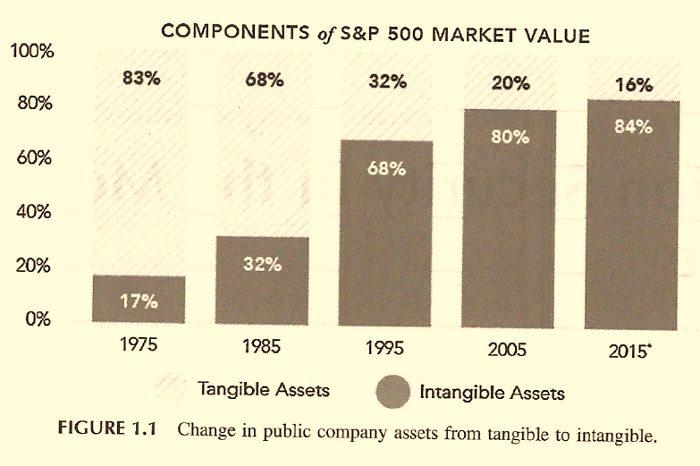
The value of business’ data is at a peak
“A generation ago the asset base of US public companies was more than 80% tangible property” (e.g. raw materials, real estate, railroad cars…)
“Today… intangibles… account for more than 80% of listed company value”
Computers and Information Security Handbook, J. Vacca, 2017, pp. 3-4

Slide 27

Transformation of Information Security
1970 data security examples
Today’s data security must consider
Guarding the photocopier
Watching who went in and out of the front door
Devices able to grab gigabytes of data and move them anywhere in the world in an instant
Laptops, tablets and smartphones with direct connection to company data are endpoints in a global network, creating thousands to millions of “front doors” leaving industry at its most vulnerable

Slide 28

What one thing about information security has not changed over the years?
Human beings remain the primary vector for loss of corporate value
AND
Humans also control the processes and technologies central to information security function that preserves corporate value

Slide 29

Key concepts
Information and Information System security = Cybersecurity
…means protecting information and information systems from unathorized:
  Access, use, disclosure of information Confidentiality
  Unauthorize modification of information Integrity
  Disruption and destruction of information Availability

Slide 30

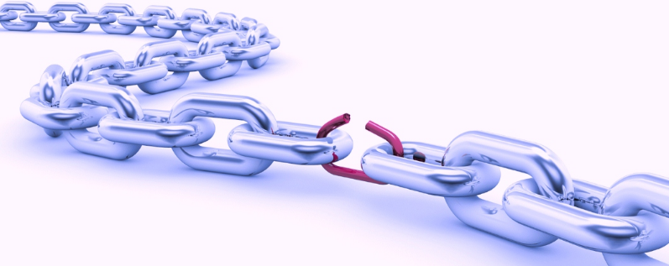


Key concepts
Threat | Potential for the occurrence of a harmful event such as a cyber attack
Vulnerability | Weakness that makes targets susceptible to an attack
Risk | Potential of loss from an attack
Risk Mitigation | Strategy for dealing with risk

Slide 31
What is a threat?
Physical
Technical
Anything that has the potential to lead to unauthorized:
  Access, use, disclosure
  Modification
  Disruption or Destruction
Administrative
of an enterprises’ information or information systems

Slide 32



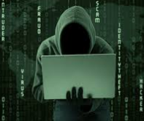
What is a threat…
Threats to information and information systems include:
  Purposeful attacks
  Human errors
  Structural Failures
  Environmental disruptions

Slide 33
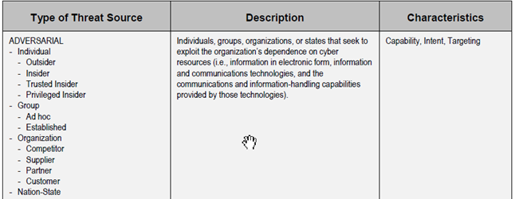
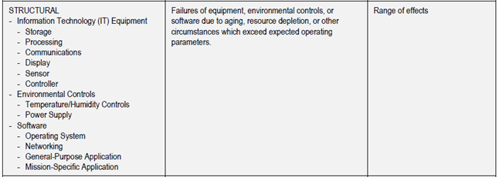
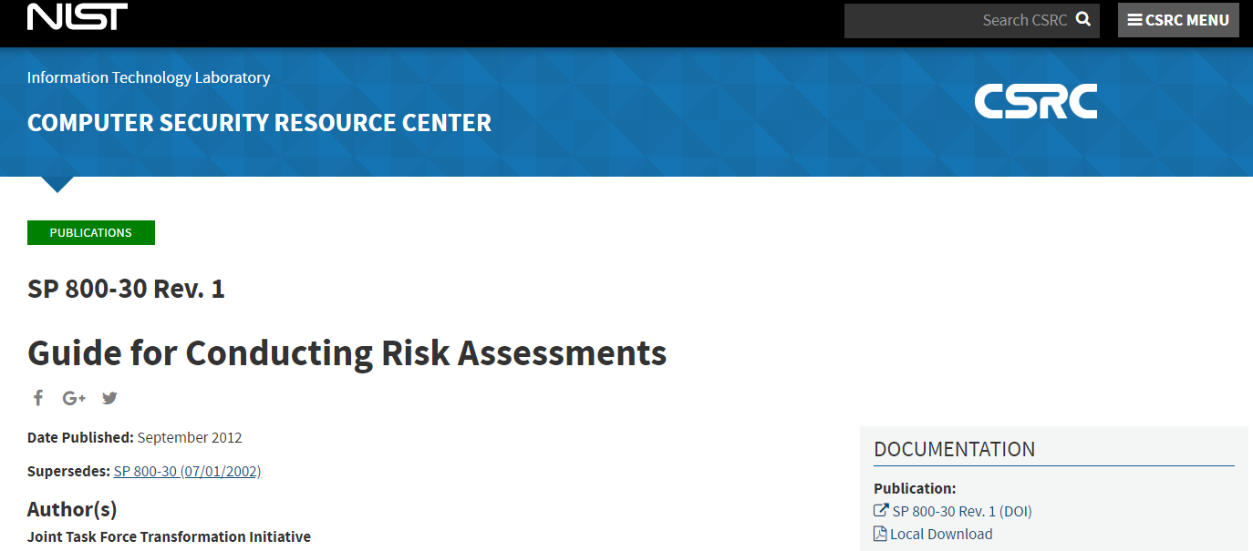
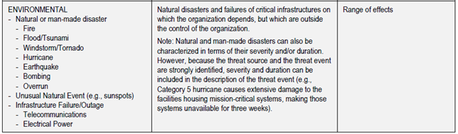
Taxonomy of threat sources
Adversarial
Accidental
Structural
Environmental
https://csrc.nist.gov/publications/detail/sp/800-30/rev-1/final

Slide 34
Adversarial Threats
“Security involves making sure things work, not in the presence of random faults, but in the face of an intelligent and malicious adversary trying to ensure that things fail in the worst possible way at the worst possible time.”
– Bruce Schneier

Slide 35
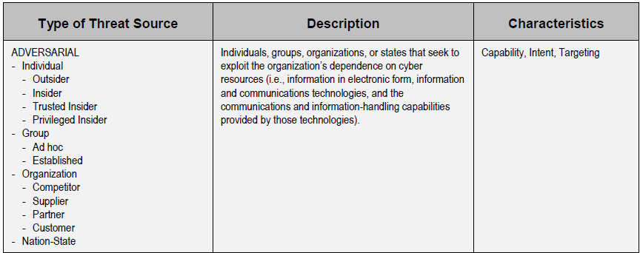

Slide 36
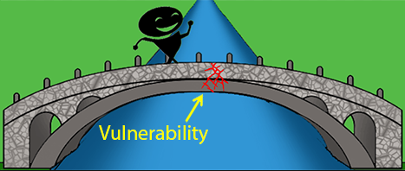
What is a Vulnerability?
What is a Vulnerability?

Slide 37
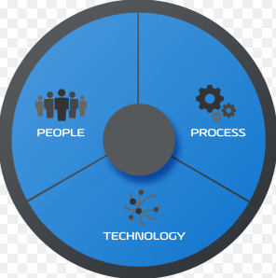
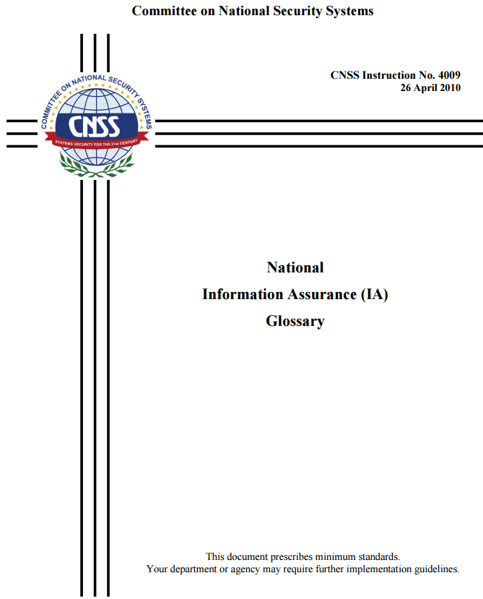

What is a Vulnerability?
Any unaddressed susceptibility to a Adversarial, Accidental, Structural or Environmental threat is an information security vulnerability

Slide 38
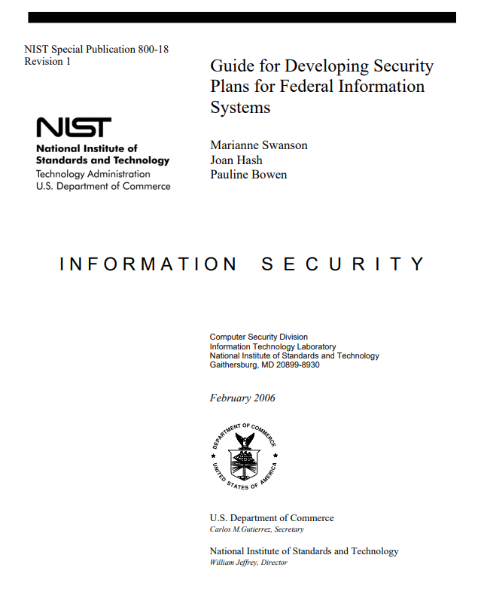
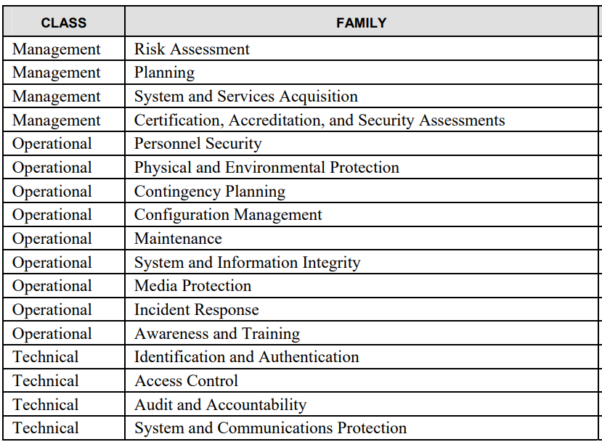
Vulnerabilities are…
Inadequacies in any of these areas which can lead to negative impacts:
Cybersecurity Controls protect against impacts

Slide 39
Vulnerability to what ?

Slide 40
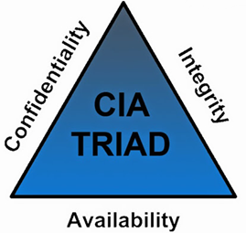
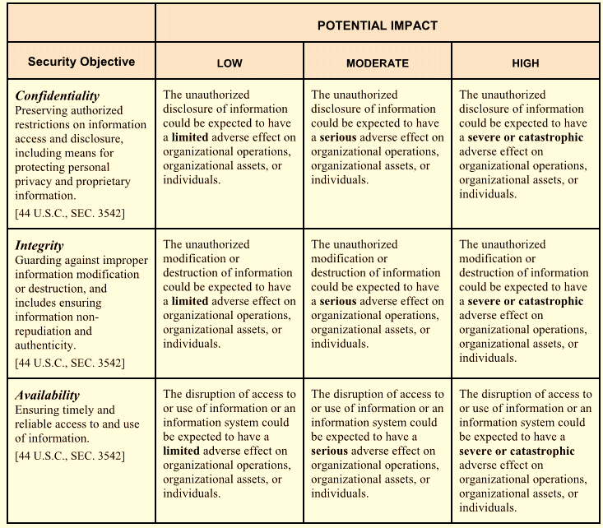
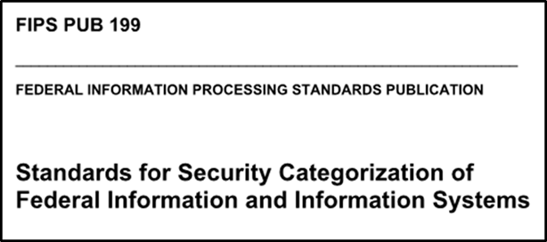
FIPS 199 Standards: Security objectives relate to avoiding negative impacts
Impact ratings:
  High: Severe or catastrophic adverse effect
  Moderate: Serious adverse effect
  Low: Limited adverse effect

Slide 41

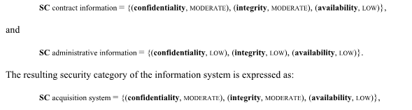
Security Categorization Standard is used to determine the security categorization of an information system that contains, processes and/or transports information
…remember the impact ratings:
High impact: Severe or catastrophic adverse effect
Moderate impact: Serious adverse effect
Low impact: Limited adverse effect
Example with multiple information types:

Slide 42
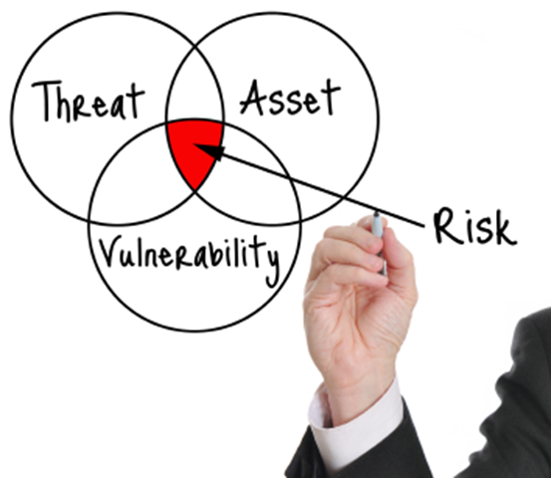
What are examples of Information security risks ?
Economic impact and financial loss
  Replacement costs (software, hardware, other)
  Backup restoration and recovery costs
  Reprocessing, reconstruction costs
  Theft/crime (non-computer, computer)
Loss of life
Losses due to fraud, theft, larceny, bribery
Impact of
  lost competitive edge
  lost data
  lost time
  lost productivity
  lost business
Bankruptcy
Business interruption
Frustration
Ill will
Injury
Impacts of inaccurate data

Slide 43
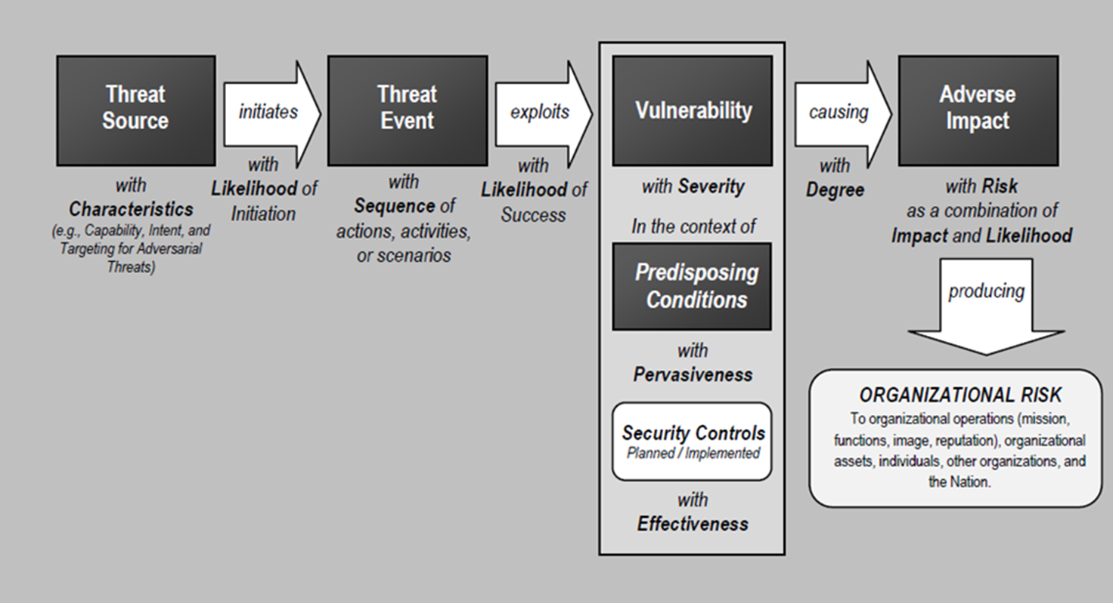
Risk analysis with an IT risk model
An IT risk model
Type | Threat Source | Can exploit this vulnerability | Resulting in this impact
Physical | Fire | Lack of fire extinguishers | Facility and computer damage, and possible loss of life
Physical | Intruder | Lack of security guard | Broken windows and stolen computers and devices
Technical | Contractor | Lax access control mechanisms | Stolen trade secrets
Technical | Malware | Lack of antivirus software | Virus infection…
Technical | Hacker | Unprotected services running on a server | Unauthorized access to confidential information
Administrative | Employee | Lack of training | Unauthorized distribution of sensitive information
NIST SP 800-30r1 “Guide for Conducting Risk Assessments”, page 21

Slide 44
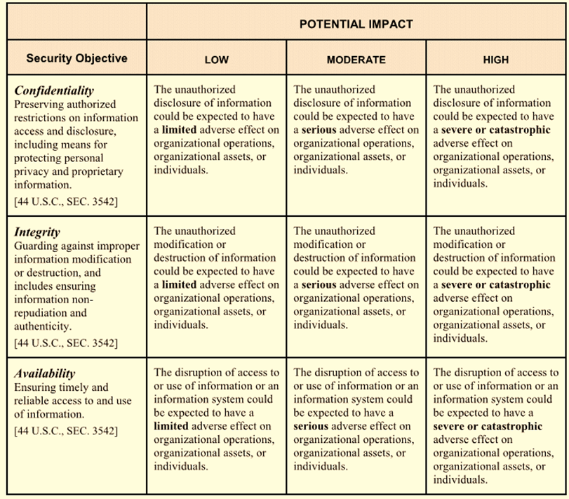

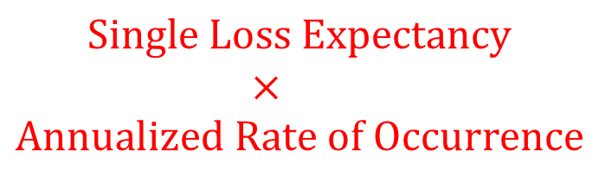
Cybersecurity Objectives
Qualitative Risk Assessment
Quantitative Risk Assessment
$$Annual Loss Expectancy =$$
$$Single Loss Expectancy$$
$$×$$
$$Annualized Rate of Occurrence$$

Slide 45
Course objectives
Explain cybersecurity as a key enterprise risk and how it can be managed
Understand methods used to identify, protect against, detect, respond to, and recover from cybersecurity threats
Use techniques of ethical hacking to perform penetration testing to assess vulnerabilities in information systems
Communicate risk in assessment reports that support management decisions

Slide 46
Risk Management Techniques
Once threats and risks are identified, each risk can be managed by:
  Avoidance
  Acceptance
  Transfer
  Mitigation (“Controls”)

Slide 47
Agenda
Instructor
Course overview
Introduction
Need for Cybersecurity Professionals

Slide 48
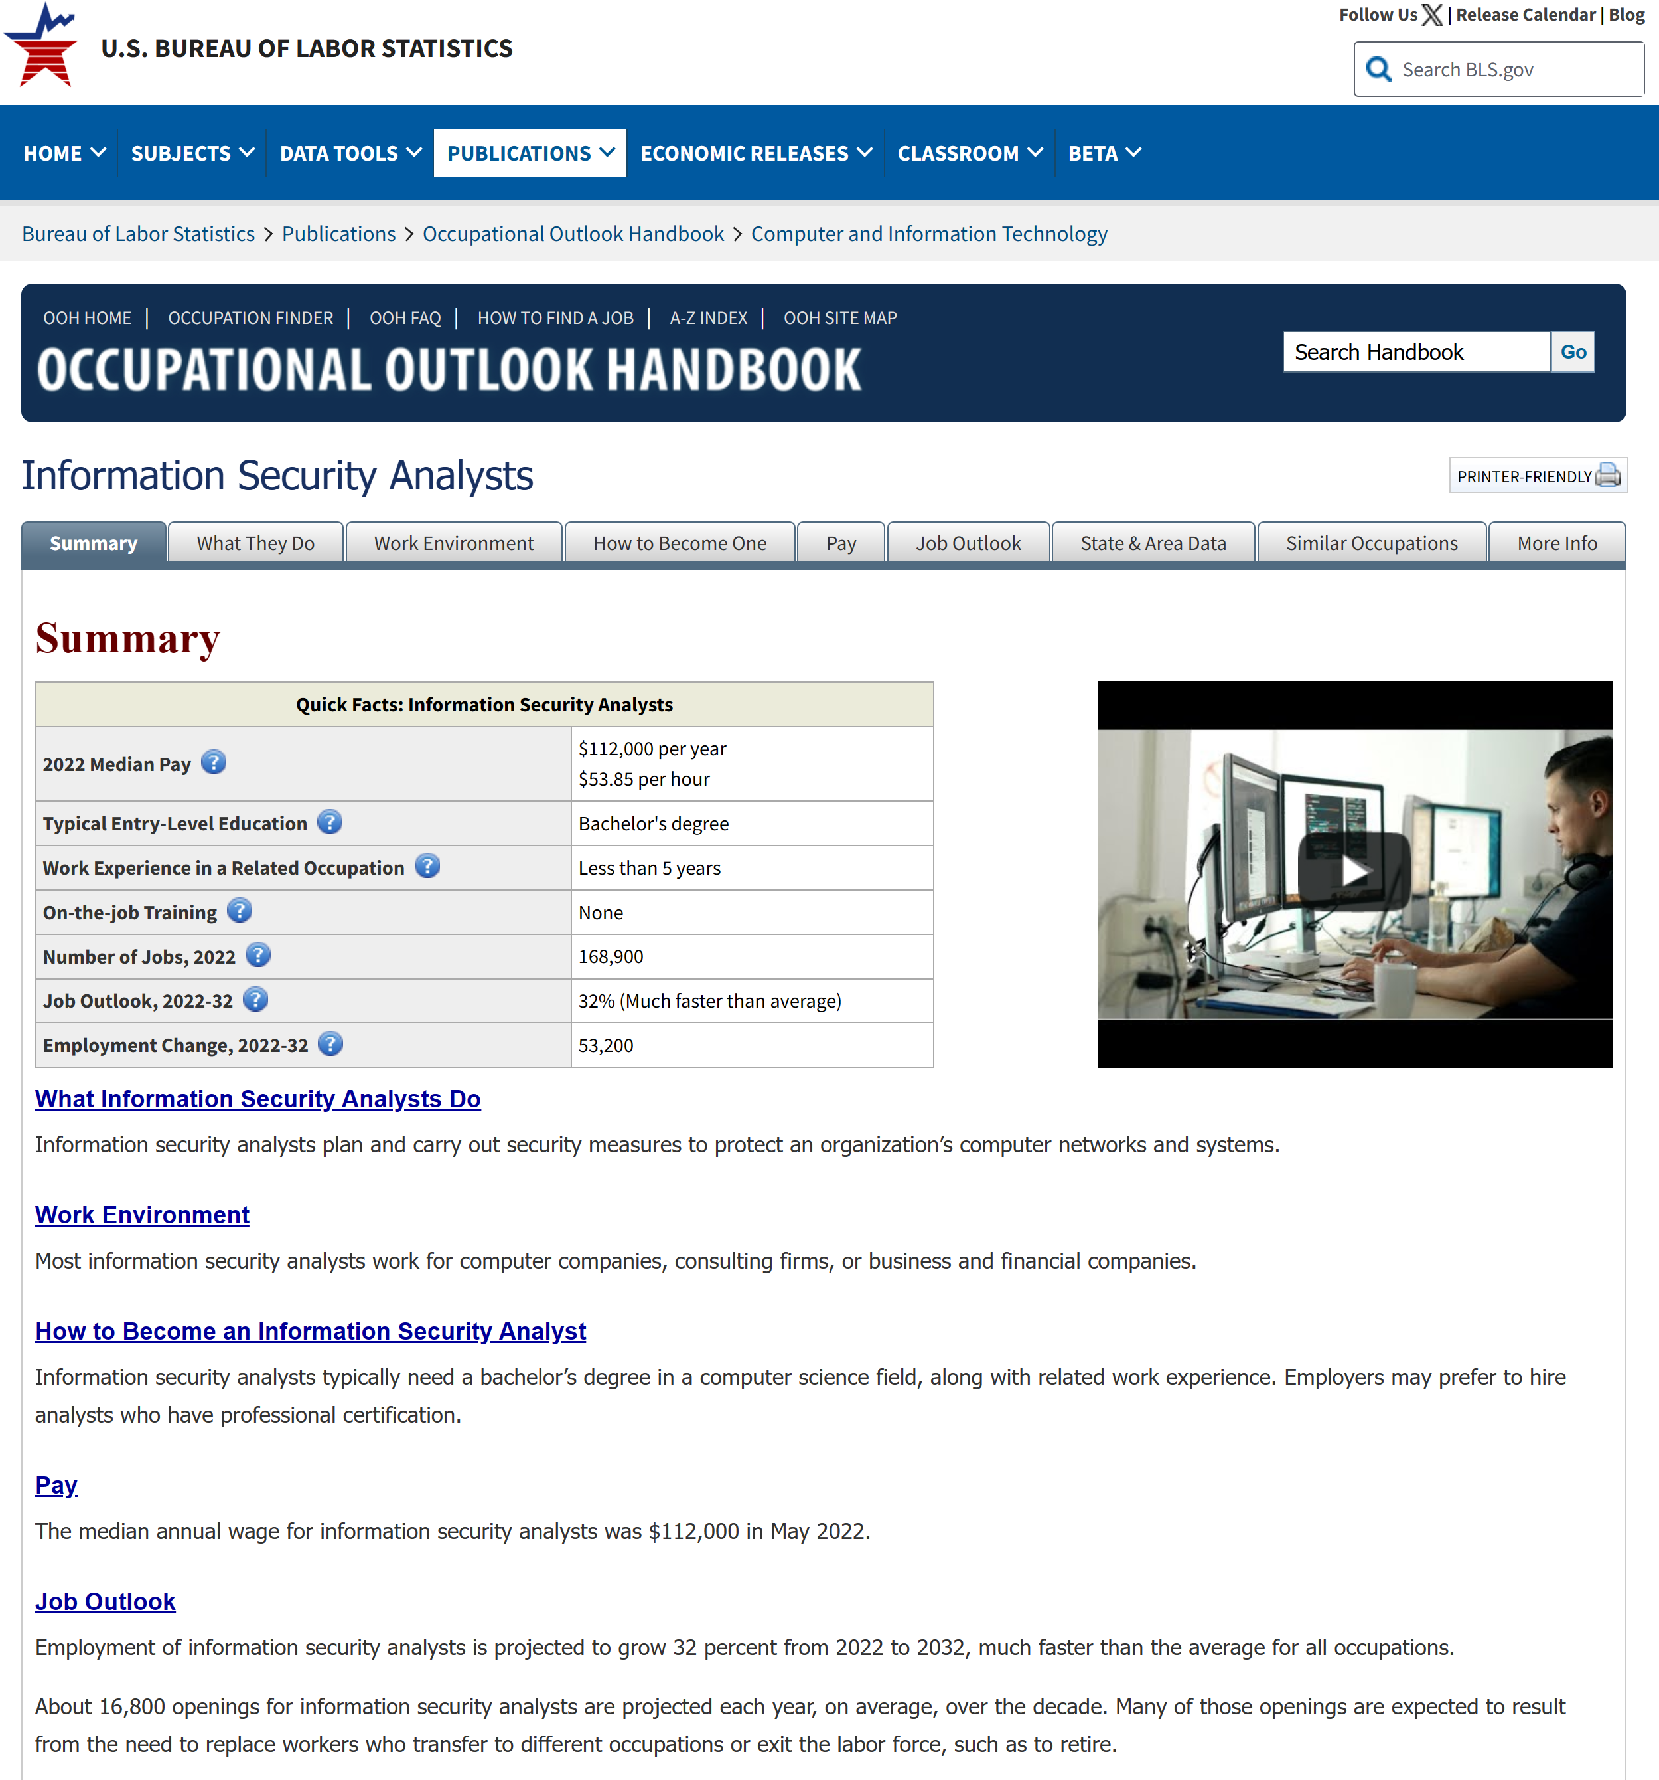
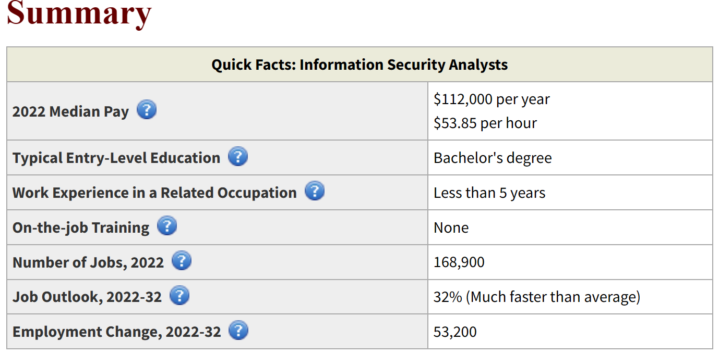
https://www.bls.gov/ooh/computer-and-information-technology/information-security-analysts.htm
Notes:
https://www.cnbc.com/2018/08/09/cybersecurity-jobs-non-technical-workers.html

Slide 49
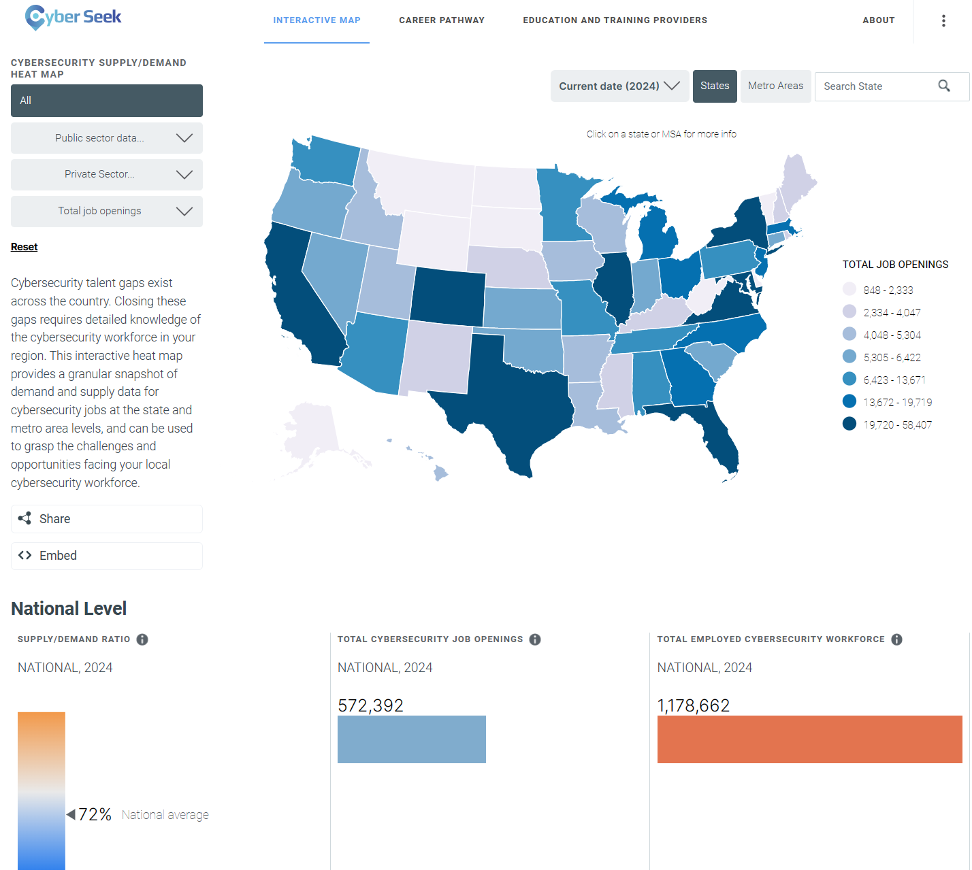
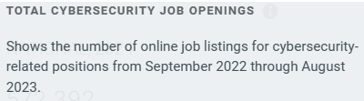
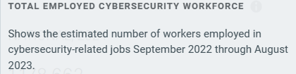
https://www.cyberseek.org/heatmap.html

Slide 50
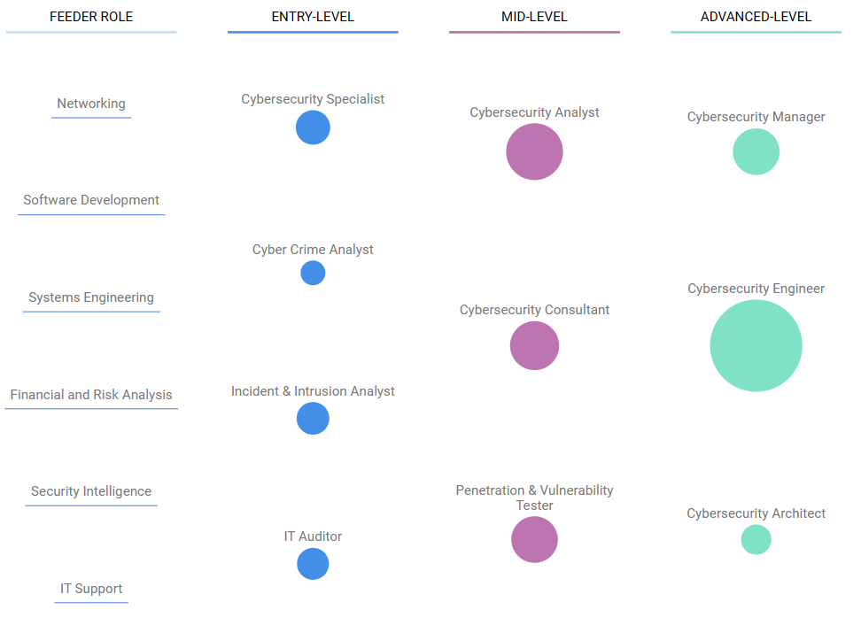
Example job types
http://www.cyberseek.org/pathway.html

Slide 51
Agenda
Instructor
Course overview
Introduction
Need for Cybersecurity Professionals

