Slide 1
Managing Enterprise Cybersecurity MIS 4596
Class 4

Slide 2
Agenda
Short history of computers, Unix and Linux
Introduction to the Google Cloud Platform
Next step… Linux tutorial

Slide 3
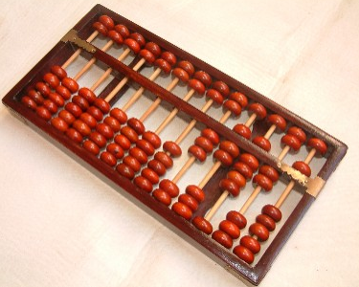
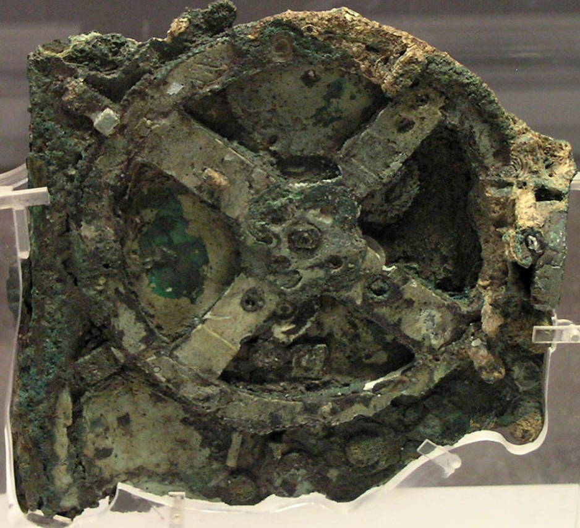
Information Systems Development – a brief history
Prior 1946 - Before “stored-program” digital computers
Devices were pure hardware and had no software - their computing powers were directly tied to their specific form and engineering
Computing as a concept goes back to ancient times
Beginning with devices such as the abacus
Calculating tool used in China, Europe, and Russia centuries before adoption of written Hindu-Arabic numeral system we use today
Continuing on through early examples of computing such as the Antikythera mechanism
Ancient Greek analog computer used as a calendar to predict eclipses and astronomical positions decades in advance
Wikipedia – History of Software

Slide 4
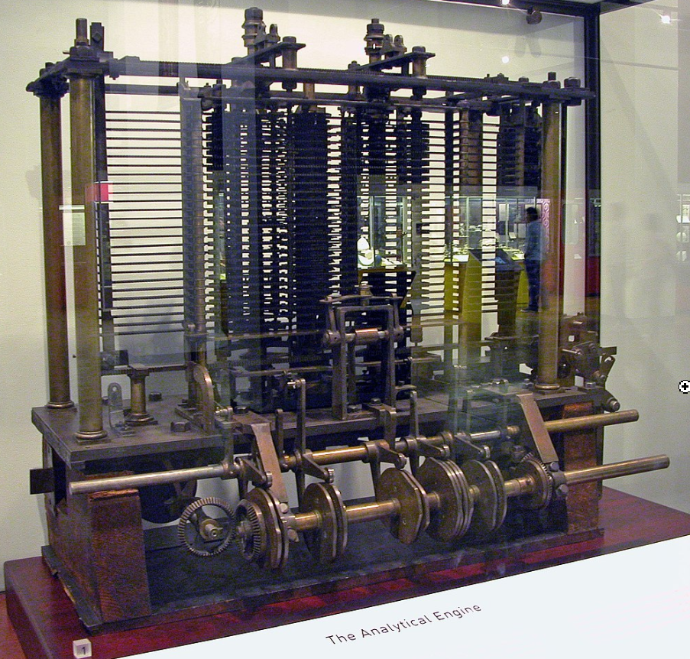
Information Systems Development – a brief history
Prior 1946 - Before “stored-program” digital computers
1837 – The Analytical Engine
First design for a general-purpose computer
Designed by English mathematician Charles Babbage
Incorporated:
Integrated memory
Arithmetic logic unit
Control flow in the form of conditional branching and loops
Logical structure essentially the same as the computer design that dominates in today’s electronic era
First known computer program was written by Ada Lovelace to implement Luigi Menabrea’s equations for generating a Bernoulli number sequence of rational numbers
The Analytical Engine predated the techniques of electrical engineering needed to run it
Wikipedia – History of Software

Slide 5
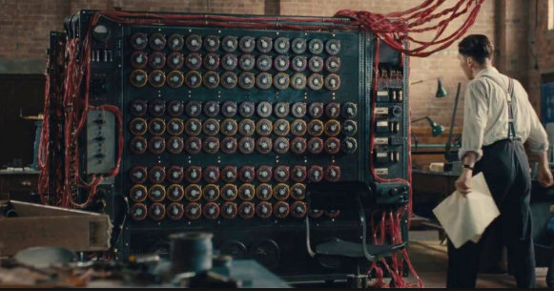
Information Systems Development – a brief history
Prior 1946 - Before “stored-program” digital computers
1935 – Alan Turing proposed the first modern theory of software
Software requires
A general-purpose processor - described as a Turing machine
Computer memory
In which reusable sets of routines and mathematical functions comprising programs can be stored, started, and stopped individually
This concept is recent in human history, led to the creation of the twin academic fields of computer science and software engineering
Wikipedia – History of Software

Slide 6
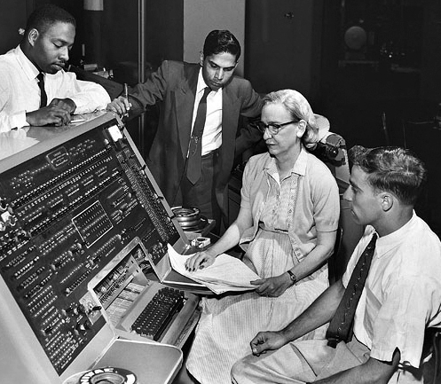
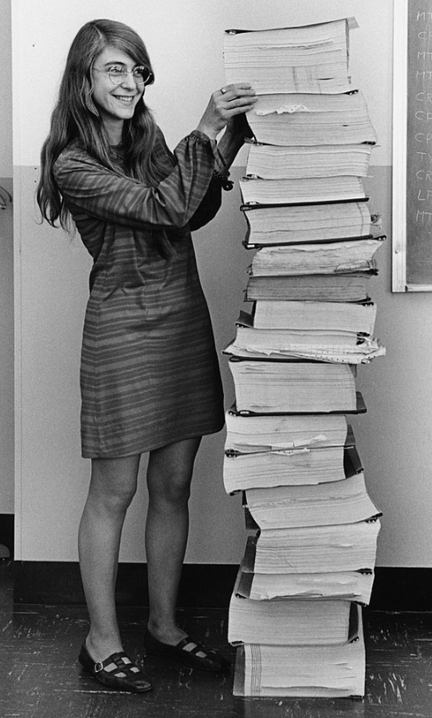
Information Systems Development – a brief history
1948 – 1979 Early days of computer software
1948 - Claud Shannon “Father of Information Theory” wrote A Mathematical theory of Communication and provided an outline for how binary logic could be implemented to program a computer
Subsequently, the first computer programmers used binary code to instruct computers to perform various tasks
1948 – Birth of Software Tim Kilburn at the University of Manchester UK wrote the first program code stored in an electronic memory to calculate the highest factor of an integer
1950’s – 1960’s Development of high-level computer languages Fortran, LISP, COBOL and BASIC allowed programs to be specified in an abstract way, independent of the precise details of the hardware architecture of the computer
Grace Hopper developed the “self-documenting” COBOL (COmmon Business Oriented Language)
Margaret Hamilton led development of the onboard flight software for NASA’s Apollo spacecraft coined the term “software engineering”
Wikipedia – History of Software

Slide 7
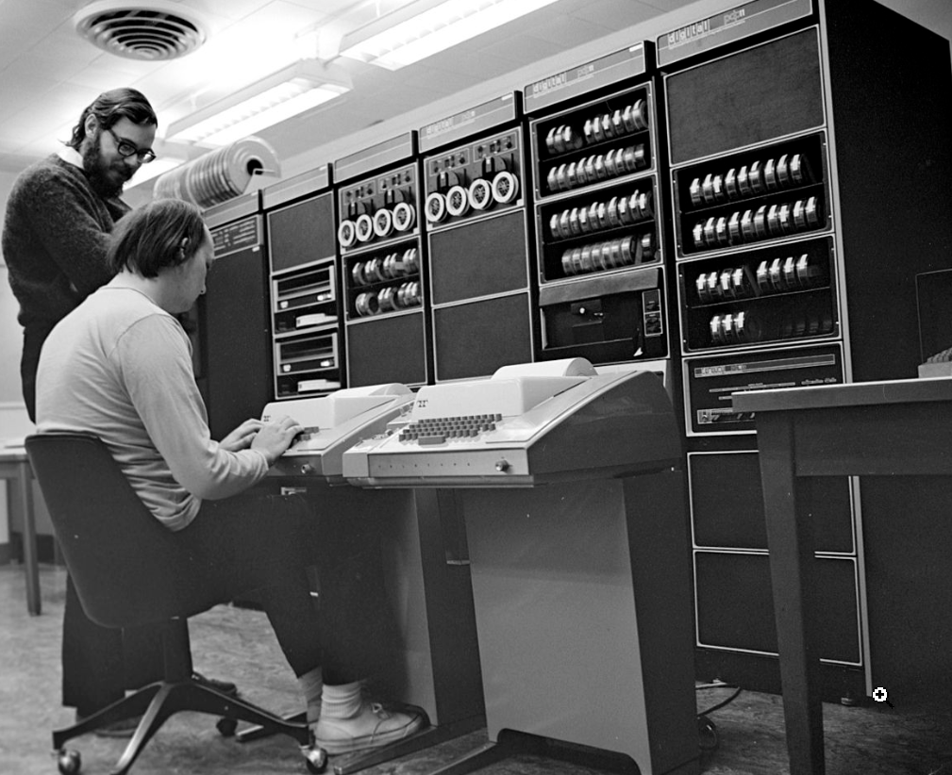
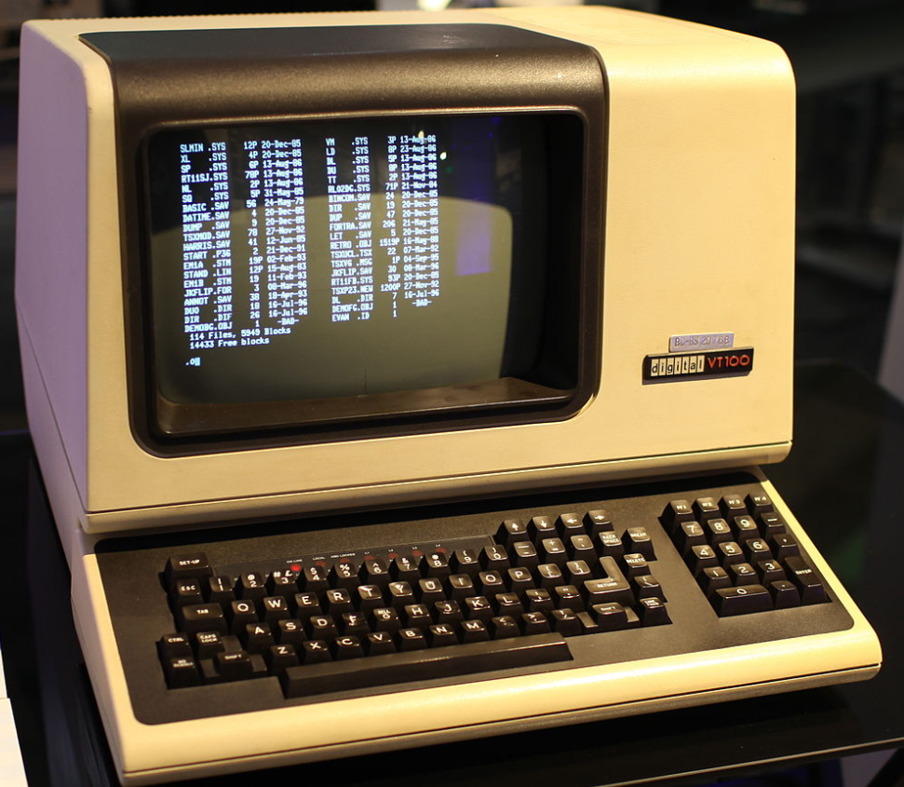
Information Systems Development – a brief history
1948 – 1979 Early days of computer software and operating systems
1960’s – Massachusetts Institute of Technology, AT&T Bell Labs, and General Electric jointly developed an experimental time sharing operating system called Multics
Allowing multiple users to access a mainframe computer simultaneously
1970’s – Bell Lab’s researchers left the team and implemented a self-hosting operating system that became UNIX on a minicomputer
Included concepts of computer processes, device files, hierarchical file system, command-line interpreter, editor, programing shell, and assembler
Text editor and first text formatting and publishing program written in assembly language
1971 – UNIX Programmer’s Manual written
1973 – Unix Version 3 rewritten in higher-level C language
Most popular variants of Unix today are
macOS Mac OS X
Linux
Wikipedia – History of Software

Slide 8
Information Systems Development – a brief history
Linux, computer operating system created in the early 1990s by Finnish software engineer Linus Torvalds and the Free Software Foundation (FSF)
While still a student at the University of Helsinki, Torvalds started developing Linux to create a system similar to MINIX (“mini-Unix”)
MINIX was first released in 1987 with its complete source code
A free open-source UNIX-like operating system developed as a learning tool to run on early personal computers
Made available to universities for study in courses and research

Slide 9
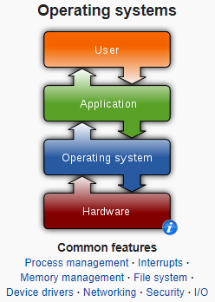
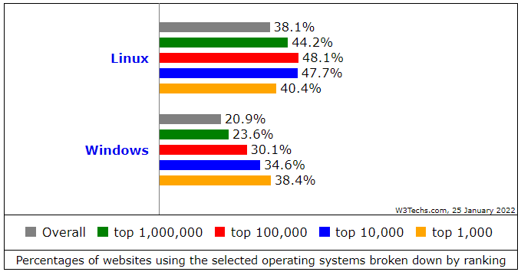
Computer Operating Sytems
An operating system (OS) manages computer hardware, software resources, and provides common services for computer programs
Operating systems are found on many devices that contain a computer – cellular phones, video game consoles, web servers and supercomputers
Operating system acts as an intermediary between programs and the computer hardware
Desktop operating systems:
Microsoft Windows with a market share of around 73.72%
macOS (OS X) by Apple Inc. is in second place (15.33%)
Varieties of Linux are collectively in third place (2.09%)
Mobile operating Systems (including smartphones and tablets):
Google Android's share was 70.01%
Apple's iOS with 29.24%
Samsung 0.43%
Internet Server operating systems
Unix and Linux 38.1%
Microsoft Windows 20.9%
Super-Computer operating systems
Linux is the operating system
https://gs.statcounter.com/os-market-share/mobile/worldwide
https://w3techs.com/technologies/comparison/os-linux,os-windows

Slide 10
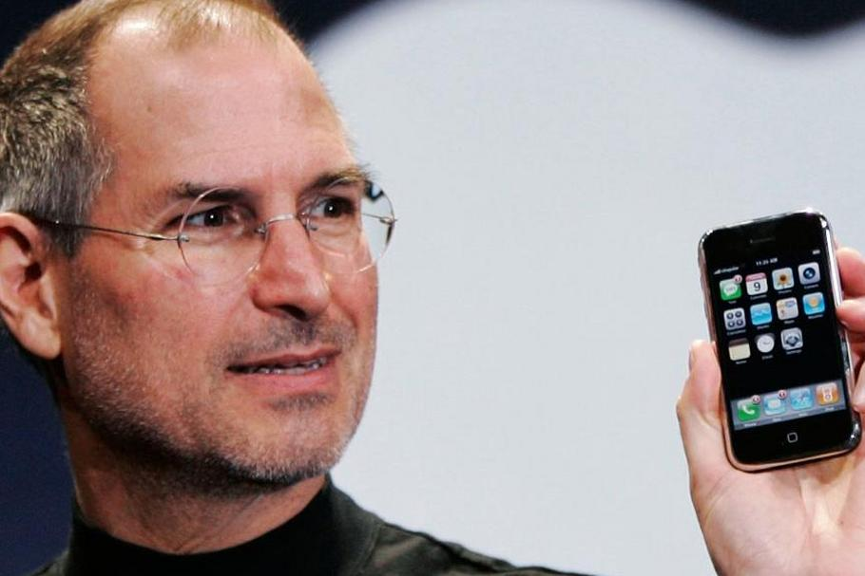
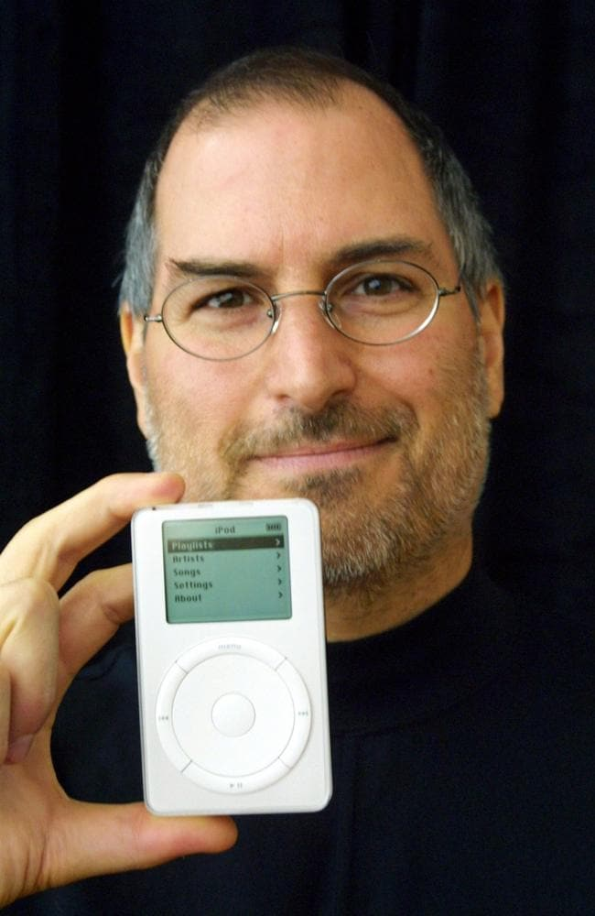
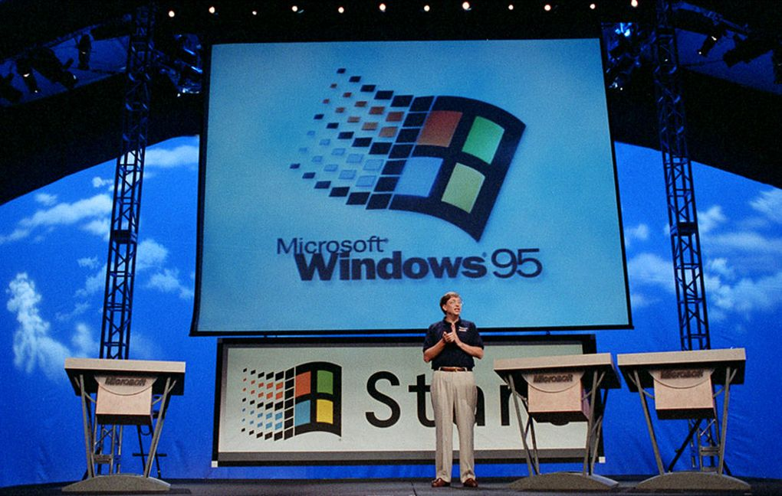

Slide 11
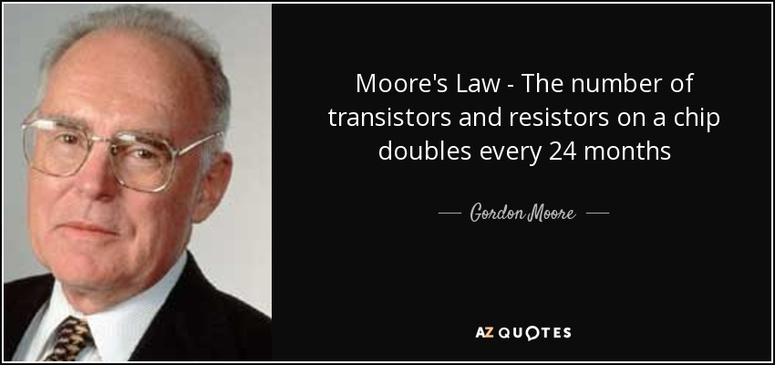

Slide 12
Leading Cloud Providers
Google Cloud Provider
Azure
AWS
Notes:
This slide highlights some of the leading cloud providers in the market today. Google Cloud, Azure, and AWS are among the top providers that offer a range of services for businesses and individuals. They provide cloud computing, storage, and other services that enable you to grow and scale your business effectively. Google Cloud offers solutions for machine learning, analytics, and data management, while Azure offers cloud-based services such as virtual machines, databases and storage, as well as application services. AWS provides a wide range of cloud computing services which include computing, storage, database, and other application services.

Slide 13
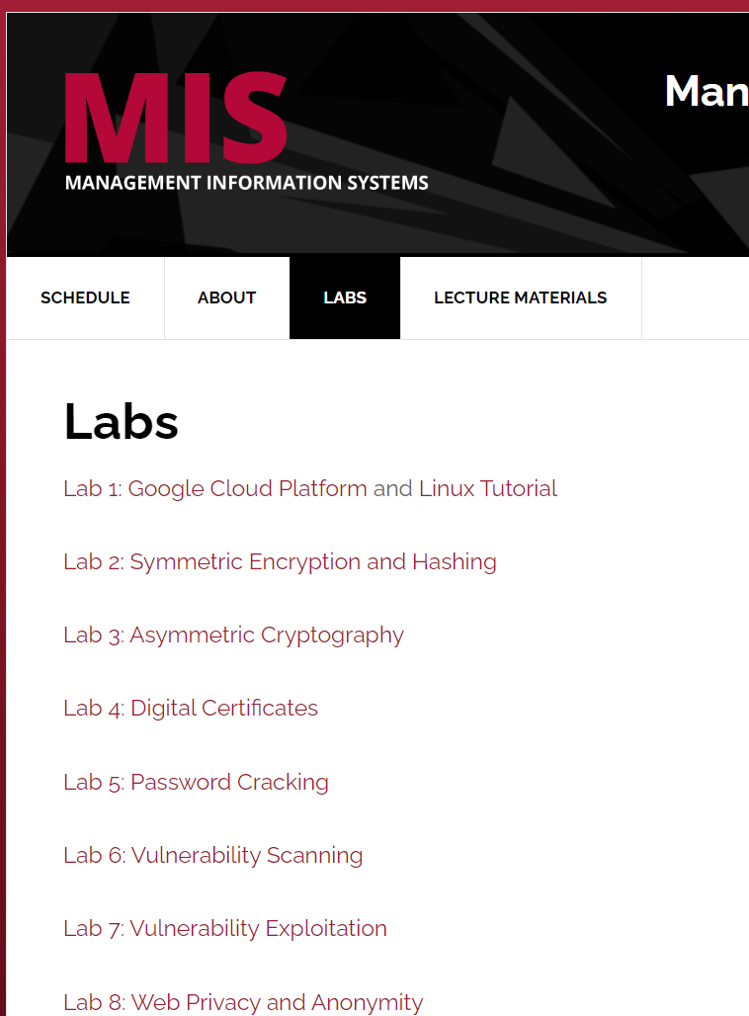
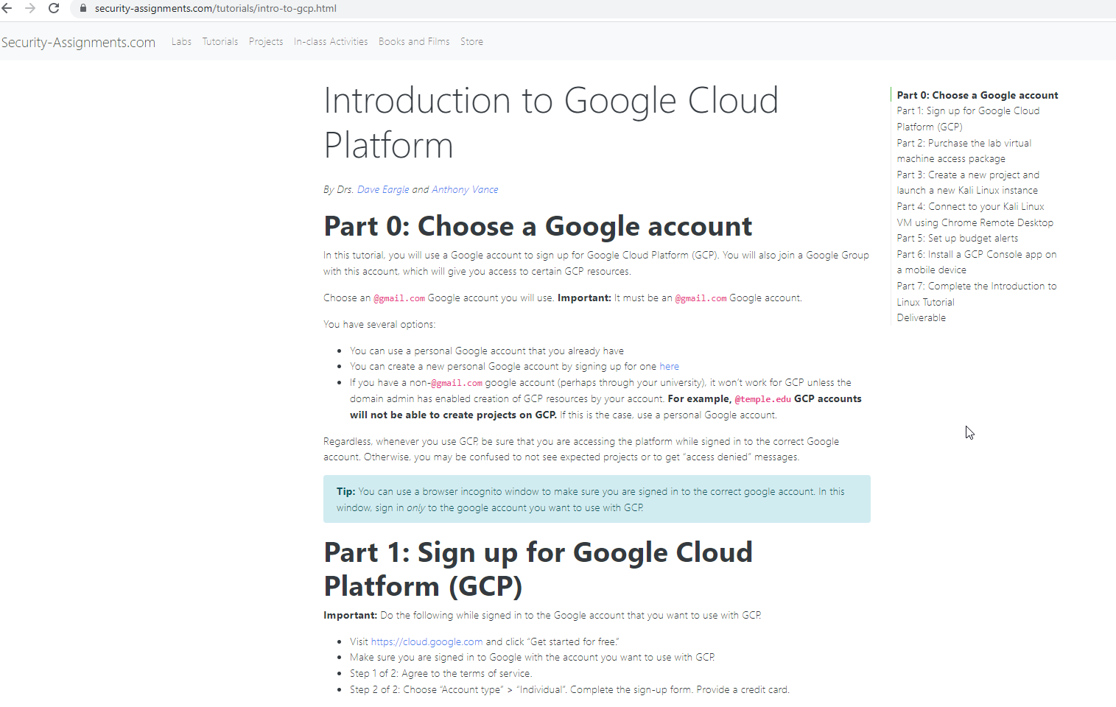
Lab 1: Google Cloud Platform

Slide 14
Follow instructions from the assignment page (I found them to be easier than the screenshots from class)

Slide 15
Complete introduction to Linux tutorial

Slide 16
Linux Management - IMPORTANT
Shutdown your Kali computer machine when you are not using it
Change your Kali root password
Everyone knows the default root password is: toor
CHANGE IT TO SOMETHING ELSE
Use a strong password: 8-10 characters long
Use upper case + lower case + numbers + symbols
Run the passwd command: “sudo passwd” without any arguments:
You will be prompted to enter your current password. If the password is correct, the command will ask you to enter and confirm the new password. Passwords are not shown on the screen when you enter them. The next time you log in to your system, use the new password.
https://www.hostinger.com/tutorials/how-to-change-password-in-linux/

Slide 17
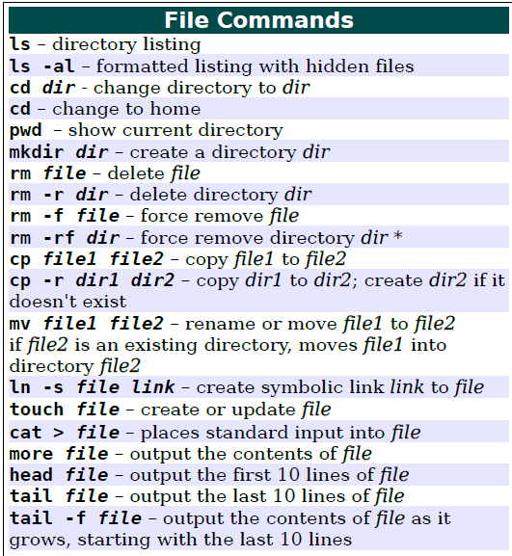
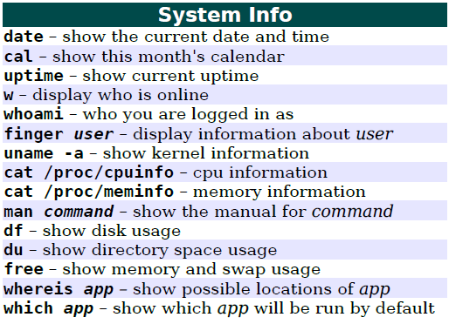
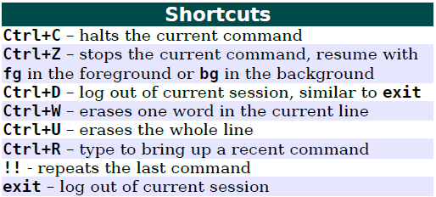
Some useful Linux commands

Slide 18
Reminders
You can ask classmates for help
If you receive help from a classmate, you can email me who and I will give them 1 extra credit point (you can only give to 1 classmate)
Everyone must submit their own assignment even if they received help
Good luck!

Slide 19
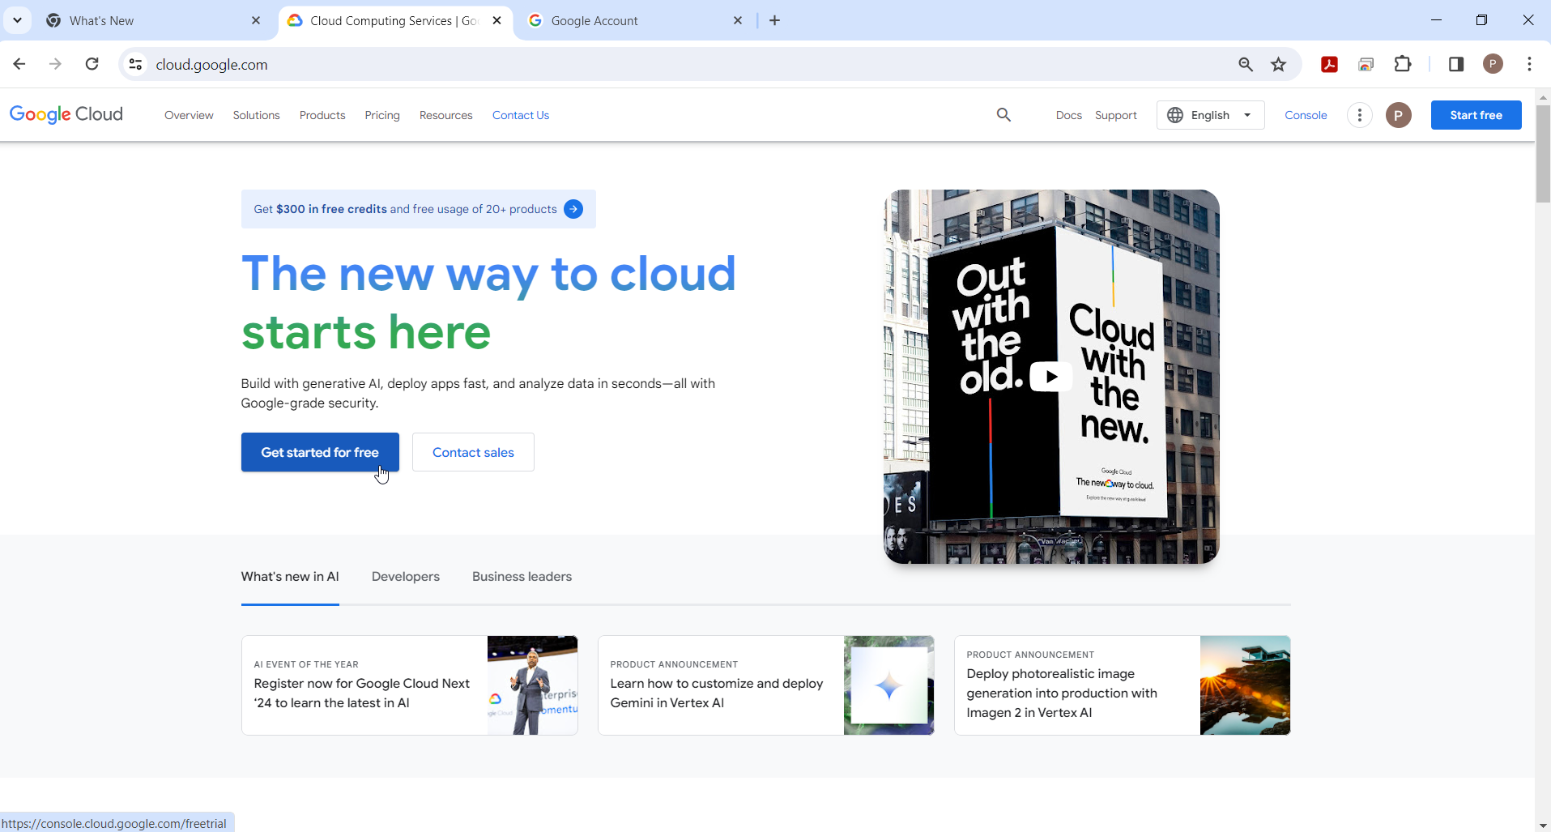

Slide 20
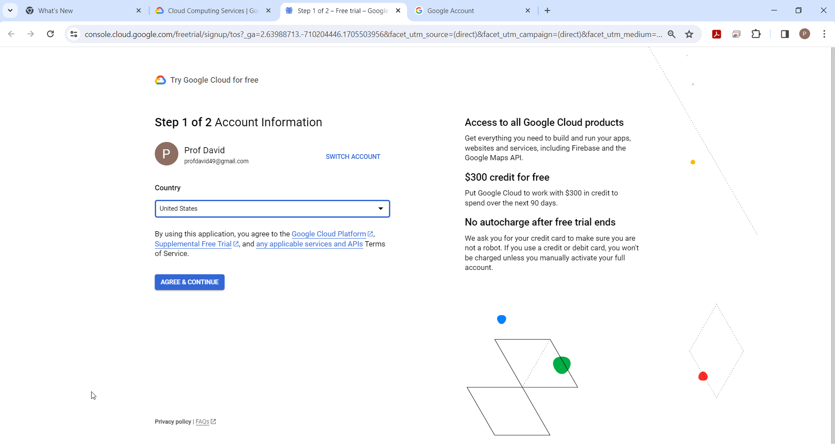

Slide 21
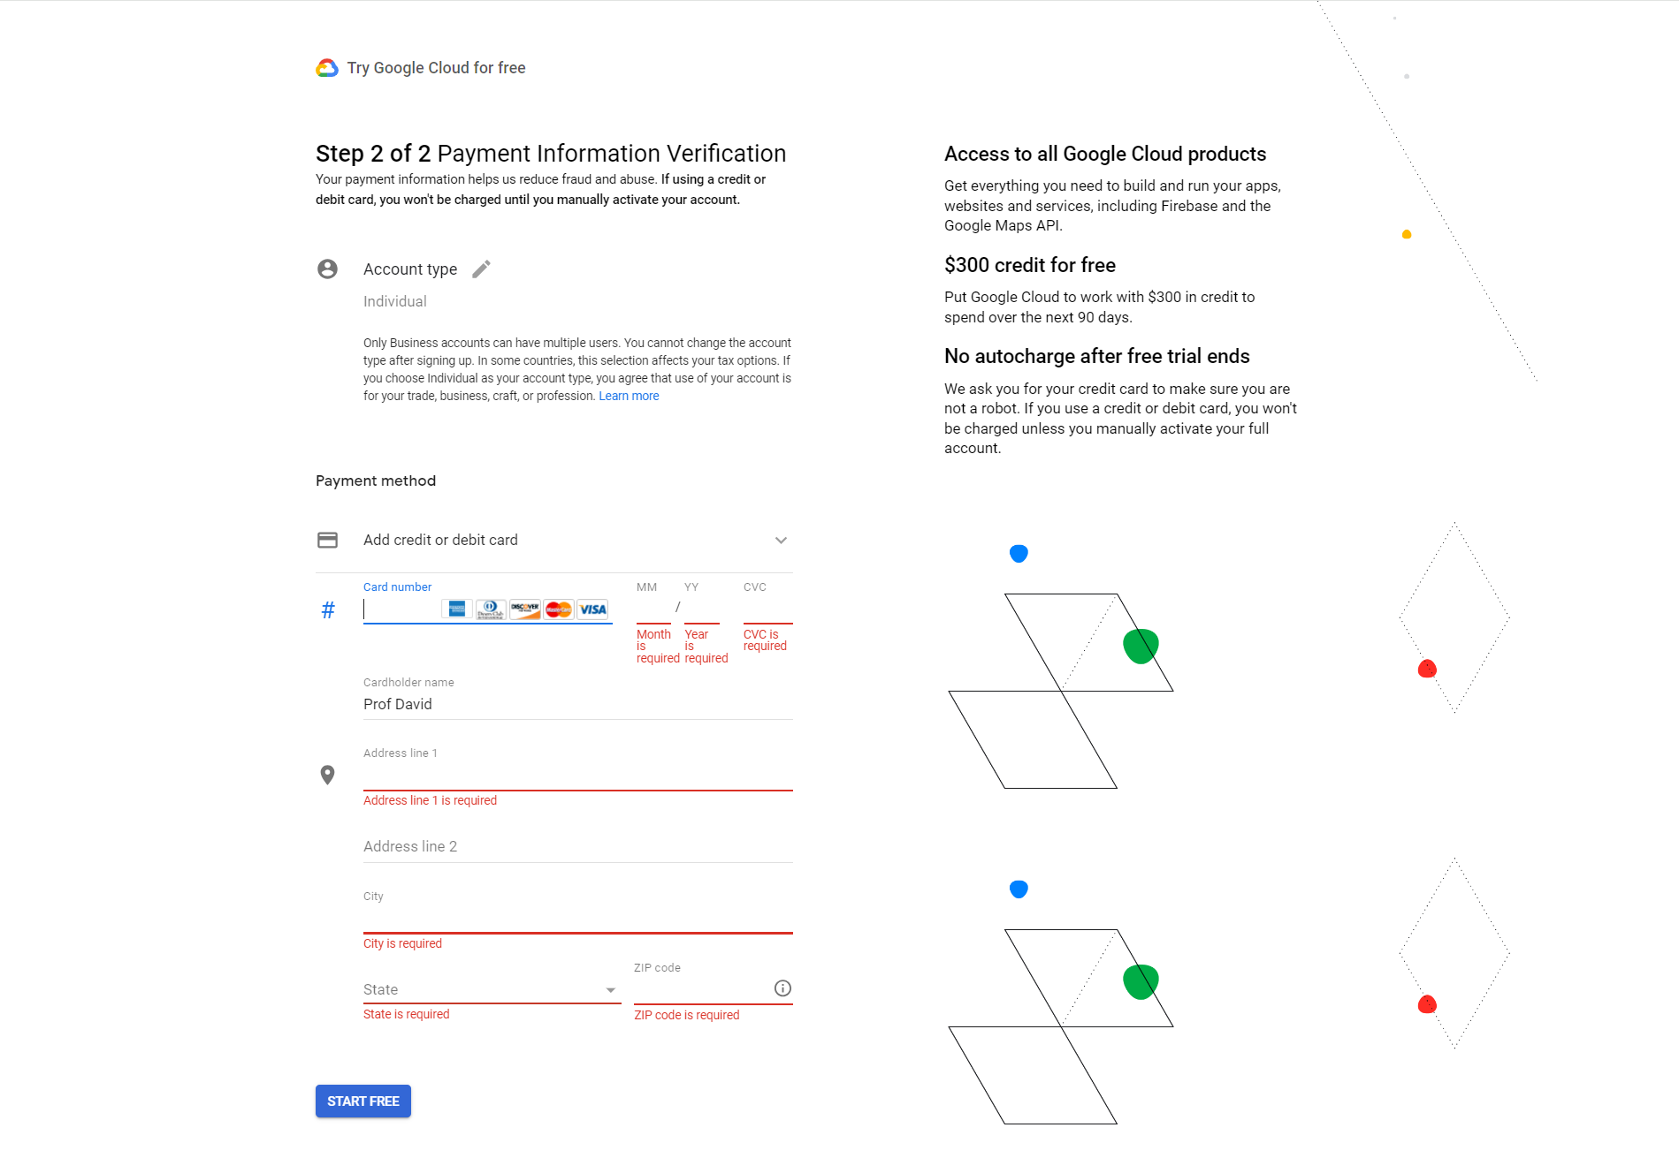

Slide 22
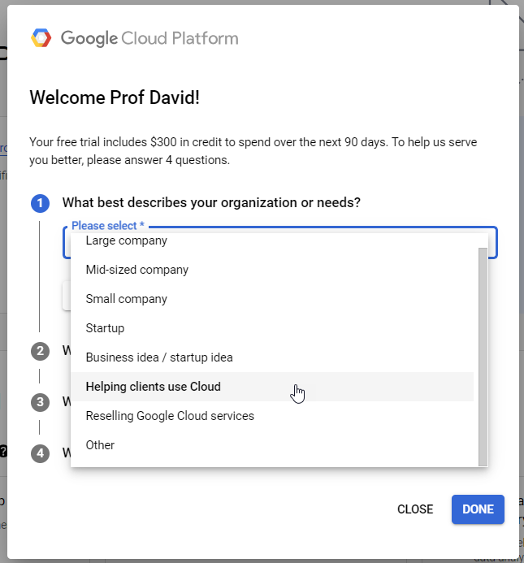
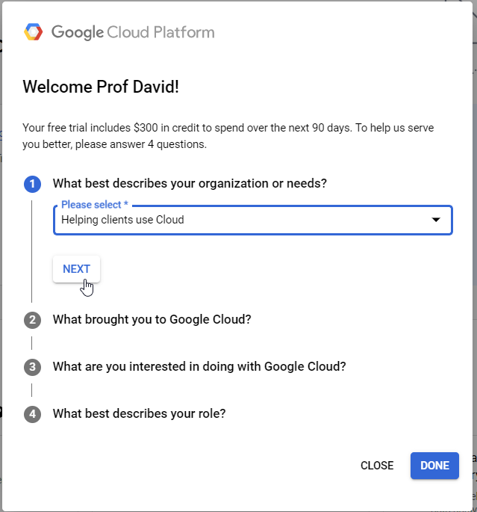

Slide 23
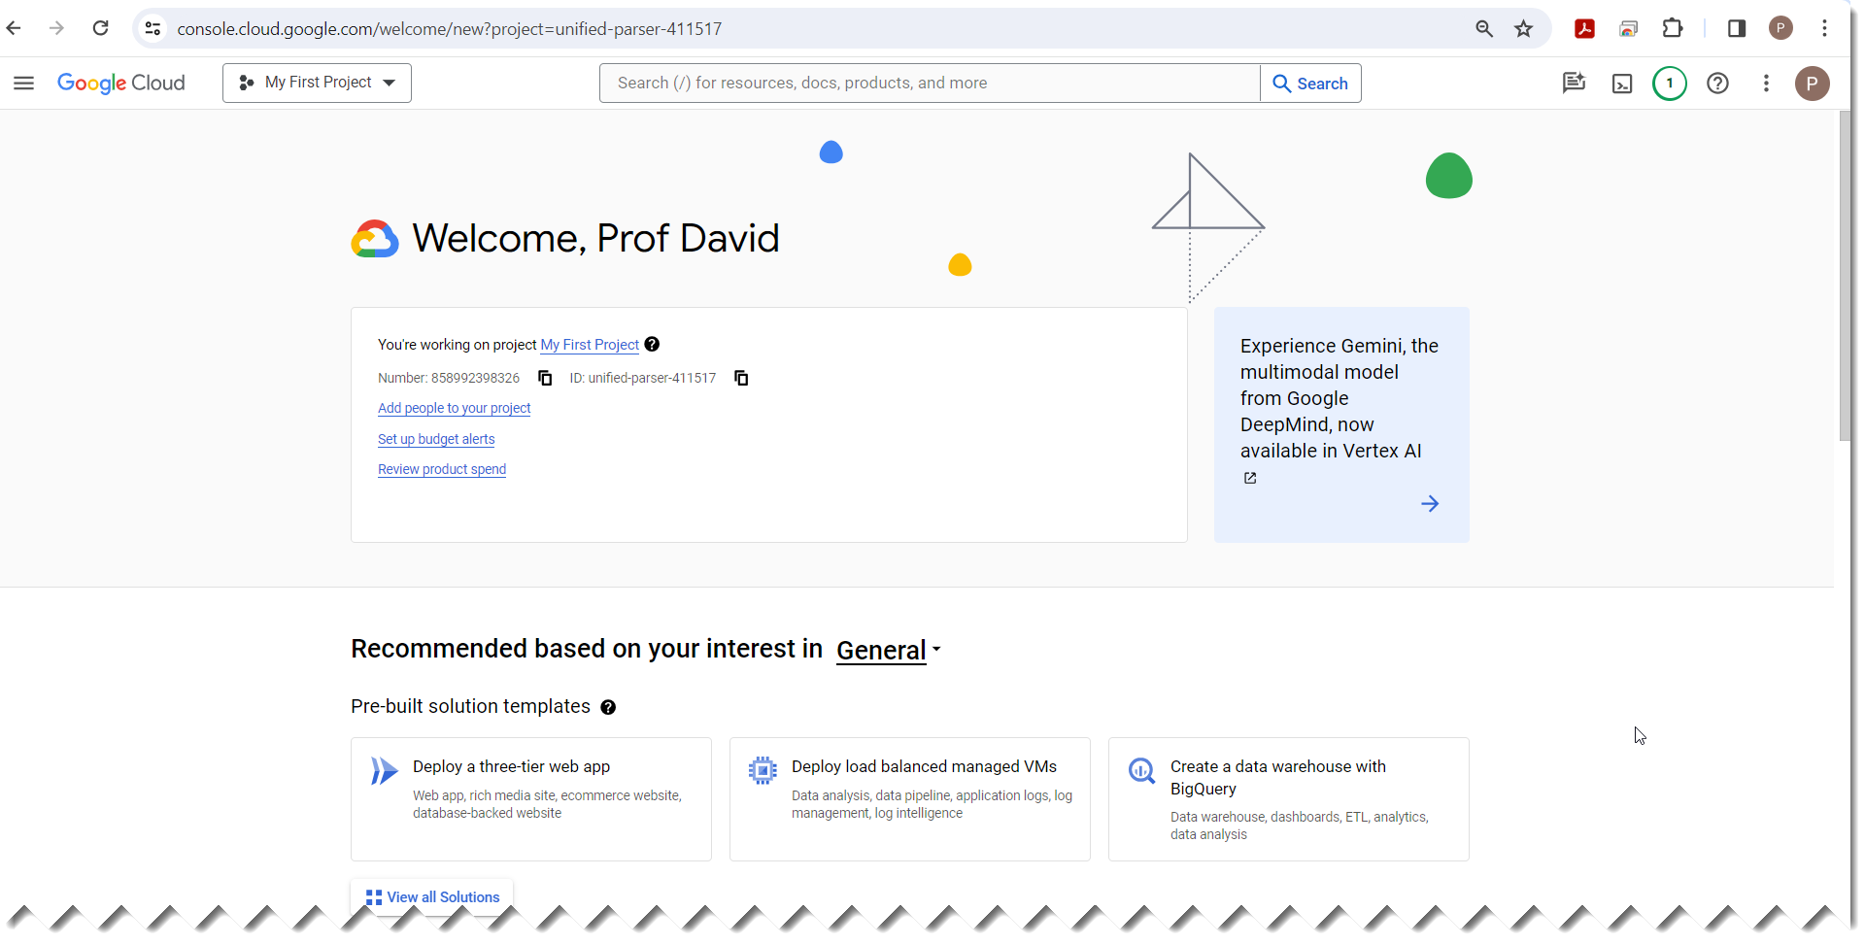

Slide 24
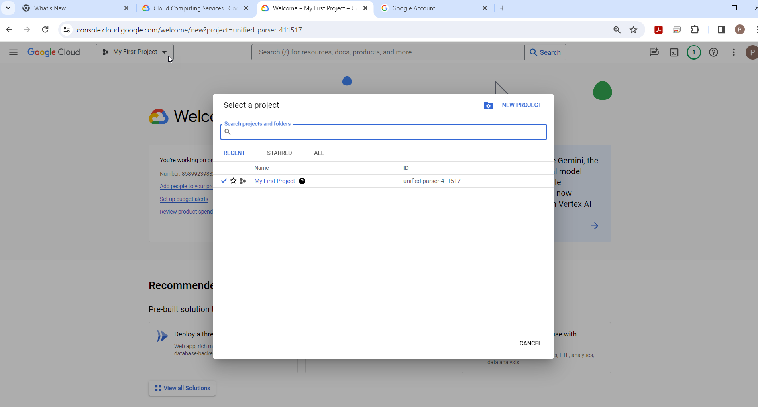

Slide 25
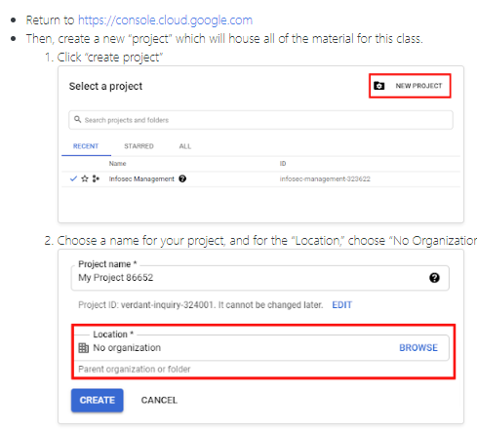
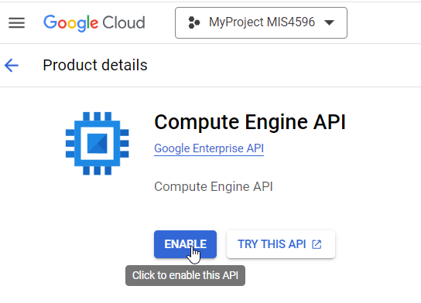

Slide 26
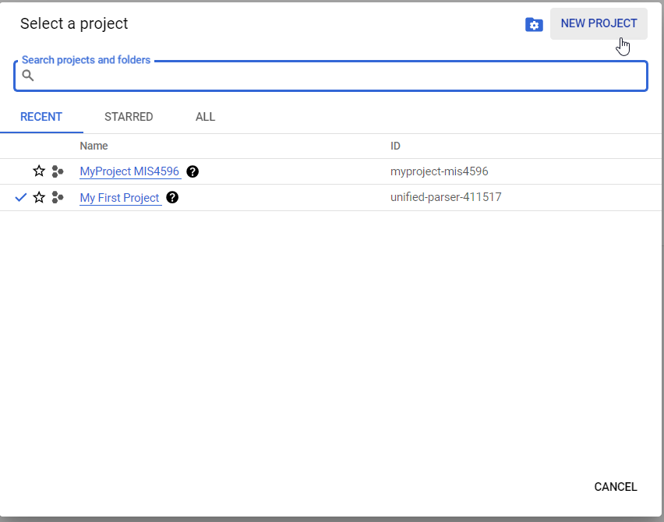

Slide 27
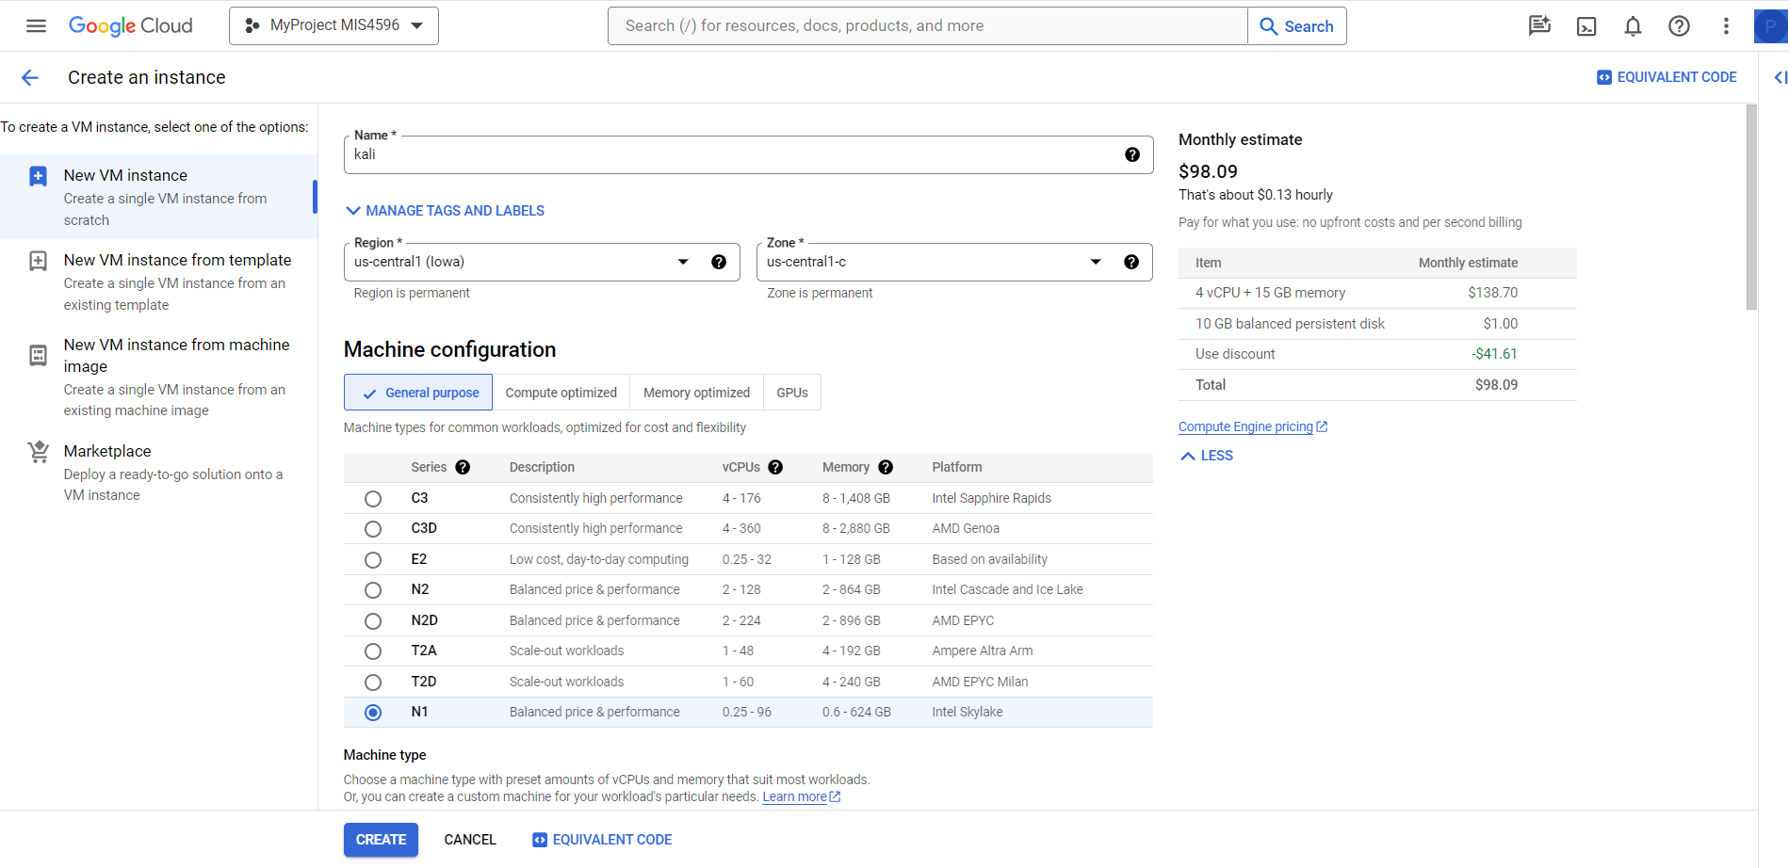

Slide 28
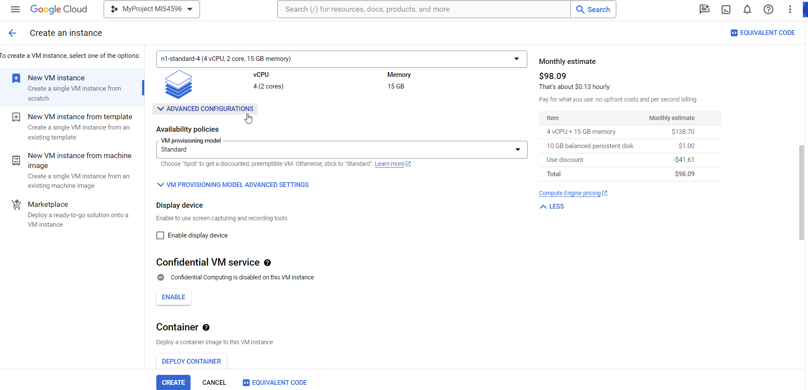

Slide 29
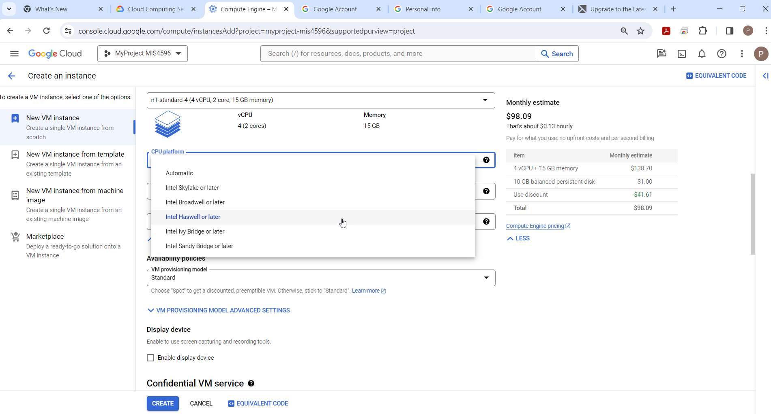

Slide 30
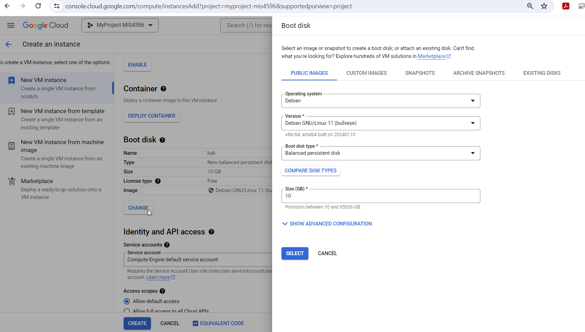

Slide 31
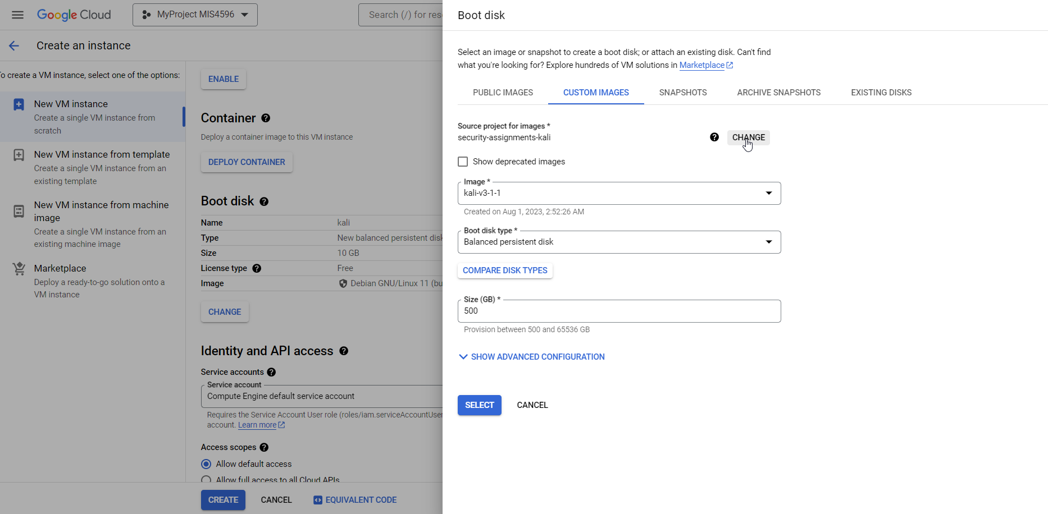

Slide 32
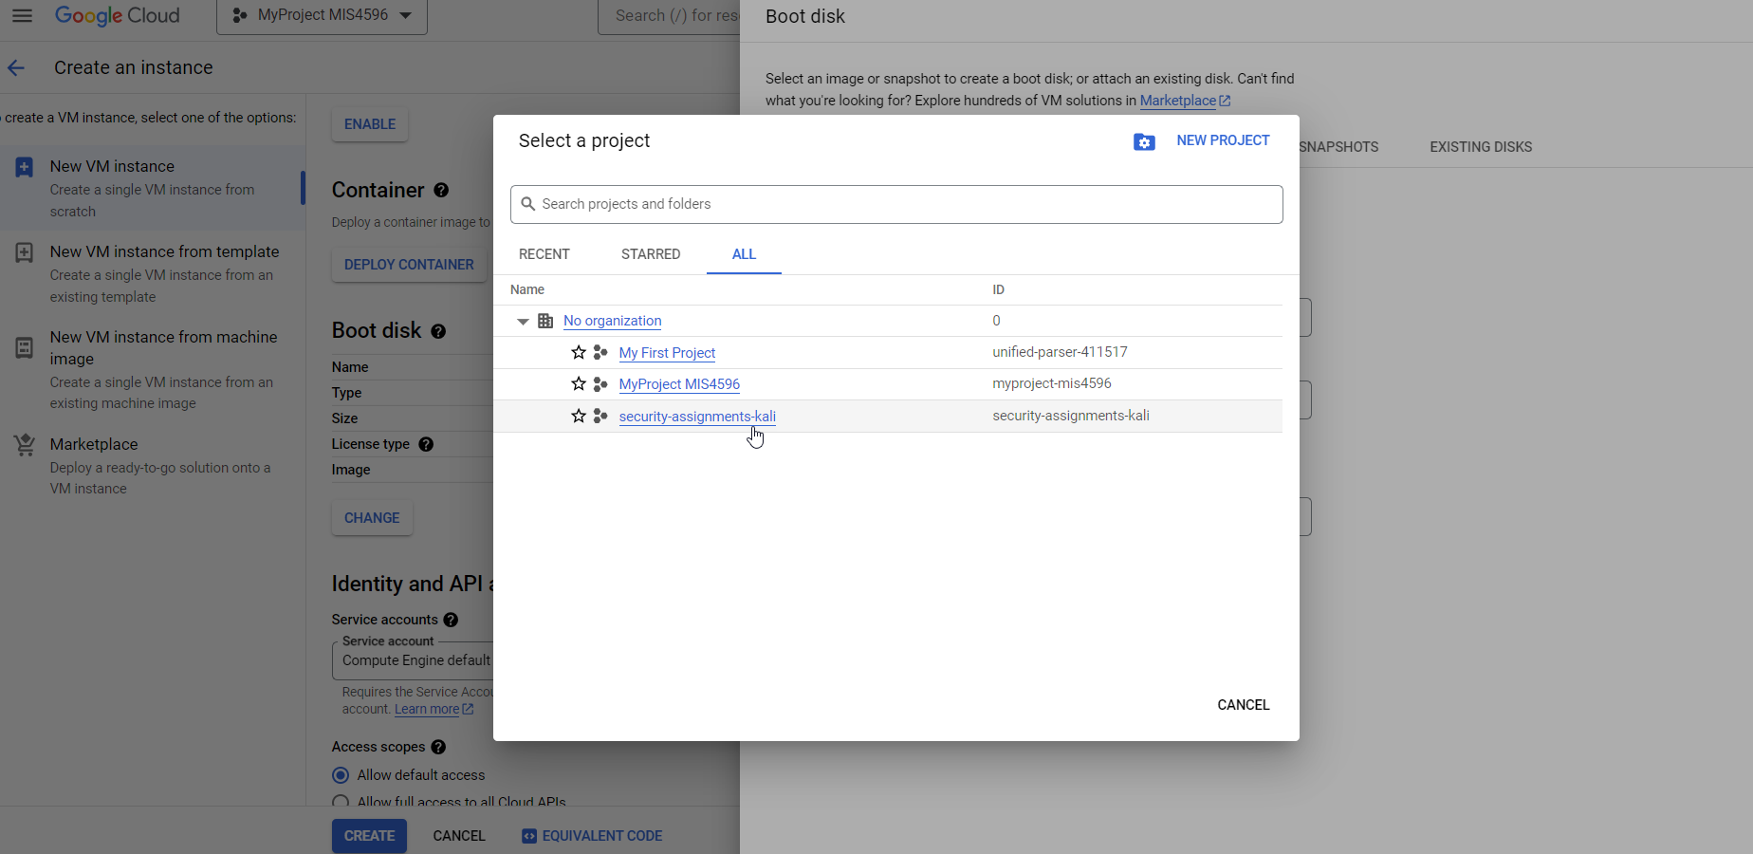

Slide 33
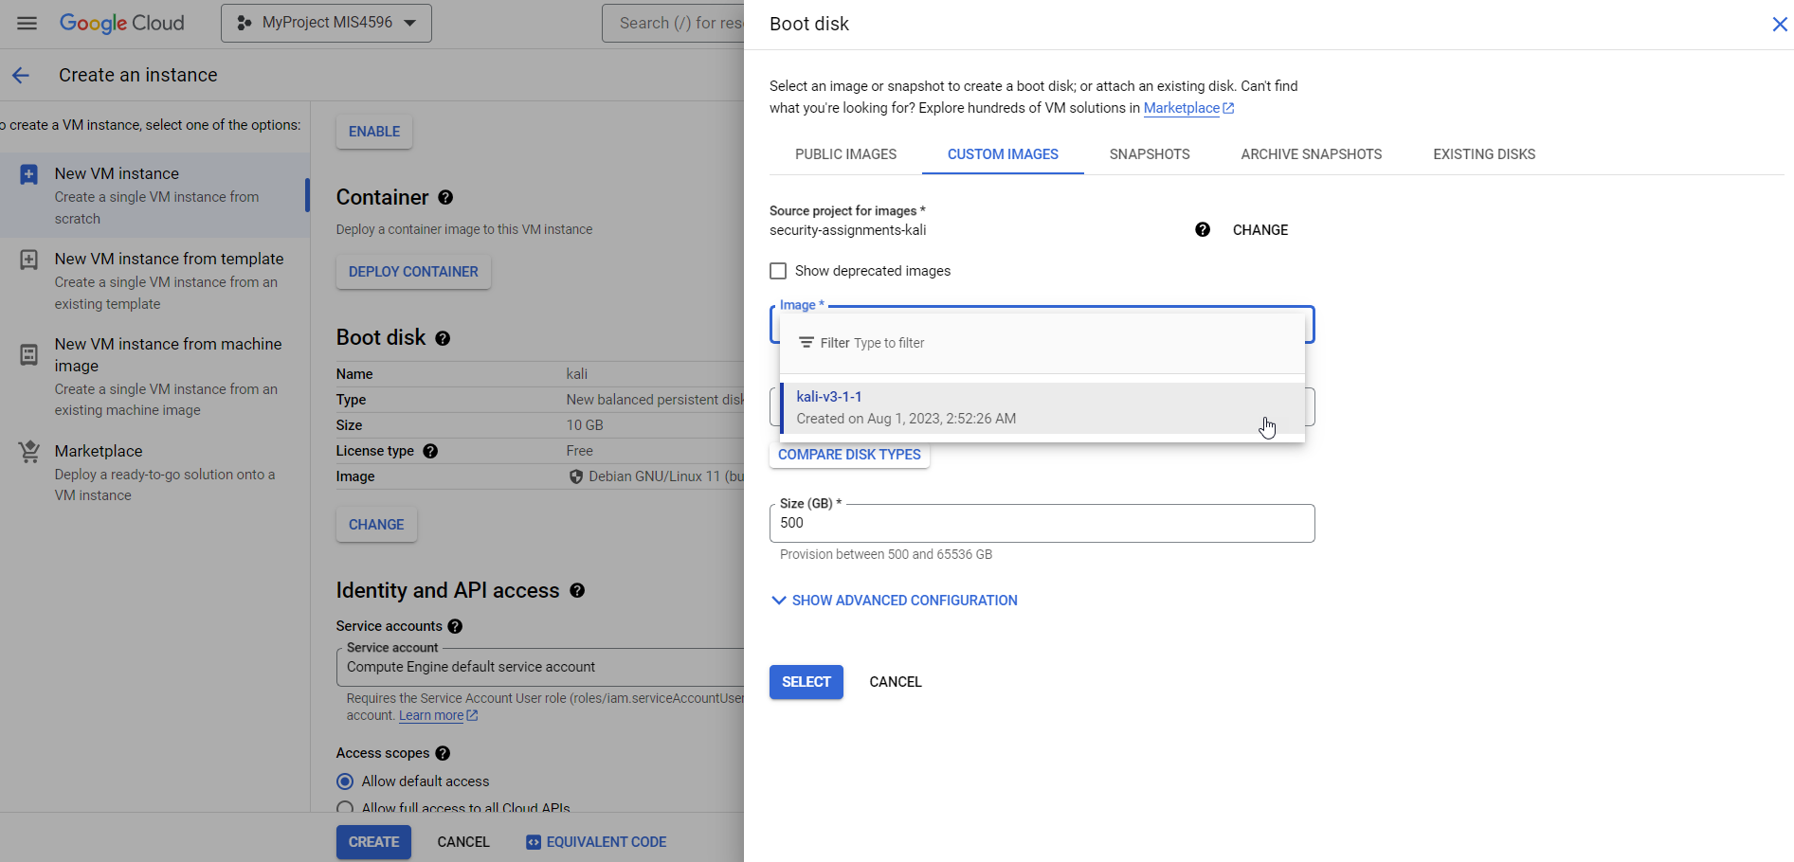

Slide 34
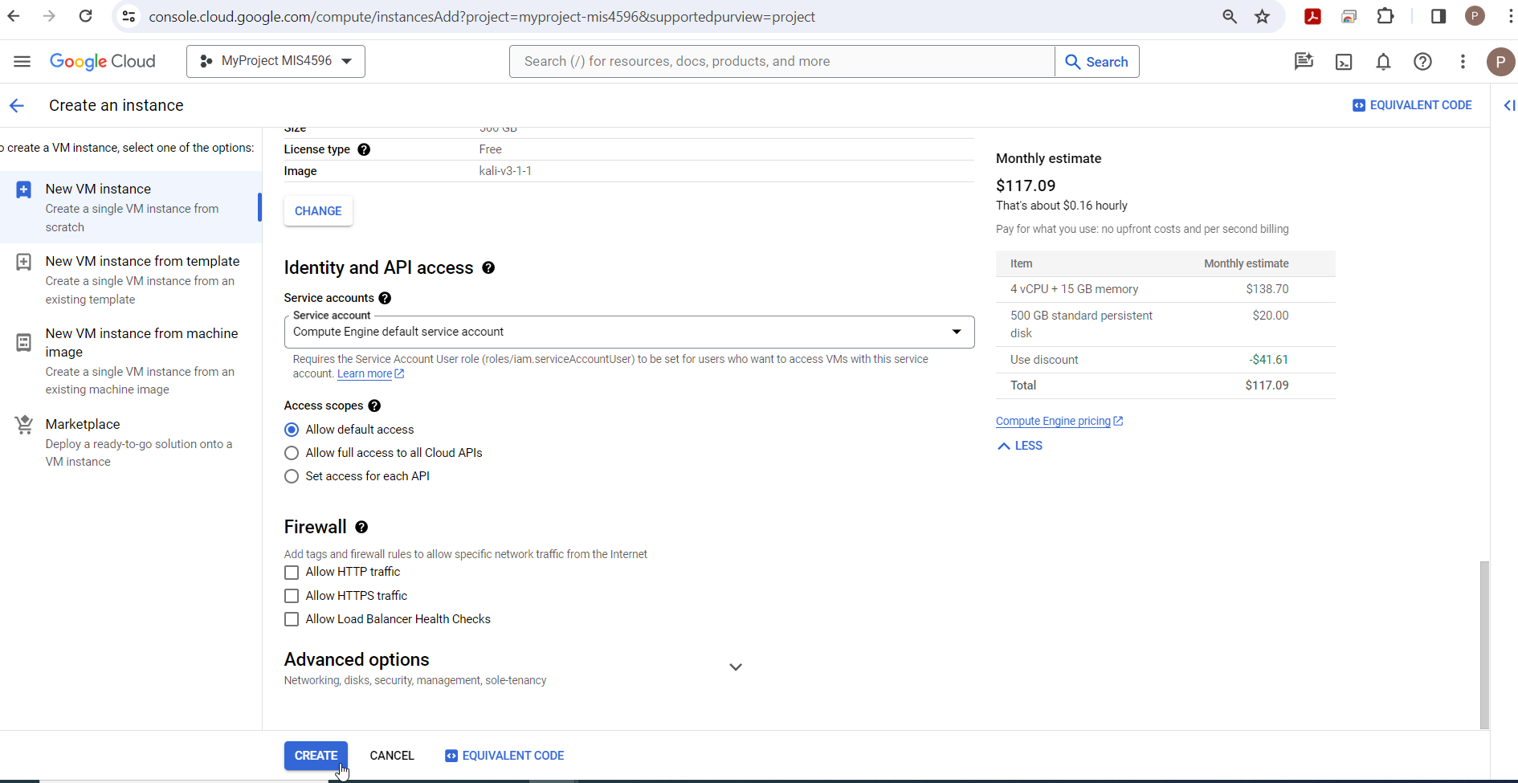

Slide 35
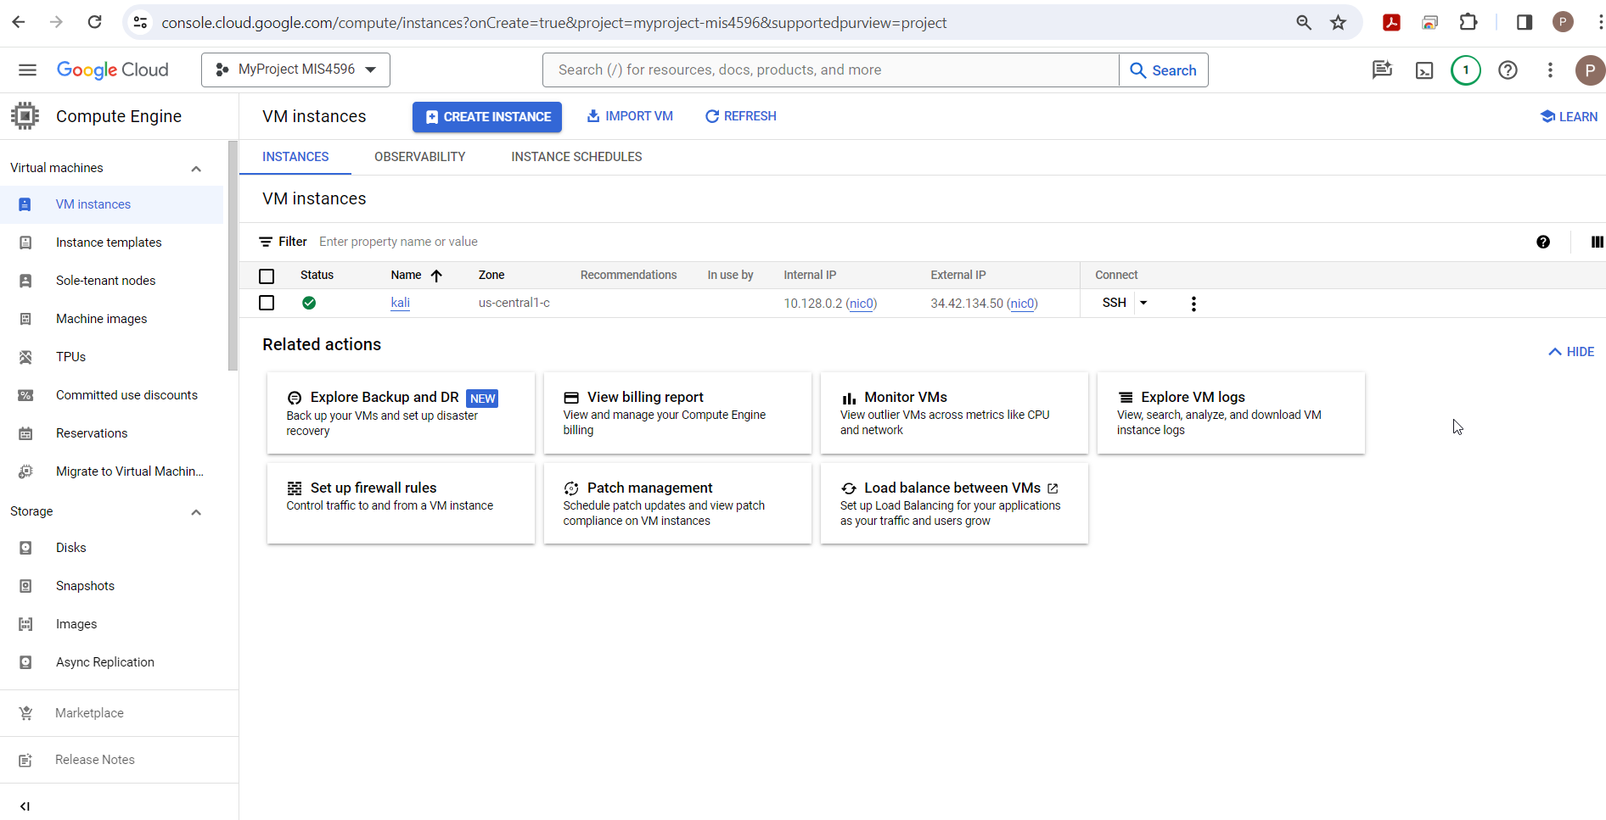

Slide 36
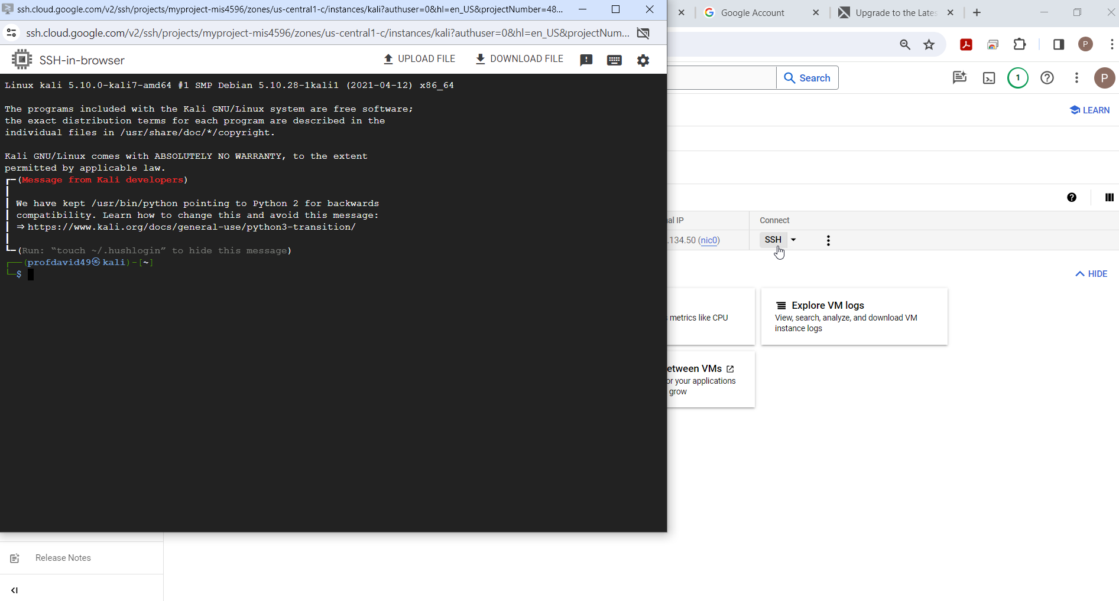

Slide 38
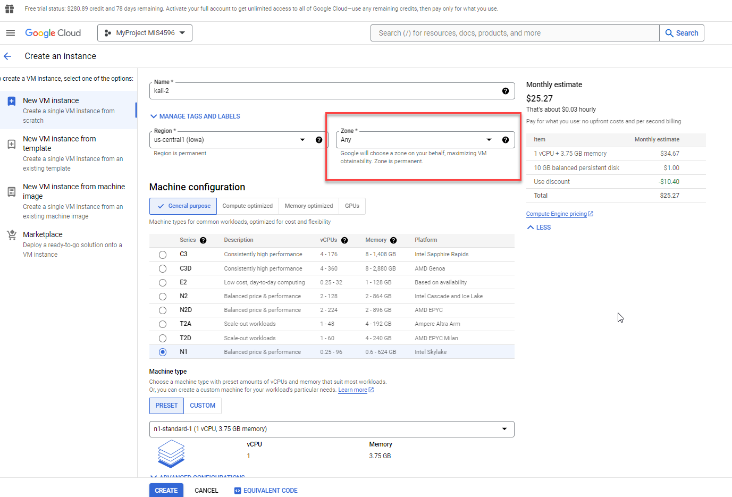

Slide 39
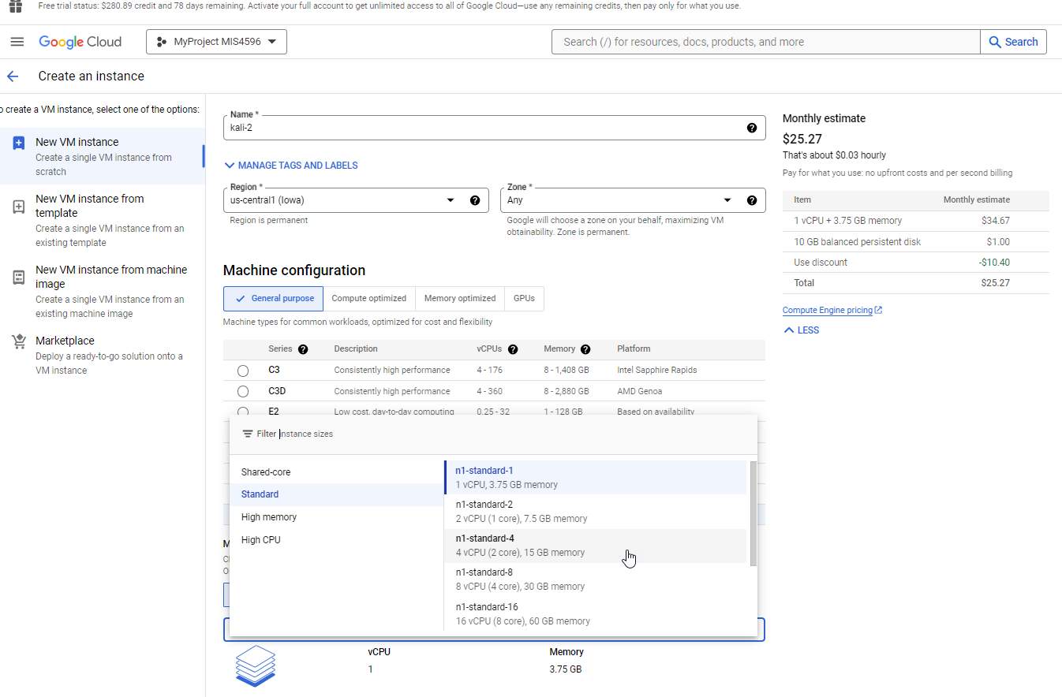

Slide 40
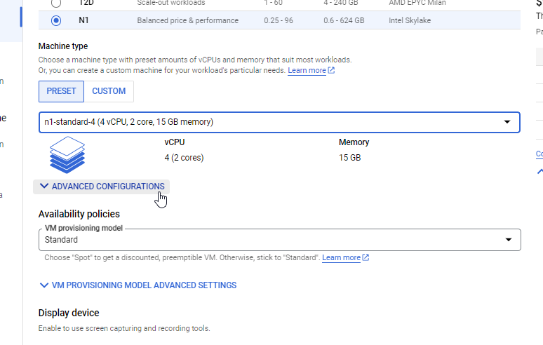

Slide 41
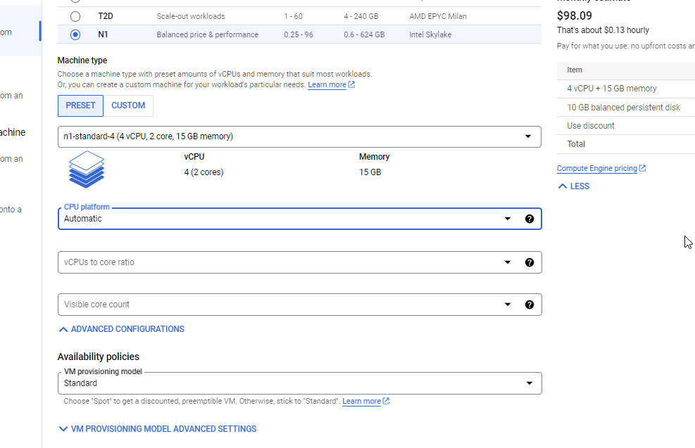

Slide 42
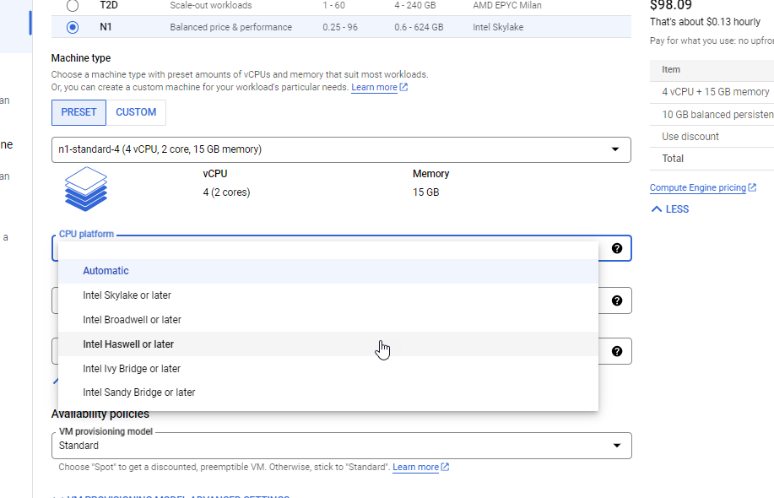

Slide 43
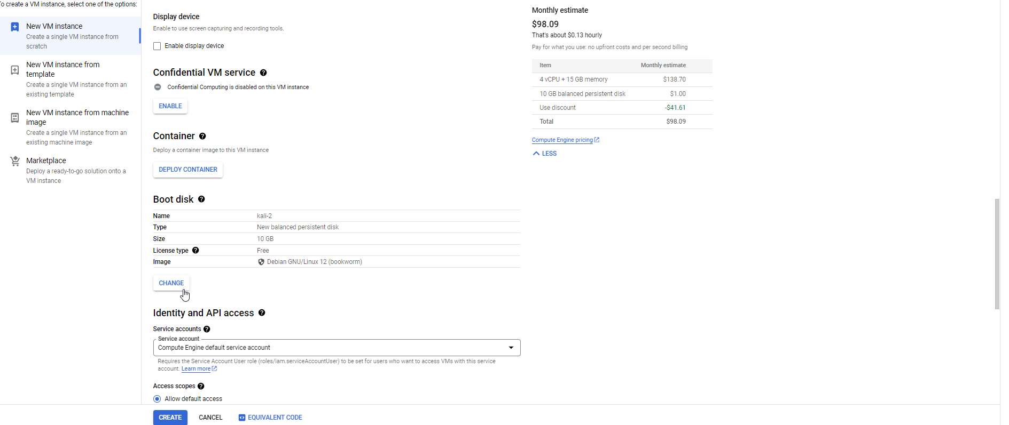

Slide 44
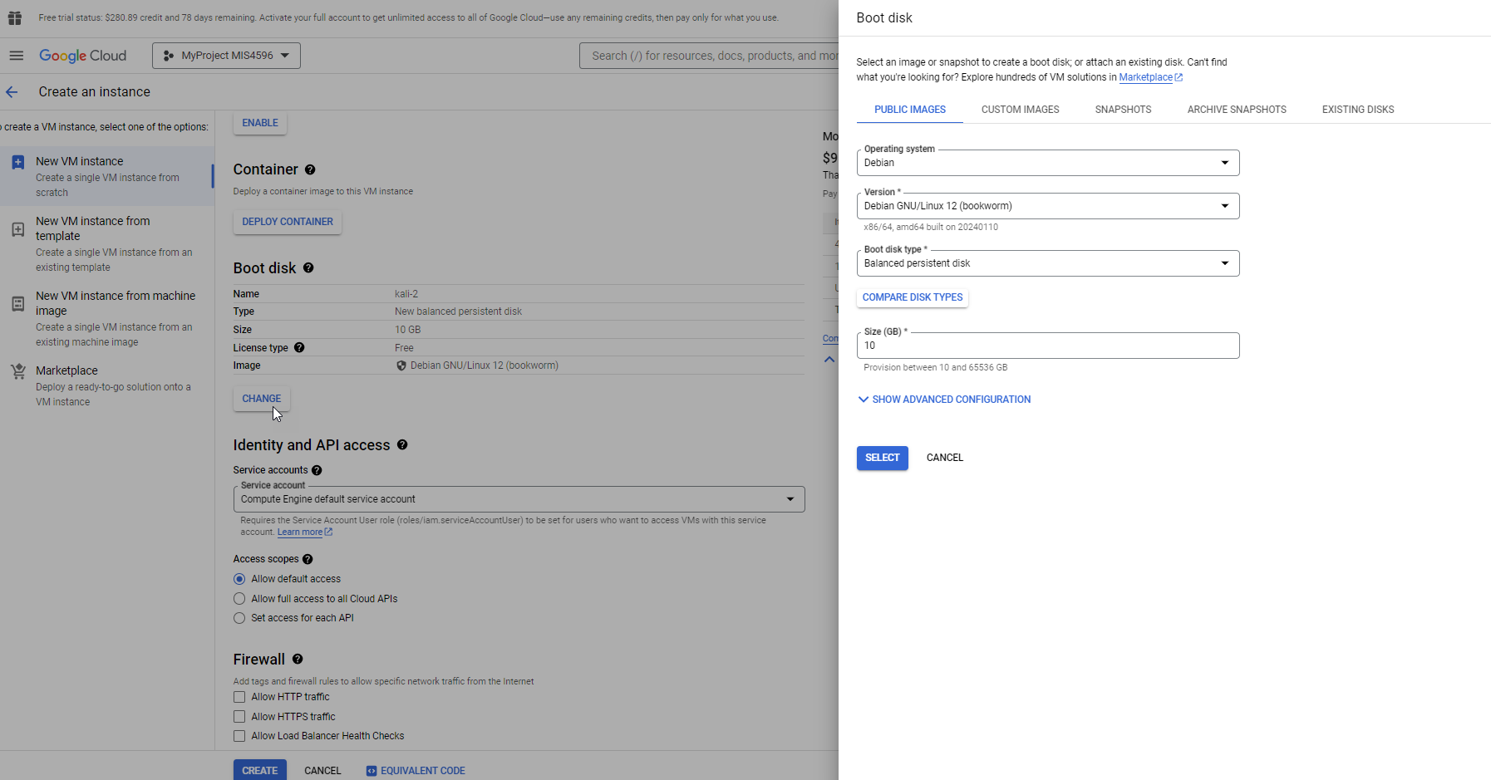

Slide 45
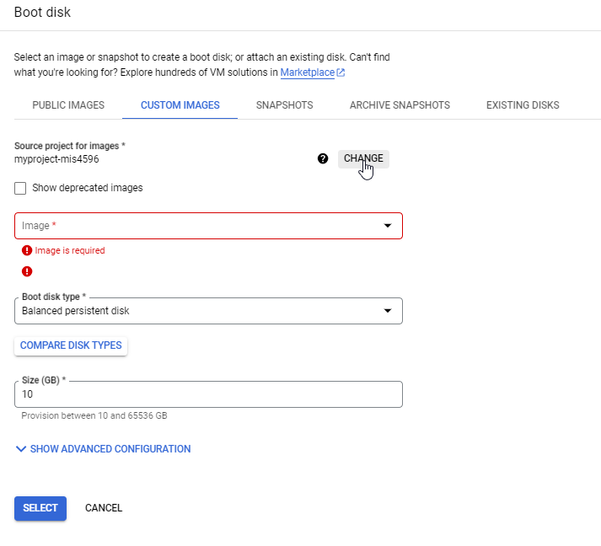

Slide 46
