Slide 1
Managing Enterprise Cybersecurity
MIS 4596
Unit #11

Slide 2
Agenda
Public Key Infrastructure
Digital Certificate
Public key Certificates
Roles in PKI: Certificate Authority (CA)
Roles in PKI: Registration Authority (RA)
PKI Steps
Chain of Trust
Root Programs
Certificate Revocation List (CRL)
PKI Roles / Workflows…

Slide 3
Public Key Infrastructure (PKI)
Public key cryptography enables entities previously unknown to each other to verify the identity of each other, validate the information being transferred, and securely communicate on an insecure public network
Public key infrastructure
  Enables online activities requiring more trust and proof of identity than simple passwords
  Provides a hierarchy of trust relationships that:
    Enable knowing a public key really belongs to the person/system you want to communicate with
    Are necessary for hybrid cryptography
    Facilitate secure electronic transfer of information for a range of network activities such as e-commerce, internet banking and confidential email

Slide 4
Public Key Infrastructure (PKI)
Is a system for creating, storing, distributing, validating, revoking and managing digital certificates used to verify the identity the owner of a public key contained within the certificate
Assumes
  Receiver’s and Sender’s identities can be positively ensured through digital certificates
  Asymmetric algorithm will automatically carry out the process of key exchange
Contains components that
  Identify users
  Creates and distributes certificates
  Maintains and revokes certificates
  Distributes and maintains encryption keys
  Enables information technologies to communicate and work together to achieve confidentiality, authentication, integrity, and non-repudiation

Slide 5
Public Key Infrastructure (PKI)
Consists of:
  Public key certificates (“digital certificates”) are electronic documents used to prove the ownership of public keys
  Roles
    Certificate Authorities (CA) store, issue and sign the digital certificates
    Registration Authorities (RA) verify identities of entities requesting their digital certificates be stored at the CA
  Technologies
    Central directory provides a secure location in which keys are stored and indexed
    Certificate management system
      Creates and delivers new certificates to be issued
      Searches, retrieves and accesses to stored certificates
  Certificate policy states procedures for allowing outsiders to analyze the PKI's trustworthiness

Slide 6
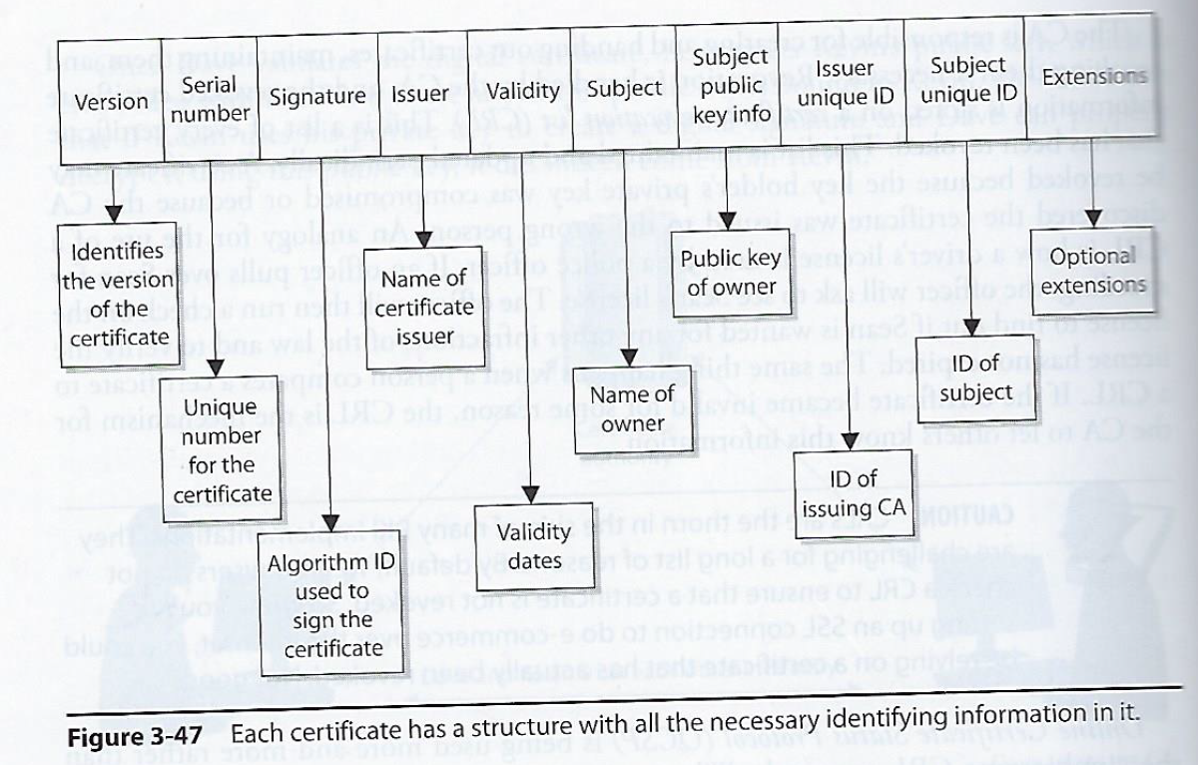
Digital Certificate
One of the most important pieces of a PKI
Associates a public key with information for uniquely identifying its owner
X.509 standard defines the format of public key certificates used in many Internet cryptographic protocols for HTTPS for servers & clients, secure email, code signing, digital signatures…

Slide 7
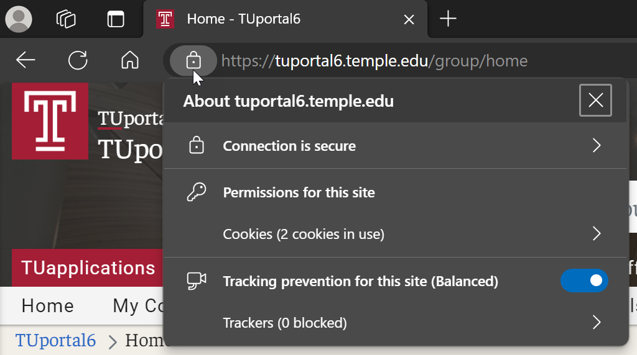
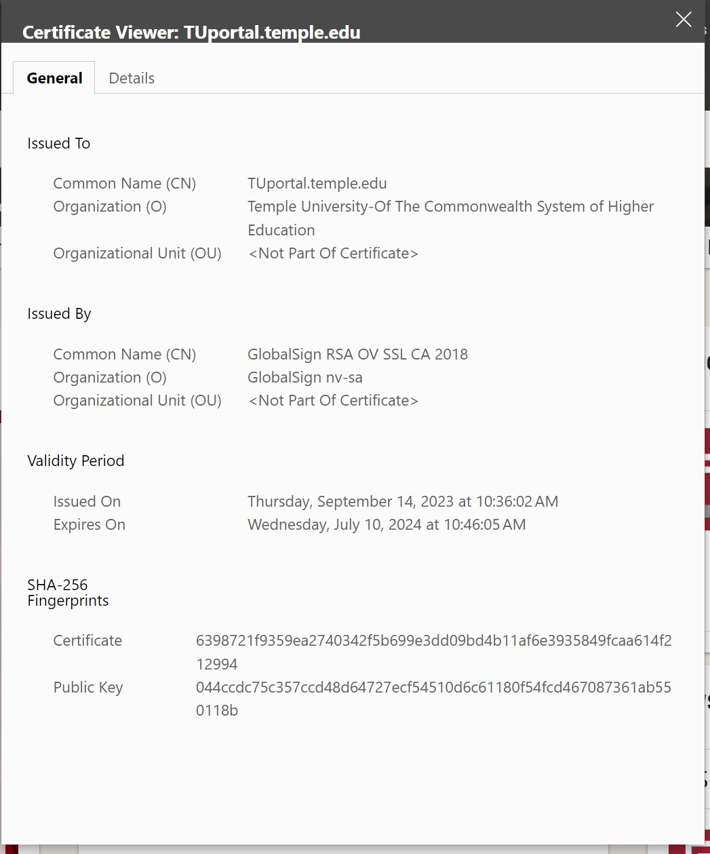
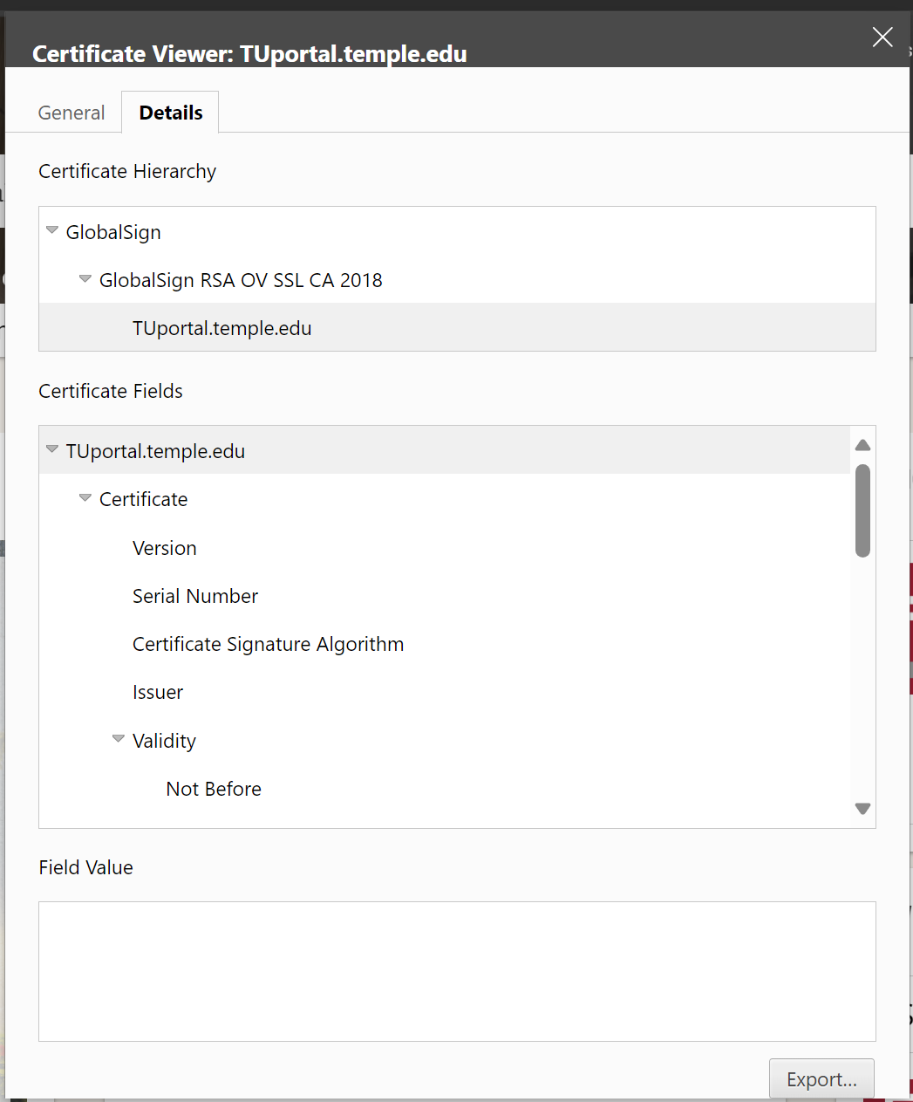
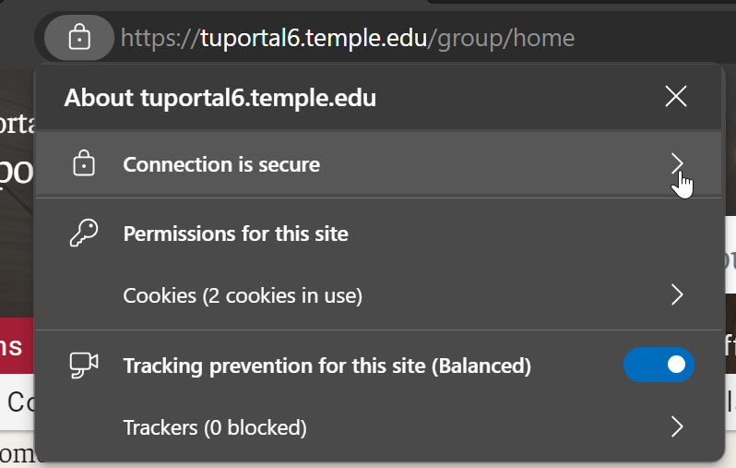
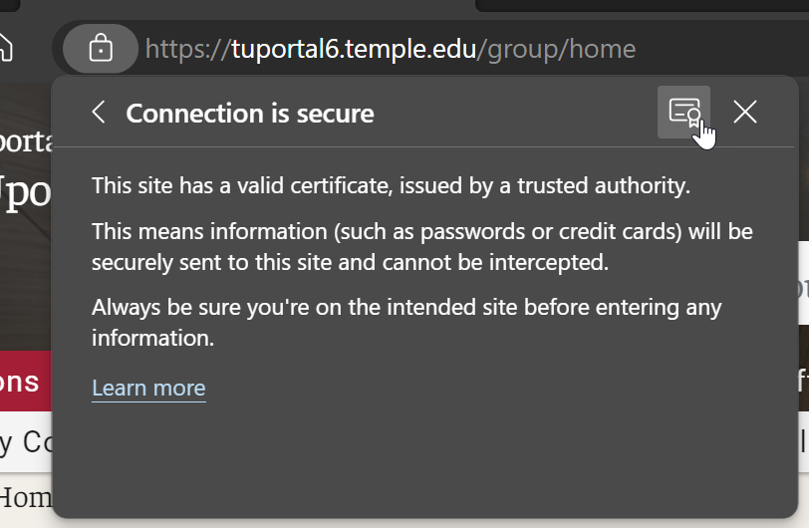
Certificate

Slide 8
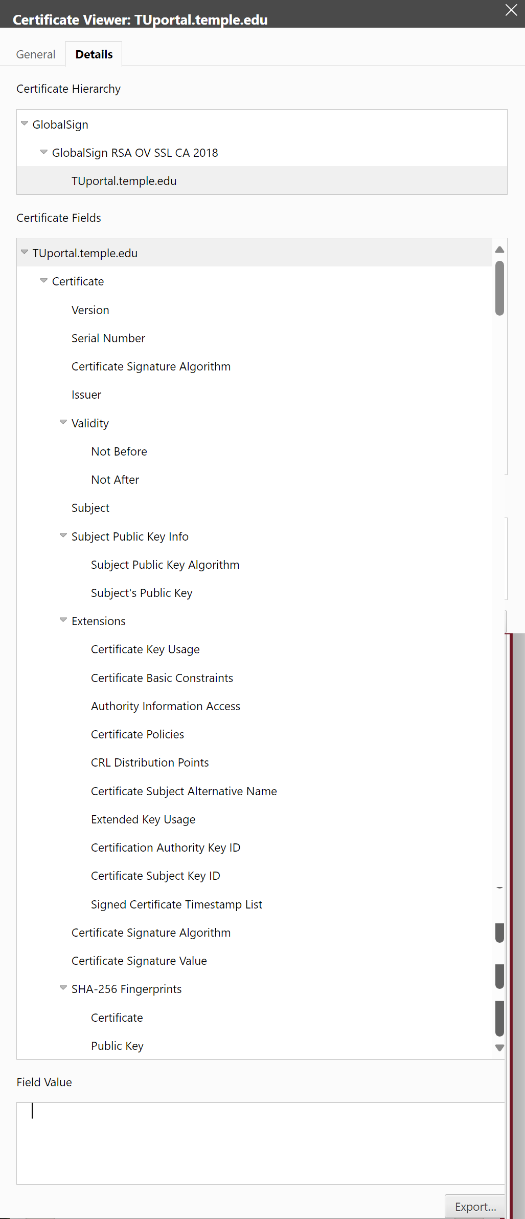
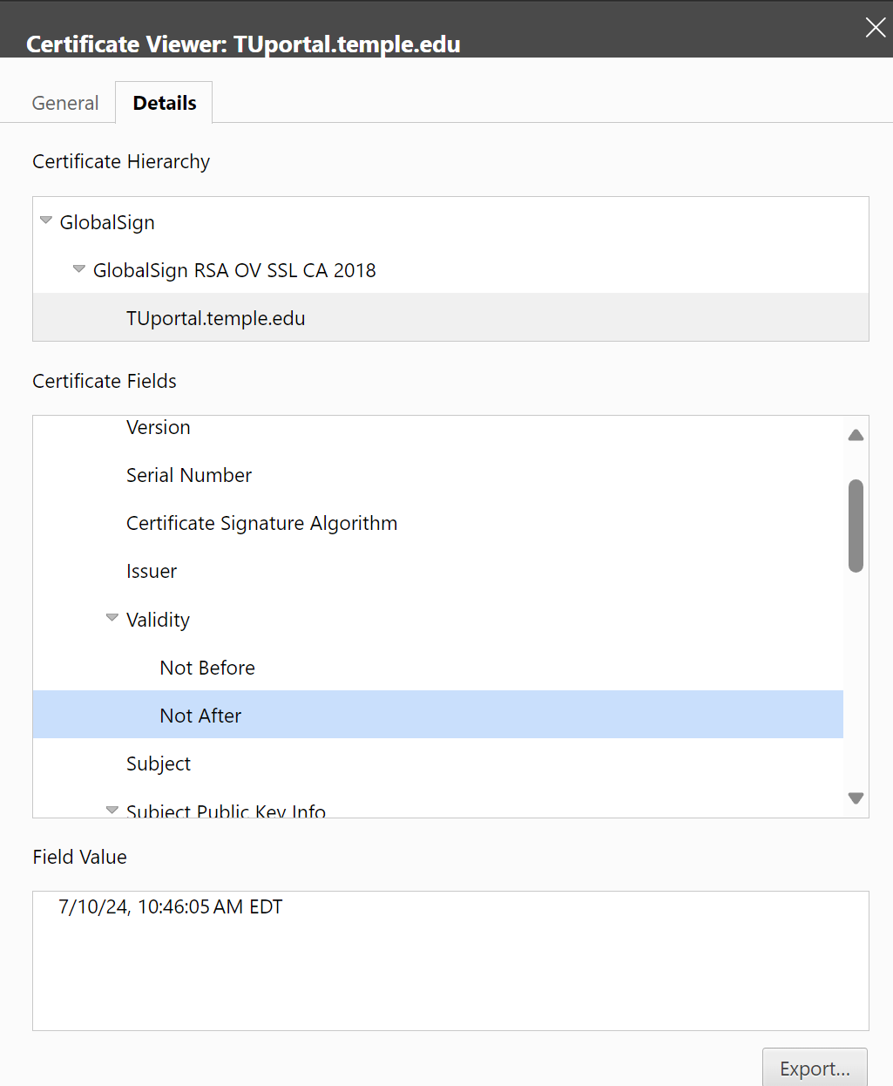
Certificate Details

Slide 9
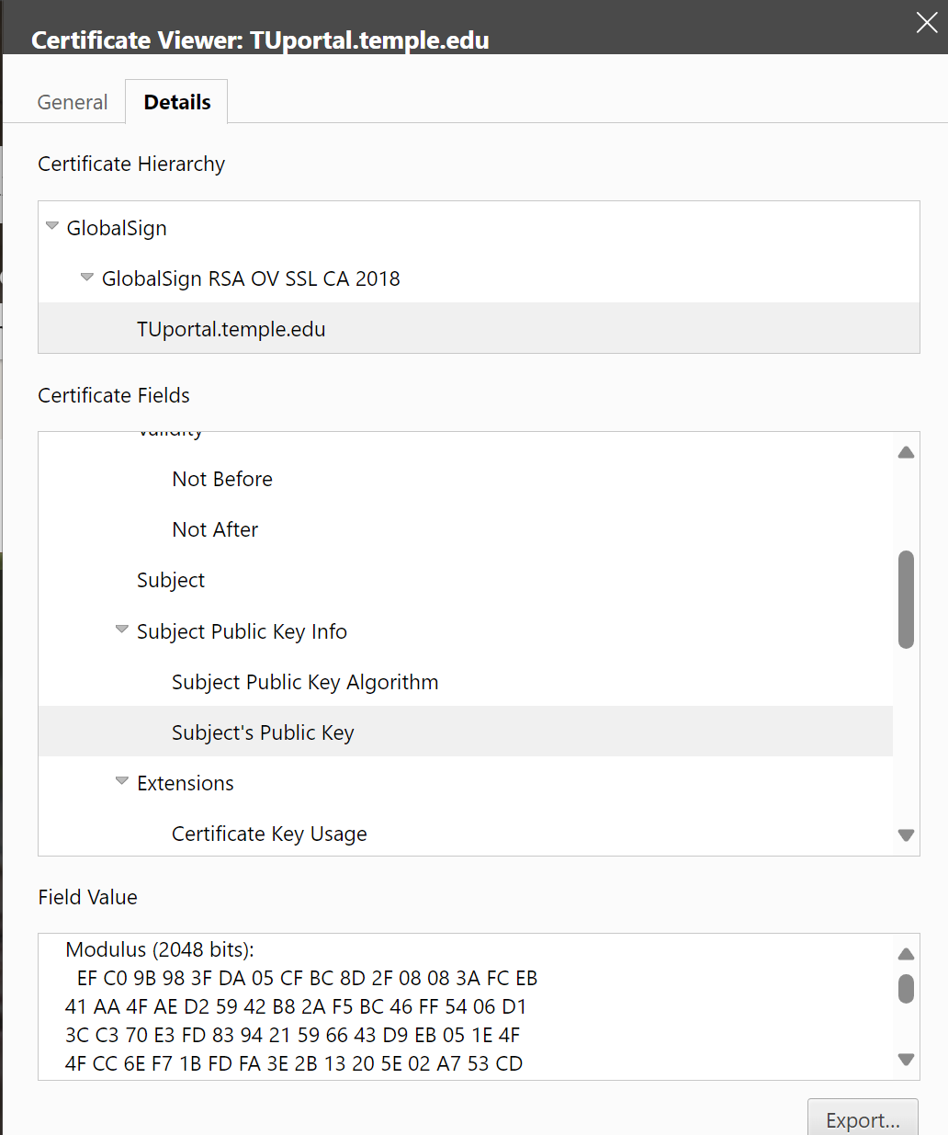
Certificate Details

Slide 10
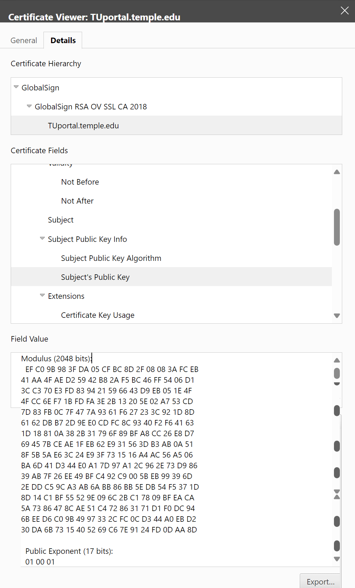
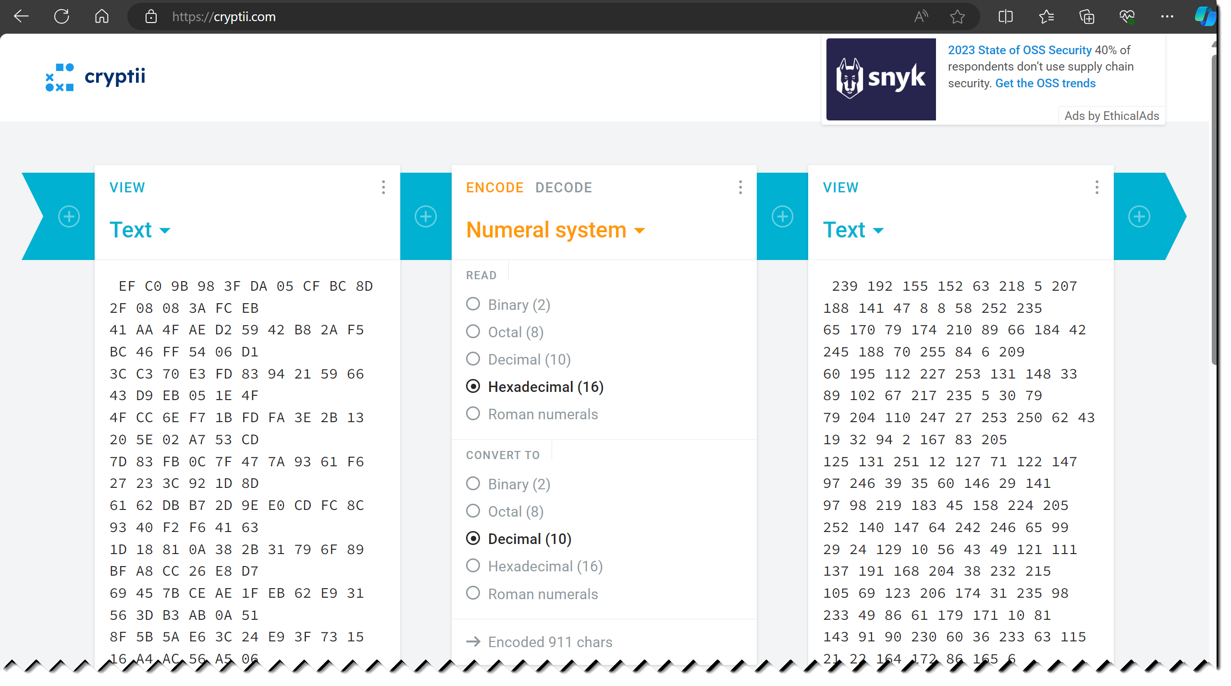
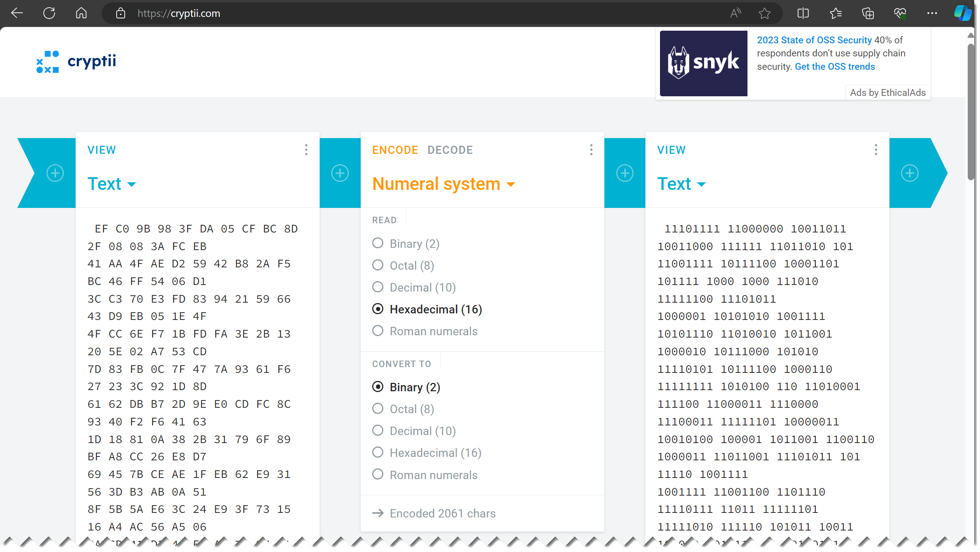
https://cryptii.com/

Slide 11
Public Key Certificate
Electronic documents used to prove ownership of a public key
A certificate includes the following common fields:
  Information about the certificate
    Serial Number: Used to uniquely identify the certificate
    Issuer: Entity that verified the information and signed the certificate
    Signature Algorithm: The algorithm used to sign the public key certificate
    Signature: A signature of the certificate body by the issuer's private key
  Information about the public key
    Not Before: Earliest time and date on which the certificate is valid.
    Not After: Time and date past which the certificate is no longer valid
    Key Usage: Valid cryptographic uses of the certificate's public key, e.g. digital signature validation, key encipherment, and certificate signing
    Extended Key Usage: Applications the certificate may be used for, e.g. TLS server authentication, email protection, code signing, or electronic signature
  Information about the identity of its owner (called the subject)
    Subject: Entity a certificate belongs to, e.g. individual, machine, or organization

Slide 12
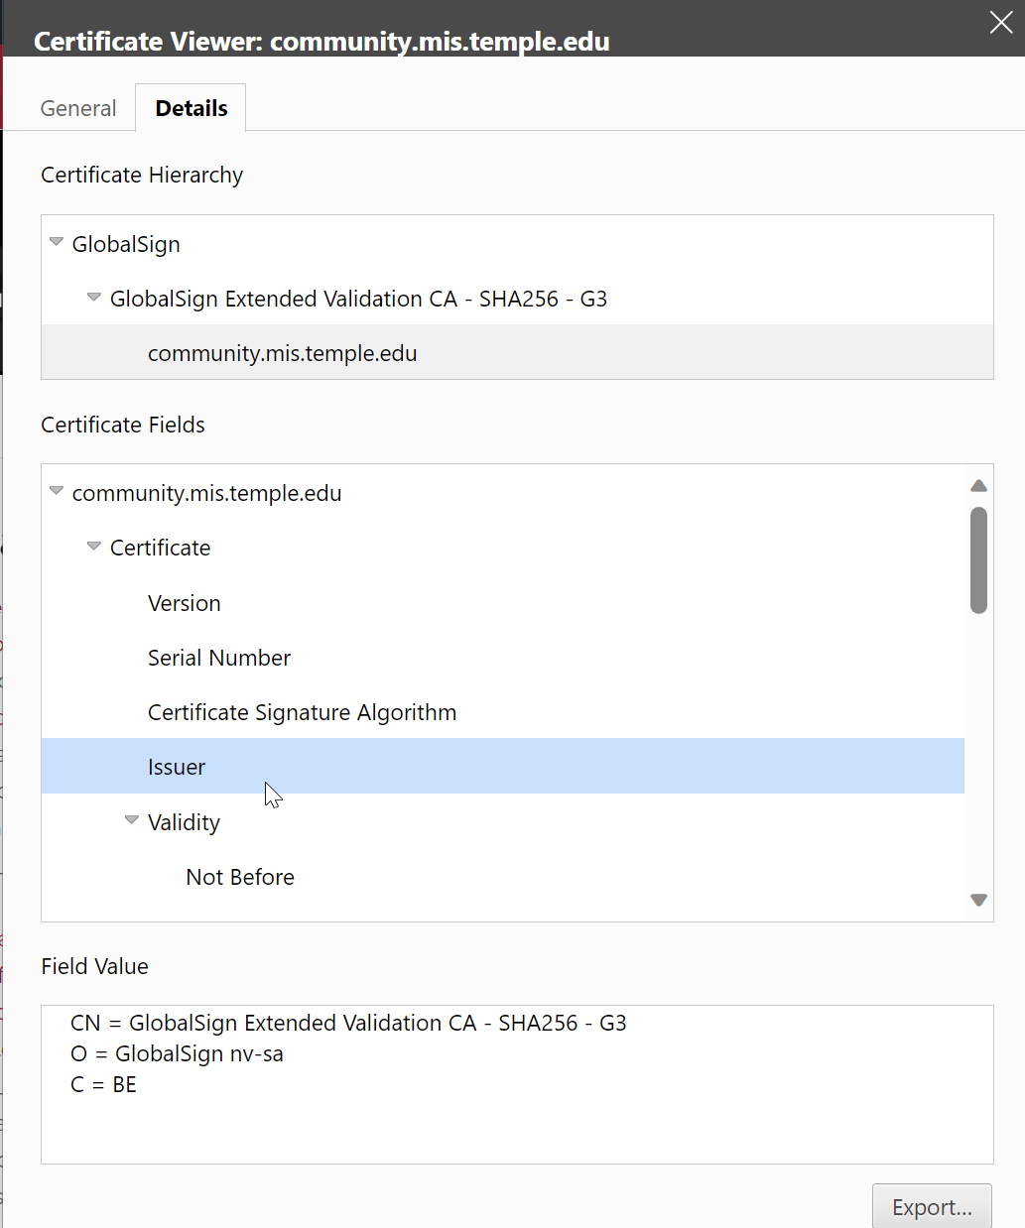
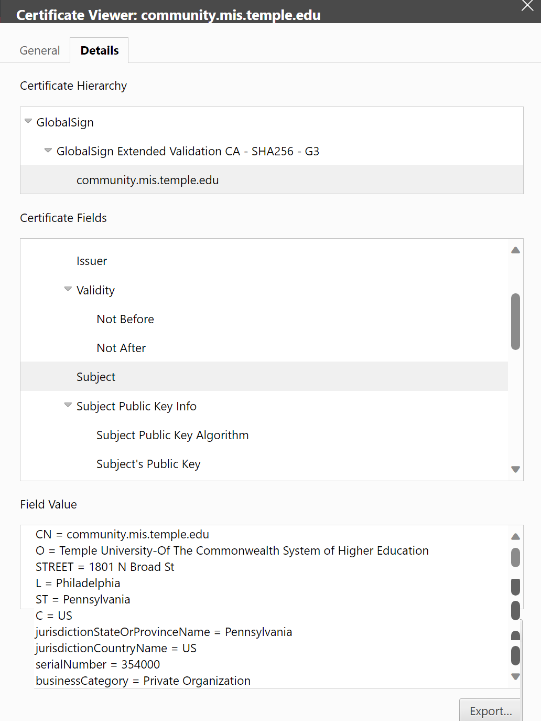

Slide 13
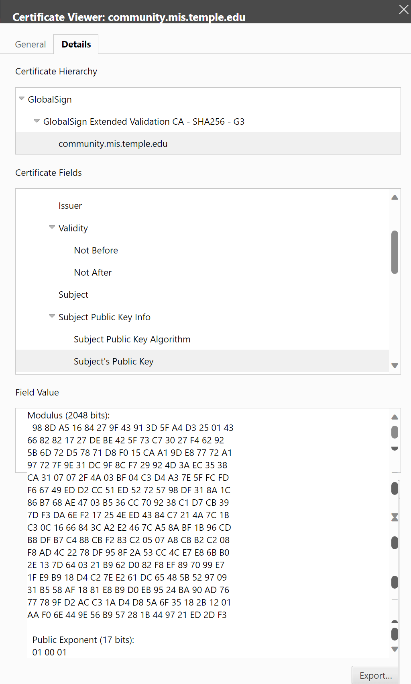
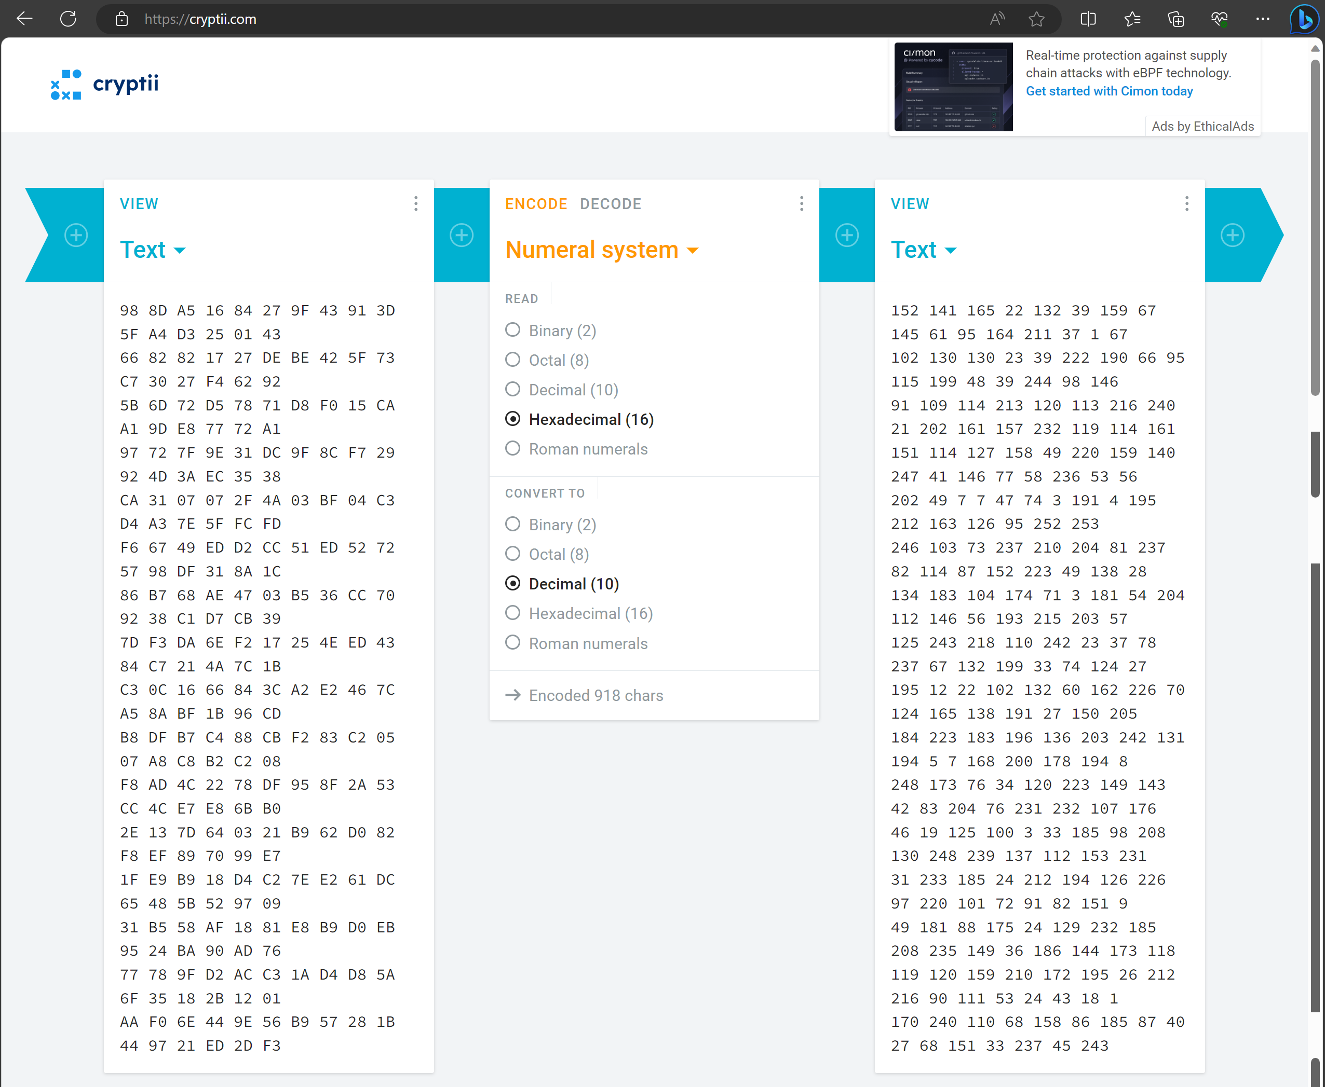
https://cryptii.com/

Slide 14
Types of Certificates: Different cryptographic protocols (“applications”)
X.509 is a standard of the International Telecommunications Union which defines the format of public key certificates used in many Internet cryptographic protocols, including:
Transport Layer Security (TLS/SSL) HTTPS protocol for securely browsing the web
  Certificate's subject is typically a computer or other device, but may also identify organizations or individuals
  Server certificate
    A server is required to present a certificate as part of the initial connection setup. A client connecting to that server will validate the certificate by checking that
      The certificate’s subject matches the hostname (i.e. domain name) to which the client is trying to connect
      The certificate is signed by a trusted certificate authority
  Client certificate (less common than server certificates)
    Used to authenticate the client connecting to a TLS service (e.g. for access control)
    Most client certificates contain an email address or personal name rather than a hostname
Email encryption certificate
  A certificate's subject is typically a person or organization
  For secure email, senders use an email certificate to discover which public key to use for any given recipient
Code signing certificate
  A code signing certificate is used to validate signatures on programs to ensure they were not tampered with during delivery
Qualified digital certificate
  A “Qualified digital certificate” identifies an individual for electronic signature purposes

Slide 15
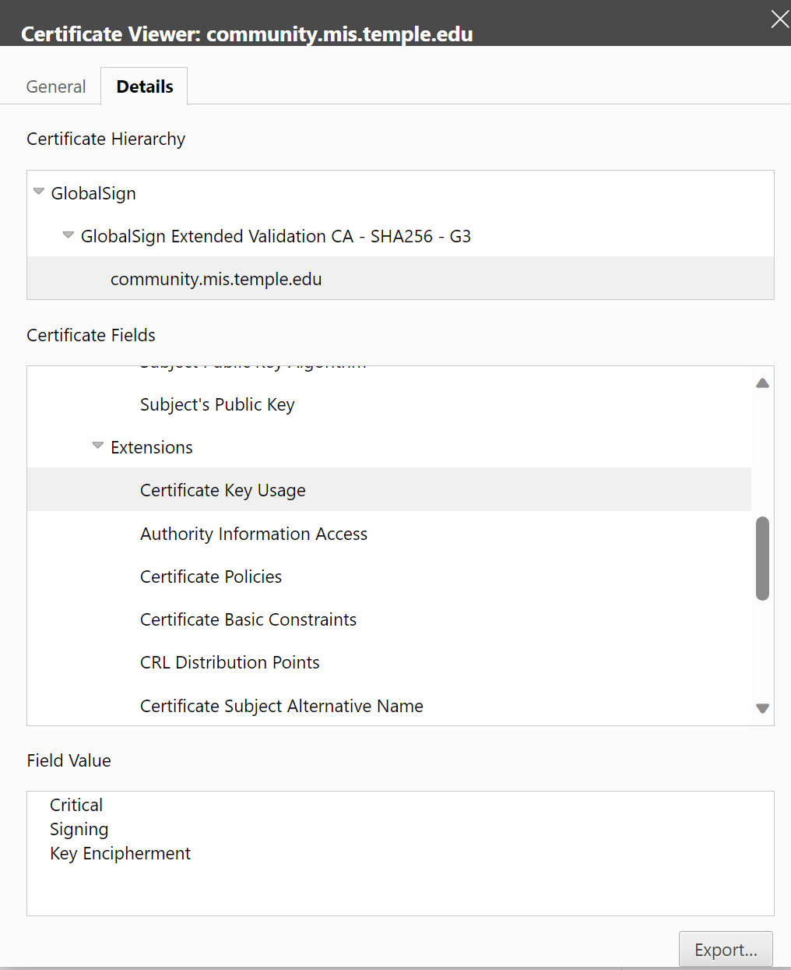
Certificate Key Usage

Slide 16
Roles in PKI - Certificate Authority (CA)
Serves as a trusted third party responsible for verifying identities and signing digital certificates of identity (“digital signature”) which are exchanged between two parties introducing themselves to each other
Each person wanting to participate in a PKI requires a digital certificate
  Digital certificate is a credential containing the public key for that individual along with other identifying information
A CA is a trusted organization (or server) responsible for:
  Issuing (creating and handing) out digital certificates
  Maintaining digital certificates
  Revoking digital certificates
Use of PKI and exchanging digital certificates is intended to block Man-in-the-Middle attacks where 2 users are not working in PKI environment do not truly know the identity of the owners of public keys

Slide 17
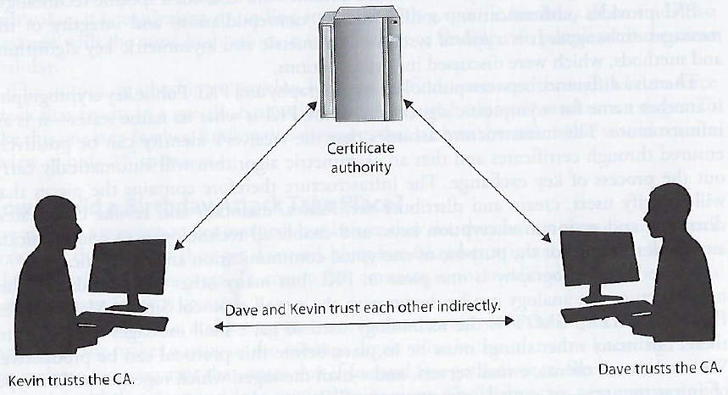
Roles in PKI - Certificate Authority (CA)
Each person wanting to participate in a PKI requires a digital certificate
  Digital certificate is a credential containing the public key for that individual, computer or organization along with other identifying information
When a CA signs the certificate, it binds the individual’s, computer’s or organization’ identity to the public key
  The CA takes liability for the authenticity of the identity
    Making a CA the “trusted 3rd party” that allows people who have never met to use their public keys to authenticate each other and communicate in a secure way
Certificate Revocation Information
  CA’s are also responsible for maintaining up-to-date revocation information about certificates they have issued, indicating when certificates of identity are no longer valid

Slide 18
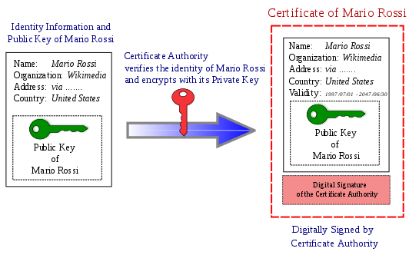
Roles in PKI – Certificate Authority (CA)
New Certificate Requests
  A CA processes requests from people or organizations requesting certificates (called “subscribers”)
    Verifies the subscriber’s information
    Potentially signs an end-entity certificate based on the subscriber’s information

Slide 19
Registration Authority (RA)
When a user needs a new certificate, the user makes a request to the RA
RA serves as a broker between the user and the CA, and performs certain certification registration tasks
  Performs the certificate life-cycle management functions
  Establishes and confirms the identity of the individual
    The RA verifies all the necessary identification information before allowing a request to go to the CA
  Initiates the certification process with the CA for the end user
RA cannot issue certificates

Slide 20
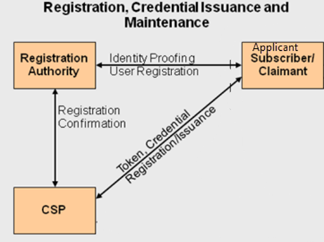
PKI Steps
Suppose: John needs to obtain a digital certificate to participate in PKI
John requests a digital certificate from a RA
The RA requests John’s identification information
  E.g. driver’s license, address, phone number, email, …
RA receives John’s information, verifies it, and sends his certificate request to CA
CA creates a certificate with John’s public key and embedded identity information
  Private/Public key pair is generated on John’s machine or by the CA (depends on system configuration)
    Usually – user generates this pair and sends his public key in as part of registration process
    If CA creates key pair, John’s private key needs to be sent to him via secure means
Now John is registered and is able to participate in PKI
Certificate Authority
Token, Credential = Public Key

Slide 21
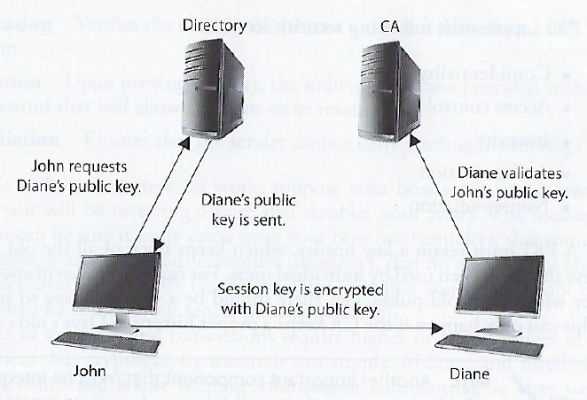
PKI Steps
John and Diane decide to communicate securely using PKI…
John requests Diane’s public key form a public directory
The directory (a.k.a. repository) sends Diane’s digital certificate
John verifies the digital certificate…
  extracts her public key, uses the public key to encrypt a session key that will be used to encrypt their messages
  John sends the encrypted session key to Diane
  John also sends his certificate, containing his public key to Diane
Diane browser receives John’s certificate, looks to see if it trusts the CA that digitally signed the certificate
  Diane’s browser trusts this CA
  After verifying the certificate, both John and Diane can communicate using encryption

Slide 22
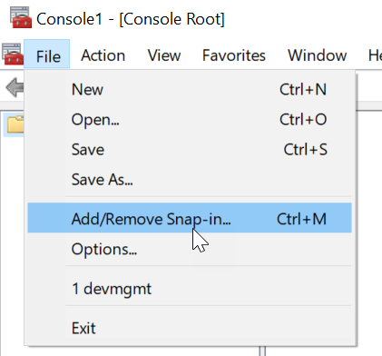
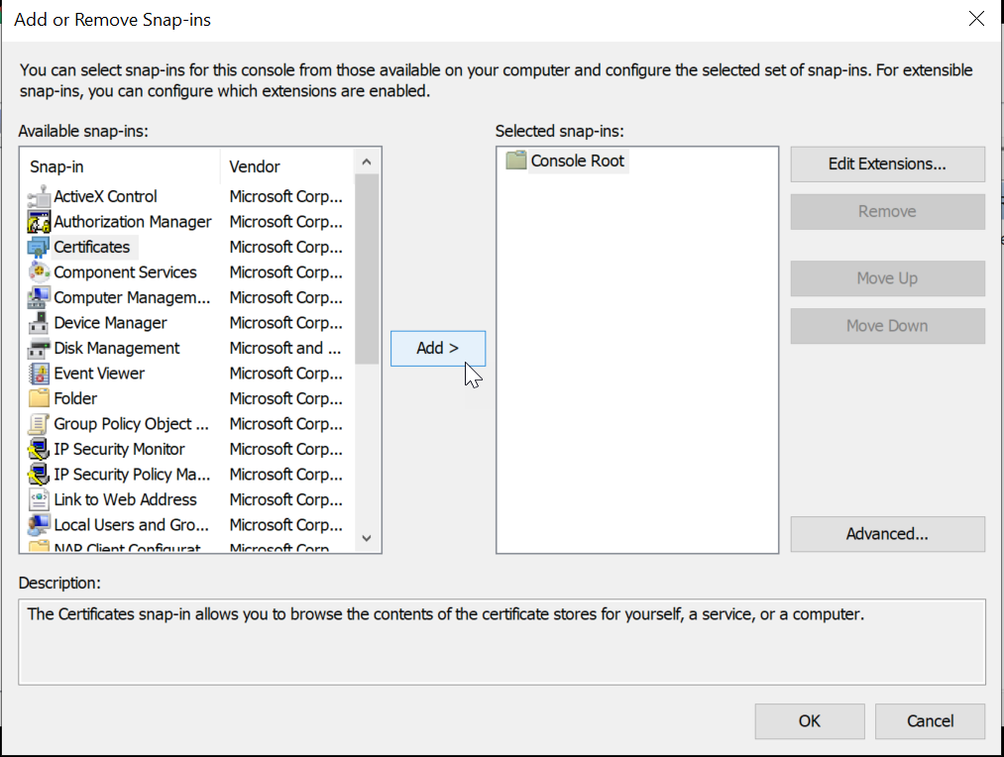
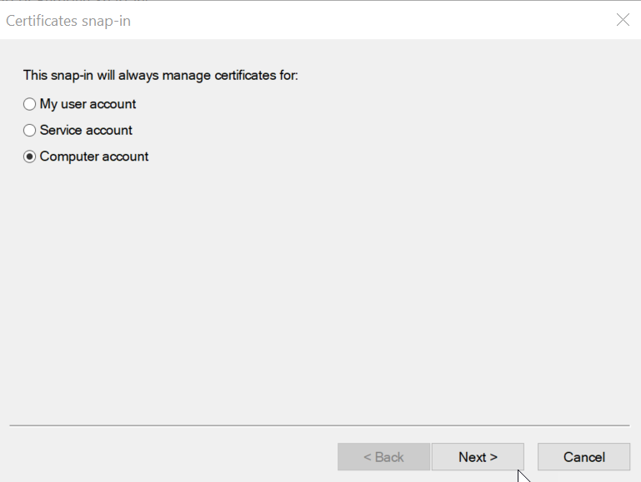
Microsoft Windows Root Program’s Trust Stores
Run mmc.exe
Select File -> Add/Remove Snap-in
Select Certificates, click Add
Select Computer Account, click next, click Finish
Expand the Certificates node -> Trusted Root Certificate Authorities Store

Slide 23
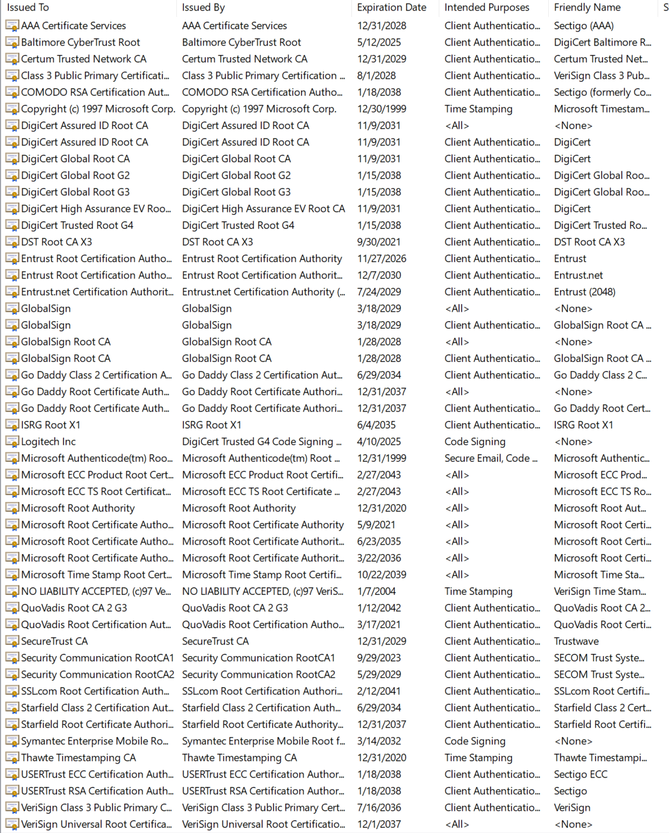

Microsoft Windows Root Program’s Trust Stores

Slide 24
Mac OS X
The root store is in the Keychain.app
  Search Finder (Spotlight) for “keychain”
  Double-click Keychain Access app
  Select “System Roots” in the left-hand pane

Slide 25
Certificate Revocation List (CRL) – in principal
CRL is the mechanism for the CA to let others know that a certificate has become invalid for some reason
A certificate may be revoked because
  The key holder’s private key was compromised
  CA discovered the Certificate was issued to the wrong person
  The certificate expired
  The certificate became invalid for other reasons…
The CA handles revocation by putting the revoked certificate’s information on a certificate revocation list (CRL)
  The CRL is a list of every certificate that has been revoked
  The CRL is maintained and updated

Slide 26
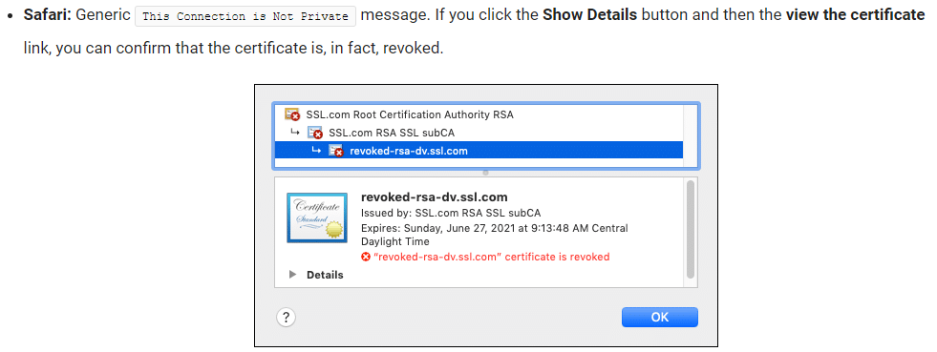
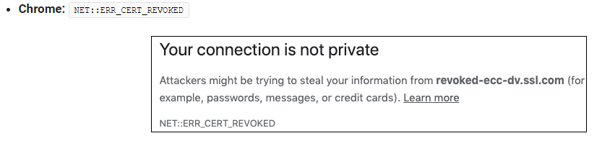
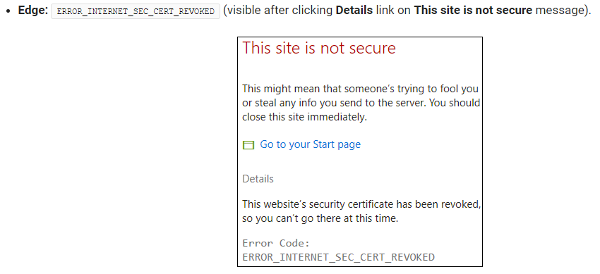
Examples of Browsers Rejecting Revoked Certificates

Slide 27
Certificate Revocation List (CRL) – in practice
CRLs are problematic in many PKI implementations for many reasons
  Either user’s browser must check a central CRL to find out if a certificate has been revoked
  …or the CA must continually push out CRL values to clients to ensure they have an updated CRL
By default, web browsers do not check a CRL to ensure that a certificate is not revoked
  So when you are setting up a SSL connection to do e-Commerce over the Internet, you may be relying on a revoked certificate and not know it
Online Certificate Status Protocol (OCSP) is increasingly being used…
  If OCSP is implemented, it works automatically
  OCSP does real-time certificate validation
    Checks the CRL maintained by the CA
    Notifies user if certificate is valid, invalid, or unknown
  Publicly trusted CAs (e.g. SSL.com) maintain HTTP servers called OCSP responders
    OCSP responders sign their responses with the CA’s private signing key so browsers can verify that the received revocation status was generated by the actual CA
Example of “invalid” certificate: https://www.iad.gov/nietp/caerequirements.cfm

Slide 28
Online Certificate Status Protocol (OCSP) – In Practice
Contacting a responder and waiting for a response for every certificate encountered by a browser encounters adds perceptible network overhead, especially in pages containing third-party content stored in remote content-distribution servers
  Amazon calculated that a delay of one second can cost them about $1.6 billion yearly
This motivated browsers and other client software to implement OCSP checking in soft-fail mode
  If an OCSP server cannot be reached or times out while giving its response, browsers consider the certificate valid and proceed with the HTTPS connection anyway
Man-in-the-middle (MITM) attackers can exploit this behavior by blocking all connections to OCSP responders, and then can use a stolen certificate and key pair for a malicious site, regardless of the certificate’s revocation status

Slide 29
OCSP Stapling Solution
Servers include (or staple) the cached OCSP response in their HTTPS responses alongside the SSL certificate
  This enables browsers before the secure connection is established to verify the CAs signature on the OCSP response and be assured that the certificate has not been revoked
  OCSP stapling enables servers to retrieve cached OCSP responses in non-real-time and remove performance overhead imposed by CRLs and OCSP
  OCSP stapling does not completely solve OCSP’s soft-fail security issue, since stapling is implemented in the server and browsers cannot know if a server actually supports Stapling or not
OCSP Must-Staple (extension of SSL Certificates: RFC 7633)
  Mandates OCSP stapling for the certificate
  If a browser encounters a certificate with this extension that is used without OCSP Stapling, then it will be rejected
  Enabling OCSP stapling on servers improves security and performance for your web site at the same time
https://www.ssl.com/article/page-load-optimization-ocsp-stapling/

Slide 30
Agenda
Public Key Infrastructure
Digital Certificate
Public key Certificates
Roles in PKI: Certificate Authority (CA)
Roles in PKI: Registration Authority (RA)
PKI Steps
Chain of Trust
Root Programs
Certificate Revocation List (CRL)
PKI Roles / Workflows…

Slide 31
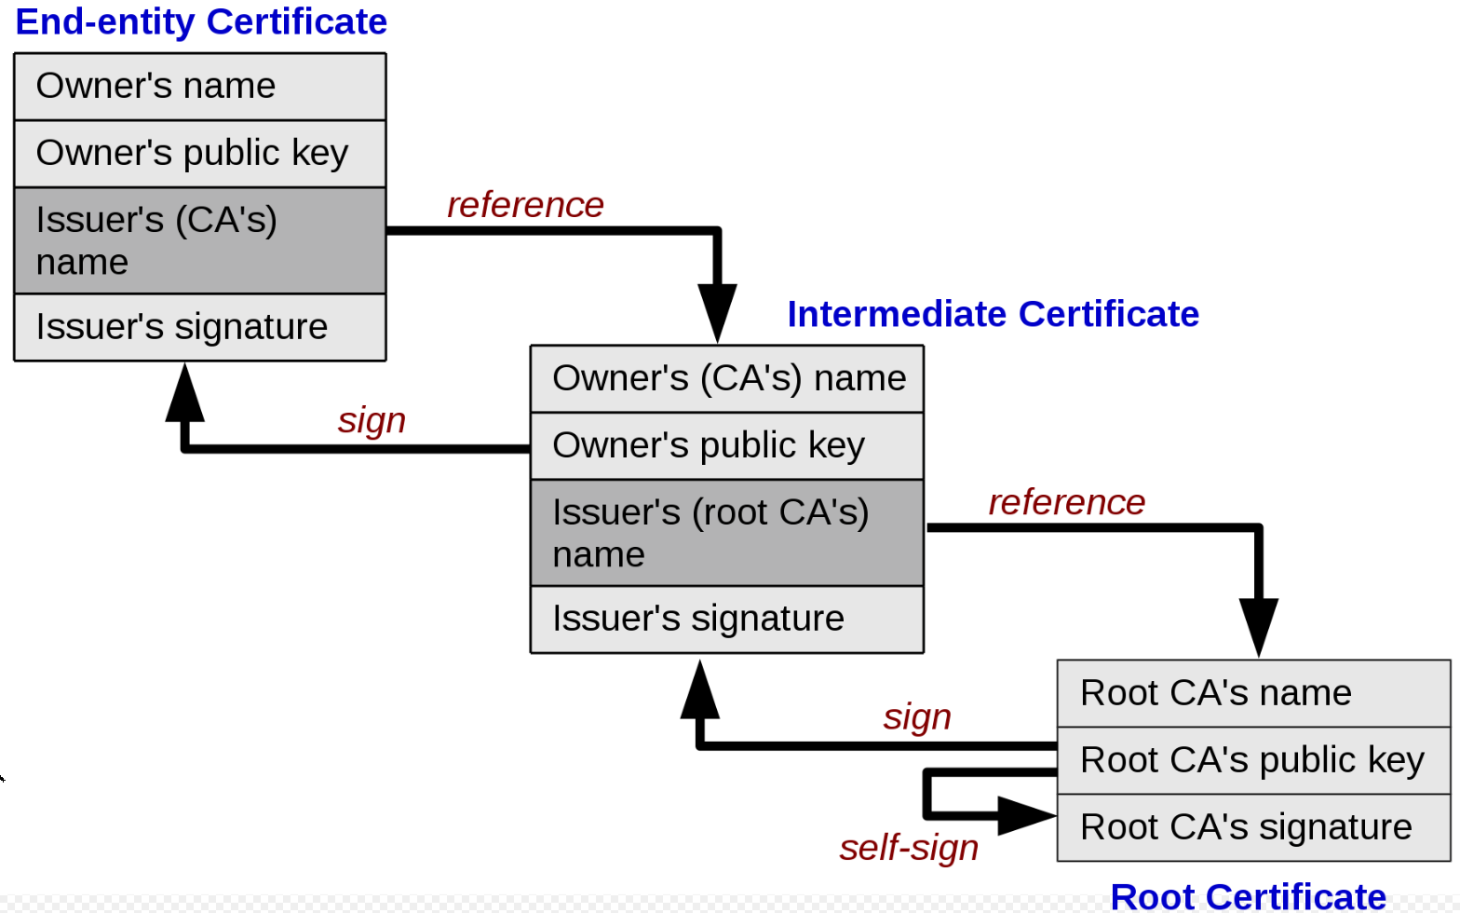
Types of certificates: Chain of trust
A PKI is often set up with multiple levels of CAs, for practical reasons:
There is a top-level CA, called the root, which issues certificates on the keys of lower-level CAs, which in turn certify the user keys
The system of identity validation still behaves in the same way, but now Diane has to check two certificates to verify John’s key
Root certificate
  Self-signed certificate used to sign other certificates
Intermediate certificate
  A certificate used to sign other certificates.
  Must be signed by either a root certificate or another intermediate certificate
End-entity (“leaf”) certificate
  Cannot be used to sign other certificates
  Include:
    TLS/SSL server and client certificates
    Email certificates
    Code signing certificates
    Qualified certificates

Slide 32
SSL Cert Youtube vid
SSL Certificate Chain Explained (Game of Thrones style) (youtube.com)

Slide 33
Appendix

Slide 34
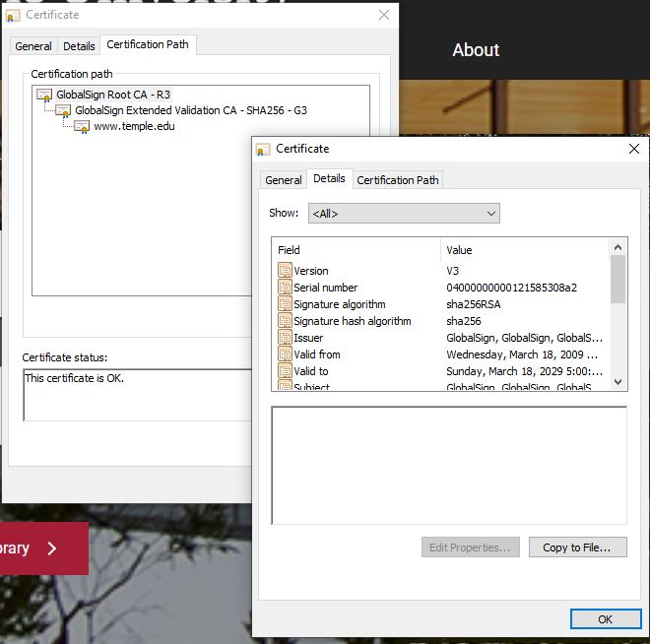
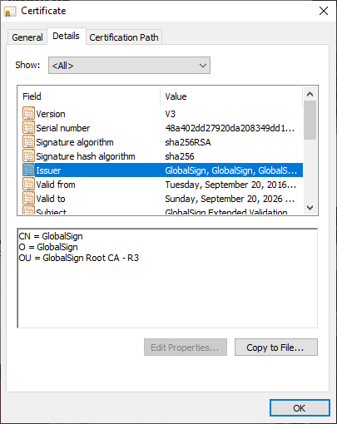
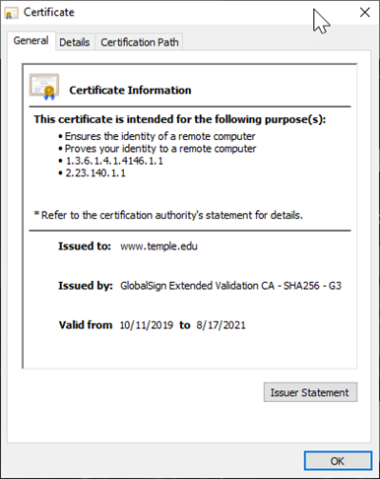
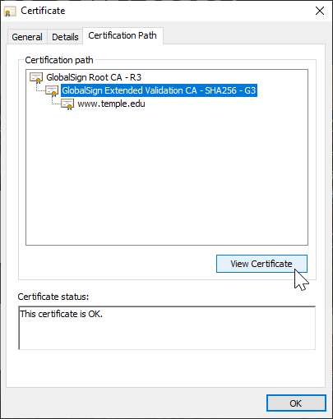
Types of certificates: Chain of trust

Slide 35
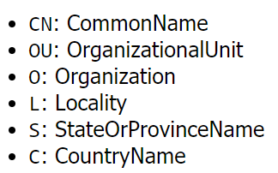
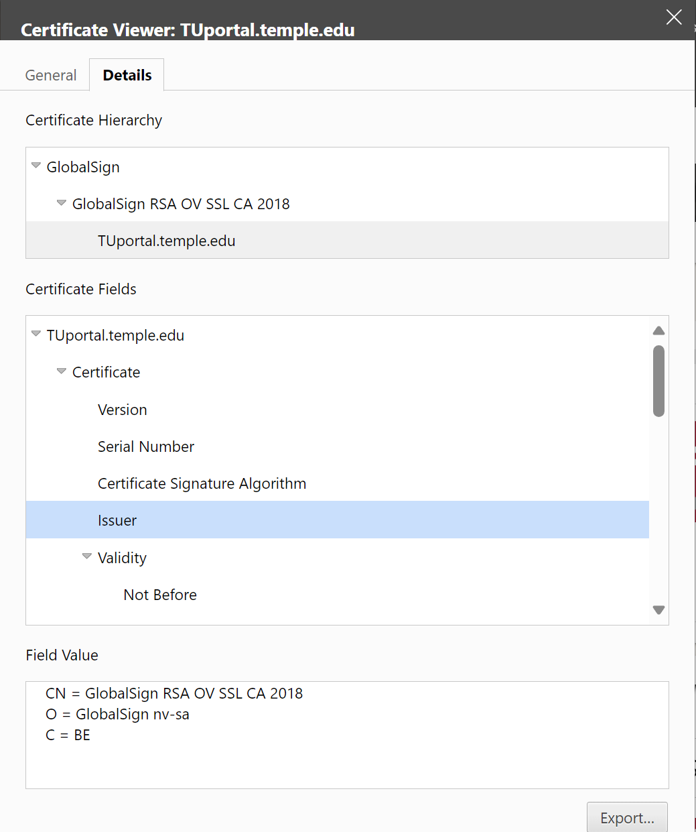
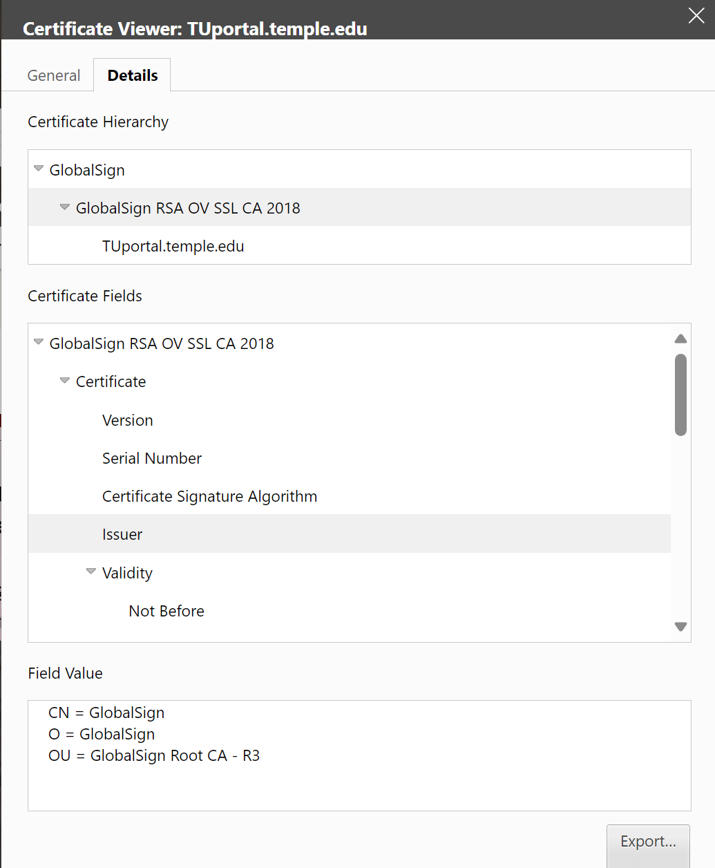
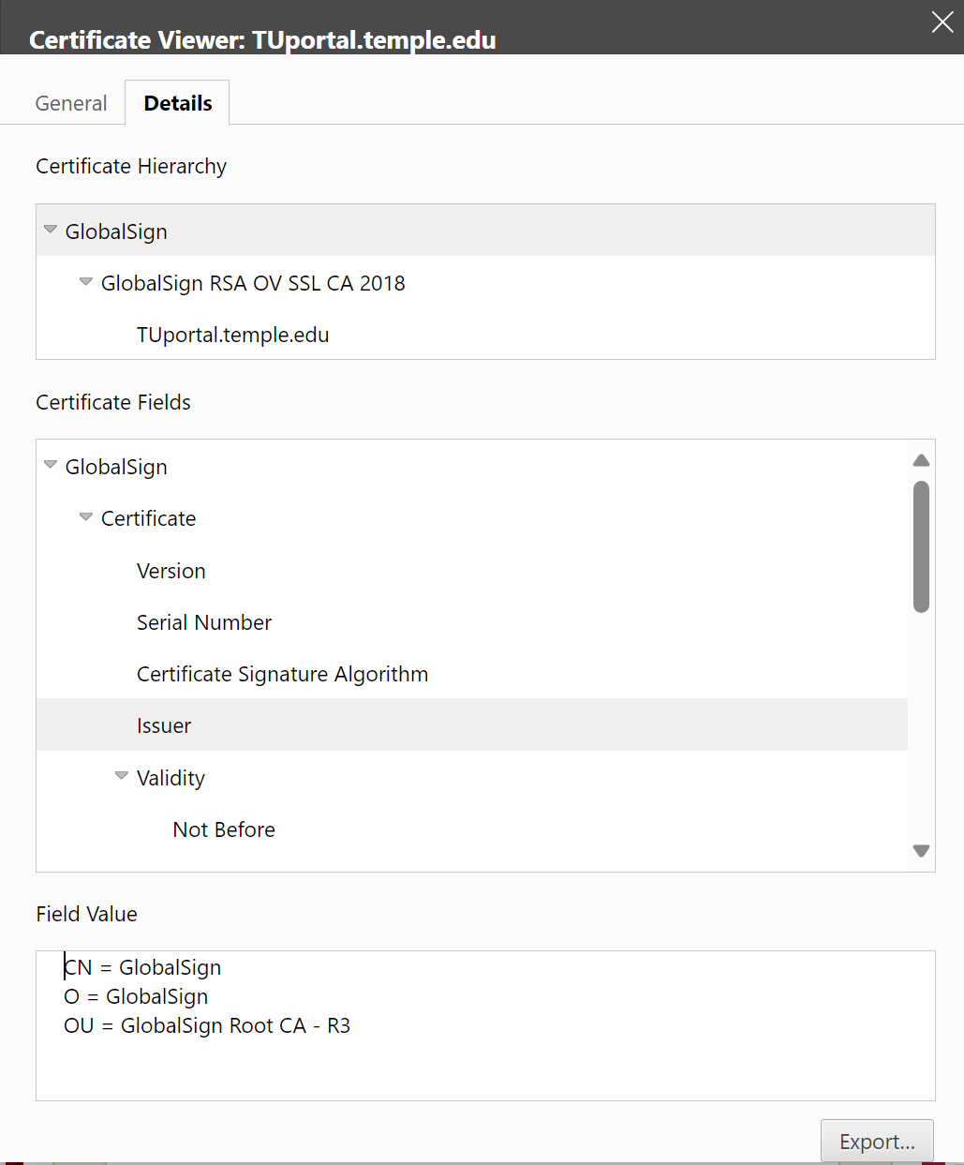
Types of certificates: Chain of trust

Slide 36
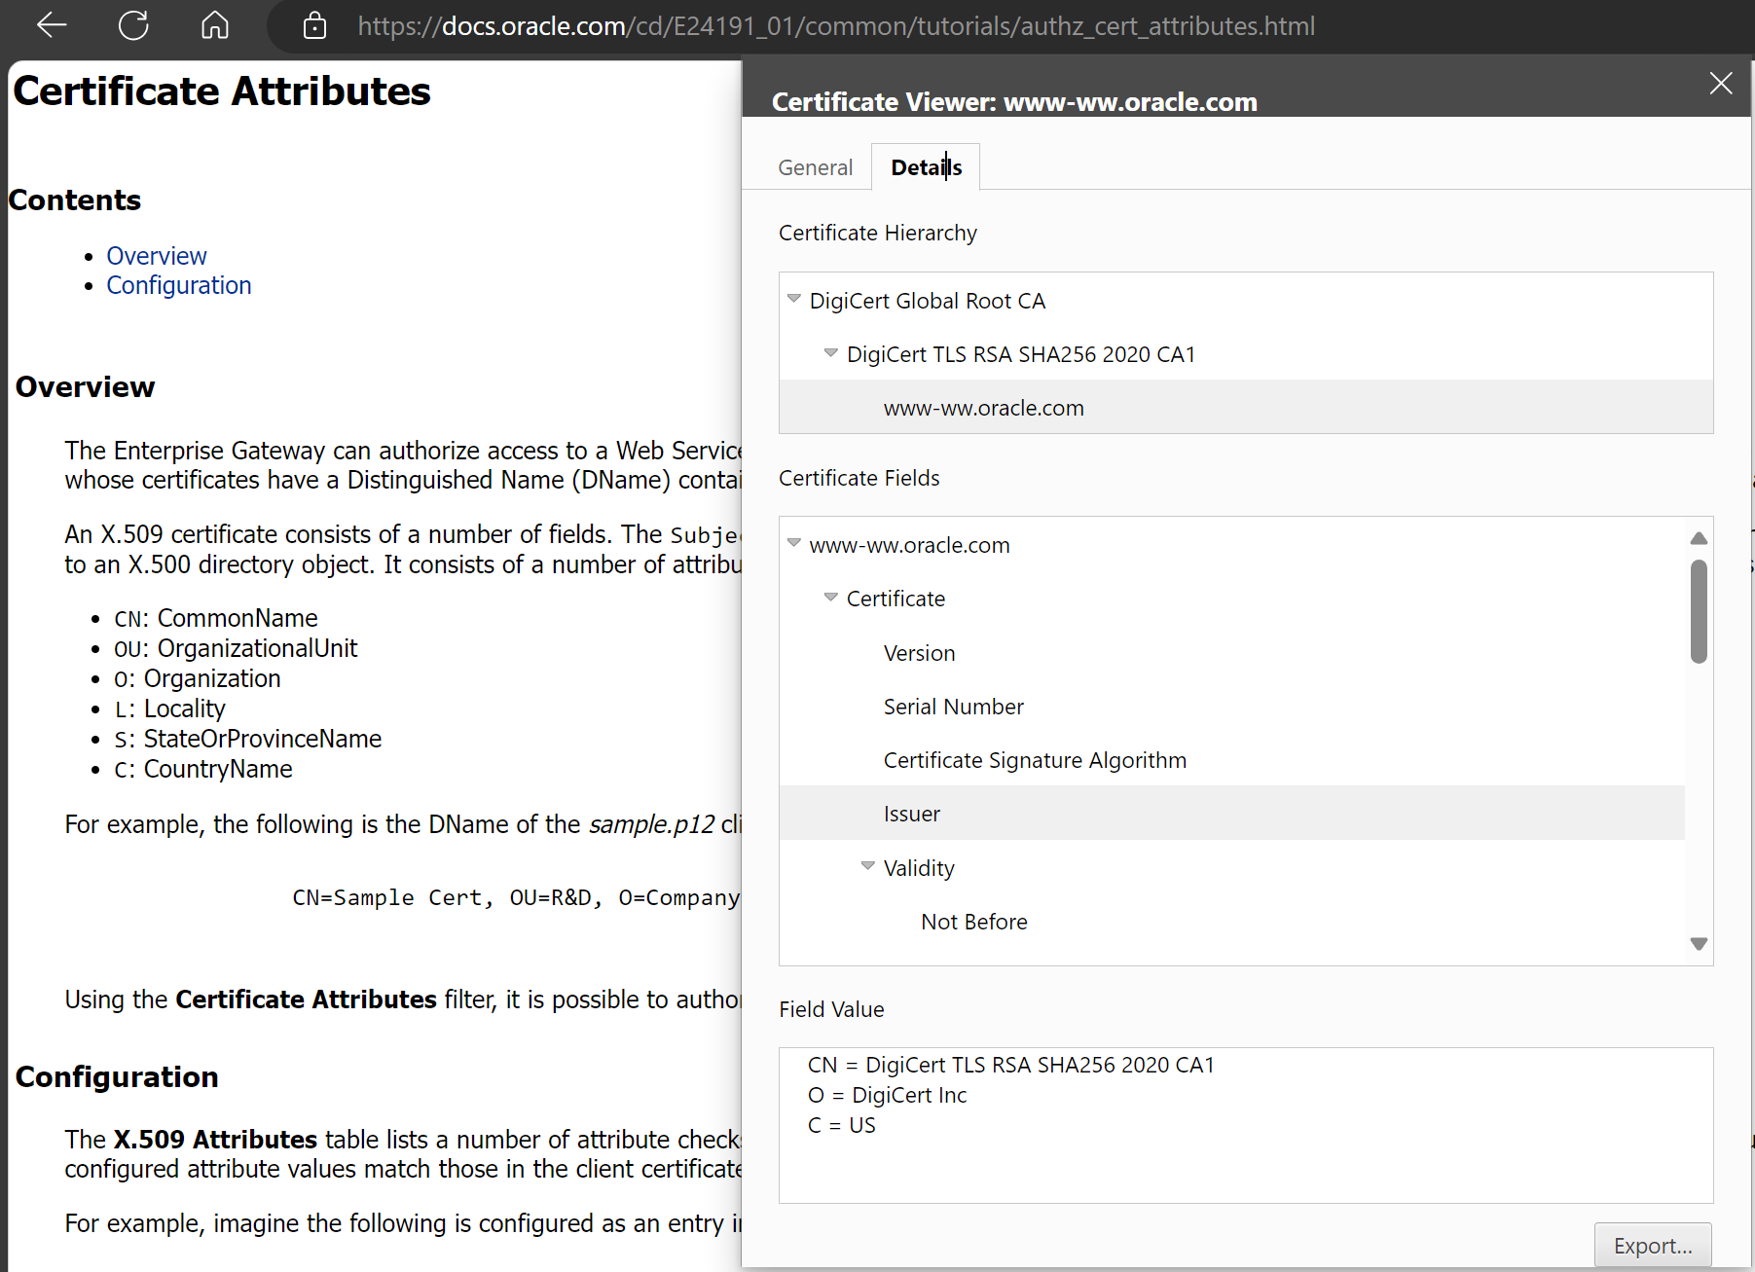
Types of certificates: Chain of trust

Slide 37
Types of certificates: Chain of trust
To perform its role effectively, a CA needs to have one or more broadly trusted root certificates or intermediate certificates and the corresponding private keys
A CA may achieve broad trust by:
  Having its root certificates included in popular software
  Obtaining a cross-signature from another CA delegating trust
Or a CA may be trusted within a relatively small community, like a business
  In which its root certificates are distributed by other mechanisms like Windows Group Policy

Slide 38
Types of certificates: Chain of trust
Root programs:
  Some major software products contain a list of certificate authorities that are trusted by default
  This makes it easier for end-users to validate certificates, and easier for people or organizations that request certificates to know which certificate authorities can issue a certificate that will be broadly trusted
  This is particularly important in HTTPS, where a web site operator generally wants to get a certificate that is trusted by nearly all potential visitors to their web site
The most influential root programs are:
  Microsoft Root Program
  Apple Root Program
  Mozilla Root Program
  Oracle Java root program
  Adobe Approved Trust List and EUTL root programs (used for document signing)

Slide 39
Types of certificates: Chain of trust
Root programs:
Browsers generally use the operating system's facilities to decide which certificate authorities are trusted:
  Google Chrome on Windows trusts certificate authorities included in Microsoft Root Program
  Google Chrome on macOS or iOS trusts certificate authorities in Apple Root Program
  Edge and Safari use their respective operating system trust stores as well, but each is only available on a single OS.
Firefox, in contrast, uses the Mozilla Root Program trust store on all platforms

Slide 40
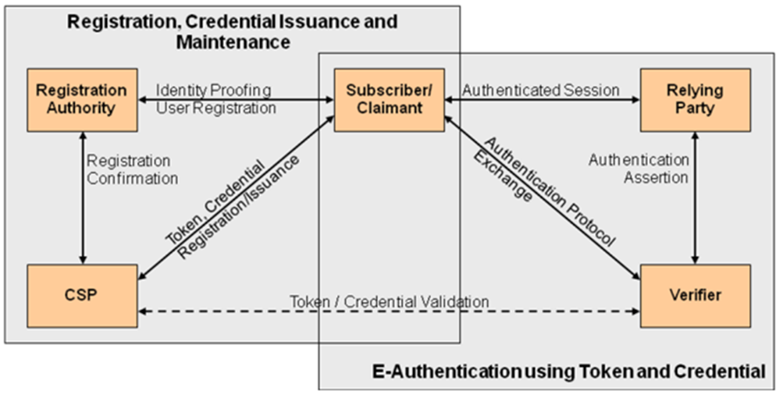
PKI Roles and Workflows
Basic Online Certificate Status Protocol (OCSP)
Alice and Bob have public key certificates issued by Carol, the certificate authority (CA)
Alice wishes to perform a transaction with Bob and sends him her public key certificate
Bob, concerned that Alice's public key may have been compromised, creates an 'OCSP request' that contains Alice's certificate serial number and sends it to Carol
Carol's OCSP responder reads the certificate serial number from Bob's request. The OCSP responder uses the certificate serial number to look up the revocation status of Alice's certificate. The OCSP responder looks in a CA database that Carol maintains. In this scenario, Carol's CA database is the only trusted location where a compromise to Alice's certificate would be recorded
Carol's OCSP responder confirms that Alice's certificate is still OK, and returns a signed, successful 'OCSP response' to Bob
Bob cryptographically verifies Carol's signed response. Bob has stored Carol's public key sometime before this transaction. Bob uses Carol's public key to verify Carol's response
Bob completes the transaction with Alice
Certificate Authority
Token, Credential = Public Key

