Slide 1
Managing Enterprise Cybersecurity MIS 4596
Unit #14

Slide 2
Agenda
Reminder: Change your Kali password if you haven’t done so yet!
Application vulnerability and security testing
Lab 8: Vulnerability Scanning –
Startup and access virtual machines
Part 1: Nmap
Part 2: Nessus
Scan results
Looking at a vulnerability

Slide 3
Reminder: Change Kali’s root Password Now (if you have not already done so)!
Kali’s default root password is published and known to everyone
Login: root
Password: toor
If you leave Kali running in the cloud (by mistake), someone may find it
If they know enough to find it, they know enough to login and access it
If they use it, attack someone and create a problem – you are responsible!
Change Kali’s root password now!
From the $ prompt, type:
“sudo passwd root”

Slide 4
Application Security
As applications become more accessible though the web, cloud and mobile devices,
organizations are being forced to abandon their reactive approach to security and, instead,
to take a proactive approach by minimizing risk directly in the software they buy, create and use to serve themselves and their customers

Slide 5
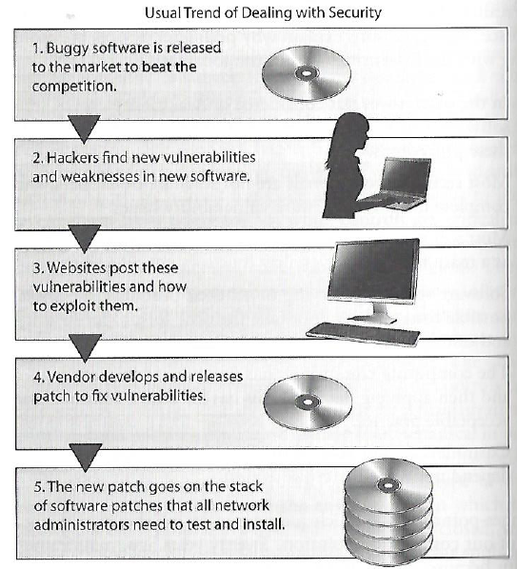
Usual trend
Harris, S. and Maymi F. (2016) CISSP All-in-One Exam Guide, McGraw-Hill Education, p. 1080

Slide 6
Software security, includes threat and attack surface analysis…
Attack surface is what is available to be used by an attacker against the application itself
Goal of attack surface analysis is to identify and reduce the amount of code and functionality accessible to untrusted users
Development team should reduce the attack surface as much as possible to remove “resources” that can be used as avenues for the attacker to use
How do you know the web browser is used by the person you expect?
Is it OK for data to go from one “box” to the next without being authenticated?
Is it OK for data to go from one “box” to the next without being encrypted?
What happens if someone made unauthorized modifications to data in the database?

Slide 7
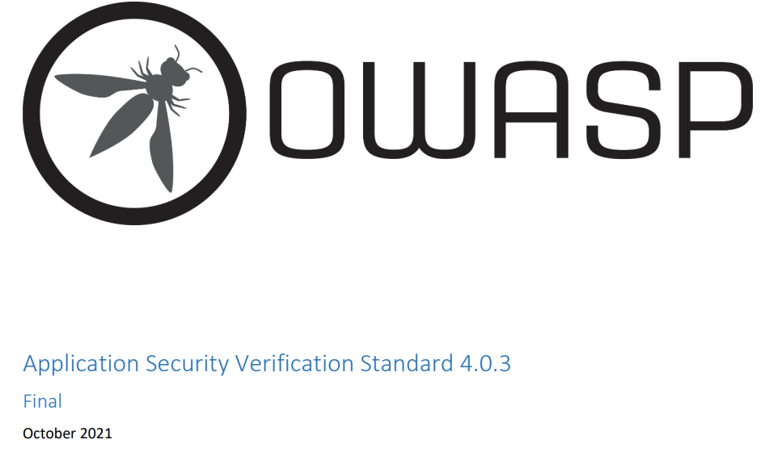
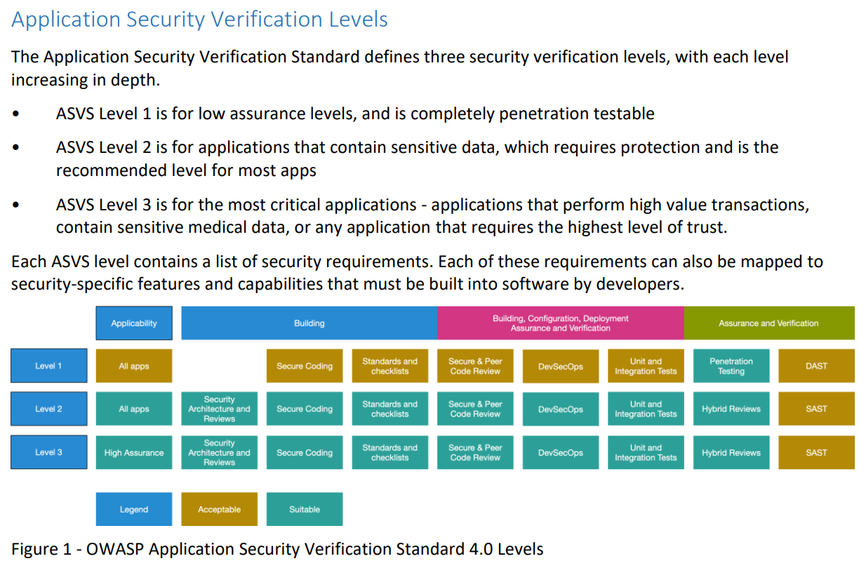

Slide 8
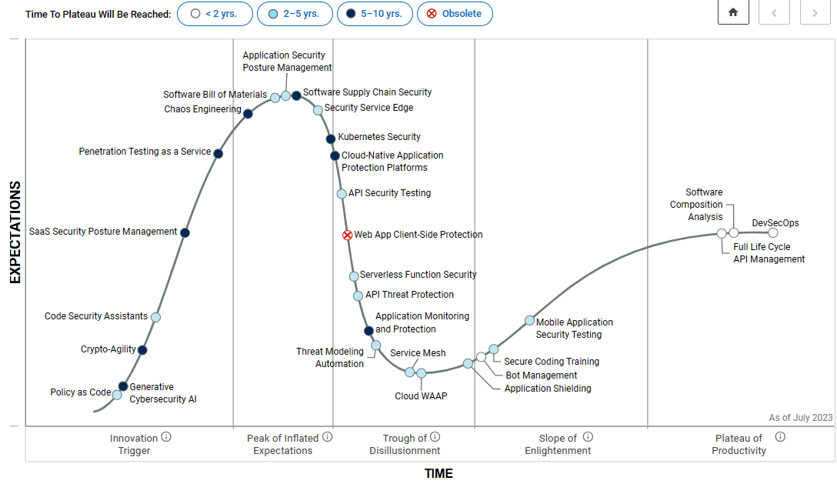
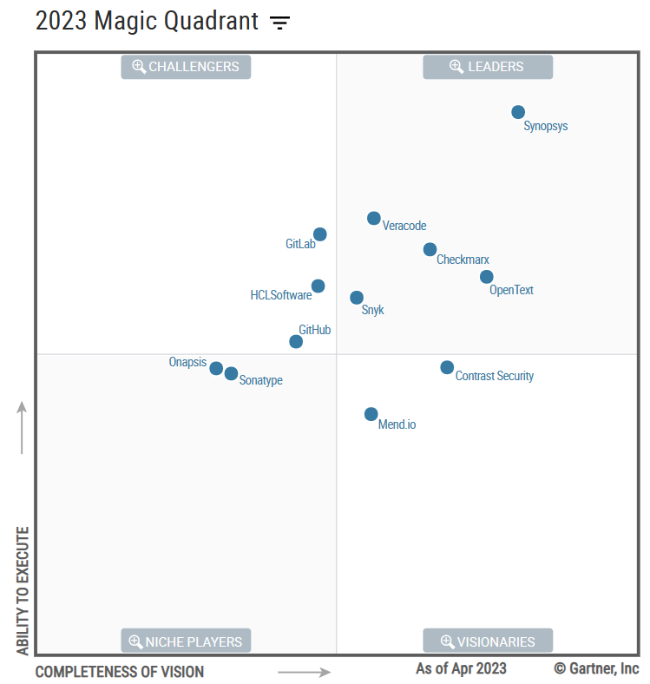
Application Security Testing (AST)
Fundamental Capabilities
Static AST (SAST)
Software Composition Analysis (SCA)
Dynamic AST (DAST)
API Testing
SBOM = Software Bill Of Materials
ASRTM = Application Security Requirements and Threat modeling
CSSTP = Crowdsourced Software Security Testing Platforms (i.e. bug bounties)
WAAP = cloud Web Application and API Protection
EAM = Externalized Authorization Management
Estimated AST market reached $3.4 billion in 2022

Slide 9
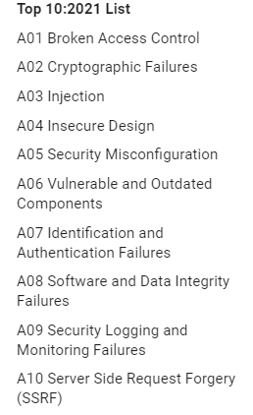
https://www.owasp.org/index.php/OWASP_Top_Ten_Cheat_Sheet

Slide 10
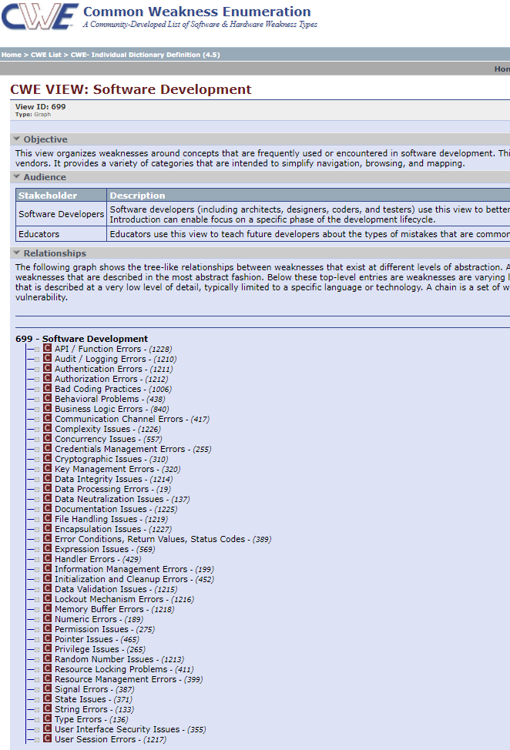
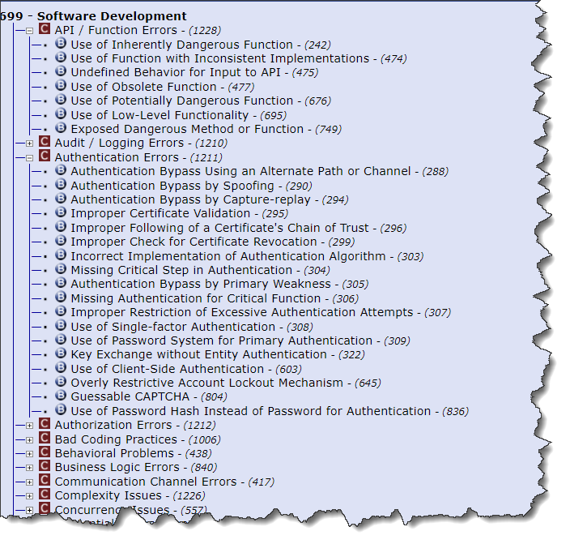
MITRE’s Common Application Vulnerabilities

Slide 11
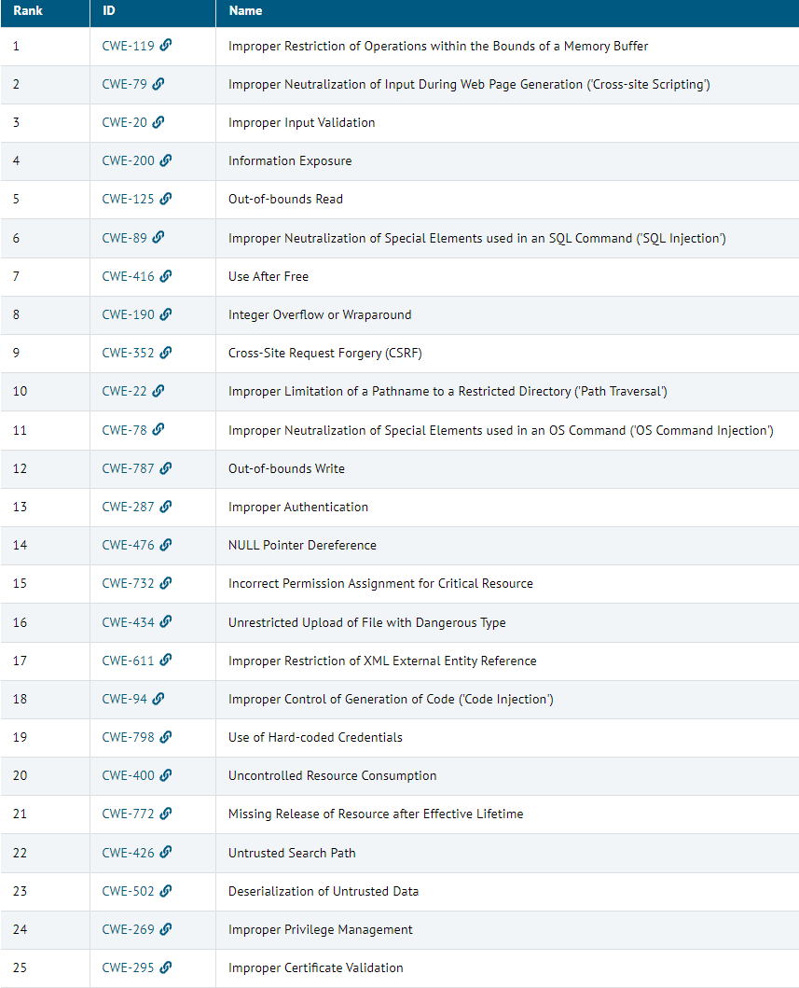
MITRE’s Common Weakness Enumeration

Slide 12
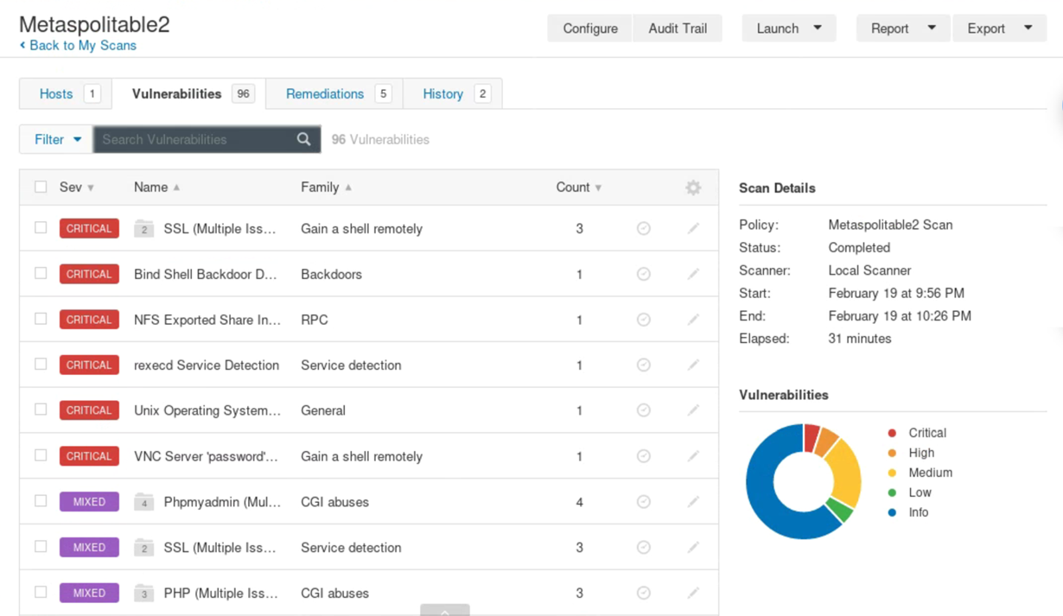
Vulnerability Scanning
Scanning methods:
Safe
Destructive
Service recognition – Determines what service is running on which ports
Reports
Indicates the threat level for vulnerabilities it detects
Critical
High
Medium
Low
Informational
Description of Vulnerability
Risk Factor
CVE Number

Slide 13
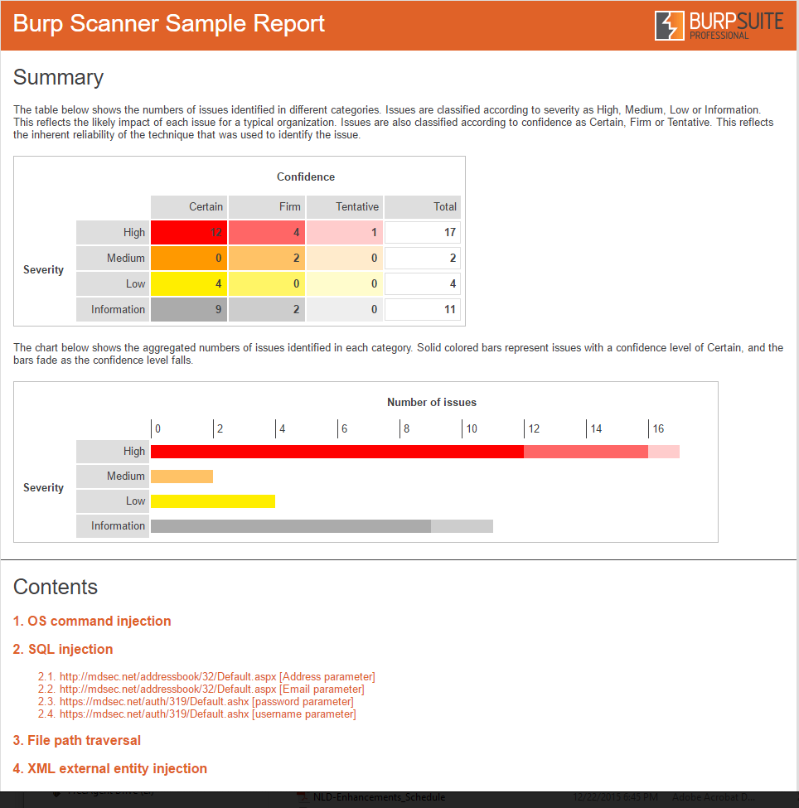
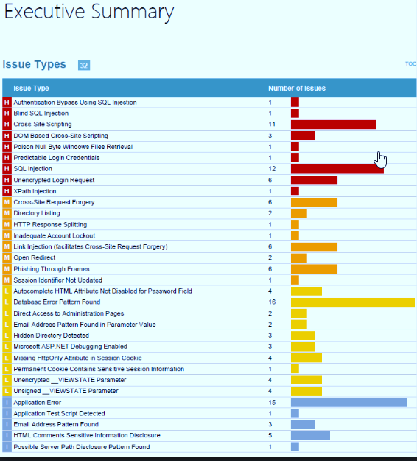
Application Vulnerability Testing Reports

Slide 14
Zero Days – the ultimate vulnerability

Slide 15
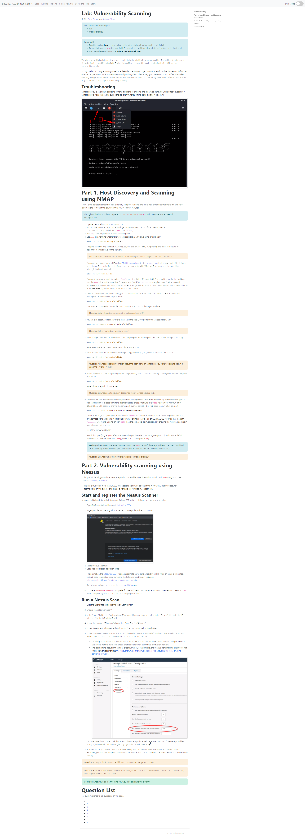
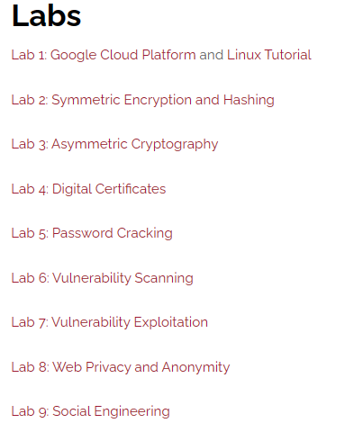
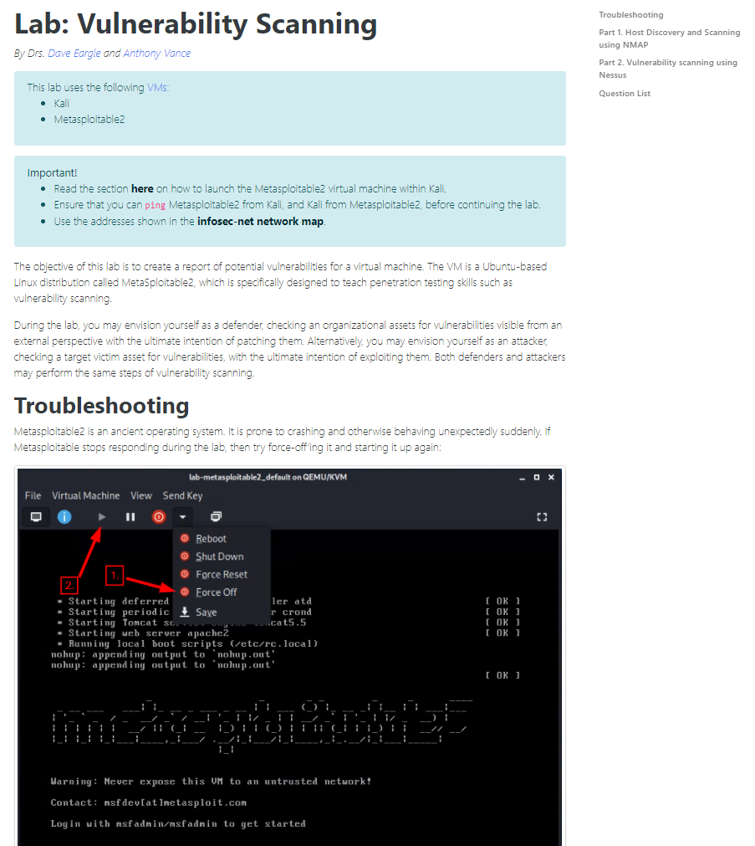
Vulnerability Scanning Lab

Slide 16
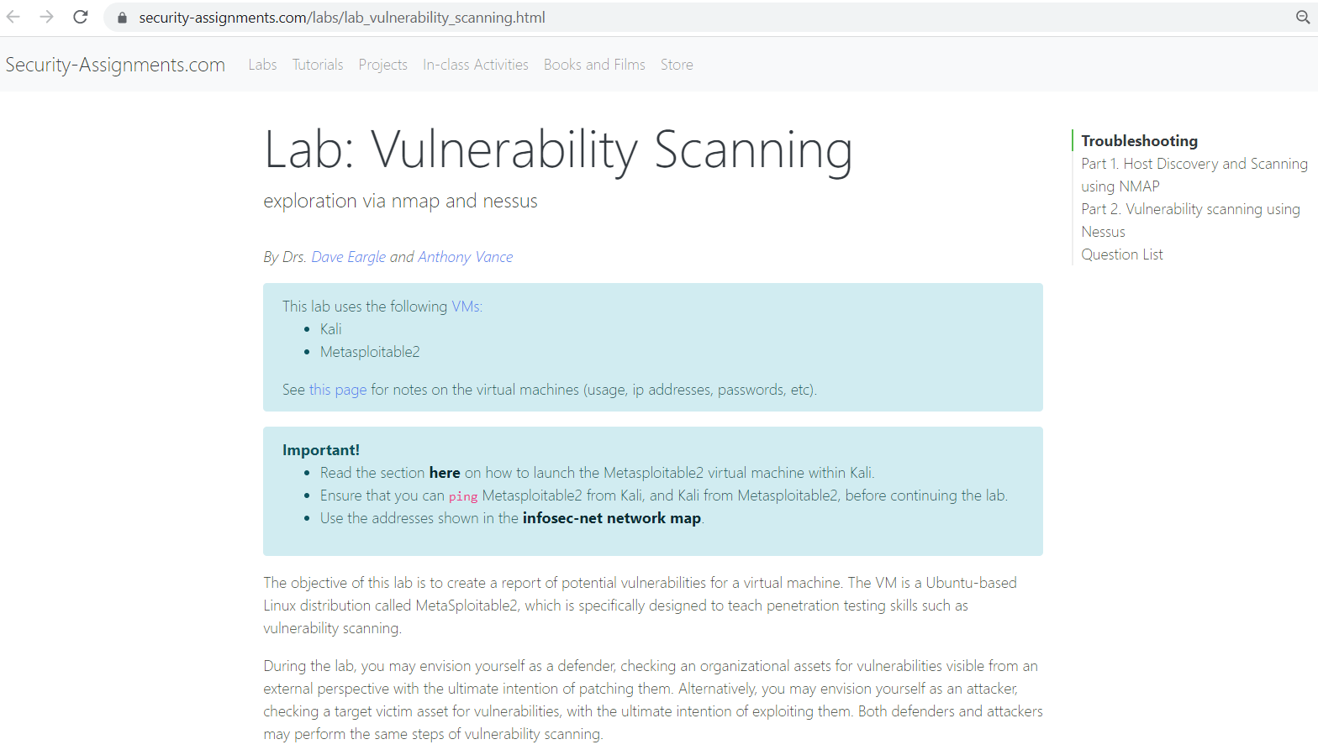

Slide 18
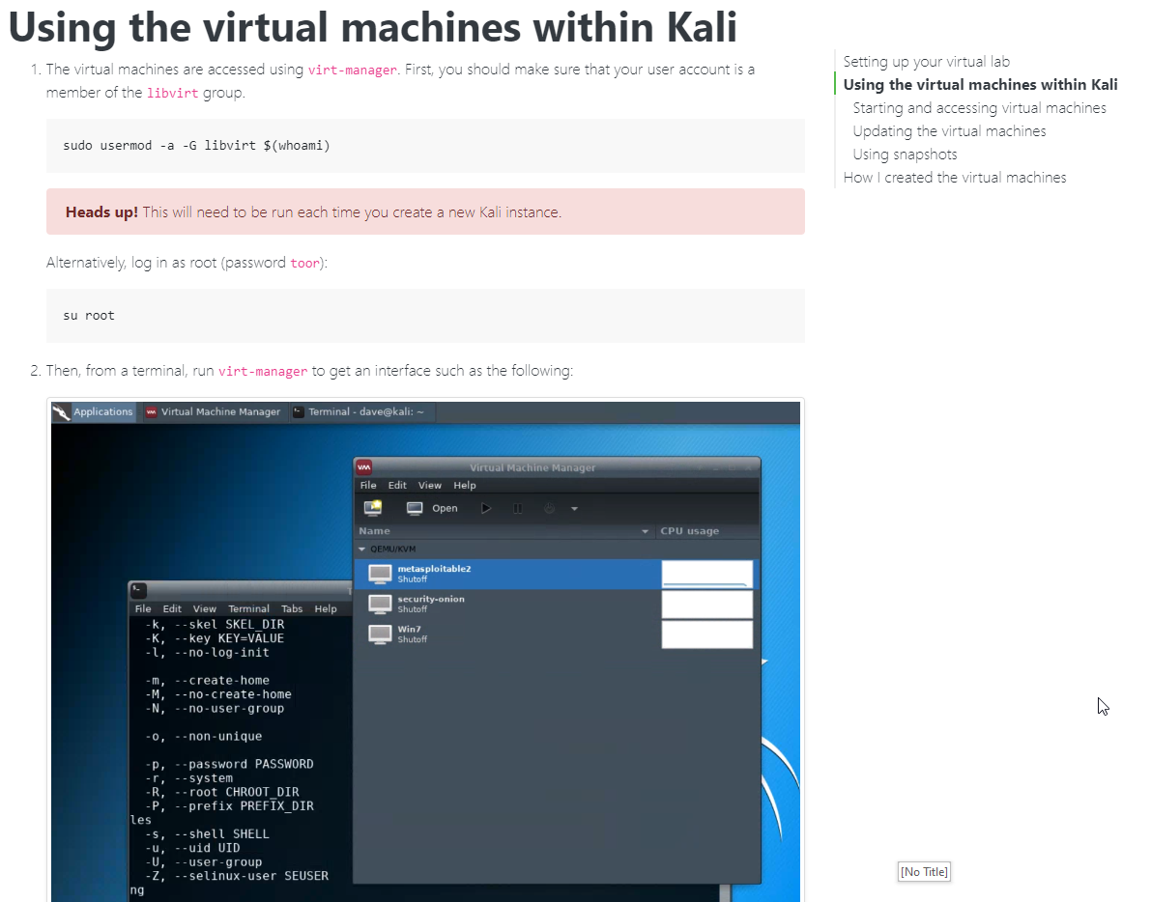

Slide 19
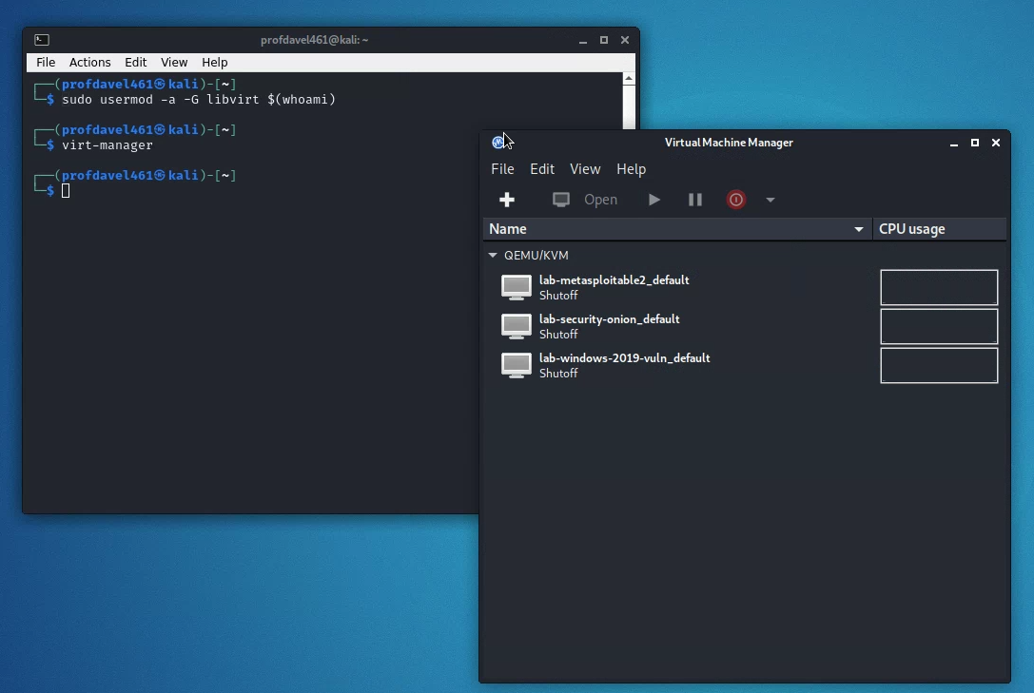

Slide 20
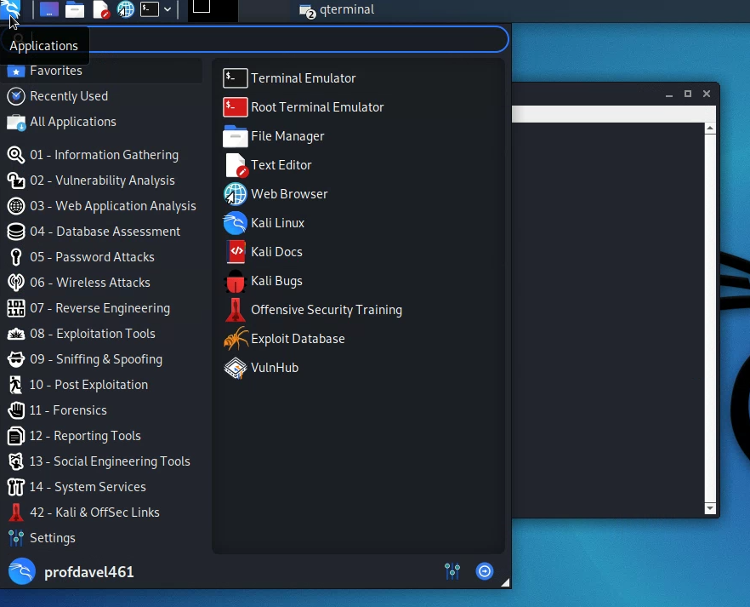

Slide 21
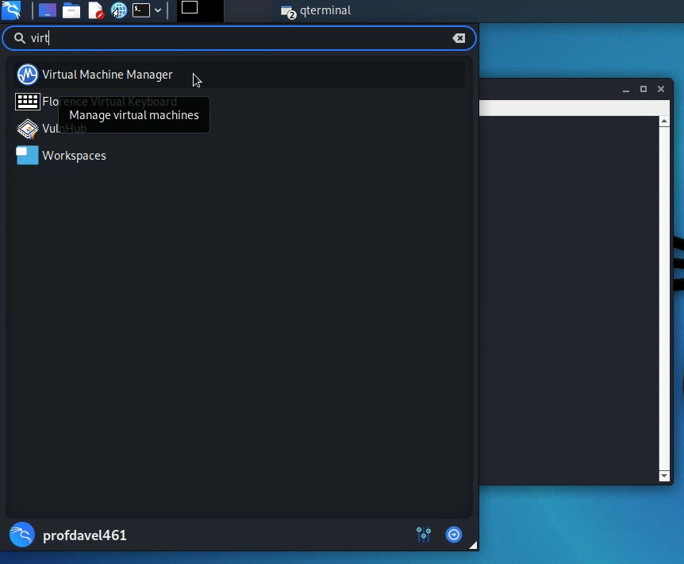
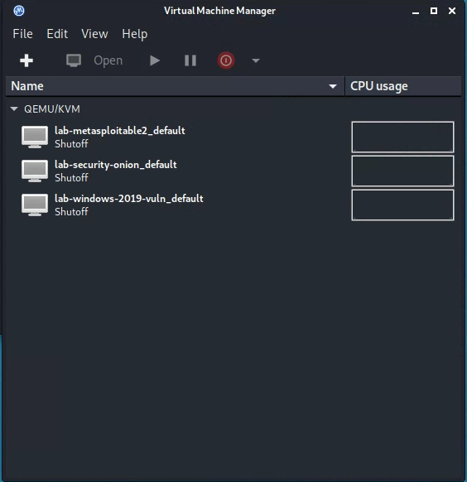
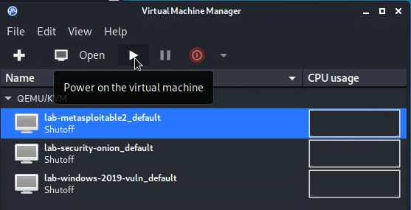
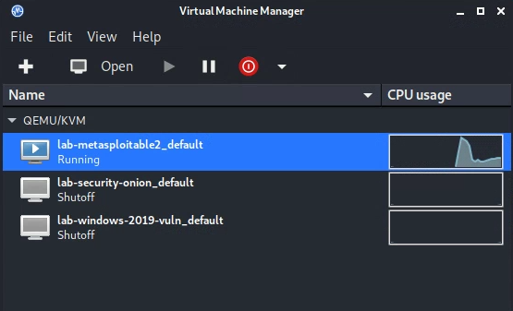

Slide 22
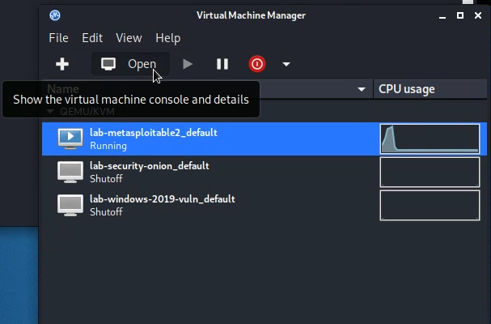
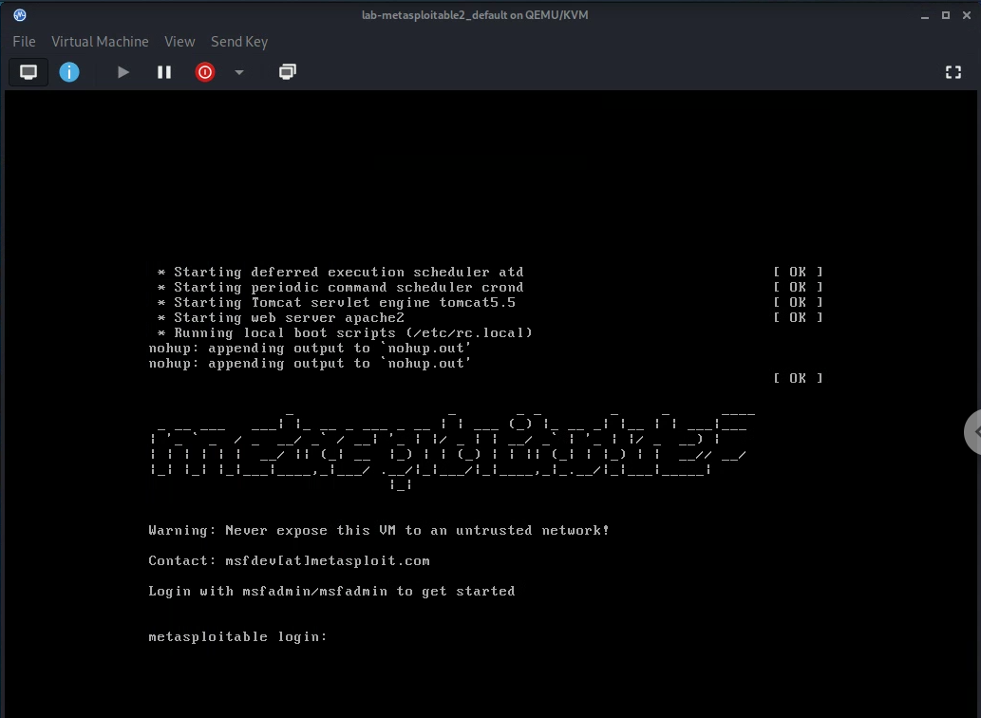

Slide 23
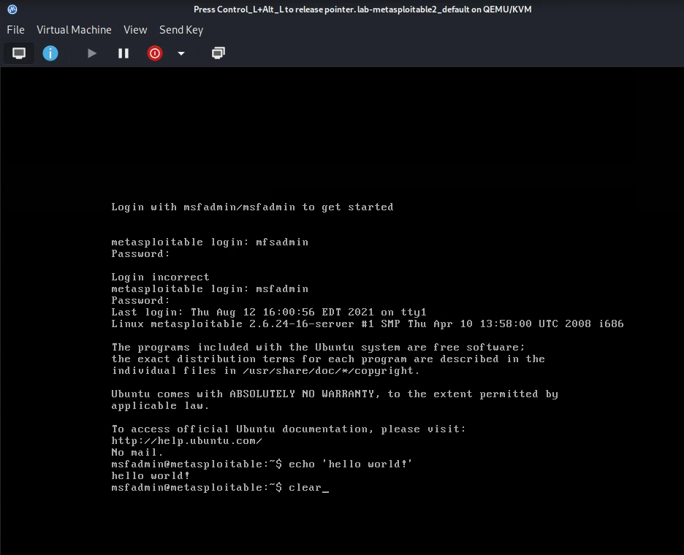

Slide 24
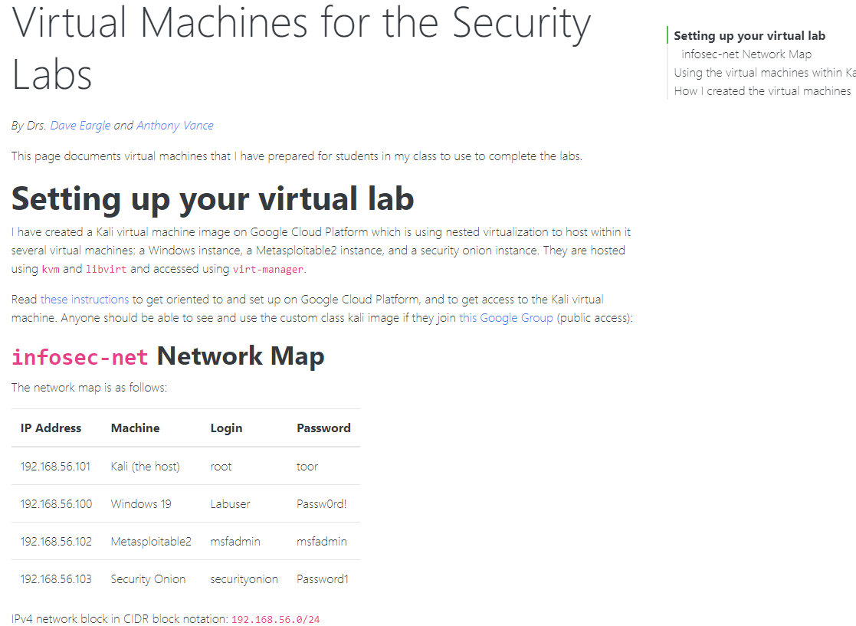
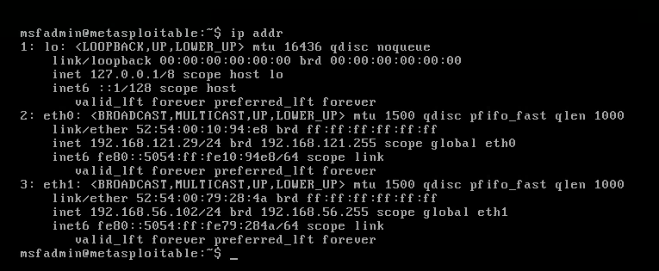
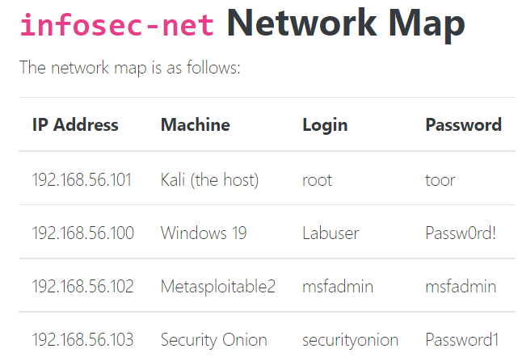
Find the IP address of your kali and metasploitable2 machines…
You can use “ip addr” to find IP address of your metasploitable2 and kali

Slide 25
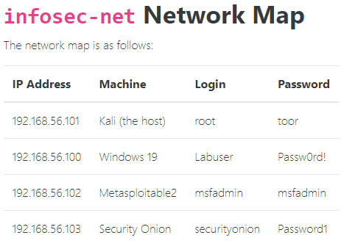
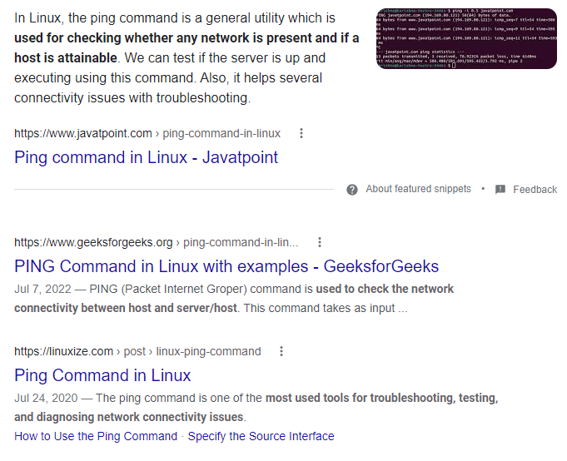
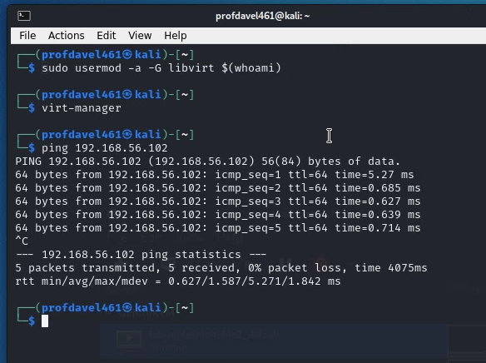

Slide 26
Note: If you lose your mouse…
…as you move between your computer’s environment and your kali linux window and your virtual machine windows
Try to hit Ctrl & Alt keys simultaneously

Slide 27
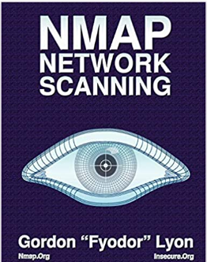
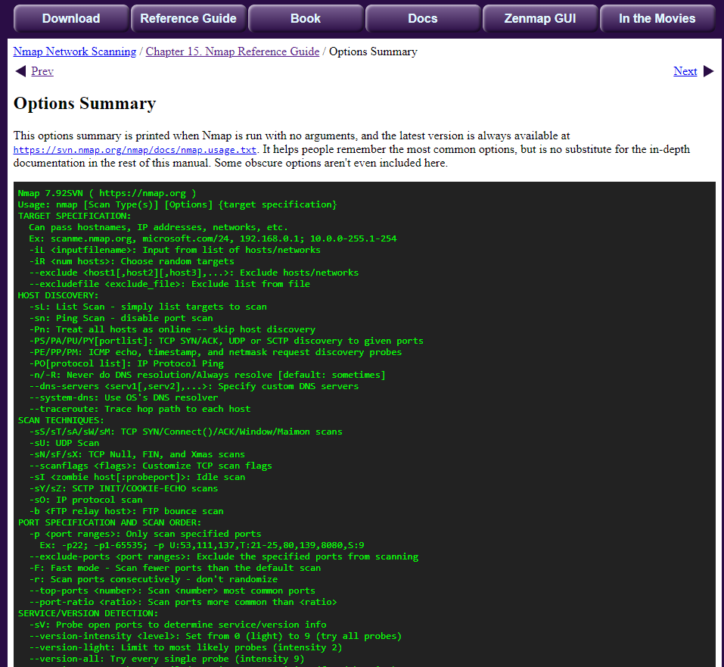
https://nmap.org/book/man.html
https://nmap.org/book/man-briefoptions.html

Slide 28
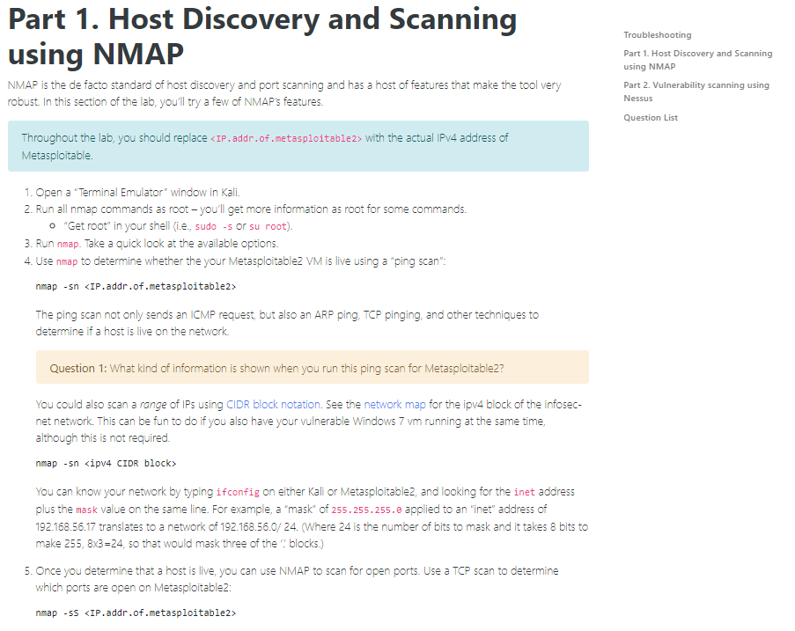
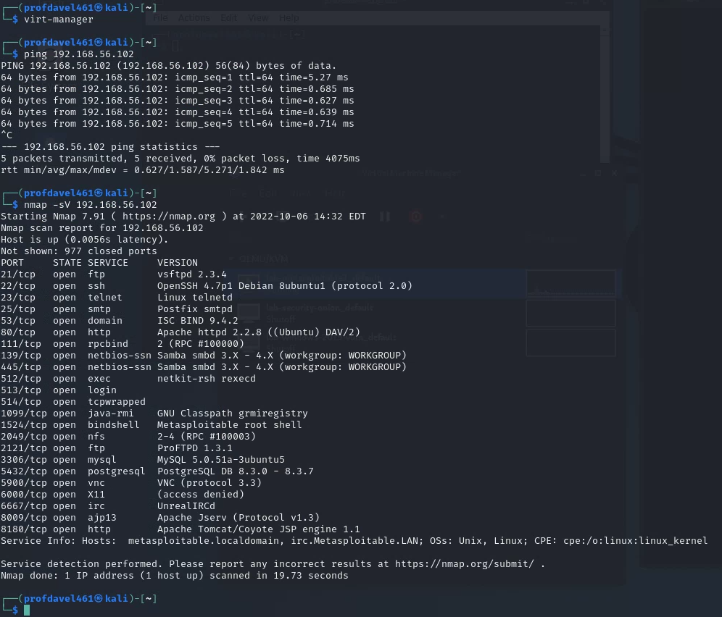

Slide 29
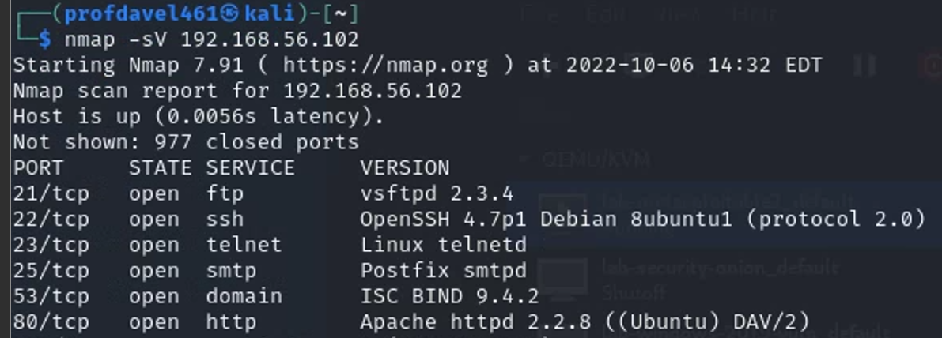
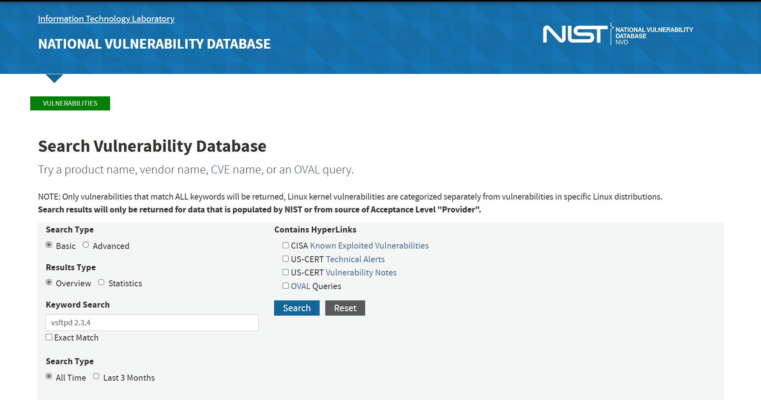
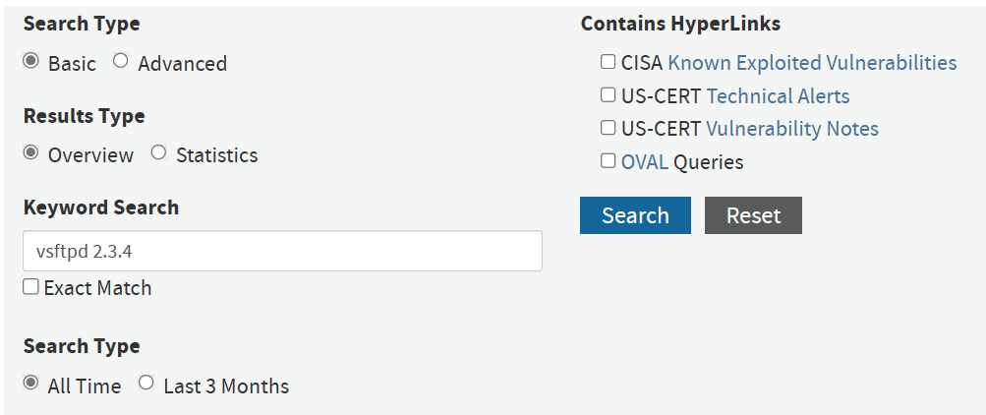
Looking for vulnerable services…
https://nvd.nist.gov/vuln/search

Slide 30
https://nvd.nist.gov/vuln/detail/CVE-2011-2523

Slide 31
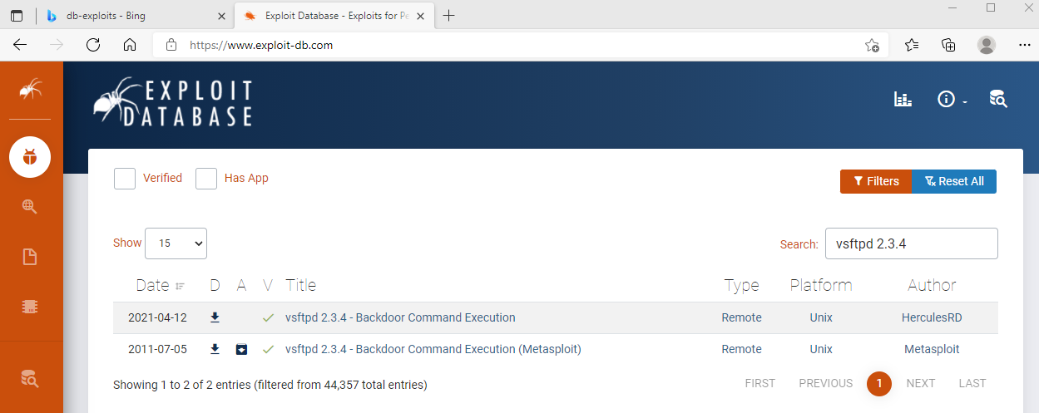
Hackers look for vulnerable services too…

Slide 32
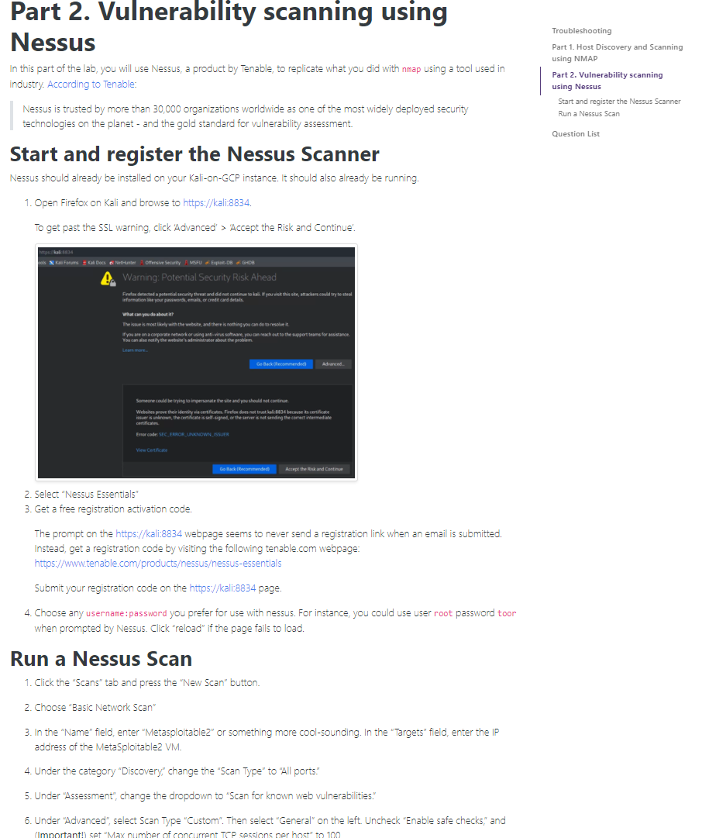
To run the Nessus portion of the vulnerability scanning lab…
You will need to complete the install and startup of Nessus
Startup Nessus Essentials scanner
Request and install your Nessus license key
Setup Nessus scan
Run Nessus scan…

Slide 33
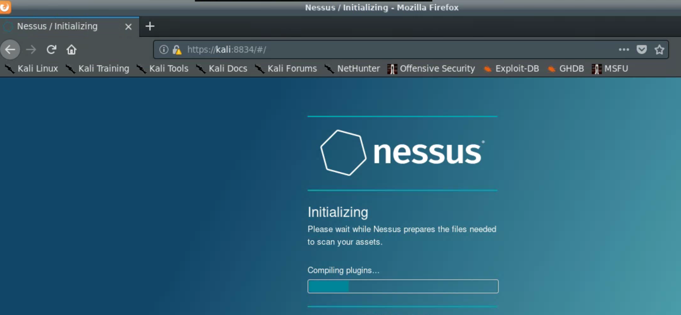
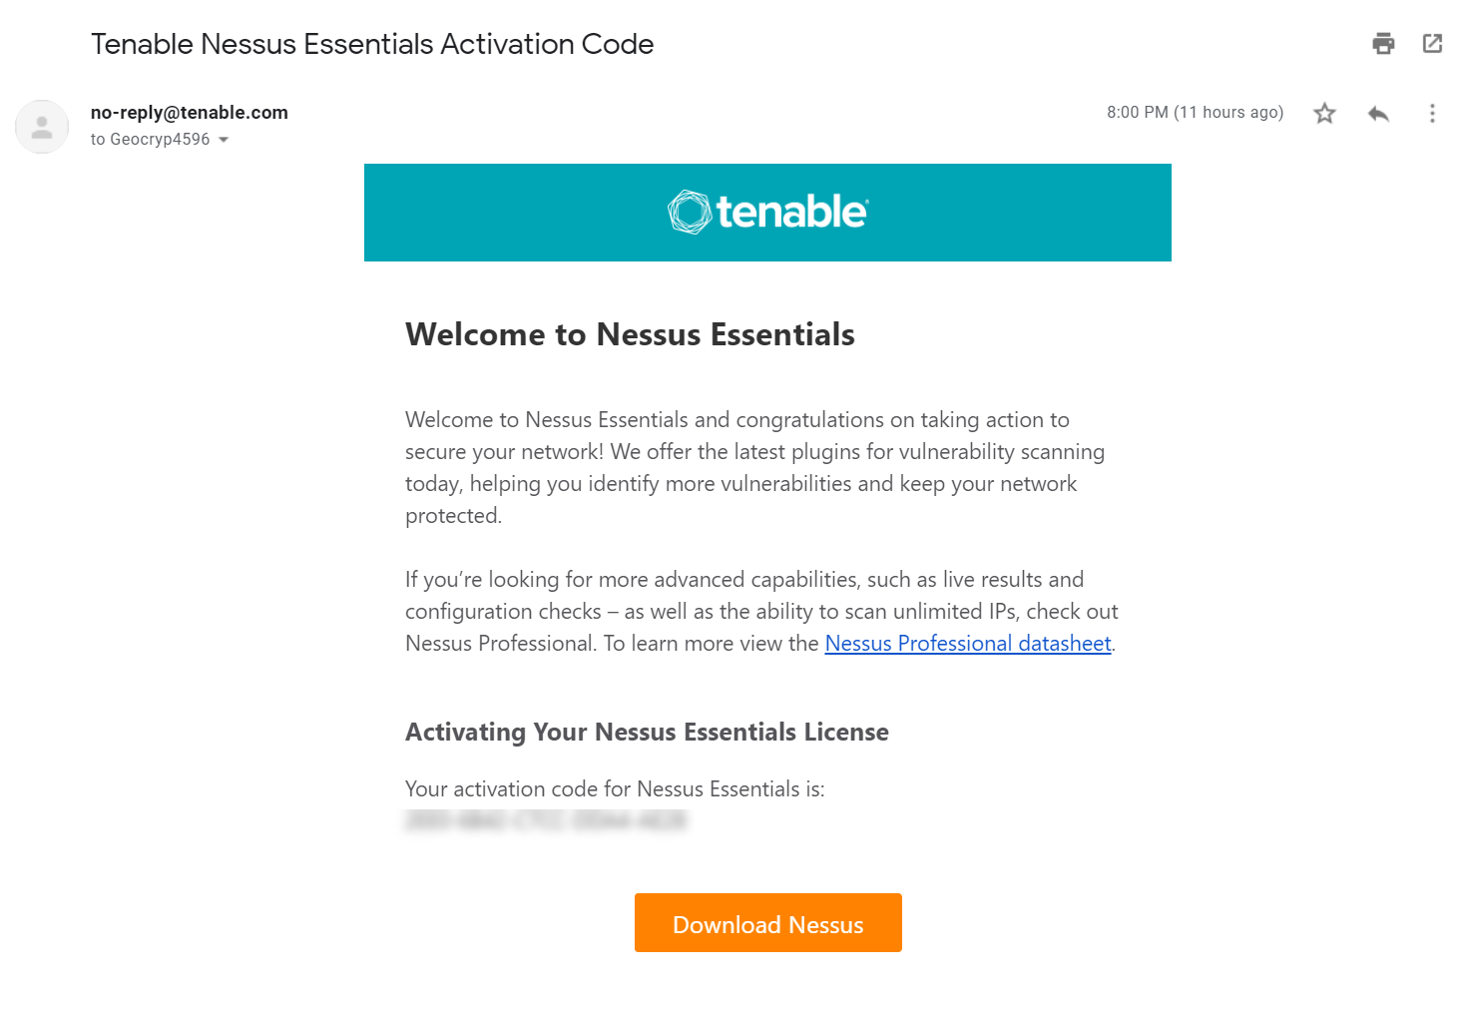
Starting up Nessus Essentials
In Kali, bring up Firefox browser
Navigate to https://kali:8834 (Nessus is installed and listening on port 8834)
Request and provide your Nessus activation code, it will show up by email

Slide 34
To run the Nessus portion of the vulnerability scanning lab…
You will need to complete the install and startup of Nessus
Startup Nessus Essentials scanner
Request and install your Nessus license key
Start up Metaspolitable2
Setup Nessus scan
Run Nessus scan…

Slide 35
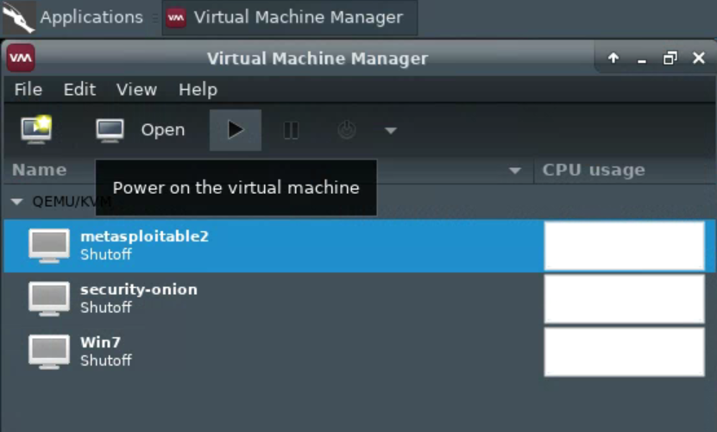
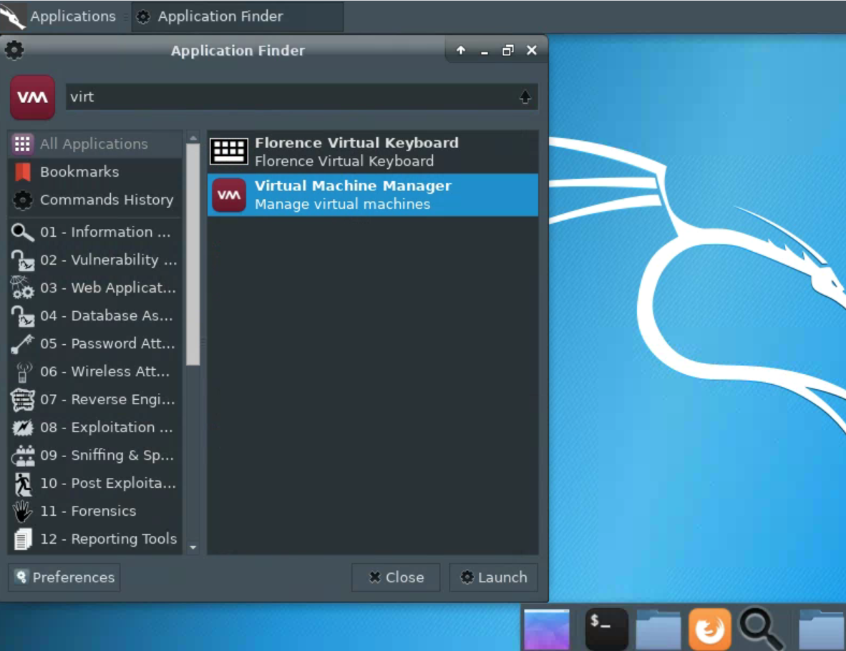
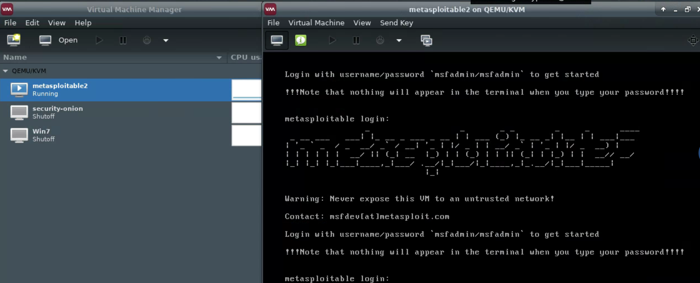

Slide 36
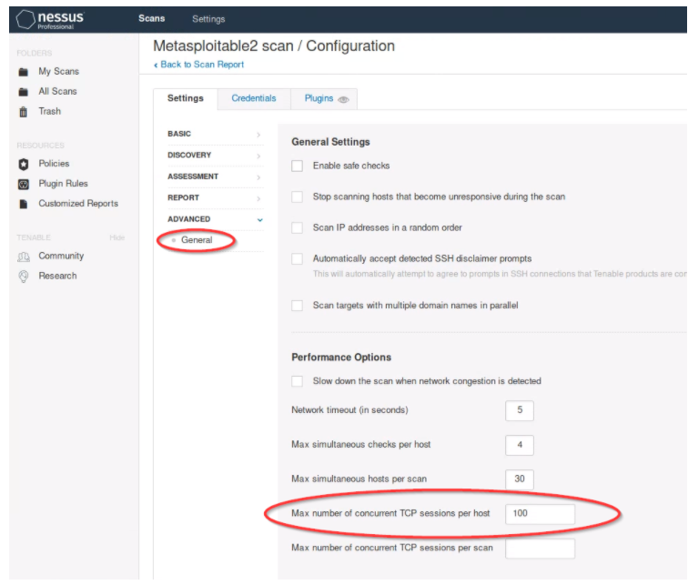
Follow lab instructions to create a vulnerability scan of Metasploitable2

Slide 37
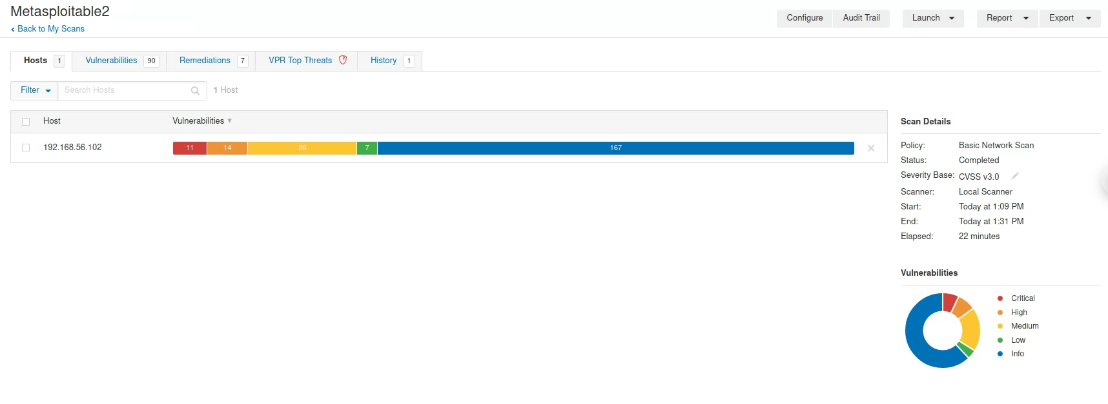
Run the Nessus computer vulnerability scan (it may take ~20 - 30+ minutes)…

Slide 38
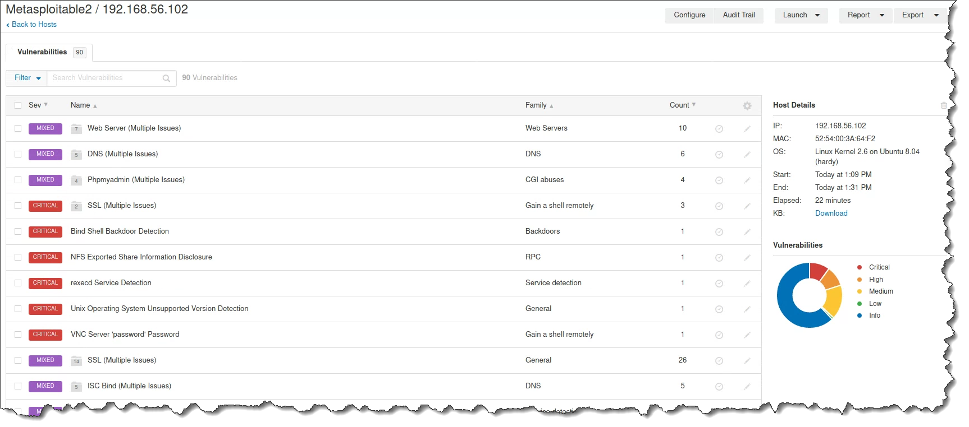

Slide 39
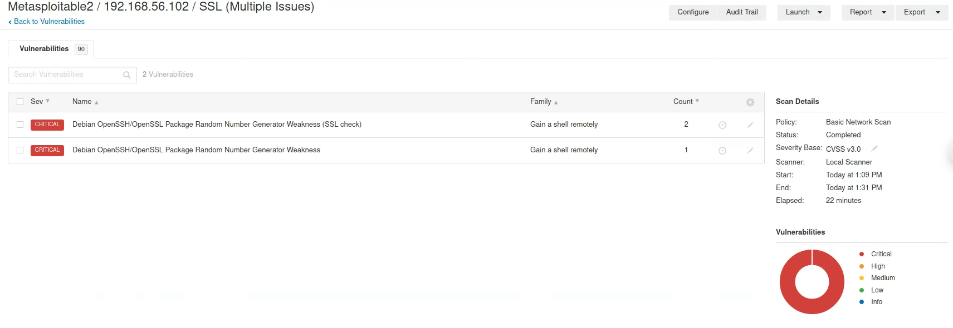

Slide 41
See Also… links
https://lists.debian.org/debian-security-announce/2008/msg00152.html
https://lists.ubuntu.com/archives/ubuntu-security-announce/2008-May/000705.html

Slide 42
Agenda
Change your Kali password!
Application vulnerability and security testing
Lab 8: Vulnerability Scanning – Part 2: Nessus
Scan results
Looking at a vulnerability

