Slide 1
Managing Enterprise Cybersecurity
MIS 4596
Class 3

Slide 2
Agenda
National Institute of Standards and Technology (NIST)
  Cybersecurity Framework
  Risk Management Framework
Applying the NIST Risk Management Framework
Milestone 1 Assignment

Slide 3

Quiz
You have five minutes to write out the first 100 digits of pi, from memory, on a sheet of paper
You need to close your laptop and put your phone face down on the table or away in your bag or pocket
Goal: Help you develop a Security Mindset

Slide 4
Agenda
National Institute of Standards and Technology (NIST)
  Cybersecurity Framework
  Risk Management Framework
Applying the NIST Risk Management Framework
Milestone 1 Assignment

Slide 5
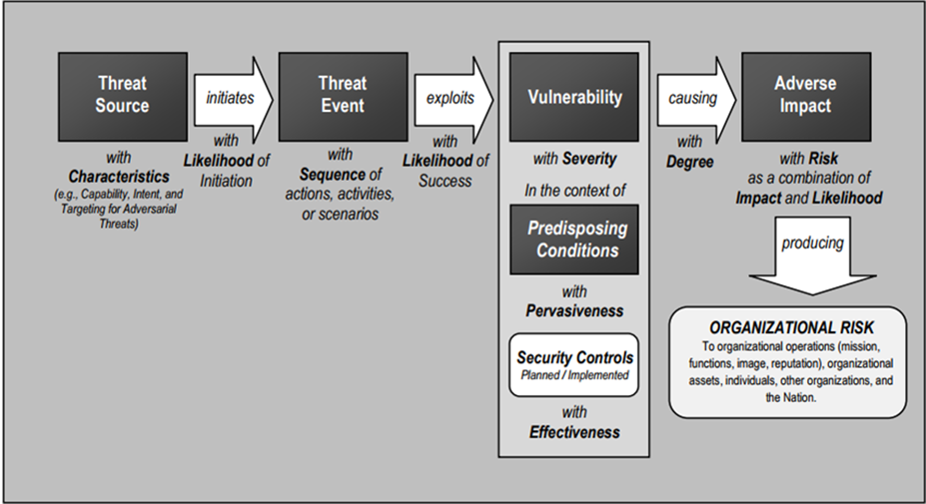
Business cybersecurity risk
…is a function of what?

Slide 6
Business cybersecurity risk
…is a function of what?
cybersecurity risk = f(?, ?, …)
f(threats, vulnerabilities, assets)
f(threat, (vulnerability * lack of control), (asset * dependencies))
Results in impacts which have an adverse effect on:
  Organizational operations
  Assets
  individuals

Slide 7

Federal Information Security Management Act (FISMA) of 2002
Federal Information Security Modernization Act (FISMA) of 2014
Recognizes importance of information security to the economy and national security
Requires each government organization to provide information security for information and information systems supporting their operations and assets
      Including those provided or managed by another agency, contractors, or other sources
Made NIST responsible for developing standards, guidelines, and associated methods and techniques for providing adequate information security for all agency operations and assets (excluding national security systems)
https://www.dhs.gov/fisma

Slide 8
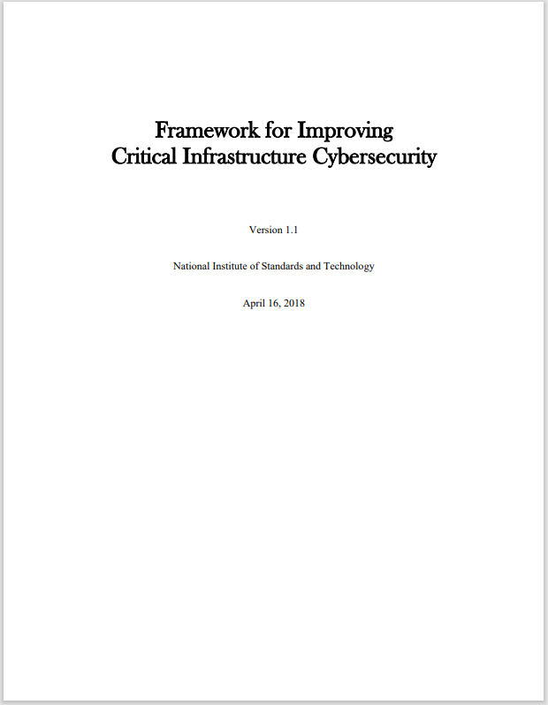
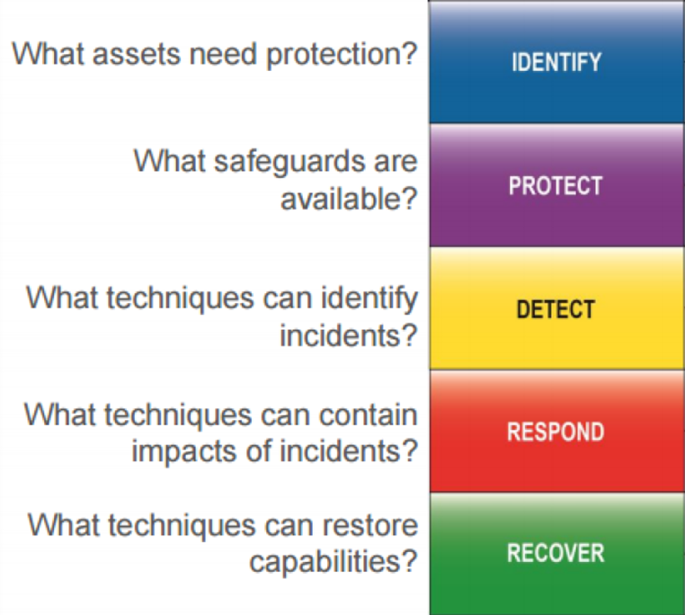
NIST’s “Cybersecurity Framework”

Slide 9
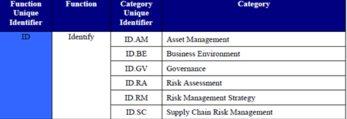
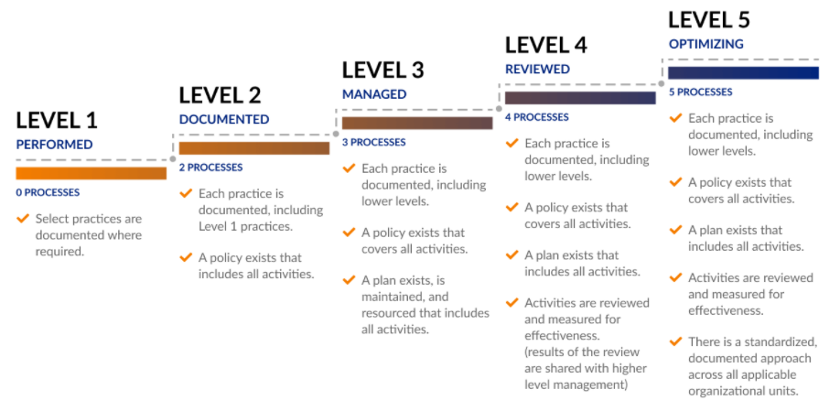
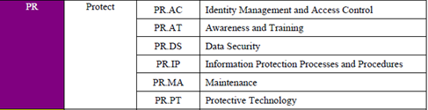

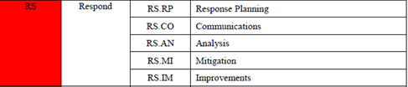

NIST Cybersecurity Framework
Cybersecurity Maturity Model Certification (CMMC) levels
Is used to assess an organization’s cybersecurity capability maturity level, and recommend steps for improvement

Slide 10
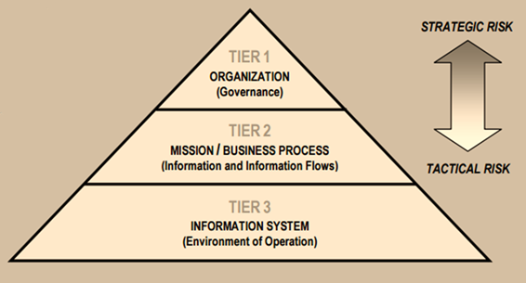
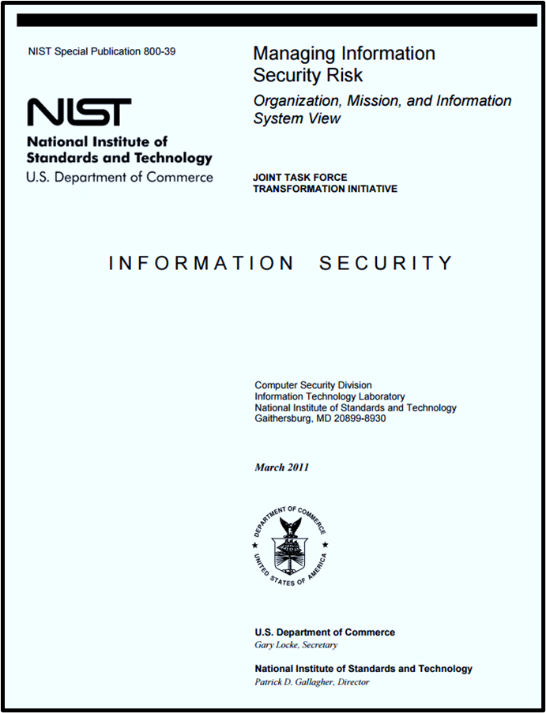
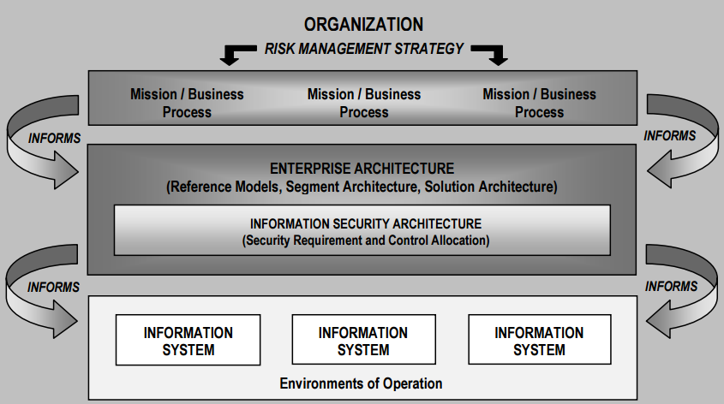
NIST’s Risk Management Framework

Slide 11
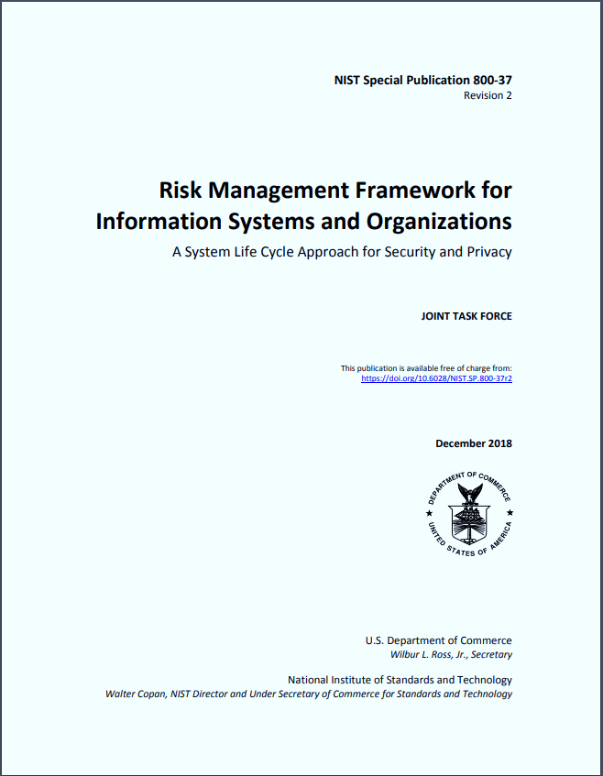
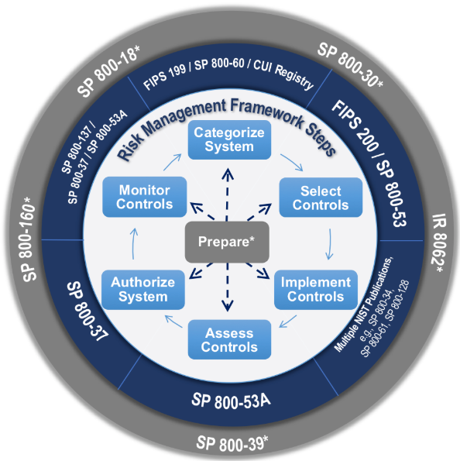
Security Categorization & Selecting a Baseline of Cybersecurity Risk Controls

Slide 12
1st Step in cybersecurity is security categorization (i.e. risk assessment)
Inventory the data content of the information system
Determine the security categorization of the information based on potential impacts a breach of confidentiality, integrity and availability will have on organizational operations, assets, or individuals based FIPS 199 standard

Slide 13
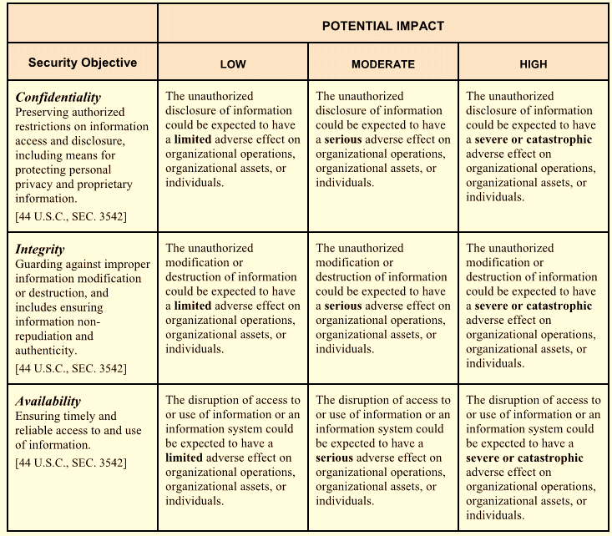
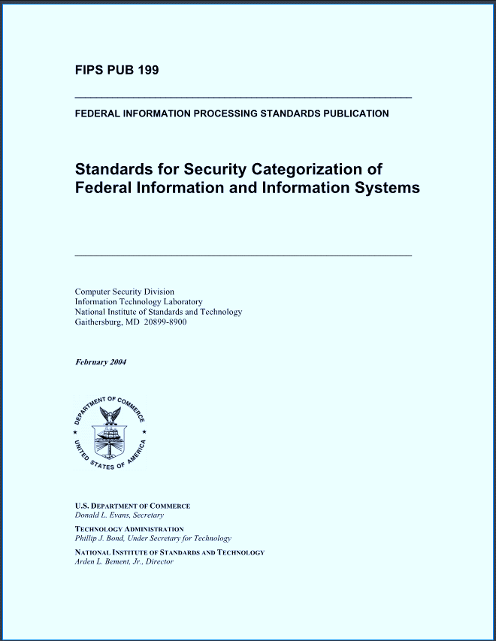
Risk is based on impact of a security breach
In the Risk Management Framework (RMF) likelihood of a breach is treated as 100%
https://nvlpubs.nist.gov/nistpubs/FIPS/NIST.FIPS.199.pdf
1/23/2025

Slide 14

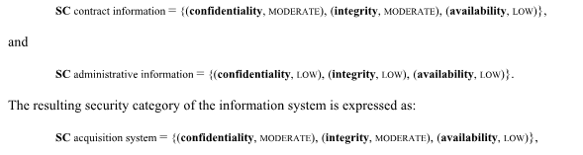
FIPS Pub 199 Standards for Security Categorization
Low: Limited adverse effect
Medium: Serious adverse effect
High: Severe or catastrophic adverse effect
Example with multiple information types:
= MODERATE rating
= LOW rating
= MODERATE rating

Slide 15
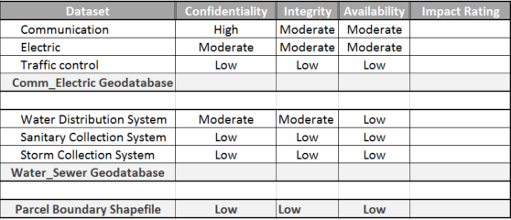
What are the security categorizations of these datasets?
?
?
?
?
?
?
?

Slide 16
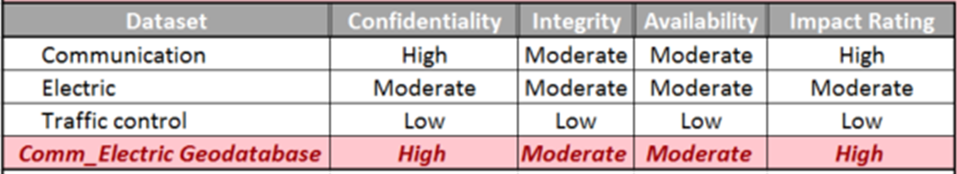
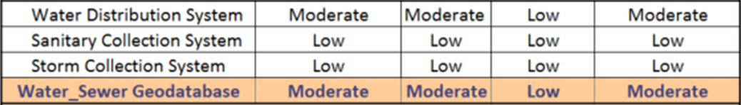
What are the security categorizations of the geodatabases?
?
?
?
?
?
?
?
?

Slide 17
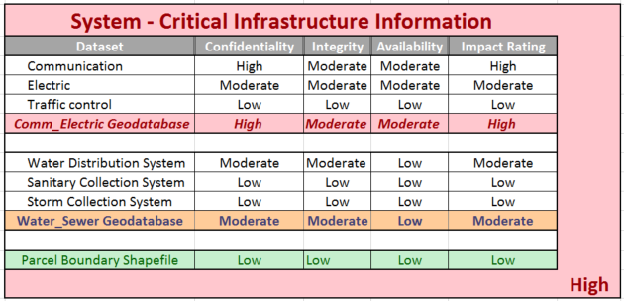
What is the overall security categorization of the information system containing these datasets?
?
?
?
?
?
?
?
?

Slide 18
Agenda
National Institute of Standards and Technology (NIST)
  Cybersecurity Framework
  Risk Management Framework
Applying the NIST Risk Management Framework
Milestone 1 Assignment

Slide 19
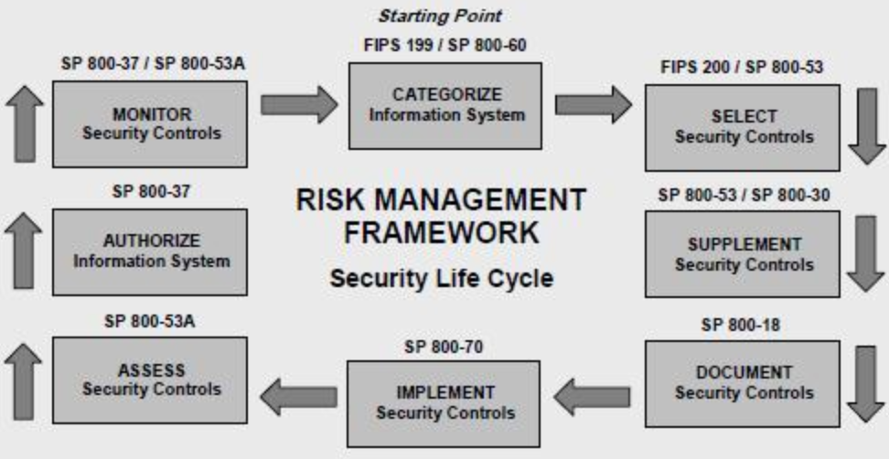
NIST Risk Management Framework

Slide 20
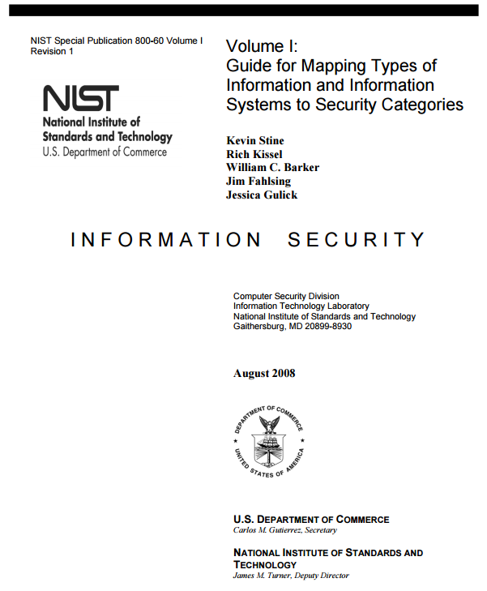
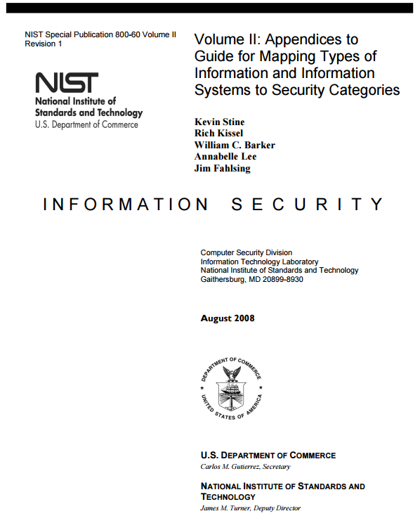
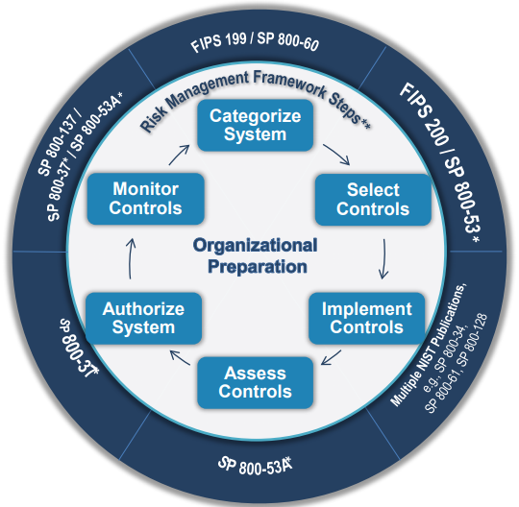
A guide for provisional security categorization
Found at NIST and on the Lecture Materials page of the MIS Community website
1/23/2025

Slide 21
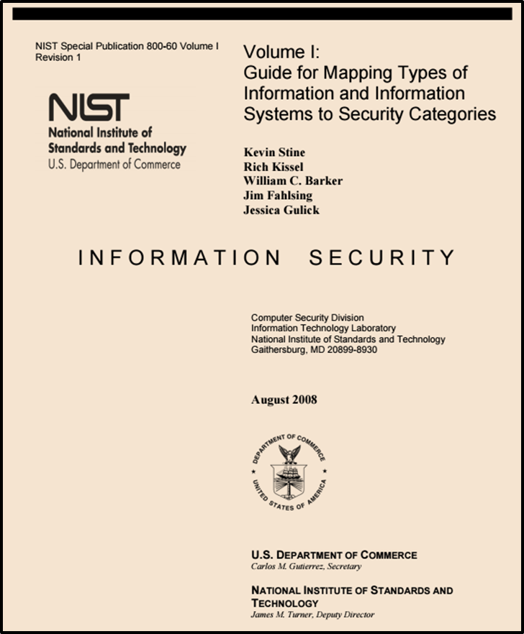
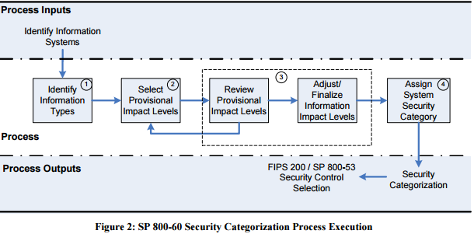
http://nvlpubs.nist.gov/nistpubs/Legacy/SP/nistspecialpublication800-60v1r1.pdf

Slide 22
2 Broad types of Information and Information Systems
Mission-based Information & Information Systems
Management and Support Information & Information Systems

Slide 23
Mission-based Information and Information Systems
Defense and National Security
Homeland Security
Intelligence Operations
Disaster Management
International Affairs and Commerce
Natural Resources
Energy
Environmental Management
Economic Development
Community and Social Services
Transportation
Education
Workforce Management
Health
Income Security
Law Enforcement
Litigation and Judicial Activities
Federal Correctional Activities
General Sciences and Innovation
Knowledge Creation and Management
Regulatory Compliance and Enforcement
Public Goods Creation and Management
Federal Financial Assistance
Credit and Insurance
Transfers to State/Local Governments
Direct Services for Citizens

Slide 24
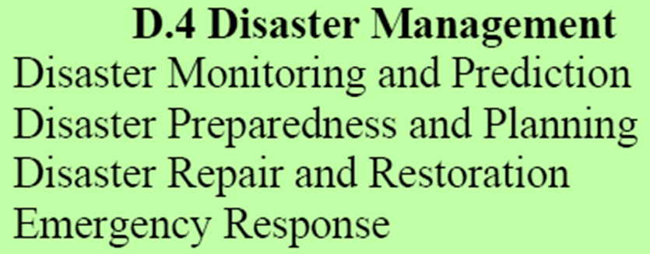
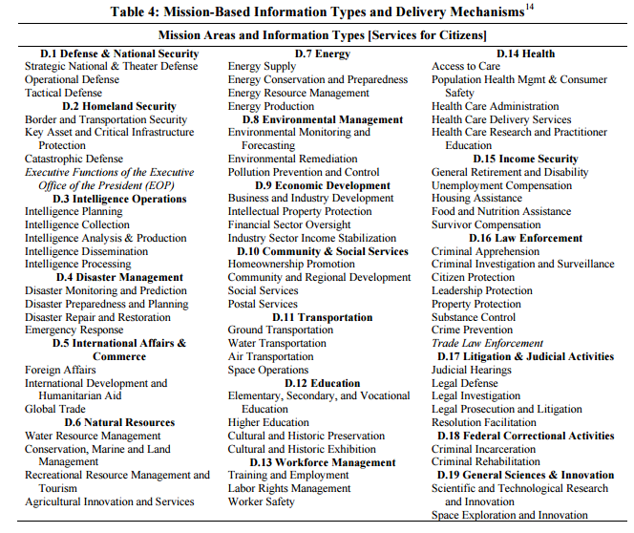
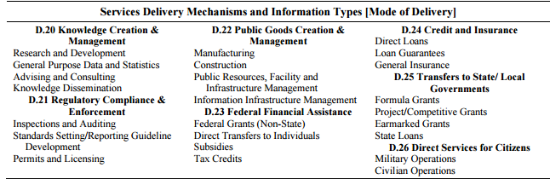
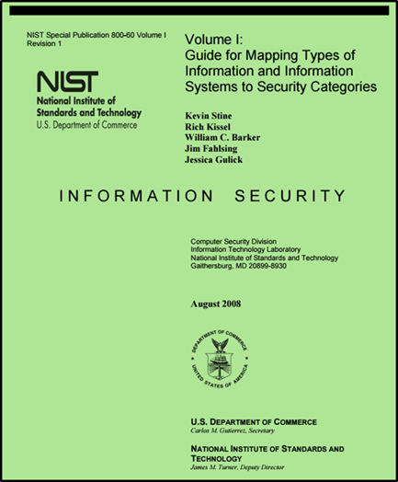
Disaster Management Information Types

Slide 25
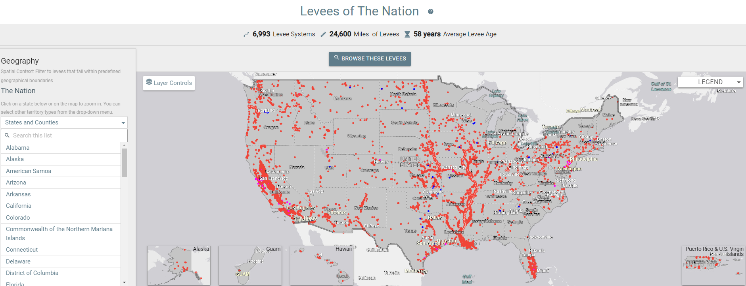

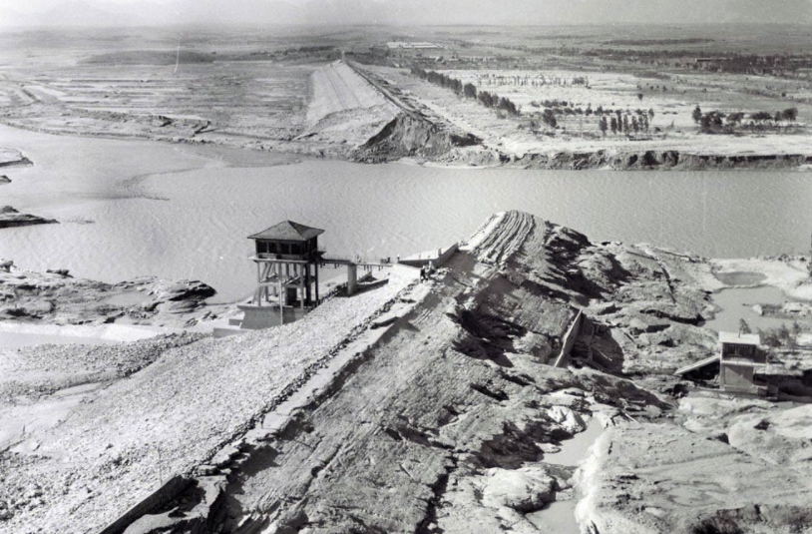


Disaster Management Information System Example
National Levee Database

Slide 26
Select Provisional Impact Levels for the identified information system

Slide 27
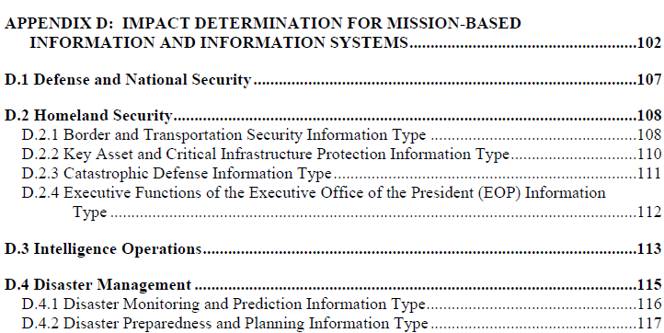
Disaster Management Information Types
https://nvlpubs.nist.gov/nistpubs/Legacy/SP/nistspecialpublication800-60v2r1.pdf

Slide 28

Disaster Management Information Impact

Slide 29
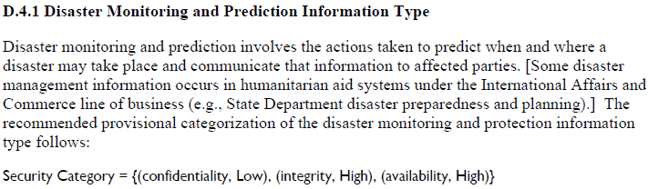
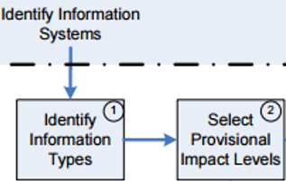
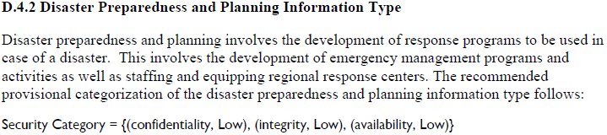
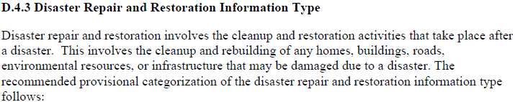
Disaster Management Information Types

Slide 30
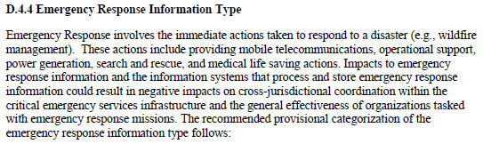
Disaster Management Information Types

Slide 31
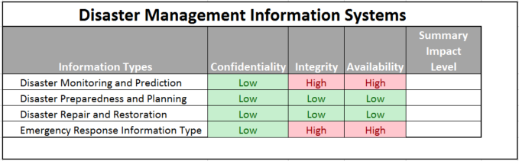
Exercise
Determine the Summary Impact Levels for the Disaster Information Types
?
?
?
?

Slide 32
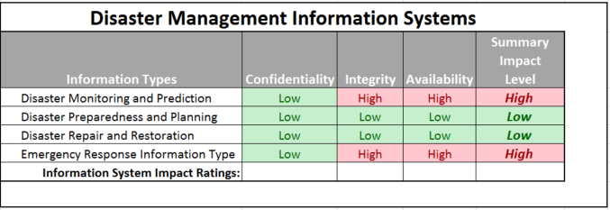
Determine the Overall Impact Levels for the Disaster Information Types
?
?
?

Slide 33
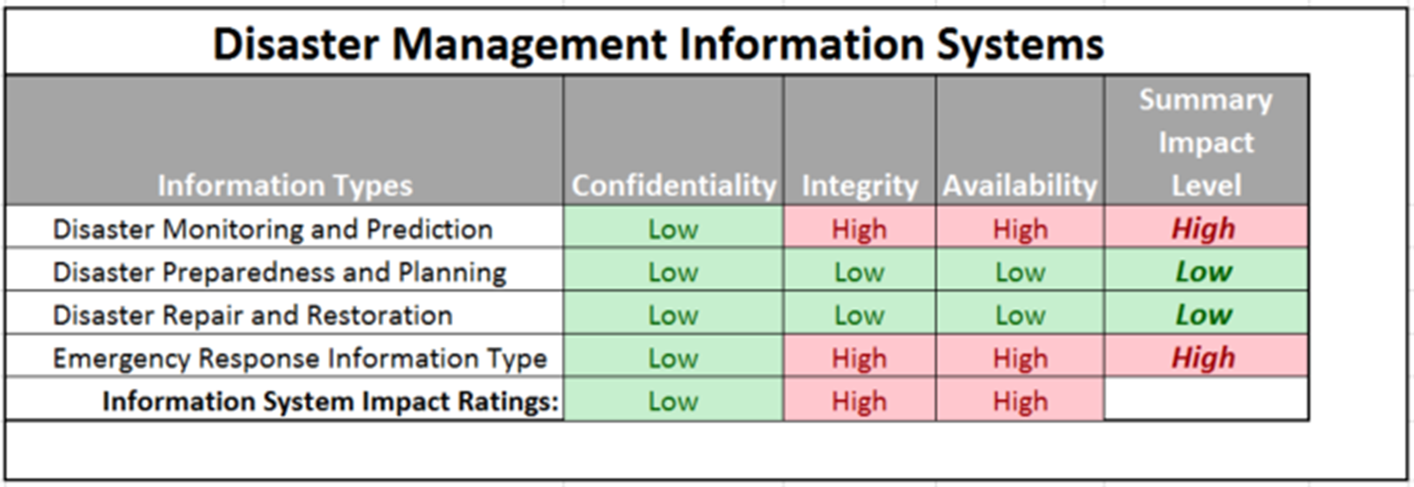
Determine the overall security categorization of a Disaster Information System
?

Slide 34
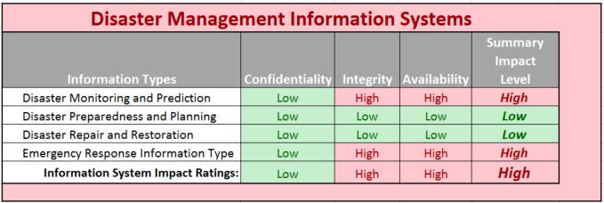
Determine the overall security categorization of a Disaster Information System

Slide 35
What synonyms should you use to explain the meaning of low, moderate, or high impact breaches?
1/23/2025
Copyright @ URISA 2021

Slide 36
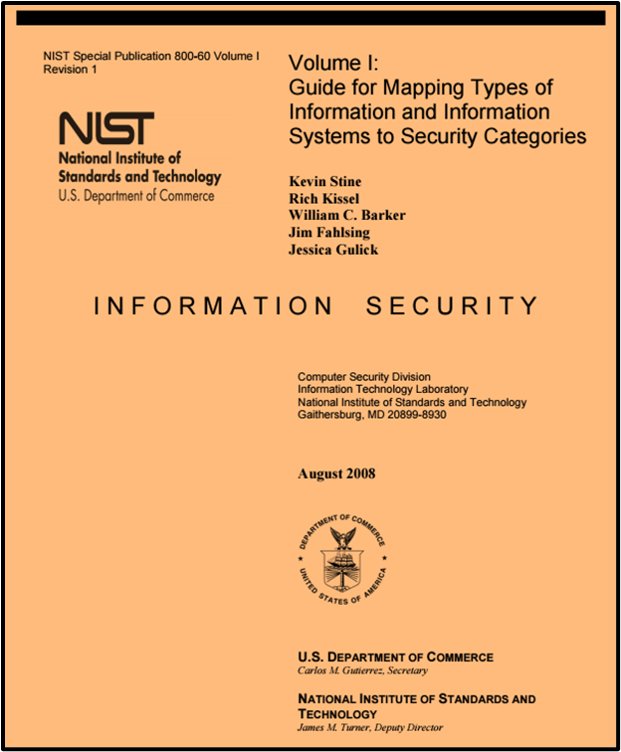
Once categorized, select security control baseline for the information system

Slide 37
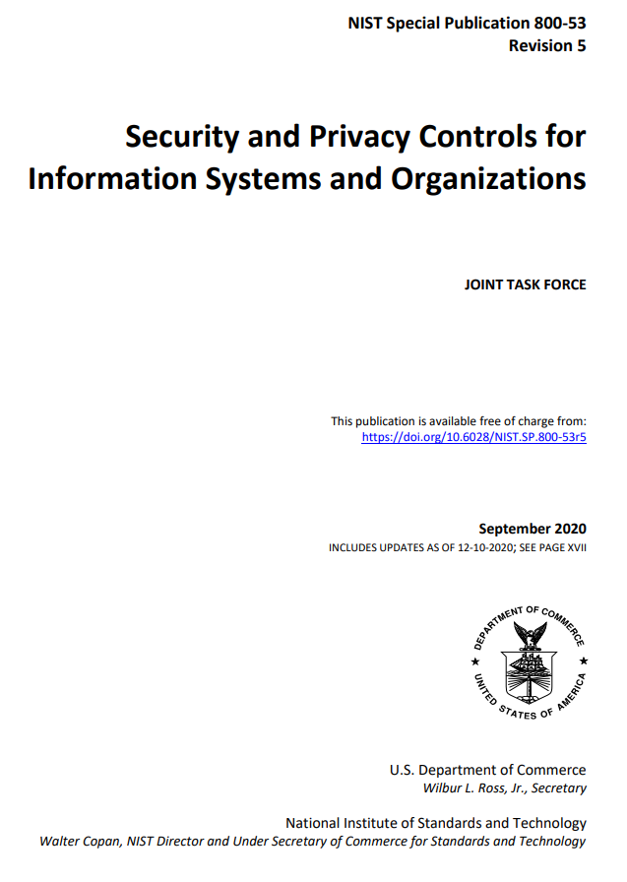
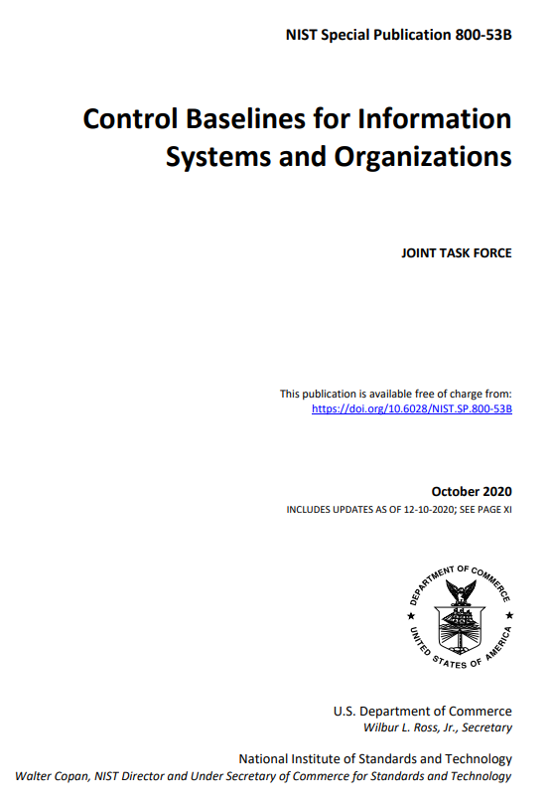
Selecting cybersecurity risk controls

Slide 38
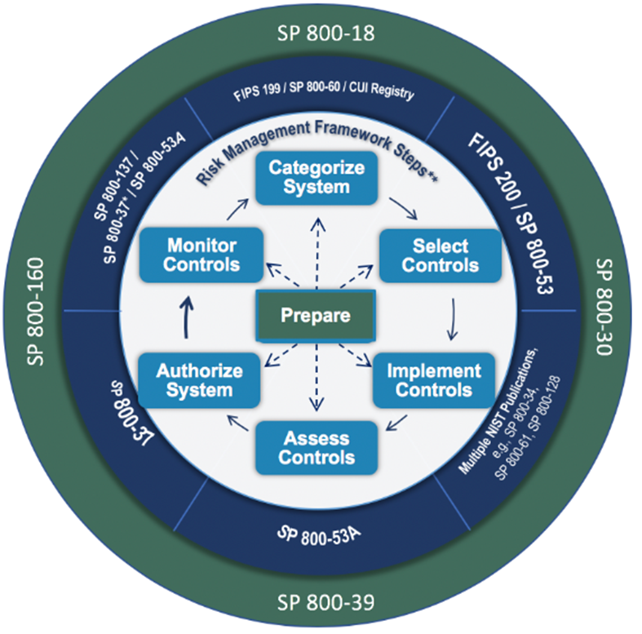
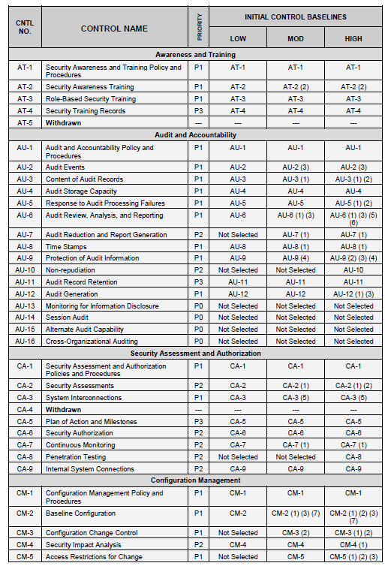
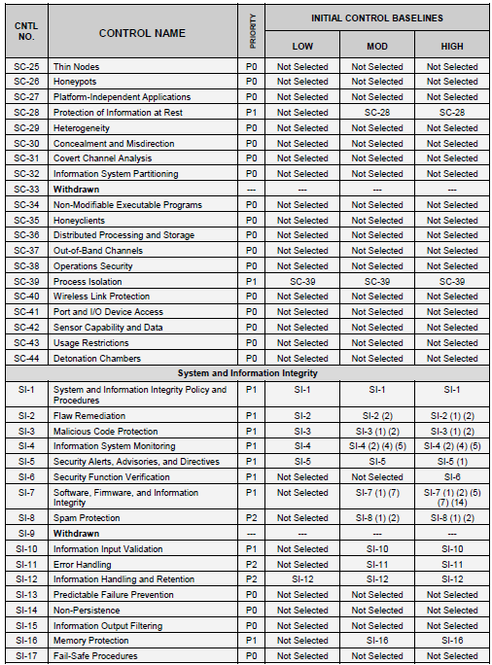
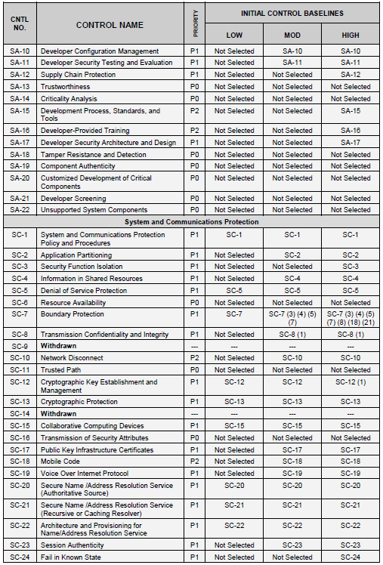
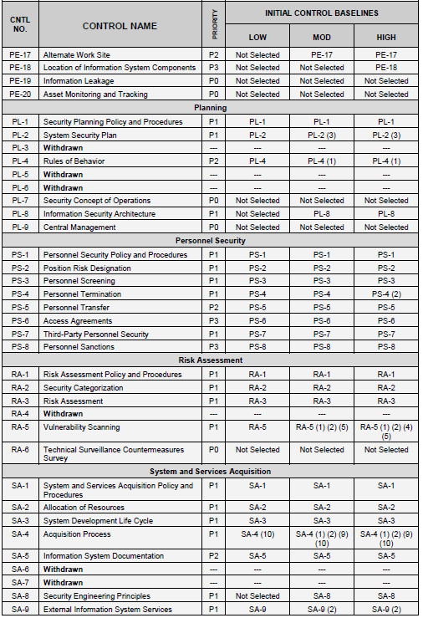
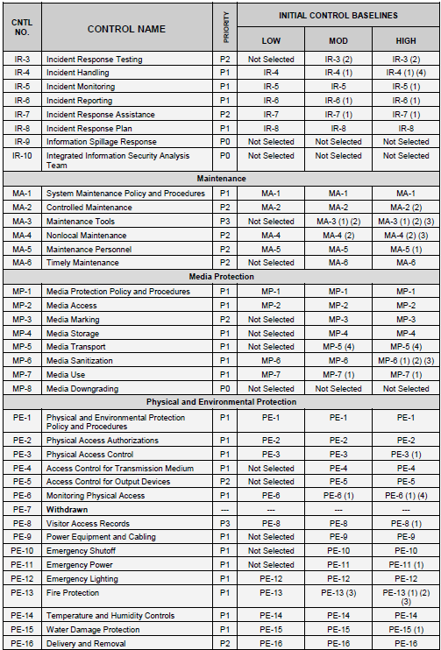



FIPS 199 categorization is used to select among 3 impact-based baselines of security controls

Slide 39
Agenda
100 Digits of Pi Quiz
National Institute of Standards and Technology (NIST)
  Cybersecurity Framework
  Risk Management Framework
Applying the NIST Risk Management Framework
Milestone 1 Assignment

Slide 40
Milestone 1 – Risk Assessment Report
Milestone 1 Assignment is found in Canvas
Your assignment is to apply the NIST Risk Management Framework and create a risk assessment report for managers of a (fictitious) company that owns and depends on financial information contained in a financial management system
Financial management involves the aggregate set of accounting practices and procedures that allow for the accurate and effective handling of all a business’ revenues, funding, and expenditures. NIST SP 800-60 Volume 2 identifies a set of business functions and associated types of data typically supported by and included in financial management information systems. What are they?
Your risk assessment assignment requires that you introduce and discuss:
  Security objectives and potential impacts defined in Federal Information Processing Standard 199: “Standards for Security Categorization of Federal Information and Information Systems”
  Methodology for assigning impact levels to information and information system types described in NIST Special Publication 800-60 Volume I
  Provisional security categorizations assigned to the financial management information types by NIST Special Publication 800-60 Volume II
  You Determination of an overall security categorization for the financial information management system (FIMS) based on the provisional security categorization of the FMIS data types

Slide 41
How should you proceed in getting started with Milestone 1 ?
Inventory content of information in the Financial Information Management System (FIMS)
  Use NIST SP 800-60v1.r1 and 800-60v2.r1
  Determine the security categorization of the information contained within the FIMS
Determine the overall security categorization of the FIMS
Translate the FIMS’ security categorization into non-technical language of organizational risk that a senior manager can understand and relate to
NIST SP800-60V2R1: “Appendices to Guide for Mapping Types of Information and Information Systems to Security Categories”

Slide 42
NIST SP 800-60 Volume I includes tables that identify broad types of information types stored in a wide variety of information systems
NIST SP800-60V1R1: “Guide for Mapping Types of Information and Information Systems to Security Categories”
Mission-based Information & Information Systems
Management and Support Information & Information Systems
  Services Delivery Support Functions
  Resource Management Functions
HINT: Use Volume 1’s tables to identify which section of Volume II will contain the security categorizations you need for the data types found in your organization’s Financial Information Systems
NIST SP 800-60 Volume II Revision 1, Volume II: “Appendices to Guide for Mapping Types of Information and Information Systems to Security Categories”

Slide 43
Agenda
National Institute of Standards and Technology (NIST)
  Cybersecurity Framework
  Risk Management Framework
Applying the NIST Risk Management Framework
Milestone 1 Assignment

