Slide 1
MIS 4596
Unit#19
Network Security Monitoring and Incident Response

Slide 2
Agenda
NIST Cybersecurity Framework
Computer security incident response vocabulary
Attackers and detection
Handling an incident
  Preparation
  Detection and analysis
  Containment, eradication and recovery
  Incident response workflow

Slide 3
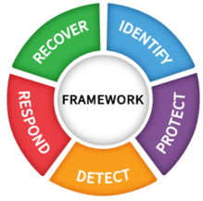
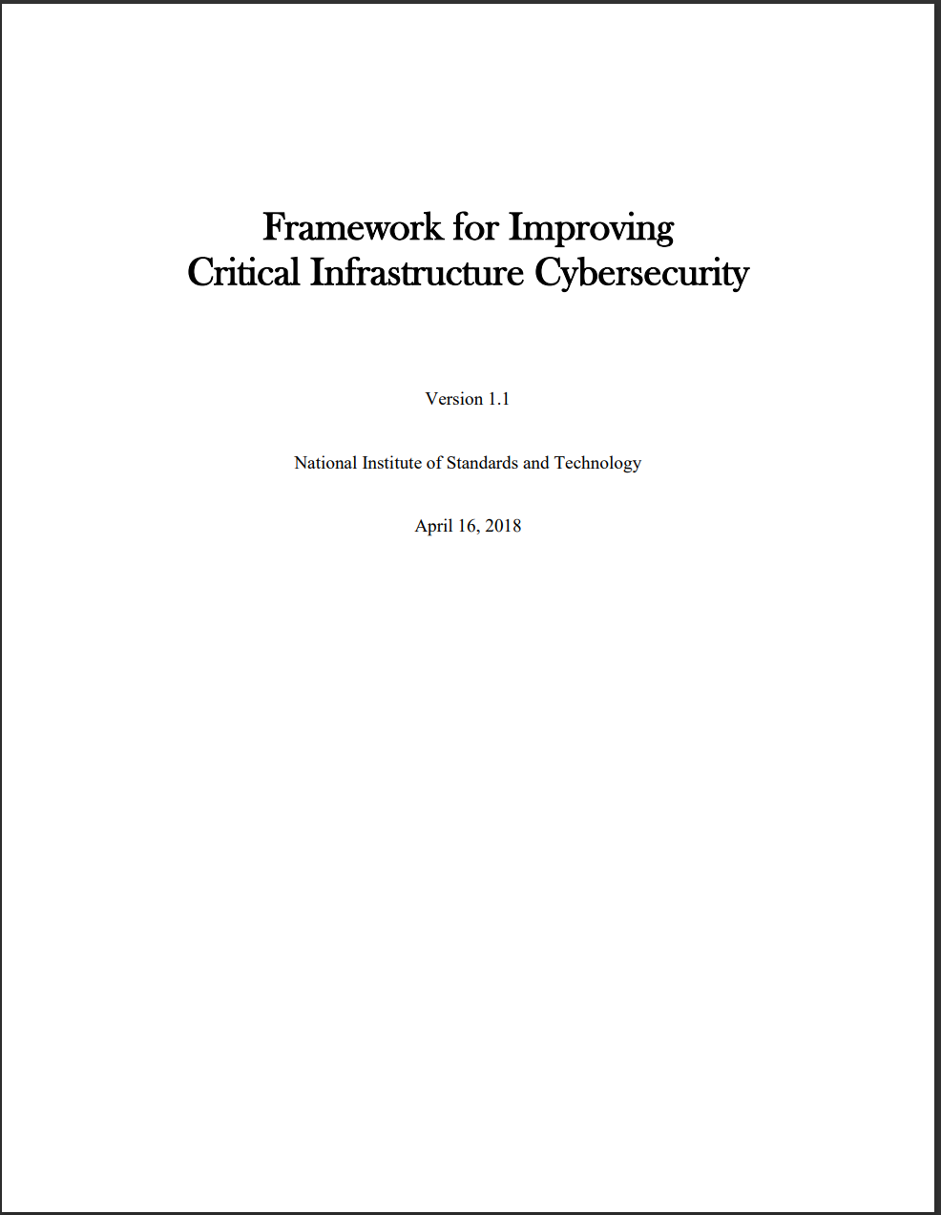
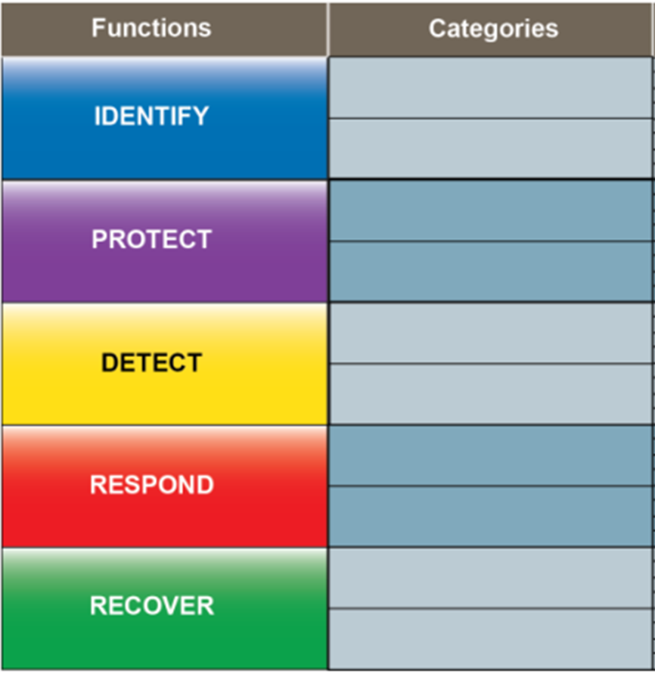
NIST “Cybersecurity Framework”
Start here
What assets need protection?
What safeguards are available ?
What techniques can identify incidents ?
What techniques can contain impacts of incidents ?
What techniques can restore capabilities?

Slide 4
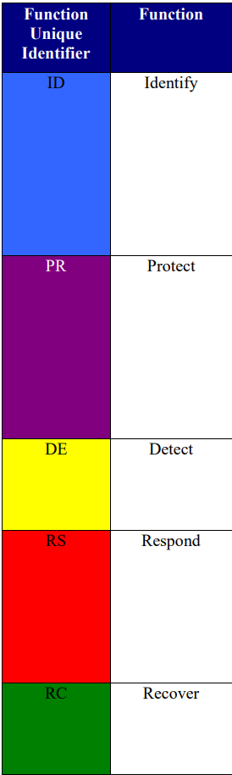
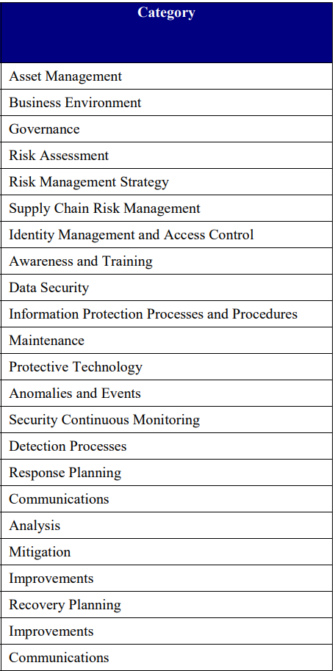
NIST Cybersecurity Framework
What assets need protection?
What safeguards are available ?
What techniques can identify incidents ?
What techniques can contain impacts of incidents ?
What techniques can restore capabilities ?
Notes:
“This publication satisfies the requirements of the federal Information Security Management Act (FISMA) and meets or exceeds the information security requirements established for executive agencies by the Office of Management Budget….
The guidelines in this publication are applicable to all federal information systems other than those systems designated as national security systems….
State, local and tribal governments, as well as private sector organizations are encouraged to consider using these guidelines, as appropriate.”

Slide 5
Computer security incident response - vocabulary
Event – any observable occurrence in a system or a network, e.g.
  User sending an email
  User connecting to a file share (i.e. file folder on another computer)
  Server receiving a request for a web page
  Firewall blocking a connection attempt
Adverse event – is an event with a negative consequence, e.g.
  System crash
  Execution of malware that destroys data
  Unauthorized use of system privileges

Slide 6
Computer security incident response - vocabulary
Computer security incident – is a violation (or imminent threat) of computer security policies, acceptable use policies, or standard practices, e.g.
  Users are tricked into opening a “quarterly report” sent via email that is actually malware; running the tool has infected their computers and established connections with an external host
  An attacker obtains sensitive data and threatens that the details will be released publicly if the organization does not pay a designated sum of money
  An attacker commands a botnet to send high volumes of connection requests to a web server, causing it to crash
  A user provides or exposes sensitive information to others by mistake or on purpose

Slide 7
Computer security incident response
Is necessary because…
  Computer security controls, systems, and processes are not perfect
  Protections designed to protect information and information systems eventually fail
  Security breaches are inevitable

Slide 8
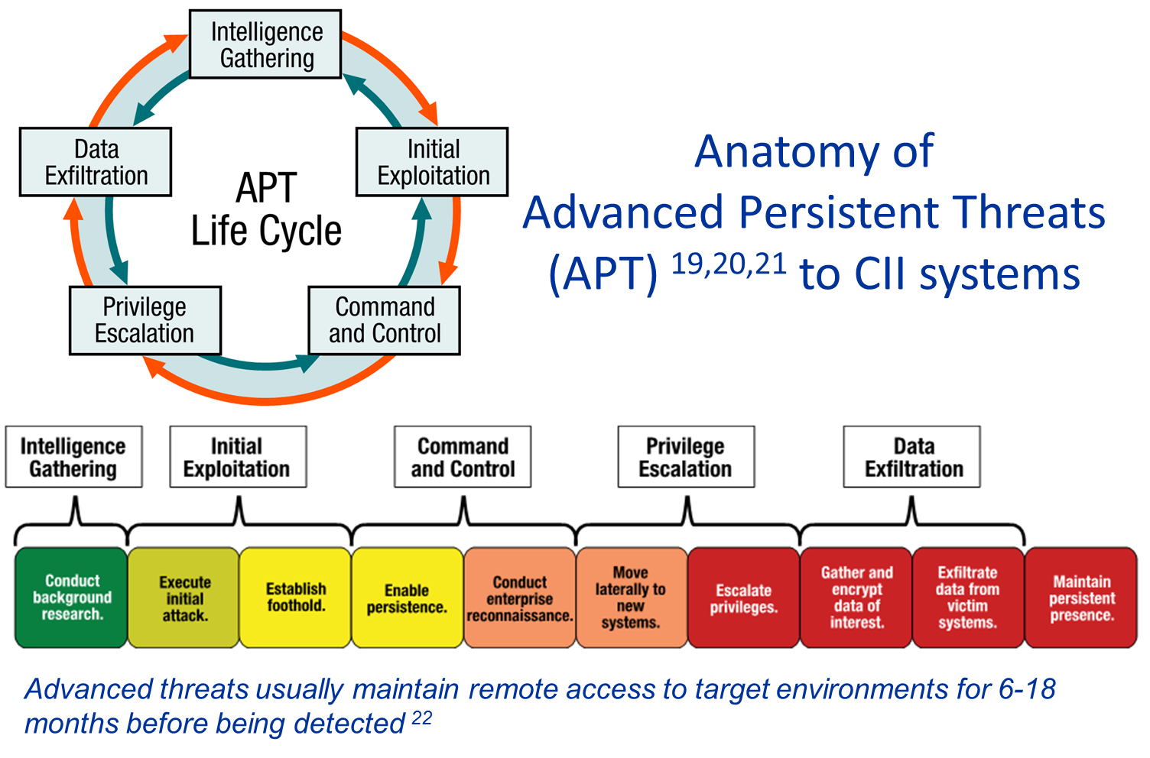

…and the incidents they create
Notes:
APT lifecycle – leading to privilege escalation and data exfiltration.

Slide 9
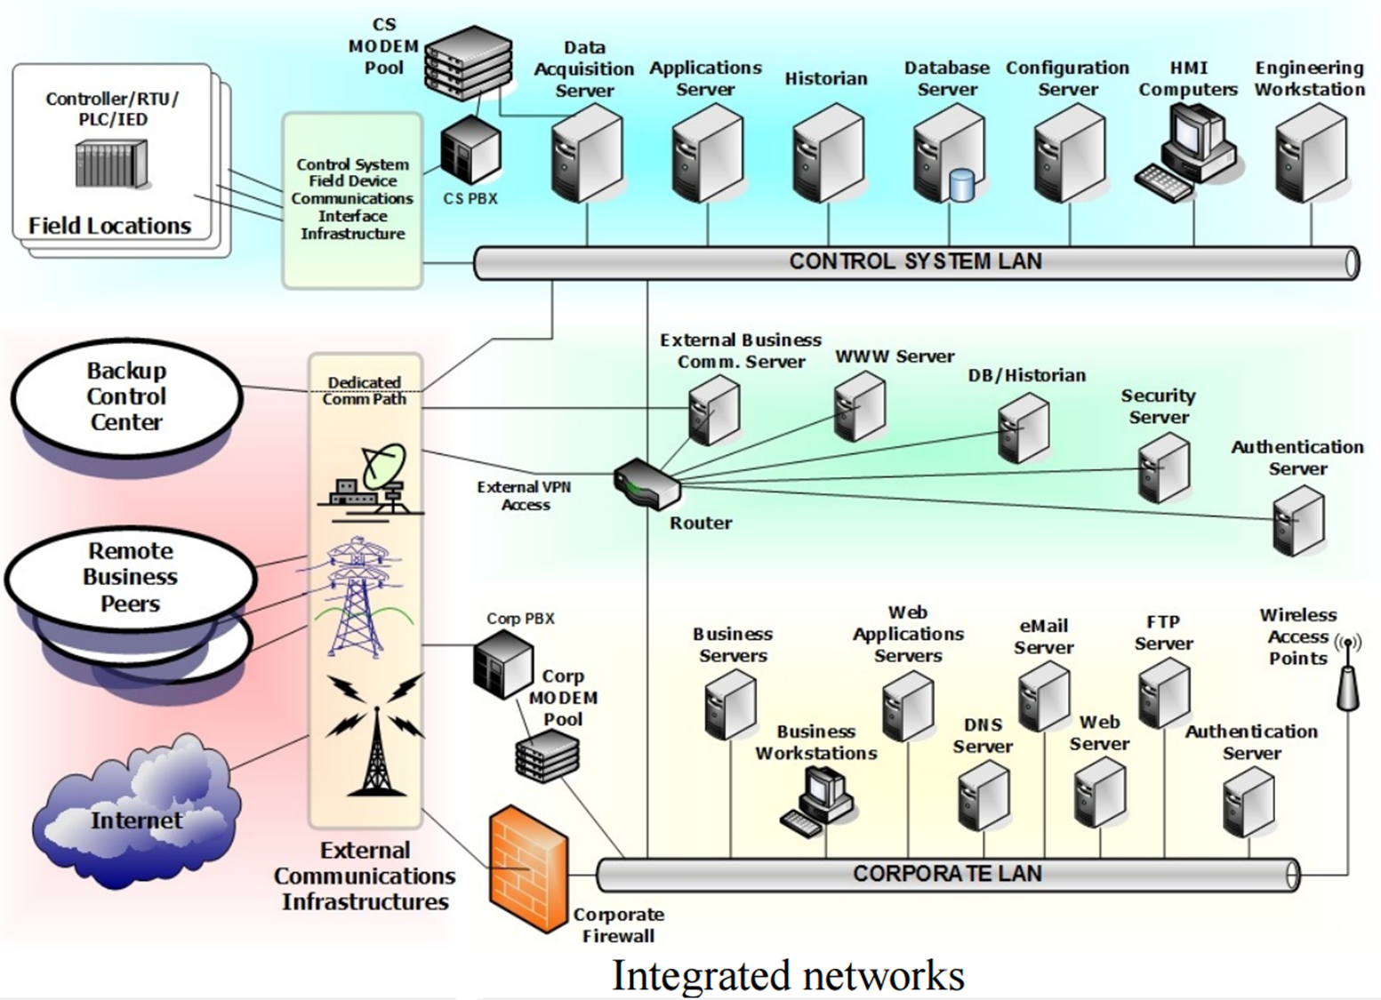
Example of a Network

Slide 10
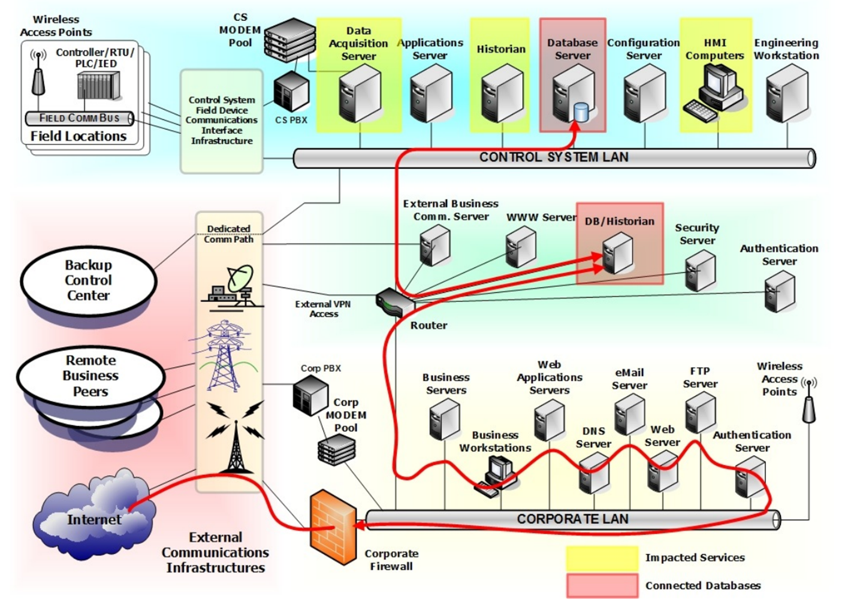
Example of Network Intrusion

Slide 11

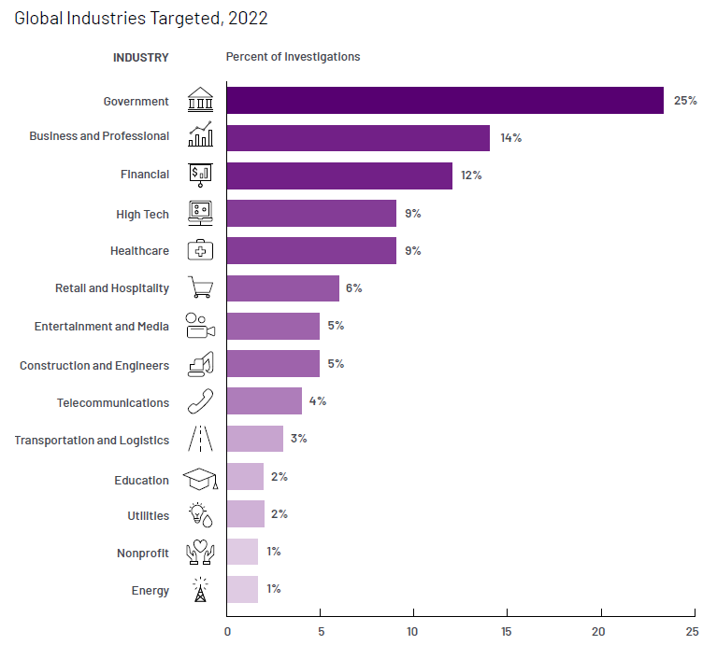
Industry Targeting
https://www.mandiant.com/m-trends

Slide 12
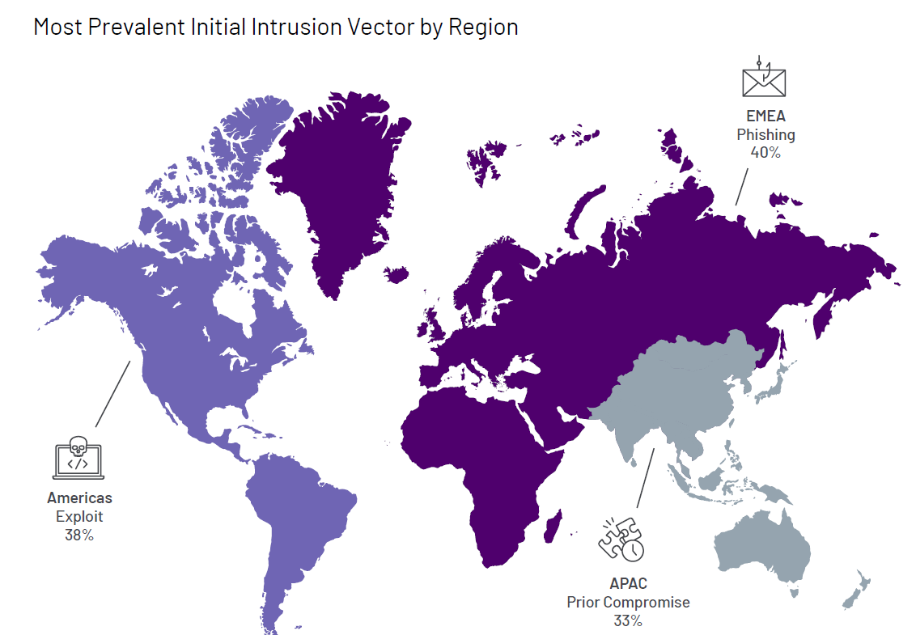
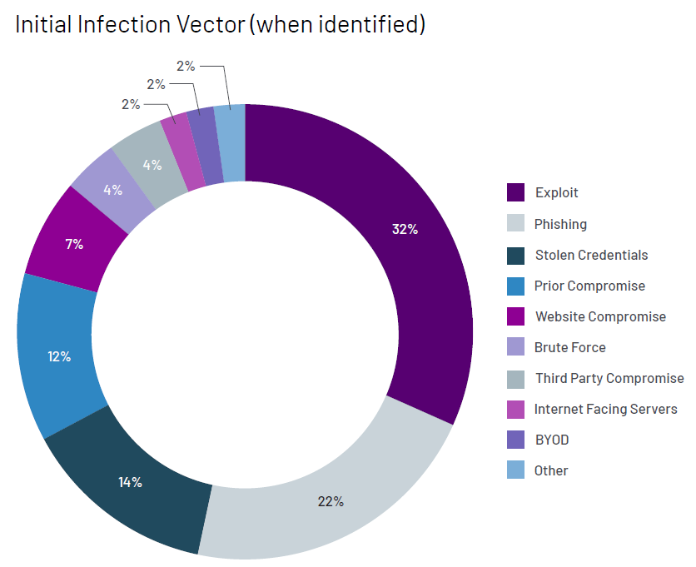
Intrusions initiated with an initial infection vector due to a prior compromise
https://www.mandiant.com/m-trends

Slide 13
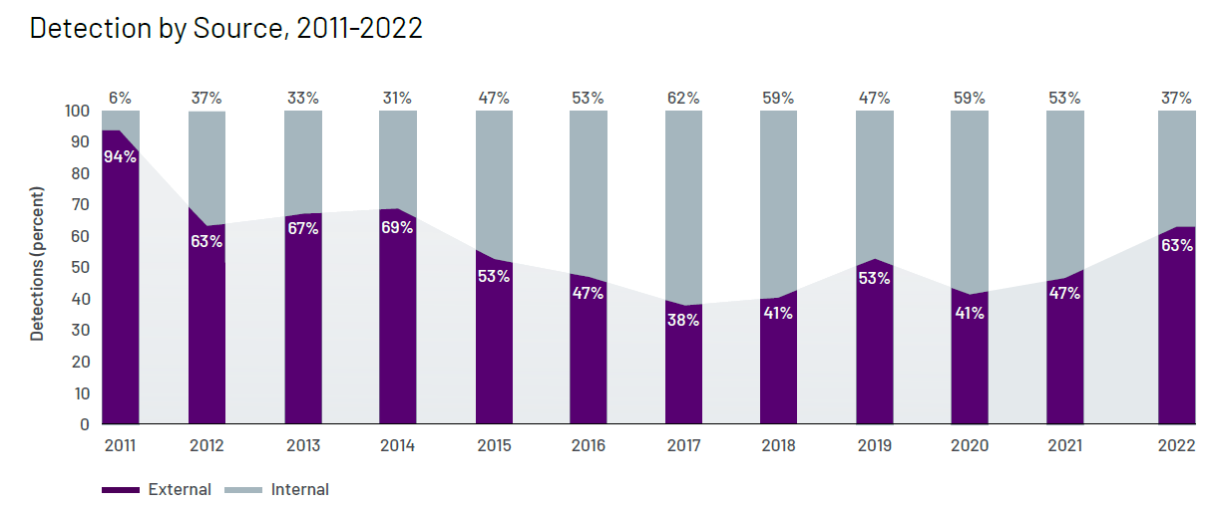
Who is detecting intrusions by attackers?
https://www.mandiant.com/m-trends

Slide 14
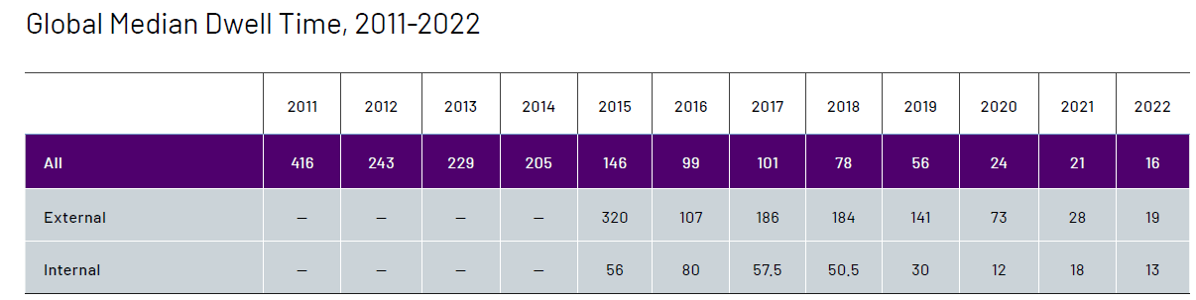
How long are attackers remaining in compromised systems?
“Dwell time is calculated as the number of days an attacker is present in a victim environment before they are detected.”
https://www.mandiant.com/m-trends

Slide 15
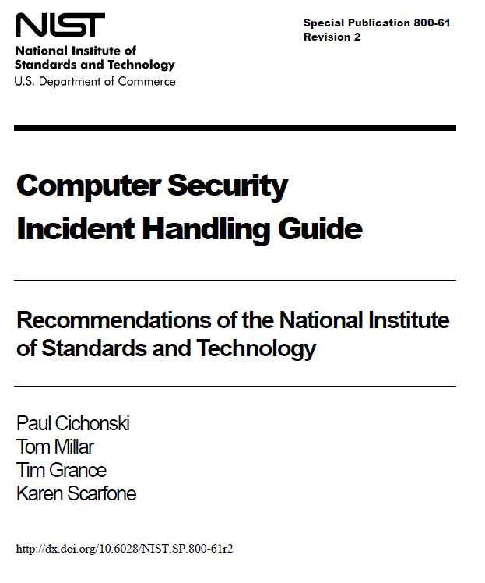
Handling an Incident
Incident response process has several phases:
  Preparation - the business attempts to limit the number of incidents that will occur by selecting and implementing a set of controls based on the results of risk assessments
    Residual risk will inevitably persist after controls are implemented
  Detection and analysis - of security breaches is necessary to alert the organization when incidents occur
Containment, Eradication & Recovery - the organization works to mitigate the impact of the incident by containing it and ultimately recovering from it
  Activity often cycles back to detection and analysis
    E.g., to see if additional hosts are infected by malware while eradicating malware
Post-Incident Activity - After the incident is adequately handled, the organization issues a report that details the cause and cost of the incident and the steps the organization should take to prevent future incidents

Slide 16
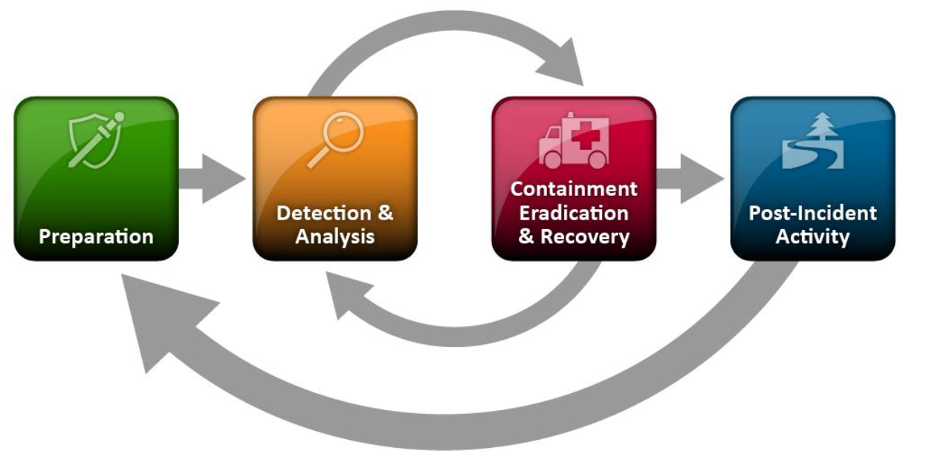
Handling an Incident - Preparation
Preventing Incidents – Keeping the number of incidents reasonably low is very important to protect the business processes of the organization
  If security controls are insufficient, higher volumes of incidents may occur, overwhelming the incident response team
  This can lead to slow and incomplete responses, which translate to a larger negative business impact (e.g., more extensive damage, longer periods of service and data unavailability)
Incident response preparation includes preventing incidents by ensuring that systems, networks, and applications are sufficiently secure
  Risk Assessments
  Host Security
  Network Security
  Malware Prevention
  User Awareness and Training

Slide 17
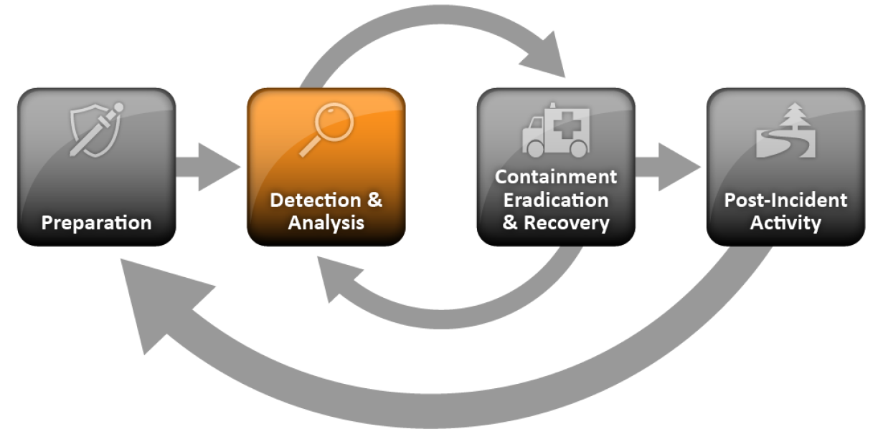
Handling an Incident – Detection and Analysis
Signs of an incident
  For many organizations, the most challenging part of the incident response process is accurately detecting and assessing possible incidents—determining whether an incident has occurred and, if so, the type, extent, and magnitude of the problem
Signs of an incident fall into one of two categories:
Precursors – a sign that an incident may occur in the future
Indicators - a sign that an incident may have occurred or may be occurring now

Slide 18
Handling an Incident – Detection and Analysis
Precursors – While rare, if precursors are detected, the organization may have an opportunity to prevent the incident by altering its security posture to save a target from attack. At a minimum, the organization could monitor activity involving the target more closely.
Examples of precursors are:
  Web server log entries that show the usage of a vulnerability scanner
  NIST National Vulnerability Database (NVD) Announcement of a new exploit targeting a vulnerability of the organization’s mail server
  A threat from a group stating the group will attack the organization

Slide 19
Detection and Analysis
Indicators - While precursors are relatively rare, indicators are all too common. Too many types of indicators exist to exhaustively list them, but some examples are listed below:
An application logs multiple failed login attempts from an unfamiliar remote system
A network intrusion detection sensor alerts a buffer overflow attempt occurs against a database server
A system administrator sees a filename with unusual characters
Antivirus software alerts when it detects that a host is infected with malware
A host records a configuration change in its log
An email administrator sees a large number of bounced emails with suspicious content
A network administrator notices an unusual deviation from typical network traffic flows

Slide 20
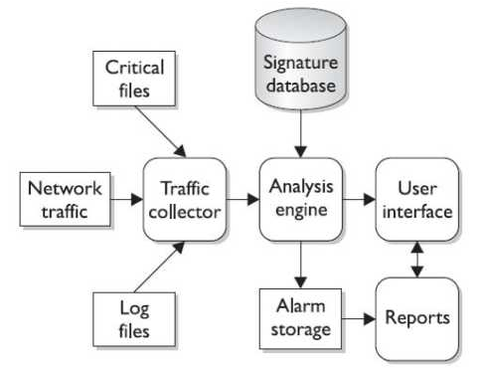
Intrusion Detection Systems (IDSs)
While firewalls and antivirus are preventive controls, IDS are access control monitoring devices designed to
  Detect a security breach
  Aid in mitigating damage caused by hackers breaking into sensitive computer and network systems
IDS’ components
  Sensors
    Collect and send traffic and user activity data to analyzers
  Analyzers
    Look for suspicious activity and if found sends alert to administrator’s interface
  Administrative interfaces

Slide 21
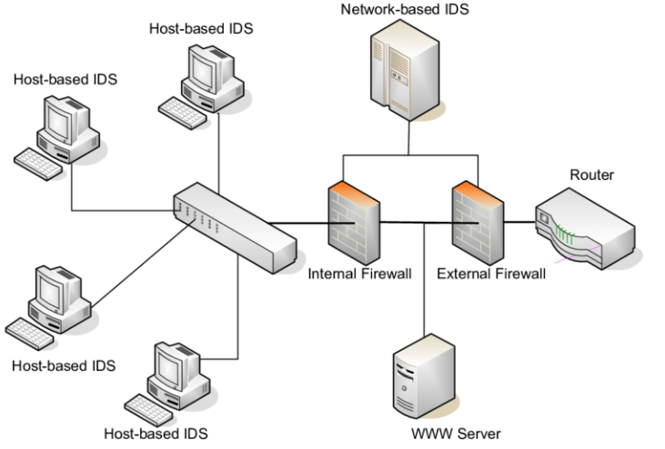
Intrusion Detection Systems (IDSs)
Two main types of IDS
  Host-based for analyzing activity within a particular computer system
  Network-based for monitoring network communications
IDS can be configured to:
  Watch for attacks
  Alert administrator as attacks happen
  Expose a hacker & her/his techniques
  Work with firewalls to terminate a connection
Internet

Slide 22
Intrusion Prevention Systems (IPS)
IDS – Detect something bad may be taking place and send an alert
  Detective and “after the fact” response
IPS – Detect something bad may be taking place and block traffic from gaining access to target
  Preventive and proactive response
  IPS can be host-based or network-based (like IDS)
  Can be content-based (looking deep into packets), conduct protocol analysis or be signature matching
  Also can use rate-based metrics to identify suspicious increases in volumes of traffic
    E.g. DoS – flood attack
    Traffic flow anomalies – “slow and low” stealth attack attempting to be undetected

Slide 23
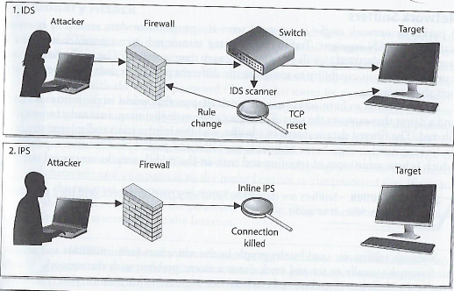
IDS versus IPS
Possible responses to a triggered event:
Disconnect communications and block transmission of traffic
Block a user from accessing a resource
Send alerts of an event trigger to other hosts, IDS monitors and administrators

Slide 24
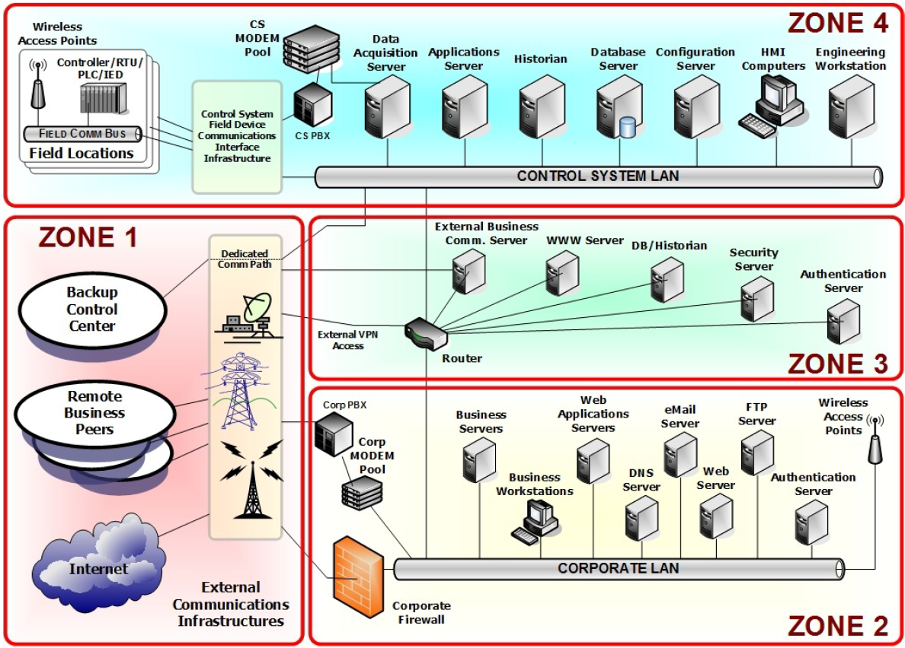
Network Security: Begins with understanding roles of assets in the topology of the network, and moves onto partitioning resources into distinct security zones…
Zone 1: External connectivity to the Internet, peer locations, and back- up facilities
Zone 2: External connectivity and corporate communications
Zone 3: Control systems (in Zone 4) sending and receiving communications to/from external services
Zone 4: Control systems operations – process based or SCADA

Slide 25
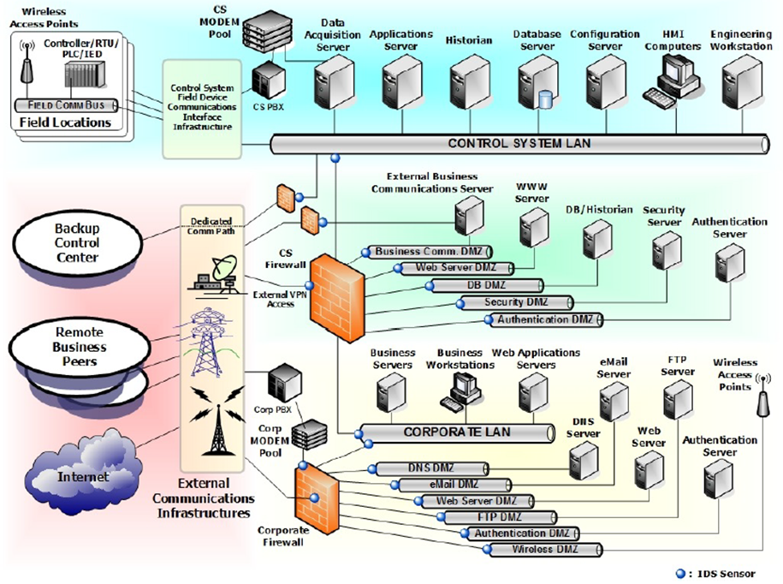
Intrusion Detection System sensors and firewalls located throughout the network

Slide 26
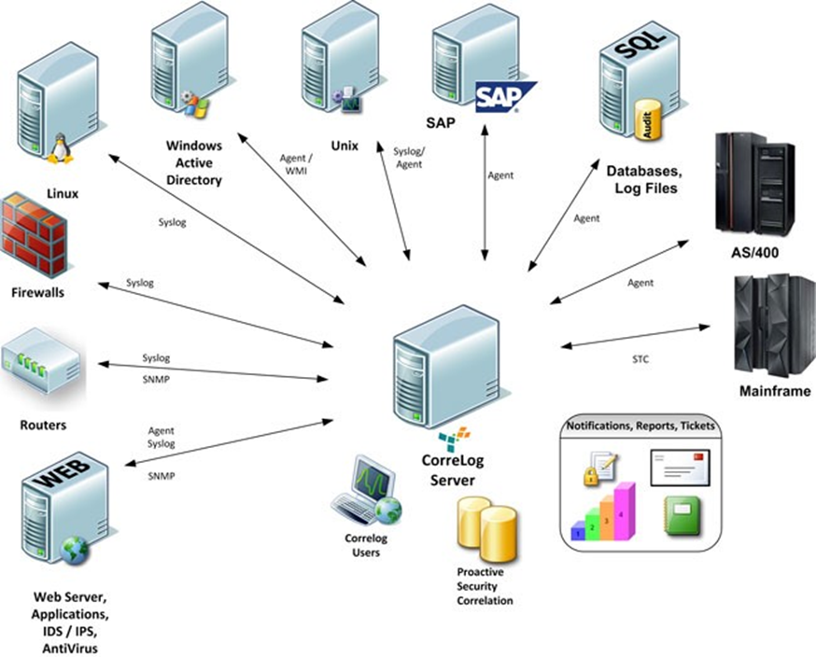
Continuous monitoring with a Security Information and Event Management (SIEM) system
Security information and event management (SIEM) is a configurable security system of record that aggregates and analyzes security event data from on-premises and cloud environments.
SIEM assists with response actions to mitigate issues that cause harm to the organization and satisfies compliance and reporting requirements.
Gartner
Hype Cycle for IT Management Intelligence, 2023
Published 20 July 2023 • ID G00792530
By Cameron Haight

Slide 27
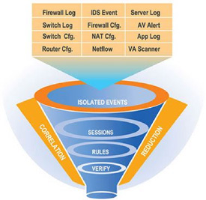
SIEM’s help with Data Analysis and Correlation
Bring raw data events into one database
Database software is programmed to look for “Notable events” or correlations
Correlations will take seemingly isolated events and bring them forward for review/action, for example:
  Windows Log: Employee denied windows login (unknown user account)
  Identity Management System: notes the user account was deleted because employee was terminated last month.
Security Domains: Access, Endpoints, Networks, Identity

Slide 28
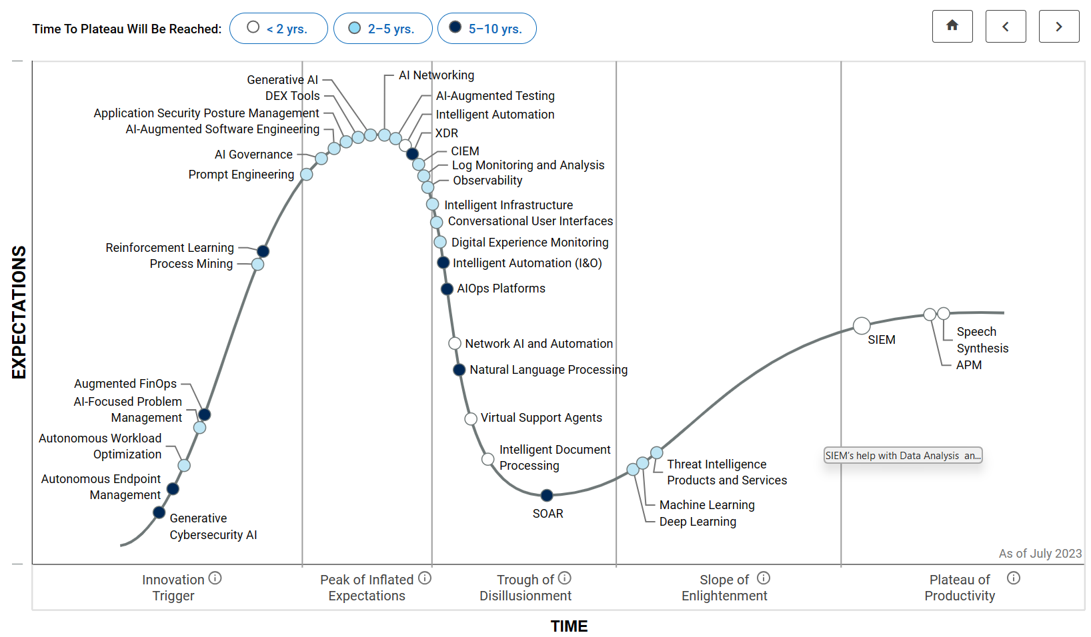
Hype Cycle for IT Management Intelligence, 2023
Published 20 July 2023 • ID G00792530
By Cameron Haight, Gartner

Slide 29
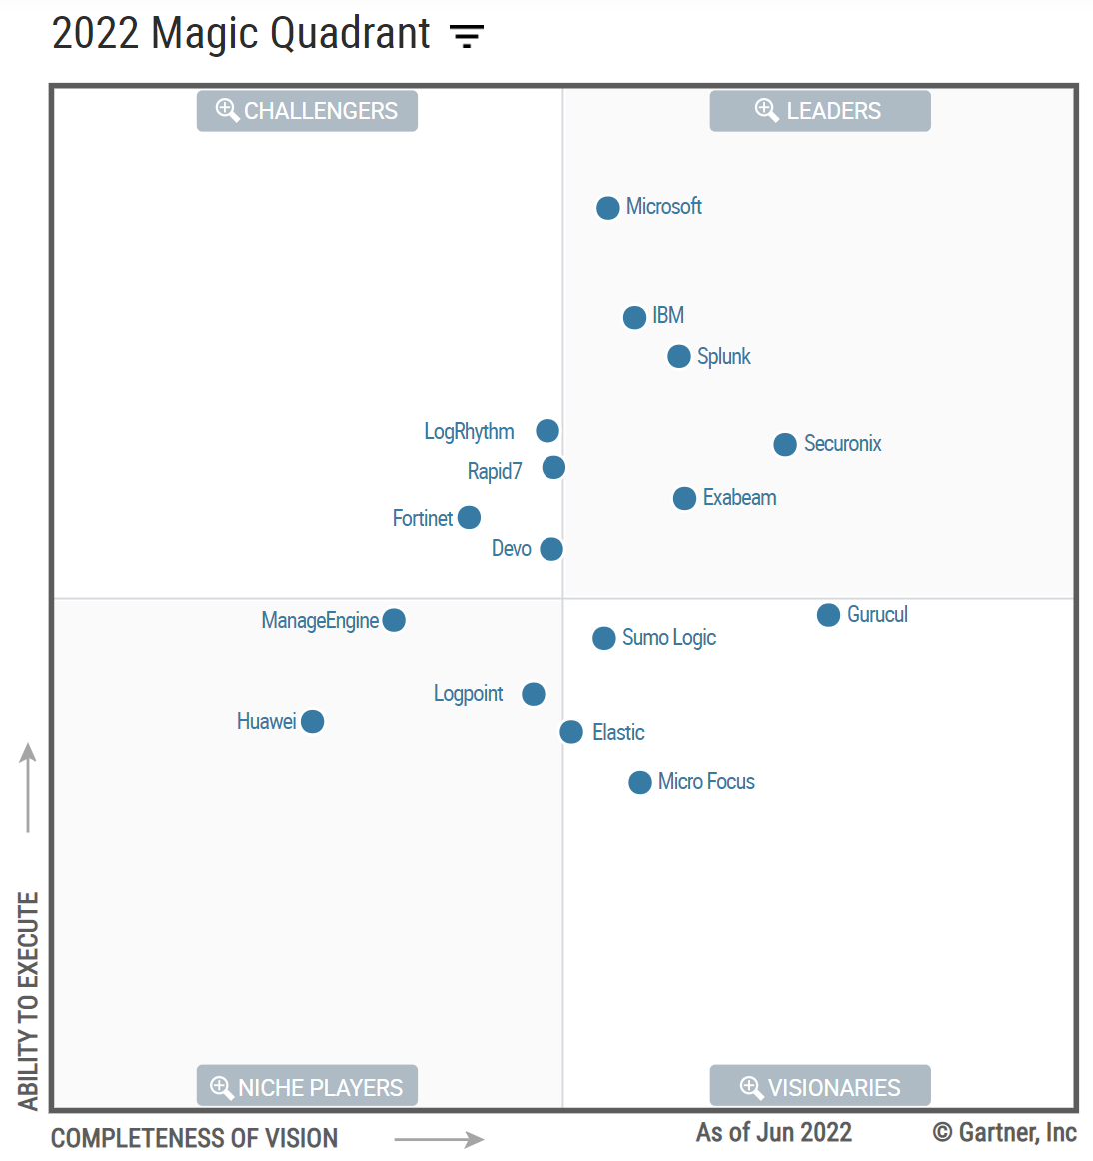
SIEM
Security Information and Event Management (SIEM) market is defined by the customer's need to analyze event data in real time
Allows for the early detection of targeted attacks and data breaches
Collect, store, investigate and report on log data for incident response, forensics and regulatory compliance.
Aggregates event data (logs) produced by security devices, network infrastructure, systems and applications
Magic Quadrant for Security Information and Event Management
Published 10 October 2022 G00755317
Analyst(s): Pete Shoard | Andrew Davies | Mitchell Schneider

Slide 30

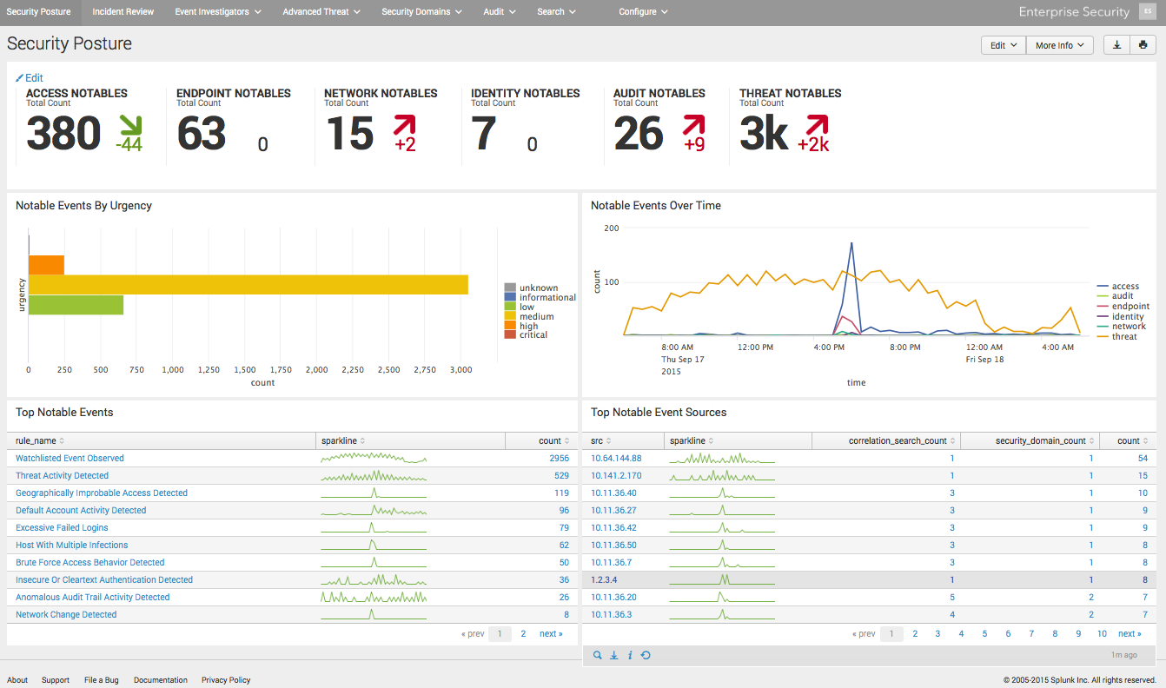

Slide 31

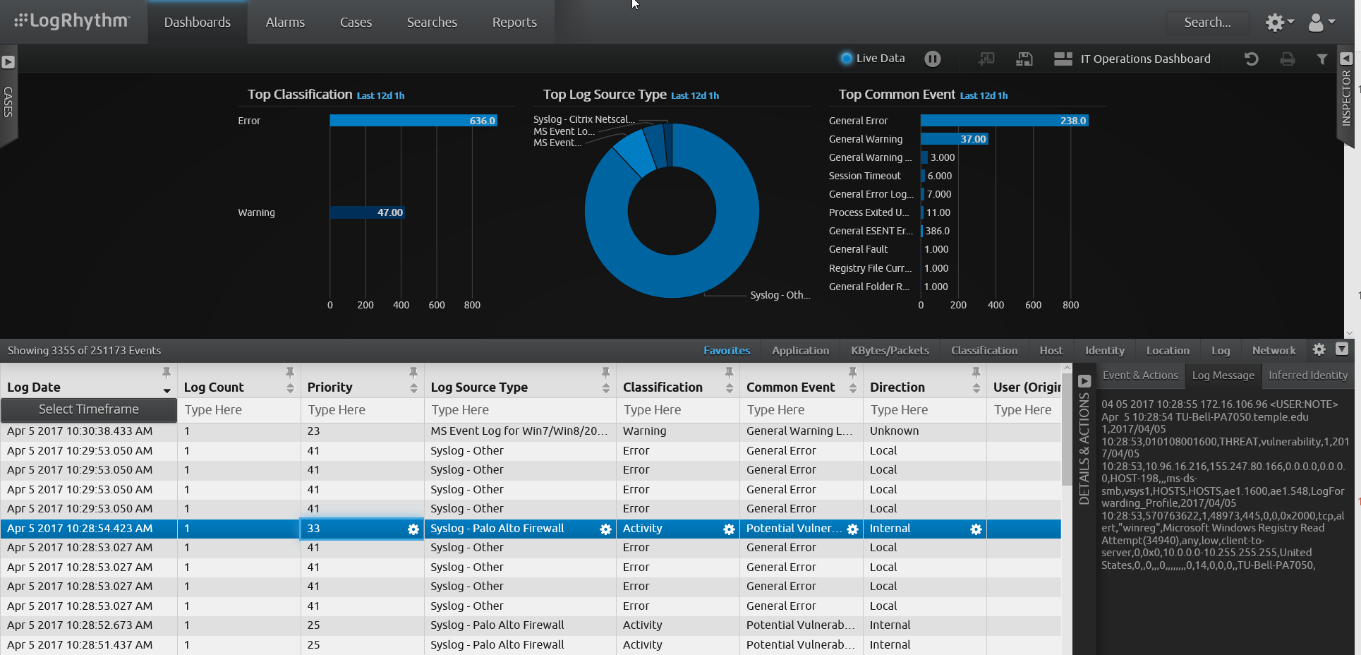

Slide 32
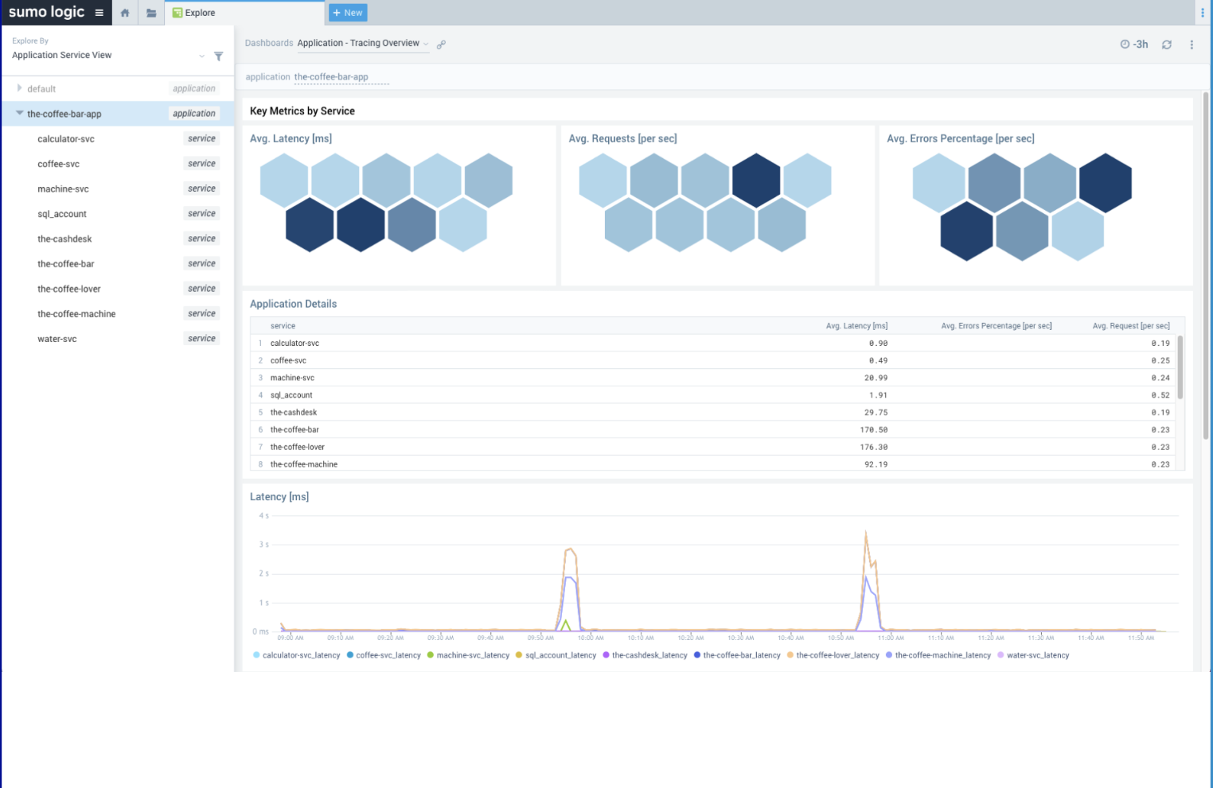
Sumologic

Slide 33
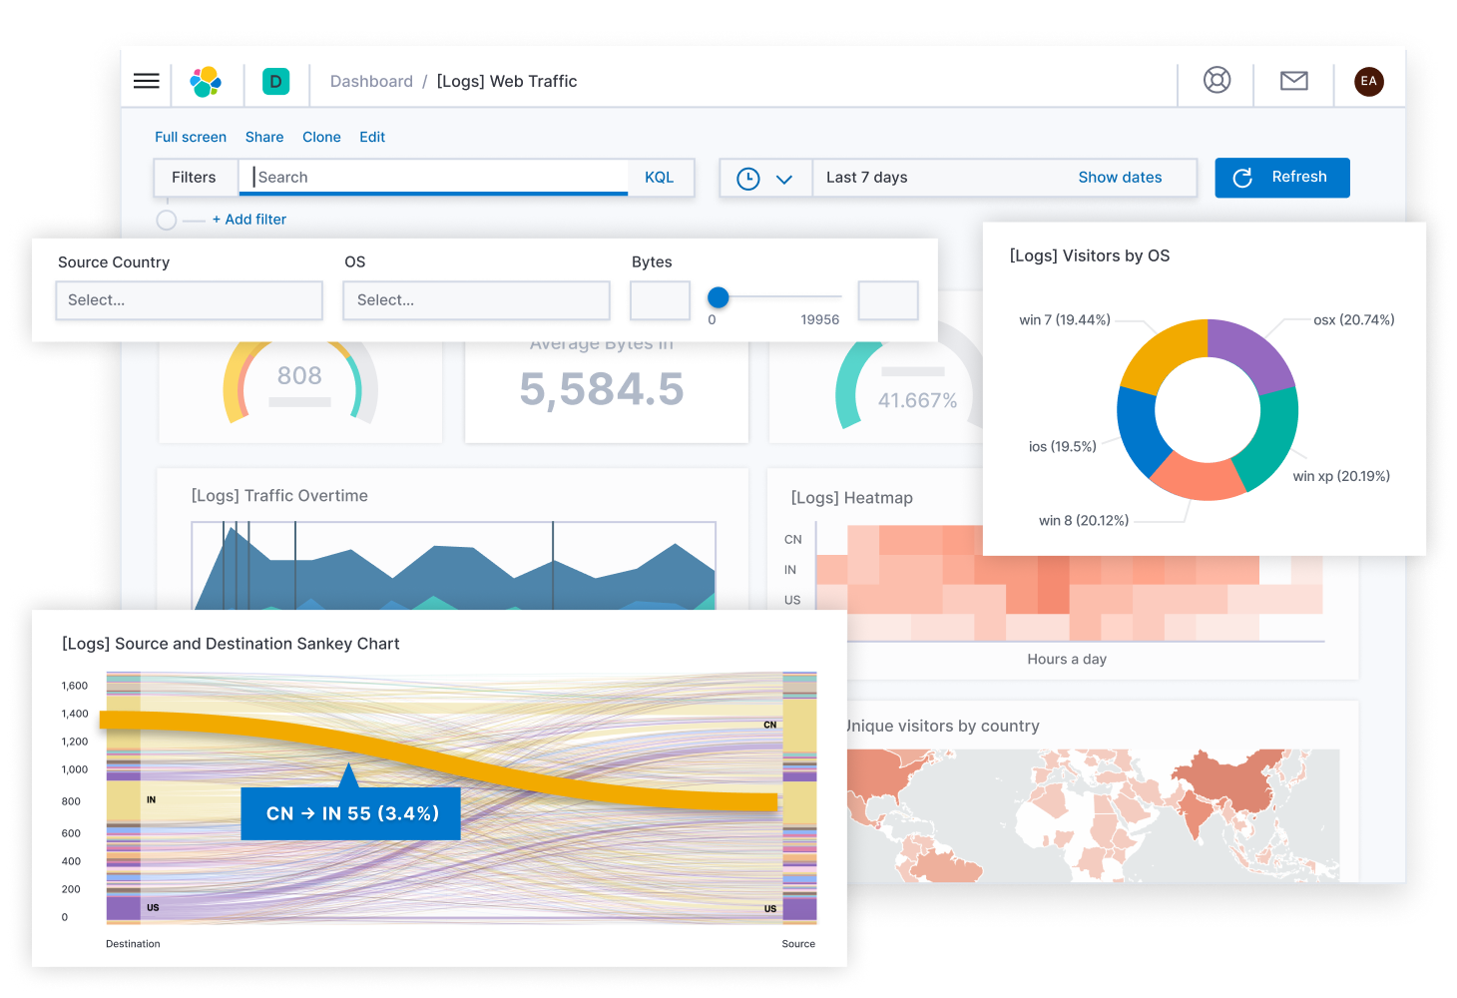

Hybrid – “ELK Stack”
On-Premises, or…
Cloud (hosted)
Note: Sankey charts are a type of flow diagram in which the width of the arrows is proportional to the flow rate

Slide 34
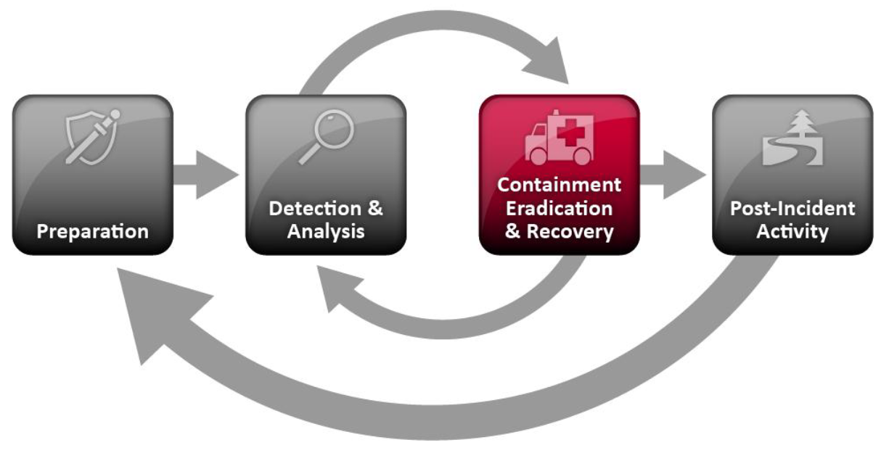
Containment, Eradication, and Recovery
Containment - is important before an incident overwhelms resources or increases damage
Most incidents require containment, which provides time for developing a tailored remediation strategy
An essential part of containment is decision-making (e.g., shut down a system, disconnect it from a network, disable certain functions)
Criteria for selecting among containment strategies are based on type of incident:
Potential damage & theft of resources
Need for evidence preservation
Service availability requirements (e.g., network connectivity, services provided to external parties)
Time & resources needed to implement
Effectiveness (e.g., partial containment, full containment)

Slide 35
Containment, Eradication, and Recovery
Eradication - After an incident has been contained, eradication may be necessary to eliminate components of the incident, such as:
Deleting malware
Disabling breached user accounts
Identifying and mitigating all vulnerabilities that were exploited
  During eradication, it is important to identify all affected hosts within the organization so that they can be remediated

Slide 36
Containment, Eradication, and Recovery
Recovery - In recovery, administrators restore systems to normal operation, confirm that the systems are functioning normally, and (if applicable) remediate vulnerabilities to prevent similar incidents
May involve such actions as:
  Restoring systems from clean backups
  Rebuilding systems from scratch
  Replacing compromised files with clean versions
  Installing patches
  Changing passwords
  Tightening network perimeter security (e.g. firewall rules, boundary router access control lists, …)
Once a resource is successfully attacked, it is often attacked again, or other resources within the organization are attacked in a similar manner
  As a result, higher levels of system logging or network monitoring are often part of the recovery process

Slide 37
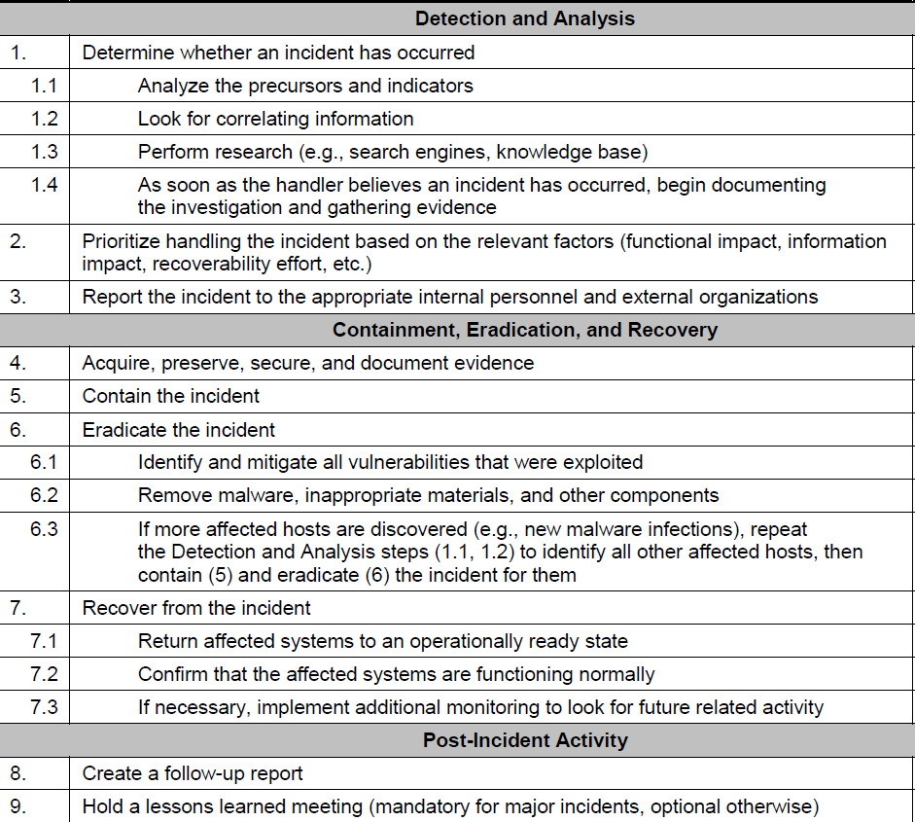
Incident Response Workflow

Slide 38
Agenda
NIST Cybersecurity Framework
Computer security incident response vocabulary
Attackers and detection
Handling an incident
  Preparation
  Detection and analysis
  Containment, eradication and recovery
  Incident response workflow

