Slide 1
Audit Findings Report
Team Member: Xiaomin Dong
Binju Gaire
Borgia Casid Sohou
Beryl (Mengqiao) Liu
Zhixin Wei

Slide 2

Agenda:
Background
Objective and Scope
Findings
Audit Opinion

Slide 3

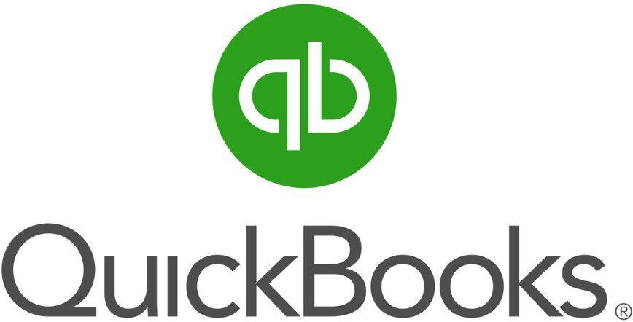
Background
QuickBooks:
an accounting software program used to manage sales and expenses and keep track of daily business transactions.
offers on-premises accounting applications as well as cloud-based versions that accept business payments, manage and pay bills, and payroll functions.
Re/Max:
an American international real estate company that operates through a franchise system.
more than 100,000 agents in 6,800 offices operates in about 100 countries.
use QuickBooks as management software to consolidate accounting, commission tracking, transaction management, reporting, and more.
Notes:
QuickBooks is an accounting software program used to manage sales and expenses and keep track of daily business transactions. It offer on-premises accounting applications as well as cloud-based versions that accept business payments, manage and pay bills, and payroll functions.
Re/Max is an American international real estate company that operates through a franchise system. Re/Max has more than 100,000 agents in 6,800 offices operates in about 100 countries.

Slide 4
Objective and Scope
Objective:
Our audit objective was to determine whether adequate controls were in place and in effect to provide reasonable assurance of using Quickbooks from a security perspective.
Scope:
We performed an audit the security controls of using QuickBooks at Re/Max, for the period of April 7, 2017 to April 7, 2018. The scope of our audit consisted of an evaluation of QuickBooks. This audit was conducted in accordance with the NIST special publication 800 63B guidelines and . These guidlines
Notes:
*ReMax has not established proper controls and procedures related to QuickBooks, so we will not perform the assessment of controls from Re/Max side.

Slide 5
Finding 1:
Fact-Passwords of the computers that are used to access Quickbooks are not required to change periodically by the employees of ReMax. There is less assurance that passwords are limiting access to data files and information only to assigned users.
Standards-Per NIST Special Publication 800-63B (Digital Identity Guidelines), reauthentication of the subscriber SHOULD be repeated at least once per 30 days during an extended usage session, regardless of user activity. The session SHOULD be terminated (i.e., logged out) when this time limit is reached
Root cause of the issue-The issue of reauthentication exists because employees are not aware of the digital identity guidelines.
Impact to the business-chance to have malicious attacks
Recommendations-Passwords should be kept confidential and periodically changed to reduce the risk of unauthorized access to computer and data.
Notes:
(You can talk about the auto fill of Chrome, just saying lol -- Beryl)

Slide 6
Finding 2:
Fact-Quickbooks doesn’t have strict controls on the accessing identity authorization. Anyone could access the information once the person have the account.
Standards-NIST Special Publication 800-63B
An attacker who can gain control of an authenticator will often be able to masquerade as the authenticator’s owner.
Root cause of the issue-Lack of periodic reauthentication of subscriber sessions.
Impact to the business-The customer personal identities and the company transactions will be disclosed.
Recommendations-Use authenticators that provide verifier impersonation resistance. Or Providing different temporary passwords for different authorized users.And only the authorized users have temporary accesses to the system.

Slide 7
Finding 3:
Fact-Quickbook can be hard to use in terms of oversight and compliance guarantee. The software offers no real time visibility into data collection and processes.
Standards-NIST 500-299 (Cloud Computing Security Reference Architecture)
Root cause of the issue-The way the software is set up does not allow all its users to has access to the same data at the same time.
Impact to the business-manually gathering information for audit request can be quite challenging and lead to incomplete results
Recommendation-Build up a cloud software that can be easily spread out across Re/max, which will assure everyone has access to the same data at the same time and that management instantly know what's going on at any time.
https://scholarworks.uni.edu/cgi/viewcontent.cgi?article=1005&context=hpt

Slide 8
Finding 4:
Fact – Users can add or change the data at anytime or any situation as long as they have the password. They can type any number they want and there is lack of backup, which would lead to records losing or error.
Standards – NIST Special Publication 800-63B (Digital Identity Guidelines)
Records Retention Policy
The CSP shall comply with its respective records retention policies in accordance with
applicable laws, regulations, and policies, including any NARA records retention schedules that may apply.
Root cause of the issue - Quickbooks is not supported by paperless and not built with the cloud in mind
Impact to the business - Records losing or error
Recommendations - Go paperless and build up a cloud database

Slide 9
Audit Opinion
Rate: Needs Improvement
Operating well, serving the needs, no significant deficiencies in function.
Require meaningful enhancement regarding the access control, reauthentication, visibility and backups.
Notes:
Based upon our audit work, our opinion is that the overall effectiveness of the processes and controls evaluated during the audit is rated as Needs Improvement.
We found that the QuickBook is operating well in the Re/Max., serving the needs of the company and no significant deficiencies in its function were noted. However, we just raises some questions regarding the appropriateness of the control environment. The control environment will require meaningful enhancement before it can be considered as fully effective, regarding the access control, reauthentication, visibility and backups.

Slide 10
Thanks!
Any Questions?

