Slide 1
TRINITY UNIVERSITY HOSPITAL
INTERNAL EXIT MEETING
HAITAO HUANG - AUDITOR-IN-CHARGE
DONGJIE WANG - SENIOR IT AUDITOR
XIAOZHOU YU - EXPERIENCED IT AUDITOR
RAISA AHMED - EXPERIENCED IT AUDITOR
DERRICK A. GYAMFI - IT AUDIT ASSOCIATE

Slide 2
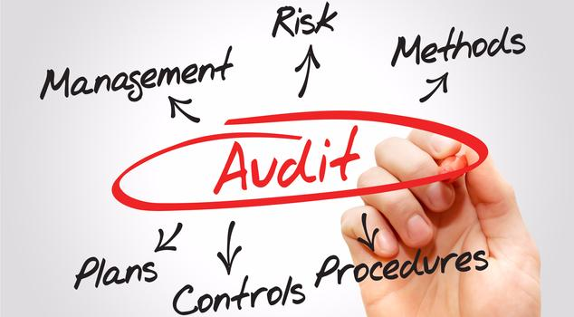
AGENDA
BACKGROUND & OVERVIEW
OBJECTIVE AND SCOPE
FINDINGS
  Risk rating, observation, standards, cause, impact and recommendation
SUMMARY

Slide 3
BACKGROUND & OVERVIEW
Trinity University Hospital is currently a 476 - bed tertiary care hospital that has been serving the Philadelphia region since 1977
Three Clinics: General Clinic, Dental Clinic, and Eye Clinic
Services offered include Emergency Services, Laboratory Services, and Physiotherapy Services
Trinity utilizes fully equipped healthcare specific ERP system solution - HANA RAISA, for patient records management
Notes:
Derrick
Trinity University Hospital is a tertiary care hospital that has been serving the North Philadelphia area since 1977.
The hospital has three department - The General Clinic, Dental Clinic and Eye Clinic.
The hospital also offers a wide arrange of services including - Emergency Services, Laboratory Services, and Physiotherapy Services’
Now to discuss the technology environment, Trinity utilities HANA RAISA, a patient records management sytem
HANA RAISA, is a fully equipped healthcare specific ERP system solution. The technology allows the hospital to
Unify and integrate patient medical records across all clinics, services, and departments
To discuss the purpose

Slide 4
OBJECTIVE AND SCOPE
The main objective of the audit is to verify that the patient records management system is appropriately safeguarded and data reliability and accuracy are maintained within the environment.
The scope of this audit project included reviews of the system for the following areas:
Data Security (Confidentiality, Integrity, Availability)
Segregation of Duties
Authentication & Access Control
Policies & Procedures

Slide 5
FINDING - ACCESS MANAGEMENT
RISK - HIGH
OBSERVATION | Lack of access termination procedure
STANDARD | HIPAA HHS Security Risk Assessment Tool
CAUSE | The requirement is not specified in the data security policy
POSSIBLE IMPACT | Legal penalty for non-compliance Unauthorized access of ePHI lead to identity theft Compromise of confidentiality, integrity or availability of ePHI
RECOMMENDATION | Review and update the information security policy Develop and implement access termination procedures Periodically review and modify logical access

Slide 6
FINDING - SEGREGATION OF DUTIES
RISK - HIGH
OBSERVATION | Inappropriate employee access to information and information systems
STANDARD | ISO 27001 NIST 800-53
CAUSE | No proper control established for employee access
POSSIBLE IMPACT | Fraud and error Manipulation of statements Costs to recover from reputational damage Compromise confidentiality, integrity, and availability
RECOMMENDATION | Review user access to data and applications to ensure access rights remain appropriate and are adequate with job duties and responsibilities. RACI Chart

Slide 7
FINDING - AUTHENTICATION (PASSWORDS)
RISK - HIGH
OBSERVATION | Weak passwords are used to access the system
STANDARD | NIST SP 800-63b
CAUSE | No standard for ensuring strong password
POSSIBLE IMPACT | Unauthorized access Compromise of sensitive patient information Reputation damage and lawsuits
RECOMMENDATION | Establish a strong password standard Use two-factor authentication Restrict access for incorrect password input Provide educational training on password security Examine password strength periodically
Notes:
https://www.giac.org/paper/gcux/12/security-audit-report/103579
https://www.computerworld.com/article/2493184/security0/passwords-are-the-weak-link-in-it-security.html
http://blog.whoa.com/top-5-password-mistakes-and-their-impact-on-your-data-security
https://pages.nist.gov/800-63-3/sp800-63b.html#sec8
Create a written password policy. It should be part of your computer usage policy. Make sure all employees are familiar with it and agree to abide by it.
https://www.acunetix.com/blog/articles/weak-password-vulnerability-common-think/
Help them understand why it is important. Listen to the groans, appreciate their issues and then insist they do it.
Help them understand what appropriate and inappropriate passwords are.

Slide 8
FINDING - POLICIES & PROCEDURES
RISK - MODERATE
OBSERVATION | Poor System Log Management Out of Date & Irregular System Log Reviews
STANDARD | Internal Hospital IT System Policy NIST 800-92 Reference
CAUSE | Employee Forgetfulness Lack of Supervision & Oversight
POSSIBLE IMPACT | Access to Incorrect Information Delayed Detection of Risks & Possible Threats
RECOMMENDATION | Automate Review Logs Prioritizing Periodic Log Reviews Assign Hard-Deadlines & Review Supervisors
Notes:
Per review of system
https://nvlpubs.nist.gov/nistpubs/legacy/sp/nistspecialpublication800-92.pdf

Slide 9

SUMMARY
Key Audit Findings
  Access Management
  Segregation of Duties
  Authentication
  Policies & Procedures
Recommended Improvements
  Existing policies and procedures updates
  New standards established
  Periodically reviews

Slide 10
Thank You!

Slide 11
REFERENCE
https://www.giac.org/paper/gcux/12/security-audit-report/103579
https://www.computerworld.com/article/2493184/security0/passwords-are-the-weak-link-in-it-security.html
http://blog.whoa.com/top-5-password-mistakes-and-their-impact-on-your-data-security
https://pages.nist.gov/800-63-3/sp800-63b.html#sec8
https://www.hipaajournal.com/ocr-record-hipaa-settlement-memorial-healthcare-system-8695/
https://www.hipaajournal.com/hipaa-violation-cases/
https://www.healthit.gov/topic/privacy-security/security-risk-assessment-tool
https://www.hhs.gov/hipaa/for-professionals/security/guidance/guidance-risk-analysis/index.html
https://healthitsecurity.com/features/the-role-of-risk-assessments-in-healthcare
https://www.hhs.gov/hipaa/for-professionals/security/laws-regulations/index.html

