Slide 1
TRINITY UNIVERSITY HOSPITAL
DEPARTMENT OF INTERNAL AUDIT
HAITAO HUANG - AUDITOR-IN-CHARGE
DONGJIE WANG - SENIOR IT AUDITOR
XIAOZHOU YU - EXPERIENCED IT AUDITOR
RAISA AHMED - EXPERIENCED IT AUDITOR
DERRICK A. GYAMFI - IT AUDIT ASSOCIATE
Notes:
H

Slide 2
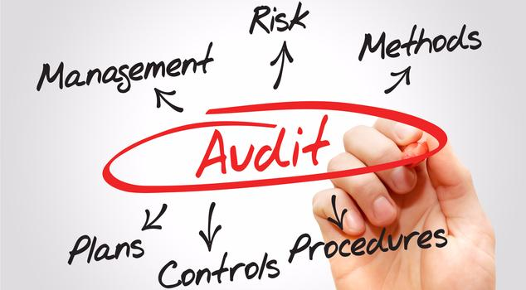
AGENDA
BACKGROUND & OVERVIEW
OBJECTIVE
SCOPE OF AUDIT
RISK ASSESSMENT
ROLES & RESPONSIBILITIES
RESOURCE BREAKDOWN
KEY DATES & DELIVERABLES
SUMMARY

Slide 3
BACKGROUND & OVERVIEW
THE HOSPITAL
Trinity University Hospital is currently a 476 - bed tertiary care hospital that has been serving the Philadelphia region since 1977.
Three Clinics: General Clinic, Dental Clinic, and Eye Clinic
Services offered include Emergency Services, Laboratory Services, and Physiotherapy Services
THE ERP SYSTEM
Trinity utilizes HANA RAISA, a patient records management software system.
HANA RAISA is a fully fledged healthcare specific ERP system solution aimed at enabling the hospital to:
Unify the entire spectrum of patient medical records across clinics and departments
Make retrieval and viewing of patient information easy and secure
Ensure the right information is in the right hands at the right time
Supply real-time tracking information for all files at all times (no more missing or mishandled records)
Deliver easy-to-use, transparent reporting in a variety of formats

Slide 4
AUDIT OBJECTIVE
The main objective of the audit is to verify that the patient records management system is appropriately safeguarded and that data reliability and accuracy are maintained within the environment.
The specific objectives of the audit is to:
Assess the application level security of the system
Evaluate data security in the patient record management system
Assess the data security in compliance with laws and regulations

Slide 5
SCOPE OF AUDIT
The scope of this audit project included reviews of the system for the following areas:
Segregation of Duties
Authentication, authorization and access control
Data security (Confidentiality, Integrity, Availability)
Disaster Recovery and Business continuity
Policies and procedures
Out-of-scope Areas:
Infrastructure of ERP system
Physical and environmental controls

Slide 6
RISK ASSESSMENT
 | Impact | Likelihood | Rationales | Findings
Inherent Risk | High | High | Sensitive data (medical records, insurance info, payments) Laws & regulations (HIPPA) Reputational & financial losses | Data is not classified based on level of sensitivity
Control Risk | High | moderate | Sensitive data Some critical procedures missing | Missing account termination procedures
Detection Risk | High | Moderate | Sensitive data Further errors and risks | System logging is not properly configured

Slide 7
ROLES & RESPONSIBILITIES
AUDITOR | ROLE | RESPONSIBILITY
Haitao Huang | Auditor-in-Charge | Oversight General review of reports Supervision and Guidance
Dongjie Wang | Senior IT Auditor | Detailed Review Planning
Derrick Gyamfi | IT Audit Associate | Data Analysis General administrative assignments in support of the audit or auditors
Xiaozhou Yu | Experienced IT Auditor | Testing Document testing results
Raisa Ahmed | Experienced IT Auditor | Testing Document testing results

Slide 8
RESOURCE BREAKDOWN
Auditing Phase | Start Date | End Date | Working Hours
Planning | 2/26/18 | 3/10/18 | 86 hrs
Testing | 3/12/18 | 5/1/18 | 400 hrs
Reporting | 5/2/18 | 5/15/18 | 76 hrs
Total |  |  | 565 hrs

Slide 9
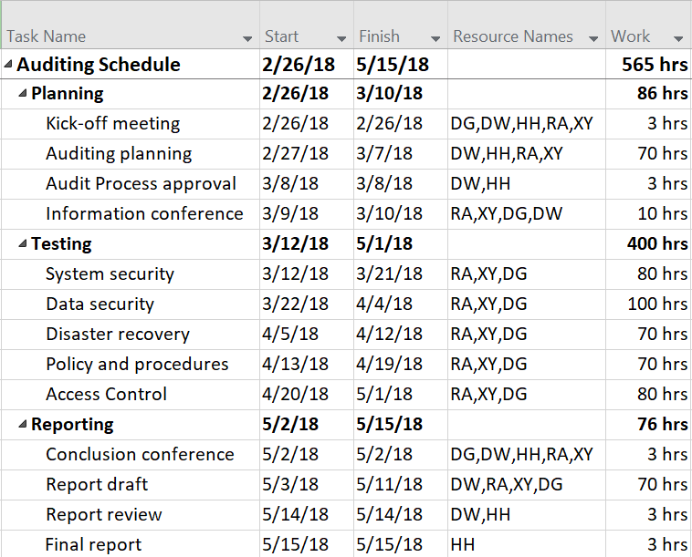
KEY DATES & DELIVERABLES

Slide 10
SUMMARY
Importance of the PRM and patient information
Provide management with assessment of control environment
Focus on inherent, control and detection risks
ensure deliverables in timely and cost-effective manner

Slide 11
Thank You!
QUESTIONS?

