Slide 1
Active Directory Audit
Mahroo Sanati Mehrizi
Adam Joskowicz
Mattew Dampf
Kevin Berg

Slide 2
Agenda
Audit Committee
Adit Scope
Four Audit Findings
Audit Opinion

Slide 3
Active Directory: Audit Committee
Auditor in charge - Mahroo Sanati Mehrizi
Audit Director - Matt Dampf
Audit Director - Adam Jostcowicz
Audit Director - Kevin Berg

Slide 4
Active Directory: Audit Scope
Scope Dates:
January 1st, 2017
December 31st, 2018
Audit Scope:
Active Directory Management
Secure Active Directory Boundaries
Domain Controllers
Domain Controllers and Controllers Setting
Administrative Practices

Slide 5
Active Directory: Out of Scope
Windows Server Configuration
Workstations
Users Access
DNS

Slide 6
Active Directory: Findings
Inadequate physical security of domain Controllers
Active directory administrator password do not expire
Increasing open access
Unaware of permission inherited in group nesting
Notes:
Low Risk Rating Finding: Inadequate physical security of domain controllers
Facts: The data center housing the domain controllers is in the same office building as the rest of the organization. The3 data center is behind two sets of locked doors, and each set of doors is keyed differently. The room housing the servers is larger than is necessary, so the room doubles as storage for audiovisual equipment. Employee interviews show that ten people possess both keys necessary to enter the data center. Four of those employees are part of the server administration group and six are from the audiovisual side of the organization.
Root Cause: Too many people have physical access to the domain controllers, including some who have no role in dealing with servers. The root cause for this finding is the dual purpose functionality of the room. Physical access to domain controllers (and the other servers in the data center) needs to be minimized to the absolute minimum number of people necessary to operate and service the servers.
Business Impact: Physical access to systems is enough to undo all other security measures, no matter how strong they are. An unauthorized person with physical access to domain controllers could interrupt business operations by shutting down the system or could compromise data by removing hard drives from the servers.
Recommendations: The data center needs to be a single purpose room dedicated to hosting servers. Keys should be granted only to personnel needed specifically to service server hardware.
Facts: The data center housing the domain controllers is in the same office building as the rest of the organization. The3 data center is behind two sets of locked doors, and each set of doors is keyed differently. The room housing the servers is larger than is necessary, so the room doubles as storage for audiovisual equipment. Employee interviews show that ten people possess both keys necessary to enter the data center. Four of those employees are part of the server administration group and six are from the audiovisual side of the organization.
Root Cause: Too many people have physical access to the domain controllers, including some who have no role in dealing with servers. The root cause for this finding is the dual purpose functionality of the room. Physical access to domain controllers (and the other servers in the data center) needs to be minimized to the absolute minimum number of people necessary to operate and service the servers.
Business Impact: Physical access to systems is enough to undo all other security measures, no matter how strong they are. An unauthorized person with physical access to domain controllers could interrupt business operations by shutting down the system or could compromise data by removing hard drives from the servers.
Recommendations: The data center needs to be a single purpose room dedicated to hosting servers. Keys should be granted only to personnel needed specifically to service server hardware.
Finding: Active Directory administrator passwords do not expire
Facts: The audit team used the DSInternals Powershell module to perform a computer-aided audit of the Active Directory password policies. The module was able to identify five accounts with passwords that do not expire - all of which are domain administrator account types.
Root Cause: The root cause of this finding is that the domain administrators have exempted themselves from the policies that apply to the rest of the users. The admins clearly understand what makes an effective password policy, as this control has been rated for as effective for the vast majority of user accounts. The passwords are a minimum of 8 characters in length, require uppercase, lowercase, number and special characters and expire every six months. However, these policies do not apply to the AD container that contain the technology department accounts.
Business Impact: The impact of compromised user accounts on an organization can be immense. These accounts provide a pathway for bad actors to access company systems, networks and data. The impact is even higher when an administrator account is the one that is compromised, as these accounts have access to everything across all business units. If anything, these accounts should be more secure - with even stronger passwords and more frequent password changing requirements.
Recommendations: Follow your password policy universally. It should apply to all user accounts in all containers. The policy has already shown to be effective - it just needs to be followed.
Finding:Increasing Open Access
Facts: The audit team requested that administrators to disable stale user accounts and delete them forever. If there are many such inactive accounts, moving them all to a single organizational unit before disabling and deleting them will be more convenient.
Checking LastLogonTimeStamp Attribute helps the administrators to find inactive and stale accounts. they can disable and delete such accounts manually from Microsoft Management Console (MMC).
Root Cause:Well-known security Principals (Domain Users, Everyone, Authenticated users, etc.) can provide users with access to a diverse range of network resources. Whilst these principles can be used to grant access to large groups of valid accounts, it’s necessary to make sure that Guest and Anonymous accounts are not granted the same open access.
Business Impact: This finding indication that leavers' processes are not fully implemented so that accounts aren't decommissioned when an employee leaves an organisation or takes a sabbatical leave. The risk is two-fold: an ex-employee has unauthorised access to the organisation's data, and the account – with all of its associated access permissions – can be hijacked by an external hacker.
Recommendation:
1-Eliminate unnecessary access privileges
2-Create service accounts from scratch
3-Take away redundant user rights
4-Secure service accounts by doing password configurations
5-Audit service accounts

Slide 7
Finding 1
Inadequate physical security of domain Controllers
Facts: The data center housing the domain controllers in the same office building as the rest of the organization.
Standards:
Root Cause of the issue: Too many people have physical access to the domain controllers, including some who have no role in dealing with servers. The root cause for this findings is the dual purpose functionality of the room.
Risk Rating: Low
Impact to the Business: An unauthorized person with physical access to domain controllers could interrupt business operations by shutting down the system or could compromise data by removing hard drives from the servers.
Recommendations: The data center needs to be a single room dedicated to hosting servers. Key should be granted to personnel needed specifically to service server hardware.

Slide 8
Finding 2
Active directory administrator password do not expire
Facts: The audit team used the DSInternals Powershell module to perform a computer-aided audit of the Active Directory password policies. The module was able to identify five accounts with passwords that do not expire - all of which are domain administrator account types.
Standards:
Root Cause of the issue: The root cause of this finding is that the domain administrators have exempted themselves from the policies that apply to the rest of the users.
Risk Rating: Medium
Impact to the Business: The impact of compromised user accounts on an organization can be immense.
Recommendations: Follow your password policy universally. It should apply to all user accounts in all containers.

Slide 9
Finding 3
Increasing open access
Facts: Stale user accounts were not enabled or deleted
Standards: NIST 800 Special Publication -53
Root Cause of the issue: Lack of disabled and old users account monitoring
Risk Rating: Medium
Impact to the Business: Unauthorized access to organization’s data and account, associate access permission can be high jacket by an external hacker.
Recommendations:
Eliminate unnecessary accounts
Create service accounts from scratch
Take away redundant user right
Secure service account by doing password configuration
Audit service account

Slide 10
Finding 4
Unaware of permission inherited in group nesting
Facts: Group nesting in AD and adding new groups to the Active Directory.
Standards: NIST 800-63B
Root Cause of the issue: Active Directory nests groups are based on parent-child hierarchy.When a group is added as a member of administrative group, all members of that group will receive administrative privileges.
Risk Rating: High
Impact to the Business: Loss of information confidentiality, lack of member and data security.
Recommendations:
Dividing users into groups with common access requirements
Group scope (Local, Domain local, Universal, Global)
Reaching to a level of maturity were some industry standard best practices can be developed.

Slide 11
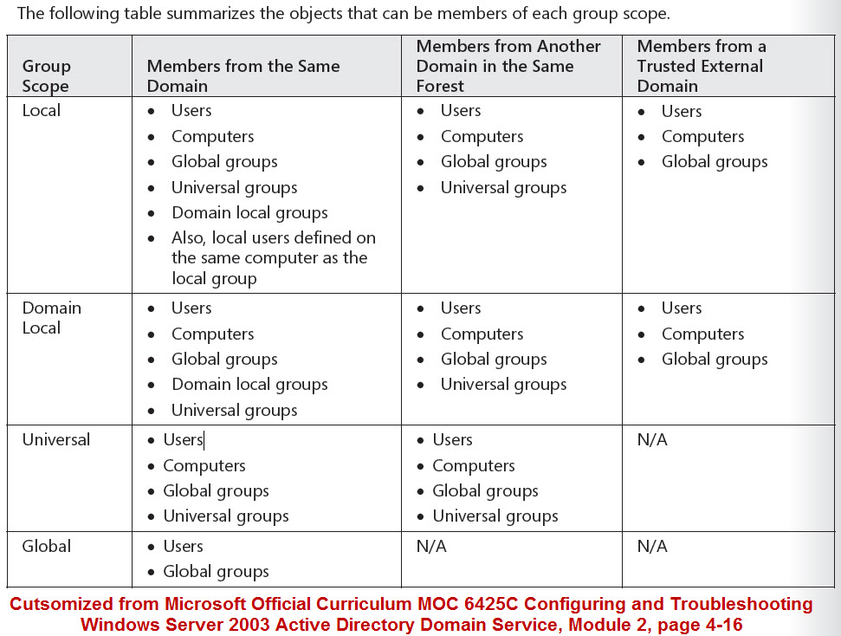
Finding 4
Unaware of permission inherited in group nesting
Notes:
High Risk Rating Finding: Unaware of Permission Inheritance in Group Nesting
Facts:Before implementing groups in the environment, the auditors have to understand how groups are used and which types of groups exist. It’s also important to understand group scope to help identify proper group type and usage in various scenarios. In addition, it’s important to define a group naming convention to easier “see” what the group type and intentions are just by looking at the name of the group, as well as to understand the group nesting feature and the benefits of using this approach.
Root Cause: Active Directory nests groups are based on a parent-child hierarchy. When a group is added as a member of an administrative group, all members of that group will receive administrative privileges. This could potentially mean unauthorized personnel getting access to sensitive data.
Business Impact: Group Policies are a critical security component of Active Directory. Among other things, Group Policy is used to lockdown workstations, deploy software and control audit settings for domains and servers. Native event logs only track that a GPO has been updated, but do not capture the specific settings changes within a GPO. In a large environment this lack of visibility can create several significant security and operational concerns, first because the time to understand when a GPO has changed is dramatically increased but also because there is no way to read auditing logs to understand exactly what setting got changed so that issue can be remediated and outage can be resolved.
Recommendation: Reaching to a level of maturity where some industry standard best practices can be developed. Whether determined by technical factors such as replication performance, or management efficiency (like optimizing the need for group membership changes), ensuring that these best practices are adhered to across an enterprise can be problematic.

Slide 12
Active Directory: Audit Opinion
Minor Improvement:
Inadequate physical security of domain Controllers
Unaware of permission inherited in group nesting
After discovery of the findings in this audit and the effectiveness of the control processes implemented, we have determined that some controls need minor improvement.
The overall structure of the organization units in the forest are soundly based off of best practices. The password policy is effective and controlled.
Notes:
Server rooms should have only one purpose and that is to house servers and nothing else. It is recommended to remove everything that is not essential to running a server from the room immediately and to revoke the access keys to non essential server task employees. Once this control has been remedied, we will have a satisfactory audit.
Understanding group objects makes it convenient for administrators to assign the appropriate permissions, however, there are times when permissions must be assigned to a user and not a group. It is highly recommended that a review of these group permissions do not allow unauthorized user access to sensitive data.

Slide 13
Any Questions?

