Slide 1
Technology Audit Plan
----BCSY University
Class: MIS-5201
Team Member: Marsha Billups
Qiyu Chen
Ping Sun
Qianru Yang

Slide 2
Agenda
Technology background overview
Scope of your audit
Risk assessment
IT Audit team members’ roles and responsibilities in this audit
Key dates and deliverable
Breakdown of audit hours for planning, testing, reporting phases

Slide 3
Background
BCSY University is a private university located in Downtown Boston. There is a Intensive English Language Program (IELP) department in BCSY university attracts students from all over the world to the historic city of Boston, a cultural, artistic and culinary center.
IELP department’s enterprise application has vulnerability on change management, and data protection which may impact user authentication, confidentiality, integrity, availability.

Slide 4
Audit Scope
IT Asset Management
Data Protection
Problem Management

Slide 5
Risk Assessment - Major changes
Risks:
USB devices risk
Dependent financial office risk
Dumpster diving risk
Changes:
Using uniform USB drives that were given by department
Building independent financial office
Using paper shredders for all hard copy documents

Slide 6
Risk Assessment - Main Risks
Operation Risk: Weak account and password access control
Cross Training Risk: Weak separate duties control
High Authority Risk: Weak authority division
Significant Project Risk: System using in uncontrolled place and environment
Paper Documents Holding Risk: Weak physical control for hard copy documents.

Slide 7
Risk Assessment - Impact/Likelihood
Risk Category | Impact | Likelihood | Overall
Operation Risk | High | High | High
Cross Training Risk | Moderate | Low | Moderate
High Authority Risk | High | High | High
Significant Project Risk | High | High | High
Paper Documents Holding Risk | High | Moderate | High

Slide 8
Audit Team Members
The Boss, Audit Manager
Marsha Billups.IT Audit Lead
Qiyu Chen, Sr. IT Auditor
Ping Sung, IT Auditor
Qianru Yang - IT Auditor

Slide 9
IT Audit Manager Roles & Responsibilities
Accountable for Audit
Onsite for Kick-Off Meeting, Key Walk-Throughs & Audit close-out
Ensures Audit process standardization across platforms
Identifies & resolves Audit issues
Communicates with Sr. Leadership
Reviews all Audit documents
Authors Executive Audit Summary and Audit Report

Slide 10
IT Lead Auditor Roles & Responsibilities
Plans Audit & Authors Scope letter with Management review
Helps ensure Audit process standardization across platforms
Leads all aspects of the audit, risk assessment, controls analysis & review process including planning, control analysis, testing, reporting, and making/writing recommendations
Manages Audit teams day-to-day activities
Communicates with Leadership
Prepares, reviews & compiles all Audit work papers
Drafts/Compiles comprehensive Audit Report for Manager

Slide 11
Sr. IT Auditor Roles & Responsibilities
Owns, designs, plans & executes Audit plan for assigned Audit area(s)
Communicates with assigned Audit Area owner(s)
Performs review of IT policies, standards & procedures
Recommends corrective actions to improve controls, enhance operations & increase efficiency
Performs independent testing and prepares/consolidated workpapers
Identifies, develops, documents & helps resolve audit issues
Assists in the preparation of the draft Audit Report
Reviews work of supporting IT Auditor

Slide 12
IT Auditor Roles & Responsibilities
Supports Sr. It Auditor in planning & execution of Audit of assigned area
Works with the Audit Area to secure requested data in an easily accessible, organized manner
Performs independent testing & prepares associated work papers
Reviews IT policies, standards & procedures
Recommends corrective actions to improve controls, enhance operations & increase efficiency
Identifies, develops, documents & helps resolve audit issues
Assists in the preparation of the draft Audit Report

Slide 13
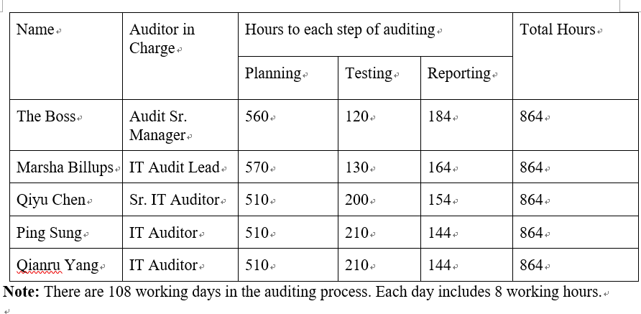
Breakdown of audit hours for planning, testing, reporting phases

Slide 14
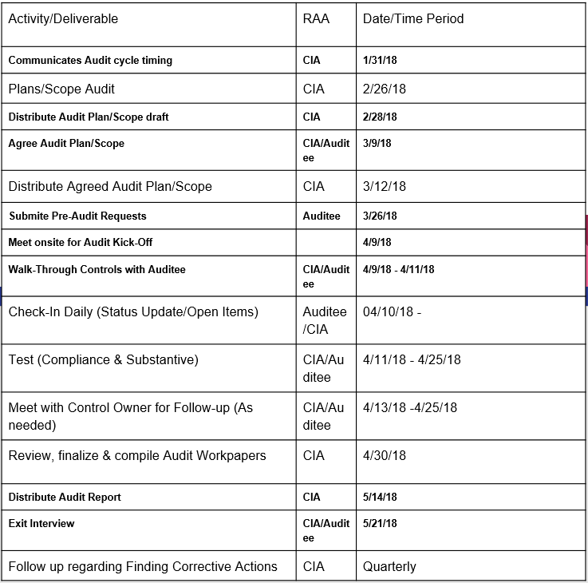
Key Dates & Deliverables

Slide 15
Questions?
Thank you!!!

