Slide 1
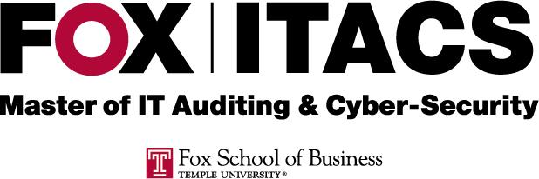
IT Audit Process
Prof. Liang Yao
Week Twelve – QA/QC, Self-assessment and Audit IT Service Providers
IT Audit Process
Prof. Liang Yao

Slide 2
Audit Quality Assurance and Quality Control
Why audit function needs QA and QC?
IPPF Standard Associated with QA
QA and QC in action
IT Audit Process
Prof. Liang Yao

Slide 3
Audit Quality Assurance and Quality Control
The needs for internal audit QA and QC function
Ensure the quality of audit workpaper
Sufficient audit planning
Adequate of testing
Relevant of evidences
Supporting of conclusion
Proper of overall opinion
Assessment of auditors’ proficiency level
Identifying skill gaps and developing areas
IT Audit Process
Prof. Liang Yao

Slide 4
Audit Quality Assurance and Quality Control
IPPF Standard Associated with QA
1300 – Quality Assurance and Improvement Program
1310 – Requirements of the Quality Assurance and Improvement Program
1311 – Internal Assessments (annual basis)
1312 – External Assessments (5 years cycle)
1320 – Reporting on the Quality Assurance and Improvement Program
1321 – Use of “Conforms with the International Standards for the Professional Practice of Internal Auditing”
1322 – Disclosure of Nonconformance
IT Audit Process
Prof. Liang Yao

Slide 5
Audit Quality Assurance and Quality Control
QA/QC in Action
Multi-layer of workpaper review
AIC review/manager review/sr. manager(direct) review
Develop and define QA and QC methodology in the Audit Methodology Manual (e.g. frequency, sampling, coverage, follow-up, etc.)
Build a QA/QC function within the audit division
Assign the right QA/QC staff
Define training requirements
External Review (IPPF 1312) Consideration
IT Audit Process
Prof. Liang Yao

Slide 6
Control Self-Assessment
Concept of Three Lines of Defense
First Line of Defense – Line of Business
1A – Day to day operations
1B - Risk management specialists embedder in the LoB
Second Line Defense – Risk Management function
Risk identification
Challenge
Independent testing
Third Line of Defense - Internal Audit
IT Audit Process
Prof. Liang Yao

Slide 7
Control Self-Assessment
Line of Business
Self-assessment
Performing
leveraging
Risk Management
Leveraging
Internal Audit
IT Audit Process
Prof. Liang Yao

Slide 8
Control Self-Assessment
CSA objectives
CSA Pros and Cons
Auditors’ role
CSA tools (GRC)
CSA Approaches
IT Audit Process
Prof. Liang Yao

Slide 9
CSA Objectives
Changing the organizing culture
Shifting control monitoring function to IT management
Empowerment of Line of Business
Define a CSA framework (e.g. COBIT)
IT Audit Process
Prof. Liang Yao

Slide 10
CSA Pros. And Cons.
CSA Benefits:
Earlier risk identification/detection
Effectively improve internal controls
Self-identifying control gaps/deficiencies
Sense of Ownership/motivation
Effective communication
Reduce audit control testing
Provide the Board and sr. management level of comfort of internal control environment
IT Audit Process
Prof. Liang Yao

Slide 11
CSA Pros. And Cons.
CSA disadvantages
CSA maturity level
Replacing audit function? Why NOT?
Additional workload (resource constrain...)
What if no action take based on CSA result by management
IT Audit Process
Prof. Liang Yao

Slide 12
Auditors’ Role in CSA process
Understanding the business process
Mapping laws and regulatory requirements to the key risks and controls identified by the business
Acting as facilitators
NOT in the position to design and implement controls
IT Audit Process
Prof. Liang Yao

Slide 13
CSA Summary
Empowerment and establish accountabilities
Kaizen process (continuous improvement)
Build a culture of control awareness
Broader Board and shareholder focus
Involving all three lines of defense
Impact on Audit
Staged approach (assessing the maturity level of CSA)
Leverage CSA results
More risk focused plan and testing
IT Audit Process
Prof. Liang Yao

