Slide 1
Introduction to Systems Development
Systems Analysis and Design

Slide 2
Introduce Yourself
Introduction
IS Project
IS Development
Other Approaches
Agile Methods
OO / UML
This Course
Introduce yourself briefly to your instructor and the class
  Education
  Work history
  Experience with Information Systems Development
  Goal for the class

Slide 3
Course BLOG
Introduction
IS Project
IS Development
Other Approaches
Agile Methods
OO / UML
This Course
https://community.mis.temple.edu/mis5214sec702spring2021/

Slide 4
Schedule
Introduction
IS Project
IS Development
Other Approaches
Agile Methods
OO / UML
This Course
Unit |  | Weekly Readings | Project (60%) | Exam (30%)
1 Introduction 1/21 | Intro | MSAD Ch. 1, Ch. 2 “Systems Development Environment” CISA Ch. 3 “Systems Development Methodologies” CISA Ch. 3 “SDLC Models” CISA Ch. 3 “SDLC Phases”
2 Project Management 1/28 | Planning | MSAD Ch.1 “Project Management” CISA Ch. 3 “Project Management and Governance”
3 Business Case & Feasibility Analysis 2/4 |  | MSAD Ch. 4 “Identifying and Selecting Projects” MSAD Ch. 5 “Initiating and Planning Information Systems Projects” CISA Ch. 3 “Business Case and Feasibility Analysis” | IS Auditors Role in Business Case Development
4 Requirement Determination 2/11 | Analysis | MSAD Ch. 6 “Determining Systems Requirements” CISA Ch. 3 “Requirements Definition” SSD “Security Requirements” | IS Auditor’s Role in the SDLC
5 Process Modeling 2/18 |  | MSAD Ch. 7 “Structured System Process Requirements” CISA Ch. 3 “Structured Techniques” SSD “Vulnerability Mapping”
6 Data Modeling 2/28 |  | MSAD Ch. 8 “Structured System Data Requirements” CISA Ch. 3 “Entity Relationship Diagrams” SSD “SDLS and SSD”
7 3/4 |  |  |  | Planning & Analysis
8 Database 3/11 | Design | MSAD Ch. 9 “Database Design” CISA Ch. 3 “Control Identification and Design” CISA Ch. 3 “Relational and Embedded Databases” SSD “Class Security Analysis” | IS Auditor’s Role in Systems Design
9 Software 3/18 |  | SSD “Procedural Security” SSD “Modular Programming” SSD “Sensitive Data Mapping” SSD “Reducing the System Attack Surface” CISA Ch. 3 “Software Development Methods” CISA Ch. 3 “System Development Tools and Productivity Aids” CISA Ch. 3 “Control Identification and Design”
10 Human-Computer Interaction 3/25 |  | MSAD Ch. 10 “Designing Forms and Reports” MSAD Ch. 11 “Designing Interfaces and Dialogues”
11 4/1 |  |  |  | Design
12 Architecture 4/8 | Implementation | MSAD Chapter 13 “System Implementation” CISA Chapter 3.5 “Business Application Development” CISA Chapter 3.6 CISA Chapter 3.9 ISACA “Auditing Risks in Virtual IT Systems” ISACA “IT Audits of Cloud and SaaS”
13 Software Development & Testing 4/15 |  | MSAD Ch. 12 “Designing Distributed and Internet Systems” CISA Ch. 3 “Infrastructure Development and Acquisition Practices” CISA Ch. 3 “Hardware and Software Acquisition” SSD “Secure Architectures” | IS Auditor’s Role in Process Reengineering
14 Migration & Deployment 4/22 |  | MSAD Ch. 13 “Systems Implementation” CISA Ch. 3 “IS Auditors Role in Project Management” CISA Ch. 3 “Software Development Methodologies” CISA Ch. 3 “Software Testing” SSD “Secure Architectures” | IS Auditor’s Role in Reviewing Application Controls
15 4/29 |  |  |  | Implementation

Slide 5
READINGS
Introduction
IS Project
IS Development
Other Approaches
Agile Methods
OO / UML
This Course
Textbooks | Valacich J.S. and George J.F., 2019, Modern Systems Analysis and Design, Ninth Edition, Pearson Education, Inc., ISBN-13: 978-0-135172759
ISACA | CISA Review Manual 27th Edition, 2019, ISACA, ISBN 978-1-60420-767-5
 | “COBIT 2019: Framework Introduction and Methodology”, ISACA, ISBN 978-1-60420-763-7
 | “COBIT 5: Enabling Processes”, 2012, ISACA, ISBN 978-1-60420-241-0
 | Chaudhuri, A., von Solms, SH, Chaudhuri, D. (2011), “Auditing Risks in Virtual IT Systems”
 | Gelbstein, E. (2015) “Auditors and Large Software Projects, Part 1”
 | Gelbstein, E. (2015) “Auditors and Large Software Projects, Part 2”
 | Gelbstein, E. (2015) “Auditors and Large Software Projects, Part 3”
 | Helskanen, A.LJK (2012) “Project Portfolio Management”
 | Kancharia, M. and Bhattacharjee, S. (2010) “Realizing Benefits of IT Investments: Overcoming the Silver-bullet View”
 | Raval, V. and Sharma, R. (2017) “Mitigating the Risk Factors of IT Project Failure”
 | Singleton, T. (2014) “The Logical Reason for Consideration of IT”
 | Singleton, T. (2014) “The Core of IT Auditing”
 | Singleton, T. (2012) “Auditing Applications, Part 1”
 | Singleton, T. (2012) “Auditing Applications, Part 2”
 | Singleton, T. (2011) “Understanding the New SOC Reports”
 | Singleton, T. (2010) “IT Audits of Cloud and SaaS”
FedRAMP | “CSP Authorization Playbook – Getting Started with FedRAMP”
FIPS | PUB 199 “Standards for Security Categorization of Federal information System and Information Systems”
NIST | Special Publication 800-34 Revision 1 “Contingency Planning Guide for Federal Information Systems”
 | Special Publication 800-53A Revision 4 “Assessing Security and Privacy Controls in Federal Information Systems and Organizations”
 | Special Publication 800-53 Revision 4 “Security and Privacy Controls for Federal information Systems and Organizations”
 | Special Publication 800-64 Revision 2 “Security Considerations in the System Development Life Cycle” (SDLC)
SANS | Hein, R. (2004) “The Application Audit Process – A Guide for Information Security Professionals”
Misc. | INTOSAI (2008) “Why IT Projects fail, Best Practices Guide”
 | Peppard, J. (2016) “A Tool to Map Your Next Digital Initiative”, Harvard Business Review

Slide 6
GRADING
Introduction
IS Project
IS Development
Other Approaches
Agile Methods
OO / UML
This Course
Item | Weight
Assignments | 60%
Participation | 10%
Exams | 30%
Total | 100%
Grading Scale
100 – 93 | A
92 – 90 | A-
89 – 87 | B+
86 – 83 | B
82 – 80 | B-
79 – 77 | C+
76 – 73 | C
72 – 70 | C-
69 – 67 | D+
66 – 63 | D
62 – 60 | D-
59 – 0 | F

Slide 7
Learning Objectives
Introduction
IS Project
IS Development
Other Approaches
Agile Methods
OO / UML
This Course
Define information systems analysis and design.
Describe the information systems development life cycle (SDLC).
Explain computer-aided software engineering (CASE) tools.
Describe Agile Methodologies and eXtreme Programming.
Explain object-oriented analysis and design and the Rational Unified Process (RUP).

Slide 8
Introduction
Introduction
IS Project
IS Development
Other Approaches
Agile Methods
OO / UML
This Course
Information Systems Analysis and Design
  Complex organizational process
  Used to develop and maintain computer-based information systems
  Used by a team of business and systems professionals
Application Software
  Computer software designed to support organizational functions or processes
Systems Analyst
  Organizational role most responsible for analysis and design of information systems

Slide 9
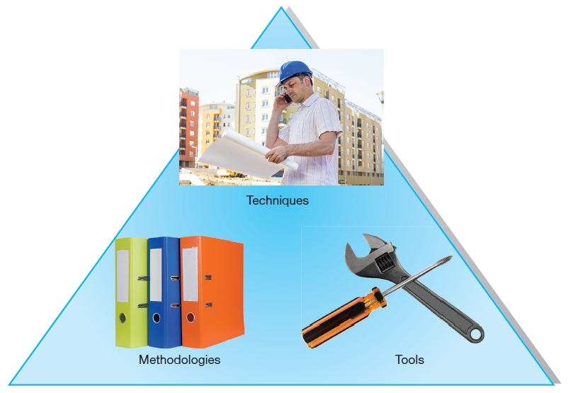
Introduction (Cont.)
Introduction
IS Project
IS Development
Other Approaches
Agile Methods
OO / UML
This Course
An organizational approach to systems analysis and
design is driven by methodologies, techniques, and tools.
Sources: Mitarart/Fotolia, PaulPaladin/Fotolia
Notes:
As a systems analyst, you fill the organizational role most responsible for the analysis and design of information systems. To do this you’ll apply methodologies, techniques, and software tools.
Methodologies are comprehensive, multiple-step approaches to systems development that will guide your work and influence the quality of your final product—the information system.
Techniques are particular processes that you, as an analyst, will follow to help ensure that your work is well thought out, complete, and comprehensible to others on your project team.
Tools are typically computer programs that make it easy to use and benefit from techniques and to faithfully follow the guidelines of the overall development methodology.

Slide 10
IT Auditors’ Responsibilities
Introduction
IS Project
IS Development
Other Approaches
Agile Methods
OO / UML
This Course
Providing assurance that enterprise objectives are being met by information systems and infrastructure management practices
Identifying which elements may represent greatest risk, and which controls are most effective at mitigating this risk
Understanding which methodologies are in use for:
  Systems development, acquisition and maintenance
  Identifying potential vulnerabilities and points requiring control
  Advising project team and senior management of deficiencies and best practices within each of these processes

Slide 11
IT Auditors’ Role
Introduction
IS Project
IS Development
Other Approaches
Agile Methods
OO / UML
This Course
Two alternative approaches
Review end-stage deliverables throughout the development process, without becoming part of the process
  Auditor reviews each stage’s deliverables to ensure:
    What was planned from the previous stage has been accomplished and the planning of the next stage has been refined appropriately
    Planning of the next stage has been refined appropriately
Internal control consultant, becoming part of the systems development process
  Auditor provides ongoing proactive recommendations by participating in selected project-management meetings including:
    risk-assessment, systems-design, development, and systems delivery meetings
  Auditor’s independence may be compromised, but this is mitigated by another auditor who should find a system with well-designed controls incorporated
Produce and provide formal audit reports to the appropriate business managers including:
  1. Overall assessment of the controlled progress of the project
  2. Areas requiring improvement to complete the project, as specified, within budget and at an appropriate level of quality
Requires an in-depth understanding of both:
  1. The overall information systems development processes adopted
  2. The business processes being computerized

Slide 12
Required Tools
You will need both:
  Microsoft Project
  Microsoft Visio
Software is available at the link below. Login with your TU credentials:
https://azureforeducation.microsoft.com/devtools

Slide 13
A Modern Approach to Systems Analysis and Design
Introduction
IS Project
IS Development
Other Approaches
Agile Methods
OO / UML
This Course
1950s: focus on efficient automation of existing processes
1960s: advent of procedural third generation languages (3GL) faster and more reliable computers
1970s: system development becomes more like an engineering discipline
1980s: major breakthrough with 4GL, CASE tools, object-oriented methods
1990s: focus on system integration, GUI applications, client/server platforms, Internet
The new century: Web application development, wireless PDAs and smart phones, component-based applications, per-use cloud-based application services.

Slide 14
Developing Information Systems
Introduction
IS Project
IS Development
Other Approaches
Agile Methods
OO / UML
This Course
System Development Methodology is a standard process followed in an organization to conduct all the steps necessary to analyze, design, implement, and maintain information systems.

Slide 15
Systems Development Life Cycle (SDLC)
Introduction
IS Project
IS Development
Other Approaches
Agile Methods
OO / UML
This Course
Traditional methodology used to develop, maintain, and replace information systems
Phases in SDLC:
  Planning
  Analysis
  Design
  Implementation
  Maintenance
Notes:
The SDLC is a particular form of business problem-solving cycles. A common feature of cycles is that they tend to loop and repeat. And each involves some sort of up-front planning and feasibility assessment, followed by more detailed and meticulous exploration and analysis of the problem, which typically result in some set of solution alternatives from which to pick and implement. After that, there should be continuous monitoring and adjustment, which often leads to earlier steps, thus making it a cycle.

Slide 16
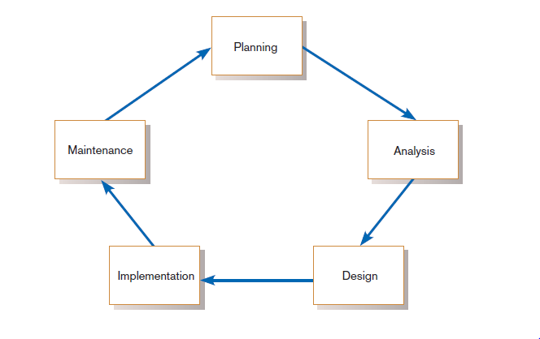
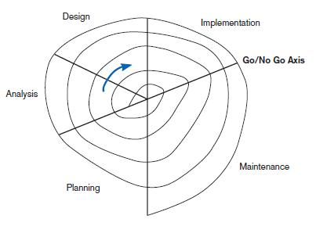
Standard and Evolutionary Views of SDLC
Introduction
IS Project
IS Development
Other Approaches
Agile Methods
OO / UML
This Course
Evolutionary model
Systems development life cycle
Notes:
The traditional SDLC is very detailed and meticulous, and originally came about in the early years of IT when legacy mainframe systems were the norm, and requirements had to be very well known in order to code the final solution. But as more tools and techniques came along, this enabled a more organic, evolutionary approach. In the following slides we’ll look at some of these differences.
Some people consider the life cycle to be a spiral, in which we constantly cycle through the phases at different levels of detail, and figure 1.3 illustrates this idea.

Slide 17
Systems Development Life Cycle (SDLC) (Cont.)
Introduction
IS Project
IS Development
Other Approaches
Agile Methods
OO / UML
This Course
Planning – an organization’s total information system needs are identified, analyzed, prioritized, and arranged
Analysis – system requirements are studied and structured
Design – a description of the recommended solution is converted into logical and then physical system specifications
Logical design – all functional features of the system chosen for development in analysis are described independently of any computer platform
Physical design – the logical specifications of the system from logical design are transformed into the technology-specific details from which all programming and system construction can be accomplished
Implementation – the information system is coded, tested, installed and supported in the organization
Maintenance – an information system is systematically repaired and improved

Slide 18
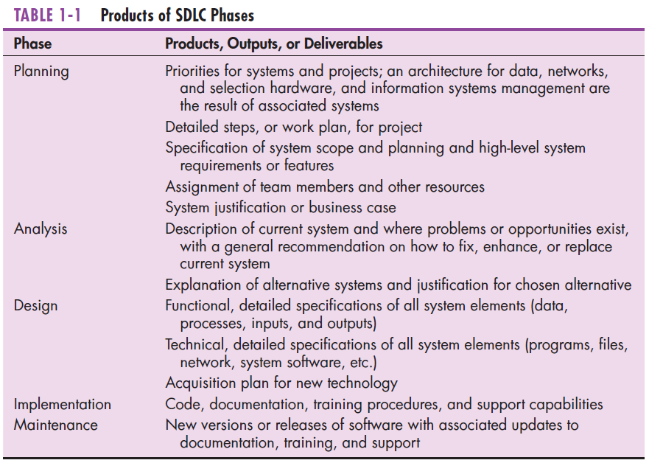
Introduction
IS Project
IS Development
Other Approaches
Agile Methods
OO / UML
This Course
Notes:
The products of each phase become inputs and resources for the next phase.
Shortly we’ll see that this traditional SDLC follows a “waterfall” approach, where one phase “flows” into the next.

Slide 19
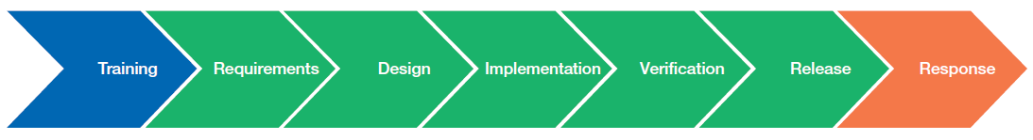
A Specialized Systems Development Life Cycle
Introduction
IS Project
IS Development
Other Approaches
Agile Methods
OO / UML
This Course
Microsoft’s Security Development Lifecycle (SDL)
Verification focuses on product quality assurance.
Release makes product available for general use.
Response deals with security problems that come up after product release.
Training focuses on security.
These are like traditional SDLC’s analysis, design, and implementation.
(Source: http://www.microsoft.com/security/sdl/default.aspx.
Used by permission.)
Notes:
Note that different companies may have their own special SDLC methodologies for certain types of information systems problems. For example, Microsoft has a method they call “security development lifecycle (SDL)” which includes these steps: training, requirements, design, implementation, verification, release, response. Although these are not exactly identical to SDLC, there is a lot of overlap. In this case, the cycle is for ensuring security in the software products Microsoft develops. In particular, the verification and release stages reflect Microsoft as a product vendor. By contrast, traditional SDLC (which include planning and maintenance) tends to apply to business or organizational applications. So, the sort of problem and the type of industry can affect your choice of SDLC methodology.

Slide 20
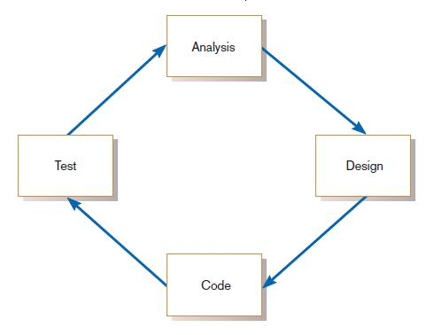
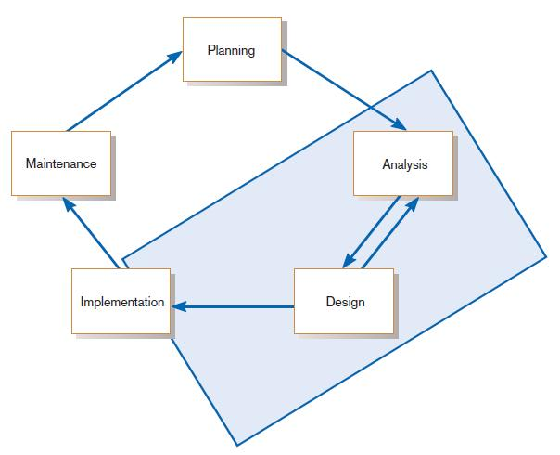
The Heart of the Systems Development Process
Introduction
IS Project
IS Development
Other Approaches
Agile Methods
OO / UML
This Course
Analysis–design–code–test loop
Current practice combines analysis, design, and implementation into a single iterative and parallel process of activities.
Notes:
We’re going to talk about eXtreme programming and Agile methodologies shortly. This is the current approach to software development. In a sense you can think of replacing one big SDLC cycle in which extensive time spend in analysis and design before programming. Instead, you have with newer approaches lots of short-term cycles involving some analysis, design, and coding, followed by another stage of analysis, design, and coding, etc. As I mentioned earlier, this is a much more evolutionary and free-flow process. And it’s possible because of the great advance in modeling, design and CASE tools, as well as software framework APIs.

Slide 21
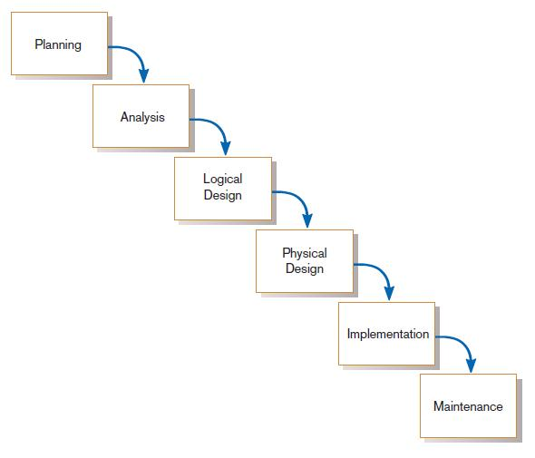
Traditional Waterfall SDLC
Introduction
IS Project
IS Development
Other Approaches
Agile Methods
OO / UML
This Course
One phase begins when another completes, with little backtracking and looping.
Traditional waterfall SDLC
Notes:
Here again we see the more traditional SDLC. As a waterfall, you don’t see cycling back. An earlier picture shows SDLC as a cycle, but although it’s a cycle, the idea is to avoid cycling back unless we encounter some problem at a particular stage. For example, if in the design phase we see that we can’t go forward without more analysis, we may go back to analysis. But the hope is to keep surging forward.

Slide 22
Problems with Waterfall Approach
Introduction
IS Project
IS Development
Other Approaches
Agile Methods
OO / UML
This Course
Feedback ignored, milestones lock in design specs even when conditions change
Limited user involvement (only in requirements phase)
Too much focus on milestone deadlines of SDLC phases to the detriment of sound development practices
Notes:
As you can see, this has its disadvantages. In general, the traditional SDLC approach is not very flexible and adaptive. It was the only plausible approach back in the days of legacy systems. But now it’s an outdated methodology. Nevertheless, it has evolved and mutated to other more timely approaches, which we’ll be discussing next.

Slide 23
Different Approaches to Improving Development
Introduction
IS Project
IS Development
Other Approaches
Agile Methods
OO / UML
This Course
CASE Tools
Agile Methodologies
eXtreme Programming
Notes:
Remember when we talked about the use of tools, methodologies, and techniques? These are three of these. We’ll discuss each in turn.

Slide 24
Computer-Aided Software Engineering (CASE) Tools
Introduction
IS Project
IS Development
Other Approaches
Agile Methods
OO / UML
This Course
Diagramming tools enable graphical representation.
Computer displays and report generators help prototype how systems “look and feel”.
Analysis tools automatically check for consistency in diagrams, forms, and reports.
A central repository provides integrated storage of diagrams, reports, and project management specifications.
Documentation generators standardize technical and user documentation.
Code generators enable automatic generation of programs and database code directly from design documents, diagrams, forms, and reports.
Notes:
IBM’s Rational products are a popular example of CASE tools.

Slide 25
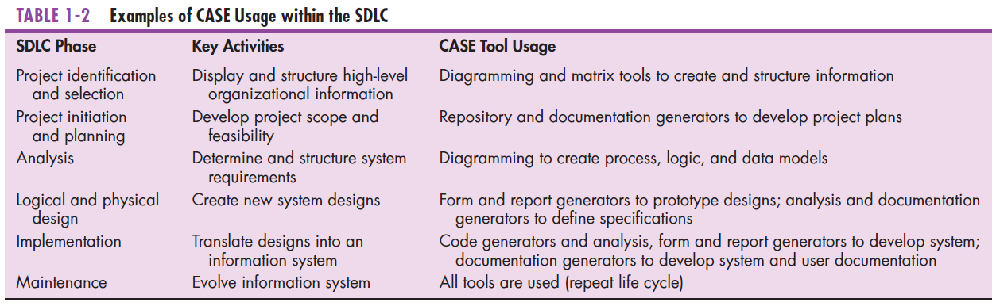
CASE Tools (Cont.)
Introduction
IS Project
IS Development
Other Approaches
Agile Methods
OO / UML
This Course
Notes:
As you can see, CASE tools are used throughout the SDLC process.
CASE helps programmers and analysts do their jobs more efficiently and more effectively by automating routine tasks. However, many organizations that use CASE tools don’t use them to support all phases of the SDLC. For example, some organizations may extensively use the diagramming features but not the code generators.

Slide 26
Agile Methodologies
Introduction
IS Project
IS Development
Other Approaches
Agile Methods
OO / UML
This Course
Motivated by recognition of software development as fluid, unpredictable, and dynamic
Three key principles
  Adaptive rather than predictive
  Emphasize people rather than roles
  Self-adaptive processes
Notes:
Another buzzword with a similar idea is “Rapid Application Development (RAD)”. This phrase has gone out of favor, and “Agile” is more in vogue. Also coming into vogue is SCRUM.
These ideas are variations on a theme of bringing adaptive techniques into the SDLC methodology. A very early “adaptive SDLC” approach in that vein was called “prototyping”.

Slide 27
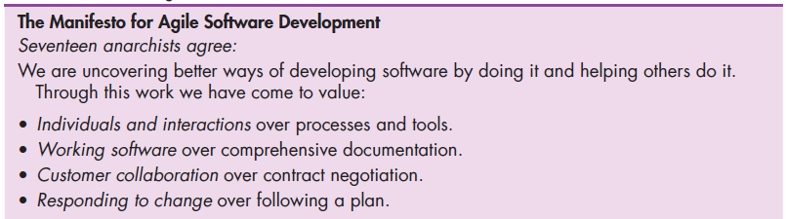
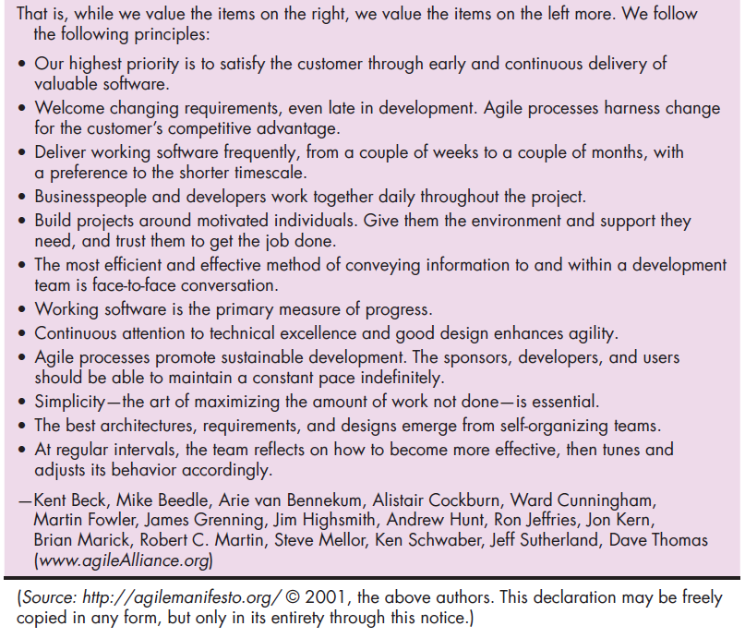
Introduction
IS Project
IS Development
Other Approaches
Agile Methods
OO / UML
This Course
The Agile Methodologies group argues that software development methodologies
adapted from engineering generally do not fit with real-world software development.
Notes:
The agile approach emphasizes people as individuals over their roles. In a way it humanizes software development and allows for change over time, whereas the traditional SDLC is more formal and structured.

Slide 28
When to use Agile Methodologies
Introduction
IS Project
IS Development
Other Approaches
Agile Methods
OO / UML
This Course
If your project involves:
  Unpredictable or dynamic requirements
  Responsible and motivated developers
  Customers who understand the process and will get involved

Slide 29
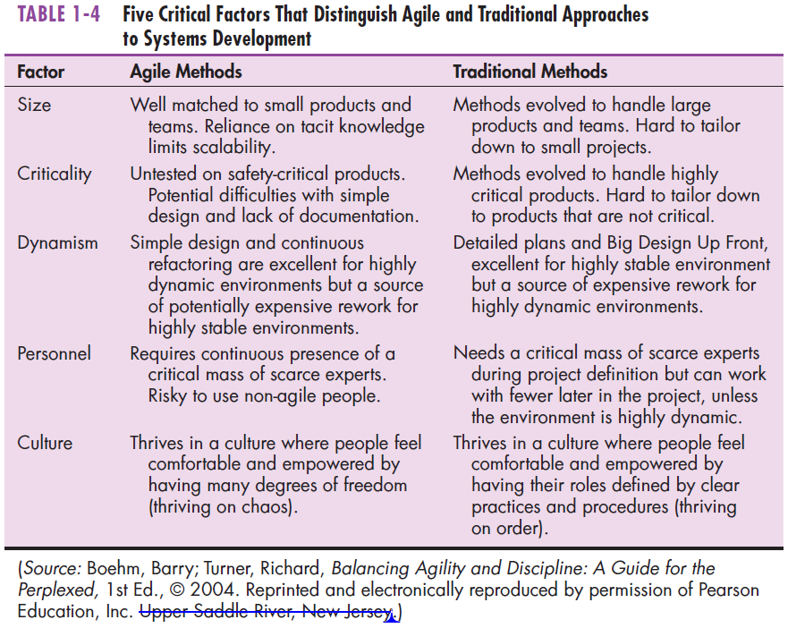

Introduction
IS Project
IS Development
Other Approaches
Agile Methods
OO / UML
This Course
Notes:
Again, you see the distinction between the agile and traditional approaches. The agile approach comes with its risks, as you can see with the statement regarding criticality. The traditional SDLC is better suited to large enterprise-wide projects whereas agile methods are better for ad hoc needs and smaller projects. It fosters creativity, but also requires people who are comfortable thinking outside the box, as you can see in the statement regarding culture.
Most companies use both methods, focusing more on agile in some projects and more on traditional SDLC in others.

Slide 30
eXtreme Programming
Introduction
IS Project
IS Development
Other Approaches
Agile Methods
OO / UML
This Course
Short, incremental development cycles
Automated tests
Two-person programming teams
Coding, testing, listening, designing
Coding and testing operate together
Advantages:
  Communication between developers
  High level of productivity
  High-quality code
Notes:
eXtreme Programming was developed by Kent Beck., who co-wrote this book referenced by our textbook:
Beck, K., and C. Andres. 2004. eXtreme Programming eXplained.
Upper Saddle River, NJ: Addison-Wesley.
Note the emphasis on small two-person teams. Also note the short development cycles. So this is definitely an example of an agile methodology.

Slide 31
Object-Oriented Analysis and Design (OOAD)
Introduction
IS Project
IS Development
Other Approaches
Agile Methods
OO / UML
This Course
Based on objects rather than data or processes
Object: a structure encapsulating attributes and behaviors of a real-world entity
Notes:
Object orientation is currently the most common software development paradigm. The previous paradigm can be described as “task decomposition”. With this approach, you have an overall program and divide it into tasks, which can further be decomposed into subtasks, etc. In this approach modularity is achieved by creating functions or subroutines to do commonly-performed tasks.
With object-orientation you have a different perspective. Here you have classes (or categories) of objects that each contain a certain state (the contents of its data) and perform certain behaviors (often called “methods”). This approach enables creation of “components” that can be grouped together in various ways to accomplish a variety of problems. Object-orientation fosters code-reusability and it also leads to more flexible software libraries. In this sense, object-orientation is very conducive with agile methodologies.

Slide 32
Object-Oriented Analysis and Design (OOAD) (Cont.)
Introduction
IS Project
IS Development
Other Approaches
Agile Methods
OO / UML
This Course
Object class: a logical grouping of objects sharing the same attributes and behaviors
Inheritance: hierarchical arrangement of classes enable subclasses to inherit properties of superclasses
Notes:
The notion of inheritance is important in OOAD. Classes can inherit properties and behaviors from superclasses, and then add specialized behaviors of their own. Conceptually, an object of a certain class is also a member of its superclass. For example, a dog is a mammal which is an animal. Therefore a dog is also an animal. Animal is a superclass of mammal which is a superclass of dog.

Slide 33
Rational Unified Process (RUP)
Introduction
IS Project
IS Development
Other Approaches
Agile Methods
OO / UML
This Course
An object-oriented systems development methodology
Establishes four phase of development: inception, elaboration, construction, and transition
  Each phase is organized into a number of separate iterations.
Notes:
RUP is a popular approach to object-oriented system development. A development project is broken into phases, each of which go through a set of iterations.

Slide 34
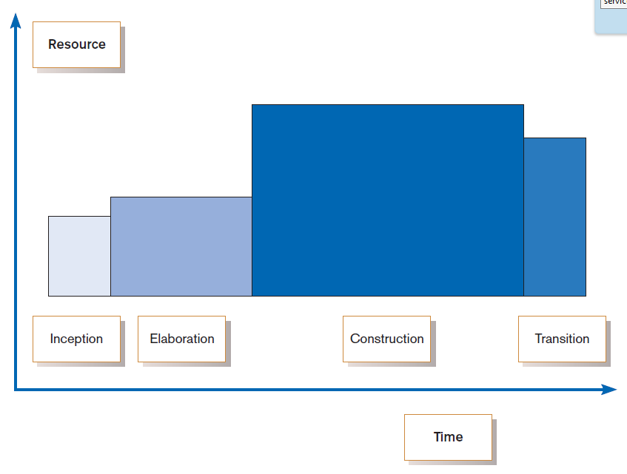
Introduction
IS Project
IS Development
Other Approaches
Agile Methods
OO / UML
This Course
Phases of OOSAD-based development
Notes:
This graph shows the four phases: inception, elaboration, construction, and transition. As you can see, the most time-consuming and resource-intensive phase is construction. Inception is a lot like planning in the traditional SDLC. Elaboration in RUP is like a combination of SDLC’s analysis and design. Construction has elements of physical design and implementation. And transition is a lot like maintenance.
So the various tasks of SDLC are also being done in RUP, but with different emphases and sequences.

Slide 35
Our Approach to Systems Development
Introduction
IS Project
IS Development
Other Approaches
Agile Methods
OO / UML
This Course
Criticisms of SDLC
  Forcing timed phases on intangible processes (analysis and design) is doomed to fail
  Too much formal process and documentation slows things down
  Cycles are not necessarily waterfalls
And yet the concept of a cycle is in all methodologies. So, SDLC is a valuable model that has many variations.

Slide 36
Summary
Introduction
IS Project
IS Development
Other Approaches
Agile Methods
OO / UML
This Course
In this presentation you learned how to:
Define information systems analysis and design.
Describe the information systems development life cycle (SDLC).
Explain computer-aided software engineering (CASE) tools.
Describe Agile Methodologies and eXtreme Programming.
Explain object-oriented analysis and design and the Rational Unified Process (RUP).

Slide 37
Addendum

Slide 38
State of the Market*
Only 47% believe internal audit department is “sufficiently resourced”
51% report that technical skills is the greatest challenge for sourcing
64% report internal auditors difficult to find; 71% report it is difficult to recruit
*Barclay Simpson Governance Recruitment Market Report 2016: Internal Audit.
Notes:
“… shortened deployment lifecycle[s] will require more agile auditing techniques such as continuous auditing and audit automation… The profession must become more technologically astute, not only to understand it [technology] but also the capability to use it in novel manners to support the audit function as well as the foresight to propose new technology advancements to support the profession.” – ISACA Future of IT Audit Report.

Slide 39
Corporate Structures
Governance Level:
Board of Directors
Responsible for:
Evaluate
Direct
Monitor
Management Level :
Management
Responsible for:
Plan
Build
Run
Monitor
Notes:
To understand the role of the auditor we must understand the context in which the auditor functions.
I will use a typical corporate structure to illustrate.
Shareholders invest resources (typically money) expecting some sort of return or value. To protect their investments and ensure value is generated they institute a board of directors (BOD) whose role is to establish appropriate governance. Their responsibility is to Evaluate, Direct and Monitor the use of resources to ensure corporate goals and objectives are met, and strategies are appropriately executed.
Management is established by the BOD to manage day-to-day operations. Their responsibilities are to Plan, Build, Run and Monitor processes and initiatives in alignment with corporate strategies, goals and objectives.

Slide 40
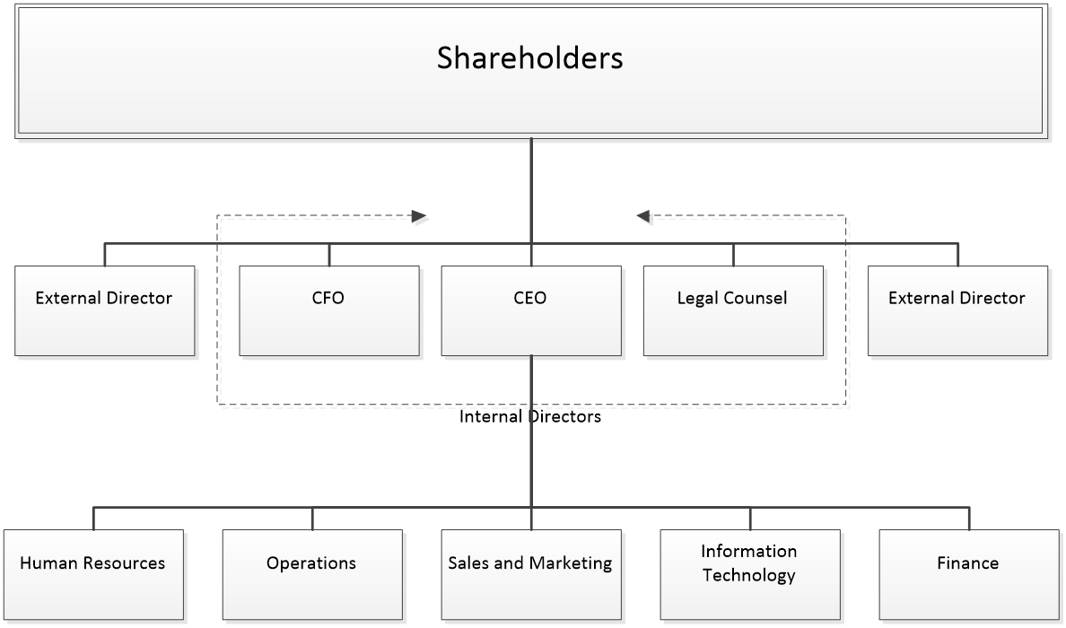
Corporate Governance
“Leadership, organizational structures and processes that ensure the enterprise sustains and extends strategies and objectives.” (ISACA Glossary).
Corporate governance helps to:
Set Strategic Direction to ensures goals and objectives are achievable
Risks are properly addressed
Resources (People, Time, Monies) are properly utilized
Notes:
Corporate Governance provides leadership, establishes organizational structures and processes to ensure the enterprise sustains and extends strategies and objectives.
Shareholders invest expecting a return
Directors represent Shareholders’ interests
Management set policy and manage operations to achieve goals
So what is the objective?

Slide 41
What is the Objective of Governance?
Stakeholder
Needs
Drive
Governance Objective: Value Creation
Benefit Realization
Risk Optimization
Resource Optimization
Notes:
The objective of governance: Value Creation.
How?
Stakeholder needs drive value creation by:
Ensuring benefits are achieved (Benefit Realization)
Applying the right level of controls (Risk Optimization)
Making the best use of resources available (Resource Optimization)
But how do we know if we are on the right track? How do we measure progress?
Financials are a good and often used way of measuring progress.
Revenues/Losses
Earnings per Share (EPS)
Dividends
Market capitalization
Etc.

Slide 42
Balanced Scorecard
Financial Stewardship
“Financial Performance”
A strategic planning and management system used extensively to
align business activities to the vision and strategy of the organization
improve internal and external communications,
monitor performance against strategic goals.” balancedscorecard.org
Customer/ Stakeholder
“Satisfaction”
Vision
and
Strategy
Internal Business Process
“Efficiency”
Organizational Capacity
“Knowledge and Innovation
Strategic Objectives
Strategy Map
Performance Measurements and Targets
Strategic Initiatives
Notes:
Robert S. Kaplan and David P. Norton proposed the Balance Scorecard in 1996 as a tool to align an organization’s vision and strategy beyond financial measures.

Slide 43
Enterprise Goals
COBIT 5 Enterprise Goals
BSC Dimension | Enterprise Goal
Financial | 1. Stakeholder value of business investments
 | 2. Portfolio of competitive products and services
 | 3. Managed business risk (safeguarding assets)
 | 4. Compliance with external laws and regulations
 | 5. Financial transparency
Customer | 6. Customer-oriented service culture
 | 7. Business service continuity and availability
 | 8. Agie responses to changing business environment
 | 9. Information-based strategic decision making
 | 10. Optimisation of service delivery costs
Internal | 11. Optimisation of business process functionality
 | 12. Optimisation of business process costs
 | 13. Managed business change programs
 | 14. Operational and staff productivity
 | 15. Compliance with internal policies
Learning and Growth | 16 Skilled and motivated people
 | 17. Product and business innovation culture
COBIT 5 IT Goals
BSC Dimension | IT Goal
Financial | 1. Alignment of IT and business strategy
 | 2. IT Compliance and support for business compliance with external laws and regulations
 | 3. Commitment of executive management for making IT-related decisions
 | 4. Managed IT-related business risk
 | 5. Realised benefits from IT-enabled investments and services portfolio
 | 6. Transparency of IT costs, benefits and risk
Customer | 7. Delivery of IT services in line with business requirements
 | 8. Adequate use of applications, information and technoloty solutions
Internal | 9. IT Agility
 | 10. Security of information, processing infrastructure and applications
 | 11. Optimisation of IT assets, resources and capabilities
 | 12. Enablement and support of business processes by integrating applications and technology into business processes
 | 13. Delivery of programmes delivering benefits, on time, on budget, and meeting requirements and quality standards
 | 14. Availability of reliable and useful informatino for decision making
 | 15. IT compliance with internal policies
Learning and Growth | 16. Competent and motivated business and IT personnel
 | 17. Knowledge, exprtise and initiatives for business innovation
Notes:
COBIT 5 (Control Objectives for Business And IT) applies the BSC concept to align the goals of IT with those of the Enterprise. The tables above list generic goals. These must be adapted to the particular organization

Slide 44
Enterprise Goals
COBIT 5 Enterprise Goals
BSC Dimension | Enterprise Goal
Financial | 1. Stakeholder value of business investments
 | 2. Portfolio of competitive products and services
 | 3. Managed business risk (safeguarding assets)
 | 4. Compliance with external laws and regulations
 | 5. Financial transparency
Customer | 6. Customer-oriented service culture
 | 7. Business service continuity and availability
 | 8. Agie responses to changing business environment
 | 9. Information-based strategic decision making
 | 10. Optimisation of service delivery costs
Internal | 11. Optimisation of business process functionality
 | 12. Optimisation of business process costs
 | 13. Managed business change programs
 | 14. Operational and staff productivity
 | 15. Compliance with internal policies
Learning and Growth | 16 Skilled and motivated people
 | 17. Product and business innovation culture
COBIT 5 Enterprise Goals
BSC Dimension | IT Goal
Financial | 1. Alignment of IT and business strategy
 | 2. IT Compliance and support for business compliance with external laws and regulations
 | 3. Commitment of executive management for making IT-related decisions
 | 4. Managed IT-related business risk
 | 5. Realised benefits from IT-enabled investments and services portfolio
 | 6. Transparency of IT costs, benefits and risk
Customer | 7. Delivery of IT services in line with business requirements
 | 8. Adequate use of applications, information and technoloty solutions
Internal | 9. IT Agility
 | 10. Security of information, processing infrastructure and applications
 | 11. Optimisation of IT assets, resources and capabilities
 | 12. Enablement and support of business processes by integrating applications and technology into business processes
 | 13. Delivery of programmes delivering benefits, on time, on budget, and meeting requirements and quality standards
 | 14. Availability of reliable and useful informatino for decision making
 | 15. IT compliance with internal policies
Learning and Growth | 16. Competent and motivated business and IT personnel
 | 17. Knowledge, exprtise and initiatives for business innovation

Slide 45
Enterprise Goals
COBIT 5 Enterprise Goals
BSC Dimension | Enterprise Goal
Financial | 1. Stakeholder value of business investments
 | 2. Portfolio of competitive products and services
 | 3. Managed business risk (safeguarding assets)
 | 4. Compliance with external laws and regulations
 | 5. Financial transparency
Customer | 6. Customer-oriented service culture
 | 7. Business service continuity and availability
 | 8. Agile responses to changing business environment
 | 9. Information-based strategic decision making
 | 10. Optimisation of service delivery costs
Internal | 11. Optimisation of business process functionality
 | 12. Optimisation of business process costs
 | 13. Managed business change programs
 | 14. Operational and staff productivity
 | 15. Compliance with internal policies
Learning and Growth | 16 Skilled and motivated people
 | 17. Product and business innovation culture
COBIT 5 Enterprise Goals
BSC Dimension | IT Goal
Financial | 1. Alignment of IT and business strategy
 | 2. IT Compliance and support for business compliance with external laws and regulations
 | 3. Commitment of executive management for making IT-related decisions
 | 4. Managed IT-related business risk
 | 5. Realised benefits from IT-enabled investments and services portfolio
 | 6. Transparency of IT costs, benefits and risk
Customer | 7. Delivery of IT services in line with business requirements
 | 8. Adequate use of applications, information and technology solutions
Internal | 9. IT Agility
 | 10. Security of information, processing infrastructure and applications
 | 11. Optimisation of IT assets, resources and capabilities
 | 12. Enablement and support of business processes by integrating applications and technology into business processes
 | 13. Delivery of programmes delivering benefits, on time, on budget, and meeting requirements and quality standards
 | 14. Availability of reliable and useful informatino for decision making
 | 15. IT compliance with internal policies
Learning and Growth | 16. Competent and motivated business and IT personnel
 | 17. Knowledge, exprtise and initiatives for business innovation

Slide 46
Enterprise Goals
COBIT 5 Enterprise Goals
BSC Dimension | Enterprise Goal
Financial | 1. Stakeholder value of business investments
 | 2. Portfolio of competitive products and services
 | 3. Managed business risk (safeguarding assets)
 | 4. Compliance with external laws and regulations
 | 5. Financial transparency
Customer | 6. Customer-oriented service culture
 | 7. Business service continuity and availability
 | 8. Agie responses to changing business environment
 | 9. Information-based strategic decision making
 | 10. Optimisation of service delivery costs
Internal | 11. Optimisation of business process functionality
 | 12. Optimisation of business process costs
 | 13. Managed business change programs
 | 14. Operational and staff productivity
 | 15. Compliance with internal policies
Learning and Growth | 16 Skilled and motivated people
 | 17. Product and business innovation culture
COBIT 5 Enterprise Goals
BSC Dimension | IT Goal
Financial | 1. Alignment of IT and business strategy
 | 2. IT Compliance and support for business compliance with external laws and regulations
 | 3. Commitment of executive management for making IT-related decisions
 | 4. Managed IT-related business risk
 | 5. Realised benefits from IT-enabled investments and services portfolio
 | 6. Transparency of IT costs, benefits and risk
Customer | 7. Delivery of IT services in line with business requirements
 | 8. Adequate use of applications, information and technoloty solutions
Internal | 9. IT Agility
 | 10. Security of information, processing infrastructure and applications
 | 11. Optimisation of IT assets, resources and capabilities
 | 12. Enablement and support of business processes by integrating applications and technology into business processes
 | 13. Delivery of programmes delivering benefits, on time, on budget, and meeting requirements and quality standards
 | 14. Availability of reliable and useful informatino for decision making
 | 15. IT compliance with internal policies
Learning and Growth | 16. Competent and motivated business and IT personnel
 | 17. Knowledge, exprtise and initiatives for business innovation

Slide 47
Enterprise Goals
COBIT 5 Enterprise Goals
BSC Dimension | Enterprise Goal
Financial | 1. Stakeholder value of business investments
 | 2. Portfolio of competitive products and services
 | 3. Managed business risk (safeguarding assets)
 | 4. Compliance with external laws and regulations
 | 5. Financial transparency
Customer | 6. Customer-oriented service culture
 | 7. Business service continuity and availability
 | 8. Agie responses to changing business environment
 | 9. Information-based strategic decision making
 | 10. Optimisation of service delivery costs
Internal | 11. Optimisation of business process functionality
 | 12. Optimisation of business process costs
 | 13. Managed business change programs
 | 14. Operational and staff productivity
 | 15. Compliance with internal policies
Learning and Growth | 16 Skilled and motivated people
 | 17. Product and business innovation culture
COBIT 5 Enterprise Goals
BSC Dimension | IT Goal
Financial | 1. Alignment of IT and business strategy
 | 2. IT Compliance and support for business compliance with external laws and regulations
 | 3. Commitment of executive management for making IT-related decisions
 | 4. Managed IT-related business risk
 | 5. Realised benefits from IT-enabled investments and services portfolio
 | 6. Transparency of IT costs, benefits and risk
Customer | 7. Delivery of IT services in line with business requirements
 | 8. Adequate use of applications, information and technoloty solutions
Internal | 9. IT Agility
 | 10. Security of information, processing infrastructure and applications
 | 11. Optimisation of IT assets, resources and capabilities
 | 12. Enablement and support of business processes by integrating applications and technology into business processes
 | 13. Delivery of programmes delivering benefits, on time, on budget, and meeting requirements and quality standards
 | 14. Availability of reliable and useful informatino for decision making
 | 15. IT compliance with internal policies
Learning and Growth | 16. Competent and motivated business and IT personnel
 | 17. Knowledge, expertise and initiatives for business innovation

Slide 48
Creating Value is a Balancing Act!
Risk = Impact X Probability
Controls
Enterprise Resources
(People, Time, Money)
Market Risk
Financial Risk
Operations Risk
Regulatory Risk
Policies and Procedures
Standards and Guidelines
Laws and Regulations

Slide 49
Poor Service
Data Leakage
Inadequate Support
Lack of Assurance
Non-compliance with regulations
Non-compliance with software licenses
Budget overruns
Significant delays
Poor quality of deliverables
Ineffective change control
Vendors and Outsourcing
Legal and Regulatory
Programs, Projects and change management
Applications and Databases
IT Risk Universe
Security& Privacy
Unsupported applications
Critical system failures
Unable to handle load
Configuration issues
Intrusion of malware
Virus attacks
Web site attacks
Poor patch management
Infrastructure
Physical Environment
Damage to servers
Inflexible IT architecture
Theft
Obsolete technology
Utilities Failures
Natural Disasters
Labor Strikes
Environmental Sanctions
Data
Staffing
Operations
Disclosure of sensitive data
Corruption of data
Unauthorized access
Failure to mine information
Loss of key IT resources
Inability to recruit IT staff
Skills mismatch
Lack of business knowledge
Operator errors during backup or maintenance
Breakdown of operational processes

Slide 50
The Role of the Audit and Assurance Professional
Audit - Formal inspection and verification to check whether a standard or set of guidelines is being followed, records are accurate, or efficiency and effectiveness targets are being met.
Assurance – pursuant to an accountability relationship between two or more parties, an IT audit and assurance professional may be engaged to issue a written communication expressing a conclusion about the subject matters to the accountable party.
Assurance engagements can include:
  support for audited financial statements,
  reviews of controls,
  compliance with required standards and practices, and
  compliance with agreements, licenses, legislation and regulation.

Slide 51
Five Components of Audit and Assurance
Three-party relationship, including:
  The accountable party (auditee)
  The user of the assurance report
  Assurance professional

Slide 52
Five Components of Audit and Assurance
Three-party relationship, including:
  The accountable party (auditee)
  The user of the assurance report
  Assurance professional
User of assurance report

Slide 53
Five Components of Audit and Assurance
Three-party relationship, including:
  The accountable party (auditee)
  The user of the assurance report
  Assurance professional
Accountable Party

Slide 54

Five Components of Audit and Assurance
Three-party relationship, including:
  The accountable party (auditee)
  The user of the assurance report
  Assurance professional

Slide 55
Five Components of Audit and Assurance
Three-party relationship, including:
  The accountable party (auditee)
  The user of the assurance report
  Assurance professional
Subject matter – the area within the audit universe that are under review in the assurance assignment.
Suitable criteria – reference against which the subject is evaluated
  Usually established by Management
  Design evaluated by assurance professional
Assurance Process –structured approach for execution of engagement
Conclusions and recommendations
  Based on observations, facts and documentation
  Identify control weaknesses and root causes
  Substantiate the risks
  Make recommendations

