Slide 1
Project Management
ITACS 5203, Unit 2

Slide 2
Learning Objectives
Introduction PM Knowledge Areas Project Roles PMs Role Project Planning WBS, Tasks, Costs Critical Path PM Triangle
explain the process of managing an information systems project, including project initiation, project planning, project execution, and project closedown,
describe how to represent and schedule project plans using Gantt charts and network diagrams, and
explain how commercial project management software packages can be used to assist in representing and managing project schedules.

Slide 3
Topics
3.1. Project Management and Governance
3.1.1. Project management Practices
3.1.1.1. Project Management Lifecycle
3.1.2. Project Management Cycle
3.1.2.1. Functional Structured
3.1.2.2. Project Structured
3.1.2.3. Matrix Structured
3.1.3. Project Management Roles and Responsibilities
3.1.3.1. Senior Management
3.1.3.2. Project Sponsor
3.1.3.3. User Management
3.1.3.4. User Project Team
3.1.3.5. Project Manager
3.1.3.6. Quality Assurance
3.1.3.7. Systems Development Management
3.1.3.8. Systems Development Project Team
3.1.3.9. Security Officer
3.1.3.10. Information Systems Security Engineer
3.1.4. Project Management Techniques
3.1.5. Portfolio/Program Management
3.1.6. Project Management Office
3.1.6.1. Project Portfolio Database
3.1.7. Project Benefits Realization
3.1.8. Project Initiation
3.1.8.1. One-on-one meetings
3.1.8.2. Kick-off meetings
3.1.8.3. Project start workshops
3.1.9. Project Objectives
3.1.10. Project Planning
3.1.10.1. Information System Development Project Cost Estimation
3.1.10.1.1. Analogous estimating
3.1.10.1.2. Parametric estimating
3.1.10.1.3. Bottom-up estimating
3.1.10.1.4. Actual costs
3.1.10.2. System Size Estimation
3.1.10.3. Function Point Analysis
3.1.10.4. Cost Budgets
3.1.10.5. Software Cost Estimation
3.1.10.6. Scheduling and Estimating Time Frame
3.1.10.6.1. GANTT Charts
3.1.10.6.2. Critical Path
3.1.10.6.3. Program Evaluation Review Technique (PERT)
3.1.10.6.4. Timebox Management
3.1.11. Project Execution
3.1.12. Project Controlling and Monitoring
3.1.12.1.1. Management of Scope Changes
3.1.12.1.2. Management of Recourse Usage
3.1.12.1.3. Management of Risk
3.1.13. Project Closing
3.1.14. Auditors Role in Project Management
Introduction PM Knowledge Areas Project Roles PMs Role Project Planning WBS, Tasks, Costs Critical Path PM Triangle
3. Project Management
3.1. Managing the Project
3.1.1. Initiating
3.1.2. Planning
3.1.3. Executing
3.1.4. Closing Down
3.2. Planning
3.2.1. Representing Project Plans
3.2.2. Calculating Expected Time Durations (PERT)
3.2.3. Diagrams
3.2.3.1. GANTT
3.2.3.2. Network

Slide 4
Knowledge Areas for Project Management
Introduction PM Knowledge Areas Project Roles PMs Role Project Planning WBS, Tasks, Costs Critical Path PM Triangle
These map to 10 knowledge areas:
  Project Integration Management
  Project Scope Management
  Project Schedule Management
  Project Cost Management
  Project Quality Management
  Project Resource Management
  Project Communications Management
  Project Risk Management
  Project Procurement Management
  Project Stakeholder Management
Project Management Institute’s (PMI) 5 lifecycle domains for Project Management Professional (PMP) certification:
  Initiating the project
  Planning the project
  Executing the project
  Monitoring and controlling the project
  Closing the project

Slide 5
Project Roles
Introduction PM Knowledge Areas Project Roles PMs Role Project Planning WBS, Tasks, Costs Critical Path PM Triangle
Project
  A planned undertaking of related activities to reach an objective that has a beginning and an end
Project management
  A controlled process of initiating, planning, executing, and closing down a project
Project manager
  A systems analyst with a diverse set of skills—management, leadership, technical, conflict management, and customer relationship—who is responsible for initiating, planning, executing, and closing down a project
Deliverable
  The end product of an SDLC phase

Slide 6
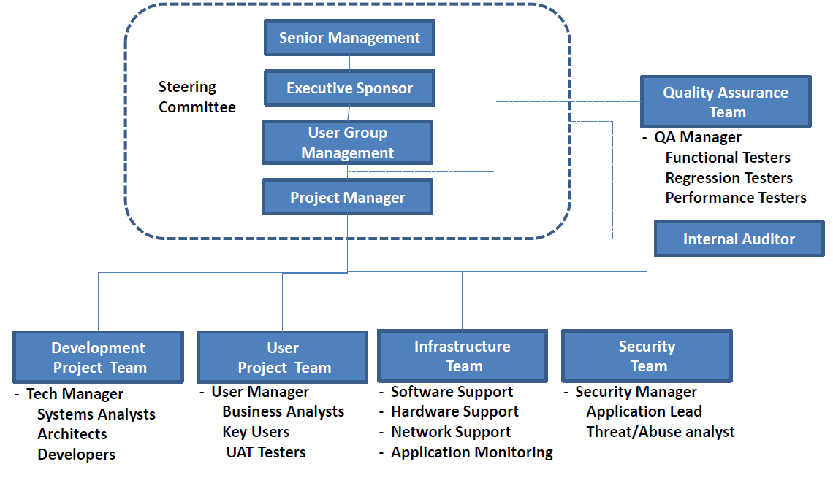
Project Roles
Introduction PM Knowledge Areas Project Roles PMs Role Project Planning WBS, Tasks, Costs Critical Path PM Triangle

Slide 7
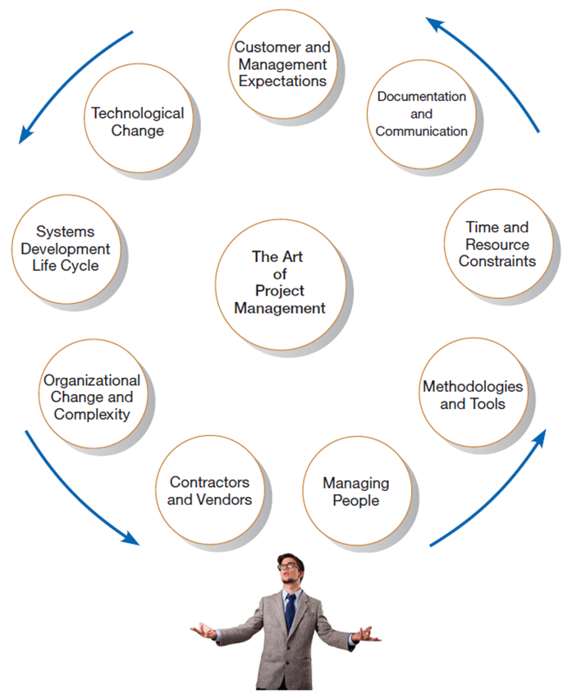
Project Manager
Introduction PM Knowledge Areas Project Roles PMs Role Project Planning WBS, Tasks, Costs Critical Path PM Triangle
Phases of Project Management Process
Phase 1: Initiation
Phase 2: Planning
Phase 3: Execution
Phase 4: Closedown
Analysis
Design
Implementation

Slide 8
Project Plan
Introduction PM Knowledge Areas Project Roles PMs Role Project Planning WBS, Tasks, Costs Critical Path PM Triangle
Should define clear, discrete activities and the work needed to complete each activity. Tasks include:
Describing Project Scope
Dividing the Project into Manageable Tasks
Estimating Resources and Creating a Resource Plan
Developing a Preliminary Schedule
Developing a Communication Plan
Determining Project Standards and Procedures
Identifying and Assessing Risk
Creating a Preliminary Budget
Setting a Baseline Project Plan

Slide 9
Project Plan
Introduction PM Knowledge Areas Project Roles PMs Role Project Planning WBS, Tasks, Costs Critical Path PM Triangle
Answers the questions:
  What tasks must be done to complete the project?
  What are the dependencies among tasks?
  Who is responsible for each task?
  What resources are required to complete the tasks?
  How long will it take to complete the project?
  Is the project possible, given the known parameters?
  Where is the project most at risk?

Slide 10
Project Plan
Introduction PM Knowledge Areas Project Roles PMs Role Project Planning WBS, Tasks, Costs Critical Path PM Triangle
Phase 1: Initiation
Phase 2: Planning
Phase 3: Execution
Phase 4: Closedown
Is a 5-step process that defines a “road map” for successful project completion:
  Define the work
    What problem or opportunity does the project address?
    What are the quantifiable results to be achieved?
    What needs to be done?
    How will success be measured?
    How will we know when we are finished?
  Develop initial project schedule
  Refine project plans
  Assess project risk
  Set fixed delivery date and publish plans

Slide 11
Project Planning – Define the Work
Introduction PM Knowledge Areas Project Roles PMs Role Project Planning WBS, Tasks, Costs Critical Path PM Triangle
Project Manager does the following:
  Reviews historical project information
  Identifies major project activities
  Decomposes major activities and identifies individual tasks
  Establishes task ownership
  Identifies skills and resources needed
Outputs of this step:
  Work Breakdown Structure (WBS)
  Clearly defined tasks and deliverables
  Tasks assigned to the Functional Leads
  Specify resources by task

Slide 12
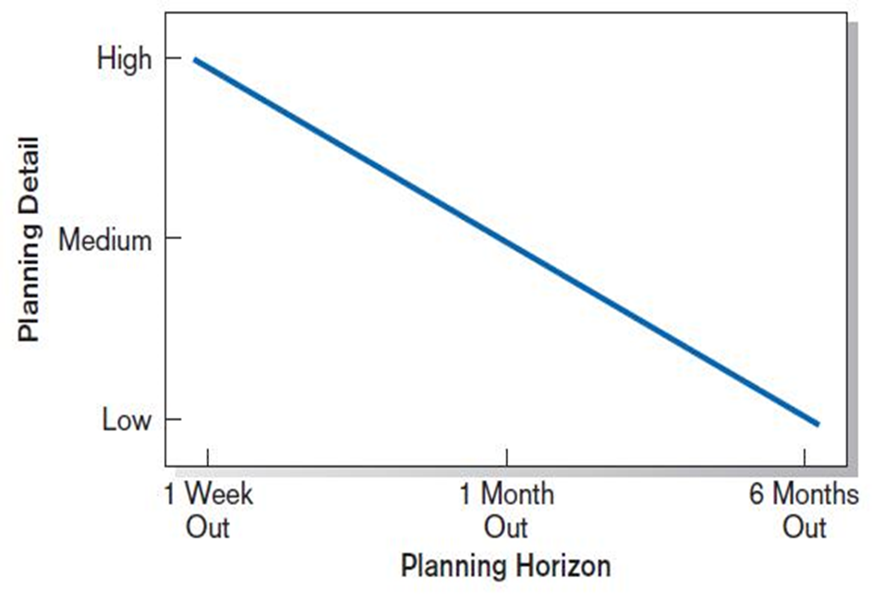
Planning Detail
Introduction PM Knowledge Areas Project Roles PMs Role Project Planning WBS, Tasks, Costs Critical Path PM Triangle
Level of project planning detail should be high in the short term, with less detail as time goes on
The general principal is that we need to accept the fact of uncertainty, and that things will change over time
Although we want a detailed idea of what we’re going to do in the immediate future, we allow for more flexibility as time goes on
This implies that planning is always going on
Plans are revisited and evolve over time

Slide 13
Dividing a Project into Manageable Tasks
Introduction PM Knowledge Areas Project Roles PMs Role Project Planning WBS, Tasks, Costs Critical Path PM Triangle
Work Breakdown Structure (WBS)
  Division of project into manageable and logically ordered tasks and subtasks
Scheduling Diagrams
  Gantt chart: horizontal bars represent task durations
  Network diagram: boxes and links represent task dependencies

Slide 14
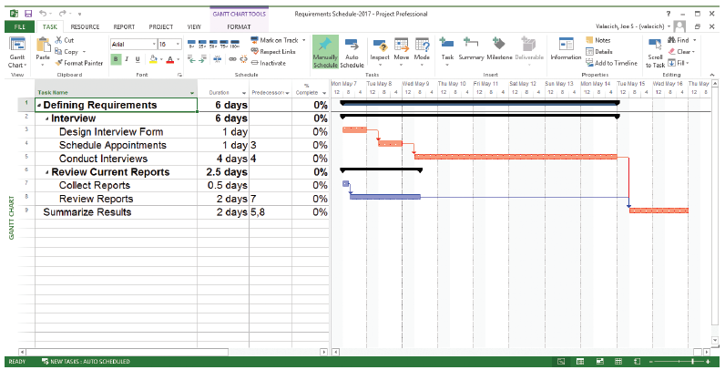
Project Schedule
Introduction PM Knowledge Areas Project Roles PMs Role Project Planning WBS, Tasks, Costs Critical Path PM Triangle
Gantt chart showing project tasks, duration times for those tasks, and predecessors
(Source: Microsoft Corporation.)

Slide 15
Work Breakdown Structure (WBS)
Introduction PM Knowledge Areas Project Roles PMs Role Project Planning WBS, Tasks, Costs Critical Path PM Triangle
Is a “top down” logical structuring of project work
At the highest level, the WBS may be broken down into major work packages that reflect phases of the SDLC, for example:
  Planning
  Analysis
  Design
  Implementation
Each work package is further broken down into tasks of greater detail, for example:
    Analysis
      Workflow requirement analysis
      Functional requirements analysis
      Data requirements analysis
      Information security requirements analysis
    Design
      User interface design
      Database design
      Applications processing design

Slide 16
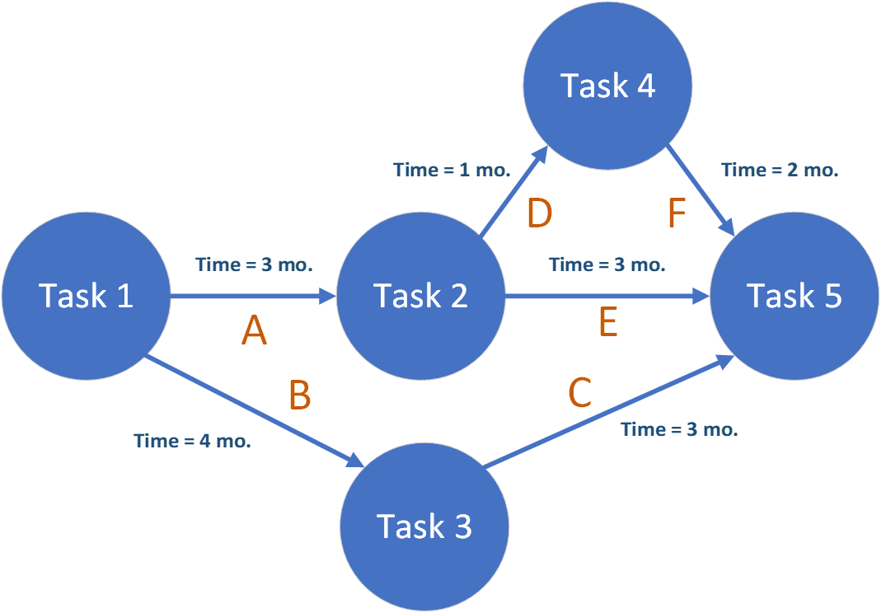
Network Diagram
Introduction PM Knowledge Areas Project Roles PMs Role Project Planning WBS, Tasks, Costs Critical Path PM Triangle
Once the tasks have been defined in a WBS, we map dependencies using a “Network Diagram”
No… Not that kind of network diagram…

Slide 17
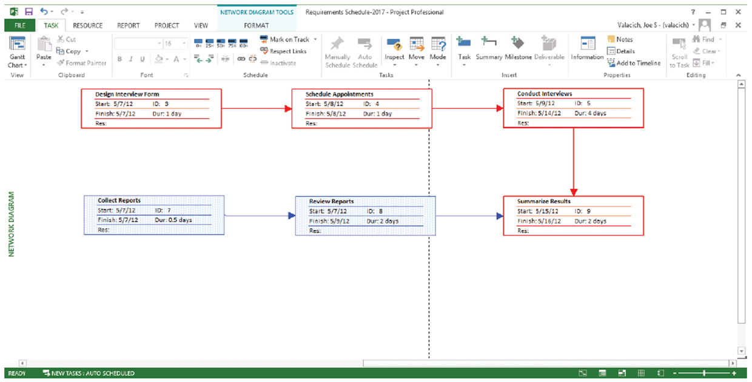
Network Diagram
Introduction PM Knowledge Areas Project Roles PMs Role Project Planning WBS, Tasks, Costs Critical Path PM Triangle
Once the tasks have been defined in a WBS, we map dependencies using a “Network Diagram”
No… Not that kind of network diagram…

Slide 18
Task Completion Time
Introduction PM Knowledge Areas Project Roles PMs Role Project Planning WBS, Tasks, Costs Critical Path PM Triangle
For each task defined in the WBS and Network Diagram, you must estimate the time to complete the task (and resources required).

Slide 19
The Critical Path
Introduction PM Knowledge Areas Project Roles PMs Role Project Planning WBS, Tasks, Costs Critical Path PM Triangle
An algorithm for scheduling a set of project activities
Used with Program Evaluation and Review Technique (PERT) network diagram
Determines
  Critical path by identifying and measuring the time required to complete the longest path of dependent activities (i.e. tasks) from start to finish
  Earliest and latest that each task can start and finish without making the project longer
    Slack time is the amount of time a task can be delayed without making the project longer
      Critical path has 0 slack

Slide 20
The Critical Path
Introduction PM Knowledge Areas Project Roles PMs Role Project Planning WBS, Tasks, Costs Critical Path PM Triangle
Which is the critical path?
PERT chart for a project with
  5 milestones: 1 through 5
  6 tasks: A through F
3 Paths through the tasks:
A, D, F = 3 + 1 + 2 = 6 mo.
Slack time = 1 mo.
A, E = 3 + 3 = 6 mo.
Slack time = 1 mo.
B, C = 4 + 3 = 7 mo.
Slack time = 0 mo.

Slide 21
Critical Path Exercise
Introduction PM Knowledge Areas Project Roles PMs Role Project Planning WBS, Tasks, Costs Critical Path PM Triangle
What is the critical path?
What is the slack time?

Slide 22
GANTT
Introduction PM Knowledge Areas Project Roles PMs Role Project Planning WBS, Tasks, Costs Critical Path PM Triangle
Once the tasks have been defined, their dependencies well understood, and the durations estimated, we can use a graphical model of the project plan:

Slide 23
GANTT Exercise
Introduction PM Knowledge Areas Project Roles PMs Role Project Planning WBS, Tasks, Costs Critical Path PM Triangle
Use the network diagram to create a GANTT using TeamGantt.com

Slide 24
Cost Estimation
Introduction PM Knowledge Areas Project Roles PMs Role Project Planning WBS, Tasks, Costs Critical Path PM Triangle
Can be based on:
  Analogous estimating – using experience from prior projects
  Parametric estimating – extending cost models from similar prior projects
  Bottom-up estimating – building up costs from detailed Work Breakdown Structure
  Actual costs – leveraging actual historic costs from identical prior project
Software Size Estimation Techniques:
  Source Lines of Code (SLOC)
  COnstructive COst Model (COCOMO)
  Function Point Analysis (FPA)
  FPA With Feature Points

Slide 25
COCOMO
Introduction PM Knowledge Areas Project Roles PMs Role Project Planning WBS, Tasks, Costs Critical Path PM Triangle
Models for estimating effort, cost, and schedule
  Boehm, B. (1981) Software Engineering Economics
  Derived from fitting regression formulas to historical project data
  Applies to 3 classes of software development projects
    Organic projects - small teams with "good" experience working with flexible requirements
    Semi-detached projects - "medium" teams with mixed experience working with a mix of rigid and less than rigid requirements
    Embedded projects - developed within a set of "tight" constraints
  A hierarchy of three increasingly detailed models:
    Basic COCOMO for quick, early, rough order of magnitude estimates of software costs
    Intermediate COCOMO added “Cost Drivers”
    Detailed COCOMO added influence of individual project phases

Slide 26
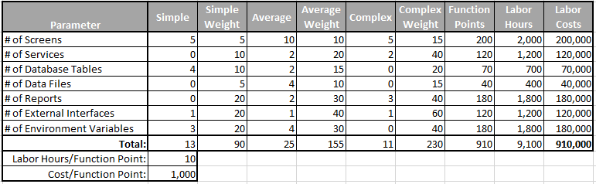
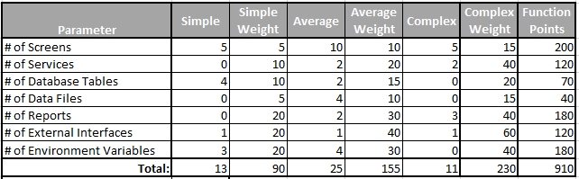
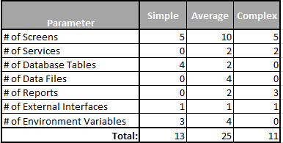
Cost Estimation – Function Point Analysis (FPA)
Introduction PM Knowledge Areas Project Roles PMs Role Project Planning WBS, Tasks, Costs Critical Path PM Triangle
A technique used to determine size of a development task, based on the number of function points
Function points are factors such as inputs, outputs, queries, and logical processing units

Slide 27
Auditors Role
Introduction PM Knowledge Areas Project Roles PMs Role Project Planning WBS, Tasks, Costs Critical Path PM Triangle
An auditor should be able to review the project plan, and asses:
  The validity of costs and estimates
    Was an accepted industry standard used?
    Are these estimates defendable?
  The reasonableness of tasks
    Was their rigor in developing the task list?
    Is there specificity, i.e., not a template?
    Is there evidence of objectivity in task definition and time estimates?
  Detail
    Is the level of detail appropriate at the time the plan was developed?
    Was the plan incrementally modified to update to a level of detail as the project progressed?
  Risk
    Was the critical path identified, and well understood?
  Consistency
    Are the various project planning models consistent?
    Ex: Each task in the WBS represented in the Network Diagram, GANTT chart, etc?

Slide 28

Project Planning - Project Management Triangle
Introduction PM Knowledge Areas Project Roles PMs Role Project Planning WBS, Tasks, Costs Critical Path PM Triangle
  Projects are planned and managed in the context of 3 constraints: Scope, Schedule and Budget
    Project Managers can trade among these 3 constraints
    Changes in one constraint necessitate changes in others or quality will suffer
SCOPE
(Deliverables)
QUALITY
Good
Cheap
Fast
Pick 2
Do not overlook implications of the
“Mythical Man-Month”
  More budget/resources can increase schedule
Good is a function of:
  Need to meet/exceed stakeholder expectations
  Need to pass User Acceptance Testing
SCHEDULE
(Time)
BUDGET
(Cost)

Slide 29
Project Planning - Project Management Triangle
Introduction PM Knowledge Areas Project Roles PMs Role Project Planning WBS, Tasks, Costs Critical Path PM Triangle
  Project planning and management accomplished in context of 3 constraints:
  Scope, Schedule and Budget
Scope involves getting information required to start a project, and the features the product would have that would meet its stakeholders requirements
  Project Scope: "The work that needs to be accomplished to deliver a product, service, or result with the specified features and functions”
  Product Scope: "The features and functions that characterize a product, service, or result."
SCOPE
(Deliverables)
QUALITY
Scope Risks: If requirements are not completely defined and described and if there is no effective change control in a project, scope creep or requirements creep may result
SCHEDULE
(Time)
BUDGET
(Cost)
A Guide to the Project Management Body of Knowledge (PMBOK Guide) - Fourth Edition. Project Management Institute, 2008. ISBN 978-1-933890-51-7

Slide 30
Project Planning - Project Management Triangle
Introduction PM Knowledge Areas Project Roles PMs Role Project Planning WBS, Tasks, Costs Critical Path PM Triangle
  Project planning and management accomplished in context of 3 constraints:
  Scope, Schedule and Budget
SCOPE
(Deliverables)
Schedule Risks:
Tasks which are exceptionally complicated
Tasks with durations longer than two weeks
Tasks on the critical path
Tasks which have several predecessors or dependencies
Tasks that have minimal slack
Optimistically estimated tasks
Tasks reliant on external resources
Start-to-Start and Finish-to-Finish dependencies
Dependencies with lags
Major milestones
Unforeseen issues (e.g., sicknesses, relocations, reorganizations)
Unstated assumptions
QUALITY
SCHEDULE
(Time)
BUDGET
(Cost)

Slide 31
Project Planning - Project Management Triangle
Introduction PM Knowledge Areas Project Roles PMs Role Project Planning WBS, Tasks, Costs Critical Path PM Triangle
  Project planning and management accomplished in context of 3 constraints:
  Scope, Schedule and Budget
SCOPE
(Deliverables)
Under-budgeted or unbudgeted
Development tasks
Testing and bug fixing tasks
Documentation tasks
Hardware, software, other equipment, or datasets
Meetings
Training of clients
QUALITY
SCHEDULE
(Time)
BUDGET
(Cost)

Slide 32
Project Planning - Project Management Triangle
Introduction PM Knowledge Areas Project Roles PMs Role Project Planning WBS, Tasks, Costs Critical Path PM Triangle
  Project planning and management accomplished in context of 3 constraints:
  Scope, Schedule and Budget
SCOPE
(Deliverables)
Resource Risks:
Tasks with one key individual assigned
Tasks using scarce resources
Tasks which are mismatched with the people assigned
Tasks which require large amounts of resources
Availability of tools and/or techniques
Tasks which rely on sub-consultants or third party vendors for their completion
Tasks which rely on resources within another organizational division or group for their completion
QUALITY
SCHEDULE
(Time)
BUDGET
(Cost)

Slide 33
Project Planning - Project Management Triangle
Introduction PM Knowledge Areas Project Roles PMs Role Project Planning WBS, Tasks, Costs Critical Path PM Triangle
  Project planning and management accomplished in context of 3 constraints:
  Scope, Schedule and Budget
SCOPE
(Deliverables)
Preventative Tasks to Mitigate Risk
Schedule high risk tasks earlier in the development cycle
Shift more experienced people to tasks
Add prototyping tasks to prove concepts
Add review tasks
Change the approach to eliminate high risk tasks
Add resources to tasks for cross-training, if budget can support it
Establish independent parallel efforts
Reduce project scope
Design in redundancy
QUALITY
SCHEDULE
(Time)
BUDGET
(Cost)

