Slide 1
Project Selection
ITACS 5203, Unit 3

Slide 2
Learning Objectives
Introduction Sources of Software Outsourcing Packaged Software Vendors Cloud Open Source In-House RFP Reuse Project ID & Selection Feasibility Assessment Technical Financial (Other)
Describe the sources of information systems,
describe the project identification and selection process,
describe the corporate strategic planning and information systems planning process, and
Perform a technical, financial, and other feasibility analysis

Slide 3
Topics
Introduction Sources of Software Outsourcing Packaged Software Vendors Cloud Open Source In-House RFP Reuse Project ID & Selection Feasibility Assessment Technical Financial (Other)
4. Identifying and Selecting Projects
4.1. Process
4.2. Deliverables
4.3. Corporate Strategic Planning
4.4. Information Systems Planning
5. Initiating and Planning Systems Development Projects
5.1. Deliverables and Outcomes
5.1.1. Baseline Project Plan
5.2. Feasibility Analysis
5.2.1. Economic
5.2.1.1. NPV
5.2.1.2. ROI
5.2.2. Technical
5.2.3. Other Feasibility
3.2. Business Case and Feasibility Analysis
3.2.1. Auditor’s Role in Business Case Development
3.3.3. SDLC Phases
3.3.3.1. Feasibility
IT Auditors are required to confirm information systems the business chooses to rely on:
  Meet return on investment (ROI) expectations
  Are planned, developed, implemented and maintained in a controlled and dependable manner

Slide 4
Sources of Software
Introduction Sources of Software Outsourcing Packaged Software Vendors Cloud Open Source In-House RFP Reuse Project ID & Selection Feasibility Assessment Technical Financial (Other)
Historically, software development for a corporate information systems department was done primarily in-house.
Now it involves use of components from external sources.
Much in-house application coding involves making the components work together.
Six sources of software:
  Information technology service firms
  Packaged software providers
  Vendors of enterprise-wide solution software
  Cloud computing
  Open-source software
  In-house development
There are ways to evaluate software from sources

Slide 5
Outsourcing
Introduction Sources of Software Outsourcing Packaged Software Vendors Cloud Open Source In-House RFP Reuse Project ID & Selection Feasibility Assessment Technical Financial (Other)
Outsourcing: The practice of turning over responsibility of some or all of an organization’s information systems applications and operations to an outside firm
Outsourcing Example
  Shell Oil outsource spending: $3.2 billion (2008)
  Shell’s outsourcing vendors (2008-2011): EDS, T-Systems, AT&T, IBM, Logica, Wipro, Accenture
Reasons to outsource
  Cost-effectiveness
  Take advantage of economies of scale
  Make up for lack of in-house knowledge
  Free up internal resources
  Reduce time to market
  Increase process efficiencies
  System development is a non-core activity for the organization
  Political reasons (e.g. labor disputes)

Slide 6
Packaged Software
Introduction Sources of Software Outsourcing Packaged Software Vendors Cloud Open Source In-House RFP Reuse Project ID & Selection Feasibility Assessment Technical Financial (Other)
  Serve many market segments
  Provide software ranging from broad-based packages (i.e. general ledger) to niche packages (i.e. day care management)
  Pre-packaged, off-the-shelf software
  Software runs on all size computers, from microcomputers to large mainframes.
  Prepackaged software is off-the-shelf, turnkey software (i.e. not customizable).
  Off-the-shelf software, at best, meets 70% of organizations’ needs.

Slide 7
Enterprise Solutions Software
Introduction Sources of Software Outsourcing Packaged Software Vendors Cloud Open Source In-House RFP Reuse Project ID & Selection Feasibility Assessment Technical Financial (Other)
Enterprise Resource Planning (ERP) systems integrate individual traditional business functions into modules enabling a single seamless transaction to cut across functional boundaries.
SAP AG is the leading vendor of ERP systems.

Slide 8
Cloud Computing
Introduction Sources of Software Outsourcing Packaged Software Vendors Cloud Open Source In-House RFP Reuse Project ID & Selection Feasibility Assessment Technical Financial (Other)
The provision of computing resources, including applications, over the Internet, so customers do not have to invest in the computing infrastructure needed to run and maintain the resources
Pay-per-use or monthly/yearly licenses
Examples:
  Google Apps– for sharing documents, spreadsheets, and presentations
  Salesforce.com – online customer relationship management (CRM) software
    An example of software as a service (SaaS)
  Microsoft Azure platform
  Amazon.com cloud infrastructure and services
    An example of hardware as a service (HaaS)

Slide 9
Cloud Computing
Introduction Sources of Software Outsourcing Packaged Software Vendors Cloud Open Source In-House RFP Reuse Project ID & Selection Feasibility Assessment Technical Financial (Other)
Heavy growth predicted
Benefits:
  Frees company of internal IT staff requirements
  Faster access to application than via internal development
  Lower cost than internal development
Concerns
  Security
  Reliability
  Regulation compliance

Slide 10
Open Source Software
Introduction Sources of Software Outsourcing Packaged Software Vendors Cloud Open Source In-House RFP Reuse Project ID & Selection Feasibility Assessment Technical Financial (Other)
Freely available including source code
Developed by a community of interested people
Performs the same functions as commercial software
Examples: Linux, mySQL, Firefox
How to make money?
  Provide maintenance/services
  Sell a more featured version of the free software

Slide 11
In-House Development
Introduction Sources of Software Outsourcing Packaged Software Vendors Cloud Open Source In-House RFP Reuse Project ID & Selection Feasibility Assessment Technical Financial (Other)
If sufficient system development expertise with the chosen platform exists in-house, then some or all of the system can be developed by the organization’s own staff.
  In-house development usually leads to more maintenance burden than other approaches
Hybrid solutions involving some purchased and some in-house components are common.

Slide 12
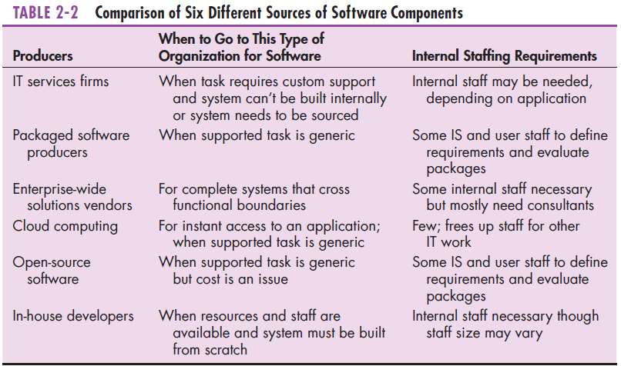
In-House Development
Introduction Sources of Software Outsourcing Packaged Software Vendors Cloud Open Source In-House RFP Reuse Project ID & Selection Feasibility Assessment Technical Financial (Other)

Slide 13
Evaluation of Sources
Introduction Sources of Software Outsourcing Packaged Software Vendors Cloud Open Source In-House RFP Reuse Project ID & Selection Feasibility Assessment Technical Financial (Other)
Cost: comparing the cost of developing the same system in-house with the cost of purchasing or licensing the software package
Functionality: the tasks that the software can perform and the mandatory, essential, and desired system features
Vendor support: whether and how much support the vendor can provide and at what cost
Viability of vendor: can vendor continue to adapt/update software to changes in systems software and hardware
Flexibility: the ease with which software is customized
Documentation: understandable and up-to-date user’s manual and technical documentation
Response time: how long it takes the software package to respond to the user’s requests in an interactive session
Ease of installation: a measure of the difficulty of loading the software and making it operational

Slide 14
Evaluation of Sources
Introduction Sources of Software Outsourcing Packaged Software Vendors Cloud Open Source In-House RFP Reuse Project ID & Selection Feasibility Assessment Technical Financial (Other)
Send a request for proposal (RFP) to vendors.
  RFP – a document provided to vendors to ask them to propose hardware and system software that will meet the requirements of a new system
Use a variety of information sources:
  Collect information from vendor
  Software documentation
  Technical marketing literature
Sometimes called a Request For Quote (RFQ)
Analyst selects best candidates based on:
  vendor bids
  a variety of information sources

Slide 15
Information Sources for RFP
Introduction Sources of Software Outsourcing Packaged Software Vendors Cloud Open Source In-House RFP Reuse Project ID & Selection Feasibility Assessment Technical Financial (Other)
Vendor’s proposal
Running software through a series of tests
Feedback from other users of the vendor’s product
Independent software testing services
Customer surveys
Articles in trade publications are sometimes biased (seeded by manufacturer)

Slide 16
Reuse
Introduction Sources of Software Outsourcing Packaged Software Vendors Cloud Open Source In-House RFP Reuse Project ID & Selection Feasibility Assessment Technical Financial (Other)
The use of previously written software resources, especially objects and components, in new applications
Commonly applied to two different development technologies:
  Object-oriented development
    Object class encapsulates data and behavior of common organizational entities (e.g. employees)
  Component-based development
  Components can be as small as objects or as large as pieces of software that handle single business functions
Can be effective (increased productivity, less defects, reduced rework)
Technical issues – lack of methodology for component library (creating and labeling reusable components)
Organizational issues – lack of commitment, training, and organizational support; hard to measure economic benefits; legal and contractual issues

Slide 17
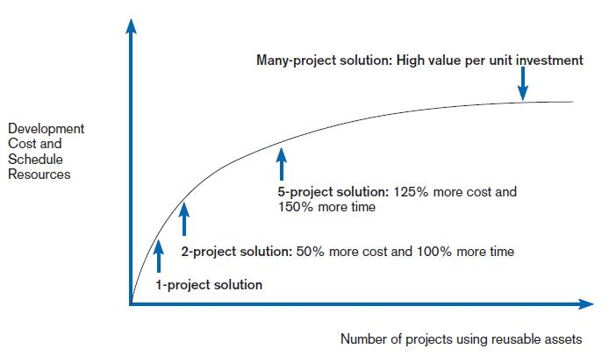
Reuse
Introduction Sources of Software Outsourcing Packaged Software Vendors Cloud Open Source In-House RFP Reuse Project ID & Selection Feasibility Assessment Technical Financial (Other)

Slide 18
Approaches to Reuse
Introduction Sources of Software Outsourcing Packaged Software Vendors Cloud Open Source In-House RFP Reuse Project ID & Selection Feasibility Assessment Technical Financial (Other)
Ad-hoc: individuals are free to find or develop reusable assets on their own
Facilitated: developers are encouraged to practice reuse
Managed: the development, sharing, and adoption of reusable assets is mandated
Designed: assets mandated for reuse as they are being designed for specific applications
(Griss 2003)

Slide 19
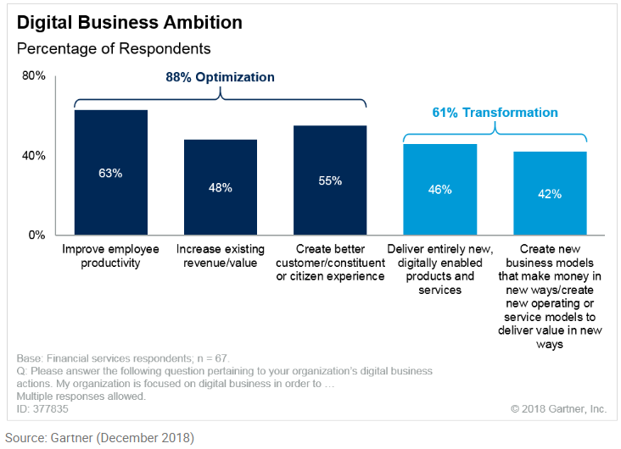
Today’s Business IT Environment
Introduction Sources of Software Outsourcing Packaged Software Vendors Cloud Open Source In-House RFP Reuse Project ID & Selection Feasibility Assessment Technical Financial (Other)
It is impossible for enterprises of any size in any market sector to exist without computers to assist in business operations
  Computer revolution started in the 1950’s continues…
  Equipment capacity and performance continues to grow while cost and size is shrinking
  Today’s focus is on developing and implementing more effective and responsive information systems that optimize and transform the business

Slide 20
Information Systems Proposals
Introduction Sources of Software Outsourcing Packaged Software Vendors Cloud Open Source In-House RFP Reuse Project ID & Selection Feasibility Assessment Technical Financial (Other)
Proposals for new information systems come from a variety of sources, for example, they may come from:
  Board of Directors as a result of a business change
  Government in the form of legislative and regulatory changes
  Management initiatives intended to…
    Improve business effectiveness or efficiencies
    Respond to competitive forces
  Information Technology which has changed

Slide 21
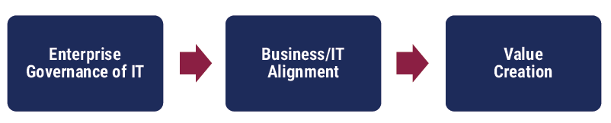
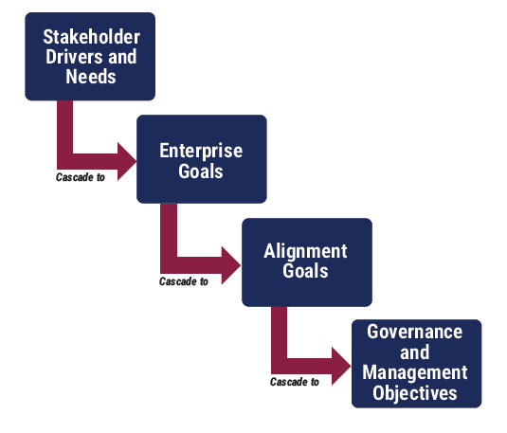
Enterprise Governance of Information and Technology
Introduction Sources of Software Outsourcing Packaged Software Vendors Cloud Open Source In-House RFP Reuse Project ID & Selection Feasibility Assessment Technical Financial (Other)
Enterprise governance of new and improved information and technology is focused on:
  Benefits Realization
  Risk Optimization
  Resource Optimization
COBIT 2019 Framework: Introduction & Methodology, ISACA, 2018

Slide 22
Enterprise Governance of Information and Technology
Introduction Sources of Software Outsourcing Packaged Software Vendors Cloud Open Source In-House RFP Reuse Project ID & Selection Feasibility Assessment Technical Financial (Other)
  Benefits Realization
        Creating value for the enterprise through IT:
          Maintaining and increasing value derived from existing IT investments
          Eliminating IT initiatives and assets that are not creating sufficient value
        Delivery of fit-for-purpose services and solutions
          On-time and within budget
          That generate the intended financial and nonfinancial benefits
        Value that IT delivers should be
          Aligned directly with targeted business values
          Measured in ways that show impact and contributions of IT-enabled investments
  Risk Optimization
        Addresses business risk associated with use, ownership, operation, involvement, influence and adoption of IT within the enterprise
        IT-related business risk consists of IT-related events that could potentially impact the business
        While value delivery focuses on creation of value, risk management focuses on the preservation of value
  Resource Optimization
        Recognizes
          Data and information are an important resources
          Exploiting data and information to gain optimal value is a key focus
        Ensures
          Appropriate capabilities are in place to execute the strategic plan
          Sufficient, appropriate and effective resources are provided
          An integrated, economical IT infrastructure is provided
          New technology is introduced as required by the business
          Obsolete systems are updated or replaced

Slide 23
The process of Identifying and Selecting Projects
Introduction Sources of Software Outsourcing Packaged Software Vendors Cloud Open Source In-House RFP Reuse Project ID & Selection Feasibility Assessment Technical Financial (Other)
  Top-down source are projects identified by top management or by a diverse steering committee.
  Broader perspective.
  Improved integration.
  Improved management support.
  Better understanding.
  Bottom-up source are project initiatives stemming from managers, business units, or the development group.
  Identifies IS development projects based on solving specific operational business problems or taking advantage of specific opportunities.
  Can be faster and less costly, so may be beneficial in certain circumstances.

Slide 24
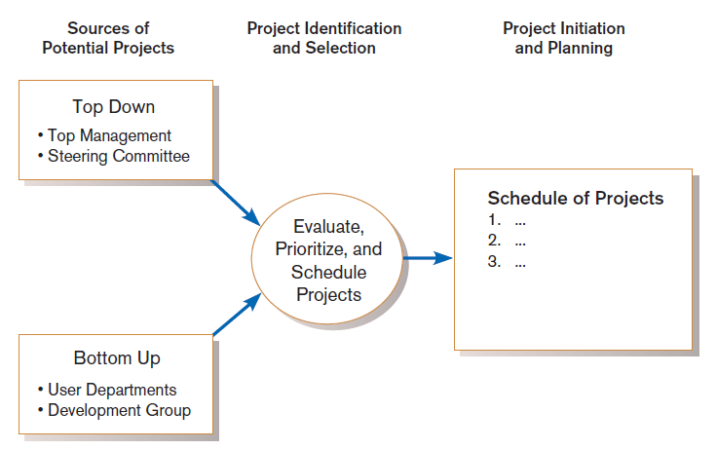
The process of Identifying and Selecting Projects
Introduction Sources of Software Outsourcing Packaged Software Vendors Cloud Open Source In-House RFP Reuse Project ID & Selection Feasibility Assessment Technical Financial (Other)
Information systems development projects come from both top-down and bottom-up initiatives.

Slide 25
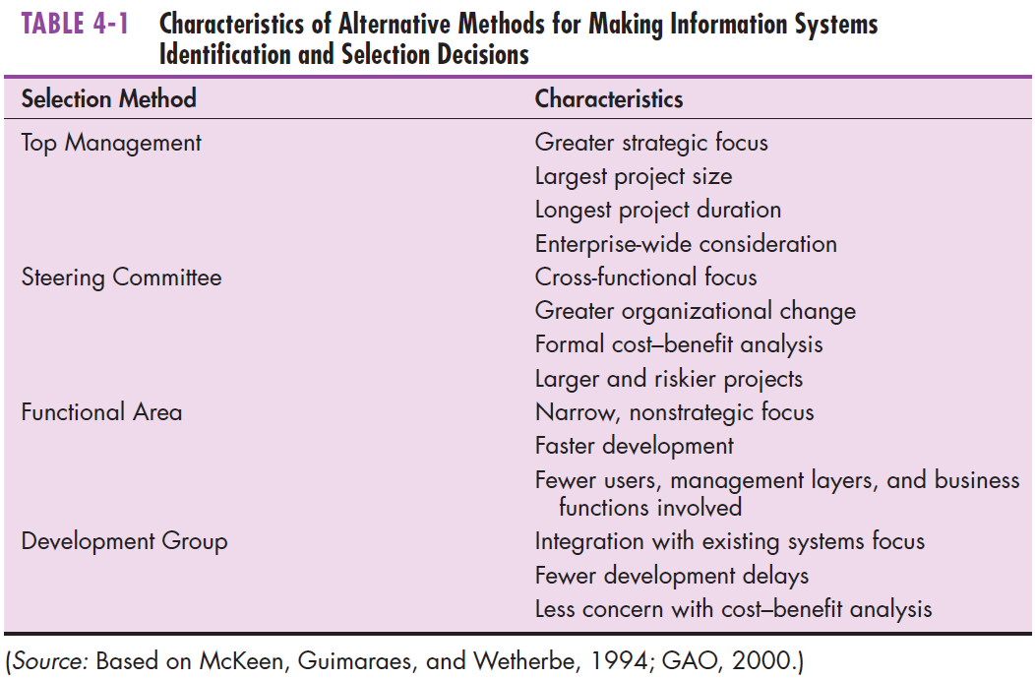
The process of Identifying and Selecting Projects
Introduction Sources of Software Outsourcing Packaged Software Vendors Cloud Open Source In-House RFP Reuse Project ID & Selection Feasibility Assessment Technical Financial (Other)

Slide 26
Classifying and Ranking IS Projects
Introduction Sources of Software Outsourcing Packaged Software Vendors Cloud Open Source In-House RFP Reuse Project ID & Selection Feasibility Assessment Technical Financial (Other)
  Evaluation Criteria
    Value Chain Analysis
      Extend to which activities add value and costs when developing products and services
    Strategic Alignment
      Extent to which the project is viewed as helping the organization achieve strategic objectives
    Potential Benefits
      Extent to which the project is viewed as improving processes
    Resource Availability
      Amount and type of resources the project requires, and their availability
    Technical Difficulty / Risks
      Level of technical difficulty to successfully complete the project

Slide 27
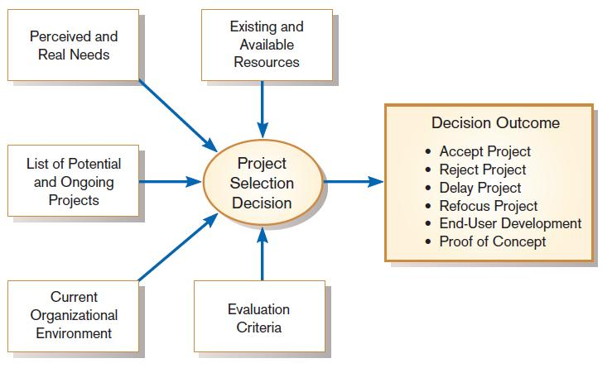
Classifying and Ranking IS Projects
Introduction Sources of Software Outsourcing Packaged Software Vendors Cloud Open Source In-House RFP Reuse Project ID & Selection Feasibility Assessment Technical Financial (Other)
Project selection decisions must consider numerous factors and can have numerous outcomes

Slide 28
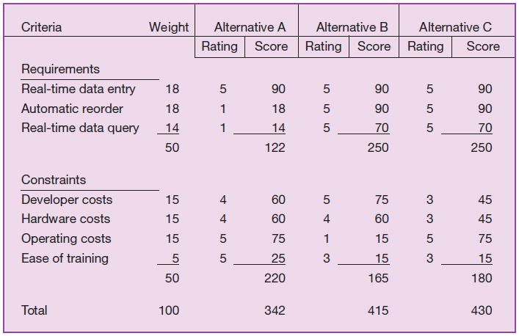
Weighted Analysis
Introduction Sources of Software Outsourcing Packaged Software Vendors Cloud Open Source In-House RFP Reuse Project ID & Selection Feasibility Assessment Technical Financial (Other)
One method for deciding among different projects or alternative designs:
  For each requirement or constraint:
  Score = weight X rating
  Each alternative: sum scores across requirements/constraints
  Alternative with highest score wins

Slide 29
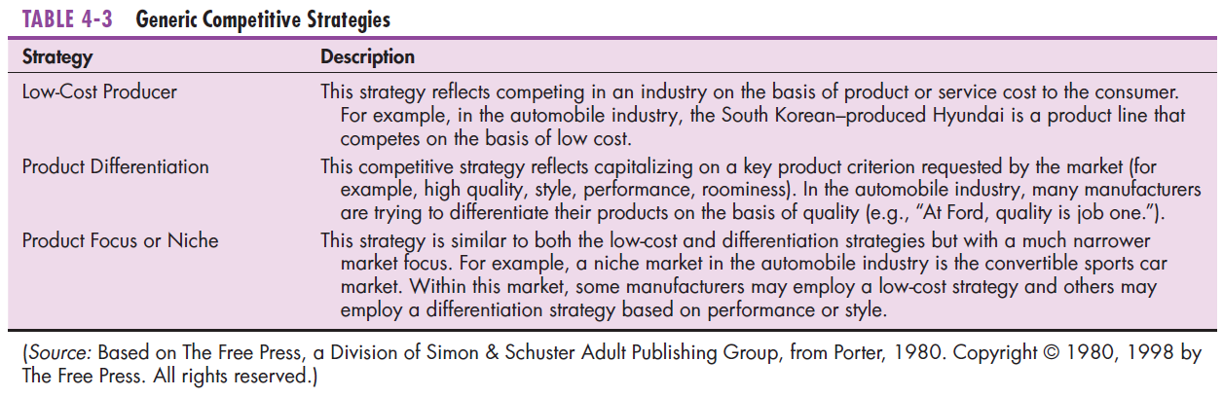
Alignment with Strategy
Introduction Sources of Software Outsourcing Packaged Software Vendors Cloud Open Source In-House RFP Reuse Project ID & Selection Feasibility Assessment Technical Financial (Other)

Slide 30
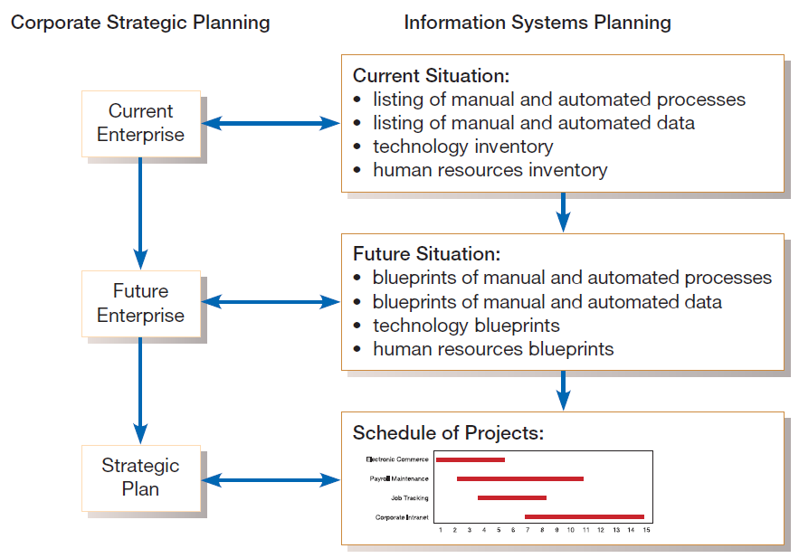
Alignment with Strategy
Introduction Sources of Software Outsourcing Packaged Software Vendors Cloud Open Source In-House RFP Reuse Project ID & Selection Feasibility Assessment Technical Financial (Other)
Parallel activities of corporate strategic planning and information systems planning

Slide 31
Assessing Technical Feasibility
Introduction Sources of Software Outsourcing Packaged Software Vendors Cloud Open Source In-House RFP Reuse Project ID & Selection Feasibility Assessment Technical Financial (Other)
Strategy
Technical feasibility: a process of assessing the development organization’s ability to construct a proposed system
Assessment of the possible target hardware, software, and operating environments
Consider system size, complexity, and the group’s experience with similar systems
The potential consequences of not assessing and managing risks can include:
  Failure to attain expected benefits from the project
  Inaccurate project cost estimates.
  Inaccurate project duration estimates.
  Failure to achieve adequate system performance levels.
  Failure to adequately integrate the new system with existing hardware, software, or organizational procedures.
Feasibility Study
Project Initiation
Business Case
Project Planning
Project Management
Project Execution
Project Closeout

Slide 32
Technical Risk Factors
Introduction Sources of Software Outsourcing Packaged Software Vendors Cloud Open Source In-House RFP Reuse Project ID & Selection Feasibility Assessment Technical Financial (Other)
Project size
  Team size, organizational departments, project duration, programming effort
Project structure
  New vs. renovated system, resulting organizational changes, management commitment, user perceptions
Development group
  Familiarity with platform, software, development method, application area, development of similar systems
User group
  Familiarity with IS development process, application area, use of similar systems

Slide 33
Technical Risk Assessment
Introduction Sources of Software Outsourcing Packaged Software Vendors Cloud Open Source In-House RFP Reuse Project ID & Selection Feasibility Assessment Technical Financial (Other)
Four general rules of risk assessment:
  Larger projects are riskier than smaller projects.
  A system in which the requirements are easily obtained and highly structured will be less risky than one in which requirements are messy, ill structured, ill defined, or subject to the judgment of an individual.
  The development of a system employing commonly used or standard technology will be less risky than one employing novel or nonstandard technology.
  A project is less risky when the user group is familiar with the systems development process and application area than if unfamiliar.

Slide 34
Financial Feasibility Analysis
Introduction Sources of Software Outsourcing Packaged Software Vendors Cloud Open Source In-House RFP Reuse Project ID & Selection Feasibility Assessment Technical Financial (Other)
Economic feasibility: a process of identifying the financial benefits and costs associated with a development project
  Often referred to as a cost-benefit analysis
  Project is reviewed after each SDLC phase in order to decide whether to continue, redirect, or kill a project

Slide 35
Determining Project Benefits
Introduction Sources of Software Outsourcing Packaged Software Vendors Cloud Open Source In-House RFP Reuse Project ID & Selection Feasibility Assessment Technical Financial (Other)
Tangible benefits refer to items that can be measured in dollars and with certainty.
Examples include:
  reduced personnel expenses
  lower transaction costs, or
  higher profit margins.
Most tangible benefits will fit within the following categories:
  Cost reduction and avoidance
  Error reduction
  Increased flexibility
  Increased speed of activity
  Improvement of management planning and control
  Opening new markets and increasing sales opportunities

Slide 36
Determining Project Benefits
Introduction Sources of Software Outsourcing Packaged Software Vendors Cloud Open Source In-House RFP Reuse Project ID & Selection Feasibility Assessment Technical Financial (Other)
Intangible benefits are benefits derived from the creation of an information system that cannot be easily measured in dollars or with certainty.
  May have direct organizational benefits, such as the improvement of employee morale
  May have broader societal implications, such as the reduction of waste creation or resource consumption

Slide 37
Determining Project Costs
Introduction Sources of Software Outsourcing Packaged Software Vendors Cloud Open Source In-House RFP Reuse Project ID & Selection Feasibility Assessment Technical Financial (Other)
Tangible cost: a cost associated with an information system that can be measured in dollars and with certainty
IS development tangible costs include:
  Hardware costs
  Labor costs, or
  Operational costs, including employee training and building renovations.
Intangible cost: a cost associated with an information system that cannot be easily measured in terms of dollars or with certainty
Intangible costs can include:
  Loss of customer goodwill,
  Employee morale, or
  Operational inefficiency.

Slide 38
Determining Project Costs
Introduction Sources of Software Outsourcing Packaged Software Vendors Cloud Open Source In-House RFP Reuse Project ID & Selection Feasibility Assessment Technical Financial (Other)
One-time cost: a cost associated with project start-up and development or system start-up
These costs encompass activities such as:
  Systems development,
  New hardware and software purchases,
  User training,
  Site preparation, and
  Data or system conversion.
Recurring cost: a cost resulting from the ongoing evolution and use of a system
Examples of these costs include:
  Application software maintenance
  Incremental data storage expenses
  Incremental communications
  New software and hardware leases, and
  Supplies and other expenses (i.e., paper, forms, data center personnel).
Both one-time and recurring costs can consist of items that are fixed or variable in nature.
Fixed costs are billed or incurred at a regular interval and usually at a fixed rate.
  Example: facility lease payment
Variable costs are items that vary in relation to usage.
  Example: long-distance charges

Slide 39
Time Value of Money
Introduction Sources of Software Outsourcing Packaged Software Vendors Cloud Open Source In-House RFP Reuse Project ID & Selection Feasibility Assessment Technical Financial (Other)
Time value of money (TVM): the concept that money available today is worth more than the same amount tomorrow
Discount rate: the rate of return used to compute the present value of future cash flows (the cost of capital)
Present value: the current value of a future cash flow
Net Present Value (NPV)
  Use discount rate to determine present value of cash outlays and receipts
Return on Investment (ROI)
  Ratio of cash receipts to cash outlays
Break-Even Analysis (BEA)
  Amount of time required for cumulative cash flow to equal initial and ongoing investment

Slide 40
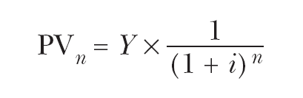
Time Value of Money
Introduction Sources of Software Outsourcing Packaged Software Vendors Cloud Open Source In-House RFP Reuse Project ID & Selection Feasibility Assessment Technical Financial (Other)
Net Present Value
  PVn = present value of Y dollars n years from now based on a discount rate of i.
  NPV = sum of PVs across years.
  Calculates time value of money

Slide 41

Time Value of Money
Introduction Sources of Software Outsourcing Packaged Software Vendors Cloud Open Source In-House RFP Reuse Project ID & Selection Feasibility Assessment Technical Financial (Other)
Break-even analysis: a type of cost-benefit analysis to identify at what point (if ever) benefits equal costs

Slide 42
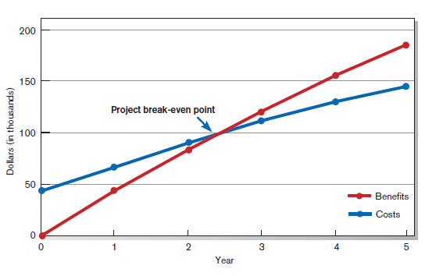
Time Value of Money
Introduction Sources of Software Outsourcing Packaged Software Vendors Cloud Open Source In-House RFP Reuse Project ID & Selection Feasibility Assessment Technical Financial (Other)
Break-even analysis: a type of cost-benefit analysis to identify at what point (if ever) benefits equal costs

Slide 43
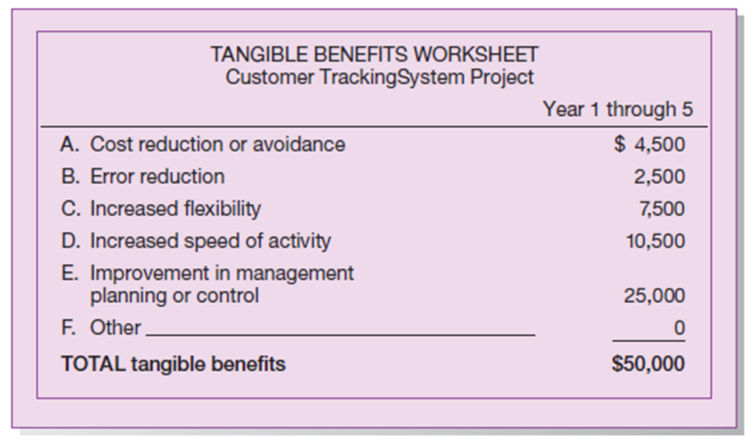
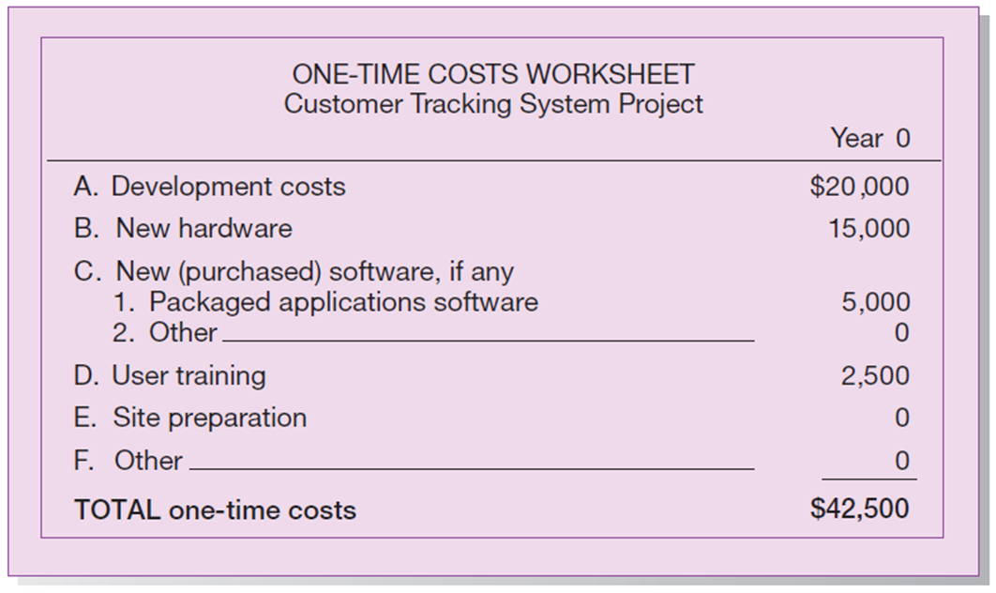
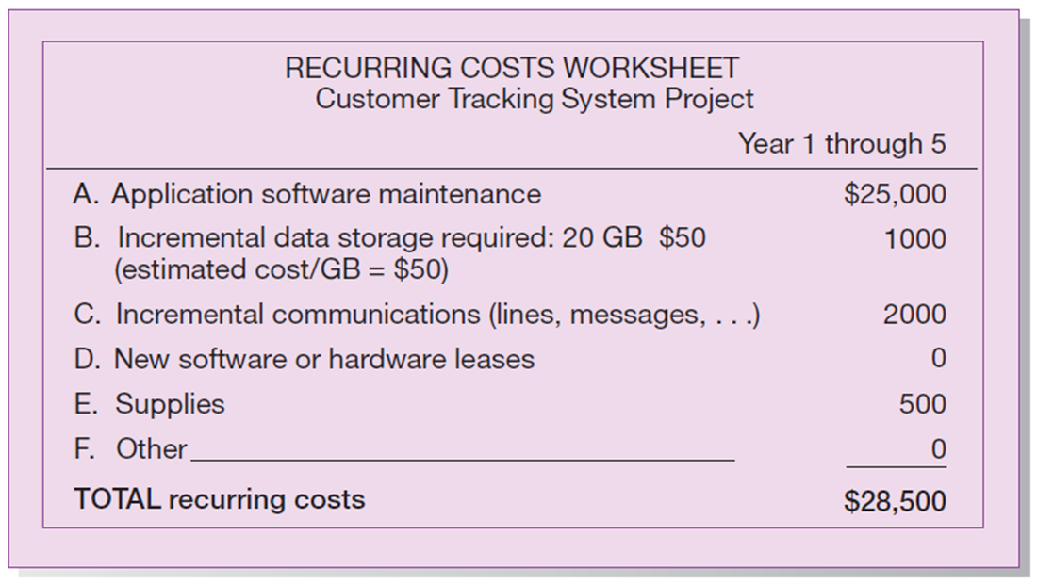
Practice Case
Introduction Sources of Software Outsourcing Packaged Software Vendors Cloud Open Source In-House RFP Reuse Project ID & Selection Feasibility Assessment Technical Financial (Other)
Practice using the CalculateProjectNPV_B.xlsx spreadsheet to calculate costs and benefits for the Customer Tracking System (Pine Valley Furniture) as you read Chapter 5 in Modern Systems Analysis and Design (MSAD). Apply the spreadsheet to illustrate cost/benefit analysis, including: Cash flow analysis, use of Net Present Value (NPV) in calculating Return on Investment (ROI), and break-even analysis

Slide 44
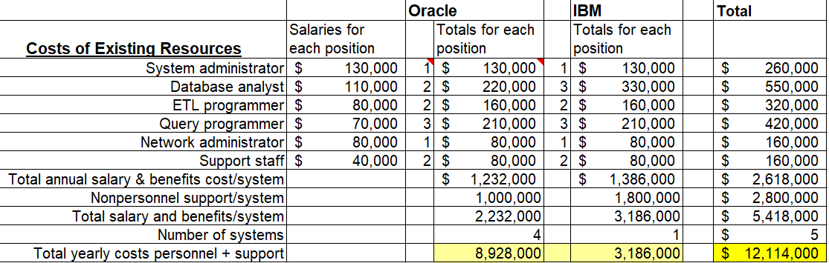
Annual Costs of Legacy Systems
Introduction Sources of Software Outsourcing Packaged Software Vendors Cloud Open Source In-House RFP Reuse Project ID & Selection Feasibility Assessment Technical Financial (Other)
…these costs become benefits of switching to the new system, i.e. costs not incurred after replacement

Slide 45
Other Feasibility Assessments
Introduction Sources of Software Outsourcing Packaged Software Vendors Cloud Open Source In-House RFP Reuse Project ID & Selection Feasibility Assessment Technical Financial (Other)
Operational
Legal / Contractual
Political

Slide 46


