Slide 1
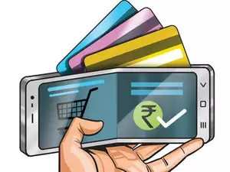
Mobile Payment
Group 2: Jing Jiang
Dongjie Wang
Haitao Huang
Binju Gaire
Parneet Toor

Slide 2
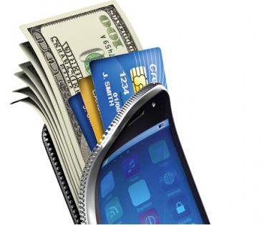
Agenda
Introduction
History
Mobile Payment Models
Current and Future Applications
Trending
Risks and samples
Controls

Slide 3
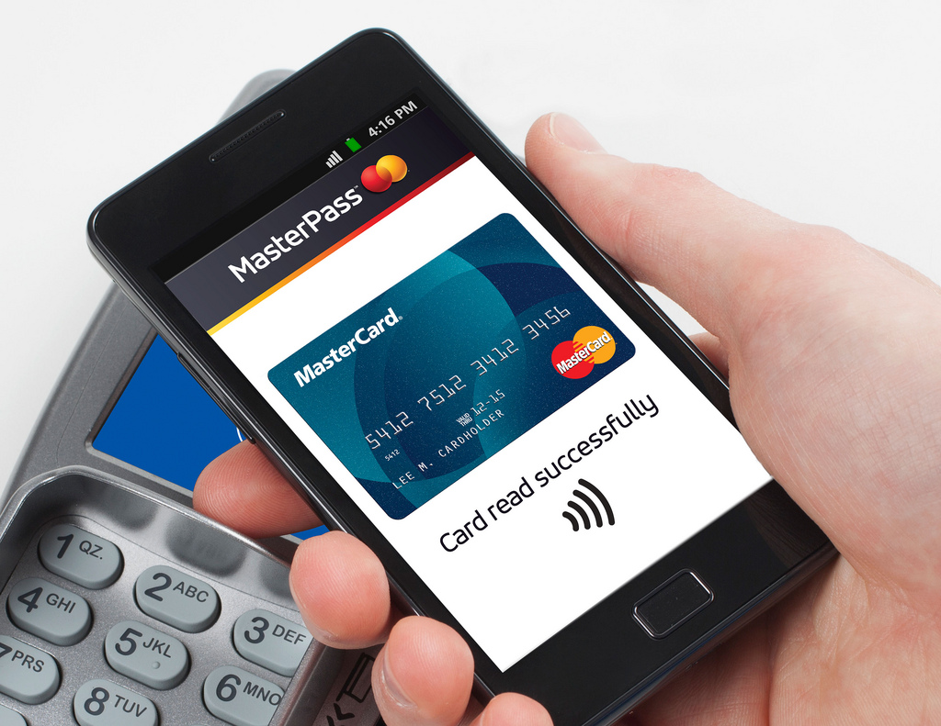
What is Mobile Payment Technology?
Other names:
m-payment
mobile money
mobile money transfer
mobile wallet
A method that allow transactions made or received with mobile devices
Instead of paying with cash, check, or credit cards
Mobile device serves as a security token
Creates a random code for the transaction
Notes:
https://www.lifewire.com/mobile-payments-4103869
https://www.tccrocks.com/blog/what-is-a-mobile-payment/
https://en.wikipedia.org/wiki/Mobile_payment

Slide 4
How It Works?
Critical Factors:
Payment App
The Internet
A User’s Payment Information

Slide 5
History
Start
First Online Purchase
$2.4 Billion Mobile Commerce
$69 billion in sales
1983
1994
In 1997, Coca-Cola introduces SMS purchasing in vending machines. Exxon Mobile begins accepting payments via Speedpass, which uses RFID technology so customers can swipe and pay instantly at the pump.
In 1998, PayPal was founded.
In 1999, mobile phones could be used to purchase movie tickets.
2000
2009
NOW
In 2001, Domino's Pizza starts taking orders via cell phone.
In 2003, 95 million users worldwide make purchases with their phones.
2005, Nokia launched the first NFC-enabled phone.
David Chaum, starts work on creating digital cash by inventing “the blinding formula. This is the beginning of cryptocurrencies
In 2011, Google Wallet is released.
In 2014, Apple launched Apple Pay.
Next year, Android and Samsung Pay are introduced
Notes:
http://www.toptenreviews.com/business/articles/the-history-of-mobile-pay/
https://techcrunch.com/2016/06/17/the-evolution-of-the-mobile-payment/

Slide 6
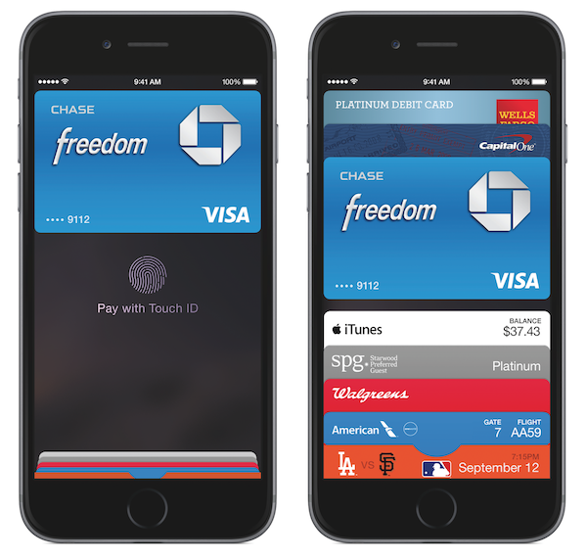
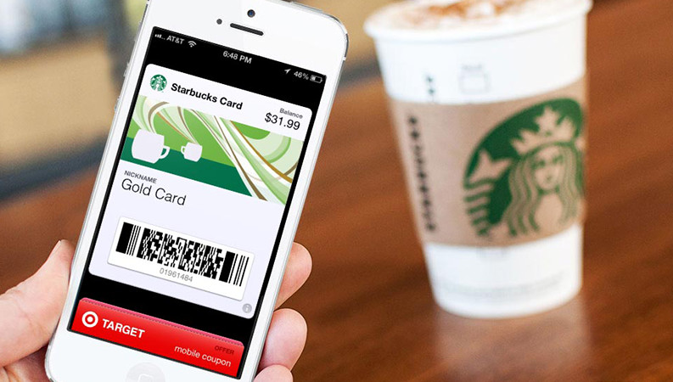
Mobile Payment Models
Mobile Wallets
Digital version of real wallet
NFC (Near-field communication)
Carrier Billing
Direct charge to mobile bills
Closed Loop Mobile Payment
Starbucks
Mobile Web Payment
Similar to desktop-based e-commerce shopping
Notes:
http://www.toptenreviews.com/business/articles/the-history-of-mobile-pay/
https://techcrunch.com/2016/06/17/the-evolution-of-the-mobile-payment/

Slide 7
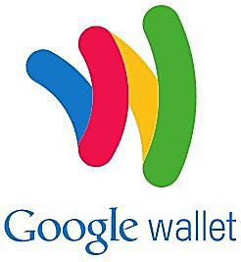
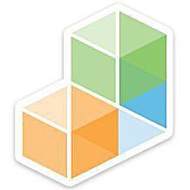
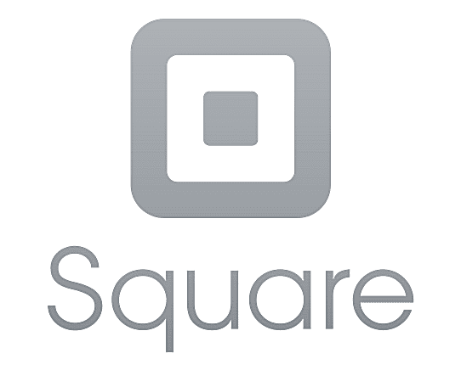
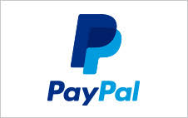
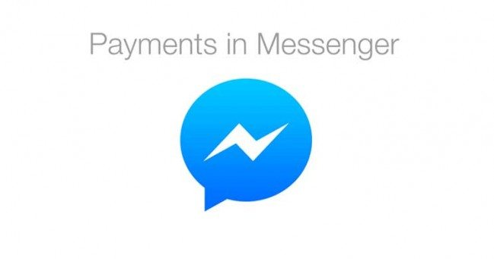
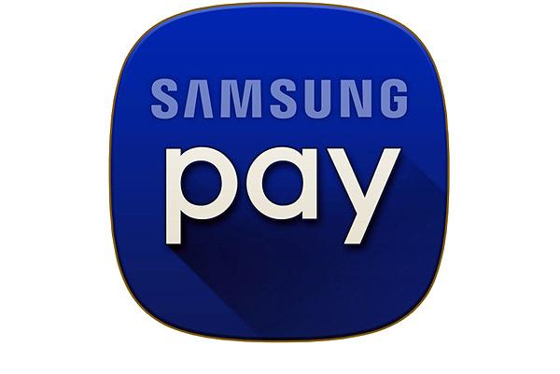
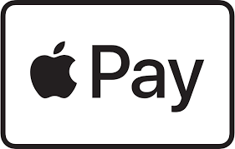
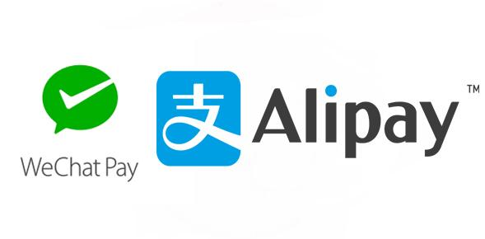
Current Application

Slide 8
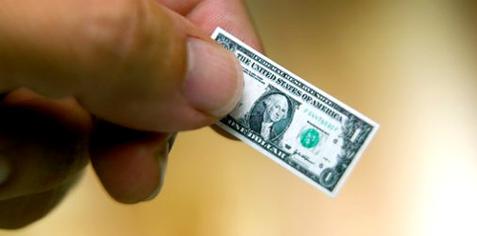
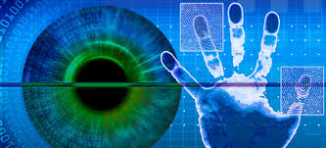
Future application
More personalized authentication methods through things like biometrics and geopositioning.
Using blockchain for payments and the Internet of things automatically process micropayments..
Notes:
https://www.bbva.com/en/future-payment-method-revolution/

Slide 9
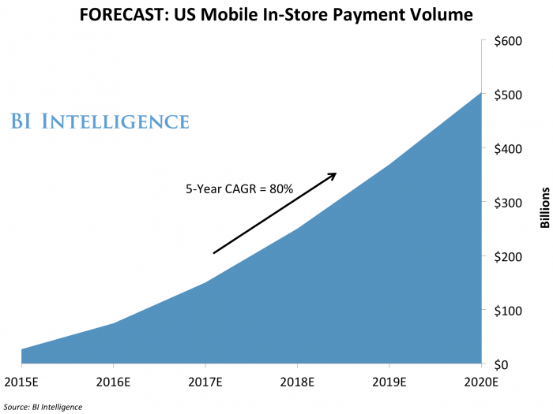
Trending
Notes:
http://www.businessinsider.com/future-of-payments-trends-in-payment-processing-2016-10
https://www.pymnts.com/mobile-wallet-adoption-2017/
海涛你看看这个link

Slide 10
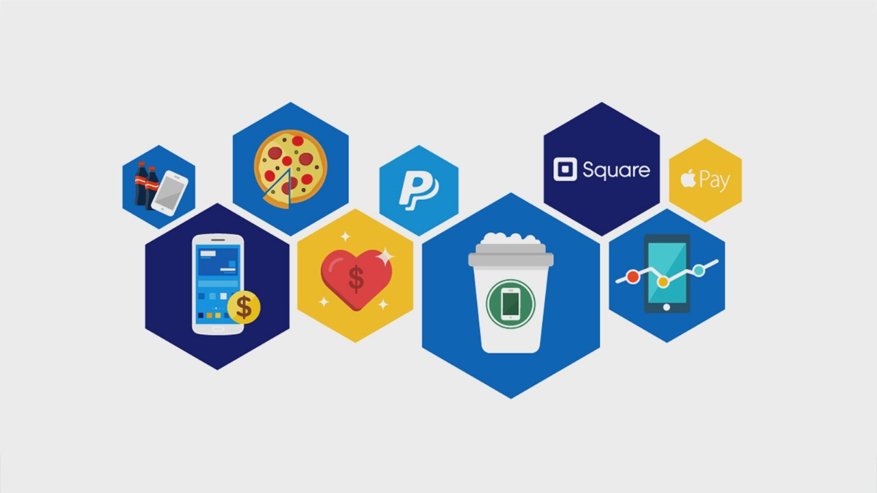
Quick Statistic from ISACA
Just 23% of the experts surveyed said they believed that mobile devices are secure enough to keep personal information safe
47 %claimed that mobile payments are not secure
An overwhelming majority 87% anticipated an increase in mobile payment data breaches over the next year
Notes:
In the year 2015, ISACA conducted a global survey that included 900 member cybersecurity experts to examine the biggest security risks for its 2015 Mobile Payment Security Experts. ISACA found:

Slide 11
Risks Associated with Mobile Payment
Unauthorized access to mobile devices
Theft and misuse of mobile devices
Use of stolen credit card information on apple/android pay
Regulatory compliance
Human error
Notes:
Just because the technology is latest does not mean it is free from security flaws.
https://securityintelligence.com/mobile-payment-protecting-applications-and-data-from-emerging-risks/

Slide 12
Controls associated with Mobile Payments
Customer Education
Implementation of remote wipe, and automatic lock out
Secure distribution and provisioning of mobile applications
Data Storage & Protection: Implement data encryption/hashing on the device and server.
Authentication, Authorization and Session Management:
Two factor authentication
Strong password policy
Validate password and sessions
Lower timeout for inactive session

Slide 13
Controls associated with Mobile Payments
6. Protection of Data in Transit : Use CA provided Certificates and secure communication channels
7. Follow secure software development standards
8. Apply defense in depth principles and lock down individual component that make up the payment system

Slide 14
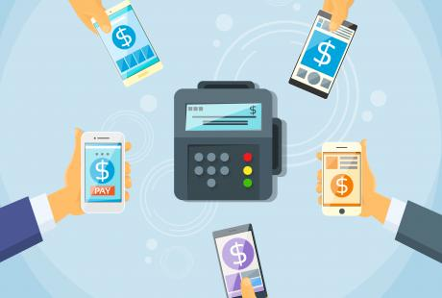
Thank You!
Any Questions?

Slide 15
References
https://www.entrepreneur.com/article/282722
https://www2.deloitte.com/content/dam/Deloitte/uk/Documents/audit/deloitte-uk-mobile-payments-opportunities-audit-advisory.pdf
https://www.sans.org/reading-room/whitepapers/ecommerce/security-mobile-banking-payments-34062
https://www.rsaconference.com/writable/presentations/file_upload/mbs-f01-security-considerations-for-mobile-payment-devices-trends-risks-and-countermeasures
https://www.lifewire.com/mobile-payments-4103869
https://www.tccrocks.com/blog/what-is-a-mobile-payment/
https://en.wikipedia.org/wiki/Mobile_payment
http://www.toptenreviews.com/business/articles/the-history-of-mobile-pay/
https://techcrunch.com/2016/06/17/the-evolution-of-the-mobile-payment/

