Slide 1
Emerging Technology Cloud Computing
Risks and Controls
Rouying Tang
Linlan Chen
Mustafa Aydin
Somayeh Keshtkar
Khawlah Alswailem
Adam M Joskowicz

Slide 2
Agenda
Introduction- Cloud Computing
History
Trending
Current & Future Applications
Cloud Computing Risks
Controls
Conclusion

Slide 3
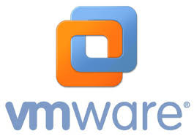
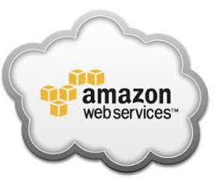
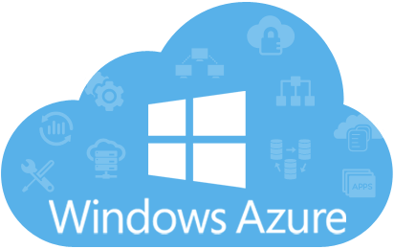
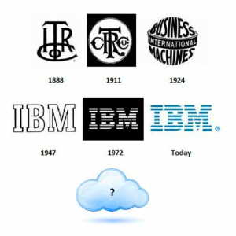
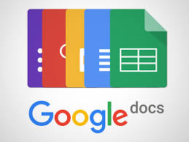
Introduction
"a style of computing in which massively scalable IT-related capabilities are provided 'as a service' using Internet technologies to multiple external customers."

Slide 4
History
Key time points:
1961 – Professor John McCarthy propose computing be organized as a “public utility”.
1991 – The World Wide Web popularizes the internet
1997 – First use of the term “Cloud Computing”
Google CEO Eric Schmidt introduced the term “cloud computing” to an industry conference on August 9, 2006

Slide 5
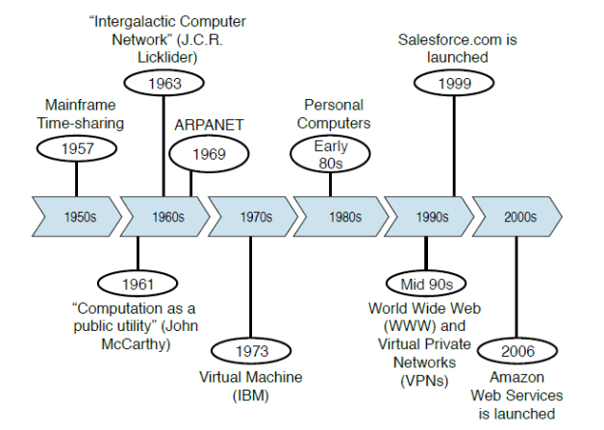
Historic
Time
Line

Slide 6
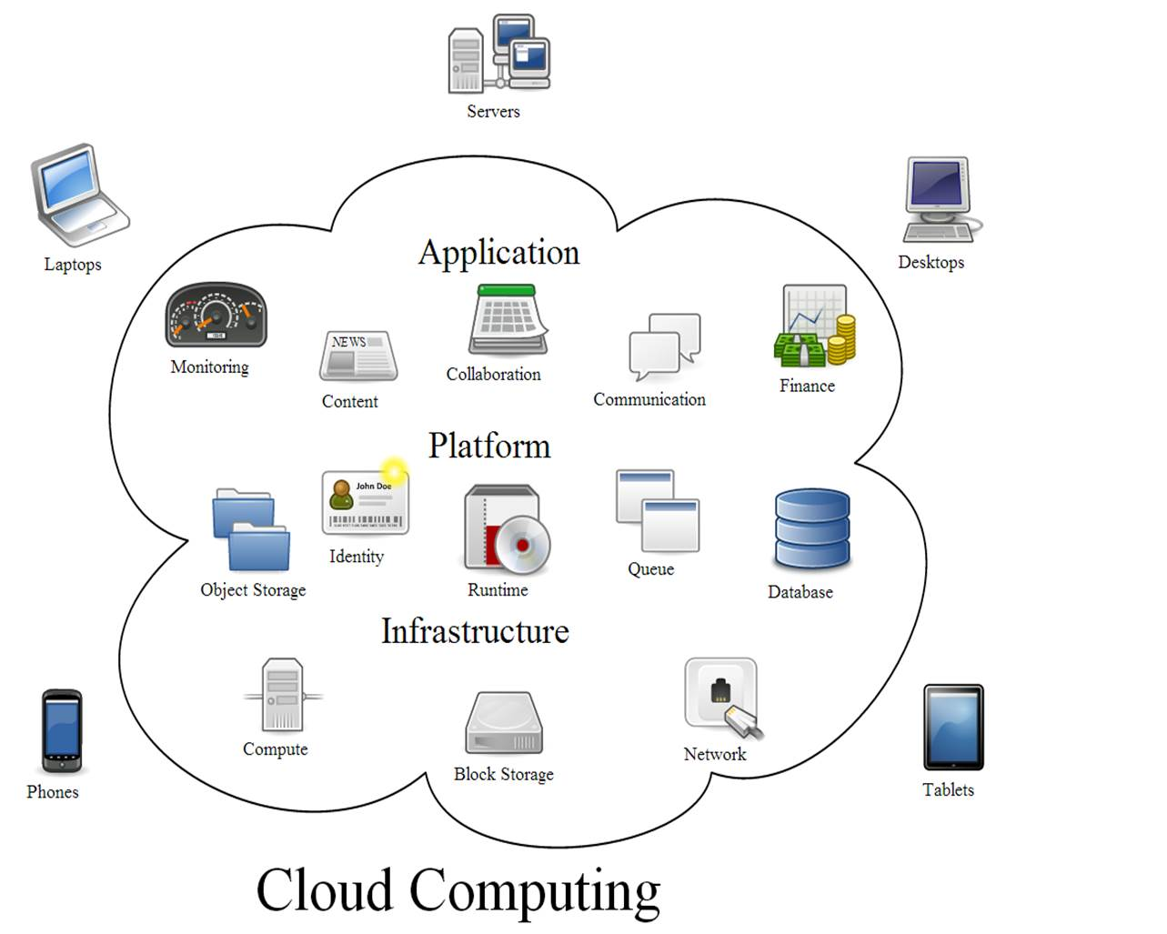
Trending
Rapid adoption of cloud computing platforms
Hybridization
Docker/Containerization of apps
Multi-vendor approach
Securing and Auditing services for cloud
Notes:
AWS, Azure, Google cloud platform, the benefit is you do not rely on IT to build a server and you can spin up servers on demand: Scalability (Traditionally building servers takes more money and time)
Hybrid cloud is a integration of on-premises (in-house) resources with cloud provider resources. This way organizations can take advantage of scalability of cloud computing while using their legacy software and hardware.
In cloud computing, the use of container allow developers to package applications into isolated environments that can be run and deploy on any computers or any cloud service providers such as AWS. This guarantees same environment settings on any plateform.
Enterprises can leverage the best of each cloud provider, and utilize the best platform in each area. This approach consist of using private and public cloud services, as each cloud provider offers different services.
Moving data and application to the cloud requires exrtra security due to risk of cyberattcks. Companies are going to take the screening proces more seriously.

Slide 7
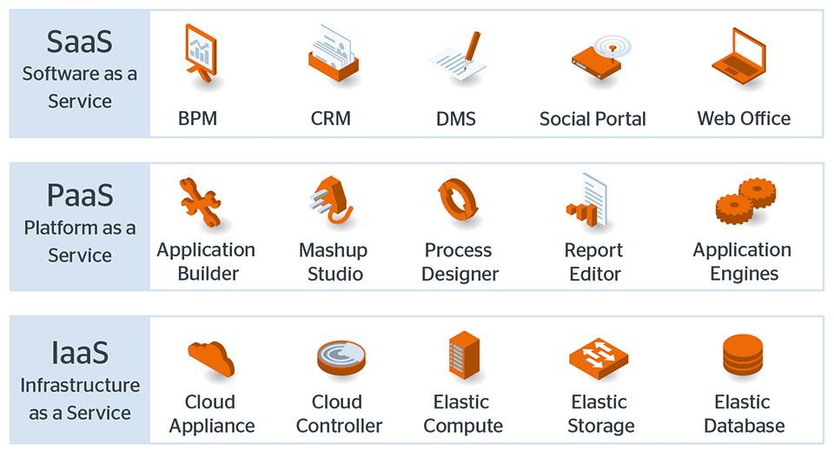
Current Application
Software-as-a-Service (SaaS)
Microsoft OfficeLive, DropBox, and CloudNumbers.
Platform-as-a-service (PaaS)
Google AppEngine, SalesForce VMforce, and Joyent Accelerator.
Infrastructure-as-a-service (IaaS)
Amazon EC2, Eucalyptus Community Cloud, and IBM Cloudburst.

Slide 8
Future of Cloud
Reduce in cost price as hardware advances
Machine learning
Full cloud adoption
Notes:
Machine learning is already a thing, but it is the next level of programming. The future is to make the process of data ingestion storage and training the models as simple as API calls.
In few years companies will be operating fully on the cloud as opposed to Hybridization model discussed earlier. Hardware will not be a problem.

Slide 9
Cloud Computing Risks
Unauthorized access to customer and business data.
Failures in Provider Security.
Availability and Reliability Issues.
Legal and Regulatory Issues.
Notes:
https://www.incapsula.com/blog/top-10-cloud-security-concerns.html
https://www.skyhighnetworks.com/cloud-security-blog/9-cloud-computing-security-risks-every-company-faces/
http://www.ists.dartmouth.edu/docs/HannaCloudComputingv2.pdf

Slide 10
Unauthorized access to customer and business data.
Loss or theft of intellectual property
21% of files uploaded to cloud-based file sharing services contain sensitive data including intellectual property.
Data Breaches
Overall data breaching was three times more likely to occur for businesses that utilize the cloud than those that don’t.
- Impact data Confidentiality
Notes:
Once you outsource a service to a third-party server, you have to worry about your staff and the vendor’s staff. More people have access to the data and systems that support the service, which means you have to extend trust to people you have never met.

Slide 11
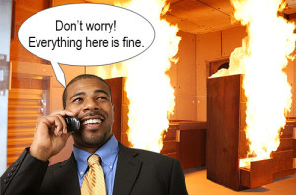
Failures in Provider Security.
Provider controls servers, network, etc.
Customer must trust provider’s security
Failures may violate CIA principles
When you host a service locally, the data and level of service is always in your control. You can confidently assure your clients that their systems and data are safe because they are always within your reach.
Notes:
When you depend on a cloud service for a business-critical task, then you put the trust of your business into the hands of other people and the quality of their work. Your reputation no longer depends on the integrity of only your business – now it also depends on the integrity of the vendor’s business. And that’s a cloud computing risk.

Slide 12
Availability and Reliability Issues.
Cloud servers may be less available than in-house IT
The cloud’s complexity increases the chance of failure
Shared resources may provide culnerabilities for attacks.
Internet/Network reliability
Although availability is a major focus, vendor could go down: Bad weather, DDoS attacks, system failure, etc.
Notes:
When you rely on a cloud service for a business-critical task, then you are putting the viability of your business in the hands of two services: the cloud vendor and your ISP.If your internet access goes down, then it will take your vendor’s cloud service with it. If you need the cloud service to process customer payments or access important data, too bad – you have to wait until the internet is back up.The client’s internet connection will also experience downtime. If you again assume 99% uptime and 1% downtime, then that’s as much as 20 business days that your client will not be able to reach the cloud service. (combining vendor downtime and internet reliability)

Slide 13
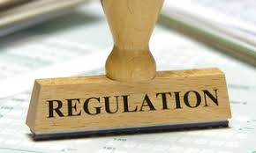
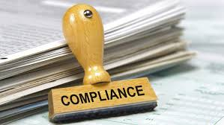
Legal and Regulatory Issues.
Laws and regulations may prevent certain cloud computing services
Vendor may not meet certification requirements
Geographical limitations
Industries that regulate data security
Regulations require protection of specific data
Companies also required to know:
Where the data resides
Who is allowed to access it
How it is protected
Reliance on an outsourced company for compliance
Notes:
The list includes healthcare, banking, government, and anyone that accepts credit cards – and the list of regulated industries continues to grow.
Many data security regulations are intended to protect a specific type of data. For example, HIPAA requires healthcare providers to protect patient data. PCI DSS requires anyone who accepts credit cards to protect cardholder data.
If a company outsources the processing or storage of data that it is required to protect, then it is relying on a cloud service provider to maintain their compliance.If the company does not have adequate legal protections, then it may be liable when there is a data breach at the cloud service that exposes the company’s data.you are transferring the responsibility of protecting the data to a third party, but you are still liable if that party fails to live up to the task (unless it is in writing you are not)

Slide 14
Cloud Computing Controls
Notes:
https://www.incapsula.com/blog/top-10-cloud-security-concerns.html
https://www.skyhighnetworks.com/cloud-security-blog/9-cloud-computing-security-risks-every-company-faces/
http://www.ists.dartmouth.edu/docs/HannaCloudComputingv2.pdf

Slide 15
Control for Unauthorized access to customer and business data.
Access controls
To ensure that only those who are authorized to access the data can do so.
Sensitive data must also be protected in storage and transfer. Encrypting the data can help to do this.
Change management controls
To ensure that data can’t be changed without proper authorization.

Slide 16
Control for Unauthorized access to customer and business data.
Backup and recovery controls.
Many security breaches come from problems in data backup. It is important to maintain physical and logical controls over data backup.
Data destruction controls
To ensure that when data is permanently deleted it is deleted from everywhere-----including all backup and redundant storage sites.

Slide 17
Control for Failures in Provider Security.
Secure the credentials
Create unique keys for each external service and restrict access following the principle of least privilege.
Create IAM roles to assign specific privileges, such as making API calls.

Slide 18
Control for Risk: Failures in Provider Security.
Improve visibility
Major cloud providers all offer some level of logging tools, so make sure to turn on security logging and monitoring to see unauthorized access attempts and other issues.

Slide 19
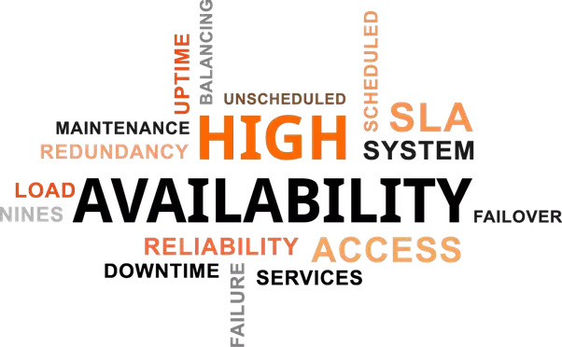
Controls for Availability and Reliability - Vendors
Redundancy
Load Balancing
Reliable Hardware
Internet Connection
Geographically Diversified Architecture

Slide 20
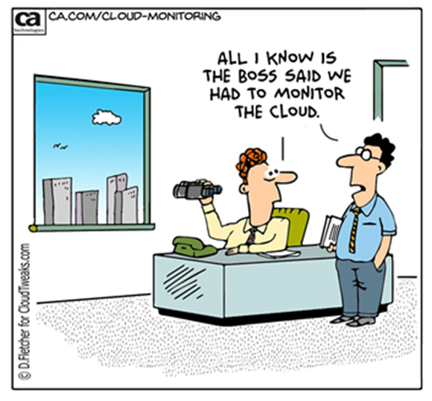
Controls for Availability and Reliability - Users
Disaster Recovery and BCPs
Understanding and Negotiating SLA
Auditing - Monitoring

Slide 21
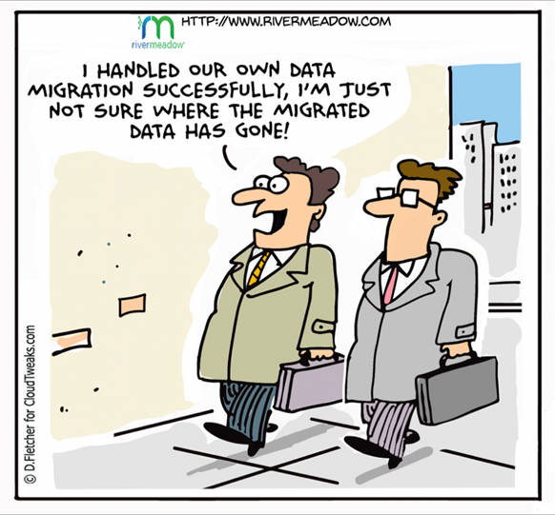
Controls for Legal and Regulatory Issues
Create current inventory of all legal and regulatory compliance obligations involving an organization’s data or infrastructure.
Identify the federal laws and mandatory standards that pertain to securing that sector’s privately owned information technology systems and data
Identify enforcement mechanisms for each of the above laws, regulations, and mandatory standards

Slide 22
Controls for Legal and Regulatory Issues
What are the characteristics of the information that will be stored on the cloud?
How sensitive is the information/what is the risk profile?
Consider what laws and regulations of general applicability apply to the information
Is the data subject to sector-specific regulations (e.g., health and medical personal information (HIPAA); non-public personal financial information (Gramm Bliley Act)
Is it imperative that the cloud provider keep the information confidential?
Would it be permissible for the cloud provider to aggregate data and use such data for its own purposes or to sell reports to others?

Slide 23
Controls for Legal and Regulatory Issues
Does the cloud provider’s product and contract adequately address the issues identified during due diligence review?
How, and by whom, will the provider handle, control, and process your organization’s information?
Where information is stored implicates what data protection legal regime may apply. Is data stored in the EU? Asia-Pacific Economic Cooperation countries? Canada? U.S. (state and federal laws potentially apply)?

Slide 24
Controls for Legal and Regulatory Issues
Does the cloud provider’s product and contract adequately address the information’s risk profile?
What are the cloud provider’s standard security guidelines, policies, and procedures?
Does the cloud provider use exclusively its own computing environment (including backup and storage capacity)?
Are the representations and warranties about data protection and regulatory compliance adequate?
Are the remedies adequate, including for data breaches, indemnification obligations, and service availability failure?

Slide 25
Prominent US & Global IT related Regulations
The Health Insurance Portability and Accountability Act (HIPAA)
PCI Data Security Standard The Cardholder Information Security Program (CISP)
The Graham-Leach-Bliley Act (GLBA)
European Union Data Protection Directive (EUDPD)
EU’s General Data Protection Regulation (GDPR)- 5/2018
Canada’s Personal Information Protection and Electronic Documents Act (PIPEDA)
The Federal Information Security Management Act The Federal Information Security Management Act of 2002 (FISMA)
Individual State Laws over Privacy & Security
California Senate Bill 1386
Massachusetts Standards

Slide 26
Reference
https://www.rightscale.com/learn/cloud-strategy/cloud-computing-trends
https://www.rightscale.com/blog/cloud-industry-insights/cloud-computing-trends-2017-state-cloud-survey
http://www.evo-uk.org/at-the-outset/cloud-computing/examples-of-current-cloud-applications/
https://medium.com/@sprocompany/what-is-the-future-of-cloud-computing-5-exciting-predictions-f96a047c0de8
http://www.futureofeverything.io/2017/04/10/future-of-cloud-computing/
https://www.rightscale.com/blog/cloud-industry-insights/cloud-computing-trends-2017-state-cloud-survey
http://www.evo-uk.org/at-the-outset/cloud-computing/examples-of-current-cloud-applications/
https://medium.com/@sprocompany/what-is-the-future-of-cloud-computing-5-exciting-predictions-f96a047c0de8
http://www.futureofeverything.io/2017/04/10/future-of-cloud-computing/
https://greatcloudmigration.wordpress.com/2014/03/03/the-history-of-cloud-computing/

Slide 27
Thank you

