Slide 1
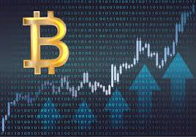
Emerging Technology: Bitcoin
MIS 5205-001 Group 5
Yingyan Wang, Mengting Li, Zhixin Wei,
Ping Sun, Oby Okereke

Slide 2
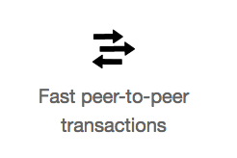
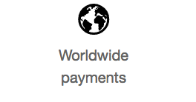
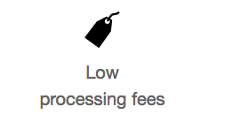
Background
Bitcoin is an innovative payment network and a new kind of money.
Notes:
Bitcoin uses peer-to-peer technology to operate with no central authority or banks; managing transactions and the issuing of bitcoins is carried out collectively by the network. Bitcoin is open-source; its design is public, nobody owns or controls Bitcoin and everyone can take part. Through many of its unique properties, Bitcoin allows exciting uses that could not be covered by any previous payment system.
https://bitcoin.org/en/

Slide 3
History
In 2007, Satoshi Nakamoto started working on the Bitcoin concept
In 2008, the Bitcoin project is registered on SourceForge.net, a collaborative community for the development and distribution of open source software
In 2010, the bitcoin market is established with the Bitcoin as a currency exchange. Florida programmer Laszlo Hanyecz offers to pay 10,000 Bitcoins for a pizza on the Bitcoin Forum marking the first, real-world transaction. In the same year, first mobile Bitcoin transaction occurs using bitcoin.
In 2015, Coinbase bitcoin exchange service launched the first regulated bitcoin exchange in 25 US states with plans to expand to thirty countries by the end of 2015
Notes:
https://futurism.com/images/the-entire-history-of-bitcoin-in-a-single-infographic/

Slide 4
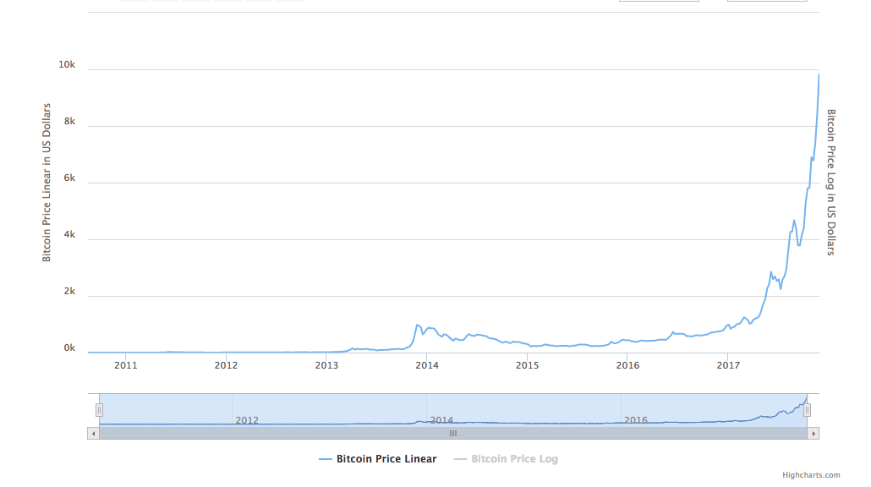
Bitcoin Price History Chart
Notes:
https://www.buybitcoinworldwide.com/price/ (chart)
What Determines Bitcoin's Price?
Bitcoin’s price is measured against fiat currency, such as American Dollars (BTCUSD), Chinese Yuan (BTCCNY) or Euro (BTCEUR). Bitcoin therefore appears superficially similar to any symbol traded on foreign exchange markets.
Unlike fiat currencies however, there is no official Bitcoin price; only various averages based on price feeds from global exchanges. Bitcoin Average and CoinDesk are two such indices reporting the average price. It’s normal for Bitcoin to trade on any single exchange at a price slightly different to the average.

Slide 5
Technology overview and applications
A new ‘peer-to-peer electronic cash system’ named Bitcoin, It was decentralised.
It redistributed the process of verifying the legitimacy of digital transactions from a central node to every single participant in the payment network, plugging the hole of misappropriations of transactions, and dividing authority.
Notes:
https://yourstory.com/2017/11/bitcoin-beginners-guide/
https://www.theguardian.com/technology/2017/sep/13/from-silk-road-to-atms-the-history-of-bitcoin
The “coins” are made by computers solving a set of complex maths problems. To spend them, users buy bitcoin and conduct transactions with them using exchanges such as San Francisco-based Coinbase. Rather than a central authority validating transactions, they are all recorded on a public ledger, called the blockchain.
Bitcoin don’t actually exist but are digital keys are stored in a digital wallet, which can also manage transactions. The wallet exists either in the cloud or on computers, and can be linked to bank accounts. If using an online wallet, investors must be sure they can trust the provider, because if hackers breach its server’s security measures the bitcoin could be stolen.
Typically, you can pay by bank transfer, mobile payments or with a Visa or Mastercard. There are also bitcoin ATMs, which allow for bitcoin to be exchanged for cash and vice versa, in London, Bristol, Brighton and Glasgow. A growing list of firms accept Bitcoin, including Tesla and Microsoft.

Slide 6
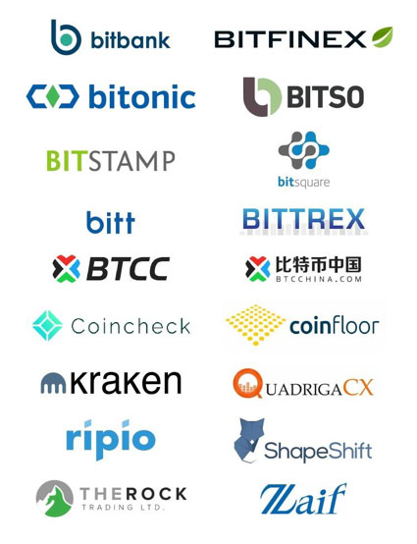
Trending
Now, bitcoin is moving towards the mainstream.
Bitcoin Exchange is becoming the preferred platform for serious investors.
In 2017, Bitcoin Exchange market evolved rapidly.
Notes:
https://www.coingecko.com/buzz/bitcoin-exchange-market-review-trends-of-future-development?locale=en

Slide 7
Trending
Major trends of bitcoin exchange market include:
Lowering and simplifying fee structures
More demand for margin trading
Transparency and integrity
Leadership in regulation and licensing
Mobile development
Great apps for trading on the go.
New mobile technologies - BTCC Mobi App: allows you to send bitcoin via text message and use a bitcoin debit card
Expanding beyond bitcoin
Altcoins and more
Bitcoin blockchain hard fork

Slide 8
Current and future application
Current Application utilizing Bitcoin Technologies
Decentralized exchanges
Distributed cloud storage
Supply chain communications and proof-of-provenance
Smart contracts
Digital voting
BitCoin - Future Application
Nasdaq plans to offer bitcoin futures
Digital rent processing
Business to Business payment service
Notes:
Bitcoin technologies will provide differentiated values to enterprises that adopt and conduct business with bitcoin. Enterprises that limit the purview of their bitcoin activity to current business models will be oblivious to new opportunities offered by bitcoin. Businesses must not miss out on the current and future transformative opportunities and possibilities offered by bitcoin.
ManageGo, a Brooklyn, New York-based rental platform that offers landlords and tenants payment and maintenance scheduling services through online and mobile applications, is now adding bitcoin to the list. Starting early next year, a tenant can pay in bitcoin through the mobile app.
Global credit card giant Visa has rolled out the first, pilot phase of its blockchain-based business-to-business payments service, B2B Connect.
First announced last year, Visa plans to use the platform to ease cross-border payments by facilitating direct payments between institutions, cutting out the middleman the industry currently relies on. The platform – developed with the assistance of blockchain startup Chain – is also designed to ensure secure, yet transparent payments between enterprises.
Digital rent processor ManageGo is integrating bitcoin, litecoin and ethereum into its payment app, and will soon allow tenants to use these cryptocurrencies to pay rent every month.

Slide 9
Key risks associated with the technology
Lack of Governance: username and password are the only way to access to the account.
Non Refundable: no refunds unless another transaction is started.
Using of illegal activities: money laundering, tax evasion, and illicit trade.
Fragile physical protection: only website or your own hard drive.
Limited number: only 21 million.

Slide 10
Key Controls
Keep your username and password in safe.
Audit and confirm every transaction you make.
Far away from illegal activities.
Back up your Bitcoin application and data.

Slide 11
Questions

Slide 12
Reference
https://bitcoin.org/en/
https://futurism.com/images/the-entire-history-of-bitcoin-in-a-single-infographic/
https://www.buybitcoinworldwide.com/price/
https://www.theguardian.com/technology/2017/sep/13/from-silk-road-to-atms-the-history-of-bitcoin
https://www.coingecko.com/buzz/bitcoin-exchange-market-review-trends-of-future-development?locale=en
https://arxiv.org/pdf/1706.00916.pdf
https://www.gartner.com/document/

