Slide 1
Self Driving Cars

Slide 2
A brief history .
Notes:
Work, or more like experiments, on autonomous cars have been underway since the 1920. Most of these experiments without complex computers are what you can imagine, mostly mechanical or radio controlled.
1925 a radio controlled car proceeded down 5th ave NY. it required an operator car to follow and send transmissions. Most of all these experiments after 1920 would require some sort of electronic controller installed under the roads.
if we skip ahead ...
next slide

Slide 3
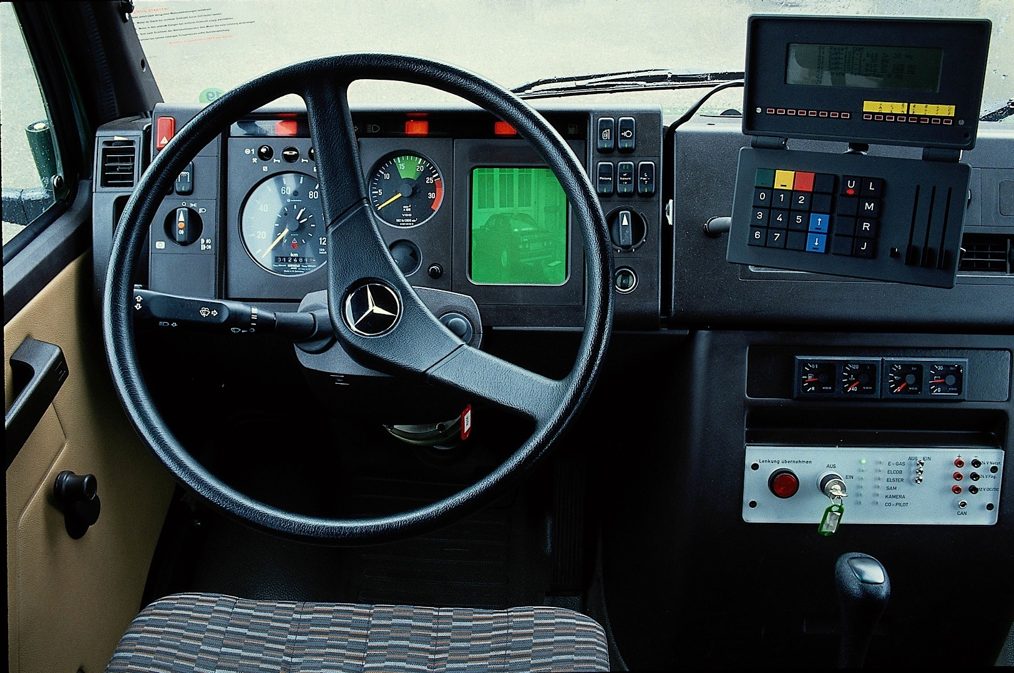
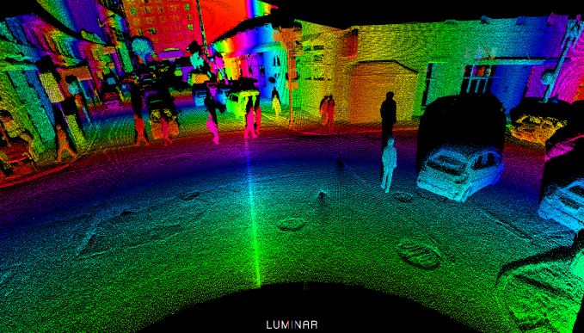
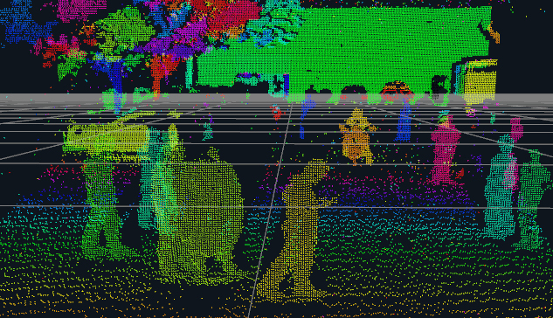
1980’s
DARPA uses LIDAR
Success = distances in thousands of feet.
Notes:
In 1980 Mercedes-Benz had success on streets without traffic at 39mph. A US DARPA funded project used lidar, computer vision and autonomous robotic control to direct a robotic vehicle at speeds of up to 19 miles per hour
but for these two success was measured in thousands of feet
next slide

Slide 4
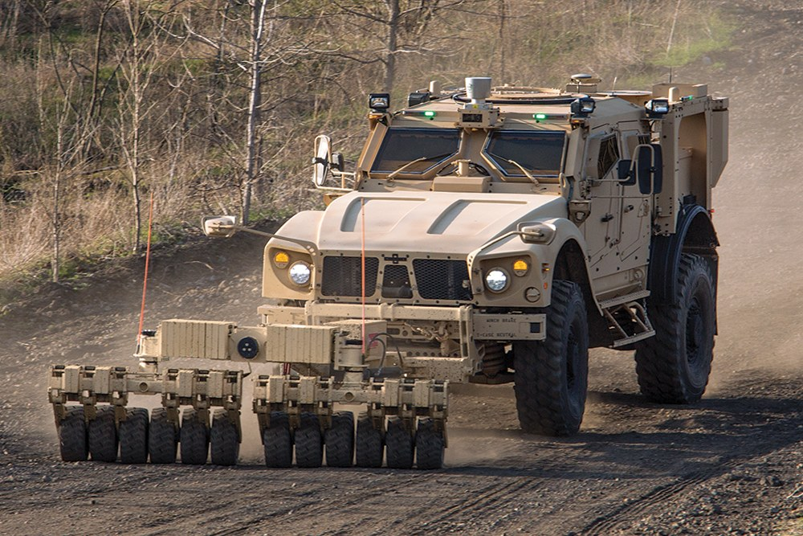
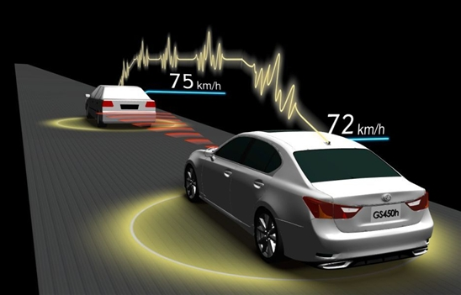
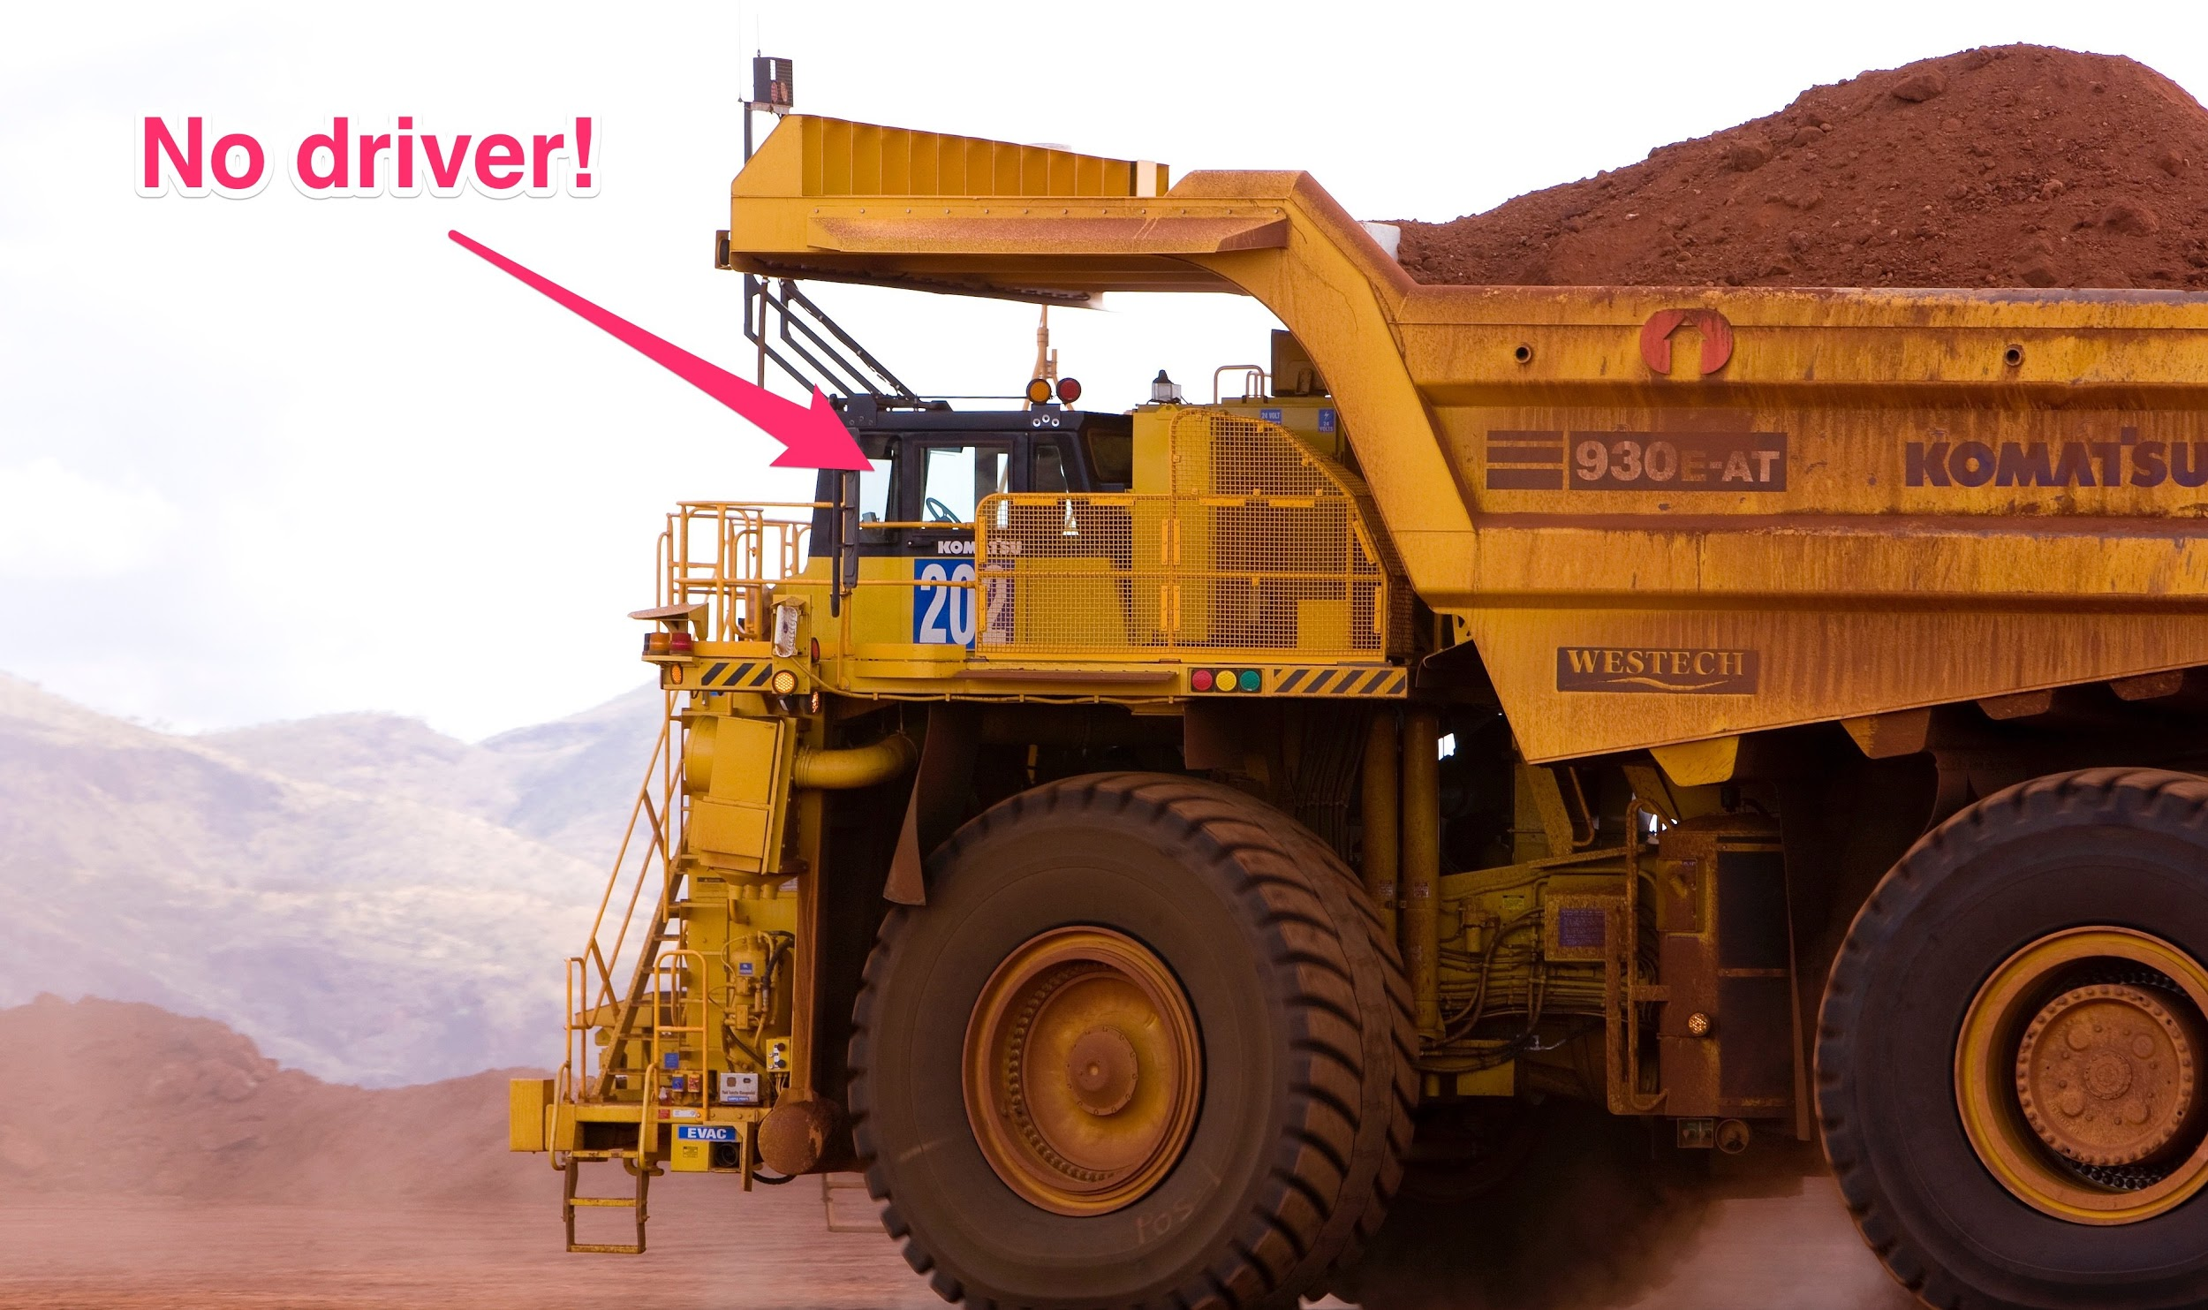
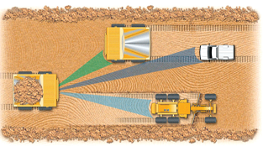
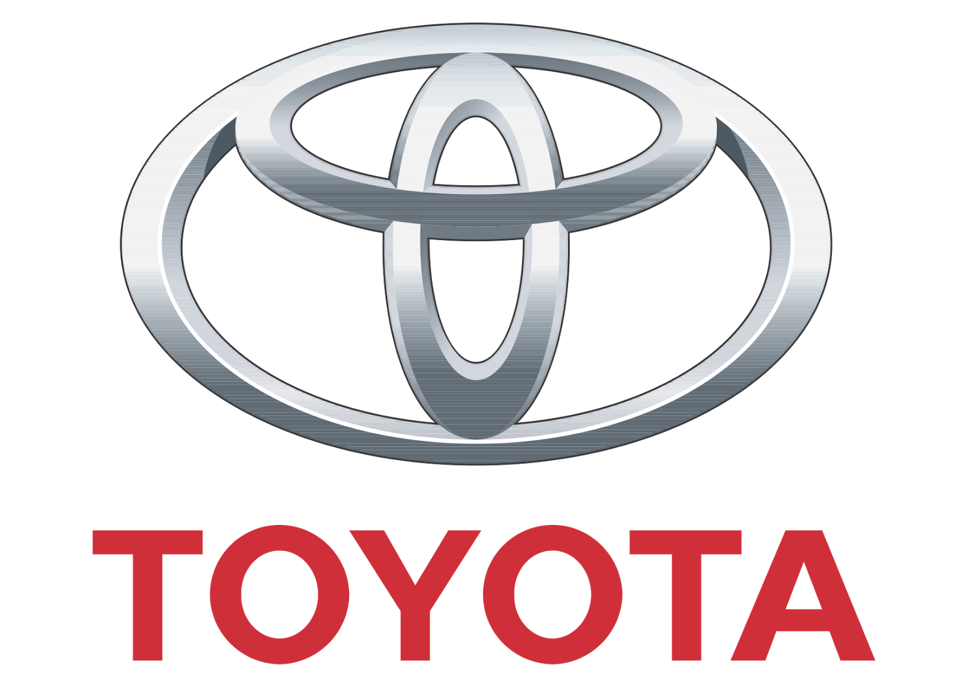
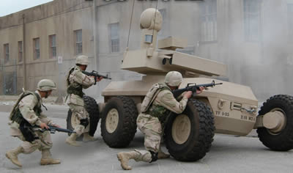
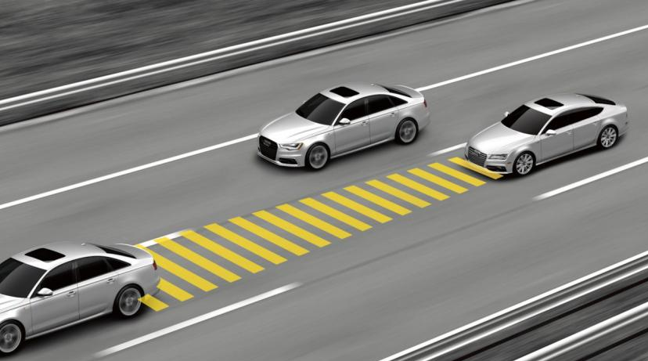
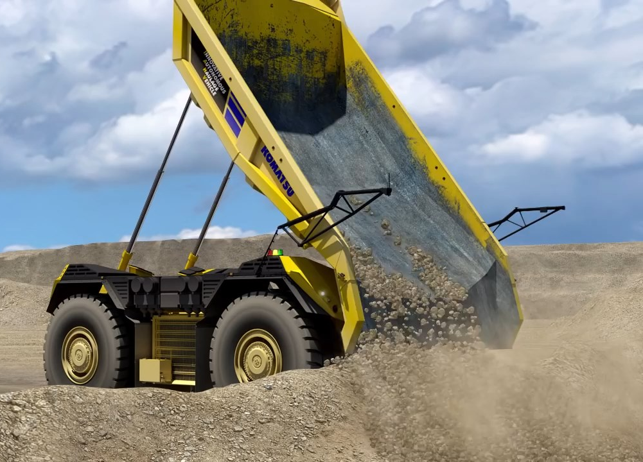
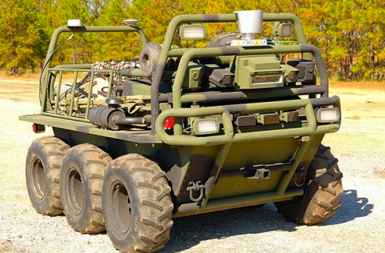
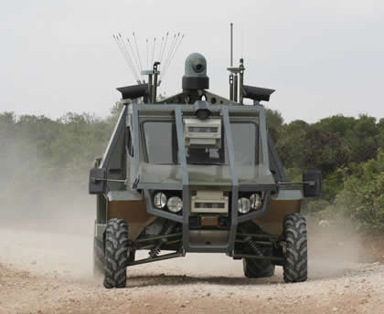
1990’s and early 00’s...
Notes:
late 90's early 00's
things came about like Toyota's adaptive cruise control
US gov military efforts are bolstered
autonomous vehicles found in mining
next slide

Slide 5
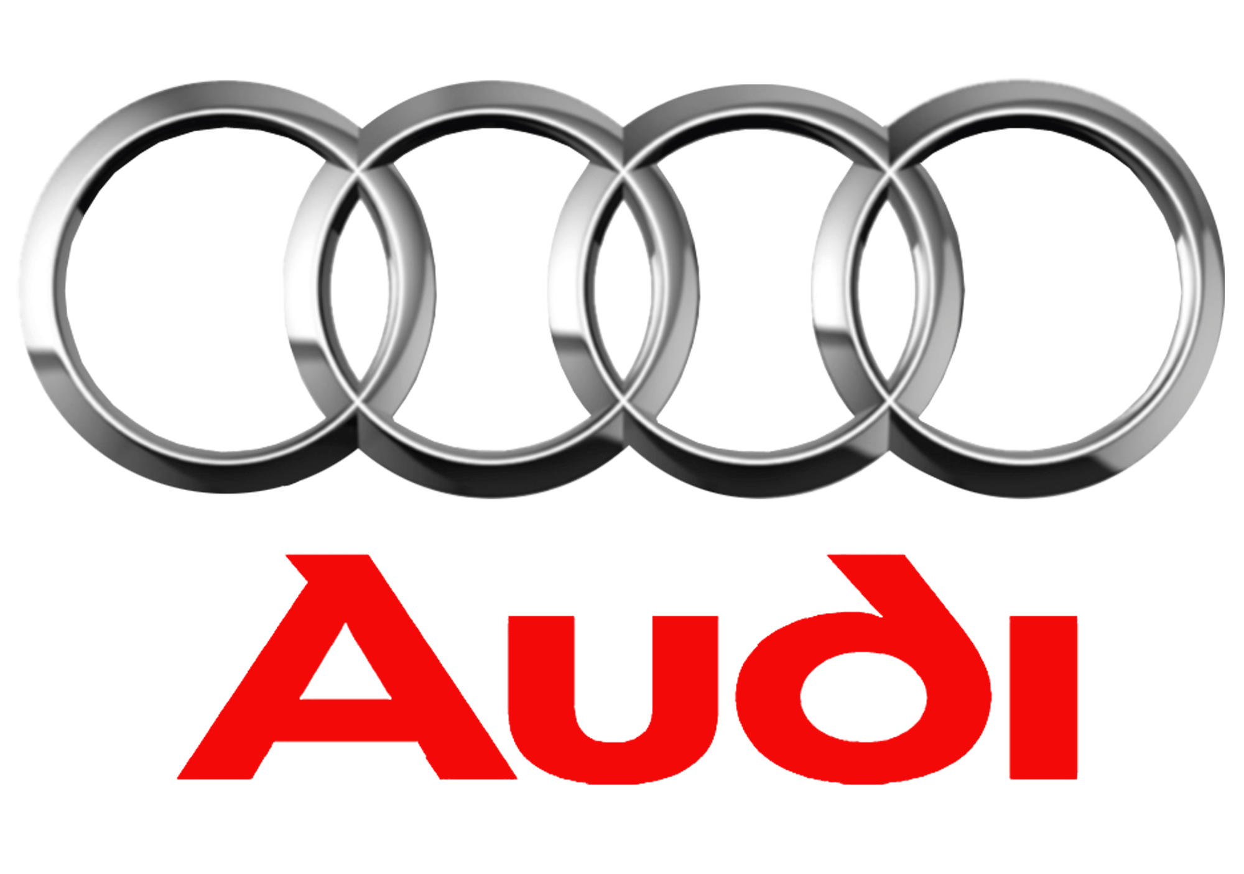
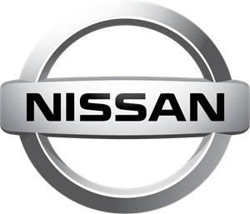
2010’s
Notes:
But in 2010 Major automotive manufactures began leap into the autonomous car game sinking millions into research. General Motors, Ford, Mercedes Benz, Volkswagen, Audi, Nissan, Toyota, BMW, and Volvo
are all seeking options in self driving cars. And there are all sorts of miles stones that these companies have passed. Each one has a success story... and probably more failure then they would like to admit.
The ultimate goal of all this corporate research is to create a level 5 automated system
next slide:

Slide 6
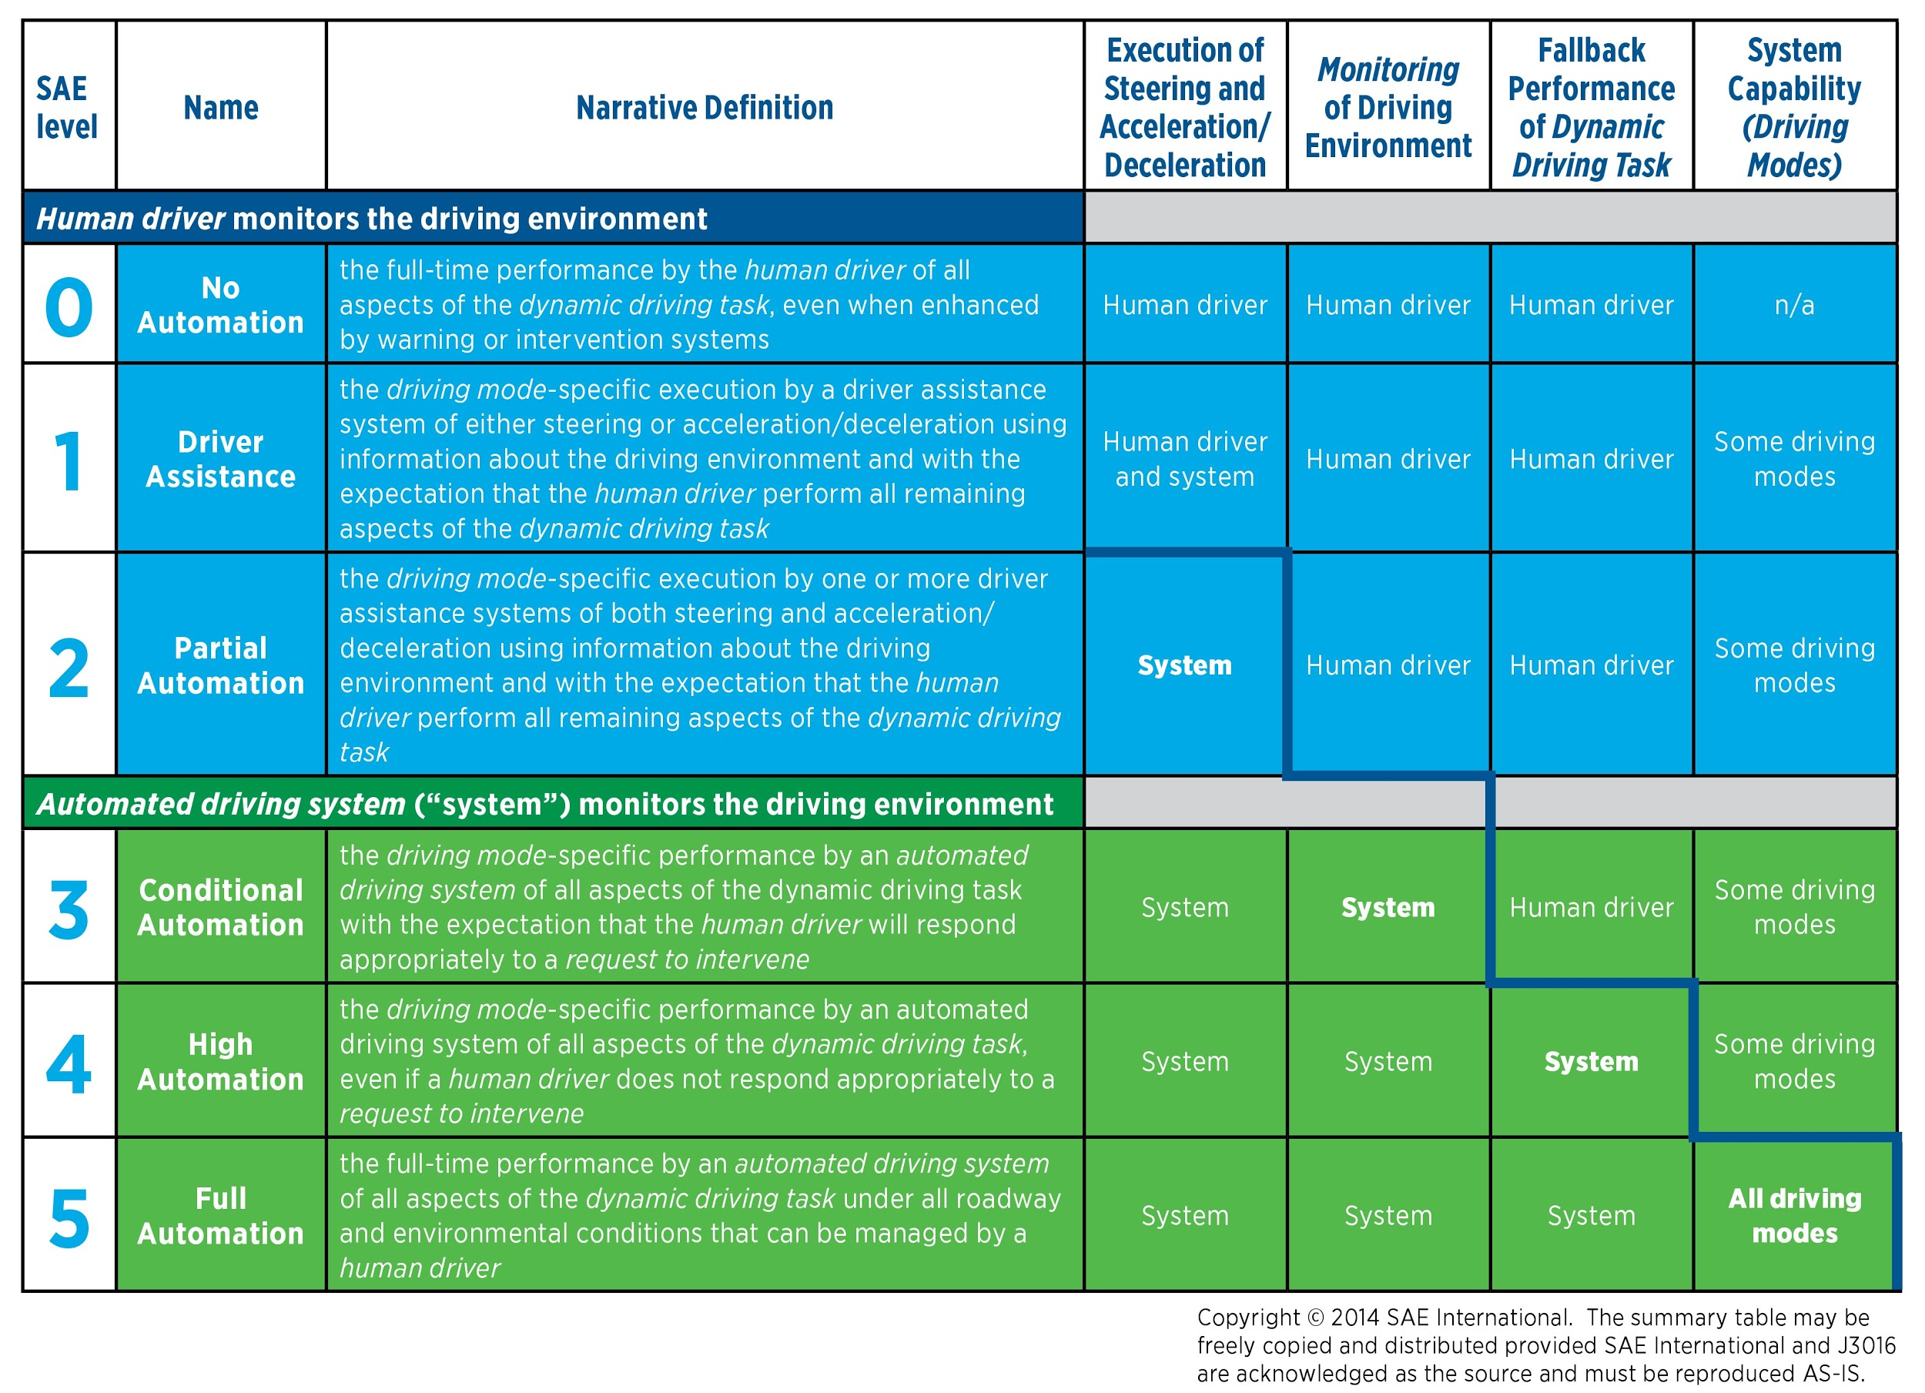
Level 0 automated systems but has no
sustained vehicle control
Level 1 hands on
Level 2 hands off
Level 3 eyes off
Level 4 mind off
Level 5 steering wheel optional
Notes:
Below you will see a table of SAE's list of levels of driving automation
I have a simple table to the left for more of a short hand version

Slide 7
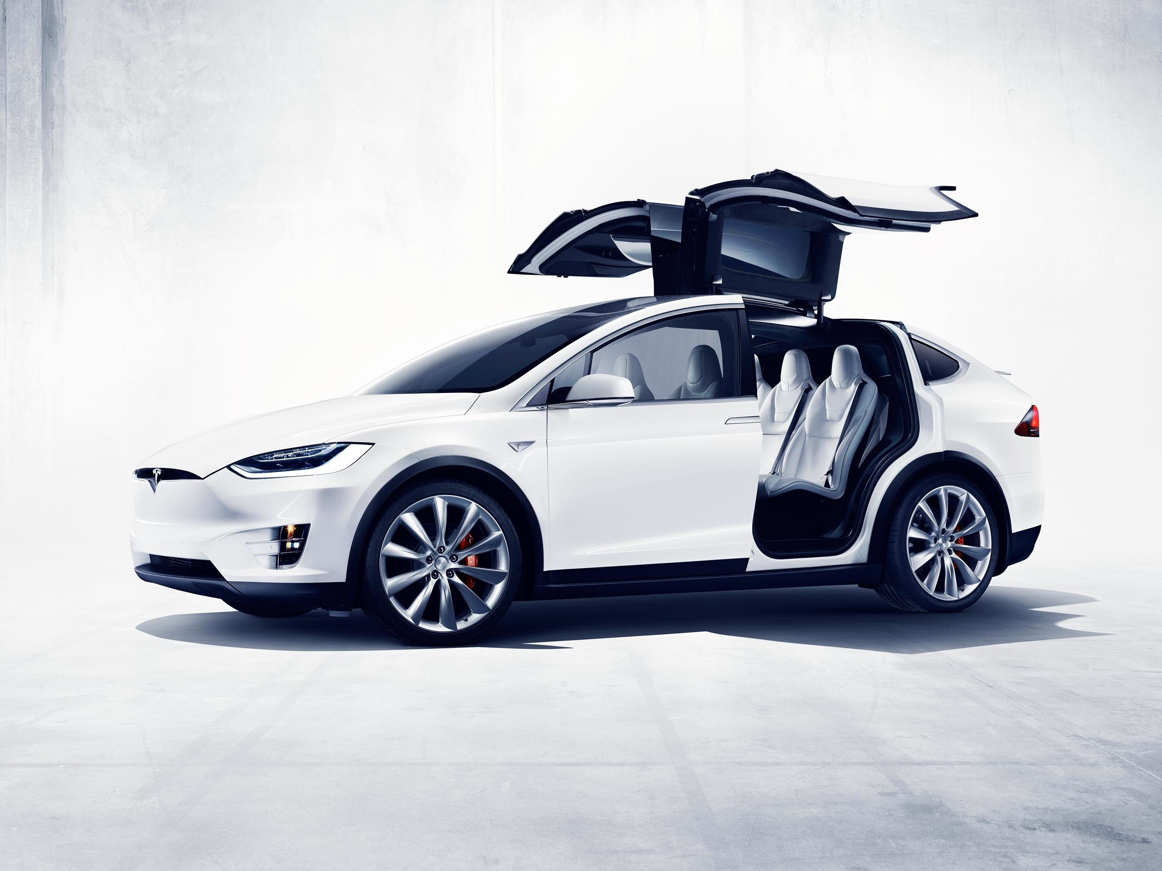
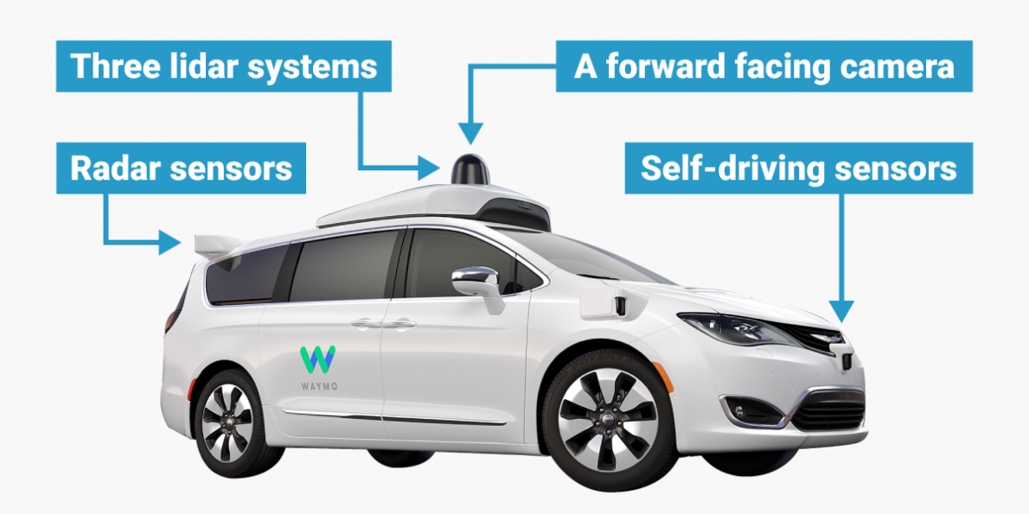
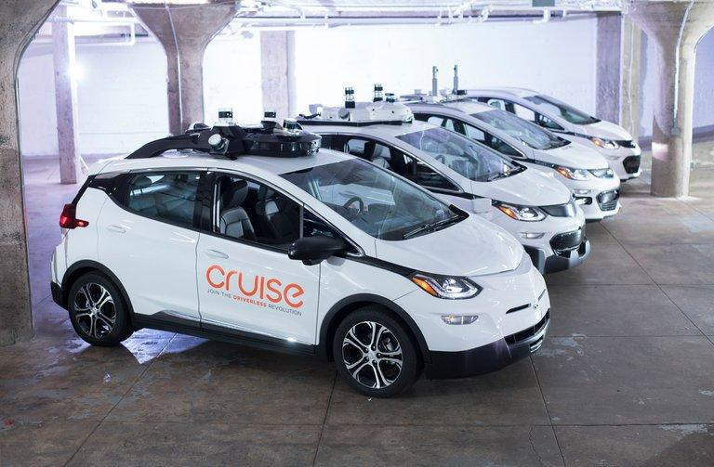
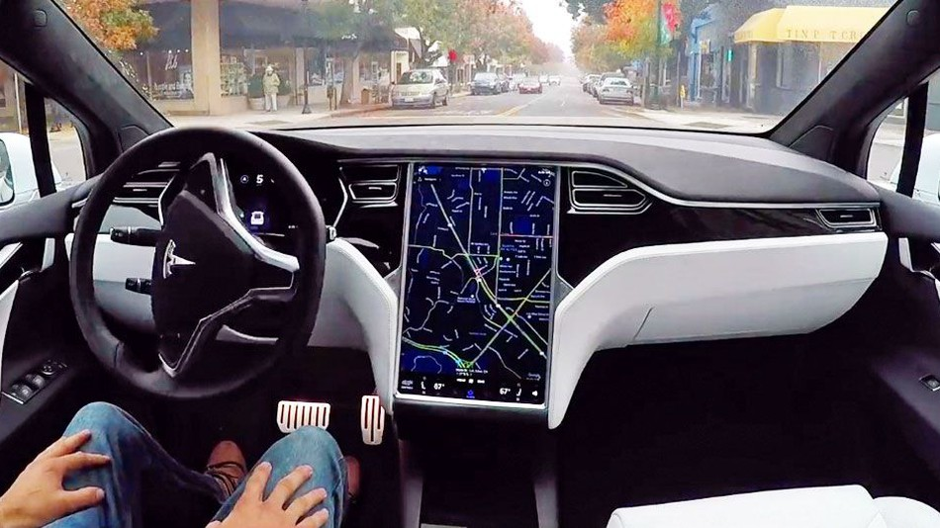
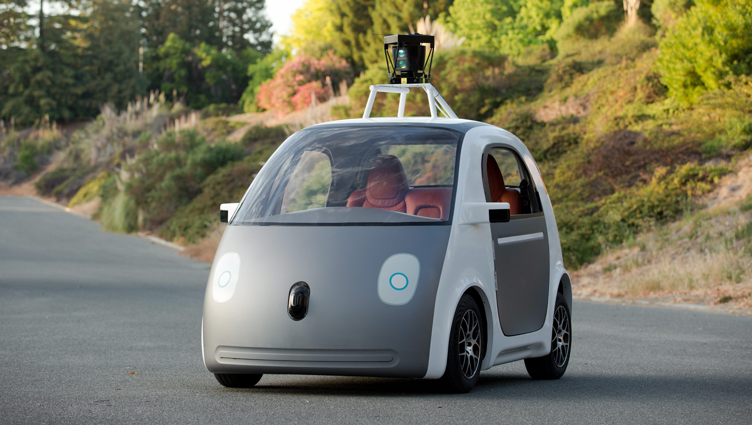
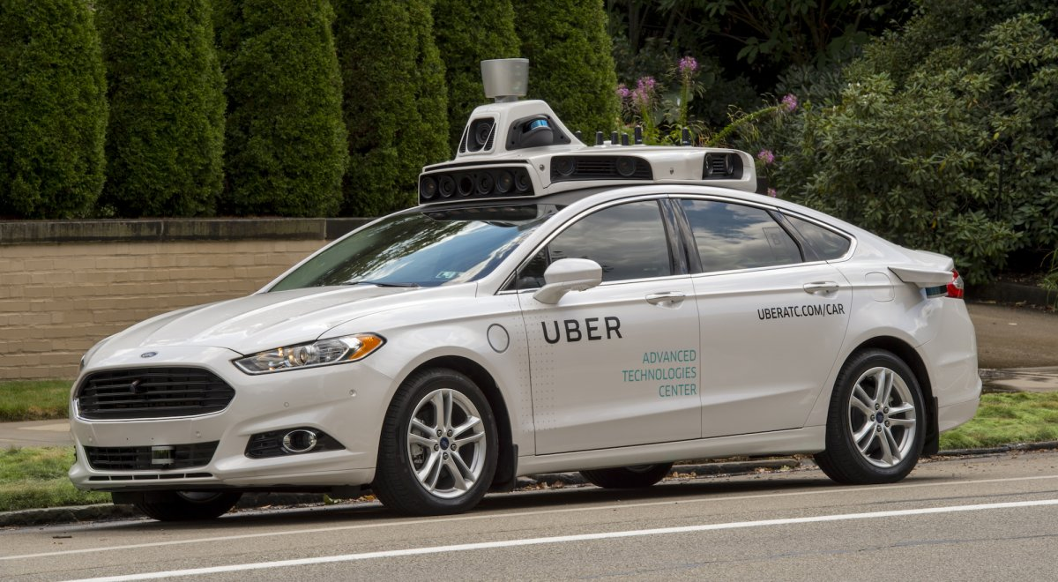
2015 & On...
And soon...
&
Notes:
Lets talk about some of the major players right now in making this Level 5 movie magic a reality. Tesla, Google with Waymo and GM are all the major contenders in bringing us self driving cars... and soon
GM says it will be "quarters not years"
Google already has self driving Waymo vans in Arizona with plans for expansion
Tesla, does not: 2015 Tesla Motors rolled out version 7 of their software in the U.S. that included Autopilot capabilities.
Tesla cars are built with full automation capabilities but are currently in "shadow mode" collecting data of millions and millions of miles.
perhaps there are taking a back seat due to a fatal car crash taking place in FL in 2016
And add to the list very soon is Uber ,and Lyft
next slide

Slide 8
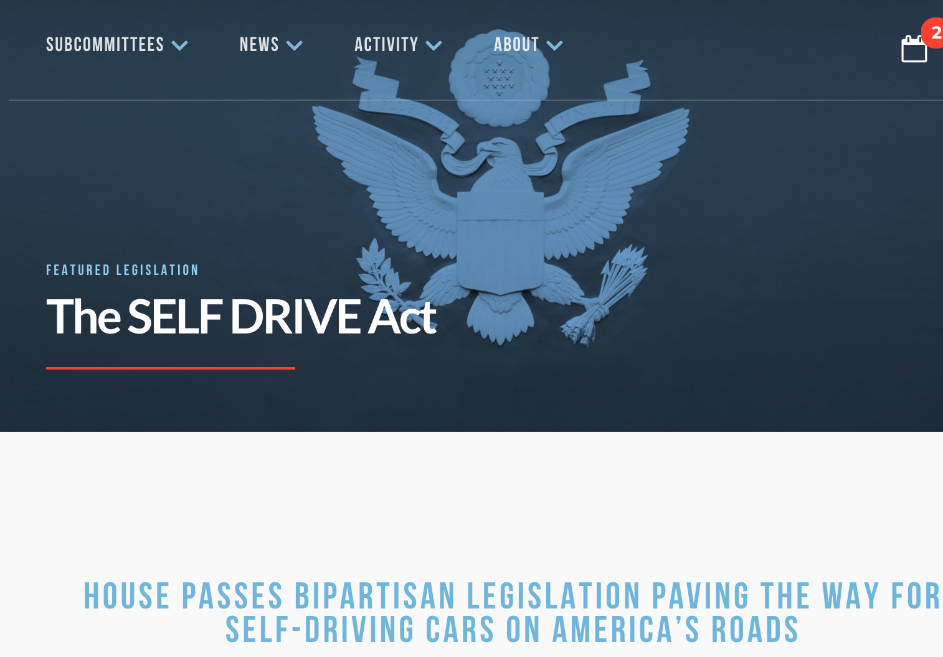
Early this year...
SELF DRIVE Act, H.R. 3388
https://energycommerce.house.gov/selfdrive/
Notes:
Earlier this year the federal government approved legislation placing autonomous vehicles on public roads more quickly by enabling an easement on vehicle safety regulations.
This bill prevents states from creating laws related to the design and operations of driverless cars
As you could imagine, there are are few groups apposed.
next slide

Slide 9
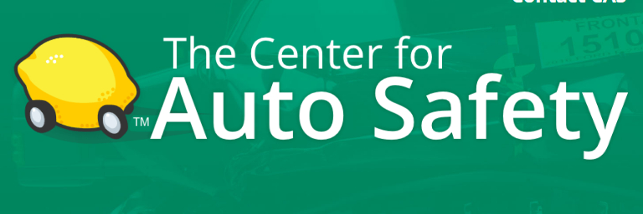
“This bill threatens the safety of the American public because it will give automakers a huge number of exemptions for safety standards for no reason at all but because they want their autonomous vehicles to be first on the lot.”
Joan Claybrook,
chairwoman of Advocates for Highway and Auto Safety
Notes:
“This bill threatens the safety of the American public because it will give automakers a huge number of exemptions for safety standards for no reason at all but because they want their autonomous vehicles to be first on the lot.”
the fight goes on:
Auto Safety organizations feel the plan is reckless
labor unions feel the threat for jobs
but the best question currently not answered:
next slide

Slide 10
If no one is technically driving a car, who is accountable for a crash?
Notes:
If no one is technically driving a car, per se, with whom does a state hold drivers accountable for a crash?

Slide 11
Key Risk
Malware Infection of the Car’s operating system, may corrupt data being processed by the car. (Integrity)
The scanners and sensors are adversly affected by unfavorable weather conditions (Tesla, July 2016) (Integrity)
Source Autonomous vehicles generate a lot of information, and such information are stored on a central server which are accessible by administrators. If security on such servers are not enforced, the passenger’s personal data maybe eroded, and their confidentiality compromised. (Confidentiality)

Slide 12
Key Risk contd .
In the future, government regulations may force the car companies to disclose passengers’ personal data for violations thereby eroding invading on passenger privacy. (Confidentiality)
These vehicles require simultaneous and mapping algorithms. This combines different sources of information to make a logical decision (originating address, destination address, etc) thus a single point of failure may render the car immobile/unavailable. (Confidentiality and Availability)
A growing concern also is who should be held accountable if / when there is an accident. This question the principle of accountability.
Also, it would be easier to hijack an autonomous vehicle from the base/server room, and remotely send the car into an accident, re-route the cars destination etc. ( the passenger might not be able to over-ride this as it's being done from the server/configuration room. (I’m not sure where this would fit under CIA)
Notes:
Work, or more like experiments, on autonomous cars have been underway since the 1920. Most of these experiments without complex computers are what you can imagine, mostly mechanical or radio controlled.
1925 a radio controlled car proceeded down 5th ave NY. it required an operator car to follow and send transmissions. Most of all these experiments after 1920 would require some sort of electronic controller installed under the roads.
if we skip ahead ...
next slide

Slide 13
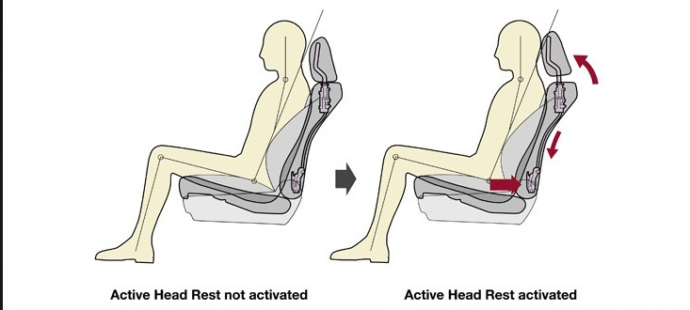
Controls
Legal, physical and logical
Legal
2013, 2016, 2017 Federal oversight and guidance, but not regulation
Variety of state laws
Feds trump states - no software oversight at state level
Data sharing for problem-solving
Physical
Active head restraints
Crash avoidance technology
Logical
Machine-learning algorithms (supervised and unsupervised)
Supervised - Learn from training material, keep increasing confidence in execution
Unsupervised - Make sense from available data without initial input
Notes:
Controls to address these risks are roughly divided into 3 large categories - legal, physical and logical.With legal controls, state and federal authorities aim to oversee the production and operation of self-driving cars to ensure public safety. 2013 saw the initial federal effort to define and identify aspects of self-driving technology. 2016 guidelines from DoT are not legally binding regulations, but they provide a framework for car designers to work within. This year, DoT released a more business-friendly version of the guidelines, enabling car makers to test vehicles without submitting safety assessments, so the control is slightly less effective, but this can be changed later. To simplify the regulatory framework as it develops, the guidelines ensure that only DoT can regulate the technology itself, while states would continue to provide licensing, registration, and other such certifications currently in their control. Finally, car makers will need to share crash data from the cars with the National Highway Traffic Safety Administration for crash investigation and to help prevent future incidents.
With physical controls, the structure of the car, the road, or other supporing infrastructure such as parking garages is designed to minimize danger to the car and the occupant as well as other cars and pedestrians. One notable example of such a control is the AHR system. This is a car seat designed to offset movement of the occupant, following a crash, to prevent head and neck injury from whiplash. This technology is already available in many cars, so it would be a simple addition to the autonomous cars. A suite of systems, collectively known as crash avoidance technology, would also be used since they already are in many ways today. One such valued feature is using the car’s auto-driving sensors to automatically stop when an obstruction appears in front of the vehicle.
Due to the non-human character of the intelligence, informal rules of the road can be more difficult for cars to understand, and a driver having a heart attack may not mean anything to a vehicle on manual steering, and this is where logical controls come into play. Algorithms have been crafted and are being refined to enable the cars to learn from a base dataset, stored in the vehicle’s main computer. The vehicle then uses data inputs to reduce error probability in a given action until a desired level is reached. In unsupervised, a car simply takes in the data and uses relationship modeling to locate patterns and concerns, giving the car commands to provide to navigation.
These are broad categories of algorithms. There are many sub-categories such as K-Means and regression, and they serve as templates as developers create the code that best reacts to the car’s environment, thus mitigating the risk of crashes.

Slide 14
Controls

Slide 15
Residual Risk
Notes:
Computers decisions will be based off software and will be taken literally
Ethical decisions will be distributed among drivers, pedestrians, cyclists and property
It will estimate a level of confidence around 98%

Slide 16
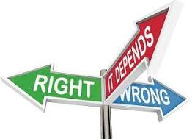
Ethical Residual Risk
Picture a bus full of school children approaching on your left, a cliff to the right, and a pedestrian jaywalking. What should the car do?
Situational Decisions:
Following the speed limit
Going around a bike
Yellow lights
Based off What?
Computers decisions will be based off software and will be taken literally
Ethical decisions will be distributed among drivers, pedestrians, cyclists and property
It will estimate a level of confidence around 98%
Notes:
Picture a bus full of school children approaching on your left, a cliff to the right, and a pedestrian jaywalking. What should the car do?
All self driving cars will be making ethical decisions. Asking computer to make an ethical decision is a dilemma in and of itself. It’s based off the algorithms that were designed in the software and will be taken literally. The decision will involve the value of the object and the value of it’s occupant. It will distribute the risk among drivers, pedestrians, cyclists and property as an ethical competent.
- Lawsuits in lower income areas settle for less money. This data will be in the software.
- Double lined roads while traveling behind a cyclist.
- Traveling the speed limit

Slide 17
Legal Residual Risk
Reasonable person legal standard comes into question.
A person has acted negligently if she has departed from the conduct expected of a reasonably prudent person acting under similar circumstances.
Regulators and litigators will thus be able to hold automated vehicles to superhuman safety standards and to subject them to intense scrutiny following the inevitable, if rare, crash
Developers will look to follow total compliance with the law but the law is not always ethical.
Where will the liability fall, the engineer (driver), car maker, or software?
Notes:
Ex: - The victim’s family sues the vehicle manufacturer on that ground, claiming that, although the car didn’t have time to brake, it could have swerved around the pedestrian, crossing the double yellow line and colliding with the empty driverless vehicle in the next lane. A reconstruction of the crash using data from the vehicle’s own sensors confirms this.

Slide 18
Notes:
In 2015, there were 32,166 fatalities, 1,715,000 injuries and 4,548,000 car crashes which involved property damage
Elon Musk threatened to start his own insurance comapny if they do not receive lower premiums for self driving cars however currently premiums are increaseing due to the cost of the cars.

