Slide 1
Big Data
Qiyu chen, Xiaomin Dong, Chenhui Lai, Xinteng Chen, Vittorio DiPentino

Slide 2
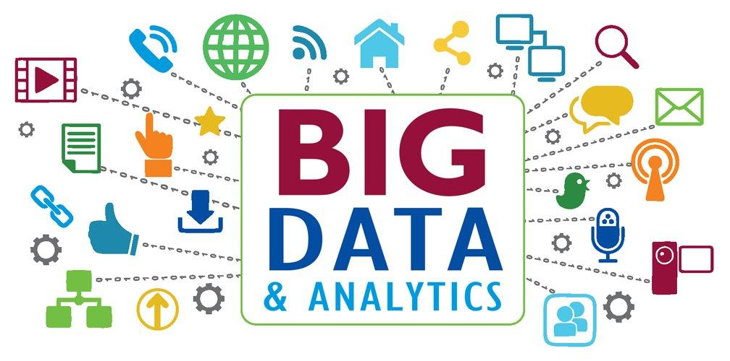
Background
Large data sets that may be analyzed computationally to reveal patterns especially relating to human behavior and interactions
Critical to understanding and meeting the needs of business operations and customers
Characteristics of big data
Volume - the quantity of generated and stored data
Variety - the type and nature of the data
Velocity - the speed at which the data is generated and processed to meet the demands and challenges that lie in the path of growth and development
Big data is considered to be any data set that cannot be managed due to the restrictions of the user
An attachment over the size of 25mb using Gmail can be considered big data due to the restriction

Slide 3
Key Risks
Security risk:
data can be stolen for criminals
E.g. Target debit card information leaking
Privacy risk:
personal data leaking will lead to expensive lawsuits and even prison
E.g. “God model” for uber
Bad Analytics:
bad analytics bring wrong results
E.g. Google’s Flu Trends project
Bad Data:
irrelevant, out of date, or erroneous data brings wrong insight.

Slide 4
Controls
Security Risk (External)
Antivirus & Firewall
Controlling incoming and outgoing network traffic.
Training
Improving security awareness
Privacy Risk (Internal)
Role-based Access Control
Assign different permissions to individuals based on their roles
Password policy
Setting up password based on certain format

Slide 5
Controls
Bad Analytics:
Test! Test! Retest before putting into use.
Bad Data:
Profile data
understanding the data (e.g. where the data comes from)
Control data
achieving data accuracy and ensuring the right users have access to the right information, which also means blocking access, as needed
Integrate data
integrating systems so that updates in one system automatically update the others, resulting in a single source of “truth” and making it easier for end users to access information
Monitor data
establishing policies, processes, and tools
Assign ownership, train users & commit to a data-quality process

Slide 6
Residual Risks
Data Redundancy
Unorganized, siloed data
Analysts need to spend a significant amount of time trying and using this data to mitigate their financial risk.
Information overload
Many business users spend time looking for valuable data from database, which can lead to missing the valid data.
Costs
Without careful budget spending will lead to cost increases.

