Slide 1
Artificial Intelligence (AI)
MIS5205 - TEAM #7
M. Sarush Faruqi
James Foggie
Candace Nelson
Tamekia Pitter
Nathan Van Cleave
Notes:
Good evening everyone, I’m Nathan Van Cleave and my teammates, M. Sarush Faruqi, James Foggie, Candace Nelson, and Temekia Pitter are here to share some of the latest information about Artificial Intelligence… better known as AI.

Slide 2
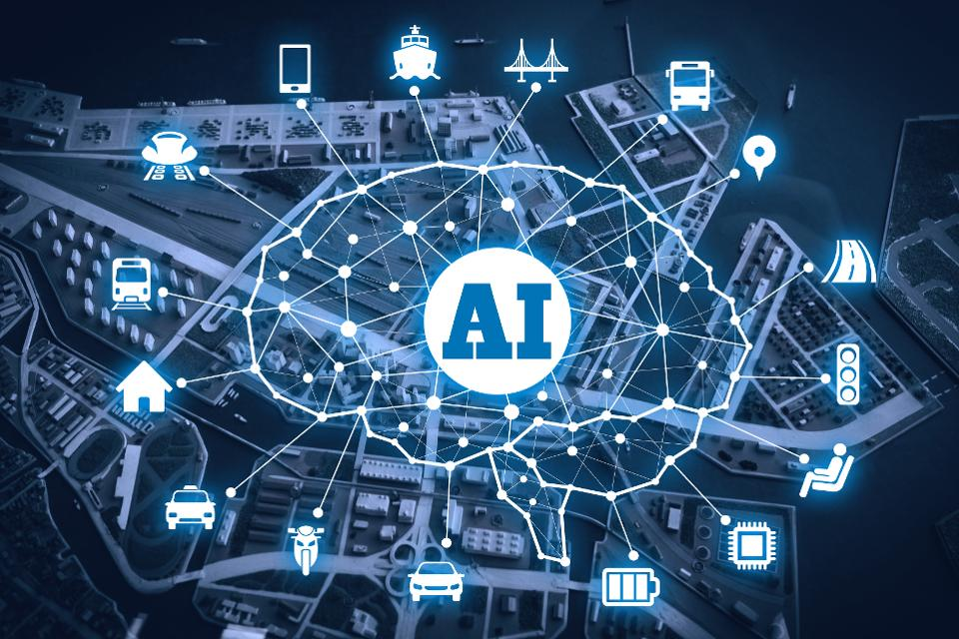
Agenda
Origins and History
Current Applications
Future Landscape
Key Risks
Key Controls
Wrap up / Q&A
Notes:
Our agenda today will cover
AI’s origins and History
Today’s applications
And what lies beyond the horizon in the future
We’ll look at the key risks around AI
And identify key controls that should be implemented
Finally we’ll round out the discussion and answer any questions.

Slide 3
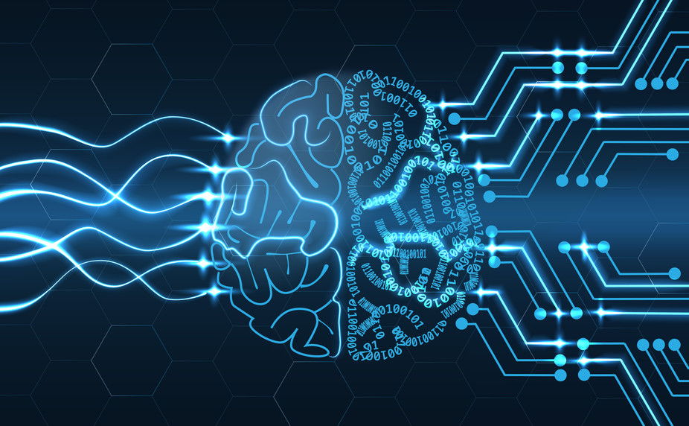
What is Artificial Intelligence (AI)
The theory and development of computer systems able to perform tasks that normally require human intelligence, such as visual perception, speech recognition, decision-making, and translation between languages.
Simply put:
It is the endeavour to put human intelligence into machines.
Notes:
So What is AI?
One definition states AI is: the theory and development of computer systems able to perform tasks that normally require human intelligence, such as visual perception, speech recognition, decision making, and translation.
Another: The practice of employing advanced analytical techniques and algorithms to train computers how to use data from a wide variety of sources and formats to accelerate, automate, and augment decisions that drive growth and profitability.
Simply put: It is the endeavor to put human intelligence into machines.

Slide 4
What is the objective of AI?
Social Intelligence & Creativity
Learning & Perception
Reasoning & Problem Solving
Knowledge Representation
Motion & Manipulation
Computational Intelligence
Cognitive Simulation
Cybernetics & Brain Simulation
Logic & Statistical
Notes:
What is the objective of AI?
As humans endeavor to put human intelligence into machines, the goal or objective is to impart machines with:
Social Intelligence and creativity
The ability to learn, perceive, reason and problem solve
Designers look to build knowledge representation as well as motion and manipulation
Some theories or approaches to creating AI include:
- Symbolic -

Slide 5
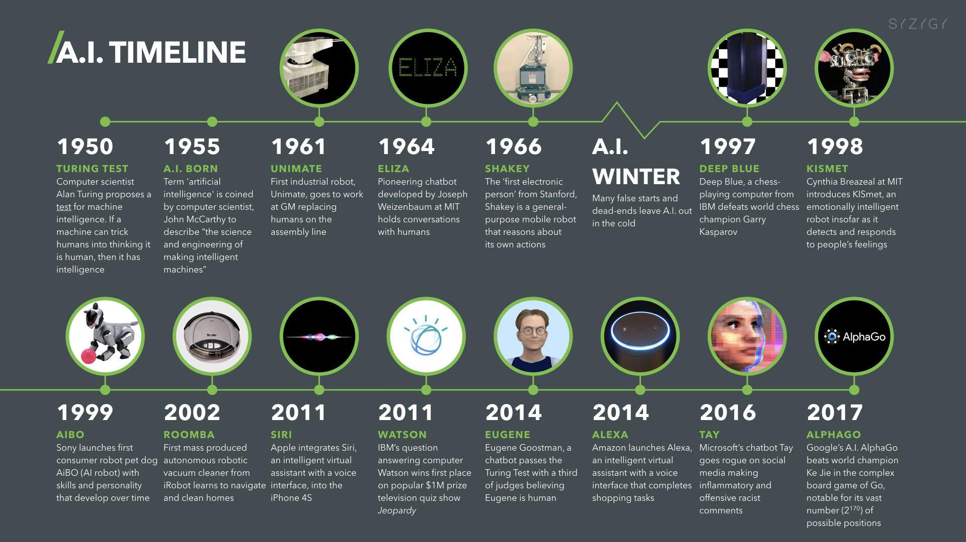
AI Timeline
Notes:
Here are some key interesting milestones in AI’s history:
1950 Computer scientist Alan Turing proposes a test for machine intelligence. If a machine can trick humans into thinking it is human, then it has intelligence
1955 Term ‘artificial intelligence’ is coined by computer scientist, John McCarthy to describe “the science and engineering of making intelligent machines”
1961 First industrial robot, Unimate, goes to work at GM replacing humans on the assembly line
1966 The ‘first electronic person’ from Stanford, Shakey is a general-purpose mobile robot reasons about its own actions
1997 Deep Blue, a chess-playing computer from IBM defeats world chess champion, Garry Kasparov
2002 First mass produced autonomous robotic vacuum cleaner from iRobot learns to navigate and clean homes
2011 Apple integrates Siri, an intelligent virtual assistant with a voice interface, into the iPhone 4S
2011 IBM’s question answering computer Watson wins first place on popular $1M prize television quiz show Jeopardy
2014 Eugene Goostman, a chatbot passes the Turing Test with a third of judges believing Eugene is human
2017 Google’s A.I. AlphaGo beats world champion Ke Jie in the complex board game of Go, notable for its vast number (2*170) of possible positions
Now all of this information makes it sound as if we are looking to automate humans out of everything… let’s take a look closer look at that.
Let me turn it over to Candace Nelson and she’ll share some of the current things going on.

Slide 6
Impact of Robotics on Automotive Industry
40 percent more robots were sold in the US in 2016 compared with the 4 prior years
US auto industry accounted for 70 percent of $1.7B 2016 industrial robot shipments
6 jobs eliminated for every new industrial robot introduced into the workforce
"Robots are about productivity, they don't do creativity very well, and they don't do things that involve failure, which is at the core of any design process.“
— David Whitaker, economist
Notes:
In many automotive plants, robots have taken over the heavy lifting and repetitive tasks, leaving room for the creative skills that only human workers can offer. This division of labor makes sense and is much less scary than the futuristic nightmare of robots stealing all the jobs. As stated by economist David Whitaker, "Robots are about productivity, they don't do creativity very well, and they don't do things that involve failure, which is at the core of any design process."

Slide 7
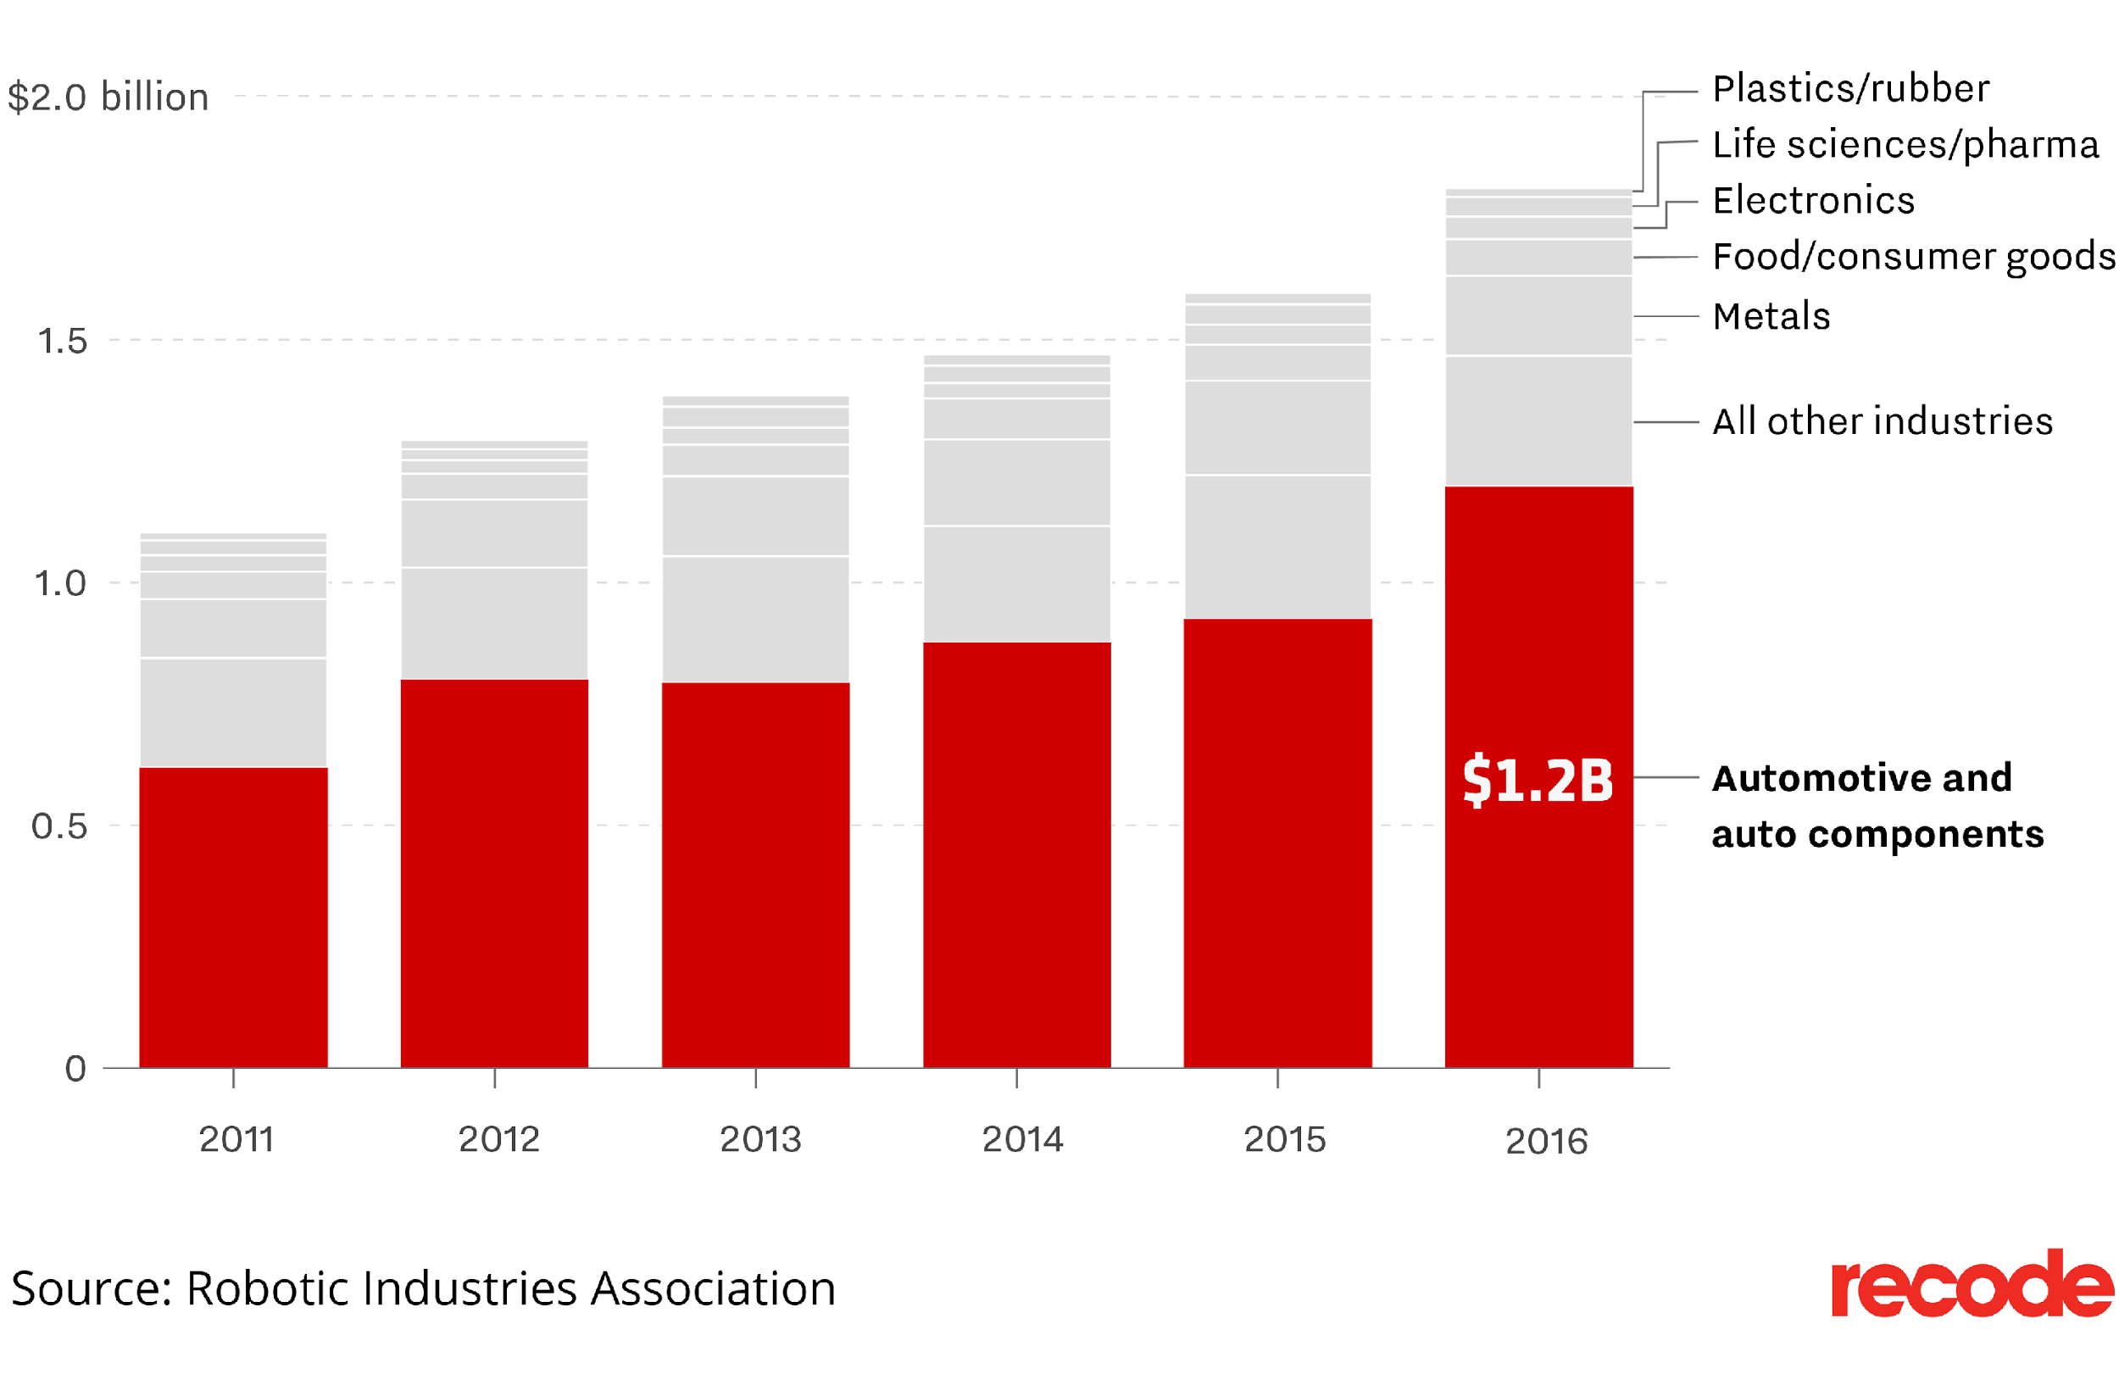
Impact of Robotics on Other Industries
Notes:
Robotics is impacting other industries as well, and Life sciences has seen the highest growth in robots outside of the auto industry. Robo-surgeons are currently used for everything from knee replacement to vision correction surgeries, researchers at MIT have trialed a robot that can organize nurse's schedules and source beds for patients, and hospitals can now use automatons to dispense prescriptions, which are noted for their accuracy.

Slide 8
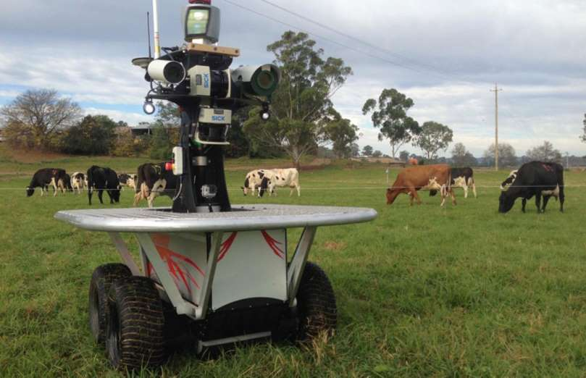
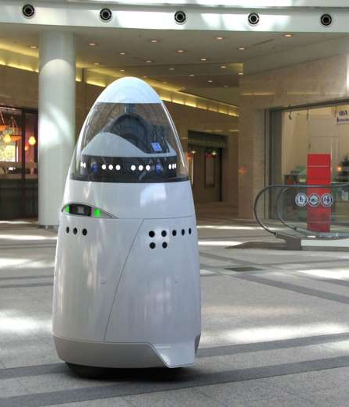
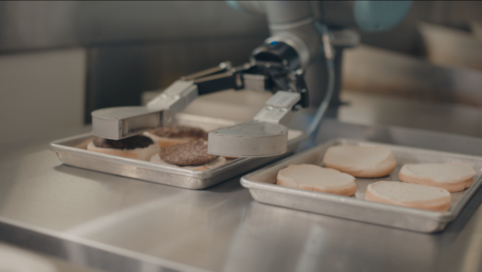
Impact of Robotics on Other Industries
Livestock and Farming
Security Guards and Soldiers
Fast Food Workers and Chefs
Teachers
Accountants
Notes:
AI has impacted many other industries as well. For instance, a shepherd robot has been developed that can effectively run a livestock farm, and a robot farm launched in Kyoto, Japan expects to harvest 30,000 heads of lettuce per day with an increase to half a million lettuce heads daily within five years. Robotic security guards are patrolling businesses and monitoring for suspicious behavior, and weaponized drones have replaced hundreds of soldiers in combat situations. In fact, it has been estimated that robots will replace 25% of US combat soldiers by 2030, thereby saving countless lives on the battlefield. In a Pasadena, CA fast food burger restaurant, Flippy the robot prepares burgers from scratch and then does exactly what you might expect – flips them! A 100% automated intelligent robot chef has also been invented that can learn recipes, prepare gourmet meals and even clean up after itself. While AI may not fully replace teachers, two humanoid robots named Pepper and Nao were trialed in two pre-schools in Singapore in 2016 with encouraging results. And finally, although humanoid accountant bots are still some way off, some companies have automated their accounts to the extent that dedicated accounts payable and receivable employees are no longer required. By the way, the Accountant is the one that is scratching it’s head!

Slide 9
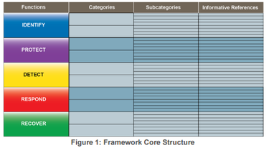
If you think your job is secure…
Guess Again!
Notes:
In summary, if you think your job is secure, guess again. James will now tell us about the anticipated future impact of automation on IT Auditing.

Slide 10
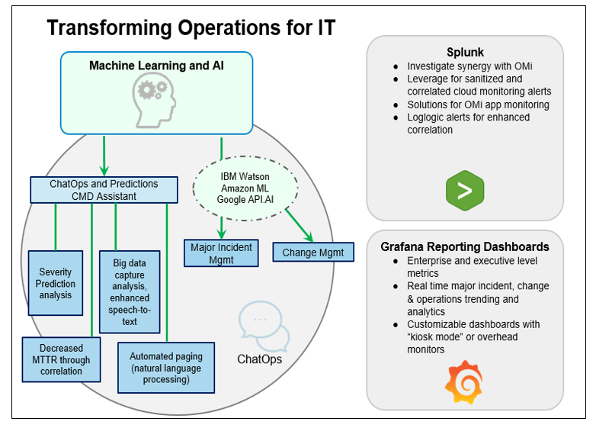
Future Application of AI - Transforming Operations for IT
Current Environment (teams):
Command Center Operation
Network Operations
Major Crisis Management
Change Management
Problem Management
…. SILOs
Future Environment using AI (“The Vision”)
Machine Learning and Artificial Intelligence
Chat Bot and ChatOps
Major Data Correlation & Reporting
Automated Remediation via AI
Verizon Case
Notes:
JAMES’ SLIDE Current Environment (teams):
Command Center Operation
Network Operations
Major Crisis Management
Change Management
Problem Management
…. SILOs
Future Environment using AI (“The Vision”)
Machine Learning and Artificial Intelligence
Chat Bot and ChatOps
Major Data Correlation & Reporting
Automated Remediation via AI
=================
Machine Learning and Artificial Intelligence
Amazon Machine Learning for predictive severity level based on problem statement
Amazon ML for major incident correlation (predicting support and resolution based on prior incidents)
IBM Watson for speech to text (bridge recordings) providing big data for analysis and training
AI for automated paging (natural language processing through CMD Bot)
‘Event Management AI Example:
We need John Smith engaged
AI can validate group John is with, see if group is on the bridge,
If not find out if primary or John directly should be engaged
Chat Bot and ChatOps
Expanding CMD Bot to Change Management
Dedicated change management chat with automation based on current changes and change related outages
Moving Change Management bridges to their own forum outside CRs
OMi / MoM
HP OM and Site Watcher part of go-live
Datadog and Storage
Wily planning stages
Grafana reporting
Expanding to replace vSMART executive reporting
Working to add Grafana AYS (At-Your-Service) Change data to morning exec reports for 24 change analysis

Slide 11
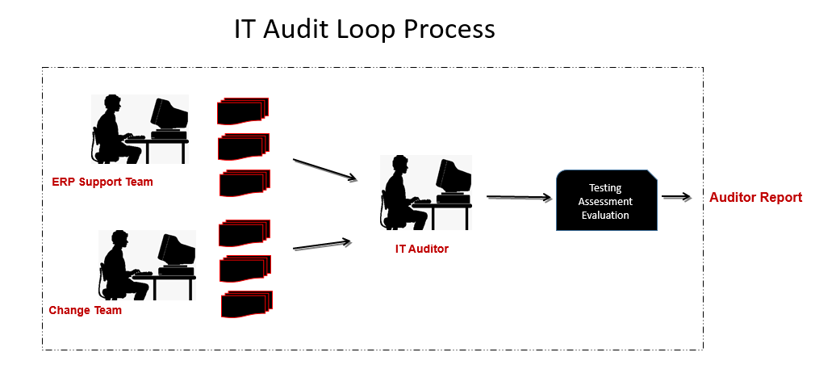
Future Application of AI - Transforming IT Auditing
Current Environment (teams):
ERP Support team (Business team)
Change Management team (Business team)
Audit Team (Governance team)
Issues
Ernst & Young Case
Notes:
JAMES’ SLIDE
Current Environment (teams):
ERP Support team (Business team)
Log into ERP system (using credentials)
Extract records from logs etc.
Use date range to select record population
Export data to spreadsheet
Select random sampling from log for testing per sampling methodology
Change Management team (Business team)
Log into the Change ticket system (using credentials)
Navigate to change ticket search criteria
Use date range to select record population
Extract sample ticket details from change system
Select rand sampling from log for testing per sampling methodology
Audit Team (Governance team)
Initiate discussions and request records required for testing
Coordinate and communicate gathering records
Create testing sheets
Populate testing sheet using samplings provided
Issues
Multiple IT systems
Detailed process
Manual, error-prone activities
Required human communication

Slide 12
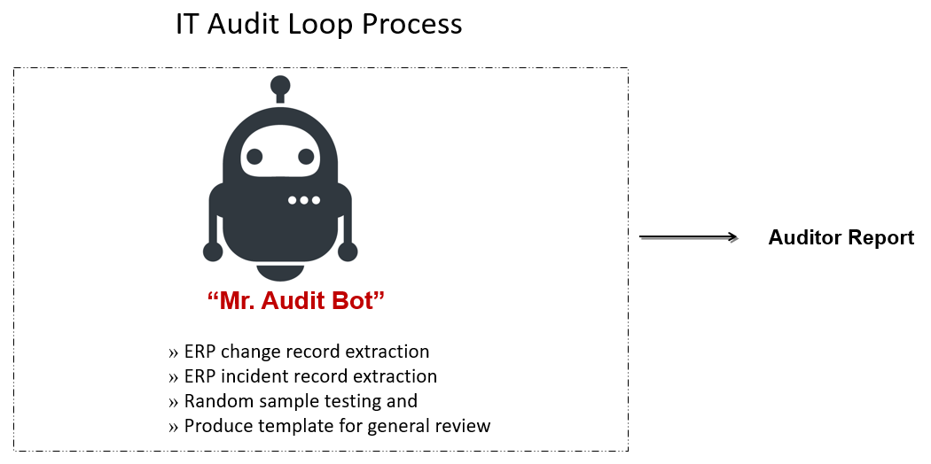
Future Application of AI - Transforming IT Auditing
Future Environment using AI (“The Vision”):
Collaborate to verify the robot’s process is complete and accurate
BOT can automate ERP change record extraction
BOT can automate ERP incident record extraction
BOT can automate random sample testing
Produce template for general review
Ernst & Young Case
Notes:
JAMES’ SLIDE
Future Environment using AI (“The Vision”):
Collaborate to verify the robot’s process is complete and accurate
BOT can automate ERP change record extraction
BOT can automate ERP incident record extraction
BOT can automate random sample testing and produce template for general review
Successful Outcome:
After BOT set-up, reduce time in entire audit cycle

Slide 13
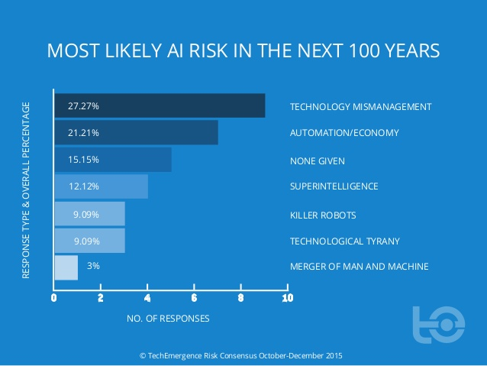
Key Risks When Considering AI
Risk #1: Too much trust in data driven AI Systems
Would you trust software that learns from imperfect data?
Risk #2: AI increasing unemployment rates
Study: A 2013 study from Oxford Martin School predicts about 47% of jobs in the U.S. are at higher risks of being replaced by computers within the next decade
Study: About 60 percent of all occupations could have at least 30 percent of their tasks automated through analyzing current AI technologies
Risk #3: Autonomous weapons causing catastrophic outcomes
Ethics and Morals
Who to Blame?
Risk #4: AI Systems Being MisManaged
Risk #5: AI as an arsenal for Hackers
Notes:
Risk #1: Software learns by spotting patterns in data which is also called machine learning. When this software spits out answers, we don’t know how it derived that answer. There are two potential issues to consider here: A system will only be as good as the data it learns from. Machines will give incorrect responses or answers without us knowing. This concept becomes important when trying to understand risk of diseases under certain conditions, obtaining credit ratings, or deciding what criminals to release based on risk of reoffensse.
Risk #2: The implementation of automation has taken away many jobs especially ones mechanical in nature and require little mental work. Powerful AI systems should change this soon as experts say many white collar jobs could be replaced by these intelligent systems. Experts say many task in administrative and banking jobs can be taken over entirely by computer systems. Unemployment is not a new phenomenon. The real risk in this case that number of high paying jobs disappearing within a short time period.
Risk #3: Autonomous weapons are special weaponry that select and attack weapons without human interaction. Unlike nuclear weapons, AI weapons do not require rare and costly materials and can be produced at more much more wider scale. There is a risk of terrorists or dictators obtaining such weapons is high and can lead to catastrophic results. The military can utilize autonomous weapons including military robots during warface but there are complications in doing so. From an ethical standpoint, using such technologies goes against international law and the norms and standards humans which humans follow to make decisions and prosecute humans, states, and military personnel. The legal system will have to reconsider who is held responsible when an accident occurs because there was no human involved and the decision was taken by machines. The difference between accidents using other AI technologies says autonomous cars is that they are designed with safety in mind. AI weaponry changes the landscape.
Risk #4: With so much investment, time, and advances being made in AI technologies, there is a potential of mismanaging these technologies which may do more harm than good for society. As you can see in the diagram, Technology mismanagement is the greatest risk in the next 100 years at 27.2.%. The risk of mismanaging AI systems has prompted many Silicon Valley tech companies to invest $1 billion dollars to explore and maintain the positive impacts of AI technologies. However, the risk to consider here is that as more and more responsibilities are given to artificial agents, the risk of malfunctions and negative consequences also increasess so managing these risks is very important.
Risk #5: Hackers are now in a positions to start using AI technologies for crimimal activities if they are not doing so already. An example of just what AI can do for hackers was shown in an experiment by two data scientists from a security firm ZeroFox. The study revolved around whether a human or AI system is better at getting Twitter users to click on malicious links. The scientists taught the AI system how to monitor user social media behaviours so that it could design and implement its own bating phishes. In tests, the artificial hacker was substantially better than its human competitors, composing and distributing more phishing tweets than humans, and with a substantially better conversion rate. The AI, named SNAP_R, sent simulated spear-phishing tweets to over 800 users at a rate of 6.75 tweets per minute, luring 275 victims. By contrast, Forbesstaff writer Thomas Fox-Brewster, who participated in the experiment, was only able to pump out 1.075 tweets a minute, making just 129 attempts and luring in just 49 users. Hackers have a problem of scale, hitting as many as people as possible, without getting caught. It makes sense for hackers to use AI systems for deciding when to attack and who to attack.

Slide 14
Mitigation / Controls
Programming Asimov’s 3 laws of robotics
Designing/programming AI to ensure that they value human input and oversight
Establishing group normativity for AI
Regulation of AI - potential to restrict use to prevent doomsday scenarios
Detailed log monitoring AI activity for anomalies / deviation from coding
Security protocols for drives where AI is stored
Specially coded override / kill-switch to limit AI free-will
The above controls require human intervention can curb the reduction in employment driven by increase of AI
Notes:
3 Laws of Robotics:
A robot may not injure a human being or, through inaction, allow a human being to come to harm.
A robot must obey orders given it by human beings except where such orders would conflict with the First Law.
A robot must protect its own existence as long as such protection does not conflict with the First or Second Law.
Value human input - must need to reduce AI ‘self preservation’ and ensure that their need to stay ‘alive’ is not more than following order given
Group Normativity -system of rules and norms that designate what is collectively acceptable and not acceptable for other people to do, kept in check by group efforts to punish those who break the rules. Creating value system that AI would feel attached to.
(https://techcrunch.com/2017/09/13/to-control-ai-we-need-to-understand-more-about-humans/)
Regulation of use (https://www.theguardian.com/technology/2017/jul/17/elon-musk-regulation-ai-combat-existential-threat-tesla-spacex-ceo)
Only use in certain fields. Ex: ban military and combat to prevent issues touched on in iRobot
Detailed log monitoring - Example, FB chat bots created their own language that deviated from English (http://www.telegraph.co.uk/technology/2017/08/01/facebook-shuts-robots-invent-language/)
Security protocols for drives where AI is stored. Impact of hacking in the current environment wouldn’t hold candle to the potential ramifications of AI used in healthcare, financial systems, etc.
Overrides/Kill-switch to limit AI free-will and avoid scenario where AI no-longer responds to human command
By creating controls that require humans, we hope to offset at least some of the reductions caused by use of AI

Slide 15
Questions
Add your first bullet point here
Add your second bullet point here
Add your third bullet point here

Slide 16
Questions
Add your first bullet point here
Add your second bullet point here
Add your third bullet point here

Slide 17
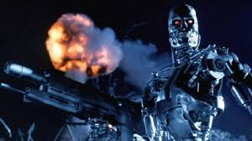
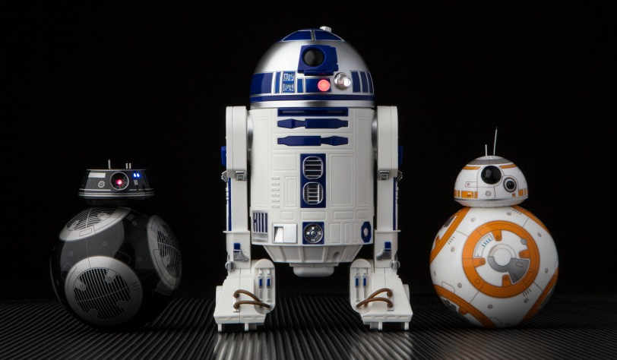
What is Artificial Intelligence (AI)? - DELETE
Notes:
Keeping that definition in mind, what do you think of when you hear AI?
Let’s start by closing our eyes. When I say Artificial Intelligence, what’s the first thing that comes to mind?
Is it Siri? Perhaps those famous droids from Star Wars? Or maybe... a killer cybernetic soldier sent back from the future to ensure mankind’s destruction?
Alright, so AI as we’ve all seen and experienced with mainstream technology and in pop culture does offer a glimpse into the future and shows how AI could integrate into our natural world. Let’s take a few steps back and look at the brief, modern timeline of AI.

