Slide 1
MIS 5206
Protection of Information Assets
Unit# 4 -
Case Study – Autopsy of a Data Breach: The Target Case

Slide 2
Agenda
In The News
Team Assignment
Case Study #2 Team Participation Activity
Team’s present their findings (i.e. 0 through 5)

Slide 3
Team Assignment
This is the Team assignment for:
  Case studies #2 and #3
  Team Project

Slide 4
Case Study #2 Participation Activity
Work together in your project teams to:
Create a presentation that addresses 1-5 below as described on the following slides
Present your presentation
Answer questions (or ask questions if you are not part of the presentation team)
0. What happened
Sources of risk
Control measures
Information security findings
Lessons learned
Timeframe
  105 minutes of class time:
    60 minutes for preparation
    45 minutes for presentations
      30 minutes presentation
      15 minutes Q&A

Slide 5
Provide a brief summary of what happened in the data breach at Target?

Slide 6
What caused the Target Breach?
What main risk sources jeopardized Target’s data?
Who played what role in the breach?
Be prepared to explain/defend your answers
Risk Sources | Role(s) in breach
Incompetent employees
Rogue employees
Hackers
Business partners
Technology partners
Technology components
…?

Slide 7
What risk mitigations were or should have been in place?
Risk Sources | Risk Mitigations
Incompetent employees
Rogue employees
Hackers
Business partners
Technology partners
Technology components
Note: The diagram on the following slide (#3) may help you think about your answer

Slide 8
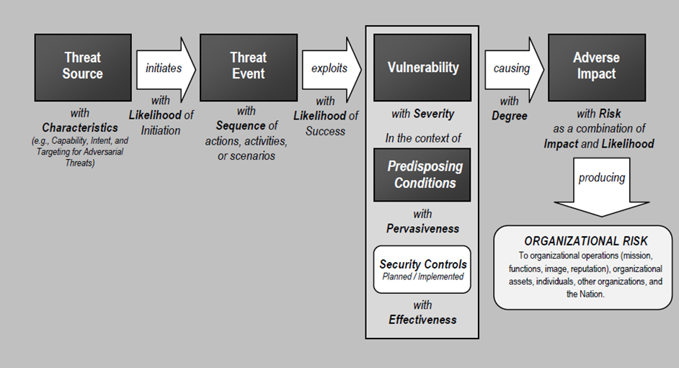
What are your main information security findings?
Apply this diagram in summarizing your main findings of the Target breach
Be sure to label the diagram with your findings as appropriate…

Slide 9
Lessons learned
What have you learned from this case?
As an information security specialist, what will you take away from this case?
What aspects of this case surprised you?

Slide 10
Team’s present their findings
Summary of the main events
Role of sources of risk
Control measures
Impact of this type of breach
Lessons learned from the Target case

Slide 11
Agenda
Team Assignment
Case Study #2 Participation Activity
Team’s present their findings (i.e. 0 through 5)

Slide 12
MIS 5206
Protection of Information Assets
Unit #4 -
Case Study – Autopsy of a Data Breach: The Target Case

