Slide 1
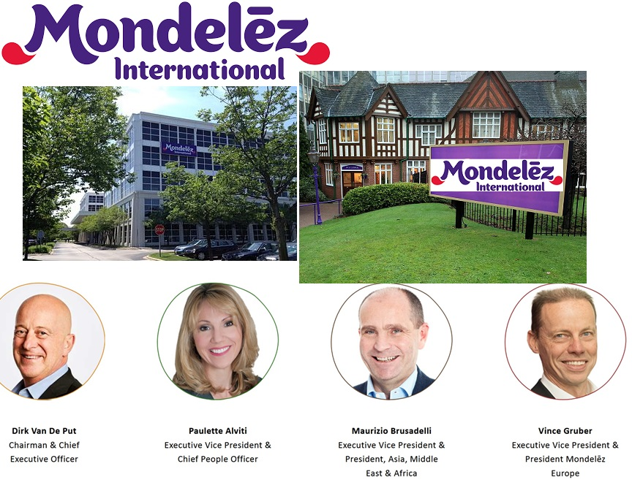

Slide 2
IP got revealed
IP Address
Domain Whois record

Slide 3
Mondelez International is an American multinational confectionery, food, holding and beverage and snack company based in Chicago, Illinois.
Annual base revenue is about $26 billion and operates in approximately 160 countries.
Founded by: Thomas H. McInnerney 1923 (97 years ago)
CEO: Dirk Van de Put since August 2017
Industry: Food processing
Products: Baby food, coffee, dairy products, breakfast cereal,
confectionery, bottle water, ice cream, pet foods.
Contemporary: Mas, kellogg, Post holding, Nestle, ferrero Danone e.t.c
Employee: 80,000
The IP Address has both the IPv4 and IPv6 in use.
Domain name: https://www.mondelezinternational.com/
NetName Host: Akamai
NetHandle: NET-23-32-0-0-1
Parent: Net23 (23-0-0-0-0)
NetType: Direct Allocation
OriginAS:
Organization: Akamai Technologies, Inc. (AKAMAI)
RefDate: 2011-05-16
Updated: 2 0212-03-02

