Slide 1
Intro to Ethical Hacking
MIS 5211.701
Week 13

Slide 2
Tonight's Plan
WEP
Revisit Kismet
Introduction to Aircrack
Attacking WEP
WPA-PSK
Shellter
Cain and Abel / John the Ripper

Slide 3
WEP
Basic encryption for wireless networks
Specified in IEEE 802.11-1997
Required a minimum 40-bit key, usually set at 104-bit
Uses RC-4 encryption
Applied only to data frames (Payload)
Still widely used, especially on older gear

Slide 4
WEP Key
Described as 64 or 128 bit
Reality is 40 or 104
The pre-shared key (Not the same as WPA-PSK) is either 5 or 13 bytes
Initialization vector is transmitted with each packet
IV and key are concatenated to create a per packet key
IV is not a secret!
Four possible keys, index 0-3

Slide 5
WEP Framing
One bit field in the frame control field
Called by a number of different names
WEP bit
Privacy bit
Secure bit
With this bit set, the receiving station expects to see a four byte WEP header immediately following the 802.11 header
Also expects to see a four byte trailer immediately following the payload or data portion

Slide 6
More on Framing
The four byte header is also the initialization vector or IV along with the index number to designate which WEP key was used
Again, this was used with the WEP key to encrypt the data packet
The four byte trailer is the Integrity Check Value or ICV
This function similar to a CRC check to protect against packet modification

Slide 7
RC4
Stream cypher
One byte at a time
100 bytes of plaintext = 100 bytes of cypher text + eight bytes of WEP overhead
Requires a unique key (No re-use)
Recall: concatenated from IV and shared secret
Uses a pseudo randomization function referred to as PRGA (Pseudo-random generation algorithm )
PRGA is XOR’d with the plaintext

Slide 8
Issues with WEP
Poor
Key selection
Message integrity check
Initialization Vector (too short)
No replay protection
Challenge response reveals PRGA
Key is reversible from cypher test (XOR)

Slide 9
Key Selection
Restricted to 5 or 13 character pre-shared key
Reduced key efficiency to 2²⁴
Users often use dictionary words

Slide 10
More on WEP Failures
Weak IV selection leads to key recovery
Known plaintext reveals key information
First two bytes of WEP payload are mandated by 802.11 header spec (0xAA 0xAA)
Once you have enough weak IVs, you can recover the key
We will look at the Aircrack-ng tool for this

Slide 11
Aircrack-ng
Pre-installed in Kali
Similar issue to Kismet, will need to launch from terminal, not from drop down
Aircrack-ng site has detailed information on installation, building from source, and use
http://aircrack-ng.org/

Slide 12
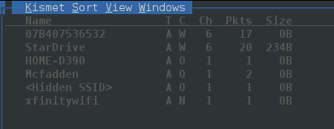
Recall Last Week
Need to connect wireless card to Kali
Need to verify using iwconfig command
Then launch Kismet for a little recon
This will also force the wireless card in to monitor mode
Since StarDrive is my AP we’ll focus on it

Slide 13
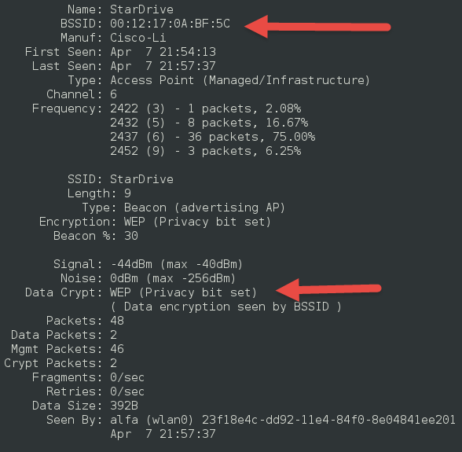
StarDrive
Double clicking on name gives me detail screen
Note
MAC Address
WEP bit
“Network” menu has option to close window and return to summary

Slide 14
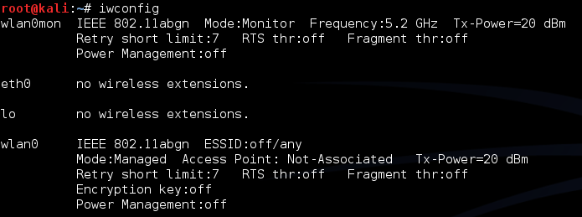
Done with Kismet
We found the AP we want to attack
Know Name (SSID), MAC Address (BSSID), WEP
This also had the affect of forcing wlan0 into monitor mode

Slide 15
Extra Help w/ Aricrack
Lots of extras at:
http://aircrack-ng.org/doku.php?id=tutorial
We’ll run through a few

Slide 16
Generarating Extra Traffic
Created ARP traffic to get data faster
You do need access to wired network, so limited applicability in the wild
Use command:

Slide 17
Running airodump-ng
Running command:
This will create log file capture*.cap for further analysis

Slide 18
Finally, aircrack-ng
Once enough data has been collected, run
aircrack-ng output*.cap
If you don’t have enough data you will see

Slide 19
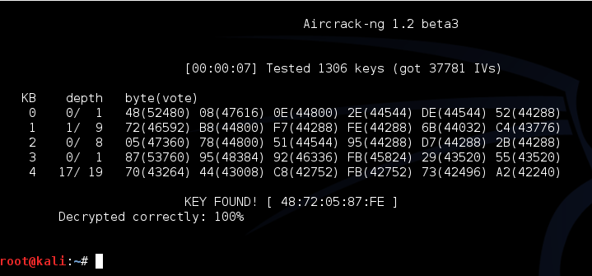
With Enough Data
Eventually, with enough IVs you can get to this:

Slide 20
WPA-PSK
Recall, WPA introduced TKIP
WPA2 introduced CCMP and kept TKIP
Both work with both personal and enterprise
Personal – PSK, Enterprise 802.1x
WPA and WPA2 very similar for PSK

Slide 21
More Acronyms
PSK – Pre-Shared Key
KEK – Key Encryption Key
PMK – Pairwise Master Key – Comes from PSK or EAP method
PTK – Pairwise Temporal Key
Two MIC keys (RX and TX
EAPOL Key Encryption Key
EAPOL Key Confirmation Key

Slide 22
WPA2-PSK PMK Derivation
PMK is 256 bits in length
PMK is derived using passphrase, ssid, and ssid length information
Hashed 4096 times using HMAC-SHA1
This means process cannot be reversed to extract passphrase

Slide 23
WPA2 PTK Derivation
Combines MAC of STA and AP with STA and AP nonces
Update nonces generate fresh keys
Uses PMK as additional input (Re: Key) along with the phrase “Pairwise Key Expansion” and combines with above and hashed w/ SHA1 to generate a PTK
Note: Nonce is a random value generated by both STA and AP

Slide 24
PTK Mapping
PTK is 384/512 bits in length
First 16 bytes – HMAC MIC key
Next 16 – EAPOL-Key KEK
Next 16 – Temporal Encryption Key
Next 8 – TX TKIP Michael (MIC) Key
Next 8 – RX TKIP Michael (MIC) Key

Slide 25
WPA2 Four-Way Handshake
Step 1 | ANonce, start new PTK negotion
 | SNonce, MIC of Frame 2 | Step 2
Step 3 | MIC of frame 3
 | MIC of frame 4, ready to TX/RX | Step 4

Slide 26
WPA2 Four-Way Capture
Example
First four lines are 4-Way Handshake
Source has capture file if you want to look for yourself
Source: http://mrncciew.com/2014/08/16/decrypt-wpa2-psk-using-wireshark/

Slide 27
Identifying WPA2-PSK
AP beacon frames identify capability information
Cypher suite support
Auth key management
Wireshark can filter traffic, then manual inspection can identify

Slide 28
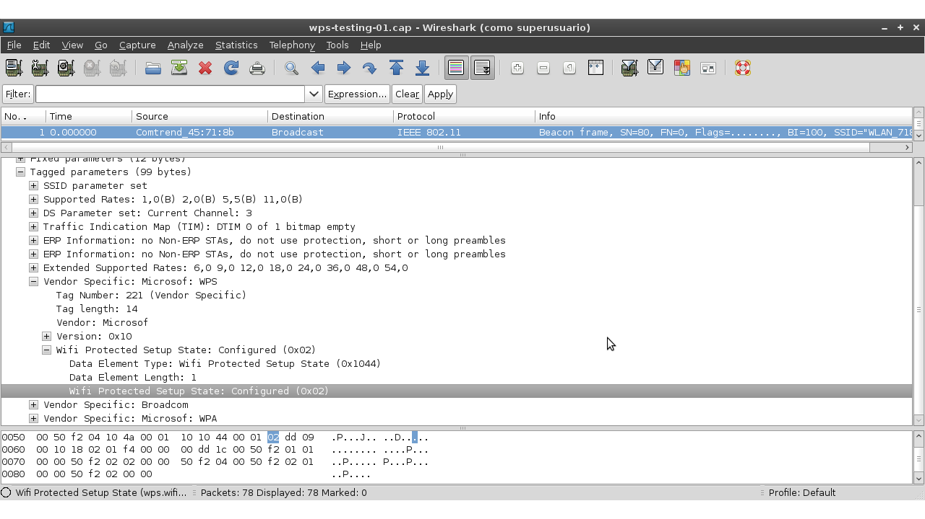
Identifying WPA2-PSK
Example of beacon frame in wireshark

Slide 29
WPA2-PSK
The PMK is generated using the following relatively processor intensive function, pseudo code:
PMK = PBKDF2(passphrase, ssid, ssidLength, 4096, 256)
This means that the concatenated string of the passphrase, SSID, and the SSID length is hashed 4096 times to generate a value of 256 bits

Slide 30
WPA2-PSK
PTK = PRF-512(PMK, "Pairwise key expansion", Min(AP_Mac, Client_Mac) || Max(AP_Mac, Client_Mac) || Min(ANonce, SNonce) || Max(ANonce, SNonce))
The PTK is a keyed-HMAC function using the PMK on the two MAC addresses and the two nonces from the first two packets of the 4-Way Handshake.

Slide 31
WPA2-PSK
Finally, recall:
MIC = HMAC_MD5(MIC Key, 16, 802.1x data)
A MIC value is calculated, using the MIC Key from the PTK and the EAPoL message.

Slide 32
WPA2-PSK
So, we captured the Mac Addresses and the ANonce and SNonce from the four way handshake
Source: http://mrncciew.com/2014/08/16/decrypt-wpa2-psk-using-wireshark/

Slide 33
WPA2-PSK
Now, if we had the right passphrase, SSID, and SSID length; we have everything we need to generate our own key.
But we don’t have this information!
At least not directly

Slide 34
Process
Collect data from four handshake
Mac Addresses
ANonce and SNonce
MIC and EAP
Read in value from a dictionary list
Calculate PMK using dictionary word and SSID
Calculate PTK using above information
Calculate MIC of frame using PTK
Compare calculated MIC to observed MIC
If equal, done! If not equal read in next dictionary word and start over

Slide 35
Automation
Several tools exist to automate this process
Cowpatty
Pre-installed in Kali
http://www.willhackforsushi.com/?page_id=50
Aircrack-ng
Pre-installed in Kali
http://aircrack-ng.org/downloads.html

Slide 36
Limitations
Slow (Very slow)
Each time you want to check a passphrase you have to go through the 4,096 hashes
Each time you go after another SSID, you start over again
Calculations are limited by the capabilities of the CPU installed

Slide 37
A Better Way
Pre-Computed Hash Tables (Rainbow)
PMK is derived from the PSK and SSID
Possible to precompute PMK’s for a given SSID
Top 1000 most common SSIDs published
https://wigle.net/
Or
http://www.renderlab.net/projects/WPA-tables/
Cowpatty will accept precomputed hash tables
See genpmk in a couple of pages

Slide 38
WIGLE

Slide 39
From Wigle.net

Slide 40
More Tools (genpmk)
Basic tool to precompute hashes
Can speed up attacks by a factor of 1300
“genpmk” written by Josh Wright
Pre-installed in Kali
Packaged with Cowpatty

Slide 41
But I Want To Do This Myself
CUDA Acceleration
Parallel computing architecture developed by nVIDIA
http://www.nvidia.com/object/cuda_home_new.html
Pyrite – CUDA acceleration of Cowpatty PMK tables
Included in Kali
Pyrite also supports AMD/ATI 43XX cards (they typically cost less)
Could also go to the cloud

Slide 42
Wireless Network Encryption (Summary)
Method | Algorhithm | IV Size | Key Length | Key Management | Integrity Check
WEP | RC4 | 24 | 40/104 | None | CRC-32
WPA | RC4, TKIP | 48 | 128 | 4-way | Michael Algorithm and CRC-32
WPA2 | AES-CCMP | 48 | 128 | 4-way | CBC-MAC
WPA3 | AES-GCMP 256 | Arbitrary 1-2^64 | 192 | ECDH and ECDSA | BIP-GMAC-256

Slide 43
Rainbow Tables
In this instance, Pre-Computed hashes of likely combinations of passphrases, SSIDs, and SSID lengths stored in tables
These tables use two functions, the hashing function and a reduction function creating a chain and storing only the first and last passphrase (In this case the PMK)
The table is then sorted for faster lookups
See: http://en.wikipedia.org/wiki/Rainbow_table

Slide 44
New Topic - Shellter
A different tool for creating malicious executables
“Encrypts” malicious code to bypass Anti-Virus
https://www.shellterproject.com/download/

Slide 45
Tools for Password Cracking
Cain and Abel
Windows-Based
No Longer Developed
John the Ripper
Multiple OS support
Compile to use
’Pro’ licensed version, pre-compiled, support options.
https://www.openwall.com/john/

Slide 46
Questions
?

