Slide 1
Intro to Ethical Hacking
MIS 5211.701
Week 14
Site:
https://community.mis.temple.edu/mis5211sec702fall2020/

Slide 2
Tonight's Plan
More on Social Engineering
Phases, Reviewed
Cyber Kill Chain
MITRE ATT&CK
Parrot
OWASP, Revisited
Questions?

Slide 3
Phases, Reviewed
Footprinting & Reconnaissance
Passive
Active
Scanning
Enumeration
Vulnerability Analysis
System Hacking
Gaining Access
Escalating Privileges
Maintaining Access
Hiding Files
Exfiltration
Covering Tracks

Slide 4
Social Engineering
Human-Based – gathered by interaction
Computer-Based – gathered with help of computers
Mobile-Based – gathered with help of mobile apps

Slide 5
Human-Based Social Engineering
Impersonation
Legitimate end user
Important user
Technical support
Vishing
Extra Help from Helpdesk
Third Party Authorization
Tech Support
Eavesdropping
Shoulder-Surfing
Dumpster-Diving
Reverse Social Engineering
Piggybacking
Tailgating
Diversion Theft
Honey Trap
Baiting
Quid Pro Quo
Elicitation
Notes:
Reverse Social Engineer – causes an incident, then presents as a p[roblem solver
Honey Trap – attractive person, fake online relationship to obtain confidential information
Baiting – offer end users something alluring in exchange for information (e.g. USB drives)
Quid Pro Quo – service to users in exchange for data or credentials
Elicitation -

Slide 6
Computer-Based Social Engineering
Phishing
Pop-Up Window Attacks
Spam
Instant Chat / Messenger
Scareware

Slide 7
Mobile-Based Social Engineering
Publishing Malicious Apps
Fake Security Apps
Repackaging Legitimate Apps
SMiShing – SMS Phishing

Slide 8
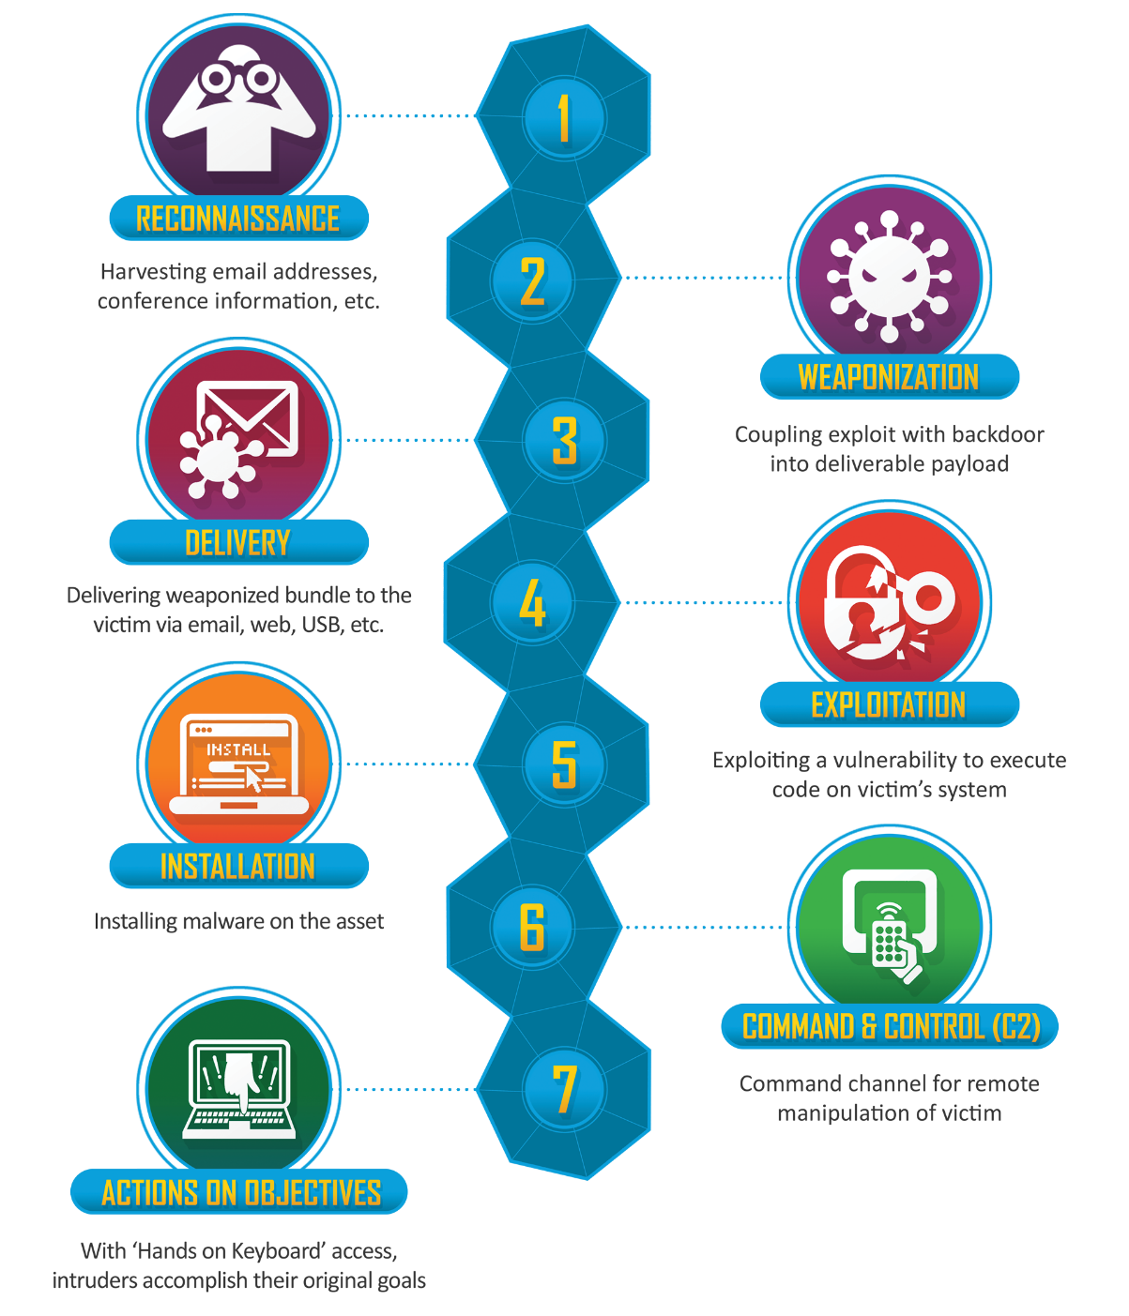
Cyber Kill Chain (Lockheed Martin)
Notes:
Cyber Kill Chain – Lockheed Martin
https://www.lockheedmartin.com/content/dam/lockheed-martin/rms/documents/cyber/Gaining_the_Advantage_Cyber_Kill_Chain.pdf

Slide 9
MITRE ATT&CK https://attack.mitre.org/#
Documents TTPs used by adversaries
Tactics
Techniques
Procedures
STIX/TAXII
ATT&CK Navigator

Slide 10
MITRE ATT&CK Matrices
Enterprise
PRE
Windows
MacOS
Linux
Cloud
Network
Mobile
ICS

Slide 11
MITRE ATT&CK - PRE (Sub-Techniques Shown)
https://attack.mitre.org/matrices/enterprise/pre/

Slide 12
MITRE ATT&CK - Enterprise
https://attack.mitre.org/matrices/enterprise

Slide 13
MITRE ATT&CK – Mobile
https://attack.mitre.org/matrices/mobile

Slide 14
MITRE ATT&CK for ICS
https://collaborate.mitre.org/attackics/index.php/Main_Page

Slide 15
Parrot f/k/a ParrotSec
https://parrotsec.org/download/
Parrot Security MATE ISO
Parrot Security KDE ISO
Parrot Security OVA

Slide 16
Parrot – New Features
Greenbone Vulnerability Management (GVM v11) f/k/a OpenVAS
MetaSploit 6
AnonSurf

Slide 17
OWASP Projects – Revisited
OWASP Top Ten (2017)
Dependency Track
Supply Chain Component Analysis Software Bill of Materials (SBOM)
Juice Shop
Mobile Security Testing Guide
Mobile App Security Verification Standard
ModSecurity Core Rule Set
Software Assurance Maturity Model (SAMM)
Security Knowledge Framework
Web Security Testing Guide
Zed Attack Proxy (ZAProxy.org)
Notes:
Juice Shop includes the OWASP Top Ten
ModSecurity – generic attack detection rules for OWASP Top Ten, etc.
Security Knowledge Framework – knowledgebase with checklists and code examples

Slide 18
OWASP Software Assurance Maturity Model (SAMM) - 2020

Slide 19
Bsides Vidoe
Security BSides Delaware 2020 - TheBlindHacker – YouTube
The Blindhacker on Soft skills and the job search

Slide 20
Questions
?

