Slide 1
Unit #3
MIS5214
Planning and Policy

Slide 2
Agenda
NIST Risk Management Framework and FIPS 199
Use of NIST SP 800-60 Volume 1 and Volume 2
Exercise – Finalize impact levels
Exercise – Determine and finalize impact levels
Exercise – Determine Information and Information System Types and provisional security categorization
Security Control Baselines – review
FIPS 200 and NIST 800-53 Security Control Baselines
Security Control Families
Risk Assessment Controls
Team Exercise Find and assess risk assessment policy
Next Time: Case Study 1

Slide 3
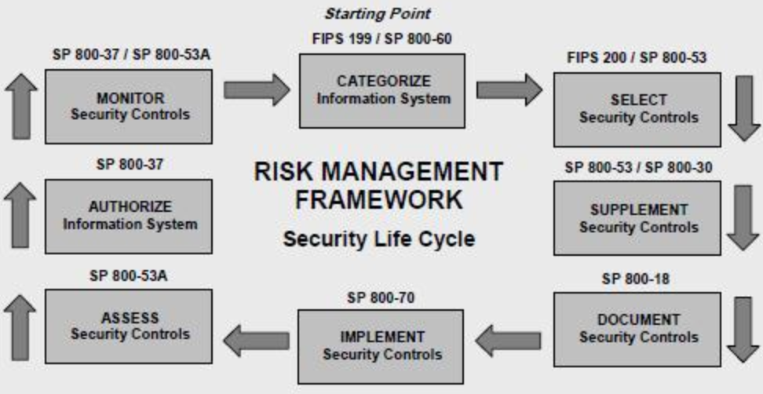
NIST Risk Management Framework

Slide 4
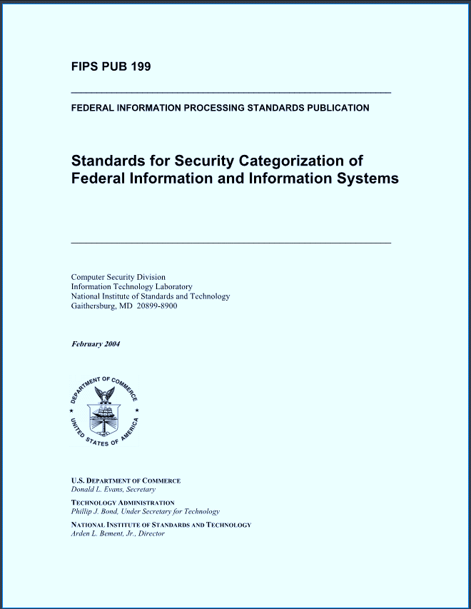
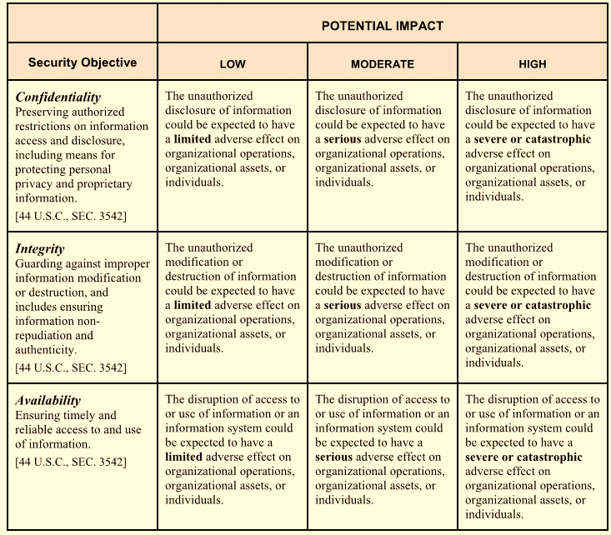
FIPS 199 – Risk Assessment based on security objectives and impact ratings for information and information system

Slide 5
NIST Risk Management Framework

Slide 6
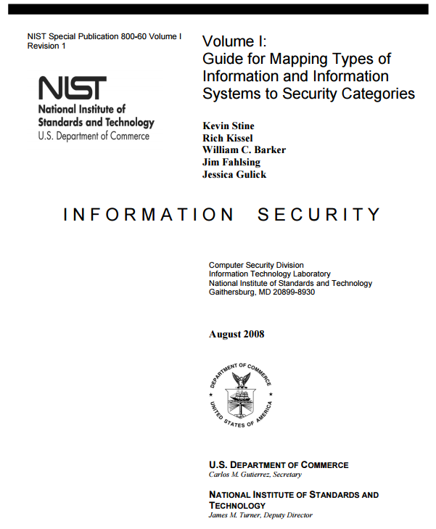
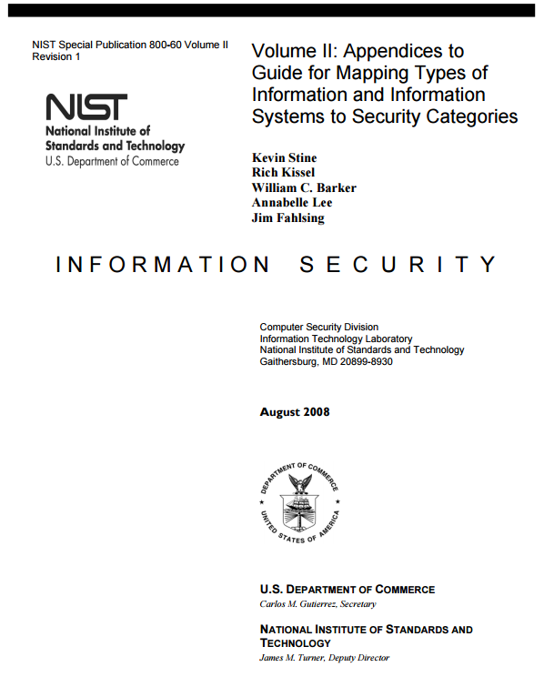
NIST SP 800-60 volumes 1 and 2

Slide 7
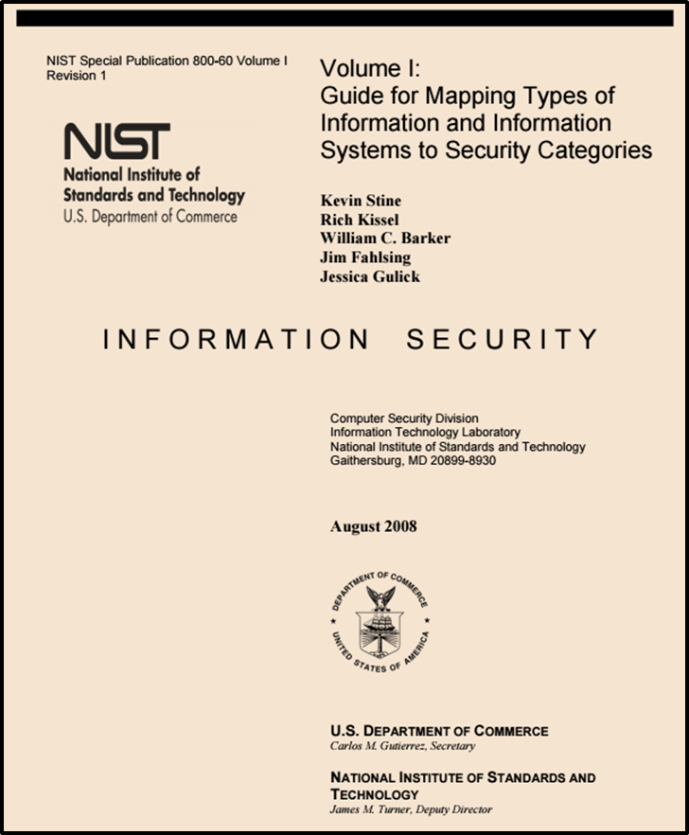
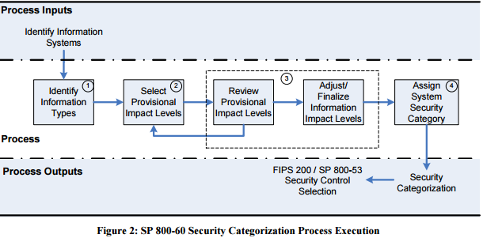
http://nvlpubs.nist.gov/nistpubs/Legacy/SP/nistspecialpublication800-60v1r1.pdf

Slide 8
2 Broad types of Information and Information Systems
Mission-based Information & Information Systems
Management and Support Information & Information Systems

Slide 9
Mission-based Information and Information Systems
Defense and National Security
Homeland Security
Intelligence Operations
Disaster Management
International Affairs and Commerce
Natural Resources
Energy
Environmental Management
Economic Development
Community and Social Services
Transportation
Education
Workforce Management
Health
Income Security
Law Enforcement
Litigation and Judicial Activities
Federal Correctional Activities
General Sciences and Innovation
Knowledge Creation and Management
Regulatory Compliance and Enforcement
Public Goods Creation and Management
Federal Financial Assistance
Credit and Insurance
Transfers to State/Local Governments
Direct Services for Citizens

Slide 10
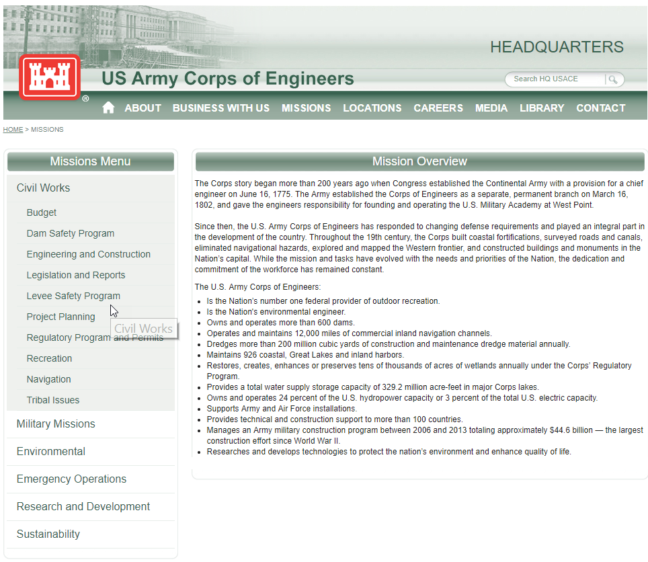
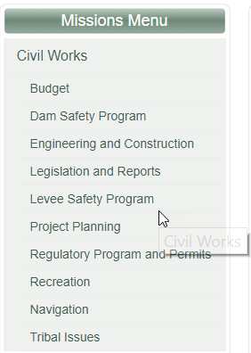
Disaster Management Information Systems

Slide 11
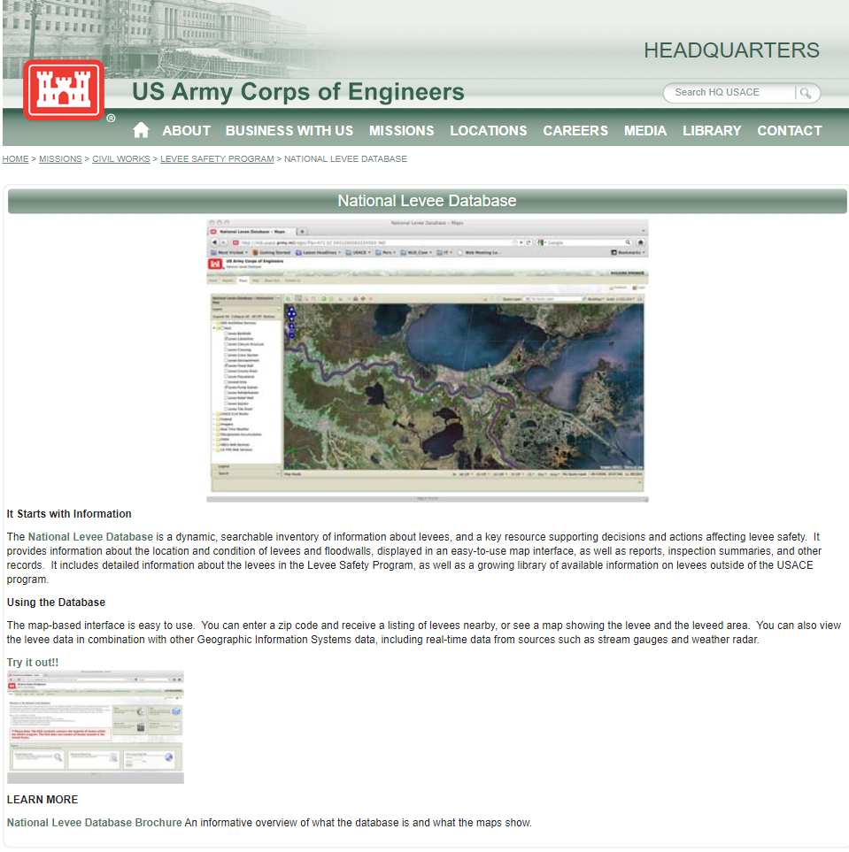
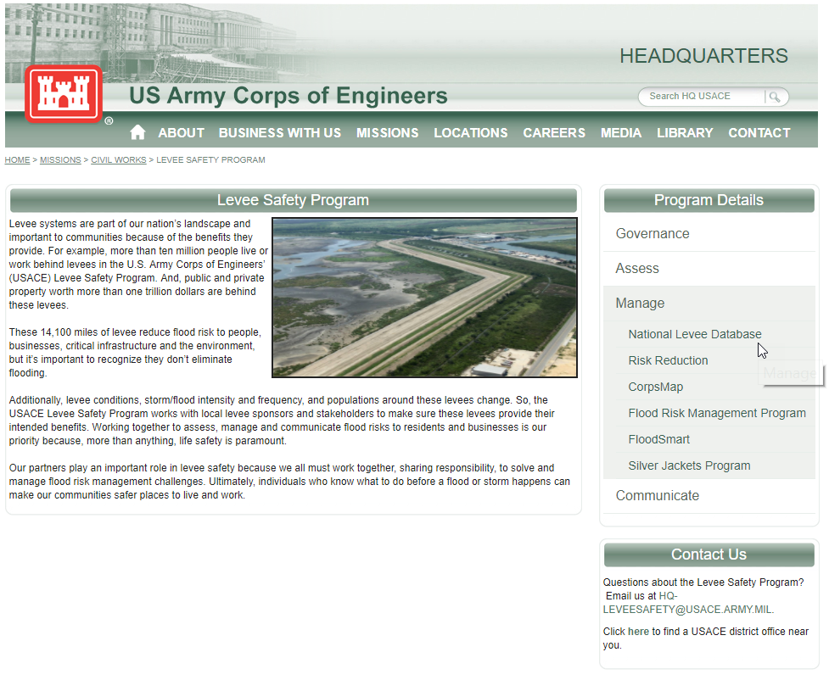

Slide 12
2 Broad Types of Information and Information Systems
Mission-based Information & Information Systems
Management and Support Information & Information Systems
Services Delivery Support Functions
Government Resource Management Functions

Slide 13
Services Delivery Support Functions and Information Types
Controls and Oversight
Regulatory Development
Planning and Budgeting
Internal Risk Management and Mitigation
Revenue Collection
Public Affairs
Legislative Relations
General Government

Slide 14
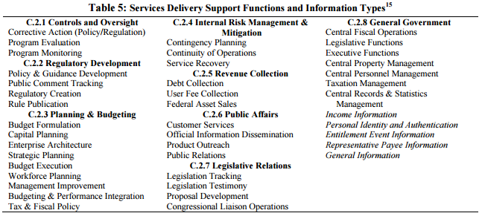
Management and Support Information and Information Systems

Slide 15
Government Resource Management Functions & Information Types
Administrative Management
Financial Management
Human Resources Management
Supply Chain Management
Information and Technology Management

Slide 16
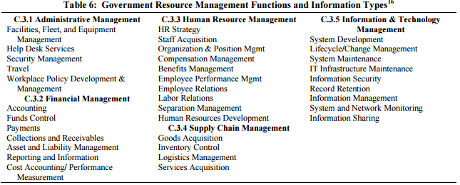
Management and Support Information and Information Systems

Slide 17
1. Identify Information Types
http://nvlpubs.nist.gov/nistpubs/Legacy/SP/nistspecialpublication800-60v1r1.pdf

Slide 18
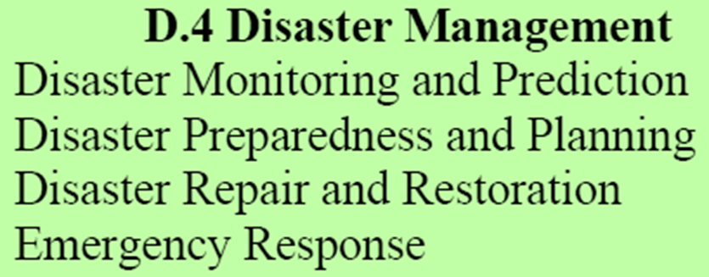
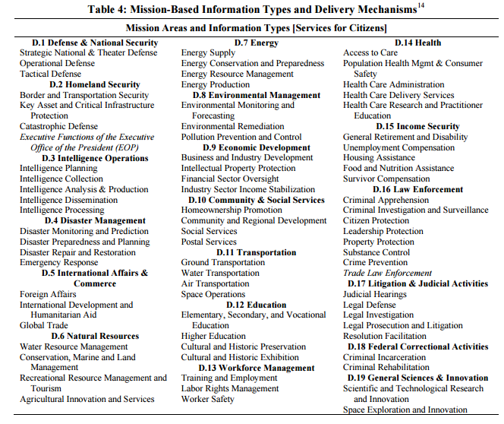
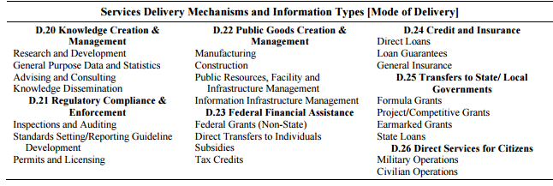
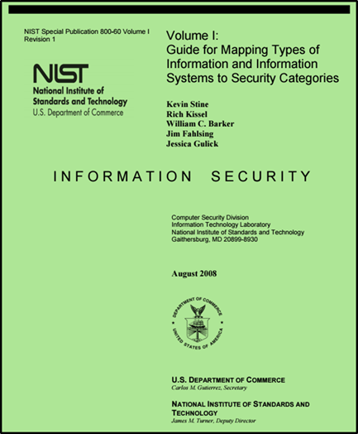
Disaster Management Information Types

Slide 19
Select Provisional Impact Levels for the identified information system

Slide 20
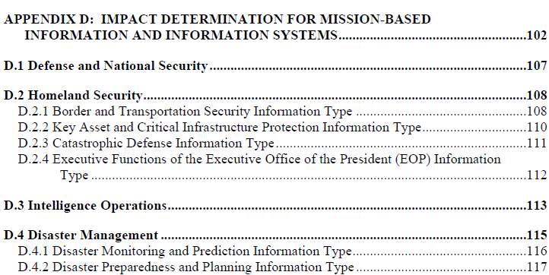
Disaster Management Information Types

Slide 21
Disaster Management Information Impact

Slide 22
Exercise
Using NIST SP 800-60 V.2 R1 determine the Impact Levels for the Disaster Information Types
?
?
?
?
?
?
?
?
?
?
?
?
?
?
?
?
Information System Impact Rating:
?
?
?
?

Slide 23
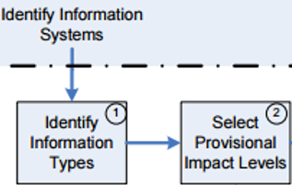
Disaster Management Information Types

Slide 24
Disaster Management Information Types

Slide 25
Exercise
Determine the Summary Impact Levels for the Disaster Information Types
?
?
?
?

Slide 26
Exercise – Answer…
Summary Impact Levels for the Disaster Information Types

Slide 27
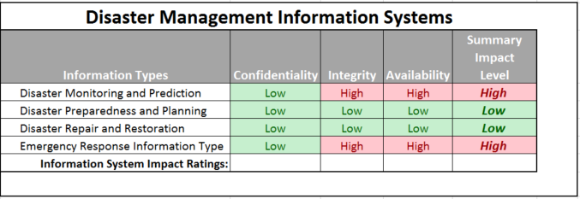
Exercise -
Determine the Overall Impact Levels for the Disaster Information Types
?
?
?

Slide 28
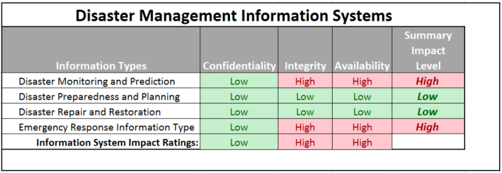
Exercise - Answer
Overall Impact Levels for the Disaster Information Types

Slide 29
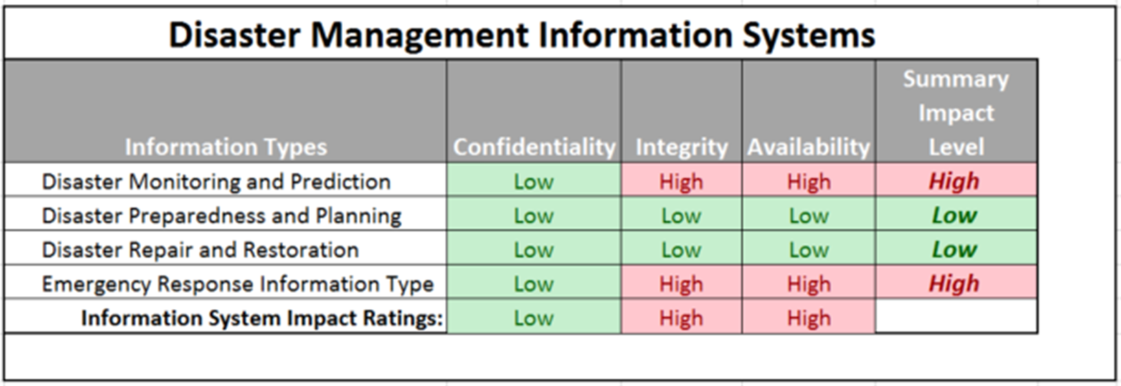
Exercise
Determine the Overall Impact Level of Disaster Information Systems
?

Slide 30
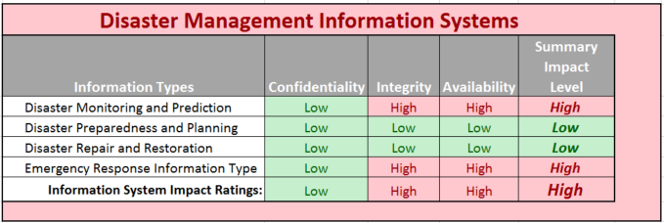
Exercise - Answer
Overall Impact Level of Disaster Information Systems

Slide 31
Adjust Information Impact Level

Slide 32
Exercise
Using NIST SP 800 60 V2R1
Look at the “Special Factors” affecting CIA impact levels for each Disaster Management information type and adjust the table accordingly adding a column “Adjusted Summary Impact Level”
20 minutes, then class discussion

Slide 33
Select Provisional Impact Levels for the identified information system

Slide 34
Exercise
Find a preliminary categorization for the following information system and adjust the categorization based on your analysis – present justifications for both preliminary and adjusted categorizations
Purpose: The system has two overarching purposes:
For clients it is a system intended to help understand sewage and storm water collection and treatment systems (i.e. pipe networks, pump stations, and treatment plants) and their capacities, overflow characteristics and controls
For the firm the system is intended to provide revenue through pay by clients for:
Direct use of the service(s) of the system
Help in benefiting from the service(s) of the system
Having the firm apply the service(s) of the system to derive beneficial information for the clients
Users:
Municipal and regional water and sewer utilities and governmental organizations will use the system to help plan capital improvement, operations, and maintenance of sewer systems (i.e. treatment plants and collection networks)
External consultants helping municipal and regional water and sewer utilities and organizations will use the system to help their clients plan capital improvement, operations, and maintenance of sewer systems
Internal consultants within the firm helping municipal and regional water and sewer utilities and organizations will use the system to help their client plan capital improvement, operations, and maintenance of sewer systems
The firm’s technical information system development staff will work directly on the information system to provide, maintain, enhance and extend the services of the information system to (1), (2) and (3) above
The system will be developed in a phased approach
The first phase (“V1”) will provide capabilities for sewer system pipe network information CRUD (create, read, update and delete) and read = display and query
Subsequent phases (“V2”, “V3”…) focus on providing modeling and analysis services including: capacity planning, overflow prediction and management, defect prediction, and maintenance management

Slide 35
Agenda
NIST Risk Management Framework and FIPS 199
Use of NIST SP 800-60 Volume 1 and Volume 2
Exercise – Finalize impact levels
Exercise – Determine and finalize impact levels
Exercise – Determine Information and Information System Types and provisional security categorization
Security Control Baselines – review
FIPS 200 and NIST 800-53 Security Control Baselines
Security Control Families
Risk Assessment Controls
Team Exercise Find and assess risk assessment policy
Next Time: Case Study 1

Slide 36
NIST Risk Management Framework

Slide 37
FIPS 200 Minimum Security Control Requirements
Access Control (AC)
Awareness and Training (AT)
Audit and Accountability (AU)
Certification, Accreditation, and Security Assessment (CA)
Configuration Management (CM)
Contingency Planning
Identification and Authentication
Incident Response (IR)
Maintenance (MA)
Media Protection (MP)
Physical and Environmental Protection *PE)
Planning (PL)
Personal Security (PS)
Risk Assessment (RA)
System and Services Acquisition(SA)
System and Communications Protection (SC)
System and Information Integrity (SI)

Slide 38
NIST Risk Management Framework

Slide 39
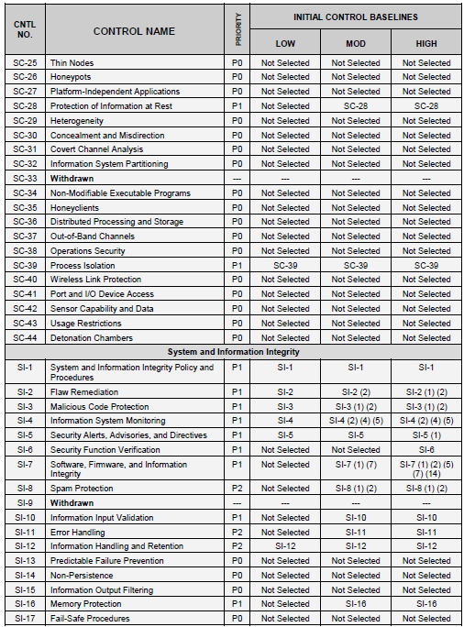
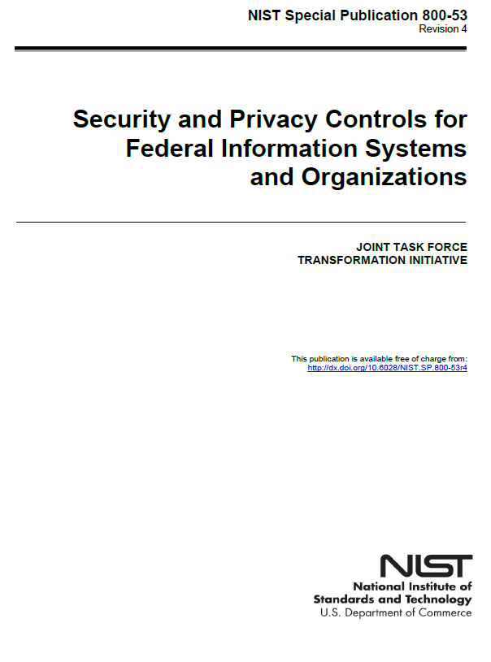
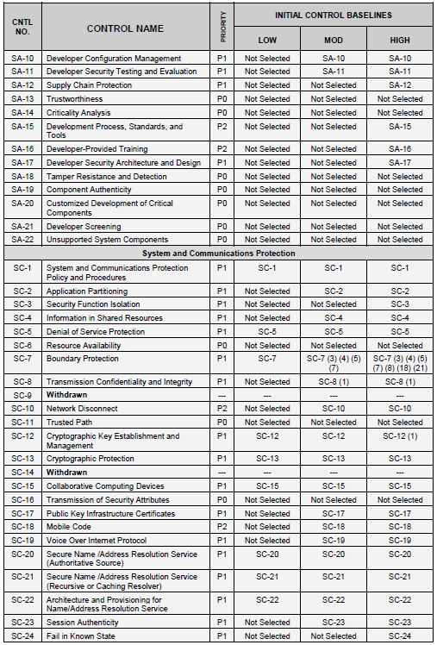
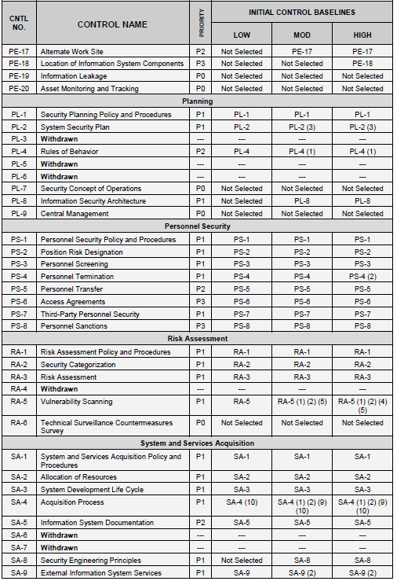
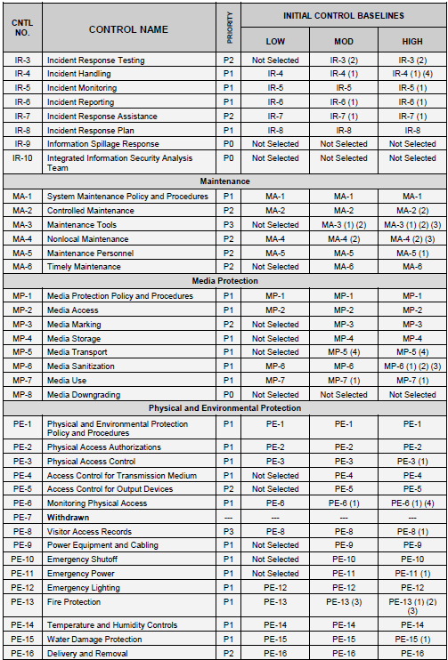
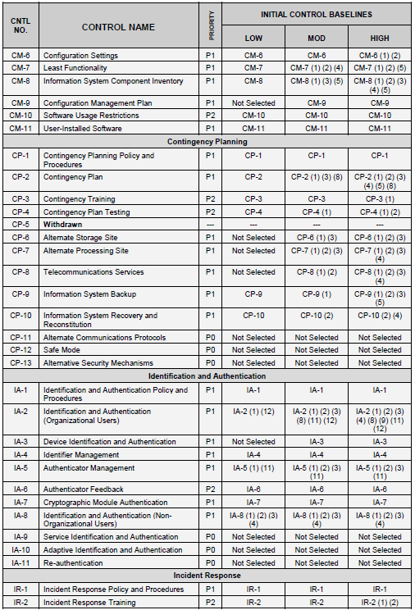
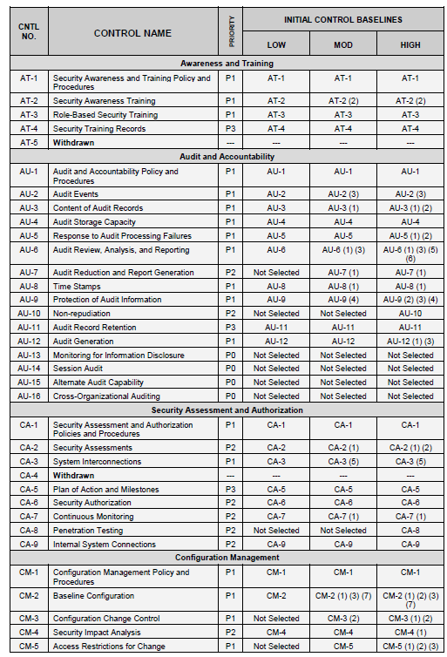
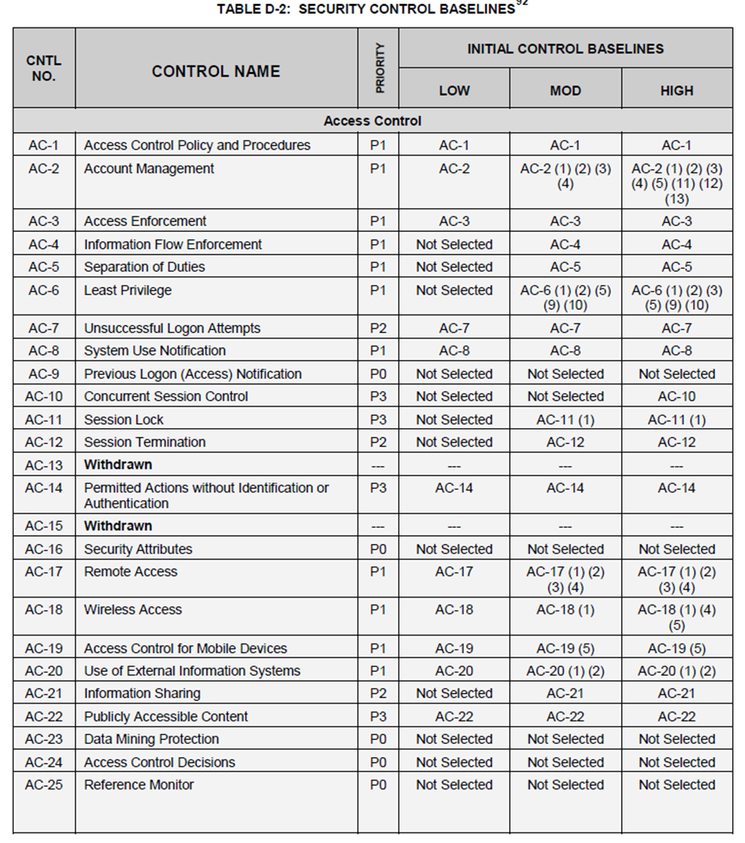

Slide 42
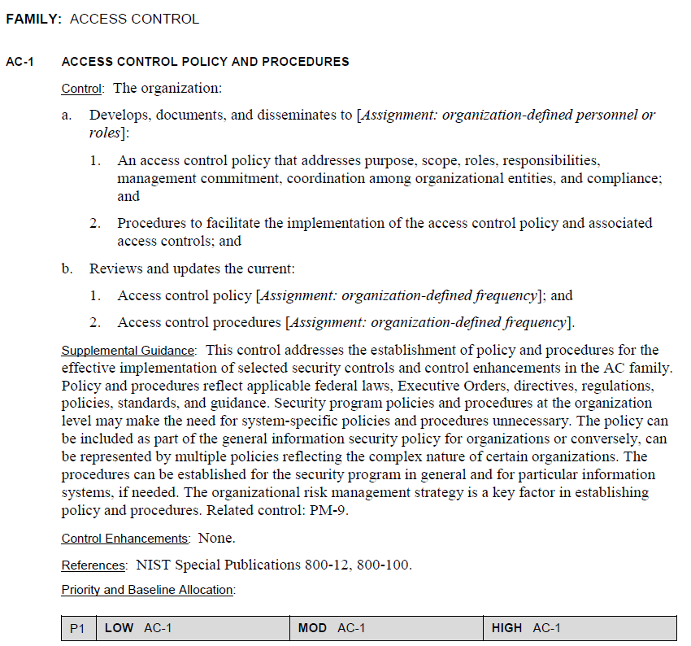
AC-1

Slide 43
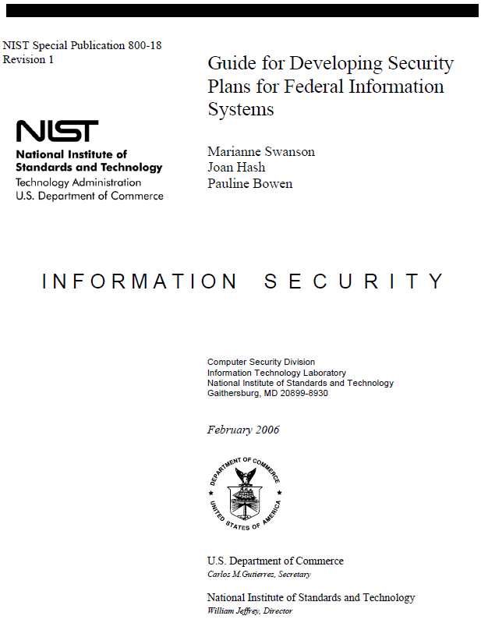
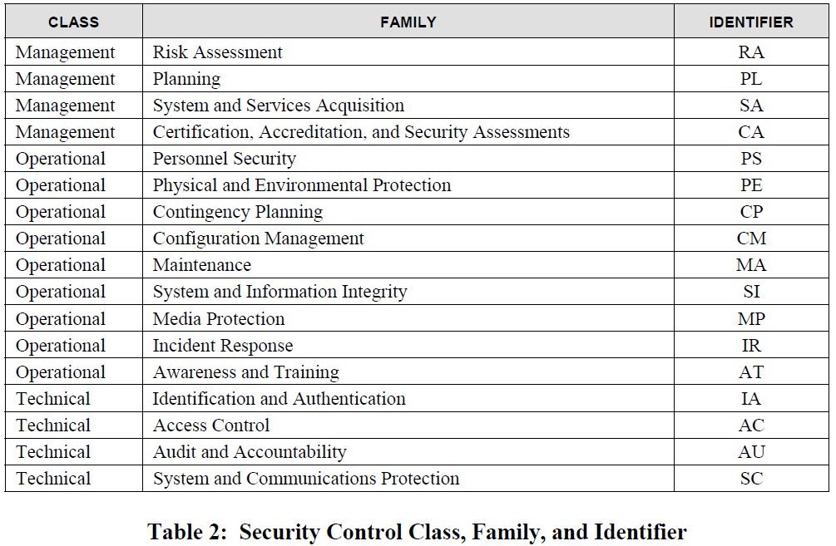

Slide 44
Risk Assessment (RA) Controls

Slide 45
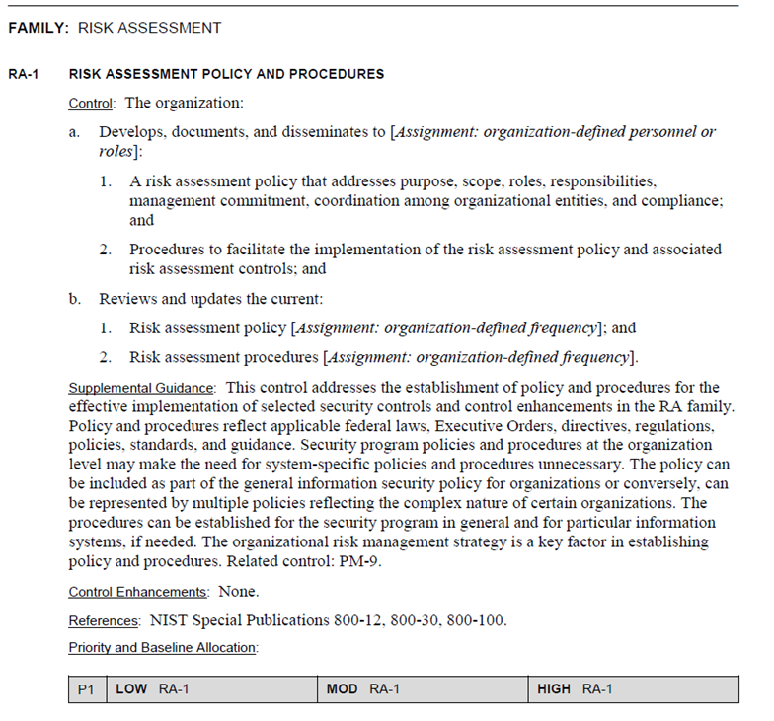
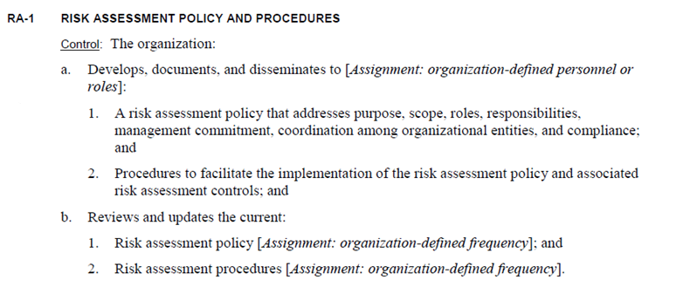
RA-1

Slide 46
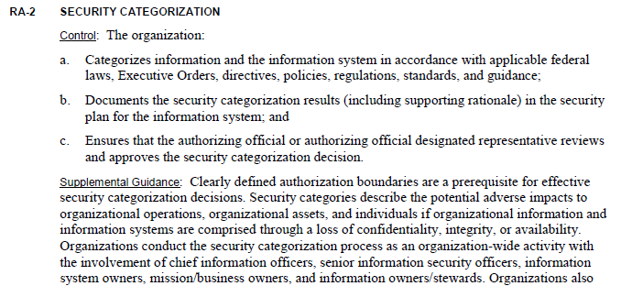
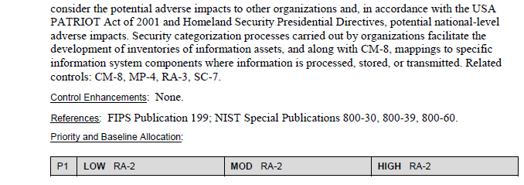
RA -2

Slide 47
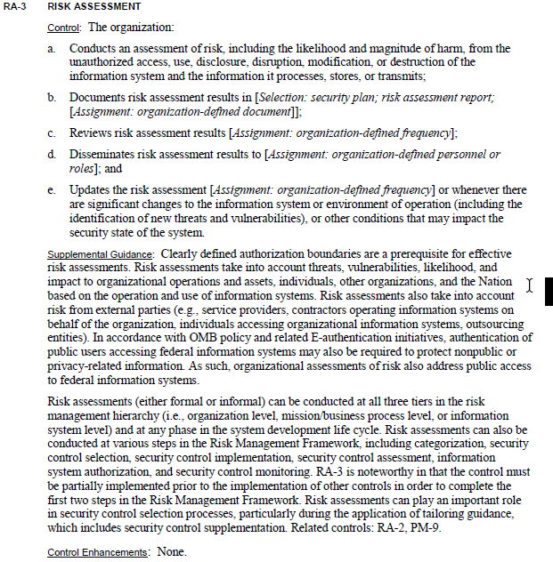
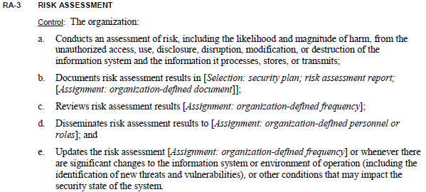
RA -3

Slide 48
Exercise
Using Google or your favorite search engine…
Find an organization’s IT risk assessment policy and procedures
Assess how well the policy meets requirements of RA-1
Assess how well the procedures meet RA2 and RA3
Return to class discussion in 20 minutes
Present your findings

Slide 49
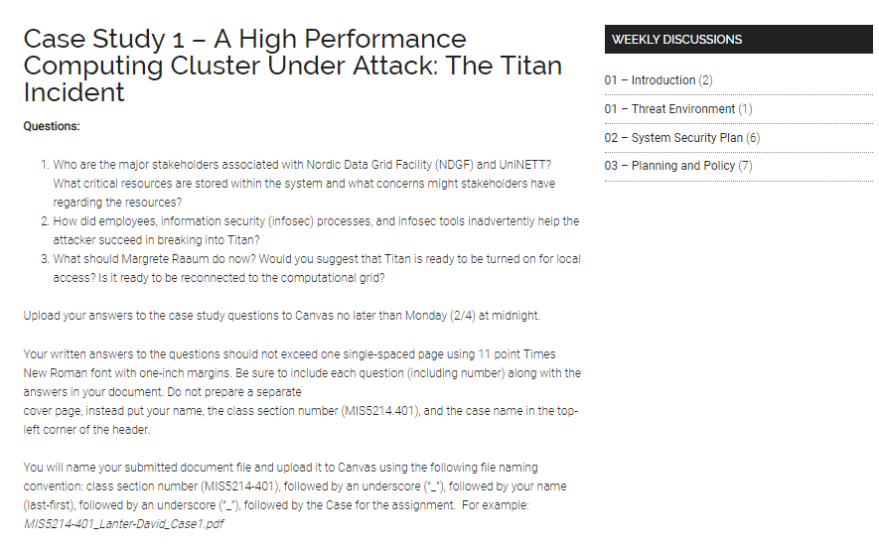
Case Study Assignment – due 2/7 midnight
Questions:
Who are the major stakeholders associated with Nordic Data Grid Facility (NDGF) and UniNETT? What critical resources are stored within the system and what concerns might stakeholders have regarding the resources?
How did employees, information security (infosec) processes, and infosec tools inadvertently help the attacker succeed in breaking into Titan?
What should Margrete Raaum do now? Would you suggest that Titan is ready to be turned on for local access? Is it ready to be reconnected to the computational grid?

Slide 50
Agenda
NIST Risk Management Framework and FIPS 199
Use of NIST SP 800-60 Volume 1 and Volume 2
Exercise – Finalize impact levels
Exercise – Determine and finalize impact levels
Exercise – Determine Information and Information System Types and provisional security categorization
Security Control Baselines – review
FIPS 200 and NIST 800-53 Security Control Baselines
Security Control Families
Risk Assessment Controls
Team Exercise Find and assess risk assessment policy
Next Time: Case Study 1

Slide 51
Unit #3
MIS5214
Planning and Policy

