Slide 1
Unit #9
MIS5214
Host Hardening

Slide 2
Agenda
Risk Management Framework – A quick review…
Implementing controls – Host hardening…
  Security configuration checklist (with STIG Viewer)
SCAP - Security Content Automation Protocol
System Security Plan’s Section 13
  Select 1 control family to fill out for your information system
System Security Plan’s Section 8
  Information System Type
Team Project - SSP draft development…

Slide 3
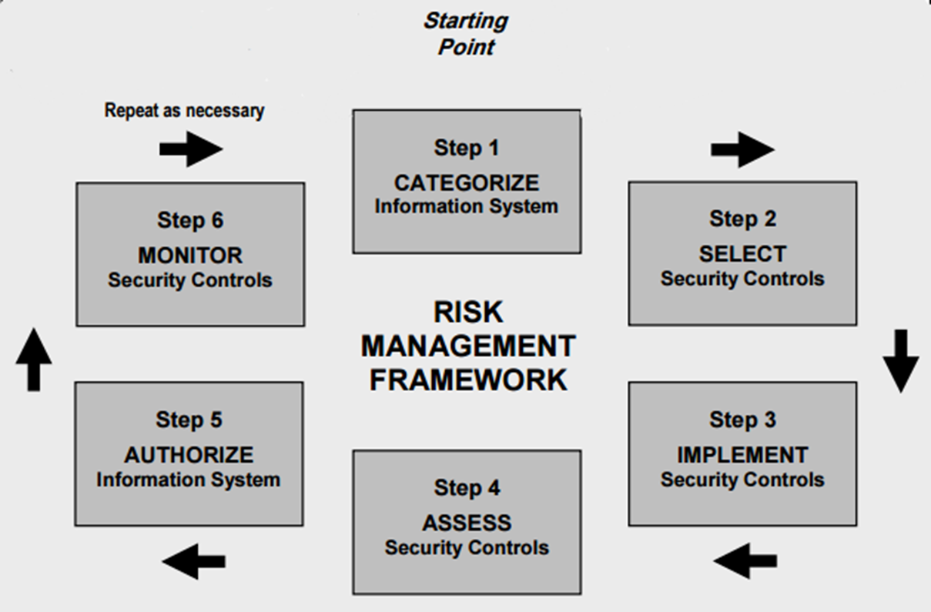
NIST Risk Management Framework

Slide 4
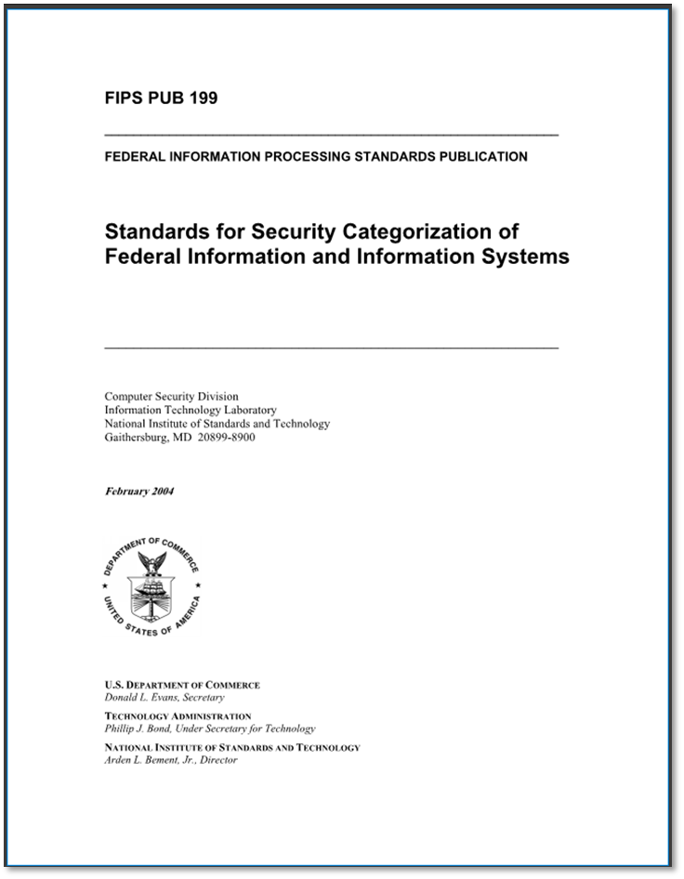
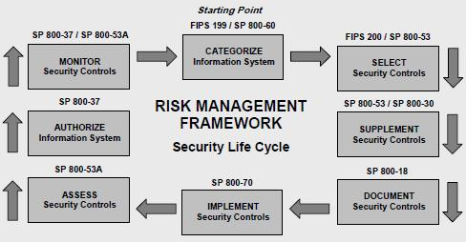
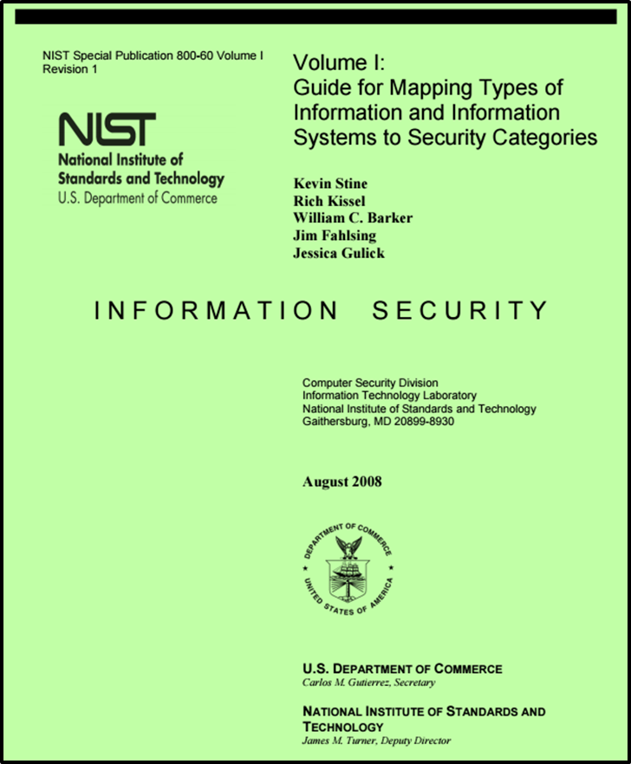
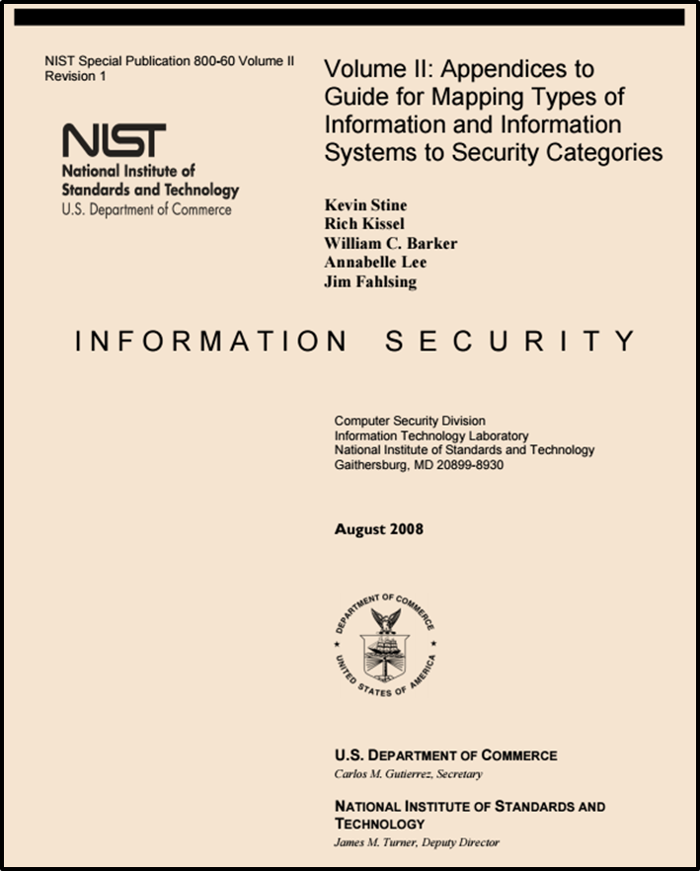
NIST Risk Management Framework

Slide 5
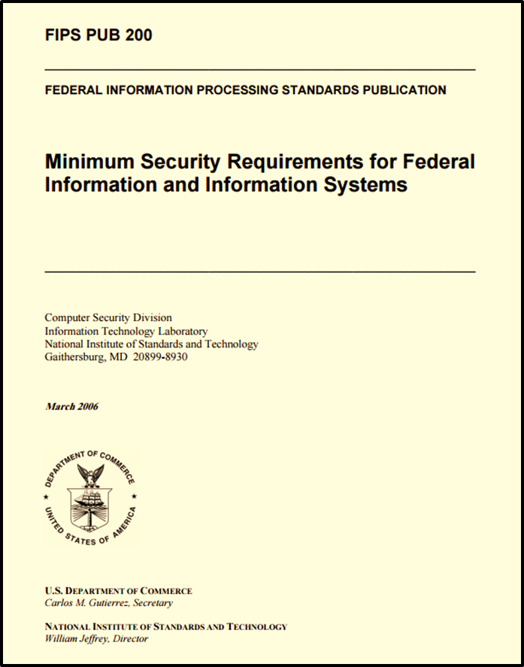
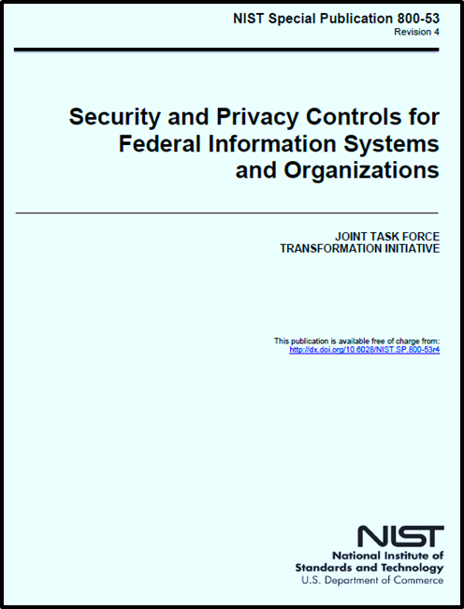
NIST Risk Management Framework

Slide 6
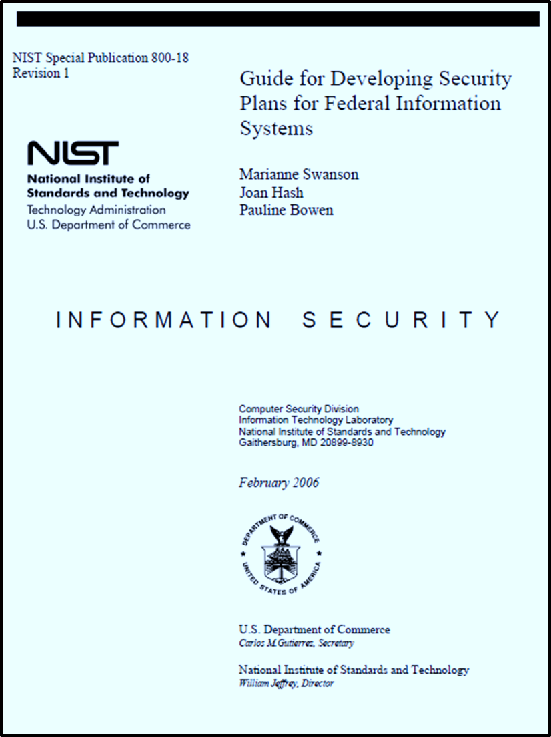
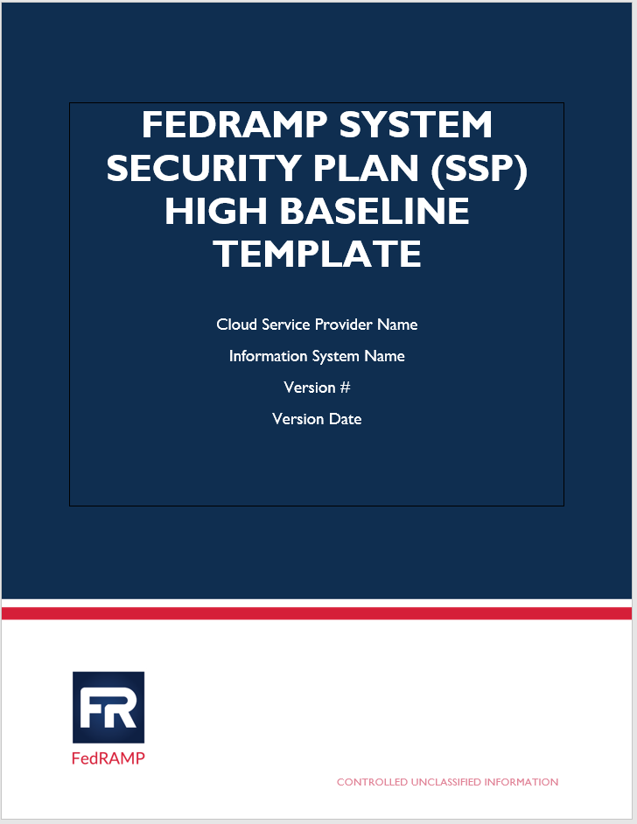
NIST Risk Management Framework

Slide 7
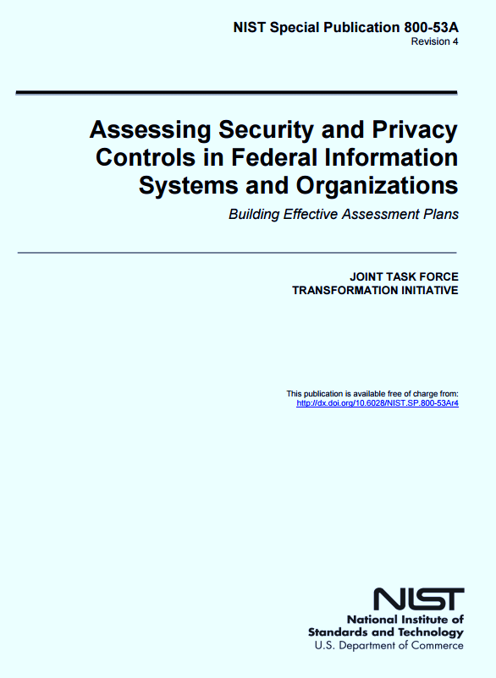
NIST Risk Management Framework

Slide 8
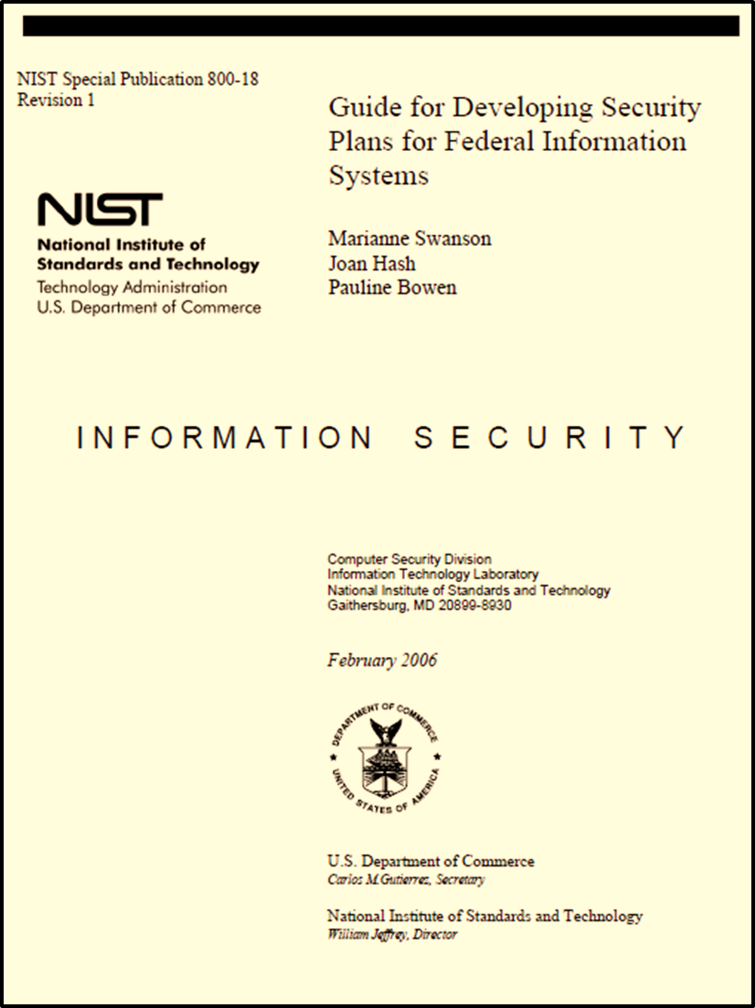
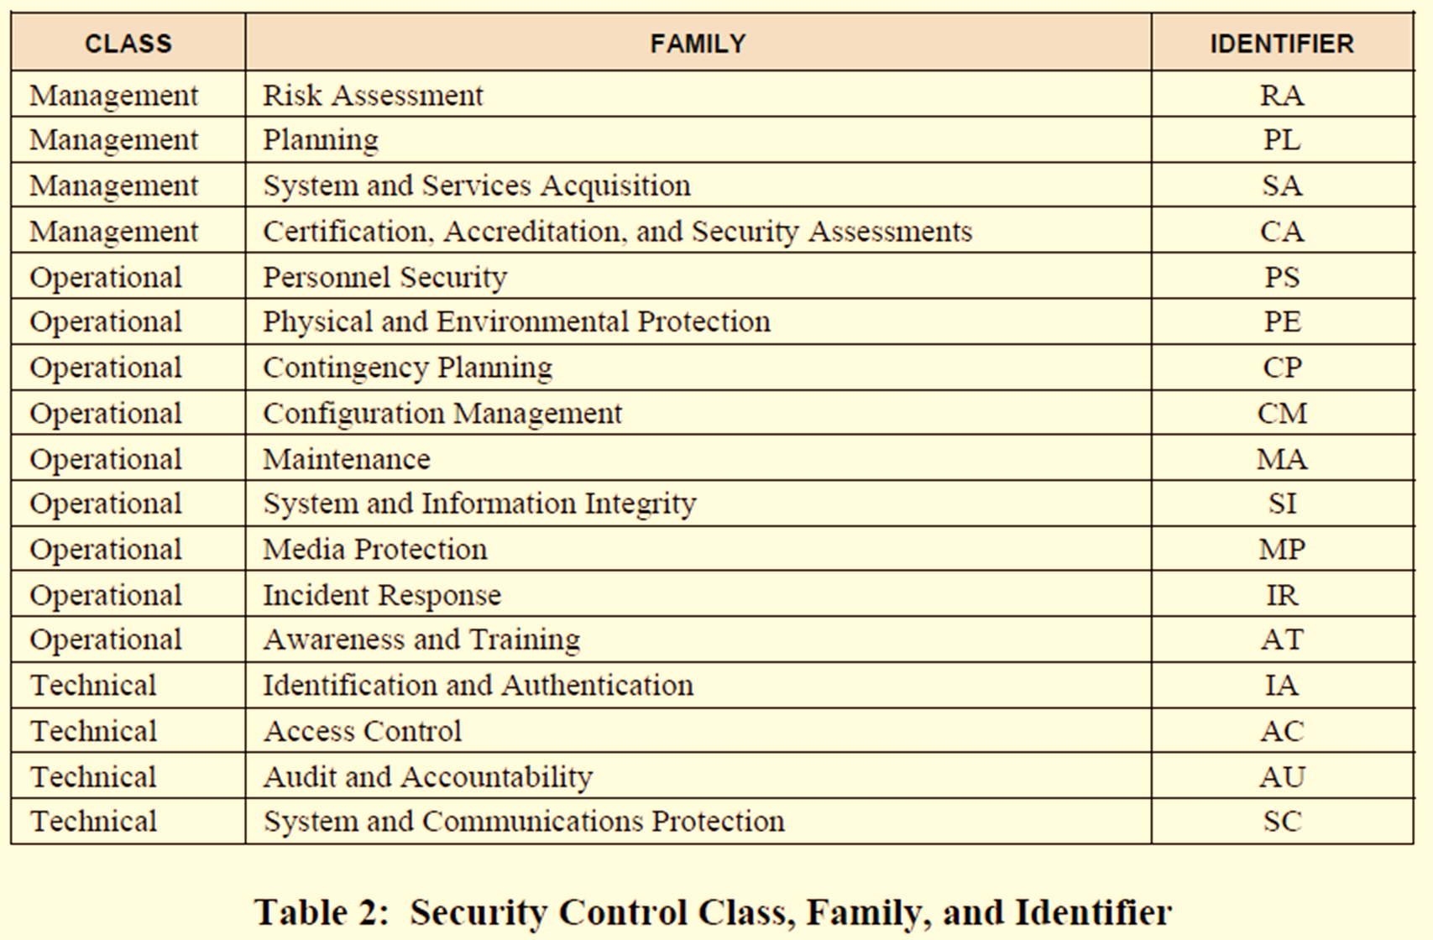
Which controls aid in Host Hardening… ?

Slide 9
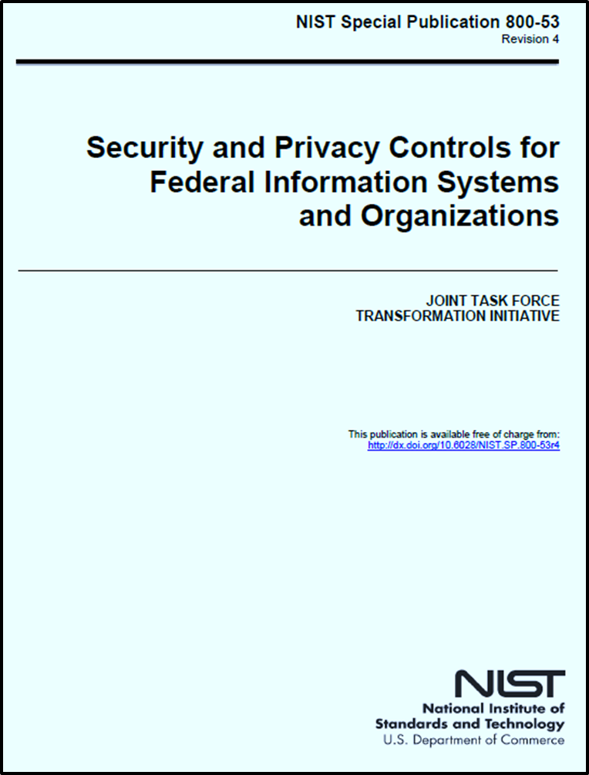

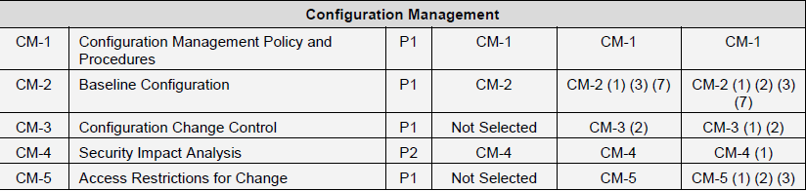
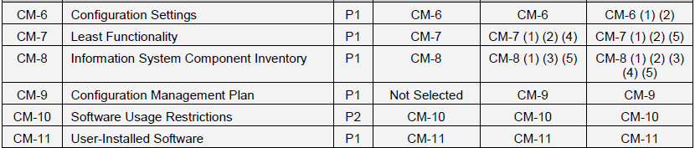
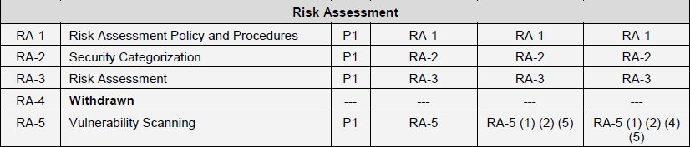

Slide 10
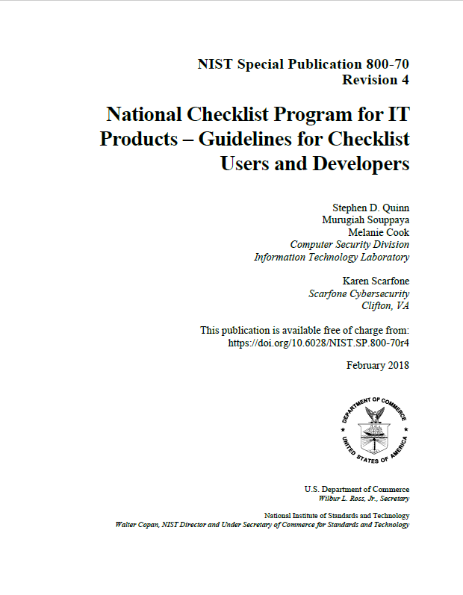
A security configuration checklist is a document containing instructions or procedures for:
  Configuring an information technology (IT) product to an operational environment
  Verifying that the product has been configured properly
  Identifying unauthorized changes to the product
Checklists can help you:
  Minimize the attack surface
  Reduce vulnerabilities
  Lessen the impact of successful attacks
  Identify changes that might otherwise go undetected

Slide 11
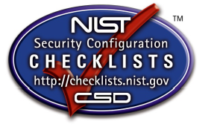
Two types of checklists
Non-Automated
  Designed to be used manually, such as written instructions that describe the steps an administrator should take to secure a system or to verify its security settings
Automated
  Used through one or more tools that automatically alter or verify settings based on the contents of the checklist
  Many checklists are written in Extensible Markup Language (XML), and there are special tools that can use the contents of the XML files to check and alter system settings
    Security Content Automation Protocol (SCAP) is a common example used to express checklist content in a standardized way that can be processed by tools that support SCAP

Slide 12
Security Configuration Checklist
There is no checklist that can make a system or product 100 percent secure
Using checklists does not eliminate the need for ongoing security maintenance, such as patch installation
Using checklists for hardening systems against software flaws (e.g., by applying patches and eliminating unnecessary functionality) and configuring systems securely will typically:
  Reduce the number of ways in which systems can be attacked
  Result in greater product security and protection from threats
  Help verify the configuration of some types of security controls for system assessments

Slide 13
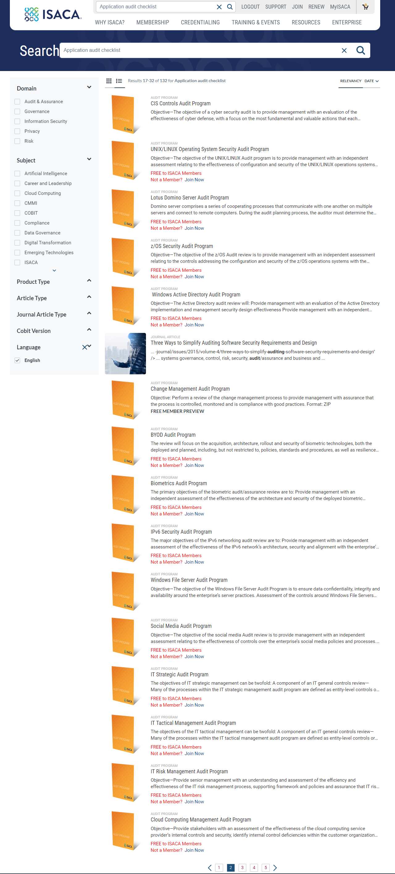
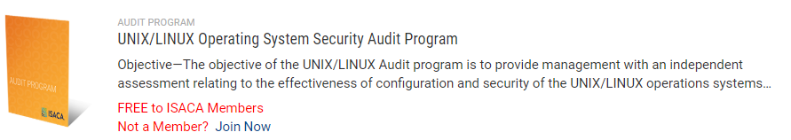
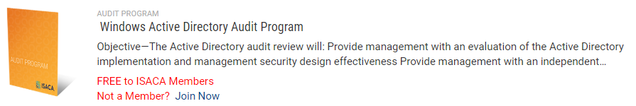
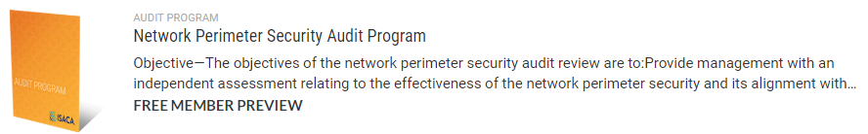
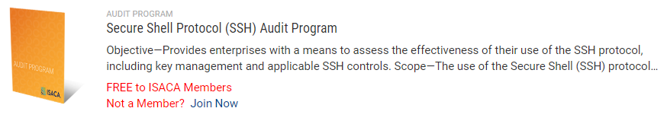
ISACA is a source of many audit control checklists

Slide 14
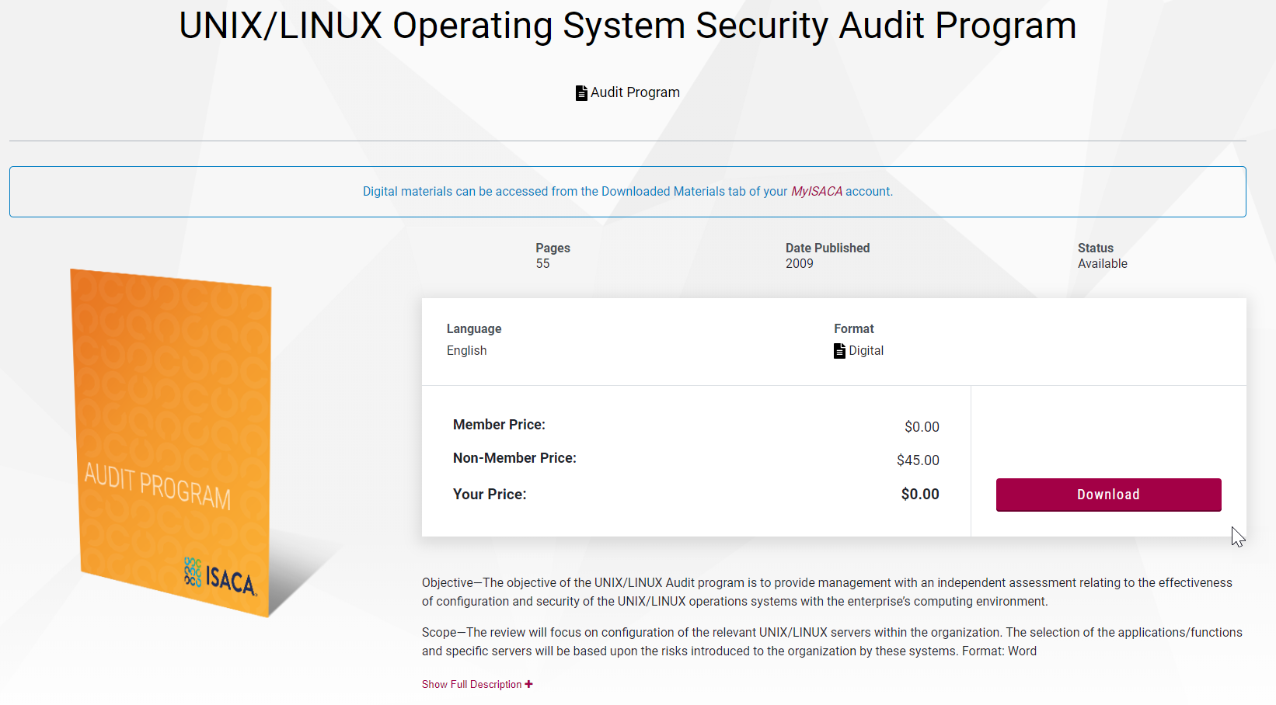
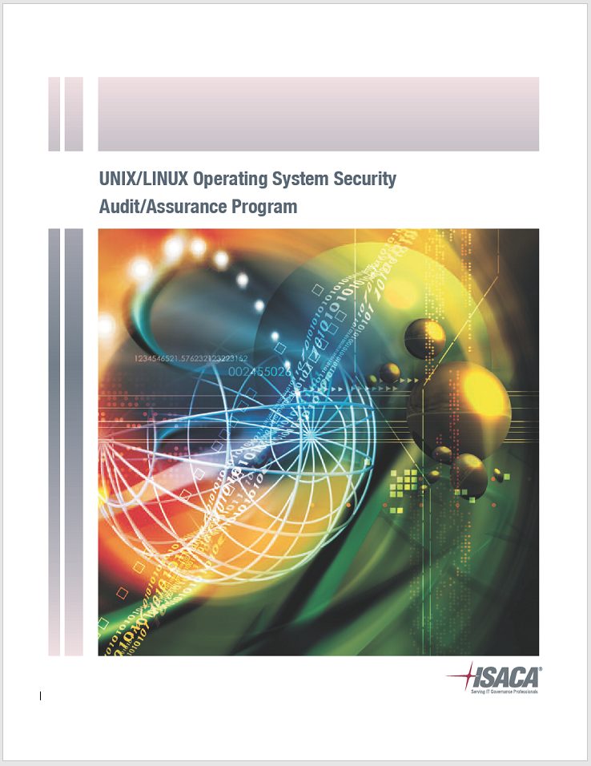
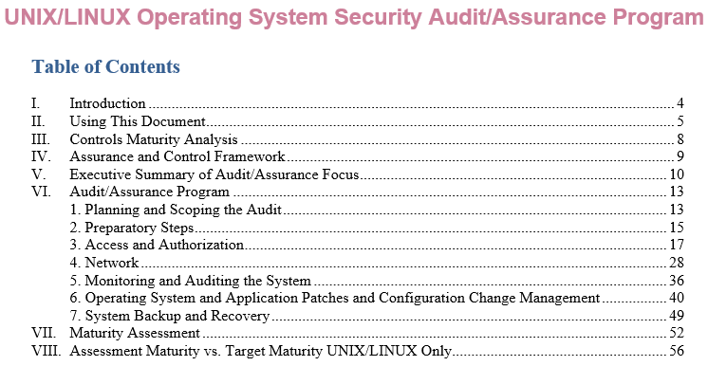

Slide 15
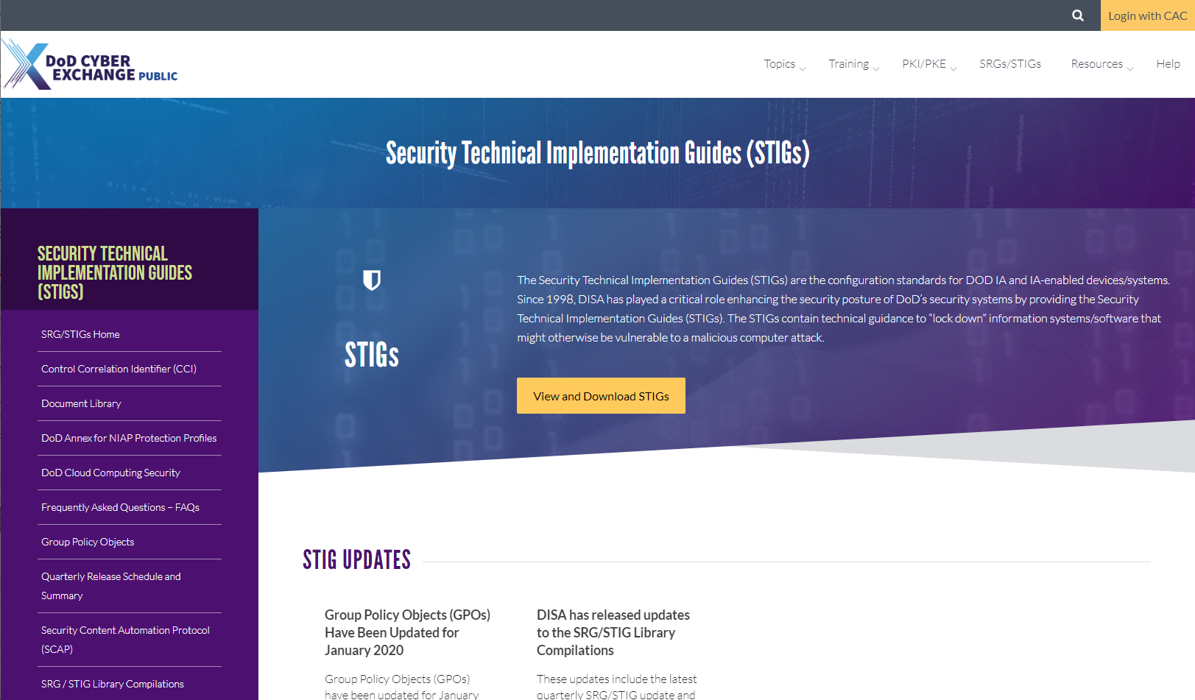
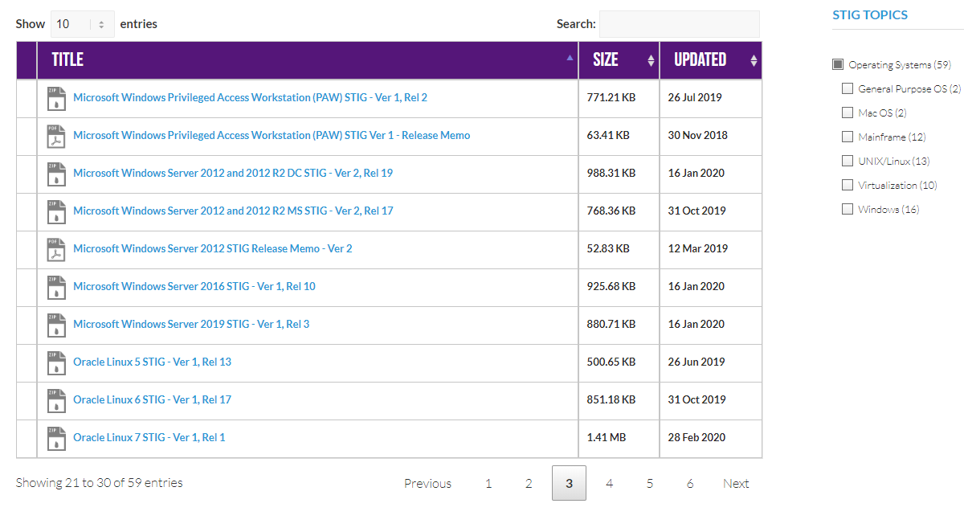
Security Technical Implementation Guides

Slide 16
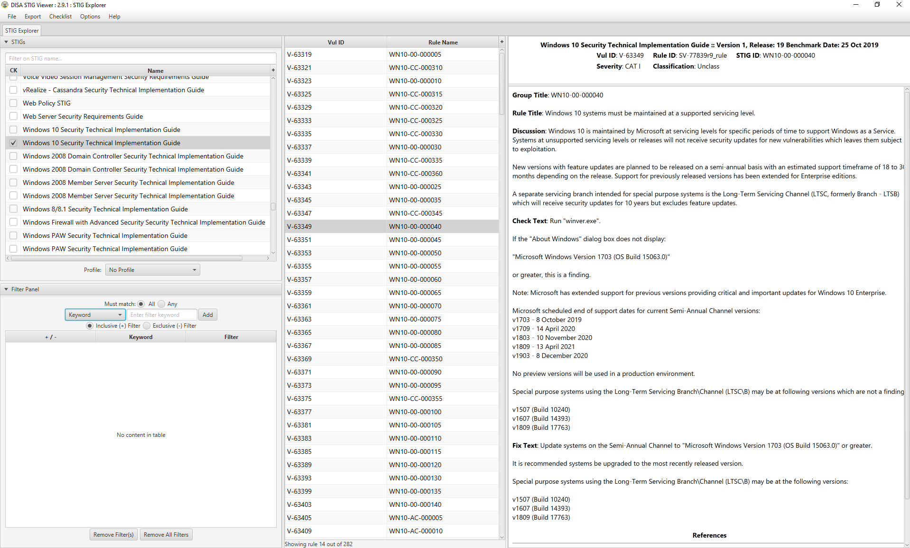

Slide 17
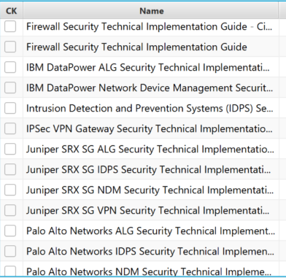
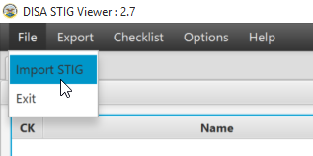
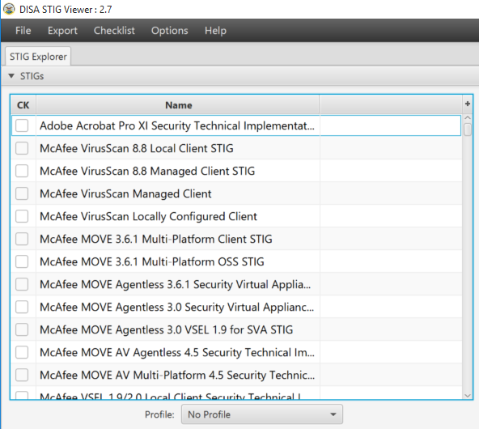
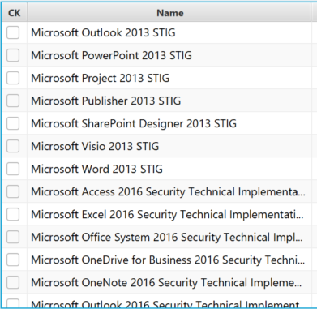
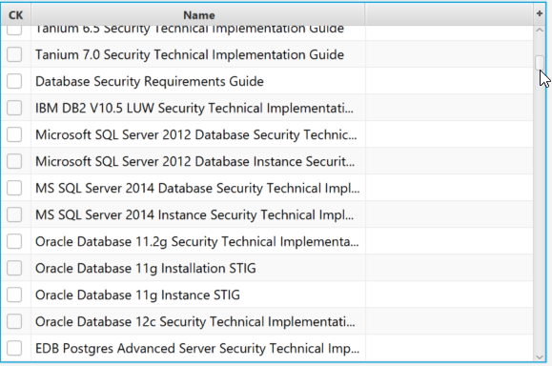
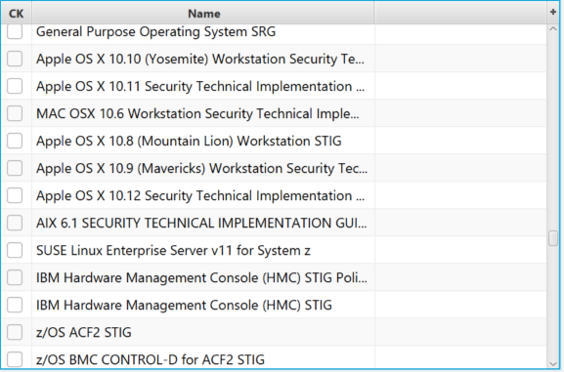

Slide 18
Severity Category Code (CAT) Levels
The risk level associated with the information assurance (IA) security weakness and the urgency for a corrective action to be completed
  CAT I Severity Code is assigned to findings that allow primary security protections to be bypassed, allowing immediate access by unauthorized personnel or unauthorized assumption of super-user privileges
    CAT I weaknesses must be corrected before an Authorization to Operate (ATO) is granted
  CAT II Severity Code is assigned to findings that have a potential to lead to unauthorized system access or activity.
    CAT II findings shall be corrected or satisfactorily mitigated before an Authorization to Operate will be granted.
    A system with a CAT II weakness can be granted an ATO only when there is clear evidence that the CAT II weakness can be corrected or satisfactorily mitigated within 180 days of the accreditation decision.
  CAT III Severity Code is assigned to recommendations that will improve IA posture but are not required for an authorization to operate

Slide 19
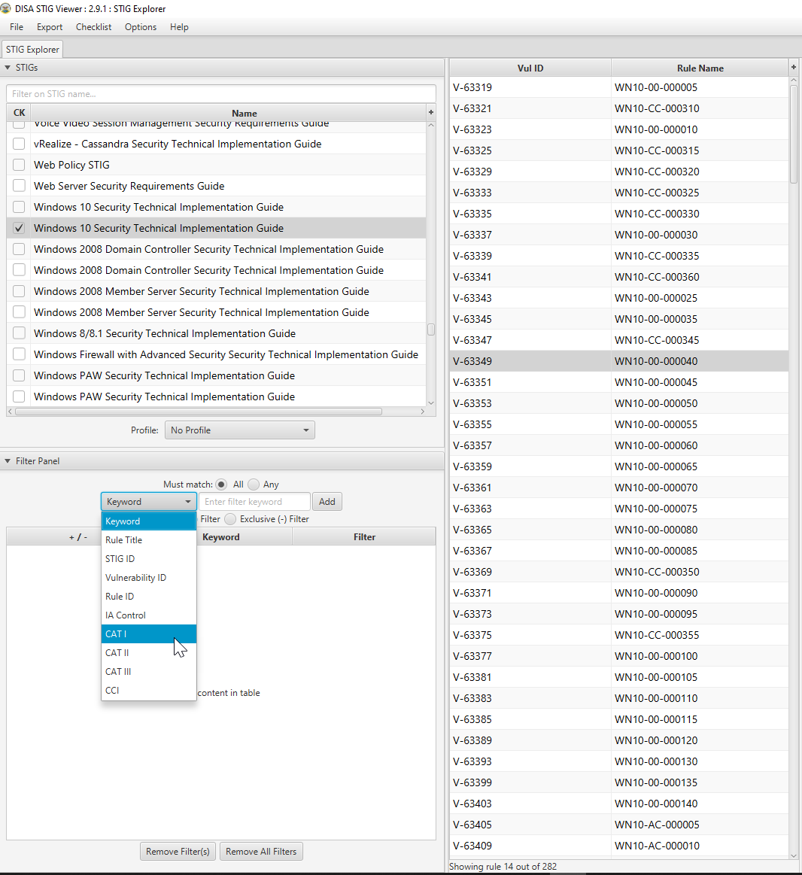
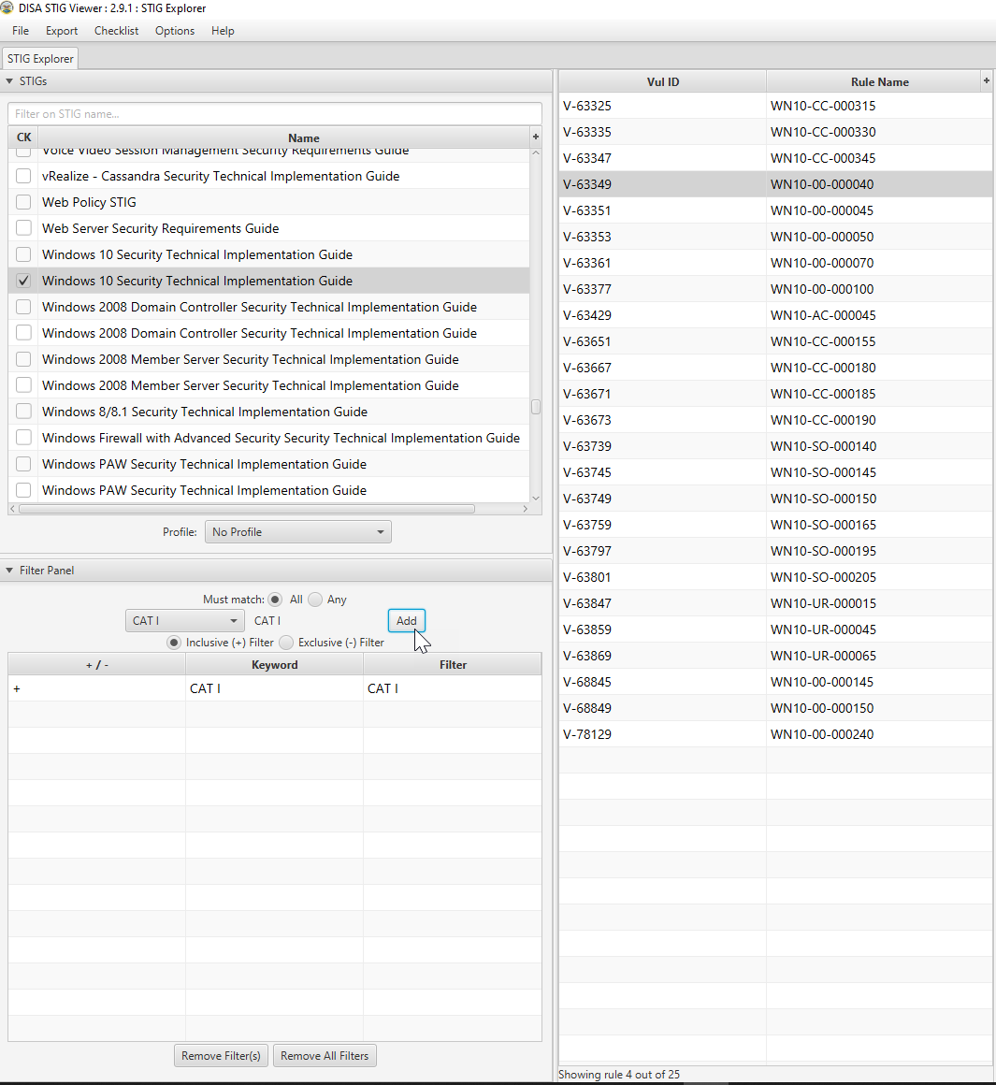

Slide 20
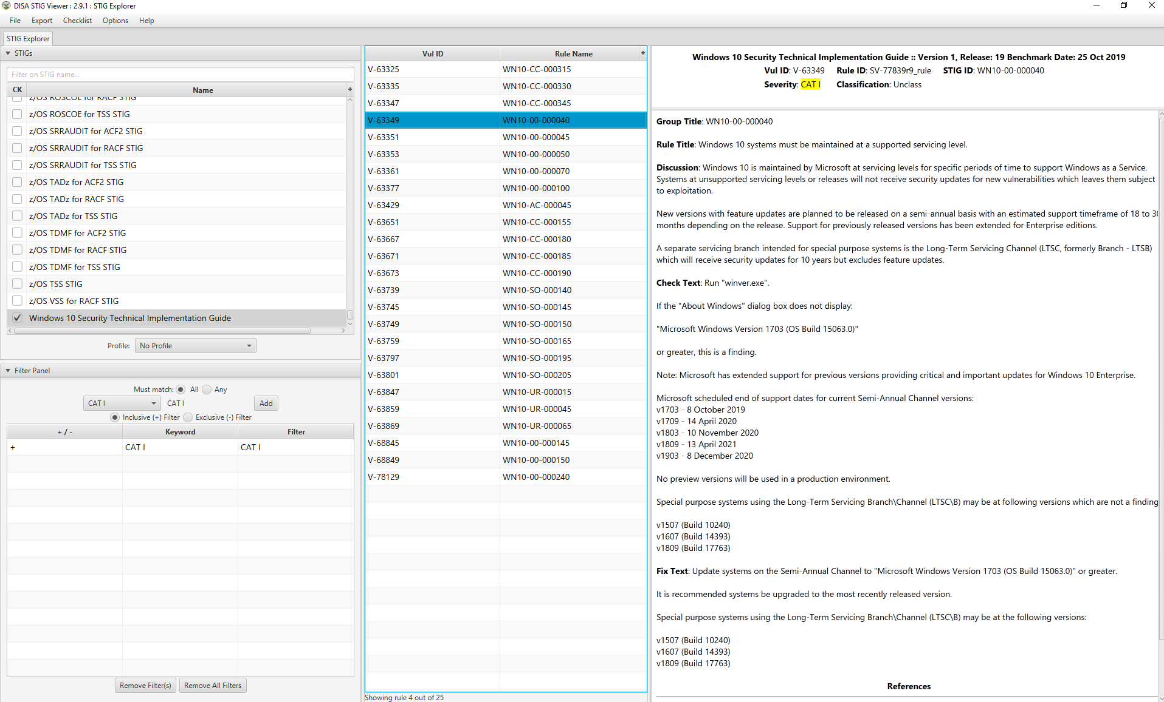

Slide 21
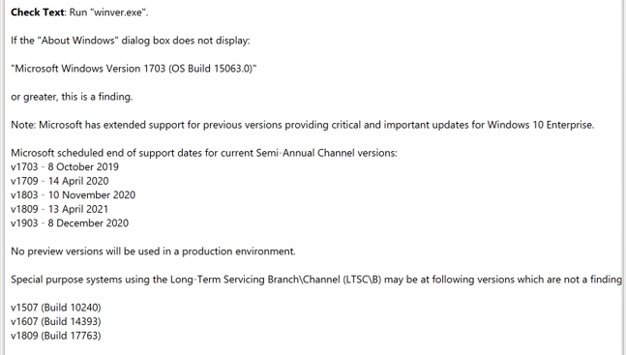
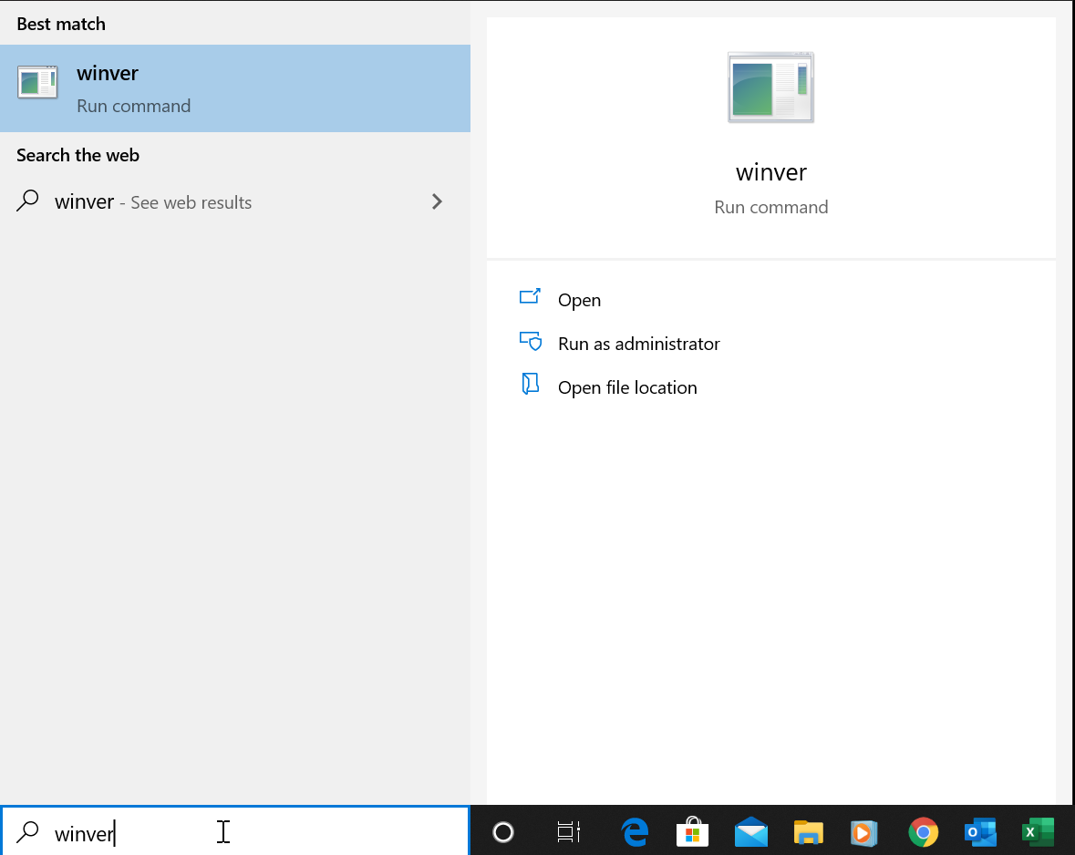
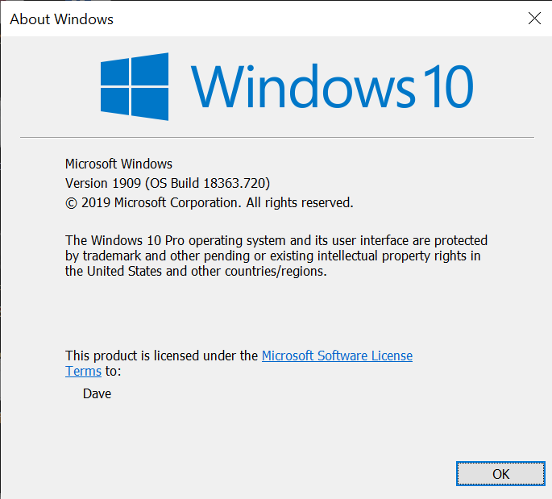

Slide 22
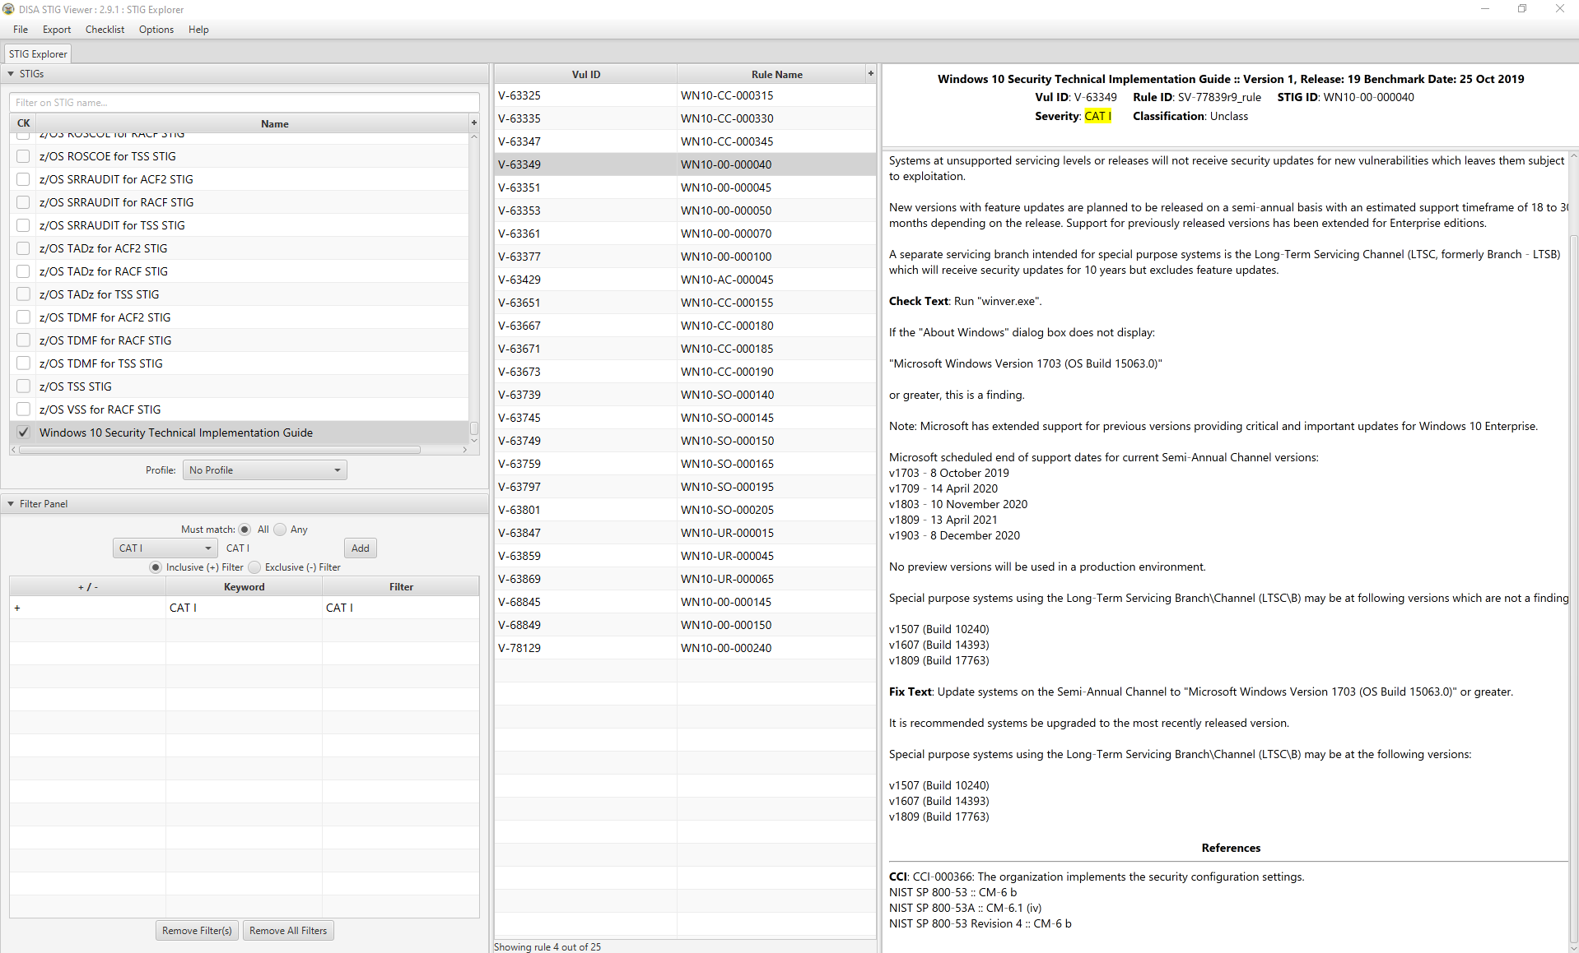
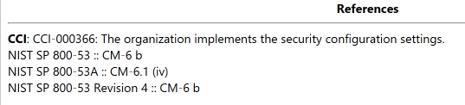

Slide 23
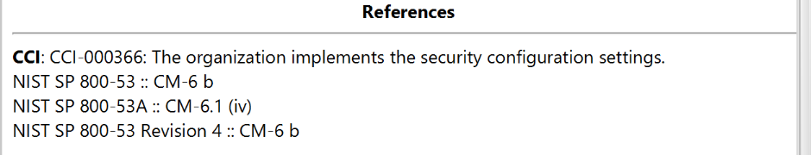
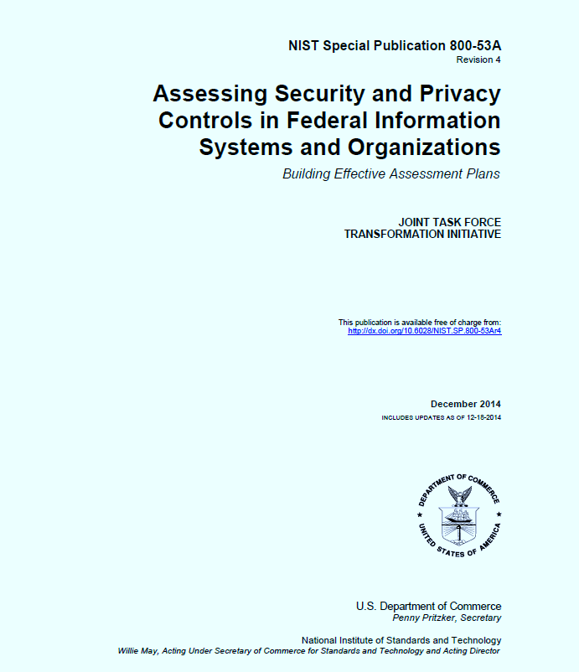
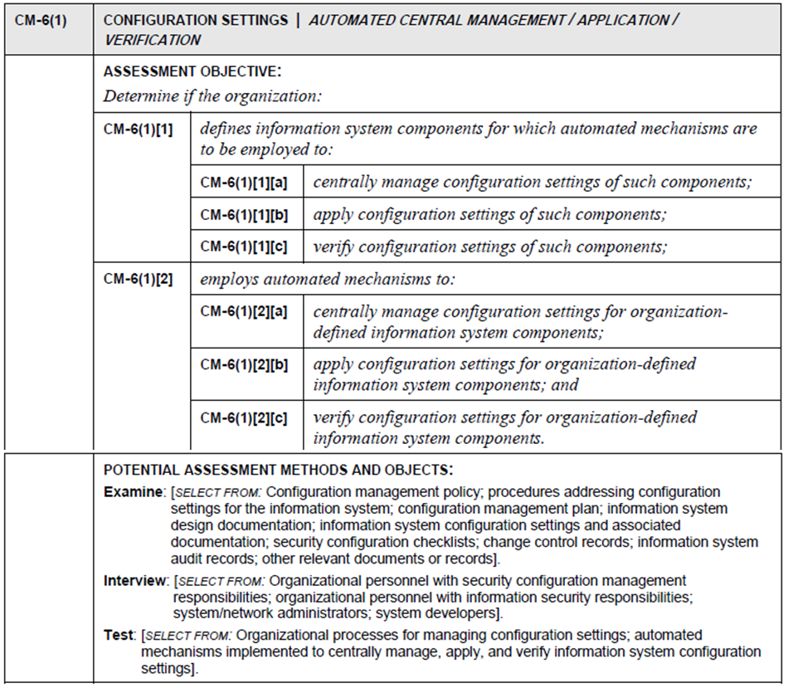

Slide 24
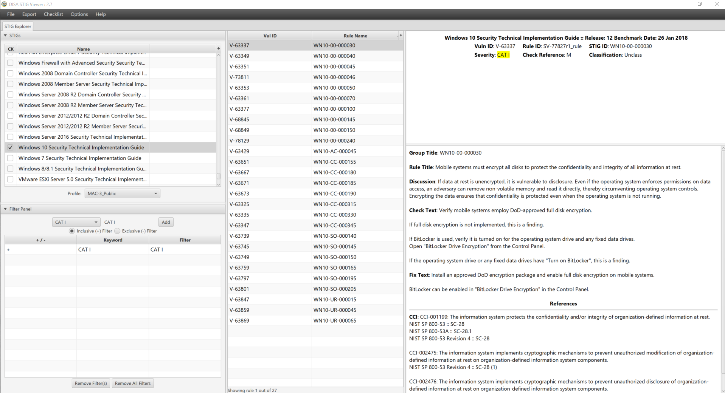

Slide 25
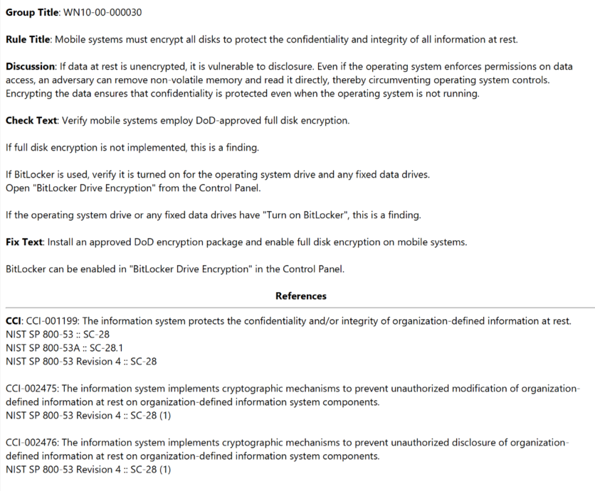
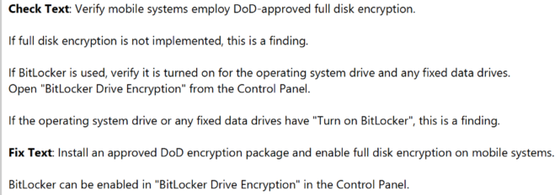

Slide 26
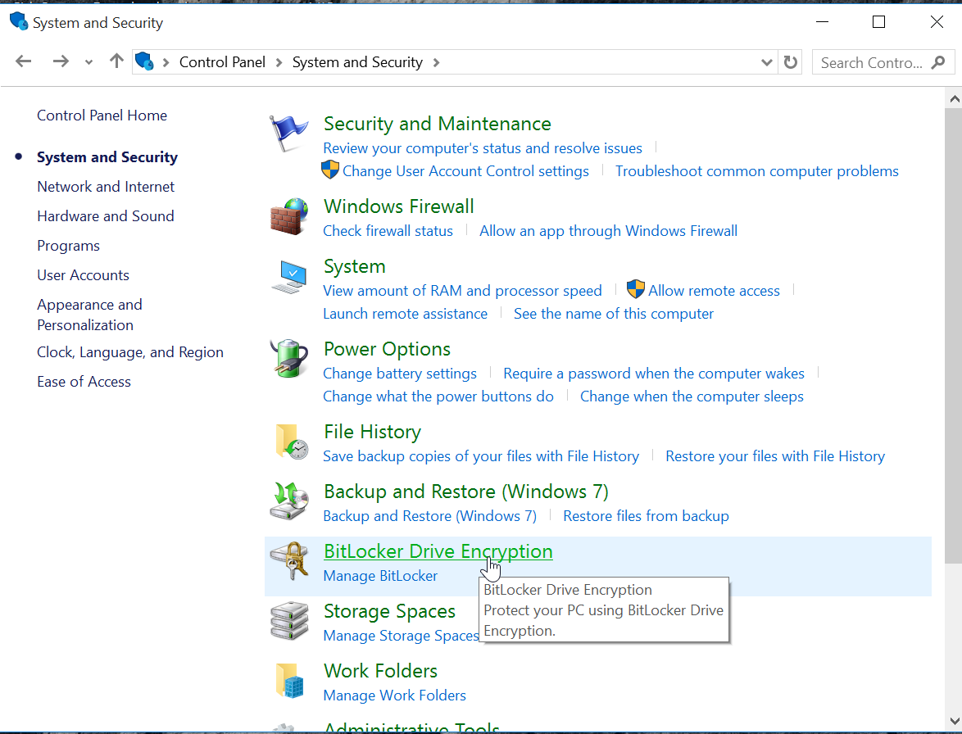


Slide 27
Agenda
Risk Management Framework – A quick review…
Implementing controls – Host hardening…
  Security configuration checklist (w/DISA STIG Viewer)
SCAP - Security Content Automation Protocol
System Security Plan’s Section 13
  Select 1 control family to fill out for your information system
Team Project - SSP draft development…

Slide 28
SCAP (Security Content Automation Protocol) pronounced “ess-cap”
Purpose: Used for continuously monitoring deployed computer systems and applications for detectable vulnerabilities and assure they incorporate security upgrades to software (“patches”) and deploy updates to configurations
SCAP based on a number of open standards, widely used to enumerate software flaws and configuration issues related to security
The National Vulnerability Database (NVD) is the U.S. government content repository for SCAP
  Vendors can get their computer system configuration scanner product validated against SCAP, demonstrating that it will interoperate with other scanners and express the scan results in a standardized way
Validated tools for automating collection of assessment objects used in Examine, Inspect and Test activities
https://en.wikipedia.org/wiki/Security_Content_Automation_Protocol

Slide 29
Examine: SCAP (Security Content Automation Protocol) validated tools may be used to automate collection of assessment objects
Common SCAP uses
  Security configuration verification
    Compare settings in a checklist to a system’s actual configuration
    Verify configuration before deployment, audit/assess/monitor operational systems
    Map individual settings to high-level requirements (requirements traceability)
    Verifying patch installation and identifying missing patches
  Check systems for signs of compromise
    Known characteristics of attacks, such as altered files or the presence of a malicious service

Slide 30


Slide 31

SCAP Compliance Scan Results

Slide 32

SCAP: Individual compliance check result for scanned host

Slide 33
SCAP (Security Content Automation Protocol) validated tools may be used to automate collection of assessment objects
National Vulnerability Database (NVD): https://nvd.nist.gov/
NVD SCAP Download: http://nvd.nist.gov/download.cfm
National Checklist Program (NCP): http://web.nvd.nist.gov/view/ncp/repository
NIST SP 800-117, Guide to Adopting and Using SCAP
NIST SP 800-126r2, The Technical Specification for SCAP
NIST SP 800-70r2, National Checklist Program for IT Products
More documentation and tools: https://scap.nist.gov/revision/1.0/index.html

Slide 34


DISA STIG Tool
+
SCAP Tool

Slide 35
Agenda
Risk Management Framework – A quick review…
Implementing controls – Host hardening…
  Security configuration checklist (w/DISA STIG Viewer)
SCAP - Security Content Automation Protocol
System Security Plan’s Section 13
  Select 1 technical control family or CM control family to fill out for your information system’s SSP
Team Project - SSP draft development questions & answers…

Slide 36
SSP’s Technical Controls: Section 13

Slide 37


SSP – Table of Contents

Slide 38

Technical Controls

Slide 39

Identification and Authentication (IA)
Organizations must identify information system users, processes acting on behalf of users, or devices and authenticate (or verify) the identities of those users, processes, or devices, as a prerequisite to allowing access to organizational information systems.

Slide 40


Identification and Authentication (IA)

Slide 41
IA-1 Identification and Authentication Policy and Procedures
Control: The organization:
Develops, documents, and disseminates to [Assignment: organization-defined personnel or roles]:
  An identification and authentication policy that addresses purpose, scope, roles, responsibilities, management commitment, coordination among organizational entities, and compliance; and
  Procedures to facilitate the implementation of the identification and authentication policy and associated identification and authentication controls; and
Reviews and updates the current:
  Identification and authentication policy [Assignment: organization-defined frequency]; and
  Identification and authentication procedures [Assignment: organization-defined frequency].

Slide 42


Slide 43


IA-1 Identification and Authentication Policy and Procedures

Slide 44
Identification and Authentication (IA)
A-2 is a common control to all baselines

Slide 45

IA-2 Identification and Authentication (Organizational Users)
Control: The information system uniquely identifies and authenticates organizational users (or processes acting on behalf of organizational users)

Slide 46






Slide 47

IA-2 Identification and Authentication
Control Enhancement:

Slide 48



Authenticator Assurance
AAL1 : = 1 Factor
AAL2 : = 2 Factors
AAL3 : = 2 Factors: Hardware-based authenticator and an authenticator that provides verifier impersonation resistance
AAL = Authenticator Assurance Level

Slide 49
Agenda
NIST Risk Management Framework – A quick review…
Implementing controls – Host hardening…
  Security configuration checklist (w/DISA STIG Viewer)
NIST 800-53Ar4 – How Controls are Assessed
SCAP - Security Content Automation Protocol
FedRAMP System Security Plan’s Section 13 – A controls deep dive
  Identity and Authentication – controls assessment questions
Team Project - SSP drafts…

Slide 50
SSP – Table of Contents

Slide 51




Slide 52
Essential Characteristics of Cloud Computing
On-demand self-service
  A consumer can unilaterally provision computing capabilities, such as server time and network storage, as needed automatically without requiring human interaction with each service provider
Broad network access
  Capabilities are available over the network and accessed through standard mechanisms that promote use by heterogeneous thin or thick client platforms (e.g., mobile phones, tablets, laptops, and workstations)
Resource pooling
  The provider’s computing resources are pooled to serve multiple consumers using a multi-tenant model, with different physical and virtual resources dynamically assigned and reassigned according to consumer demand. There is a sense of location independence in that the customer generally has no control or knowledge over the exact location of the provided resources but may be able to specify location at a higher level of abstraction (e.g., country, state, or datacenter). Examples of resources include storage, processing, memory, and network bandwidth
Rapid elasticity
  Capabilities can be elastically provisioned and released, in some cases automatically, to scale rapidly outward and inward commensurate with demand. To the consumer, the capabilities available for provisioning often appear to be unlimited and can be appropriated in any quantity at any time
Measured service
  Cloud systems automatically control and optimize resource use by leveraging a metering capability (typically done on pay-per-use or charge-per-use basis) at some level of abstraction appropriate to the type of service (e.g., storage, processing, bandwidth, and active user accounts). Resource usage can be monitored, controlled, and reported, providing transparency for both the provider and consumer of the utilized service

Slide 53
Cloud Service Models
Infrastructure as a Service (IaaS)
  The capability provided to the consumer is to provision processing, storage, networks, and other fundamental computing resources where the consumer is able to deploy and run arbitrary software, which can include operating systems and applications
  The consumer does not manage or control the underlying cloud infrastructure but has control over operating systems, storage, and deployed applications; and possibly limited control of select networking components (e.g., host firewalls)
Platform as a Service (PaaS)
  The capability provided to the consumer is to deploy onto the cloud infrastructure consumer-created or acquired applications created using programming languages, libraries, services, and tools supported by the provider
  The consumer does not manage or control the underlying cloud infrastructure including network, servers, operating systems, or storage, but has control over the deployed applications and possibly configuration settings for the application-hosting environment
Software as a Service (SaaS)
  The capability provided to the consumer is to use the provider’s applications running on a cloud infrastructure. The applications are accessible from various client devices through either a thin client interface, such as a web browser (e.g., web-based email), or a program interface
  The consumer does not manage or control the underlying cloud infrastructure including network, servers, operating systems, storage, or even individual application capabilities, with the possible exception of limited userspecific application configuration settings

Slide 55
Cloud Deployment Models
Private cloud
  The cloud infrastructure is provisioned for exclusive use by a single organization comprising multiple consumers (e.g., business units)
  It may be owned, managed, and operated by the organization, a third party, or some combination of them, and it may exist on or off premises
Community cloud
  The cloud infrastructure is provisioned for exclusive use by a specific community of consumers from organizations that have shared concerns (e.g., mission, security requirements, policy, and compliance considerations)
  It may be owned, managed, and operated by one or more of the organizations in the community, a third party, or some combination of them, and it may exist on or off premises
Public cloud
  The cloud infrastructure is provisioned for open use by the general public
  It may be owned, managed, and operated by a business, academic, or government organization, or some combination of them. It exists on the premises of the cloud provider
Hybrid cloud
  The cloud infrastructure is a composition of two or more distinct cloud infrastructures (private, community, or public) that remain unique entities, but are bound together by standardized or proprietary technology that enables data and application portability (e.g., cloud bursting for load balancing between clouds)

Slide 57
Agenda
NIST Risk Management Framework – A quick review…
Implementing controls – Host hardening…
  Security configuration checklist (w/DISA STIG Viewer)
NIST 800-53Ar4 – How Controls are Assessed
SCAP - Security Content Automation Protocol
FedRAMP System Security Plan’s Section 13 – A controls deep dive
  Identity and Authentication – controls assessment questions
System Security Plan’s Section 8
  Information System Type
Team Project - SSP drafts…

Slide 58

Next Time We Meet 3/31 – Logical diagrams
Network diagram depicting locations and relationships among:
  Servers
  Security components
  Internet
  Users
  Interconnected systems
Boundary diagram - network diagram that also depicting boundaries and flow of data across interconnections that cross internal and external boundaries:
  Security zones
  Internal Interconnections to external systems
Data flow (simplified) – a series of individual boundary diagrams that also depict data flowing to/from individual classes of users that enable seeing how their data packets are secured as they flow across the boundaries and through the logical network
  End users
  System administrators
  Testers
  Developers

Slide 59
Agenda
NIST Risk Management Framework – A quick review…
Implementing controls – Host hardening…
  Security configuration checklist (w/DISA STIG Viewer)
NIST 800-53Ar4 – How Controls are Assessed
SCAP - Security Content Automation Protocol
FedRAMP System Security Plan’s Section 13 – A controls deep dive
  Identity and Authentication – controls assessment questions
System Security Plan’s Section 8
  Information System Type
Team Project - SSP drafts…

