Slide 1
Unit #10
Application Security
MIS5214

Slide 2
Agenda
Distributed Systems​
File Server Architecture​
Client/Server Architecture​
N-Tier Architecture​
Cloud Architecture​
Service Oriented Architecture (SOA)
Frameworks for application security assessment
Best practices for secure application development
Test areas for auditing applications
Team Project – guidance and status reporting

Slide 3
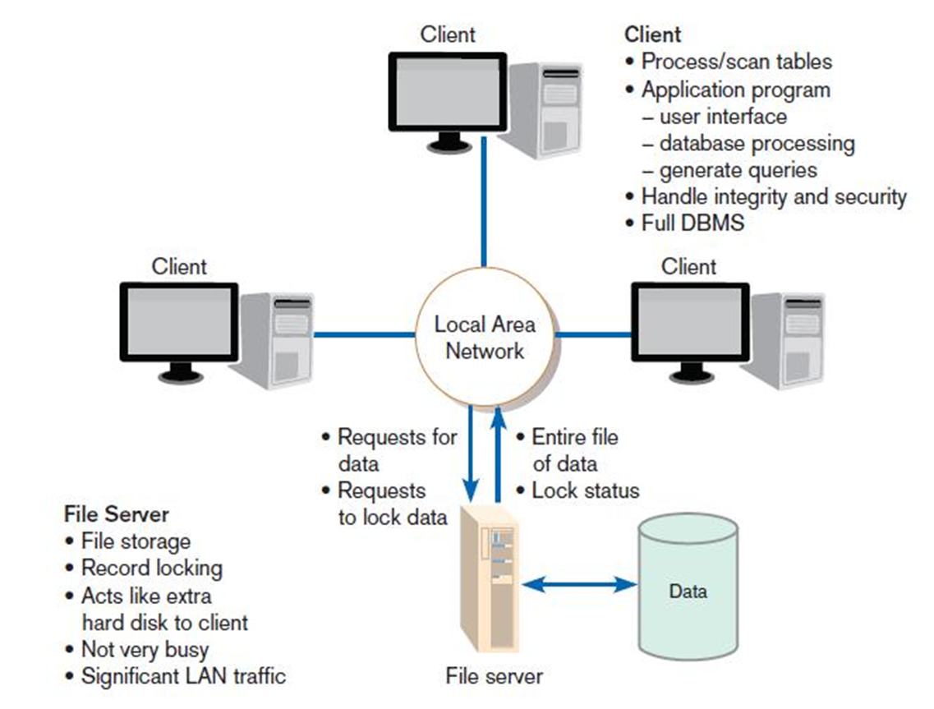
File Server architecture
File server: a device that manages file operations and is shared by each client PC attached to a LAN
The simplest configuration
Applications and data control take place on the client computers.
The file server simply holds shared data

Slide 4
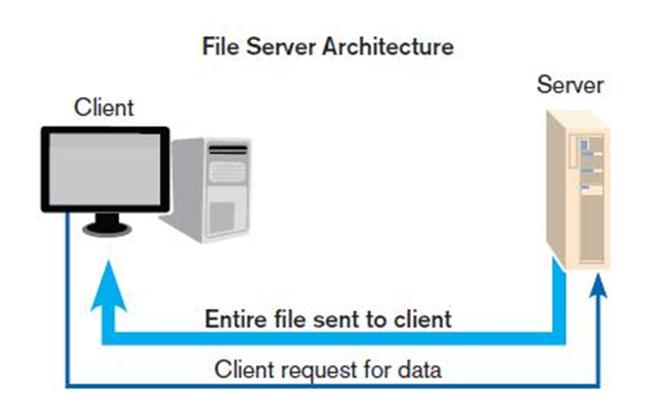
Limitations of File Server Architecture
Excessive data movement
Entire dataset must be transferred, instead of individual data records
Need for powerful client workstations
Each client workstation must devote memory and computational resources to run a complete standalone application
Decentralized data control
Data file concurrency control, recovery, and security are complicated

Slide 5
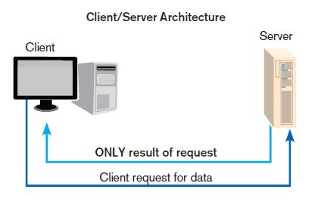
Client-Server Architecture
LAN-based computing environment in which
A central database server or engine performs all database commands sent to it from client workstations
Application programs on each client concentrate on user interface functions
Application processing is divided between client and server
Client manages the user interface
Database server is responsible for data storage and query processing
Increased efficiency and control over File server
Server only sends specific data, not entire files, which saves on network bandwidth
Computing load is carried out by the server
Increasing security
Decreasing computing demand on the clients

Slide 6
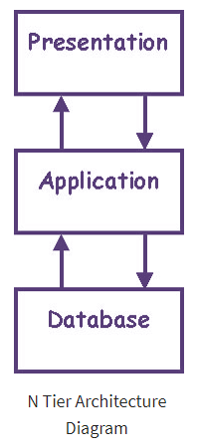
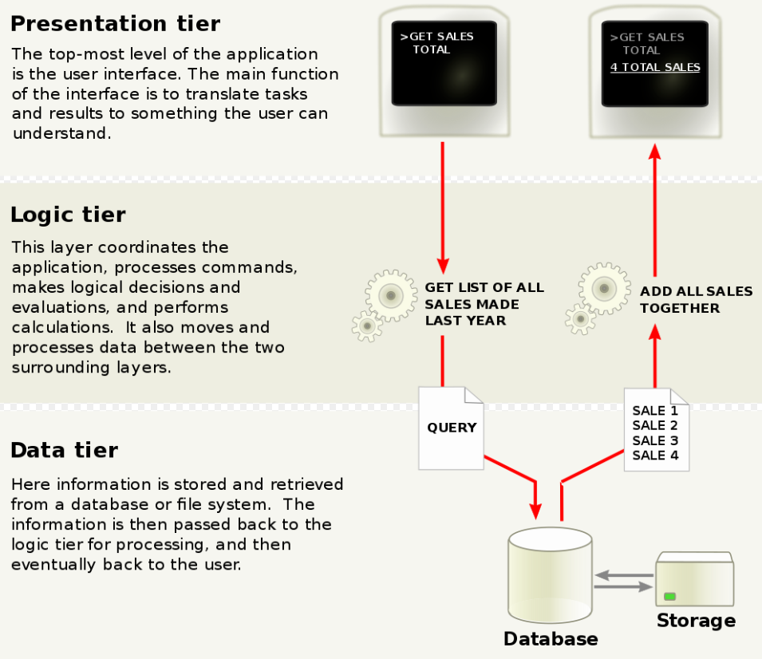
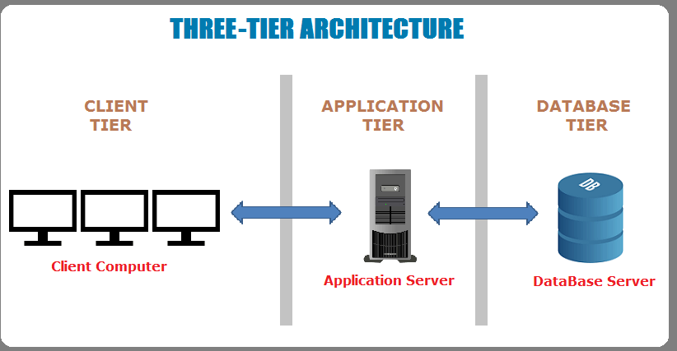
N-Tier Architecture

Slide 7
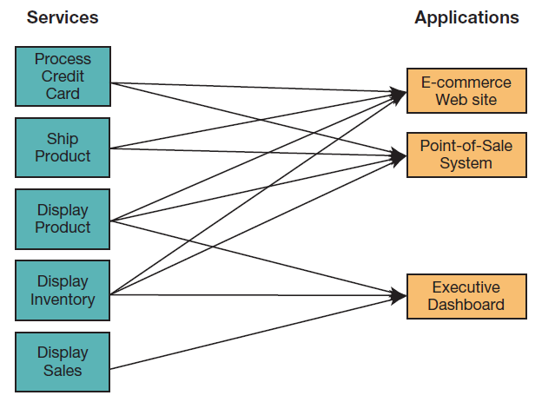
Service Oriented Architecture (SOA)
A software architecture
Business processes broken down into individual components (services)
Designed to achieve desired results for the service consumer
Application
Another service
Person (user)
Principles:
Reusability
Interoperability
Componentization
Using SOA, multiple applications can invoke multiple services

Slide 8
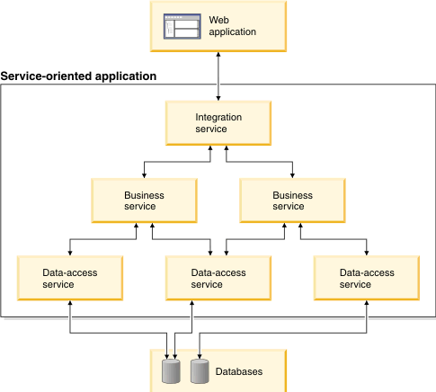
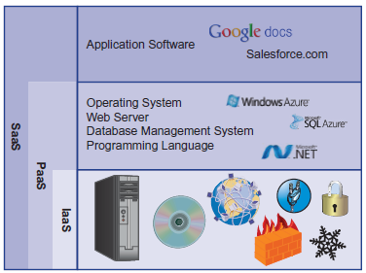
N-Tier Applications using SOA in the cloud

Slide 9
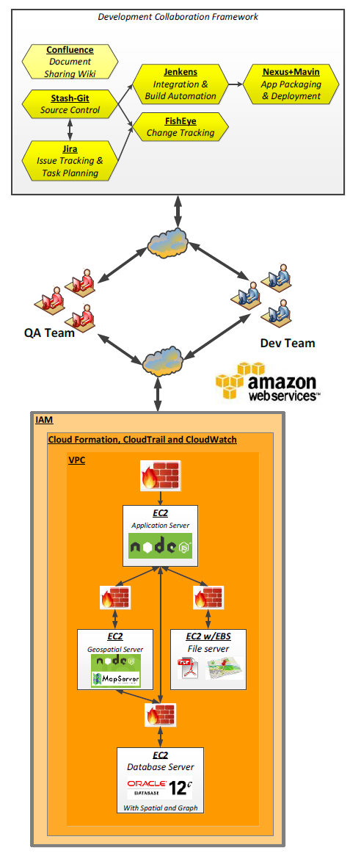
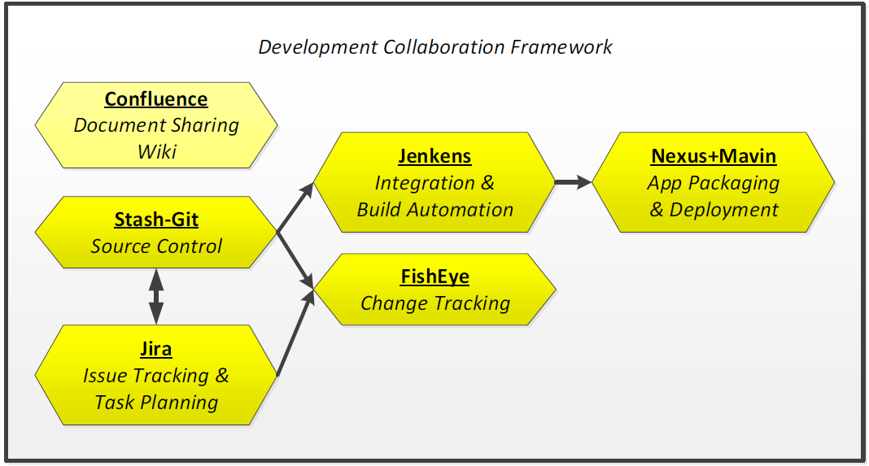
Development Infrastructure Example…
Examples of supporting systems

Slide 10
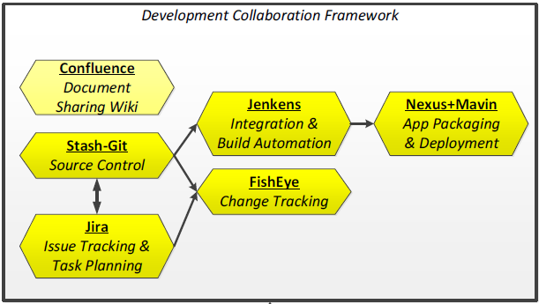
Source Control
Web-based hosting of repository service for distributed access and version control of programming code
Enables maintaining versioned shareable software code and design artifacts with check-in/check-out and maintenance capabilities

Slide 11
Issue Tracking System
Enables organization, prioritization, triage, planning and tracking resolution of issues, bugs, and project tasks
Provides visibility of issues and tasks on “To Do”, “In Progress”, “For Review”, and “Done lists”
Integration of Issue Tracking and Source Control Systems enables end-to end traceability of issue and tasks through resolution to source code implementation and issue to source code resolution
Change tracking and control enables visualizing and reporting on revisions and changes made to source code and documents by project teammates
Enables linking software issue documentation to code differences, sets of changes, full source code and provides a visual audit trail of changes over time in Source Control

Slide 12
Continuous Integration & Continuous Deployment
Helps development team make system builds, triggered by either
A commit of updated source code to the version control system
Scheduling directive
A dependency on the completion of another component’s build
Developer kicking off the build using a URL to make the request

Slide 13
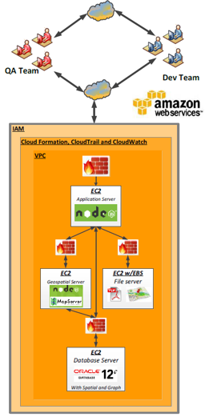
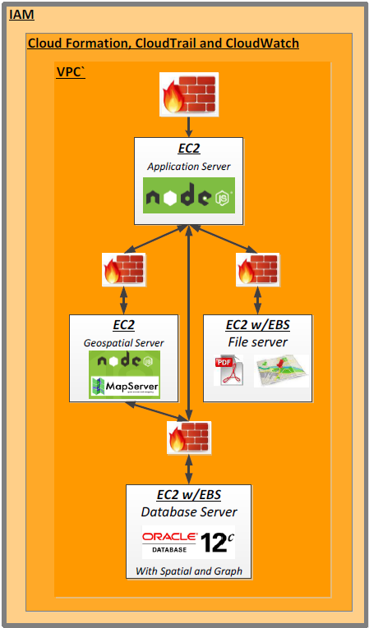
Development Infrastructure Example…
VPC = virtual private cloud

Slide 14
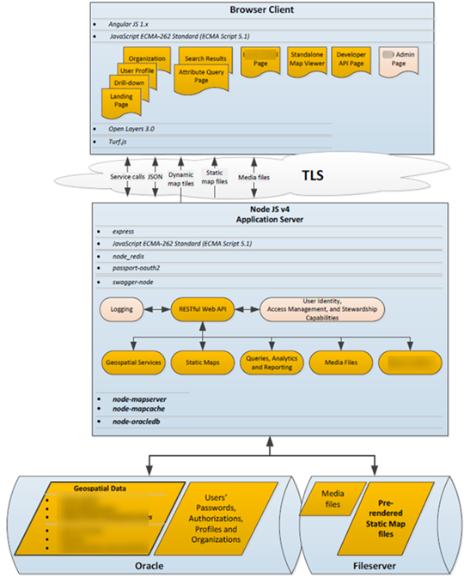
Application 3+ Tier Architecture example

Slide 15
PPTM - People, Processes, Tools, and Measures
A brainstorming framework for examining security of an application from the macro-level, based on
People – describes every aspect of the application that deals with a human
Make sure the right people are involved in planning, design, implementation or operations, and the right stakeholders are involved
E.g. If the application involves end users, ensure:
The application has controls around providing and removing access
End users have been involved with the planning and design of components they will (to ensure usability)
Process – Describes every aspect of the application that is involved in a policy, procedure, method, or course of action
Review the interaction of the application with interfacing systems and verify compliance with security models
E.g. Ensure that firewalls are in place to protect the application from external applications, users, business partners, …
Policies and procedures should be written to support how the application is intended to be used
Adequate documentation should exist to support technicians who need to maintain the application
Tools – Describe every aspect of the application that deals with concrete technology or product
Ensure appropriate hardware and environment exist to support the application
Ensure the application interfaces with recommended technologies appropriate for your intended policies and procedures
Verify that the application and infrastructure are tested and audited appropriately
Measures – Describe every aspect of the application that is quantifiable conceptually, such as the business purpose or application performance
E.g. verify that the application meets well-documented and well-thought out acceptance criteria
E.g. if the application is intended to solve a quantifiable business problem verify that it does indeed solve the problem
Verify that the logs are meaningful and that you can measure the performance of the application

Slide 16
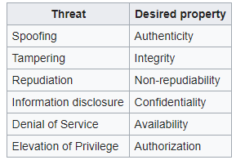
STRIDE
A “simplified threat-risk model” which is easy to remember
Spoofing Identity
Is a key risk for applications with many users and a single execution context at the application and database tiers
Users should not be able to become any other user or assume the attributes of another user
Tampering with Data
Data should be stored in a secure location, with access appropriately controlled
The application should carefully check data received from the user and validate that it is “sane” (i.e. relevant and valid) and applicable before storing or using it
Data entered in the client (e.g. browser) should be checked and validated on the server and not in the client where the validation checks might be tampered with
Application should not send and calculate data in the client where the user can manipulate the data, but in the server-side code
Repudiation
Determine if the application requires nonrepudiation controls, such as web access logs, audit trails at each tier, or the same user context from top to bottom
Users may dispute transactions if there is insufficient auditing or record-keeping of their activity
Denial of Service
Application designers should be aware that their applications are at risk of denial of service attacks
Use of expensive resources (e.g. large files, heavy-duty searches, long queries) should be reserved for authenticated and authorized users and should not be available to anonymous users.
Every facet of the application should be engineered to perform as little work as possible, to use fast and few database queries, and to avaoid exposing large files or unique links per user to per user to prevent simple denial-of-service attacks
Elevation of Privilege
If an application provides distinct user and administrative roles, ensure that the user cannot elevate his or her role to a more highly privileged one
All actions should be controlled through an authorization matrix to ensure that only the permitted roles can access privileged functionality. It is not sufficient, for example, to not display privileged-role links

Slide 17
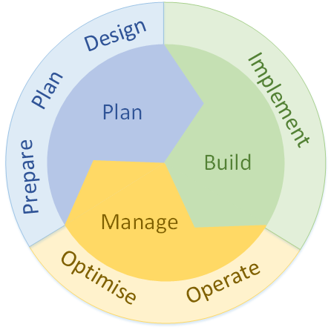
PPDIOO – Prepare, Plan, Design, Implement, Operate, Optimize
from CISCO Systems
Can help considers potential network challenges for a new application system
Creates a baseline of how a network should perform and behave
Uses the baseline to measure project success and monitor network health
Prepare: Establishes organization and business requirements, develops a network strategy, and proposes a high-level architecture
Plan: Identifies the network requirements by characterizing and assessing the network and performing a gap analysis
Design: Provides high-availability, reliability, security, scalability, and performance
Implement: Installation and configuration of new equipment
Operate: Day-to-day operations
Optimize: Proactive network management; modifications to the design

Slide 18
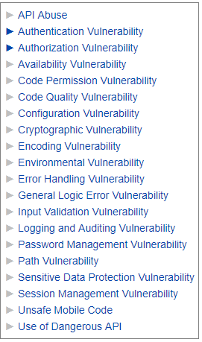
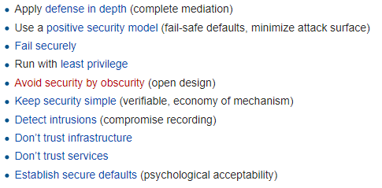
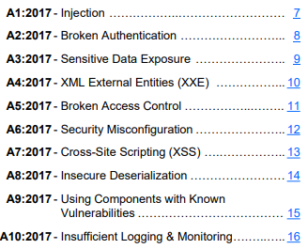
OWASP (Open Web Application Security Project) Frameworks
Vulnerabilities
Principles
Top 10 Web Application Security Risks
Injection: Injection flaws, such as SQL, QS, and LDAP injection occur when untrusted data is sent to an interpreter as part of a command or query. The attacker’s hostile data ran trick the interpreter into executing unintended commands or accessing data without proper authorization.

Slide 19
Agenda
Frameworks for application security assessment
Best practices for secure application development
Test areas for auditing applications
Team Project – guidance and Q&A

Slide 20
Static & Dynamic Application Security Testing
Static application security testing (SAST)
Can be thought of as testing the application from the inside out
By examining its source code, byte code or application binaries for conditions indicative of a security vulnerability
Dynamic application security testing (DAST)
Can be thought of as testing the application from the outside in
By examining the application in its running state, and trying to poke it and prod it in unexpected ways in order to discover security vulnerabilities
Some vulnerabilities can be found only with SAST testing, others with DAST
Testing in both ways yields the most comprehensive testing
Many web applications that would be traditionally scanned with DAST tools also use a significant amount of client-side code often in the form of Javascript, Python, CSS, PHP, Ruby,…
This code must also be analyzed for security vulnerabilities, typically using static analysis

Slide 21
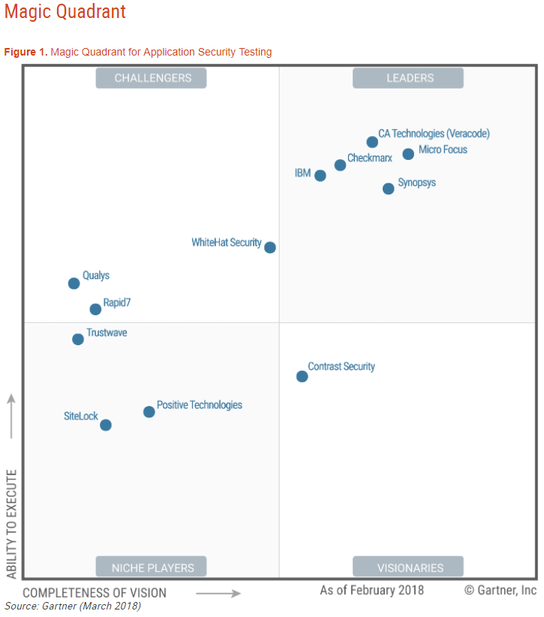
Automated application security testing tools
Many vendors provide both SAST and DAST tools

Slide 22
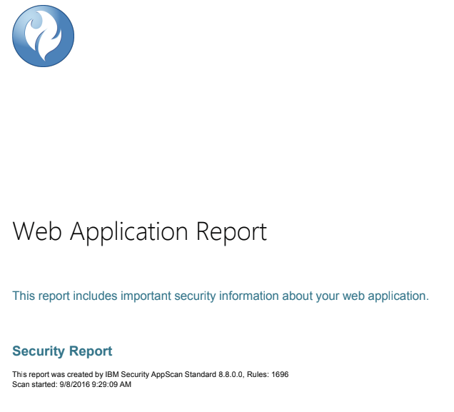
Automated application security testing tools often provide vulnerability reports

Slide 23
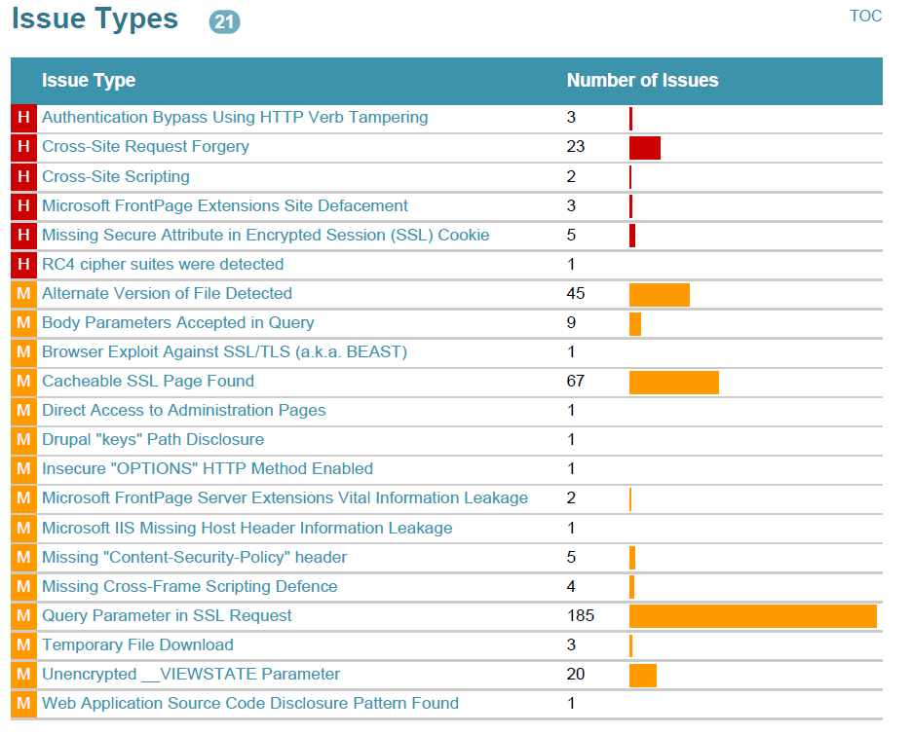
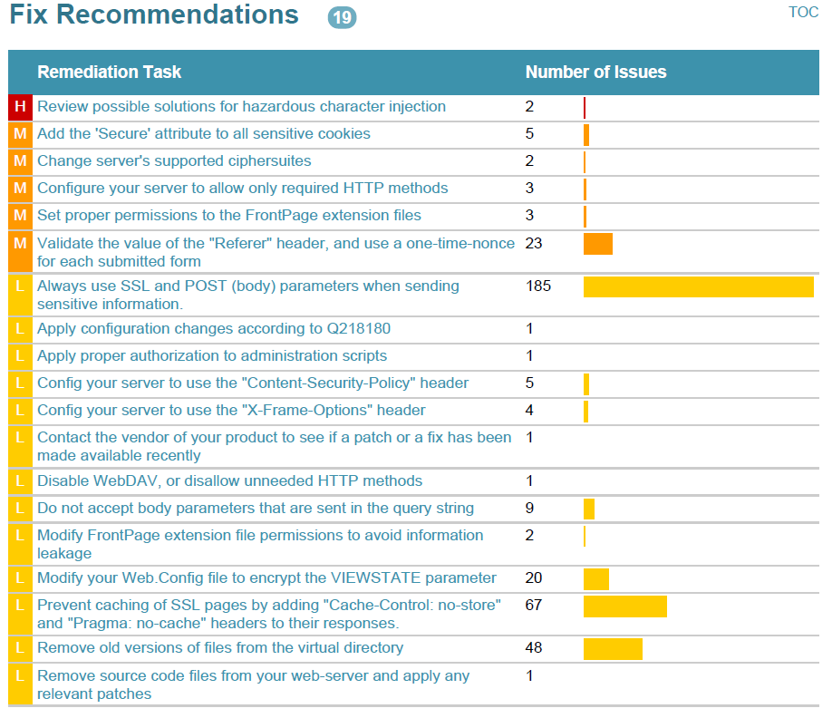
Application Security Assessment and Recommendations

Slide 24
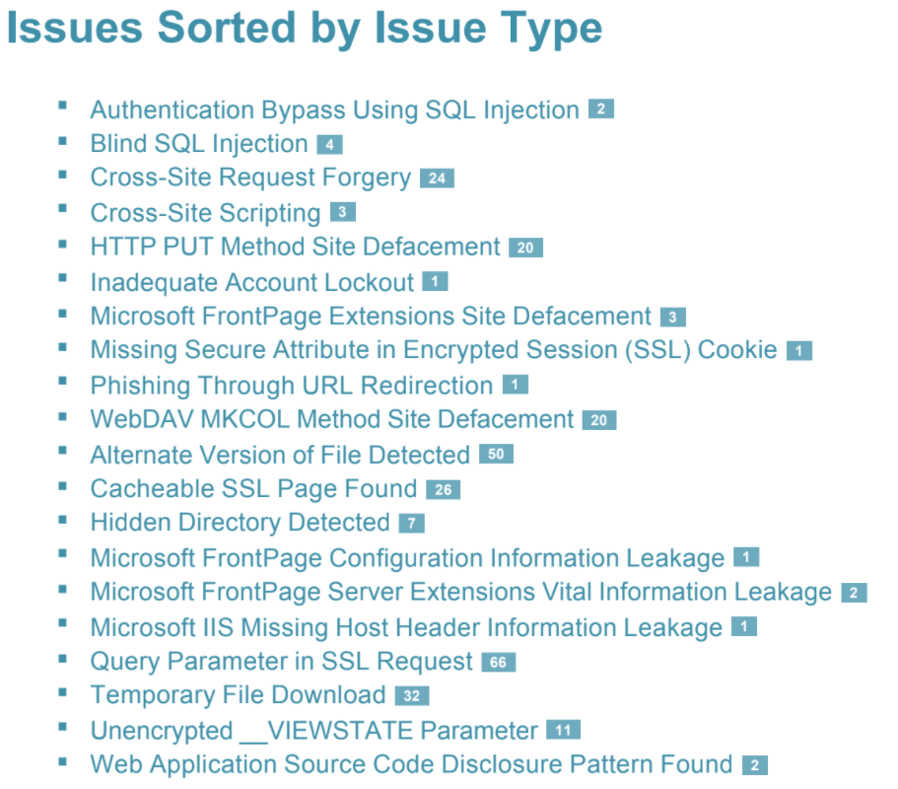
Application Security Vulnerability
Assessment Report

Slide 25
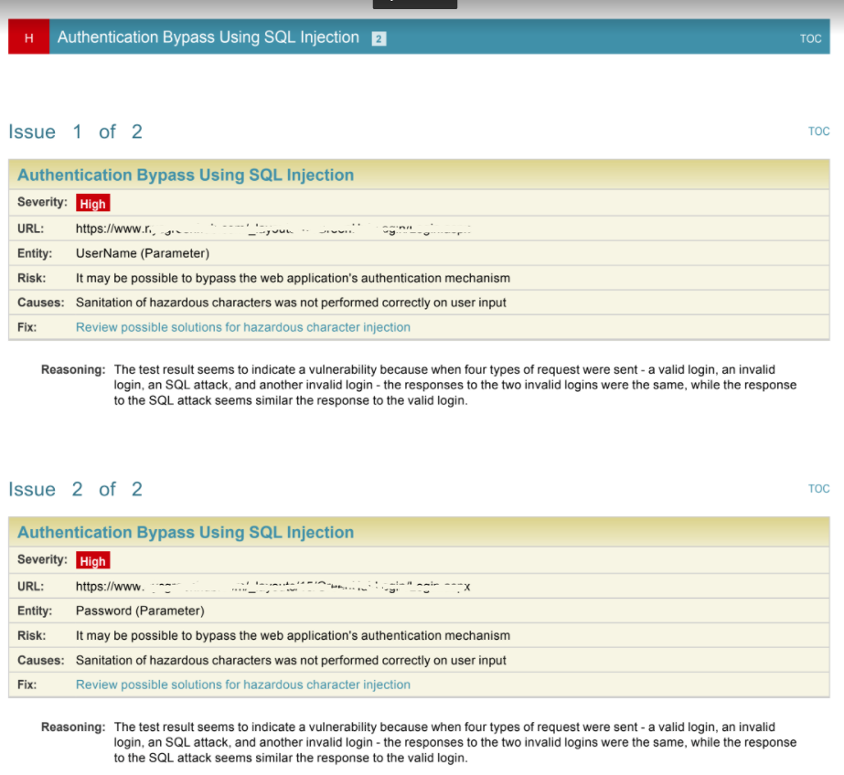
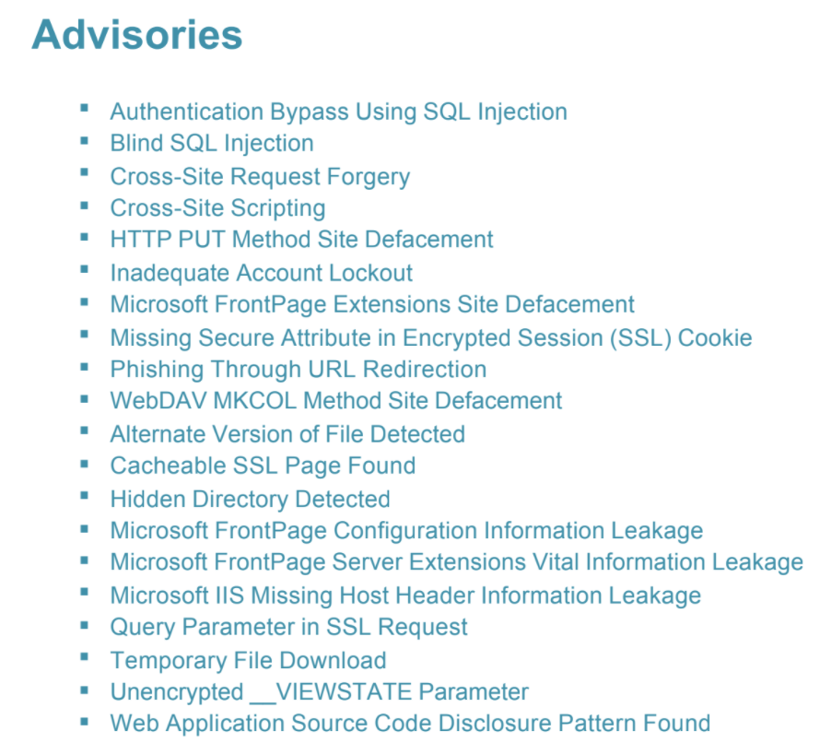
IBM AppScan example

Slide 26
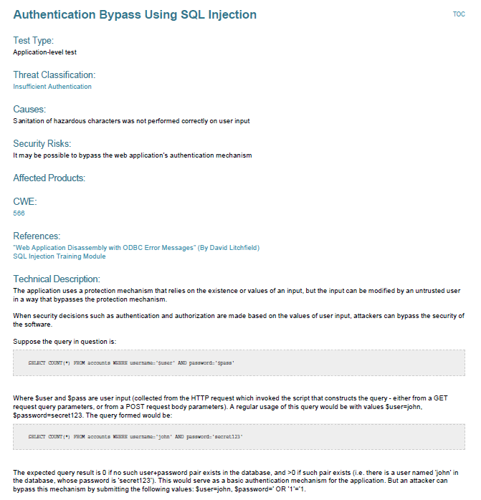

Slide 27
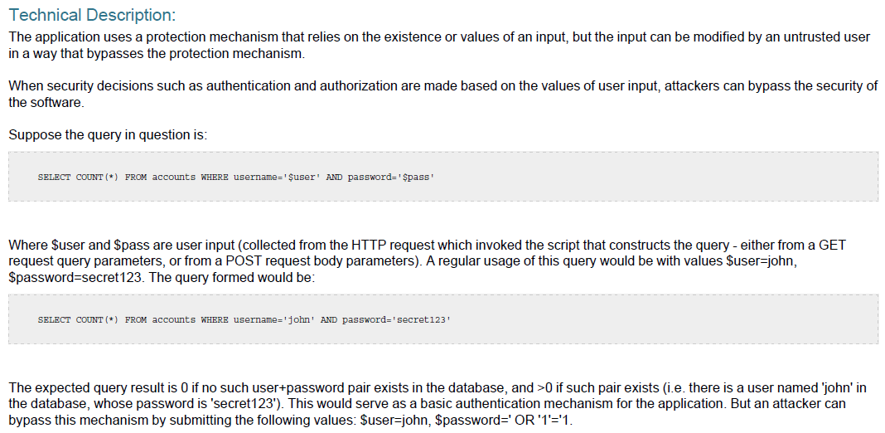

Slide 28
Additional best practices for secure application development
Defense-in-Depth
Positive Security Model
Fail Securely
Run with Least Privilege
Avoid Security by Obscurity
Keep Security Simple
Use Open Standards
Keep, manage and analyze logs to detect Intrusions
Never Trust External Infrastructure and Services
Establish Secure Defaults
Characteristics which can help in quickly spotting common weaknesses and poor controls

Slide 29
Defense In Depth
Layered approaches provide more security over the long term than one complicated mass of security architecture
Sequences of routers, firewalls and intrusion detection/protection monitoring devices used to examine data packets, reduce undesired traffic and protect the inner information systems
Access Control Lists (ACLs), for example, on the networking routers and firewall equipment to allow only necessary traffic to reach the application
Quickly eliminating access to services, ports, and protocols significantly lowers the overall risk of compromise to the system on which the application is running

Slide 30
Positive Security Model
Positive security models use “whitelist” to allow only what is on the list, excluding everything else by default
“Deny by default”
A challenge for antivirus programs
In contrast with negative (blacklist) security models that allow everything by default, eliminating only the items known to be bad
Problems:
Blacklist must be kept up to date
Even if blacklist is updated, an unknown vulnerability can still exist
Attack surface is much larger than with a positive security model

Slide 31
Fail Safely
An application failure can be dealt with in one of 3 ways:
Allow
Block
Error
In general, application errors should all fail in the same way:
Disallow the operation (as viewed by the user) and provide no or minimal information on the failure
Do not provide the end user with additional information that may help in compromising the system
Put the error information in the logs, but do not provide to the user to use in compromising the system

Slide 32
Run with Least Privilege
Principle of Least Privilege mandates that accounts have the least amount of privilege possible to perform their activity
This includes:
User rights
Resource permissions such as CPU limits, memory capacity, network bandwidth, file system permissions, and database permissions

Slide 33
Avoid Security by Obscurity
Obfuscating data (hiding it) instead of encrypting it is a very weak security mechanism
If a human can figure out how to hide the data a human can learn how to recover the data
Never obfuscate critical data that can be encrypted or never stored in the first place

Slide 34
Keep Security Simple
Simple security mechanisms are easy to verify and easy to implement correctly
Avoid complex security mechanisms if possible
“The quickest method to break a cryptographic algorithm is to go around it”
Do not confuse complexity with layers: Layers are good; complexity isn’t

Slide 35
Use Open Standards
Open security standards provide increased portability and interoperability
IT infrastructure is often a heterogeneous mix of platforms, open standards helps ensure compatibility between systems as the application grows
Open standards are often well known and scrutinized by peers in the security industry to ensure they remain secure

Slide 36
Keep, manage and analyze logs to help detect intrusions
Applications should have built-in logging that is protected and easily read
Logs help you troubleshoot issues, and just as important – help you to track down when or how an application might have been compromised

Slide 37
Never Trust and “Zero Trust” External Infrastructure and Services
Many organizations use the processing capabilities of third-party partners that more than likely have differing security policies and postures than your organization
It is unlikely that you can influence or control an external third party
Implicitly trusting externally run systems is dangerous!

Slide 38
Establish Secure Defaults
New applications should arrive or be presented to users with the most secure default settings possible that still allow business to function
This may require training end users or communications messages
End result is a significantly reduced attack surface
Especially when application is pushed out across a large population

Slide 39
Agenda
Frameworks for application security assessment
Best practices for secure application development
Test areas for auditing applications
Team Project – guidance and Q&A

Slide 40
Test Areas for Auditing Applications
Input Controls
Review and evaluate controls built into system transactions for input data
Determine the need for error/exception reports related to data integrity and evaluate whether this need has been filled
Interface Controls
Review and evaluate the controls in place over data feeds to and from interfacing systems
If the same data is kept in multiple databases and/or systems, ensure that periodic sync processes are executed to detect any inconsistencies in the data
Audit Trails
Review and evaluate the audit trails present in the system and the controls over those audit trails
Ensure that the system provides a means of tracing a transaction or piece of data from the beginning to the end of the process enabled by the system

Slide 41
Test Areas for Auditing Applications
Software Change Controls
Ensure that the application software cannot be changed without going through a standard checkout/staging/testing/approval process after it is placed into production
Evaluate controls regarding code checkout and versioning
Evaluate controls regarding the testing of application code before it is placed into a production environment
Evaluate controls regarding batch scheduling
Backup and Recovery
Determine whether a Business Impact Analysis (BIA) has been performed on the application to establish backup and recovery needs
Ensure that appropriate backup and recovery controls are in place
Ensure appropriate recovery controls are in place

Slide 42
Test Areas for Auditing Applications
Data Retention and User Involvement
Evaluate controls regarding the application’s data retention
Evaluate overall user involvement and support for the Application
Identity, Authentication, and Access Controls…
Host Hardening…

Slide 43
Agenda
Frameworks for application security assessment
Best practices for secure application development
Test areas for auditing applications
Team Project – guidance and Q&A

Slide 44
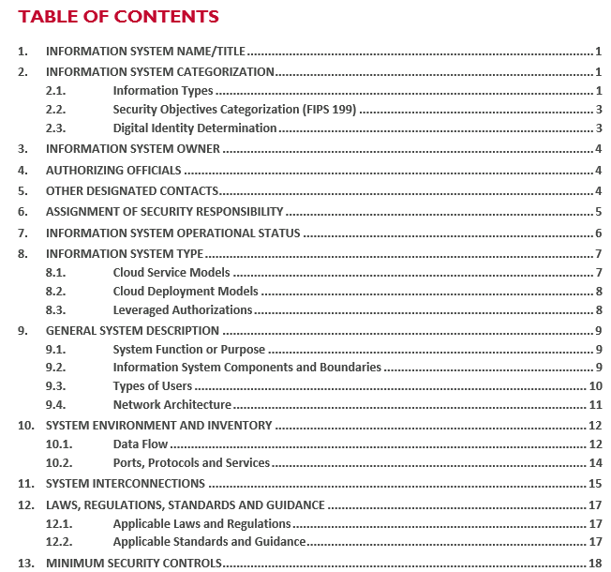
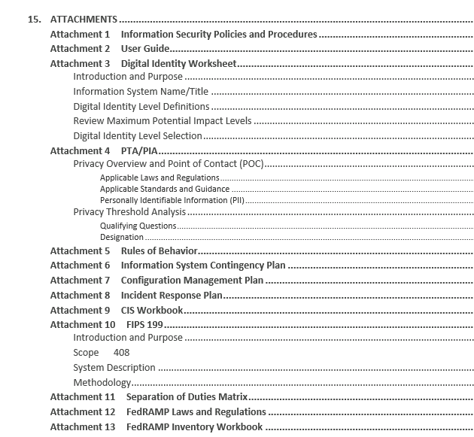
Team Project SSP Deliverable Sections to Fill out: 1, 2, 7, 8, 9, 10.1, 11, 13 (one technical control family), Attachments 3, 4, 6, and 10

Slide 45
Team Project Guidance
Instructions for diagrams for sections:
9.2 (Information System Components and Boundaries),
9.4 (Network Architecture)
10.1 (Data Flow)
These can all be based on the high-level logical network diagram you create for section 9.4 (Network Architecture)
Be sure to include the locations of the users in your diagram
In addition to including them in your SSP, you should include and label this diagrams in a separate PDF file document that you deliver along with your SSP

Slide 46
Team Project Guidance
Instructions for diagrams for sections:
9.2 (Information System Components and Boundaries),
9.4 (Network Architecture)
10.1 (Data Flow)
These can all be based on the high-level logical network diagram you create for section 9.4 (Network Architecture)
Be sure to include the locations of the users in your diagram
In addition to including them in your SSP, you should include and label this diagrams in a separate PDF file document that you deliver along with your SSP

Slide 47
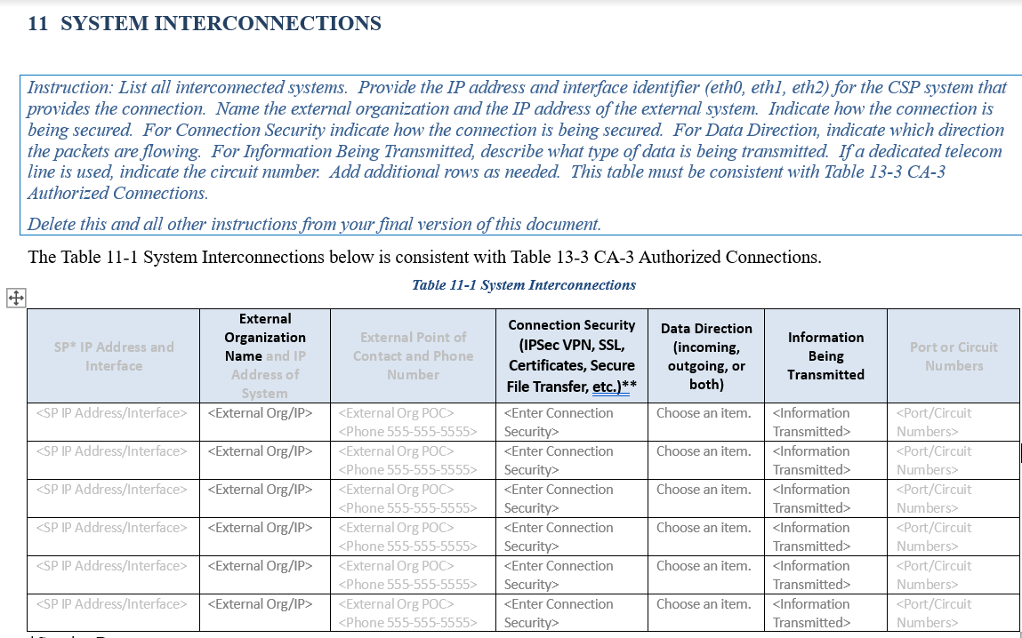
Team Project Guidance
Instructions for Section 11’s Table 11-1, only identify:
External System (column 2)
Connection Security (column 4)
Data Direction (column 5)
Information Being Transmitted (column 6)

Slide 48
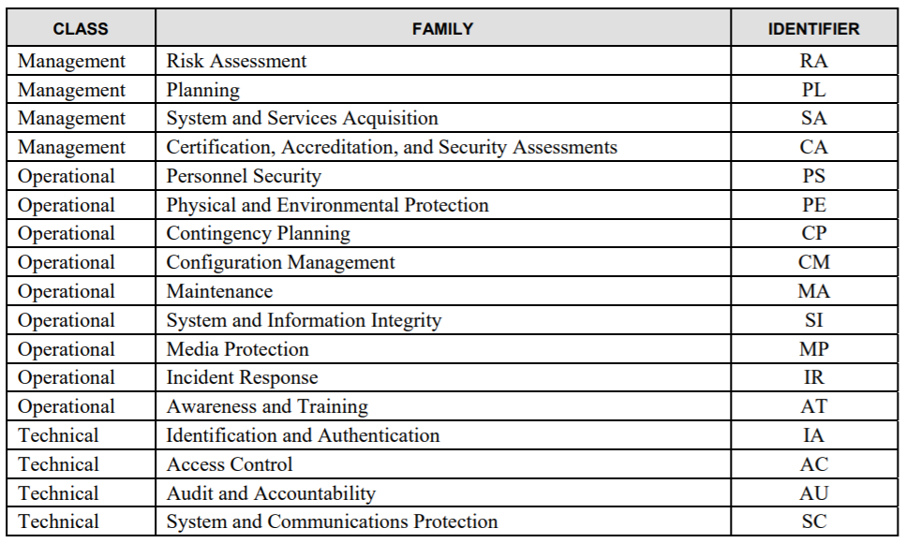
Team Project Guidance
Instructions for Section 13: Only select and complete one technical control family
From NIST SP 800-18r1 Guide for Developing Security Plans for Federal Information Systems

Slide 49
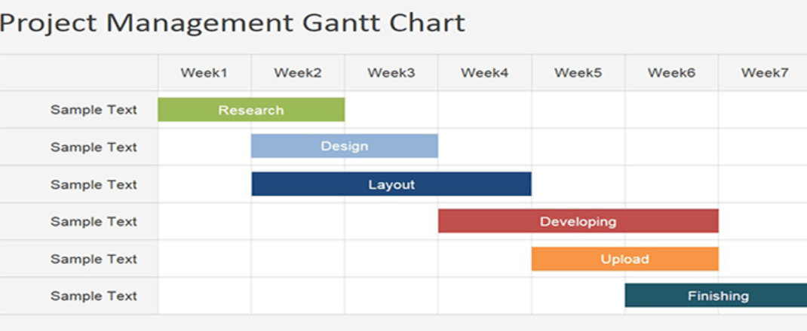
Guidance notes
Attachment 6 - Information System Contingency Plan: Only provide a plan (include a schedule tasks with labor estimate in person-hours) for completing Attachment 6 which is a Information System Contingency Plan (ISCP) based on FedRAMP ISCP Template

Slide 50
Team status reporting and security diagram reviews…

Slide 51
Agenda
Frameworks for application security assessment
Best practices for secure application development
Test areas for auditing applications
Team Project – guidance and Q&A

