Slide 1
Unit #11
Data Protection
MIS5214

Slide 2
Agenda
Data protection by design
System Security Plan
  Cloud computing specifications
  Security control inheritance
  Team project SSP review and discussion

Slide 3
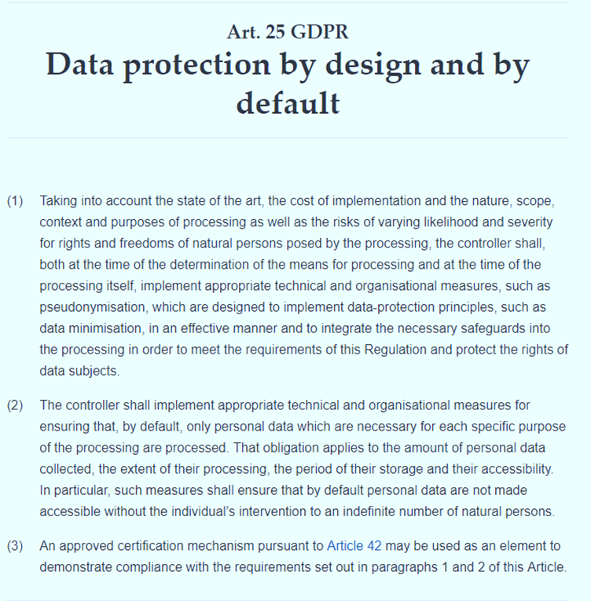

Data security by design and default…
Key General Data Protection Regulation (GDPR) requirements:
Data protection capabilities must work from beginning to end of data processing to enable protection of individuals’ personal data by default
Collection of personal data is fully avoided or minimized at the earliest stage of processing
Data subjects give specific, informed and explicit consent to the processing of their data
Data subjects have right to access, review and rectify their personal data
Data subjects have the right to withdraw given consent with effect for the future and
  Block access
  Constrain processing and use
  Erase their personal data
Personal data obtained for one purpose must not be processed for other purposes not compatible with the original purpose
Danezis, G. et al. (2014) “Privacy and Data Protection by Design”,
European Union Agency for Network and Information Security (ENISA)
D’ Acquisto, G. et al. (2015) “Privacy by design in big data”,
European Union Agency for Network and Information Security (ENISA)

Slide 4
Achieving “Privacy by Design” is difficult
Privacy is a complex, multifaceted and contextual notion
Not the primary requirement of an information system
May come into conflict with other requirements
  “…privacy and data protection features are… ignored by traditional engineering approaches when implementing desired functionality.
    This ignorance is caused by limitations of awareness and understanding of developers and data controllers as well as lacking tools to realize privacy by design”
Danezis, G. et al. (2014) “Privacy and Data Protection by Design”,
European Union Agency for Network and Information Security (ENISA)

Slide 5
Privacy and Data Protection by Design
“Although the concept has found its way into legislation as the… European General Data Protection Regulation, its concrete implementation remains un-clear at the present moment”
Danezis, G. et al. (2014) “Privacy and Data Protection by Design”,
European Union Agency for Network and Information Security (ENISA)

Slide 6
Some challenging data protection requirements may be solved with techniques presented in this webinar…
Collection of personal data is fully avoided or minimized at the earliest stage of processing
Data subjects give specific, informed and explicit consent to the processing of their data
Data subjects have right to access, review and rectify their personal data
Data subjects have the right to withdraw given consent with effect for the future and
  Block access
  Constrain processing and use
  Erase their personal data
Personal data obtained for one purpose must not be processed for other purposes not compatible with the original purpose

Slide 7
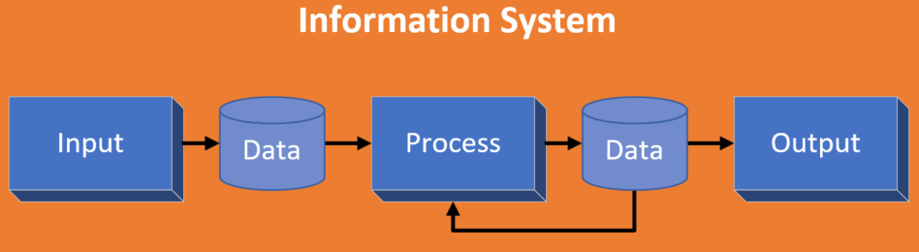
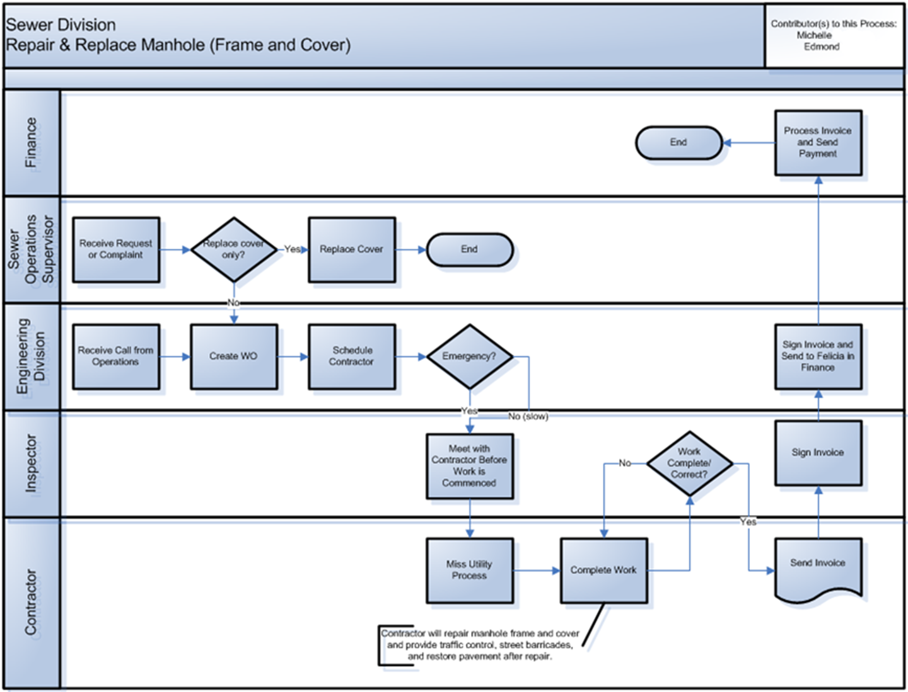
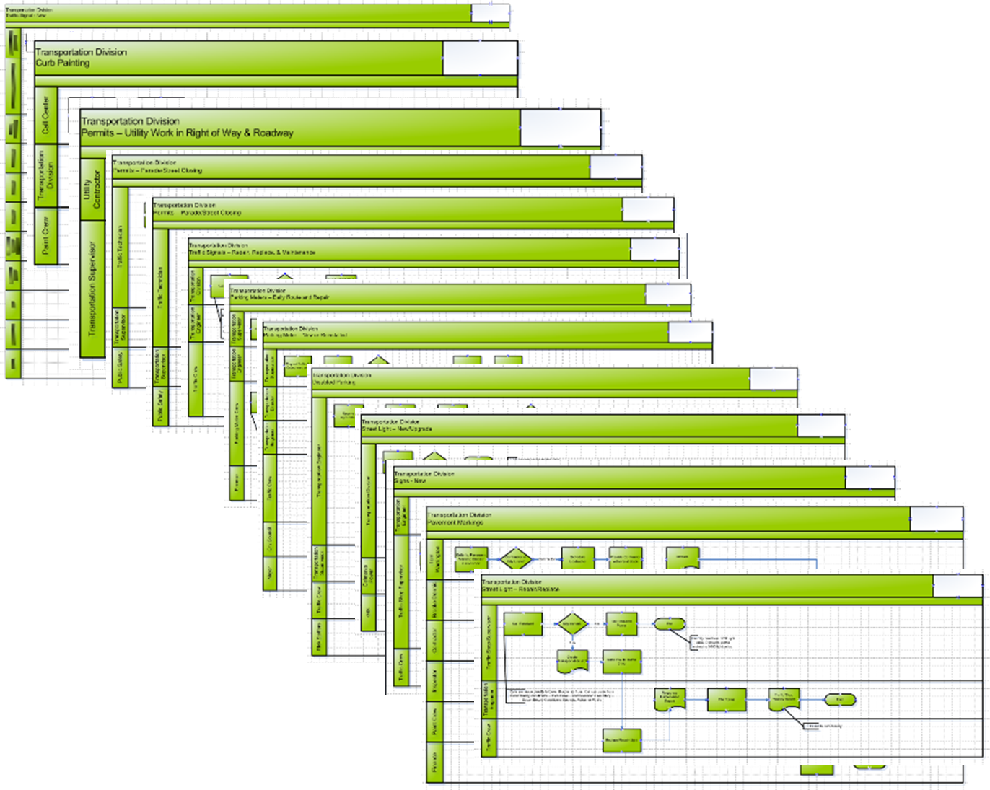
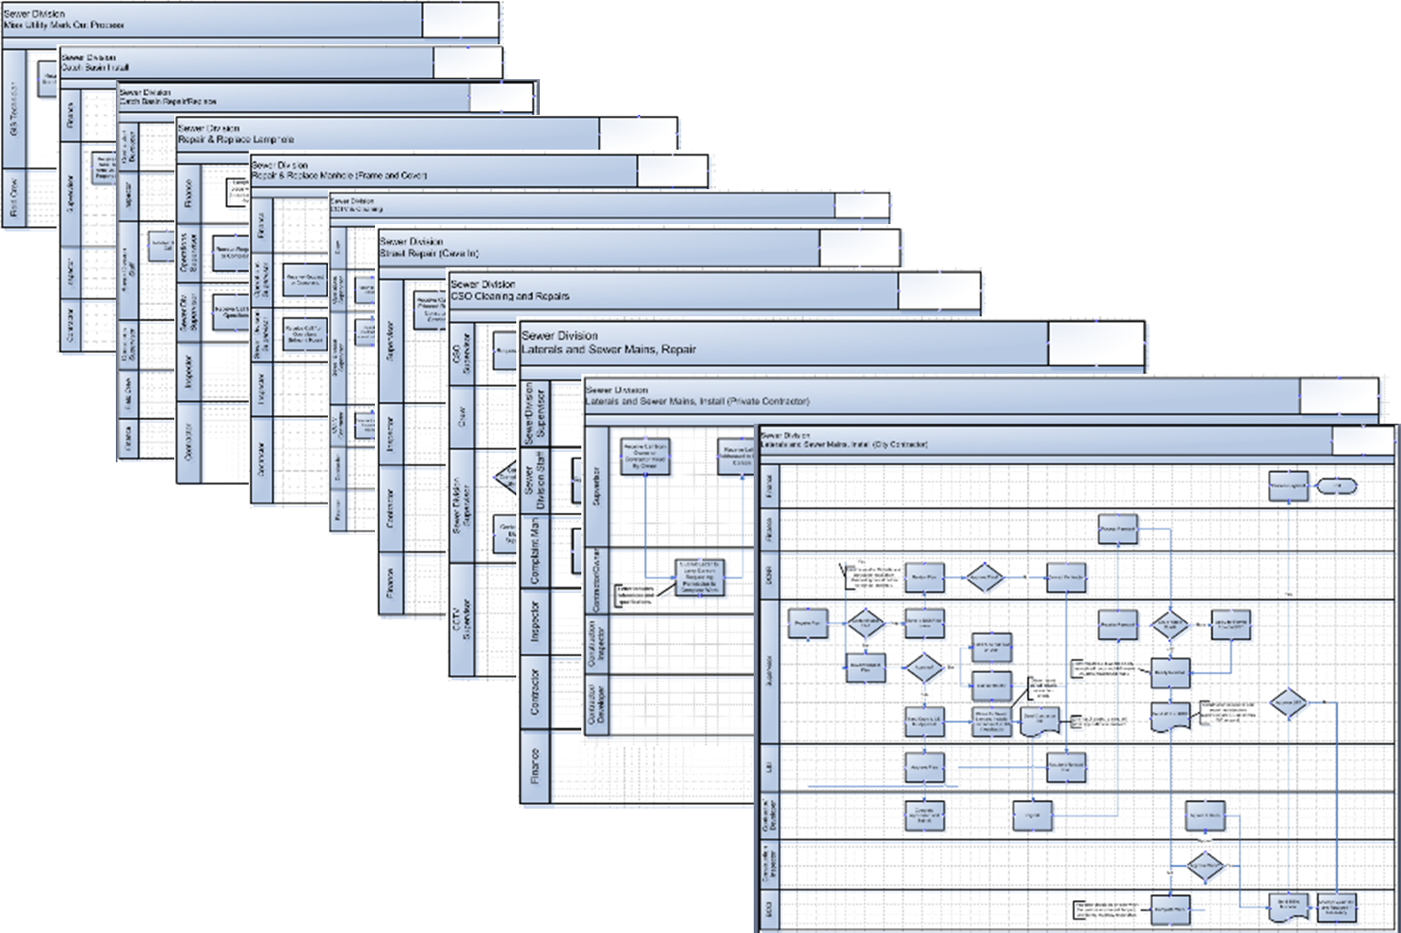
As a practical matter…
Data within information systems are often stored and organized as datasets within files and/or databases…
z
Regardless of application, there is reliance on data processing workflows to produce and use information

Slide 8
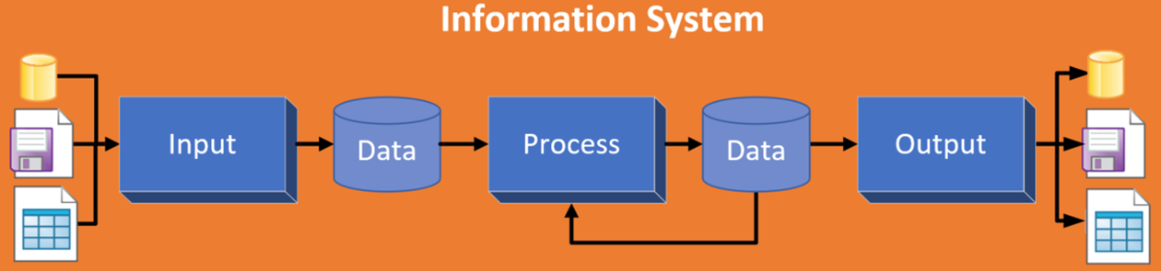
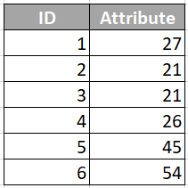
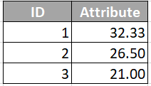
Data processing often transforms existing data into new data, which is a double-edged sword…
The resulting database may have more information than the older version
The meaning of the new information, however, is exogenous and not found in the data itself
Transformations
Mean
Median
Mode
Derived data
Input data

Slide 9
Evaluating & judging data’s “fitness for use”
    Is not the responsibility of the producer
    Is the responsibility of the user …and IT Auditor
  Data produced for one purpose is often used to serve other purposes
Data producers should provide information about data that permit informed determinations of fitness for use

Slide 10
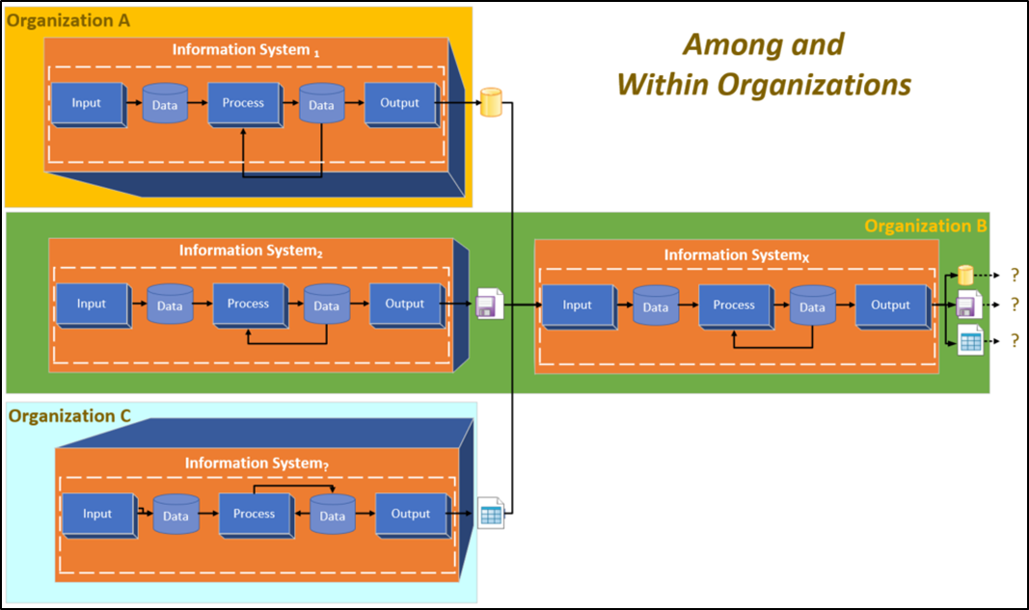
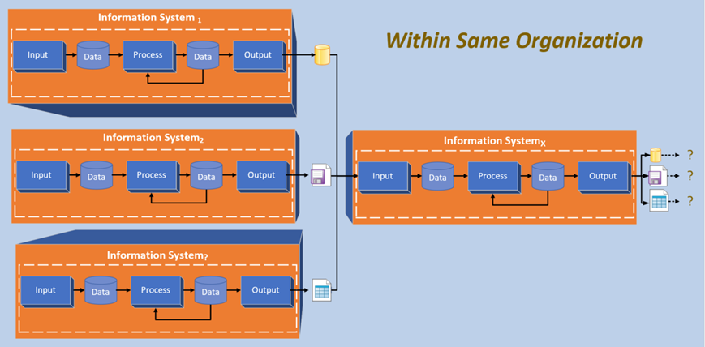
Datasets are often exchanged without information needed to determine their fitness for use…

Slide 11
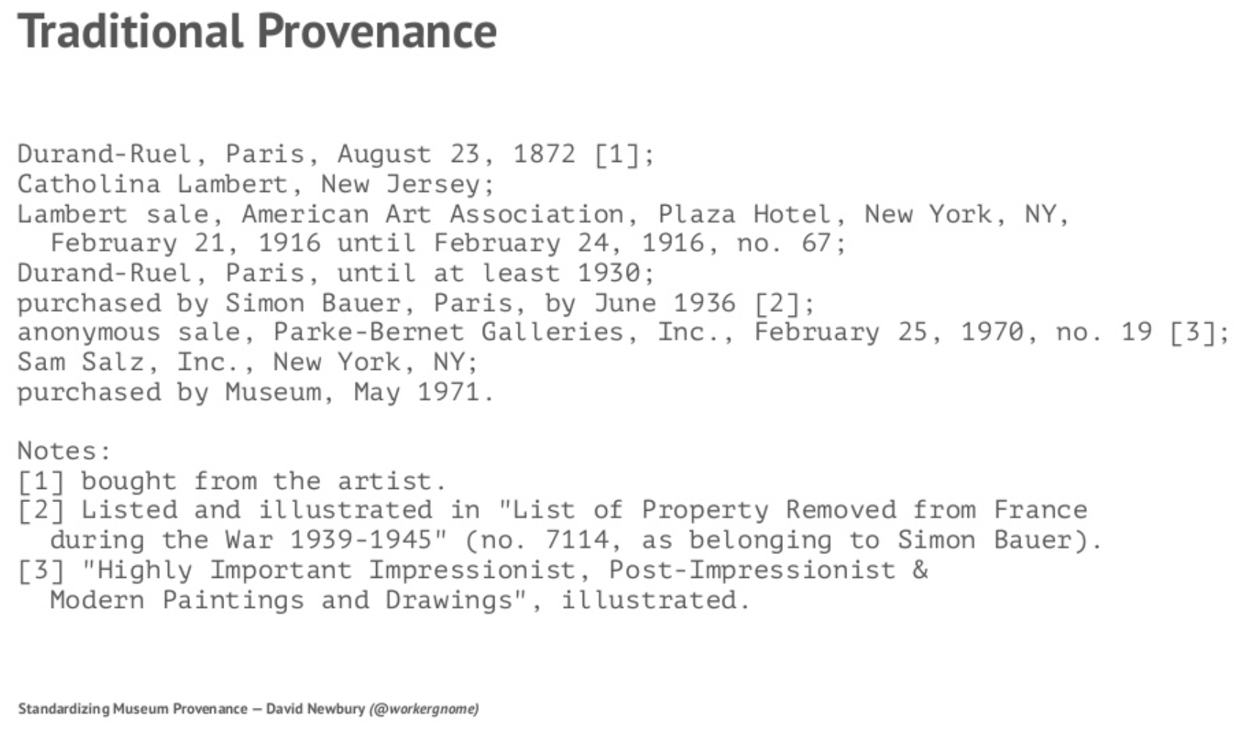
Provenance
Provenance traces back to 1294 in Old French as a derivative of the Latin provenire
  To come from, to be due to, be the result of
In the art domain provenance entails an artifact’s complete ownership history
Newbury, D. (2017) “Standardizing Museum Provenance for the Twenty-First Century”, from talk given at the Yale Center for British Art
There is an established research process for obtaining an artifact’s trusted provenance
  The information is highly valued, particularly to authenticate real versus fraudulent works
“Provenance” is now increasingly used in a broad range of fields with various degrees of conflation of two closely related but distinct concepts of trust and metadata
Tullis, J.A. et al., 2016, “Geoprocessing, Workflows, and Provenance”, in Remote Sensing Handbook: Remotely Sensed Data Characterization, Classification, and Accuracies, edited by P. Thenkabail, Vol. 1., pp. 401-422, Boca Raton, FL: CRC Press.

Slide 12
Provenance
W3C Provenance Incubator Group’s definition of provenance (in a web resource context):
  Provenance is a record that describes entities and processes involved in producing and delivering or influencing a resource
  Provenance provides a critical foundation for assessing authenticity, enabling trust, and allowing reproducibility
  Provenance assertions are contextual metadata that can become important records with their own provenance
https://www.w3.org/TR/prov-primer/

Slide 13
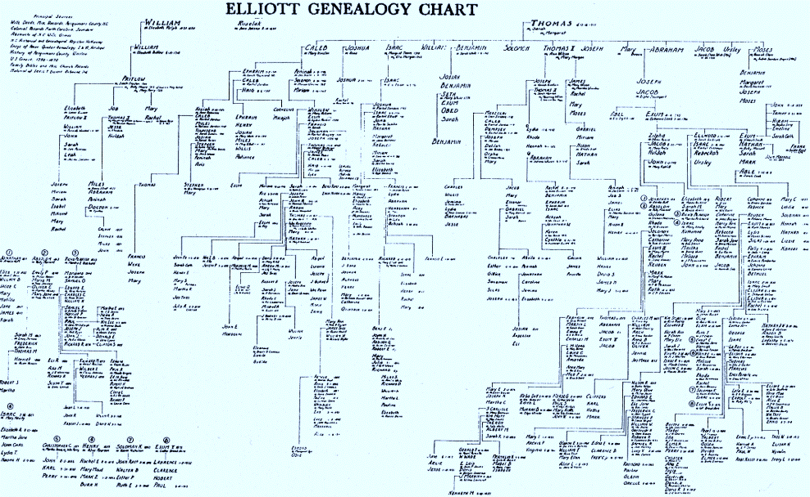
Provenance and data lineage
“Data provenance” and “data lineage” is used here interchangeably, overlooking subtle differences in their meanings
  Data provenance suggests process history
  Data lineage implies a kind of genealogy or data pedigree record relative to both
    Sources of data
    Processing applied to the sources to produce an information product
This presentation explores how data lineage metadata can aid understanding and establish trust of data

Slide 14
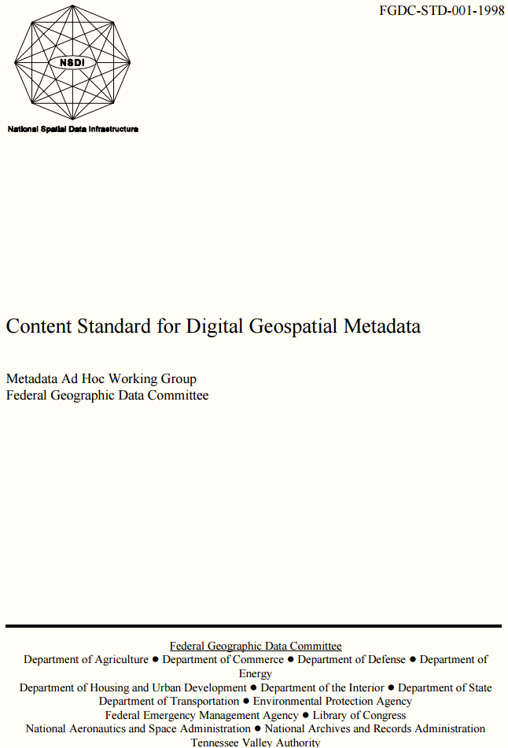
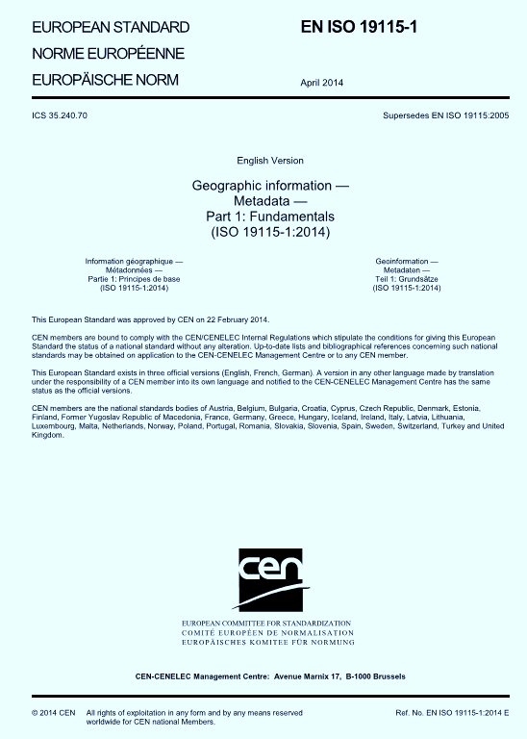
Early metadata standards for documenting lineage of data produced with Geographic Information Systems

Slide 15
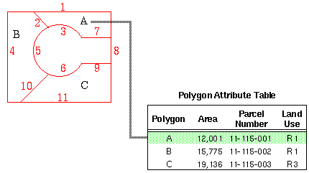
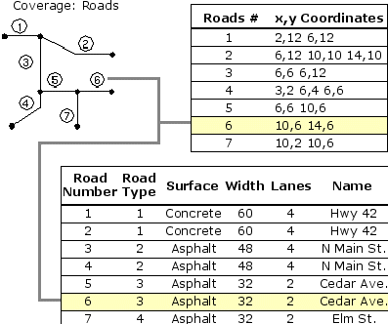
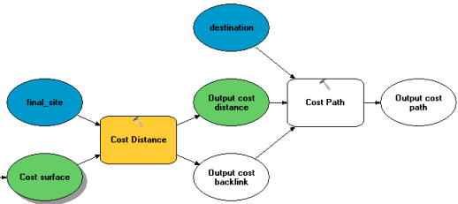
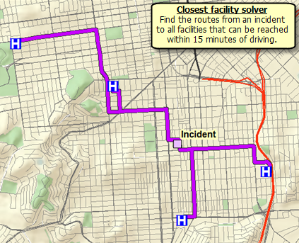
Geographic Information System (GIS)
Provides similar data import, query, manipulation, analysis (e.g. statistics), reformat, display/visualization, output and report capabilities as other information systems
Also organize their data in
  Data base management systems
  File systems
With the addition of spatial analysis and cartographic mapping capabilities

Slide 16
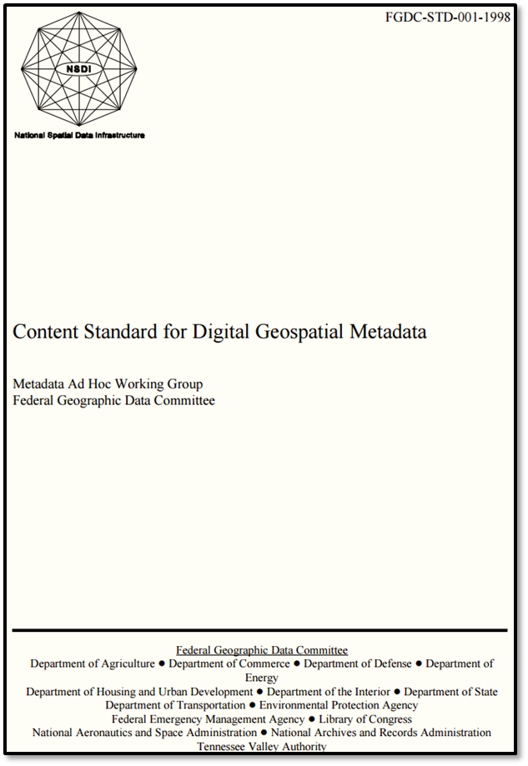
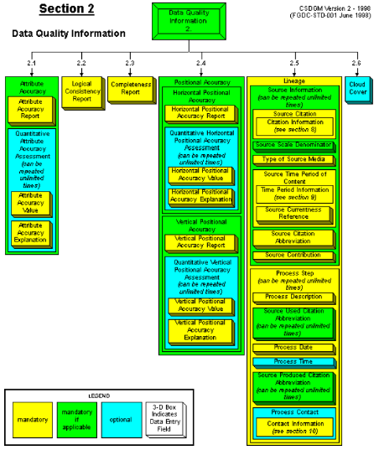
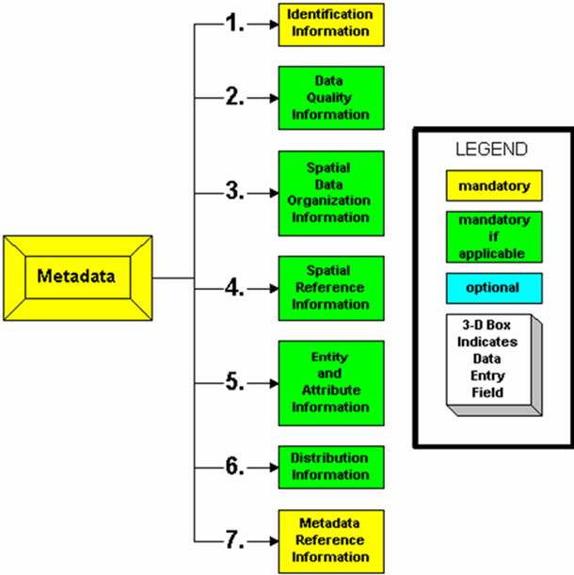

Slide 17
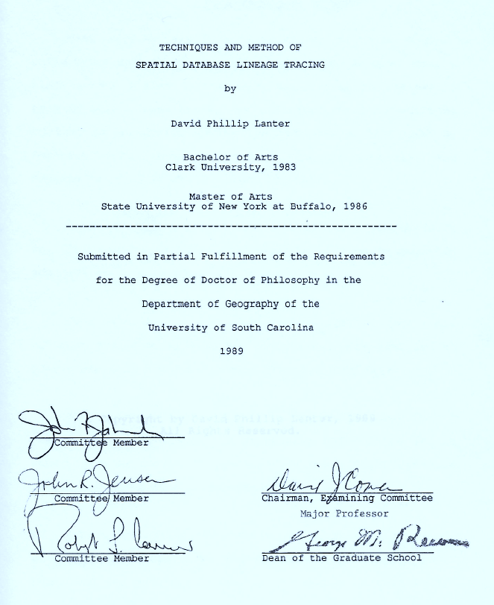
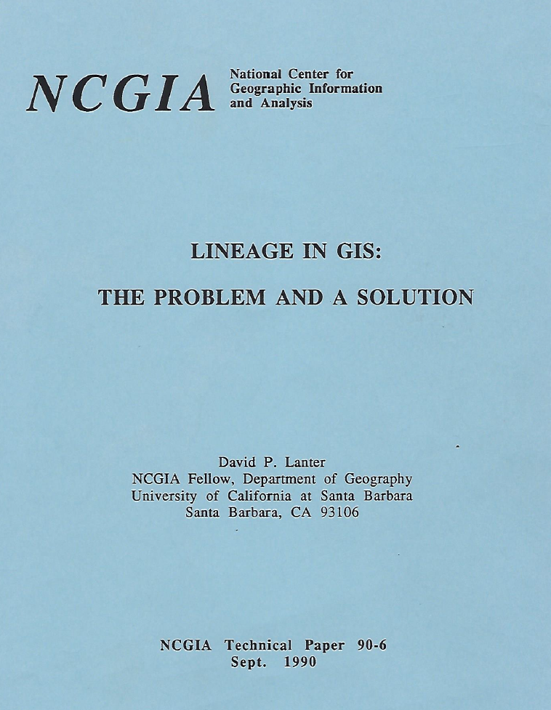
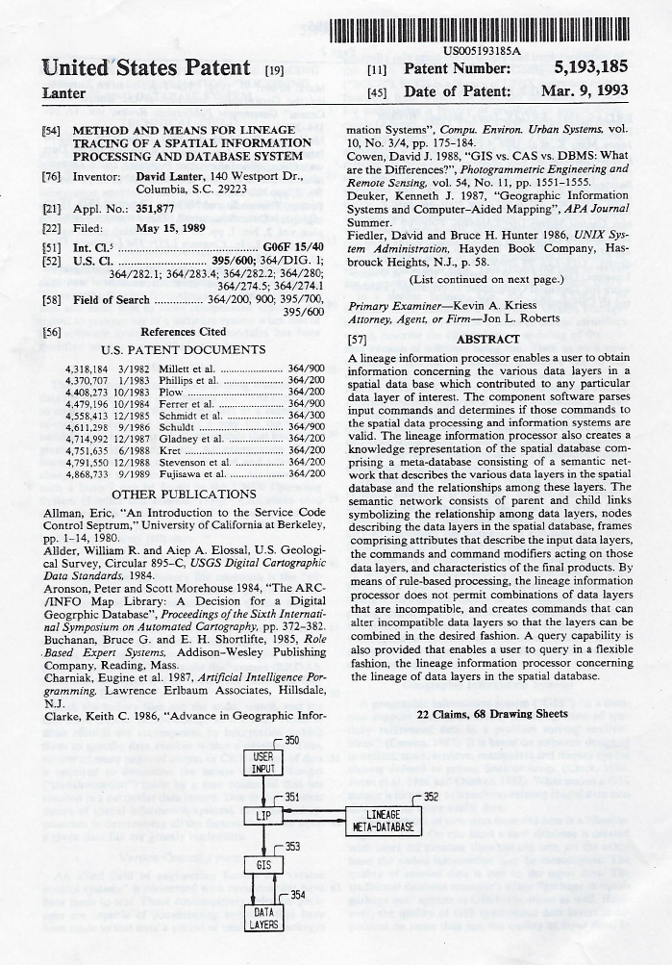
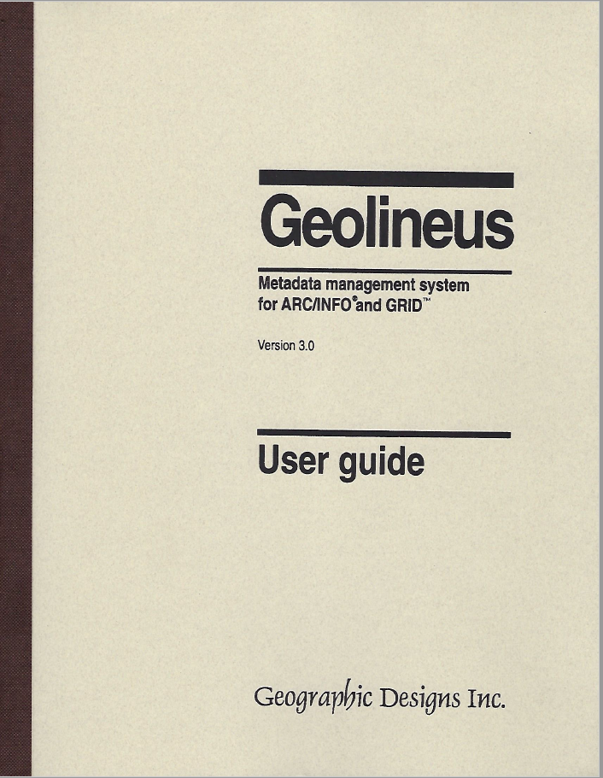
1st Metadata Processing System focused on data lineage (provenance)

Slide 18
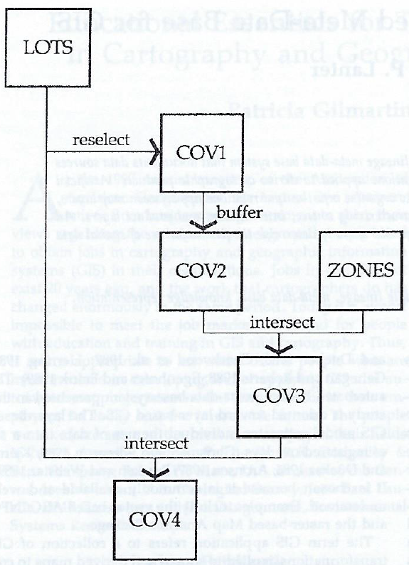
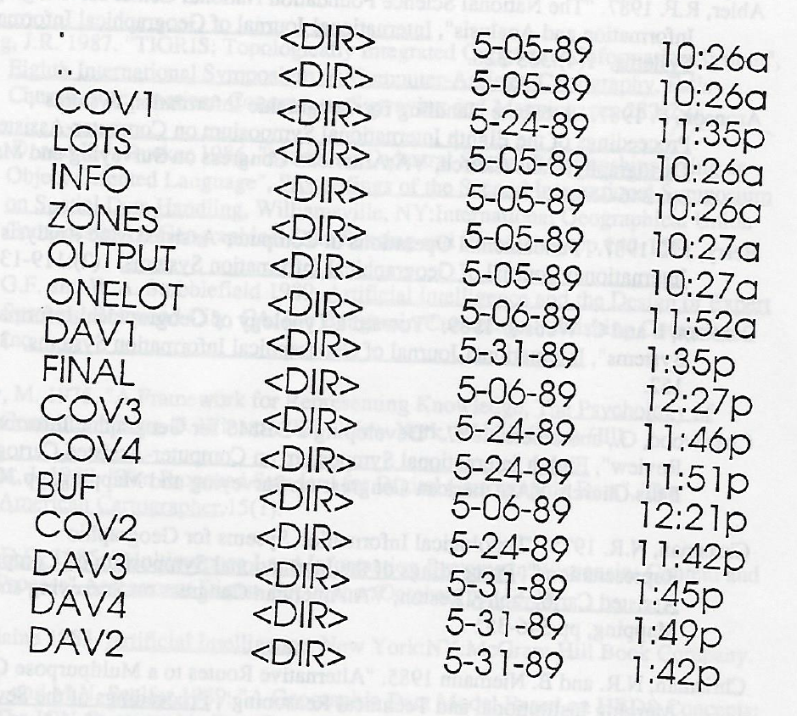
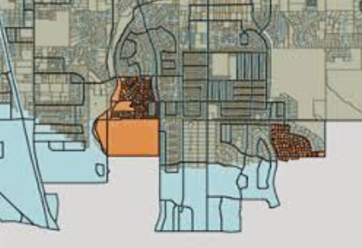
Datasets presented by the operating system after data processing concluded…
Information processing steps in the head of the user as he transformed the LOTS and ZONES datasets to derive COV4…
Datasets organized as files in folders

Slide 19


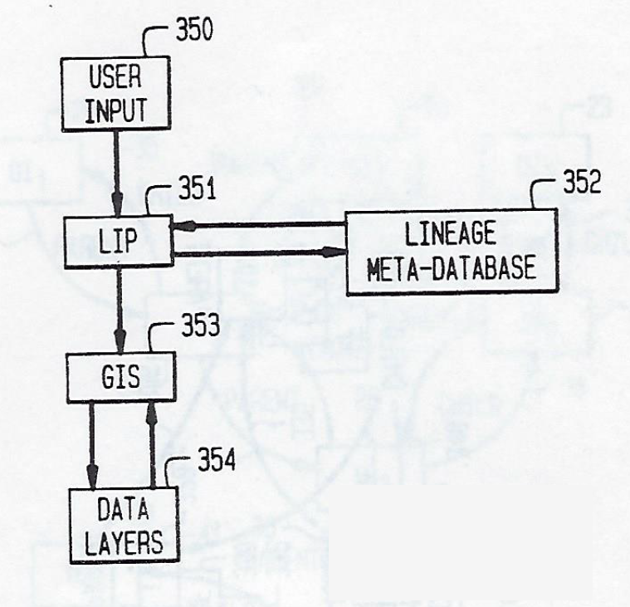
How can I program the computer to help me remember what I knew about the data I was processing when I was processing it?
LIP = Lineage Information Processor

Slide 20
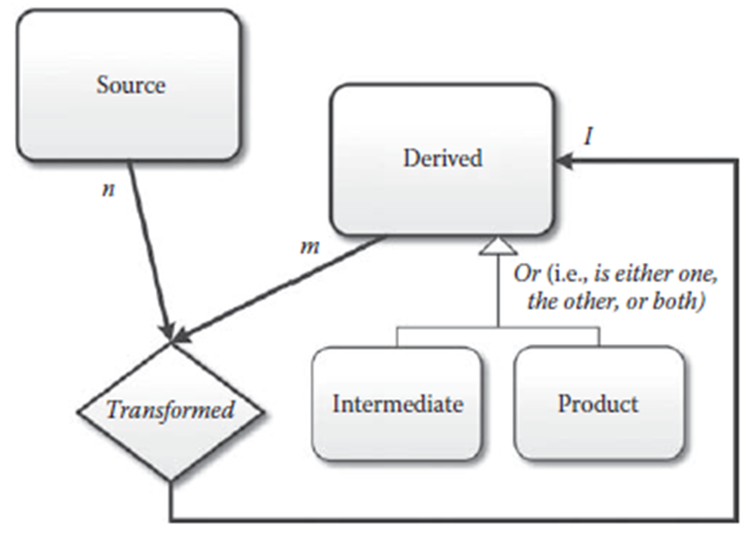
How do we understand differences among datasets created during processing applications?
LOTS
ZONES
COV4
COV1
COV2
COV3

Slide 21

Data lineage vocabulary helps communicate how data is processed in an information system
and can aid thinking about how to meet privacy by design requirements
Source datasets may contain personal data
Derived datasets inherit this personal data from their input
  Using transformations such as:
    Relational database joins and relates
    Queries, arithmetic, statistical, spatial processing…

Slide 22
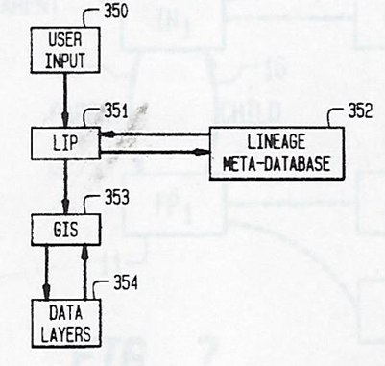
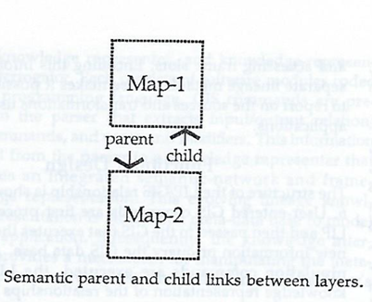
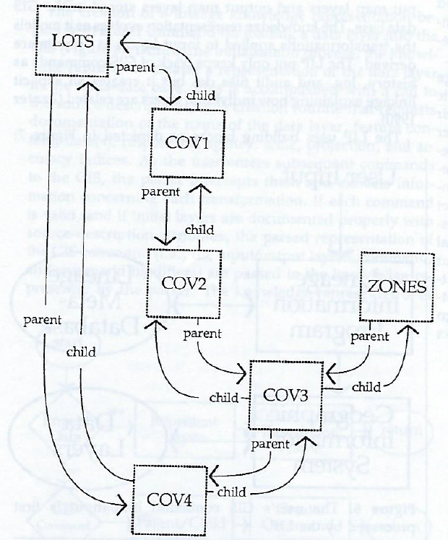
Semantic “parent” & “child” metadata links added to enable deductions about relationships among input & output datasets…
Input datasets provided with parent links pointing to output datasets can answer the question: Who am I the parent of?
Output datasets’ child links connect them back to their input datasets can answer the question: Who am I the child of?

Slide 23
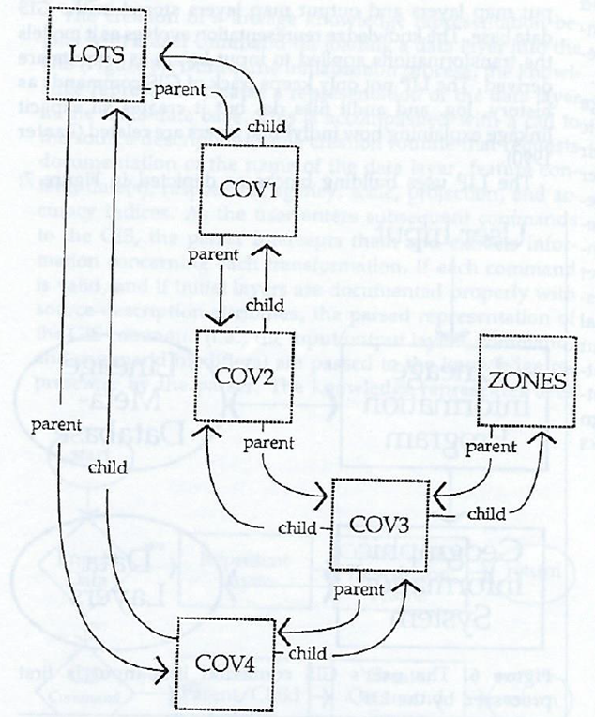
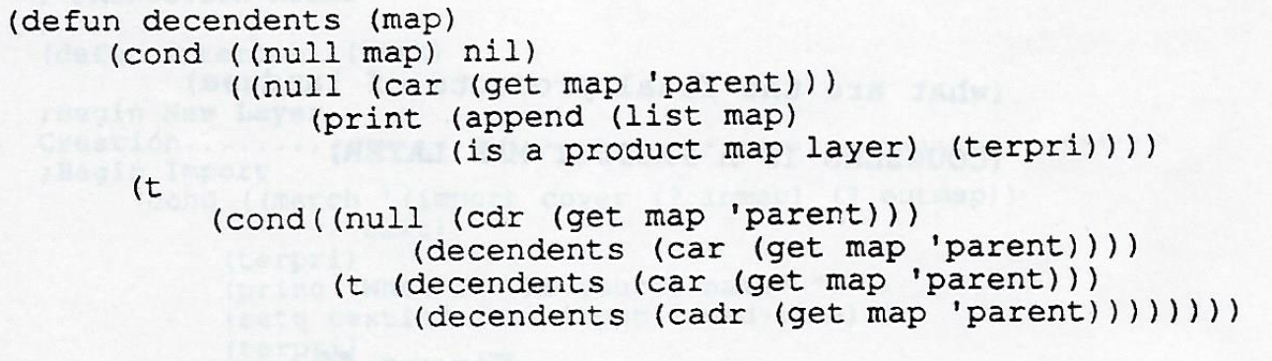
Descendants function traces parent links to identify all datasets derived from a source or other derived input dataset used within the application.
Descendants (“LOTS”) = (COV1, COV2, COV3, COV4)
Ancestors function traces child links to identify input datasets used to create a derived dataset
Ancestors (“COV4”) = (LOTS, COV3, ZONES, COV2, COV1, LOTS)

Slide 24
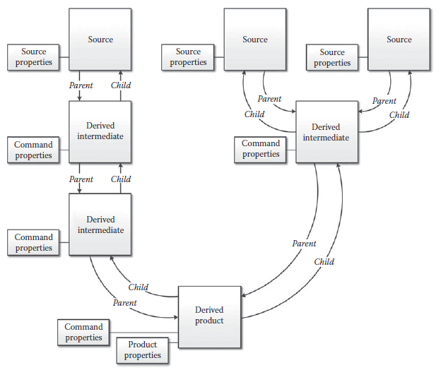
Source properties can include:
  Originating organization
  Data content (i.e. entity and attribute definitions)
  Timeliness (e.g. when collected, when acquired,…)
  Accuracy
  Confidentiality security categorization of attributes
    Privacy sensitivity of attributes
  Integrity categorization of attributes…
  Availability categorization…
Command properties include details of the transformation
Product properties include the product’s
intended goal
Users
when published
responsible manager,…

Slide 25

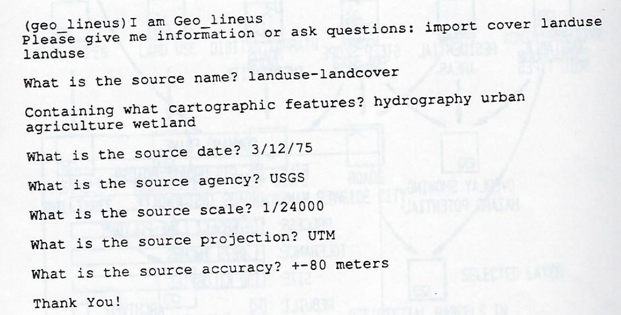

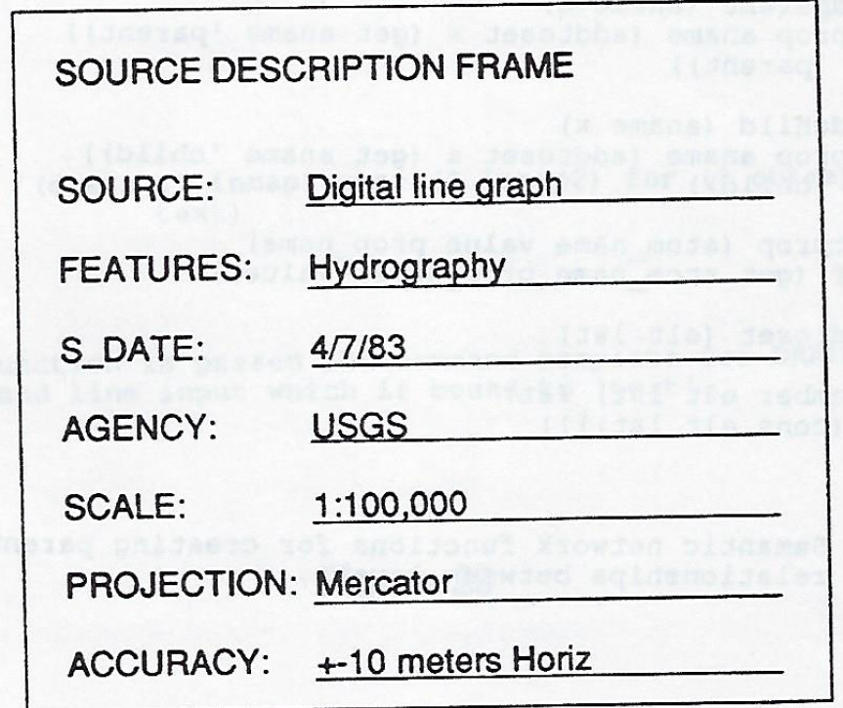
Meet Geo_lineus source metadata input

Slide 26
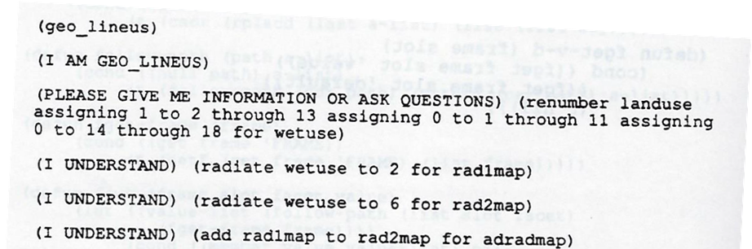
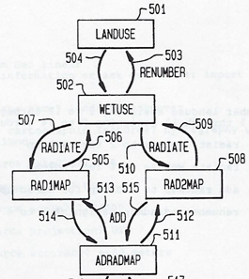
Command metadata input…

Slide 27
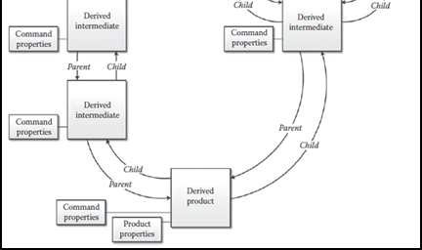
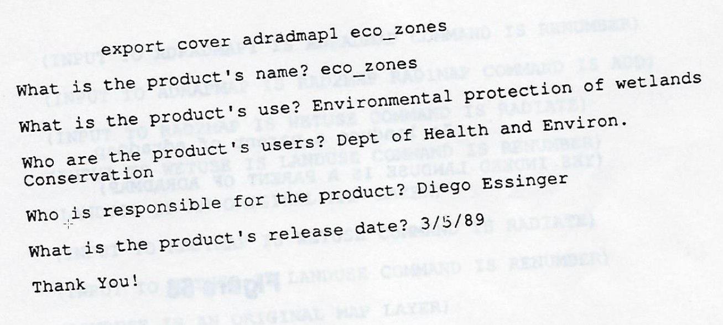
Product
Metadata input…

Slide 28
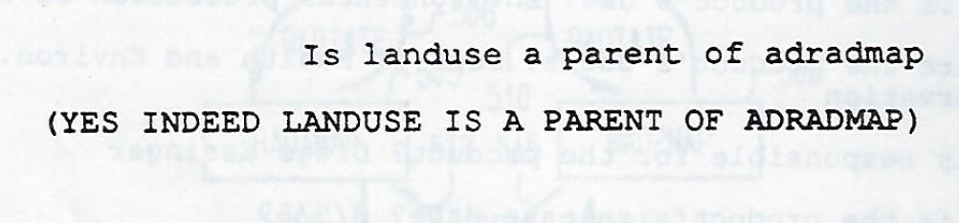
Querying metadata…

Slide 29
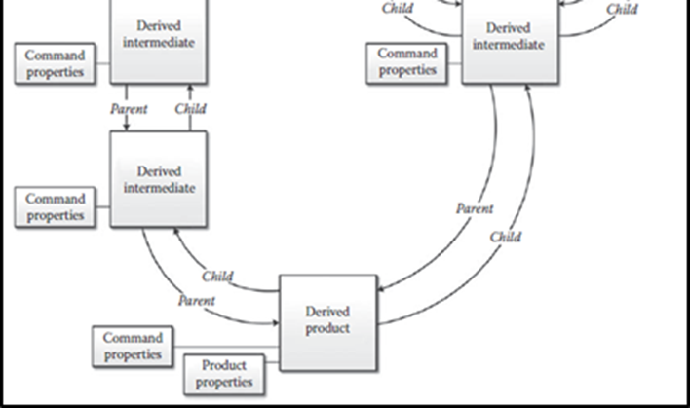
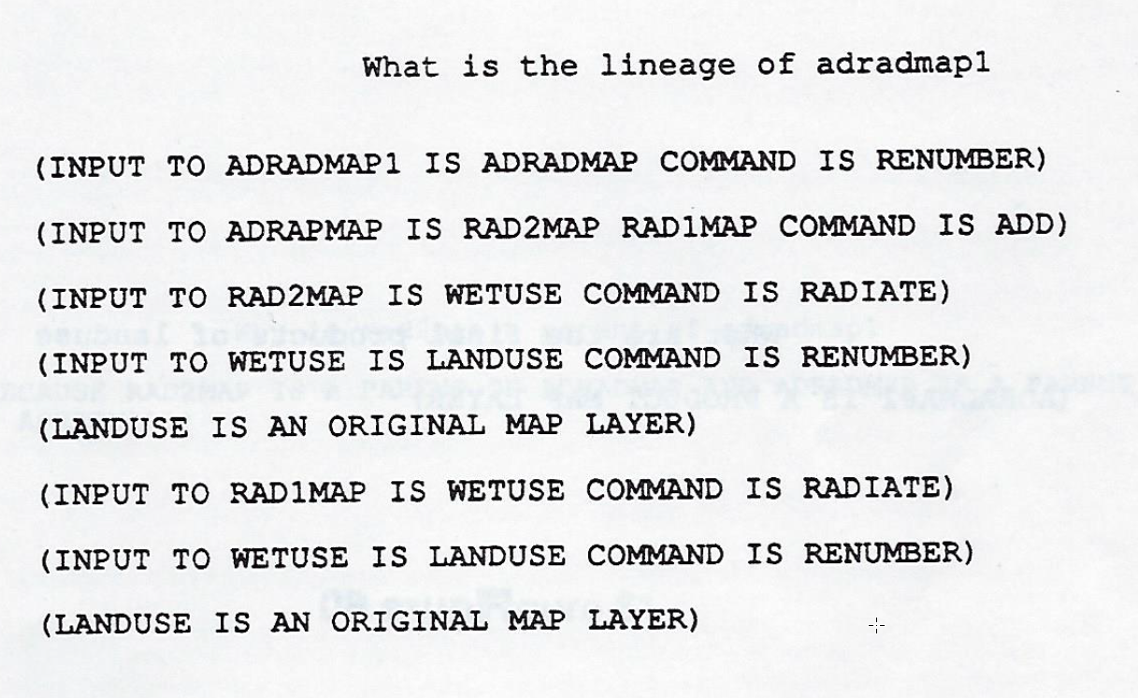
Querying metadata…

Slide 30
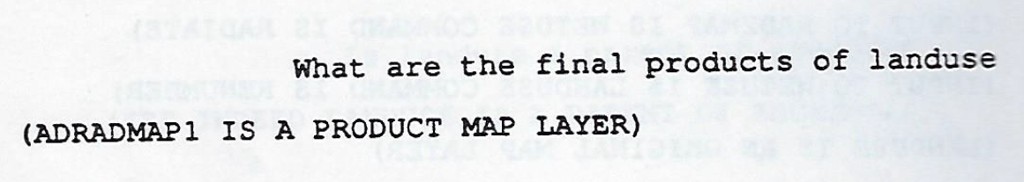
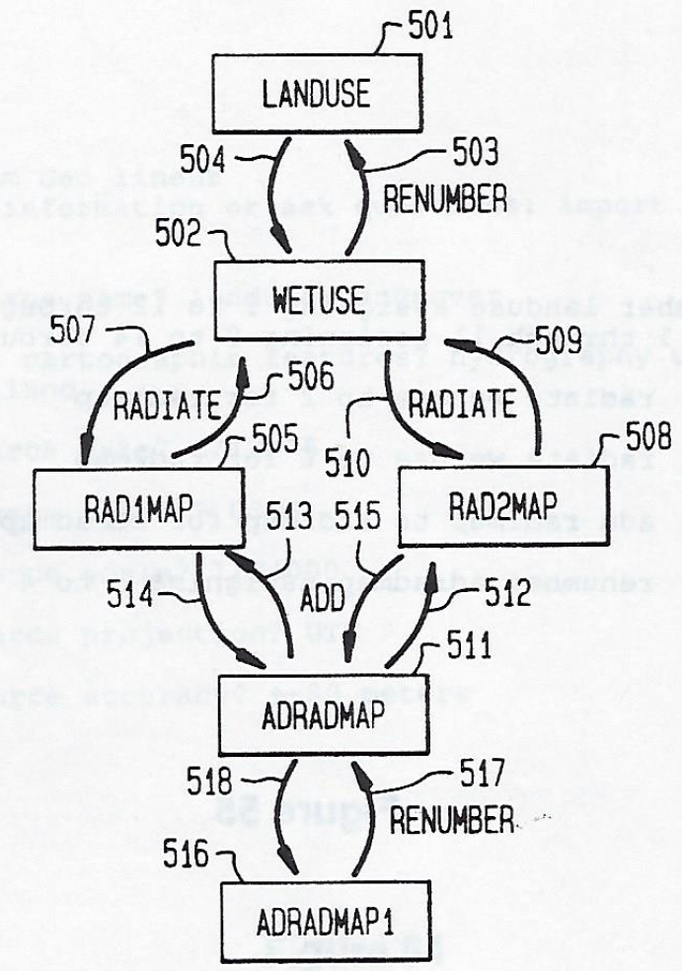
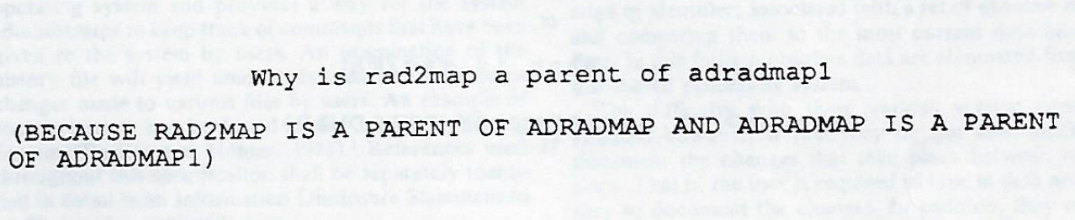
Querying metadata…

Slide 31
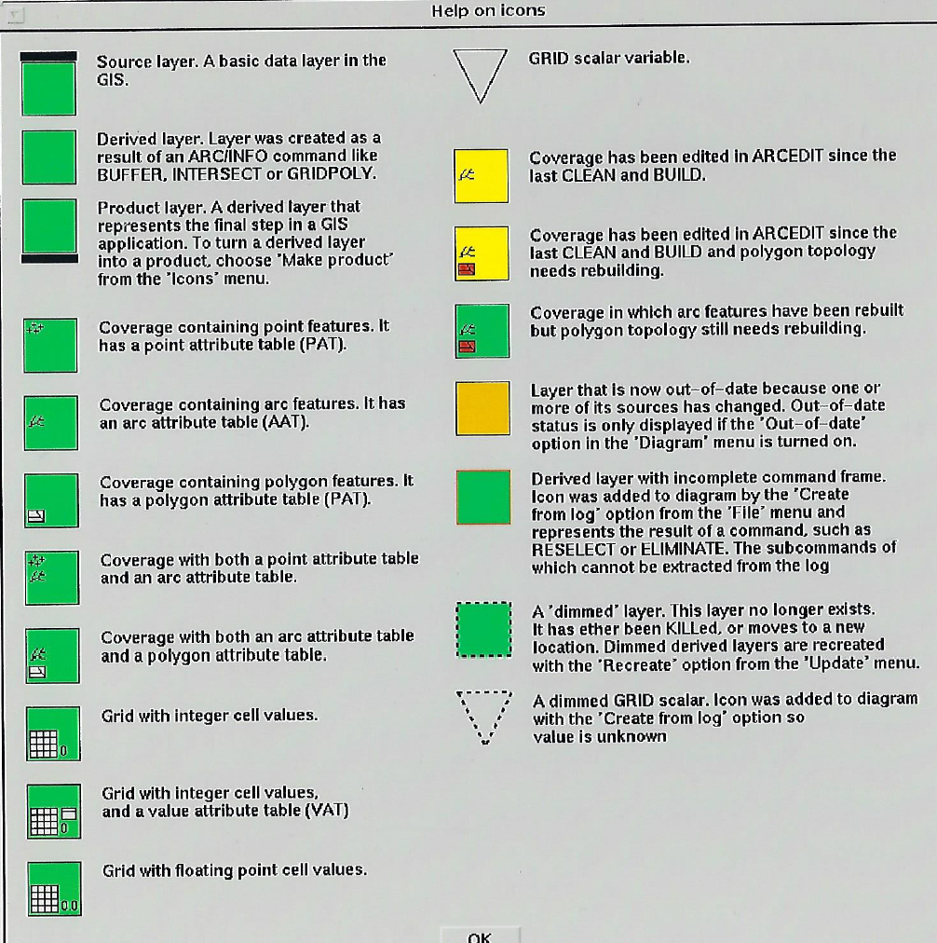
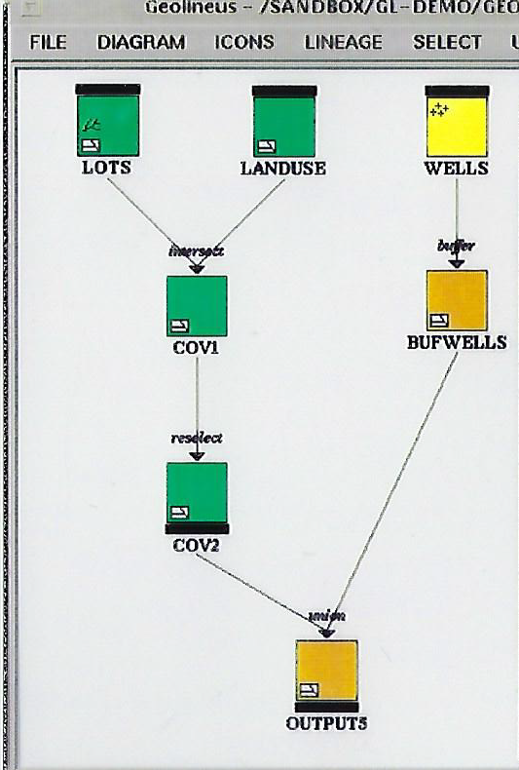
Adding a graphical user interface…
GUI design by Rupert Essinger

Slide 32


Working with source and command metadata
This is where CIA metadata for derived data could be added…
This is where CIA source metadata would be added…

Slide 33

Update propagation…

Slide 34





Data source metadata based integrity constraints

Slide 35


Data lineage metadata can help information systems meet key data privacy by design requirements, including:
Enabling data subjects access, review and rectify their personal data?
Enable data subjects to withdraw given consent with effect for the future by:
  Blocking access to their personal data?
  Constraining processing and usage of their personal data?
  Erasing their personal data?
Blocking and restricting personal data obtained for one purpose from being processed for other purposes not compatible with the original purpose

Slide 36

Case Study: Data lineage metadata enabled audit at Southern California Edison
Focus of the audit:
Documentation and understanding of GIS decision support data
Replicability of data used in decision making

Slide 37



Data provenance audit problem…

Slide 38




Metadata Analysis of data and processing
Log Files

Slide 39

Lineage metadata enabled audit of data and processing at Southern California Edison
9 visits with SCE’s GIS Lab’s technical staff in 1992, collected:
Descriptions of 14 data processing projects
Metadata for data sources that were acquired and imported into the enterprise GIS database for the projects
Processing log files for the projects

Slide 40

Lineage metadata enabled audit of data and processing at Southern California Edison
Descriptions of 14 data processing projects
  …for 7 corporate divisions were examined:
  Customer Service
  Engineering
  Environmental Research
  Information Services
  Power Generation
  Project Development
  Sewer & Hydrologic Engineering

Slide 41

Linage metadata enabled audit of data and processing at Southern California Edison
Identified data acquired from internal and external sources and collected metadata on these data
  Entity types (“features”) and attribute content
  Format
  Area covered
  Scale and spatial resolution
  Spatial coordinate system
  Spatial projection
  Supplying agency
  Original source organization
  Original publication date
  Production source date
  Responsible staff member
  Statement of data quality

Slide 42
Metadata enabled audit of data and processing at Southern California Edison
Processing log files obtained for each of the 14 projects
Reverse engineer lineage metadata from the log files

Slide 43
Metadata enabled audit of GIS data and processing at Southern California Edison
GIS Lab analysts identified 54 data files input into the Information System to support their projects, obtained from:
    Internal client department
    Other internal departments
    California state agencies
    Outside consultants
  Log processing identified 806 datasets referenced in the log files :
    487 source datasets (i.e. lacking child links pointing to inputs)
    319 derived datasets

Slide 44



Metadata enabled audit of GIS data and processing at Southern California Edison
Next step… would have focused on use of metadata analysis to identify commonalities and differences in:
  Source data usage
  Analytical processing logic
Source equivalence testing
Derived equivalence testing

Slide 45
Metadata enabled audit of GIS data and processing at Southern California Edison
But… findings:
  Much metadata for documenting the data sources were missing…
    GIS Lab Technical Staff analysts were unable to remember much about the data they had used in earlier projects
    Of the 54 data files used as input to the GIS database:
      89% were of unknown Spatial Projections
      79% were of unknown Original Publication Dates
      70% were of unknown Scales and Spatial Resolutions
      68% were from unknown Original Source Organizations
      43% contained attributes and spatial data assumed “fit for use” but untested

Slide 46
Metadata enabled audit of GIS data and processing at Southern California Edison
Findings:
  Lack of naming conventions for identifying primary data source files and source datasets once they were imported into the Information System
    For example,
      “TER” used as mnemonic device to name datasets after import:
        5 datasets in Project 1: TERBND, TER.MRK, TERMRK1, TERMRK2, and TERMERK3
        3 datasets in Project 2: TERRITORY, SCE-TERR, SCE-TERR2
        Information Analysts could not differentiate them
Utility company only had one service territory boundary, there were 8 different versions of it. Without taking the itme to visually inspect and compare the actual data – it was not clear what, if any, significant differences existed among the versions

Slide 47


Metadata enabled audit of GIS data and processing at Southern California Edison
Recommendation:
  GIS Lab’s “…database was inadequately documented and should not be reused.”

Slide 48
Conclusion: Data lineage metadata can help information systems meet key data privacy by design requirements, including:
Enabling data subjects access, review and rectify their personal data?
Enable data subjects to withdraw given consent with effect for the future by:
  Blocking access to their personal data?
  Constraining processing and usage of their personal data?
  Erasing their personal data?
Blocking and restricting personal data obtained for one purpose from being processed for other purposes not compatible with the original purpose

Slide 49
Conclusion:
Data lineage metadata can be used to help information system developers meet key data protection by design requirements:
Data subjects have right to access, review and rectify their personal data
Data subjects have the right to withdraw given consent with effect for the future and
  Block access
  Constrain processing and use
  Erase their personal data
Personal data obtained for one purpose must not be processed for other purposes not compatible with the original purpose

Slide 50


Outlook: Commercial database management systems are beginning to include lineage metadata capabilities for tracking attribute values processed and transformed among relational database tables …

Slide 51
Agenda
Data protection by design
System Security Plan
  Cloud computing specifications
  Security control inheritance
  Team project SSP review and discussion

Slide 52

Cloud computing
Cloud computing enables ubiquitous, convenient, on-demand network access to a shared pool of configurable computing resources that can be rapidly provisioned and released with minimal management effort or service provider interaction

Slide 53
Essential Characteristics of Cloud Computing
On-demand self-service
Broad network access
Resource pooling
Rapid elasticity
Measured service
http://nvlpubs.nist.gov/nistpubs/Legacy/SP/nistspecialpublication800-145.pdf

Slide 54

Which Service Model(s) of cloud computing is your project’s information system providing to your end users?

Slide 55
3 Service Models of Cloud Computing
Infrastructure as a Service (IaaS)
Provides processing, storage, networks, and other fundamental computing resources
Consumer is able to deploy and run arbitrary software, which can include operating systems and applications
The consumer does not manage or control the underlying cloud infrastructure,
  but has control over operating systems, storage, and deployed applications; and possibly limited control of select networking components (e.g., host firewalls)
http://nvlpubs.nist.gov/nistpubs/Legacy/SP/nistspecialpublication800-145.pdf

Slide 56
3 Service Models of Cloud Computing
Platform as a Service (PaaS)
Consumer is provided capability to deploy onto the cloud infrastructure consumer-created or acquired applications created using programming languages, libraries, services, and tools supported by the provider
  The consumer does not manage or control the underlying cloud infrastructure including network, servers, operating systems, or storage,
    but has control over the deployed applications and possibly configuration settings for the application-hosting environment
http://nvlpubs.nist.gov/nistpubs/Legacy/SP/nistspecialpublication800-145.pdf

Slide 57
3 Service Models of Cloud Computing
Software as a Service (SaaS)
The capability provided to the consumer is to use the provider’s applications running on a cloud infrastructure
  Accessible from various client devices through either a thin client interface, such as a web browser or a program interface
  The consumer does not manage or control the underlying cloud infrastructure including network, servers, operating systems, storage, or even individual application capabilities, with the possible exception of limited user specific application configuration settings
http://nvlpubs.nist.gov/nistpubs/Legacy/SP/nistspecialpublication800-145.pdf

Slide 58

Which cloud deployment model is your project’s information system based on?

Slide 59
4 Deployment Models of Cloud Computing
Public cloud
The cloud infrastructure is provisioned for open use by the general public
  It may be owned, managed, and operated by a business, academic, or government organization, or some combination of them. It exists on the premises of the cloud provider
http://nvlpubs.nist.gov/nistpubs/Legacy/SP/nistspecialpublication800-145.pdf

Slide 60
4 Deployment Models of Cloud Computing
Private cloud
The cloud infrastructure is provisioned for exclusive use by a single organization comprising multiple consumers (e.g., business units)
  It may be owned, managed, and operated by the organization, a third party, or some combination of them, and it may exist on or off premises.
http://nvlpubs.nist.gov/nistpubs/Legacy/SP/nistspecialpublication800-145.pdf

Slide 61
4 Deployment Models of Cloud Computing
Community cloud
Provisioned for use by a specific community of consumers from organizations with shared concerns
  It may be owned, managed, and operated by one or more of the organizations in the community, a third party, or some combination of them, and it may exist on or off premises
http://nvlpubs.nist.gov/nistpubs/Legacy/SP/nistspecialpublication800-145.pdf

Slide 62
4 Deployment Models of Cloud Computing
Hybrid cloud
A composition of two or more distinct cloud infrastructures (private, community, or public) that remain unique entities
  …but are bound together by standardized or proprietary technology that enables data and application portability
http://nvlpubs.nist.gov/nistpubs/Legacy/SP/nistspecialpublication800-145.pdf

Slide 63
Agenda
Data protection by design
Cloud computing specifications
Security control origination
Team project SSP progress review and discussion

Slide 64
Security Control Origination
Security control “inheritance” exist when
an information system or application receives protection from security controls developed, implemented, assessed, authorized, and monitored by entities other than those responsible for the system or application
NIST SP 800-53 Revision 4

Slide 65
Control Originatoin
Many of the controls needed to protect organizational information systems are inheritable by other systems, e.g.
  Security awareness training
  Incident response plans
  Physical access to facilities
  Rules of behavior
  Public Key Infrastructure [PKI]
  Authorized secure standard configurations for clients/servers
  Access control systems
  Boundary protection
  Cross-domain solutions

Slide 66

Control Origination
Indicate what sections of the security control are inherited and provide a description of what is inherited
If a entire control is inherited, it must be clear to the Assessor what is inherited
The writer does not need to describe how the leveraged service is performing the particular function
  That detail is found in the SSP of the leveraged system from which the control is inherited
If a policy has been published and is referenced as is the basis for the implementation of the inherited security control, make sure that published document is provided as an attachment, or a supporting artifact with the SSP when submitted for FedRAMP review
https://www.fedramp.gov/weekly-tips-cues-february-15-2017/

Slide 67

Control Origination

Slide 68
Agenda
Data protection by design
System Security Plan
  Cloud computing specifications
  Security control inheritance
  Team project SSP review and discussion

