Slide 1
Unit #3
MIS5214
Planning and Policy

Slide 2
Agenda
NIST Risk Management Framework and FIPS 199
Use of NIST SP 800-60 Volume 1 and Volume 2
Exercise – Finalize impact levels
Exercise – Determine and finalize impact levels
Exercise – Determine Information and Information System Types and provisional security categorization
Security Control Baselines – review
FIPS 200 and NIST 800-53 Security Control Baselines
Security Control Families
Risk Assessment Controls
Team Exercise Find and assess risk assessment policy
Next Time: Case Study 1

Slide 3
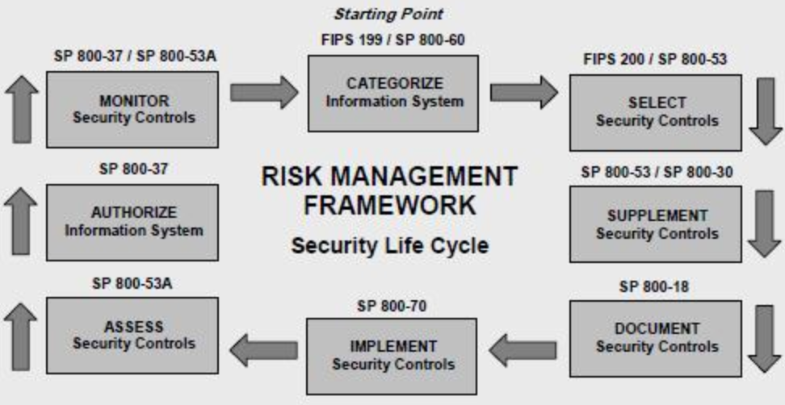
Risk Management Framework

Slide 4
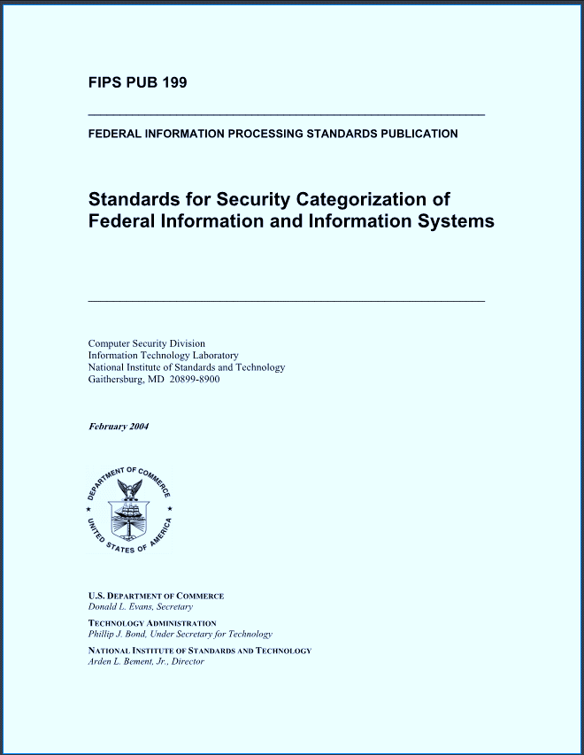
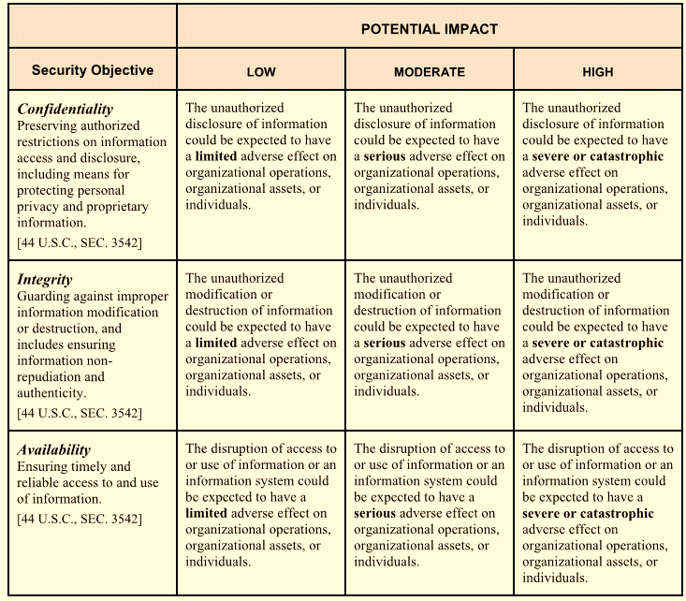
Risk Assessment based on security objectives and impact ratings for information and information system

Slide 5
Risk Management Framework

Slide 6
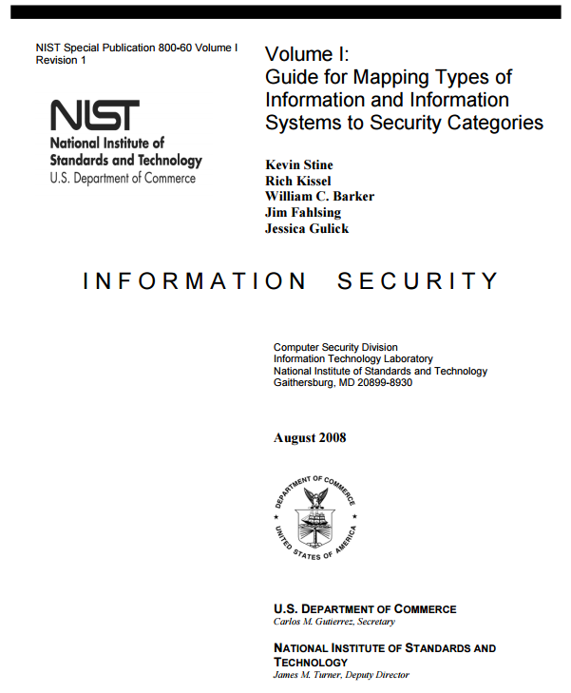
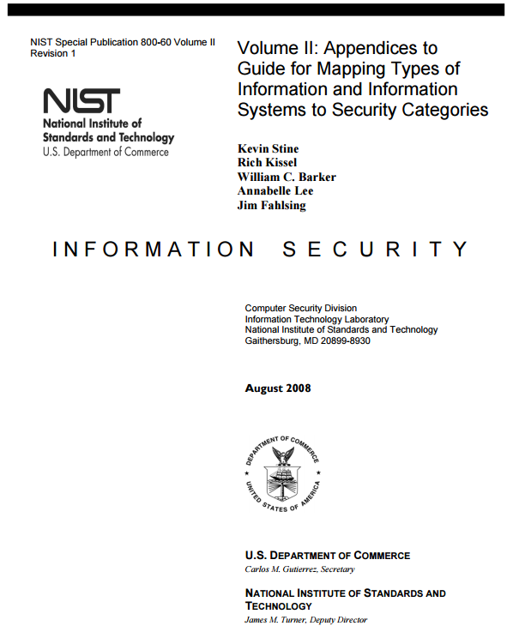
Mapping IS Types to Security Categories
https://nvlpubs.nist.gov/nistpubs/Legacy/SP/nistspecialpublication800-60v1r1.pdf
https://nvlpubs.nist.gov/nistpubs/Legacy/SP/nistspecialpublication800-60v2r1.pdf

Slide 7
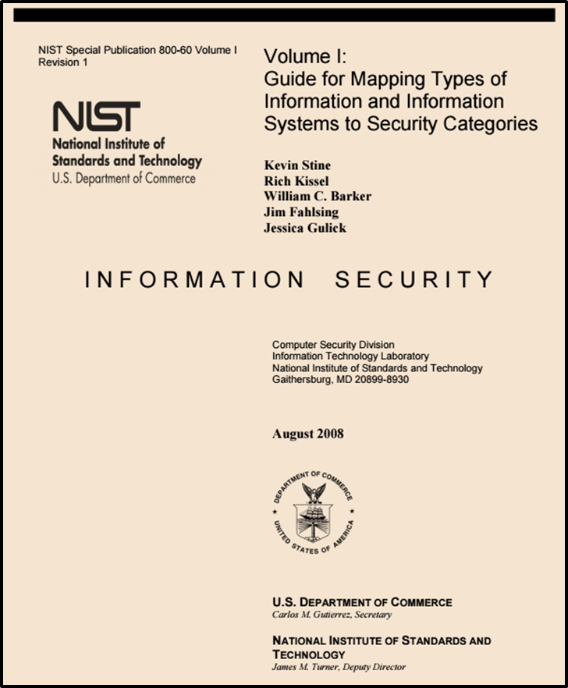
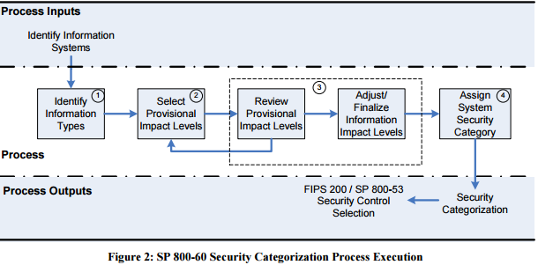
http://nvlpubs.nist.gov/nistpubs/Legacy/SP/nistspecialpublication800-60v1r1.pdf

Slide 8
2 Broad types of Information and Information Systems
Mission-based Information & Information Systems
Management and Support Information & Information Systems

Slide 9
Mission-based Information and Information Systems
Defense and National Security
Homeland Security
Intelligence Operations
Disaster Management
International Affairs and Commerce
Natural Resources
Energy
Environmental Management
Economic Development
Community and Social Services
Transportation
Education
Workforce Management
Health
Income Security
Law Enforcement
Litigation and Judicial Activities
Federal Correctional Activities
General Sciences and Innovation
Knowledge Creation and Management
Regulatory Compliance and Enforcement
Public Goods Creation and Management
Federal Financial Assistance
Credit and Insurance
Transfers to State/Local Governments
Direct Services for Citizens

Slide 10
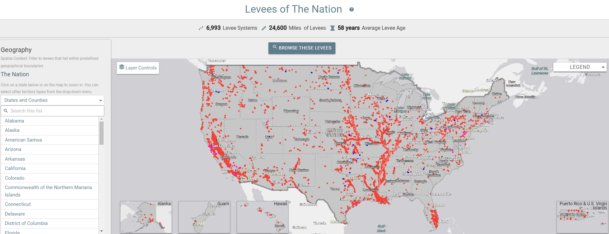
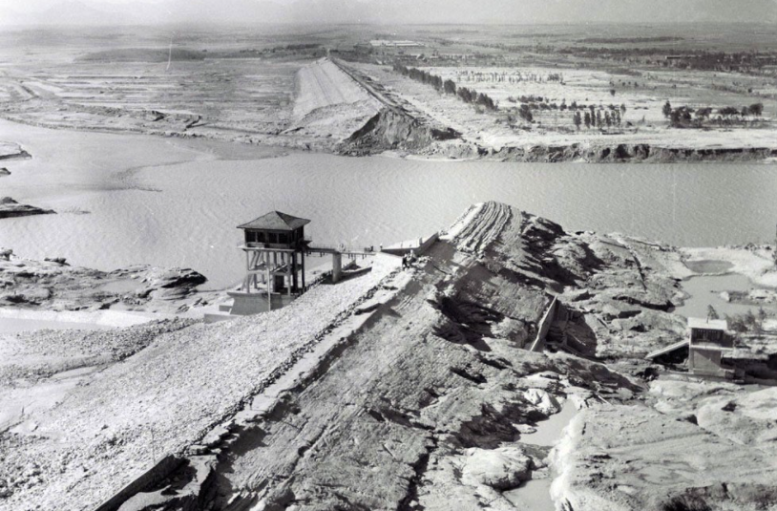
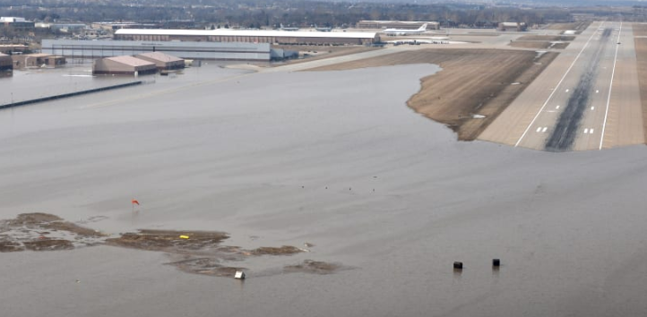
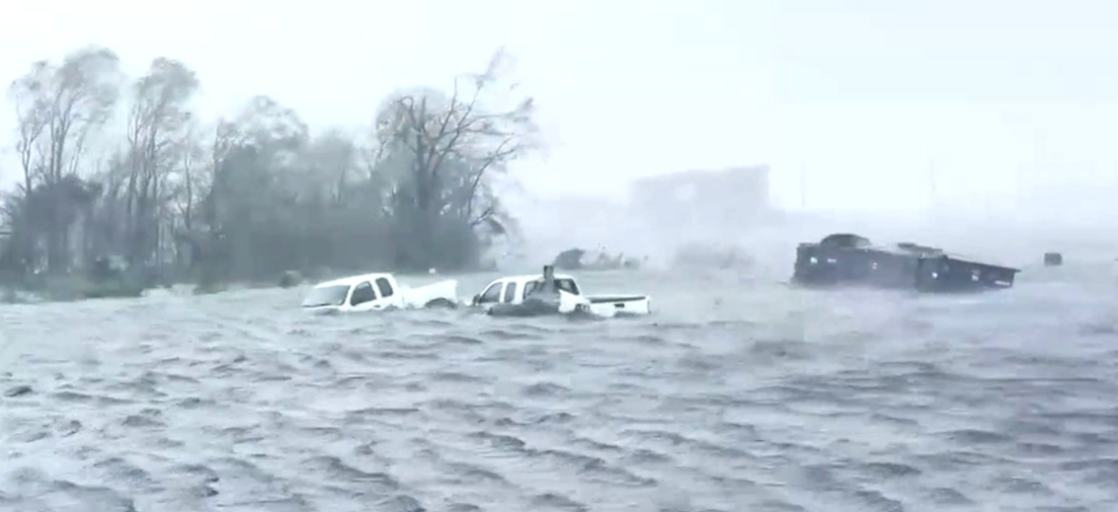
Disaster Management Information System Example
National Levee Database

Slide 11
2 Broad Types of Information and Information Systems
Mission-based Information & Information Systems
Management and Support Information & Information Systems
Services Delivery Support Functions
Government Resource Management Functions

Slide 12
Services Delivery Support Functions and Information Types
Controls and Oversight
Regulatory Development
Planning and Budgeting
Internal Risk Management and Mitigation
Revenue Collection
Public Affairs
Legislative Relations
General Government

Slide 13
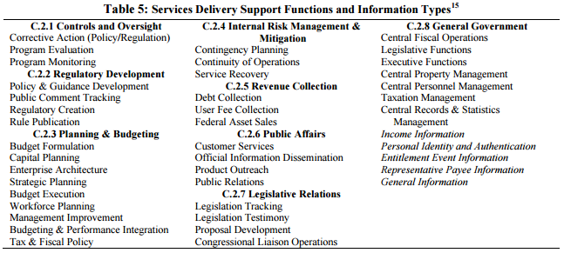
Example Management & Support Information & Information Systems

Slide 14
Example Resource Management Functions & Information Types
Administrative Management
Financial Management
Human Resources Management
Supply Chain Management
Information and Technology Management

Slide 15
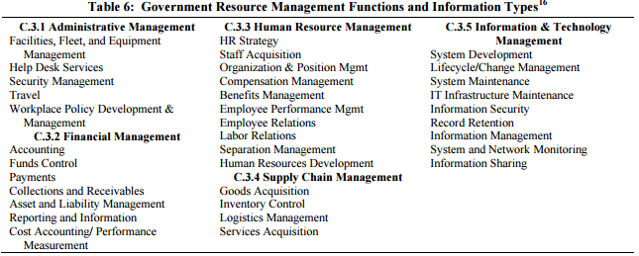
Example Management and Support Information and Information Systems

Slide 16
1. Identify Information Types
http://nvlpubs.nist.gov/nistpubs/Legacy/SP/nistspecialpublication800-60v1r1.pdf

Slide 17
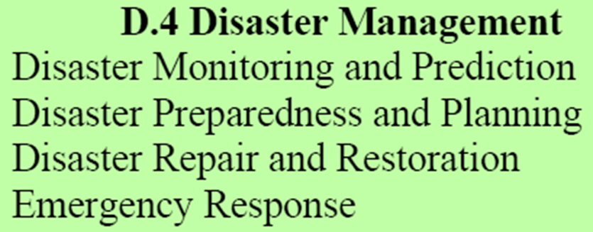
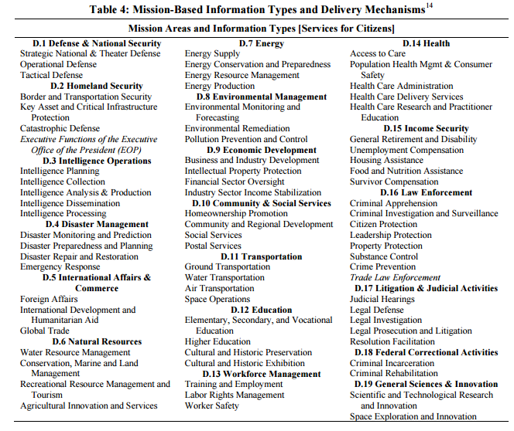
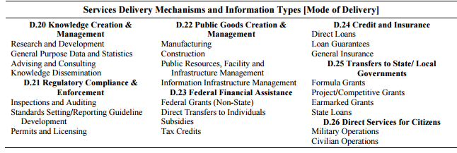
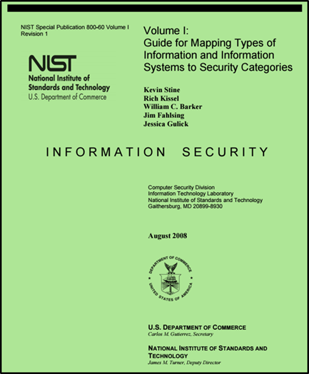
Disaster Management Information Types

Slide 18
Select Provisional Impact Levels for the identified information system

Slide 19
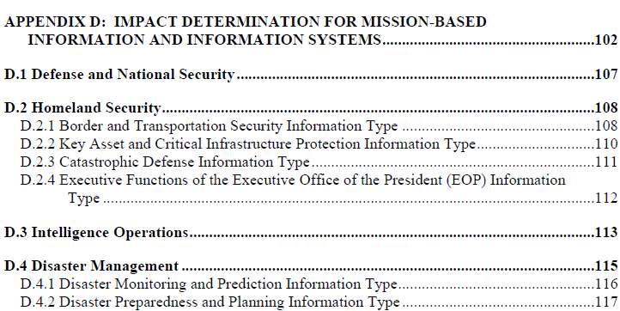
Disaster Management Information Types
https://nvlpubs.nist.gov/nistpubs/Legacy/SP/nistspecialpublication800-60v2r1.pdf

Slide 20
Disaster Management Information Impact

Slide 21
Can you use…
NIST SP 800-60 V.2 R1 to determine the Impact Levels for the Disaster Information Types ?
Break out 5 minutes…
?
?
?
?
?
?
?
?
?
?
?
?

Slide 22
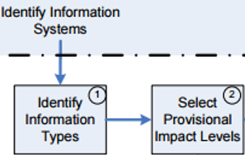
Disaster Management Information Types

Slide 23
Disaster Management Information Types

Slide 24
Question
Can you determine Summary Impact Levels for Disaster Information Types ?
?
?
?
?

Slide 25
Answer…
Summary Impact Levels for the Disaster Information Types

Slide 26
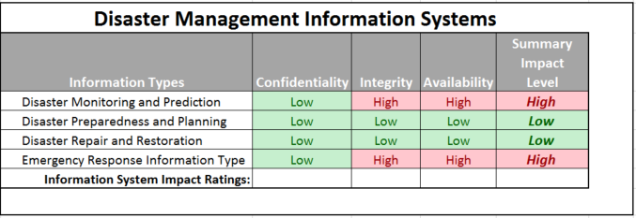
Question -
Can you determine Overall Impact Levels for Disaster Information Types?
?
?
?

Slide 27
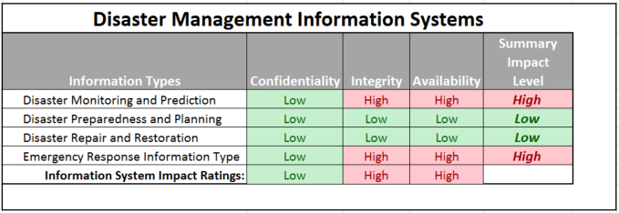
Answer
Overall Impact Levels for the Disaster Information Types

Slide 28
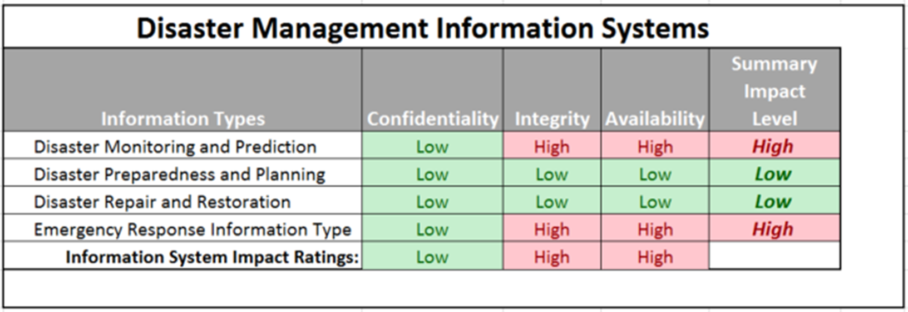
Question
Can you determine overall Impact Level of a system of Disaster Information Systems ?
?

Slide 29
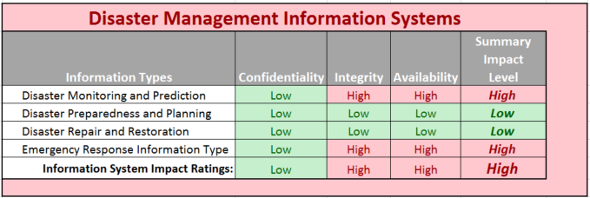
Answer
Overall Impact Level of Disaster Information Systems

Slide 30
Adjust Information Impact Level

Slide 31
To adjust preliminary impact levels…
Use NIST SP 800 60 V2R1
…looking at the “Special Factors” affecting CIA impact levels for each Disaster Management information type
How might we adjust the impact levels ?
15 minutes, then class discussion

Slide 32
Select Provisional Impact Levels for the identified information system

Slide 33
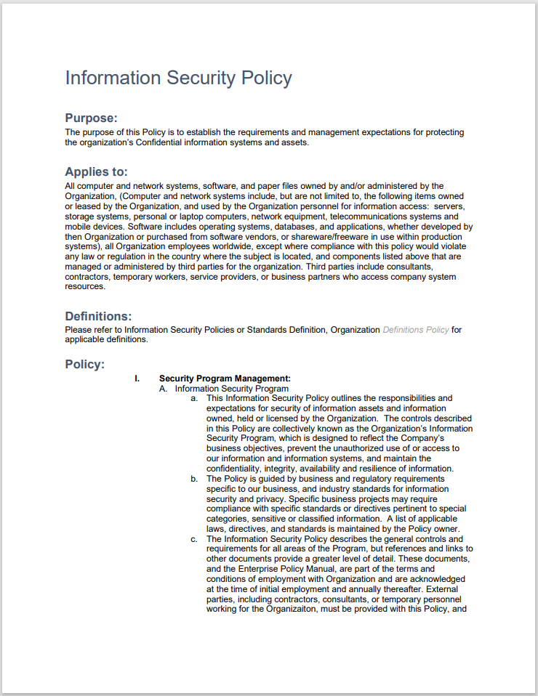
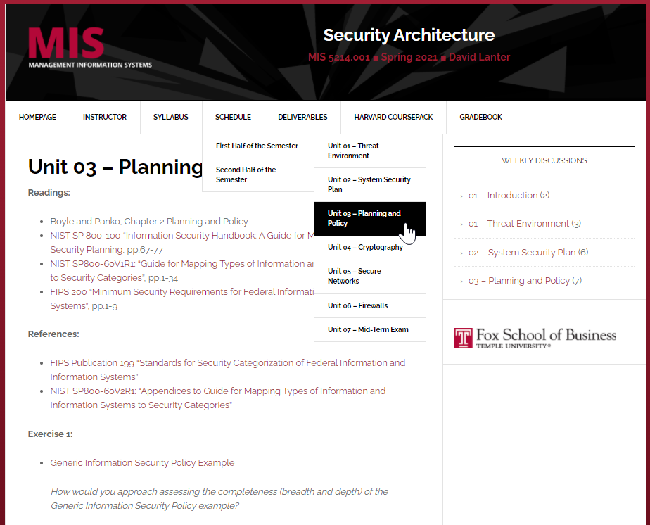
Exercise: How would you approach assessing the completeness (breadth & depth) of the Generic Information Security Policy example?

Slide 34
Teams in Breakout Rooms
How would you approach assessing the completeness (breadth & depth) of the Generic Information Security Policy example?
15 Minutes

Slide 35
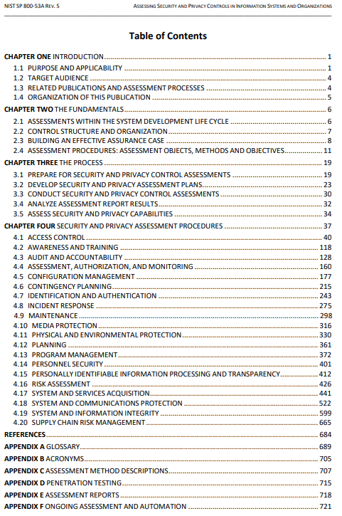
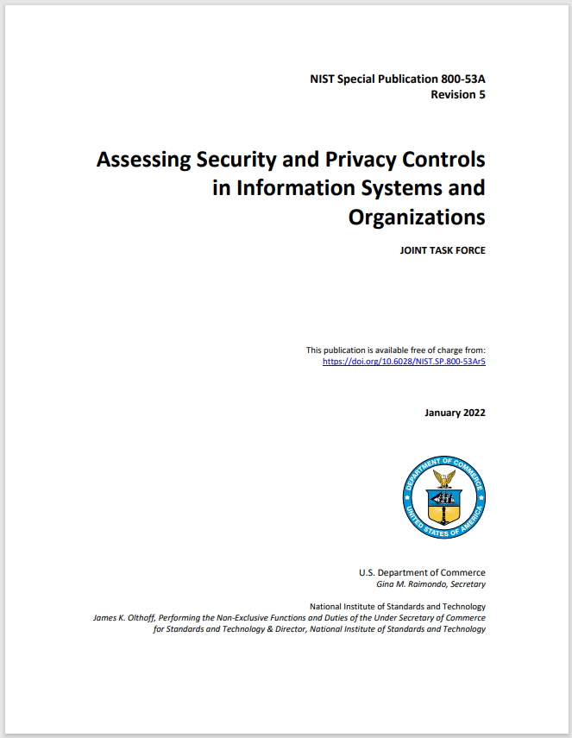
Information Security Control Families of NIST SP 800-53/800-53A grouped within 3 classes of NIST SP 800-18 provide a good framework for assessing completeness of Information Security Policies and controls

Slide 36
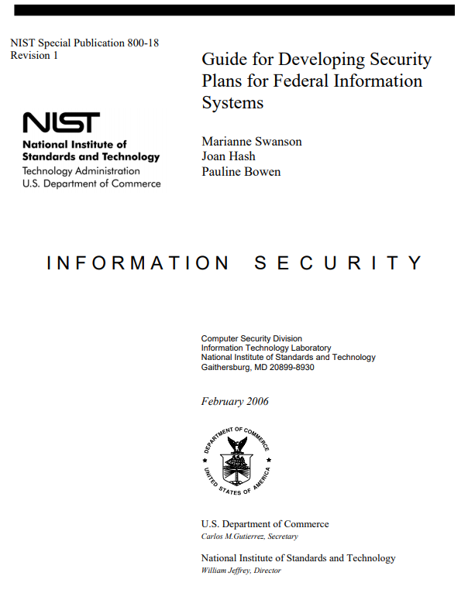
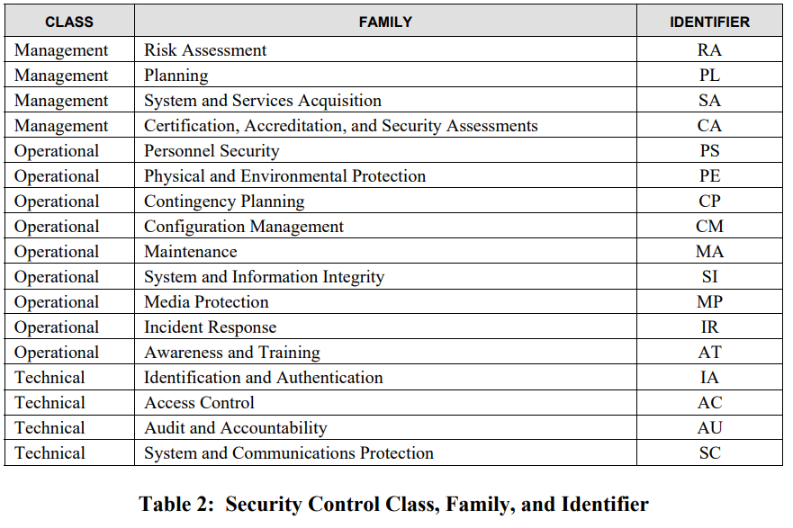
Information Security Control Families of NIST SP 800-53/800-53A grouped within 3 classes of NIST SP 800-18 provide a good framework for assessing completeness of Information Security Policies and controls

Slide 37
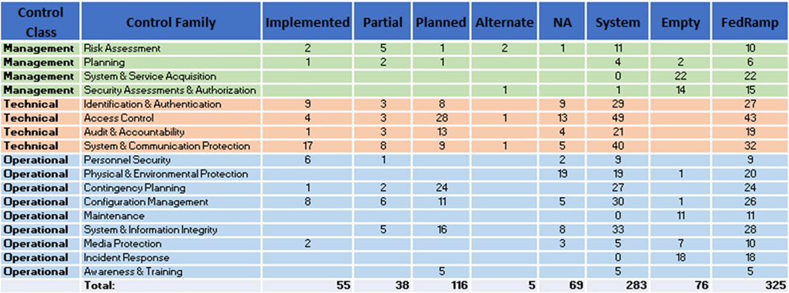
Information Security Control Families of NIST SP 800-53/800-53A grouped within 3 Control Classes of NIST SP 800-18 provide a framework for assessing completeness of Information Security Policies and controls
Completeness?

Slide 38
Exercise
Using NIST SP 800-60, find a preliminary categorization for the following information system and adjust the categorization based on your analysis – present justifications for both preliminary and adjusted categorizations
Purpose: The system has two overarching purposes:
For clients it is a system intended to help understand sewage and storm water collection and treatment systems (i.e. pipe networks, pump stations, and treatment plants) and their capacities, overflow characteristics and controls
For the firm the system is intended to provide revenue through pay by clients for direct use of the service(s) of the system
Users:
Municipal and regional water and sewer utilities and governmental organizations and the contractors that support them will use the system to help plan capital improvement, operations, and maintenance of sewer systems (i.e. treatment plants and sewage collection networks)

Slide 39
Teams in Breakout Rooms
20 Minutes

Slide 40
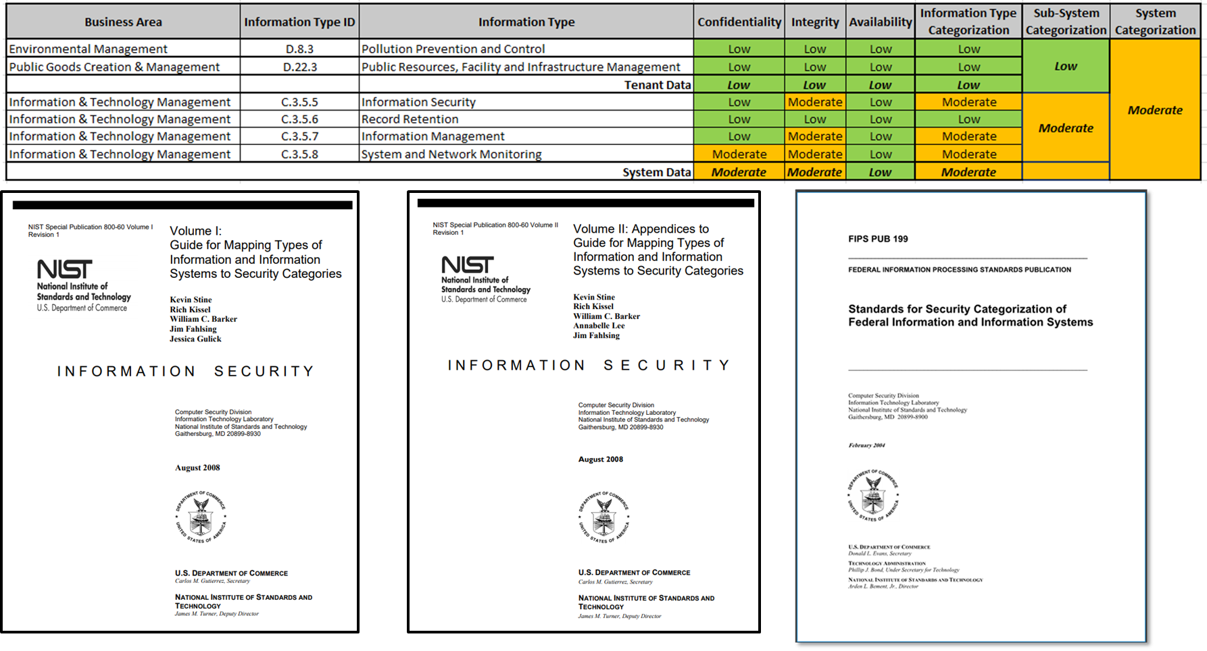
Below is a preliminary categorization for the information system based on NIST SP 800-60 Vol

Slide 41
Agenda
Risk Management Framework and IS Security Categorization
Mapping Information Types to Security Categorizations
Exercises – Determine and finalize impact levels
Exercise – Determine Information and Information System Types and provisional security categorization
Security Control Baselines – review
Minimum Security Controls and Security Control Baselines
Security Control Families
Risk Assessment Controls
Team Exercise Find and assess risk assessment policy

Slide 42
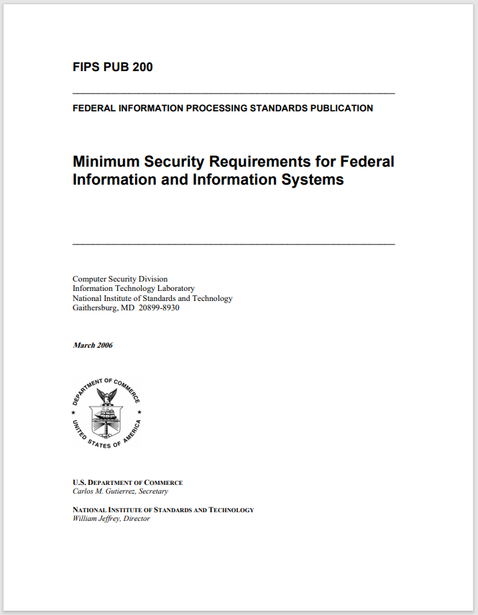
Risk Management Framework

Slide 43
Minimum Security Control Requirements
Access Control (AC)
Awareness and Training (AT)
Audit and Accountability (AU)
Certification, Accreditation, and Security Assessment (CA)
Configuration Management (CM)
Contingency Planning
Identification and Authentication
Incident Response (IR)
Maintenance (MA)
Media Protection (MP)
Physical and Environmental Protection *PE)
Planning (PL)
Personal Security (PS)
Risk Assessment (RA)
System and Services Acquisition(SA)
System and Communications Protection (SC)
System and Information Integrity (SI)

Slide 44
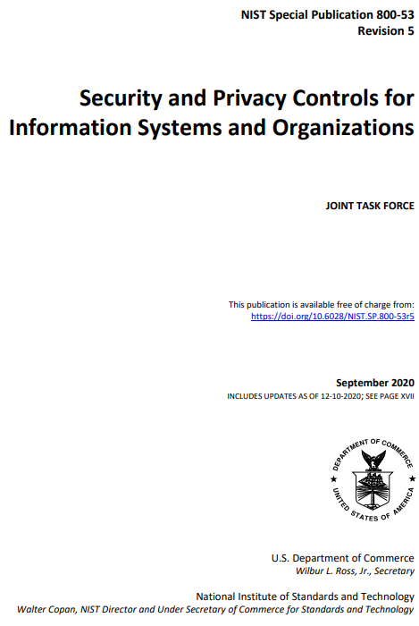
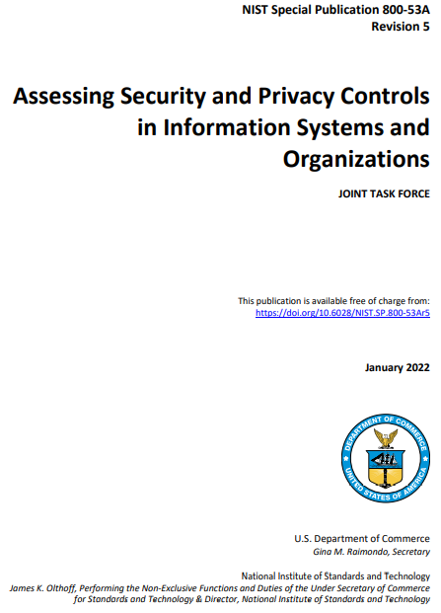
Risk Management Framework

Slide 45
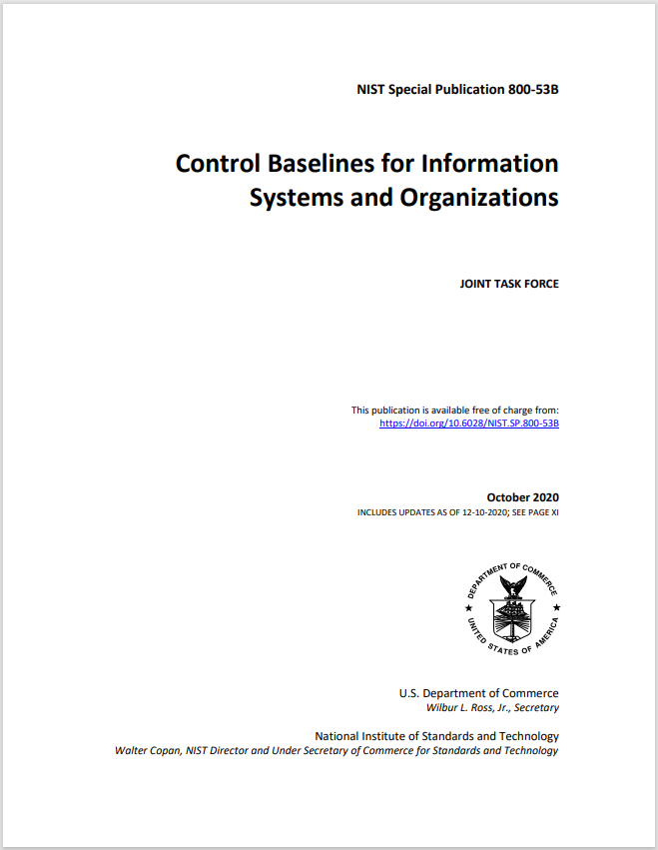
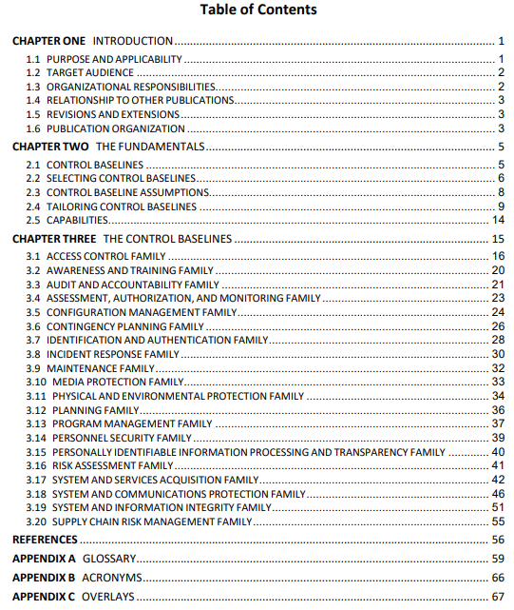
https://nvlpubs.nist.gov/nistpubs/SpecialPublications/NIST.SP.800-53B.pdf

Slide 46
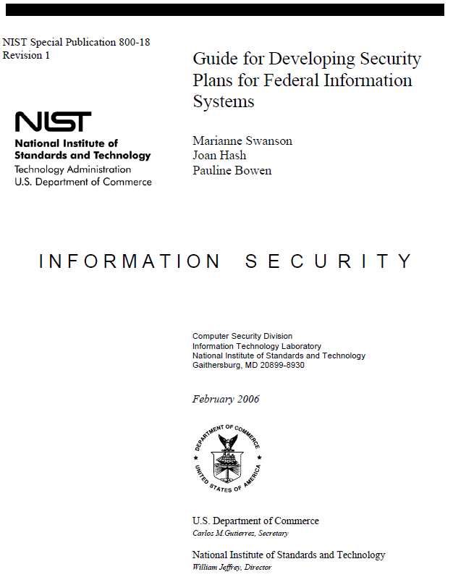
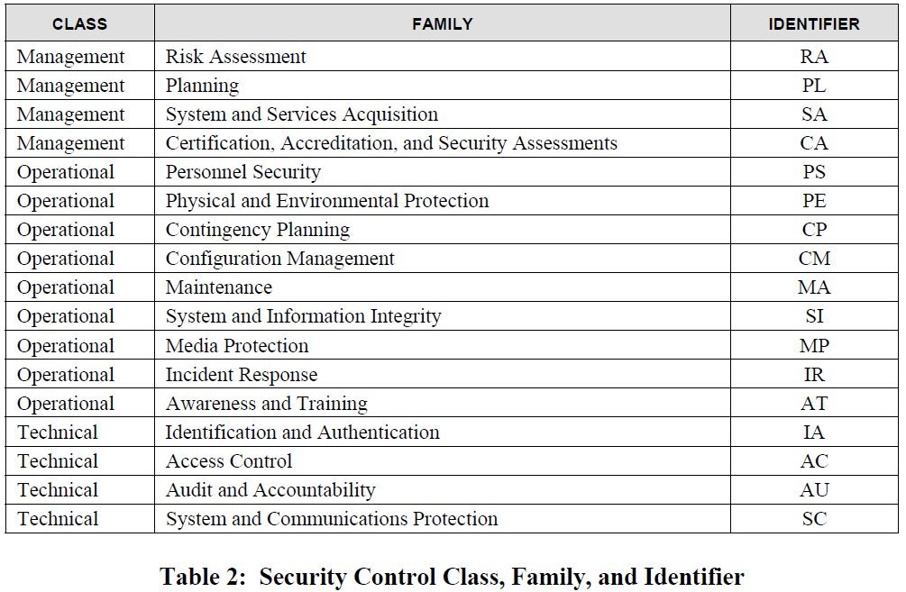
What kind of control is Planning ?

Slide 47
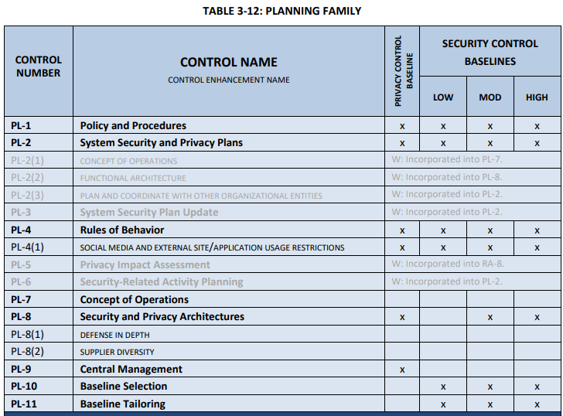
https://nvlpubs.nist.gov/nistpubs/SpecialPublications/NIST.SP.800-53B.pdf

Slide 48
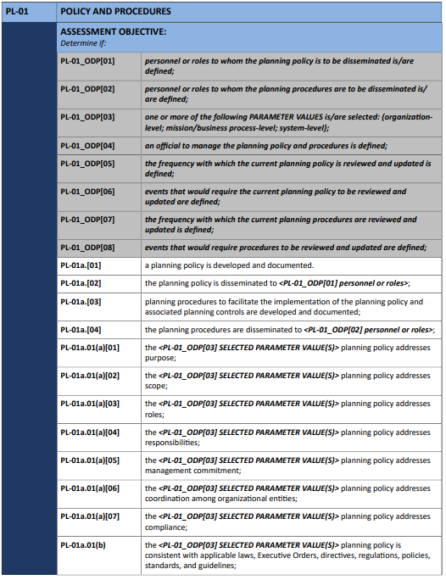
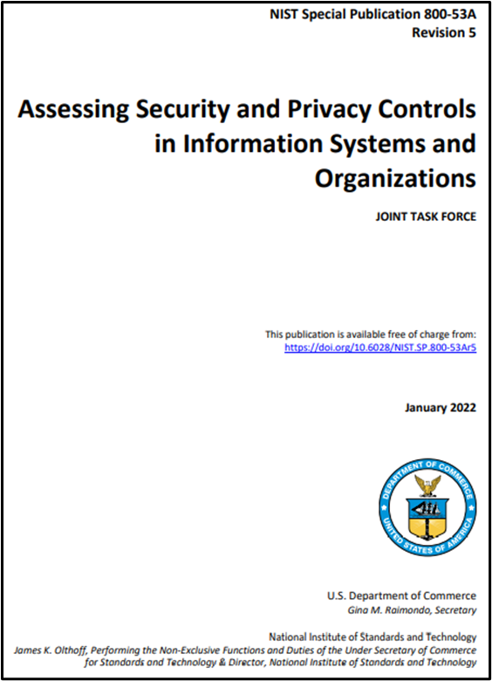
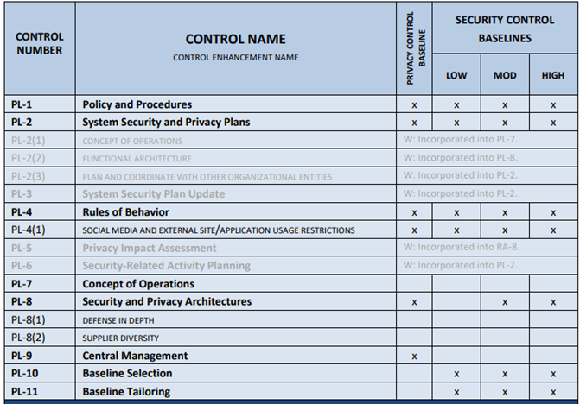
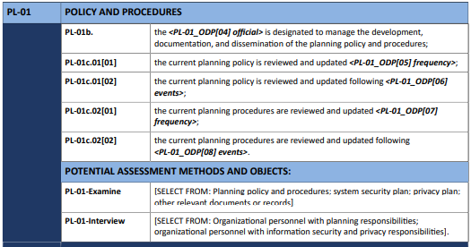
Control further granularized from SP 800-53
Corresponds directly with SP SP 800-53
ODP = Organizational-defined parameters

Slide 49
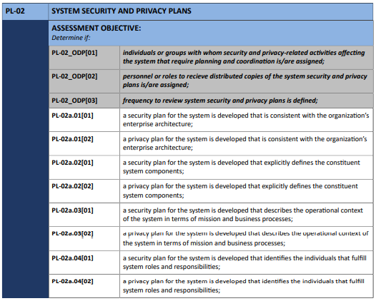
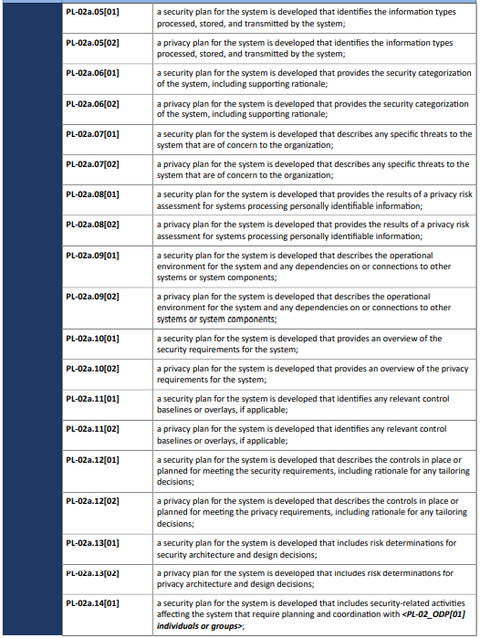
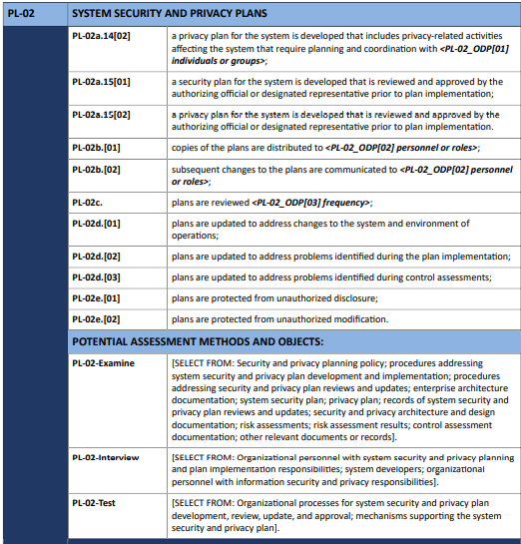

Slide 50
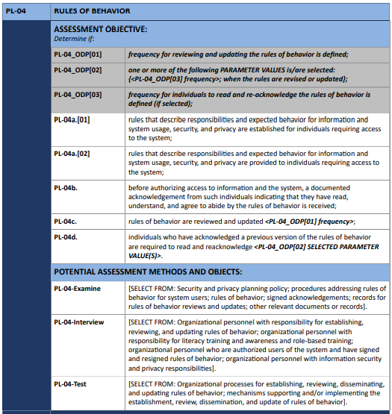
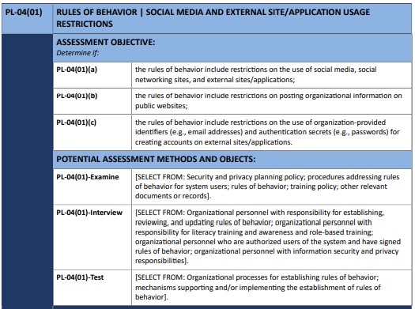
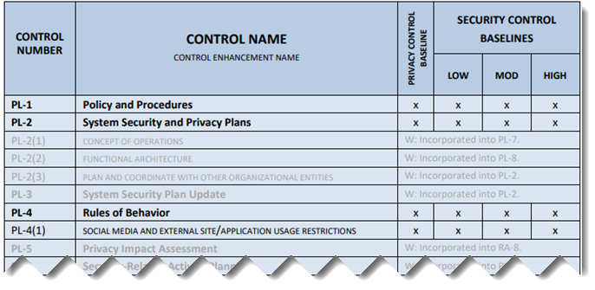

Slide 52
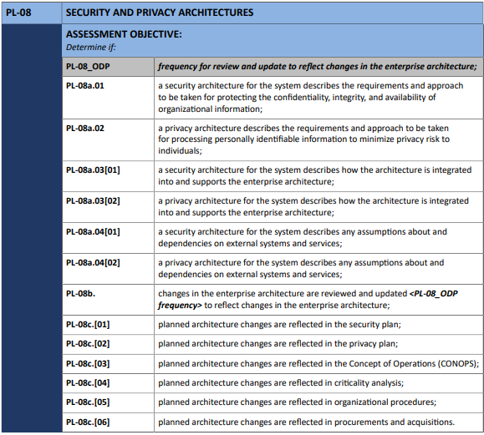

Slide 56
Exercise
Using Google or your favorite search engine…
Find an organization’s IT risk assessment policy and procedures
Assess how well the policy meets requirements of RA-1
Assess how well the procedures meet RA2 and RA3
Return to class discussion in 20 minutes
Present your findings

Slide 57
Case Study Assignment – due 1/30 midnight
Questions:
Who are the major stakeholders associated with Nordic Data Grid Facility (NDGF) and UniNETT? What critical resources are stored within the system and what concerns might stakeholders have regarding the resources?
How did employees, information security (infosec) processes, and infosec tools inadvertently help the attacker succeed in breaking into Titan?
What should Margrete Raaum do now? Would you suggest that Titan is ready to be turned on for local access? Is it ready to be reconnected to the computational grid?

Slide 58
Agenda
NIST Risk Management Framework and FIPS 199
Use of NIST SP 800-60 Volume 1 and Volume 2
Exercise – Finalize impact levels
Exercise – Determine and finalize impact levels
Exercise – Determine Information and Information System Types and provisional security categorization
Security Control Baselines – review
FIPS 200 and NIST 800-53 Security Control Baselines
Security Control Families
Risk Assessment Controls
Team Exercise Find and assess risk assessment policy
Next Time: Case Study 1

Slide 59
Unit #3
MIS5214
Planning and Policy

