Slide 1
Unit #4
MIS5214
Case Study 1 and Cryptography

Slide 2
Agenda
Case Study – The Titan Incident
Cryptography
Cryptographic information system security controls
Case Study revisited
Quiz

Slide 3
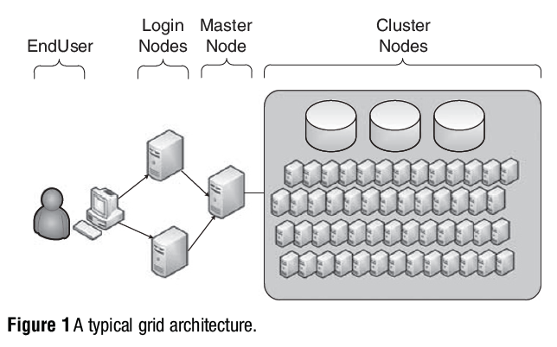
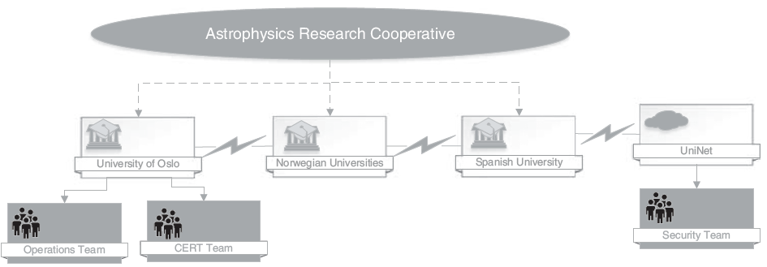
A High Performance Computing Cluster Under Attack: The Titan Incident
What was the specific attack vector(s) used by attacker:
?
?
?
?
?
?

Slide 4
A High Performance Computing Cluster Under Attack: The Titan Incident
Specific attack vector used by attacker:
Attacker obtained valid user names and password combinations from a system in Spain that had a research agreement with University of Oslo (UiO)
Attacker accessed the Titan cluster as a research user using the valid credentials that were “harvested” from the previously compromised system
The attacker used a local system exploit (CVE-2010-3847) to gain administrative privileges on the Titan system
Once administrative privileges were obtained, the attacker modified system files to collect the usernames and passwords of other end-users as they accessed the grid
The attacker created at least one “backdoor”, or method of accessing the system without relying on the compromised accounts
The newly stolen credentials were used to gain unauthorized access to other systems, and they may also have been sold on the black market

Slide 5
What kind of failings permitted the attack’s success?
IT Governance
End users
Information technology services
Information security
Incident response

Slide 6
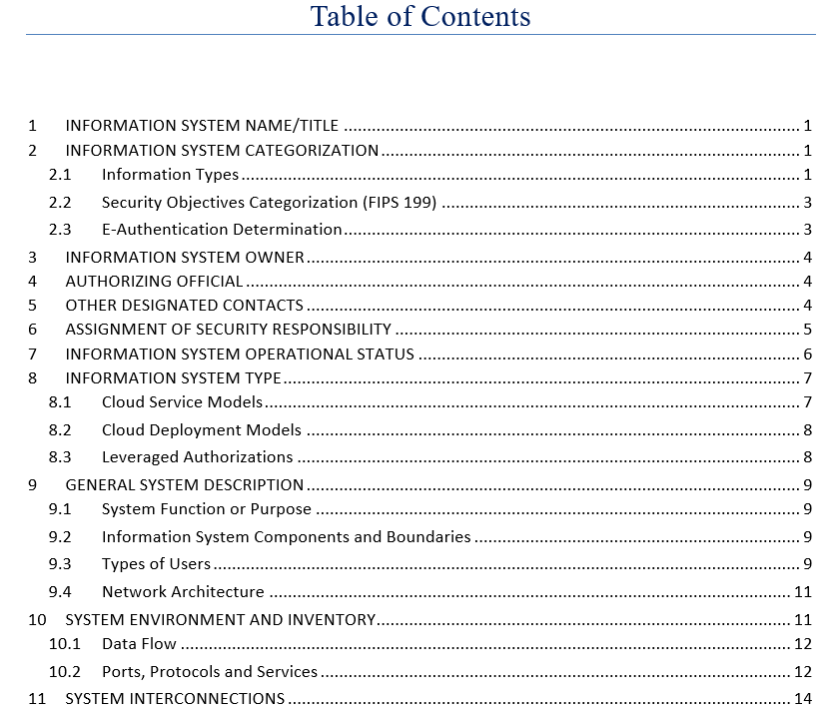
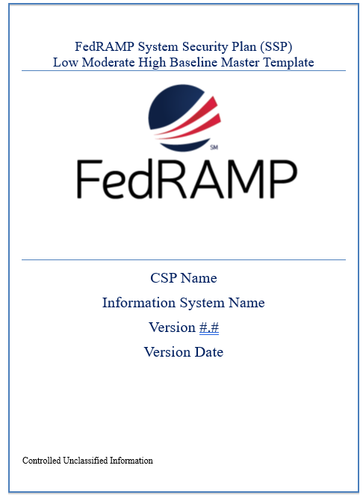
Where in the FedRAMP System Security Plan would you look for information to help you audit the security of the Titan Information System?

Slide 7
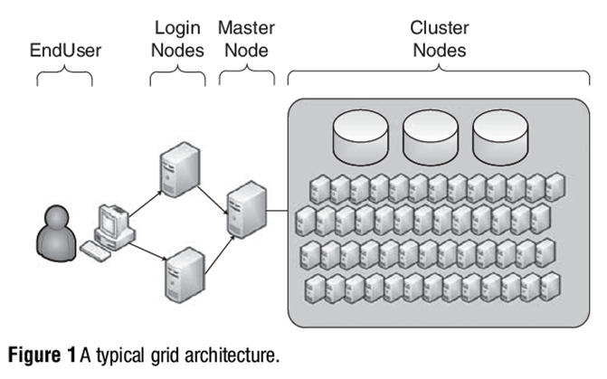
Draw a logical network diagram adding in graphical elements that illustrate the system boundary, interconnections and data flow

Slide 8
What should Margrete Raaum do next?
 | Preventive Controls | Detective Controls | Corrective/Responsive Controls
Information Security
Incident Response
IT Governance

Slide 9
Epilogue

Slide 10
Agenda
Case Study – The Titan Incident
Cryptography
Case Study revisited
Quiz

Slide 11
Cryptography
Method of transmitting and storing data in a form that only those it is intended for can read and process
An effective way of protecting sensitive information as it is transmitted through untrusted network communication paths or stored on media
Complements physical and logical access controls

Slide 12
Cryptanalysis
The study of methods to break cryptosystems
Often targeted at obtaining a key
Attacks may be passive or active
Kerckhoff’s Principle
The only secrecy involved with a cryptosystem should be the key
Cryptosystem Strength
How hard is it to determine the secret associated with the system?

Slide 13
Terminology
Plaintext – is the readable version of a message
Ciphertext – is the unreadable results after an encryption process is applied to the plaintext
Cryptosystem – includes all the necessary components for encryption and decryption
Algorithms
Keys
Software
Protocols
Harris, S. and Maymi, F. (2016) All-In-One CISSP Exam Guide, McGraw Hill Education

Slide 14
Cipher = encryption algorithm
2 main attributes combined in a cypher
Confusion: usually carried out through substitution
Diffusion: Usually carried out through transposition
Harris, S. and Maymi, F. (2016) All-In-One CISSP Exam Guide, McGraw Hill Education

Slide 15
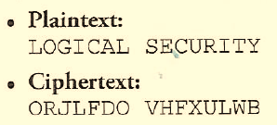
Example: Substitution cipher or algorithm
A mono-alphabetic substitution cipher
Poly-alphabetic substitution cipher
“SECURITY” <=> “HVXFIRGB”

Slide 16
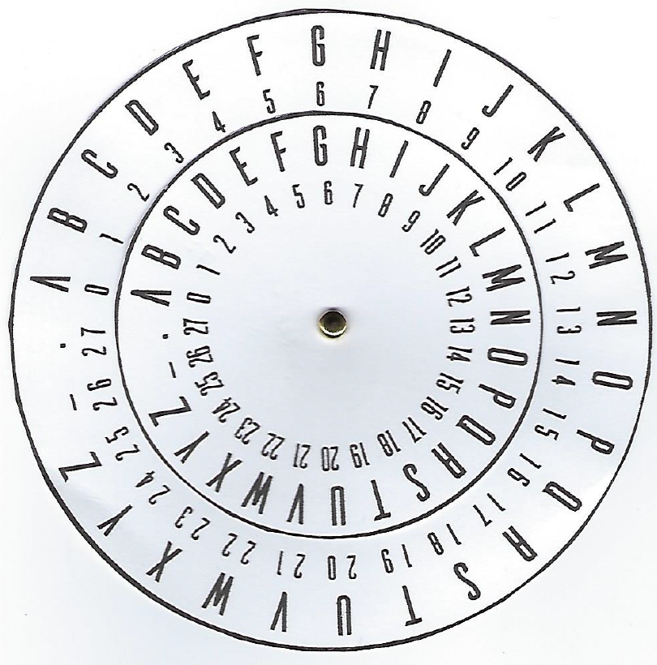
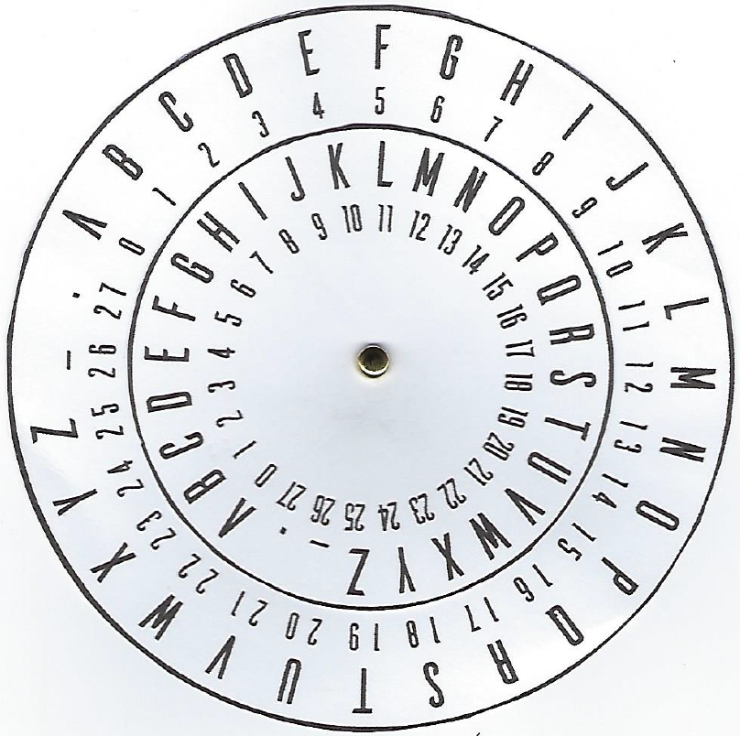
Cipher Disk based substitution
Outer wheel is for the plaintext alphabet
Inner wheel is for ciphertext
When the outer wheel and inner wheel and are both aligned at the letter “A” (i.e. position zero), there is no encryption mapping the letters on the outer wheel to letters on the inner wheel

Slide 17
Secret
0

Slide 18
Tfdsfu
1

Slide 19
Ugetgv
2

Slide 20
Keyspace is the number of possible keys
28

Slide 21
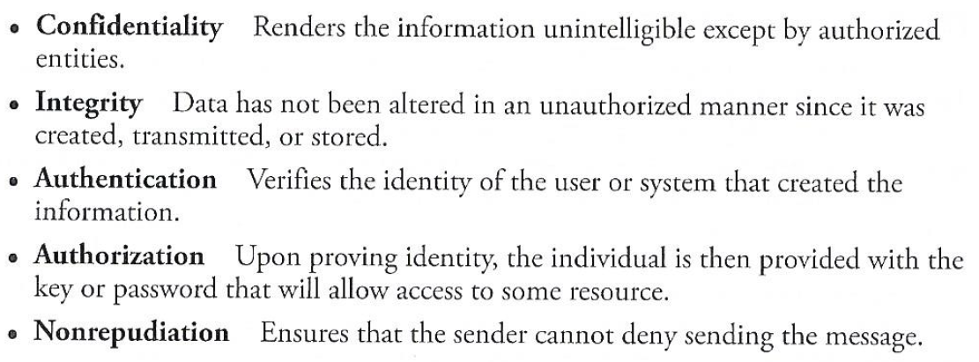
Services of cryptosystems
Repudiation – the sender denying he sent the message
Harris, S. and Maymi, F. (2016) All-In-One CISSP Exam Guide, McGraw Hill Education

Slide 22
XOR – Exclusive OR
Creating “confusion” through a binary mathematical function called “exclusive OR”, abbreviated as XOR
Harris, S. and Maymi, F. (2016) All-In-One CISSP Exam Guide, McGraw Hill Education

Slide 23
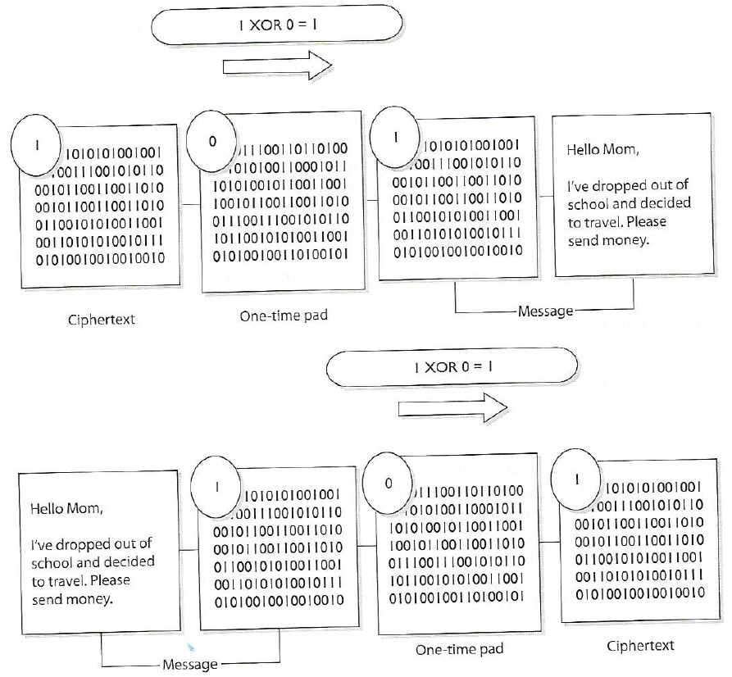
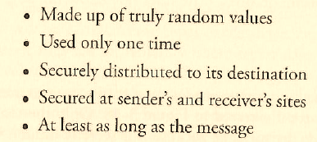
One-Time Pad a perfect encryption scheme
One-Time Pad Requirements
Harris, S. and Maymi, F. (2016) All-In-One CISSP Exam Guide, McGraw Hill Education

Slide 24
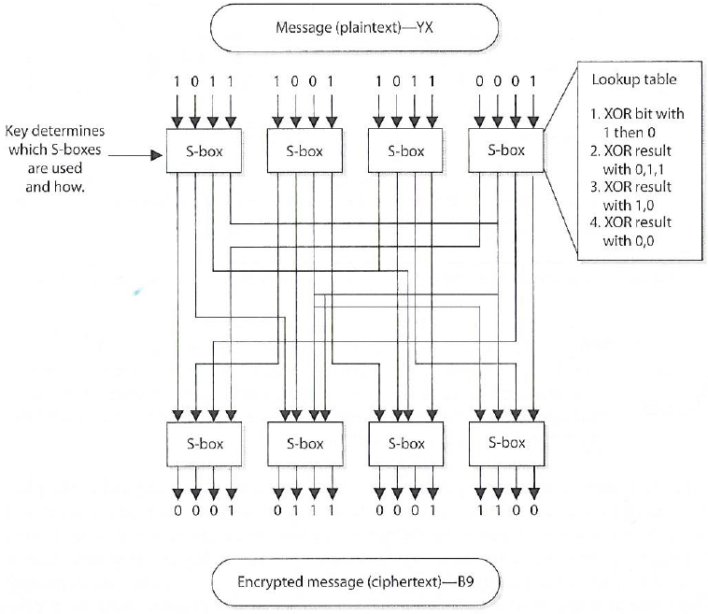
2 main attributes combined in a cypher
Confusion: usually carried out through substitution
Diffusion: Usually carried out through transposition
Harris, S. and Maymi, F. (2016) All-In-One CISSP Exam Guide, McGraw Hill Education

Slide 25
Dichotomies is cryptography
Symmetric versus Asymmetric
Stream versus block
Synchronous versus Asynchronous
1-Way functions versus 2-Way functions

Slide 26
Symmetric versus asymmetric algorithms
Symmetric cryptography
Use a copied pair of symmetric (identical) secret keys
The sender and the receive use the same key for encryption and decryption functions
Asymmetric cryptography
Also know as “public key cryptography”
Use different (“asymmetric”) keys for encryption and decryption
One is called the “private key” and the other is the “public key”

Slide 27
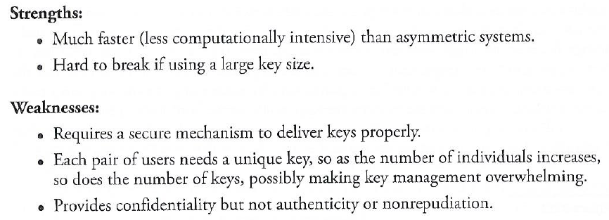
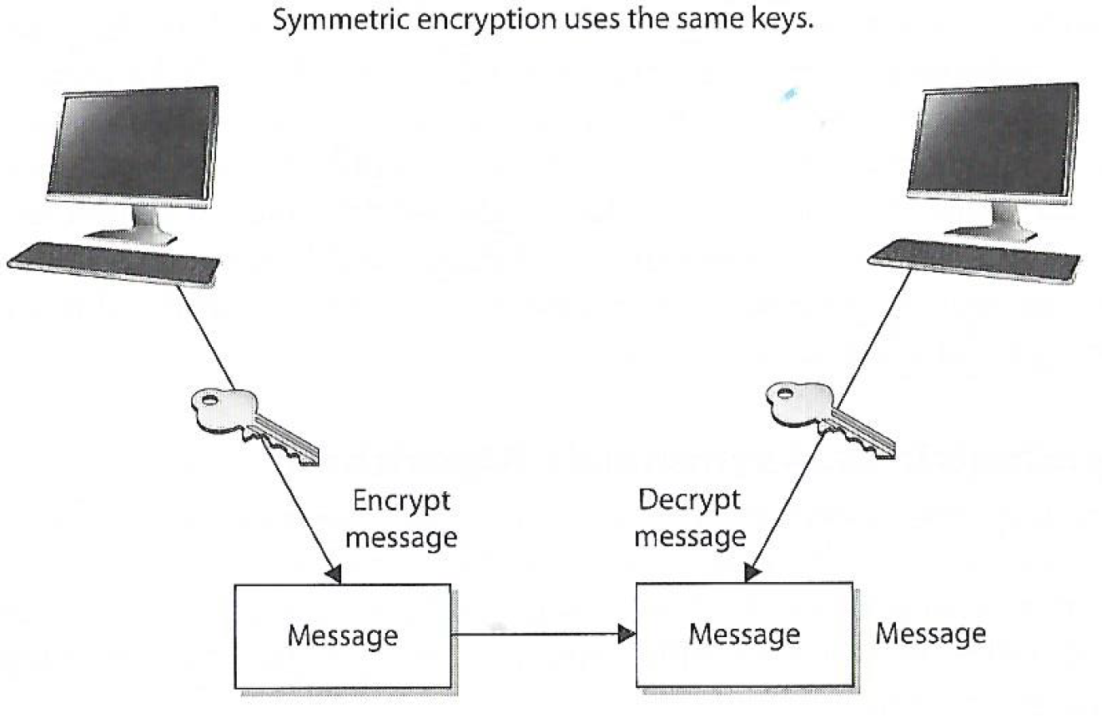
Symmetric cryptography
Two types: Stream and Block Ciphers
Stream Ciphers treat the message a stream of bits and performs mathematical functions on each bit individually
Block Ciphers divide a message into blocks of bits and transforms the blocks one at a time

Slide 28
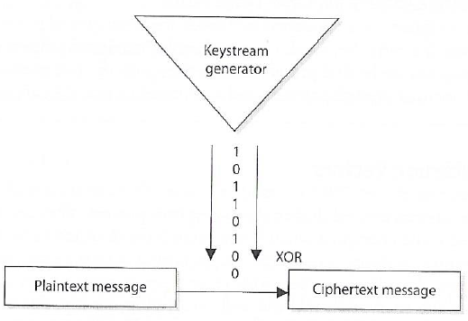
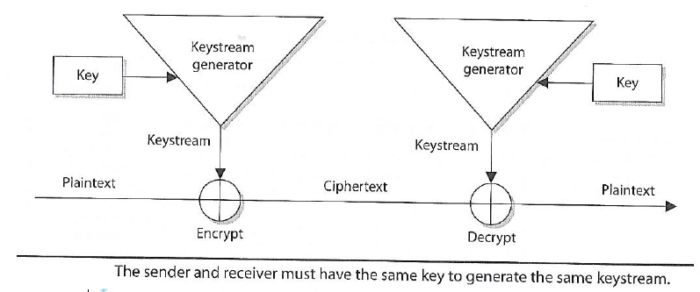
Symmetric Stream Ciphers
Easy to implement in hardware
Used in cell phones and Voice Over Internet Protocol
Harris, S. and Maymi, F. (2016) All-In-One CISSP Exam Guide, McGraw Hill Education

Slide 29
Symmetric versus asymmetric algorithms
Symmetric cryptography
Use a copied pair of symmetric (identical) secret keys
The sender and the receive use the same key for encryption and decryption functions
Asymmetric cryptography
Also know as “public key cryptography”
Use different (“asymmetric”) keys for encryption and decryption
One is called the “private key” and the other is the “public key”

Slide 30
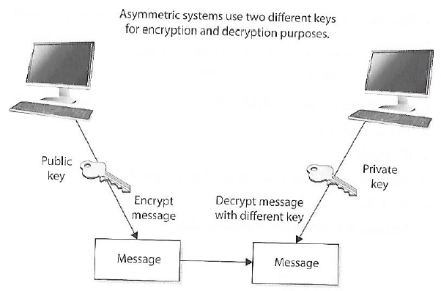
Asymmetric cryptography
Public and Private keys are mathematically related
Public keys are generated from private key
Private keys cannot be derived from the associated public key (if it falls into the wrong hands)
Public key can be known by everyone
Private key must be known and used only by the owner
Asymmetric cryptography is computational intensive and much slower than symmetric cryptography
Harris, S. and Maymi, F. (2016) All-In-One CISSP Exam Guide, McGraw Hill Education

Slide 31
Asymmetric cryptography
Do not get confused and think the public key is only for encryption and private key is only for decryption!
Each key type can be use used to encrypt and decrypt
If data is encrypted with a private key it cannot be decrypted with the same private key (but it can be decrypted with the related public key)
If data is encrypted with a public key it cannot be decrypted with the same public key (but it can be decrypted with the related private key)

Slide 32
Asymmetric cryptography
If the sender (“Jill”) encrypts data with her private key, the receiver (“Bill”) must have a copy of Jill’s public key to decrypt it
By decrypting the message with Jill’s public key Bill can be sure the message really came from Jill
A message can be decrypted with a public key only if the message was encrypted with the corresponding private key
This provides authentication because Jill is only the only one who is supposed to have her private key
If Bill (the receiver) wants to make sure Jill is the only one who can read his reply, he will encrypt the response with her public key
Only Jill will be able to decrypt the message, because she is the only one who has the necessary private key
This provides confidentiality because only Jill is able to decrypt the message with her private key

Slide 33
Asymmetric cryptography
Why would Bill (now the sender) choose to encrypt his reply to Jill with his private key instead of using Jill’s public key?
Authentication – Bill wants Jill to know that the message came from him and no one else
If he encrypted the data with Jill’s public key, it does not provide authenticity because anyone can get Jill’s public key
If he uses his private key to encrypt the data, then Jill can be sure the message came from him and no one else
Note: Symmetric keys do not provide authenticity – because the same key is used on both ends (using one of the secret keys does not ensure the message originated from a specific individual

Slide 34
Asymmetric cryptography
If confidentiality is the most important security service, the sender would encrypt the file with the receiver’s public key
This is called a “secure message format” because it can only be decrypted by the person with the corresponding private key
If authentication is most important, the sender would encrypt the data with his private key
This provides assurance to the receiver that the only person who could have encrypted the data is the individual in possession of the private key
If the sender encrypted the data with receivers public key, authentication is not provided because the public key is available to anyone
Encrypting data with the senders private key is called an “open message format” because anyone with a copy of the corresponding public key can decrypt the message
Confidentiality is not assured

Slide 35
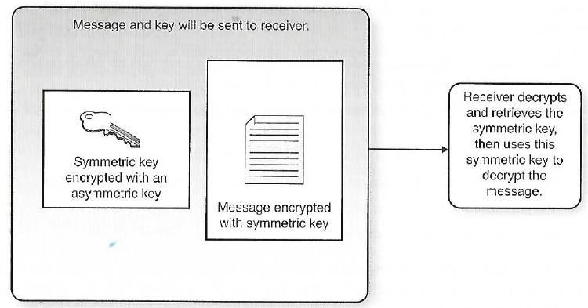
Hybrid Encryption (a.k.a. “digital envelope”)
Symmetric and asymmetric and algorithms are often used together
Public key cryptography’s asymmetric algorithm is used to create public and private keys for secure automated key distribution
Symmetric algorithm is used to create secret keys for rapid encryption/decryption of bulk data
Harris, S. and Maymi, F. (2016) All-In-One CISSP Exam Guide, McGraw Hill Education

Slide 36
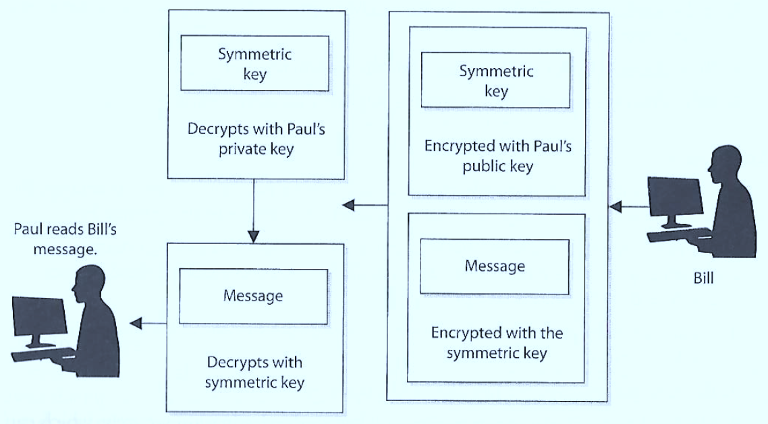
Hybrid Encryption
3
2
1
4
Symmetric algorithm uses a secret key to encrypt the message and the asymmetric key encrypts the secret key for transmission (SSL/TLS uses hybrid)
Harris, S. and Maymi, F. (2016) All-In-One CISSP Exam Guide, McGraw Hill Education

Slide 37
Quick review
If a symmetric key is encrypted with a receiver’s public key, what security service is provided?

Slide 38
Quick review
If a symmetric key is encrypted with a receiver’s public key, what security service is provided?
Confidentiality: only the receiver’s private key can be used to decrypt the symmetric key, and only the receiver should have access to this private key

Slide 39
Quick review
If data is encrypted with the sender’s private key, what security services is provided?

Slide 40
Quick review
If data is encrypted with the sender’s private key, what security services are provided?
Authenticity of the sender and nonrepudiation. If the receiver can decrypt the encrypted data with the sender’s public key, then receiver knows the data was encrypted with the sender’s private key

Slide 41
Quick review
Why do we encrypt the message with the symmetric key rather than the asymmetric key?

Slide 42
Quick review
Why do we encrypt the message with the symmetric key rather than the asymmetric key?
Because the asymmetric key algorithm is too slow

Slide 43
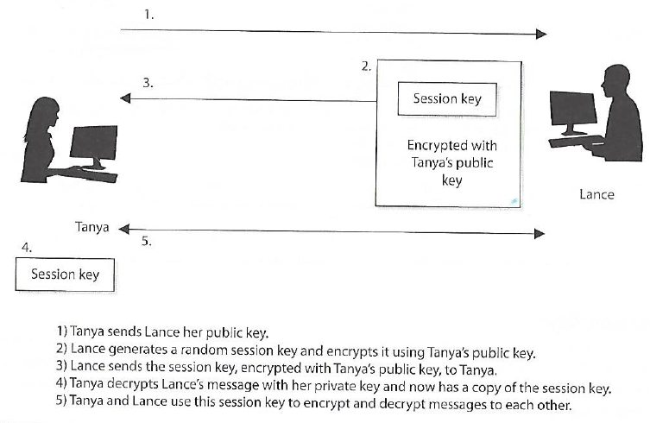
Session keys
Single-use symmetric keys used to encrypt messages between two users in an individual communication session
This is how secure web client applications communicate with server-side services
Harris, S. and Maymi, F. (2016) All-In-One CISSP Exam Guide, McGraw Hill Education

Slide 44
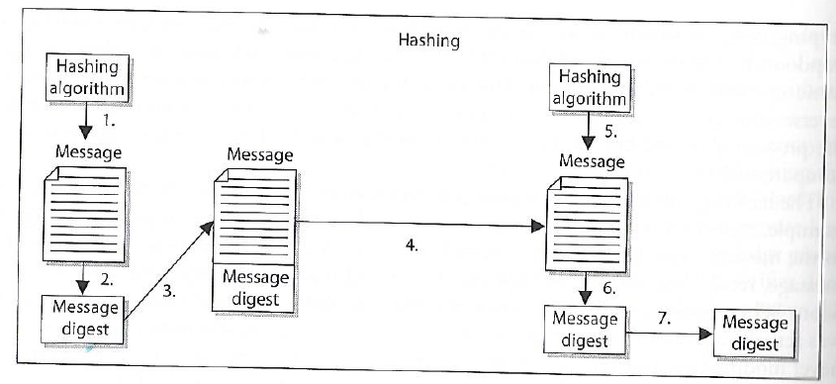
One-way Hash
Sender puts message through hashing function
Message digest generated
Message digest appended to the message
Sender sends message to receiver
Receiver puts message through hashing function
Receiver generates message digest value
Receiver compares the two message digests values. If they are the same, the message has not been altered
Assures message integrity
A function that takes a variable-length string (i.e. message) and produces a fixed-length value called a hash value
Does not use keys

Slide 45
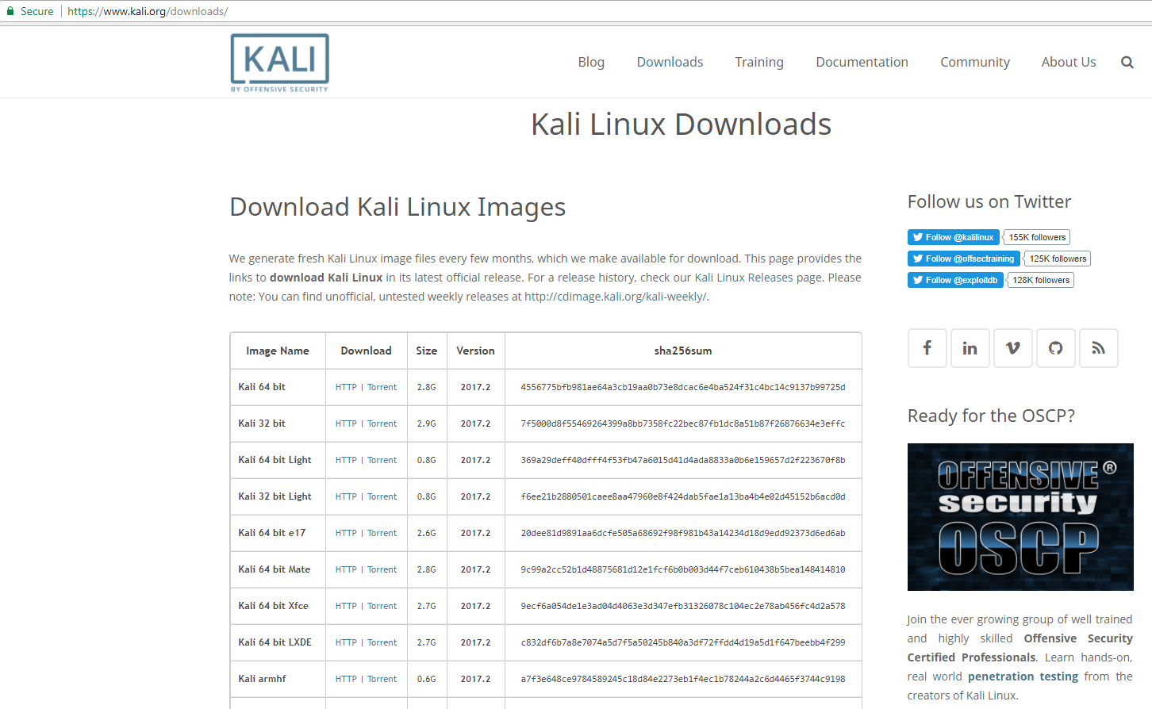
One-way hash example…
Testing the integrity of a file (e.g. program) downloaded from the internet…

Slide 46
One-way hash example…
Testing the integrity of a file (e.g. program) from the internet…
Is the Kali I downloaded the same Kali that was published?

Slide 47
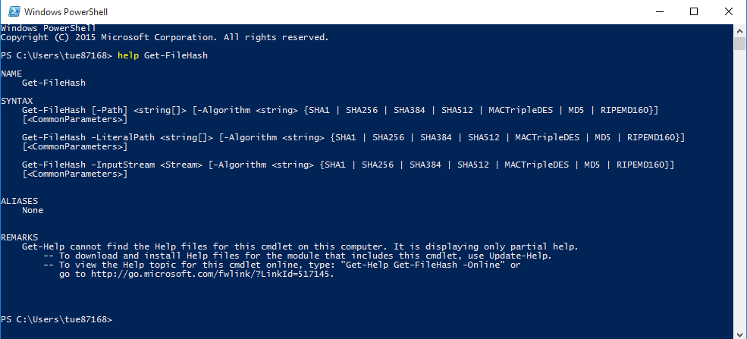
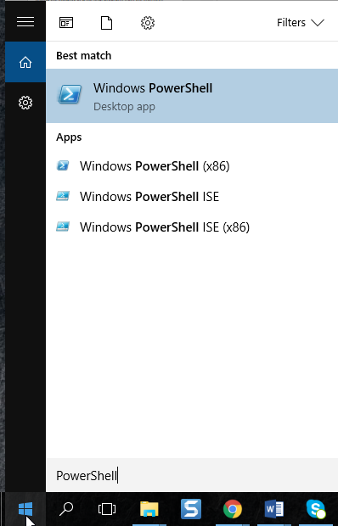
One-way hash example…

Slide 48
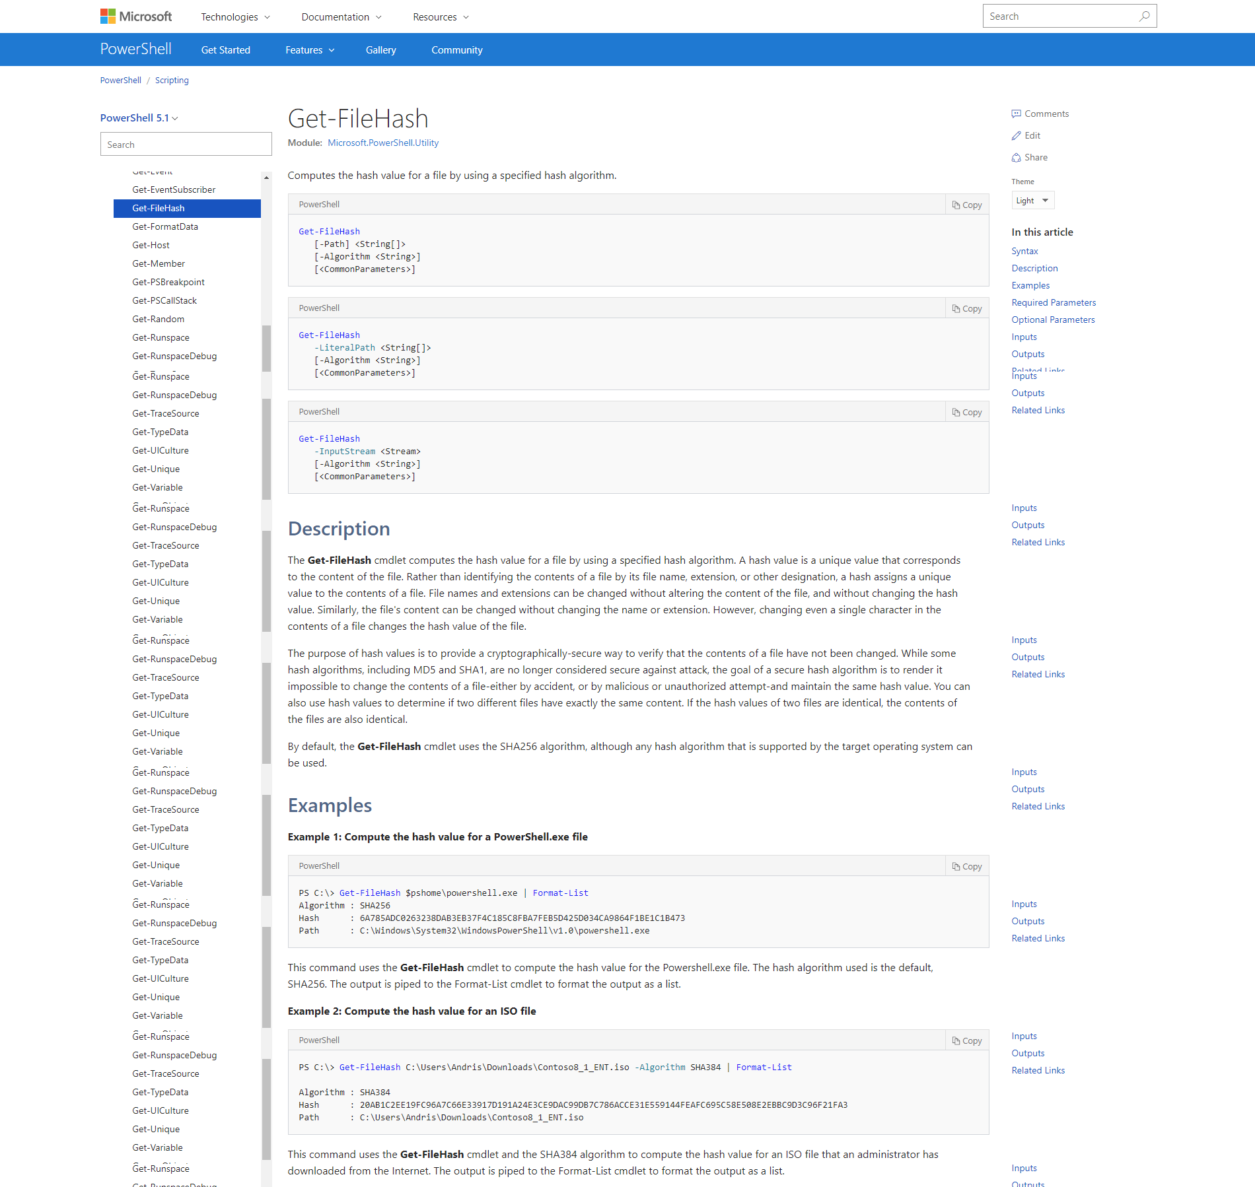
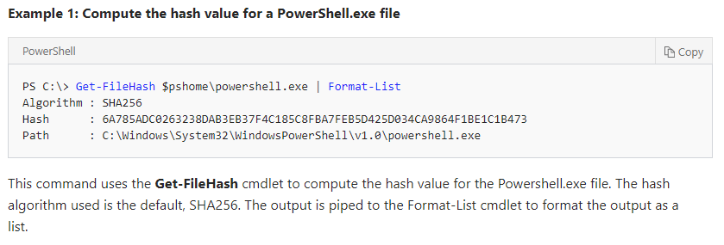
One-way hash example…
https://docs.microsoft.com/en-us/powershell/module/microsoft.powershell.utility/get-filehash?view=powershell-5.1

Slide 49
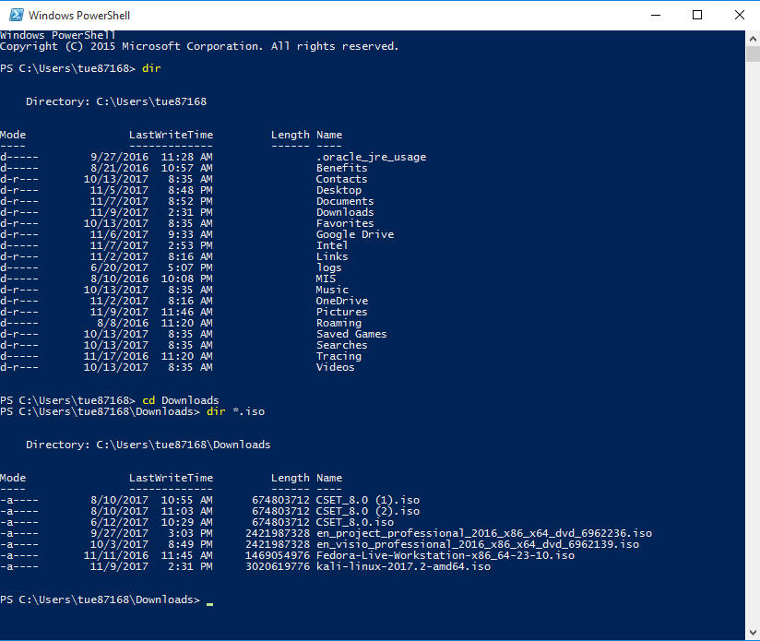

Slide 50
One-way hash example…

Slide 51
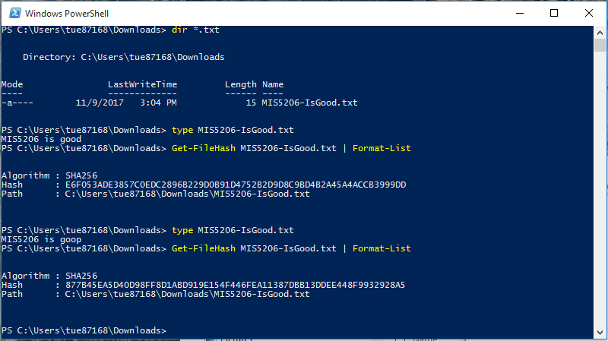
One-way hash example…
Notice the amount of confusion and diffusion resulting from a 1 character change!

Slide 52
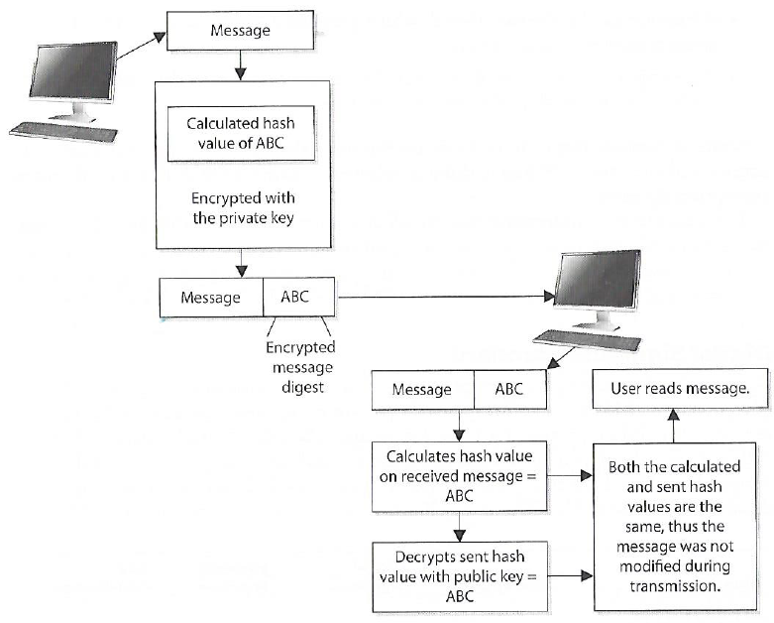
Digital Signature
A hash value encrypted with the sender’s private key
The act of signing means encrypting the message’s hash value with the private key
Creating a digital signature for a message
Harris, S. and Maymi, F. (2016) All-In-One CISSP Exam Guide, McGraw Hill Education

Slide 53
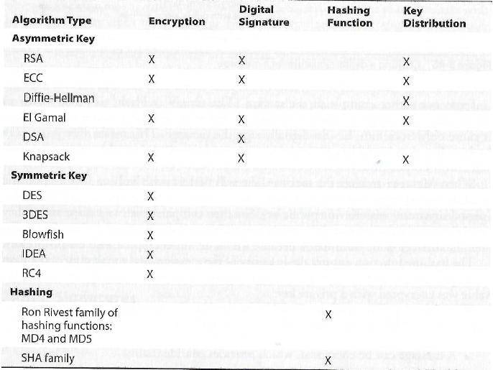
Cryptographic algorithms and their functions
Harris, S. and Maymi, F. (2016) All-In-One CISSP Exam Guide, McGraw Hill Education

Slide 54
Services of cryptosystems
Harris, S. and Maymi, F. (2016) All-In-One CISSP Exam Guide, McGraw Hill Education

Slide 55
How did the attacker attack the Titan cluster?
Attacker obtained valid user names and password combinations from a system in Spain that had a research agreement with University of Oslo (UiO)
Attacker accessed the Titan cluster as a research user using the valid credentials that were “harvested” from the previously compromised computer used by a researcher in Spain
The attacker used a local system exploit (CVE-2010-3847) to gain administrative privileges on the Titan system
Once administrative privileges were obtained, the attacker modified SSH system files to collect the usernames and passwords of other end-users as they accessed the grid

Slide 56
…the attacker modified SSH system files to collect the usernames and passwords of other end-users as they accessed the grid
Secure Shell (SSH) is a cryptographic network protocol for operating network services securely over an unsecured network. SSH provides a secure channel over an unsecured network in a client-server architecture, connecting an SSH client application with an SSH server
Common applications include remote command-line login and remote command execution, but any network service can be secured with SSH. The protocol specification distinguishes between two major versions, referred to as SSH-1 and SSH-2.
The most visible application of the protocol is for access to shell accounts on Unix-like operating systems, but is in limited use on Windows as well

Slide 57
SSH uses public-key cryptography to authenticate the remoted computer and allow it to authenticate the user
There are several ways to use SSH:
One is to use automatically generated public-private key pairs to simply encrypt a network connection, and then use password authentication to log on
Another is to use a manually generated public-private key pair to perform the authentication, allowing users or programs to log in without having to specify a password
In this scenario, anyone can produce a matching pair of different keys (public and private). The public key is placed on all computers that must allow access to the owner of the matching private key (the owner keeps the private key secret)

Slide 58
Remember… Session keys ?
Single-use symmetric keys used to encrypt messages between two users in an individual communication session
This is how secure web client applications communicate with server-side services

Slide 59
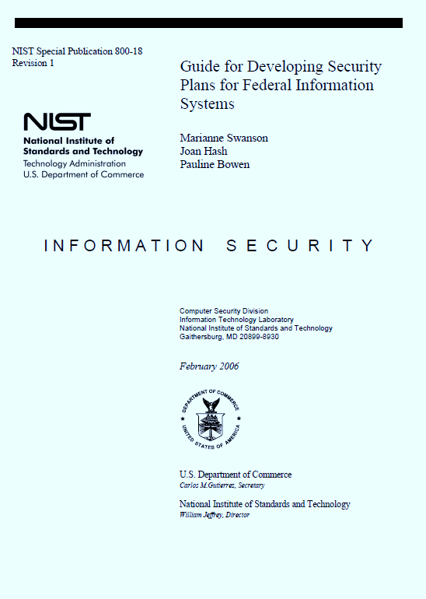
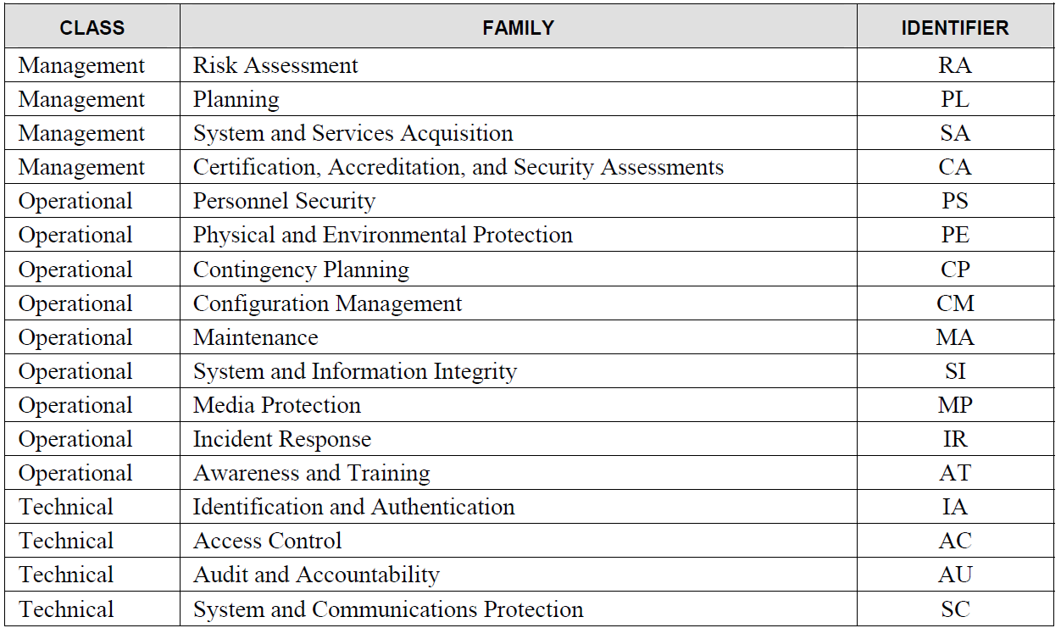
Where do you look for encryption related controls that could help Titan?

Slide 60
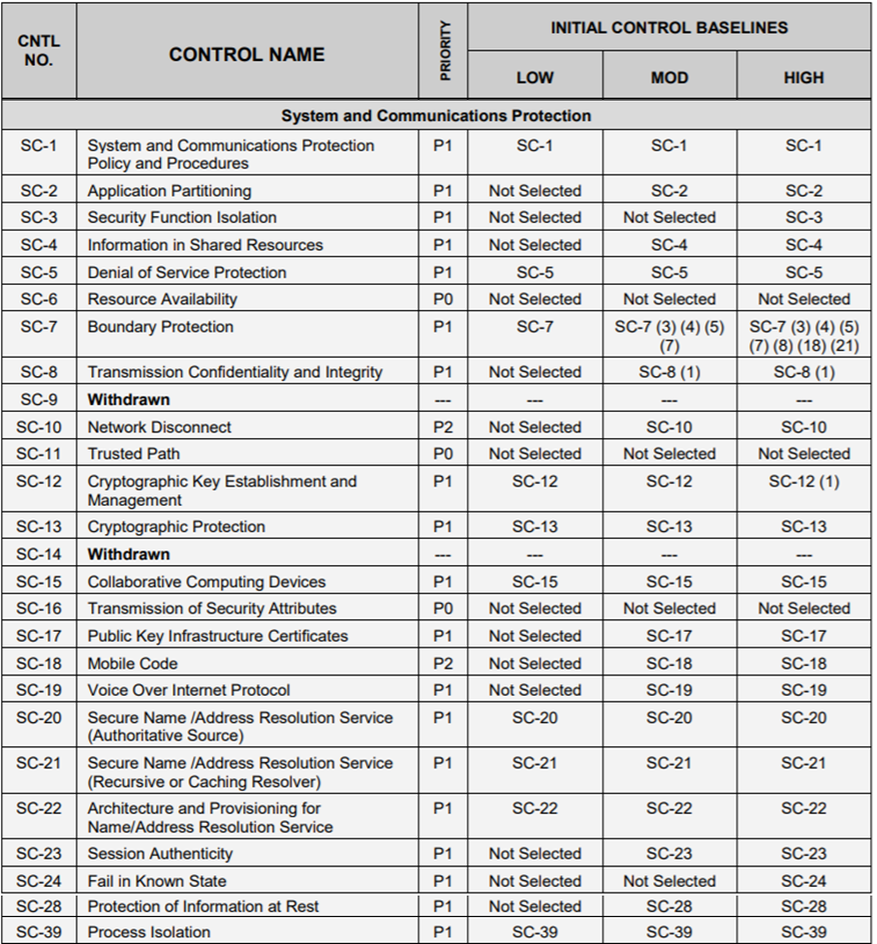
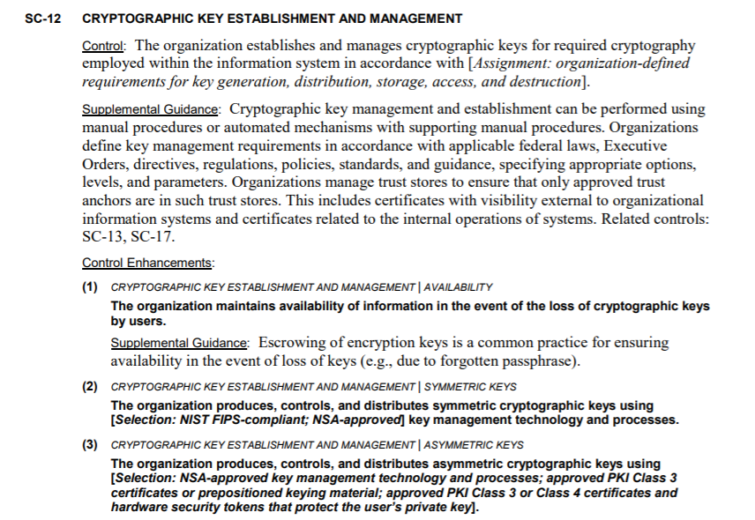

Slide 61
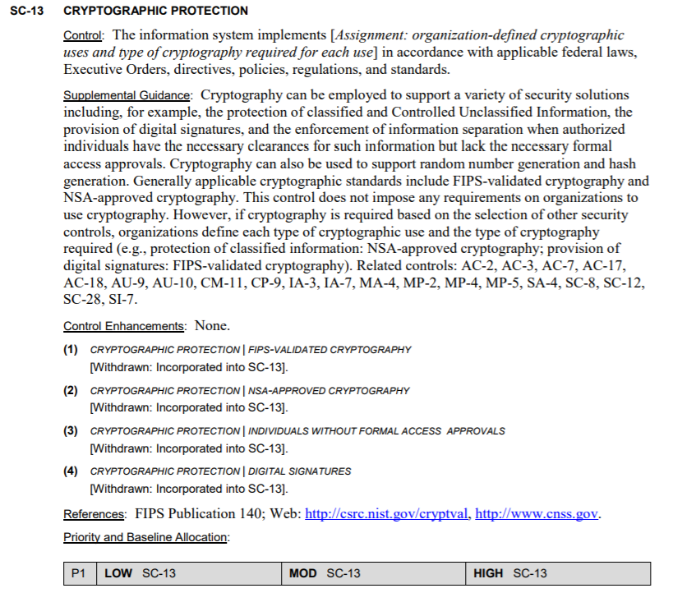
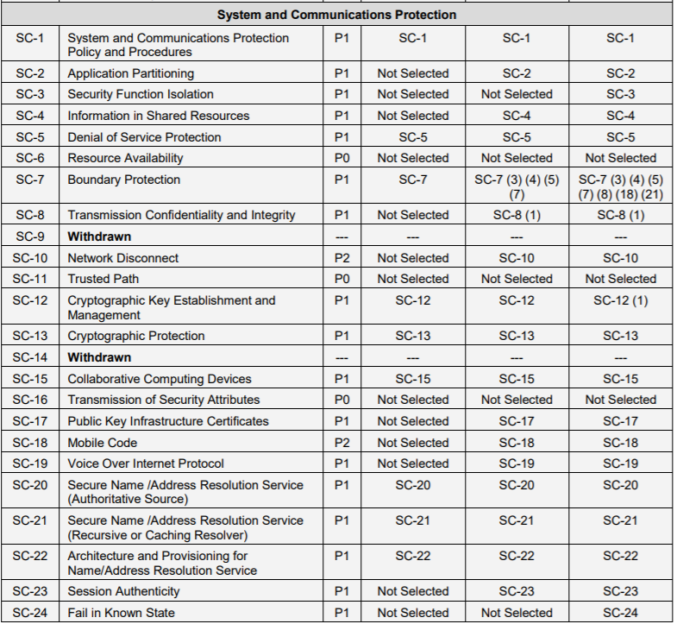

Slide 62
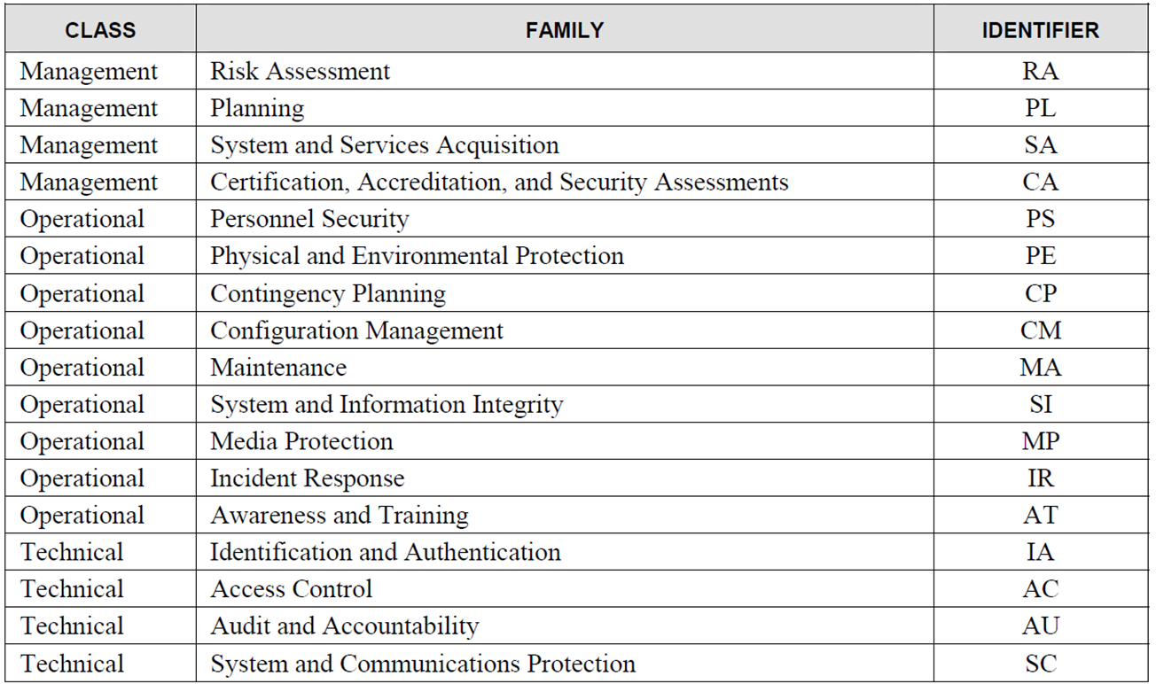

Slide 63
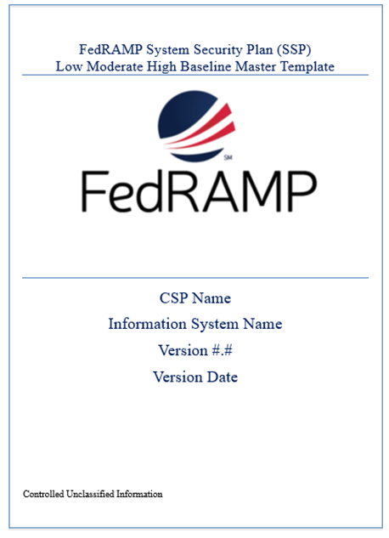
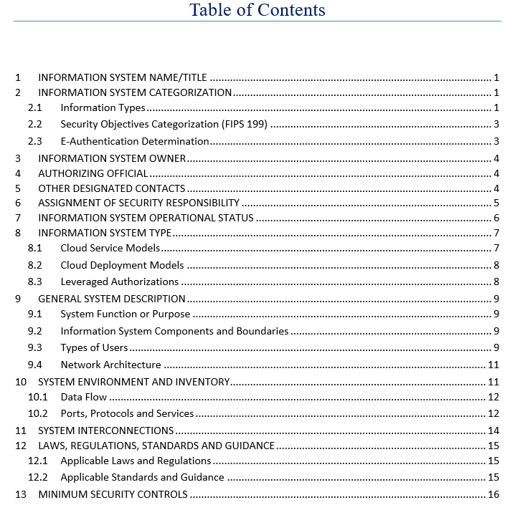
Where do you document this information in your SSP?

Slide 64
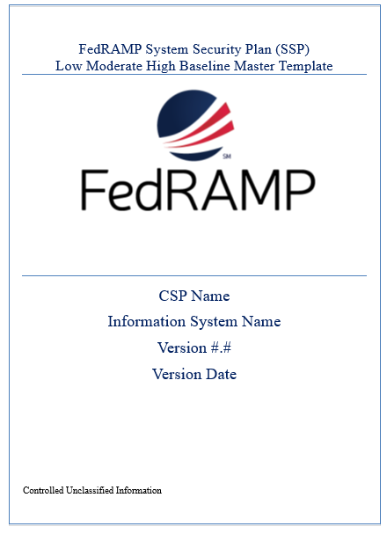
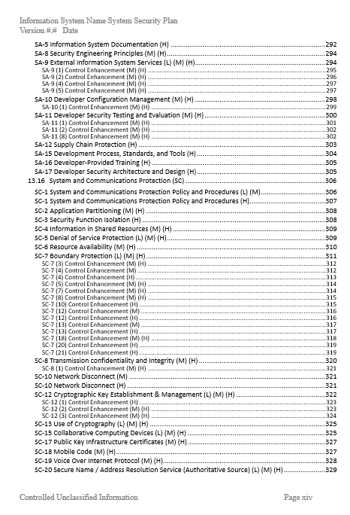
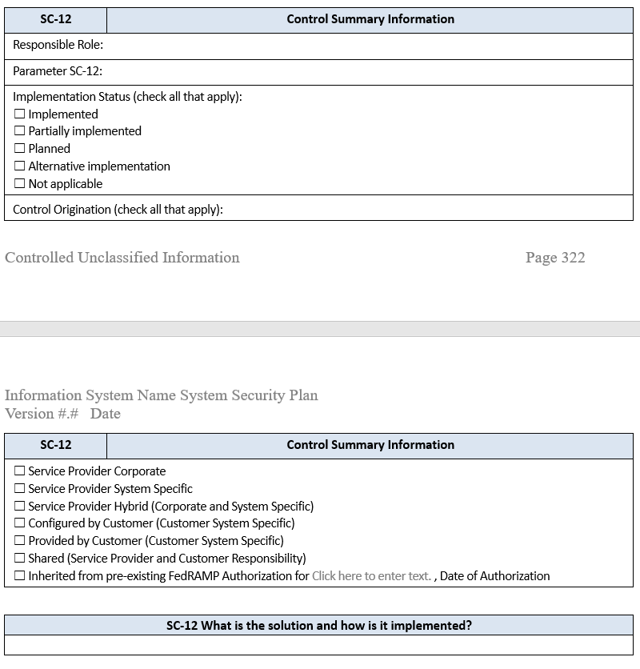

Slide 65
Quiz
Which control is the BEST way to ensure that the data in a file have not been changed during transmission?
Reasonableness check
Parity bits
Hash values
Check digits
The PRIMARY reason for using digital signatures is to ensure data:
confidentiality
integrity
availability
Timeliness
Which of the following provides the GREATEST assurance for database password encryption?
Secure hash algorithm-256 (SHA-256)
Advanced encryption standard (AES)
Secure Shell (SSH)
Triple data encryption standard (DES)
Email message authenticity and confidentiality is BEST achieved by signing the message using the:
Sender’s private key and encrypting the message using the receiver’s public key
Sender’s public key and encrypting the message using the receiver’s private key
Receiver’s private key and encrypting the message using the sender’s public key
Receiver’s public key and encrypting the message using the sender’s private key

Slide 66
Agenda
Case Study – The Titan Incident
Cryptography
Cryptographic information system security controls
Case Study revisited
Quiz

