Slide 1
Agenda
Welcome and Introductions
Course Introduction Goals
Introductory Terminology
The Threat Environment
Next Week…

Slide 2
Course Goals – Security Architecture
Learn about how organizations
Align their IT security capabilities with their business goals and strategy
Plan, design and develop enterprise security architectures
Assess IT system security architectures and capabilities
Objectives
Learn key Enterprise Security Architecture concepts
Develop an understanding of contextual, conceptual, logical, component, and physical levels of security architectures and how they relate to one another
Learn how security architectures are planned, designed and documented
Gain an overview of how security architectures are evaluated and assessed
Gain experience working as part of a team, developing and delivering a professional presentation

Slide 3
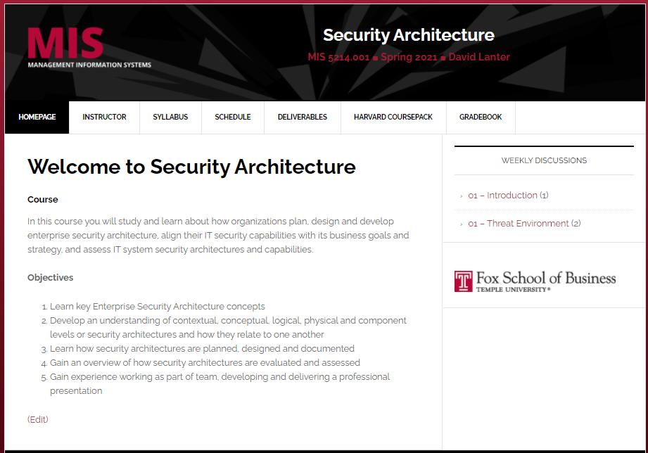
Course Web Site
https://community.mis.temple.edu/mis5214sec702spring2021/

Slide 4
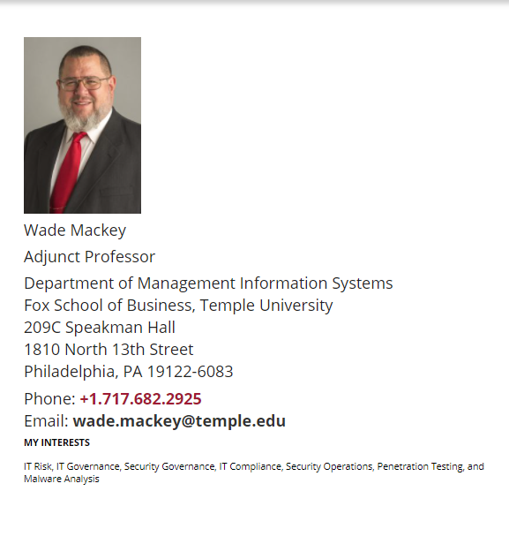
Instructor

Slide 5
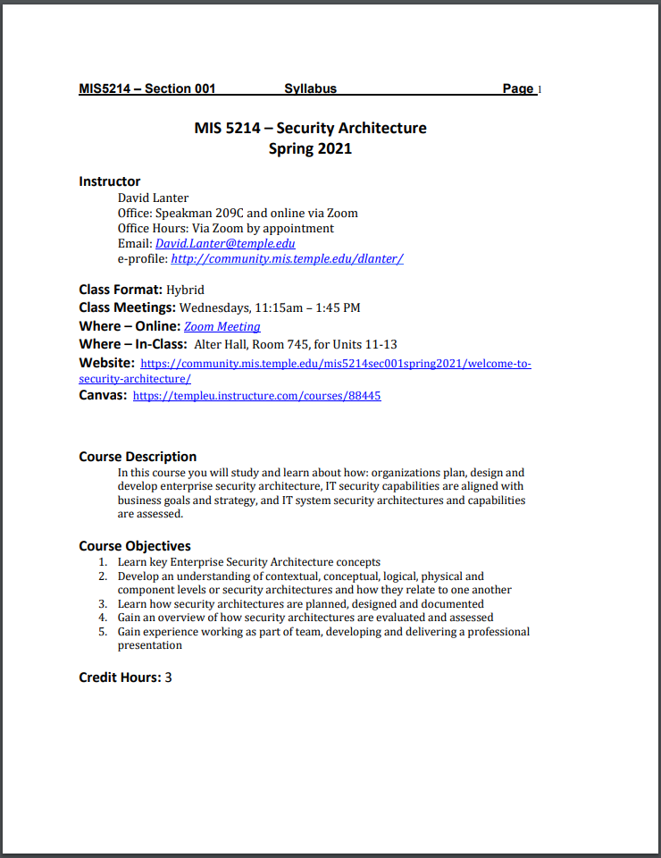
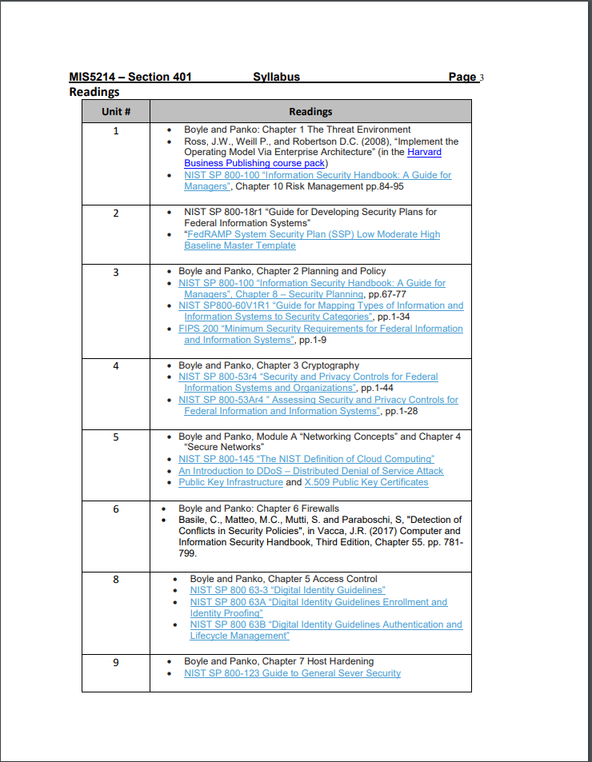
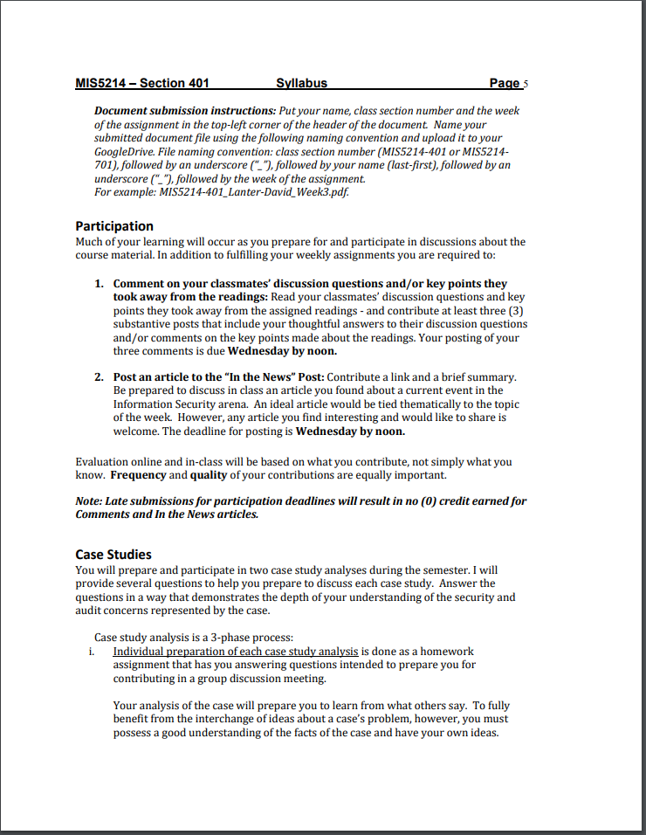
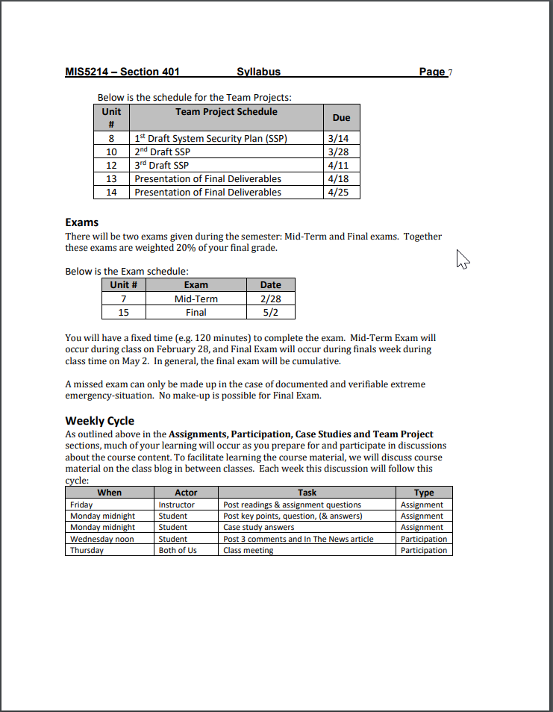
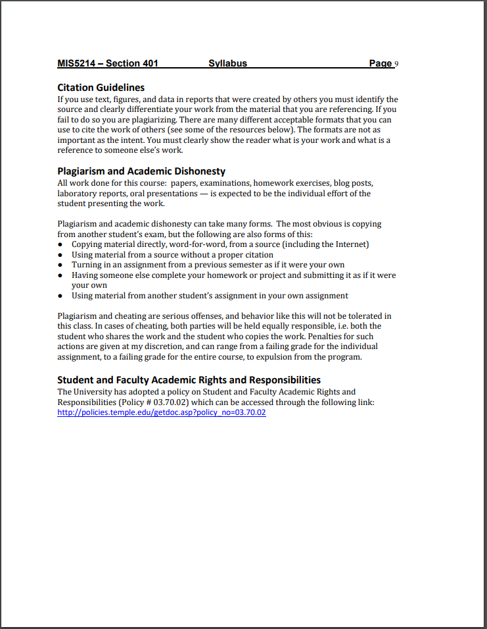
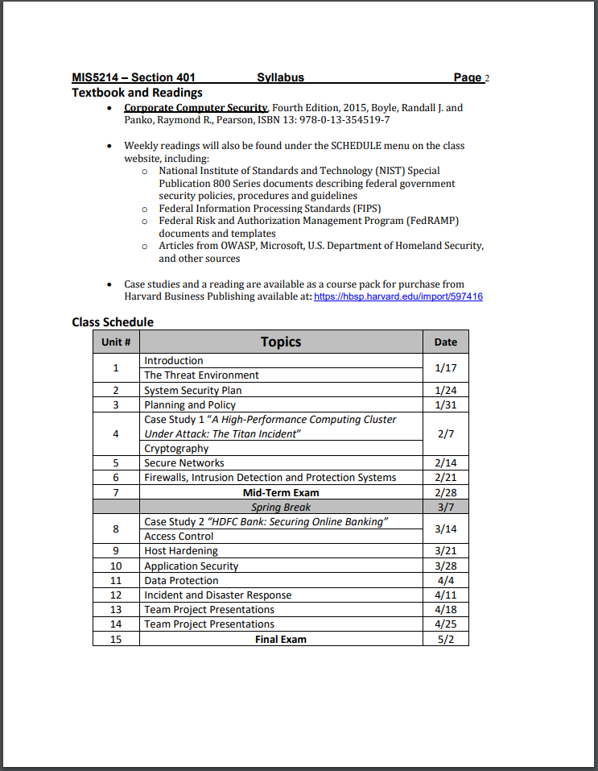
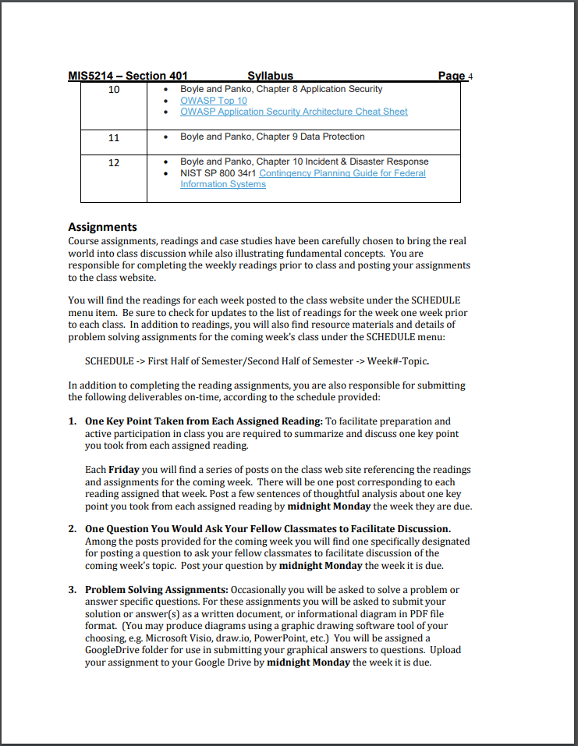
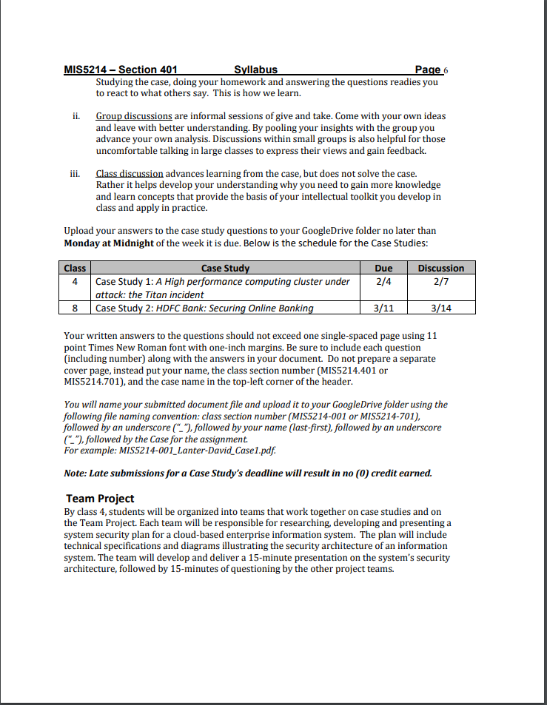
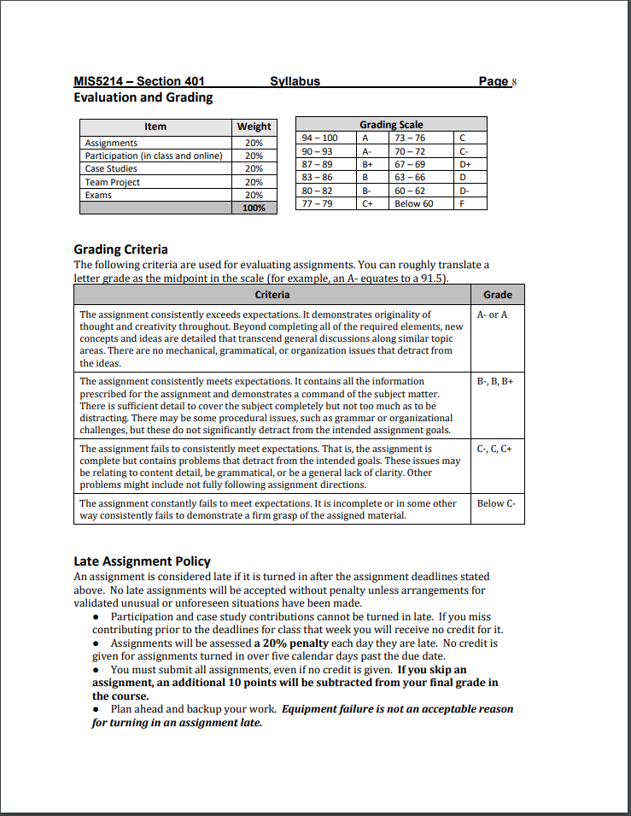
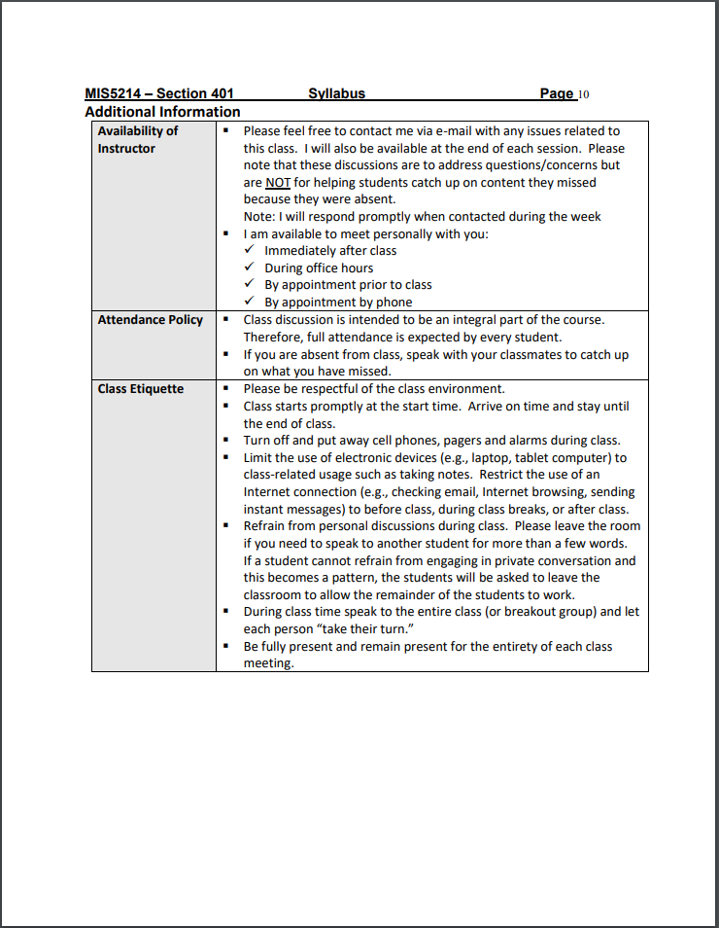
Syllabus

Slide 6
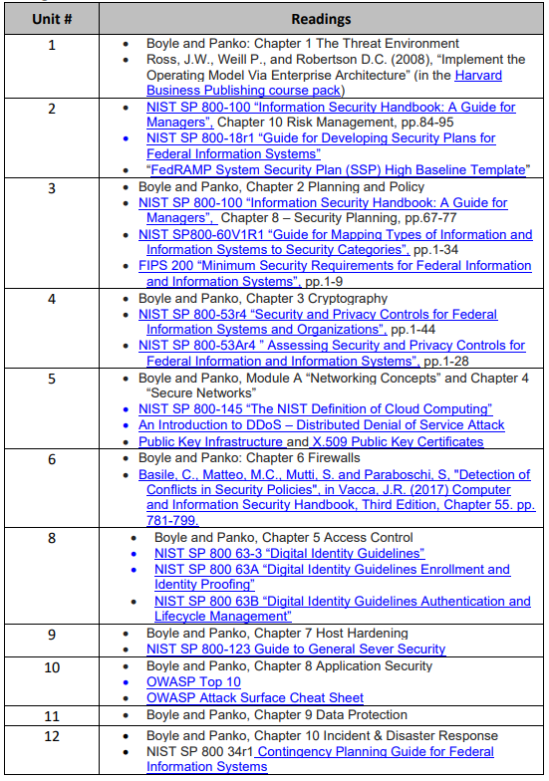
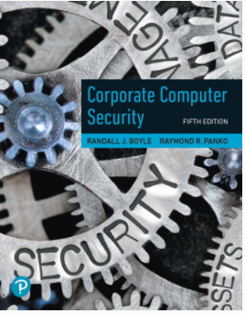
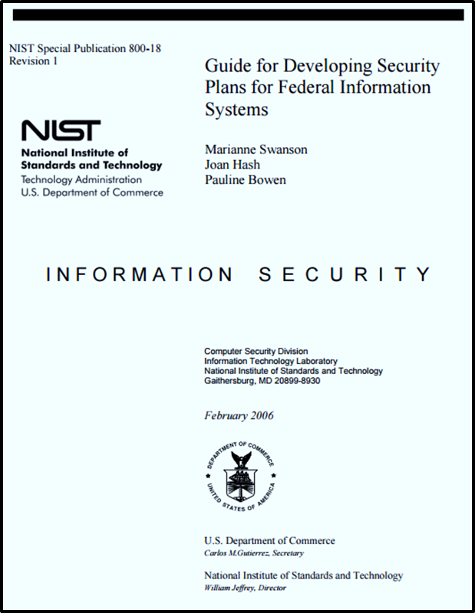
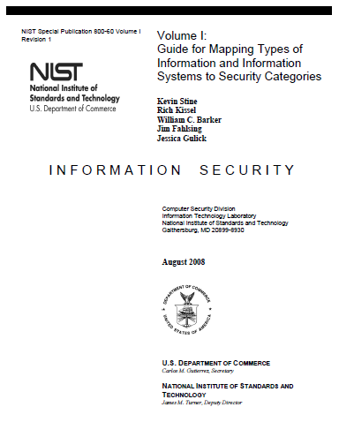
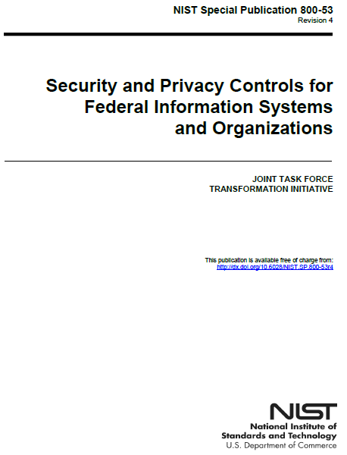
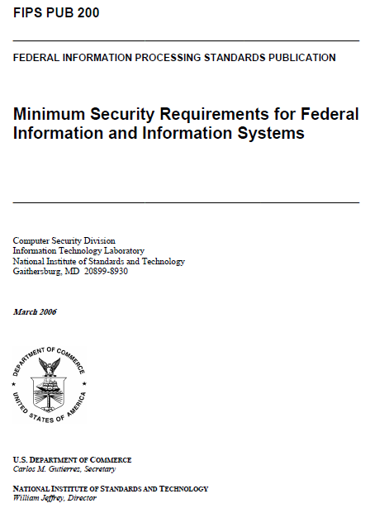
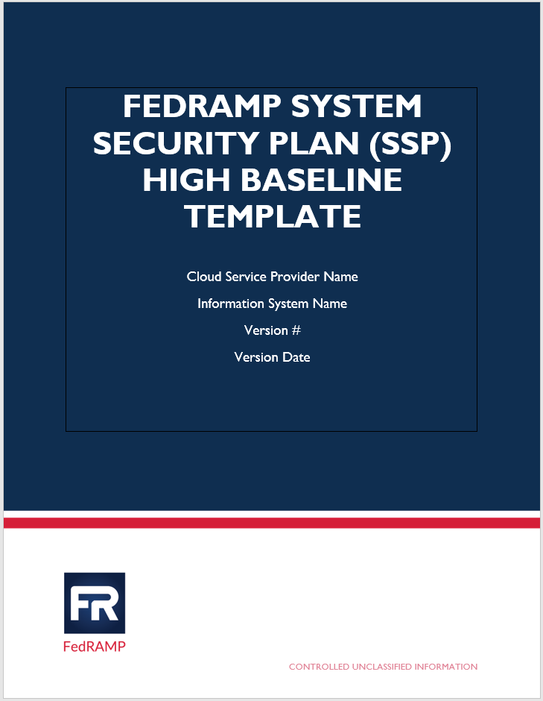
Textbook and Readings
…

Slide 7
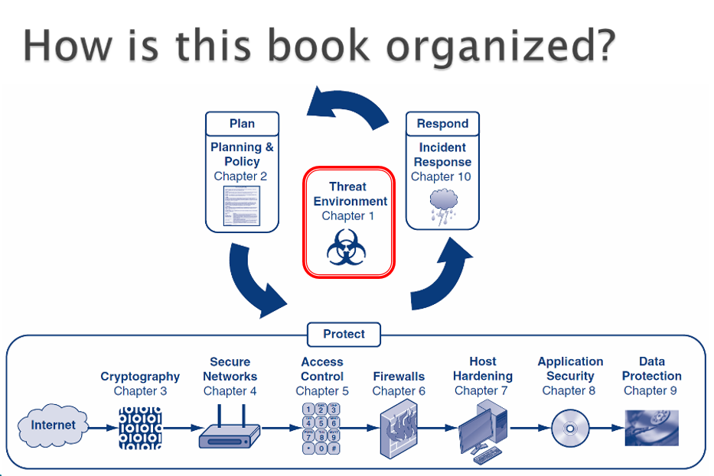
Organization of textbook

Slide 8
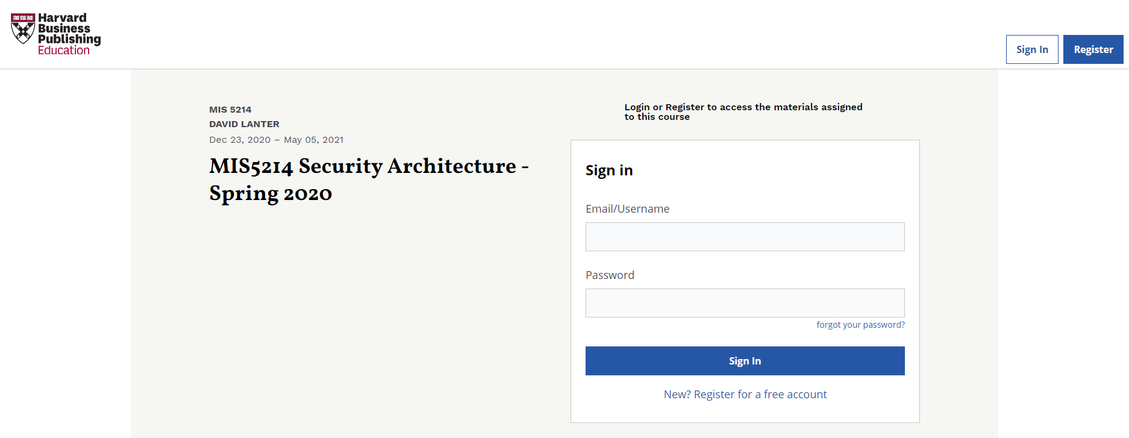
Harvard Business Publishing Course Pack
1 Reading
2 Case Studies

Slide 9
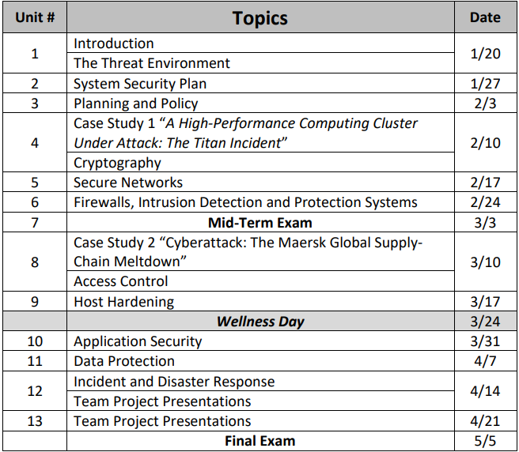
Class Schedule

Slide 10
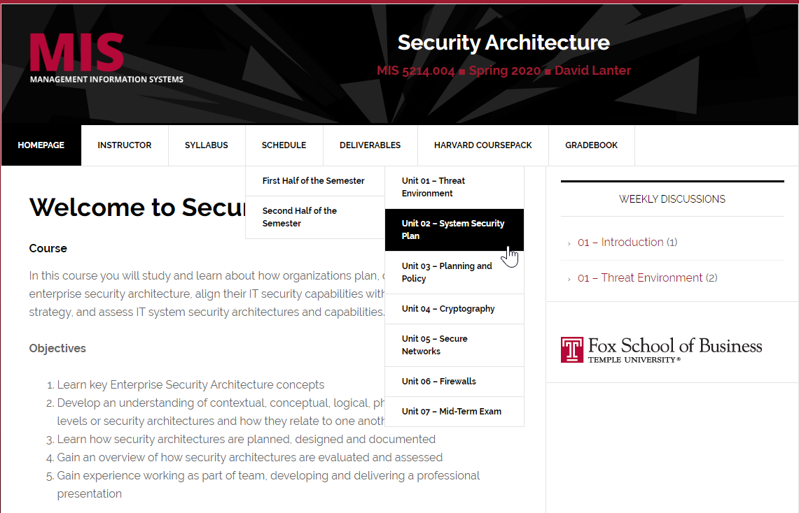
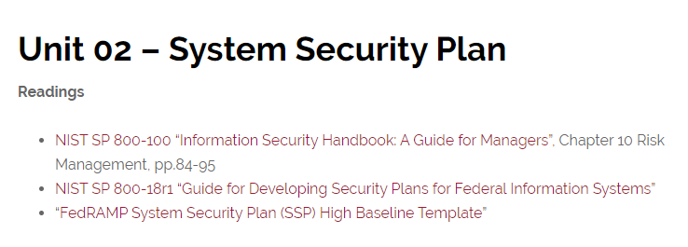
Readings listed under SCHEDULE

Slide 11
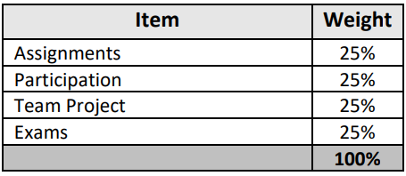
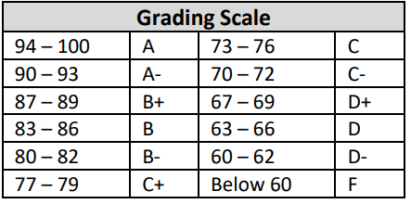
Grading

Slide 12
Grading - Assignments
One Key Point Taken from Each Assigned Reading
Post one or two sentences of thoughtful analysis about one key point you took from each assigned reading by midnight Sunday the week they are due
One Question You Would Ask Your Fellow Students to Facilitate Discussion
Problem Solving Assignments

Slide 13
Grading - Participation
Comment on your classmates’ discussion questions and/or key points they wrote about taking away from the readings
Contribute at least three (3) substantive posts that include your thoughtful answers to their discussion questions and/or comments on the key points made by your classmates about the readings. Your posting of your three comments is due Tuesday by noon.
Post an “In the News” article (link and brief summary)
Be prepared to discuss in class an article you found about a current event in the Information Security arena. An ideal article would be tied thematically to the topic of the week. However, any article you find interesting and would like to share is welcome. The deadline for posting is Tuesday by noon.

Slide 14
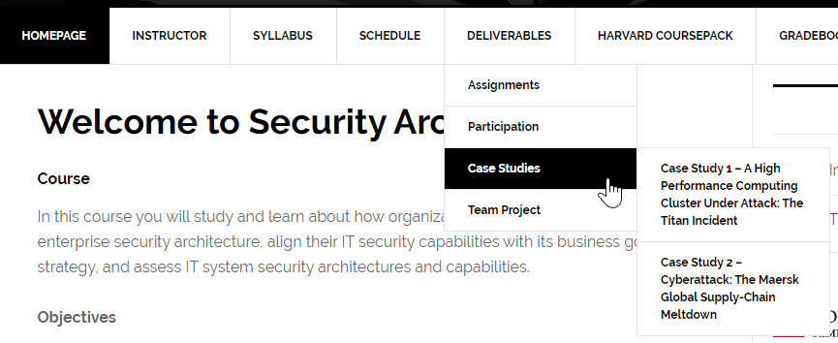
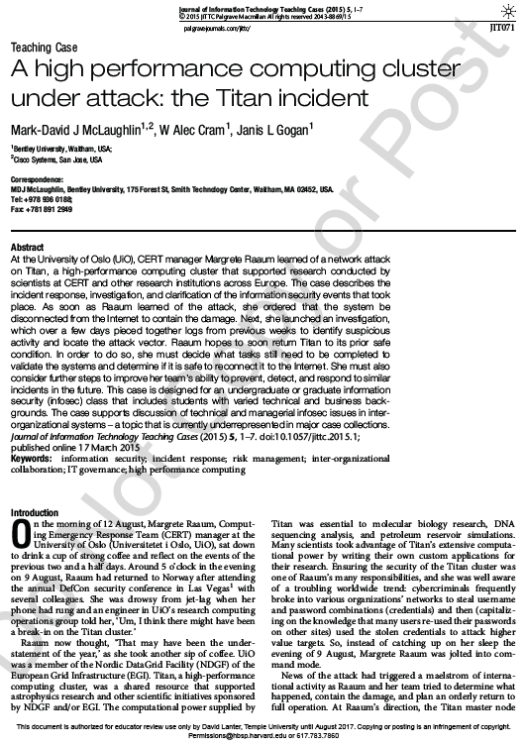
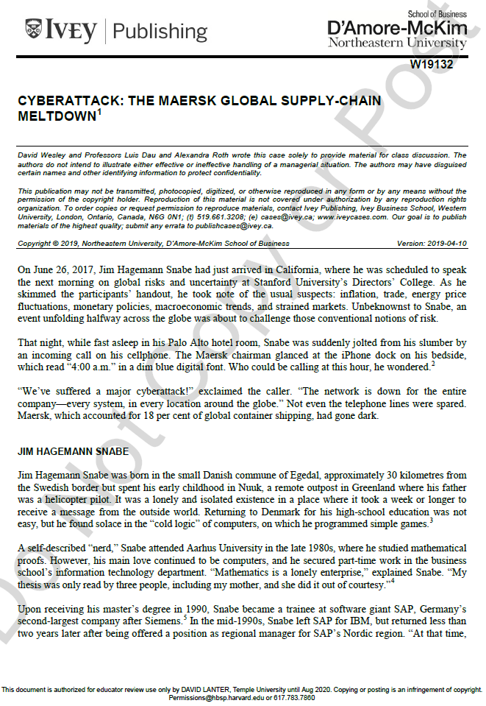
Grading - Case Studies
Case study analysis
Individual preparation
Group discussion
Class discussion

Slide 15
Grading - Team Projects
By class 4, students will be organized into teams that work together on case studies and on the Team Project
Each team will be responsible for researching, developing and presenting a system security plan (SSP) for a cloud-based enterprise information system
SSP will include technical specifications and diagrams illustrating the logical network architecture and security architecture of an information system
Teams will develop and deliver a 15-minute presentation on the system’s security architecture, followed by questioning by the other project teams

Slide 16
Grading - Exams

Slide 17
Weekly Cycle

Slide 18
Agenda
Welcome and Introductions
Course Introduction Goals
Introductory Terminology
The Threat Environment
Next Week…

Slide 19
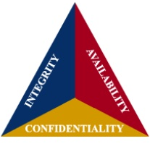
Introductory Terminology
“Information security” is protection of…
Confidentiality, integrity, and availability (“CIA”) of data and information
Data, information and information systems from unauthorized…
Access, use, disclosure = Confidentiality
Modification or distruction = Integrity
Disruption or loss of access = Availability

Slide 20
Terminology: Compromises
Successful attacks
Also called incidents
Also called breaches (not breeches)

Slide 21
Terminology: Countermeasures
Tools used to thwart attacks
Also called: safeguards, protections, mitigations and controls
Types of countermeasures:
Preventative controls
For reducing risk
Deterrent controls – preventative controls for discouraging violations
Detective controls
For identifying violations and incidents
Corrective controls
Attempt to reverse the impact of an incident
Compensating controls
Alternative controls when a primary control is not feasible

Slide 22
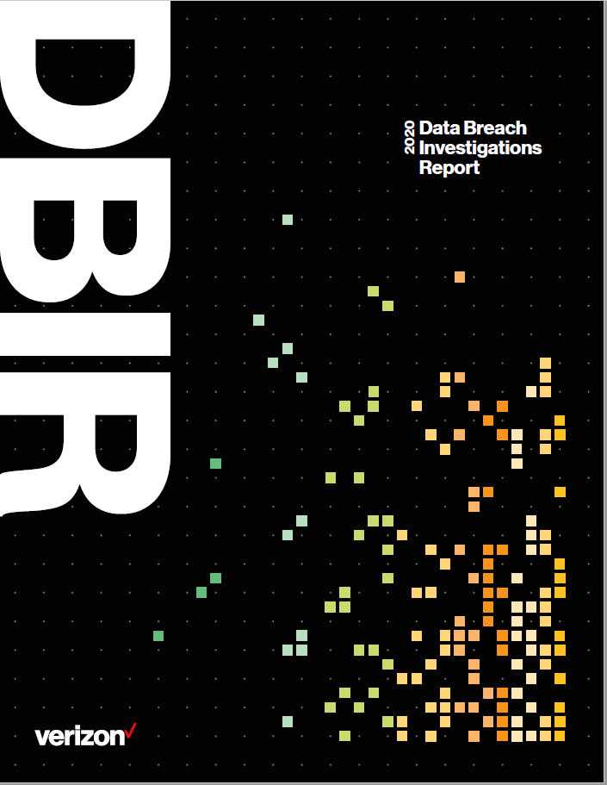
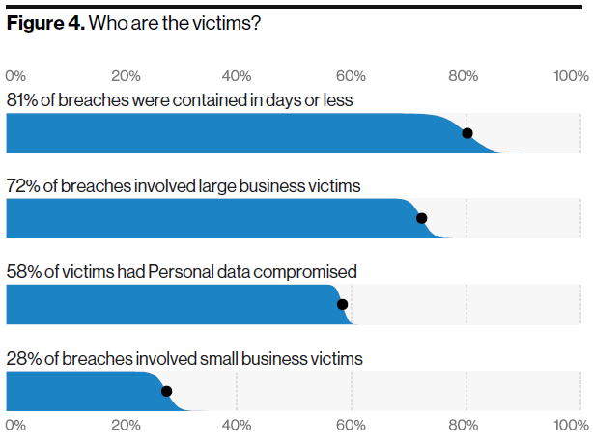
Threat Environment
Based on analysis of 157,525 security incidents, of which 3,950 were confirmed data breaches

Slide 23
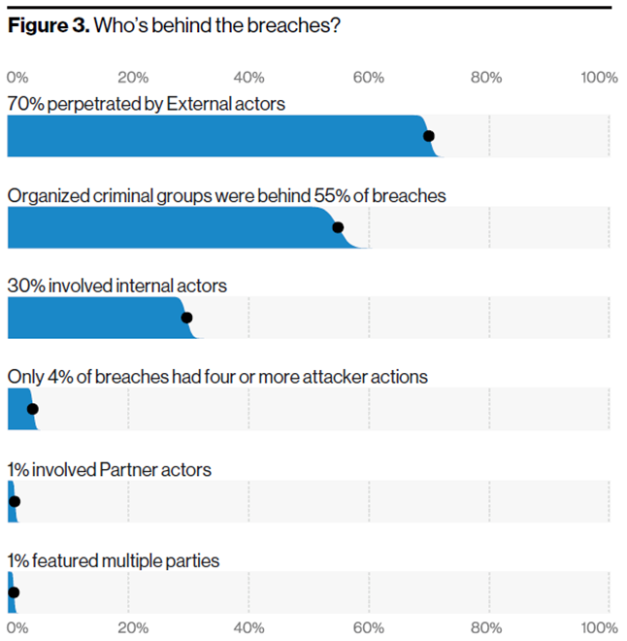
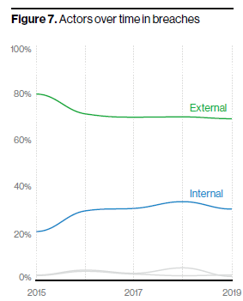
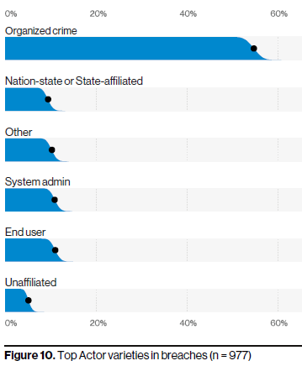
Threat Environment
Based on analysis of 157,525 security incidents, of which 3,950 were confirmed data breaches

Slide 24
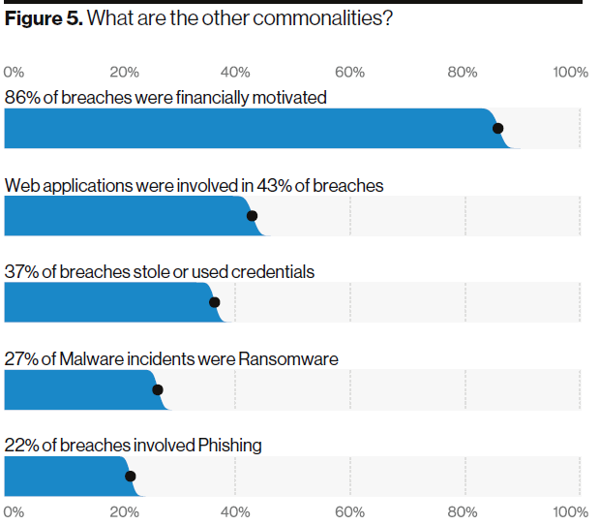
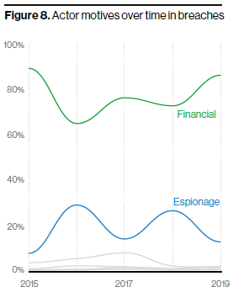
Threat Environment
Based on analysis of 157,525 security incidents, of which 3,950 were confirmed data breaches

Slide 25
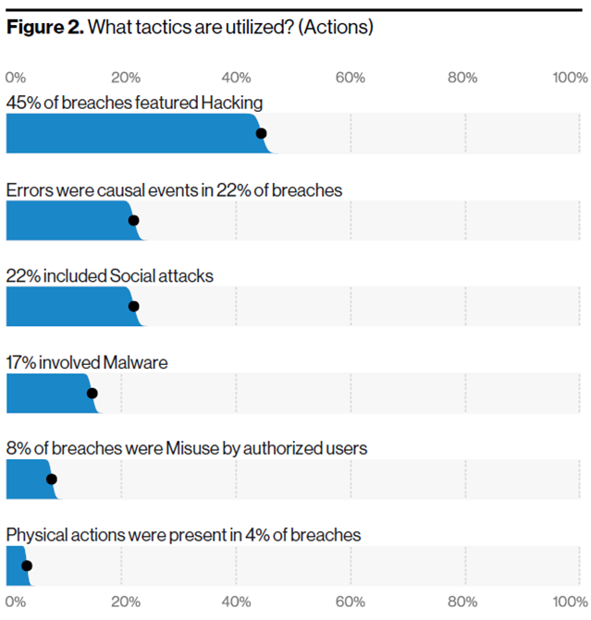
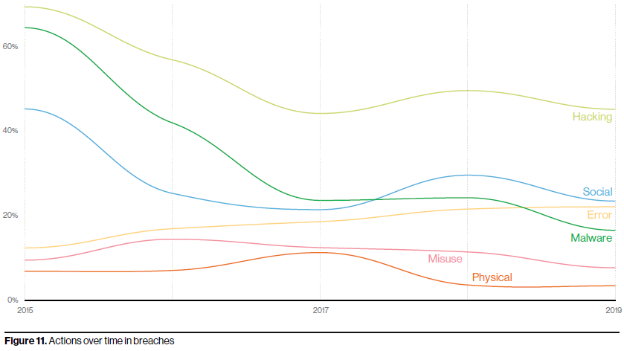
Threat Environment
Based on analysis of 157,525 security incidents, of which 3,950 were confirmed data breaches

Slide 26
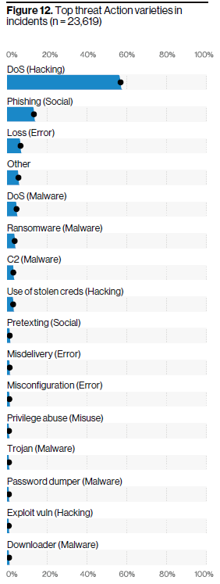
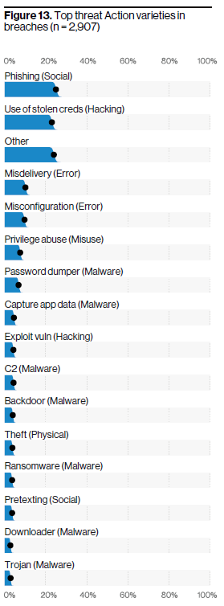
Threat Environment
Based on analysis of 157,525 security incidents, of which 3,950 were confirmed data breaches

Slide 27
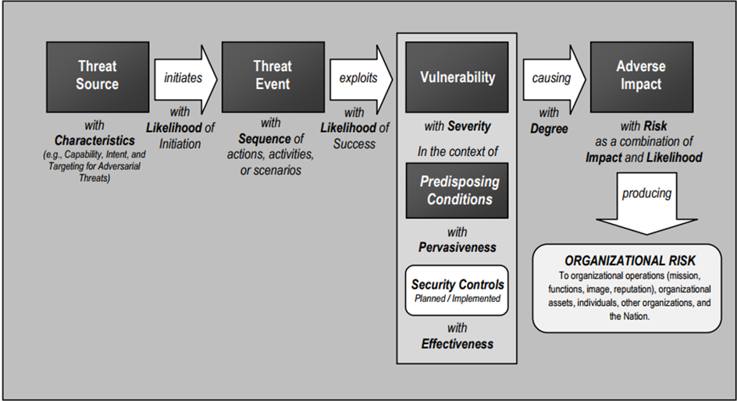
Security architects think about the interactions among threats, vulnerabilities, impacts and risks
From NIST 800-30r1 Guide for Conducting Risk Assessment p. 12

Slide 28
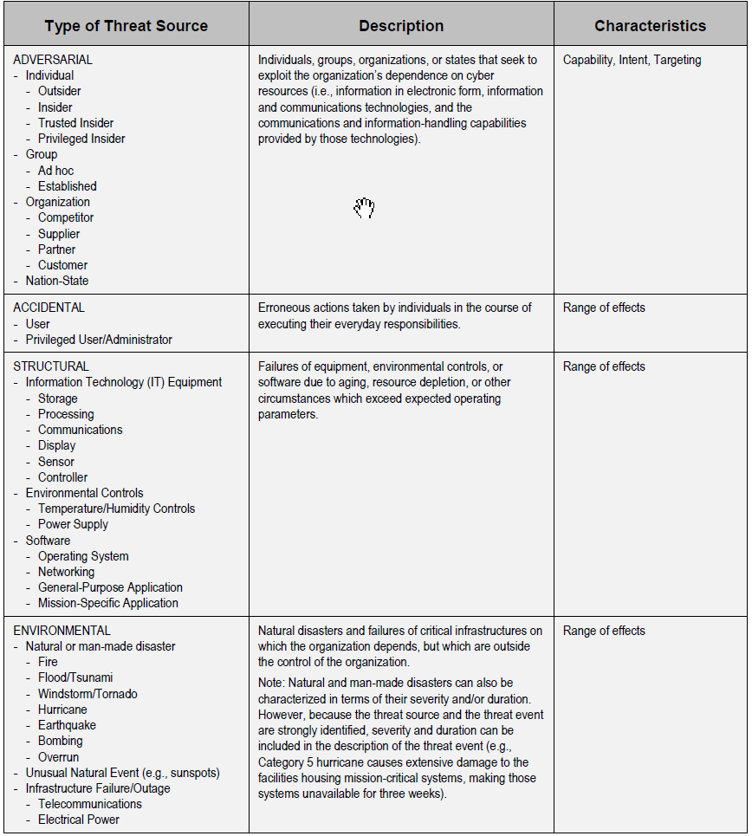
The Threat Environment
NIST SP 800-30r1 “Guide for Conducting Risk Assessments”, page 66
MIS 5214 Security Architecture

Slide 29
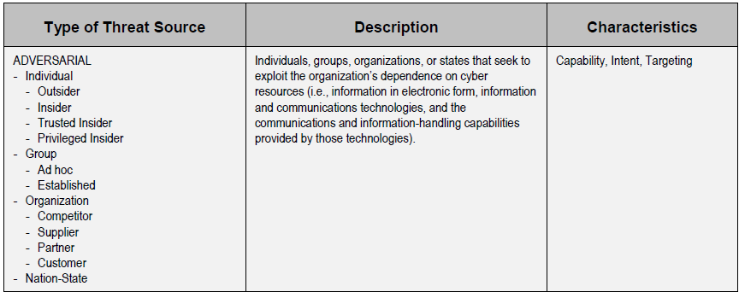
Adversarial (i.e. purposeful) threat sources
NIST SP 800-30r1 “Guide for Conducting Risk Assessments”, page 66
MIS 5214 Security Architecture

Slide 30
What type of Hacker are you?
“You need to decide if you’re going to aspire to safeguarding the common good or settle for pettier goals. Do you want to be a mischievous, criminal hacker or a righteous, powerful defender?
…the best and most intelligent hackers work for the good side. They get to exercise their minds, grow intellectually, and not have to worry about being arrested. They get to work on the forefront of computer security, gain the admiration of their peers, further human advancement in the name of all that is good, and get well paid for it.”
Grimes, R. (2017), Hacking the Hacker, John Wiley and Sons
MIS 5214 Security Architecture

Slide 31
Most Hackers Aren’t Geniuses
“…readers often assume” bad-guy hackers are super smart, “…because they appear to be practicing some advanced black magic that the rest of the world does not know. In the collective psyche of the world, it’s as if ‘malicious hacker‘ and ‘super-intelligence’ have to go together.
A few are smart, most are average, and some aren’t very bright at all, just like the rest of the world. Hackers simply know some facts and processes that other people don’t, just like a carpenter, plumber, or electrician.”
Grimes, R. (2017), Hacking the Hacker, John Wiley and Sons
MIS 5214 Security Architecture

Slide 32
Defenders are Hackers Plus
“If we do an intellectual comparison alone, the defenders on average are smarter than the attackers. A defender has to know everything a malicious hacker does plus how to stop the attack. And that defense won’t work unless it has almost no end-user involvement, works silently behind the scenes, and works perfectly (or almost perfectly) all the time.
Show me a malicious hacker with a particular technique, and I’ll show you more defenders that are smarter and better. It’s just that the attacker usually gets more press.” It’s time for equal time for the defender!
Grimes, R. (2017), Hacking the Hacker, John Wiley and Sons
MIS 5214 Security Architecture

Slide 33
Hackers are Special
While not all are super-smart, “they all share a few common traits:”
Broad intellectual curiosity
Willingness to try things outside the given interface or boundary
Not afraid to make their own way
Usually they are life hackers:
Hacking all sorts of things beyond computers
Questioning the status quo and exploring all the time
Most useful trait:
Persistence
Malicious hackers look for defensive weaknesses
Both malicious hackers and defenders are looking for weaknesses, just from opposite sides of the system
Both sides participate in an ongoing war with many battles, wins and losses. The most persistent side wins
Grimes, R. (2017), Hacking the Hacker, John Wiley and Sons
MIS 5214 Security Architecture

Slide 34
The Secret to Hacking
“If there is a secret to how hackers hack, it’s that there is no secret to how they hack. It’s a process of learning the right methods and using the right tools for the job…. There isn’t even one way to do it. There is, however, a definitive set of steps that describe the larger, encompassing process”
Hacking Methodology Model
Information gathering (“reconnaissance”)
Penetration
Optional: Guaranteeing future easier access
Internal reconnaissance
Optional: Movement
Intended action execution (e.g. data exfiltration)
Optional: Covering Tracks
MIS 5214 Security Architecture
Grimes, R. (2017), Hacking the Hacker, John Wiley and Sons

Slide 35
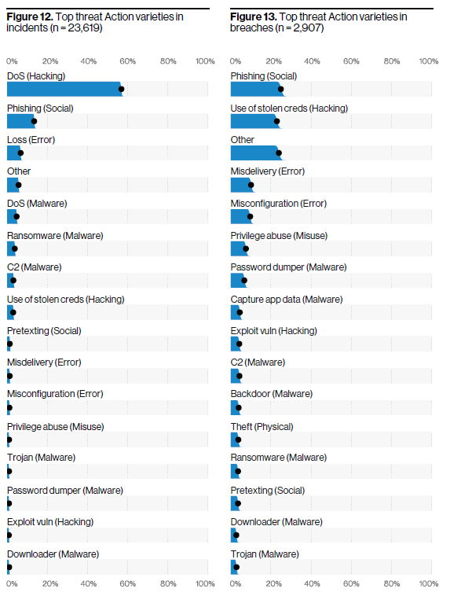
C2 = Command & Control malware

Slide 36
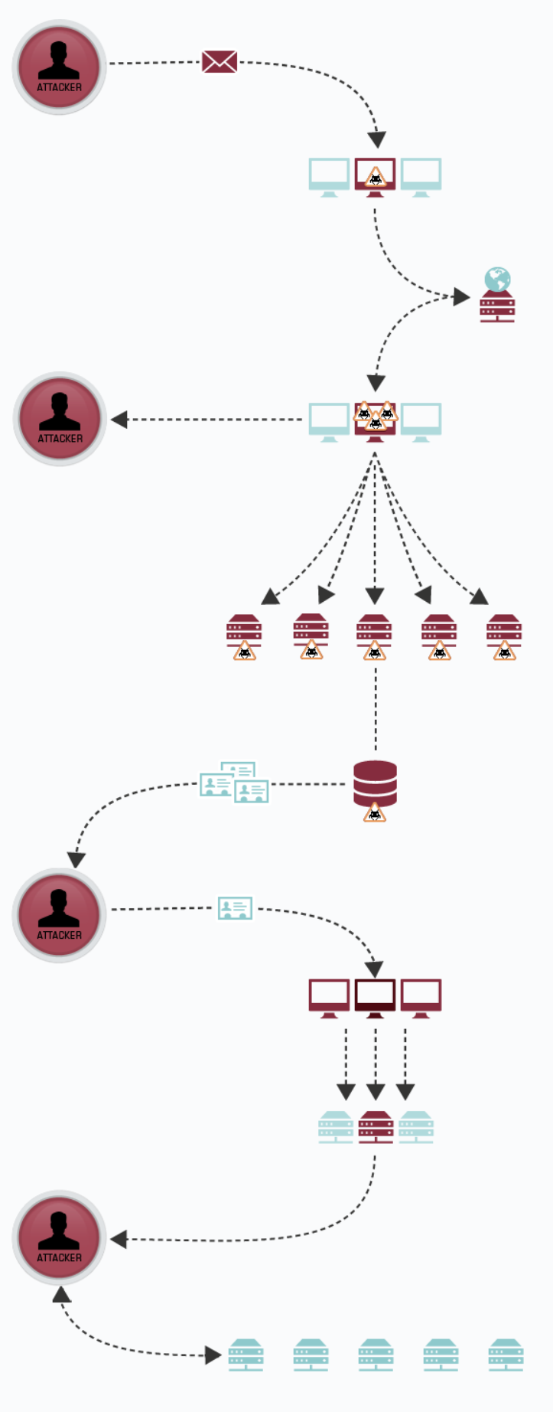
Anatomy of an Attack
Attacker sends spear phishing e-mail
Victim opens attachment
Custom malware is installed
Custom malware communicates to control web site
Pulls down additional malware
Attacker establishes multiple backdoors
Attacker accesses system
Dumps account names and passwords from domain controller
Attacker cracks passwords
Has legitimate user accounts to continue attack undetected
Attacker reconnaissance
Identifies and gathers data
Data collected on staging server
Data ex-filtrated
Attacker covers tracts
Deletes files
Can return any time
(MANDIANT, 2015)
Threat landscape
Advanced persistent threats (APT) usually maintain remote access to target environments for 6-18 months before being detected (i.e. they are persistent)
(Holcomb & Stapf, 2014)

Slide 37
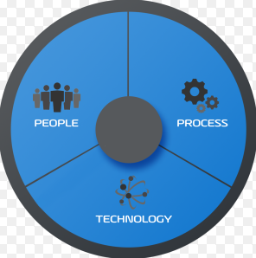
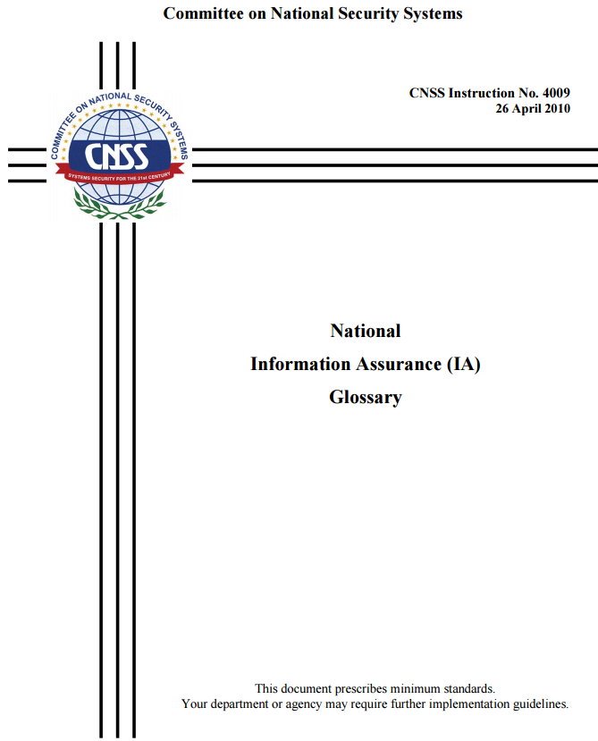
What is a Vulnerability?
Any unaddressed susceptibility to a physical, technical or administrative information security threat

Slide 38
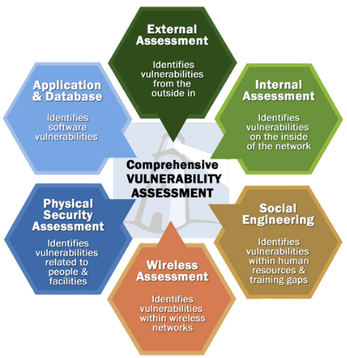
Vulnerabilities can be classified by asset class
Physical examples
Buildings in environmental hazard zones (e.g. low floor in flood zone)
Unlocked and unprotected doors to data center
Unreliable power sources
Technical examples
Hardware – susceptibility to humidity, dust, soiling, unprotected storage
Software – insufficient testing, lack of audit trail, poor or missing user authentication and access control
Data – unencrypted transfer or storage, lack of backup
Network – Unprotected communication lines, insecure architecture
Organizational examples
Inadequate screening and recruiting process, lack of security awareness and training
Lack of regular audits
Lack of security and IT related business continuity plans
http://www.infosightinc.com/collaterals/CVA-PT_March2016.pdf

Slide 39
What is a Risk?
A measure of threat
Potential loss resulting from unauthorized:
Access, use, disclosure
Modification
Disruption or destruction
…of an enterprises’ information
Can be expresses in quantitative and qualitative terms

Slide 40
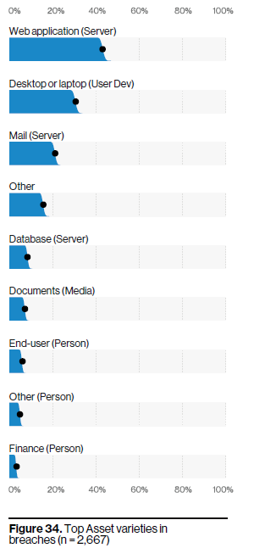
Steps in a risk assessment methodology
What are the business assets ?
What possible threats put the business assets at risk ?
Which vulnerabilities and weaknesses may allow a threat to exploit the assets ?
For each threat, if it materialized, what would be the business impact on the assets ?

Slide 41
Assessing risk – quantitative method

Slide 42
Assessing risk – qualitative method

Slide 43
FIPS 199: Risk assessment based on security objectives and impact ratings

Slide 44
Security Architecture
A comprehensive and rigorous method to plan, design and describe current and desired future structure and behavior of an organization's:
Business sub-units
Processes and Personnel
Information security systems
Information systems’ security
…so they align with the organization's core goals and strategic direction
Wikipedia: https://en.wikipedia.org/wiki/Enterprise_information_security_architecture

Slide 45
Security Architecture
“…the art and science of designing and supervising the construction of business systems, usually business information systems, which are:
Free from danger, damage, etc.
Free from fear, care, etc.
In safe custody
Not likely to fail
Able to be relied upon
Safe from attack”
Sherwood et al. (2005) Enterprise Security Architecture: A Business-Driven Approach

Slide 46
Defenders must be perfect
“One mistake by the defender essentially renders the whole defense worthless”
…every computer and software program must be patched, every configuration appropriately secure, and every end-user perfectly trained. Or at least that is the goal.
The defender knows that applied defenses may not always work or be applied as instructed, so they create “defense-in-depth” layers.”
Grimes, R. (2017), Hacking the Hacker, John Wiley and Sons
MIS 5214 Security Architecture

Slide 47
Security Architecture
Thinking about security architecture enables understanding enterprise information systems the way attackers do – as large diverse attack surfaces
https://graquantum.com/blog/cyber-basics-cyber-attack-surface/

Slide 48
Defense in Depth
Also known as:
Layered Security
Castle Approach to Security

Slide 49
Enterprise Information and Security Architecture
Sherwood et al. (2005) Enterprise Security Architecture: A Business-Driven Approach
Huxham, H. (2006) “Own view of Enterprise Information Security Architecture (EIS))Framework”
Wikipedia: https://en.wikipedia.org/wiki/Enterprise_information_security_architecture, accessed 2017-1-19

Slide 50
Security architecture questions
What is the system that is/has being/been built?
What can go wrong with it once it is built?
What should be done about those things that can go wrong?
Did you do a good job in your analysis?
Threat Modeling: Designing for Security, Adam Shostack, 2014

Slide 51
Security architecture framework
Model the system that is being built, deployed, or changed
Find threats using that model
Address (i.e. mitigate/control) the threats
Validate the mitigations for completeness and effectiveness
Threat Modeling: Designing for Security, Adam Shostack, 2014

Slide 52
What is the system?
Draw a picture…
What can go wrong here?
Threat Modeling: Designing for Security, Adam Shostack, 2014

Slide 53
Draw and identify trust boundaries (“attack surfaces”) in the system diagram
…these are found wherever different people can access and control different parts of the system
Organizational boundaries
Different physical computers or virtual machines
Different subsystems
Different access points or network interfaces
Almost anywhere there will/should be different privileges

Slide 54
What can go wrong?
Where are the attack surfaces in this system?
Where are the trust boundaries in this system?

Slide 55
What can go wrong?
How do you know the web browser is used by the person you expect?
Is it OK for data to go from one box to the next without being encrypted?
What happens if someone modified data in the database?

Slide 56
What can go wrong?
Where are the trust boundaries in this system?
STRIDE
Model of threats developed by Microsoft for identifying security architecture threats
Is a mnemonic for 6 categories of threats:

Slide 57
STRIDE
Created by Microsoft to help developers identify threats to security architecture of their systems
Is a mnemonic for 6 categories of threats
Spoofing is pretending to be something or someone you are not
Tampering is modifying something you are not supposed to modify
E.g. data packets in motion on the network, bits on disk, bits in memory…
Repudiation means claiming you did not do something (regardless of whether you did or did not)
Information Disclosure is exposing information to people who are not authorized to see it
Denial of Service are attacks design to prevent the system’s service availability
E.g. Crashing it, making it unusably slow, filling all of its storage, …

Slide 58
STRIDE – What can go wrong?
Spoofing: Someone might pretend to be a customer, is there a way to authenticate users?
Tampering: Can someone tamper with the data in the system’s backend?
Repudiation: Any preceding actions might require figuring out what happened
Are there system logs? Is the right information being logged? Are the logs protected against tampering?
Information Disclosure: Can anyone connect to the database and read/write data?
Denial of Service: What happens if 300,000 customers show up a once at the website?
What if the system goes down?
Elevation of Privileges: Perhaps the web front end is the only place customers should access, but what enforces that?
What prevents them from connecting directly to the business logic server, or uploading new code?
What controls access to the database? What happens in an employee wants to edit the system files or makes a mistake?

Slide 59
Techniques for managing threats (i.e. managing risk)
Avoid
Accept
Transfer
Mitigate

Slide 60
Readings for next week…
Unit 02 – System Security Plan
Readings
NIST SP 800-100 “Information Security Handbook: A Guide for Managers”, Chapter 10 Risk Management, pp.84-95
NIST SP 800-18r1 “Guide for Developing Security Plans for Federal Information Systems”
“FedRAMP System Security Plan (SSP) High Baseline Template”

Slide 61
Team Project work involves drawing security architecture diagrams

Slide 62
Useful tools for the course
Microsoft Azure education site

Slide 63
Useful tools for the course
https://app.diagrams.net/

Slide 64
Questions for next week…
One Key Point Taken from Each Assigned Reading

Slide 65
Agenda
Welcome and Introductions
Course Introduction Goals
Introductory Terminology
The Threat Environment
Next Week…

Slide 66
Unit - #1
MIS5214 – Security Architecture

