Slide 1
Unit #2
MIS5214
System Security Plan

Slide 2
Agenda
Threat Modeling Exercise
Information Systems – some definitions
Conceptual models of information systems
NIST Risk Management Framework
FIPS 199 Security Categorization
Transforming qualitative risk assessment into quantitative risk assessment
FedRAMP System Security Plan – overview
  NIST 800-53 Security controls
  Role of FIPS 199 in selecting a security control baseline
  NIST 800-18 classification of security control families

Slide 3
Automotive Security example
https://www.youtube.com/watch?v=MK0SrxBC1xs
Modern cars are computer networks on wheels, with most have many computers that control various aspects of the car
Two hackers developed a tool that can hijack a Jeep over the internet. WIRED senior writer Andy Greenberg takes the SUV for a spin on the highway while the hackers attack it from miles away.

Slide 4
University of Washington Security Cards
A security threat brainstorming activity – find threat modeling cards here: http://securitycards.cs.washington.edu/cards.html
Break up into teams:
  Pretend you are security professionals
    A car company tasked you with thinking through the security implications of the modern car computer systems
  Start with the blue suit of cards (“Human Impact”), consider what impacts to people would result if an attacker misused modern car systems like the attack you just witnessed
    Either think about one car, or think about the entire car product line
    Rank order the cards from most relevant
    Explain your 3 top choices

Slide 5
University of Washington Security Cards
A security threat brainstorming activity
  Next move onto the orange “Adversary Motivation” suit
  Consider what motivations adversaries might have for attacking modern car systems
    Either think about one car, or think about the entire car product line
    Rank order the adversary motivations from most relevant to least
    Explain your 3 top choices

Slide 6
University of Washington Security Cards
A security threat brainstorming activity
  Next move onto the red “Adversary’s Resources” suit
  Consider what resources adversaries might have for attacking modern car systems
    Either think about one car, or think about the entire car product line
    Rank order the cards from most relevant
    Explain your 3 top choices

Slide 7
STRIDE
Threat model created by Microsoft, based on 6 types of threats:
Spoofing – Can an attacker gain access using a false identity?
Tampering – Can an attacker modify data as it follows through the application?
Repudiation – If an attacker denies doing something, can we prove he/she did it?
Information disclosure – Can an attacker gain access to private or potentially injurious data?
Denial of service – Can an attacker crash or reduce the availability of the system?
Elevation of privilege – Can an attacker assume the identify of a privileged user?

Slide 8
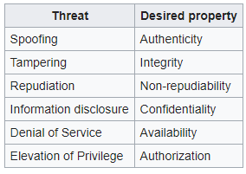
STRIDE Threat Modeling
A security threat brainstorming activity
  Set aside the cards, and use the STRIDE model
  Consider what methods adversaries might use for attacking modern car systems
    Either think about one car, or think about the entire car product line
    Rank order the threats from most relevant
    Explain your 3 top choices

Slide 9
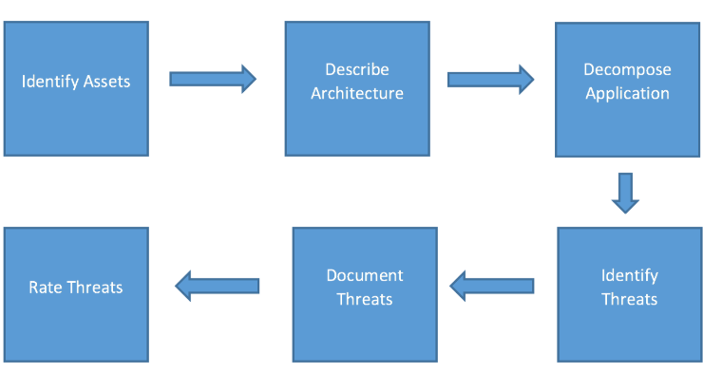
Threat Modeling
Can be a full-time job for cyber security professionals
Is now a skill information systems designers, developers and architects need to have

Slide 10
Agenda
Threat Modeling Exercise
Information Systems – some definitions
Conceptual models of information systems
NIST Risk Management Framework
FIPS 199 Security Categorization
Transforming qualitative risk assessment into quantitative risk assessment
FedRAMP System Security Plan – overview
  NIST 800-53 Security controls
  Role of FIPS 199 in selecting a security control baseline
  NIST 800-18 classification of security control families

Slide 11
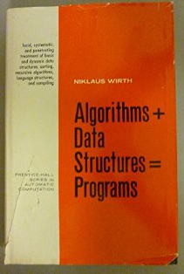
Information Systems – some definitions
Data Structure is a particular way of organizing data in a computer so that it can be manipulated by an algorithm
Algorithm is a step-by-step procedure in a computer program for solving a problem or accomplishing a goal
Programs = Algorithms + Data Structures
Software are programs used to direct the operation of a computer
Hardware are tangible physical parts of a computer system and IT network
Firmware is software embedded in a piece of hardware
Information systems are software and hardware systems that support data-intensive applications
Enterprise information system is an information system which enable an organization to integrate and improve its business functions

Slide 12
Information System Architecture
Is an abstraction that provides the “big picture” goals for the system
  Guides the development process, answering questions including:
    How is it going to be used?
    What environment will it work within?
    What type of security and protection is required?
    What does it need to be able to communicate with?
  Describes the major components of the system and how they interact with each other, with the users, and with other systems

Slide 13
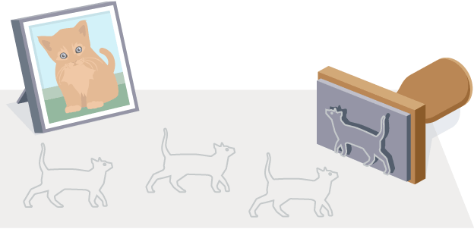
What is meant by the term “abstraction” ?
A fundamental human capability that enables us to deal with complexity
Its purpose is to limit the universe so we can do things
Selective examination of certain aspects of a problem
Its goal is the purposeful isolation of important aspects and suppression of unimportant aspects (i.e. omitting details)
  Purpose determines what is and what is not important
  All abstractions are incomplete and inaccurate – but this is their power and does not limit their usefulness
Many different abstractions of the same thing are possible
  Depending on the purpose for which they are made – The problem solving context explains the source of their intent

Slide 14
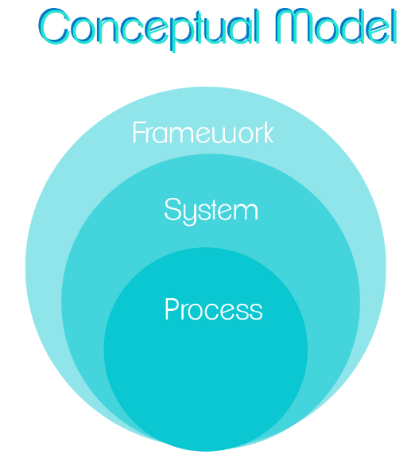
What is a conceptual model ?
An abstraction of things for the purpose of understanding them
Enables dealing with systems that are too complex to understand directly
Omits nonessential details making them easier to manipulate than the original entities
  The human mind can cope with only a limited amount of information at one time
  Models reduce complexity by separating out a small number of important things to deal with at a time
Aids understanding complex systems by enabling visualization and communication of different aspects expressed as individual models (“views”) using precise notations
  Communicate an understanding of content, organization and function of a system
  Useful for verifying that the system meets requirements
    To be relied on, models must be validated by comparison to the implemented system to assure they accurately represent and document the implemented system
Serves several purposes
  Testing a physical entity before building it
  Communicating a shared understanding of the system with stakeholders, users, developers, information system auditors and testers

Slide 15
Models help us understand Information Systems… and how to defend them…
Models are ways to describe reality
Model quality depends on skill of model designers and qualities of the selected model
Building blocks of models is a small collection of abstraction mechanisms
  Classification
  Aggregation
  Generalization
Abstractions help the designer understand, classify, and model reality

Slide 16
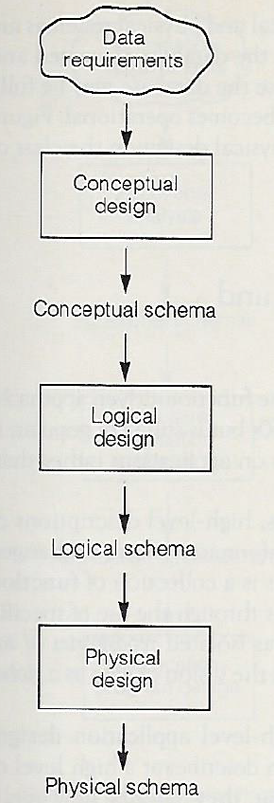
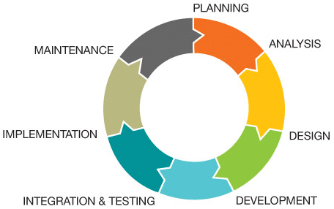
Conceptual models of information system design and development…
SDLC
Database design

Slide 17
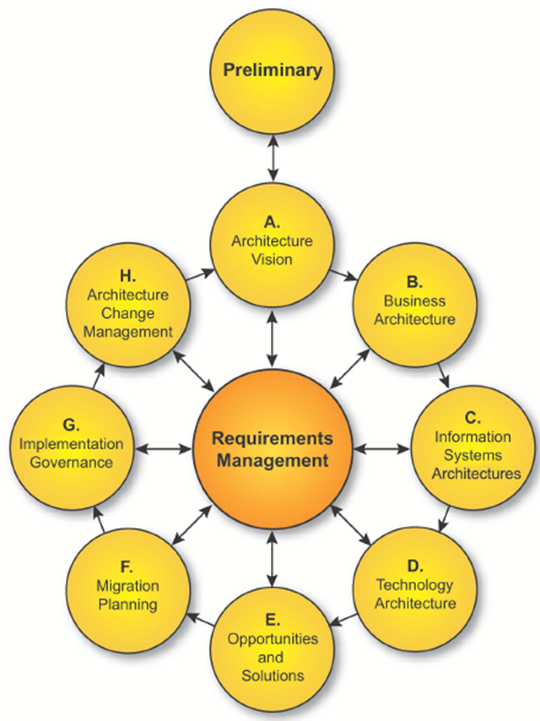
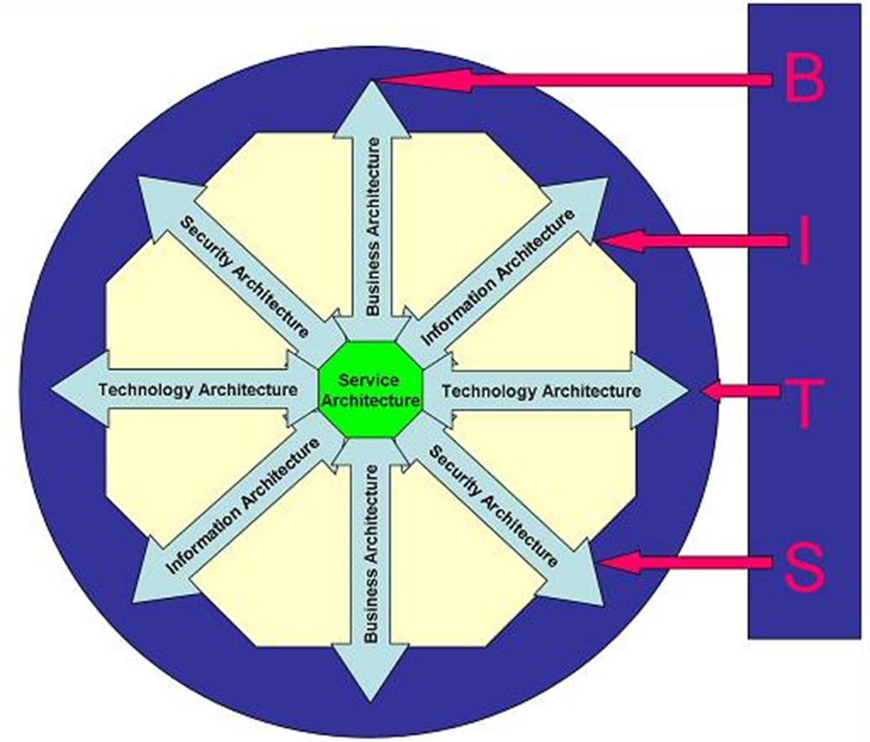
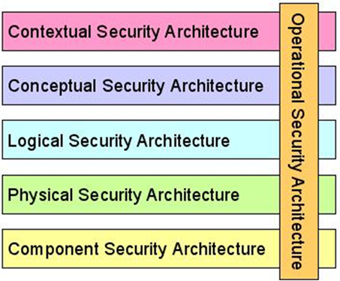
Models help us understand enterprise information systems and their security
The Open Data Group Architecture Framework
(TOGAF) Version 9.2
Sherwood Applied Business Security Architecture
Horatio Huxham’s BITS
https://en.wikipedia.org/wiki/Enterprise_information_security_architecture
https://www.opengroup.org/architecture/togaf91/downloads.htm
http://www.sabsa.org/white_paper

Slide 18
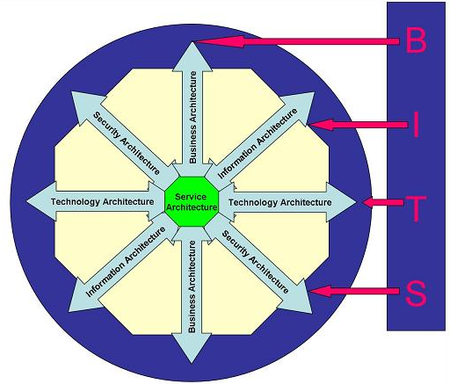
Wikipedia: https://en.wikipedia.org/wiki/Enterprise_information_security_architecture, accessed 2017-1-19
Enterprise architecture consists of:
Business Architecture
Information Architecture
Technology Architecture
Security Architecture
Horatio Huxham’s BITS
https://en.wikipedia.org/wiki/Enterprise_information_security_architecture

Slide 19
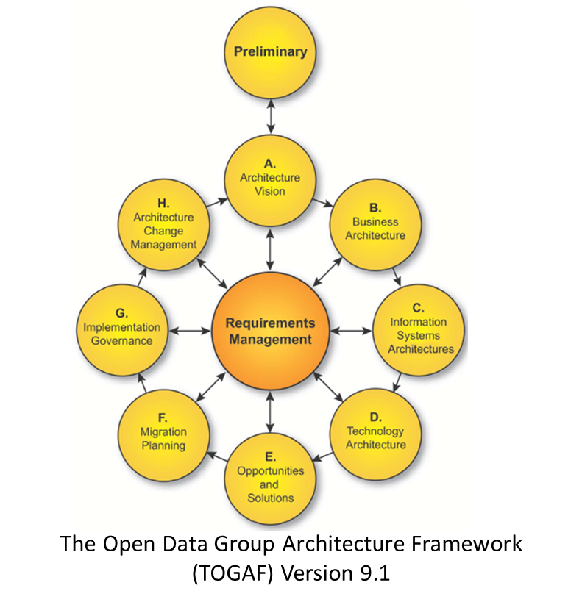

Slide 20
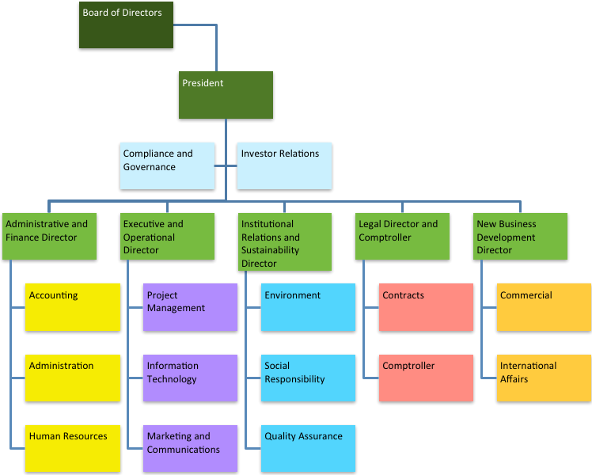


Business Architecture

Slide 21
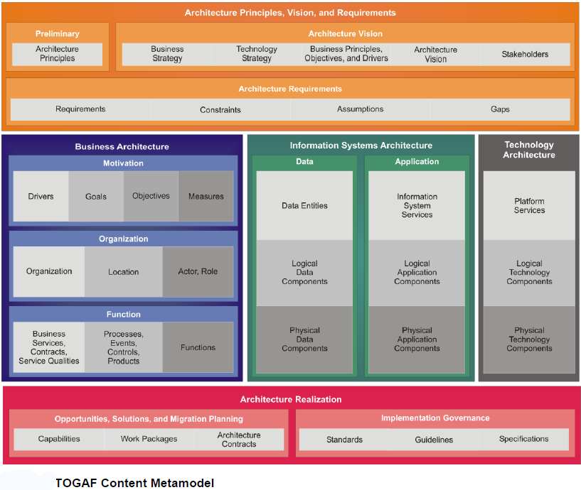

Information Architecture
Data Architecture
Application
Architecture

Slide 22
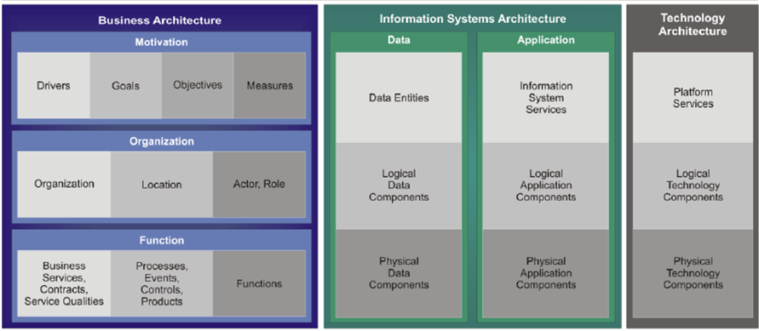
Information Architecture

Slide 23
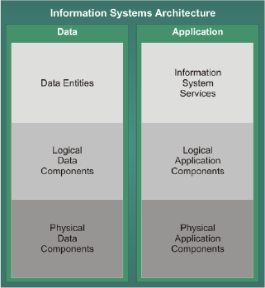
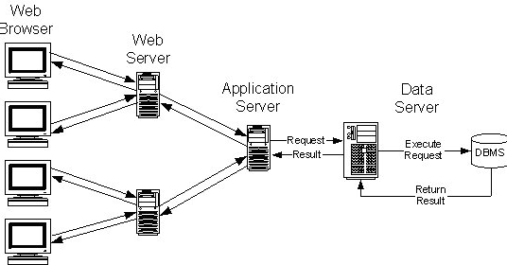
Conceptual models of Information Systems
Content & Structure
Function & Use

Slide 24
In-Class Exercise: Draw an N-Tier Architecture for a Web-Based System
Consider the purpose and contents of a web-based system for managing the data of public utilities for a small town
Identify who the users are
Using what you learned in the video, draw an N-Tier Architecture for the web-based system
  https://app.diagrams.net/

Slide 25
Agenda
Threat Modeling Exercise
Information Systems – some definitions
Conceptual models of information systems
NIST Risk Management Framework
FIPS 199 Security Categorization
Transforming qualitative risk assessment into quantitative risk assessment
FedRAMP System Security Plan – overview
  NIST 800-53 Security controls
  Role of FIPS 199 in selecting a security control baseline
  NIST 800-18 classification of security control families

Slide 26
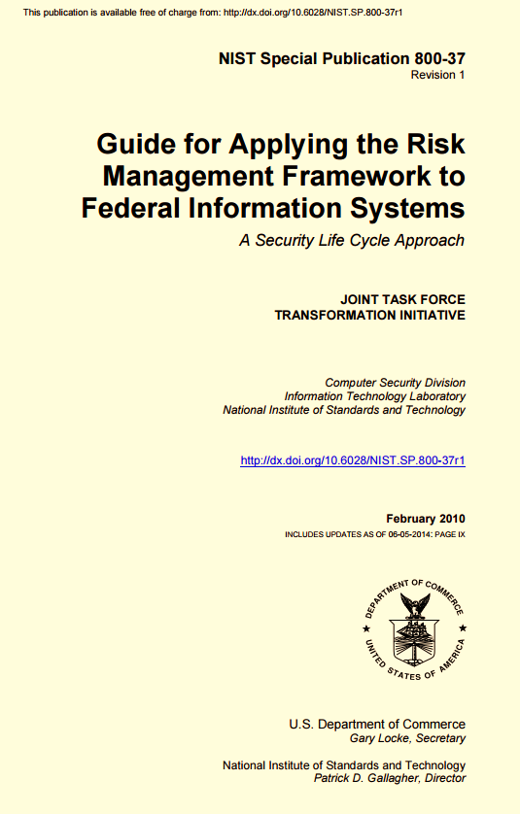
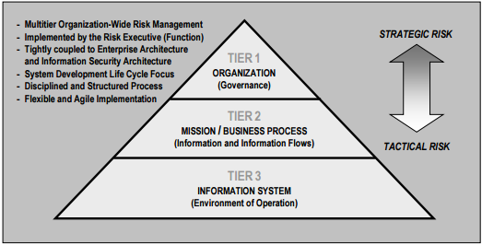
NIST Risk Management Framework

Slide 27
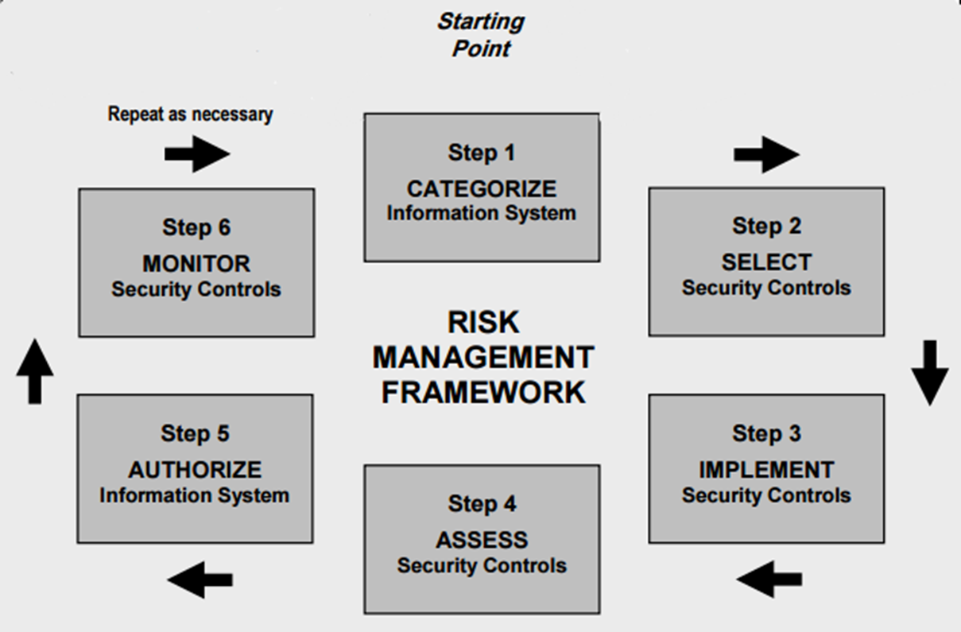
NIST Risk Management Framework

Slide 28
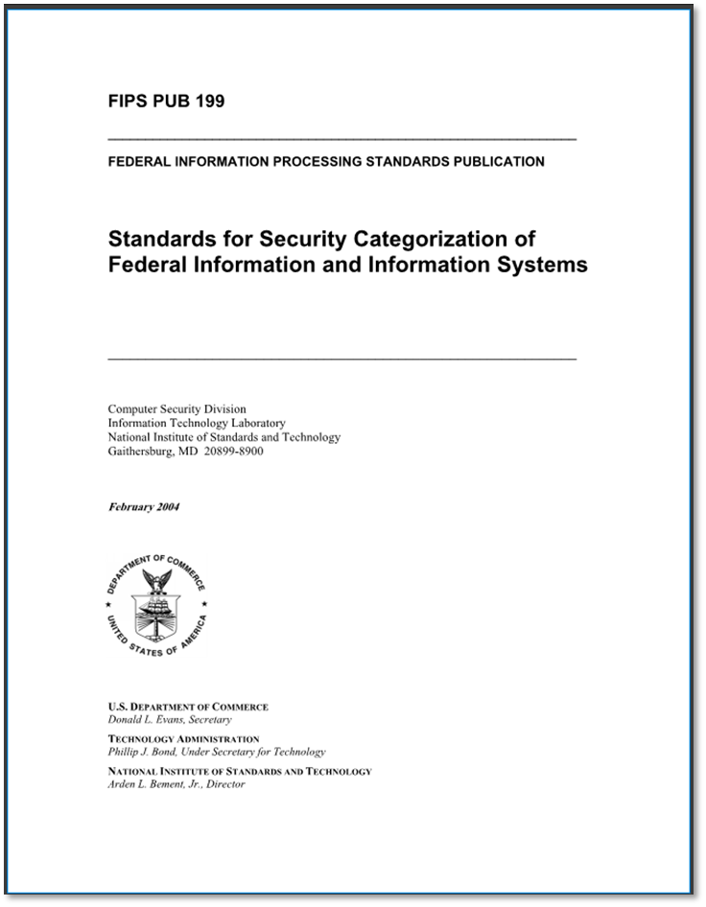
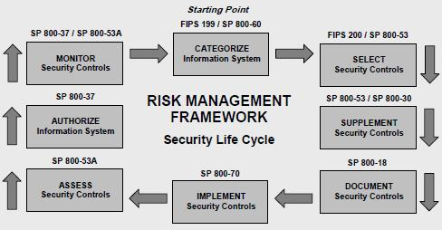
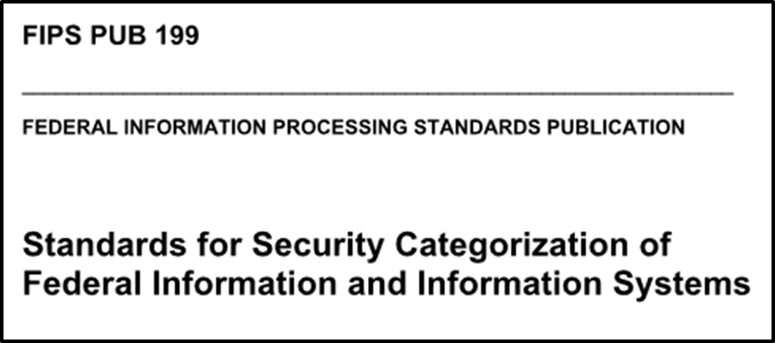
NIST Risk Management Framework

Slide 29
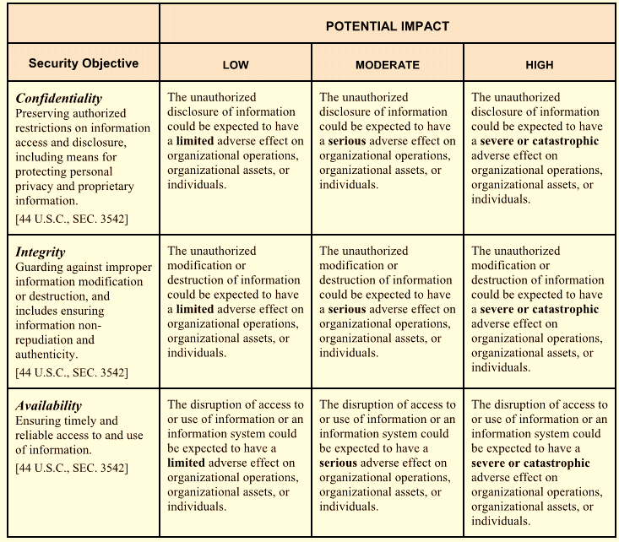
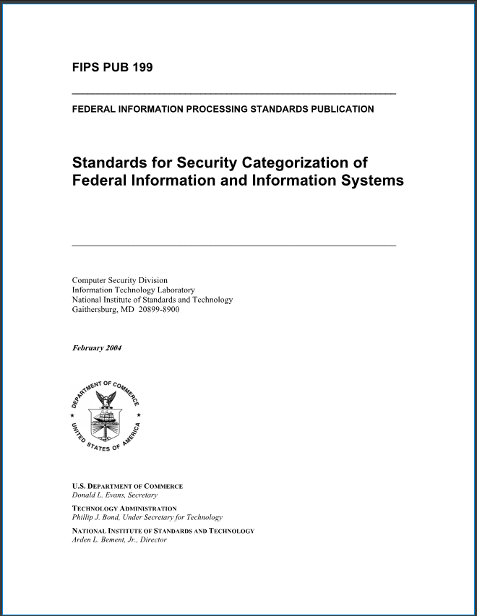
FIPS 199: Qualitative risk assessment based on security objectives

Slide 30
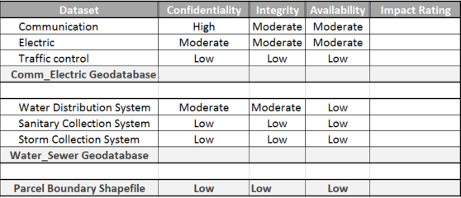
What are the security categorizations of these datasets?

Slide 31

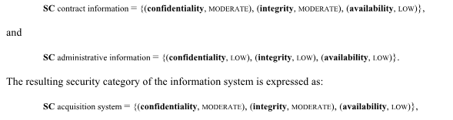
FIPS Pub 199 Standards for Security Categorization
Low: Limited adverse effect
Medium: Serious adverse effect
High: Severe or catastrophic adverse effect
Example with multiple information types:
= MODERATE rating
= LOW rating
= MODERATE rating

Slide 32
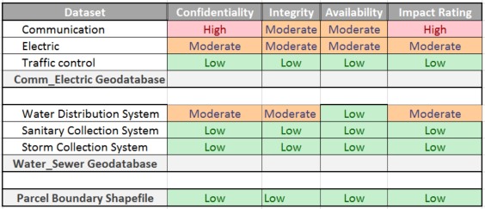
What is the overall impact ratings of the datasets?

Slide 33
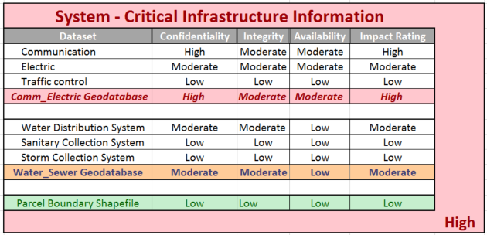
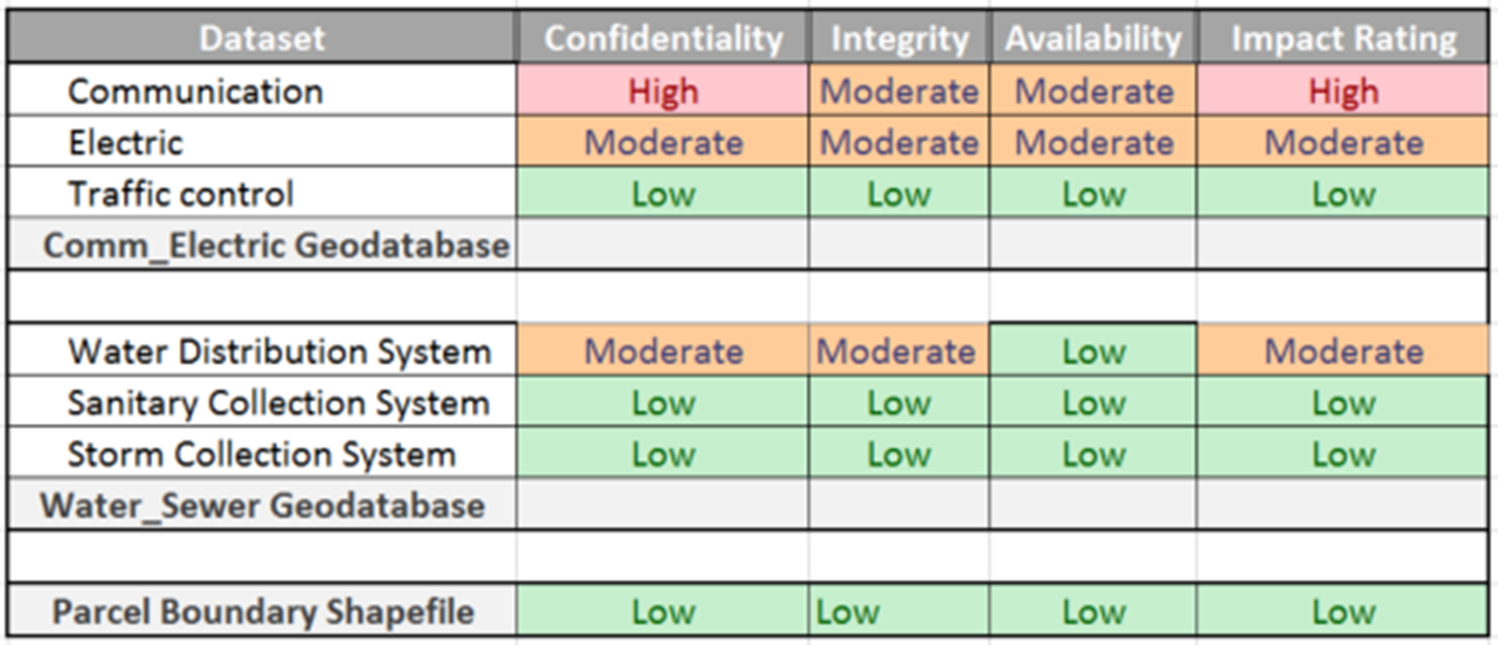
What is the overall Information System impact rating?

Slide 34
How would you transform these ordinal impact ratings into quantitative risk measures?

Slide 35
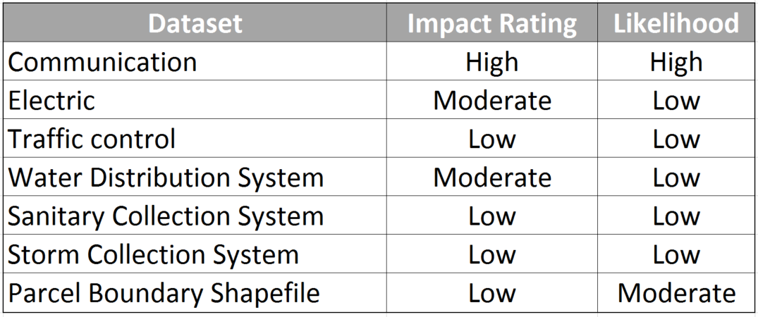
How would you quantify risk to prioritize asset types for cost-effective information security protection?

Slide 36
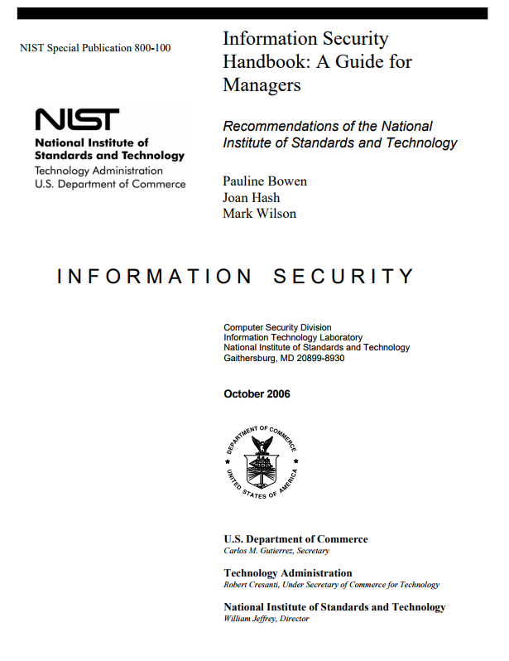
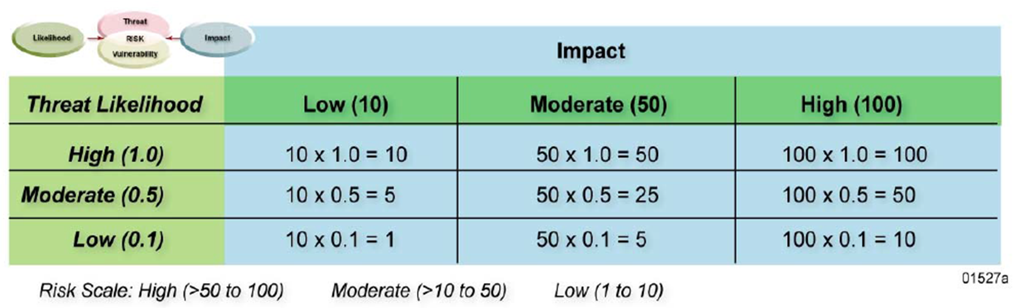
Hint:

Slide 37
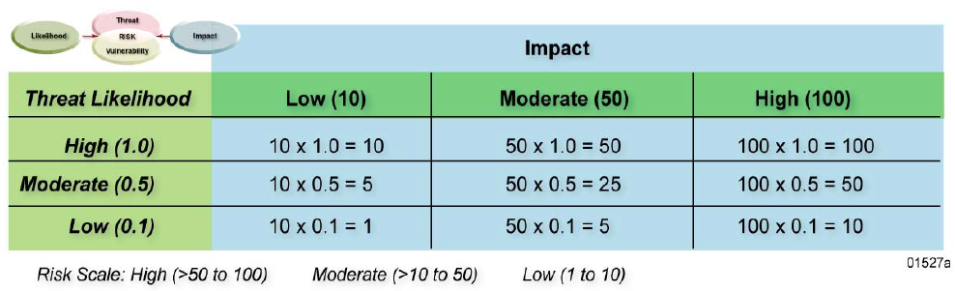
Transformation of ordinal qualitative risk categories to interval quantitative risk measures
Requires the risk analyst to contribute additional information to move ordinal onto interval scale…
NIST SP 800-100 “Information Security Handbook: A Guide for Managers”, page 99

Slide 38
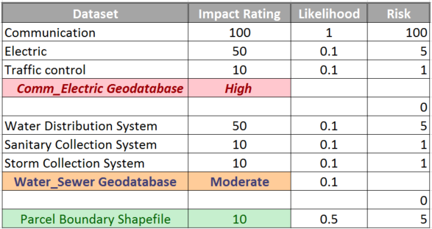


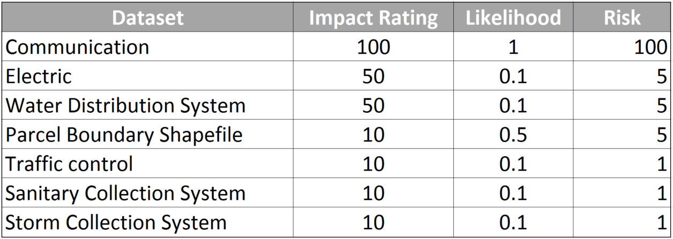
Solution
+
= ?

Slide 39
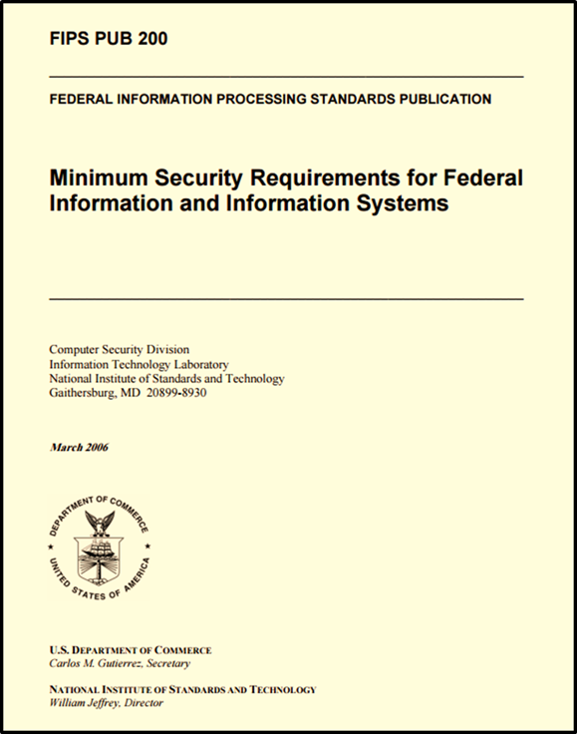
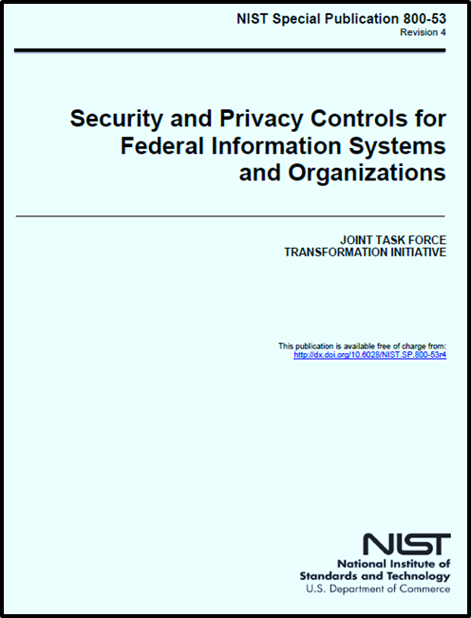
How do we use security categorization to select security controls?

Slide 40
Agenda
Information Systems – some definitions
Conceptual models of information systems
NIST Risk Management Framework
FIPS 199 Security Categorization
Transforming qualitative risk assessment into quantitative risk assessment
FedRAMP System Security Plan – overview
  NIST 800-53 Security controls
  Role of FIPS 199 in selecting a security control baseline
  NIST 800-18 classification system for security control families

Slide 41
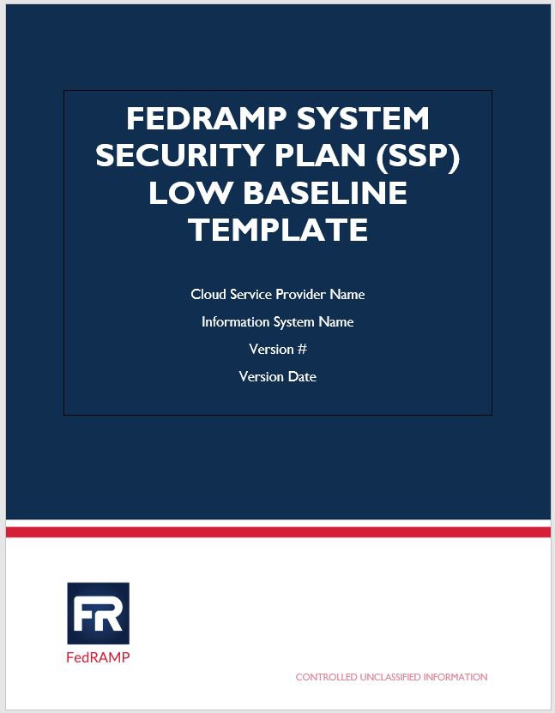
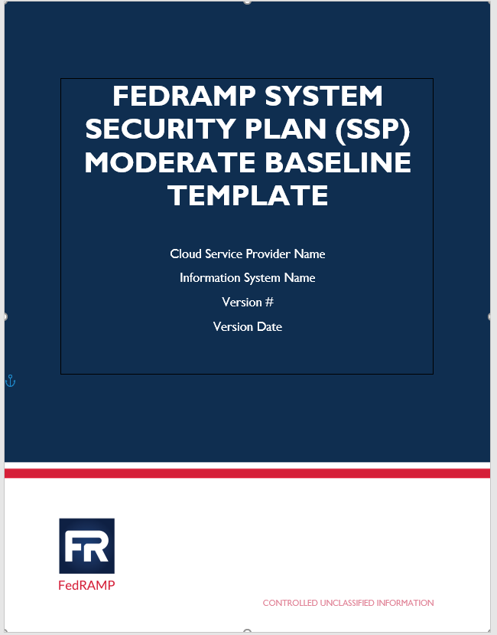
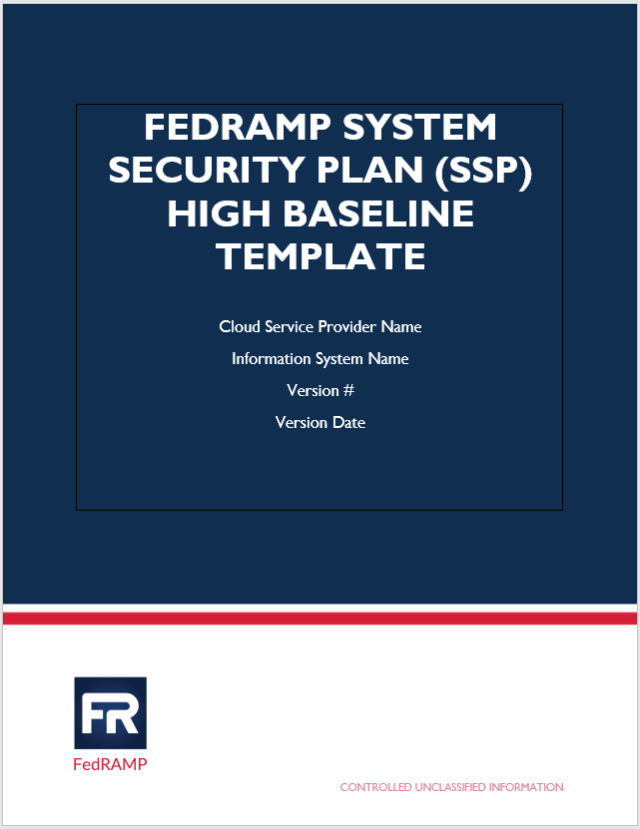
System Security Plan (SSP)
FedRAMP = Federal Risk and Authorization Management Program
Unit 02 – System Security Plan (temple.edu)

Slide 42
Information System Security Plan (SSP)

Slide 43
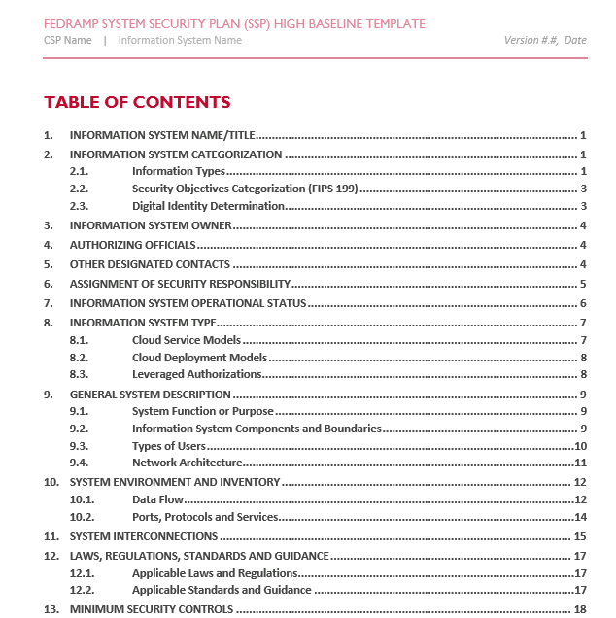
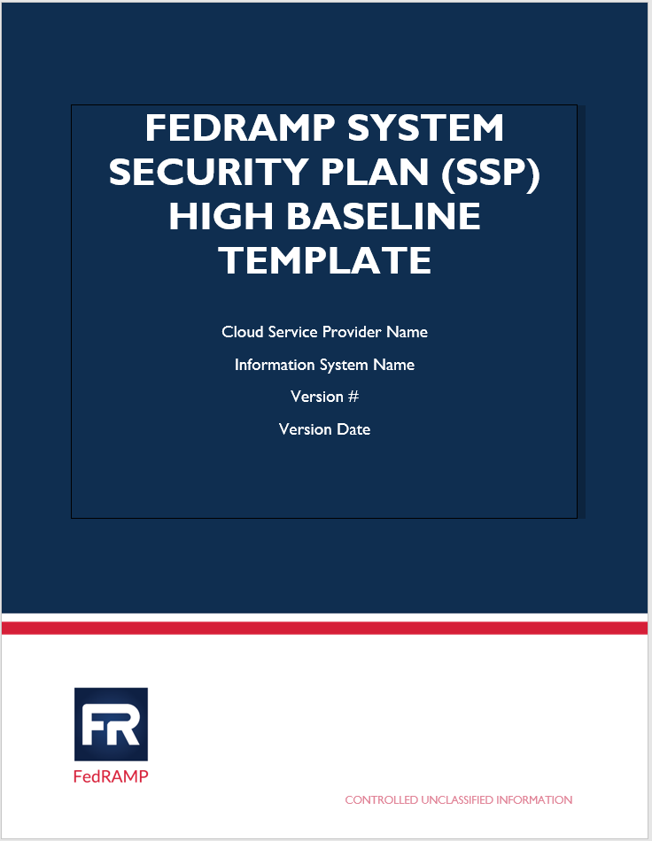

Slide 44
Information System Security Plan (SSP)

Slide 46
FIPS 200 Minimum Security Control Requirements
Access Control (AC)
Awareness and Training (AT)
Audit and Accountability (AU)
Certification, Accreditation, and Security Assessment (CA)
Configuration Management (CM)
Contingency Planning
Identification and Authentication
Incident Response (IR)
Maintenance (MA)
Media Protection (MP)
Physical and Environmental Protection *PE)
Planning (PL)
Personal Security (PS)
Risk Assessment (RA)
System and Services Acquisition(SA)
System and Communications Protection (SC)
System and Information Integrity (SI)

Slide 47
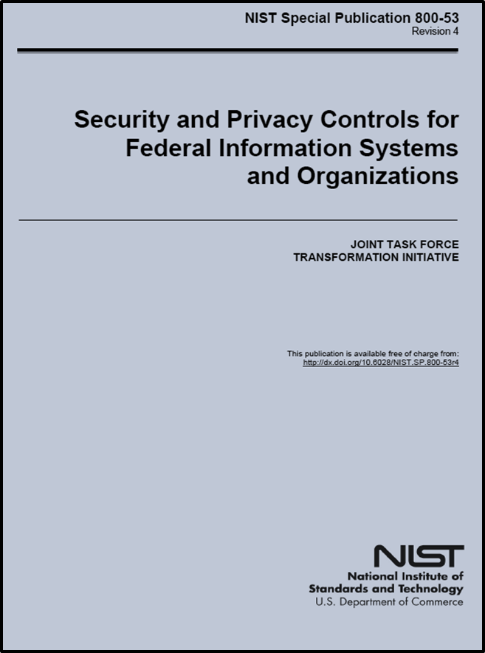
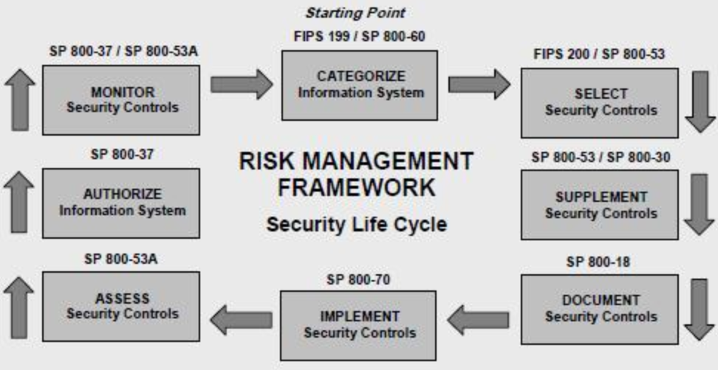
NIST Risk Management Framework

Slide 48
How do we use FIPS 199 security categorization to select security controls?

Slide 49
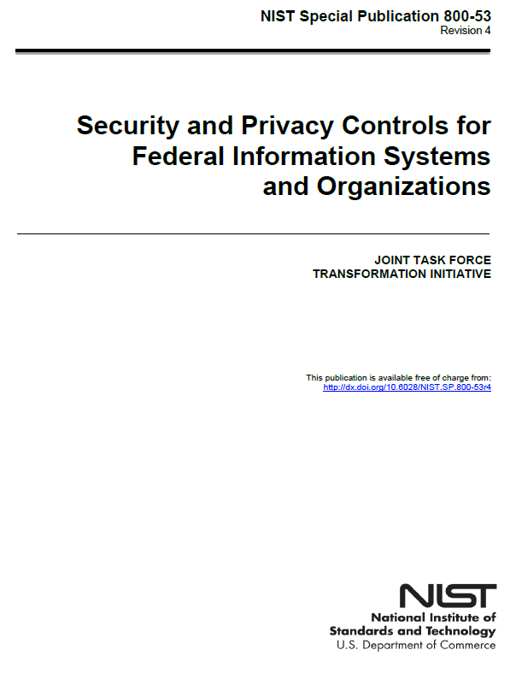
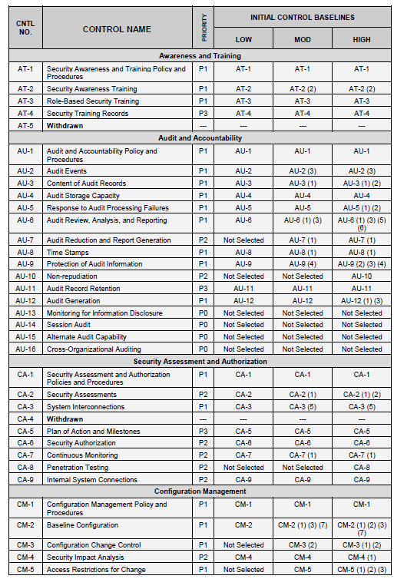
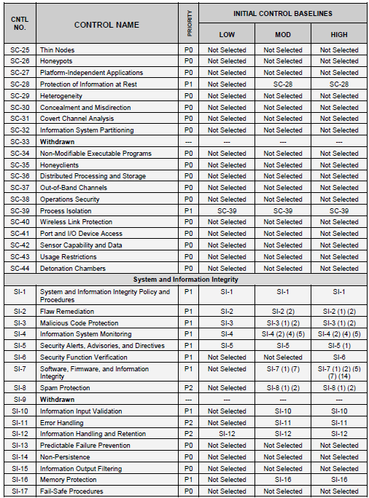
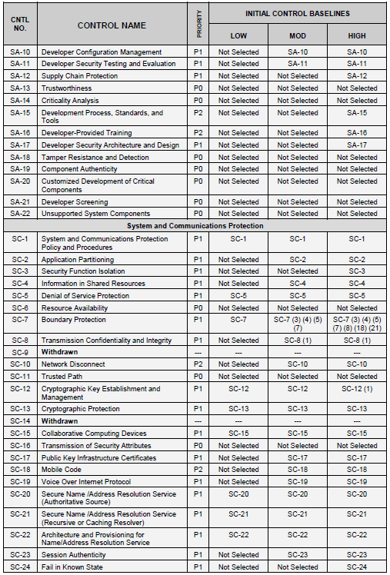
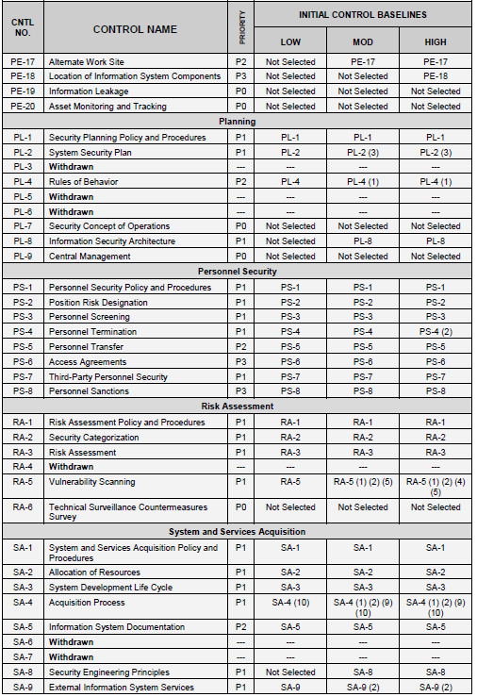



Slide 50


Slide 51
NIST 800-53 Controls are presented alphabetically
Access Control (AC)
Awareness and Training (AT)
Audit and Accountability (AU)
Certification, Accreditation, and Security Assessment (CA)
Configuration Management (CM)
Contingency Planning
Identification and Authentication
Incident Response (IR)
Maintenance (MA)
Media Protection (MP)
Physical and Environmental Protection *PE)
Planning (PL)
Personal Security (PS)
Risk Assessment (RA)
System and Services Acquisition(SA)
System and Communications Protection (SC)
System and Information Integrity (SI)

Slide 52


NIST 800-53 Controls are grouped by “Class”

Slide 53

Risk Assessment (RA) Controls

Slide 54


RA-1

Slide 55


SSP – Control Inventory Example

Slide 56



RA -2

Slide 57

SSP – Control Inventory Example

Slide 58



RA -3

Slide 59



SSP – Control Inventory Example

Slide 60
Agenda
Threat Modeling Exercise
Information Systems – some definitions
Conceptual models of information systems
NIST Risk Management Framework
FIPS 199 Security Categorization
Transforming qualitative risk assessment into quantitative risk assessment
FedRAMP System Security Plan – overview
  NIST 800-53 Security controls
  Role of FIPS 199 in selecting a security control baseline
  NIST 800-18 classification of security control families

Slide 61
QUESTIONS???

