Slide 1
Unit #5
MIS5214
Secure Networks

Slide 2
Agenda
Digital Certificates
Public Key Infrastructure
Types of Networks
OSI Model
Layer 1 Network Devices
Layer 2 Network Devices
Layer 3 Network Devices
Layer 3 – 7 Network Devices

Slide 3
Public Key Infrastructure (PKI)
Public key cryptography enables entities previously unknown to each other to verify the identity of each other, validate the information being transferred, and securely communicate on an insecure public network
Public key infrastructure
  Enables online activities requiring more trust and proof of identity than simple passwords
  Provides a hierarchy of trust relationships that:
    Enable knowing a public key really belongs to the person/system you want to communicate with
    Are necessary for hybrid cryptography
    Facilitate secure electronic transfer of information for a range of network activities such as e-commerce, internet banking and confidential email

Slide 4
Public Key Infrastructure (PKI)
Is a system for creating, storing, distributing, validating, revoking and managing digital certificates used to verify the identity the owner of a public key contained within the certificate
Assumes
  Receiver’s and Sender’s identities can be positively ensured through digital certificates
  Asymmetric algorithm will automatically carry out the process of key exchange
Contains components that
  Identify users
  Creates and distributes certificates
  Maintains and revokes certificates
  Distributes and maintains encryption keys
  Enables information technologies to communicate and work together to achieve confidentiality, authentication, integrity, and non-repudiation

Slide 5
Public Key Infrastructure (PKI)
Consists of:
  Public key certificates (“digital certificates”) are electronic documents used to prove the ownership of public keys
  Roles
    Certificate Authorities (CA) store, issue and sign the digital certificates
    Registration Authorities (RA) verify identities of entities requesting their digital certificates be stored at the CA
  Technologies
    Central directory provides a secure location in which keys are stored and indexed
    Certificate management system
      Creates and delivers new certificates to be issued
      Searches, retrieves and accesses to stored certificates
  Certificate policy states procedures for allowing outsiders to analyze the PKI's trustworthiness

Slide 6
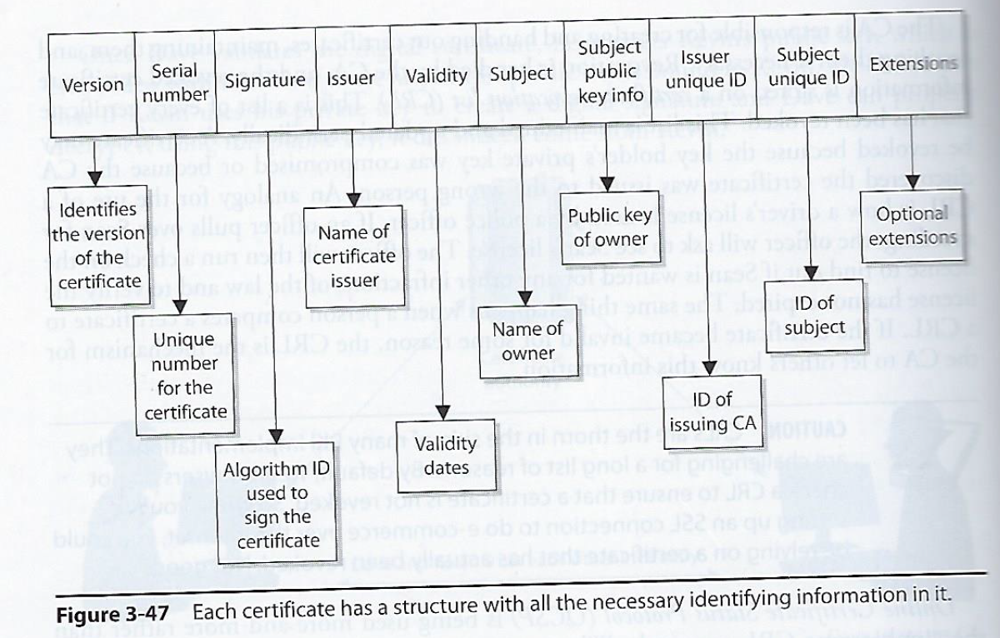
Digital Certificate
One of the most important pieces of a PKI
Associates a public key with information for uniquely identifying its owner
X.509 standard defines the format of public key certificates used in many Internet cryptographic protocols for HTTPS for servers & clients, secure email, code signing, digital signatures…

Slide 7
Public Key Certificate
Electronic documents used to prove ownership of a public key
A certificate includes the following common fields:
  Information about the certificate
    Serial Number: Used to uniquely identify the certificate
    Issuer: Entity that verified the information and signed the certificate
    Signature Algorithm: The algorithm used to sign the public key certificate
    Signature: A signature of the certificate body by the issuer's private key
  Information about the public key
    Not Before: Earliest time and date on which the certificate is valid.
    Not After: Time and date past which the certificate is no longer valid
    Key Usage: Valid cryptographic uses of the certificate's public key, e.g. digital signature validation, key encipherment, and certificate signing
    Extended Key Usage: Applications the certificate may be used for, e.g. TLS server authentication, email protection, code signing, or electronic signature
  Information about the identity of its owner (called the subject)
    Subject: Entity a certificate belongs to, e.g. individual, machine, or organization

Slide 8
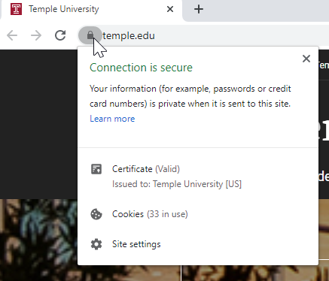
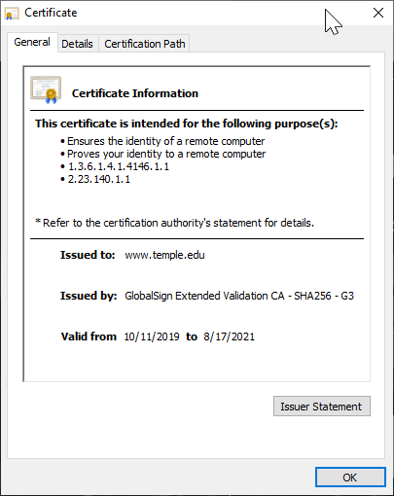
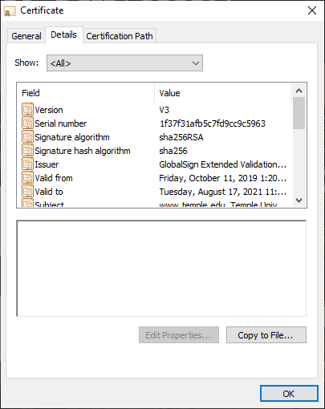
Certificate

Slide 9
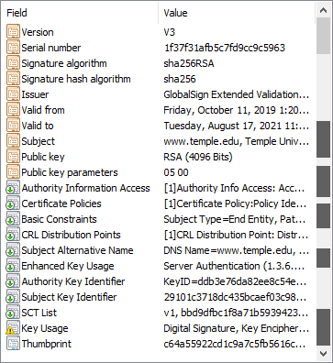

Slide 10
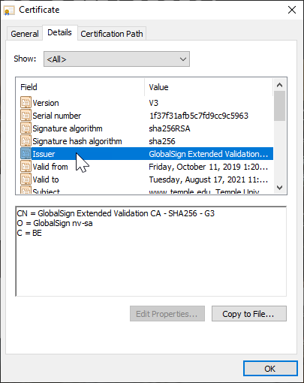
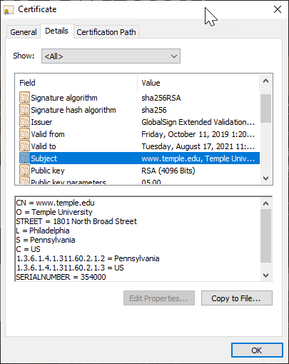

Slide 11
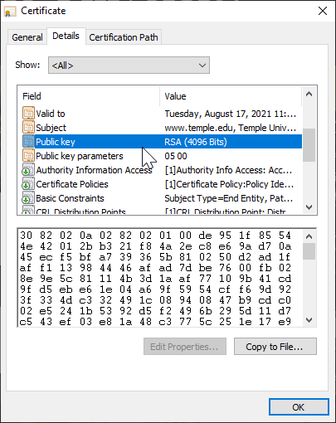
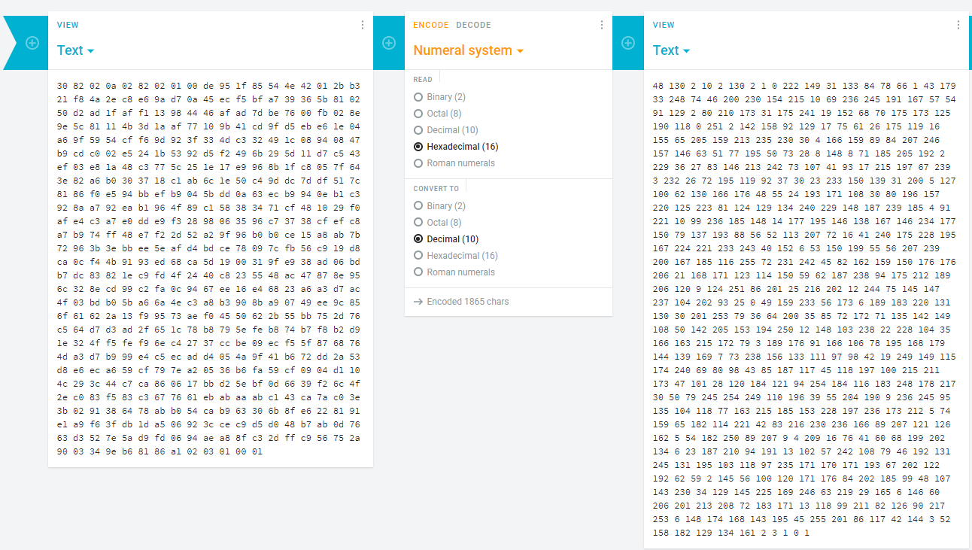
https://cryptii.com/

Slide 12
Types of Certificates: Different cryptographic protocols (“applications”)
X.509 is a standard of the International Telecommunications Union which defines the format of public key certificates used in many Internet cryptographic protocols, including:
Transport Layer Security (TLS/SSL) HTTPS protocol for securely browsing the web
  Certificate's subject is typically a computer or other device, but may also identify organizations or individuals
  Server certificate
    A server is required to present a certificate as part of the initial connection setup. A client connecting to that server will validate the certificate by checking that
      The certificate’s subject matches the hostname (i.e. domain name) to which the client is trying to connect
      The certificate is signed by a trusted certificate authority
  Client certificate (less common than server certificates)
    Used to authenticate the client connecting to a TLS service (e.g. for access control)
    Most client certificates contain an email address or personal name rather than a hostname
Email encryption certificate
  A certificate's subject is typically a person or organization
  For secure email, senders use an email certificate to discover which public key to use for any given recipient
Code signing certificate
  A code signing certificate is used to validate signatures on programs to ensure they were not tampered with during delivery
Qualified digital certificate
  A “Qualified digital certificate” identifies an individual for electronic signature purposes

Slide 13
Roles in PKI - Certificate Authority (CA)
Serves as a trusted third party responsible for verifying identities and signing digital certificates of identity (“digital signature”) which are exchanged between two parties introducing themselves to each other
Each person wanting to participate in a PKI requires a digital certificate
  Digital certificate is a credential containing the public key for that individual along with other identifying information
A CA is a trusted organization (or server) responsible for:
  Issuing (creating and handing) out digital certificates
  Maintaining digital certificates
  Revoking digital certificates
Use of PKI and exchanging digital certificates is intended to block Man-in-the-Middle attacks where 2 users are not working in PKI environment do not truly know the identity of the owners of public keys

Slide 14
Lets see a video on CA’s!
(20) What is a certificate authority? - YouTube

Slide 15
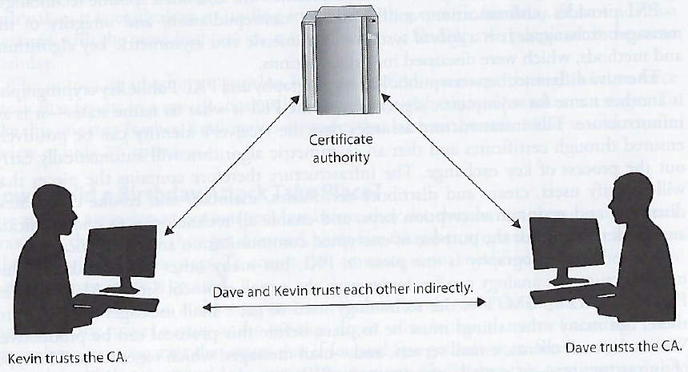
Roles in PKI - Certificate Authority (CA)
Each person wanting to participate in a PKI requires a digital certificate
  Digital certificate is a credential containing the public key for that individual, computer or organization along with other identifying information
When a CA signs the certificate, it binds the individual’s, computer’s or organization’ identity to the public key
  The CA takes liability for the authenticity of the identity
    Making a CA the “trusted 3rd party” that allows people who have never met to use their public keys to authenticate each other and communicate in a secure way
Certificate Revocation Information
  CA’s are also responsible for maintaining up-to-date revocation information about certificates they have issued, indicating when certificates of identity are no longer valid

Slide 16
Certificate Revocation List (CRL) – in principal
CRL is the mechanism for the CA to let others know that a certificate has become invalid for some reason
A certificate may be revoked because
  The key holder’s private key was compromised
  CA discovered the Certificate was issued to the wrong person
  The certificate expired
  The certificate became invalid for other reasons…
The CA handles revocation by putting the revoked certificate’s information on a certificate revocation list (CRL)
  The CRL is a list of every certificate that has been revoked
  The CRL is maintained and updated

Slide 17
Certificate Revocation List (CRL) – in practice
CRLs are problematic in many PKI implementations for many reasons
  Either user’s browser must check a central CRL to find out if a certificate has been revoked
  …or the CA must continually push out CRL values to clients to ensure they have an updated CRL
By default, web browsers do not check a CRL to ensure that a certificate is not revoked
  So when you are setting up a SSL connection to do e-Commerce over the Internet, you may be relying on a revoked certificate and not know it
Online Certificate Status Protocol (OCSP) is increasingly being used…
  If OCSP is implemented, it works automatically
  OCSP does real-time certificate validation
    Checks the CRL maintained by the CA
    Notifies user if certificate is valid, invalid, or unknown

Slide 18
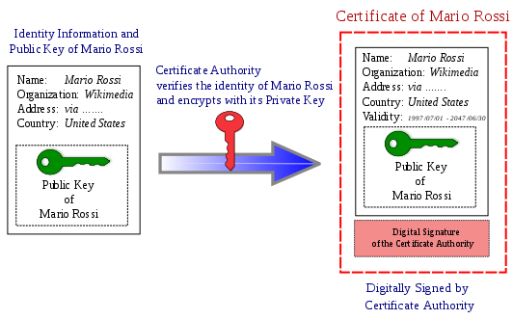
Roles in PKI – Certificate Authority (CA)
New Certificate Requests
  A CA processes requests from people or organizations requesting certificates (called “subscribers”)
    Verifies the subscriber’s information
    Potentially signs an end-entity certificate based on the subscriber’s information

Slide 19
Registration Authority (RA)
When a user needs a new certificate, the user makes a request to the RA
RA serves as a broker between the user and the CA, and performs certain certification registration tasks
  Performs the certificate life-cycle management functions
  Establishes and confirms the identity of the individual
    The RA verifies all the necessary identification information before allowing a request to go to the CA
  Initiates the certification process with the CA for the end user
RA cannot issue certificates

Slide 20
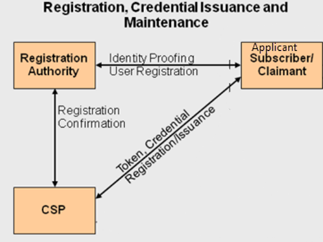
PKI Steps
Suppose: John needs to obtain a digital certificate to participate in PKI
John requests a digital certificate from a RA
The RA requests John’s identification information
  E.g. driver’s license, address, phone number, email, …
RA receives John’s information, verifies it, and sends his certificate request to CA
CA creates a certificate with John’s public key and embedded identity information
  Private/Public key pair is generated on John’s machine or by the CA (depends on system configuration)
    Usually – user generates this pair and sends his public key in as part of registration process
    If CA creates key pair, John’s private key needs to be sent to him via secure means
Now John is registered and is able to participate in PKI
Certificate Authority
Token, Credential = Public Key

Slide 21
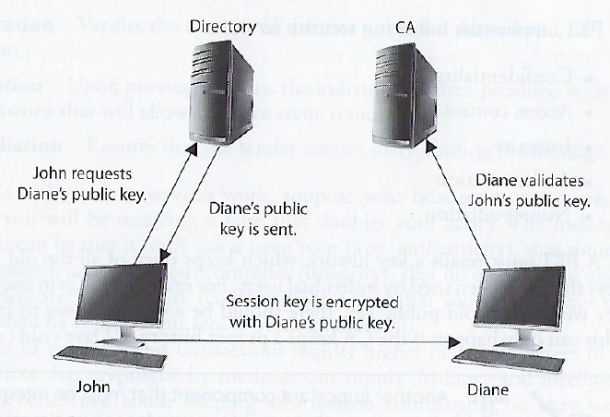
PKI Steps
John and Diane decide to communicate securely using PKI…
John requests Diane’s public key form a public directory
The directory (a.k.a. repository) sends Diane’s digital certificate
John verifies the digital certificate…
  extracts her public key, uses the public key to encrypt a session key that will be used to encrypt their messages
  John sends the encrypted session key to Diane
  John also sends his certificate, containing his public key to Diane
Diane browser receives John’s certificate, looks to see if it trusts the CA that digitally signed the certificate
  Diane’s browser trusts this CA
  After verifying the certificate, both John and Diane can communicate using encryption

Slide 22
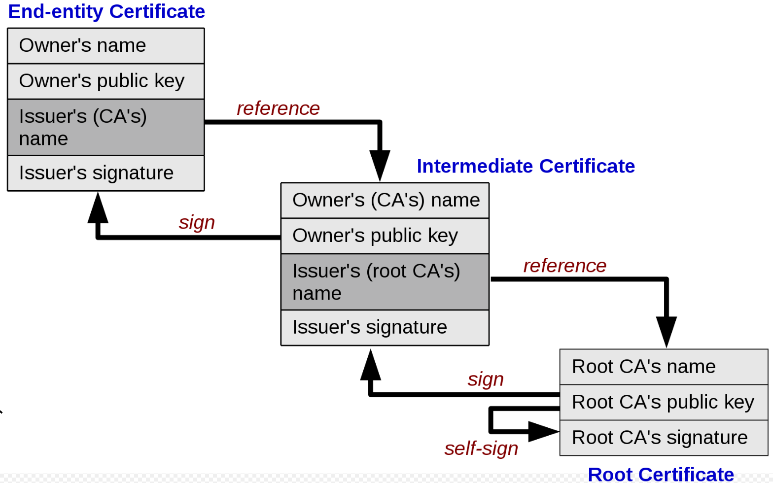
Types of certificates: Chain of trust
A PKI is often set up with multiple levels of CAs, for practical reasons:
There is a top-level CA, called the root, which issues certificates on the keys of lower-level CAs, which in turn certify the user keys
The system of identity validation still behaves in the same way, but now Diane has to check two certificates to verify John’s key
Root certificate
  Self-signed certificate used to sign other certificates
Intermediate certificate
  A certificate used to sign other certificates.
  Must be signed by either a root certificate or another intermediate certificate
End-entity (“leaf”) certificate
  Cannot be used to sign other certificates
  Include:
    TLS/SSL server and client certificates
    Email certificates
    Code signing certificates
    Qualified certificates

Slide 23
Recall… Temple.edu’s certificate…

Slide 24
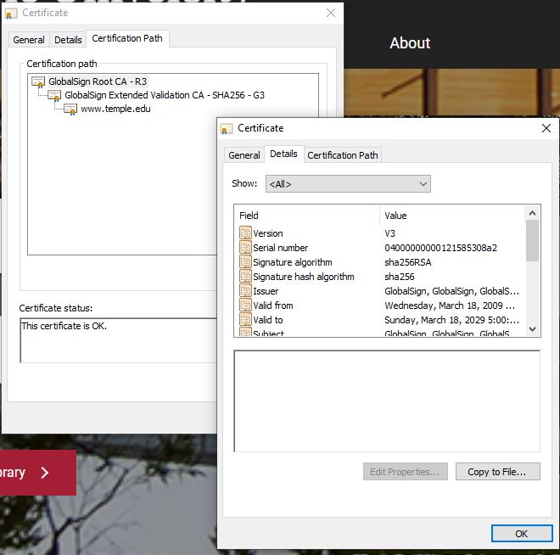
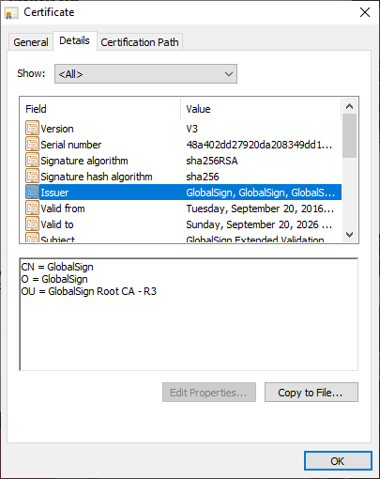
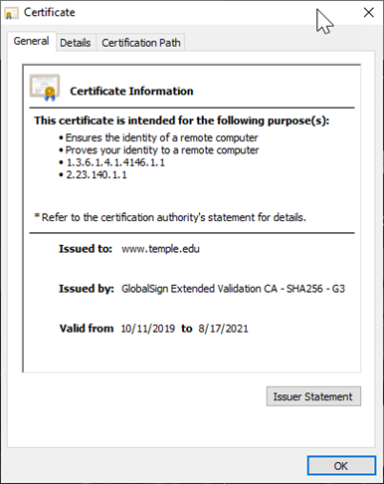
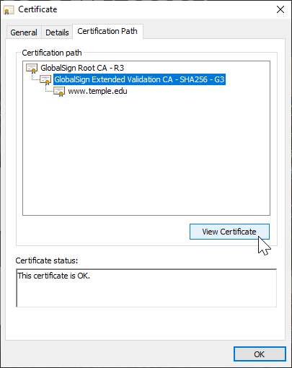
Types of certificates: Chain of trust

Slide 25
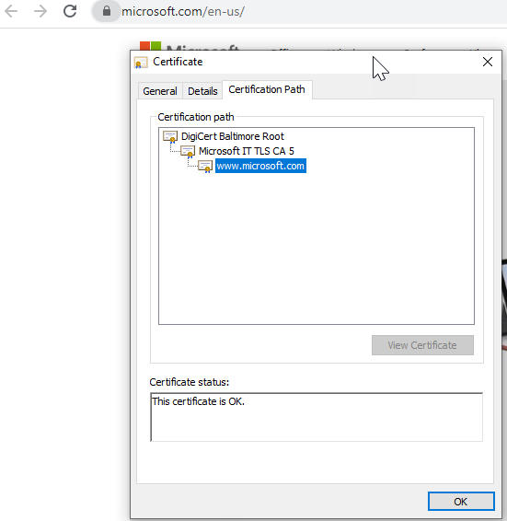
Types of certificates: Chain of trust

Slide 26
Types of certificates: Chain of trust

Slide 27
Types of certificates: Chain of trust
To perform its role effectively, a CA needs to have one or more broadly trusted root certificates or intermediate certificates and the corresponding private keys
A CA may achieve broad trust by:
  Having its root certificates included in popular software
  Obtaining a cross-signature from another CA delegating trust
Or a CA may be trusted within a relatively small community, like a business
  In which its root certificates are distributed by other mechanisms like Windows Group Policy

Slide 28
Types of certificates: Chain of trust
Root programs:
  Some major software products contain a list of certificate authorities that are trusted by default
  This makes it easier for end-users to validate certificates, and easier for people or organizations that request certificates to know which certificate authorities can issue a certificate that will be broadly trusted
  This is particularly important in HTTPS, where a web site operator generally wants to get a certificate that is trusted by nearly all potential visitors to their web site
The most influential root programs are:
  Microsoft Root Program
  Apple Root Program
  Mozilla Root Program
  Oracle Java root program
  Adobe Approved Trust List and EUTL root programs (used for document signing)

Slide 29
Types of certificates: Chain of trust
Root programs:
Browsers generally use the operating system's facilities to decide which certificate authorities are trusted:
  Google Chrome on Windows trusts certificate authorities included in Microsoft Root Program
  Google Chrome on macOS or iOS trusts certificate authorities in Apple Root Program
  Edge and Safari use their respective operating system trust stores as well, but each is only available on a single OS.
Firefox, in contrast, uses the Mozilla Root Program trust store on all platforms

Slide 30
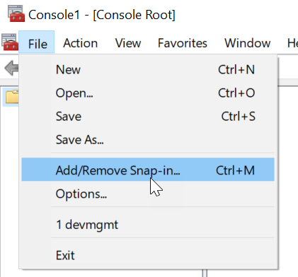
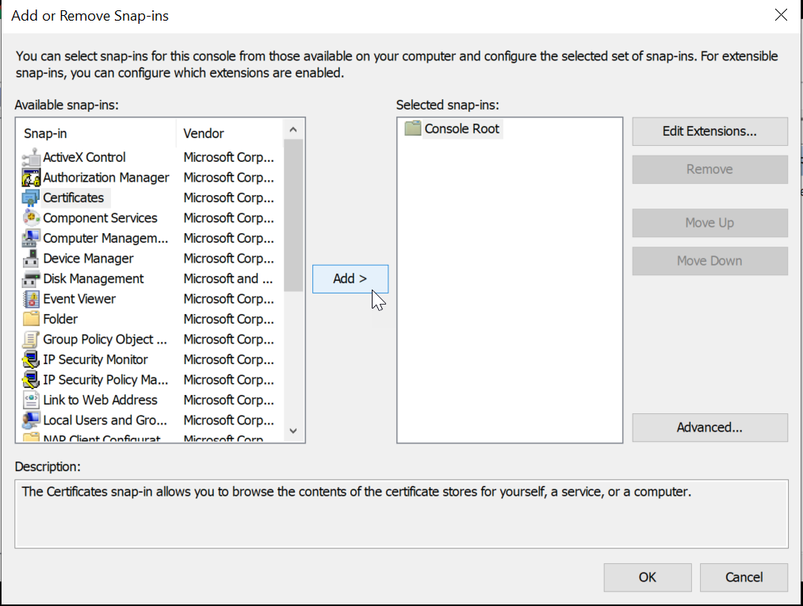
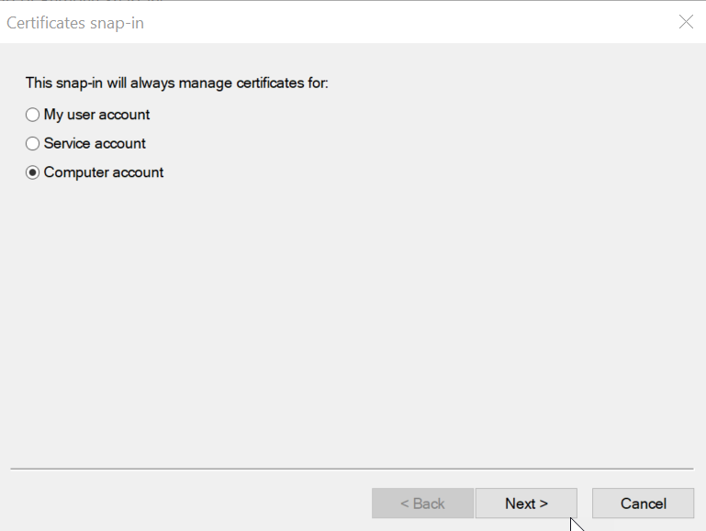
Microsoft Windows Root Program’s Trust Stores
Run mmc.exe
Select File -> Add/Remove Snap-in
Select Certificates, click Add
Select Computer Account, click next, click Finish
Expand the Certificates node -> Trusted Root Certificate Authorities Store

Slide 31

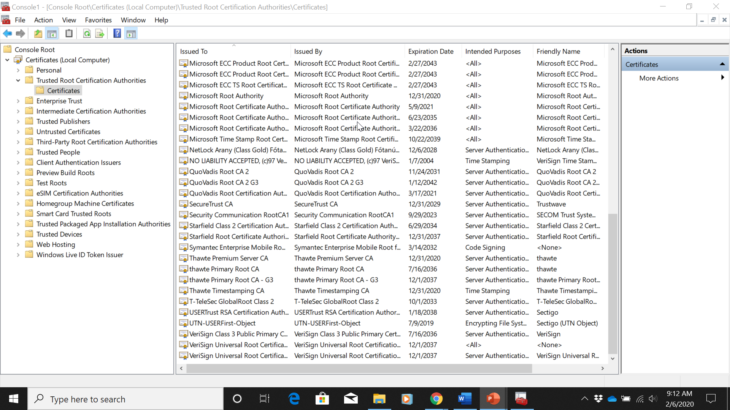
Microsoft Windows Root Program’s Trust Stores

Slide 32
Microsoft Windows Root Program’s Trust Stores

Slide 33
Mac OS X
The root store is in the Keychain.app
  Search Finder (Spotlight) for “keychain”
  Double-click Keychain Access app
  Select “System Roots” in the left-hand pane

Slide 34
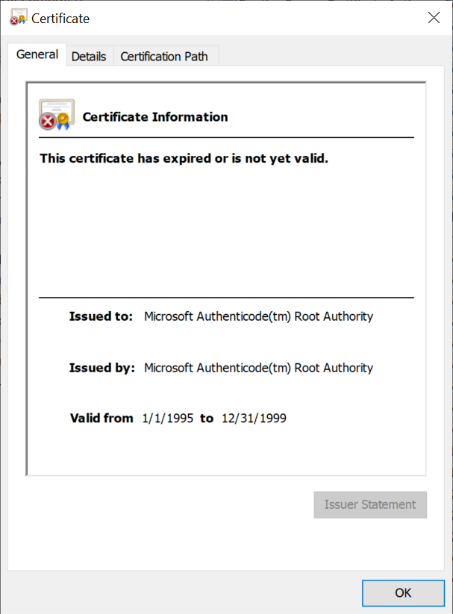
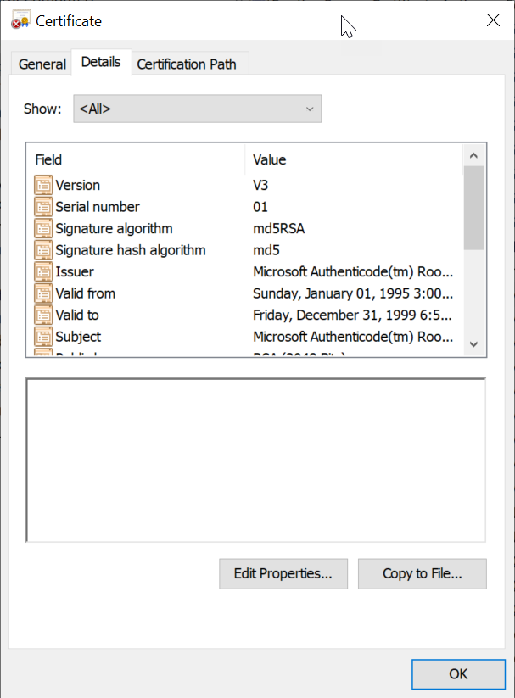
Microsoft Windows Root Program’s Trust Stores

Slide 35
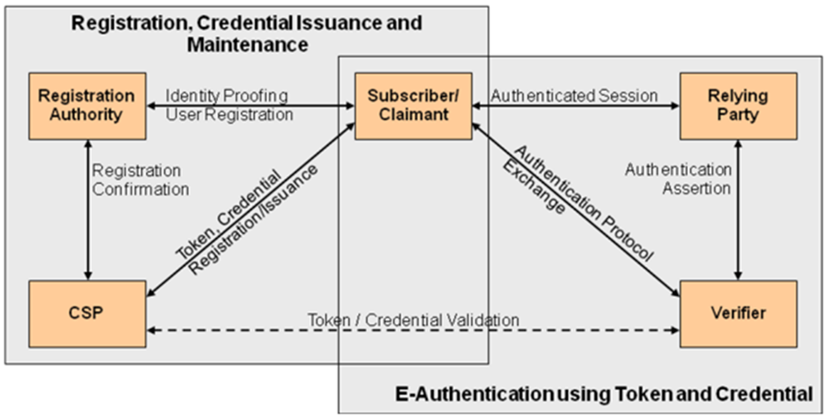
PKI Roles and Workflows
Certificate Authority
Token, Credential = Public Key

Slide 36
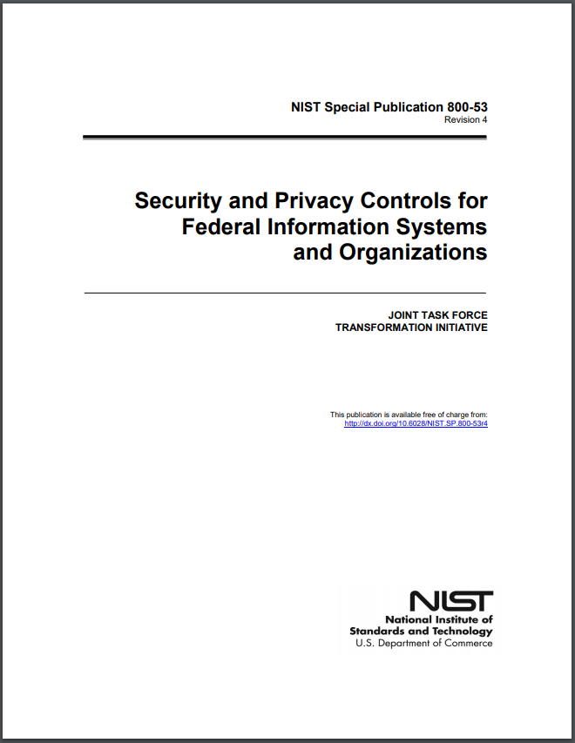

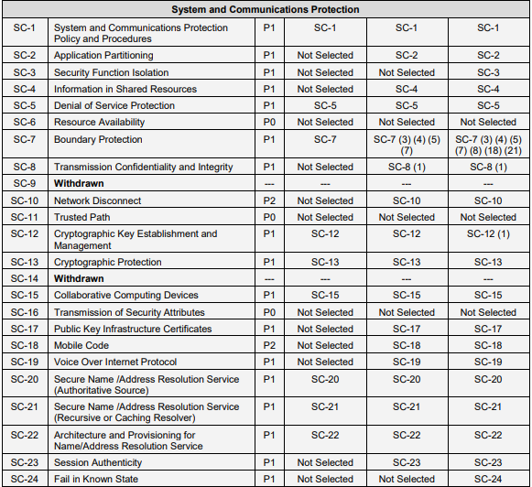
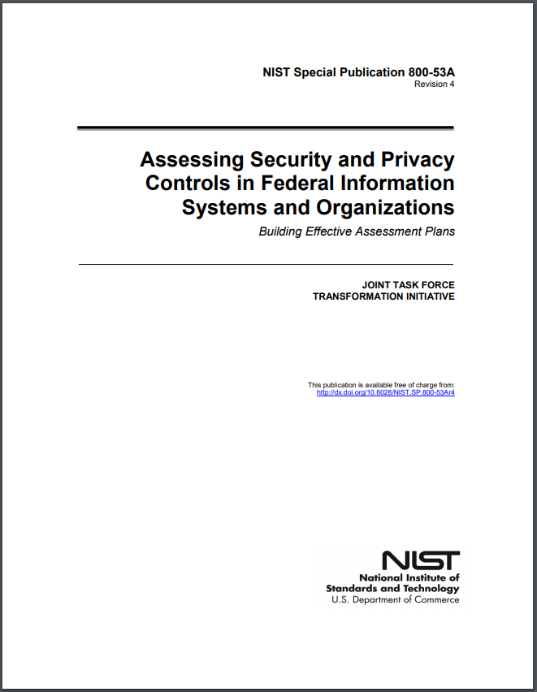
Where do you look for Security Controls for PKI Certificates ?

Slide 37

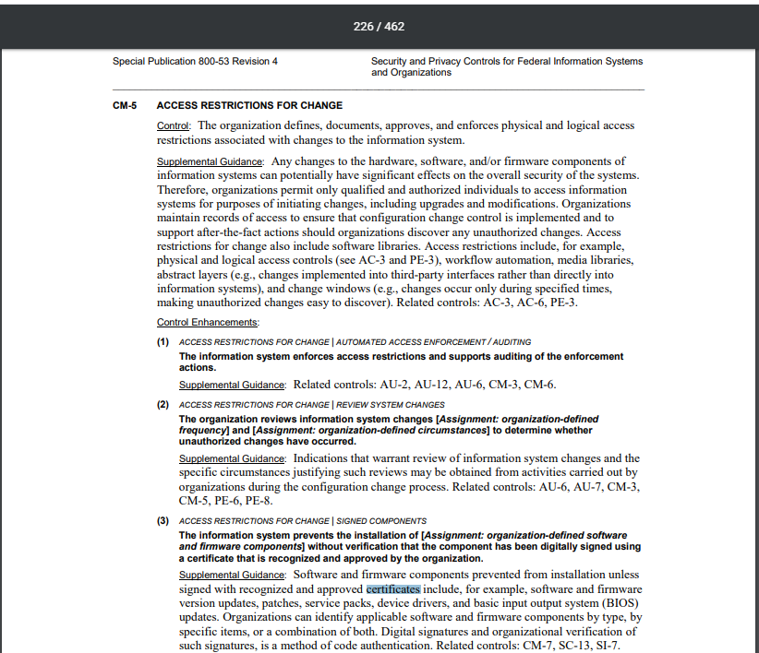
Where else do you look for Security Controls based on the use of PKI Certificates ?
CM-5, IA-5, MA-4, SC-12, SC-17, SC-13, SC-23, SI-7,…

Slide 38
Agenda
Digital Certificates
Public Key Infrastructure
Types of Networks
OSI Model
Layer 1 Network Devices
Layer 2 Network Devices
Layer 3 Network Devices
Layer 3 – 7 Network Devices

Slide 39
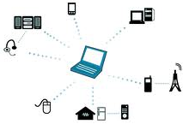
Types of networks
Personal Area Network (PAN)
  Generally, a microcomputer network used for communications among personal computer devices being used by an individual
    Laptops, tablets, printers, scanners, cameras, telephones
  May also be connected to a higher-level network and the Internet
  Extent is typically within 10 meters (33 feet)
  May be wired with computer buses such as Universal Serial Bus (USB)
  A Wireless PAN (WPAN) can be set up using network technolog such as infrared data association (IrDA) and Bluetooth (piconet)
    A piconet can include up to 8 active devises in master-slave relationship can range from 10 meters to 100 meters

Slide 40
Types of networks
Local Area Network (LAN)
  Cover a limited area, such as home, office or campus
  Characteristics: High data transfer rates, with smaller geographic range
  Eithernet and Wi-Fi (WLANs) are the 2 most common technologies used
Storage Area Network (SAN)
  Centralize the process for the storage and administration of data
  Variation of LAN dedicated to connecting storage devices to servers and other computing devices
Wide Area Network (WAN)
  Computer network that covers a broad area, such as a city, region, nation or an international link
  Used to connect LANS and other types of networks together so that users and computers in one location can communicate with users and computers in other locations
    May be private and built for 1 particular organization
    May be built by Internet Service Providers (ISPs) to provide connections from an organization’s LAN to the Internet
    May be wireless (WWAN)
  Internet is the largest example of a WAN
Metropolitan Area Network (MAN)
  A WAN that is limited to a city or a region
  MANs are usually, characterized by higher data transfer rates than WANs

Slide 41
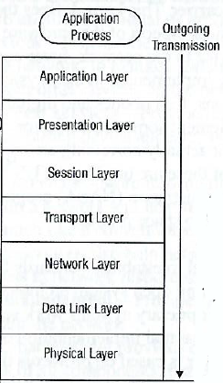
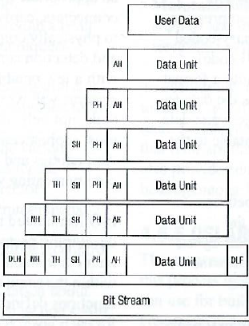
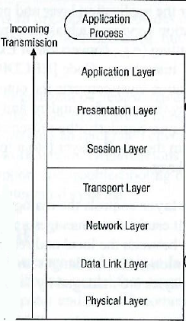
OSI Model and Video
https://www.youtube.com/watch?v=-6Uoku-M6oY
Data/file requests and terminals
Standard formats, encryption, compression
Applications communicating data
Computers communicating
Routing packets formed
Data frames ready for transfer
Signal processing

Slide 42
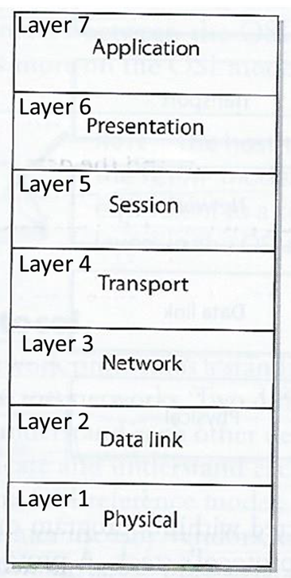
Layer 1: Physical Layer
Network Interface Card (NIC)
  Produces and interprets electromagnetic signals from the network to/from binary bits processed in the computer
  Converts bits into signals or voltages suitable for transmission across the Local Area Network (LAN) and/or Wide Area Network technology it is connected to
  Determines synchronization, data transfer rates, line noise and transmission techniques based on the physical connection to electrical, optical or mechanical equipment
E.g. A ‘1’ bit transmitted via Ethernet would be translated by the NIC to +0.5-volt electric signal, and ‘0’ bit would be transmitted as 0-volts
TIA – Telecommunications Industry Association
EIA – Electronic Industry Alliance
Standard interfaces at this layer include:
RS/EIA/TIA-422, RS/EIA/TIA-423, RS/EIA/TIA-429, RS/EIA/TIA-449, RS/EIA/TIA-485
10Base-T, 10Base2, 10Base5, 100Base-TX, 100Base-FX, 100Base-T, 1000Base-T, 1000-Base-SX

Slide 43
Layer 1 Network Components – Repeaters & Hubs
A repeater provides the simplest type of connectivity
  Work at the physical layer (Layer 1) – looks at the electrical signal (not within the packets)
  Add-on devices for extending a network over a greater distance by repeating electrical signals between cable segments
  Needed to amplify signals because signals are attenuated (reduced) the further they travel
A hub is a multiport repeater
  Often referred to as a “concentrator” physically connecting several computers and devices enabling them to communicate with each other
  When 1 system sends a signal to go to another system, the hub broadcasts the signal to all ports and systems connected to the hub
Does not understand nor work with IP or MAC addresses
Can work as a line conditioner to clean up signals
  Works much better when amplifying digital signals which are discrete units – making removal of background noise much easier
  When amplifying analog signals, accompanying noise can be amplified too – further distorting the signal

Slide 44
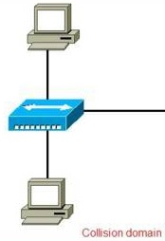

Layer 1 Collision Domain – Hubs
The term collision domain is used to describe a part of a network where packet collisions can occur
  Packet collisions occur when two devices on a shared network segment send packets simultaneously
  The colliding packets must be discarded and sent again, which reduces network efficiency
Collisions occur often in a hub environment because all devices connected to the hub are in the same collision domain
  Total network bandwidth is shared among all devices
  Only one device may transmit at time, and all the other devices connected to the hub must listen to the network in order to avoid collisions
  This contention and resulting collisions causes traffic delays and uses up previous bandwidth

Slide 45
Layer 2 Network Components – Bridge
Local Area Network (LAN) device used to connect LAN segments
  Works at the data link layer (Layer 2) – looks at the MAC address within the header
  Used to segment larger overburdened networks into smaller segments to reduce collision domains and ensure better use of bandwidth and traffic control
  Amplifies the electrical signal (like a repeater)
  Has more intelligence than a repeater for filtering frames and controlling where they go
Filters data frames based on MAC addresses at data link layer (not with IP addresses)
  When data frame arrives the bridge determines if MAC address is on LAN segment, and if so it sends the data to the port which the network segment is connected
  If MAC address is not on LAN segment, bridge forwards frame to correct network segment
“Transparent bridging”
  Enables bridges to dynamically learn and record MAC addresses and ports from computers sending data frames
3 types of bridges:
  Local bridge – connects 2+ LAN segments within a local area (e.g. building)
  Remote bridge – connects 2+ LAN segments over a Metropolitan Area Network (MAN) using telecommunication links (e.g. telephone or other transmission lines)
  Translation bridge – translates protocols as it connects 2+ different types of networks (e.g. Ethernet and fiberoptic)

Slide 46
Layer 2 Network Components – Switch (basic)
Works at the data link layer (Layer 2), forwarding traffic based on MAC addresses
Is a multiport bridging device, and each port provides dedicated bandwidth to each device attached to it
  A port is bridged to another port so the 2 devices have an end-to-end private link
  Employs full-duplex communication, ensures the 2 are not competing for the same bandwidth
    1 wire pair is used for sending, another pair used for receiving
Reduces and removes the sharing of the network medium and problems that come with it
  When the data frame comes to the switch, the switch sends the frame directly to the destination computer or network
    Results in
      A reduction of traffic
      More efficient use of network bandwidth
      Decreased latency
      Increased security – each computer can only see traffic sent to it MAC address (blocks eavesdropping)
Contention between computers using the network and collisions are not issues when switches are used

Slide 47
Layer 3 Network Components - Routers
Works at the network layer (Layer 3), looking farther into the frame at the IP address and other routing information
Used by administrator to divide network along the lines of departments, workgroups, or other business-oriented divisions
Connecting 2 or more networks together
  Can connect similar types of networks (e.g. 2 Ethernet LANS) or different types of networks (e.g. Ethernet LAN to a Token Ring LAN)
Has 2+ interfaces, a routing table, and is able to calculate the shortest route between sending and receiving hosts
  Changes header information in the packet so the packet can go to the next correct router, or if the destination computer is on the connecting network, the changes made enable the packet to go directly to the destination computer
Has a 1st generation fire-wall i.e. Access Control List (ACL) built in
  When packets arrive at one of the interfaces, the router compares the source and destination IP addresses, protocol type, and source and destination ports to the ACL
  Decides which packets are allowed in and which are denied

Slide 48
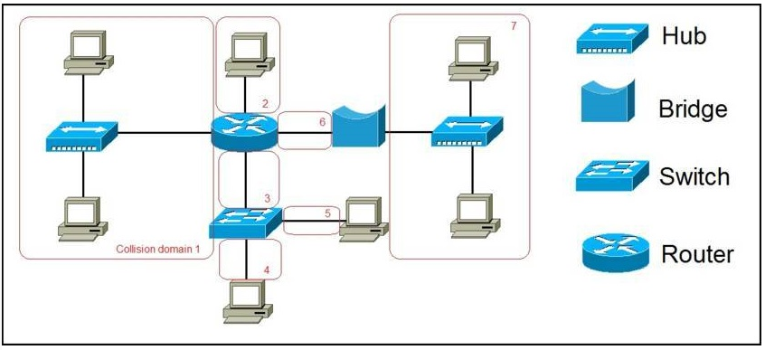
Collision Domains - Bridge, Switch, and Router
In contrast to hubs, every port on a bridge, switch, or a router is in a separate collision domain
This eliminates the possibility of collisions and enables the devices to use the full-duplex mode of communication, which effectively doubles the maximum data capacity
The picture depicts a network of:
7 computers, two hubs, a bridge, a switch, and a router
7 collision domains are created by these devices, marked in red
  All devices connected to a hub are in the same collision domain
  Each port on a bridge, a switch or router is in a separate collision domain

Slide 49
Network Components – Layer 3 Switches
Switches have evolved…
They now can work at the Network Layer…
Layer 3 switch is a “router of steroids”
  Has the intelligence of a router (MAC and IP addressing) but is much more efficient
    While a router’s functionality is implemented in software running on a microprocessor, a layer 3 switch’s routing functionality is implemented directly in hardware
    Layer 3 (& 4) switches use Multiprotocol Label Switching (MPLS) for
      Faster more direct routing between sender and receiver
      Addressing additional service and security requirements of different types of packets
        Time-sensitive traffic has higher priority than less sensitive traffic
        More granular access control

Slide 50
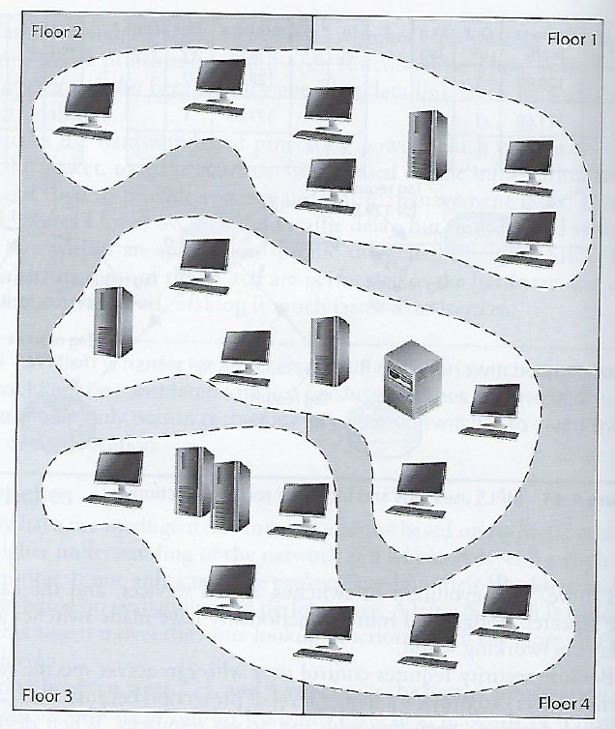
Layer 3+ VLANS
Modern layer 3+ switches enable administrators to create Virtual LANs (VLANs) to separate and group computers logically based on:
  Business needs, resource requirements, and security policies
  Rather than physical location of the systems (as is done with repeaters, bridges, and routers)
Harris and Maymi (2019) All In One CISSP Exam Guide, p. 604

Slide 51
Layer 3+ VLANS
VLANs enable the administrator the flexibility to apply different security policies to respective logical groups
  If tighter security is required for the payroll department, the administrator can develop policy, add all payroll systems to a specific VLAN, and apply the security policy only to the payroll VLAN
VLANS must be properly configured and managed for security
  VLAN hopping and switch spoofing attacks allow attackers to access traffic in various VLAN segments

Slide 52
Network Components – Layer 4 through 7 Switches
Layer 4 switch works at the transport layer, supporting TCP and UDP
  More resource intensive
  Able to perform policy-based switching to off-load a sever by balancing traffic across a cluster of servers based on individual session information and status
Layer 4 – 7 switches are also known as
  Content switches
  Web-switches
  Application-switches
Used for load-balancing among groups of servers based on: HTTP, HTTPS, VPN, or for any application TCP/IP traffic using a specific port
Can also be used for TLS encryption/decryption and to centralize the management of digital certificates

Slide 53
Summary – Some differences of Network Devices
Device | OSI Layer | Functionality
Repeater | 1 - Physical | Amplifies the signal and extends networks
Bridge | 2 - Data link | Forwards packets and filters based on MAC addresses; Forwards broadcast traffic, but not collision traffic
Router | 3 - Network | Separates and connects LANS creating internetworks; routers filter based on IP addresses
Switch | 2 through 7 – Data link, Network, Transport, Session, Presentation, Application | Provides private virtual link between communicating devices; allows for VLANS; reduces collisions; impedes network sniffing
Gateway | Application | Connects different types of networks; performs protocol and format translations

Slide 55
Agenda
Digital Certificates
Public Key Infrastructure
Types of Networks
OSI Model
Layer 1 Network Devices
Layer 2 Network Devices
Layer 3 Network Devices
Layer 3 – 7 Network Devices

