Slide 1
Unit #3
MIS5214
Planning and Policy

Slide 2
Agenda
NIST Risk Management Framework and FIPS 199
Use of NIST SP 800-60 Volume 1 and Volume 2
Exercise – Finalize impact levels
Exercise – Determine and finalize impact levels
Exercise – Determine Information and Information System Types and provisional security categorization
Security Control Baselines – review
FIPS 200 and NIST 800-53 Security Control Baselines
Security Control Families
Risk Assessment Controls
Team Exercise Find and assess risk assessment policy
Next Time: Case Study 1

Slide 3
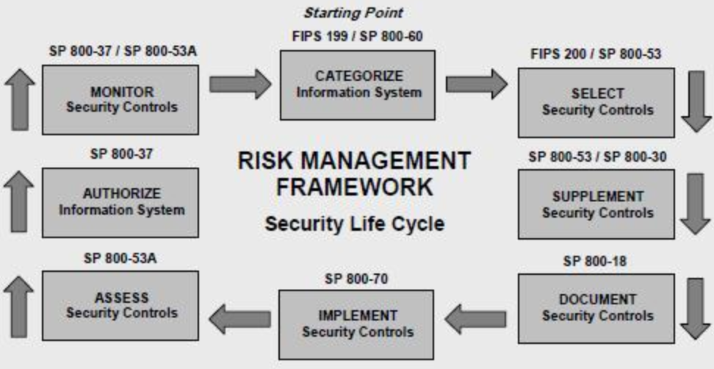
NIST Risk Management Framework
Notes:
Security categorization standards for information and information systems provide a common framework and understanding for expressing security that promotes: (i) effective management and oversight of information systems and (ii) consistent reporting to the Office of Management and Budget (OMB) and Congress. The NIST security categorization standards and guidance are defined in FIPS 199, Standards for Security Categorization of Federal Information and Information Systems, and NIST SP 800-60, Guide for Mapping Types of Information and Information Systems to Security Categories.

Slide 4
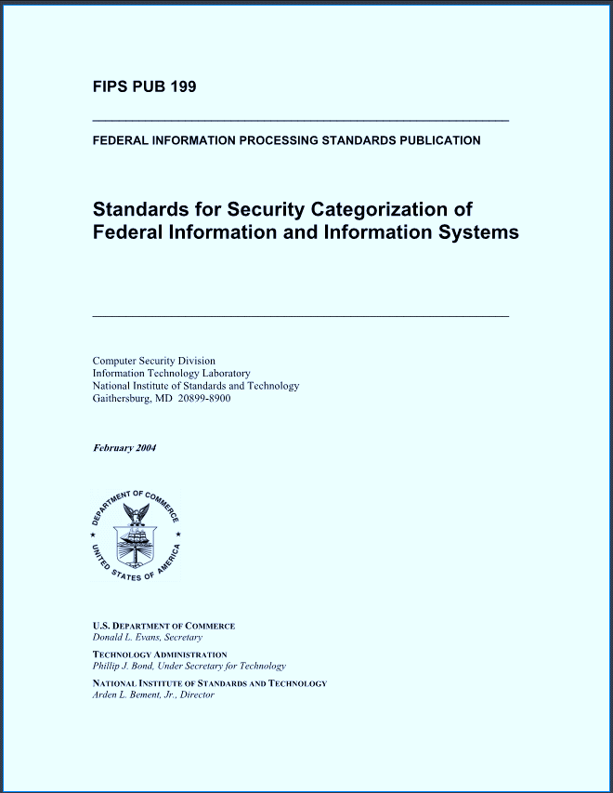
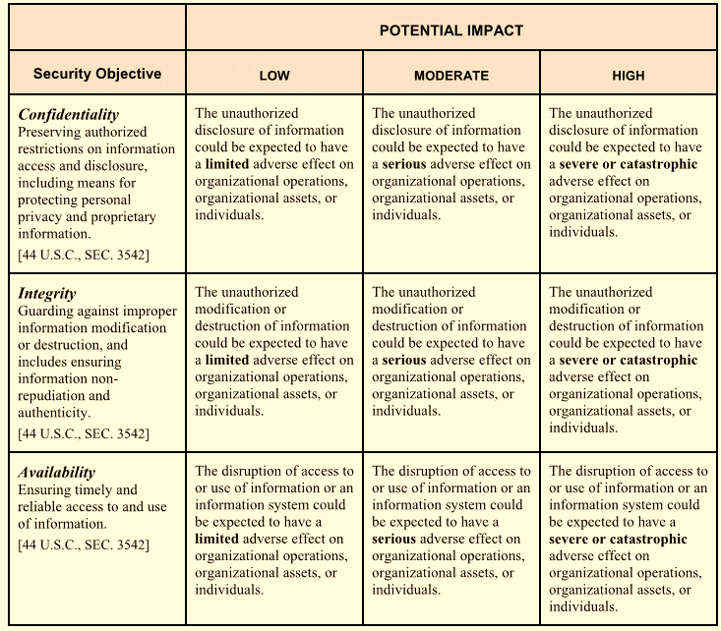
FIPS 199 – Risk Assessment based on security objectives and impact ratings for information and information system
Notes:
The purpose of this document is to provide a standard for categorizing federal information and information systems according to an agency's level of concern for confidentiality, integrity, and availability and the potential impact on agency assets and operations should their information and information systems be compromised through unauthorized access, use, disclosure, disruption, modification, or destruction.

Slide 5
NIST Risk Management Framework
Notes:
Security categorization provides a structured way to determine the criticality and sensitivity of the information being processed, stored, and transmitted by an information system. The security category is based on the potential impact (worst case) to an organization should certain events occur that jeopardize the information and information systems needed by the organization to accomplish its assigned mission, protect its assets and individuals, fulfill its legal responsibilities, and maintain its day-to-day functions.1 The information owner/information system owner identifies the types of information associated with the information system and assigns a security impact value (low, moderate, high) for the security objectives of confidentiality, integrity, or availability to each information type. The high water mark concept is used to determine the security impact level of the information system for the express purpose of prioritizing information security efforts among information systems and selecting an initial set of security controls from one of the three security control baselines in NIST SP 800-53

Slide 6
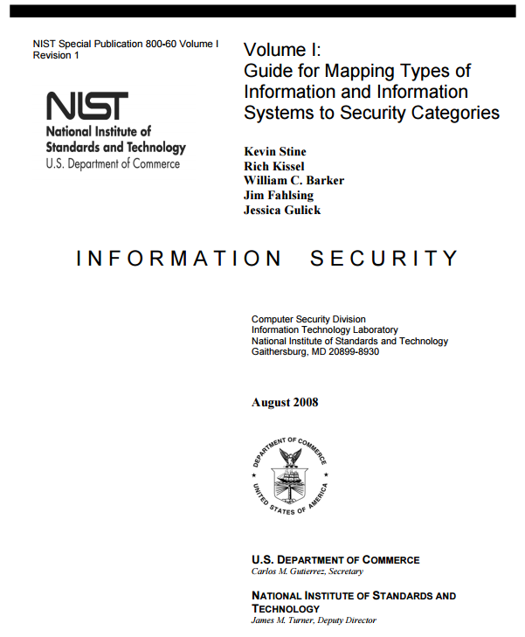
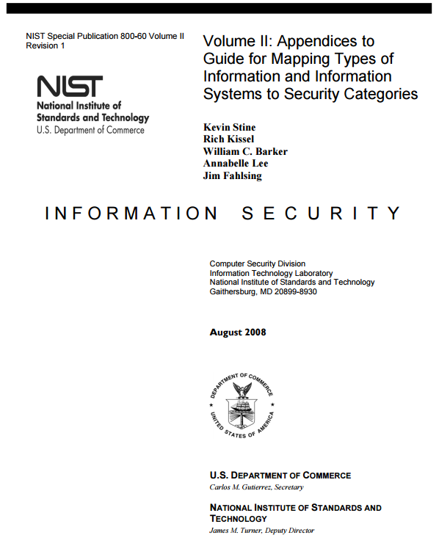
NIST SP 800-60 volumes 1 and 2
Notes:
NIST SP 800-60 addresses the FISMA direction to develop guidelines recommending the types of information and information systems to be included in each category of potential security impact. This guideline is intended to help agencies consistently map security impact levels to types of: (i) information (e.g., privacy, medical, proprietary, financial, contractor sensitive, trade secret, investigation); and (ii) information systems (e.g., mission critical, mission support, administrative). This guideline applies to all Federal information systems other than national security systems. National security systems store, process, or communicate national security information.2
NIST, Volume I: Guide for Mapping Types of Information and Information Systems to Security Categories (NIST Special Publication 800-60) (Aug. 2008) (full-text).
NIST, Volume 2: Appendices to Guide for Mapping Types of Information and Information Systems to Security Categories (NIST Special Publication 800-60) (Aug. 2008) (full-text).

Slide 7
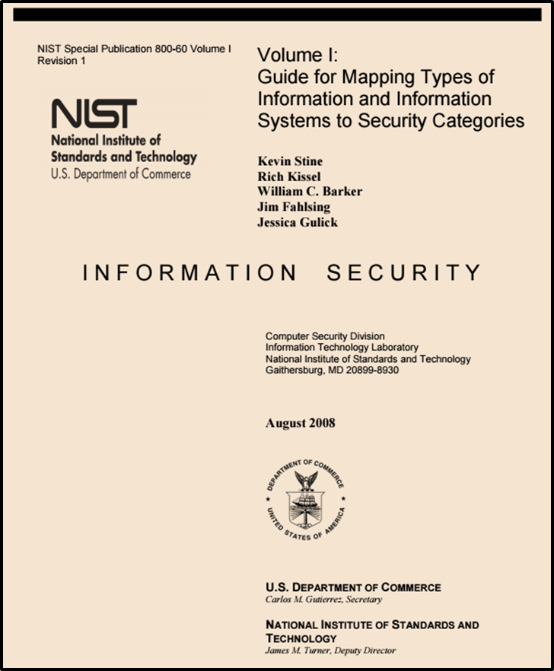
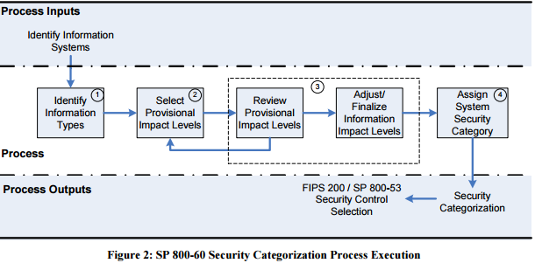
http://nvlpubs.nist.gov/nistpubs/Legacy/SP/nistspecialpublication800-60v1r1.pdf
Notes:
In accordance with FIPS 199, agencies shall identify all of the applicable information types that
are representative of input, stored, processed, and/or output data from each system. The initial
activity in mapping types of Federal information and information systems to security objectives
and impact levels is the development of an information taxonomy, or creation of a catalog of
information types.
The four business areas separate government operations into high-level categories relating:
• The purpose of government (services for citizens);
• The mechanisms the government uses to achieve its purpose (mode of delivery);
• The support functions necessary to conduct government operations (support delivery of services); and
• The resource management functions that support all areas of the government’s business (management of government resources).

Slide 8
2 Broad types of Information and Information Systems
Mission-based Information & Information Systems
Management and Support Information & Information Systems
Notes:
Mission-based information types are, by definition, specific to individual departments and agencies or to specific sets of departments and agencies. The BRM services for citizens business area provides the primary frame of reference for determining the security objectives impact levels for mission-based information and information systems. The consequences or impact of unauthorized disclosure of information, modification or destruction of information, and disruption of access to or use of information are defined by the nature and beneficiary of the service being provided or supported. The BRM establishes 26 direct services and delivery support lines of business with 98 associated information types

Slide 9
Mission-based Information and Information Systems
Defense and National Security
Homeland Security
Intelligence Operations
Disaster Management
International Affairs and Commerce
Natural Resources
Energy
Environmental Management
Economic Development
Community and Social Services
Transportation
Education
Workforce Management
Health
Income Security
Law Enforcement
Litigation and Judicial Activities
Federal Correctional Activities
General Sciences and Innovation
Knowledge Creation and Management
Regulatory Compliance and Enforcement
Public Goods Creation and Management
Federal Financial Assistance
Credit and Insurance
Transfers to State/Local Governments
Direct Services for Citizens
Notes:
The approach to establishing mission-based information types at an agency level begins by documenting the agency’s business and mission areas. The owner, or designee, of each information system is responsible for identifying the information types stored in, processed by, or generated by that information system. In the case of mission-based information, the responsible individuals, in coordination with management, operational, and security stakeholders, should compile a comprehensive set of lines of business and mission areas conducted by the agency. In addition, the responsible individuals should identify the applicable sub-functions necessary to conduct agency business and in turn accomplish the agency’s mission. For example, one mission conducted by an agency might be law enforcement. Subfunctions that are part of the agency’s law enforcement mission might include criminal investigation and surveillance, criminal apprehension, criminal incarceration, citizen protection, crime prevention, and property protection. Each of these sub-functions would represent an information type.

Slide 10
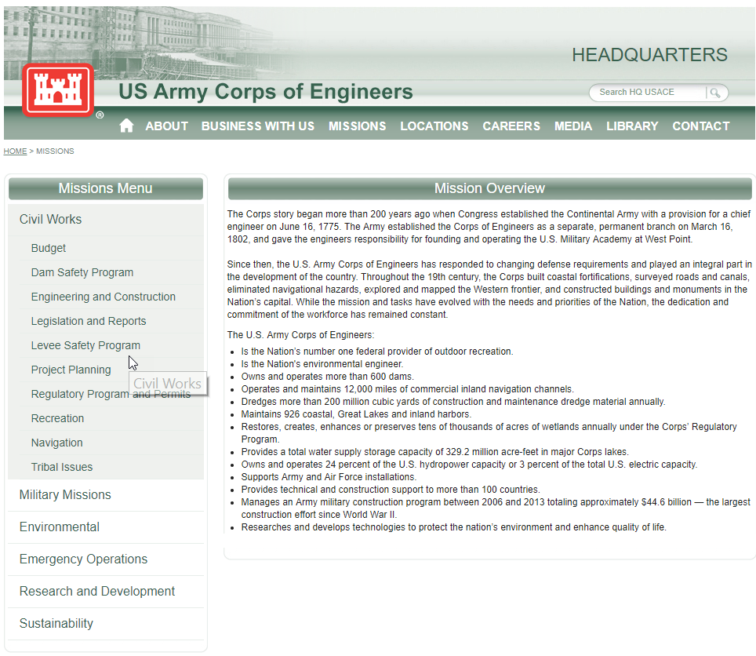
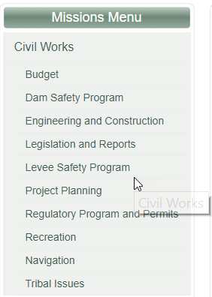
Disaster Management Information Systems
Notes:
Here is an example of the a Disaster Management Information System. Specifically the Levee Safety Program.
Just so we are on the same page this is what the Levee program is..
Levee systems are part of our nation’s landscape and important to communities because of the benefits they provide. For example, more than ten million people live or work behind levees in the U.S. Army Corps of Engineers Levee Safety Program. And, public and private property worth more than one trillion dollars are behind these levees. These 14,100 miles of levee reduce flood risk to people, businesses, critical infrastructure and the environment, but it’s important to recognize they don’t eliminate flooding. Additionally, levee conditions, storm/flood intensity and frequency, and populations around these levees change. So, the USACE Levee Safety Program works with local levee sponsors and stakeholders to make sure these levees provide their intended benefits. Working together to assess, manage and communicate flood risks to residents and businesses is our priority because, more than anything, life safety is paramount.

Slide 11
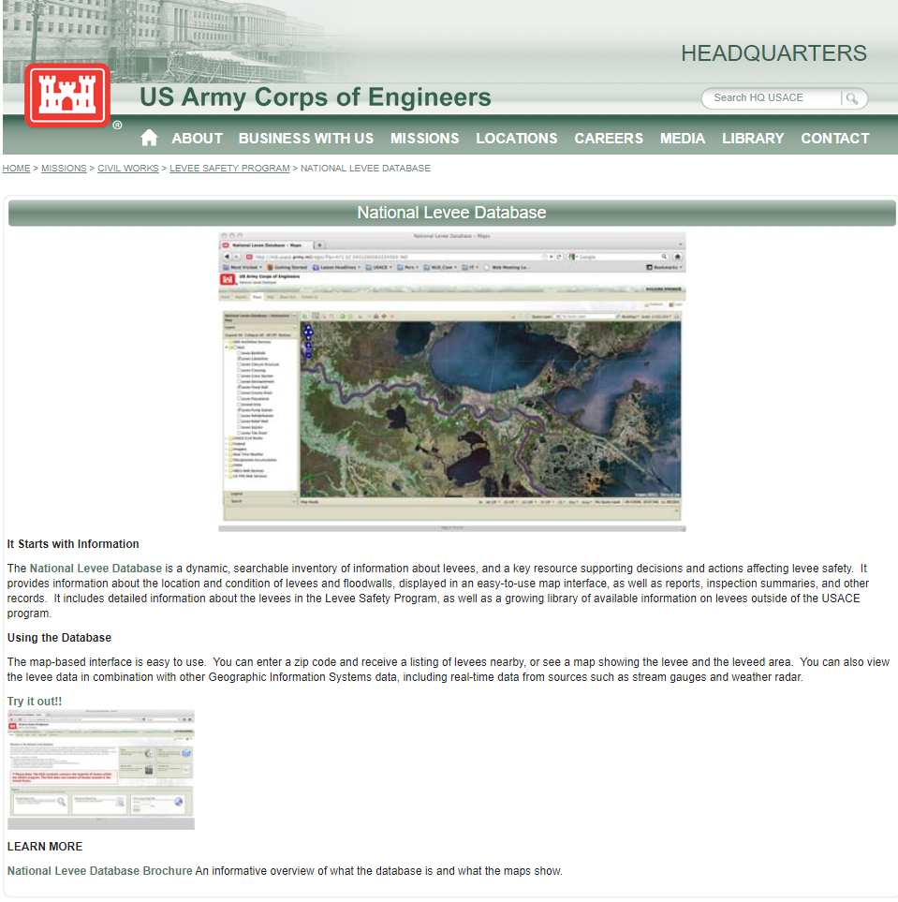
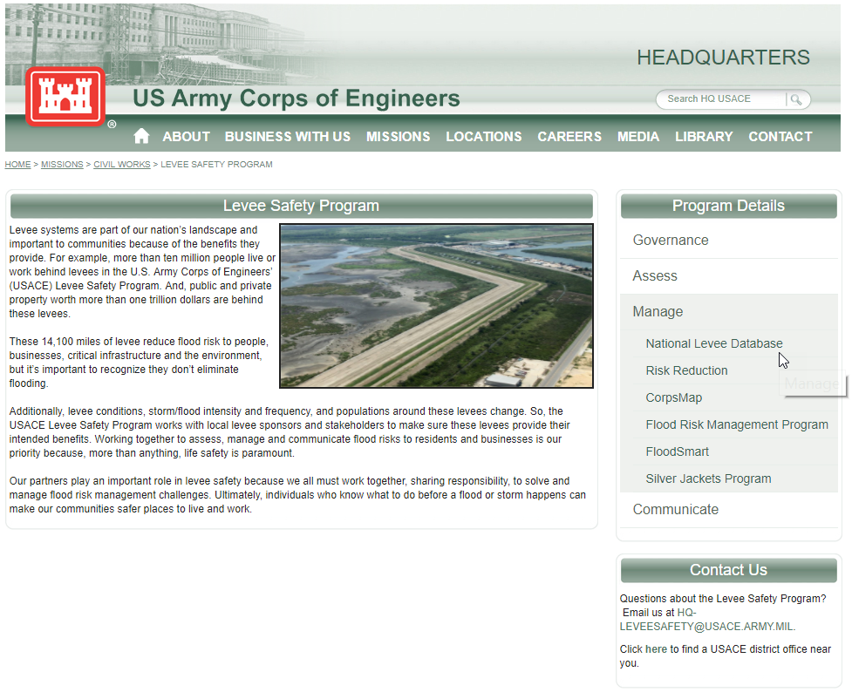
Notes:
The National Levee Database (NLD), developed by the U.S. Army Corps of Engineers (USACE), is the focal point for comprehensive information about our nation's levees. The database contains information to facilitate and link activities, such as flood risk communication, levee system evaluation for the National Flood Insurance Program, levee system inspections, flood plain management, and risk assessments. The NLD continues to be a dynamic database with ongoing efforts to add levee data from federal agencies, states, and tribes across the United States.

Slide 12
2 Broad Types of Information and Information Systems
Mission-based Information & Information Systems
Management and Support Information & Information Systems
Services Delivery Support Functions
Government Resource Management Functions
Notes:
Much Federal government information and many supporting information systems are not
employed directly to provide direct mission-based services, but are primarily intended to support
delivery of services or to manage resources. The support delivery of services and management of
resources business areas are together composed of 13 lines of business. The 16
BRM subdivides the lines of business into 72 sub-functions. The support delivery of services and
management of resource business areas are common to most Federal government agencies, and
the information associated with each of their sub-functions is identified in this guideline as a
management and support information type.

Slide 13
Services Delivery Support Functions and Information Types
Controls and Oversight
Regulatory Development
Planning and Budgeting
Internal Risk Management and Mitigation
Revenue Collection
Public Affairs
Legislative Relations
General Government
Notes:
Most information systems employed in both service delivery support and resource management activities engage in one or more of the eight support delivery of services lines of business. Each of the information types associated with support delivery of services sub-functions is provided in Table 5. Volume II, Appendix C.2 on the next slide, “Services Delivery Support Functions,” recommends provisional impact levels for confidentiality, integrity, and availability security objectives. These service support functions are the day-to-day activities necessary to provide the critical policy, programmatic, and managerial foundation that support Federal government operations. The direct service missions and constituencies ultimately being supported by service support functions comprise a significant factor in determining the security impacts associated with compromise of information associated with the support delivery of services business area.

Slide 14
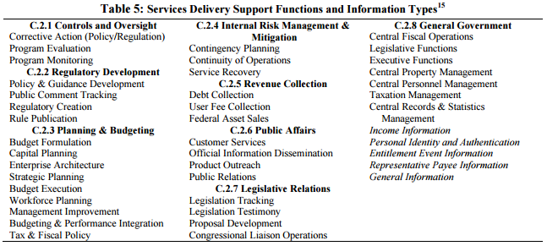
Management and Support Information and Information Systems

Slide 15
Government Resource Management Functions & Information Types
Administrative Management
Financial Management
Human Resources Management
Supply Chain Management
Information and Technology Management
Notes:
The government resource management information business area includes the back office support activities enabling the Federal government to operate effectively. The five government resource management information lines of business and the sub-functions associated with each
information type are identified in Table 6. Volume II, Appendix C.3 on the next slide, “Government Resource Management Information,” recommends provisional impact levels for confidentiality, integrity, and availability security objectives. Many departments and agencies operate their own support systems. Others obtain at least some support services from other organizations. Some agencies’ missions are primarily to support other government departments and agencies in the conduct of direct service missions. As indicated above, security objectives and associated security impact levels for administrative and management information and systems are determined by the nature of the supported direct services and constituencies being supported

Slide 16
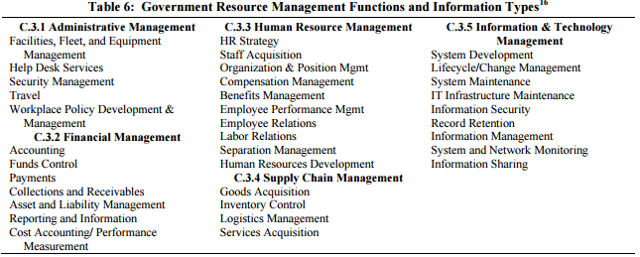
Management and Support Information and Information Systems

Slide 17
1. Identify Information Types
http://nvlpubs.nist.gov/nistpubs/Legacy/SP/nistspecialpublication800-60v1r1.pdf

Slide 18
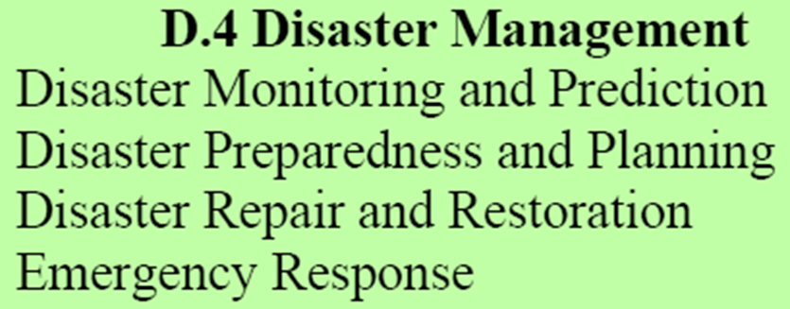
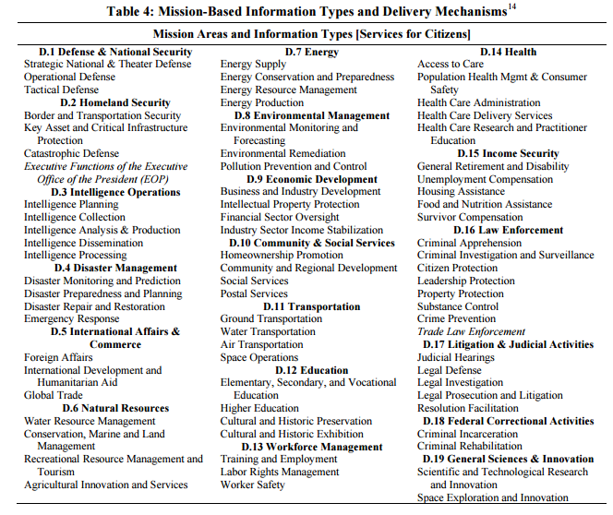
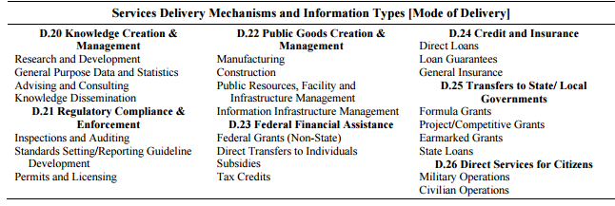
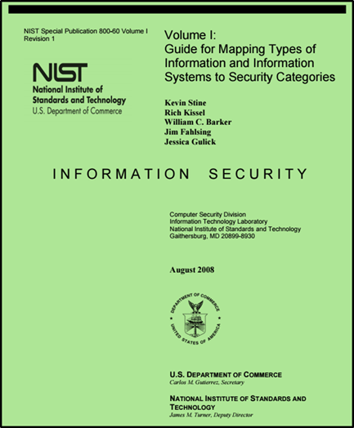
Disaster Management Information Types

Slide 19
Select Provisional Impact Levels for the identified information system
Notes:
In Step 2, organizations should establish provisional impact levels based on the identified information types in Step 1. The provisional impact levels are the original impact levels assigned to the confidentiality, integrity, and availability security objectives of an information type from Volume II before any adjustments are made. Also in this step, the initial security categorization for the information type is established and documented. Volume II, Appendix C suggests provisional confidentiality, integrity, and availability impact levels for management and support information types, and Volume II, Appendix D provides examples of provisional impact level assignments for mission-based information types. Using the impact assessment criteria identified in Section 3.2 for the security objectives and types of potential losses identified in Section 3.1.2, the organizational entity responsible for impact determination must assign impact levels and consequent security categorization for the missionbased and management and support information types identified for each information system.

Slide 20
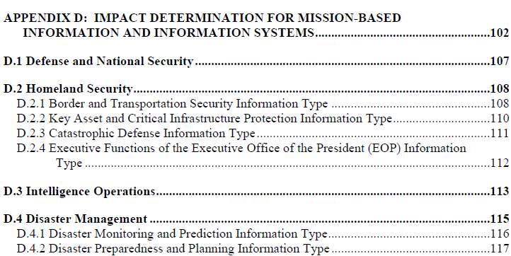
Disaster Management Information Types
Notes:
The approach to establishing mission-based information types at an agency level begins by documenting the agency’s business and mission areas. The owner, or designee, of each information system is responsible for identifying the information types stored in, processed by, or generated by that information system. In the case of mission-based information, the responsible individuals, in coordination with management, operational, and security stakeholders, should compile a comprehensive set of lines of business and mission areas conducted by the agency. In addition, the responsible individuals should identify the applicable sub-functions necessary to conduct agency business and in turn accomplish the agency’s mission. For example, one mission conducted by an agency might be law enforcement. Subfunctions that are part of the agency’s law enforcement mission might include criminal investigation and surveillance, criminal apprehension, criminal incarceration, citizen protection, crime prevention, and property protection. Each of these sub-functions would represent an information type.

Slide 21
Disaster Management Information Impact

Slide 22
Exercise
Using NIST SP 800-60 V.2 R1 determine the Impact Levels for the Disaster Information Types
?
?
?
?
?
?
?
?
?
?
?
?
?
?
?
?
Information System Impact Rating:
?
?
?
?
Notes:
Based on everything we learned last week and covered today go into NIST SP 800-60 and determine the Impact levels. I will randomly select students to fill in certain areas…

Slide 23
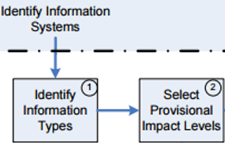
Disaster Management Information Types
Notes:
Here are the security categories by information type there are 4.

Slide 24
Disaster Management Information Types

Slide 25
Exercise
Determine the Summary Impact Levels for the Disaster Information Types
?
?
?
?

Slide 26
Exercise – Answer…
Summary Impact Levels for the Disaster Information Types

Slide 27
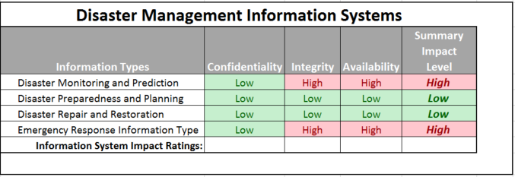
Exercise -
Determine the Overall Impact Levels for the Disaster Information Types
?
?
?

Slide 28
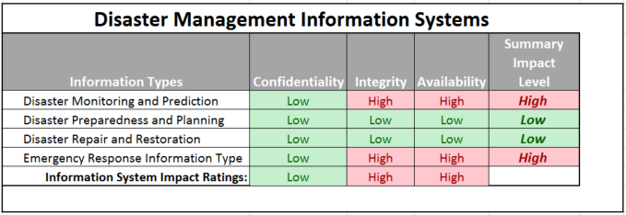
Exercise - Answer
Overall Impact Levels for the Disaster Information Types

Slide 29
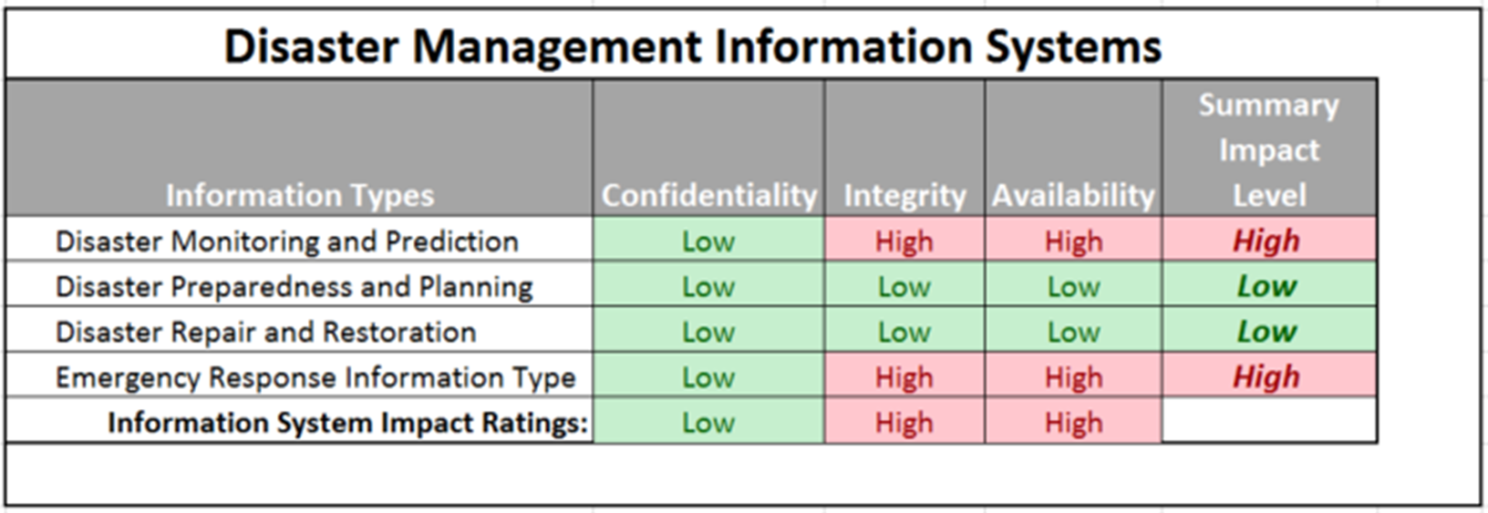
Exercise
Determine the Overall Impact Level of Disaster Information Systems
?

Slide 30
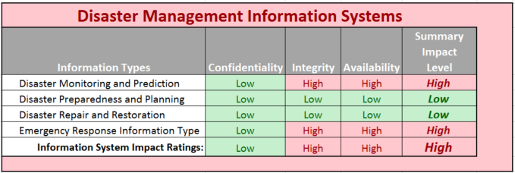
Exercise - Answer
Overall Impact Level of Disaster Information Systems

Slide 31
Adjust Information Impact Level
Notes:
In Step 3, organizations should review and adjust the provisional security impact levels for
the security objectives of each information type and arrive at a finalized state. To accomplish
this, organizations should: (i) review the appropriateness of the provisional impact levels
based on the organization, environment, mission, use, and data sharing; (ii) adjust the
security objective impact levels as necessary using the special factors18 guidance found in
Volume II, Appendices C and D; and (iii) document all adjustments to the impact levels and
provide the rationale or justification for the adjustments.
When security categorization impact levels recommended in Section 4.2 or Volume II,
Appendices C and D are adopted as provisional security impact levels, the agency should
review the appropriateness of the provisional impact levels in the context of the organization,
environment, mission, use, and data sharing associated with the information system under
review. This review should include the agency’s mission importance; lifecycle and
timeliness implications; configuration and security policy related information; special
handling requirements; etc. The FIPS 199 factors presented in Section 4.2.2 of this
document should be used as the basis for decisions regarding adjustment or finalization of the
provisional impact levels. The confidentiality, integrity, and availability impact levels may
be adjusted one or more times in the course of the review. Once the review and adjustment
process is complete, the mapping of impact levels by information type can be finalized.
The impact of information compromise of a particular type can vary in different agencies or
in dissimilar operational contexts. Also, the impact for an information type may vary
throughout the life cycle. For example, contract information that has a moderate
confidentiality impact level during the life of the contract may have a low impact level when
the contract is completed. Policy information may have moderate confidentiality and
integrity impact levels during the policy development process, low confidentiality and
moderate integrity impact levels when the policy is implemented, and low confidentiality and
integrity impact levels when the policy is no longer used.

Slide 32
Exercise
Using NIST SP 800 60 V2R1
Look at the “Special Factors” affecting CIA impact levels for each Disaster Management information type and adjust the table accordingly adding a column “Adjusted Summary Impact Level”
20 minutes, then class discussion

Slide 33
Select Provisional Impact Levels for the identified information system
Notes:
Once the security impact levels have been selected, reviewed and adjusted as necessary for the
security objectives of each individual information type processed by an information system, it is
necessary to assign a system security category based on the aggregate of information types. The
Step 4 activities include the following: (i) review identified security categorizations for the
aggregate of information types; (ii) determine the system security categorization by identifying
the high water mark for each of the security objectives (confidentiality, integrity, availability)
based on the aggregate of the information types; (iii) adjust the high water mark for each system
security objective, as necessary, by applying the factors discussed in section 4.4.2; (iv) assign the
overall information system impact level based on the highest impact level for the system security
objectives; and (v) document all security categorization determinations and decisions.

Slide 34
Exercise
Find a preliminary categorization for the following information system and adjust the categorization based on your analysis – present justifications for both preliminary and adjusted categorizations
Purpose: The system has two overarching purposes:
For clients it is a system intended to help understand sewage and storm water collection and treatment systems (i.e. pipe networks, pump stations, and treatment plants) and their capacities, overflow characteristics and controls
For the firm the system is intended to provide revenue through pay by clients for:
Direct use of the service(s) of the system
Help in benefiting from the service(s) of the system
Having the firm apply the service(s) of the system to derive beneficial information for the clients
Users:
Municipal and regional water and sewer utilities and governmental organizations will use the system to help plan capital improvement, operations, and maintenance of sewer systems (i.e. treatment plants and collection networks)
External consultants helping municipal and regional water and sewer utilities and organizations will use the system to help their clients plan capital improvement, operations, and maintenance of sewer systems
Internal consultants within the firm helping municipal and regional water and sewer utilities and organizations will use the system to help their client plan capital improvement, operations, and maintenance of sewer systems
The firm’s technical information system development staff will work directly on the information system to provide, maintain, enhance and extend the services of the information system to (1), (2) and (3) above
The system will be developed in a phased approach
The first phase (“V1”) will provide capabilities for sewer system pipe network information CRUD (create, read, update and delete) and read = display and query
Subsequent phases (“V2”, “V3”…) focus on providing modeling and analysis services including: capacity planning, overflow prediction and management, defect prediction, and maintenance management

Slide 35
Agenda
NIST Risk Management Framework and FIPS 199
Use of NIST SP 800-60 Volume 1 and Volume 2
Exercise – Finalize impact levels
Exercise – Determine and finalize impact levels
Exercise – Determine Information and Information System Types and provisional security categorization
Security Control Baselines – review
FIPS 200 and NIST 800-53 Security Control Baselines
Security Control Families
Risk Assessment Controls
Team Exercise Find and assess risk assessment policy
Next Time: Case Study 1

Slide 36
NIST Risk Management Framework

Slide 37
FIPS 200 Minimum Security Control Requirements
Access Control (AC)
Awareness and Training (AT)
Audit and Accountability (AU)
Certification, Accreditation, and Security Assessment (CA)
Configuration Management (CM)
Contingency Planning
Identification and Authentication
Incident Response (IR)
Maintenance (MA)
Media Protection (MP)
Physical and Environmental Protection *PE)
Planning (PL)
Personal Security (PS)
Risk Assessment (RA)
System and Services Acquisition(SA)
System and Communications Protection (SC)
System and Information Integrity (SI)

Slide 38
NIST Risk Management Framework
Notes:
Talked about this last week but to refresh…. SP 800-53 Provides a catalog of security and privacy controls for all U.S. federal information systems except those related to national security. It is published by the National Institute of Standards and Technology, which is a non-regulatory agency of the United States Department of Commerce. NIST develops and issues standards, guidelines, and other publications to assist federal agencies in implementing the Federal Information Security Modernization Act of 2014 (FISMA) and to help with managing cost effective programs to protect their information and information systems.[1]

Slide 39
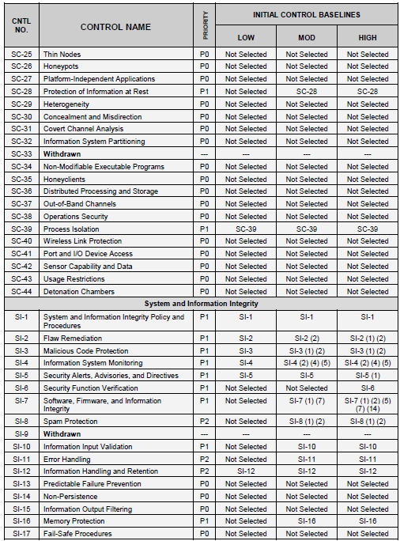
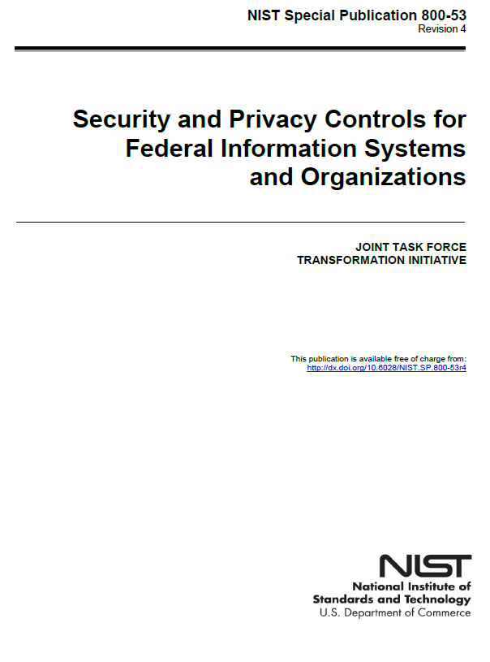
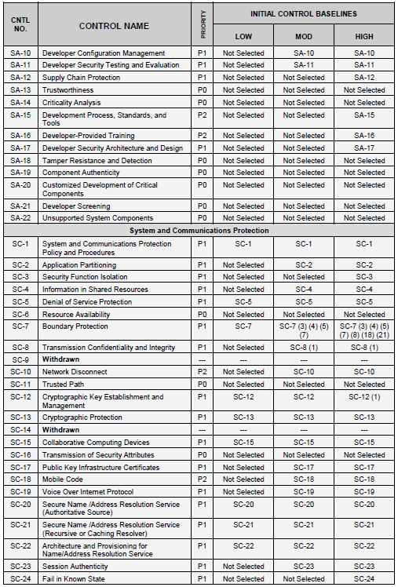
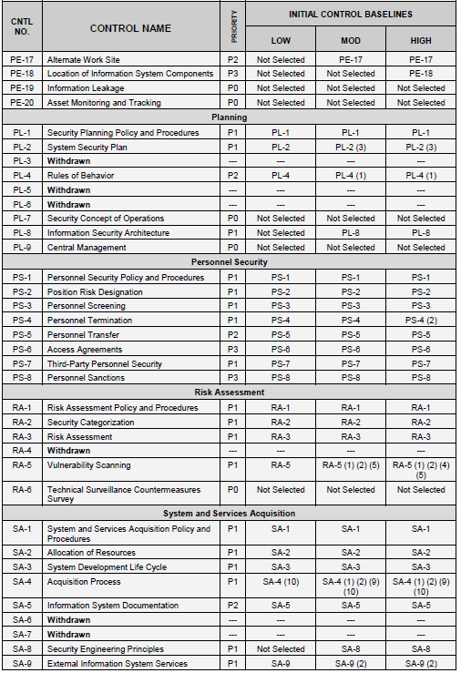
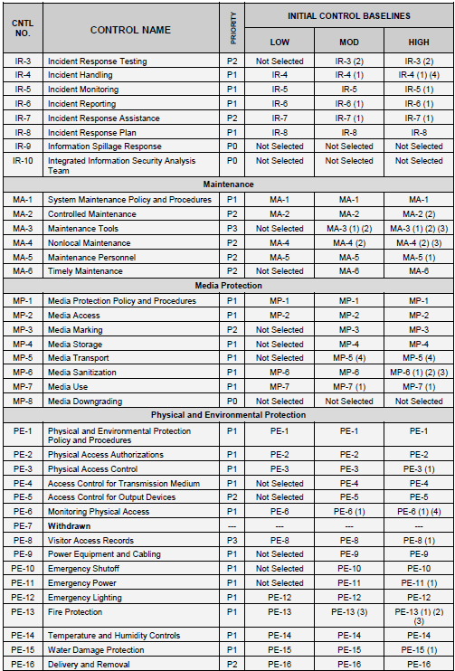
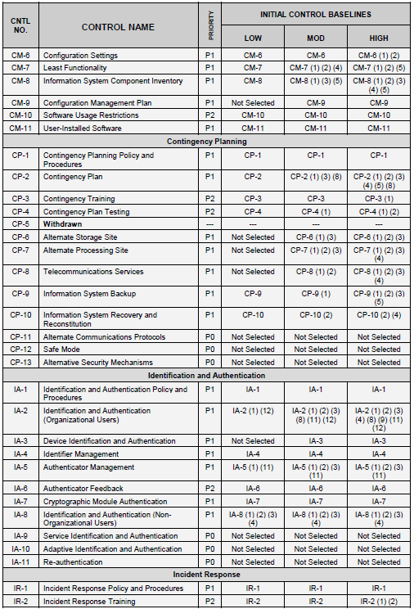
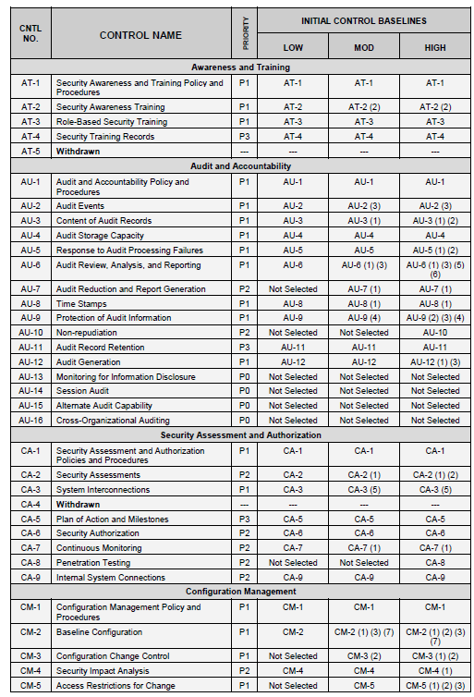
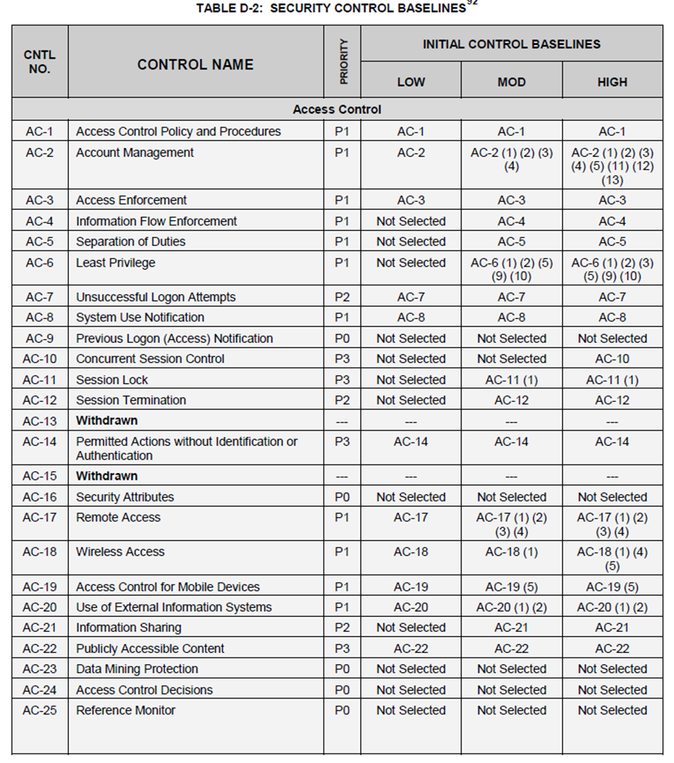
Notes:
We have hundreds of controls…. How do you select the right controls….
Three main tasks…
The security categorization gives you a baseline of what controls you need..
Tailor the controls…
Common Controls We need to know what common controls are inheritable from the organization. For example bring a server into a data center it inherits all those existing Physlical controls…
Specific controls where you have to turn on controls for example Audit Logs you have to go in and turn that on.
Hybrid Control you have say production ops who monitors your systems, but if you don’t turn on the logs you can’t take advantage of the inherited controls of the monitoring team.

Slide 42
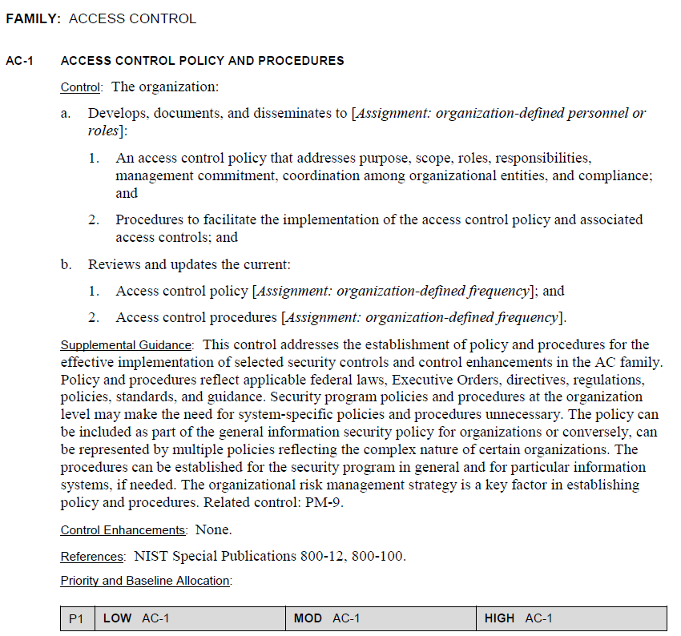
AC-1

Slide 43
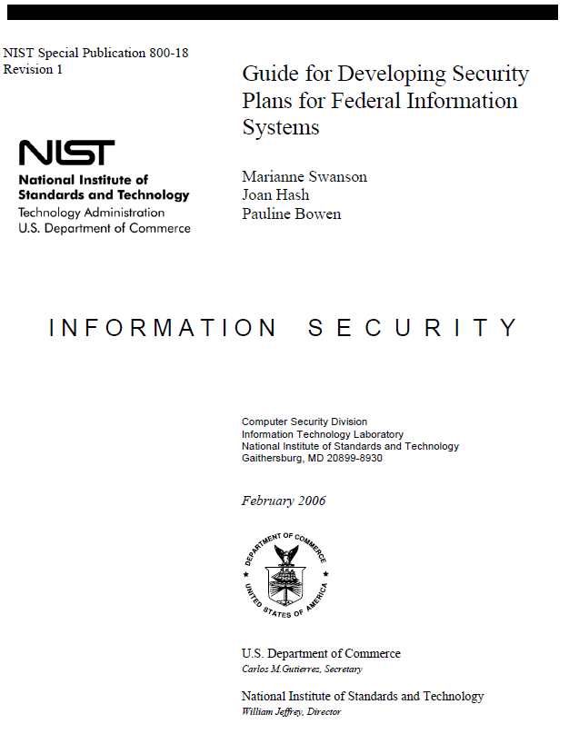
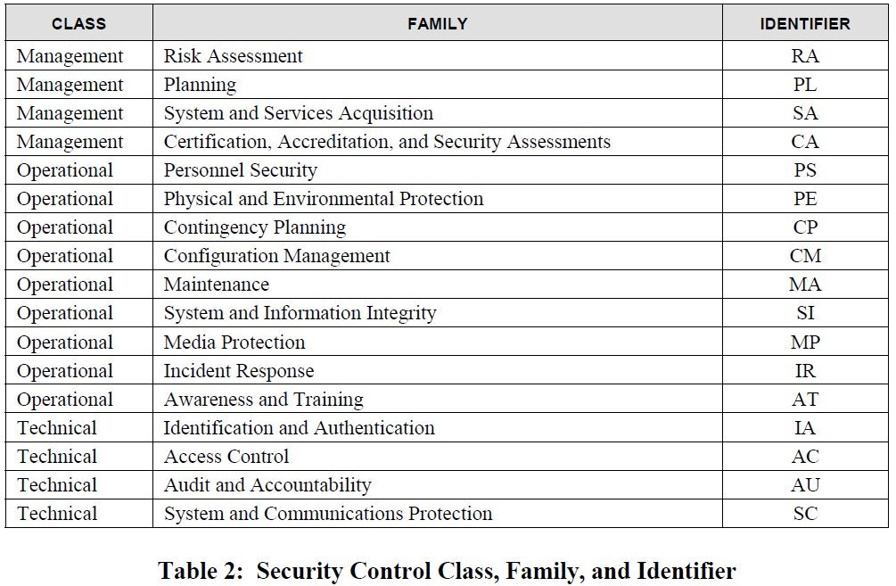
Notes:
The objective of system security planning is to improve protection of information
technology (IT) resources. All federal systems have some level of sensitivity and require
protection as part of good management practice. The protection of a system must be
documented in a system security plan. The completion of system security plans is a
requirement of the Office of Management and Budget (OMB)
The purpose of the security plan is to provide an overview of the security requirements of
the system and describe the controls in place or planned for meeting those requirements.
The system security plan also delineates responsibilities and expected behavior of all
individuals who access the system. The security plan should be viewed as documentation
of the structured process of planning adequate, cost-effective security protection for a
system. It should reflect input from various managers with responsibilities concerning
the system, including information owners, the system operator, and the system security
manager. Additional information may be included in the basic plan and the structure and
format organized according to agency needs, so long as the major sections described in
this document are adequately covered and readily identifiable.
The management control measures (in place or planned) that are intended to meet the protection requirements of the major application or general support system. Management controls focus on the management of the computer security system and the management of risk for a system. The types of control measures shall be consistent with the need for protection of the major application or general support system.

Slide 44
Risk Assessment (RA) Controls
Notes:
an assessment of risk is required as part of a risk-based approach to
determining adequate, cost-effective security for a system. The methods used to assess
the nature and level of risk to the system should include a consideration of the major
factors in risk management: the value of the system or application, threats,
vulnerabilities, and the effectiveness of current or proposed safeguards. The methods
used should be described in at least one paragraph. For example, did the selected risk
assessment methodology identify threats, vulnerabilities, and the additional security
measures required to mitigate or eliminate the potential that those threats/vulnerabilities
could have on the system or its assets? Include the date that the system risk assessment
was conducted. State how the identified risks relate to the requirements for
confidentiality, integrity, and availability determined for the system.

Slide 45
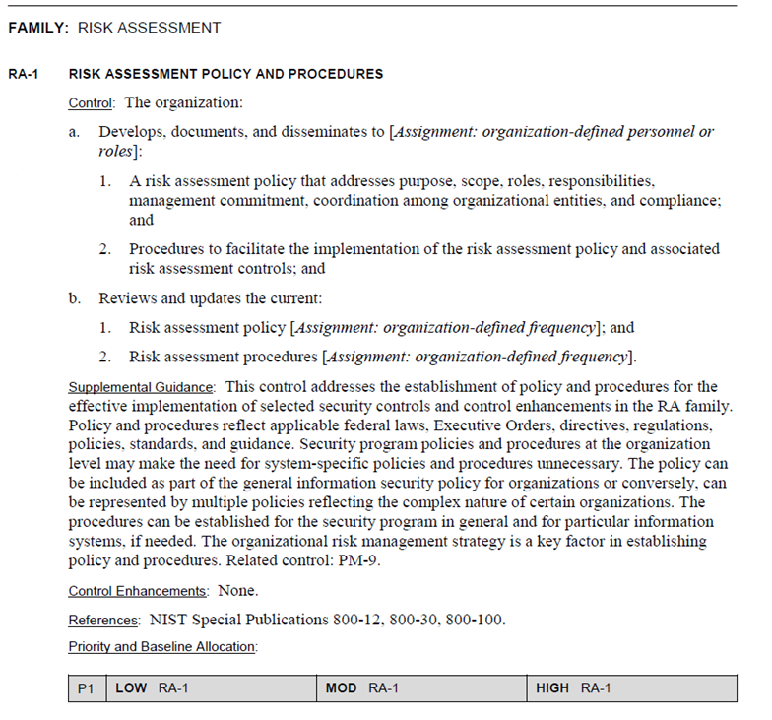
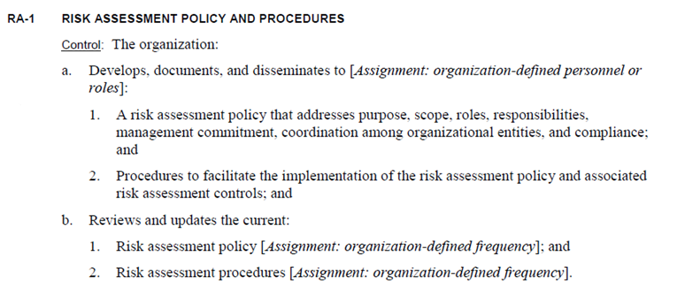
RA-1

Slide 46
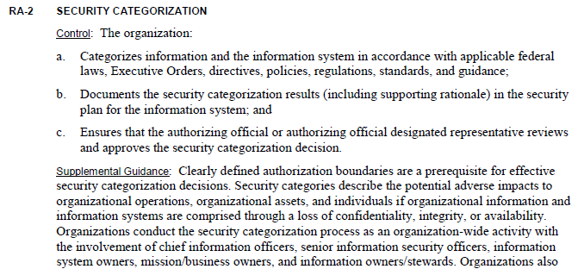
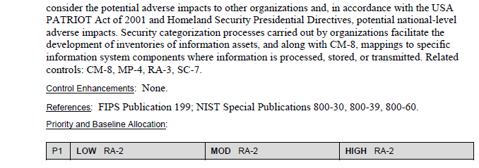
RA -2

Slide 47
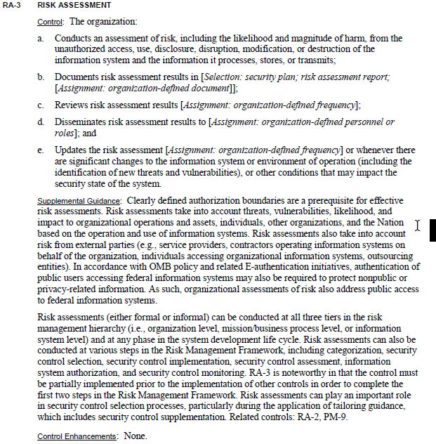
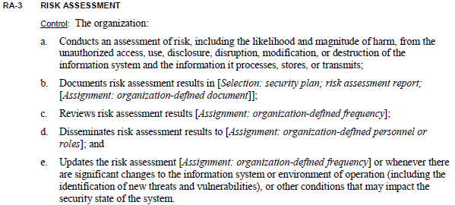
RA -3

Slide 48
Exercise
Using Google or your favorite search engine…
Find an organization’s IT risk assessment policy and procedures
Assess how well the policy meets requirements of RA-1
Assess how well the procedures meet RA2 and RA3
Return to class discussion in 20 minutes
Present your findings

Slide 49
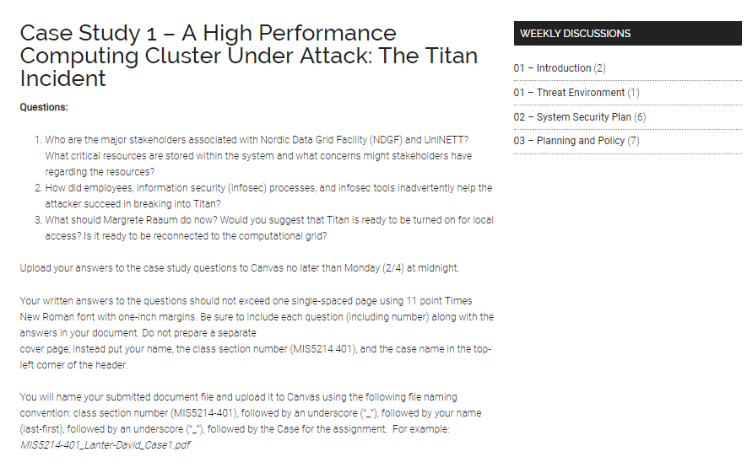
Case Study Assignment – Tomorrow
Questions:
Who are the major stakeholders associated with Nordic Data Grid Facility (NDGF) and UniNETT? What critical resources are stored within the system and what concerns might stakeholders have regarding the resources?
How did employees, information security (infosec) processes, and infosec tools inadvertently help the attacker succeed in breaking into Titan?
What should Margrete Raaum do now? Would you suggest that Titan is ready to be turned on for local access? Is it ready to be reconnected to the computational grid?

Slide 50
Agenda
NIST Risk Management Framework and FIPS 199
Use of NIST SP 800-60 Volume 1 and Volume 2
Exercise – Finalize impact levels
Exercise – Determine and finalize impact levels
Exercise – Determine Information and Information System Types and provisional security categorization
Security Control Baselines – review
FIPS 200 and NIST 800-53 Security Control Baselines
Security Control Families
Risk Assessment Controls
Team Exercise Find and assess risk assessment policy
Next Time: Case Study 1

Slide 51
Unit #3
MIS5214
Planning and Policy

