Slide 1
Firewalls, IDS and IPS
- Unit #6 –
MIS5214

Slide 2
Agenda
Introduction
Physical “air-gap” security and how we undermined it
Firewalls
Types of firewalls
Some architectural patterns based on firewall placement
Firewalls have rules
Intrusion Detection System (IDS) & Intrusion Prevention System (IPS)
Defense in Depth with security zones (“Security Domains”)
Project Team Assignment
Preparation for Mid Term Exam

Slide 3
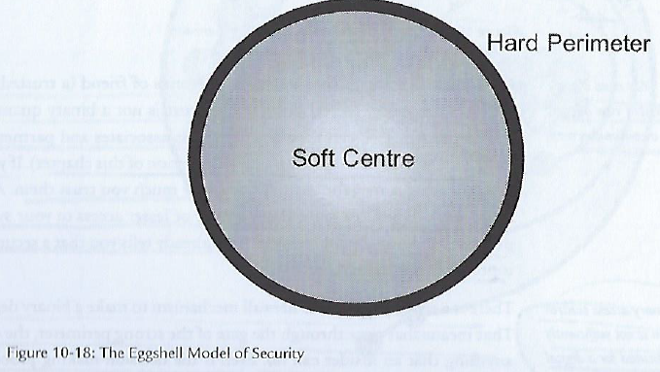
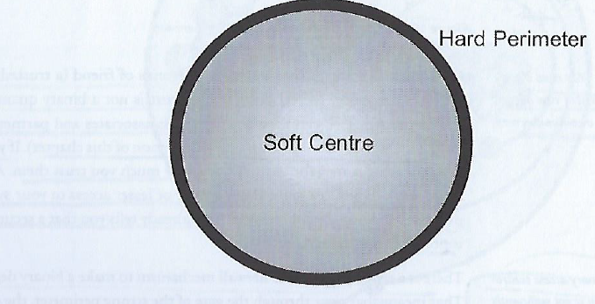
What is implied by this model of security?

Slide 4
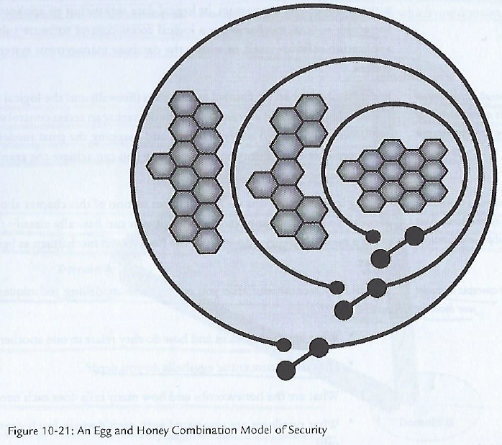
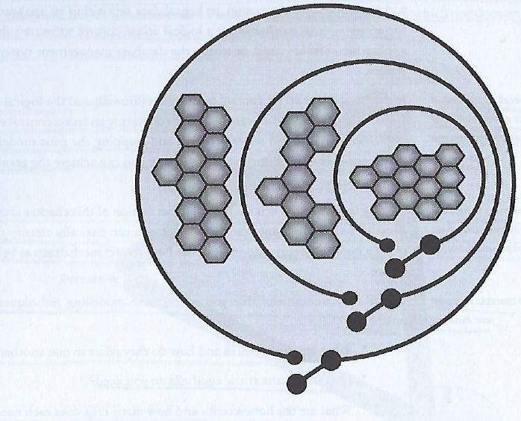
What is implied with this architectural model?

Slide 5
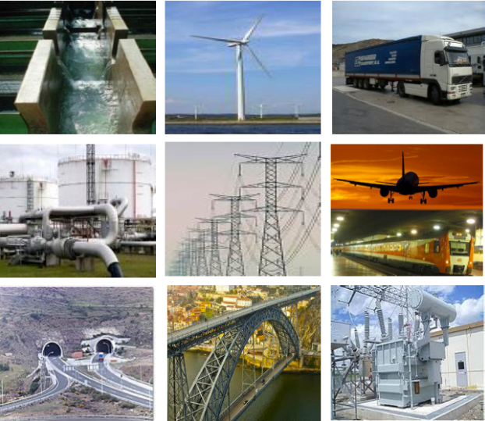
Early computer architecture of automated control systems separated Corporate and Control Domains
Critical infrastructure systems supporting major industries are dependent on information systems for command and control
Financial, Manufacturing, Transportation, Energy, Water…
Highly dependent on disparate legacy proprietary control systems which were physically isolated from corporate information systems
Control system security used to mean physical security of a closed-loop system

Slide 6
LAN 1 – connected via
layer 2 switch
PBX
LAN 2 – connected via
layer 2 switch
PBX
HMI = Human Machine Interface
CS = Control System
PBX = Private Branch Exchange telephone system switches between users on local lines while allowing users to use a fixed # of external phone lines
RTU = Remote Terminal Unit is a computer controlled device that connects physical machines to distributed control systems
PLC = Programmable Logic Controller
IED = Intelligent End device

Slide 7
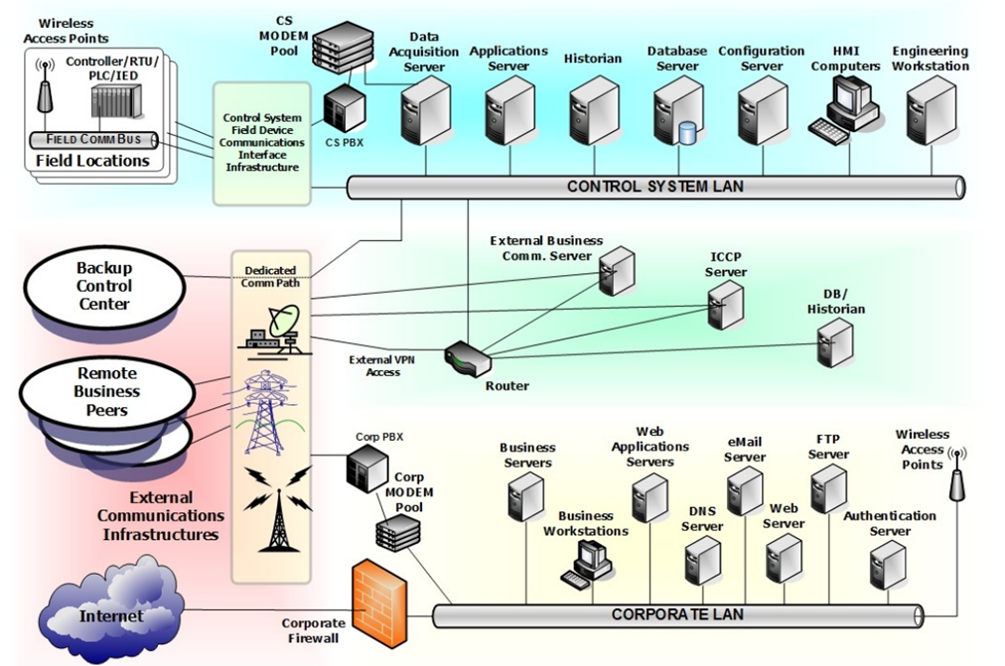
Security based on
Isolation from the Internet
“Security by Obscurity”
Few, if any, understood the architecture or operation of the resources on the controls systems Local Area Network (LAN)
“Air Gap” between control system LAN and corporate LAN
Worked well for environments that had no external connections
Allows organization to focus on physical security

Slide 8
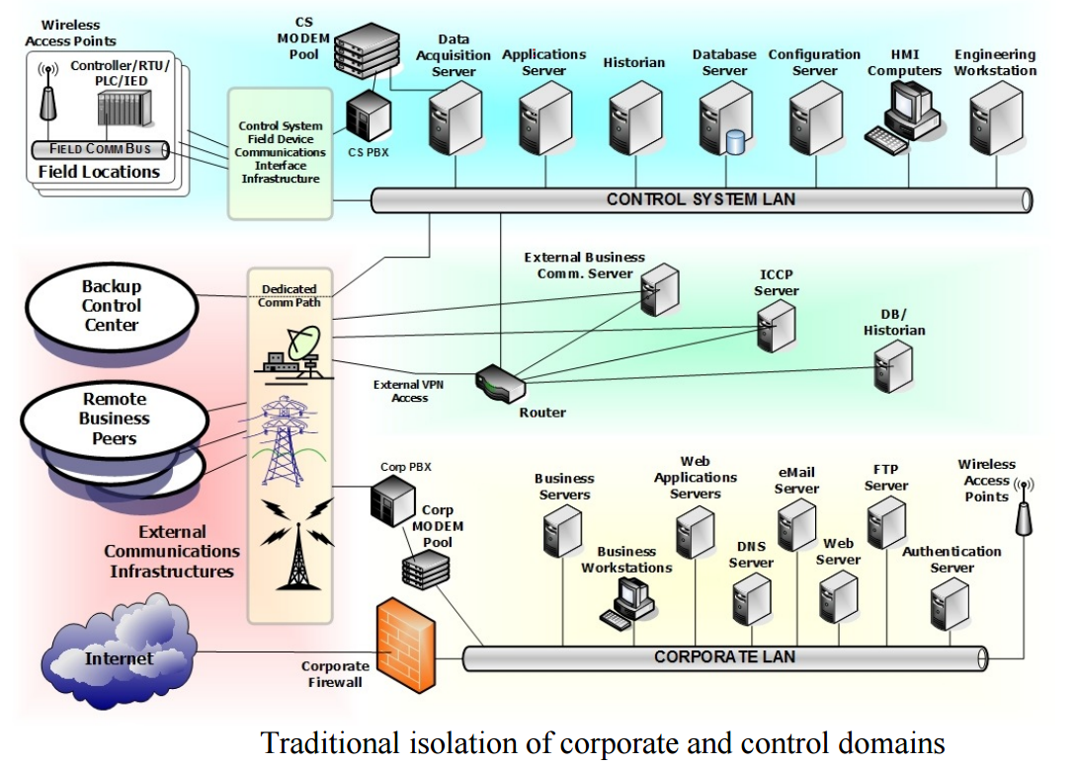
Total isolation from the untrusted external network resulted in reduced need for communications security
Only threats to operations were physical access to a facility or plant floor
Most data communication in isolated information infrastructure required limited authorization and security oversight
Operational commands, instructions and data acquisition occurred in a closed environment where all communications were trusted
If a command or instruction was sent via the network it was expected to arrive and perform the authorized function – as only authorized operators had access to the system
“Control Systems Cyber Security: Defense in Depth Strategies”, Prepared by Idaho National Laboratory’s Control Systems Security Center, for U.S. Department of Homeland Security, External Report# INL/EXT-06-11478, May 2006

Slide 9
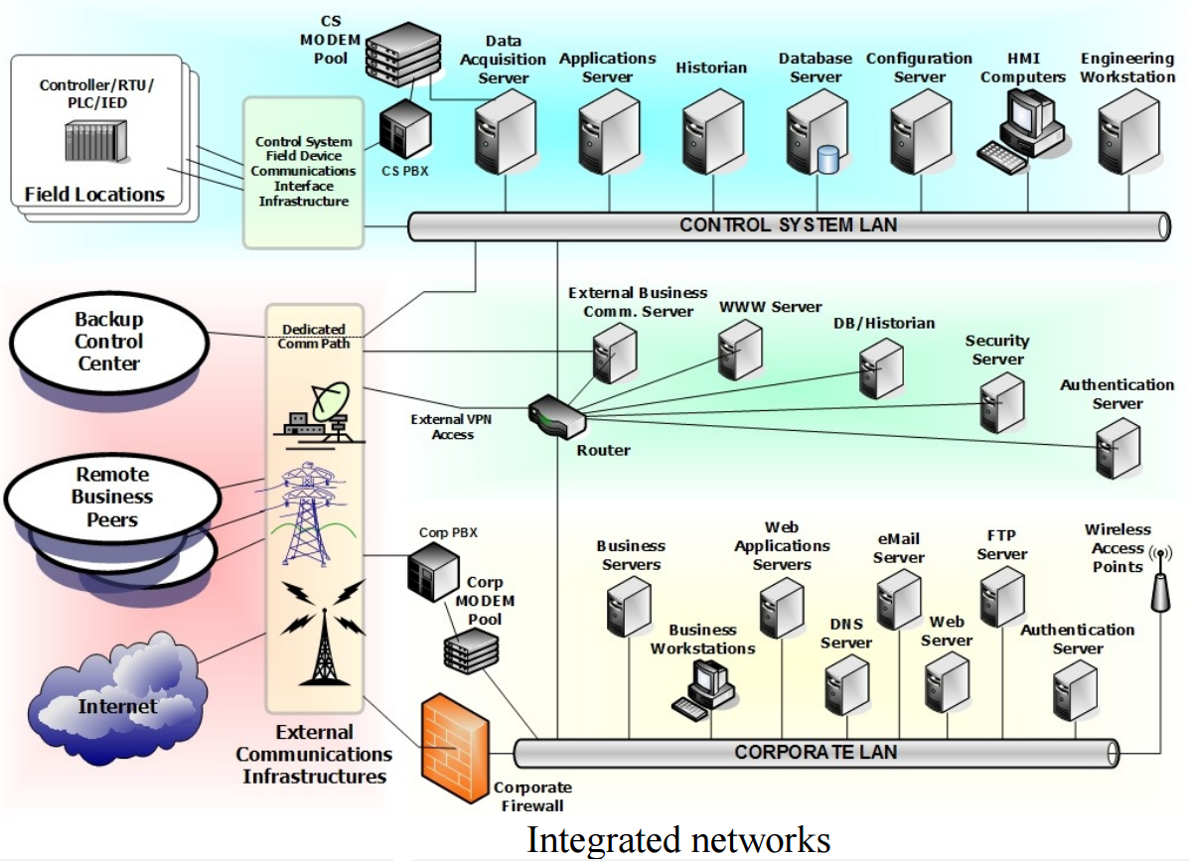
Year ~2000 saw isolated control system networks beginning to be interconnected with corporate networks via simple routers
Router is a networking device that forwards data packets between computer networks
Routers perform the traffic directing functions on the Internet

Slide 10
Many previously isolated industrial control system networks were interconnected as part “IT modernization”
Introducing IT components into the control system domain continues to result in security problems:
No business case for cyber security in control system environments
Increased dependency on automation of control systems
Use of technologies we now know have vulnerabilities
Considerable amount of open source information available on control system configurations and operations
Legacy control system communication protocols lack security functionality
Control system technologies have limited security, and if they do – vendor supplied security capabilities often enabled if the administrator is aware of the capability

Slide 11
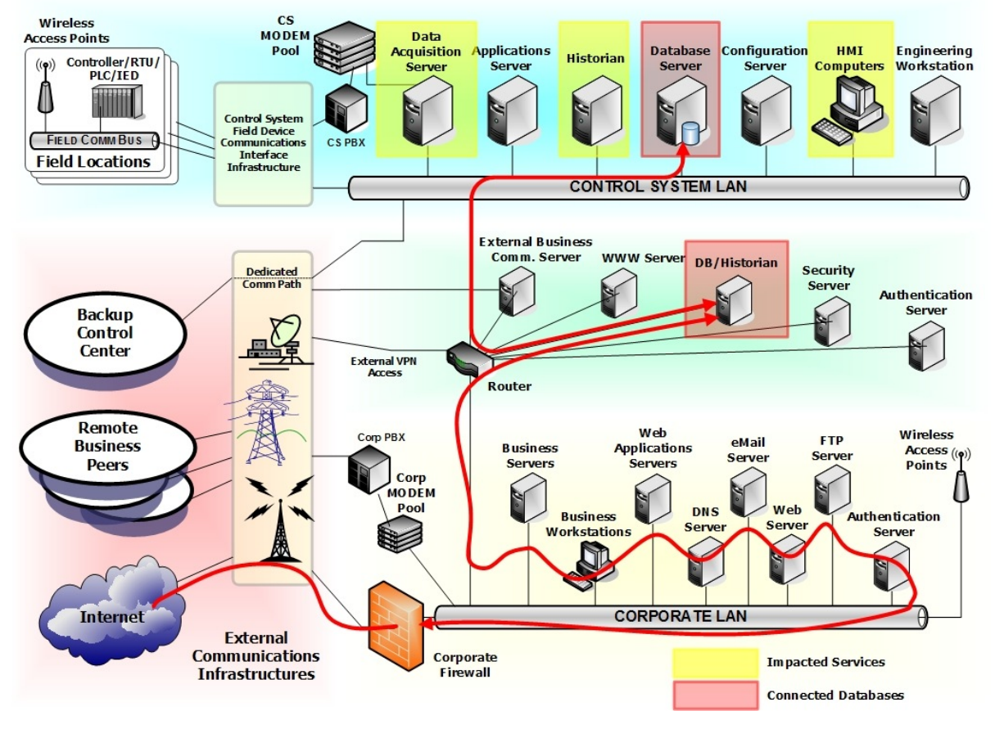
Attack begins at some point outside the control zone, after initial intrusion attacker pries deeper and deeper into the architecture

Slide 12
Risk of Multilayer protocols –
Distributed Network Protocol 3 (DNP3) communications protocol for SCADA systems used by water and power utilities
Not all protocols fit nicely within OSI model layers, especially in the case of devices on networks that were never intended to interoperate with the Internet
DNP3 lacked robust security features for protecting CIA of data it was used to communicate
Previously isolated devices and networks increasingly connected to unanticipated threats
DNP3 created before networking with OSI’s 7 layer model was a consideration
DNP3’s developers used Enhanced Performance Architecture (EPA) that approximated OSI layers: 7 (app), 4 (transport) & 2 (data link)
No presentation layer (layer 6)encryption or authentication
No session management (layer 5)
No Intrusion Detection Systems able to understand connections between DNP3 and IP networks and identify DNP3 attacks!
December 2015 – attackers cut power to utilities’ supervisory control and data acquisition (SCADA) systems creating first known cyberattack created blackout impacting 80,000 homes in Ukraine

Slide 13
Agenda
Introduction
Physical “air-gap” security and how we undermined it
Firewalls
Types of firewalls
Some architectural patterns based on firewall placement
Firewalls have rules
Intrusion Detection System (IDS) & Intrusion Prevention System (IPS)
Defense in Depth with security zones (“Security Domains”)
Project Team Assignment
Preparation for Mid Term Exam

Slide 14
Firewalls
https://youtu.be/N2sOPGhva1M

Slide 15
Defense in Depth is achieved through Network Segmentation to create Security Domains
IT network infrastructure domains are sets of logical (and physical) resources available to a subject
User
Process
Application
Resources within each domain are:
Working under the same security policy
Managed by the same group
Different domains are separated by logical boundaries created by components that enforce security policy for each domain, such as:
Firewalls
Directory services making access decisions
Objects having their own access controls indicating which individuals and groups can access and run operations/processes on them

Slide 16
Firewalls used to Implement Network Security Policy
Support and enforce an organization’s network security policy
Implement high-level directives on acceptable an unacceptable actions to protect critical assets
Firewall security policy:
What services can be accessed
What IP addresses and ranges are restricted
What ports can be accessed

Slide 17
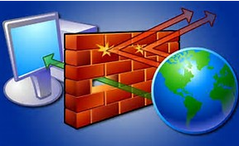
Firewalls are security architecture “choke points” in an IT network
All communication should flow through, be inspected and restricted by firewalls
Firewalls are used to restrict access from one network to another network
From the internet to access corporate networks
Between internal network segments
Restrict access
Between origin and destination
Based on determination of acceptable traffic type(s)

Slide 18
Firewall Technology
May be implemented as a
Software product running on a server
Specialized hardware appliance
Monitors data packets coming into and out of the network it is protecting
Packets are filtered by:
Source and destination addresses and ports
Header information
Protocol type
Packet type
Service
Data content – i.e. application and file data content

Slide 19
Types of Firewalls
Packet filtering
Dynamic packet filtering
Stateful inspection
Proxy Firewall
Kernel Proxy

Slide 20
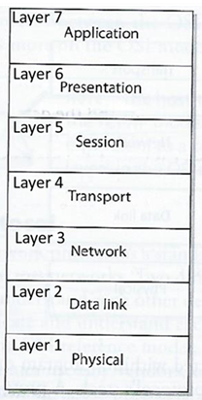
Packet-filtering firewalls
“First-generation” firewall technology – most basic and primitive
Capabilities built into most firewalls and routers
Configured with access control lists (ACLs) which dictate the type of traffic permitted into and out of the network
Filters compare protocol header information from network and transport layers with ACLs

Slide 21
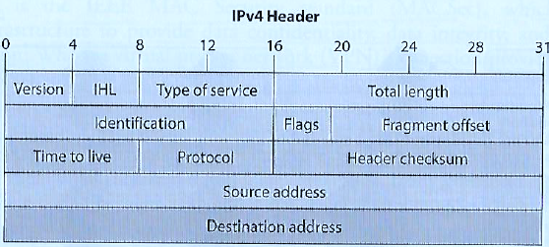
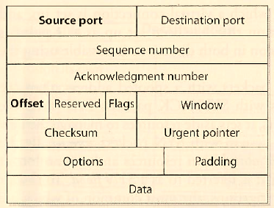
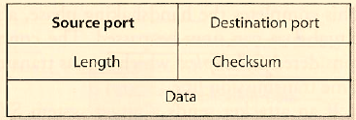
Packet-filtering Firewalls
Compares ACLS with network protocol header values to determine permit/deny network access based on:
Source and destination IP addresses
Source and destination port numbers
Protocol types
Inbound and outbound traffic direction
Network Layer 3
TCP format
UDP format
Transport Layer 4

Slide 22
Example ACL Rules
Router configuration allowing TCP traffic to travel from system 10.1.1.2 to system 172.16.1.1 to SMTP (Simple Mail Transfer Protocol) port (port 25) :
permit tcp host 10.1.1.2 host 172.16.1.1 eq smtp
Allow UDP traffic from 10.1.2 to 172.16.1.1:
permit udp host 10.1.1.2 host 172.16.1.1
Block all ICMP (Internet Control Message Protocol) i.e. router error messages and operational information traffic from entering through a certain interface:
deny icmp any any
Allow standard web traffic ( to a web server listening on port 80) from system 1.1.1.1 to system 5.5.5.5:
permit tcp host 1.1.1.1 host 5.5.5.5 eq www

Slide 23
Packet-filtering firewalls
Packet filtering firewalls: monitor traffic and provide “stateless inspection” of header attribute values (i.e. delivery information) of individual packets
…and after the decision to permit or deny access to the network is made the firewall forgets about the packets
Weakness: No knowledge of data moving between applications communicating across the network
Cannot protect against packet content, e.g. probes for specific software with vulnerabilities and exploit a buffer overflow for example
Should not be used to protect an organization’s infrastructure and information assets
Strengths: Useful at the edge of a network to quickly and efficiently strip out obvious “junk” traffic
High performance and highly scalable because they do not carry out extensive processing on the packets and are not application dependent
First line of defense to block all network traffic that is obviously malicious or unintended for a specific network
Typically complemented with more sophisticated firewalls able to identify non-obvious security risks

Slide 24
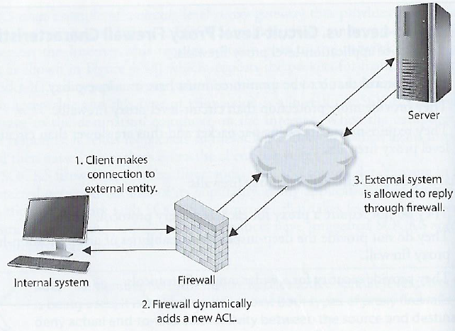
Dynamic Packet-Filtering Firewalls
When an internal system needs to communicate with a computer outside its trusted network it needs to choose an identify its source port so the receiving system knows how/where to reply
Ports up to 1023 are reserved for specific server-side services and are known as “well-known ports”
Sending system must choose a randomly identified port higher than 1023 to use to setup a connection with another computer
The dynamic packet-filtering firewall creates an ACL that allows the external entity to communicate with the internal system via this high-numbered port
The ACLs are dynamic in nature – once the connection is finished the ACL is removed
The dynamic packet-filtering firewall offers the benefit of allowing any type of traffic outbound and permitting only response traffic inbound

Slide 25
Stateful Inspection Firewall
Remembers and keeps track of what computers say to each other
Tracks where packets went until each particular connection between computers is closed
Uses a “state table” which it updates to track the contents of packets each computer sent to each other
Makes sure the sequential process of packet message interchange involved in connection-oriented protocols (e.g. TCP – transmission control protocol) are properly synchronized and formatted
If not an attack is detected and blocked

Slide 26
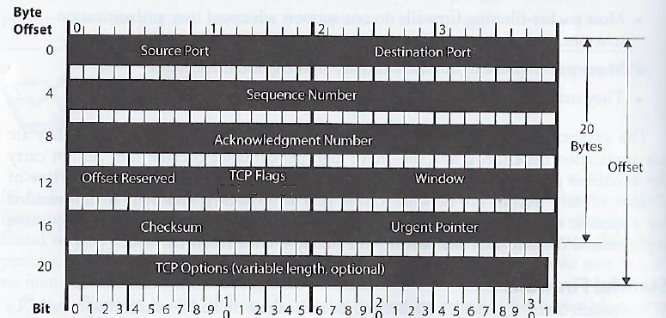
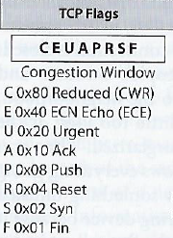
Stateful Inspection example
Determine if all TCP Flags set to 1
Attackers send packets with all TCP flags set to 1 with hope that the firewall will not understand or check these values and forward them to the server
Under no circumstances during legitimate TCP connections are all values turned to 1
If detected connection is blocked
C
E
U
A
P
R
S
F

Slide 27
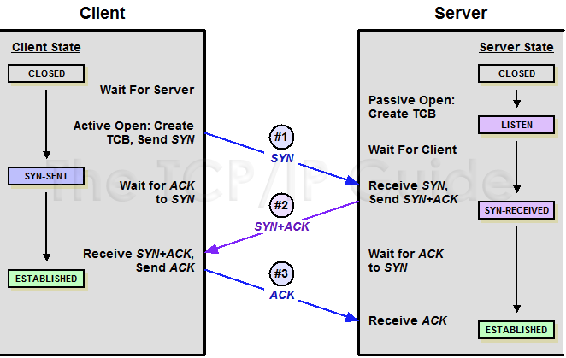
Stateful Inspection example
Stateful inspection firewall assures that TCP (connection-oriented protocol) proceeds through a series of states:
Stateful firewall keeps track of each of these states for each packet passing through, along with corresponding acknowledgement and sequence numbers
Out of order acknowledgement and/or sequence numbers can imply a replay attack is underway and the firewall will protect internal systems from this activity

Slide 28
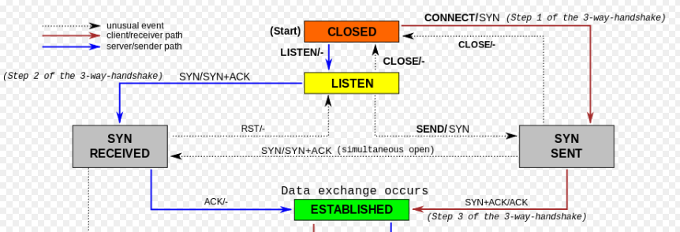
Stateful Inspection example
Stateful inspection firewall assures that TCP (connection-oriented protocol) proceeds through a series of states:
LISTEN
SYN-SENT
SYN-RECEIVED
ESTABLISHED
Stateful firewall keeps track of each of these states for each packet passing through, along with corresponding acknowledgement and sequence numbers
If a remote computer sends in a SYN/ACK packet without an internal computer first sending out a SYN packet, this is against protocol rules and the firewall will block the traffic
It knows how the protocols are supposed to work, and if something out of order (incorrect flag values, incorrect sequences, etc.) is detected the traffic is blocked

Slide 29
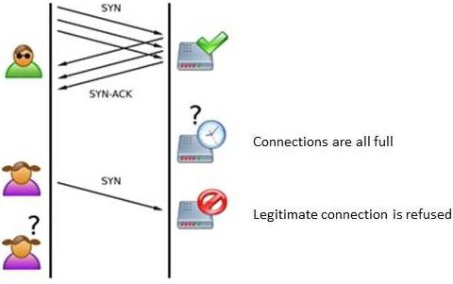
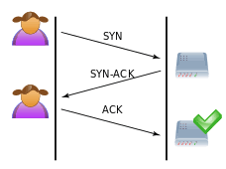
Stateful Inspection Firewalls
Strength: Maintains a state table that tracks each and every communication session to validate the session
Provides high-degree of security, without introducing a huge performance hit
Is scalable and transparent to users
Tracks both connection-oriented protocols (e.g. TCP) and connectionless protocols (UDP and ICMP)
Weakness: Susceptible to Denial of Service (DoS) attacks aided at flooding the state table with fake information
Poorly designed stateful firewalls with state-tables filled with bogus information may freeze or reboot

Slide 30
Proxy Vs Reverse Proxy Vs Load Balancer
(20) Proxy vs reverse proxy vs load balancer (2023) | Explained with real life examples - YouTube

Slide 31
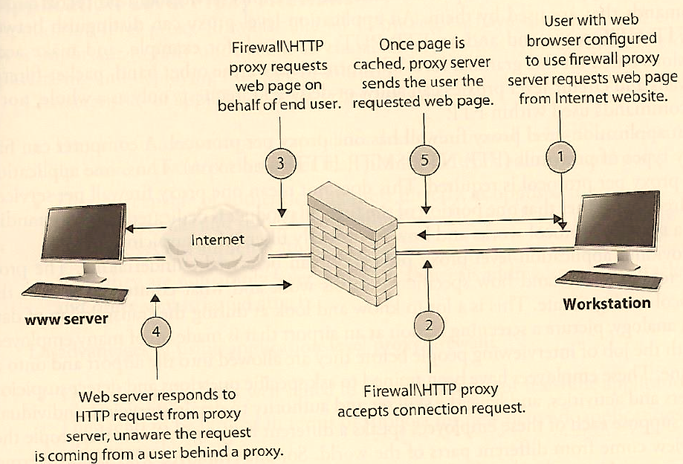
Proxy Firewall
Is a “middleman” standing between a trusted and untrusted networks, denying end to end connectivity between source and destination computers
Puts itself between the pair in both directions intercepting and inspecting each message before delivering it to the intended recipient
Applies ACL rules, and also…
Ends the communication session, breaking the communication channel between source and destination, so there is no direct connection between two communicating computers
Inspects the traffic
When traffic is “approved” the proxy firewall starts a new session from itself to the receiving system

Slide 32
Application and Circuit Proxy Firewalls both
Act as a proxy
Deny actual end-to-end connectivity between the source and destination computers
Clients attempting remote connection connects and communicates to the proxy; the proxy – in turn – establishes a connection to the destination system and makes requests to it on behalf of the client
The proxy maintains 2 independent connections for every one network transmission, turning a 2-party session into a 4-party session – providing the middle processes emulating the 2 real systems

Slide 33
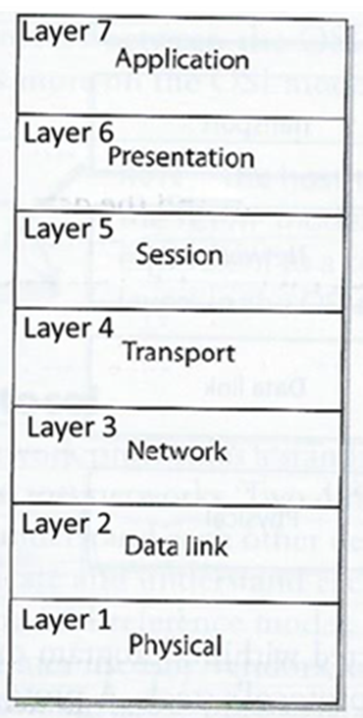
Proxy Firewall – two types working at different levels in the OSI model
Application-level proxies work up through Layer 7
Understand entire contents of packets, making decisions based on API services, protocols and commands (e.g. FTP PUT and GET commands)
A Proxy Firewall will have a series of application-level proxies to detect suspicious data transmission – one proxy per API protocol (i.e. one for FTP, and different ones for SMTP, HTTP, …)
Circuit-level gateways (proxies) work up through the session layer
Monitor TCP handshaking between packets to determine whether a requested session is legitimate
Information passed to a remote computer appears to have originated from the gateway – hiding information about the protected private network
Firewall traffic rules control traffic to/from acknowledged computers only
Relatively inexpensive
Do not filter content of individual packets like application-level proxies do

Slide 34
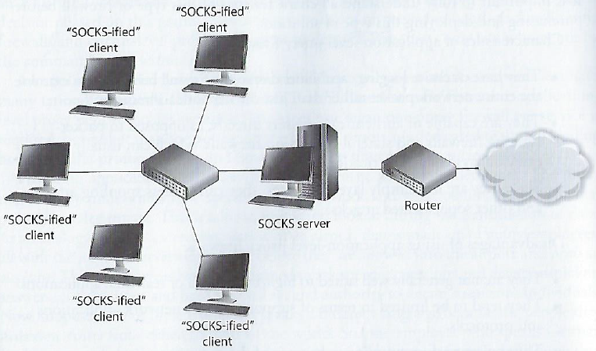
Circuit-level Proxy Firewalls
Only examines network addresses and ports – similar to packet filtering firewalls, but provides proxy services insulating the internal identities and addresses of machines from external devices
Does not understand application-level protocols, and cannot provide more granular level control protecting from malicious transactions and content

Slide 35
Application-level Proxy Firewalls
Advantages
Have extensive logging capabilities that go hand-in-hand with ability to examine contents of the entire network packet rather than just addresses and ports
Capable of authenticating users directly
Packet-filtering and stateful-inspection firewalls only able to authenticate systems (not users)
Functioning a higher levels in the OSI stack enable them to detect and address spoofing and other sophisticated attacks
Disadvantages
May not be well suited for real-time or high-bandwidth applications
Create performance issues due to processing needed to inspect and analyze “deep content” of packets
Limited support for newer network applications and protocols

Slide 36
Kernal Proxy Firewalls
Considered a “fifth generation” firewall
Functions as a proxy – conducting network address translation so it function as a “middleman”
Creates a dynamic, customized virtual network stacks for each packet that consists of only the protocol proxies needed to examine it
The packet is evaluated at every layer of the stack simultaneously
Data link header
Network header
Transport header
Session layer information
Presentation layer information
Application layer data
If anything is determined unsafe the packet is discarded
Much faster than an application-level proxy because it is optimized to function at the lower level kernel level of the operating system

Slide 37
Next-Generation Firewalls (NGFW)
Combines the best capabilities of the other firewalls
Ensures traffic is well-behaved and in accordance with applicable protocols
Breaks direct connection between internal and external systems (proxy)
Provides dynamic port assignment
Also includes a signature-based Intrusion Detection System (IPS) engine
Able to look for specific indicators of attack even in traffic is well behaved
Able to use centralized data sources
Able to be updated with new attack signatures from cloud aggregators
For consistent up to date whitelists, blacklists and policies
Can connect to Active Directory to provide URL to IP address translations
Tend to be expensive – cost of ownership beyond small and medium sized organizations

Slide 38
Summary
Firewall type | OSI Layer | Characteristics
Packet Filtering | Network Layer | Looks at destination and source addresses, ports, and services requested. Routers use ACLs monitor network traffic
Dynamic Packet Filtering | Network Layer | Allows any permitted type of traffic outbound and only response traffic inbound
Stateful | Network Layer | Looks at the state and context of packets. Keeps track of each conversation using state table
Circuit-level Proxy | Session Layer | Provides proxy services, but looks only at the header packet information (less detailed level of control that application-level proxy)
Application-level Proxy | Application Layer | Looks deep into packets and makes granular access control decisions, It requires one proxy per protocol
Kernal Proxy | Application Layer | Faster than application-level proxy because processing performed in operating system kernel. One network stack created for each packet
Next-generation | Multiple Layers | Very fast and supports high bandwidth. Built-in IPS, able to connect to external services like Active Directory

Slide 39
Some Firewall Architecture Patterns based on firewall placement
Bastion host
Dual-homed Firewall
Screened host
Screened Subnet

Slide 40
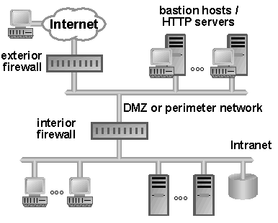
Bastion Host
Bastion host system is a highly exposed device closer than any other system to an untrusted network, that is most likely to be targeted by attacker
A special-purpose computer on a network specifically designed and configured to withstand attacks. The computer generally hosts a single application, for example a proxy server, and all other services are removed or limited to reduce the threat to the computer
Typically directly connected to an untrusted network, or placed inside DMZ
Needs to be extremely locked down and hardened to reduce its attack surface (i.e. vulnerabilities reduced as much as possible):
All unnecessary:
Services disabled
Accounts removed
Applications removed
Subsystems and administrative tools removed

Slide 41
Characteristics of Firewall Architecture
Dual-homed
A single computer with separate NICs connected to internal and external network
Used to divide an external untrusted network from an internal trusted network
Must harden and disable computer’s forwarding and routing functionality so the two networks communicate through the computer’s firewall software and are truly segregated
Screened host
A router filters and screens traffic applying its ACL to drop ‘junk’ traffic before it is passed to the firewall
Screened subnet
An external router filters/screens traffic before it enters the subnet, sending remaining traffic through two firewalls before making its way to the internal network

Slide 42
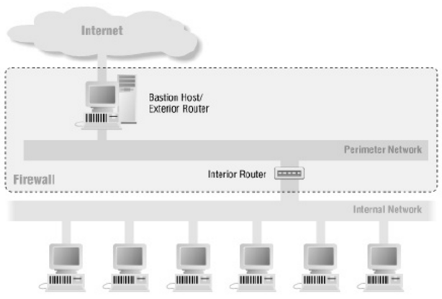
Dual-Homed Firewall Architecture
A “dual-homed” device has two network interface cards (NICs)
Multi-homed devices have multiple NICs
Firewall software running on a dual-homed device
Underlying operating system should have packet forwarding and routing turned off for security
Packet comes to the external NIC from an untrusted network and is forwarded up through the firewall software and if not dropped forwarded to the internal NIC
Without redundancy, if this goes down the dual-homed firewall becomes a single point of failure
One layer of protection lacks “defense in depth”
If an attacker compromises one firewall they can gain direct access to the organizations network resources

Slide 43
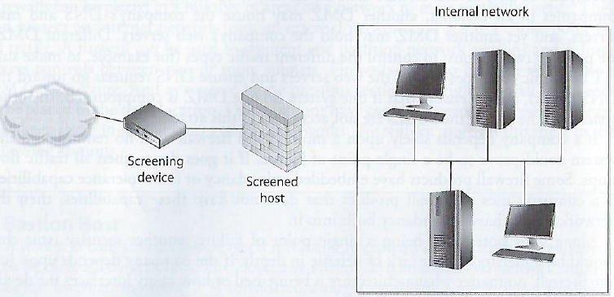
Screened Host Firewall Architecture
A firewall that communicates directly with a perimeter router and the internal network
Traffic from the Internet first passes through a packet filtering router applying ACL rules which filters out (i.e. drops) junk packets
Traffic that makes it past this phase is sent to the screen-host firewall which applies more rules to the traffic and drops the denied packets
Remaining traffic moves to the internal network
Router provides network-level packet filtering
Application-based firewall provides packet filtering at the application layer
“One-tier tiered configuration”
Security level is higher than a bastion dual-homed firewall because attacker would need to compromise 2 systems to succeed

Slide 44
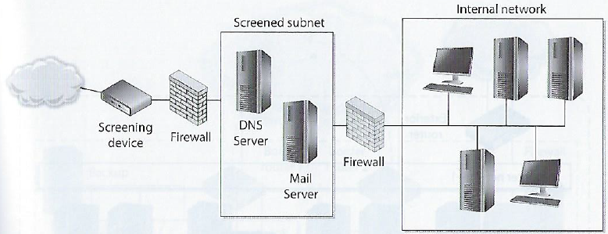
Screened Subnet Architecture
Adds another layer of depth to the security of the screened-host architecture
The external firewall screens traffic entering the screened sub-network, instead of firewall redirecting traffic to the internal network
The second interior firewall also filters the traffic – this creates a screened subnet (i.e. DMZ)
Creates a DMZ between 2 firewalls which functions as a small network isolated between trusted internal and untrusted external network
3-devices working together provides more protection than a stand-alone firewall or a screened-host firewall
All 3 need to be compromised by an attacker to gain access to the internal network
DMZ
“Two-tiered configuration”

Slide 45
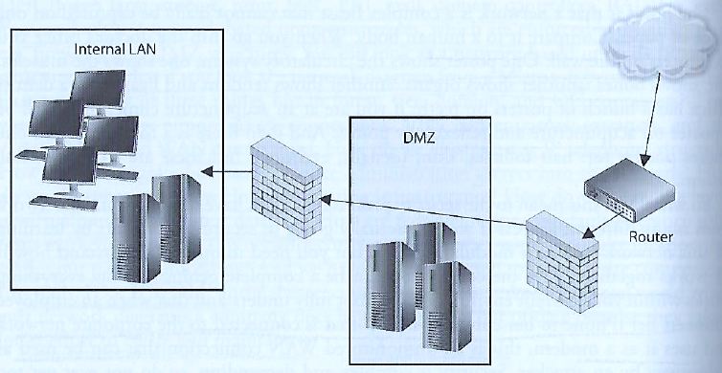
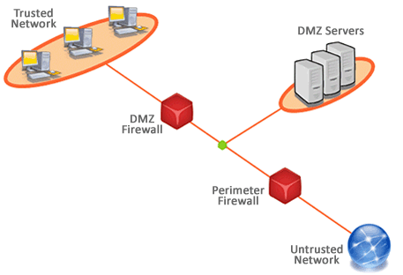
Demilitarized Zone (DMZ)
Firewalls are installed to construct DMZ areas
Network segments which are located between protected and unprotected networks
Provides a buffer zone between the dangerous Internet and valuable assets the organization seeks to protect
Usually 2 firewalls are installed to form a DMZ
May contain mail, file, and DNS (Domain Name System) servers
Usually contain an Intrusion Detection System sensor which listens for suspicious and malicious behavior
Servers in DMZ must be hardened to serve as the first line of protection against attacks coming from the internet
DMZ Video
(20) What is a DMZ? (Demilitarized Zone) - YouTube

Slide 46
Firewalls have rules…
Good firewall behavior: default action is to deny any packets explicitly not allowed
If no rule in the ACL explicitly says the packet can come in, it is dropped
Any packet coming in from the Internet containing the source address of an internal host should be dropped
Spoofing or masquerading attack reflected in a modified packet header having the source address of a host inside the target network
No packet should be permitted to leave that does not contain a source address of an internal host – this is how DDoS zombies work
Many companies deny packets with source routing information in the headers which may circumnavigate internal routers and firewalls
Firewalls not effective “out of the box”
Need to understand internal default rules which may negate user provided rules
Can create bottlenecks
Need to effectively distribute them throughout the network to control network access points and provide appropriate “defense in depth”
Do not protect against malware, complex attack types, sniffers, rogue access points

Slide 47
Common firewall rules:
Stealth rule
Disallow unauthorized systems from accessing to firewall software
Silent rule
Identify and drop “noisy” traffic without logging it to reduce log sizes by not responding to unimportant packets
Cleanup rule
Last rule in the rule base drops and logs remaining traffic that does not meet preceding rules
Negate rule
Create tighter rules by specifying what system can be accessed and how (whitelisting), and do not use broad and permissive rules that default to any traffic (e.g. blacklisting)

Slide 48
Agenda
Introduction
Physical “air-gap” security and how we undermined it
Firewalls
Types of firewalls
Some architectural patterns based on firewall placement
Firewalls have rules
Intrusion Detection System (IDS) & Intrusion Prevention System (IPS)
Defense in Depth with security zones (“Security Domains”)
Project Team Assignment
Preparation for Mid Term Exam

Slide 49
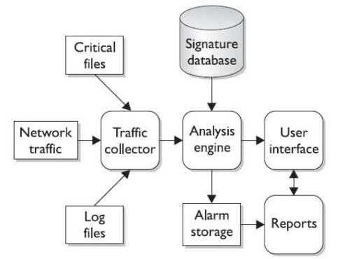
Intrusion Detection Systems (IDSs)
While firewalls and antivirus are preventive controls, IDSs are access control monitoring devices designed to
Detect a security breach
Aid in mitigating damage caused by hackers breaking into sensitive computer and network systems
IDS’ components
Sensors
Collect and send traffic and user activity data to analyzers
Analyzers
Look for suspicious activity and if found sends alert to administrator’s interface
Administrative interfaces

Slide 50
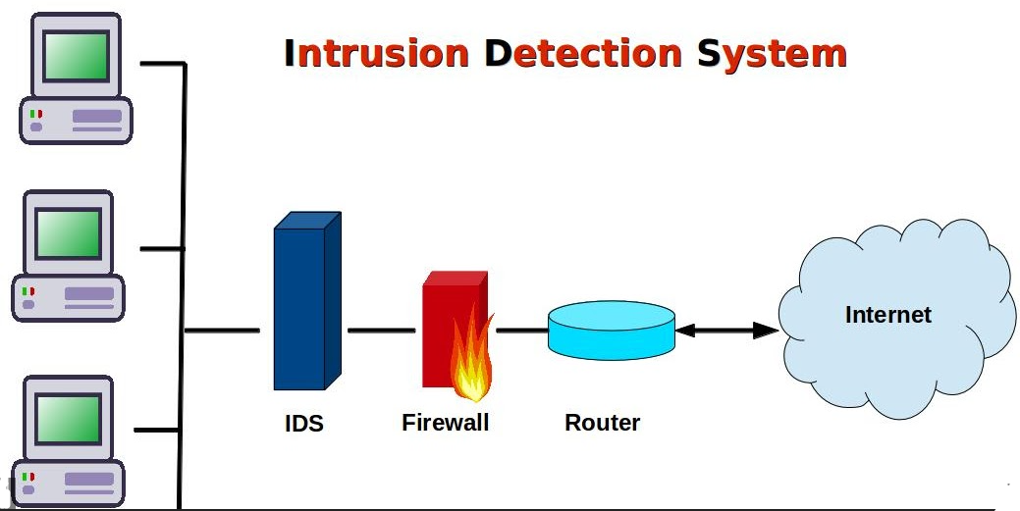
Intrusion Detection Systems (IDSs)
Two main types of IDS
Host-based for analyzing activity within a particular computer system
Network-based for monitoring network communications
IDS can be configured to:
Watch for attacks
Parse audit logs
Terminate a connection
Alert administrator as attacks happen
Expose a hacker and her/his techniques
Illustrate which vulnerabilities need to be addressed

Slide 51
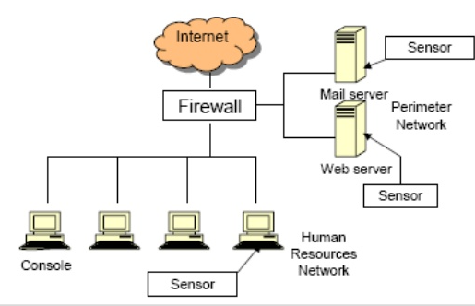
Intrusion Detection Systems (IDSs)
Host-based IDS (HIDS)
Can be installed to look at the data packets within the higher levels of the OSI stack for anomalous or inappropriate activity on individual servers and/or workstations
Usually installed on critical servers (too much administrative overhead to put them everywhere)
Make sure users do not put the system at risk by activities such as deleting system files or reconfiguring important settings
Does deeper inspection of the packets
Does not understand network traffic

Slide 52
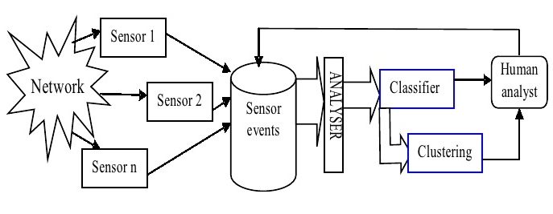
Intrusion Detection Systems (IDS)
Network-based IDS (NIDS)
Uses sensors which can be either host computers with specialized software installed or dedicated appliances
Each have a NIC (network interface card)
NIC is configured in promiscuous mode to capture all traffic (rather than packets addressed to the host computer
Copies packets – sending one copy up the TCP stack (for normal processing or possible analysis with a HIDS), and another copy to analyzer looking for specific patterns in the network traffic
Monitors network traffic, cannot see the activity happening within the higher levels of the OSI stack (HIDS is used for this)

Slide 53
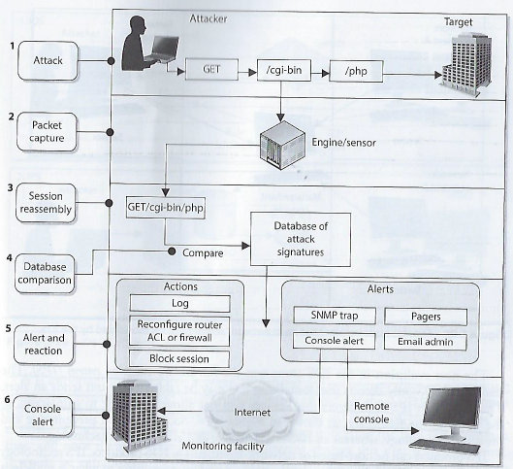
Basic architecture of a Network IDS
Harris, S. and Maymi, F. (2016) All In One CISSSP Exam Guide, Seventh Edition, McGraw-Hill Education

Slide 54
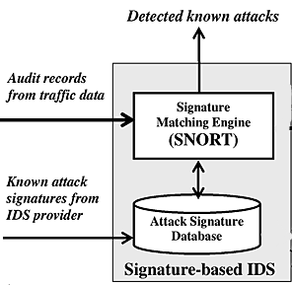
Intrusion Detection Systems (IDS)
NIDS and HIDS can be one of the following types:
Signature-based:
Pattern matching, similar to antivirus software
Signatures must be continuously updated
Cannot identify new attacks
2 types
Pattern matching: Compares individual packets to signatures
Stateful matching: Compares patterns among packets
Anomaly-based (a.k.a. Heuristic-based or Behavior-based):
Behavioral-based system able to learn from “normal activities”
Can detect new attacks
3 Types:
Statistical anomaly-based – creates a normal profile used to compare sensed activities
Protocol anomaly-based – Identifies incorrect uses that violate protocols (e.g. TCP 3-way handshake)
Traffic anomaly-based – Identifies unusual activity in network traffic
Rule-based
Uses artificial intelligence expert systems that process rules in the form of “If situation then action” statements to identify combinations of activities within the data of the packets
e.g. “IF a root user creates FileA AND FileB IN same directory and there is a call to Administrative ToolK THEN trigger alert”
Cannot detect new attacks
The more complex the rules, the greater the need for processing power to support the software and hardware requirements so the IDS does not become a bottleneck and performance problem

Slide 55
Intrusion Prevention Systems (IPS)
IDS – Detect something bad may be taking place and send an alert
Detective and “after the fact” response
IPS – Detect something bad may be taking place and block traffic from gaining access to target
Preventive and proactive response
IPS can be host-based or network-based (like IDS)
Can be content-based (looking deep into packets), conduct protocol analysis or be signature matching
Also can use rate-based metrics to identify suspicious increases in volumes of traffic
E.g. DoS – flood attack
Traffic flow anomalies – “slow and low” stealth attack attempting to be undetected

Slide 56
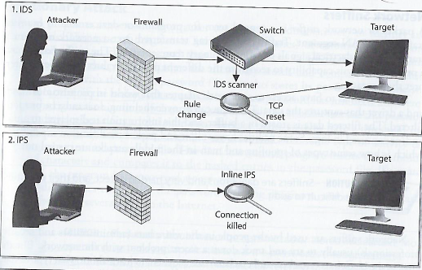
IDS versus IPS
Possible responses to a triggered event:
Disconnect communications and block transmission of traffic
Block a user from accessing a resource
Send alerts of an event trigger to other hosts, IDS monitors and administrators

Slide 57
Agenda
Introduction
Physical “air-gap” security and how we undermined it
Firewalls
Types of firewalls
Some architectural patterns based on firewall placement
Firewalls have rules
Intrusion Detection System (IDS) & Intrusion Prevention System (IPS)
Defense in Depth with security zones (“Security Domains”)
Project Team Assignment
Preparation for Mid Term Exam

Slide 58
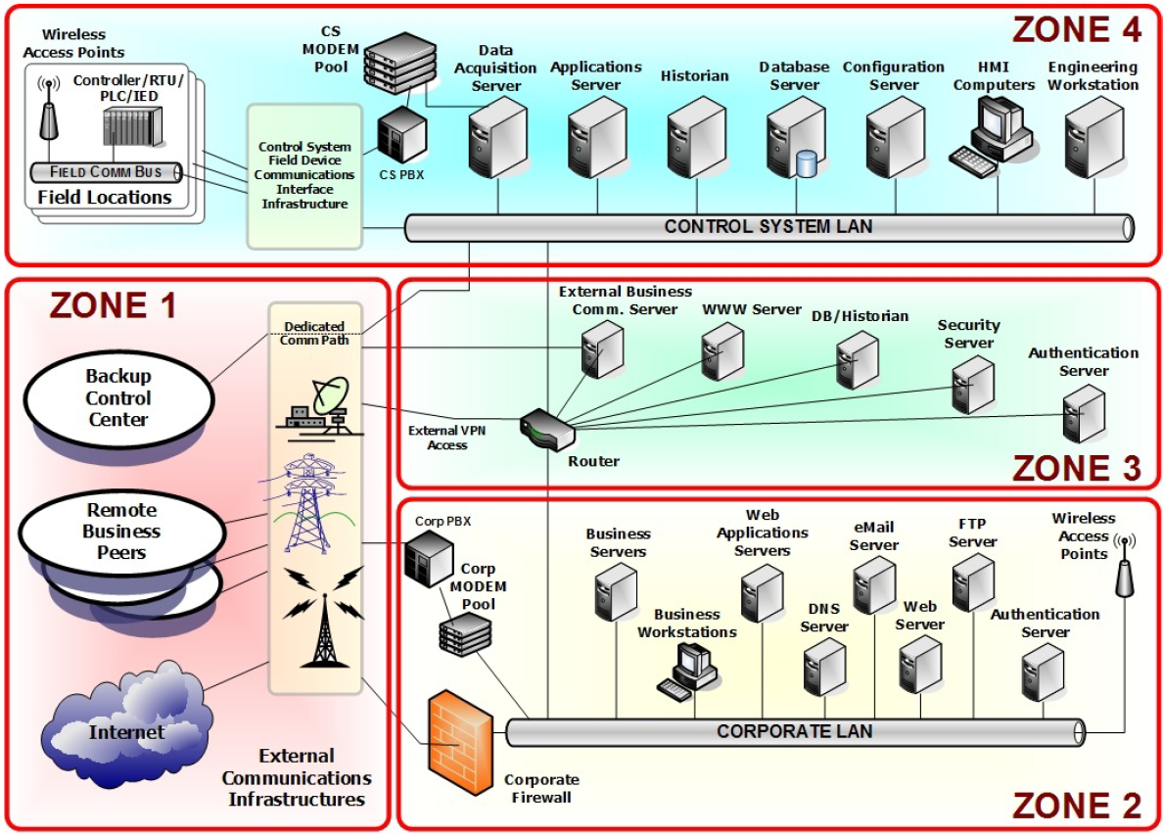
Zone 1: External connectivity to the Internet, peer locations, and back- up facilities
Zone 2: External connectivity for corporate communications
Zone 3: Control systems communications from external services
Zone 4: Control systems operations – process based or SCADA

Slide 59
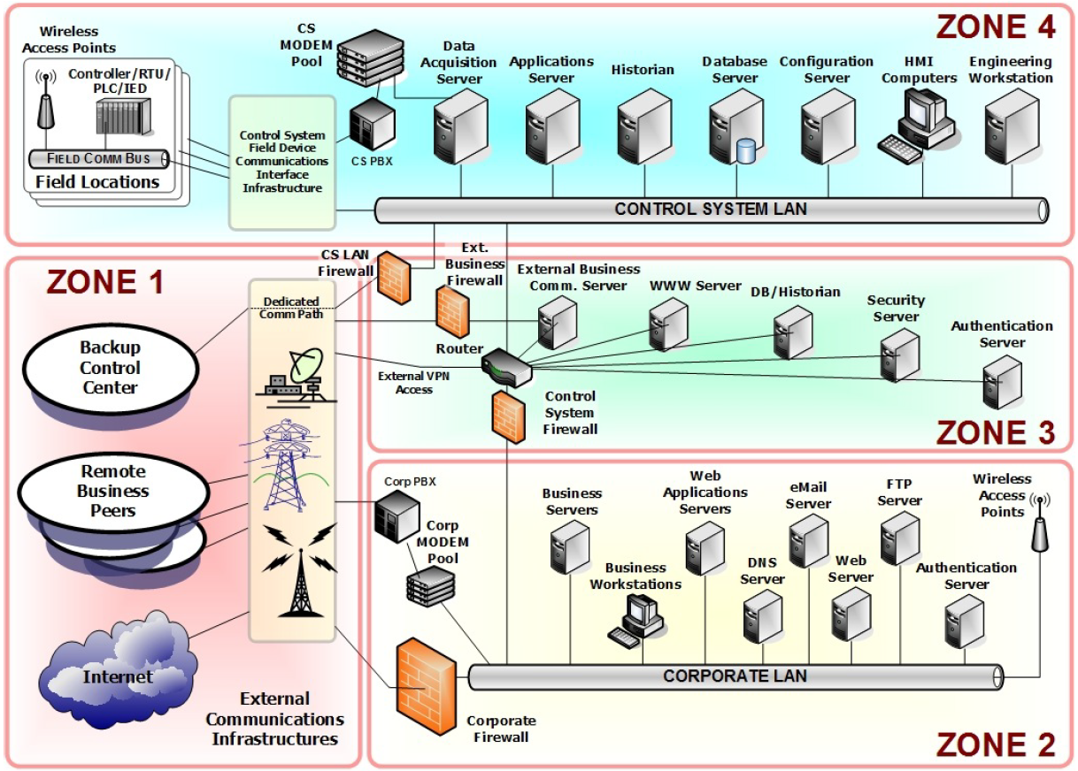
Attack scenarios suggest…
Intrusions begins at some point outside the control zone, and attacker pries deeper and deeper into the architecture
Securing each core zone creates a defensive strategy with depth
Offering administrators more opportunities for information and control of resources
Introduces cascading countermeasures that will not necessarily impede business functionality
“Control Systems Cyber Security: Defense in Depth Strategies”, Prepared by Idaho National Laboratory’s Control Systems Security Center, for U.S. Department of Homeland Security, External Report# INL/EXT-06-11478, May 2006

Slide 60
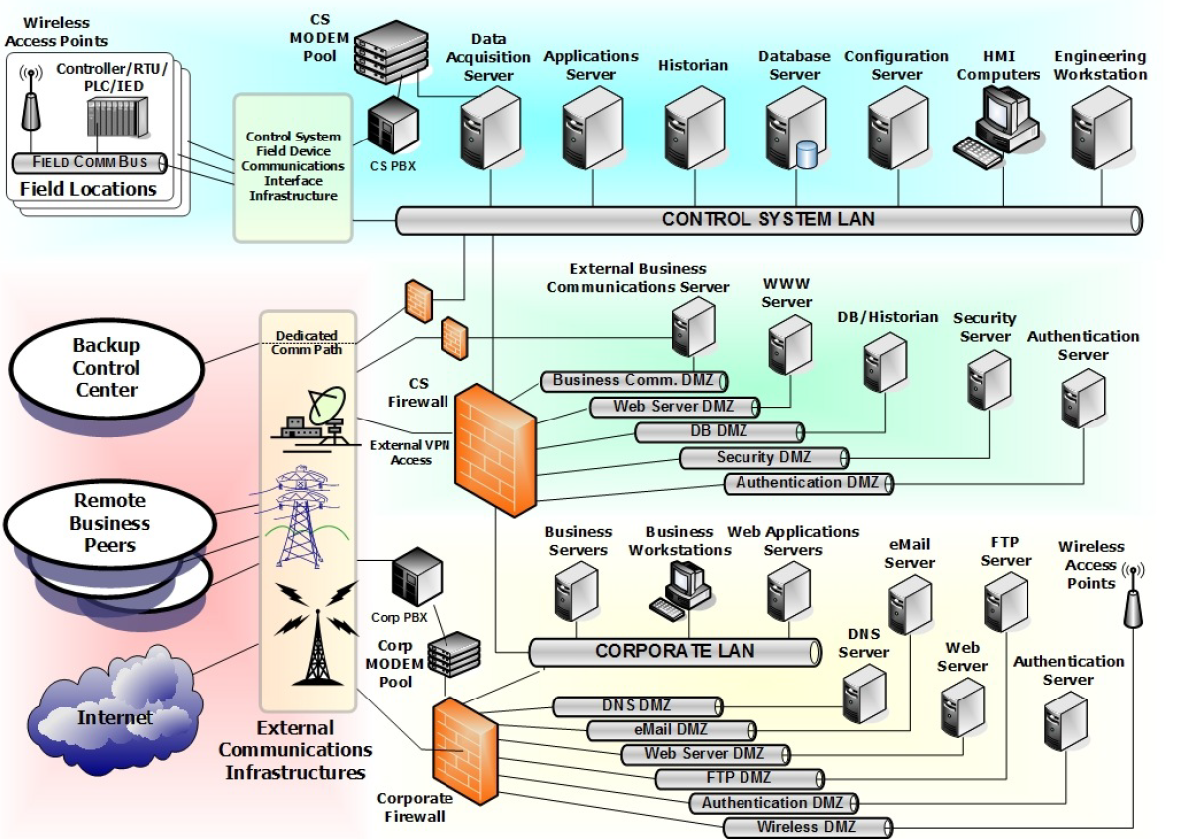
Firewalls DMZ deployments
“Control Systems Cyber Security: Defense in Depth Strategies”, Prepared by Idaho National Laboratory’s Control Systems Security Center, for U.S. Department of Homeland Security, External Report# INL/EXT-06-11478, May 2006

Slide 61
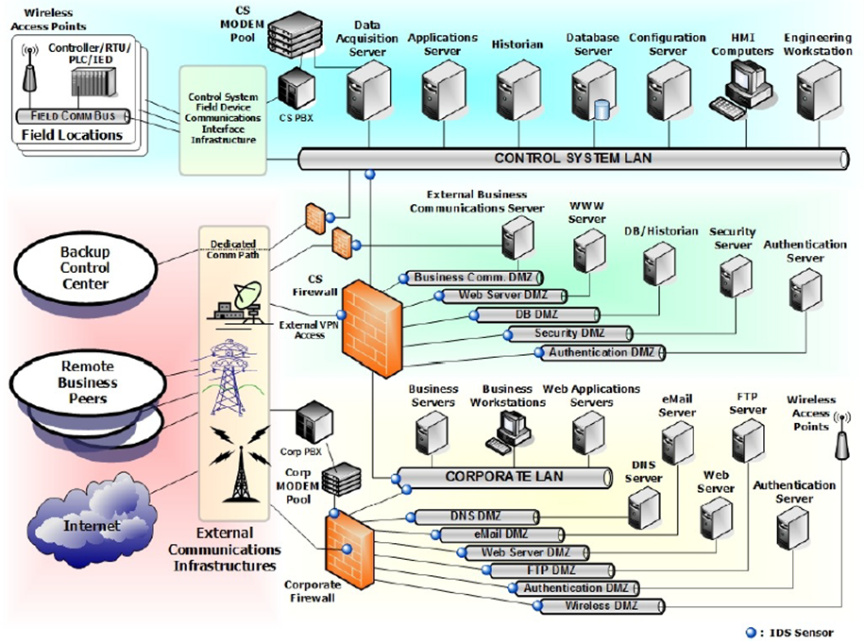
Intrusion Detection System Sensors located throughout the network
What is wrong with this logical diagram?

Slide 62
Agenda
Introduction
Physical “air-gap” security and how we undermined it
Firewalls
Types of firewalls
Some architectural patterns based on firewall placement
Firewalls have rules
Intrusion Detection System (IDS) & Intrusion Prevention System (IPS)
Defense in Depth with security zones (“Security Domains”)
Project Team Assignment
Preparation for Mid Term Exam

Slide 63
Team Assignment – Part 1 (do this part first)
Select a mission-based or service delivery information system your firm will develop and host in the cloud to support one or more governmental agencies
Use NIST Special Publication 800-60 Volume 1 Guide for Mapping Types of Information Systems to Security Categories
Determine the security categorization of the information and information system your firm will develop, host and support
Use NIST Special Publication 800-60 Volume 2 Appendices to Guide for Mapping Types of Information Systems to Security Categories
and
NIST FIPS 199 Standards for Security Categorization of Federal Information and Information Systems
Step 1 of the assignment:
Complete FedRAMP System Security Plan’s Cover Page, Sections 1, 2.1, 2.2, 9.1, and 9.3
Complete FedRAMP System Security Plan’s Attachment 10 – FIPS 199, including Table 2-1 “CSP Applicable Information Types with Security Impact Levels Using NIST SP 800-60 V2 R1”
The level of detail should be one at which you would feel comfortable explaining to a group of senior executives

Slide 64
Team Assignment – Part 2a (do this part second)
Based on your team’s Part 1 Deliverables (from 1 and 2) draft a logical network diagram of the information system architecture and infrastructure needed by your firm to develop and maintain the mission-based or service delivery information system for your government agency clients
You may use app.diagrams.net, Visio, or Cyber Security Evaluation Tool (available here: CSET) CSET’s Diagram Tool, to draw the logical network diagram of the information system infrastructure
Use appropriate network symbols and annotation in your architectural diagram, include:
Information System Servers: e.g. Web Server(s), Application Server(s), Database Server(s), File Server(s)
[NOTE: You may use a single server symbol for each server type in your diagram to represent a collection of servers of similar type]
Use the cloud symbol to represent the Internet Be sure to use the cloud internet symbol to:
Separate your system’s users from your cloud-based system
Separate any interconnected systems from your cloud-based system
Locations of end users (Note: They are not in the cloud)
Strongly consider having 3 parallel versions of the system: Development System, Test System, and Production System

Slide 65
Team Assignment – Part 2b (do this part third)
Transform the draft of the logical network diagram of the information system architecture you created in step 3 into a logical security architecture diagram that represents recommendations for technical security infrastructure for the information system
Use appropriate network symbols and annotation
Information System Servers: e.g. Web, Application, Database, File, …
Groups of desktop/laptop computers illustrating organized within LANS of organizational units
Security zones (i.e. security domain areas) based on security categorizations
Appropriately placed switches, routers, firewalls, Intrusion Detection System(s) and/or Intrusion Protection Systems.
Be sure to label all firewalls, IDSs IPS, and annotate to indicate the type of firewall technology and the type of IDS/IPS technology you placed in each location of your diagram
Identify the system’s boundaries, locations of interconnection(s) to the Internet, and ther information systems and to the Internet
Identify where and how various user groups including clients and remote staff access your organization various IT system via the Internet and illustrate the data flow between each user group and the information system
Step 2 of the assignment:
Complete FedRAMP System Security Plan’s Sections 8.1, 8.2, 9.2, 9.4, 10.1
Hand in your assignment individually via Canvas:
Each member of the team should submit an identical copy of the team’s SSP document via your individual Canvas accounts by March 10.
Your SSP should have the following sections completed:
FedRAMP System Security Plan’s Cover Page, Sections 1, 2.1, 2.2, 8.1, 8.2, 9.1, 9.2, 9.3, 9.4, and 10.1
If the network diagram does not fit into section 9.4 and display well, you may also include a copy as a separate PDF file with your hand-in via Canvas.
Complete FedRAMP System Security Plan’s Attachment 10 – FIPS 199, including Table 2-1
Make sure that your team’s identity (i.e. replace CSP Name with your Team # and members’ names), and Information System Name, SSP Version and Version Date are listed on the cover page of the SSP document you hand in for your assignment cover page. Note: CSP = Cloud Service Provider.

Slide 66
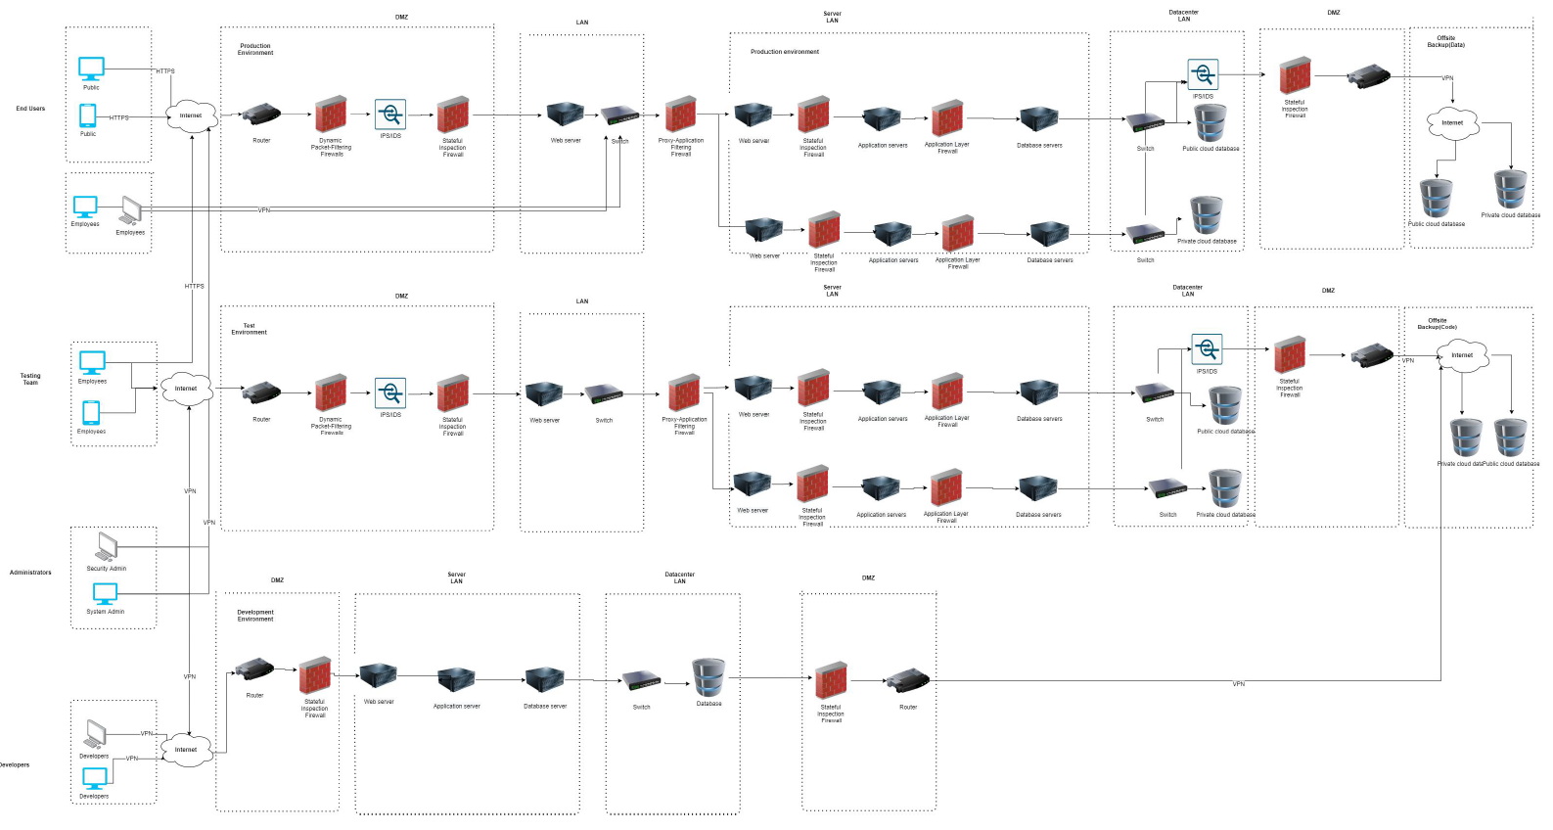
Example of a student team’s draft logical network diagram:

Slide 67
Preparation for Mid Term Exam
Emphasis on terminology and concepts
Study lecture slides and notes
Readings
Textbook assigned chapters (look at practice questions in textbook)
Other readings (e.g. NIST and FIPS documents) as covered/discussed in class lectures
Subjects covered:
Threat environment
Planning and policy
Cryptography
Secure Networks (and Module A: Networking Concepts)
Firewalls, security architecture patterns, and IDS/IPS

Slide 68
Agenda
Introduction
Physical “air-gap” security and how we undermined it
Firewalls
Types of firewalls
Some architectural patterns based on firewall placement
Firewalls have rules
Intrusion Detection System (IDS) & Intrusion Prevention System (IPS)
Defense in Depth with security zones (“Security Domains”)
Project Team Assignment
Preparation for Mid Term Exam

