Slide 1

The Bullpen Decision
By: Ryan Roscoe, Jesse Smeraglia, Cole Faurl, Dylan Parker, Gabriella Picariello

Slide 2
Scenario
The Phillies are looking to cut a reliever and a starter, based off 2025 season stats.
The stats in question are WHIP and WAR
Question
Who are the 2 pitchers that will be cut from their roster for the upcoming season?
Importance
Showcases the performance of all 2025 Phillies pitchers over the course of the entire season.
Visualizes the stats to make the decision easier for the Management to decide who needs to go.

Slide 3
Data Overview
Key Elements
Pitcher Roles: Starters vs Relievers
2025 season statistics for all pitchers
WHIP (Walks + Hits per Inning Pitched)
WAR (Wins Above Replacement)
Data Source
Data collected from Baseball Reference
Team specific data for the 2025 Phillies season, specifically pitching statistics
Pulled the data and put it into an Excel file

Slide 4
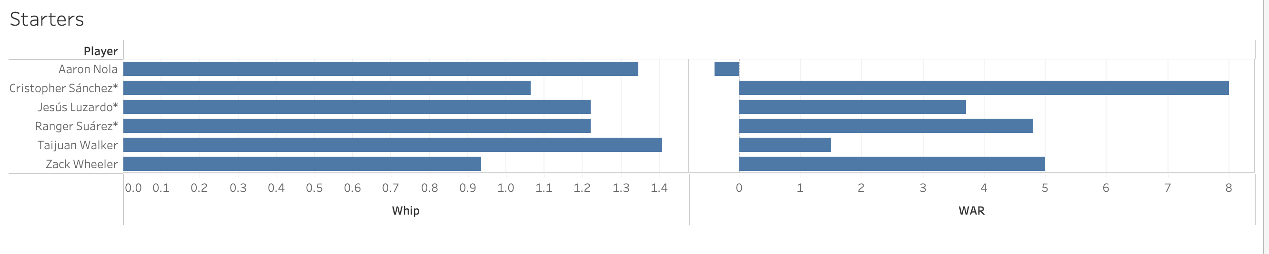
This chart compares pitchers using Whip, which shows how many baserunners they allow per inning. Zack Wheeler clearly stands out, giving up the fewest runners and showing the best control overall. Christopher Sánchez and Ranger Suárez follow closely behind, both pitching efficiently and doing a good job of keeping runners off base. Jesús Luzardo falls in the middle of the group, while Aaron Nola and Taijuan Walker have higher Whips, meaning they allow more runners to reach base. Overall starters are strong.
This chart compares pitchers using WAR, which shows their overall value to the team. Christopher Sánchez stands out clearly, delivering the most impact over the course of the season. WAR is a defensively independent stat which makes it a better indicator than a more traditional pitcher stat like ERA.
WAR = [[([(League “FIP” – “FIP”) / Pitcher Specific Runs Per Win] + Replacement Level) * (IP/9)] * Leverage Multiplier for Relievers] + League Correction-per Fangraphs

Slide 5
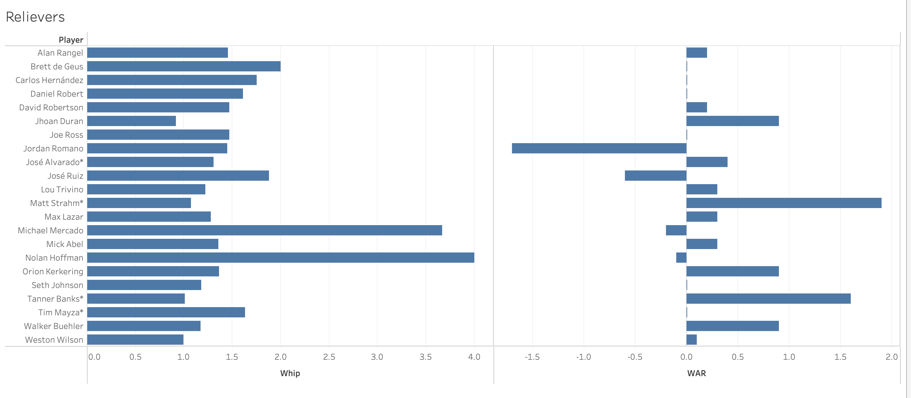
*
Several other relievers fall in the middle of the pack, allowing a moderate number of runners on bases. At the other end, Michael Mercado and Nolan Hoffman give up the most baserunners per inning, placing them at the bottom of the WHIP rankings. WHIP is useful as baserunners are bad for a pitcher, but alone they do not account for slugging or scoring metrics.
The reliever data shows far more inconsistencies in the Phillies pitching than their starting rotation. It is unlikely they would cut one of their starters, seeing their WAR wasn't steep and Aaron Nola, the only negative WAR starter, having tenure with the Phillies. The WAR data suggests Jordan Romano is terrible. This is why it is important to factor in two variables because if you simply looked at his WHIP which is middle of the pack among the Phillies, you would think he is better than he is.

Slide 6
Conclusion
Starter: Aaron Nola
Aaron had the second highest WHIP at 1.346
Higher the WHIP more bases they are giving up
He is the only starter with a negative WAR stat at –0.4
He is contributing to the performance of the team significantly lower compared to the other starters
Reliever: Jordan Romano
Jordan had an average WHIP at 1.453
An average WHIP compared to other relievers
He has the lowest overall contribution with a WAR stat at –1.7
His WAR stat is over 2x lower than the next performing reliever.

Slide 7
References
https://www.baseball-reference.com/teams/PHI/2025.shtml

