Slide 1
Zara Website
Saurav Singh
12/20/23
Amy Lavin
MIS 3506

Slide 2
Introduction
Zara is a Spanish fashion retailer.
It was established in 1974 by Amancio Ortega and Rosalia Mera.
Know for its designs, trendsetting approach.
It has become a staple for fashion conscious individuals.
Problem :
The website is so confusing.
Menus overlaying each other.
Hard to navigate through the website.
Hard and complicated to look for products.
Goals :
Provide clean UI/UX.
Make it simple for users to checkout.
Easy and Simple navigation.
Showcase products more easily.

Slide 3
Zara Analysis
Users primarily use Zara website to explore and browse the latest products.
Add items to cart and checkout.
Check for fashions in trend.
Look for discounts.
Support and FAQs.

Slide 4
User Persona

Slide 5
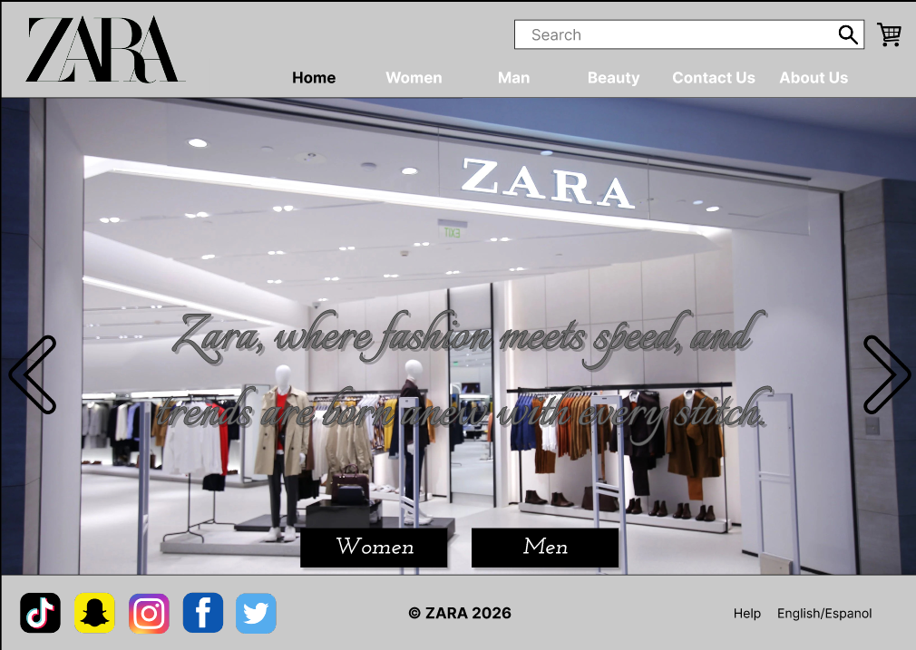
Website Link
https://www.figma.com/file/NR9eFim2xlkXHPXaQGb322/Zara?type=design&node-id=0%3A1&mode=design&t=B0R5dsQ0KYeCqBjB-1

