Slide 1
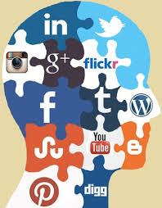
Keeping Your Social Media Identity Safe
Zoya Qazi
MIS 4596 – Spring 2025
Company name

Slide 2
Cyberthreats and Digital Life
Our lives revolve around social media—TikTok, Instagram, and Snapchat allow us to share everything
Every post has a risk since fraudsters are constantly keeping an eye on it.
Social media contains a wealth of personal information that is abused through password cracking, ransomware, and social engineering.

Slide 3
What Your Posts Provide Hackers
It is possible to take advantage of seemingly harmless things like pet names or favorite colors.
Behind every post lies a risk—cybercriminals are always watching
Social media is full of personal info and is exploited using ransomware, social engineering, and password cracking

Slide 4
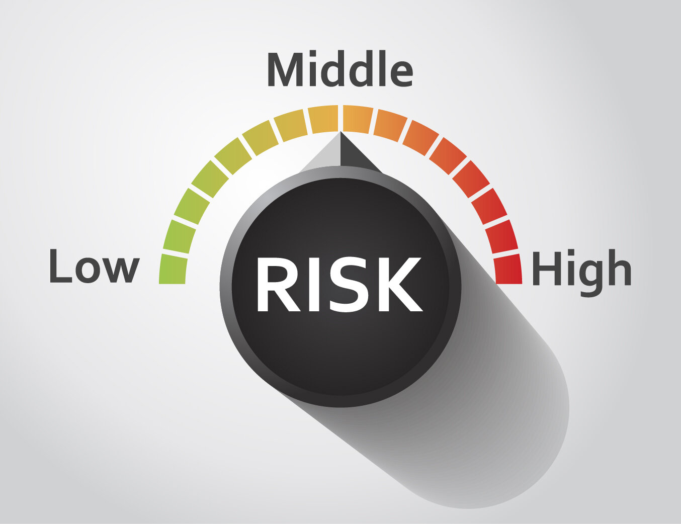
The Reasons Behind Social Media's High Risk
Social media is intentionally public.
Through friends, applications, or tags, information can even be leaked from private accounts.
Hackers exploit users using social engineering.
Example from Lab 9: phishing links or counterfeit brands

Slide 5
Passwords and 2FA
Using weak passwords again is a serious risk.
Multiple accounts can be accessed by hackers in a single breach.
Create strong, one-of-a-kind passwords using letters, numbers, and symbols.
Enable two-factor authentication (2FA) at all times.

Slide 6
The Consequences of Being Hacked
Account hijacking is more than just humiliation.
Hackers can initiate ransomware attacks or distribute malware.
Ransomware reading: encryption plus demands for payment
Large accounts and influencers are particularly vulnerable.

Slide 7
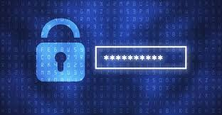
The Practice of Vulnerability Exploitation
The lab demonstrated how quickly an attacker may take control of a system.
They can reset credentials or phish others if they have access to email or chat.
Rapid damage, impersonation, and identity theft

Slide 8
Cybersecurity is Physical Security
Safety of devices is essential.
Publicly unlocked phones pose an immediate risk.
discussed in the brief on physical security
Stay alert, lock screens, and stay away from public charging outlets.

Slide 9
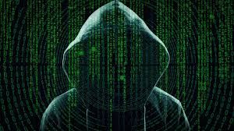
SC DOR: A Practical Instruction
One phishing email led to a massive breach.
Millions of records were made public.
The same strategies approach people on social media.
Your best line of defense is knowledge and caution.

Slide 10
The Knowledge We Acquired in the Labs
Lab 6: Hackers use scanning tools to identify vulnerabilities
Lab 7: Those flaws are swiftly taken advantage of
Pen Testing Report: Everything may be accessed using a single vulnerability
The same dangers are present on social media

Slide 11
Protecting Yourself: Being Astute, Not Terrified
2FA and strong passwords are crucial.
Be wary of dubious DMs and links.
Maintain the privacy of accounts
Update apps frequently.
Consider your post before publishing it.

Slide 12
Concluding Remarks
Cybersecurity is not only a technical problem; it's a way of life.
It's worth preserving your internet presence.
No one is too tiny to be a target, as demonstrated by class themes.
Be mindful, be safe, and take control of your internet presence

Slide 13
Citations
.Cybersecurity & Infrastructure Security Agency. (n.d.). Social media cybersecurity tips. CISA. Retrieved April 25, 2025, from https://www.cisa.gov/news-events/news/social-media-cybersecurity-tips
Federal Trade Commission. (n.d.). The Equifax data breach. Retrieved April 25, 2025, from https://www.ftc.gov/enforcement/refunds/equifax-data-breach-settlement
BBC. (2018, August 22). How NotPetya crippled Maersk, the world’s largest shipping firm. BBC News. https://www.bbc.com/news/technology-41319683
NortonLifeLock. (n.d.). What is social engineering? Norton. Retrieved April 25, 2025, from https://us.norton.com/blog/emerging-threats/what-is-social-engineering
South Carolina Department of Revenue. (2013). South Carolina Department of Revenue data breach report. South Carolina Government

